Slide 1



Effect of transverse stress applied during reaction heat treatment on the stiffness of Nb₃Sn Rutherford cable stacks
EuroCirCol WP5 coordination meeting
22 May 2018
Felix Wolf, Friedrich Lackner, Christian Scheuerlein,
Daniel Schoerling, Davide Tommasini

Slide 2
Content
The samples
Stress-strain measurements in tension and in compression
Determination of elastic modulus from stress-strain curves
Set-ups used for stress-strain measurements in compression and validation tests
Axial tensile stress-strain measurements of Nb₃Sn wires
Estimation of axial ten stack stiffness by the rule of mixtures
Effect of epoxy volume fraction on axial ten-stack stiffness and comparison of axial tensile and compression stress-strain results
Effect of unloading stress on ten-stack stiffness
Effect of epoxy volume fraction on transverse ten-stack stiffness
Effect of load direction on the ten-stack stiffness
Comparison of ten-stack and 11 T coil segment stiffness

Slide 3
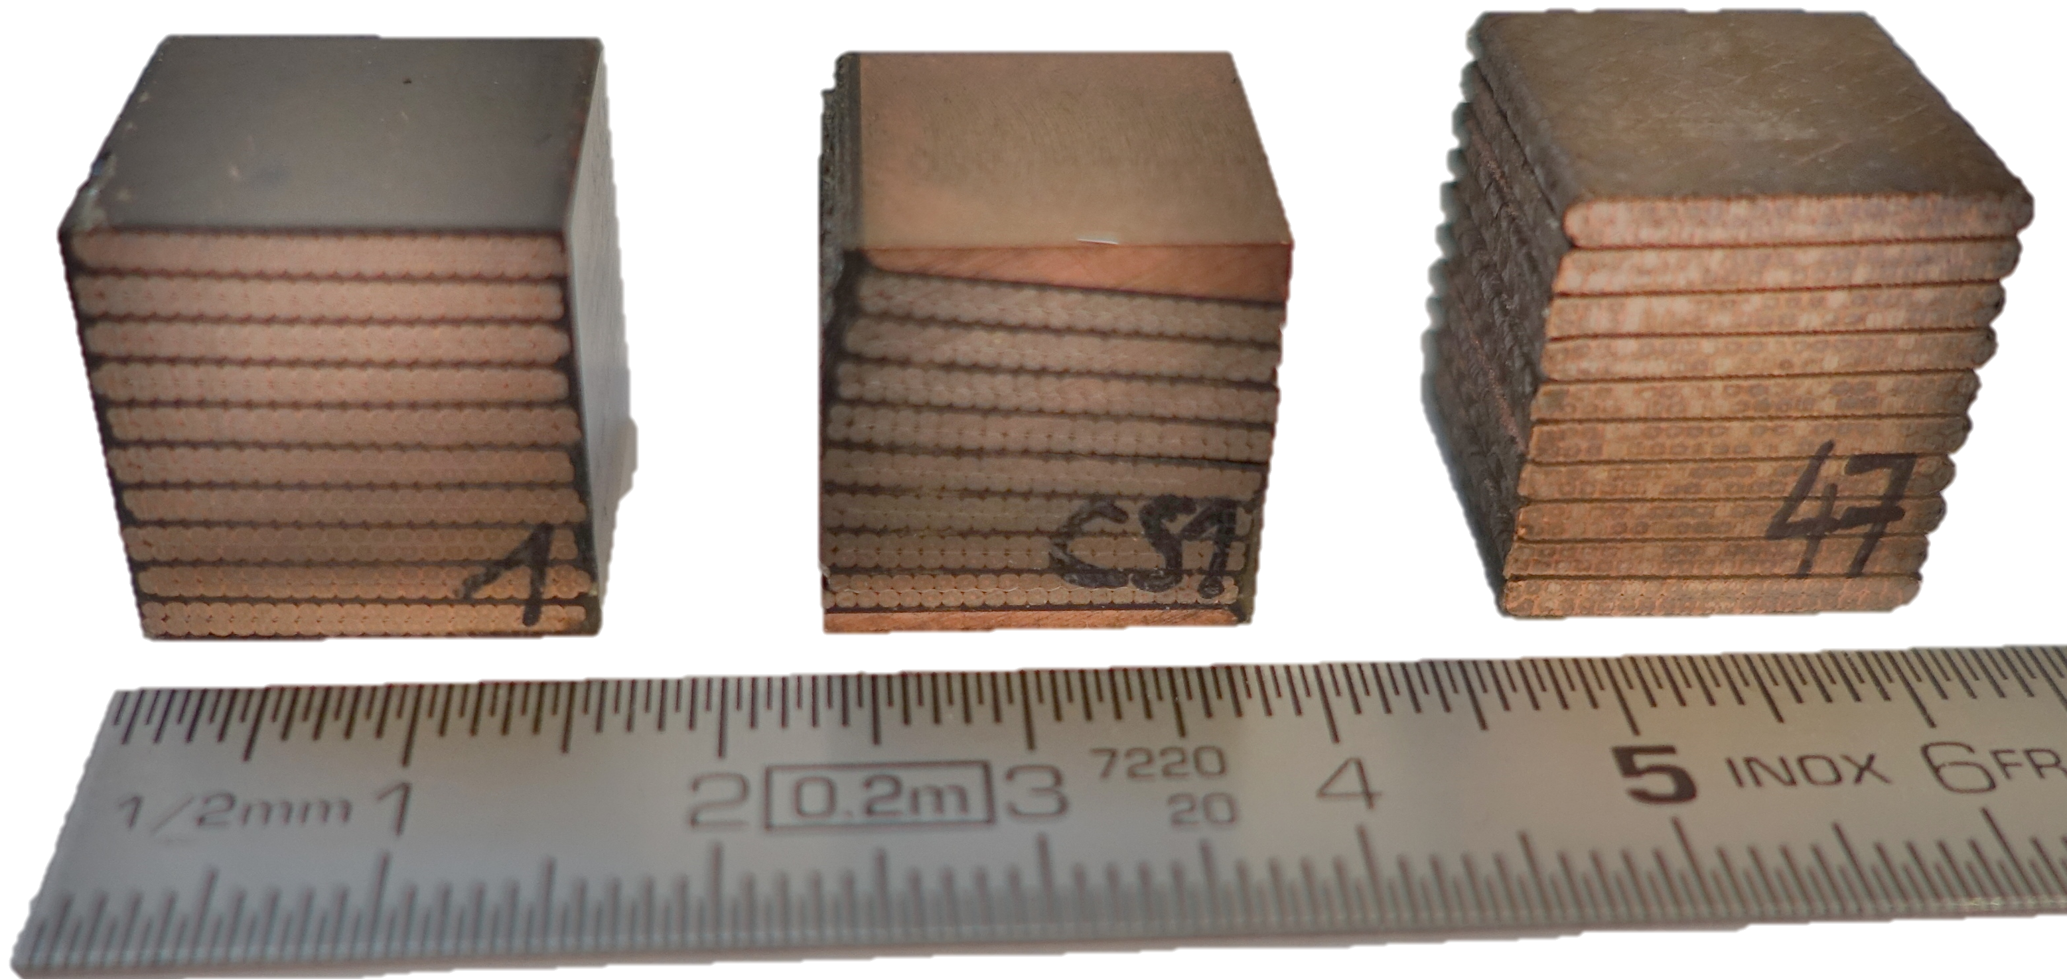
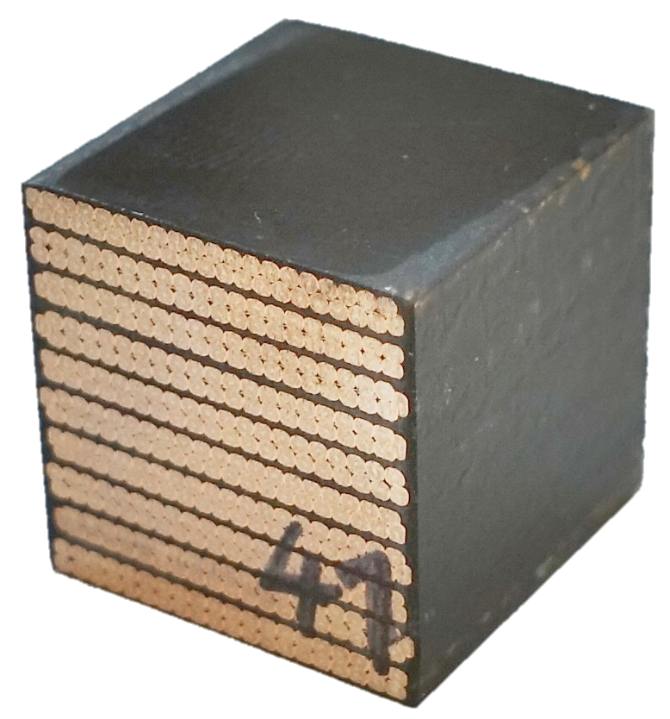
The samples
All samples are made of Nb₃Sn 11 T dipole Rutherford cable.
Cube samples with approximate edge lengths of 15 mm and with parallel surfaces enable compression tests in axial, transverse and radial directions.
Ten-stack samples reacted in a dedicated mould with three different levels of compaction, due to a clearance variation.
11 T dipole coil block machined out of the coil after magnet cold test, containing adjacent coil wedges to compensate the keystone angle.
The samples are impregnated with an epoxy resin system, so-called CTD-101K from Composite Technology Development, Inc.
Transverse compression experiments have also been performed with a non-impregnated 11 T dipole ten stack sample.
All samples have a Mica and S2 glass insulation.
For comparison uniaxial tensile test results of a RRP type wire are presented as well.
a)
c)
Radial
Axial
b)
Height
d)
Transversal
Width
Length
Nb₃Sn Rutherford cable sample types: (a) ten-stack, (b) 11 T dipole coil segment and
(c) non impregnated ten-stack (d) Sample orientations.

Slide 4
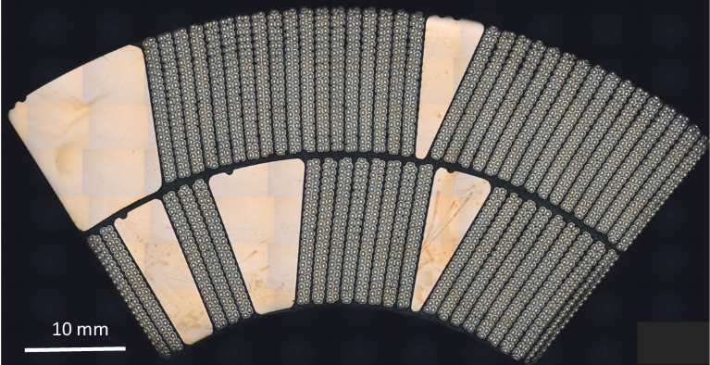
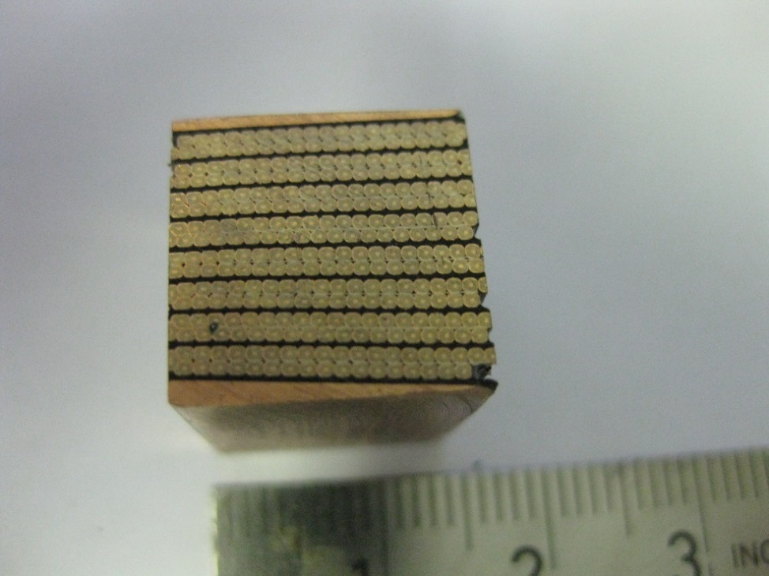
11 T dipole conductor block segment
(a) Metallographic cross section of 11 T dipole coil CR107 with six conductor blocks. Courtesy M. Meyer, CERN. (b) Extracted conductor block sample used for compression tests. Courtesy CERN central workshop team.

Slide 5
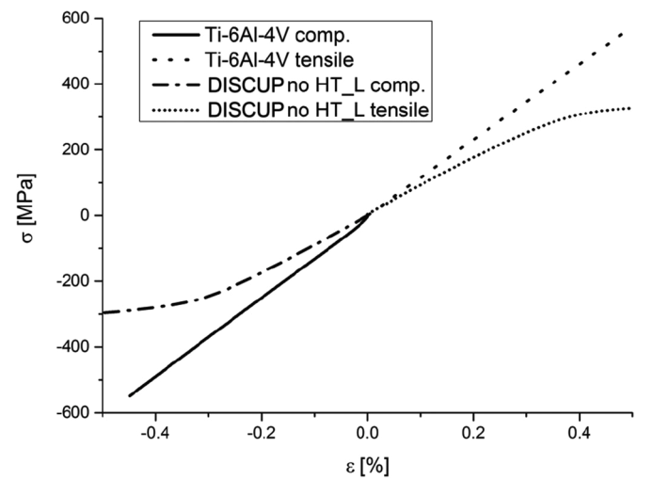
Stress-strain measurements in tension and in compression
Tensile tests:
Flat tensile test samples DIN 50125-E 3mm × 8mm × 30mm
Clip on extensometer with 25 mm gauge length
Compression tests
Cylinder sample ∅ 10 mm, height 15 mm (small ratio height to diameter in order to sample buckling)
  Use lubricant between contact surfaces to limit friction artefacts
Clip on extensometer with 8 mm gauge length
  The direct strain measurement using extensometers is crucial in order to avoid an influence of the load frame compliance.
  For metals differences between tensile and compression stress-strain curves are usually small.
Comparison of tensile and compressive stress-strain curves of Ti-6Al-4V and DISCUP up to 0.5 % strain [1].
[1] IEEE Trans. Appl. Supercond., 27(4), (2017), 4003007
22 May 2018
Notes:
Mechanical Properties of the HL-LHC 11 T Nb₃Sn Magnet Constituent Materials
Christian Scheuerlein; Friedrich Lackner; Frederic Savary; Birgit Rehmer; Monika Finn; Patrick Uhlemann
IEEE Transactions on Applied Superconductivity Year: 2017, Volume: 27, Issue: 4
Article Sequence Number: 4003007
Referenced in:
IEEE Journals & Magazines

Slide 6
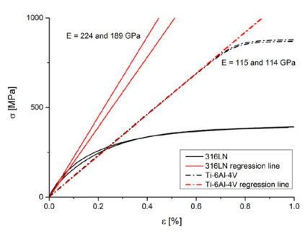
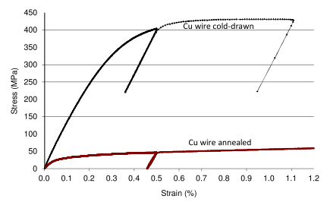
Determination of elastic moduli from stress-strain curves
In favourable cases the elastic modulus can be determined from the initial linear slope of the stress-strain curve (e.g. for Ti-6Al-4V).
Many metals like Cu or stainless don’t exhibit linear elastic behaviour. For these metals the elastic modulus can be estimated from unloading stress-strain curves.
Comparison of stainless-steel 316LN and Ti-6Al-4V stress-strain curves. For 316LN a precise measurement of elastic modulus from the initial loading curve is not possible [1].
Comparison of hard-drawn and annealed Cu wire stress-strain curves with unloading slopes for determination of the elastic modulus [1].
[1] IEEE Trans. Appl. Supercond., 27(4), (2017), 4003007
Notes:
Mechanical Properties of the HL-LHC 11 T Nb₃Sn Magnet Constituent Materials
Christian Scheuerlein; Friedrich Lackner; Frederic Savary; Birgit Rehmer; Monika Finn; Patrick Uhlemann
IEEE Transactions on Applied Superconductivity Year: 2017, Volume: 27, Issue: 4
Article Sequence Number: 4003007
Referenced in:
IEEE Journals & Magazines

Slide 7
Test parameters for ten-stack sample compression tests
Two different set-ups have been used for compressive stress-strain measurements.
The sample strain in load direction was directly measured with calibrated clip-on extensometers (either 12 mm gauge length or 6 mm gauge length), eliminating the effect of load frame compliance on the strain results.
Load plateaus were kept constant for one hour
Load rate between plateaus was 50 N/s
Stiffness is defined as the initial linear slope of the unloading engineering stress-strain curves
Validation tests were performed with known materials (Ti-6Al-4V and Al 7075)
Good agreement of stress-strain results achieved with both compressive stress-strain measurement set-ups.
Notes:
Why compressive test?
Tensile test data are valid until the uniform expansion limit (necking) occurs
Due to the complex material structure it is useful, to apply the load in procedure similar to the application
Error range for small loads can be caused due to imperfection in the tool-Surface parallelism
Compressive test does not indicate a characteristic yield strength
Friction between tooling and sample surface can cause a barrelling of the sample

Slide 8
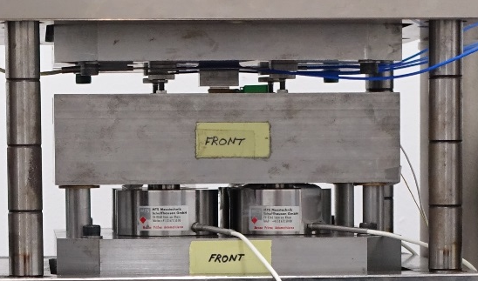
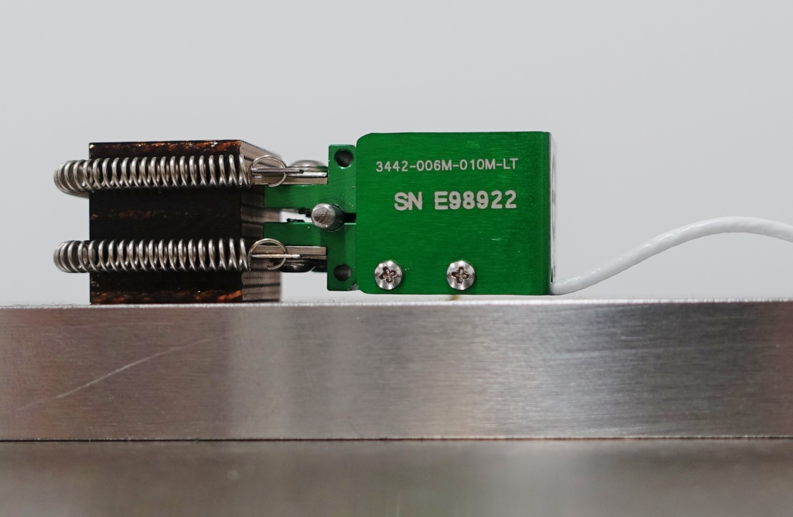
Two set-ups used for stress-strain measurements in compression
Set-up at CERN
  Load measured with calibrated load cells (Burster type 8526)
  Strain measured with clip on extensometer (Epsilon 3442-006M-010-LT Class B-1)
Validation measurement:
  Cubic Ti-6Al-4V sample
  Determined E modulus: 117.4 GPa
  Literature E modulus: 115 GPa [1]
Sample
Extensometer
Sample holder
Ten-stack sample with clip-on extensometer with 6 mm gauge length.
[1] IEEE Trans. Appl. Supercond., 27(4), (2017), 4003007
Reference measurement Ti-6Al-4V

Slide 9
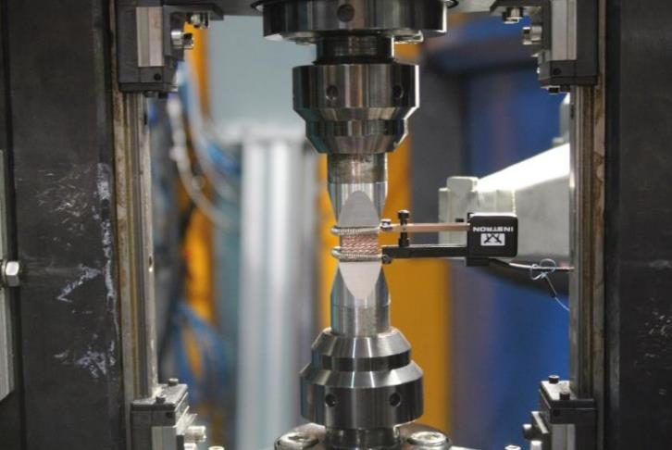
Two set-ups used for stress-strain measurements in compression
Extensometer
Set-up at MLZ StressSpec beam line
Load measured with calibrated load cells (HBM Typ 03, 50 kN)
Strain measured with clip on extensometer (Instron 2620-602)
Validation measurement:
  Cubic Al7075 sample
  Determined E modulus: 72.7 GPa
  Lit: 71.7 GPa [2]
Sample
Sample holder
Sample with clip-on extensometer with 12 mm gauge length installed in the load frame at StressSpec.
[2] Metals Handbook, Vol.2 ASM International 10th Ed. 1990.
Reference measurement Al7075
Notes:
Metals Handbook, Vol.2 - Properties and Selection: Nonferrous Alloys and Special-Purpose Materials, ASM International 10th Ed. 1990.

Slide 10
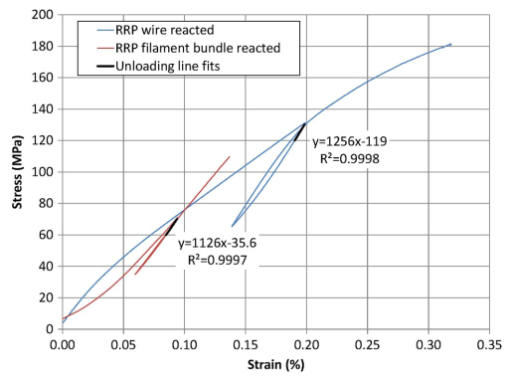
Elastic modulus of RRP type Nb₃Sn wire
Test performed with a tensile test machine “Inspekt table BLUE 05” from Hegwald & Peschke
Load measured with AST KPA-S load cell with a maximum load of 1 kN
Strain measured with a MTS clip-on extensometer 632.27F-21 with 25 mm gauge length
E is defined as the initial linear slope of the unloading curve.
Determined elastic modulus of the reacted RRP wire: 126 GPa
Irreversible plastic strain
Reversible elastic strain
Stress-strain curves measured at room temperature on a reacted RRP wire and its extracted filaments. [3]
[3] IEEE Trans. Appl. Supercond., 25(6), (2015), 8400605
Notes:
Elastic Anisotropy in Multifilament hboxNb 3 hboxSn Superconducting Wires
C. Scheuerlein; B. Fedelich; P. Alknes; G. Arnau; R. Bjoerstad; B. Bordini
IEEE Transactions on Applied Superconductivity Year: 2015, Volume: 25, Issue: 3
Article Sequence Number: 8400605
Referenced in:
Cited by: Papers (3)
IEEE Journals & Magazines

Slide 11
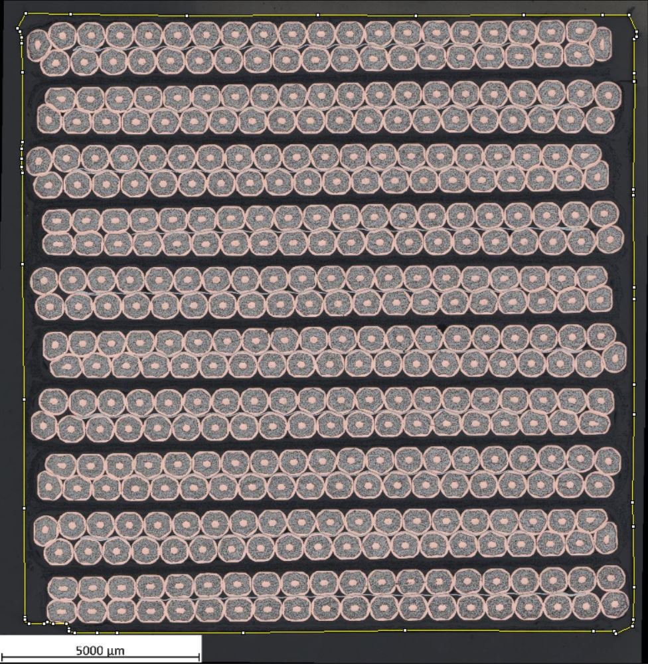
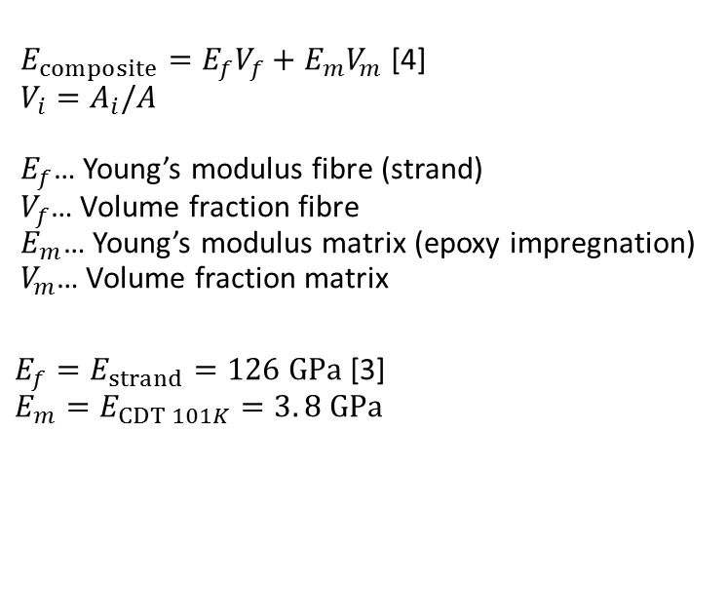
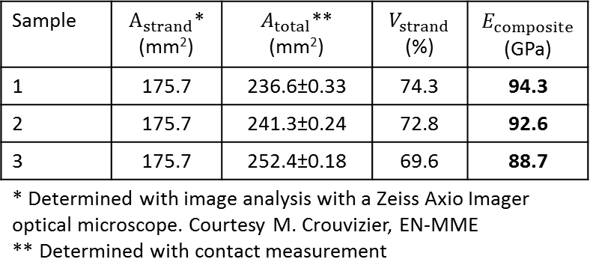
Estimation of the ten stack stiffness in axial direction from the wire and epoxy properties according to the Rule of Mixtures (ROM)
$E_{composite}=E_{f}V_{f}+E_{m}V_{m}$ [4]
$$V_{i}=A_{i}/A$$
$E_{f}$… Young’s modulus fibre (strand)
$V_{f}$… Volume fraction fibre
$E_{m}$… Young’s modulus matrix (epoxy impregnation)
$V_{m}$… Volume fraction matrix
$E_{f}=E_{strand}=126 GPa$[3]
$$E_{m}=E_{CDT 101K}=3. 8 GPa$$
Axial
Definition of axial sample orientation
Sample | $A_{strand}$* (mm²) | $A_{total}$** (mm²) | $$V_{strand}$$ (%) | $E_{composite}$ (GPa)
1 | 175.7 | 236.6±0.33 | 74.3 | 94.3
2 | 175.7 | 241.3±0.24 | 72.8 | 92.6
3 | 175.7 | 252.4±0.18 | 69.6 | 88.7
* Determined with image analysis with a Zeiss Axio Imager optical microscope. Courtesy M. Crouvizier, EN-MME ** Determined with contact measurement
Metallographic cross section of ten stack samples for the determination of the epoxy volume fraction by digital image analysis. Courtesy M. Crouvizier, EN-MME
[3] IEEE Trans. Appl. Supercond., 25(6), (2015), 8400605
[4] Mechanics of composite materials, Taylor and Francis, 1999
Notes:
Mechanics of composite materials
Second edition
Robert M. Jones
Taylor and Francis, Inc. London 1999
Elastic Anisotropy in Multifilament hboxNb 3 hboxSn Superconducting Wires
C. Scheuerlein; B. Fedelich; P. Alknes; G. Arnau; R. Bjoerstad; B. Bordini
IEEE Transactions on Applied Superconductivity Year: 2015, Volume: 25, Issue: 3
Article Sequence Number: 8400605
Referenced in:
Cited by: Papers (3)
IEEE Journals & Magazines

Slide 12
Comparison between stiffness in axial direction in tension (wire, V_{strand}=100%) and compression (ten-stack)
Ten-stack V_{strand}=74.3%, E= 99.5 GPa
(ROM estimate E_{Composite} = 94.3 GPa)
Wire (V_{strand}=100%), E=126 GPa
Ten-stack V_{strand}=69.6%, E= 94.1 GPa
(ROM estimate E_{Composite} = 88.7 GPa)
Comparison of stress-strain curves of Nb₃Sn wire (axial tension) and ten-stack samples (axial compression).

Slide 13
Effect of unloading stress on ten-stack stiffness in transverse direction– first loading
The ten-stack stiffness increases with increasing unloading stress.
A creep behaviour is observed when the transversal load exceeds about 125 MPa.
Transverse compressive stress-strain curve of the ten-stack sample (V_{strand}=69.6%).
Transverse compressive stiffness at different unloading stress levels of a ten stack.

Slide 14
Indications for creep behaviour of a free standing ten-stack
Curve changes in unloading - loading transition after 135 MPa applied load
Small displacement at constant load
Transverse compressive stress-strain curve of the ten-stack sample (V_{strand}=69.6%).
Increased displacement at constant load

Slide 15
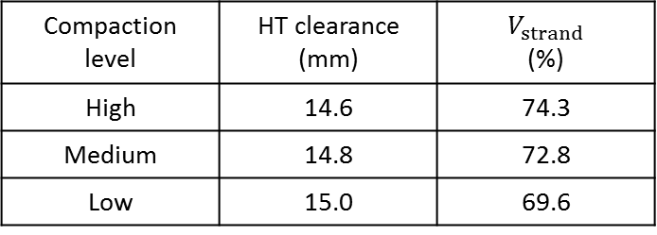
Effect of epoxy volume fraction on transverse ten-stack stiffness (first loading cycle)
Samples with three different compaction levels during RHT have been investigated.
The stiffness increases with increasing unloading stress.
The stiffness in transverse direction increases with increasing compaction level during RHT and varies between 40 - 60 GPa
Compaction level | HT clearance (mm) | $$V_{strand}$$ (%)
High | 14.6 | 74.3
Medium | 14.8 | 72.8
Low | 15.0 | 69.6
Transverse stiffness of ten-stack samples with different epoxy volume fraction at different unloading levels

Slide 16
Effect of load direction on the ten-stack stiffness (first loading cycle)
Radial
Axial
Transversal
Sample orientation
Stiffness is strongly dependent to the load direction
Axial stiffness is 2 × transverse stiffness
Radial stiffness is 1.3 × transverse stiffness
Stiffness in different load directions of a ten stack (V_{strand}=72.8%)

Slide 17
Comparison of ten-stack and 11 T coil segment stiffness (second loading cycle)
Transverse compressive stress strain measurement of 11 T dipole coil segment
Stiffness comparison of impregnated and non impregnated samples
Stiffness is dependent from the loading level
Strong creep behaviour starting at 125 MPa
Stiffness is depended to the unloading stress

Slide 18
Conclusion I
Good agreement of the stiffness results for identical Nb₃Sn Rutherford cable ten-stack samples measured with two independent test set-ups.
Uncertainties caused by the compliance of the test set-ups are avoided by using extensometers for direct strain measurements.
In axial load direction the ten-stack stiffness can be predicted by the rule of mixtures assuming iso-strain conditions.
In the 11 T coil block and in the ten-stack samples made of the same conductor and with similar epoxy volume fraction, the macroscopic stiffness and creep behaviour under compressive loading are similar, suggesting that the ten-stack samples can represent well the 11 T dipole conductor block.
It remains to be studied if the test configuration of free-standing samples can represent the conductor loading in a magnet coil, where the conductor is constrained in axial and radial directions.
Macroscopic stress-strain results can be compared with neutron diffraction measurements to determine the strain and stress state in the Nb₃Sn filaments and the Cu matrix.

Slide 19
Conclusion II
The ten stack stiffness depends on:
    Epoxy volume fraction (depending on the sample compression during the RHT)
    The unloading stress level
    The load history
    The load direction (axial stiffness is 2 × transverse stiffness, radial stiffness is 1.3 × transverse stiffness).
    The transverse stiffness of 11 T dipole coil block corresponds with that of the ten stack samples with similar epoxy volume fraction.
    A strong creep behaviour is observed when the transversal load exceeds about 125 MPa.

Slide 20
Some open questions and outlook
How is the load case of free standing ten-stack samples related to the loading of constraint coils in a magnet?
What is the conductor block stiffness at 4.2 K?
How are stiffness (“elastic” properties) and plastic properties best taken into account in FE models?
What is the effect of the load rate?
What is the effect of creep?

Slide 21
References
[1] C. Scheuerlein, F. Lackner, F. Savary, B. Rehmer, M. Finn, and P. Uhlemann, “Mechanical properties of the HL-LHC 11 Tesla Nb₃Sn magnet constituent materials”, IEEE Trans. Appl. Supercond., vol. 27, no. 4, Jun. 2017, Art. no. 4003007.
[2] C. Scheuerlein, B. Fedelich, P. Alknes, G. Arnau, R. Bjoerstad, and B. Bordini, “Elastic anisotropy in multifilament Nb₃Sn superconducting wires”, IEEE Trans. Appl. Supercond., vol. 25, no. 3, Jun. 2015, Art. no. 8400605.
[3] Metals Handbook, Vol.2 - Properties and Selection: Nonferrous Alloys and Special-Purpose Materials, ASM International 10th Ed. 1990.
[4] Robert M. Jones, “Mechanics of composite materials”, Second edition, Taylor and Francis, Inc. London 1999

