Slide 1


EuroCirCol WP4
FCC-hh beam vacuum system
Francis Perez (ALBA)
on behalf of EuroCirCol WP4 team
EuroCirCol: 'The European Circular Energy-Frontier Collider Study (EuroCirCol) project has received funding from the European Union's Horizon 2020 research and innovation programme under grant No 654305. The information herein only reflects the views of its authors and the European Commission is not responsible for any use that may be made of the information.'

Slide 2
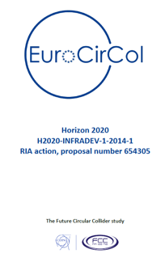
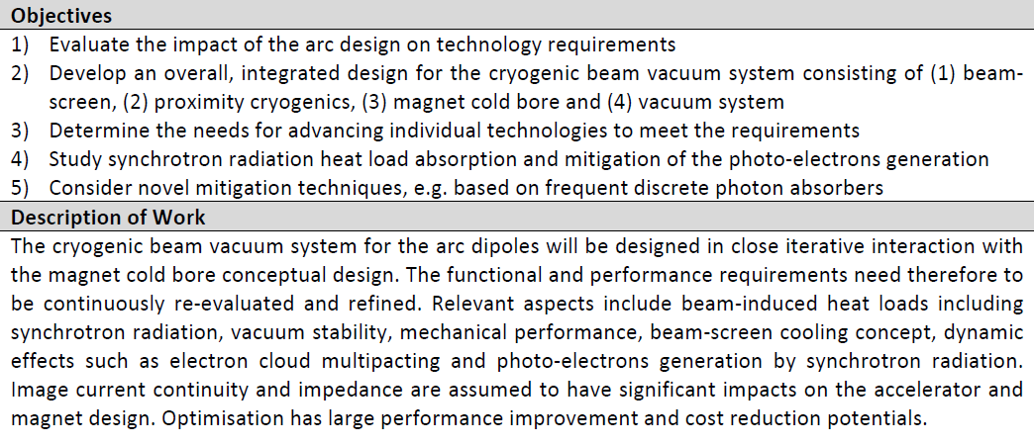
The charge of WP4:
Cryogenic Beam Vacuum System
Vacuum stability
Beam induced heat load
Impedance
Photo-electrons
cooling
Synchrotron radiation
Mechanical stability
Image current

Slide 3




The charge of WP4:
Divided in several tasks
Coordination
Study of beam induced vacuum effects
Study of mitigation techniques of e-cloud and ion instabilities
Study of vacuum stability at cryogenic temperatures (40-60 K)
Develop a mechanical (conceptual) design
Prototyping and measurements

Slide 4
FCC-hh cryogenic beam-vacuum requirement in the arcs
The challenge:
x100+ higher synchrotron radiation power density
 | FCC-hh | Present LHC
Proton energy [TeV] | 50 | 7
Temperature of cold mass [K] | 1.9 | 1.9
Number of bunches at 25 ns | 10600 | 2808
Bunch population [10¹¹] | 1 | 1.15
SR photon flux [ph s⁻¹m⁻¹] above cut-off at 4 eV | 1.34x10¹⁷ | 2.02x10¹⁶
Arc SR heat load per beam [W m⁻¹] | 28.4* | 0.17
SR critical energy [eV] | 4300 | 44
E-cloud
expected
* Bending synchrotron emission power
Main issue
FCC Week 2019
June 24th, 2019

Slide 5
Due to the higher SR power density:
The mass flow of gas in the cooling channel must be increased. The diameter of the channel has to be increased to avoid too high pressure drop.
The beam screen temperature must be increased in the range 40 to 60 K, as compared to the 5 to 20 K in LHC, to reduce the needed cryogenic power. The higher temperatures have large repercussions on the vacuum due to higher equilibrium vapour pressures.
There is an increased photo-desorption due to an higher number of photons (x6 above cut-off at 4 eV). Higher effective pumping is needed.
Consequence: The present LHC beam
is not adapted for the FCC-hh.
LHC-like
design:
closed, slotted beam screen

Slide 6
1st proposed design of the FCC-hh arc vacuum system
Discontinuous ribs for photon absorption
and mechanical reinforcement
LHC-like
design:
closed, slotted beam screen
Original proposal at
“FCC Week Conference”, Washington D.C., March 2015;
One-slot beam screen with reduced number of pumping slots
(source of impedance)

Slide 7
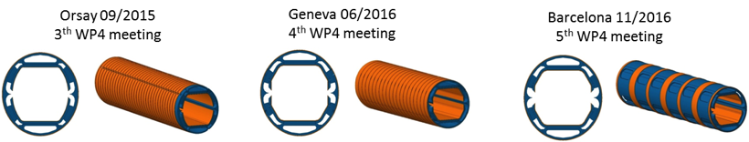
Progress with the FCC-hh beam screen design
In the last four years, the beam screen design has been modified several times to attain:
  Improved heat transfer (as cold spray copper ring in the outer surface)
  Reduced transverse impedance (symmetric cross section)
  Higher pumping efficiency (larger pumping holes)
  Easier manufacturing (polygonal shape)

Slide 8
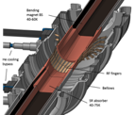
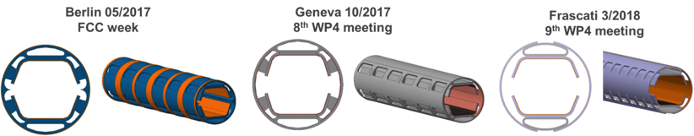
Progress with the FCC-hh beam screen design
Last year a conceptual change was done, by going from Reflection to Absortion concept, in order to in order reduce the undesired SR scattering and in addition, reduce the head load in the interconnection section.
  Remove the deflector
  Introduce Saw-tooth
  Re-design for simplification (remove rips, thickness)

Slide 9
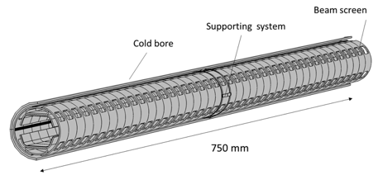
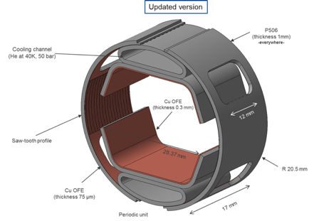
Latest version of the Cryogenic Beam Vacuum System
Wednesday 26th 11:30 - 11:50
Ballroom II (Ground floor)
Update of the design and thermal mechanical study of the FCC-hh beam screen
Marco Morrone
M. Morrone

Slide 10
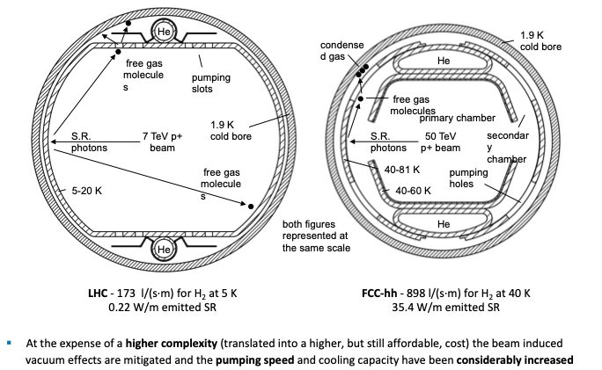
LHC FCC hh
I. Bellafont

Slide 11
Study of beam induced vacuum effects
Expected conditioning achieved in 3-4 months
Wednesday 26th 08:30 - 08:50 Ballroom II (Ground floor)
Study on the beam induced vacuum effects in the FCC-hh beam vacuum chamber
Ignasi Bellafont

Slide 12
To achieve these results and conclusions
work in the several tasks have been crucial and
have increased our understanding of the involved materials and technologies

Slide 13
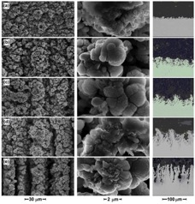
Study of mitigation techniques of e-cloud and ion instabilities
Wednesday 26^{th.} 10:30 - 10:50 Ballroom II (Ground floor)
Evaluation of LASER ablated surface engineering of copper and stainless steel for particle accelerators
Reza Valizadeh

Slide 14
Study of mitigation techniques of e-cloud and ion instabilities
Wednesday 26^{th.} 10:50 – 11:10 Ballroom II (Ground floor)
Recent Results on NEG Coating Characterisation
Ruta Sirvinskaite

Slide 15
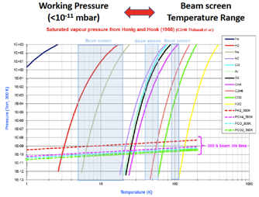
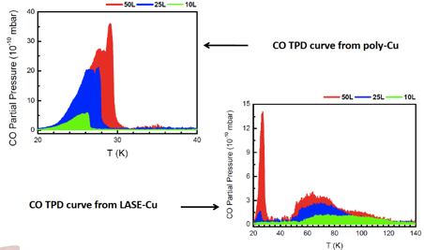
Study of vacuum stability at cryogenic temperatures (40-60 K)
Wednesday 26^{th.} 08:50 – 09:10 Ballroom II (Ground floor)
Material properties of relevance to cryogenic vacuum systems
Luisa Spallino

Slide 16
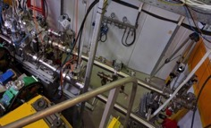
Prototyping and measurements
Experiment at KARA-BESTEX

Slide 17
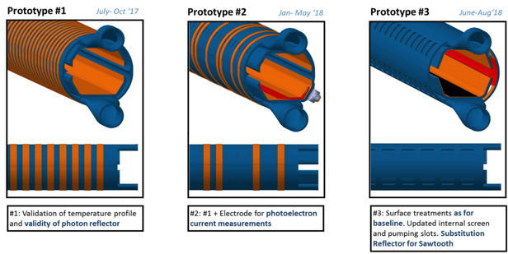
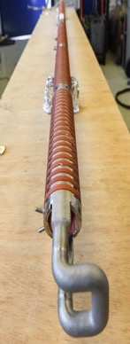
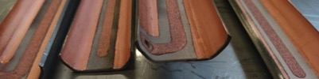
Prototyping and measurements

Slide 18
Prototyping and measurements
Experiment at KARA-BESTEX
Wednesday 26^{th.} 11:10 – 11:30 Ballroom II (Ground floor)
Photodesorption Studies on FCC-hh Beam Screen Prototypes at KARA
Luis Antonio Gonzalez Gomez

Slide 19
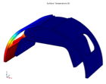
Develop a mechanical (conceptual) design
Quench analysis
Thermal analysis
Installation in cold bore
Wednesday 26th 11:30 - 11:50 Ballroom II (Ground floor)
Update of the design and thermal mechanical study of the FCC-hh beam screen
Marco Morrone

Slide 20
Develop a mechanical (conceptual) design
POSTER
Considerations for large scale production of the FCC-hh beam screens
Cedric Garion

Slide 21
In addition,
the EuroCirCol WP4 project
has created
a series of “spin-off” collaborations

Slide 22

Reflectivity studies
Incident Radiation = Transmitted + Reflected + Absorbed
Reflected Radiation
Synchrotron Radiation
Vacuum Chamber Wall
LNF launched a long term proposal (MICA) and received support by INFN and beamtime by the project CALIPSOplus. (under the Grant Agreement 730872 from the EU Framework Programme for Research and Innovation HORIZON 2020)
Wednesday 26^{th.} 09:10 – 09:30 Ballroom II (Ground floor)
Reflectivity and PY from candidate materials for the FCC-hh Vacuum system
Roberto Cimino

Slide 23

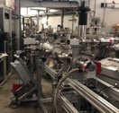
WINDY set-up
CERN collaboration:
K E 3 7 2 4 / T E / H L - L H C - Addendum N o. 4 to Agreement TKN3083
Wednesday 26^{th.} 09:30 – 09:50 Ballroom II (Ground floor)
Photo desorption studies at the WINDY set-up at LNF
Marco Angelucci

Slide 24
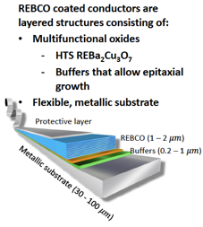
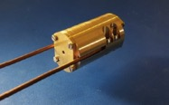

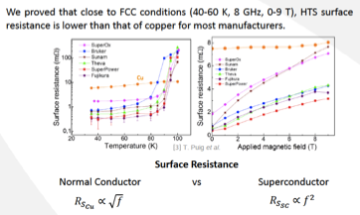

Feasibility of
High Temperature Coated Superconductors for the Vacuum Beam Screen
In situ Irradiation
and DC resistance testing
Surface resistance
vs. B and T

Slide 25
Feasibility of
High Temperature Coated Superconductors for the Vacuum Beam Screen
Wednesday 26^{th.} 14:10 – 14:30
Clarity (8th floor)
RF Characterisation of HTS-CC Tapes as Alternative Coating for the FCC-hh Beam Screen
Patrick Krkotić
Wednesday 26^{th.} 14:30 – 14:50
Clarity (8th floor)
REBa2Cu3O7 coated conductors as a beam screen coating: Using the classical rigid-fluxon model to link surface resistance to microstructure
Artur Romanov
POSTERS Klimt (Ground floor)
HTS REBaCuO coated conductors for the FCC-hh beam screen: Performance under photon irradiation at the ALBA Synchrotron Light Source
Patrick Krkotić
Coating the FCC-hh beam screen chamber with REBa2Cu3O7-x coated conductors
Joffre Gutierrez Royo

Slide 26
Conclusions
Design of the beam screen concept has required several iterations.
The optimisation of the beam screen is completed; thermal, mechanical and vacuum behaviours are fully simulated.
The dipole-end photon absorber has been optimised and engineering design is in progress.
At the KARA-BESTEX set-up, three prototypes have been measured and an upgrade for testing with LN2 is in progress.
The optimisation of the laser treatment for the mitigation of electron cloud have been broadly investigated, further analysis including the impredance resistance is in progress.
Study of gas adsorption effects on SEY has been done. Further test at the new set-ups are in progress.

Slide 27
Future R&D
Perform further photo desorption studies at LN2 temperature
  KARA - BESTEX.
  LNF - WINDY
Perform quench test of a 2 meter prototype to test the mechanical stability.
Further optimization of the beam screen large scale production.
Investigate other surfaces:
  amorphous carbon coating.
  high temperature coated superconductors.
Measurements of the surface impedance of the different materials.
Improve the computational models with the new data.
…

Slide 28
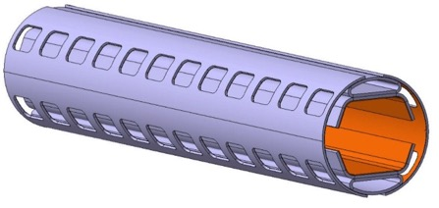

The charge of WP4:
Cryogenic Beam Vacuum System
Successfully done!

Slide 29
Thanks to the team!
Paolo Chiggiato
Roberto Kersevan
Vincent Baglin
Olivier Brunner
Cedric Garion
Sergio Calatroni
Roberto Cimino
Marco Angelucci
Luis Antonio Gonzalez Gomez
Luisa Spallino
Marco Morrone
Anke-Susanne Mueller
Erhard Huttel
Sara Casalbuoni
Miguel Gil Costa
Javier Fernandez Topham
Oleg Malyshev
Reza Valizadeh
Peter McIntosh
Taaj Sian
Ruta Sirvinskaite
Francis Perez
Carles Colldelram
Raquel Monge
Joan Casas
Ignasi Bellafont

Slide 30
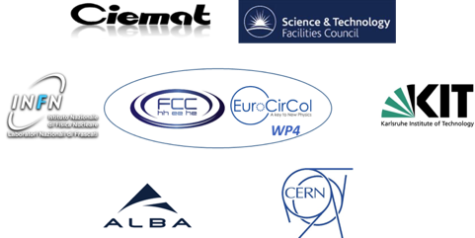
Thanks for
your attention!

Slide 31








WP4
EuroCirCol: 'The European Circular Energy-Frontier Collider Study (EuroCirCol) project has received funding from the European Union's Horizon 2020 research and innovation programme under grant No 654305. The information herein only reflects the views of its authors and the European Commission is not responsible for any use that may be made of the information.'

