Slide 1

Improved concept of the Nelium Turbo-Brayton cycle for the FCC-hh beam screen cooling
Sofiya Savelyeva, Steffen Klöppel, Christoph Haberstroh, Hans Quack
Technical University Dresden // Bitzer Chair Of Refrigeration, Cryogenics And Compressor Technology
FCC Week 2019, Brussels // 26.06.2019
EASITrain – European Advanced Superconductivity Innovation and Training. This Marie Sklodowska-Curie Action (MSCA) Innovative Training Networks (ITN) has received funding from the European Union’s H2020 Framework Programme under Grant Agreement no. 764879

Slide 2
Outline
Cycle requirements & former baseline
Limiting factors
Comparison of cycle arrangements
New baseline
Upper heat exchanger design
Natural Nelium mixture

Slide 3
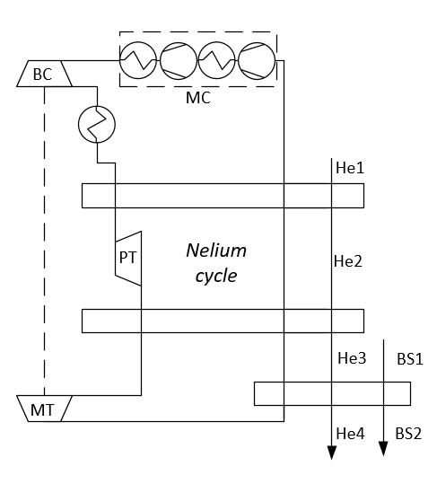
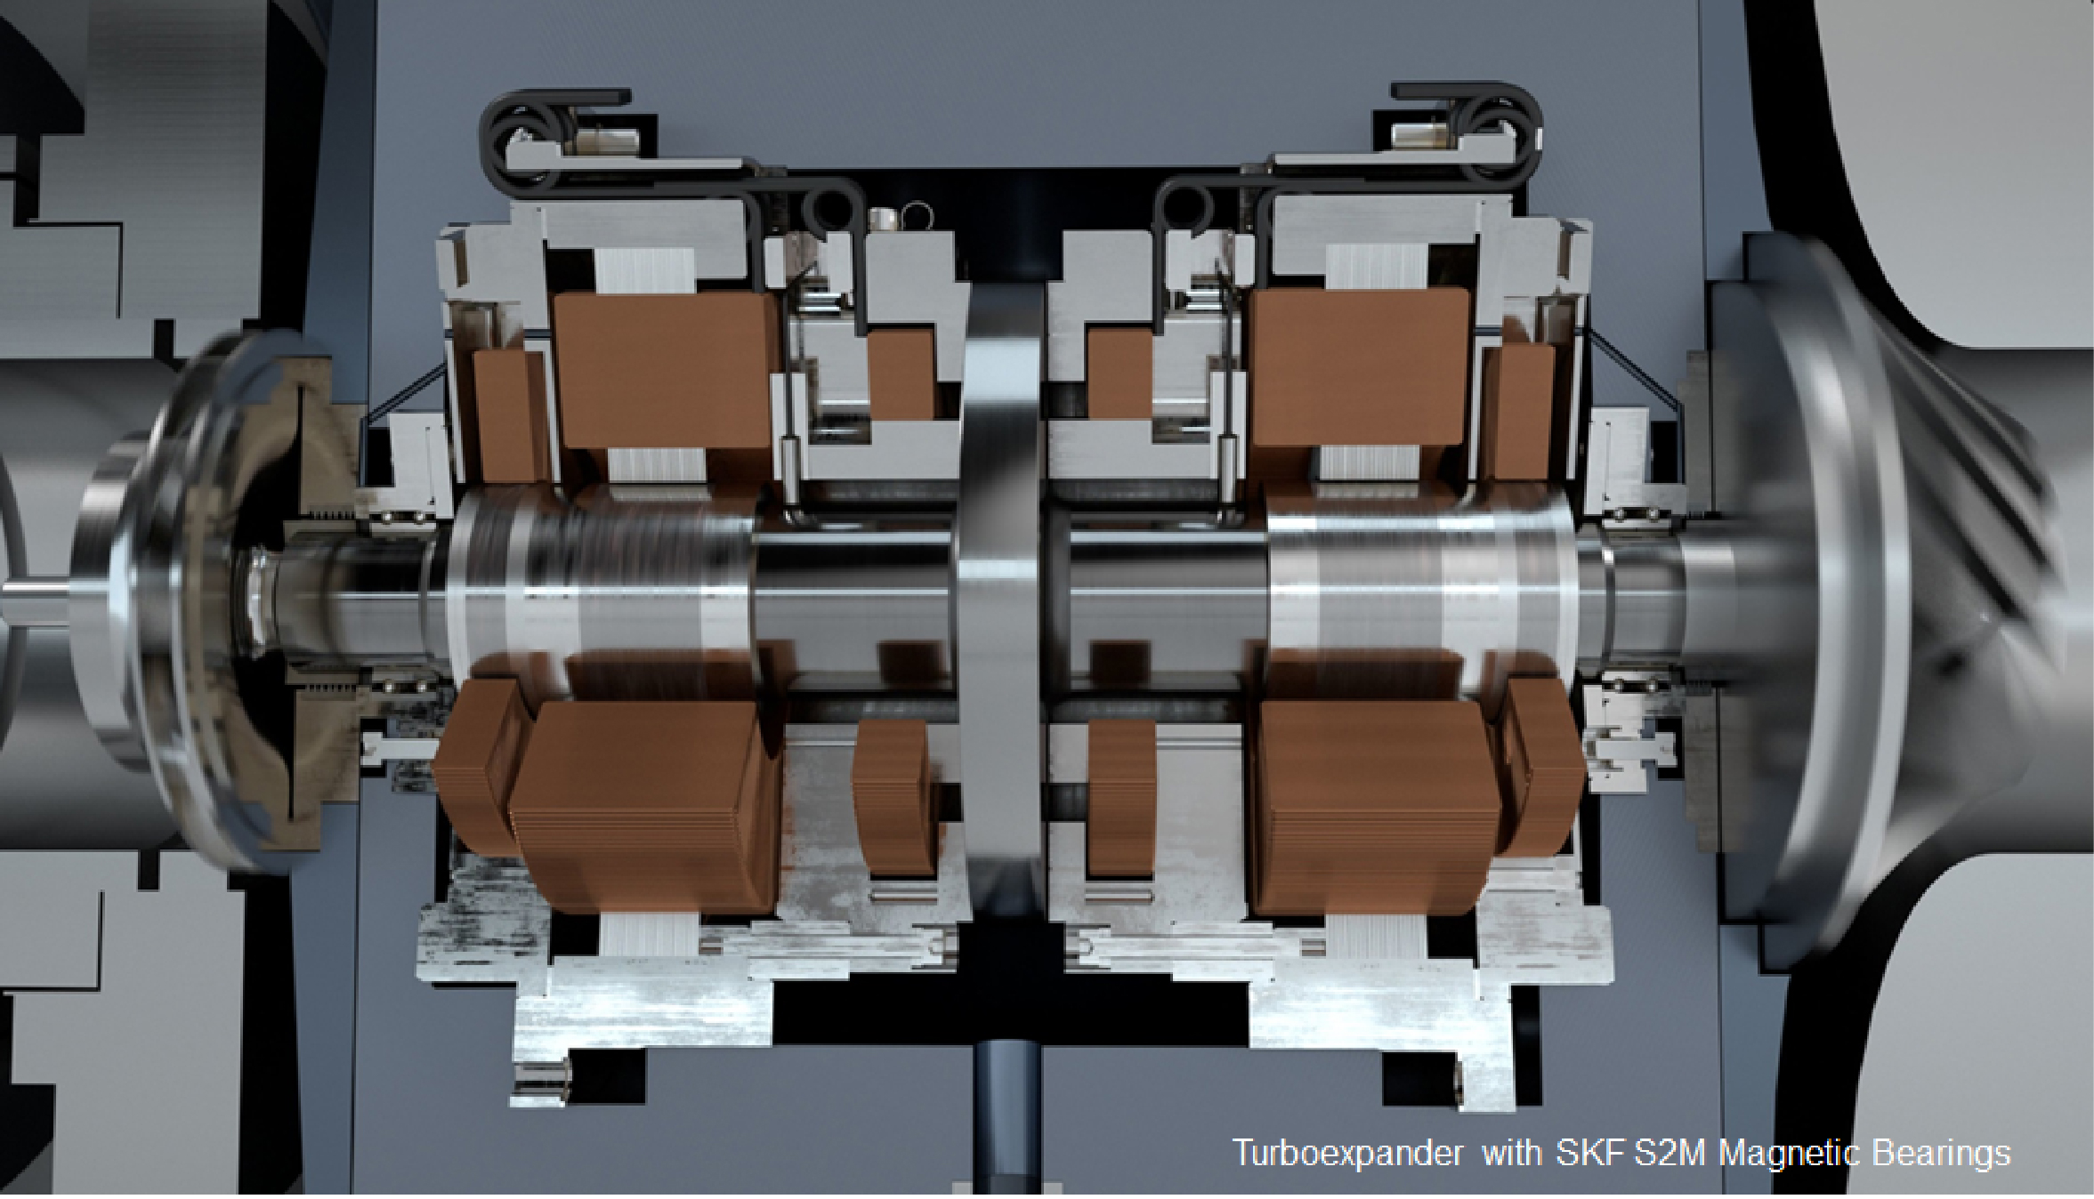
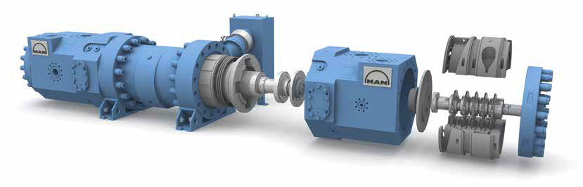
Baseline cryogenic cycle
Cooling power requirements:
680 kW for beam screens cooling (60 to 40 K)
270 kW for Helium cycle pre-cooling (300 to 40 K)
Key components:
multi-stage centrifugal compressor (~10 MW range)
turbo-expander ~700 kW → power recovery in compressor
Considered Nelium composition: 33 vol. % of neon
Nelium Turbo-Brayton cycle: former baseline cycle layout
Image courtesy: MAN Diesel and Turbo
Image courtesy: SKF

Slide 4

Limiting factors
Number of required compressor casings depending on the helium content
(M. Podeur, University of Stuttgart; MAN)
1. Turbo-compressor design
Design inputs: first cycle baseline parameters
Design limitations:
maximal impeller diameter,
rotor dynamics,
shaft length, etc.
Currently developed 1-tandem design:
up to 40 vol. % He;
total compressor isentropic efficiency: ~73 %
Poster session (25.06.19 15:30):
- M. Podeur, D. Vogt, “Optimisation of a multi-stage turbocompressor architecture operating with a neon-helium gas mixture”;
- M. Podeur, D. Vogt, S. Savelyeva, S. Kloeppel, Ch. Haberstroh, H. Quack, “Test rig for the experimental evaluation of turbo-compressor impeller designs for light gases”

Slide 5
Limiting factors
2. System size and gas mass
Example:
67 vol. % helium - 240 kg of gas
30 vol. % helium - 510 kg of gas

Slide 6
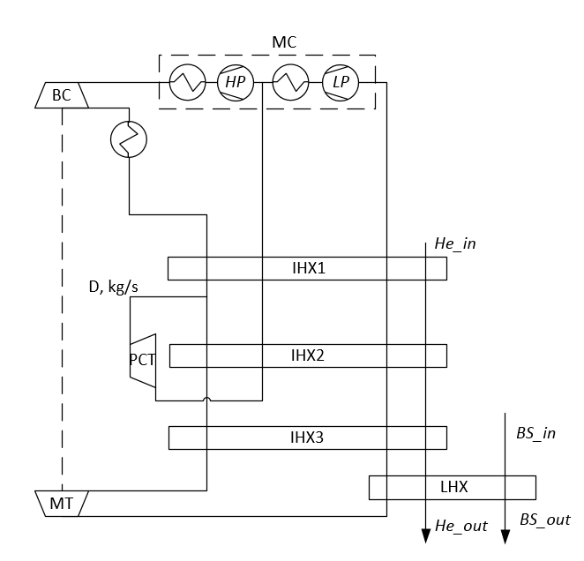
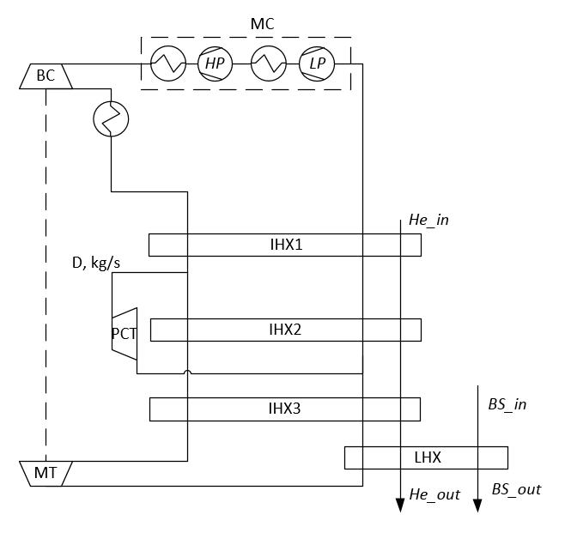
Compared cycle arrangements
Cycle A (baseline)
Cycle B
Cycle C

Slide 7
Compared cycle arrangements
✓ 2 inner heat exchangers | ✓ reduced pressure ratio | ✓ reduced pressure ratio
 | ✓ easier pressure control | ✓ higher volumetric flow to the second compressor casing
 |  | ✓ reduced pressure ratio of pre-cooling turbine compared to cycle B
✗ higher pressure ratio | ✗ additional heat exchanger | ✗ additional heat exchanger
 | ✗ high speed of the pre-cooling turbine (high pressure ratio)
Cycle A (baseline)
Cycle B
Cycle C
Chosen arrangement

Slide 8
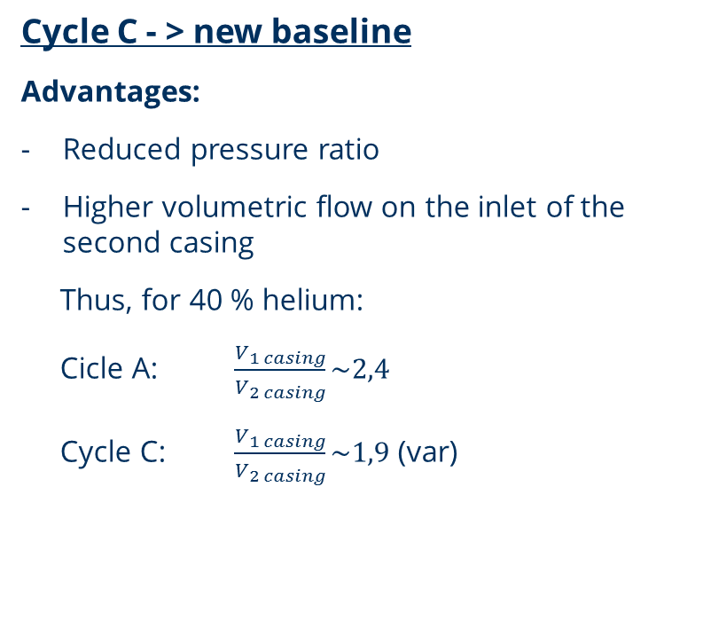
Compared cycle arrangements
Cycle C - > new baseline
Advantages:
Reduced pressure ratio
Higher volumetric flow on the inlet of the second casing
Thus, for 40 % helium:
Cicle A: $\frac{V_{1 casing}}{V_{2 casing}}\sim 2,4$
Cycle C: $\frac{V_{1 casing}}{V_{2 casing}}\sim 1,9$ (var)
Increase helium content up to 60 vol. % He
or
- 1 compressor impeller → +4..5 % to the total compresor ηs↑

Slide 9
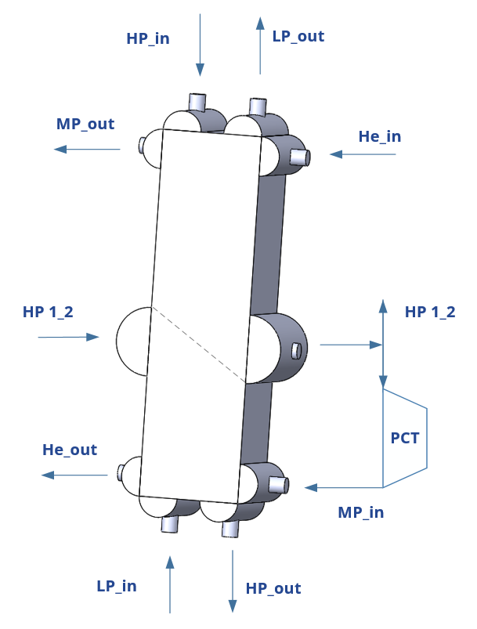
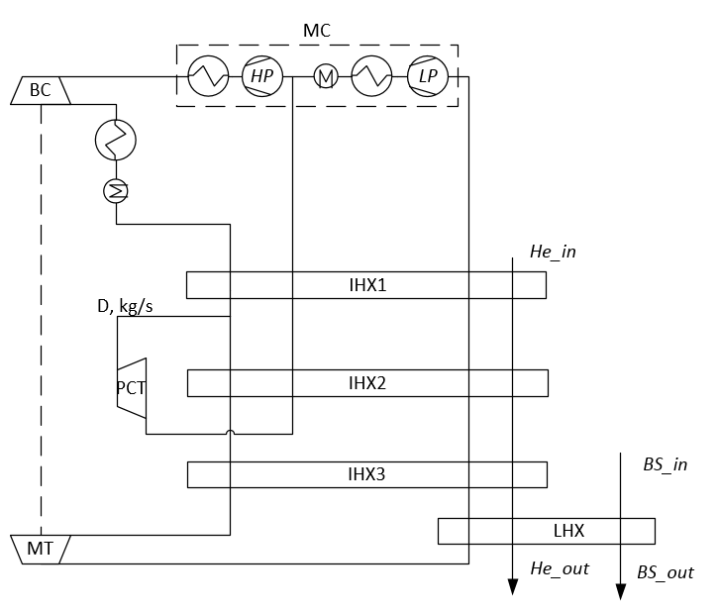
Upper heat exchanger design
IHX1
Reduction of the heat exchanger cross-section area and the cold box diameter
IHX2
New baseline cycle flow diagram

Slide 10
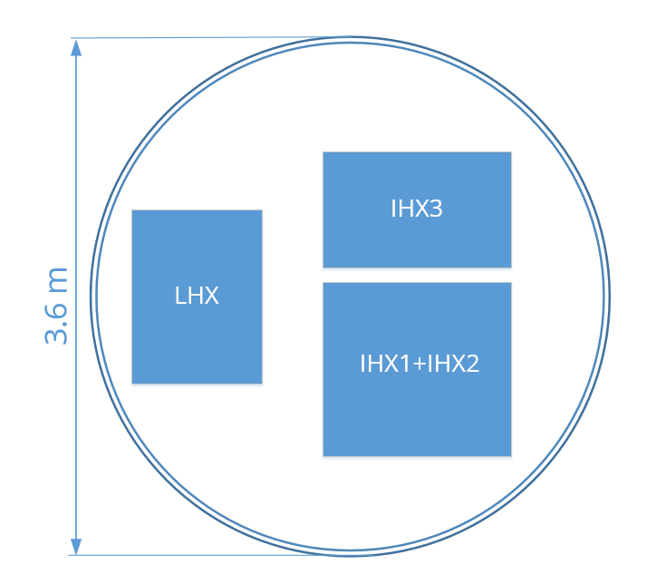
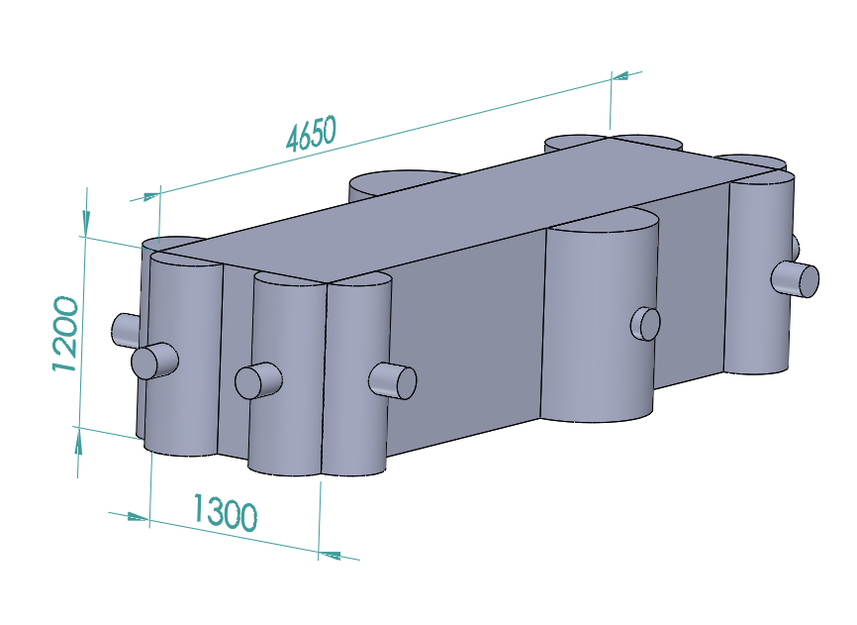
Cold box size
Cold box cross section
Upper heat exchanger (IHX1+IHX2):
L x W x H: ~4.7 x 1.3 x 1.2 m
↓
Within maximal industrially possible size: 8 x 1.5 x 3.4 m
Cold box:
Length: 5.6…6 m;
Diameter: 3.6..3.8 m
↓
Transportable
Upper heat exchanger
IHX 1 + IHX2 – upper heat exchanger,
IHX3 – inner heat exchanger,
LHX – load heat exchanger

Slide 11
Improved cycle concept
NTU of the upper heat exchanger reduced from 40 to 30;
Optimal NTU of IHX1: 17...18
Case study (under progress): matching the turbo-compressor middle pressure with the cycle parameters
Estimated total power for the chosen case: ~9.7 MW
New baseline cycle flow diagram

Slide 12
Improved cycle concept
✓ Preliminary check of the turbines design:
↓
no limitations observed
 | Power, kW | D, m | N, rpm | Ns
MT | 789 | 0.18 | 23000 | 0.57
PCT | 362 | 0.10 | 54000 | 0.61
✓ Possible chillers implementation
New baseline cycle flow diagram
Poster session (25.06.19 15:30):
H. Quack, F. Holdener, S. Savelyeva, S. Kloeppel, C. Haberstroh
“Cooling of the refrigerant with chilled water before the inlet of the compressor”

Slide 13
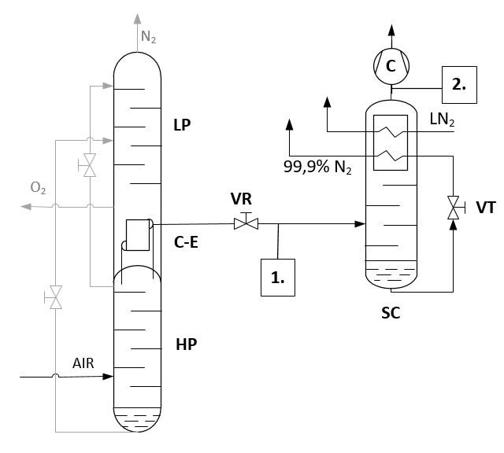
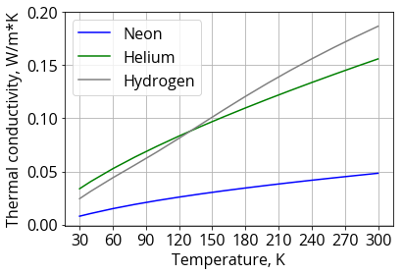
Natural Nelium concept
Corresponds to the neon-helium ratio in the air:
Natural Nelium: 68.8 % Ne, 23.4 % He, 7.8 % H2 (3…8 %)
Economically advantageous
Current target composition: 60 % neon, 40 % helium → cheaper helium can be added
Hydrogen presence in the mixture: good thermophysical properties
Problem: instability of composition
Crude nelium mixture production flow diagram

Slide 14
Next steps
Case study for the turbo-compressor and cycle parameters matching
Transient operation modes for the improved cycle
Detailed cool-down investigation using the improved cycle
Further study of the Natural Nelium concept

Slide 15
Thank you for your attention!
Improved concept of the Nelium Turbo-Brayton cycle for the FCC-hh beam screen cooling
S. Savelyeva, S. Klöppel, Ch. Haberstroh, H. Quack
EASITrain – European Advanced Superconductivity Innovation and Training. This Marie Sklodowska-Curie Action (MSCA) Innovative Training Networks (ITN) has received funding from the European Union’s H2020 Framework Programme under Grant Agreement no. 764879

