Slide 1


FCC Week – 24-28 June 2019
Transient conjugate heat transfer numerical simulation in superfluid helium
Andrea Vitrano, Romain Bruce, Bertrand Baudouy
andrea.vitrano@cea.fr
CEA Paris-Saclay

Slide 2
Outline
Research question
Experimental setup
Numerical model
Ongoing work
1.
2.
3.
4.

Slide 3
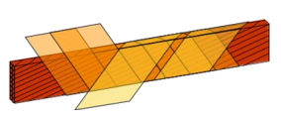
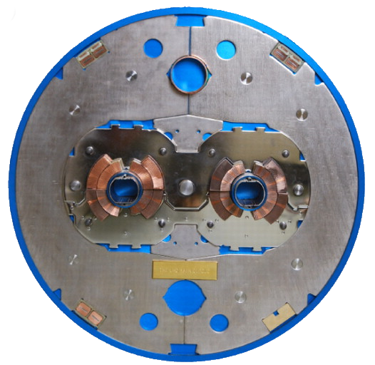
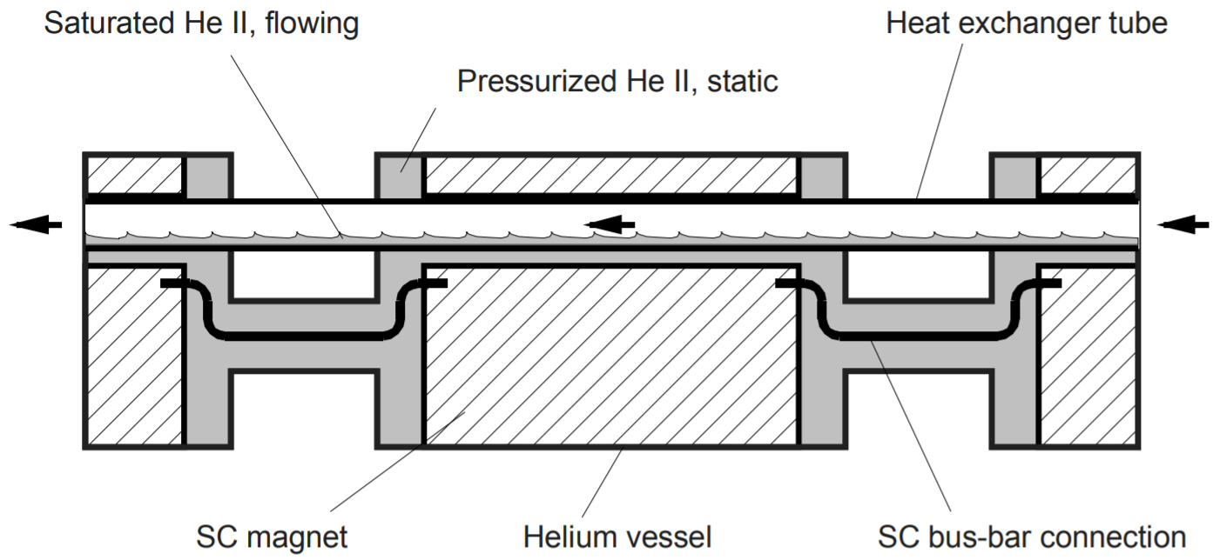
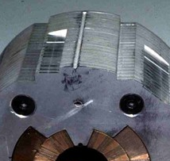
Heat transfer in accelerators magnets
Research question
Experime-ntal setup
Numerical model
Ongoing work
  Cable electrical insulation
  Space between steel collars
(a)
(b)
DOI: 10.1098/rsta.2011.0453

Slide 4
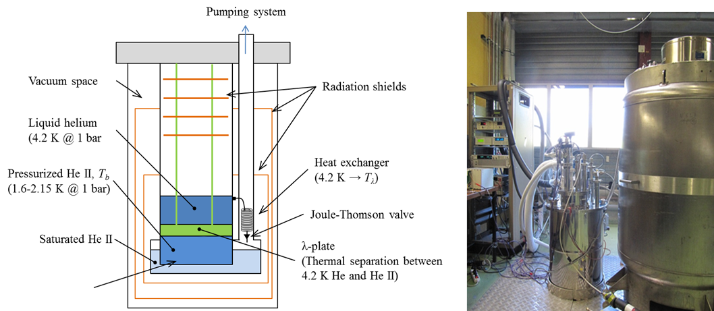
Experimental Test Rig
Research question
Experime-ntal setup
Numerical model
Ongoing work
Experiment location

Slide 5
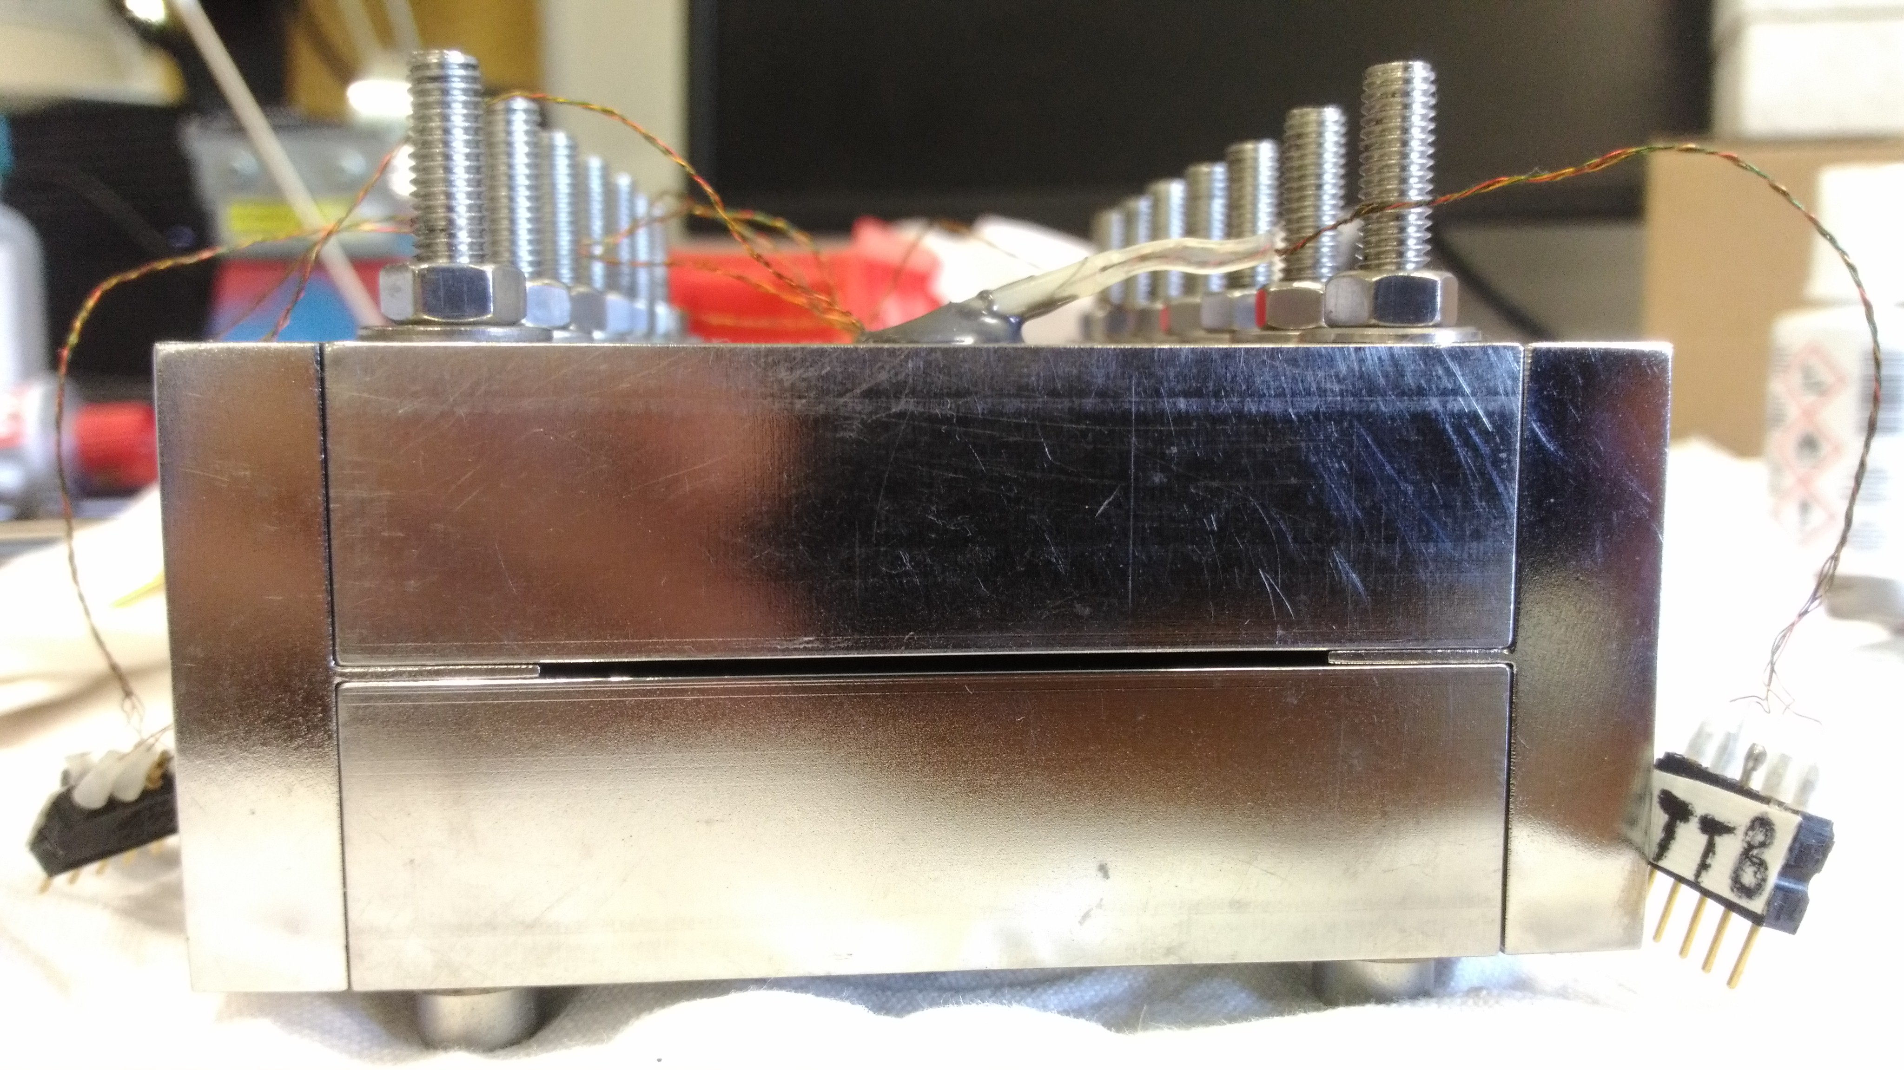
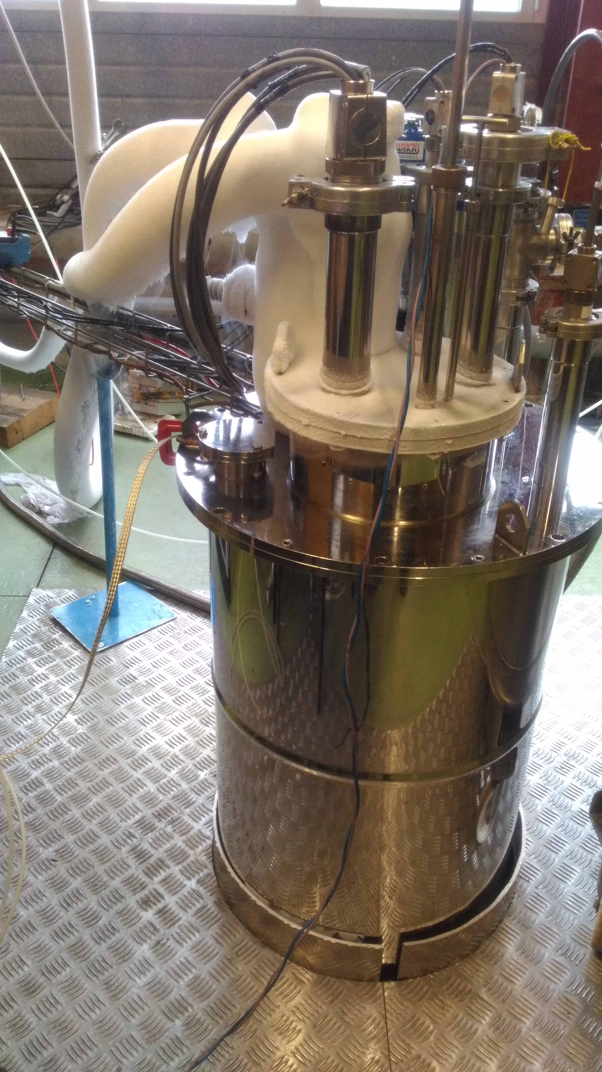
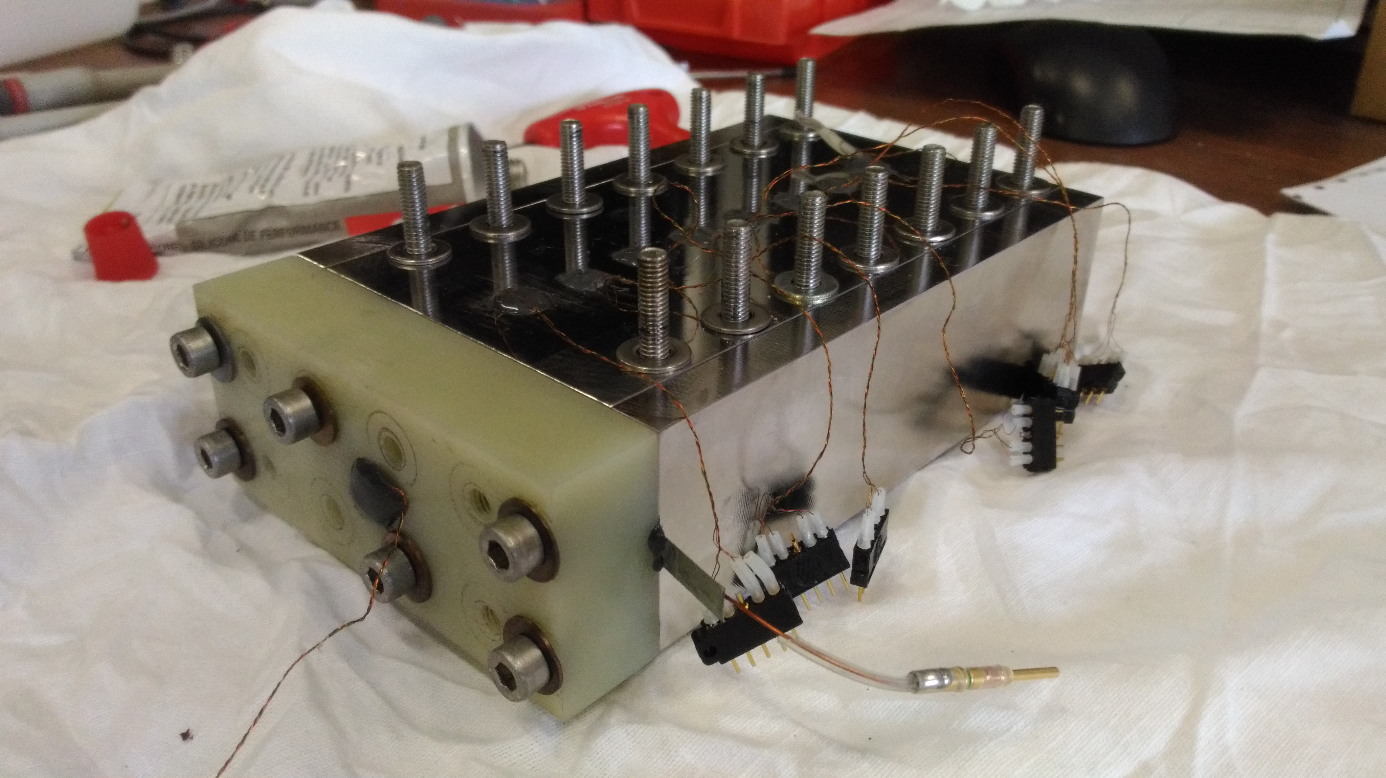
Experimental Sample
Cryostat
Research question
Experime-ntal setup
Numerical model
Ongoing work
Temperature sensors 1-8
1mm thick, 5cm wide, 14cm long channel
Heater support
Heater

Slide 6
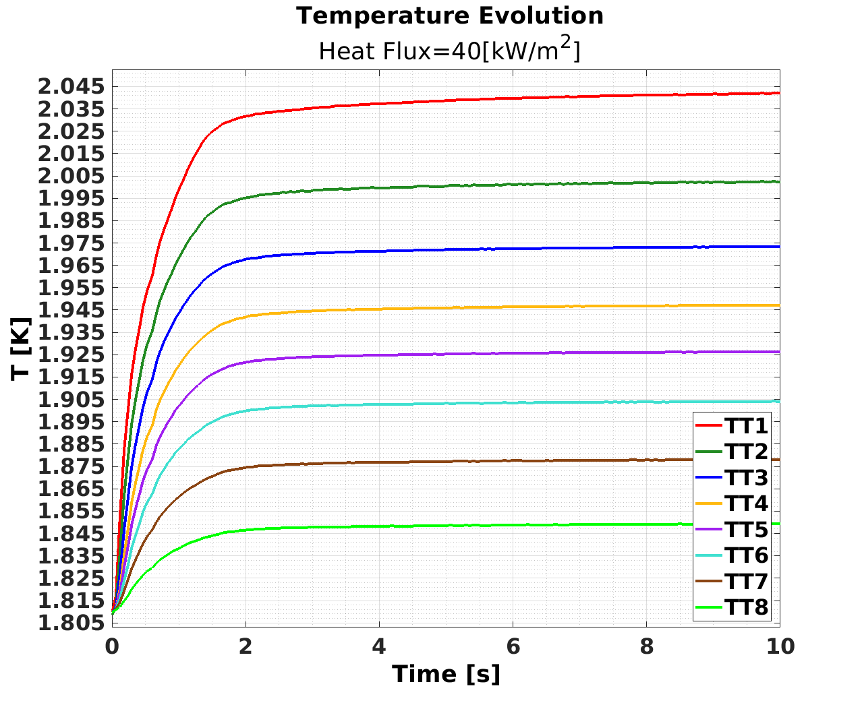
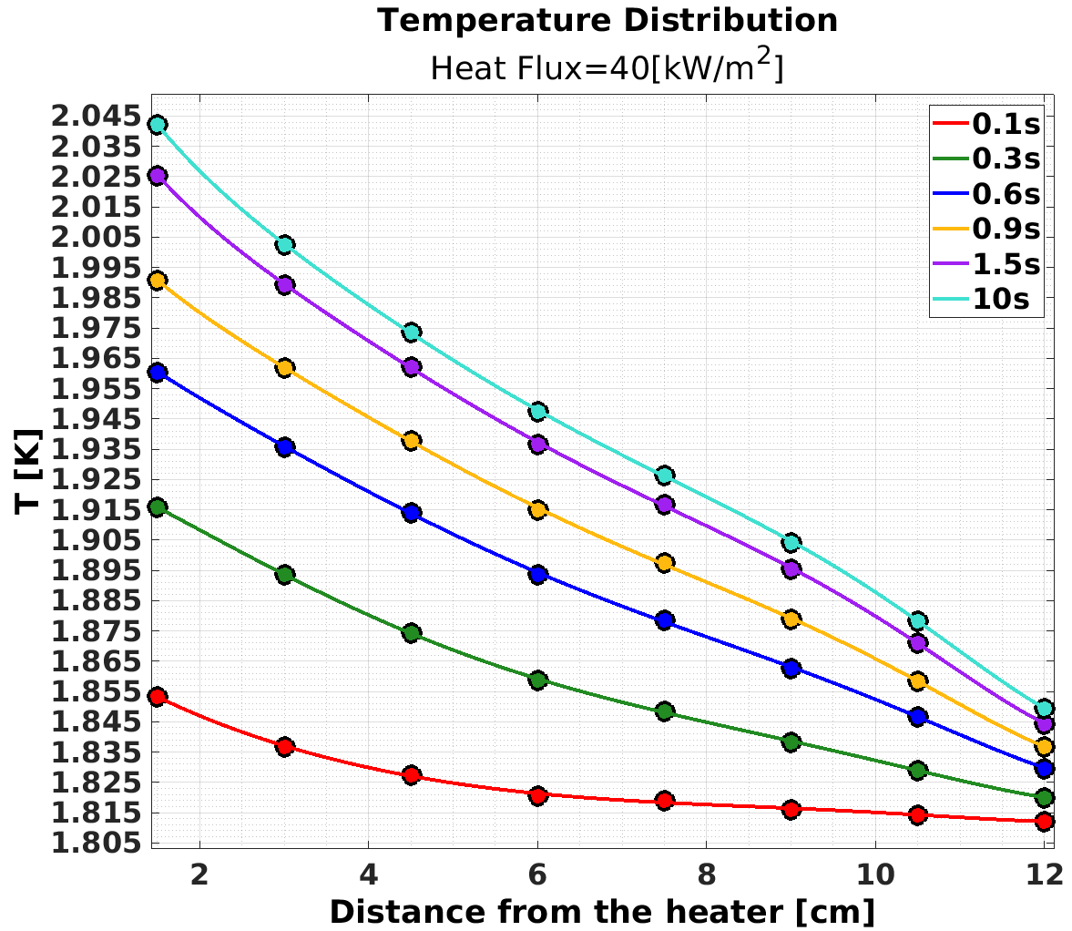
Measurements @ T < T_{λ}
Research question
Experime-ntal setup
Numerical model
Ongoing work

Slide 7
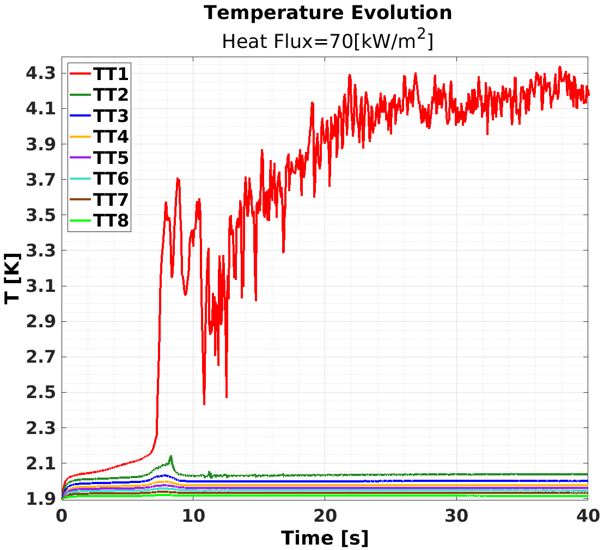
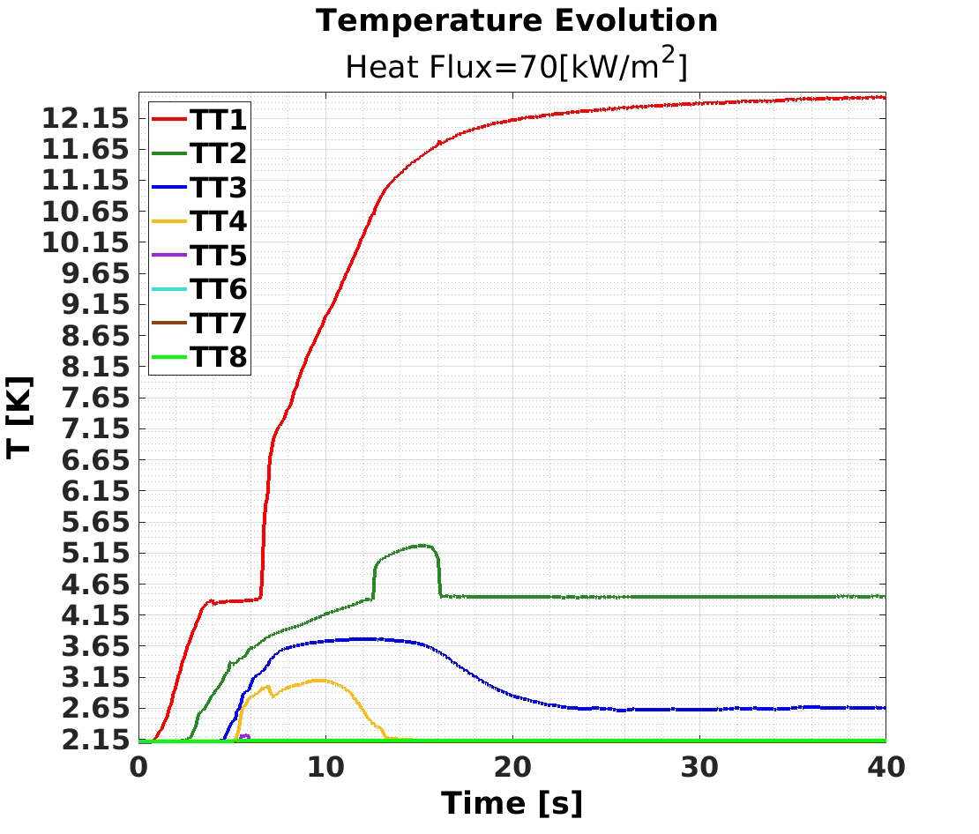
Measurements @ T > T_{λ}
Research question
Experime-ntal setup
Numerical model
Ongoing work

Slide 8
CFD solver
Research question
Experime-ntal setup
Numerical model
Ongoing work
OpenFOAM version: 3.0.1
Solver: chtMultiRegionFOAM
“Solver for steady or transient fluid flow and solid heat conduction, with conjugate heat transfer between regions, buoyancy effects, turbulence, reactions and radiation modelling”
  Segregated solution approach
  PISO algorithm
  Compressible fluids
  Enthalpy based energy equation

Slide 9

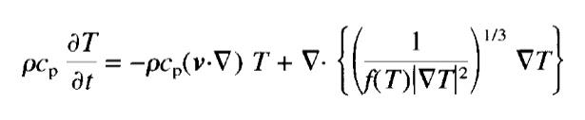
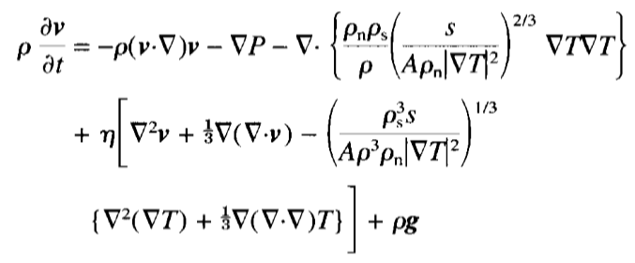
Kitamura’s simplified model
Research question
Experime-ntal setup
Numerical model
Ongoing work
  Assumption:
  Energy equation:
  Momentum equations:
Terms to be added to the OpenFOAM solver
DOI: 10.1016/S0011-2275(96)00096-3

Slide 10





Heat conductivity function
Research question
Experime-ntal setup
Numerical model
Ongoing work
  Theory (m = 3)
  Sato formulation (m = 3.4)
  Properties taken from HEPAK database
DOI: 10.1016/B978-008044559-5/50204-0

Slide 11


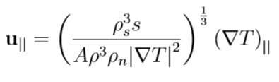

Boundary Conditions
Research question
Experime-ntal setup
Numerical model
Ongoing work
  Partial slip of He II
  v_{n} = 0
  new boundary condition
  superfluidPartialSlipFvPatchVectorField

Slide 12
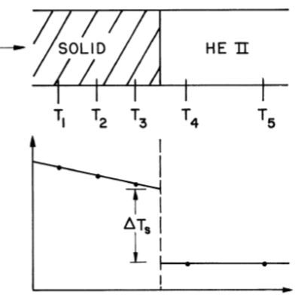
Boundary Conditions
  Kapitza resistance
Research question
Experime-ntal setup
Numerical model
Ongoing work
  q = h_{k} (T_{s} - T_{He})
  h_{k} = a T_{He}^{b}
  (a , b) = f (solid material)
  new boundary condition
  temperatureKapitzaCoupledBaffleFvPatchScalarField

Slide 13
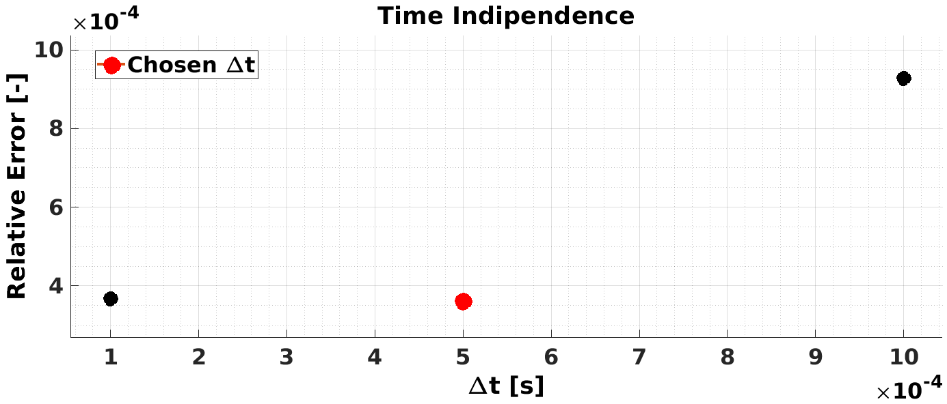
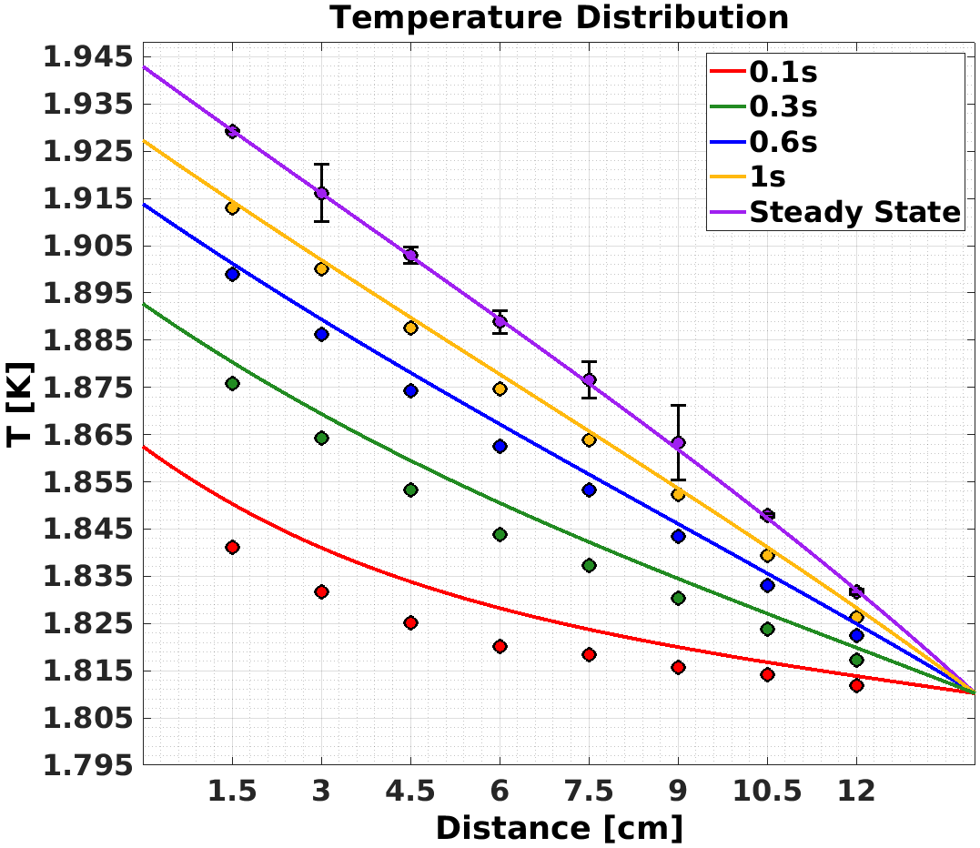
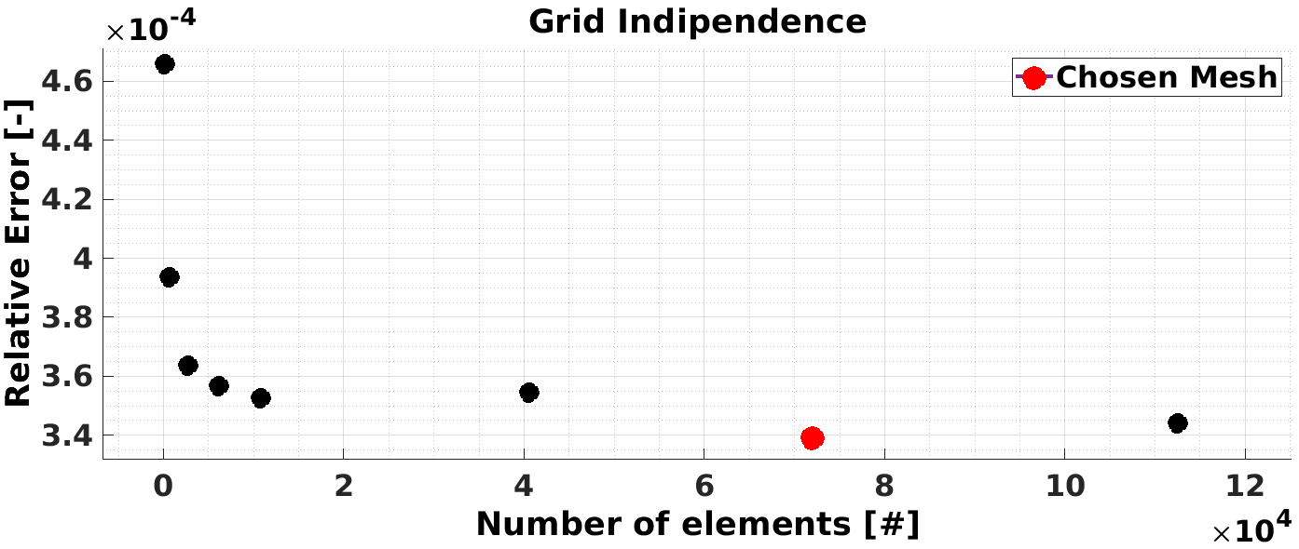
He II Model Validation
Research question
Experime-ntal setup
Numerical model
Ongoing work
Heat Flux ≈ 22 [kW/m²]
T_{bath} = 1.8102 [K]

Slide 14
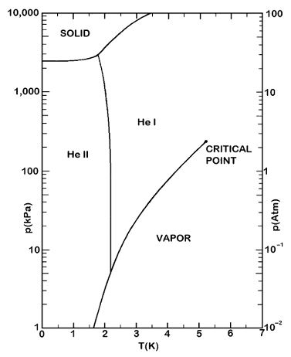
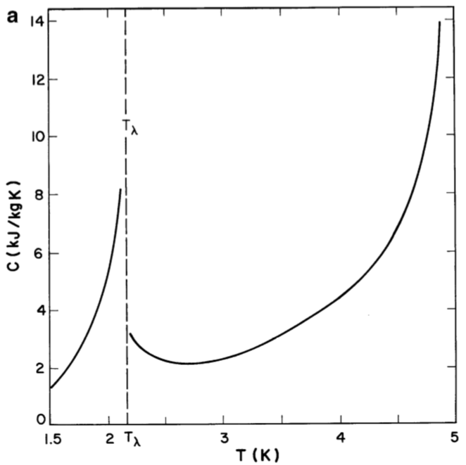
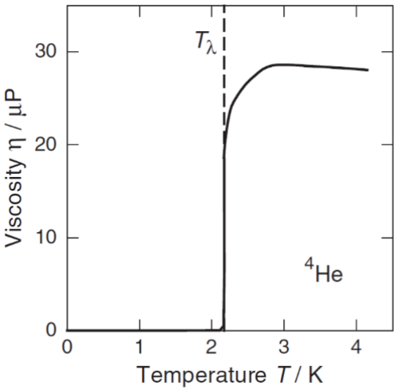
He II – He I Phase Transition
Research question
Experime-ntal setup
Numerical model
Ongoing work
DOI: 10.1007/978-1-4419-9979-5
ISBN 978-3-540-26619-8

Slide 15
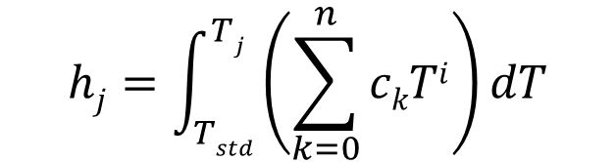
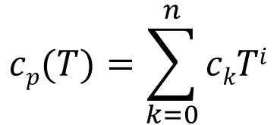
Temperature Calculation
  Enthalpy based energy equation
  the T needs to be computed
Research question
Experime-ntal setup
Numerical model
Ongoing work
  OpenFOAM heatTransfer solvers temperature calculation
$$cp(T)=\sum_{k=0}^{n}{ckTi}$$
$$hj=\int_{Tstd}^{Tj}{\left(\sum_{k=0}^{n}{ckTi}\right)dT}$$
  second order transition
  Newton-Raphson iterative method
  non-linear equation
  enthalpy – temperature table for interpolation
  highly unstable

Slide 16
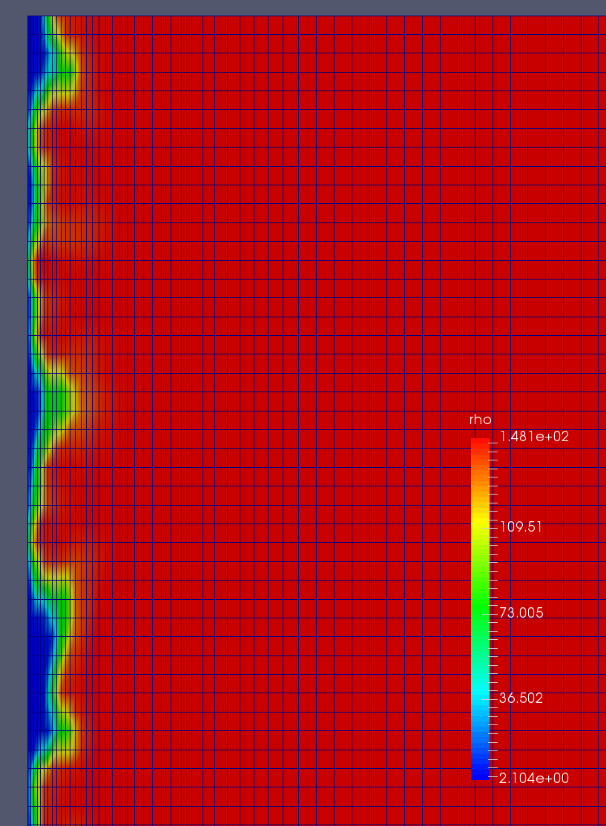
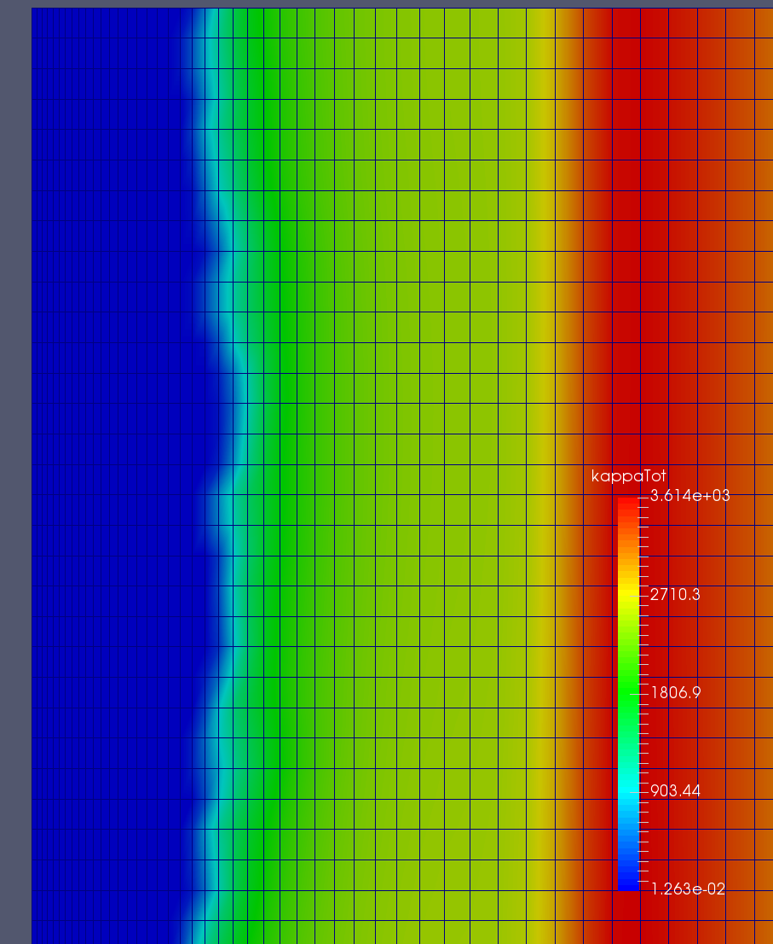
He II – He I simulations
Density:
From 148[kg/m³] down to 2[kg/m³]
Thermal conductivity:
From 3.6·10³[W/m/K] down to 1.2·10⁻²[W/m/K]
Research question
Experime-ntal setup
Numerical model
Ongoing work
Rectangular cross section channel
1mm thick
orthogonal hexahedrons
number of cells ≈ 70k
wall refinement ≈ 2e-3[m]
Heat Flux ≈ 500 [W/m²]
T_{bath} = 2.16 [K]

Slide 17
Thank you for your attention

