Slide 1

Evolution of the canted costheta (CCT) design
B. Auchmann CERN/PSI, R. Felder PSI, J. Gao PSI, G. Montenero PSI,
S. Sanfilippo PSI, S. Sidorov PSI, L. Brouwer LBNL, S. Caspi LBNL
26.06.2019, FCC Week 2019, Brussels.
Work supported by the Swiss State Secretariat for Education, Research and Innovation SERI.

Slide 2
Overview
CCT Design Evolution
CHART1 Model-Magnet Program
  Where we stood 1 year ago
  Where we stand now
CHART2 Program

Slide 3
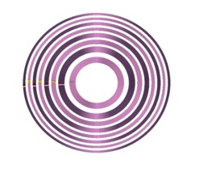
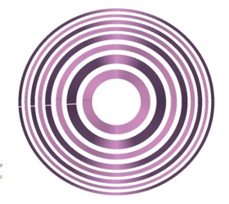
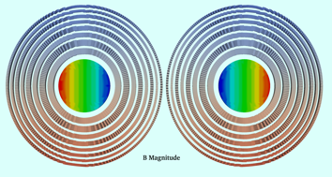
Initial 2016 LBNL Design
2015/16 FCC Weeks, Shlomo Caspi
Clear bore ID=50mm,
Strand dia=0.8mm,
Coil OD=245mm
Clear bore ID=50mm,
Strand dia=1.0mm,
Coil OD=322mm
Larger strands and spars
Strand /magnetic length = 16.2(Km/m)
Weight/magnetic-length = 72.6(Kg/m)
Weight/magnet = 1.0(Ton/magnet)
Weight/beam = 4.7 (Kton/beam)
Strand /magnetic length = 19.8(Km/m)
Weight/magnetic-length = 138(Kg/m)
Weight/magnet = 2.0(Ton/magnet)
Weight/beam = 9.06 (Kton/beam)

Slide 4
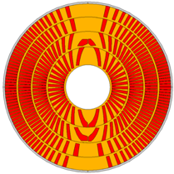
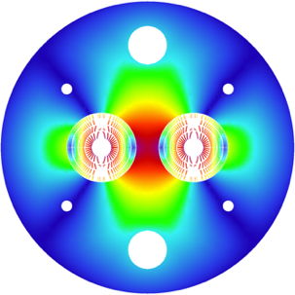
PSI’s CCT Design for FCC
Almost unchanged since FCC Week 2017
Current: 18135 A
Optimize J_{e} optimal winding angle,
minimal spars, and ribs, wide cable.
FCC-wide conductor use: 9.7 kt
Total inductance: 19.2 mH/m
  Total energy: 3.2 MJ/m
Ribs
Spar
Layer # | n_{S} | diam [mm] | cuNc | loadline marg. [%] | current marg. [%] | T_{peak} [K] | V_{grnd} [V] | J_{cu} [A/mm²]
1 | 29 | 1.2 | 0.8 | 14.2 | 111 | 292 | 1133 | 1237
2 | 25 | 1.2 | 1.1 | 14.4 | 95 | 342 | 1264 | 1217
3 | 22 | 1.2 | 1.95 | 14.4 | 74 | 310 | 1156 | 1096
4 | 20 | 1.2 | 2.6 | 15.7 | 70 | 338 | 1144 | 1103

Slide 5
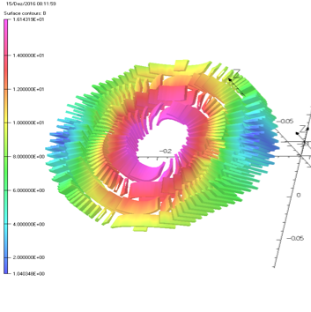
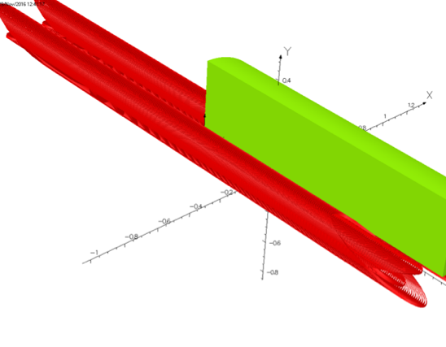
3-D Magnetic Design
3-D modeling results:
Yoke cut-back not needed (20 mT peak-field enhancement in ends).
Magnetic length with yoke equal to that of bare coil.
Physical length minus magn. length = 53 cm; equal to 11 T magnet.
Peak field minus main field at 16-T bore field: 0.14 T excluding self field.
  comparable or lower than cos-theta due to continuous current distribution.
Courtesy M. Negrazus

Slide 6
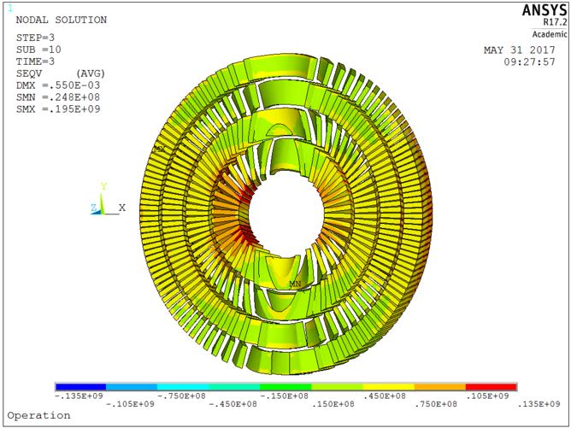
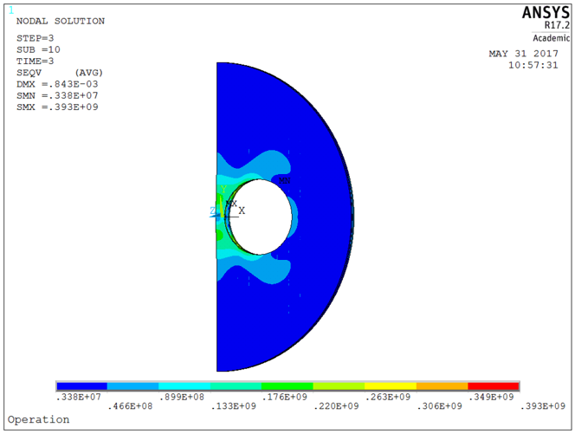
3-D Periodic Simulation
Generalized plane stress condition applied
(following D. Arbelaez, L. Brouwer, LBNL)
135 MPa on conductor
Courtesy G. Rolando

Slide 7
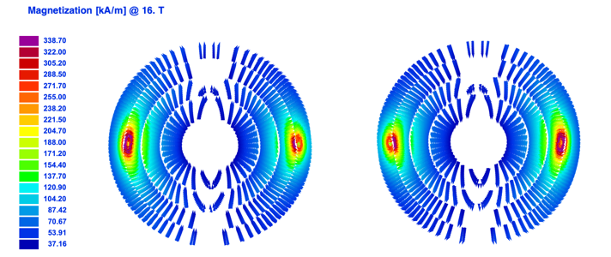
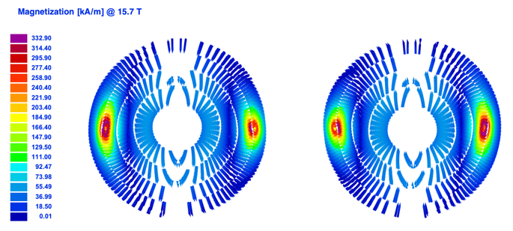
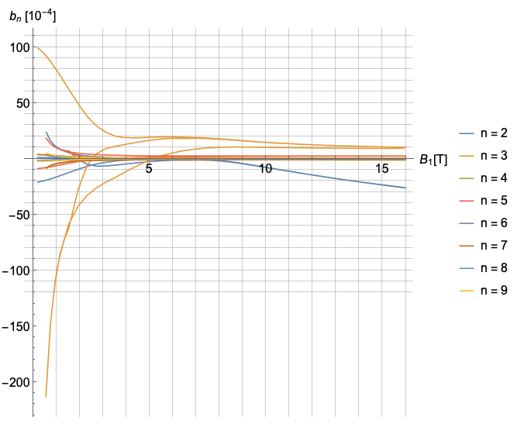
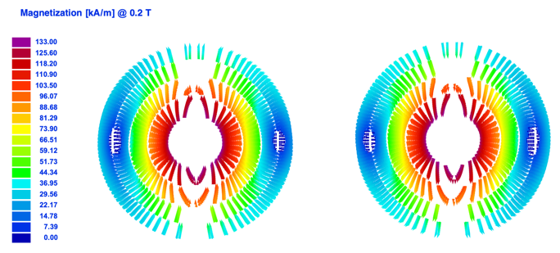
Persistent Currents
First-of-a-kind CCT persistent-
current simulation assuming
axial current-flow like in any
2-D electromagnetic simulation.
Similar order of magnitude as other
designs.

Slide 8
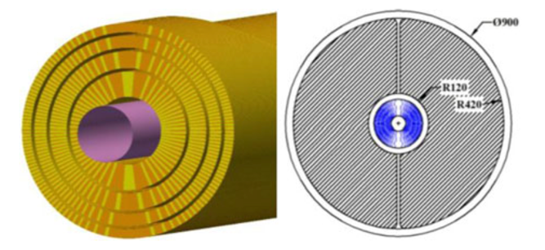
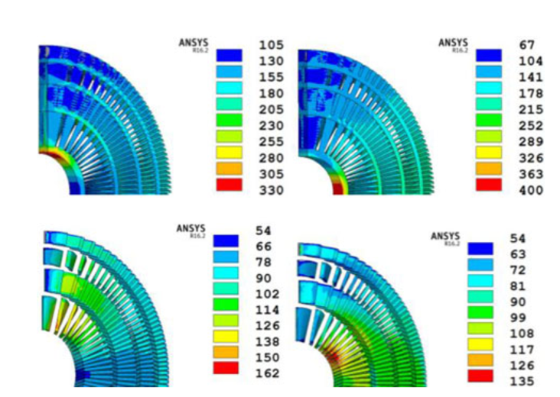
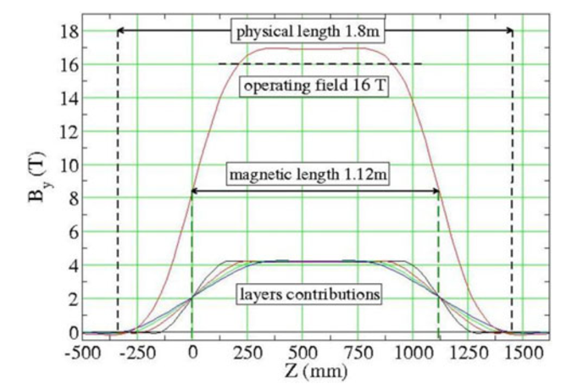
Updated LBNL Design, 2017
S. Caspi et al., “Design of a Canted-Cosine-
Theta Superconducting Dipole Magnet for
Future Colliders”, IEEE Trans. On Appl.
SC., Vol 27, No 4, June 2017
Uses same design features to
increase effective current density.

Slide 9
Overview
CCT Design Evolution
CHART1 Model-Magnet Program
  Where we stood 1 year ago
  Where we stand now
CHART2 Program

Slide 10
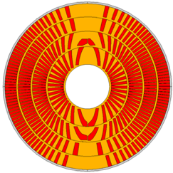
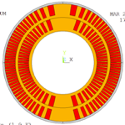
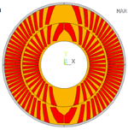
PSI/CHART Goals towards FCC Requirements
Ribs
Spar
Joint funding from CHART and the FCC design study from mid 2016
until the end of 2019.
Goal: Demonstrate key technological features of an efficient 16-T CCT in two-layer technology model magnets.
Thin ribs and spars
Exterior mechanical structure
Fast quench detection and CLIQ protection.
Wide Rutherford cable.
Inclined channels.
Improved impregnation procedures.
CD1..n
CDn+1

Slide 11
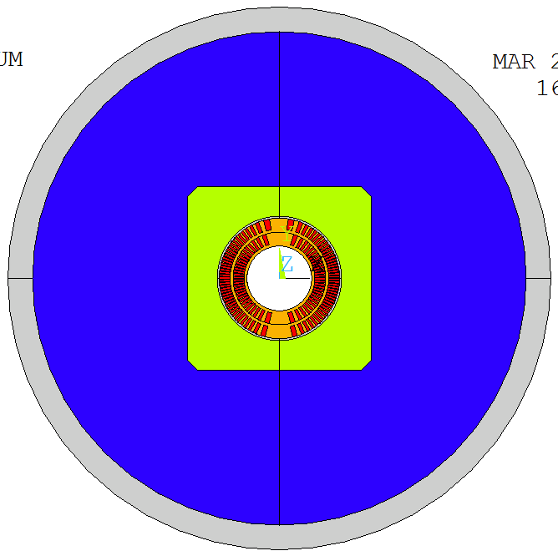
Mechanical Structure
Bladder and Key technology chosen for tuneability and relative simplicity.
  Closed and pre-loaded pad gap for maximum-rigidity cage around coils.
  Steel pads to better match coil differential contraction.
  Designed with S. Caspi, LBNL.
Closed pad gap
Bladder locations
Vertical and horizontal keys
Al shell 25 mm
Protective Al shell 5 mm
Vertically split Al-bronze pad
Vertically split yoke, OR 250 mm
Al-bronze former
Open yoke gap
International conceptual design review of CD1 on June 26 at CERN (http://indico.cern.ch/e/cd1cdr).
Notes:
show loading concept via reaction forces

Slide 12
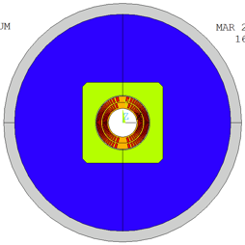
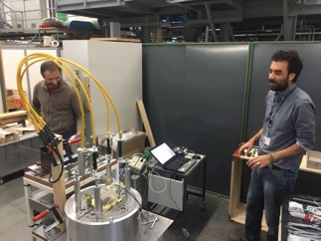
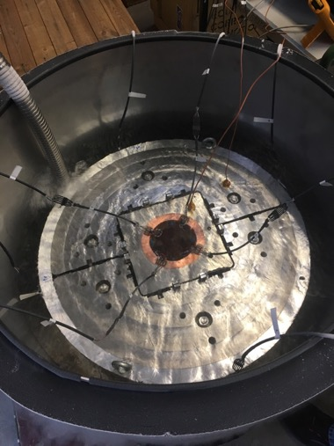
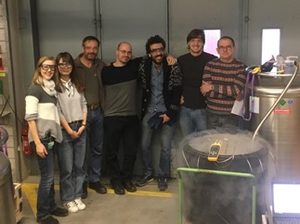
Short Mechanical Model

Slide 13
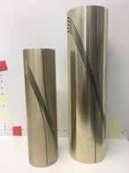
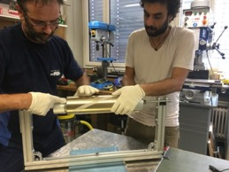
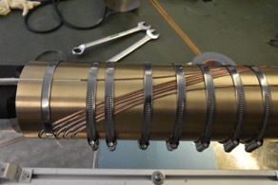
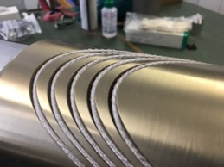
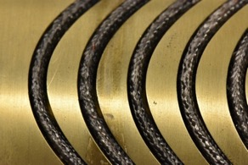
Machining and Reaction Tests.
CD1 reaction-trial at CERN successful, channel-geometry validated.
Test formers delivered.
Test winding completed.
Preparation for heat treatment.
Before heat treatment
After heat treatment

Slide 14
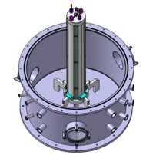
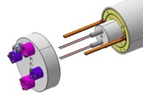
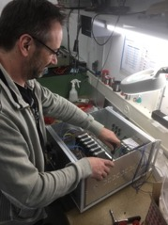
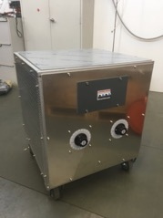
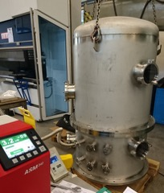
Vacuum Impregnation Equipment
Vacuum vessel designed from CERN specs.
Factory-Acceptance-Test passed and delivered.
Heater powering and control units
designed and built.
Commissioned last week.
G. Montenero and R. Felder

Slide 15
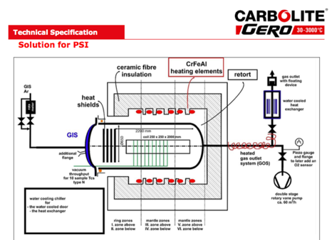
Procurement of Reaction Furnace
Heat treatment furnace with Argon flow.
Order placed following CERN specs.
Working volume 2 m in length, >30 cm in diameter.
Expected on-site commissioning June ‘18.

Slide 16
Superconducting Magnet Fabrication Lab
Coil winding, instrumentation, assembly
Assembly and RT mag. meas.
Reaction
Storage
Impregnation, mixing
Workplace
Crane

Slide 17
Overview
CCT Design Evolution
CHART1 Model-Magnet Program
  Where we stood 1 year ago
  Where we stand now
CHART2 Program

Slide 18
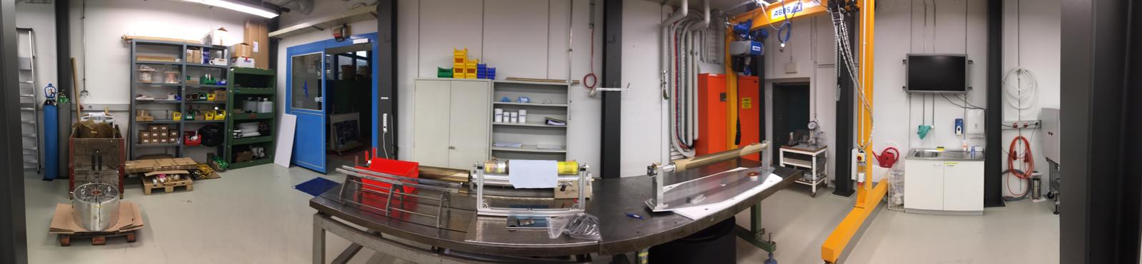
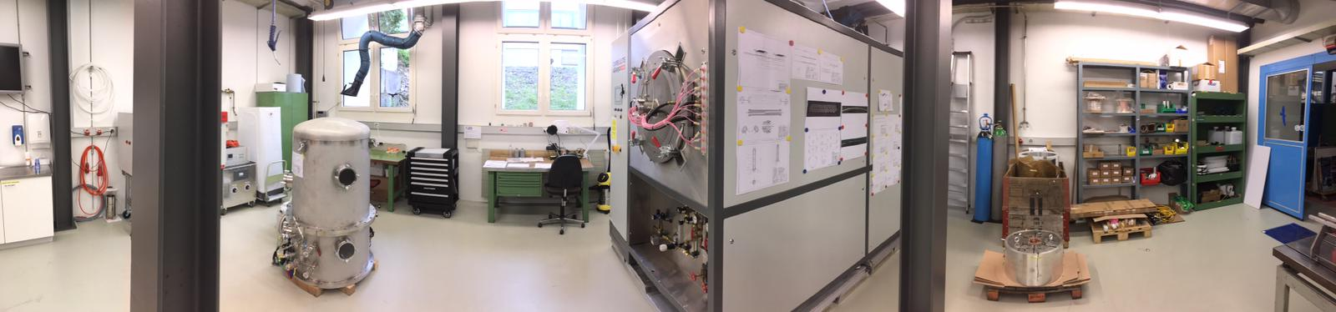
PSI SC Magnet Lab
Portal crane
Storage
Winding table
4-m winding/instrum/assembly bench
Vacuum Impregnation
Coil reaction

Slide 19
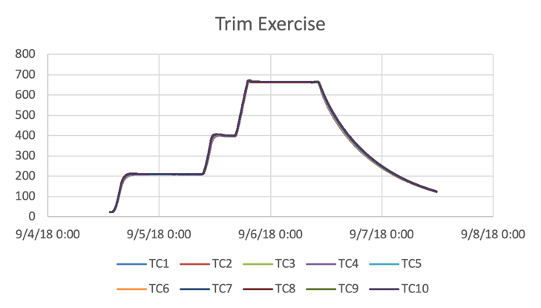
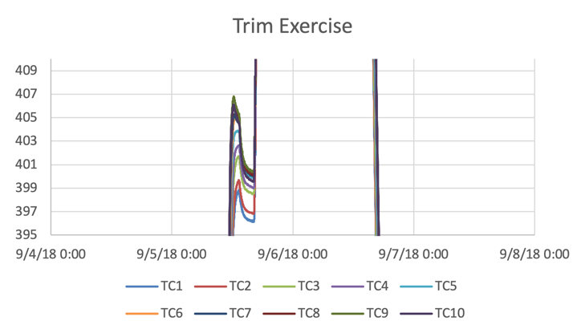
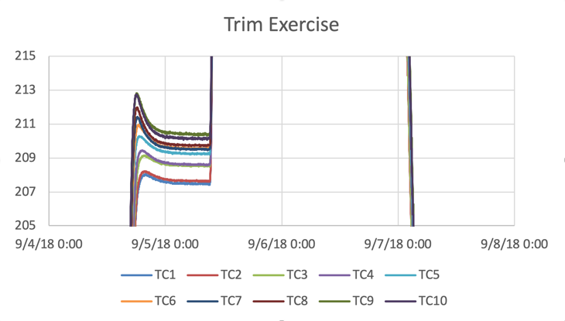
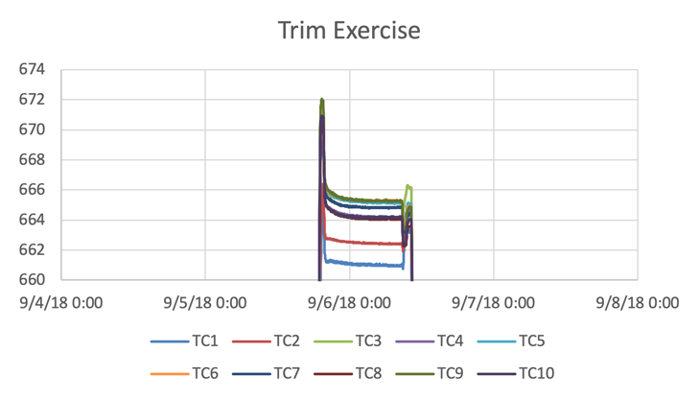
Reaction Furnace Trimming
All plateau axial maps well within +/- 3 K.

Slide 20
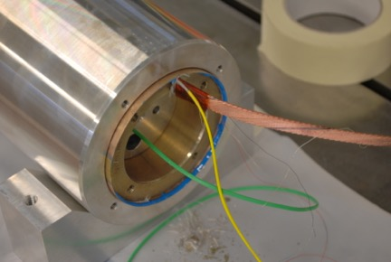
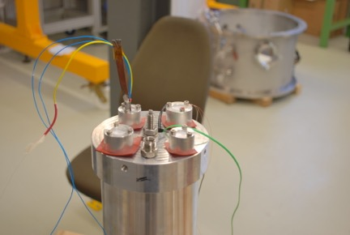
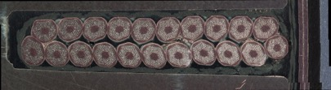
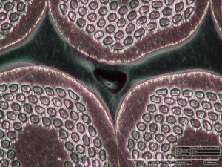
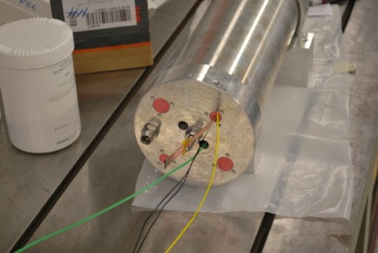
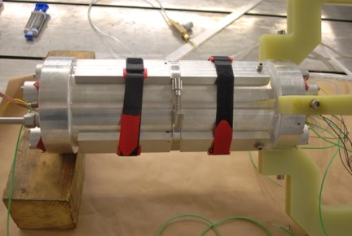
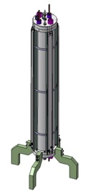
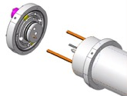
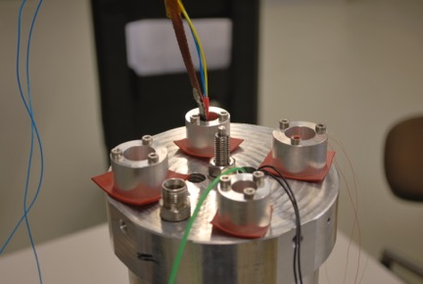


5-Turn Sample Preparation, CD1 Mold

Slide 21




Impregnation Infrastructure
Thanks to generous
advice by David Smekens (CERN),
Jim Swanson (LBNL), and Steven Krave (FNAL)
For better control of flow velocity
and more reliable setup, introduced
peristaltic pump and single tube from de-gassing
pot to mold with pinch-on valves.

Slide 22

Production Readiness Review
End of August ‘18.
Reviewers: Davide Tommasini (Chair),
Paolo Ferracin, Herman ten Kate,
Glyn Kirby, Juan Carlos Perez
Some comments and recommendations
report at http://indico.psi.ch/event/cd1prr:
  Overall, the RC was positively impressed
  by the status of advancement of the
  project and of the associated infrastructure …
  Furthermore, the proactive and networking attitude with other laboratories, in particular LBNL and CERN, was also greatly appreciated.
  A weakness has been identified in the integrity of the dielectric insulation during winding ...

Slide 23


Insulation Challenge
Winding with “mica-C + glass braid” insulated cable.
Winding complete with 12 MΩ low-voltage resistance to former.
The following day this had dropped to 0.2 Ω.

Slide 24




Insulation Challenge and “Cable Keepers”
Removing of insulation and straightening of cable.
Re-insulation with thicker glass braid (no mica).
Winding restarted – same result!
Inserting glass tape (U-shaped) around the cable
along the poles:
  Immediate improvement in insulation.
  better conductor placement by application of
  winding tension.
  better success with “cable-keeper”
  concept.

Slide 25




IL Reaction
After reaction,
  Insulation has turned resistive.
    Likely culprit: reinforcing glass ribbon.
    Final resistance after impregnation to be seen.
  Cable is below IL OD, but …
  … Faro arm shows substantial former
  deformation.
    Al-bronze loses >90% of strength at 665ºC.
    Annealing step at max. 400 degrees needed.

Slide 26




Splicing, Instrumentation, OL Re-Machining
Splicing of IL and OL without
incidents (after extensive training
@LBNL and CERN).
Sliding planes soldered and sealed
around IL.
The OL ID was drilled to accommodate
deformed IL shape. Test assembly
successful.

Slide 27





OL Preparation and Assembly
OL winding and reaction without incidents.
Same insulation problem as IL.
However, cable was pushed out of channel OD!
  Next time channels on poles need additional space.
  PTFE-coated glass fiber will be installed instead of sliding plane
  between OL and Al protective shell.
Assembly for impregnation is under way.
Testing expected at LBNL in autumn.

Slide 28

Main challenges to be overcome …
CCT specific challenges
  Bonding of cable inside channels (as seen @LBNL, CCT5 post-training analysis).
  Reliable insulation against former.
FCC specific challenges
  Smaller ID and thinner insulation lead to
    more difficult winding, need for clamping.
    more mechanical wear of insulation during winding.
  Thinner spar leads to
    higher risk for former deformation.
    need for annealing <= 400ºC or reaction mold
[Courtesy D. Arbelaez, LBNL]

Slide 29



Enabling R&D Actions Started …
1.
Polymer-system characterization and development
and adhesion testing with of ETHZ Soft-Mat Group,
CERN, and PSI. Poster by B. Gold, A. Brem.
Al₂O₃ coating of channels at Oerlikon Metco AG.
  First trials show room for improvement.
  Second trial for parameter tuning under way.
Search for alternative insulation materials and
thermal/chemical de-sizing with von Roll AG.
Study of additive manufacturing for formers
with ETHZ’s Inspire AG, incl. enhanced adhesion.
Annealing trials at PSI.
2.

Slide 30
Overview
CCT Design Evolution
CHART1 Model-Magnet Program
  Where we stood 1 year ago
  Where we stand now
CHART2 Program

Slide 31
CHART2 – Swiss Accelerator Research and Technology
Mission with regard to applied superconductivity:
  Develop a sustainable and Swiss-based expertise in applied superconductivity and superconducting magnets for HEP, in view of a possible FCC-hh or HE-LHC. This shall be anchored in the existing institutes and universities, and further developed thanks to additional recruitment and hands-on training of applied scientists and technicians in the practical objectives described below (R&D, prototyping and testing).
High-field magnets:
  evaluate CCT technology for Nb₃Sn 16-T dipoles,
  develop an up to 2-m-long high-field demonstrator – possibly of different coil geometry.
  contribute to the development of Nb₃Sn conductors that match the performance targets […] and of the cable optimization and test.
HTS magnets:
  develop technologies for HTS based accelerator magnets,
  design, build, and test an HTS variant of the SLS 2.0 superbend magnet.
  design, build, and test several periods of an HTS undulator magnet.
Infrastructure:
  To establish the infrastructure needed to build and test all aspects
  of FCC-hh, HE-LHC magnets and other SC accelerator magnets.
Infrastructure
Enabling Technologies
Wire R&D
LTS Magnet R&D
HTS Magnet R&D
HFM Demonstrator

Slide 32











CHART Applied Superconductivity Network
Strand / Tape
LTS and HTS strand/tape
R&D, Procurement, QA
Cable
Rutherford / Roebel production
Magnet Design
FCC-hh / HE-LHC conceptual and technical
Coil Manufacturing
Nb3Sn and HTS coils
Mechanical Assembly
Mechanical loading
Magnet Testing
LTS and HTS magnet tests
INJECTION

Slide 33


CHART Applied Superconductivity Network
Polymer R&D
Insulation and composite R&D
Splices
Strand / Tape
LTS and HTS strand/tape
R&D, Procurement, QA
Cable
Rutherford / Roebel production
Magnet Design
FCC-hh / HE-LHC conceptual and technical
Coil Manufacturing
Nb3Sn and HTS coils
Mechanical Assembly
Mechanical loading
Magnet Testing
LTS and HTS magnet tests
INJECTION

Slide 34

CHART Applied Superconductivity Network
CCT CNC former manufacturing
CCT former coating
Additive manufacturing
Winding automation
Coil interfaces
Strand / Tape
LTS and HTS strand/tape
R&D, Procurement, QA
Cable
Rutherford / Roebel production
Magnet Design
FCC-hh / HE-LHC conceptual and technical
Coil Manufacturing
Nb3Sn and HTS coils
Mechanical Assembly
Mechanical loading
Magnet Testing
LTS and HTS magnet tests
INJECTION

Slide 35
CHART Applied Superconductivity Network
Quench Protection System
R&D for Nb3sn (FCC-hh)
and HTS
Strand / Tape
LTS and HTS strand/tape
R&D, Procurement, QA
Cable
Rutherford / Roebel production
Magnet Design
FCC-hh / HE-LHC conceptual and technical
Coil Manufacturing
Nb3Sn and HTS coils
Mechanical Assembly
Mechanical loading
Magnet Testing
LTS and HTS magnet tests
INJECTION

Slide 36
Summary
CHART1 has
  established CCT as an alternative for FCC worth studying.
  built and commissioned a SC-magnet laboratory.
  introduced Nb₃Sn CCT magnet technology at PSI.
  identified the key R&D challenges of CCT for FCC.
  launched enabling-technology R&D activities.
  and will finish and test CD1.
For CHART2 we plan to
  engage in enabling-technology R&D targeted for CCT, but also useful for
  tightly-packed coils.
  build, equip, and commission a larger lab at PSI.
  further evaluate CCT technology for high-fields through subscale and demo magnets.
  enter the field of HTS magnet R&D.
  design and build a high-field demonstrator magnet.
Thanks to the continued support by CERN, LBNL, FNAL and others

Slide 37





CCT Protection
Goal of PhD by Jiani Gao:
  Design an efficient detection & protection system for CCT.
  Prove that LHC-based EuroCirCol criterion (40 ms from quench init. to full protection efficiency) can be improved upon.
  Many findings are expected to carry over to other magnet types
Detection:
  Co-wound Cu wire for optimal inductive compensation
  of voltage signals.
  Co-wound SC wire for current-based detection: have ~ 1 A
  circulate in co-wound SC wire and main cable; propagation of quench to co-wound wire and the 1 A quickly drops; detect dI/dt.
  Co-wound optical fiber (Federico Scurti, Justin-Schwartz Group)
  on top of channel post-reaction – use Rayleigh backscattering.
    Mostly for diagnostics with distributed hot-spot sensing;
    evaluate potential for detection.
x
x
x
x
x
x
x
x
x
x
x
x
x
x
x
x
x
x
x
x
x
x
x
x
x
x
x
x
x

Slide 38



Insulation Trial
Cu wire
x
x
x
x
x
x
x
x
x
x
x
x
x
x
x
x
x
x
x
x
x
x
x
x
x
x
x
x
x
Mica spool
Cu wire
spool
Cable
J. Mazet (CERN)

