Slide 1


Thermo-mechanical studies of collimator robustness
G. Gobbi, M. Pasquali, F. Carra, A. Bertarelli, M. Varasteh, R. Bruce, S. Redaelli
FCC Week 2019
25/6/2019

Slide 2
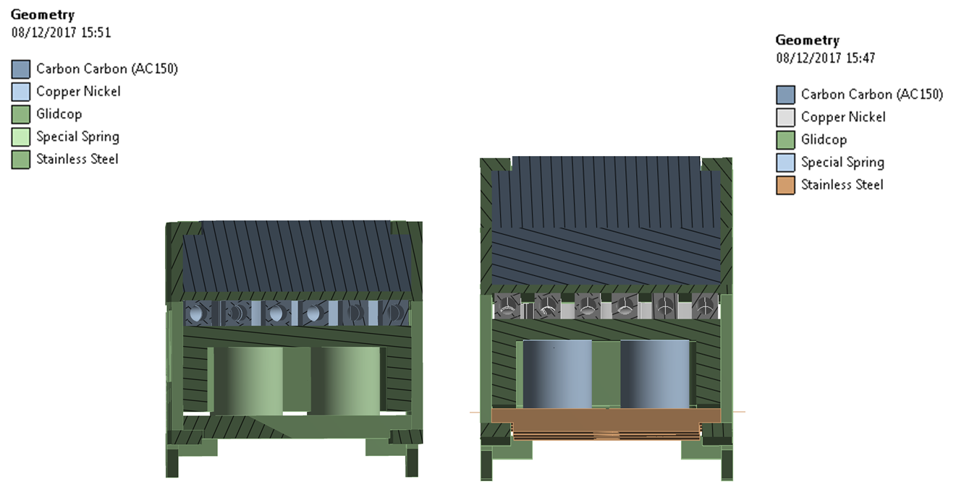
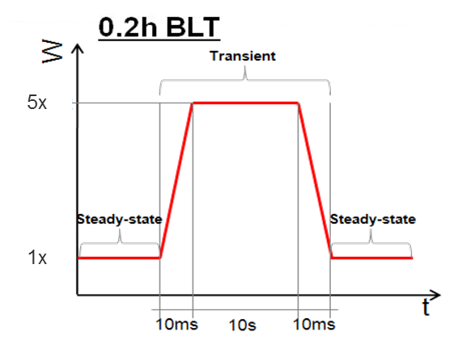
Case studies
Most loaded primary and secondary collimators: TCP and TCSP
Design as those currently installed in LHC but with thicker jaw
Slow losses:
  Primary collimator
  Accidental case: 0.2h BLT (10s)
  Secondary collimator
  Nominal operation: 1h BLT
  Accidental case: 0.2h BLT (10s)

Slide 3
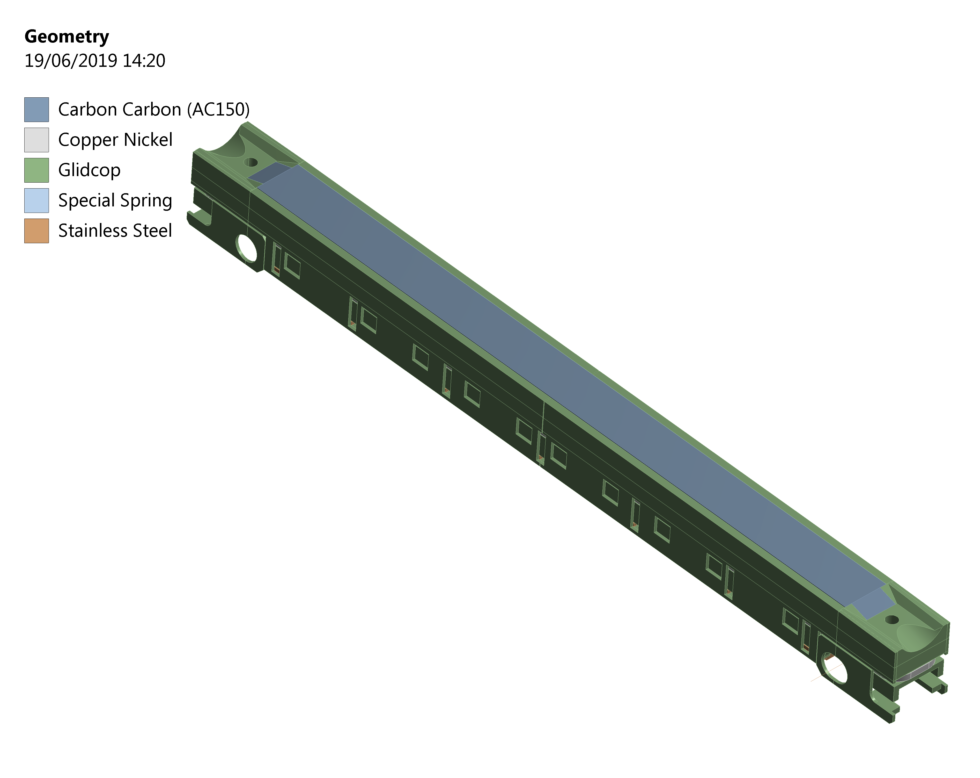
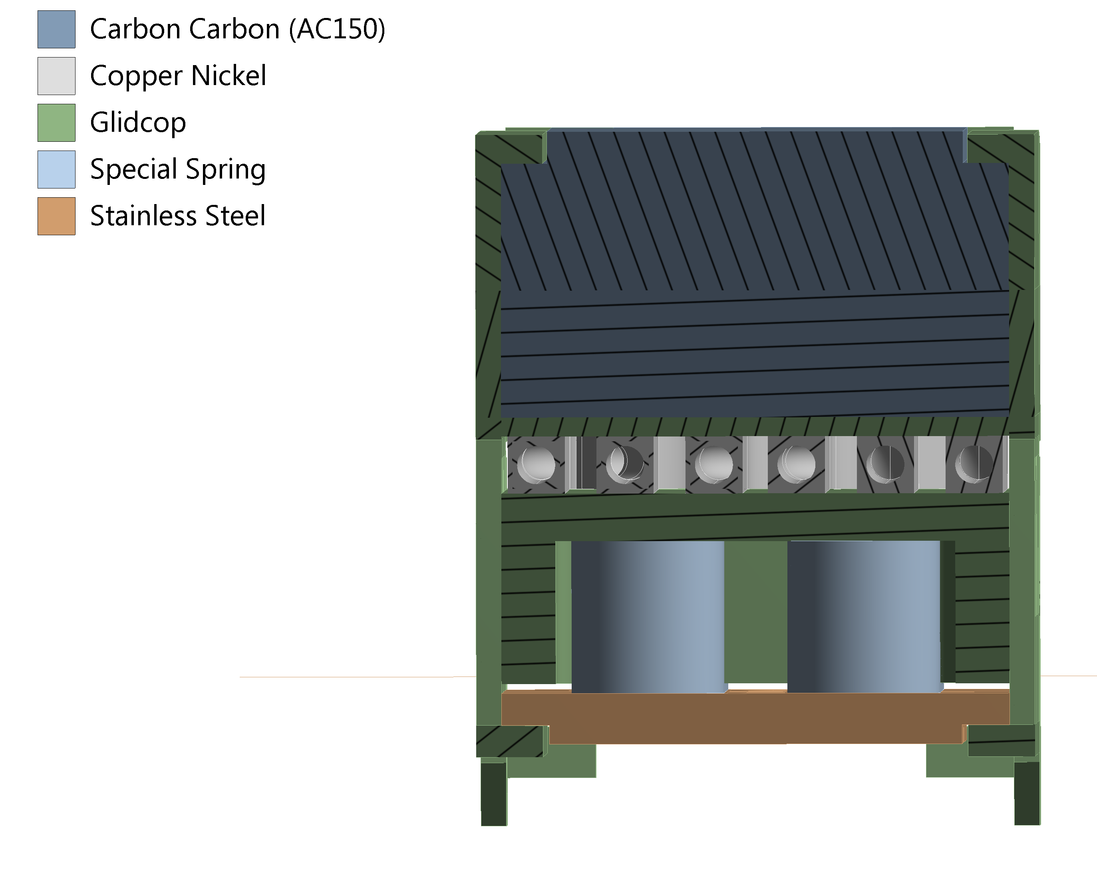
Method
Tracking code
Energy deposition Fluka
Thermo-mechanical simulations Ansys
  Assumption
  Stiffer structure than the current one (LHC), simulated with bonded contacts between CFC and Glidcop housing

Slide 4
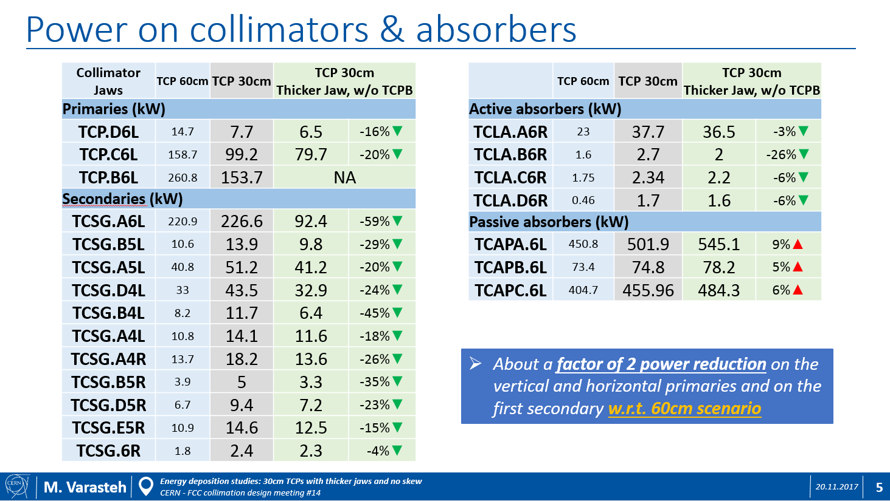
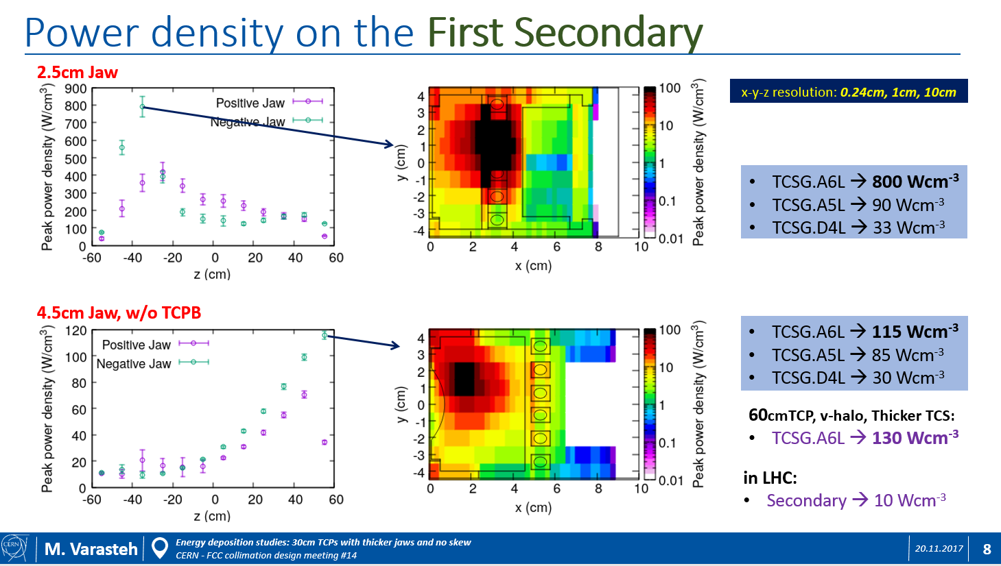
Secondary collimator
TCSP most loaded jaw of the first secondary collimator (TCSGA6L)
Thicker jaw: 4.5 cm instead of 2.5 cm
Skew TCP removed and thickness of primary collimator jaws (30 cm long) increased from 2.5 cm to 3.5 cm
+2 cm

Slide 5
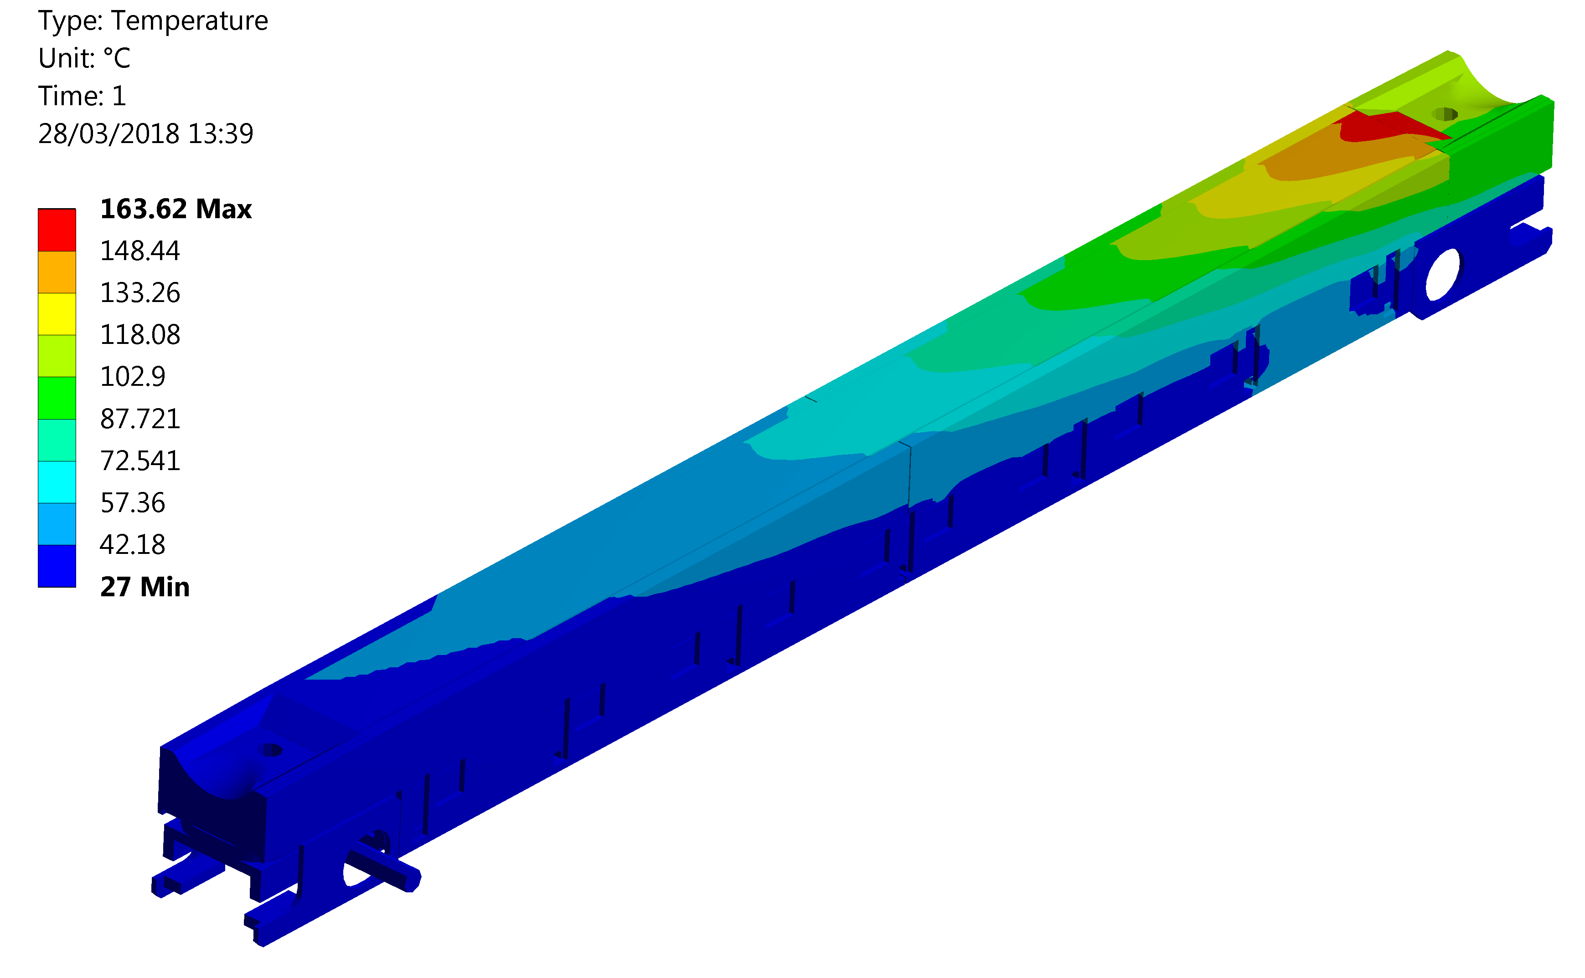
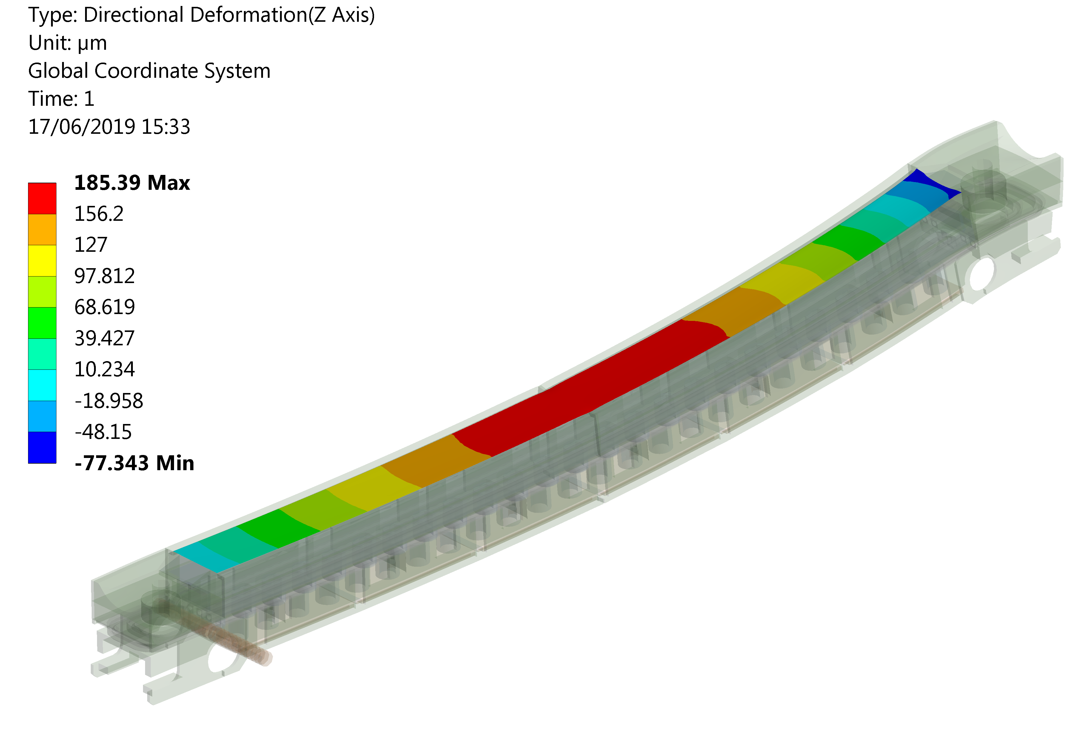
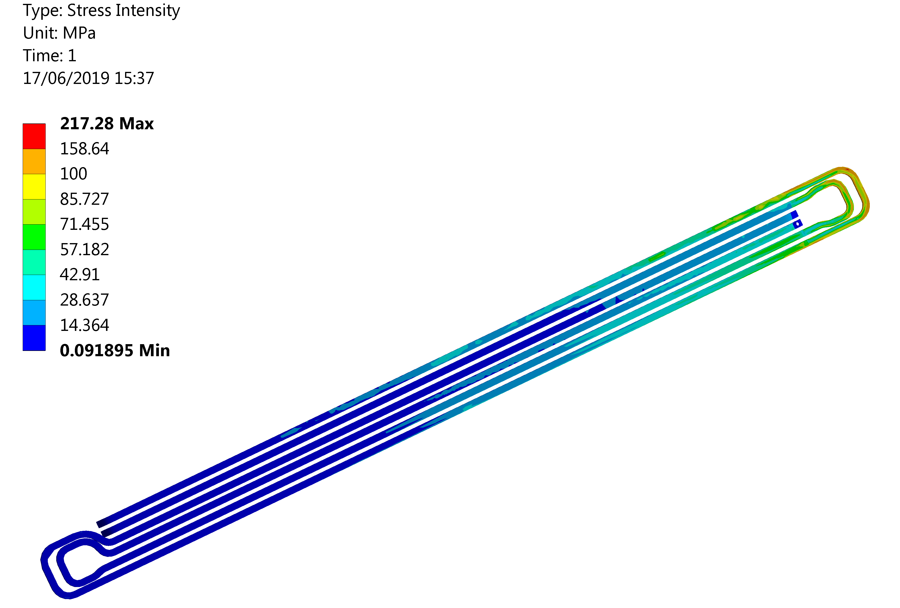
Results - 1h BLT
T_{max} = 164 ºC
Deflection = 262 µm
Cooling water at T = 27 ºC (constant)
Plasticity downstream
Moderate temperature on the overall collimator, with local peak → improved pumping system could be beneficial
Jaw assembly survives without plasticity (except pipes)
Deflection away from the beam
Low stresses on the CFC absorber
σ_{y} CuNi 90/10

Slide 6
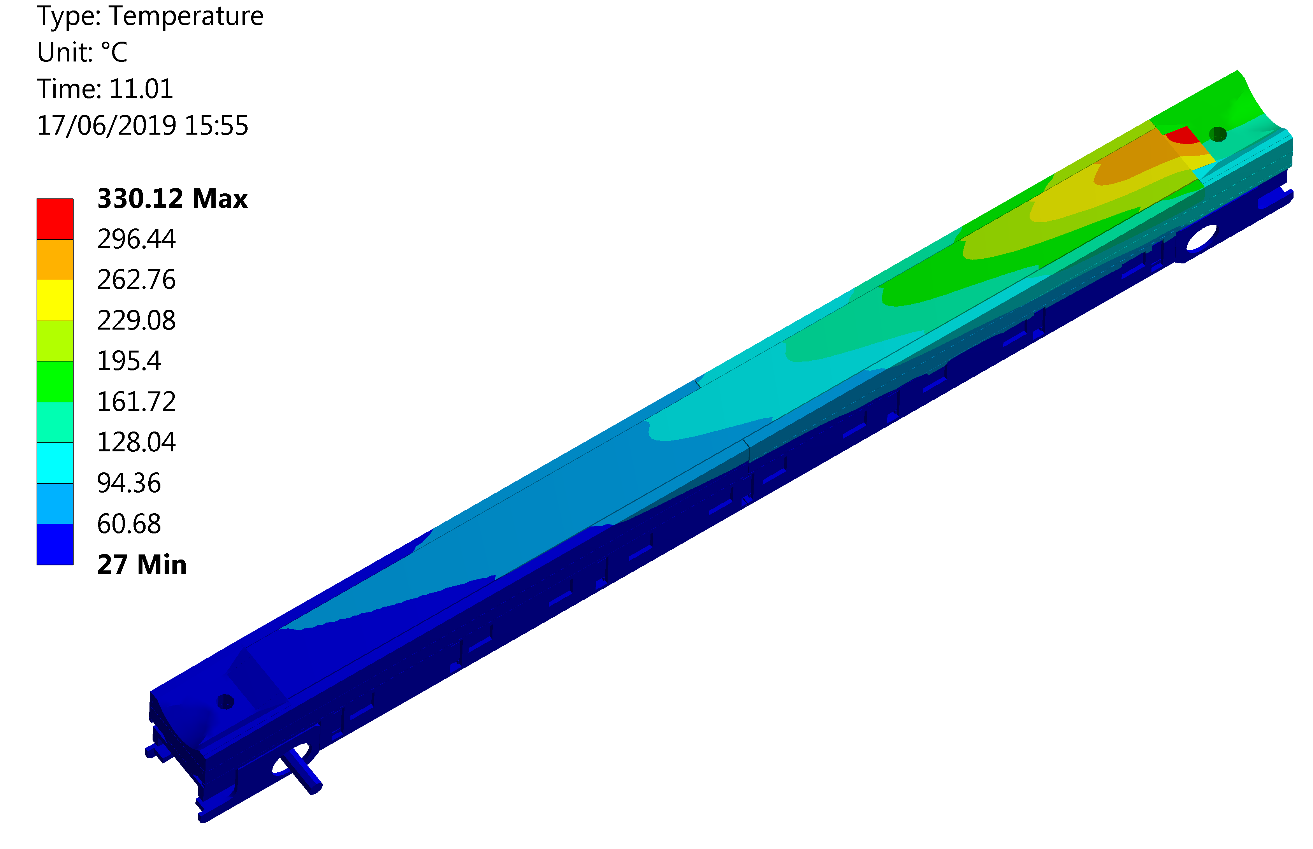
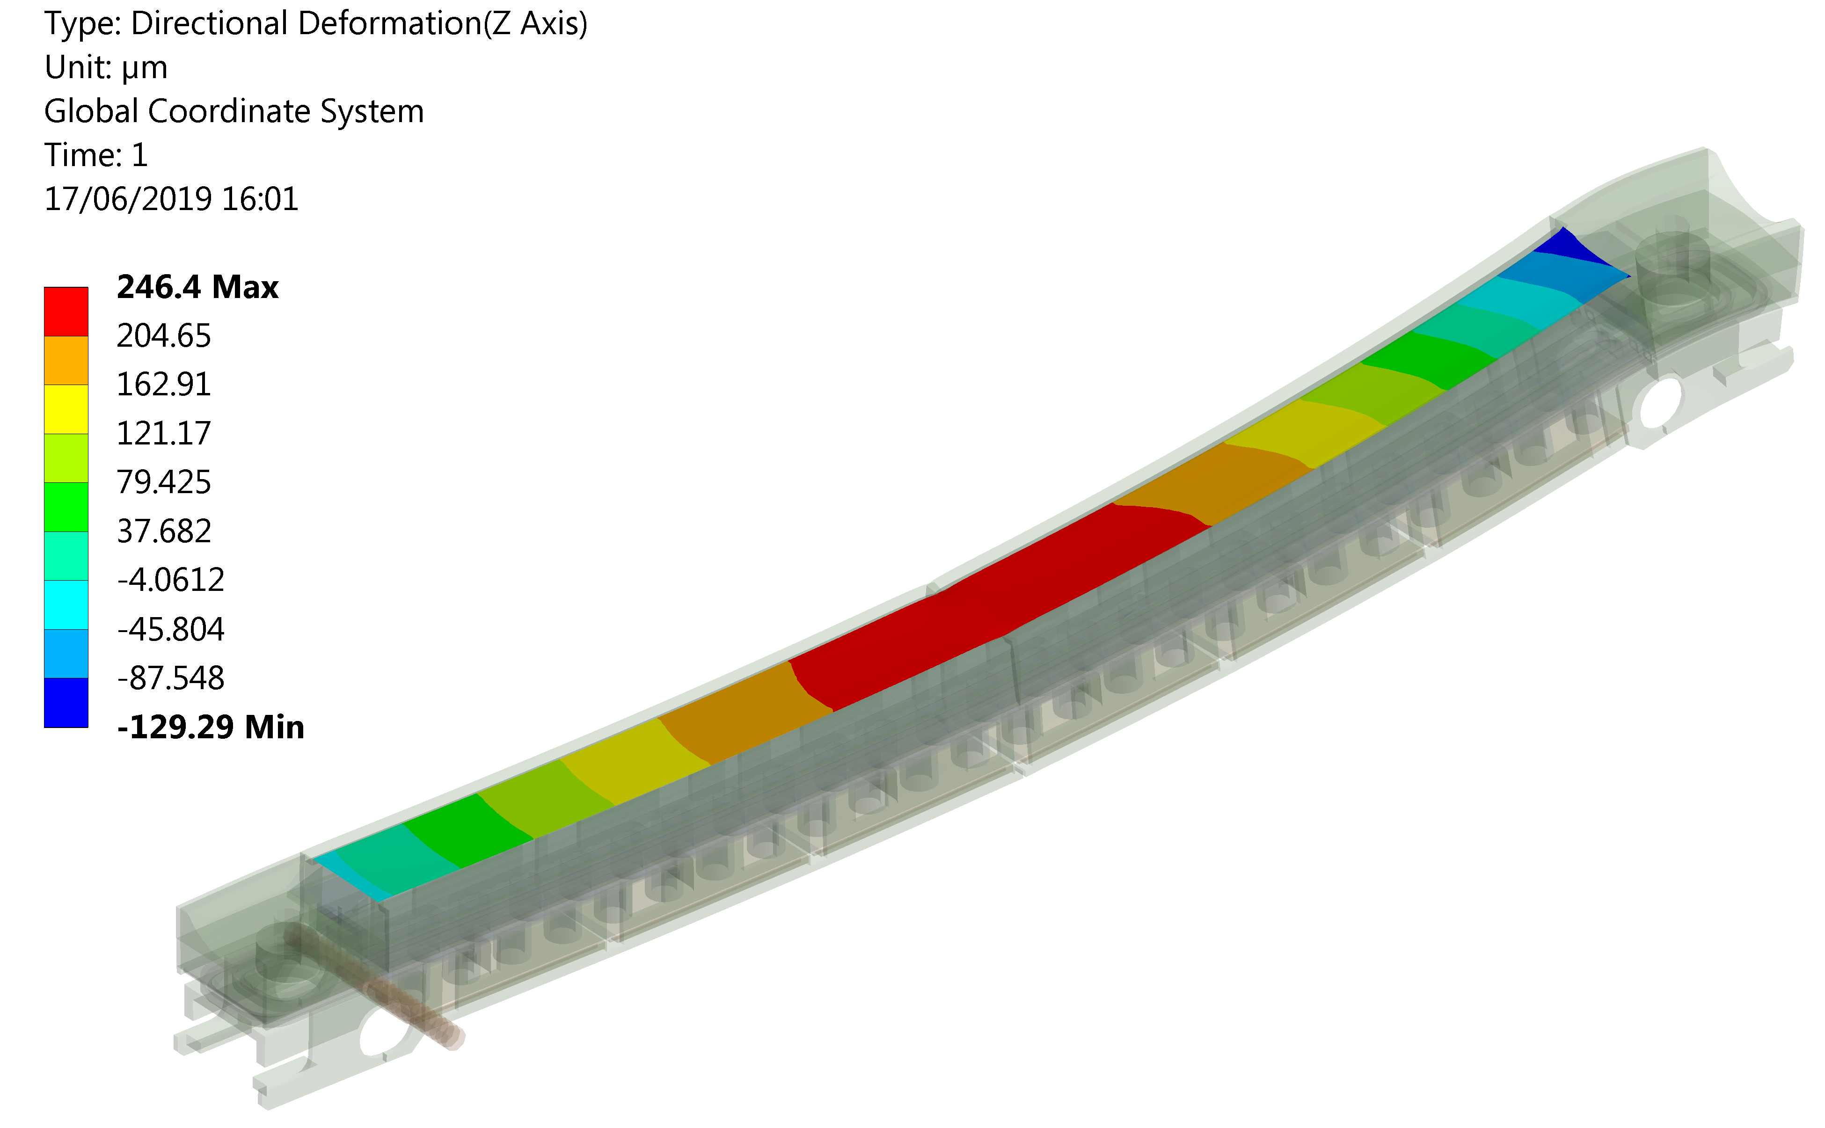
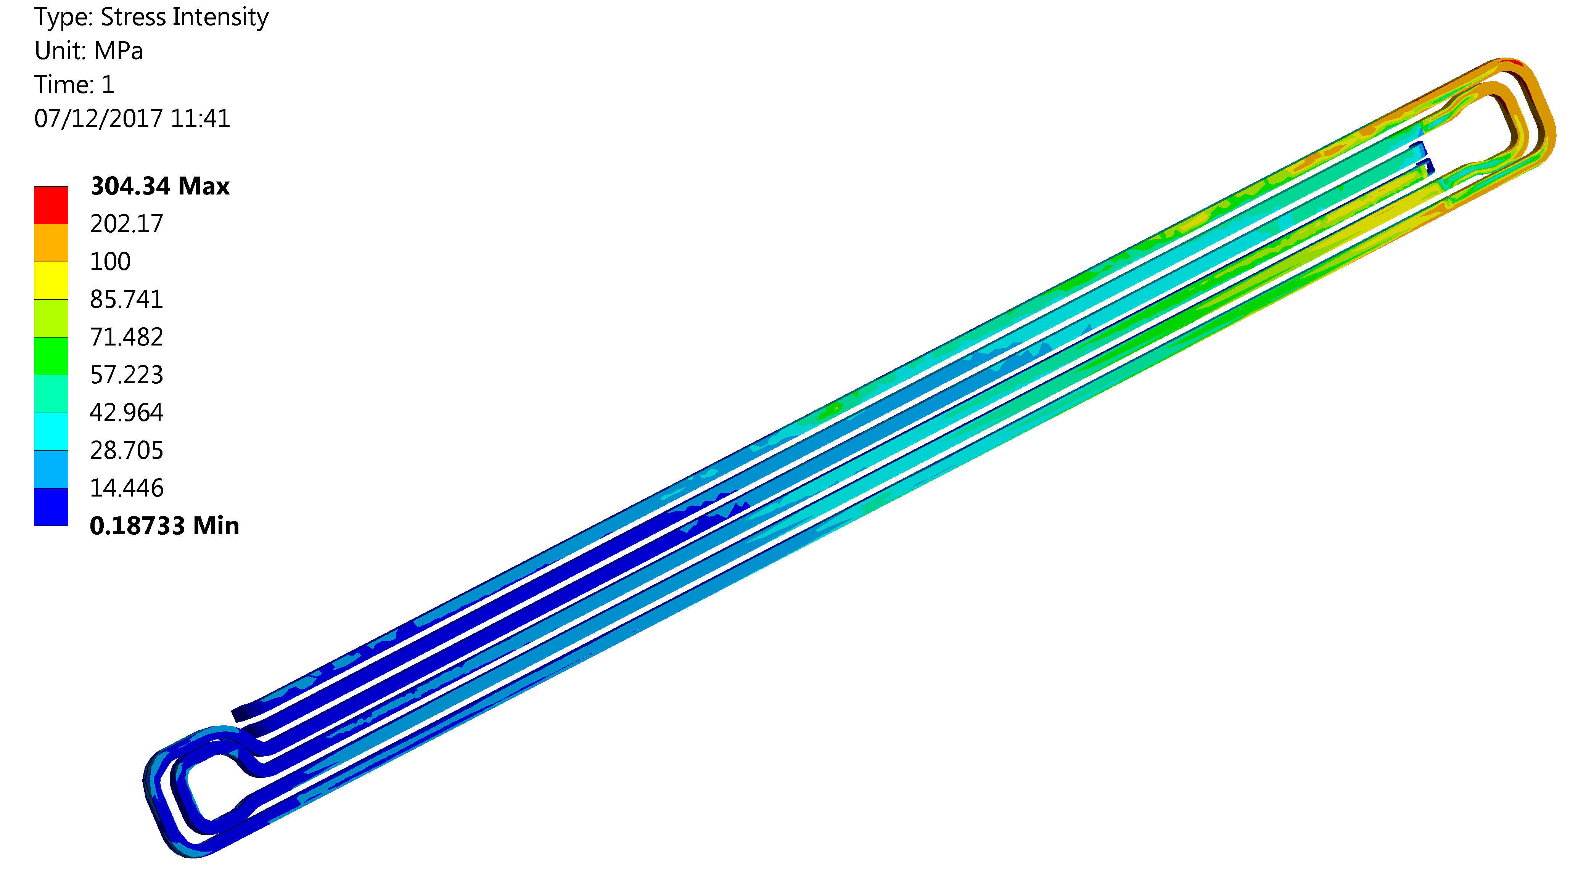
Results - 0.2h BLT
T_{max} = 330 ºC
Deflection = 375 µm
Plasticity downstream
High temperature → but for 10 s
Jaw assembly survives without plasticity (except pipes)
Onset of plasticity on cooling pipes could be addressed by using different material
σ_{y} CuNi 90/10

Slide 7
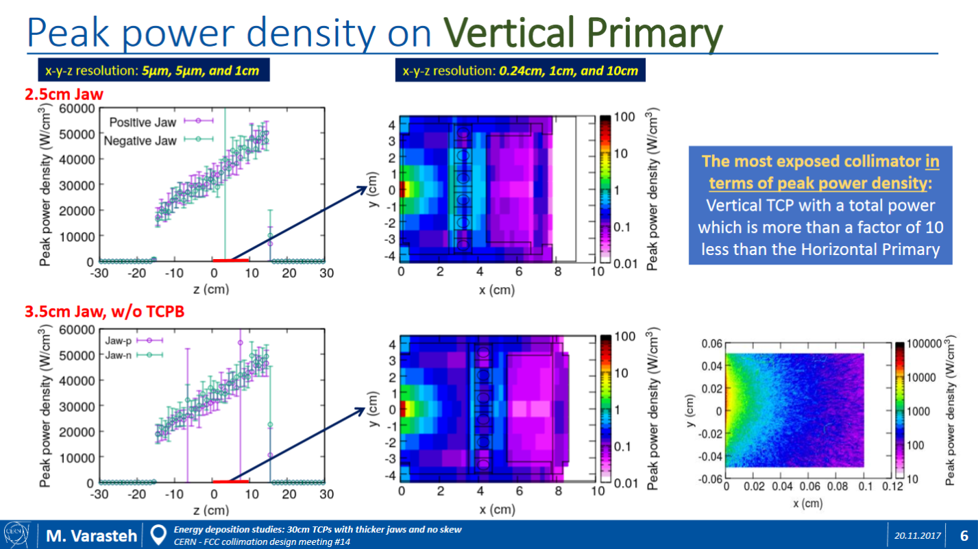
Primary collimator
Vertical primary collimator (TCPD6L)
The most exposed collimator in terms of peak power density
Thicker jaw: 3.5 cm instead of 2.5 cm
Active length 30 cm
+1 cm

Slide 8
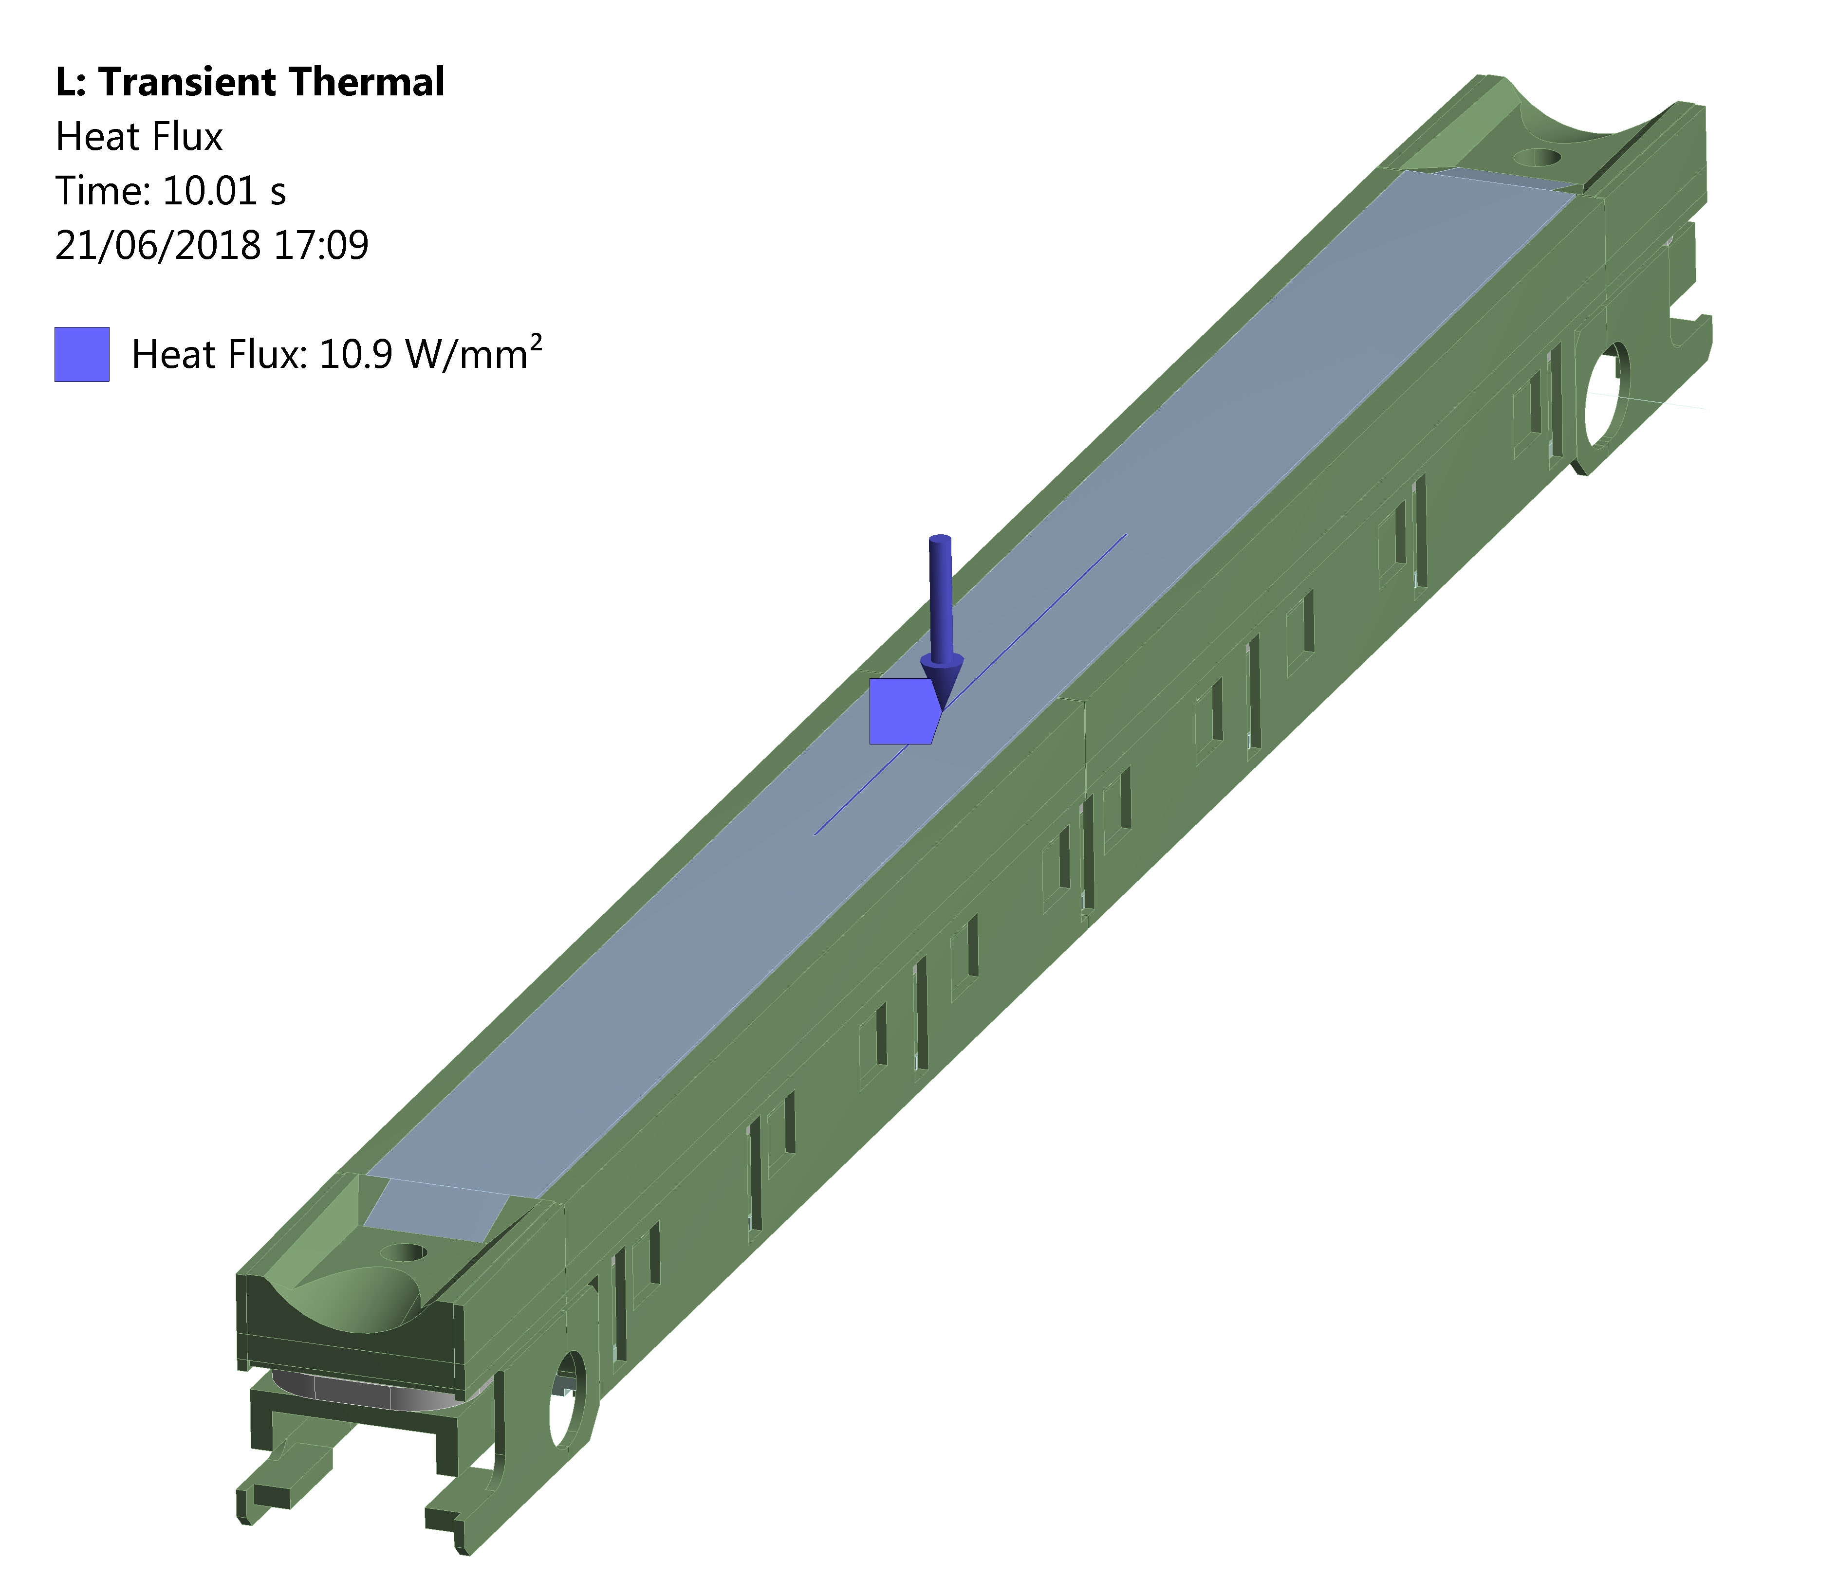
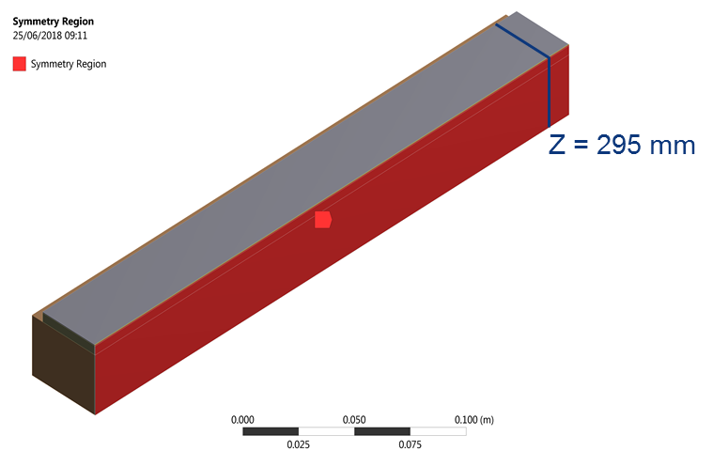
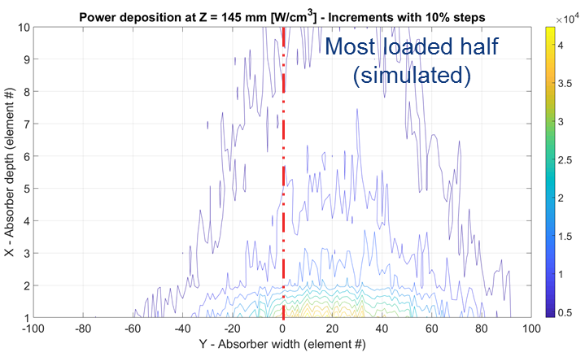
Approach
COLLIMATOR STRUCTURE
CFC ABSORBER
Surface 300 x 1 mm
Heat flux equivalent to 3.27 kW (total thermal load on the absorber)
t = 10 s
Half absorber, the most loaded one
Biased mesh down to 2.5 x 2.5 x 1000 µm
44400 W/cm³ max thermal load

Slide 9
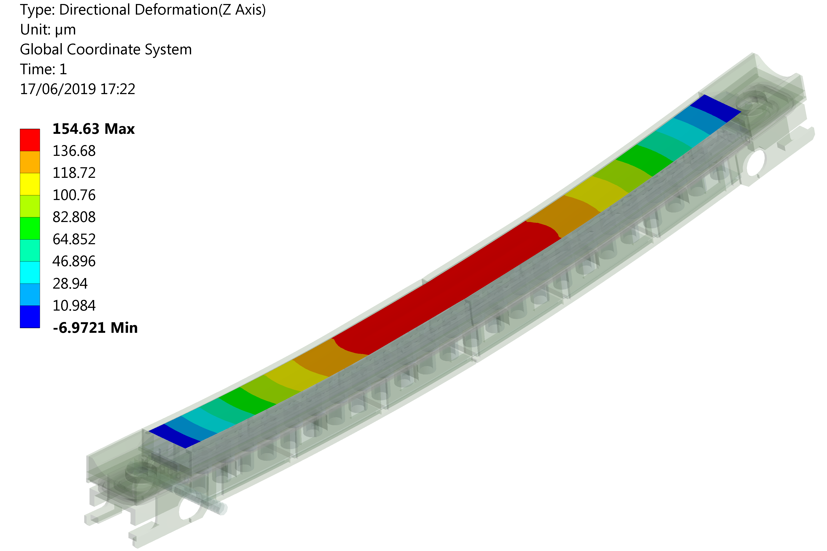
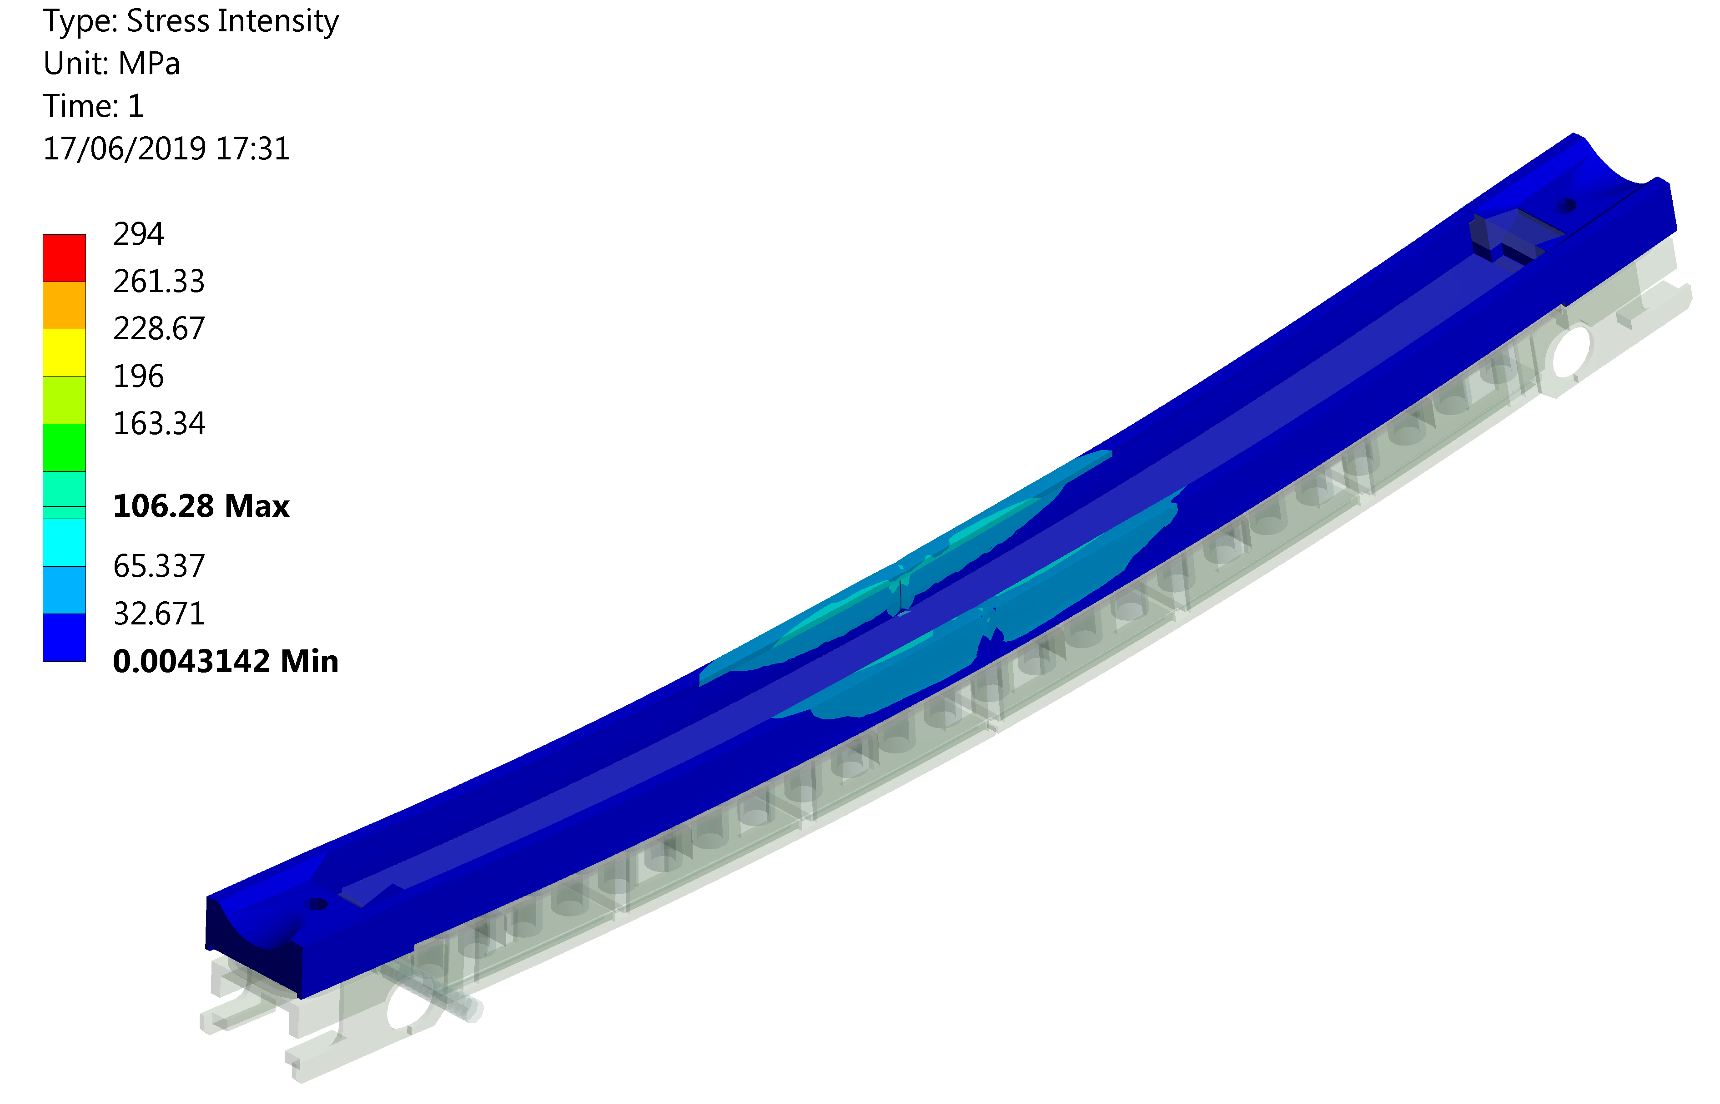
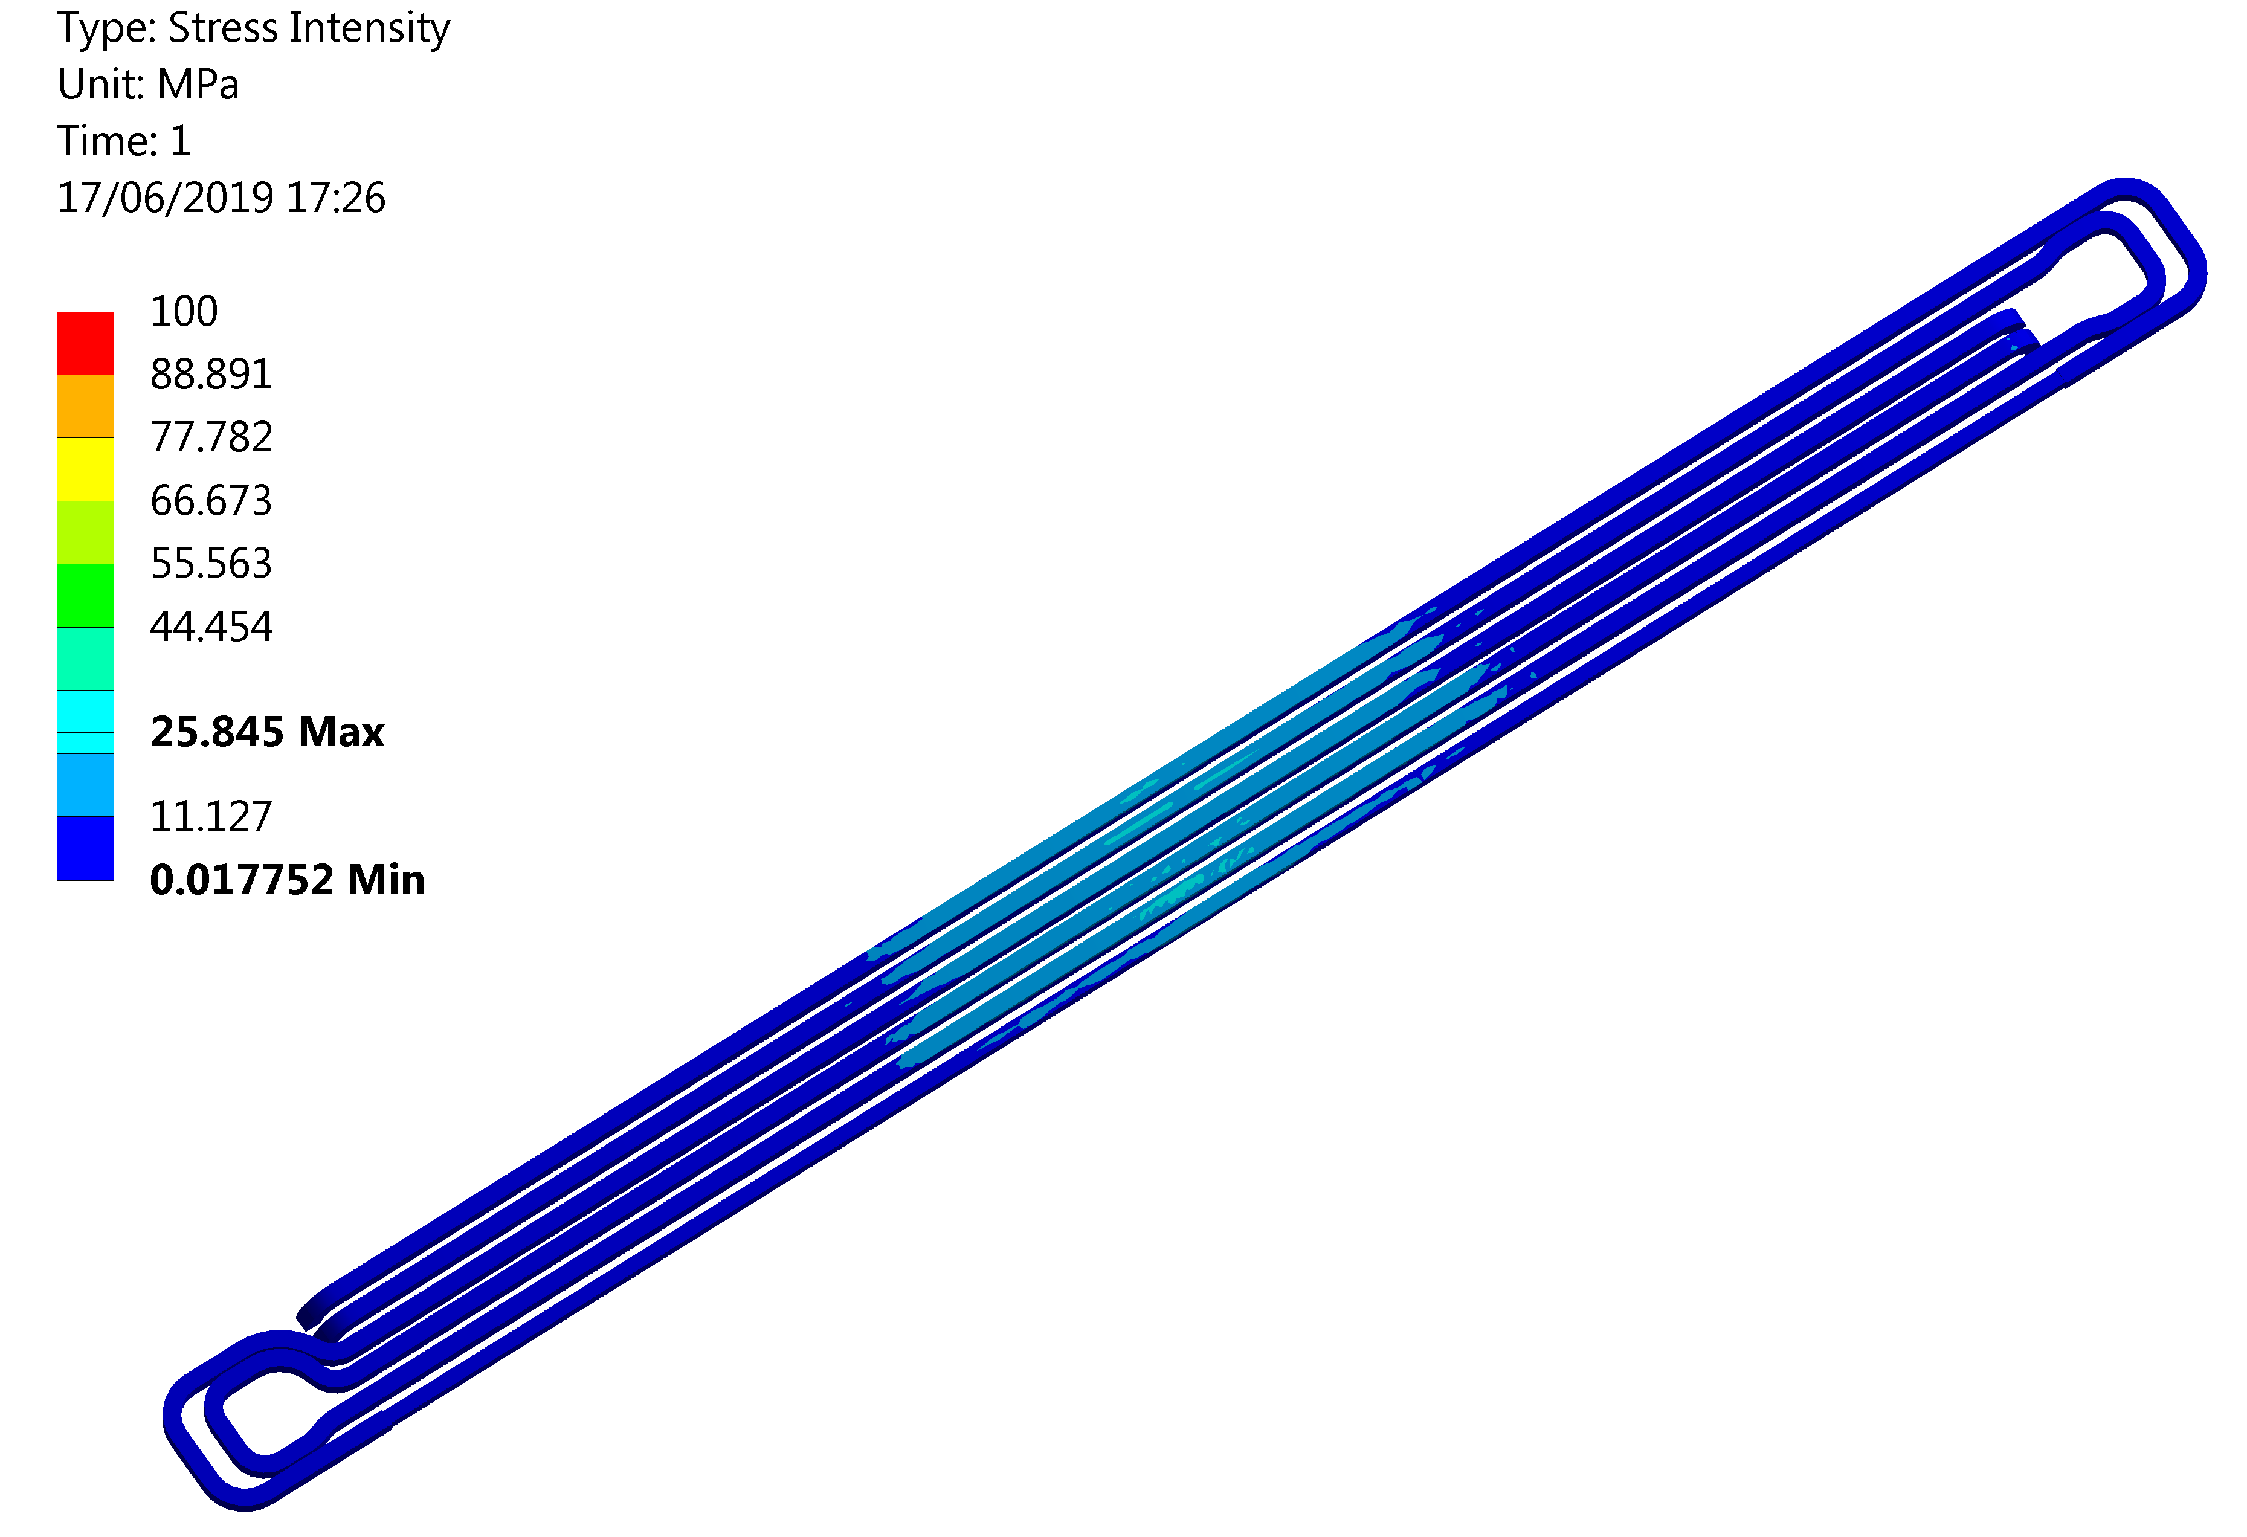
Results – Collimator structure
Deflection
162 µm
No plastic strain
No plastic strain
No relevant issues for the jaw structure → load concentrated on the absorber

Slide 10
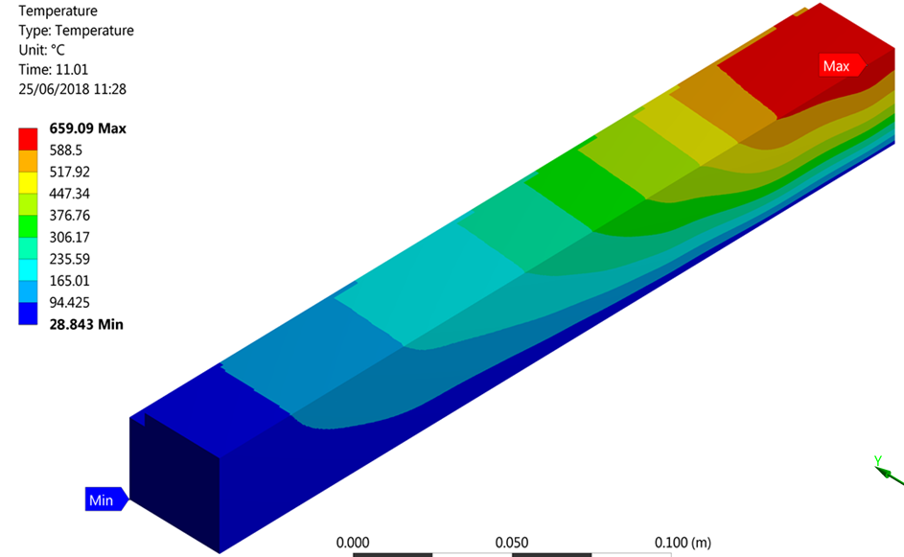
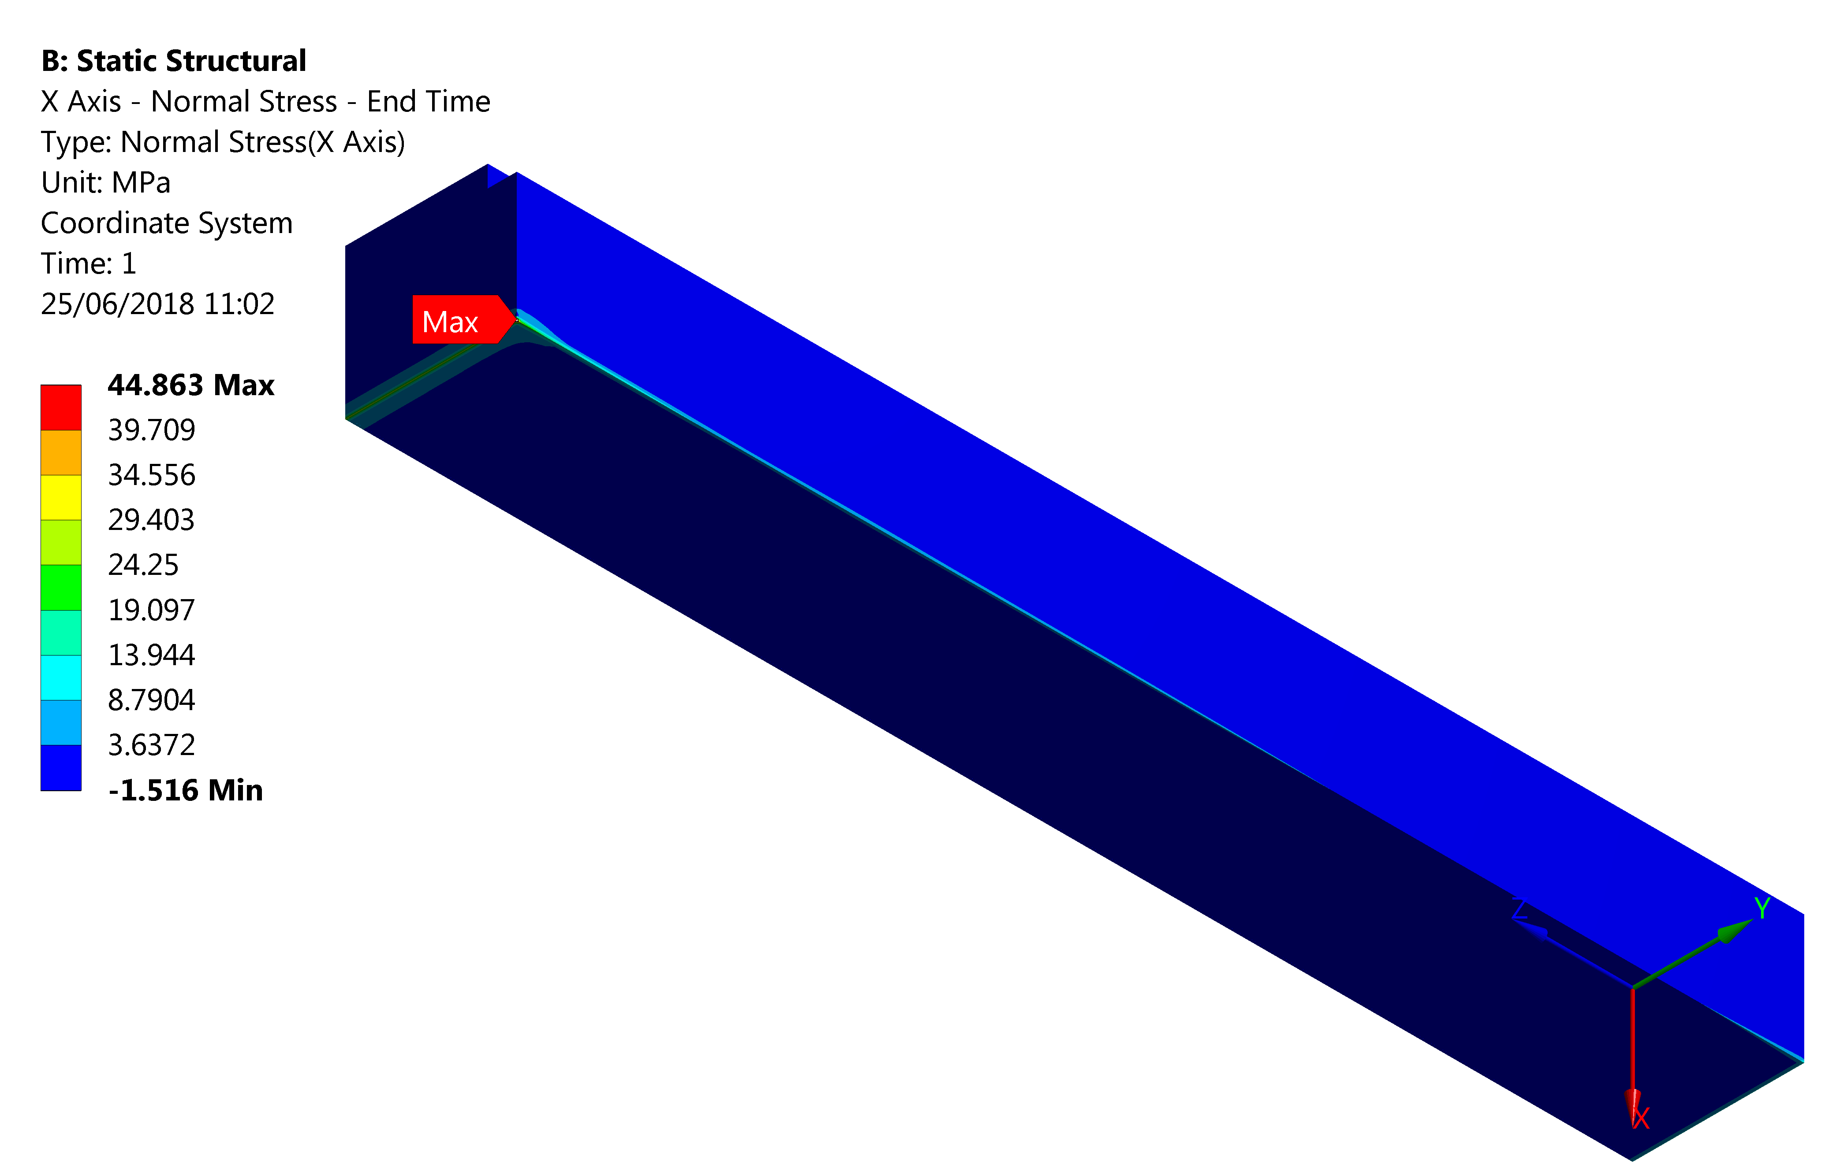
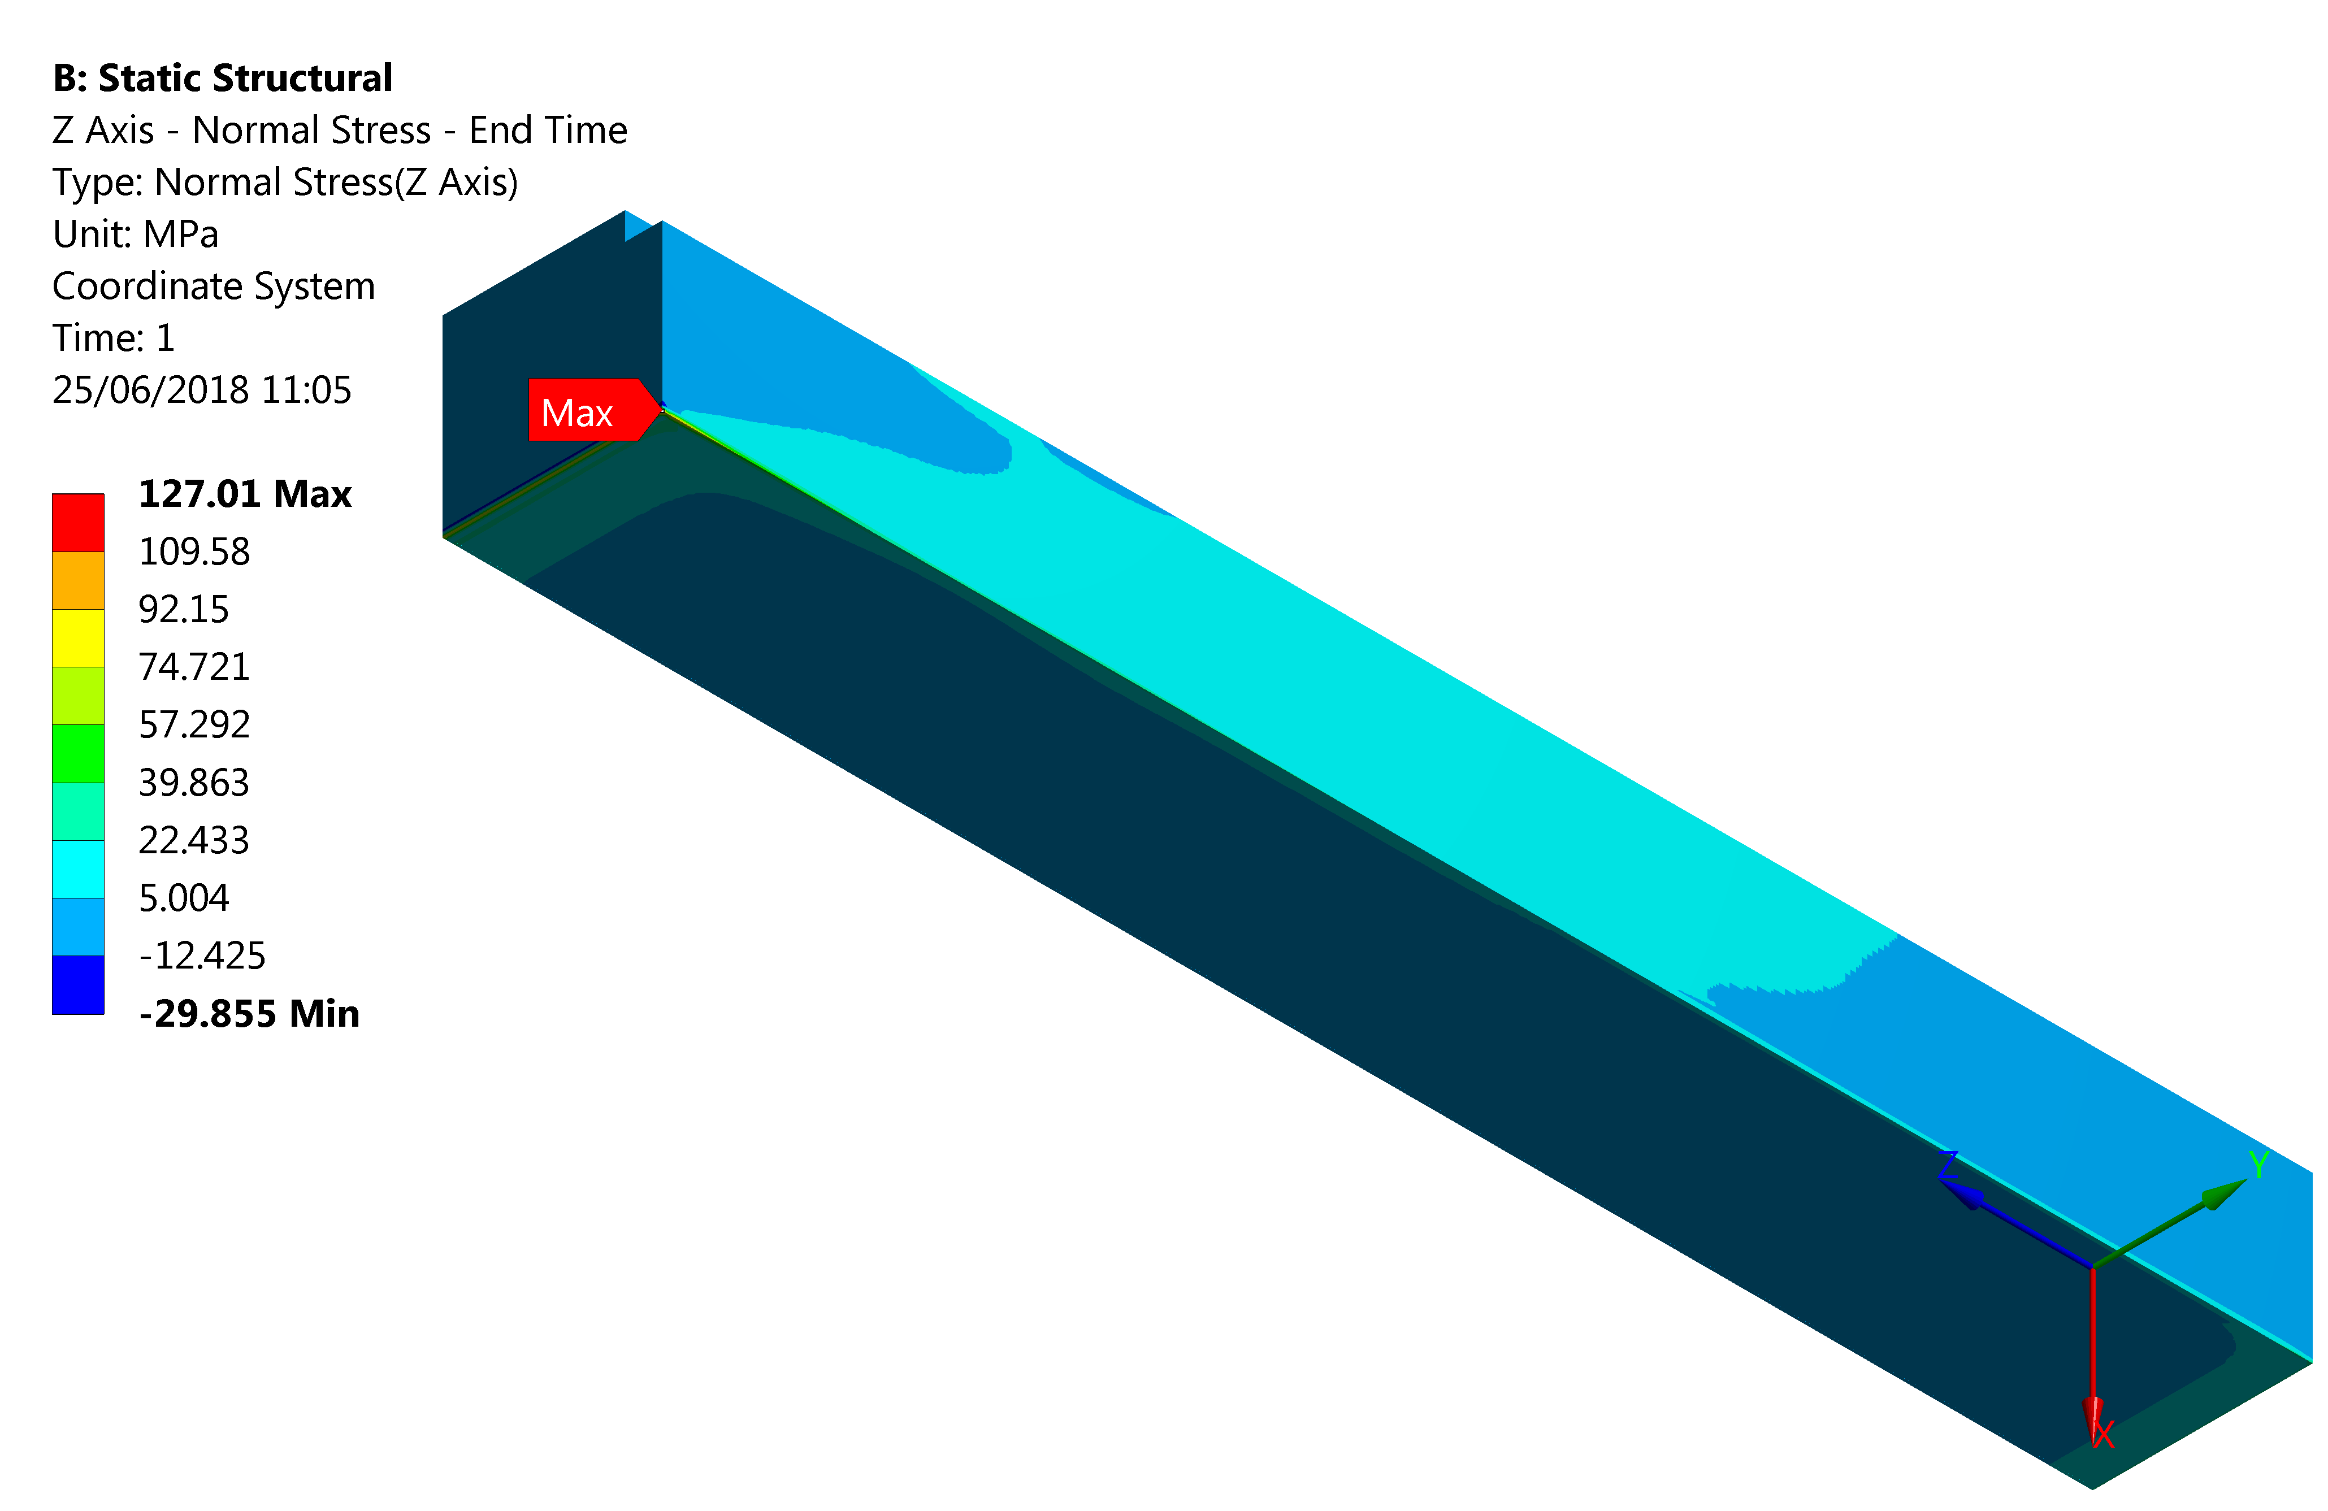
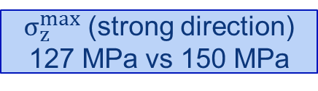
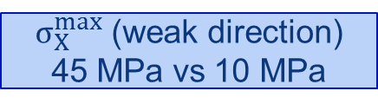
Results - CFC absorber
T_{max} = 660 ºC
$σ_{X}^{max}$ (weak direction) 45 MPa vs 10 MPa
$σ_{z}^{max}$ (strong direction) 127 MPa vs 150 MPa
Temperature high (smooth gradient)
Vacuum issue? (t = 10 s)
Numerical stresses higher than material limit → failure?

Slide 11
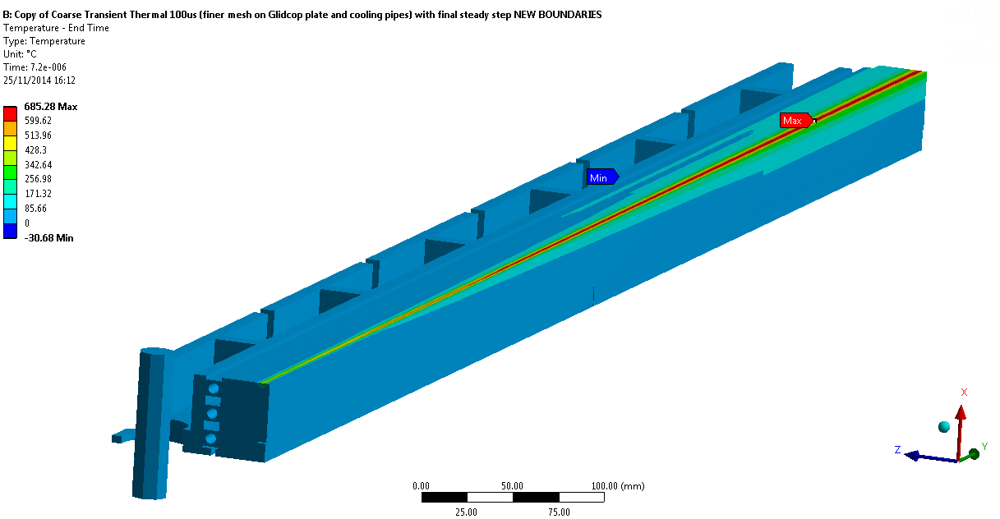
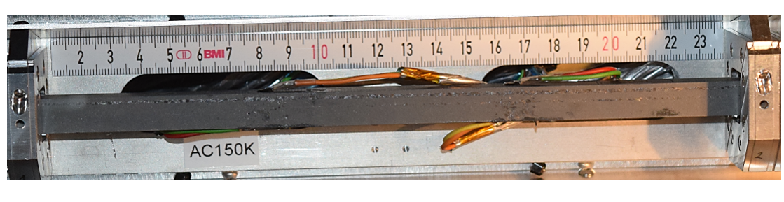
Results - CFC absorber
T_{max} = 660 ºC
The HRMT-23 case: max simulated T on CFC jaw: 685 ˚C (288b, 3.79E13p, σ = 0.35 mm)
No failure observed experimentally
Beam
No failure demonstrated experimentally
Numerical model overestimates stresses
The HRMT-36 case: >1500 ˚C (grazing shot at 288b, 3.72E13p, σ = 0.25 mm) →No failure observed

Slide 12
Conclusions
Thermo-structural studies of most loaded primary (TCP) and secondary (TCS) collimators of the FCC performed for 1h and 0.2h BLT
Stiff structure considered for the conceptual design→ bonded assembly
Highest value of jaw deflection for the most loaded secondary collimator, 0.2h BLT, around 370 µm away from the beam
Highest temperature, 660 °C, on primary collimator for 0.2h BLT scenario without CFC failure
Collimators survive without permanent damage in spite of extreme loss conditions
  Onset of plasticity on the cooling pipes could be cured with alternative materials or geometry
Overall, high temperatures may lead to high outgassing …

Slide 13
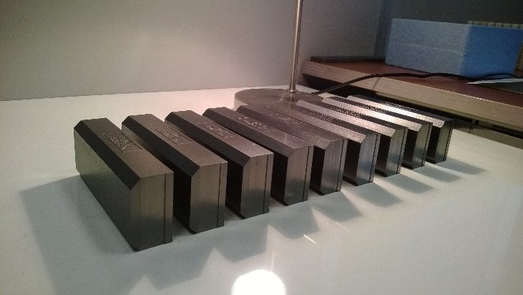
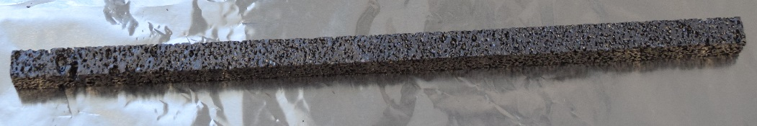
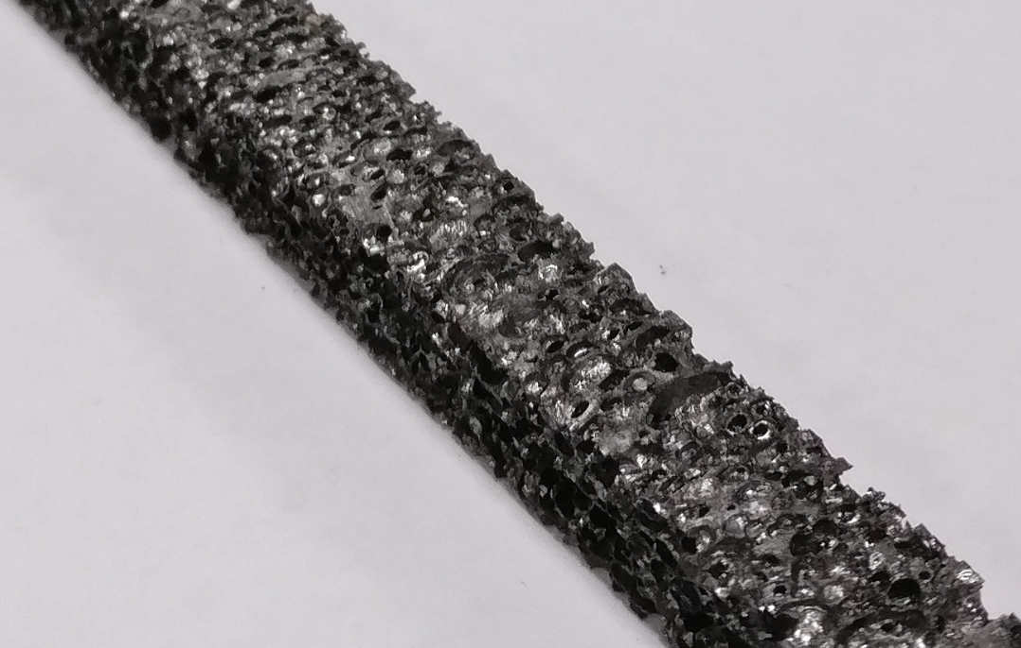
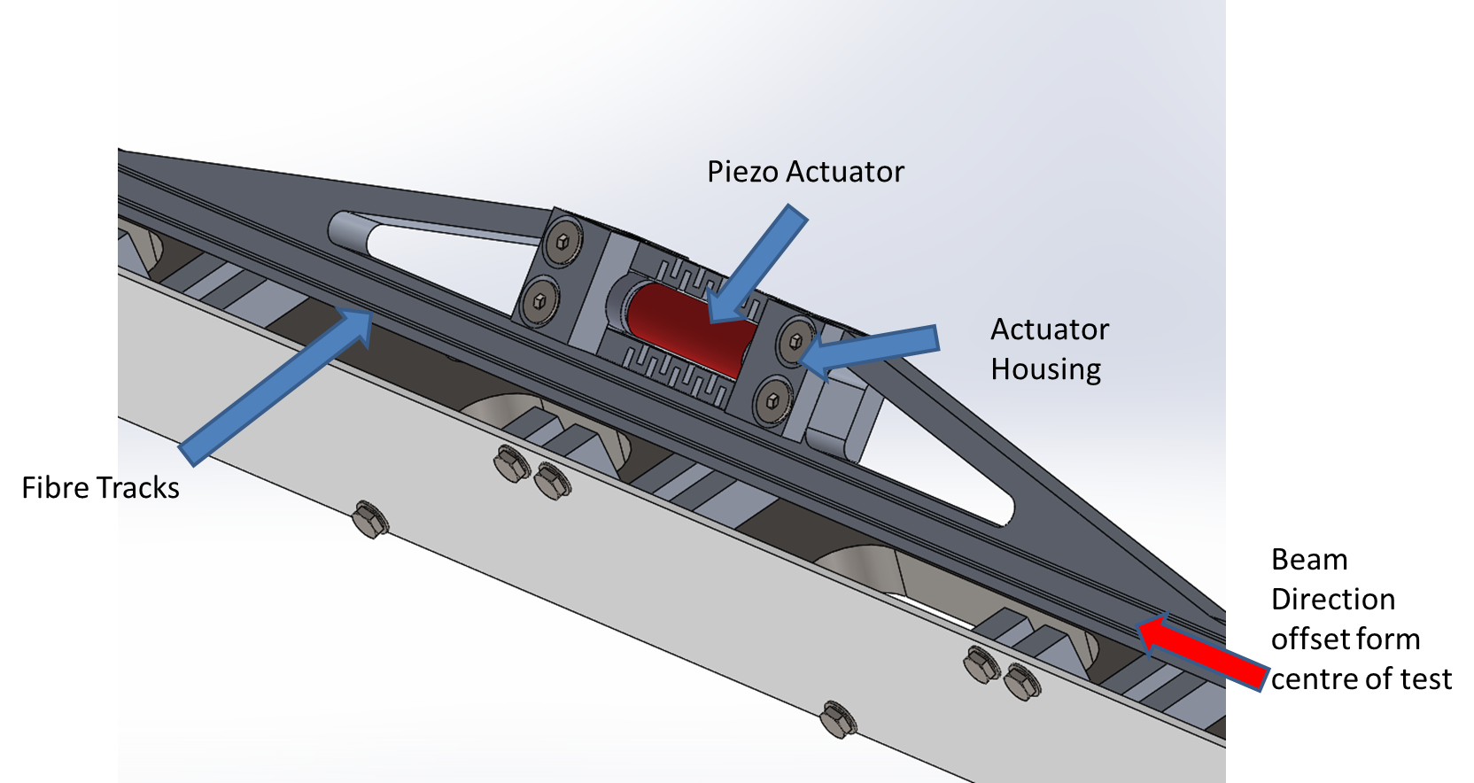
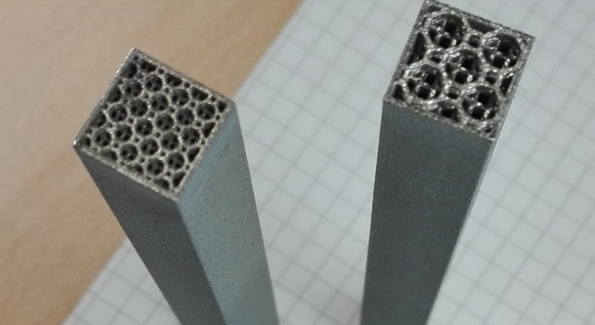
What’s next ?

Slide 14
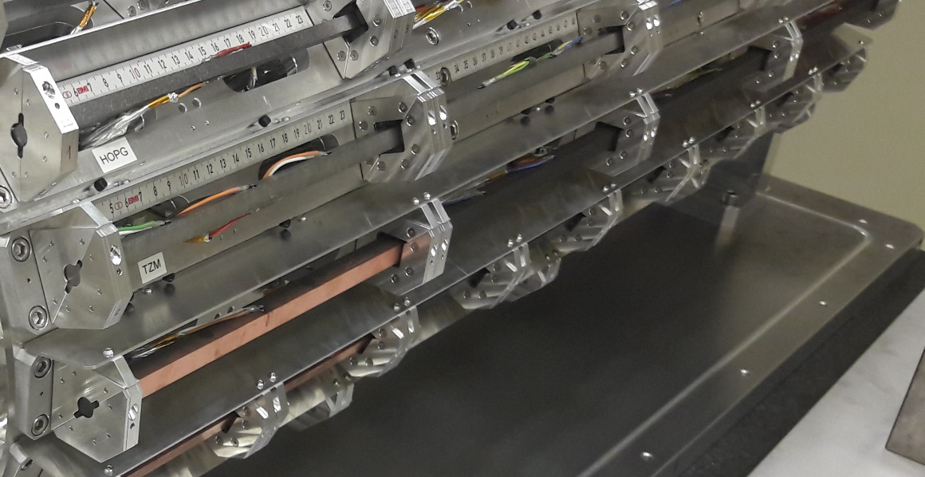
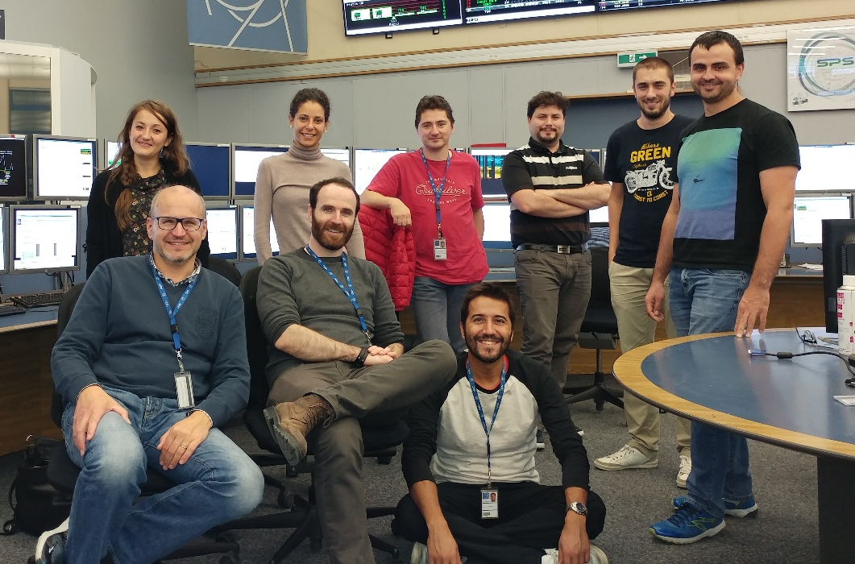
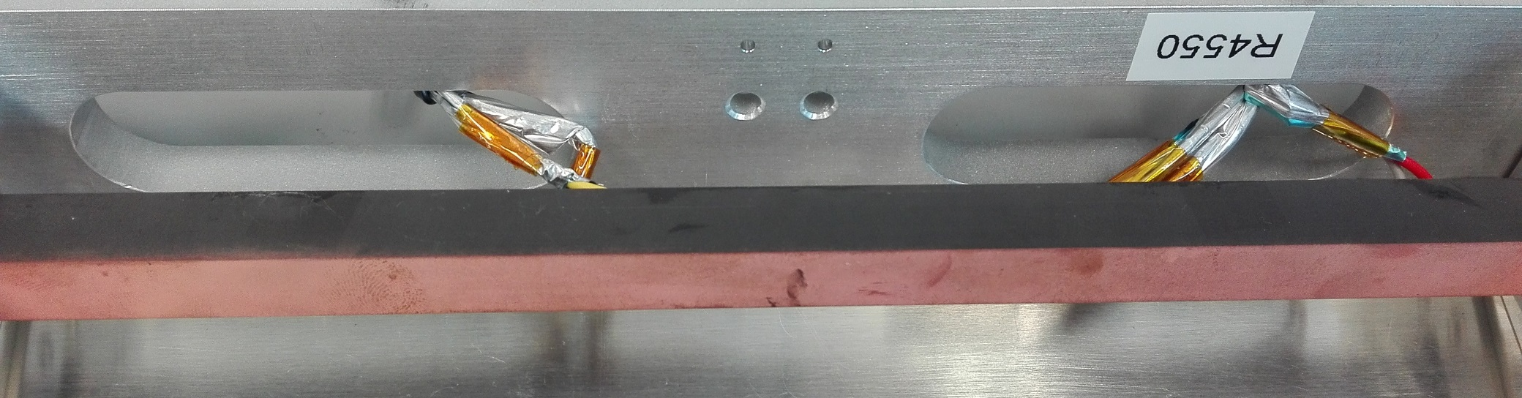
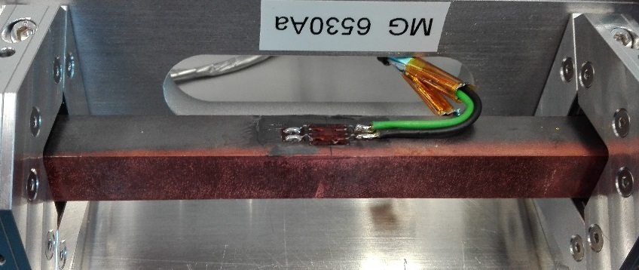
What’s next
HRMT-36 MultiMat

Slide 15
Thanks for your attention

Slide 16
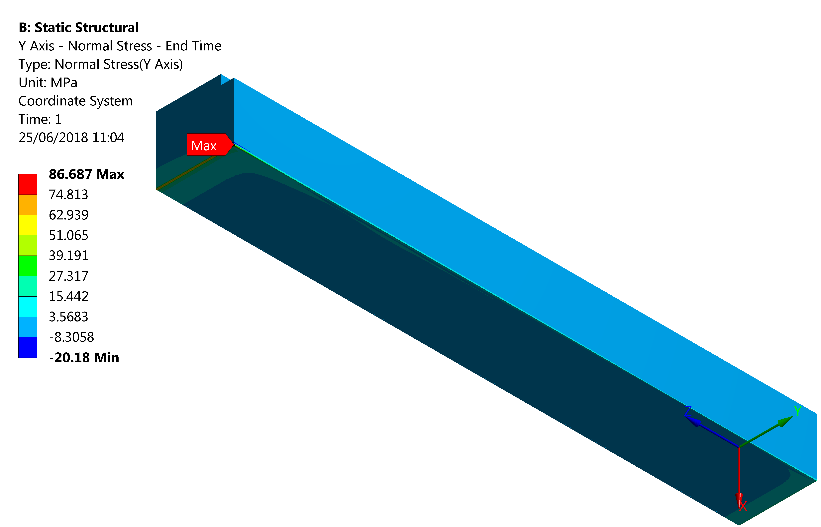
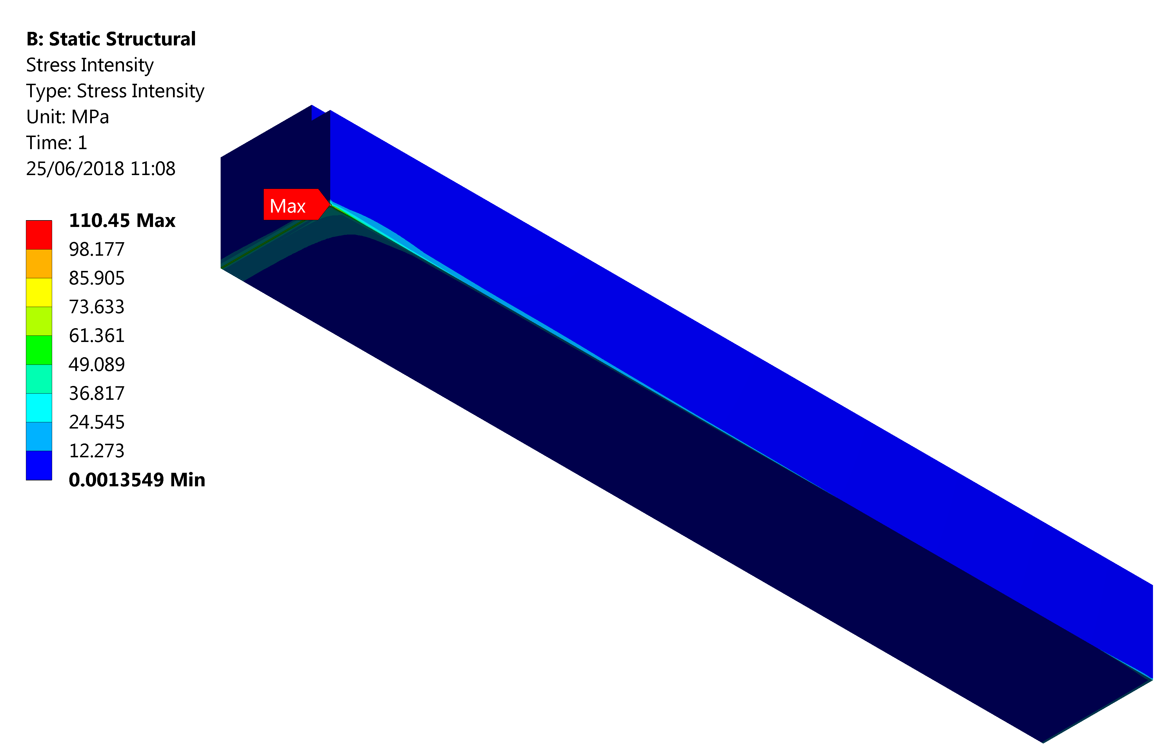

Results - CFC absorber
$σ_{X}^{max}$ (weak) = 45 MPa

Slide 17
Slow losses
 | Power deposition (kW)
 | 1h BLT |  |  | 0.2h BLT
 | TCSP_{CFC} (LHC) | TCSPM_{CFC} (HL-LHC) | TCSPM_{MoGr} (HL-LHC) | TCSP_{CFC} (LHC) | TCSPM_{CFC} (HL-LHC) | TCSPM_{MoGr} (HL-LHC)
Most loaded jaw | 2 | 5 | 8.9 | 10 | 25 | 44.5
Absorber of most loaded jaw | 0.4 | 1.1 | 4 | 2 | 5.5 | 20
Total on collimator | 4.5 | 12.6 | 20.7 | 22.5 | 63 | 103.5

