Slide 1




The SACLA C-band Linac
June 25, 2019, Brussels
Future Circular Collider Conference (FCC week 2019)
Takahiro Inagaki, Takao Asaka, Chikara Kondo, Hirokazu Maesaka,
Takashi Ohshima, Tatsuyuki Sakurai, and Hitoshi Tanaka
RIKEN SPring-8 center
JASRI / SPring-8
RIKEN SPring-8 Center

Slide 2
Outline
Introduction
  X-ray free electron laser SACLA
  C-band main accelerator
Component design and performance
  Acceleration structure
  RF pulse compressor
  Klystron & pulse modulator
  Timing and low-level RF system
Operational status at SACLA
  History and statistics
  Accelerating gradient
  Fault rate
Consideration of FCC-ee injector
Summary

Slide 3
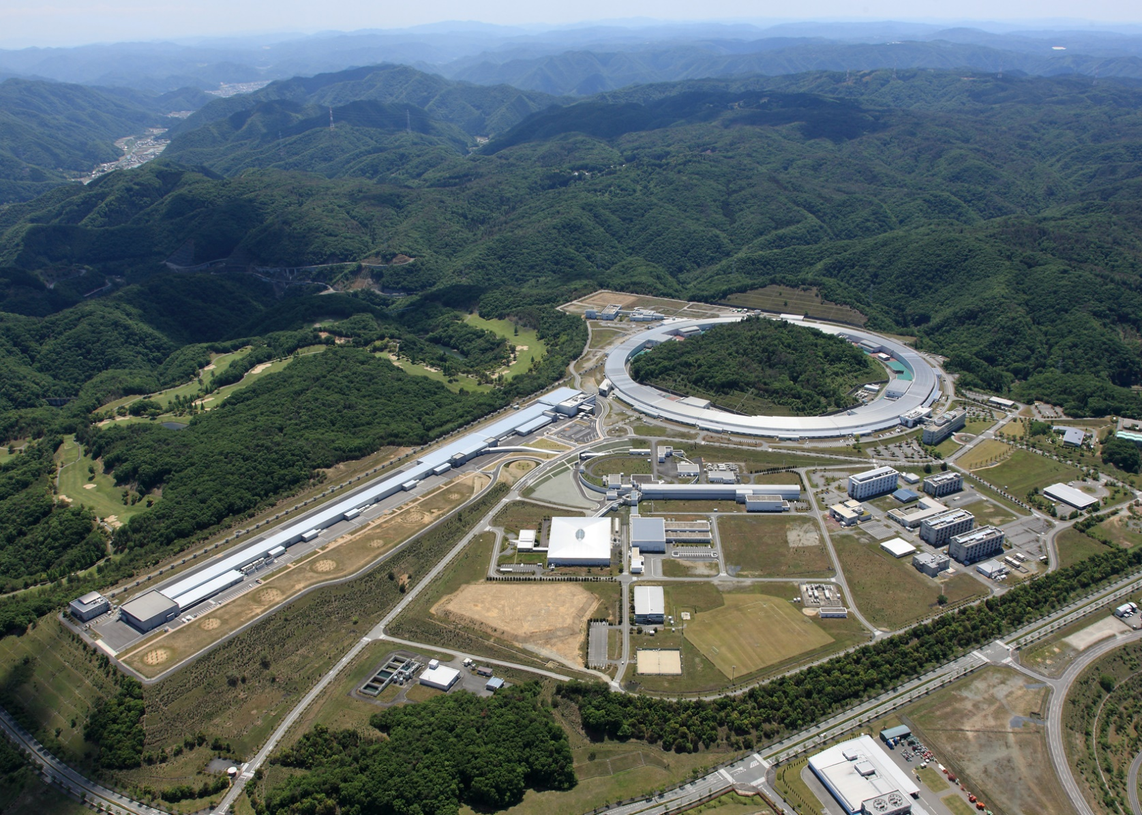
World’s leading photon source facilities in Japan
SACLA (2011~)
X-ray free electron laser
SPring-8 (1997~)
8 GeV storage ring
56 hard-X & soft-X beamlines
Beam injection from SACLA (2018~, commissioning)
Low emittance ring
SPring-8-II (202X~)
1 km ring
700 m
New SUBARU (1998~)
1.5 GeV storage ring
owned by Univ. of Hyogo pref.

Slide 4
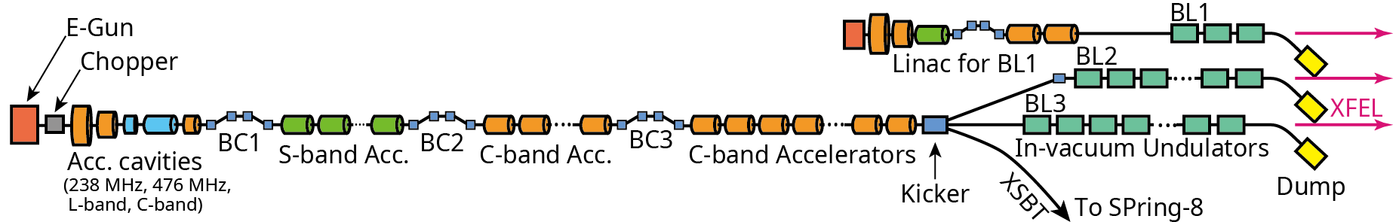
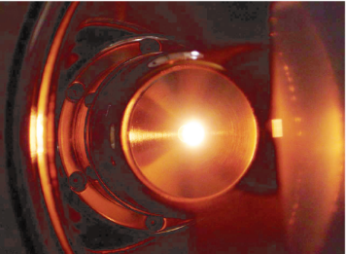
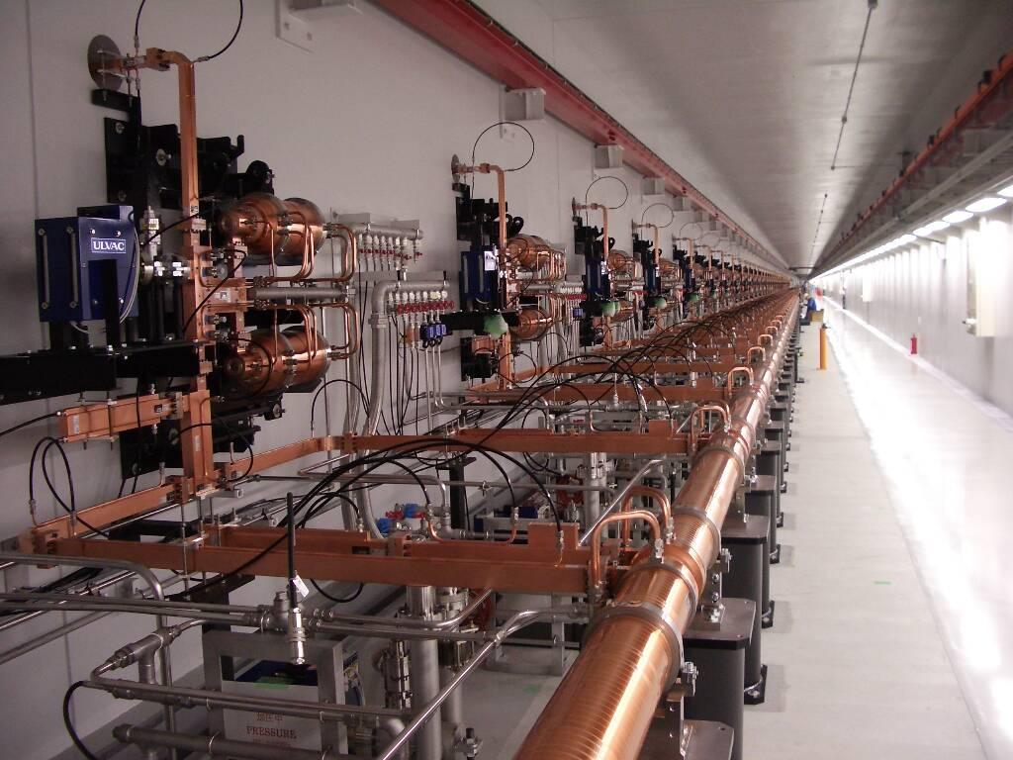
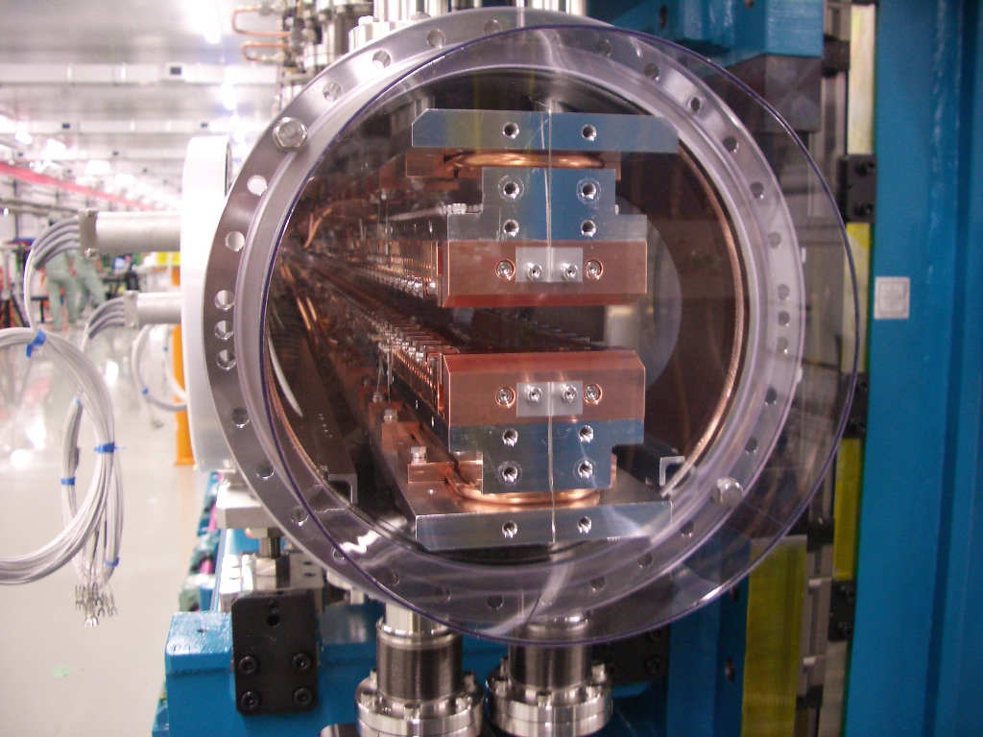
X-ray free electron laser SACLA
Short facility size (700 m)
  Low emittance (< 1 mm mrad) E-gun
  High peak current (> 10 kA) by 3 BCs
  High gradient (35 MV/m) C-band structure
  Short period (18 mm) in-vacuum undulator
Stable XFEL generation
  CeB6 thermionic cathode E-gun
  Stable (ΔV/V < 10ppm) klystron modulator
  Stable (Δt < 100 fs) Low-level RF system
Parameter | BL3, BL2 | BL1
Beam energy | 6 – 8 GeV | ~ 0.8 GeV
Bunch length | ~ 10 fs | < 1ps
Peak current | > 10 kA | 300 A
Photon energy | 4 - 20 keV | 20~150 eV
Pulse energy | > 500 μJ | ~ 100 μJ
Pulse rep. rate | 60 pps | 60 pps
~ 0.8 GeV
~ 100 eV Soft-X, FEL
500 kV
40 MeV
0.4 GeV
1.3 GeV
4 ~ 8 GeV
~ 10 keV XFEL
8 GeV
E-gun
C-band
Undulator

Slide 5
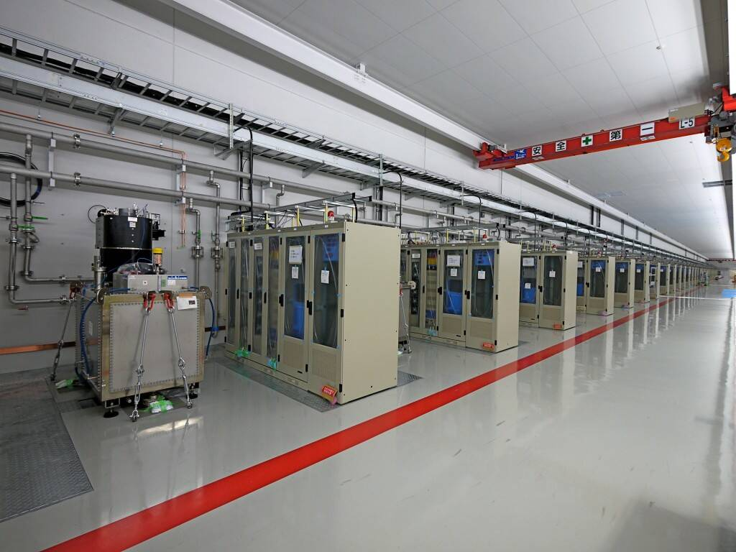
Why we use C-band ?
f=5.712 GHz
High accelerating gradient
  High accel. gradient 35-42 MV/m
  Copper surface field ~ 100 MV/m
  Achievable with present technology
Practical cavity size & accuracy
  Beam aperture >12 mm
  Alignment accuracy ~ 0.1 mm
  Wakefield effect is acceptable.
Normal conducting RF
  No cryogenic system.
  Repetition rate (60 pps) is suitable for experiments (CCD frame rate).
Components are available
  Initially developed at KEK for the linear collider project in 1990s.
C-band accelerator in tunnel
Klystron gallery

Slide 6
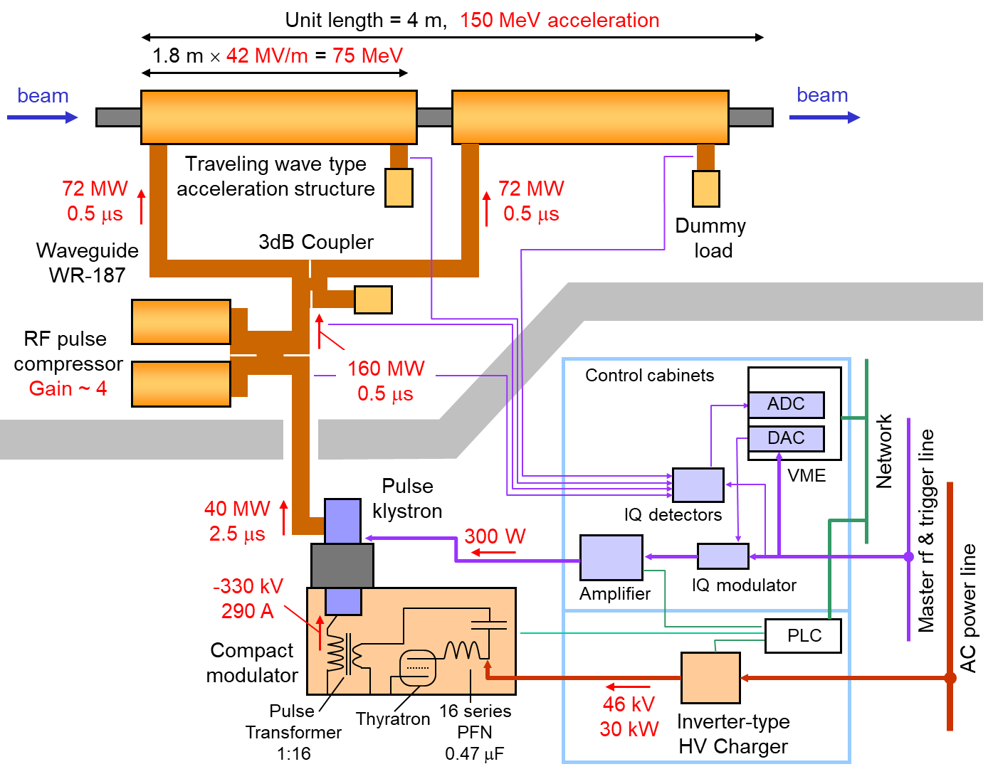
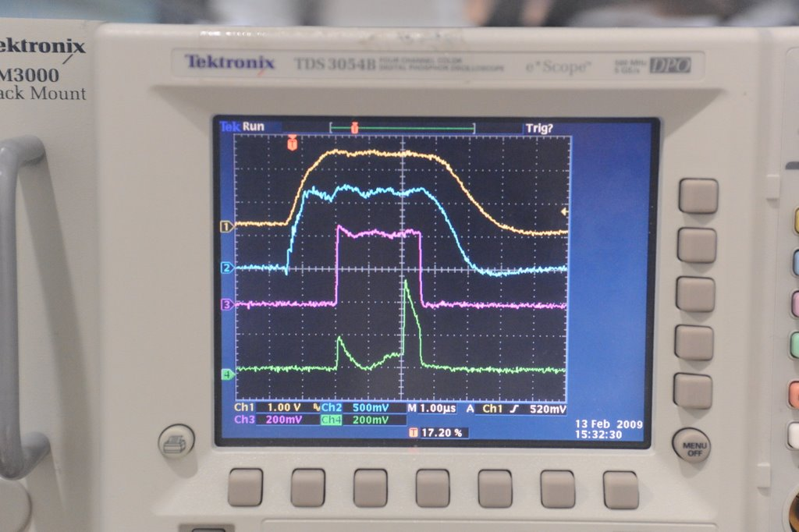
C-band (5.712 GHz) RF system
T. Inagaki, PR-AB 17 080702 (2014)
Key features
High RF field
  Accel. structure
  Pulse comp.
Stability
(100ppm, 0.2 deg.)
  Klystron
  Modulator
  Low-level RF
Typical waveform
4.5μs
Klystron HV
-330 kV
Klystron beam
290 A
Klystron output
40 MW
Pulse compressed
160 MW
2.5μs

Slide 7
Outline
Introduction
  X-ray free electron laser SACLA
  C-band main accelerator
Component design and performance
  Acceleration structure
  RF pulse compressor
  Klystron & pulse modulator
  Timing and low-level RF system
Operational status at SACLA
  History and statistics
  Accelerating gradient
  Fault rate
Consideration of FCC-ee injector
Summary

Slide 8
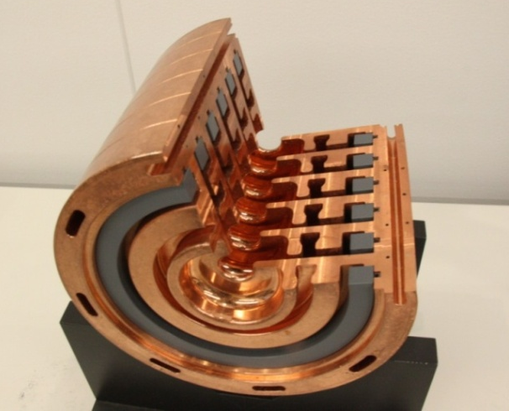
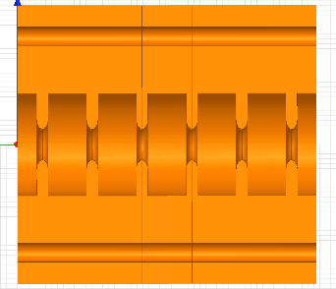
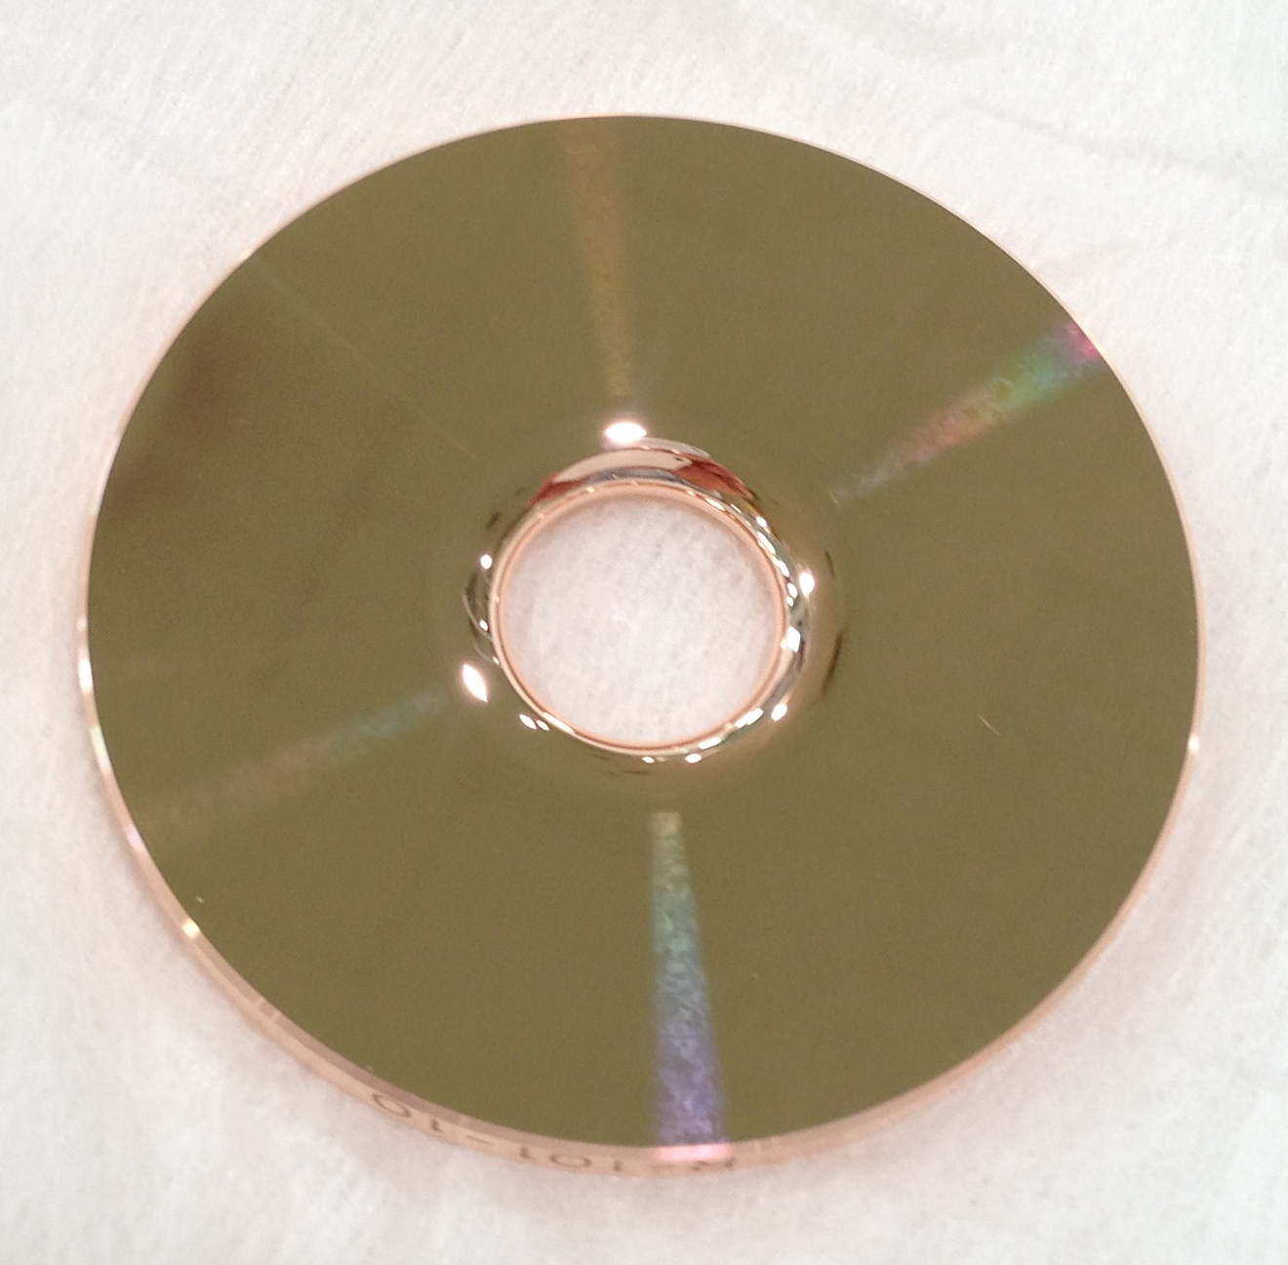
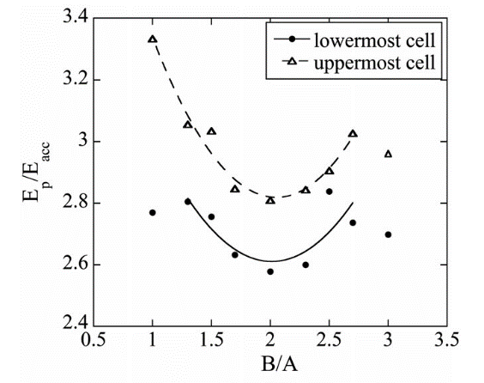
Acceleration structure
Choke-mode type structure
T. Inagaki, PR-AB 17 080702 (2014)
Choke filter
Two types of traveling wave structure
8GeV linac (2011-): Choke-mode-type, 128 tubes
potential of multi-bunch (~30) operation
but….no practical operation of multi-bunch mode
800MeV linac (2014-): High gradient type, 10 tubes
mitigate surface field for higher gradient, low cost
SiC
absorber
High gradient type structure
T. Sakurai, PR-AB 20 042003 (2017)
 | Choke-mode | High gradient
Structure type | Quasi-CG | Quasi-CG
RF mode | TM01 - 3π/4 | TM01 - 2π/3
Accelerator length | 1.79 m | 1.77 m
Iris aperture (2a) | 13.6 ~ 17.3 mm | 12.1 ~ 15.9 mm
Atten. param (τ) | 0.53 | 0.54
Filling time | 300 ns | 270 ns
Quality factor | 10.300 | 8,900
Shunt impedance | 54 MΩ/m | 64 MΩ/m
Accel. gradient | 35-39 MV/m | 42 MV/m
Disk
Ellipsoidal shape
10% reduction
Electric field ratio
Curvature ratio

Slide 9
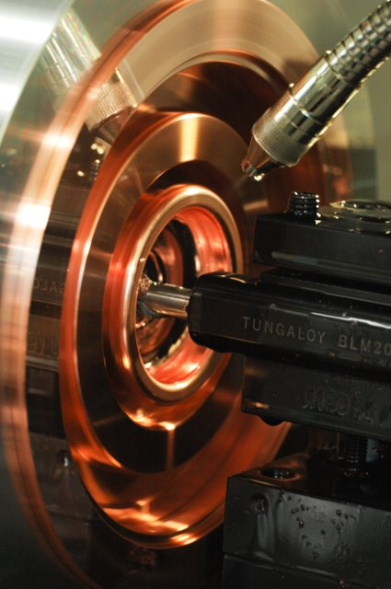
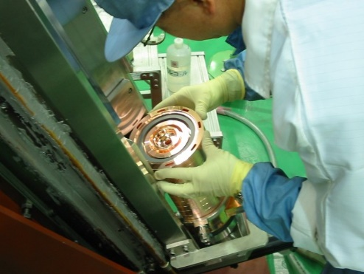
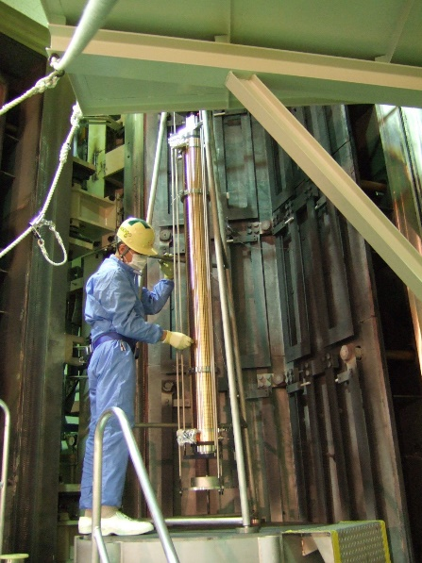
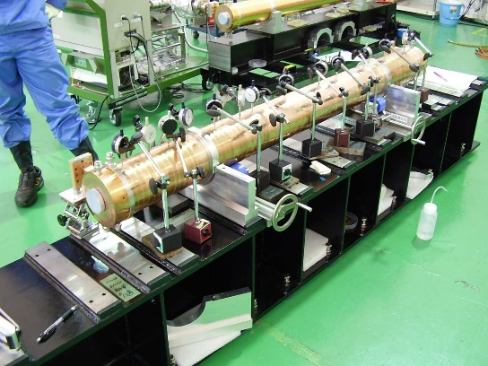
Fabrication of the structure
Copper
  Oxigen free copper (OFC), class-1
  hot iso-static pressing (HIP)
Machining
  High precision lathe, without lubricant oil
  No electrochemical polishing, no rinsing
Assembly
  Assembly in the clean room
  RF measurement to check the cavity
  Vacuum brazing with silver solder
Inspection
  RF characteristics (reflection, attenuation, …)
  Physical dimension, straightness
  Vacuum leak check
  Out gas measurement
Shipping
Machining
Assembly
Brazing
Straightness
measurement

Slide 10
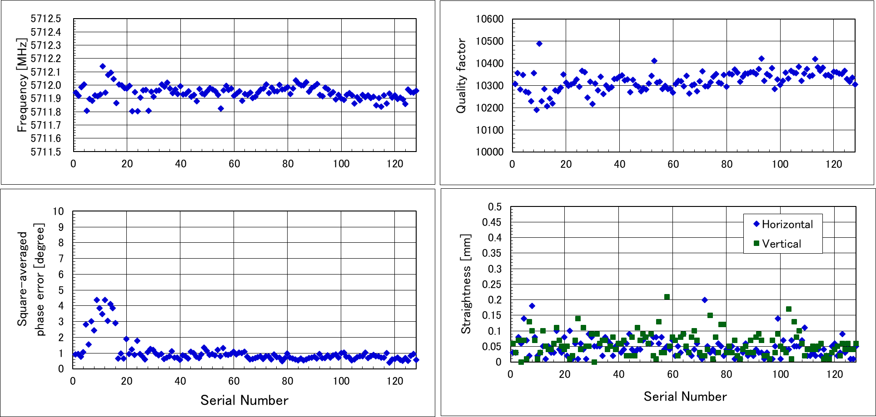
Quality of the acceleration structure for SACLA
During the mass-production, MHI modified the cavity design and brazing process.
Finally they produced 128 structures with excellent quality
Finally adjusted by water temperature
Frequency
5712±0.2 MHz
Quality factor >10,000
Phase error
< 1 degree
Straightness <0.2 mm

Slide 11
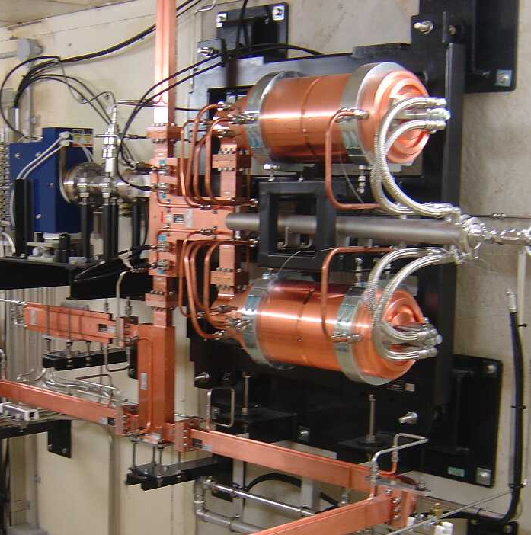
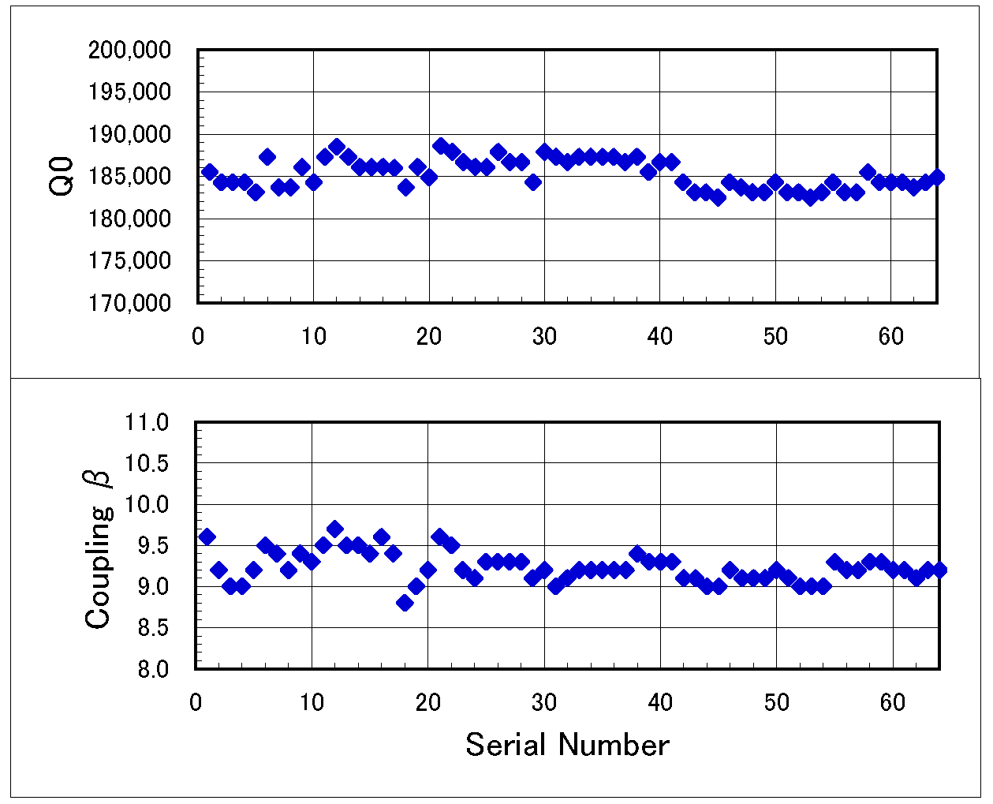
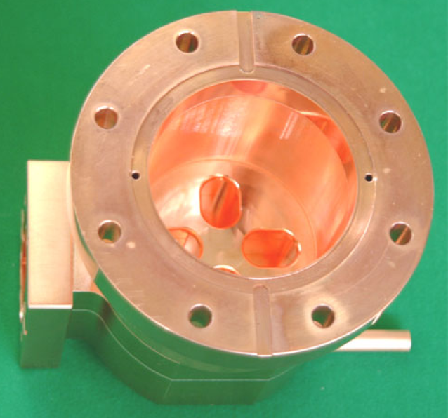
RF pulse compressor (SLED)
Compress RF pulse 2.5 μs → 0.5 μs
Multiply peak RF power 40 MW → 160 MW (average of 300 ns filling time)
SLED type: pair of high-Q (TE mode) cavity + 3dB coupler
Frequency tuning
  Precise tuner 500 kHz/turn
  Temperature controlled by cooling water
Cavity RF mode | TE0,1,15
Q₀ | 185 k
β | 9 ~ 9.5
VSWR | <1.05
RF monitor
(dir. coupler)
3dB coupler
Mode converter
WG → cylinder
Tuner
Diaphram structure
differential screw

Slide 12
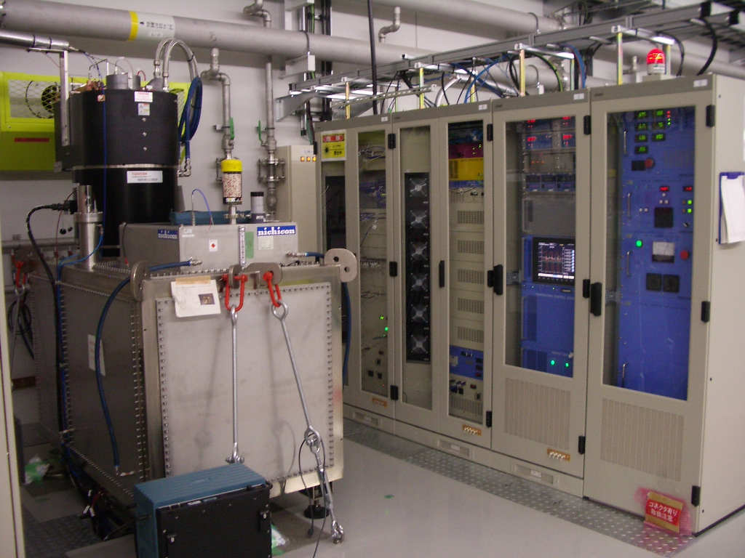
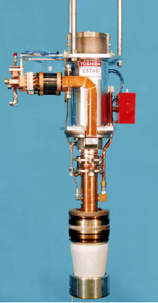
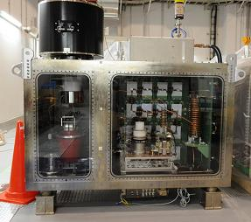
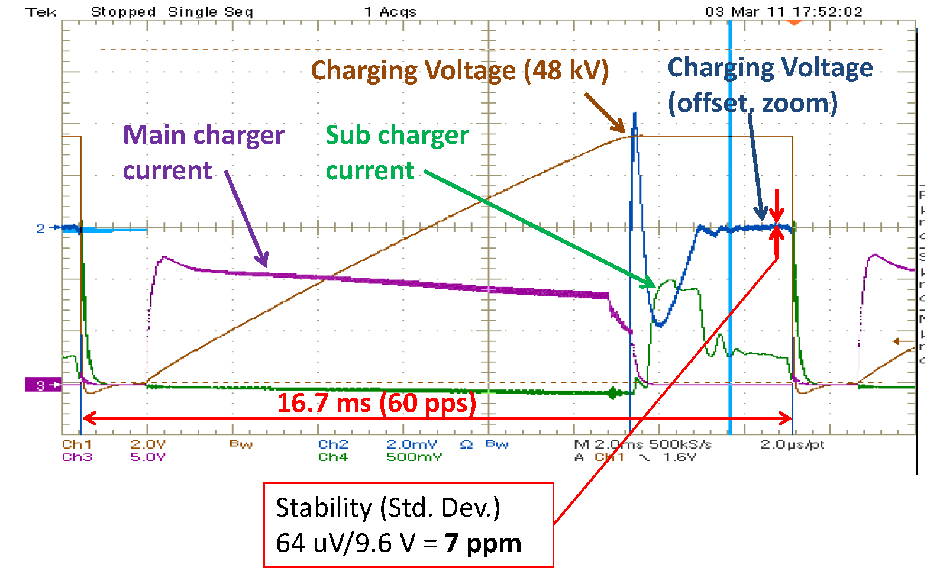
Klystron & modulator
50 MW pulse klystron (Canon E37212)
  Power efficiency ~ 43%, gain ~ 53dB
Pulse modulator
  -370 kV, 330 A, 5 μs pulse in 60 pps.
  Pulse Forming Network (PFN) type
  Thyratron switch (jitter < 1ns)
  Insulation-oil filled, for high reliability
  Steel tank for perfect noise shielding
Ultra-precise HV charger
  Combination of two inverter modules
  Main charger (35 kW) charged to 99.9%.
  Sub charger (1 kW) precisely regulate capacitor voltage to the target value.
Klystron
HV charger
Modulator
 | Stability (rms)
PFN capacitor volt. | 7 ppm
Klystron cathode volt. | 24 ppm
Klystron RF amplitude | 92 ppm
Klystron RF phase | 0.03 degree

Slide 13
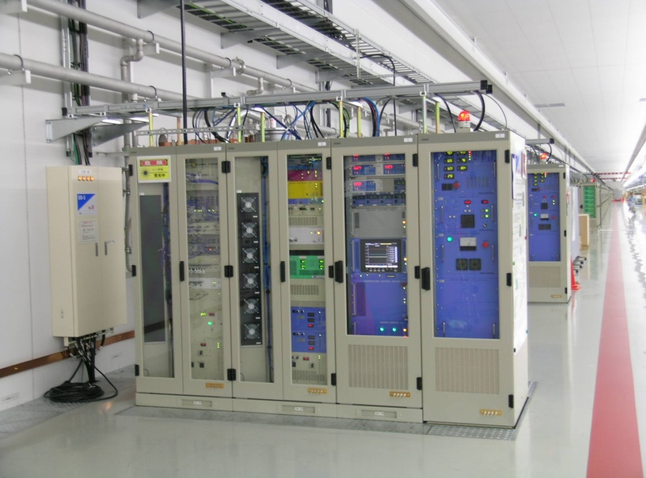
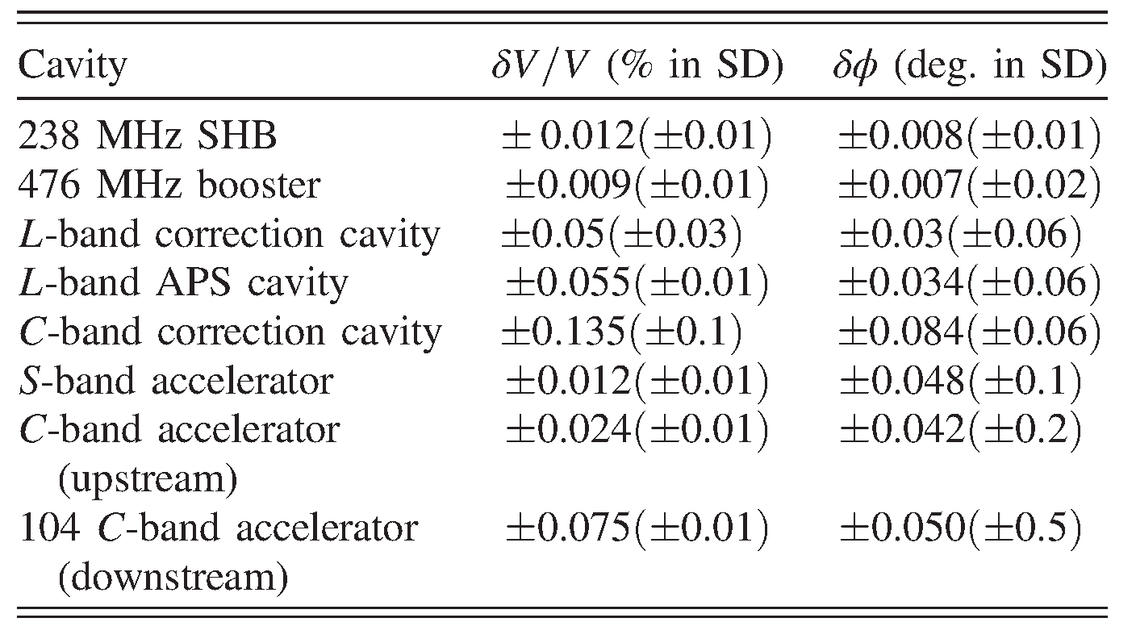
Timing and low-level RF system
Y. Otake, PR-AB 19 022001 (2016)
T. Ohshima, NIMA 820, 65-74 (2016)
Timing distribution (RF & trigger)
  Phase-stabilized optical fiber
  Water cooled duct.
  Fiber length feedback control
  using Michelson interferometry method.
Low-level RF system
  IQ-modulator & IQ-demodulator
  VME 16-bit, 238 MHz DAC & ADC
  VME Time delay unit
  Low-noise DC power supply
  Series regulator (no switching noise)
  Large noise filter at DC line.
  Water cooled cabinet
  Temperature stabilized within ~0.1 K.
Water cooled
cabinet
Optical fiber & duct
Low level RF
Driver amplifier
Measured stability
requirement

Slide 14
Outline
Introduction
  X-ray free electron laser SACLA
  C-band main accelerator
Component design and performance
  Acceleration structure
  RF pulse compressor
  Klystron & pulse modulator
  Timing and low-level RF system
Operational status at SACLA
  History and statistics
  Accelerating gradient
  Fault rate
Consideration of FCC-ee injector
Summary

Slide 15
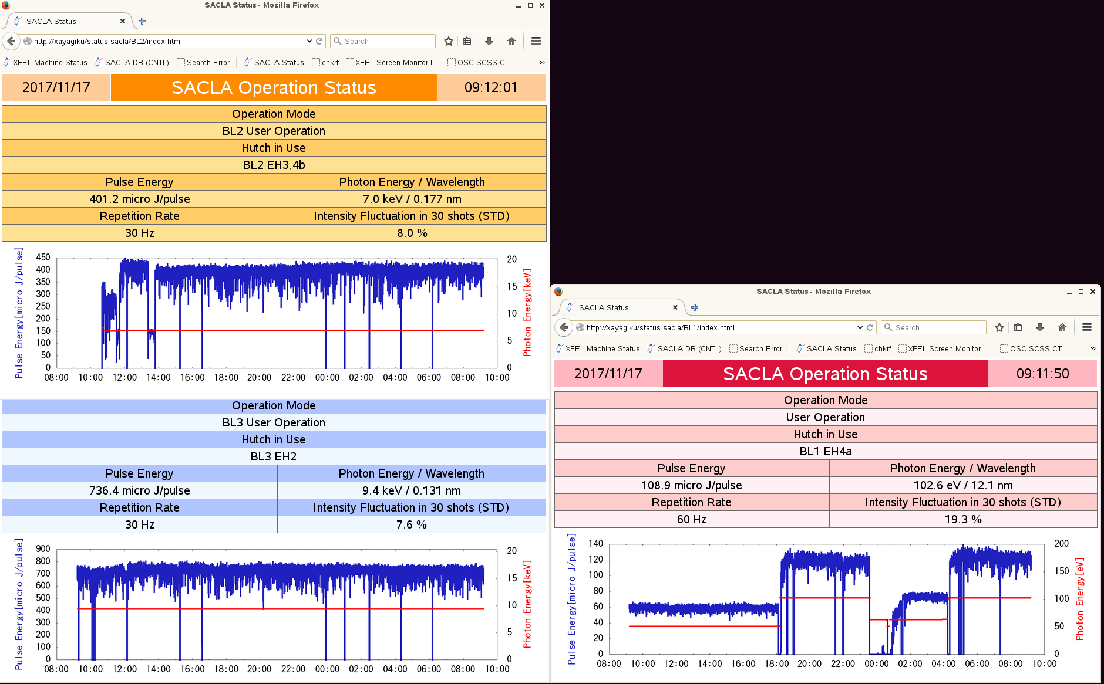
Operation status of SACLA
History
2011 Commissioning, first lasing.
2012 BL3 user experiments.
2015 BL1 commissioning.
2017 BL2 & BL3 multi-beamline operation.
2018 SPring-8 beam injection.
BL2 7.0 keV, 30 Hz
Statistics (FY 2018) | BL2 and BL3 Hard-X FEL | BL1 EUV FEL
Accel. operation | 6,281 hours
User experiments | 5,046 hours | 1,224 hours
Laser availability | 97% | 94%
MTBF | 56 hours | 190 hours
BL3 9.4 keV, 30 Hz

Slide 16
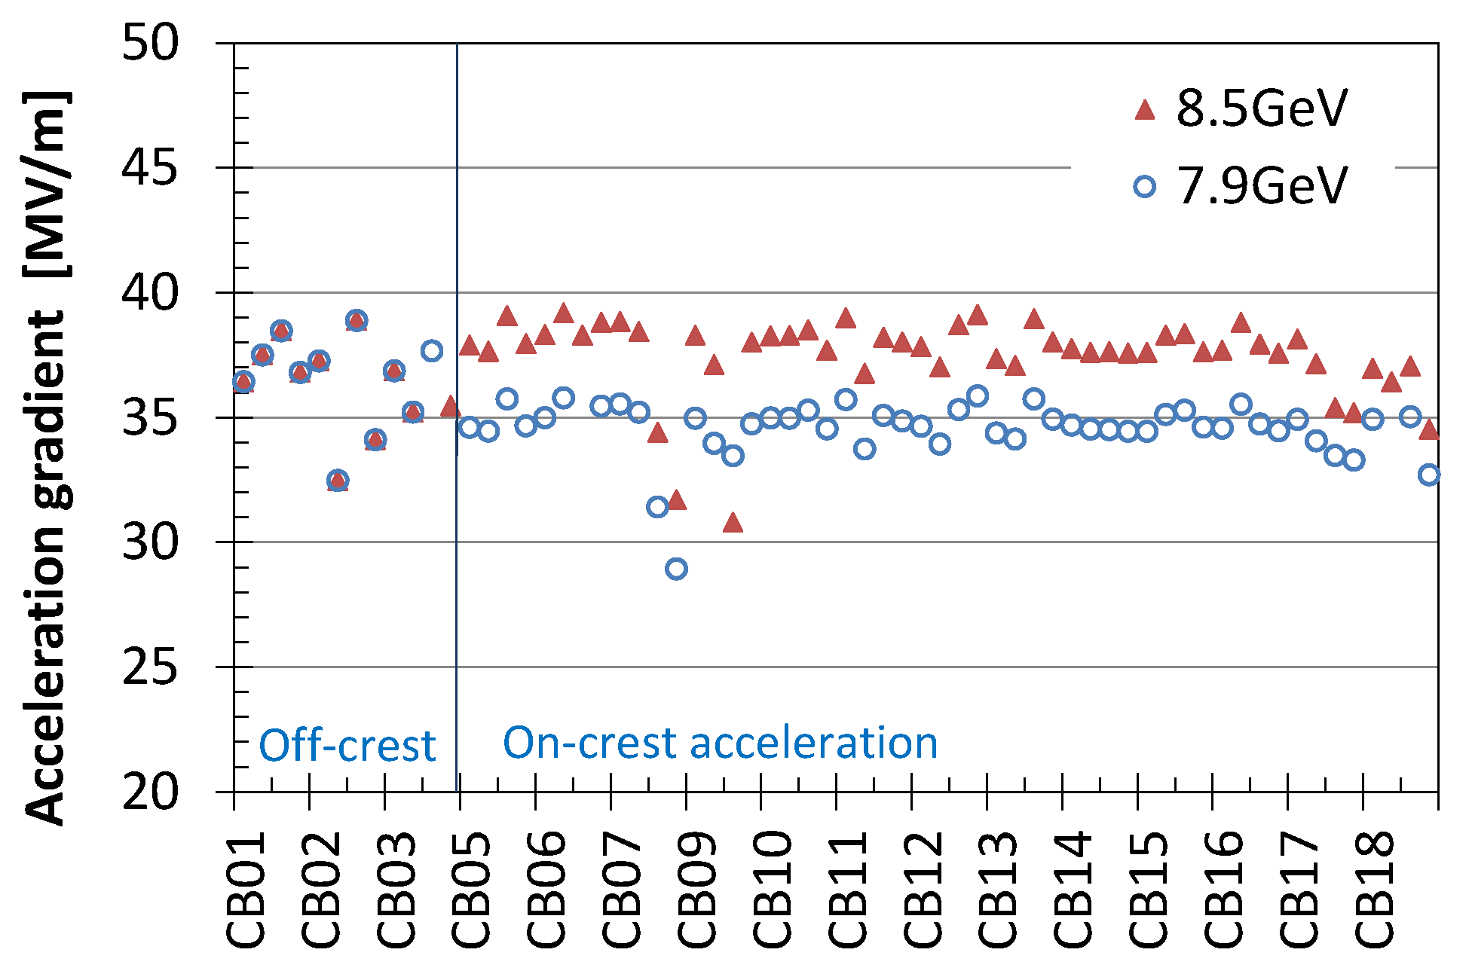
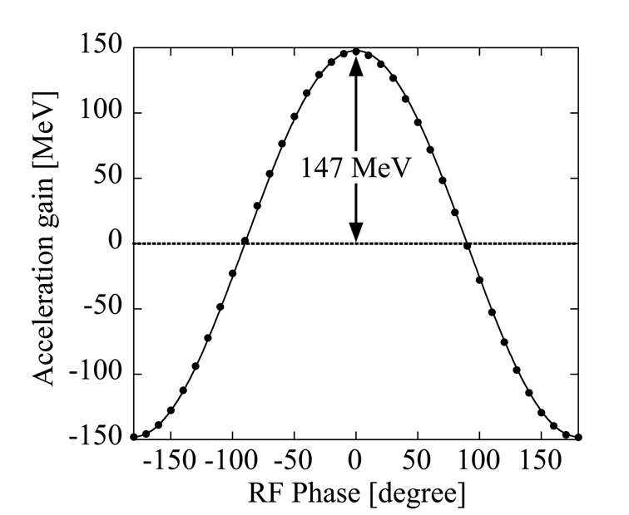
Acceleration gradient of C-band accelerator
 | Beam energy | RF units | Structure type | Accel. gradient
8GeV linac | 6 ~ 8.5 GeV | 64 | Choke-mode-type | 35~39 MV/m
800MeV linac | 250 ~ 800 MeV | 8 | High-gradient-type | ~ 42 MV/m
Operational gradient for SACLA 8 GeV linac
Beam energy measurement
at SACLA 800MeV linac
147 MV / 3.5 m = 42 MV/m

Slide 17
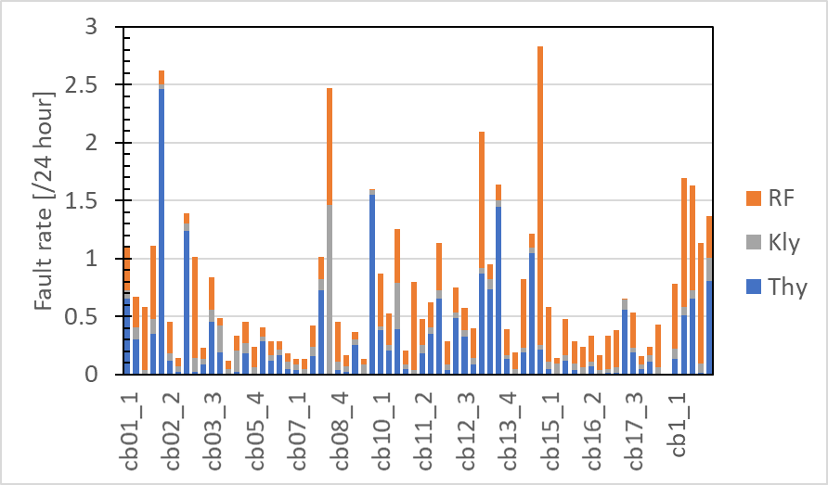
Fault rate of C-band accelerator (Jan~Apr. 2019)
 | 8 GeV linac | 800 MeV linac
Average fault rate per unit | 0.67 times/day | 1.32 times/day
Fault rate of accelerator | 1.8 times/hour | 0.27 times/hour
Mean time before failure (MTBF) | 30~60 minutes | 3 hours
RF arcing (45%)
Klystron HV arcing (13%)
Thyratron pre-trigger (42%)
Average
0.67 times /day
Average
1.32 times /day
800 MeV linac
5 units, ~42 MV/m
8 GeV linac 64 units, ~35 MV/m

Slide 18
Outline
Introduction
  X-ray free electron laser SACLA
  C-band main accelerator
Component design and performance
  Acceleration structure
  RF pulse compressor
  Klystron & pulse modulator
  Timing and low-level RF system
Operational status at SACLA
  History and statistics
  Accelerating gradient
  Fault rate
Consideration of FCC-ee injector
Summary

Slide 19
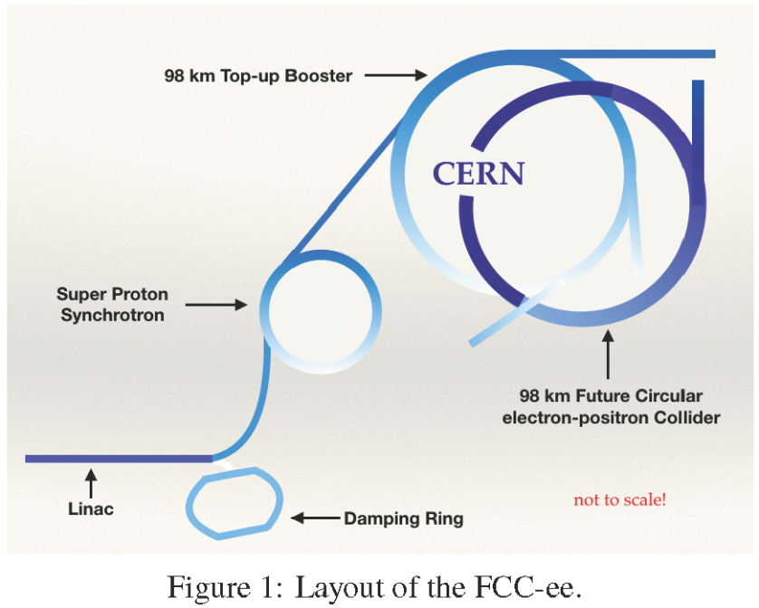
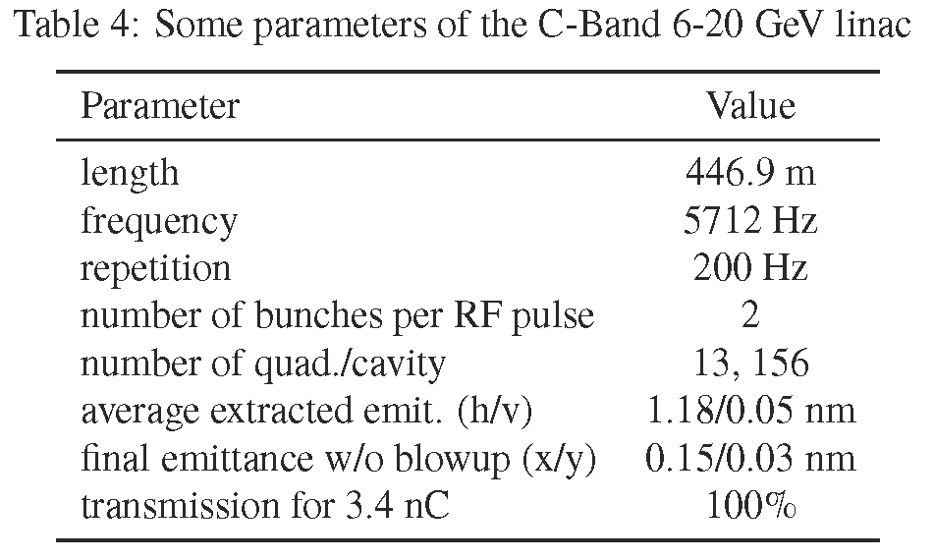
Consideration of FCC-ee injector
Copied from “S. Ogur, et. al.,
Proc. of eeFACT2018”
Acceleration gradient ~35 MV/m
  14 GeV / 35 MV/m = 400 m
Repetition rate: 200 Hz
  We tested up to 120 Hz.
  Klystron, modulator cooling capacity.
  Fault rate should be considered.
2 bunch operation is not tested at SACLA.
Hardware cost ~ 2M-Euro /1unit (125 MeV)
without building, infrastructure, and cabling
(from SACLA construction in 2006-2010.)

Slide 20
Summary
In SACLA, the C-band RF system constantly operate with 35-42 MV/m in 60 pps repetition rate.
The fault rate (MTBF 30~60 min.) is acceptable level of the operation.
XFEL requires high RF stability (100 ppm, 0.2 degree for C-band RF).
We achieved the required stability based on….
  Precise HV charging of klystron modulator
  Precise timing distribution system and low-level RF system.
C-band RF system has been well established at SACLA.
Recently C-band RF system was also adopted as an injector linac of a new 3 GeV light source in Japan-Tohoku (2019-2023).
We hope to be widely used C-band RF system for new accelerator facilities.

Slide 21
Backup slides

Slide 22
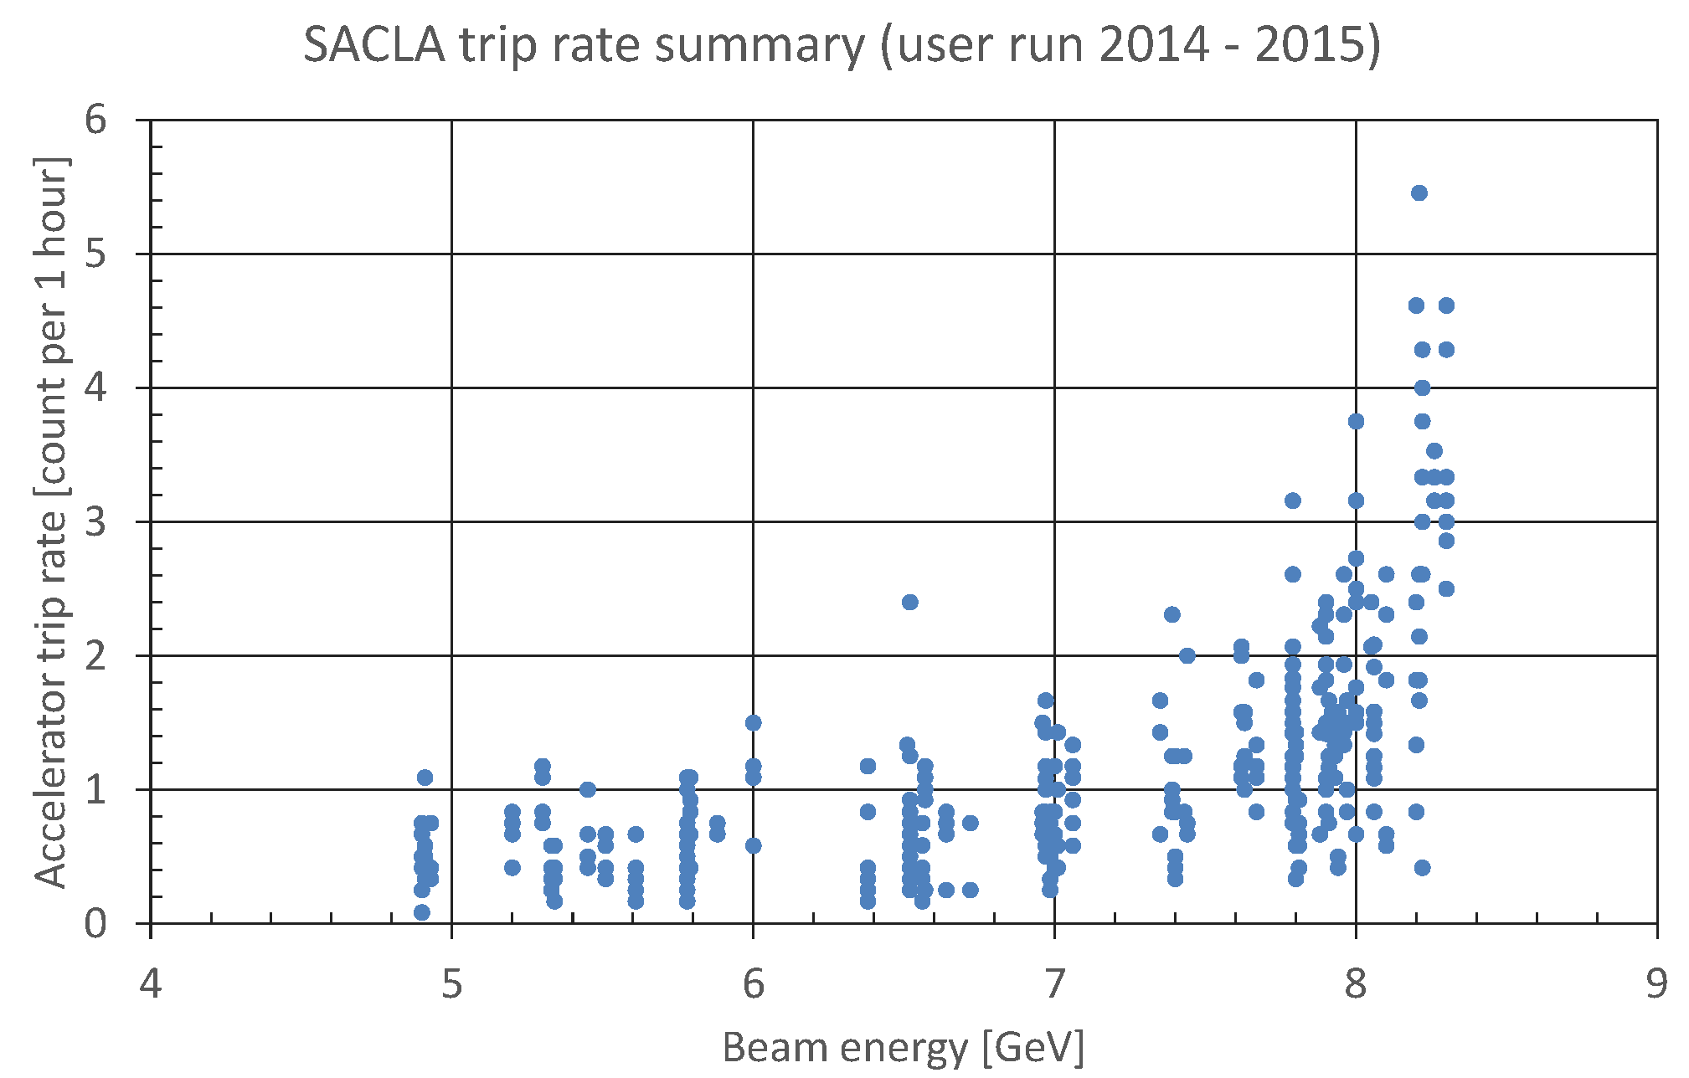
Beam energy vs. fault rate
User run 2014-2015, 30 pps
Frequent operation at 10 keV
7.8 GeV (35 MV/m), K=2.1

Slide 23
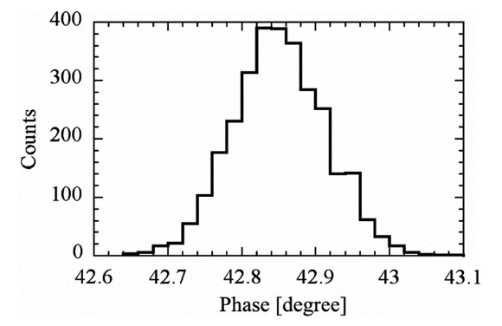
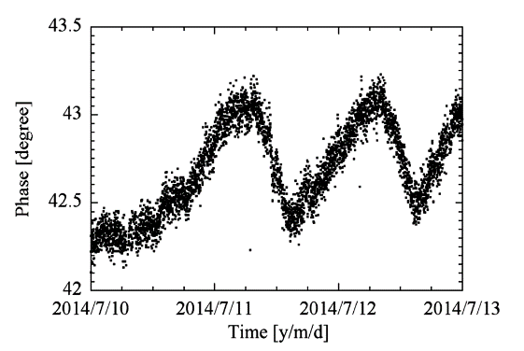
Beam arrival time stability
From
Y. Otake, PR-AB 19 022001 (2016)
Measured by a cavity-BPM at the end of undulator.
The measured value includes the instability of the BPM system and the master timing distribution system.
Jitter
of 4.8 GHz
Drift
σ=82 fs
< 580 fs
of 4.8 GHz

Slide 24
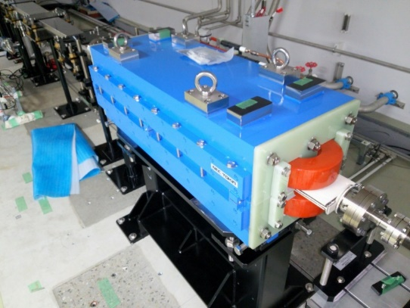
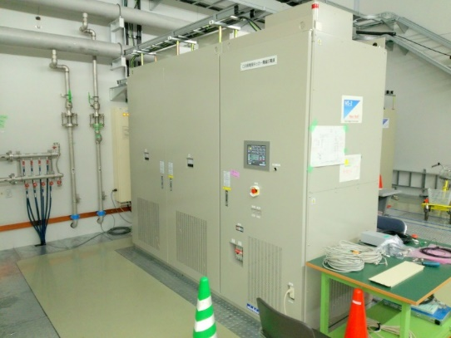
Multi-XFEL beamline operation
T.Hara, PR-AB 21 040701 (2018)
C. Kondo, RSI 89, 064704 (2018)
High quality & stable electron beam
  300 pC, >10 kA, 10 fs, several mm*mrad
  Energy stability ΔE/E ~ 10⁻⁴
Precise kicker magnet
  Switching ±300 A with 10 ppm stability
New dog-leg optics
  Pair of double-bend achromat cancels CSR induced horizontal kick
Independent control of electron beam
  Pulse-by-pulse control of C-band RF
    RF phase and trigger timing
  Different energy and bunch profile
Kicker magnet
Kicker pulsar

Slide 25
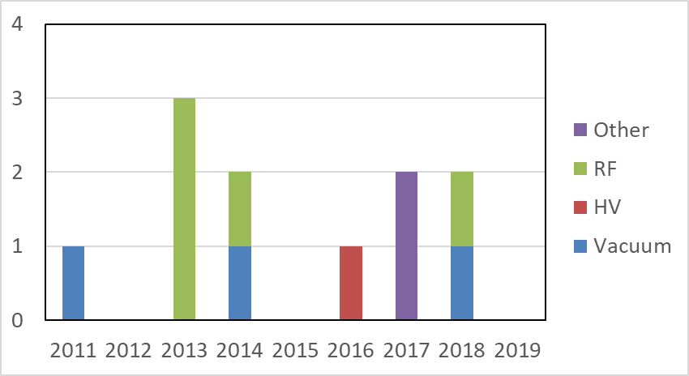
50 MW pulse klystron
Klystron gallery at SACLA
Solenoid focus high power klystron
Suppliers (compatible)
  Canon Electron Tube & Device
  Mitsubishi Electric
Operating C-band klystrons: 71
Replaced since 2011: 11
 | Nominal operation
Output RF power | 50 MW
Power efficiency | 43%
Gain | 53 dB
Cathode voltage | -370 kV
Beam current | 330 A
RF pulse width | 2.5 μs
Pulse repetition | 60 pps
Number of replaced klystrons

