Slide 1
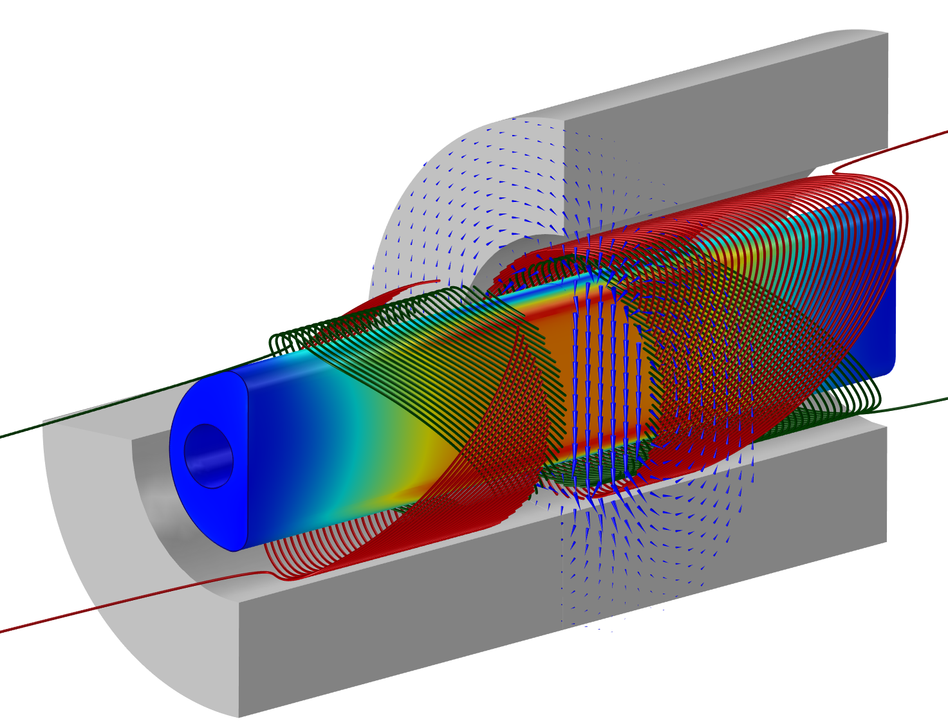






Status of the SuShi septum project
M. Novák, D. Barna - Wigner Research Centre for Physics
M. Atanasov, J. Borburgh, G. Kirby - CERN
A.B. Palotás, V. Mertinger, G. Szabó - Univ. Miskolc

Slide 2
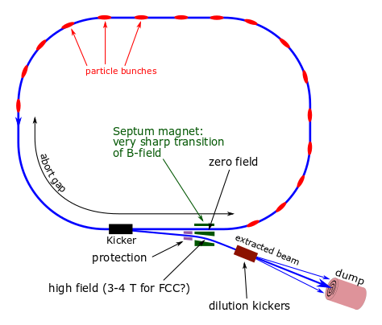
Introduction
LHC uses Lambertson septum
Conventional technologies
Reliable
Limited ~ 1.5 T
For FCC it would be too long
High energy consumption
Goals:
Demonstrator prototype
Septum with 3+ T field
<25 mm apparent thickness
CCT magnet with a bulk
sc. shield inside of it

Slide 3
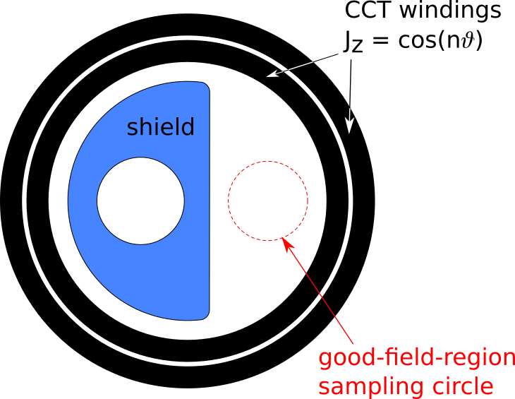
2D optimization
Simulate the field around the half-moon shaped shield (perfect diamagnet) for J_{z}=cos(n𝜗) (n=1..6) using COMSOL
Sample field around GFR, calculate multipole composition for each n
Invert the problem (linear algebra) to get weights J_{n} of multipole current
J_{z}(𝜗) = ∑ J_{n} * cos(n𝜗)
which gives pure dipole field
circulating beam
(no field)
extracted beam
(high field)
Review of Scientific Instruments, 90 (2019) 053302, doi: 10.1063/1.5096020

Slide 4
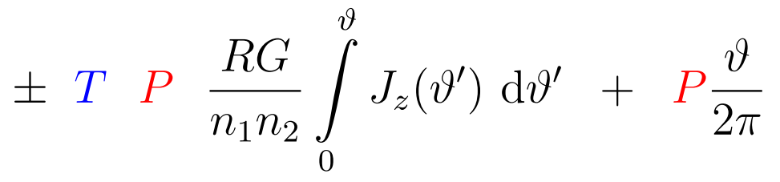
3D geometry of coils from 2D optimization
3D winding path:
x(𝜗) = R cos(𝜗)
y(𝜗) = R sin(𝜗)
z(𝜗) =
Coil radius, groove depth, # of wires
Current from 2D optimization
transfer
function, only free parameter
pitch - choose smallest possible for a given T
Study magnet parameters, field pattern etc. as a function of the transfer function T
Notes:
\pm \,\,\textcolor{blue}{T}\,\,\,\,\textcolor{red}{P}\,\,\,\, \frac{R G}{n_1 n_2} \int\limits_0^{\vartheta} J_z(\vartheta') \,\,\mathrm{d}\vartheta' \;\; + \;\; \textcolor{red}{P} \frac{\vartheta}{2\pi}

Slide 5
Design goals
Keep in mind: proof-of-concept prototype for a shield+magnet septum, and not a CCT-magnet R&D project →
CCT magnet as standard as possible, use same parameters, concepts (even test hardware) from the HL-LHC CCT corrector project, as much as possible
Key element: shield !
Reach 3.2 Tesla central field
Over a plateau of at least 10 cm
(to measure field homogeneity, required: ±1.5%)
80 cm device/shield length (gives feasible parameters, see later)
105 mm bore diameter (= hi-lumi CCT corrector)
Do not try to maximize ∫ B dz (it will only be important in a ring)
If the shield works → experts can tune up the magnet to maximize ∫ B dz

Slide 6
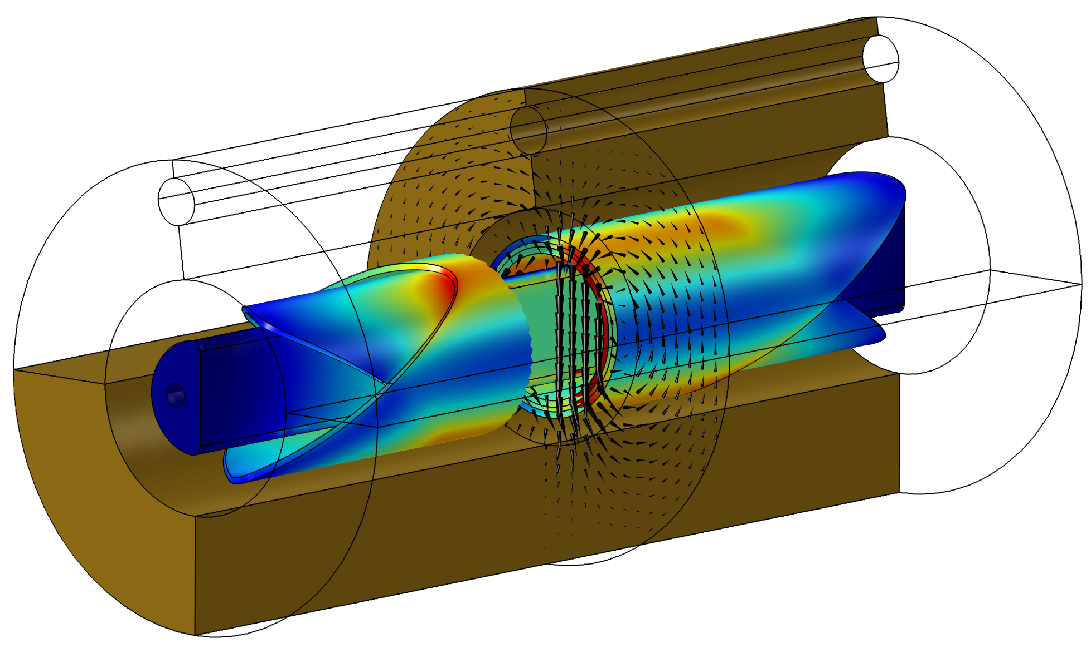
3D simulation
Winding is difficult to mesh →
use “block coils” with
distributed current

Slide 7
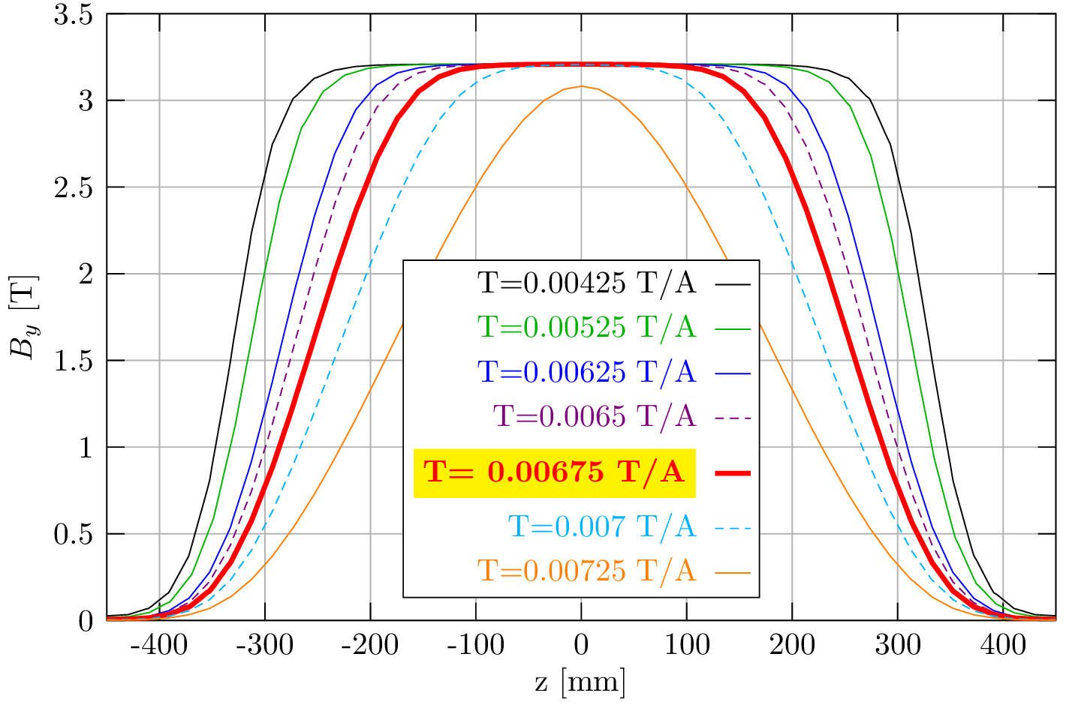
Min. 10 cm central plateau of B_{y}
T = 0.00675 T/A gives > 10 cm plateau
I₀ = 475 A
for B₀=3.2 T
Geometry fixed

Slide 8
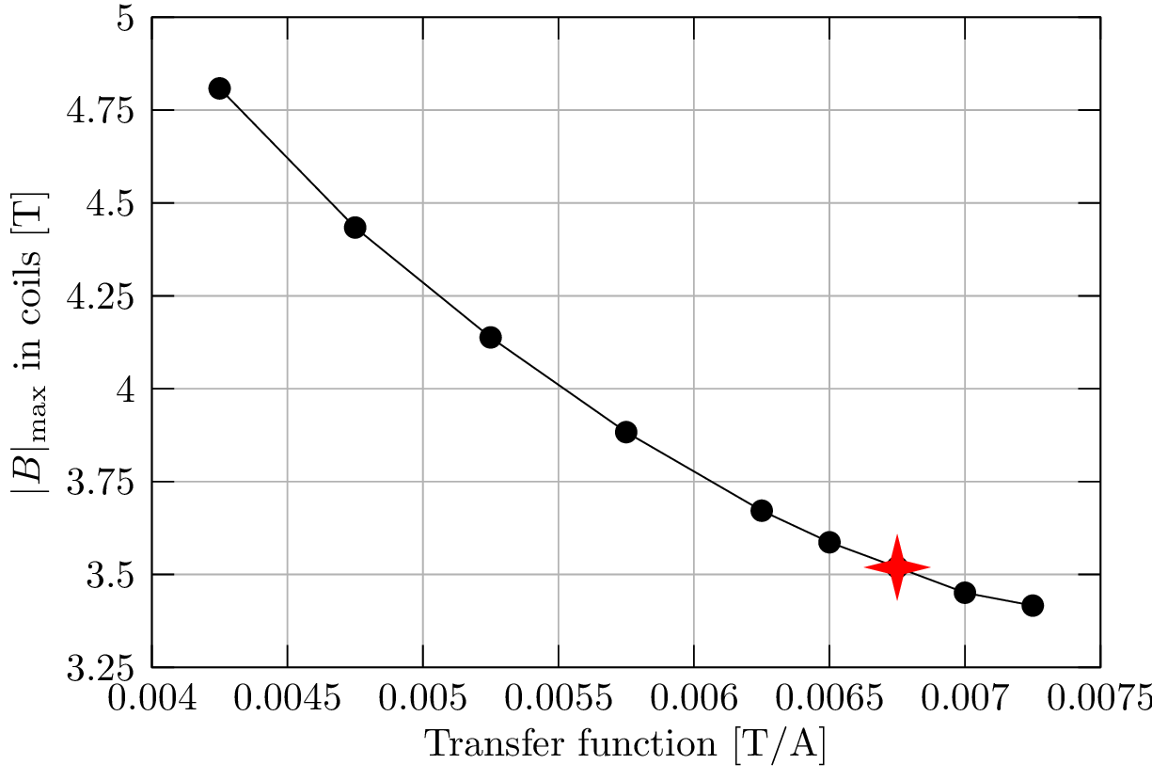
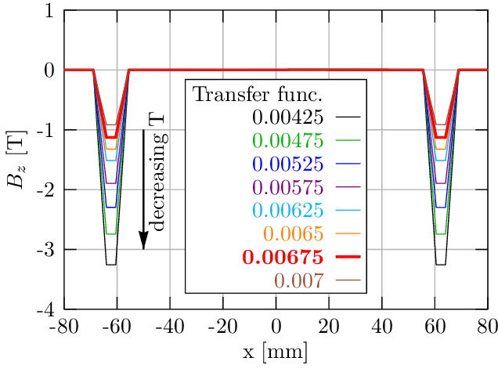
Max |B| in coils for B₀=3.2 T
B_{peak} = 3.52 T in the coils
Reason: for low T the coils “straighten up”, producing more B_{z} between coils

Slide 9
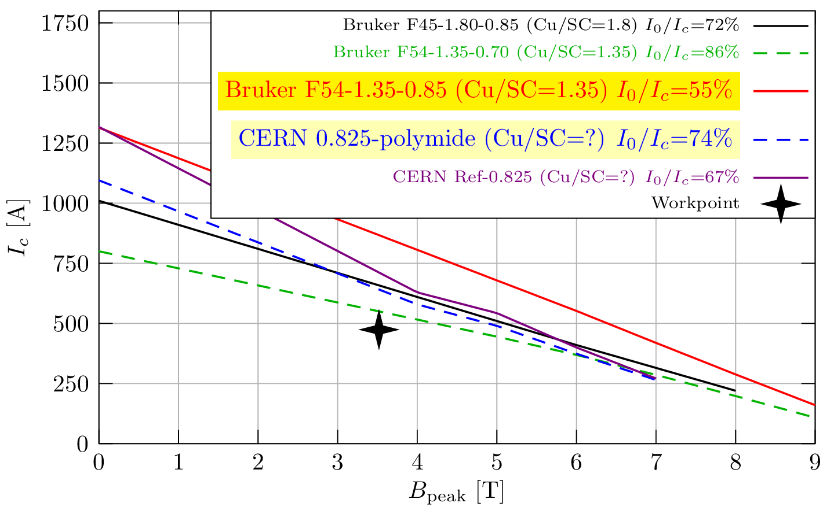
Choice of SC wire
Largest current margin
Available in CERN stocks

Slide 10
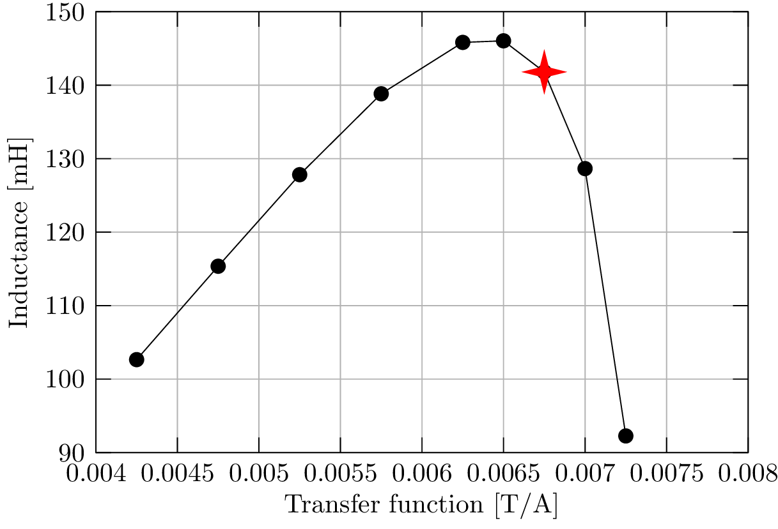
Inductance
L = ∫ B·H / I² = 142 mH
Compare to hi-lumi CCT corrector prototypes:
0.5 m: 102 mH
2.2 m: 820 mH

Slide 11
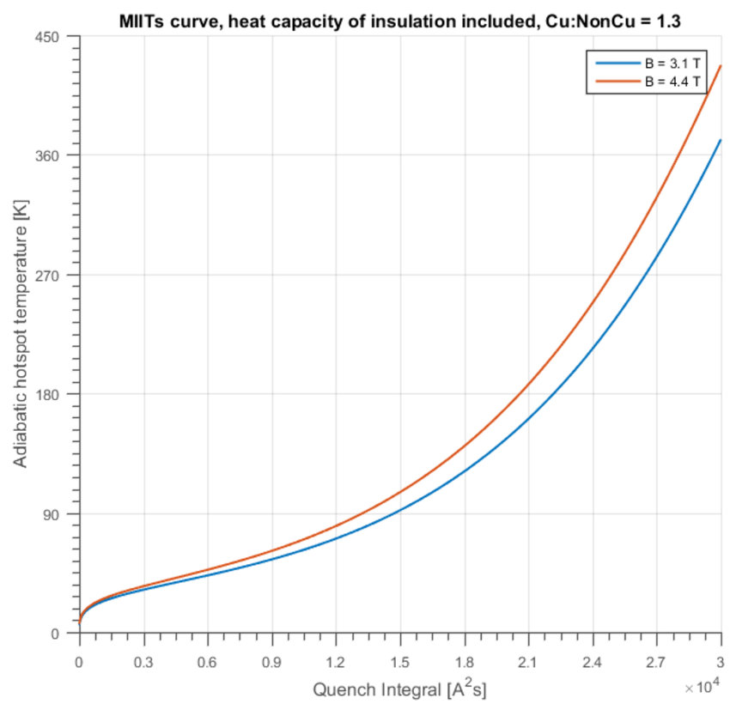
Quench protection
Goal: try with simple external damp resistor, as for HL-LHC CCT corrector magnets [IEEE TAS 28, 4004806]
Set max voltage: U₀=400 V
Damp resistor: R_{d}=U₀/I₀=843 mΩ
𝜏 = 168 ms
∫ I² dt = 18885 A² s
T_{hotspot} ≈ 160 K
Overestimation
  Neglects quench back
  Shield acting as a quench fuse
  (please ask…)
Thanks to G. Kirby

Slide 12
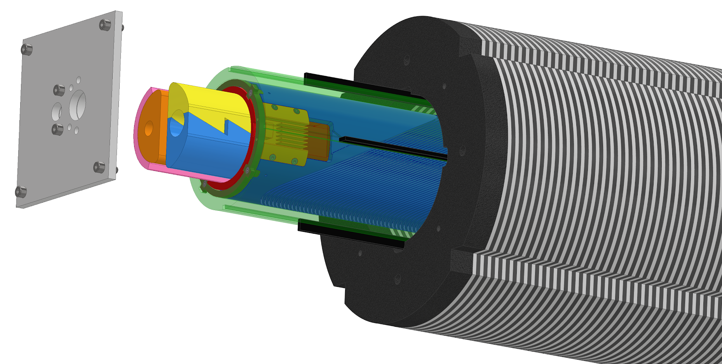
CAD design
solid, monolithic support within bore (forces!)
shield
Well advanced, profiting from hi-lumi CCT corrector design
(thanks: G. Kirby, M. Canale, L. Gentini)

Slide 13
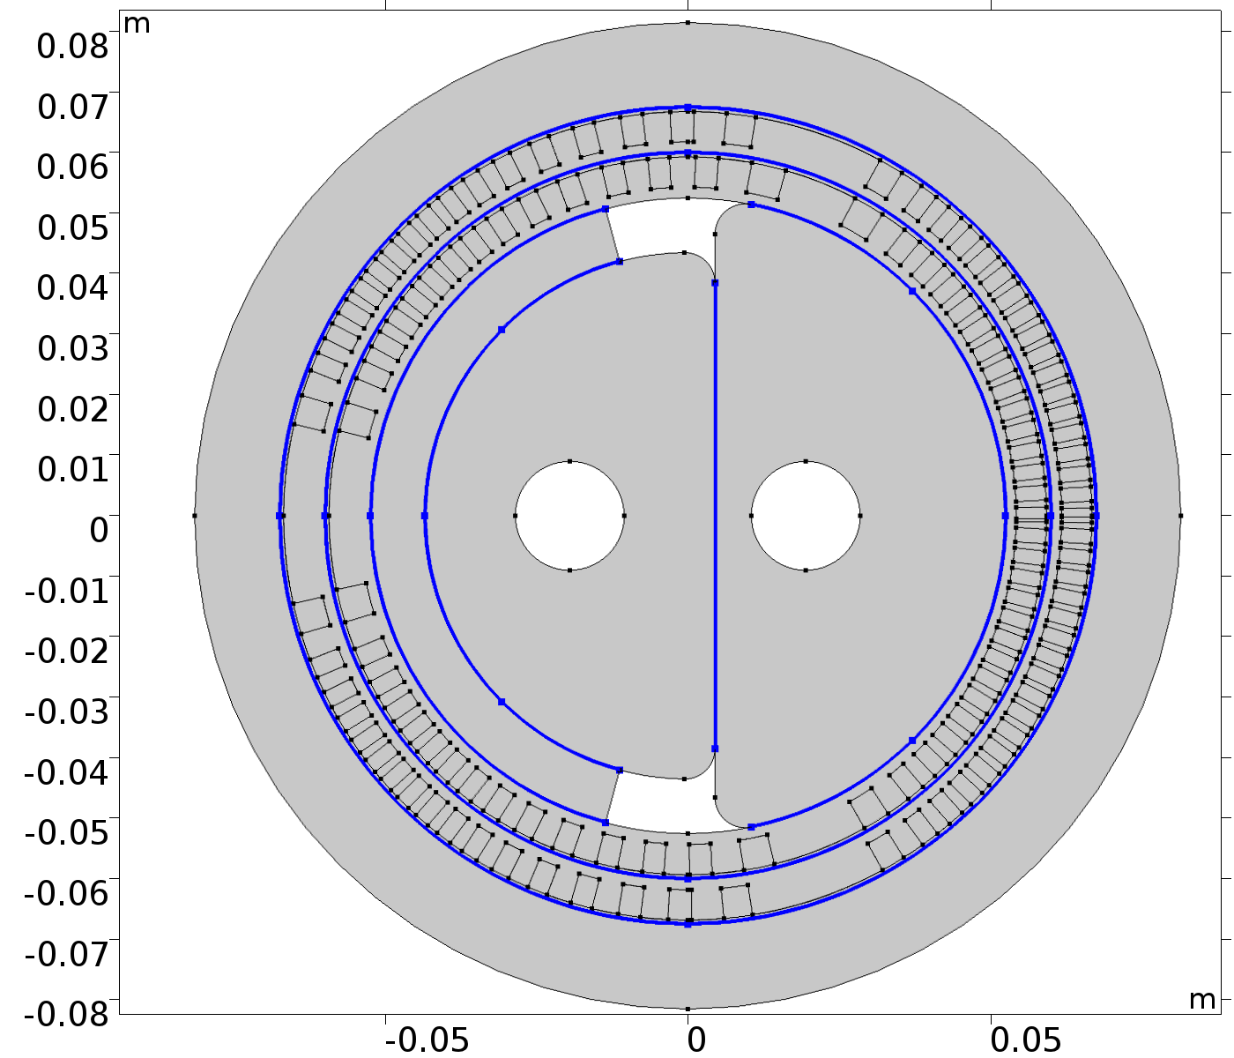
Mechanical simulations, forces
Model the 3D coil (only)
Using ‘Coil’ feature, calculate the
current distribution in it
Create 2D slice of the coil, and build
the rest of the geometry (formers, etc)
A-formulation in 2D → Magnetic fields,
currents
The shield is modelled with Campbell’s
model
Multibody mechanics simulation
Prescribed displacement constraint
In x=0 and y=0 planes to eliminate
rigid body modes
The applied loads are the Lorentz
forces

Slide 14
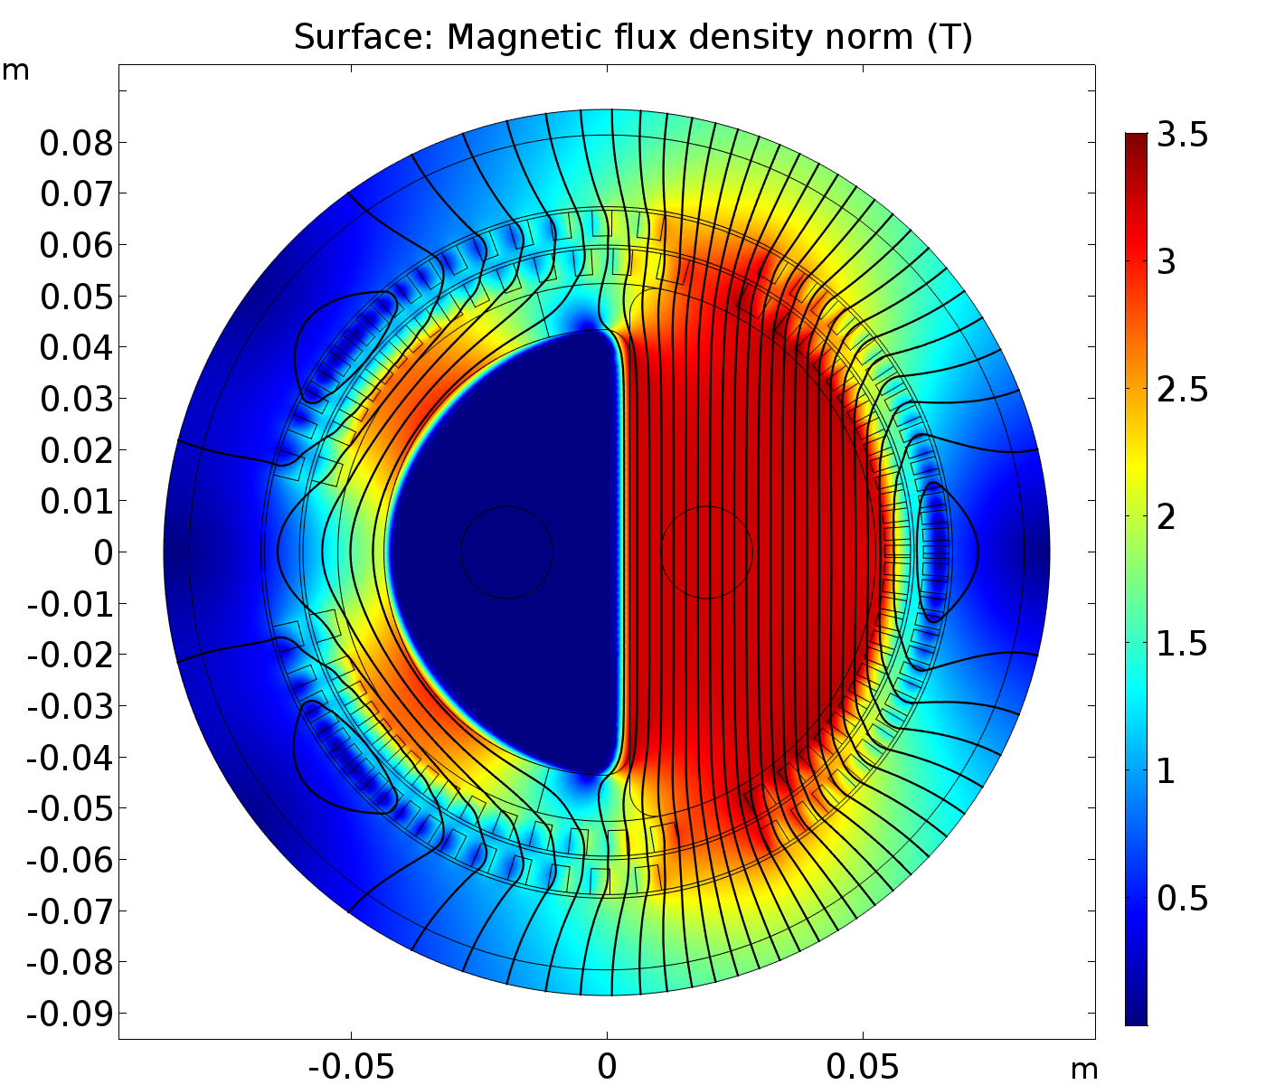
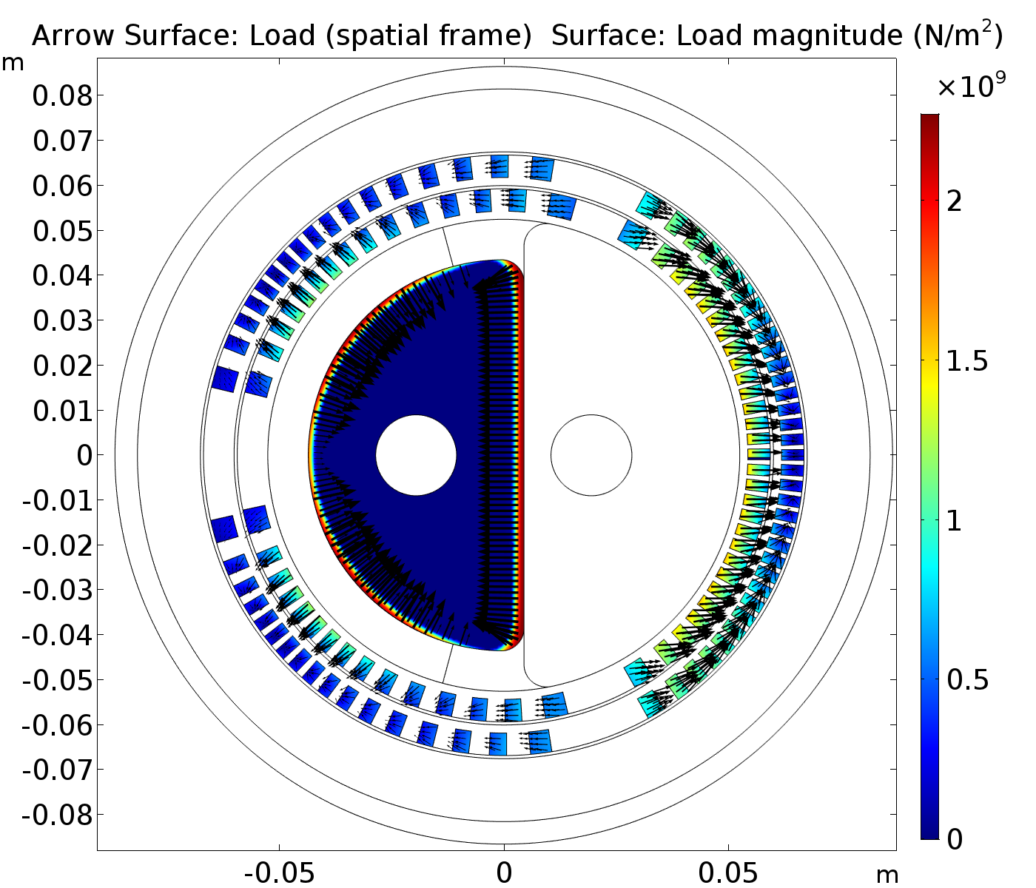
Mechanical simulations, forces

Slide 15
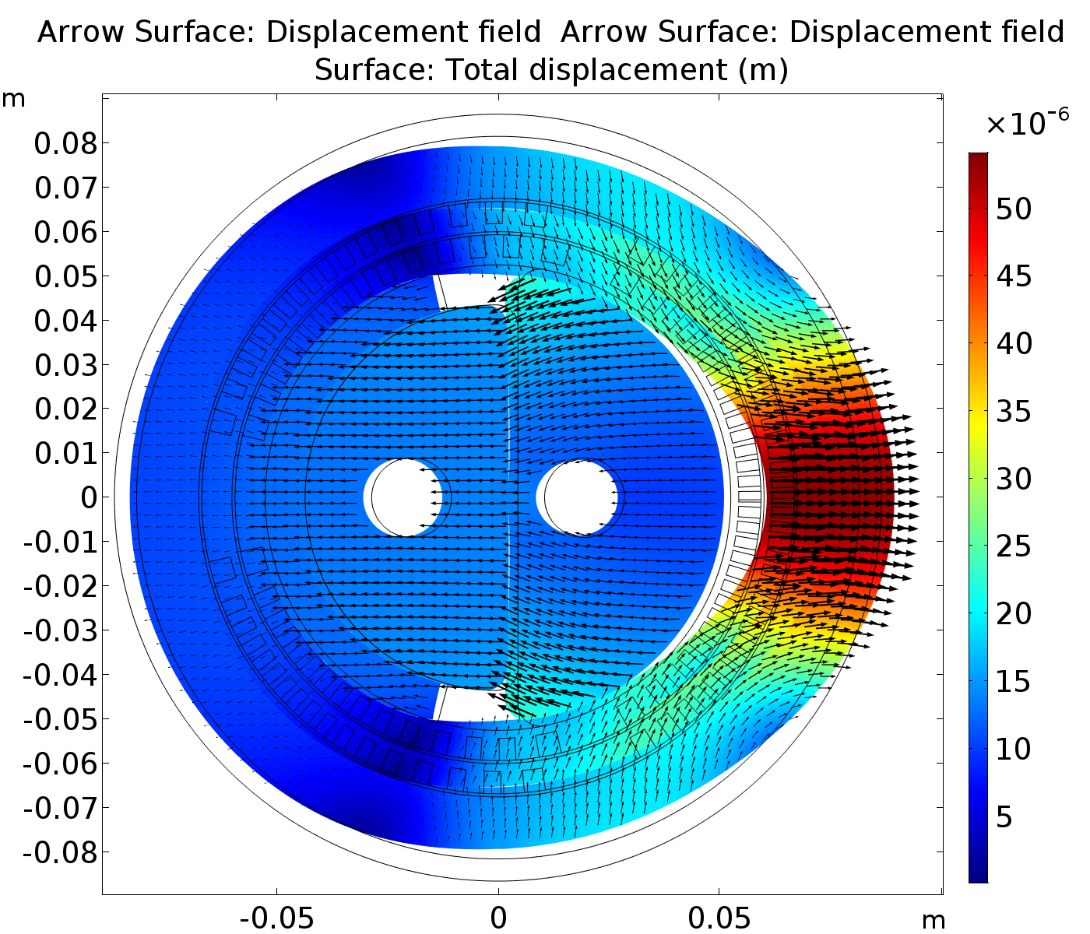
Mechanical simulations, forces
Vertically asymmetric deformation
Right support element pushes the shield
against the former
  Reduces the possibility of wobbling
Forces acting on the shield:
  F_{x} = -∫ B_{y}*J_{z} dA = -1.45e5 N/m
  F_{y} = ∫ B_{x}*J_{z} dA = 321 N/m
  (numerical error, should be 0)

Slide 16
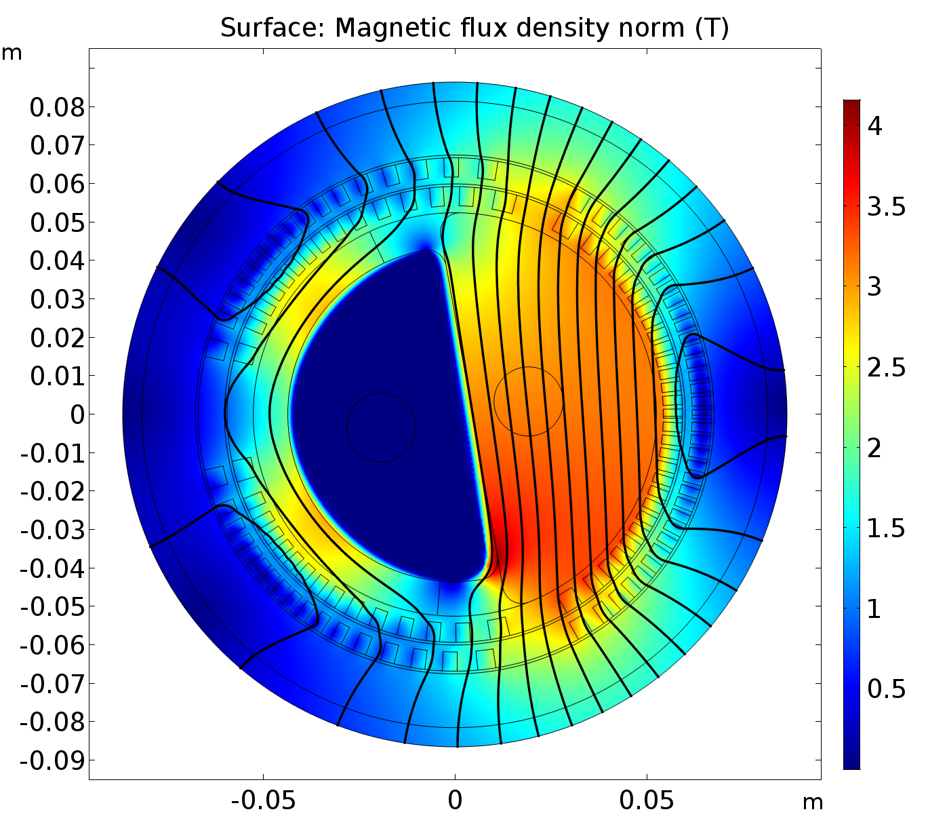
Mechanical simulations, forces
5° misalignment for illustration
Misalignments of the shield cause distortion in the field pattern
  x component of B appears
  B_{x} ~ tan(ɑ) ~ 40 mT for 1°
  The requirements on field quality determine the assembly precision
Torque on the shield
  𝛕_{z} = -235.19 (N*m)/m for 1°
Even for 1° it is quite large
Luckily, stabilizing

Slide 17
MgB₂ shield
Tubular MgB₂: shielded 2.75 T with a thickness of 8.3 mm
[To appear in IEEE Trans. Appl. Supercond. https://doi.org/10.1109/TASC.2019.2920359]
Worse than NbTi/Cu, but can be manufactured quickly
Half-moon shaped shield ordered in May 2019
To be tested this year, in the hi-lumi CCT prototype

Slide 18
NbTi/Cu multilayer shield
Excellent performance (no flux jumps, can be demagnetized, 3 T shielded by 3.2 mm thickness)
IEEE Transactions in Applied Superconductivity 29 (2019), 4900108
Best candidate so far
Expensive, availability unclear even on short term
Material R&D is explicitly out-of-scope for FCC project
↦ Collaboration with the University of Miskolc started
(unofficial yet) http://www2.mak.uni-miskolc.hu/en/
von Roll experimental rolling mill
ovens for hot rolling
sophisticated material characterization (XRD for texture analysis and residual stress measurement, pole figures, Scanning Electron Microscopy, EDXS, etc.)

Slide 19
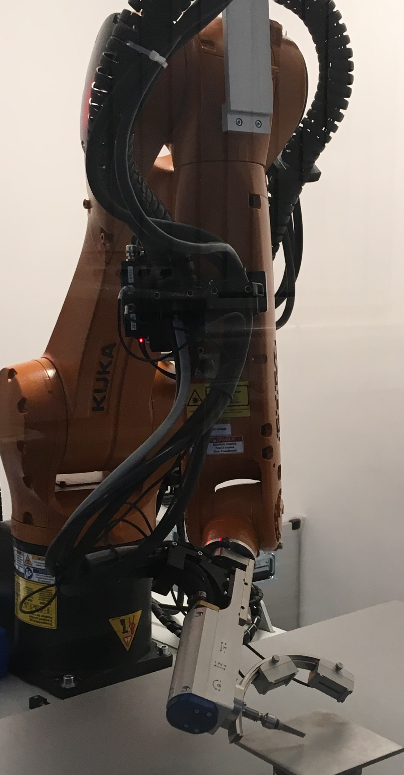
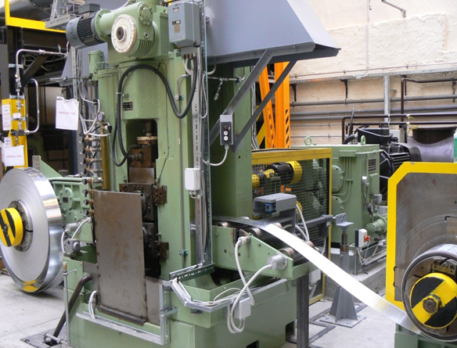
NbTi/Cu multilayer rolling @ Miskolc
(Infrastructure snapshots)
von Roll experimental rolling mill
Robotized texture
measurements

Slide 20
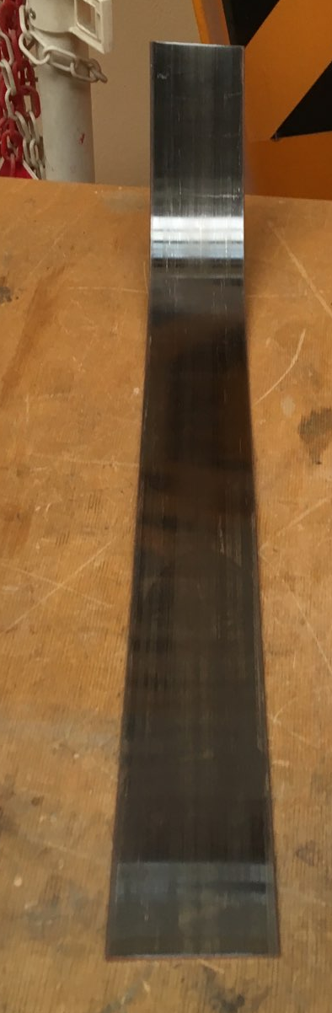
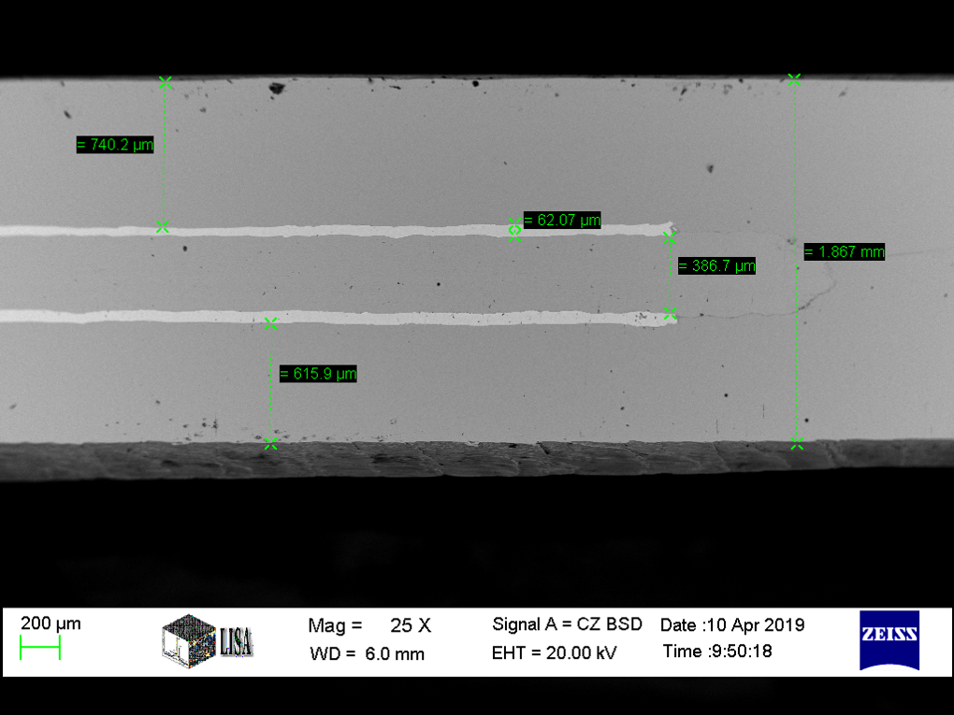
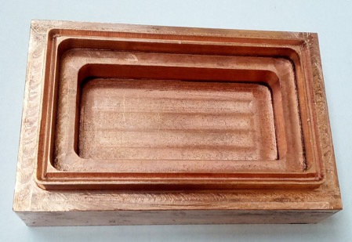
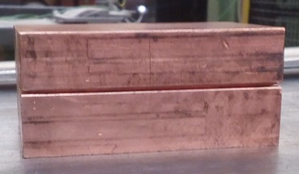
NbTi/Cu multilayer - first rolling tests
Single sequence: Cu-Nb-NbTi-Nb-Cu
Assembled in a Cu cassette in Argon, closed by a 70-ton press
Good metallic bond, no traces
of oxygen.
Cu
NbTi
Nb
Cu

Slide 21
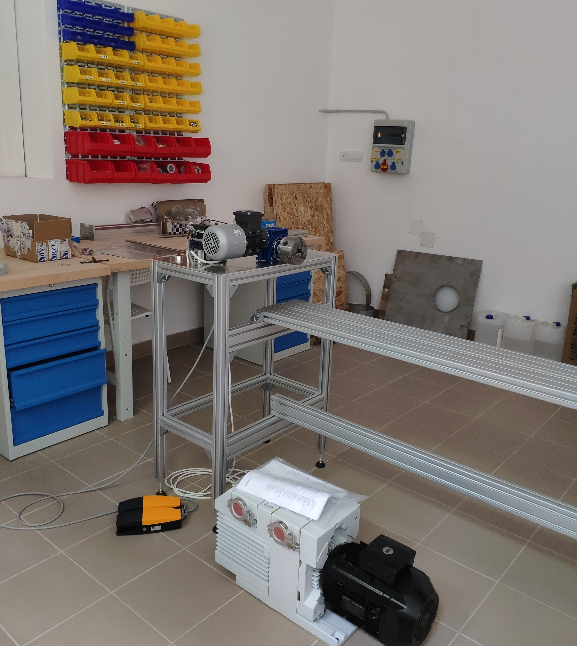
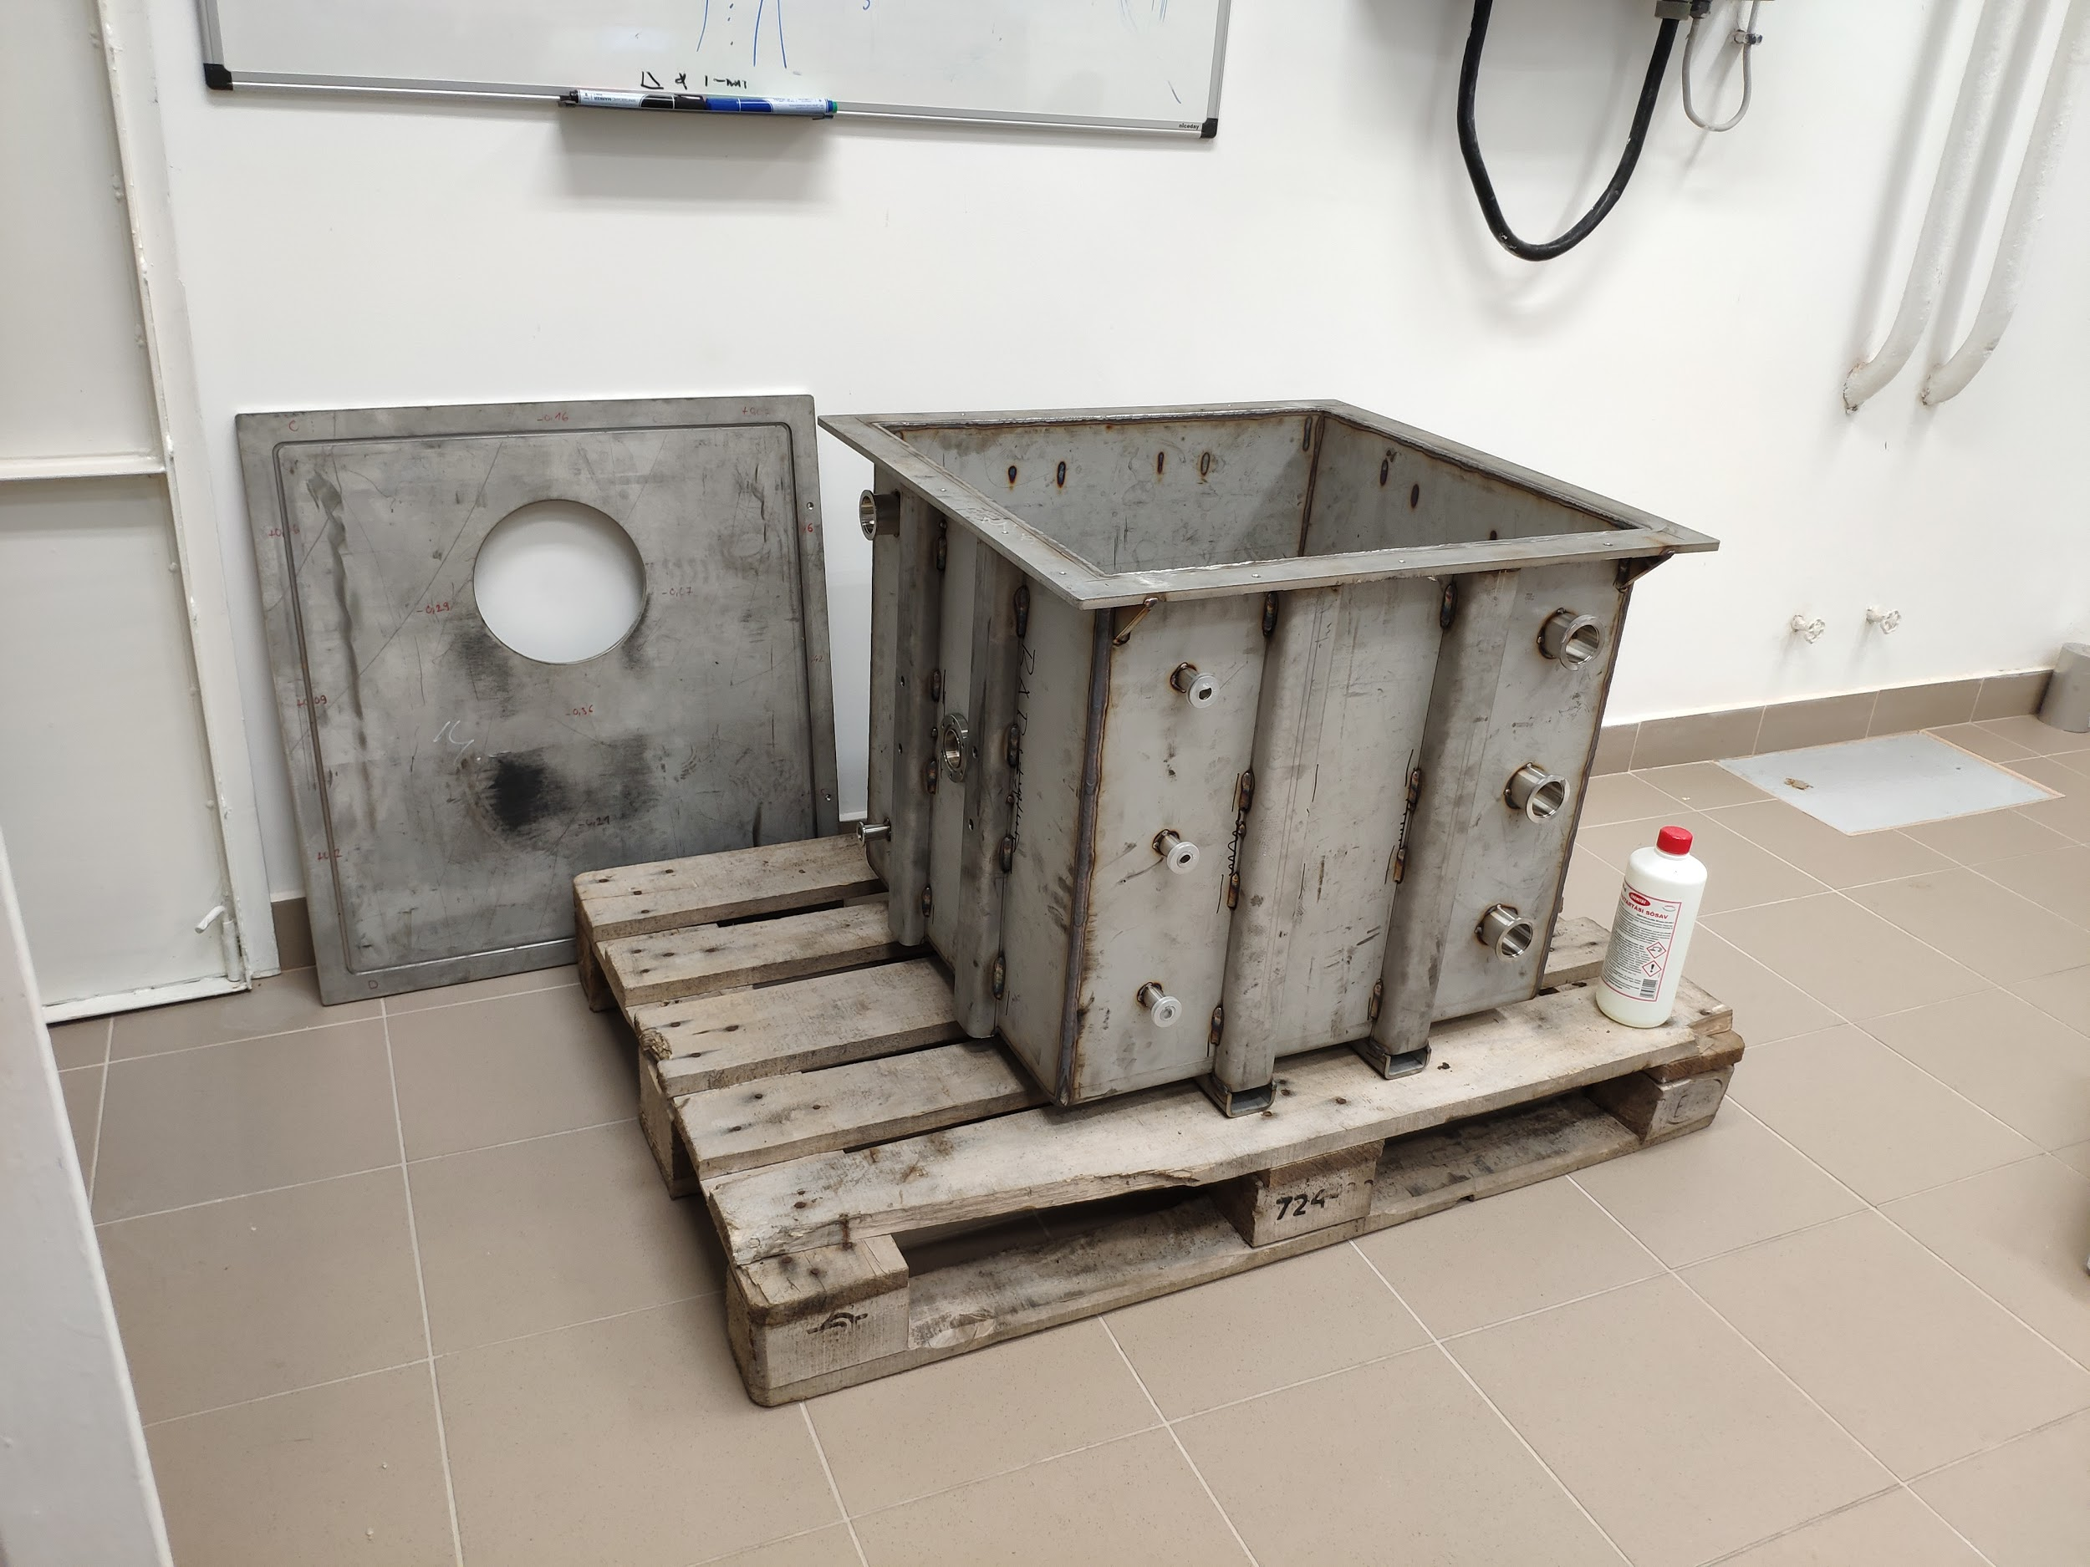
Infrastructure
Vacuum epoxy impregnation system,
winding machine being prepared

Slide 22
Conclusions
Acknowledgements
Most of the pre-prototype studies progress according to schedule
  Detailed quench simulation still a TODO
The first measurement with the actual half-moon shaped shield in a “regular” CCT magnet (hi-lumi corrector prototype) is on its way, hopefully will be performed until the end of this year
The first rolling experiments were successful
The manufacturing of the magnet expected to start next year
Akira Yamamoto, Márta Bajkó, Glyn Kirby, Juan Carlos Perez, Luca Bottura, Matthias Mentink, Lorenzo Bortot, SM18, Carlo Petrone, Ikou Itoh
Aries-2 (grant agreement # 730871)
Hungarian National Research, Development and Innovation Ofﬁce under grant #K124945
János Bolyai scholarship

Slide 23
Backup slides

Slide 24
References
Basic idea: “High field septum magnet using a superconducting shield for the Future Circular Collider” - Phys. Rev. Accel. Beams 20, 041002 (2017)
First experimental tests: Talk at FCC Week, Berlin, June 1st, 2017, 13:48
CCT+SuShi concept & exp. results: Talk presented at FCC Week 2018, 09-13 April, Amsterdam
NbTi/Cu shield test results: IEEE Transactions in Applied Superconductivity 29 (2019), 4900108
MgB2 shield test results: IEEE TAS early access, 10.1109/TASC.2019.2920359
CCT 2D geometry optimization: Review of Scientific Instruments, 90 (2019) 053302, doi: 10.1063/1.5096020

Slide 25
Quench protection - extra
Field pattern around the shield is quasi-stable
Quench will induce eddy currents in the shield, causing flux jump
Reorganization of the full field pattern
Induces currents in the formers and windings
Helps to quench the windings
Shield is acting as a kind of “quench fuse”

Slide 26
Project goal
FCC-hh extraction septum magnet demonstrator prototype
> 3 Tesla field
< 25 mm apparent septum thickness
Concept: canted-cosine-theta (CCT) magnet with a superconducting shield

Slide 27
Project history:
Successful proof-of-concept experiments:
  MgB₂ shield - 2.75 Tesla with 8.3 mm wall thickness - flux jumps after first cycle
  NbTi/Nb/Cu multilayer shield - 3 Tesla with 3.2 mm wall thickness - no flux jumps
FCC Week 2018: presentation of the concept of the complete device
(CCT-like magnet & shield)
2019 March: CERN-Wigner collaboration agreement signed to construct a demonstrator prototype

Slide 28
Project overview - milestones
2019 Dec: test a half-moon shaped MgB₂ shield in Hi-Lumi CCT magnet prototype (cheap, gain experience before constructing a SC magnet)
2020 March: CCT magnet design report
2020 June: CCT magnet prototype
2020 July: NbTi/Cu shield design report
2020 October: NbTi/Cu shield
2021 July: tests of MgB₂ and NbTi/Cu shields in magnet
Design, simulation & construction @ Wigner RCP
With supervision/help from CERN
CCT construction training is foreseen @ CERN for Wigner personnel

