Slide 1

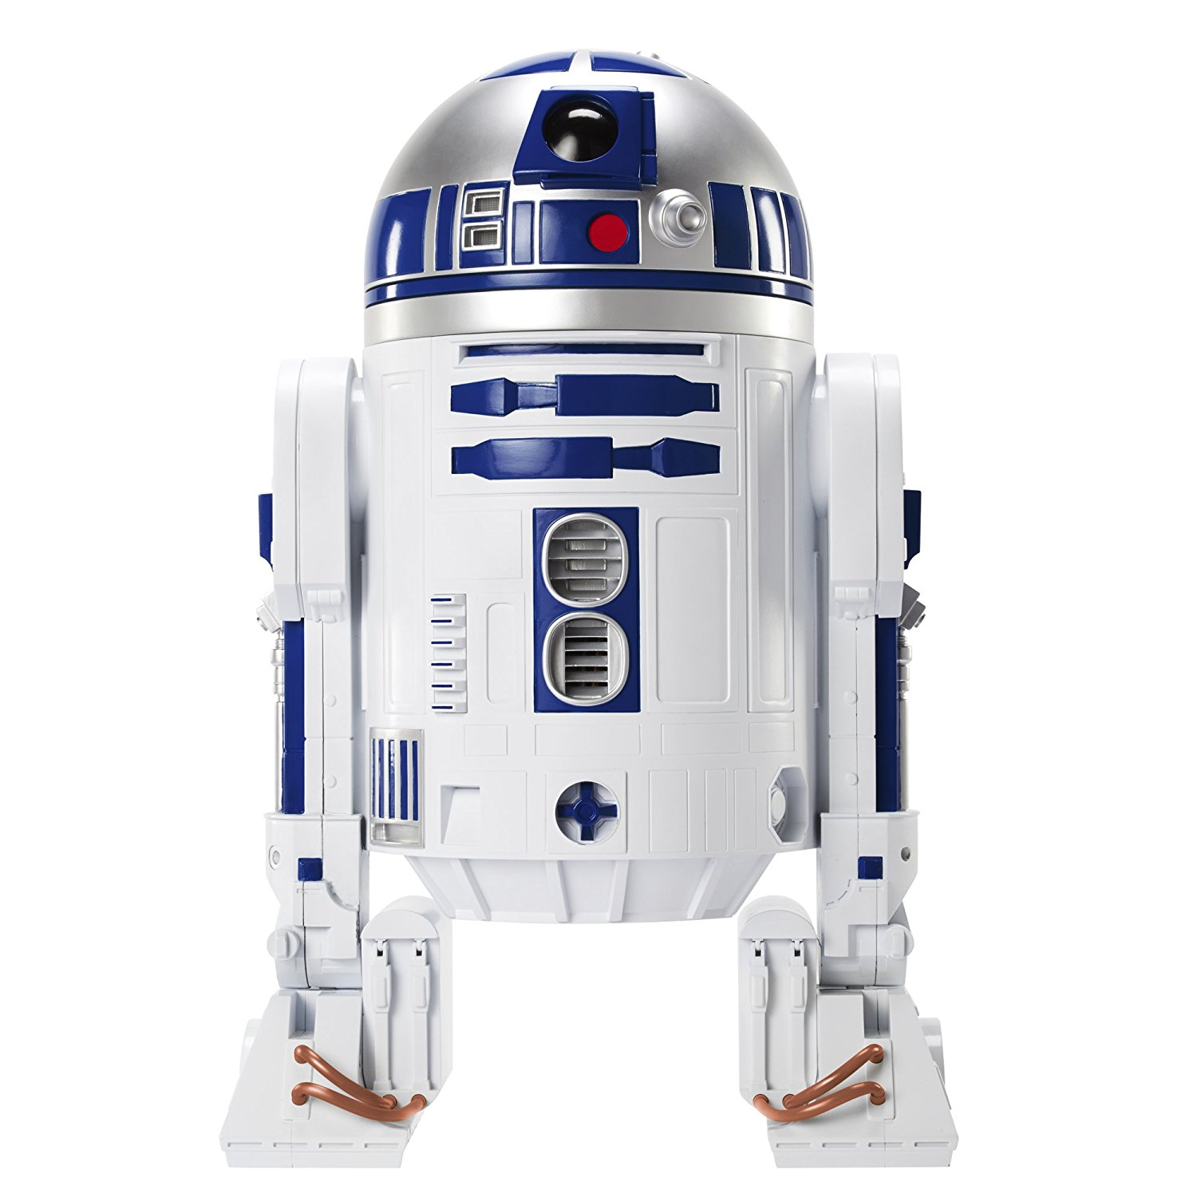
F2D2:
the CEA Dipole Model
for the FCC
F2D2 =
FCC Flared-ends Dipole Demonstrator
TM & © Lucasfilm Ltd.
All Rights Reserved
CEA: E. Rochepault, V. Calvelli, M. Durante, H. Felice, P. Mallon, P. Manil, J.F. Millot, G. Minier, J.M. Rifflet, L. Ramos-Vieira
CERN: S. Izquierdo Bermudez, D. Tommasini, J. Fleiter
27/06/2019

Slide 2
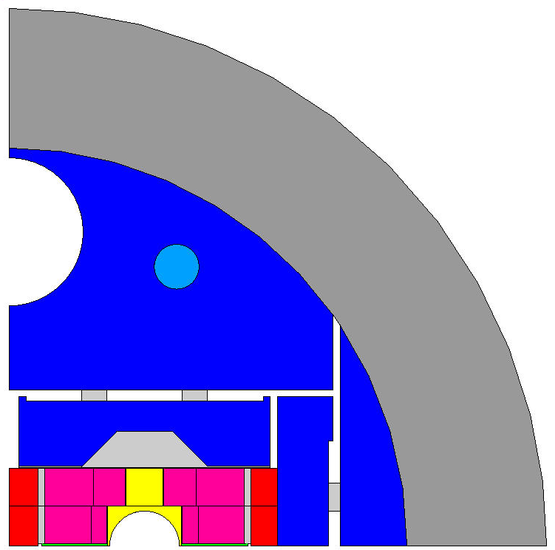
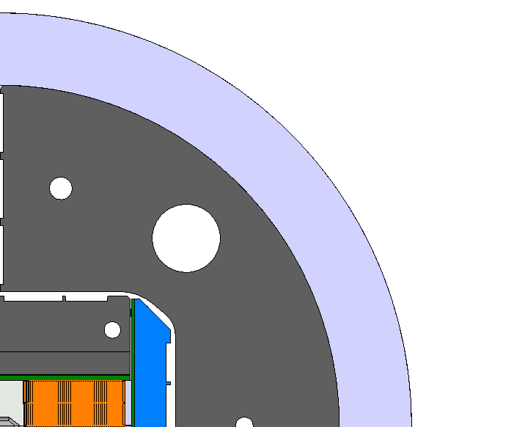
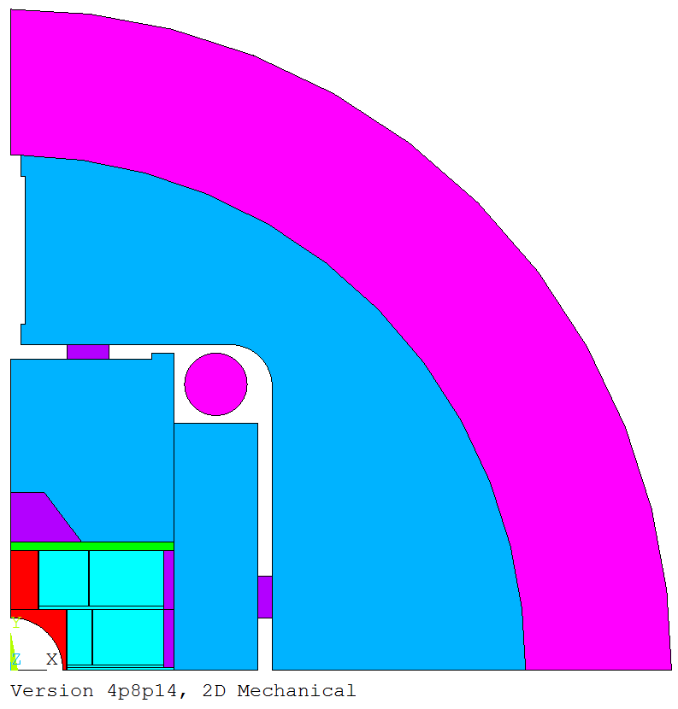
Strong Interaction with Magnet Programs
CEA-CERN Program
CERN Programs
ECC block-coil design [1-2]
16T Conceptual design
Double aperture
SMC models
Technology development
Conductor qualification
ERMC/RMM models [4,5]
  16T magnet R&D
[1] M. Segreti et al., “2D and 3D Design of the Block-coil Dipole Option for the Future Circular Collider”, IEEE TAS, 2019
[2] See “Evolution of the block-coils design”, this conference
[4] S. Izquierdo et al., “Design of ERMC and RMM, the Base of the Nb3Sn 16 T Magnet Development at CERN”, IEEE TAS, 2017
[5] See “Mechanical validation of the support structure of the eRMC and RMM, the 16-T R&D magnets for the FCC”, this conference
F2D2 short model [3]
Design/fabrication at CEA
Test at CERN
Single aperture
Same coil design as ECC
EPFL-CERN Program
R&D on jonction technology [6-7]
[6] M. Kumar et al. “Preliminary Tests of Soldered and Diffusion-Bonded Splices Between Nb3Sn Rutherford Cables for Graded High-Field Accelerator Magnets”, IEEE TAS, 2019
[7] See “Soldered and diffusion-bonded splices between Nb3Sn Rutherford cables for graded high-field accelerator magnets “”, this conference
[3] H. Felice et al. “F2D2: a Block-coil Short Model Dipole Toward FCC”, IEEE TAS, 2019

Slide 3
2D Magnetic Design - Finalized
Maximize central field with margins:
Harmonics representative of an accelerator magnet:
Today:
1200 A/mm²
Tomorrow:
1500 A/mm²
Nominal Current Inom | 10378 A
Short sample current I_{ss} | 12118 A
Bore field By₀ at Inom (I_{ss}) | 15.54 (17.81) T
Peak Field at Inom (HF/LF) | 16.20 / 11.85 T
Peak Field at Iss (HF/LF) | 18.58 / 13.62 T
Loadline Margin at Inom (HF/LF) | 14.0 / 15.4 %
Stored Energy Inom | 1.4 MJ/m
+/- 3 units
15 units

Slide 4
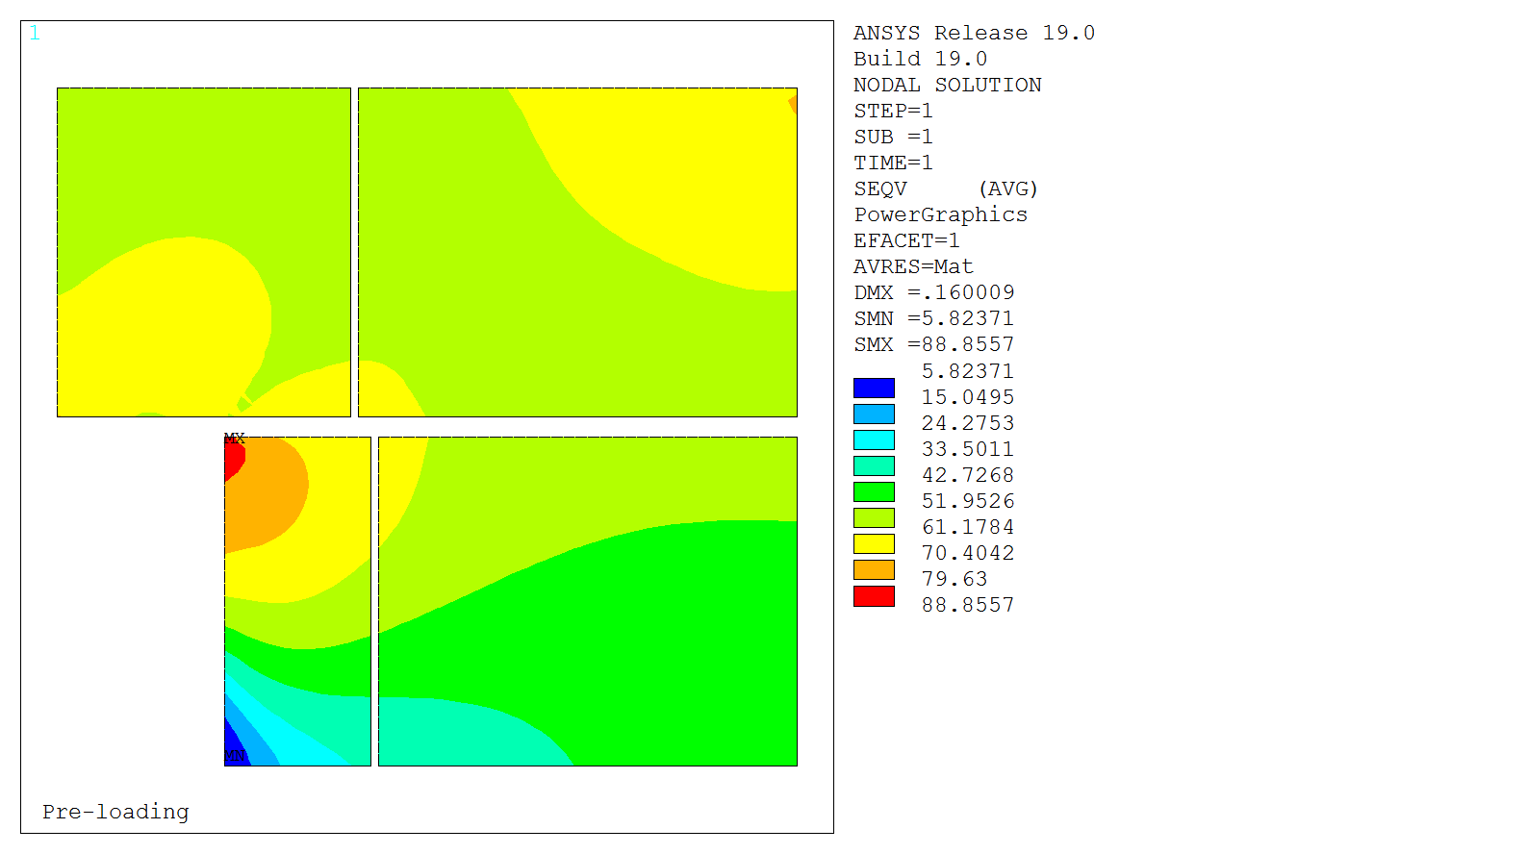
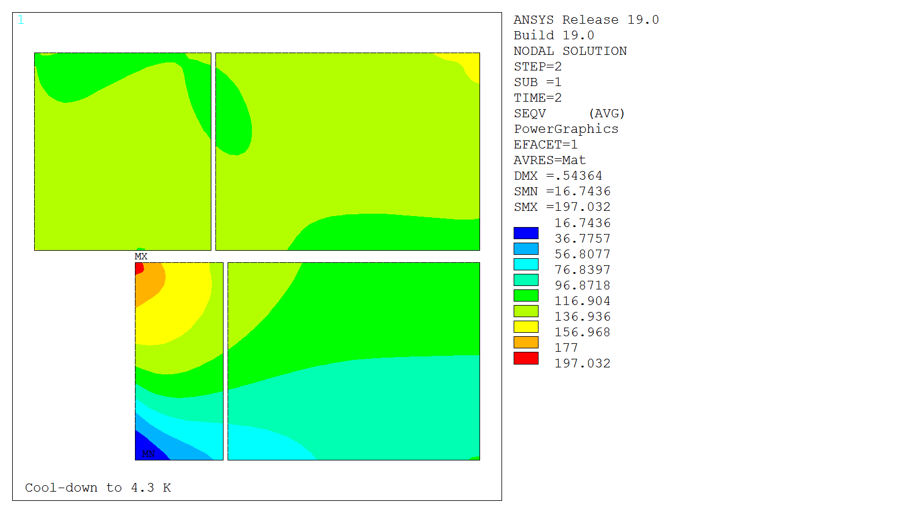
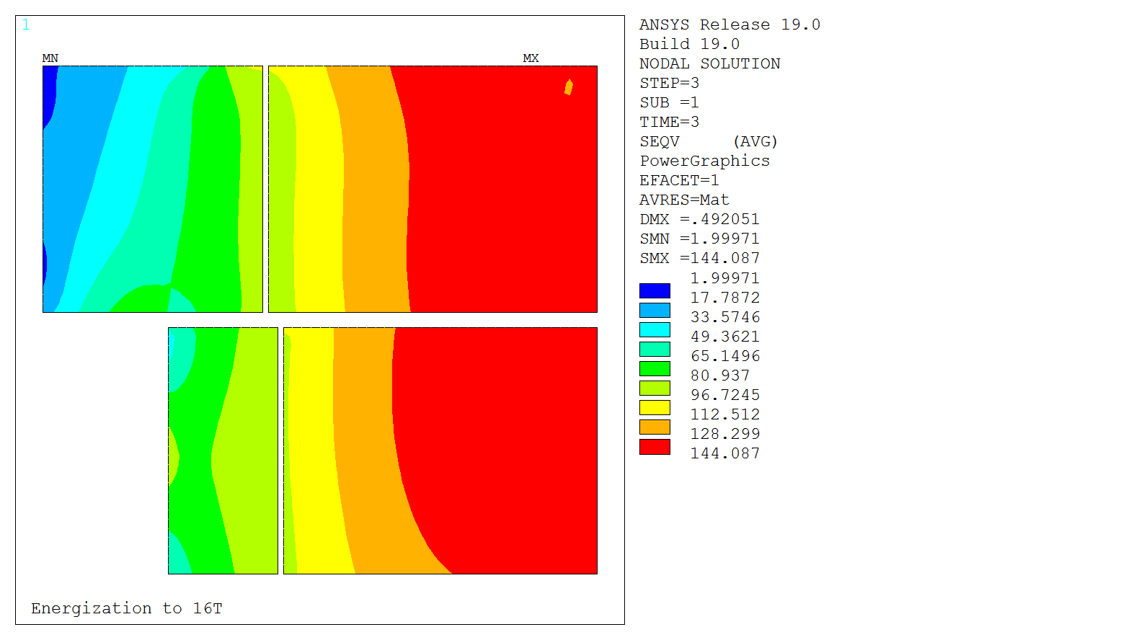
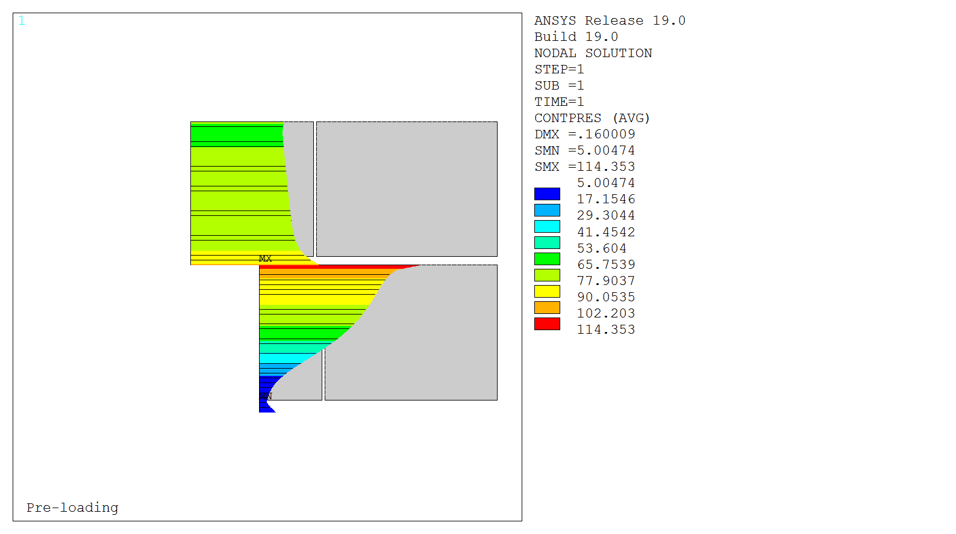
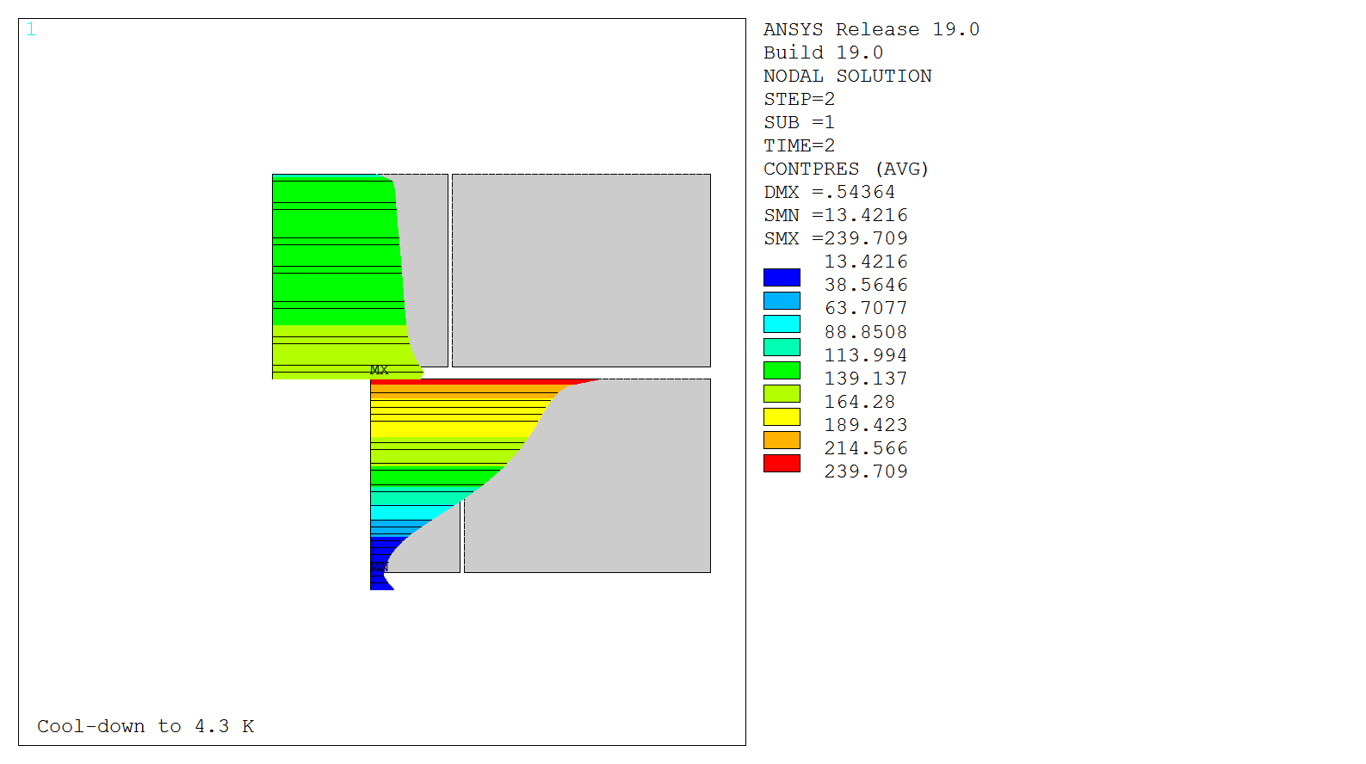
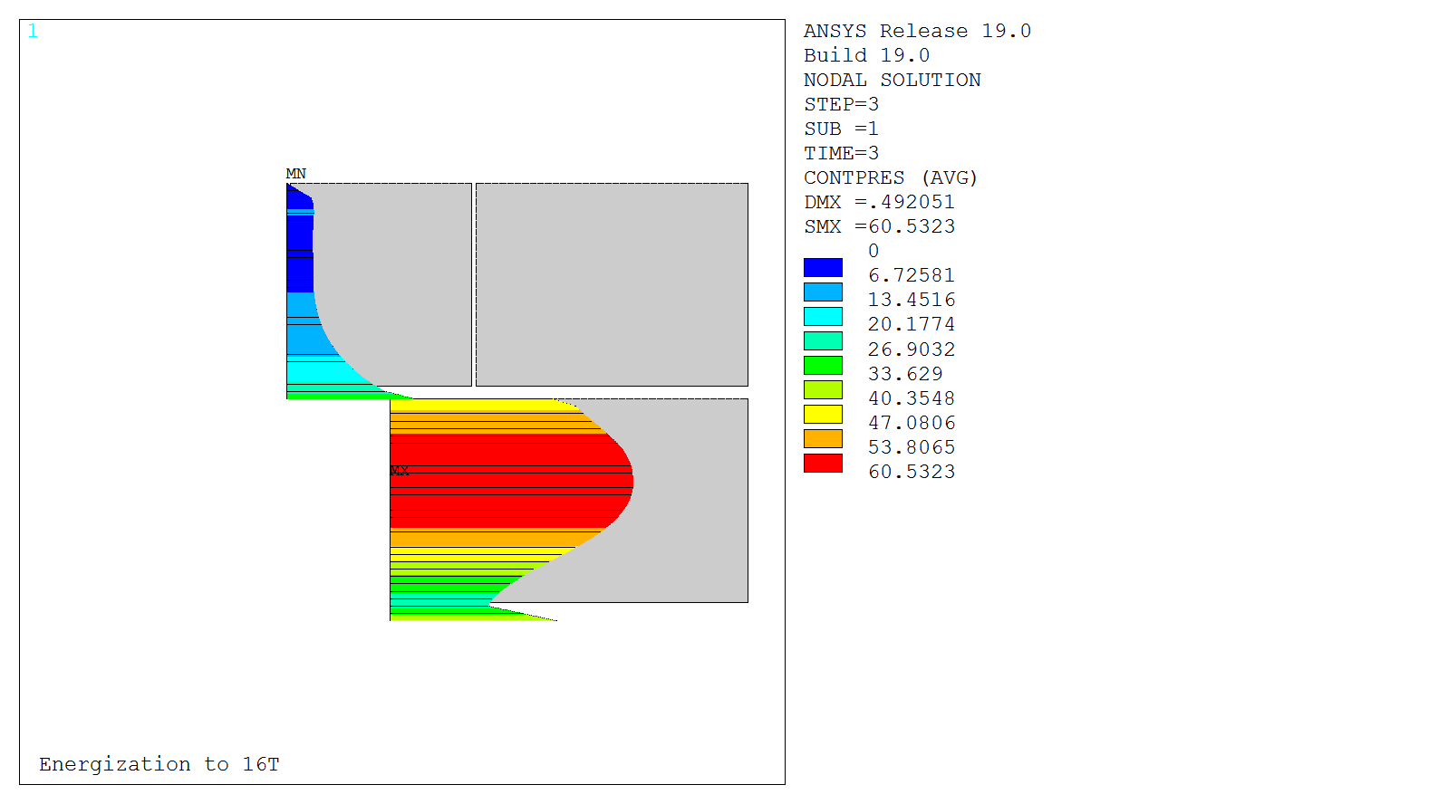
2d Mechanical Design - Finalized
144 MPa
<150 MPa
σ Von Mises
89 MPa
<150 MPa
197 MPa
<200 MPa
0.6 mm interference
1.9 K
10.3 kA, 15.5 T
Post-Coil
Contact pressure
6 MPa
Provide coil-pole contact during nominal operation
Keep peak stress below (reversible) degradation limits
V4.8.14a

Slide 5
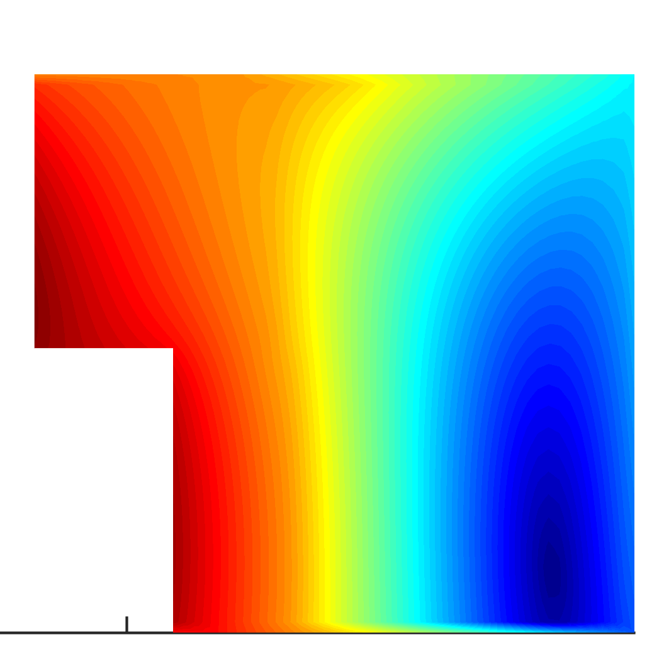
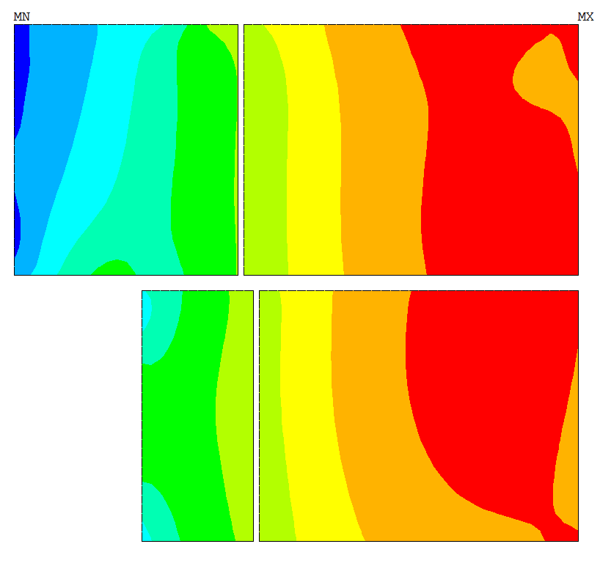
2d Magneto-Mechanical Design - Finalized
Field map B(x,y)
Stress map
S(x,y)
I_{SS limit}
= I_{c}(B_{max})
Traditional approach
S_{limit}
= 150 MPa

Slide 6
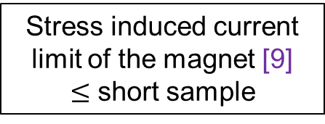
2d Magneto-Mechanical Design - Finalized
Field map B(x,y)
Stress map
S(x,y)
I_{c}(B,S) for a cable [8]
Map of I_{c} reduction I_{c}(x,y)
I_{SS limit}
= I_{c}(B_{max})
S_{limit}
= 150 MPa
Trade-off on the pre-stress (interference):
Minimize I_{c} reduction
Provide sufficient pre-stress
At nominal current :
Negligible I_{c} reduction → I_{limit} = 99% I_{ss}
100 % coil in contact with the post
Stress induced current limit of the magnet [9]
$≤$ short sample
[8] See “Electro-mechanical properties of Nb3Sn conductors for application to high-field magnets”, this conference
[9] E. Rochepault et al., “Current Limits in Nb3Sn Superconducting Magnets Considering Magnetic Field and Stress”, submitted to IEEE TAS

Slide 7
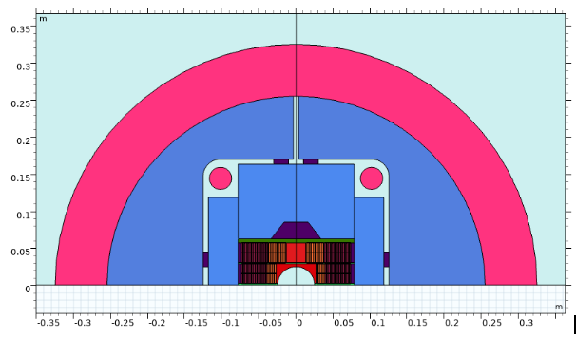
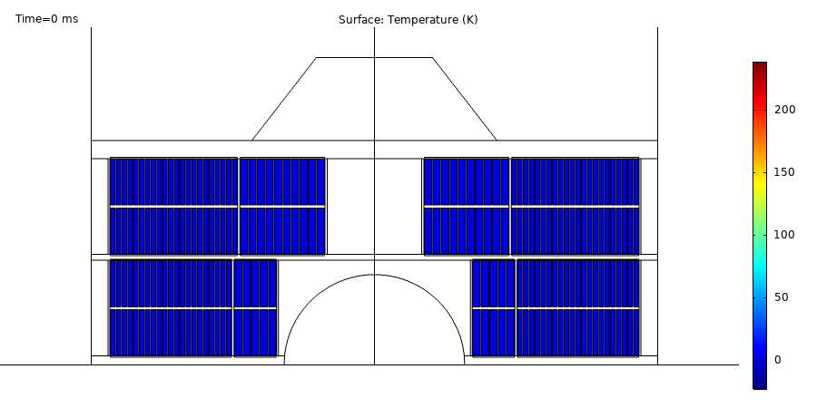
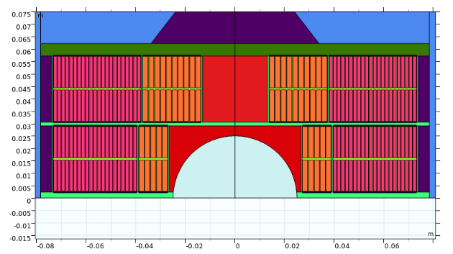
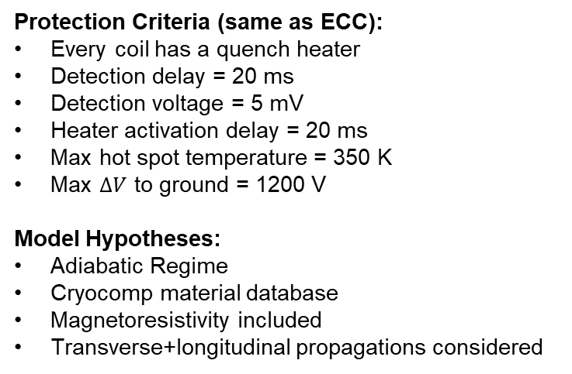
2D Quench Protection - Ongoing
Protection Criteria (same as ECC):
Every coil has a quench heater
Detection delay = 20 ms
Detection voltage = 5 mV
Heater activation delay = 20 ms
Max hot spot temperature = 350 K
Max $∆V$ to ground = 1200 V
Model Hypotheses:
Adiabatic Regime
Cryocomp material database
Magnetoresistivity included
Transverse+longitudinal propagations considered
Quench Study using Comsol
→ Magnetic, electrical, thermal models validated
Case study : QH HF1+HF3 off

Slide 8
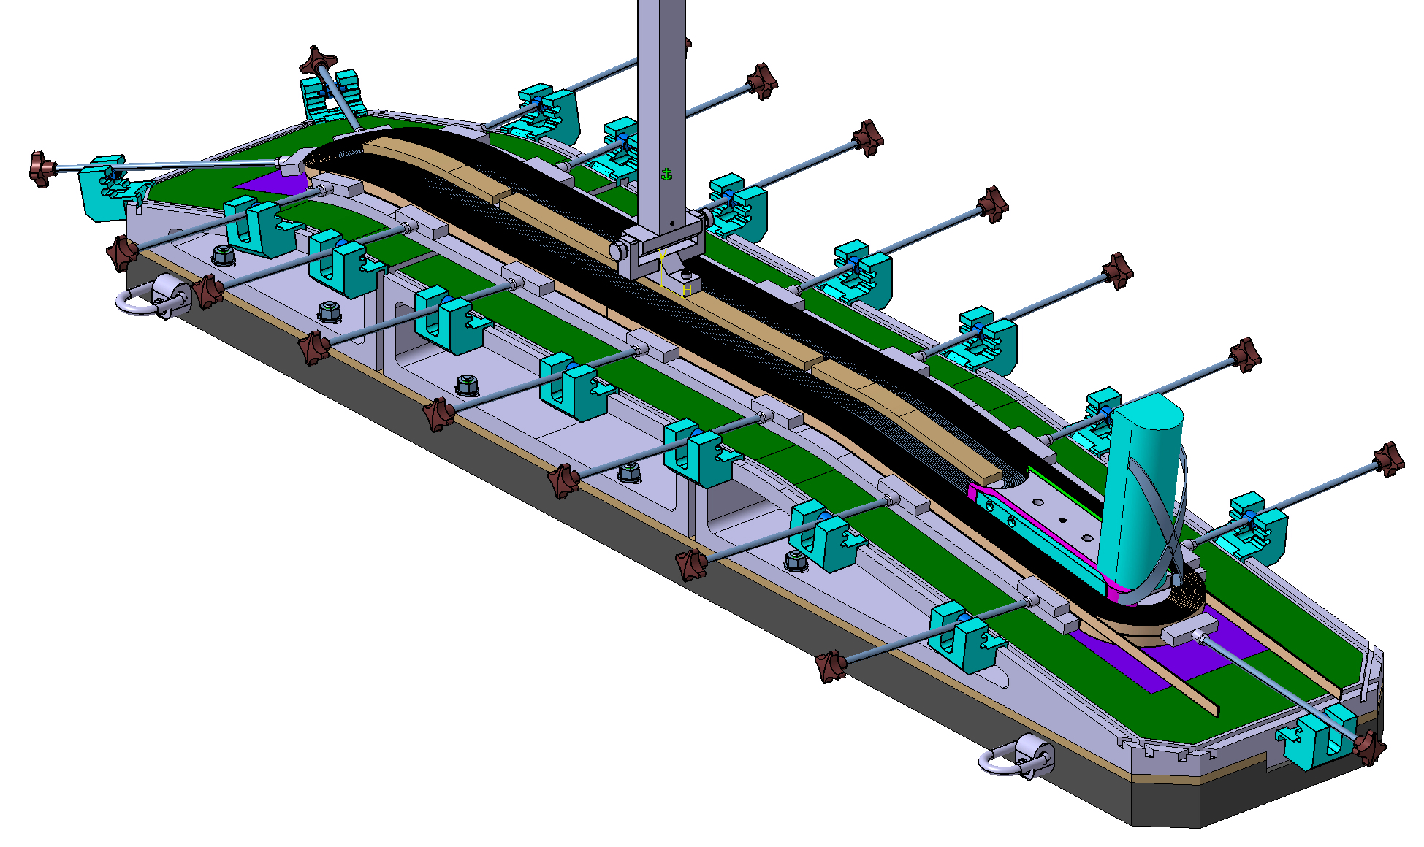
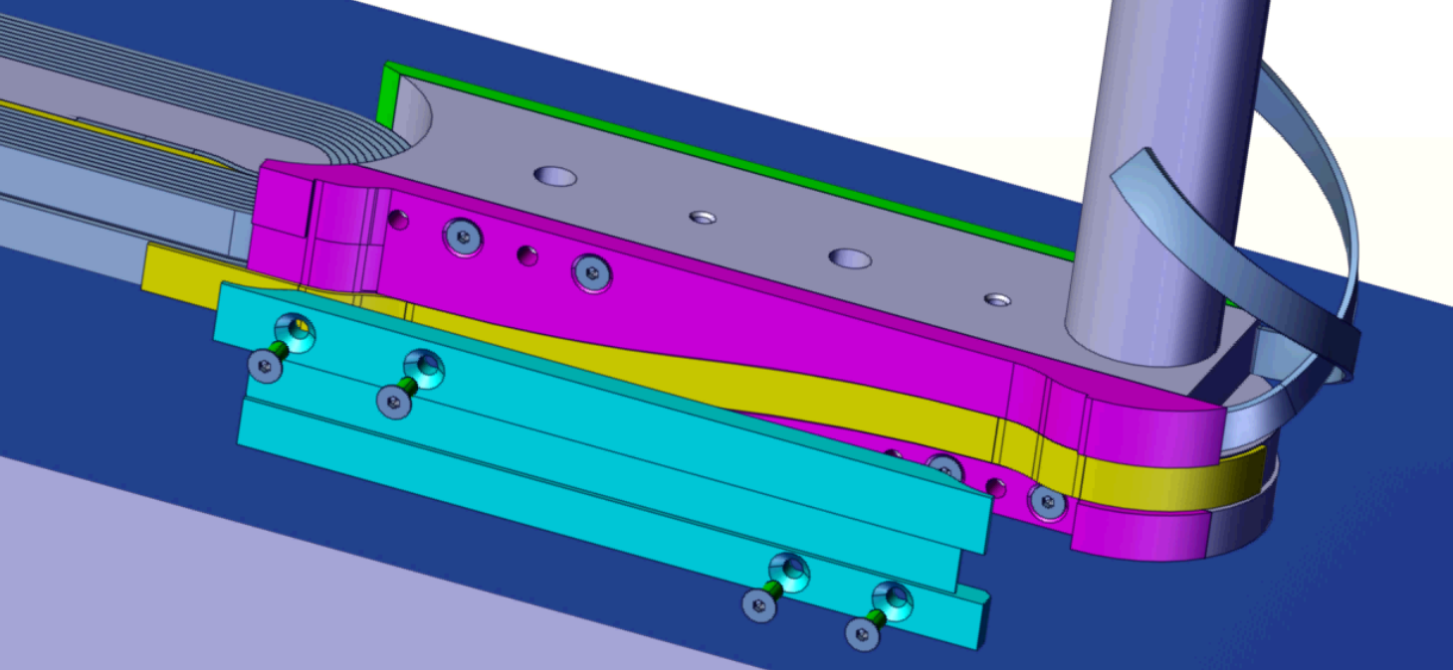
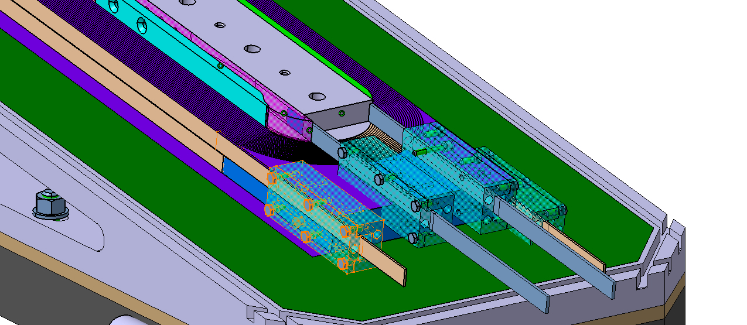
Preliminary CAD Design - Ongoing
Turn-by-turn coil model
→ External joints option
→ Define path for cable exits
3. Coil fabrication tooling
→ Winding + reaction + splicing + impregnation
→ Study compatibility with the fabrication process
Turn-by-turn coil model
→ Define paths for the leads
Winding
2. Coil components
→ Study concepts for external joints
Splicing
(external)

Slide 9
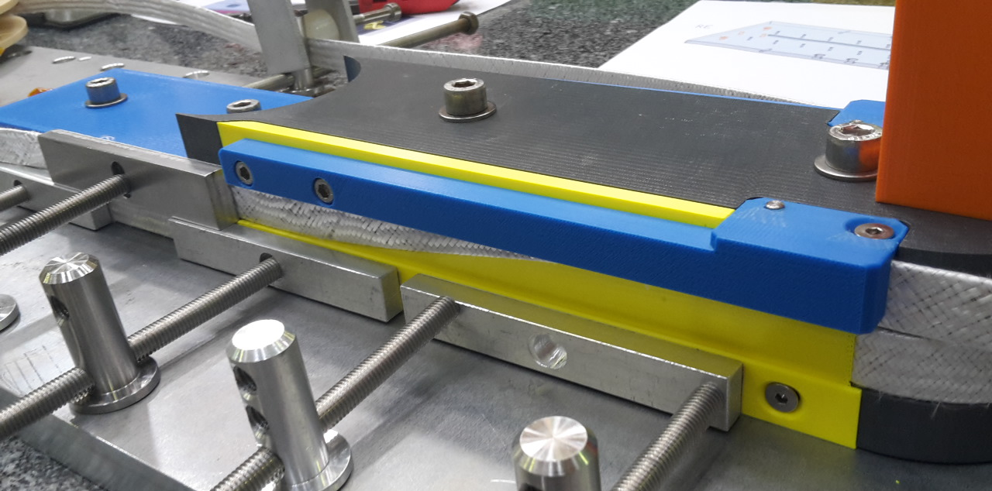
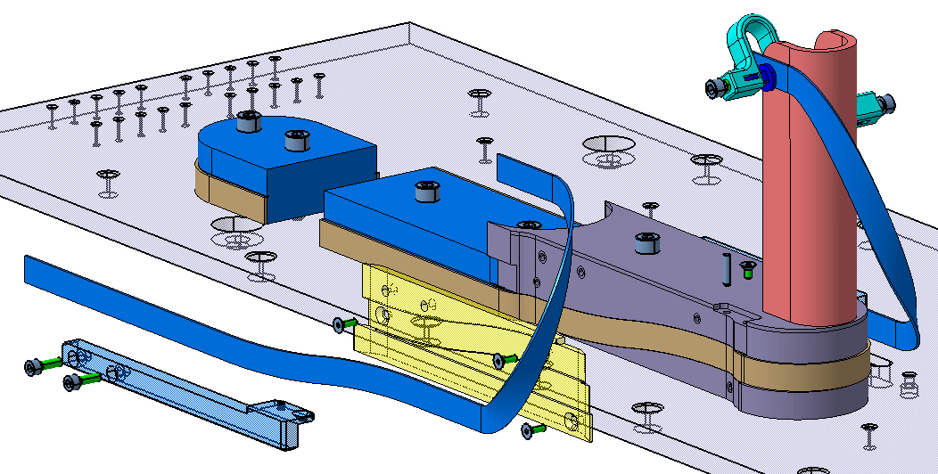
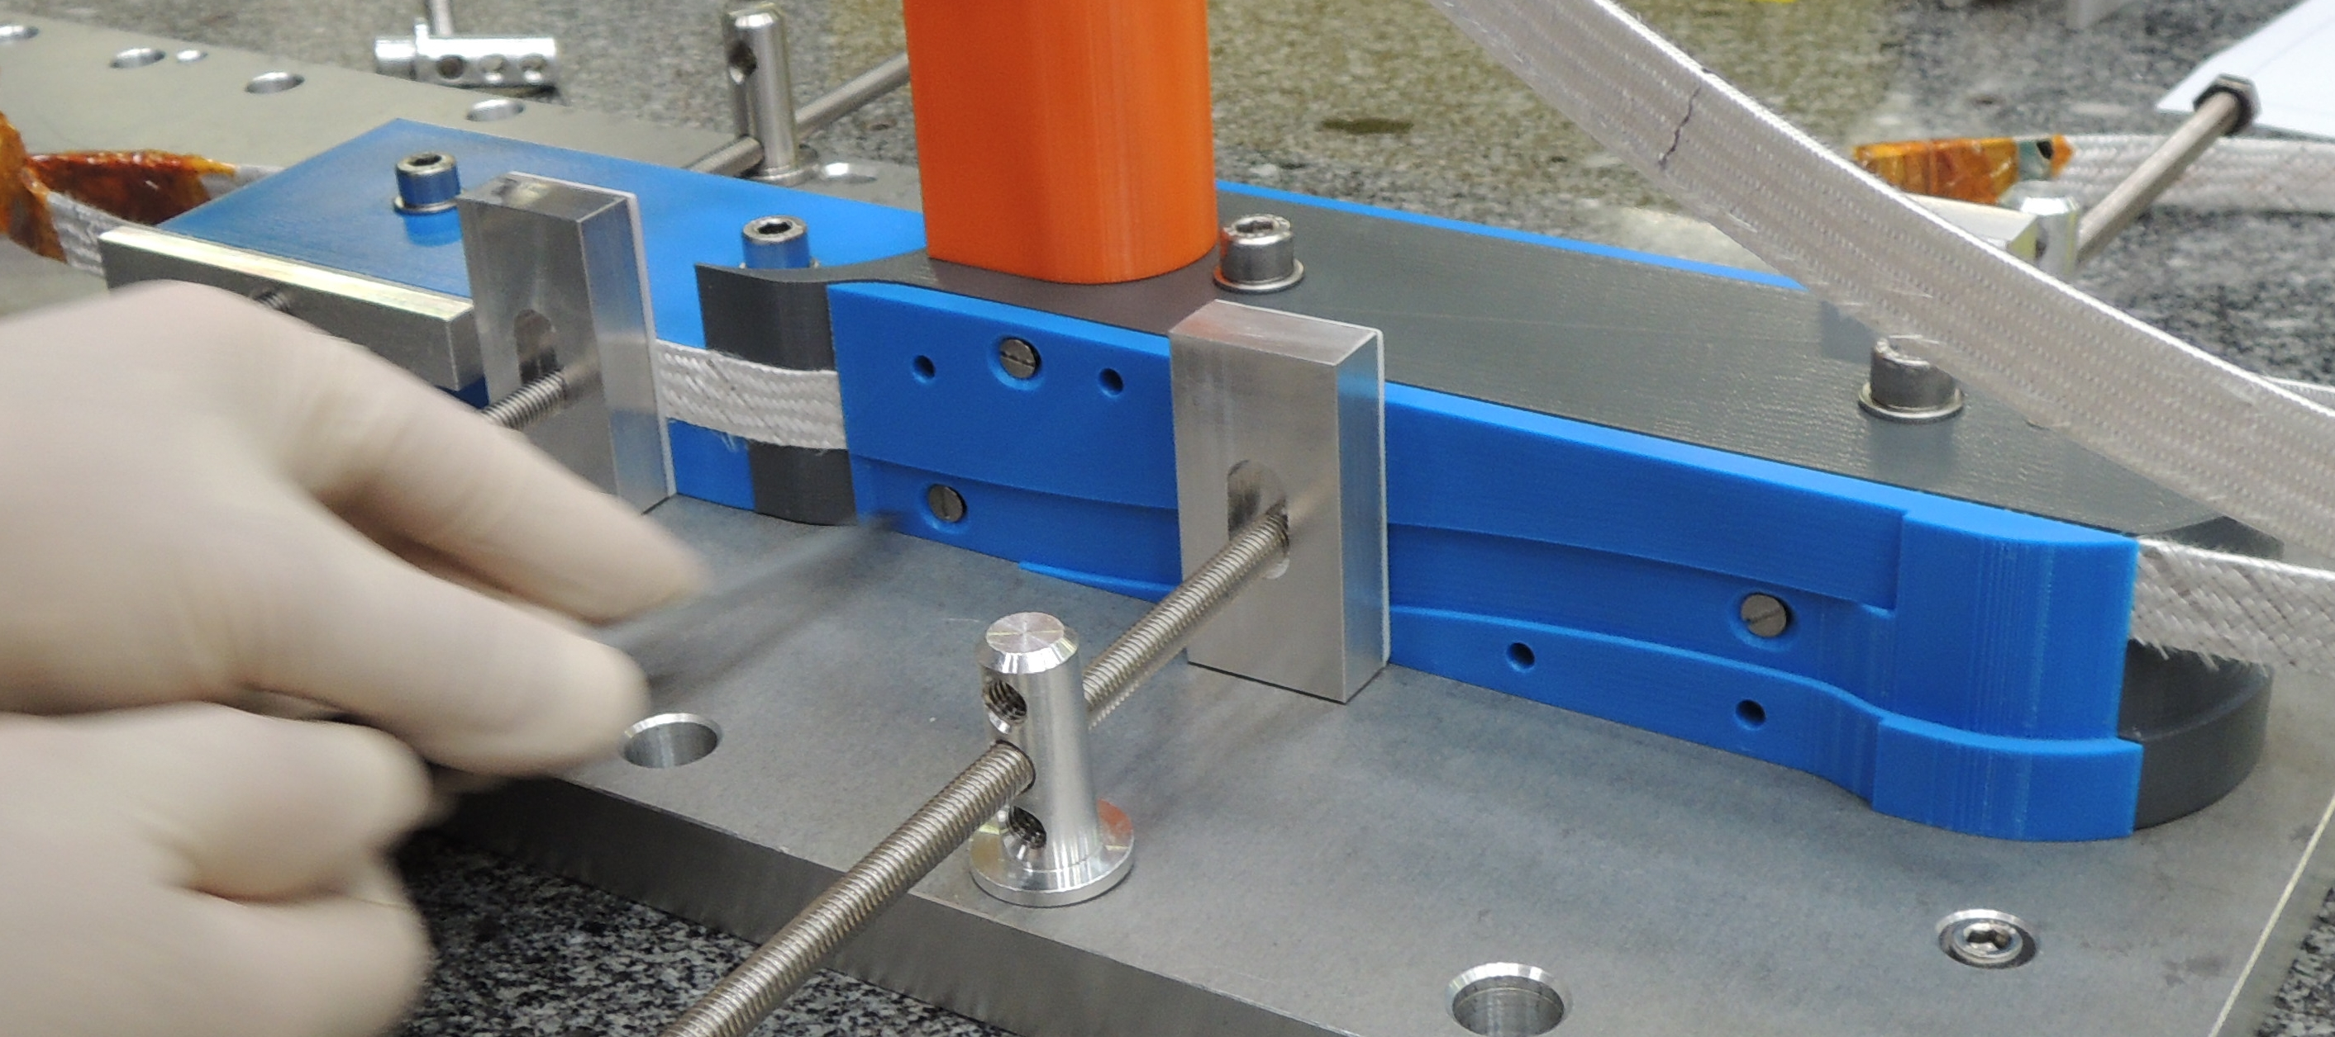
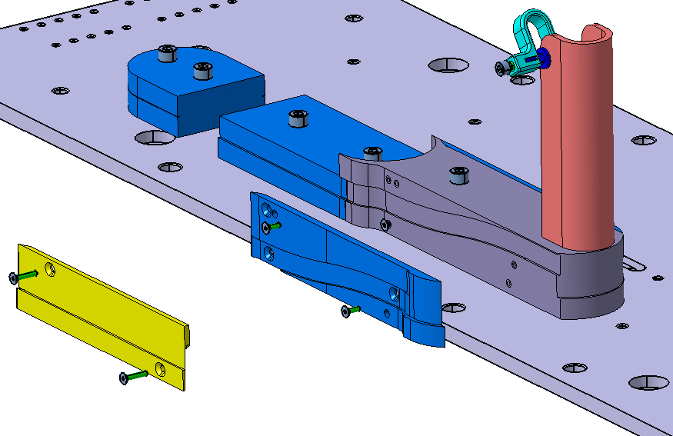
Winding Mockups - Finalized
2 options for cable exits:
Winding trials with SMC-11T cable:
A: → Hard-way only
→ 1 layer jump shim
B: → Easy-way + Hard-way
→ 2 layer jump shims

Slide 10
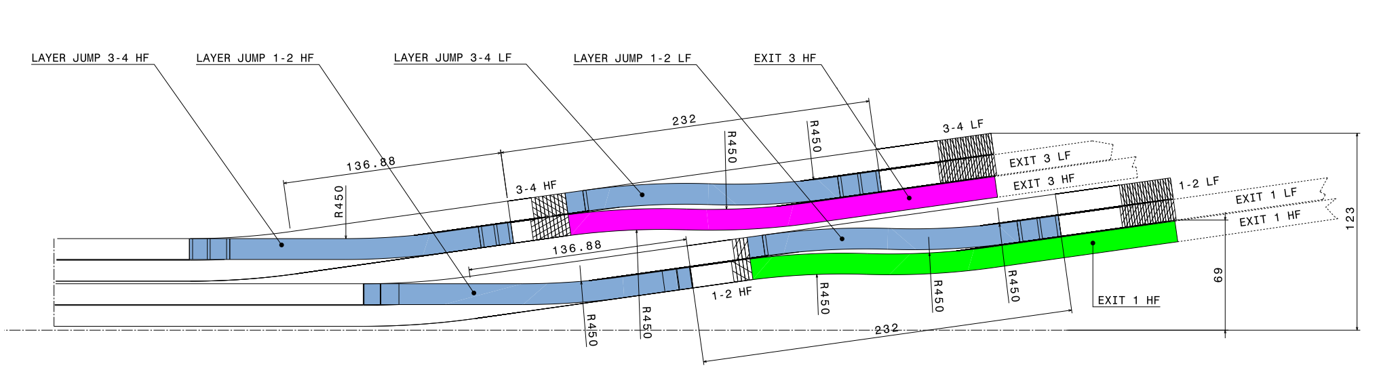
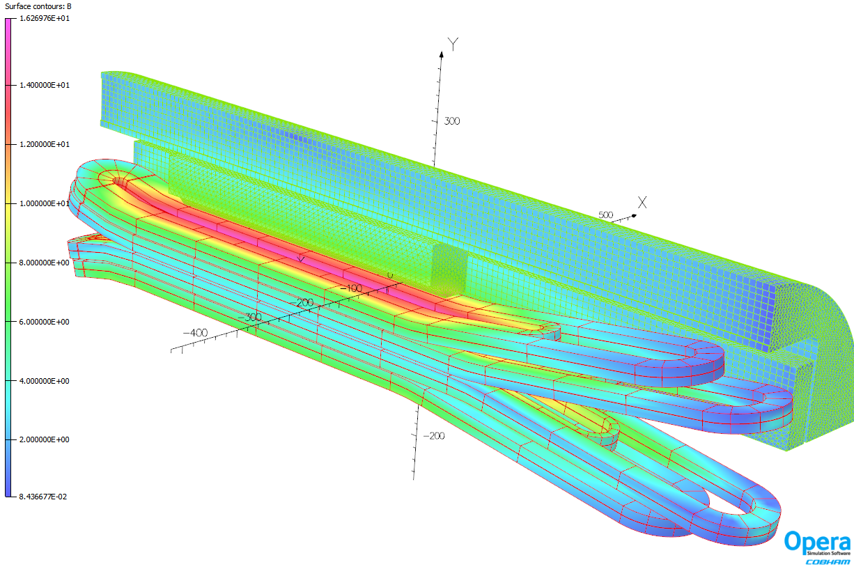
3D Magnetic design - Finalized
Preliminary CAD model of the coils
3D simplified Opera FEM:
  Central field:
    Magnetic Length = 1042 mm
    Uniform field region (±1%) = 249 mm
  Field in critical areas:
    Peak field in straight section
    Field in the layer jumps < 14 T
V4.8.14

Slide 11
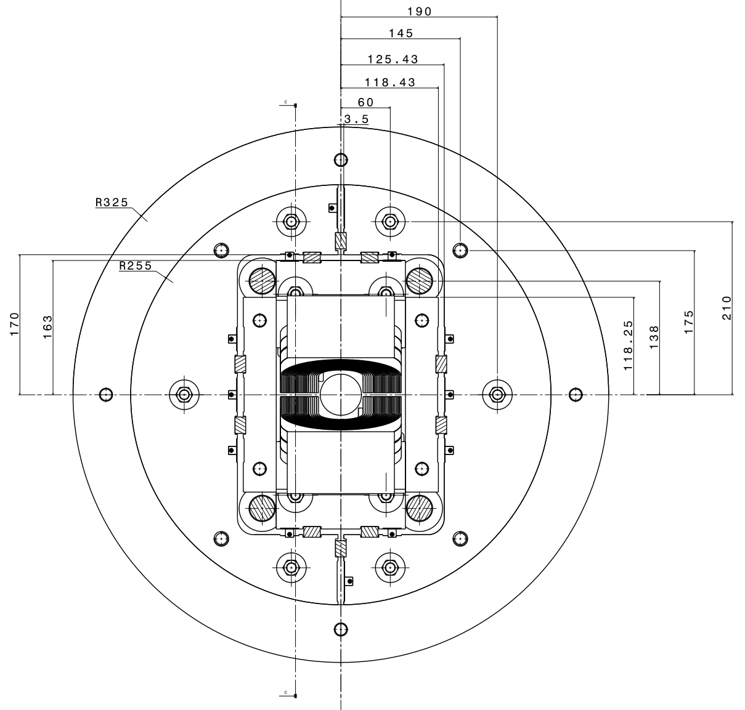
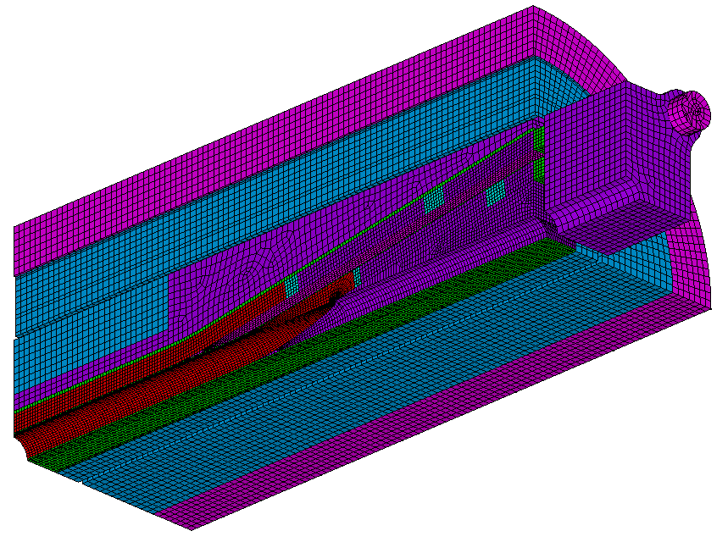
3D Mechanical Design - Ongoing
Preliminary CAD model of the structure
3D simplified Ansys FEM:
  Optimize the transverse preload
  Stay below the stress limits:
    Coil
    Components
V4.8.15

Slide 12
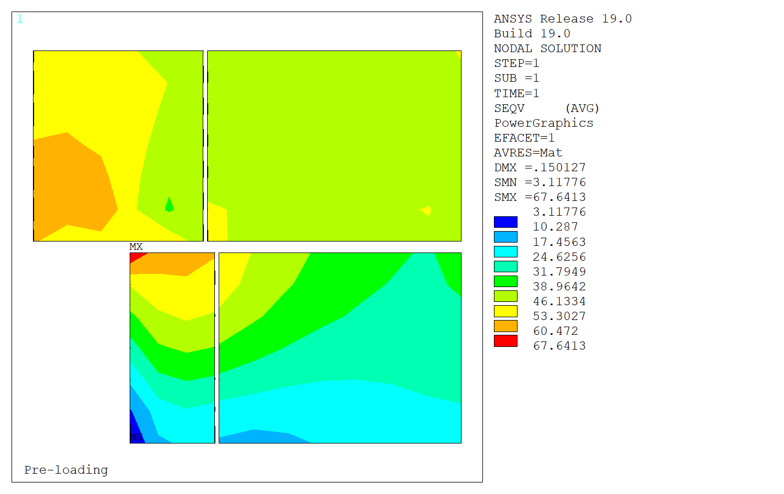
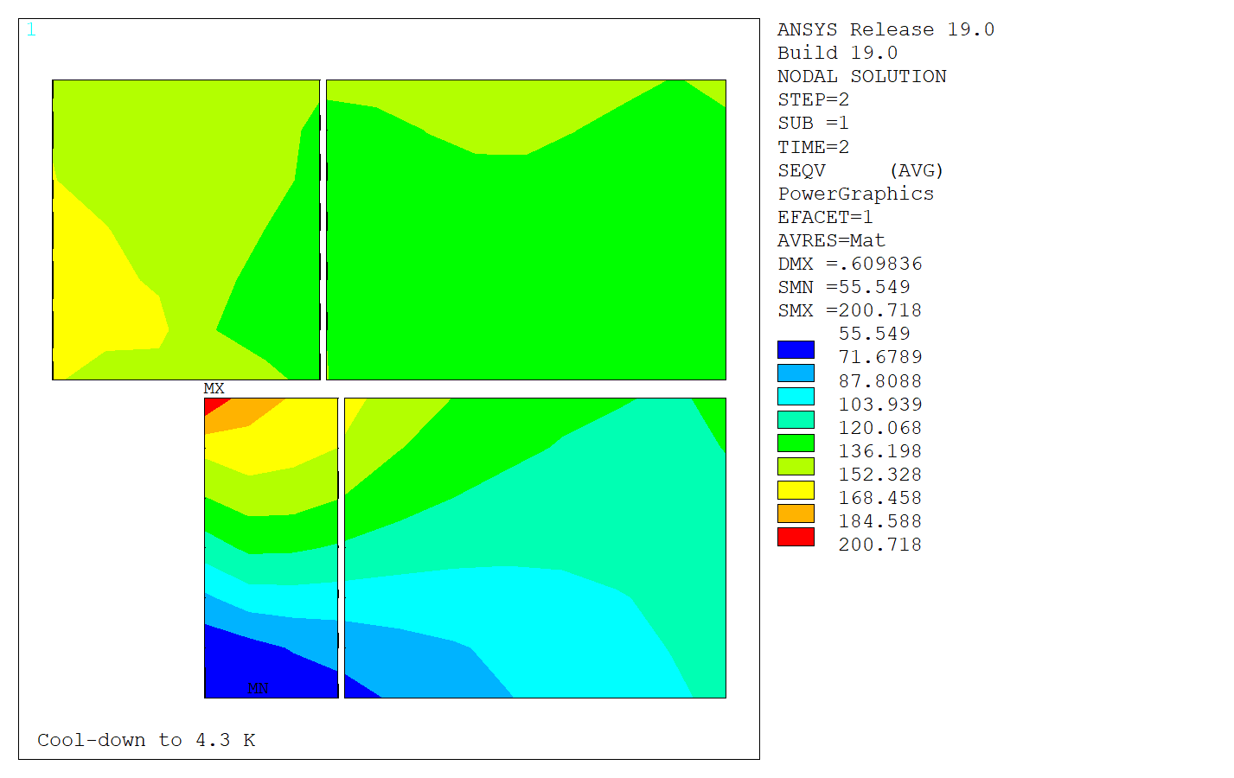
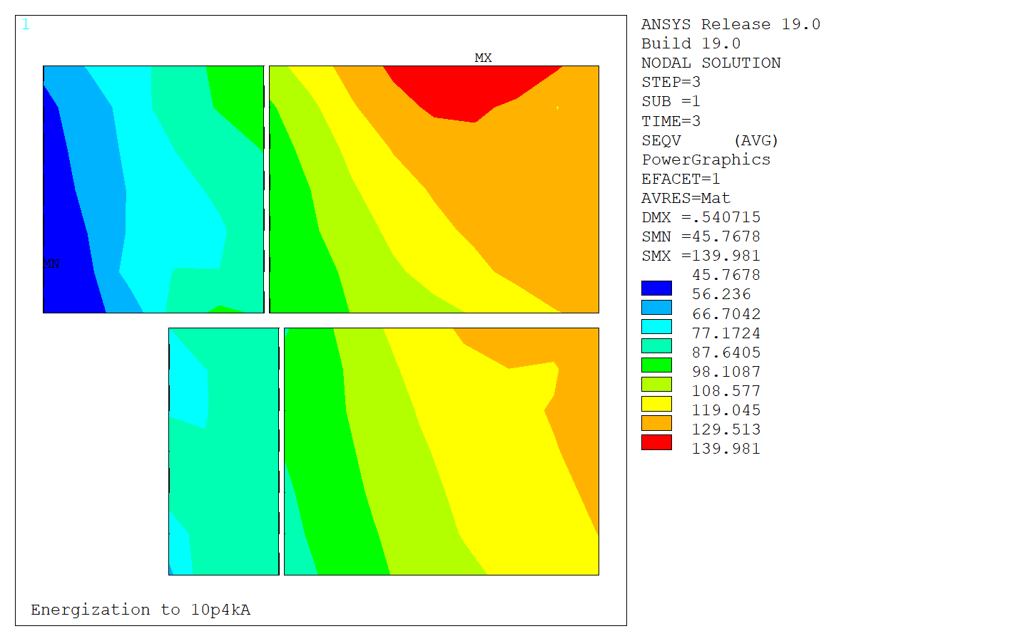
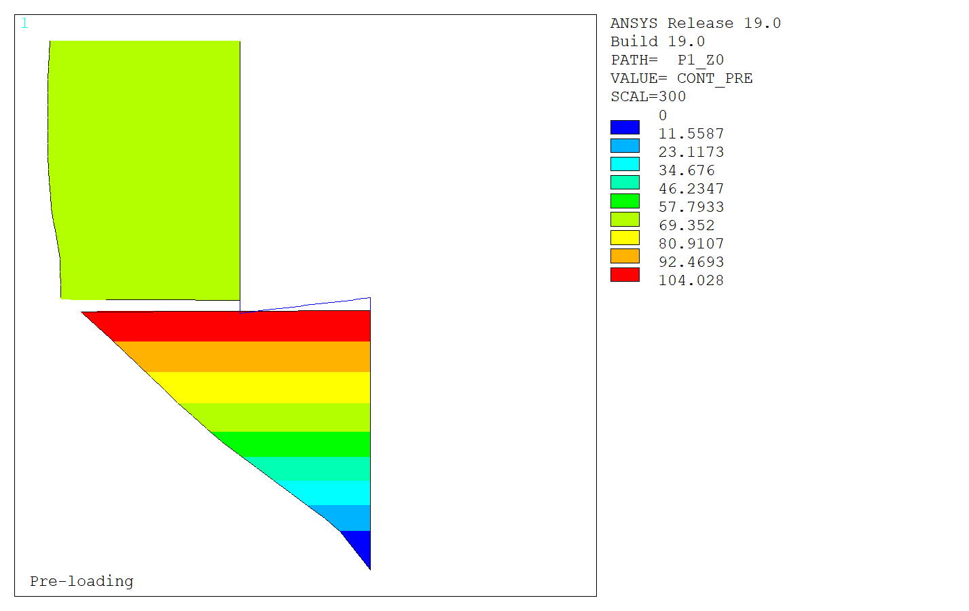
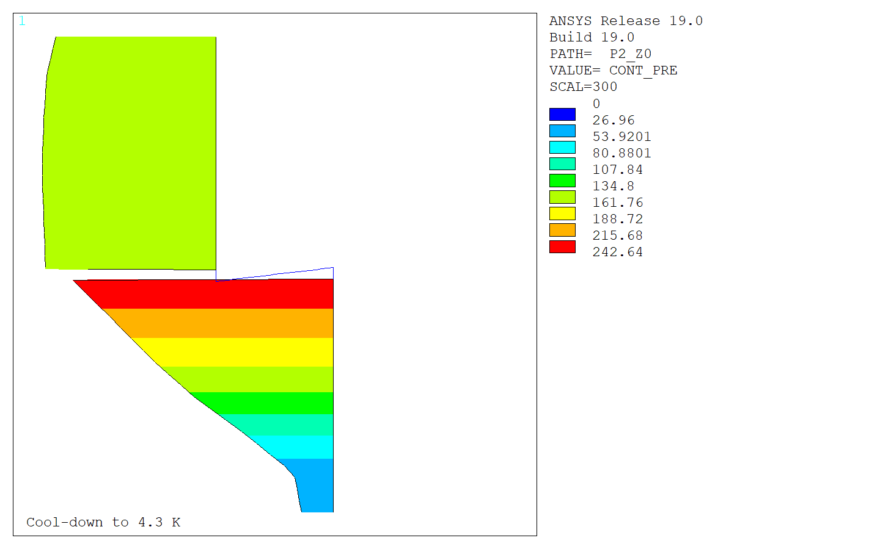
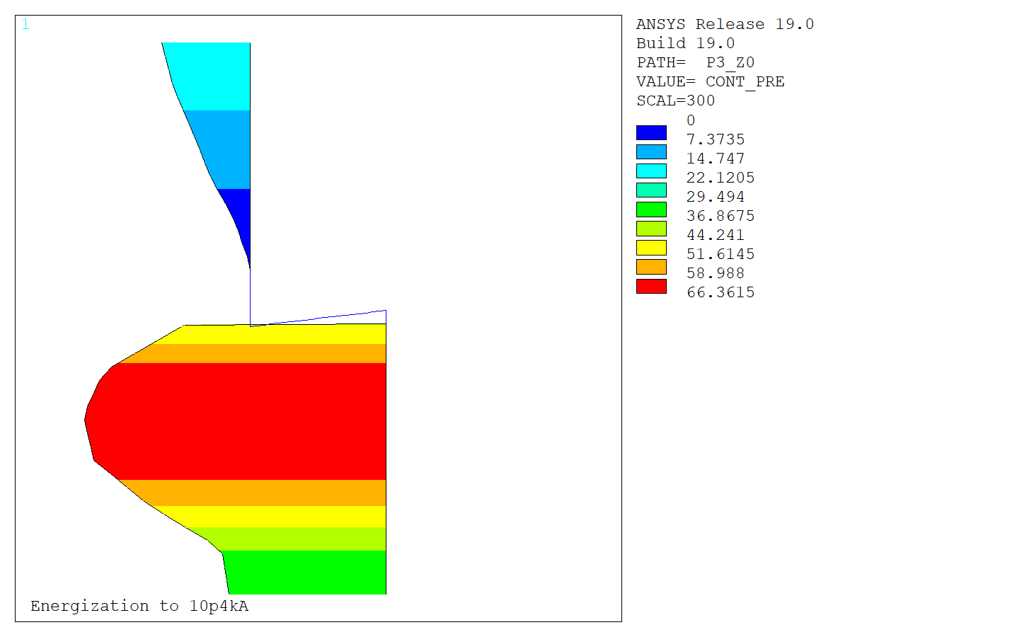
3d Mechanical Design - Ongoing
140 MPa
σ Von Mises
68 MPa
200 MPa
0.6 mm interference
1.9 K
10.3 kA, 15.5 T
0 MPa
Post-Coil
Contact pressure
Verified consistency with 2D model at z=0
Coil peak stress within targets at z=0
V4.8.15e

Slide 13
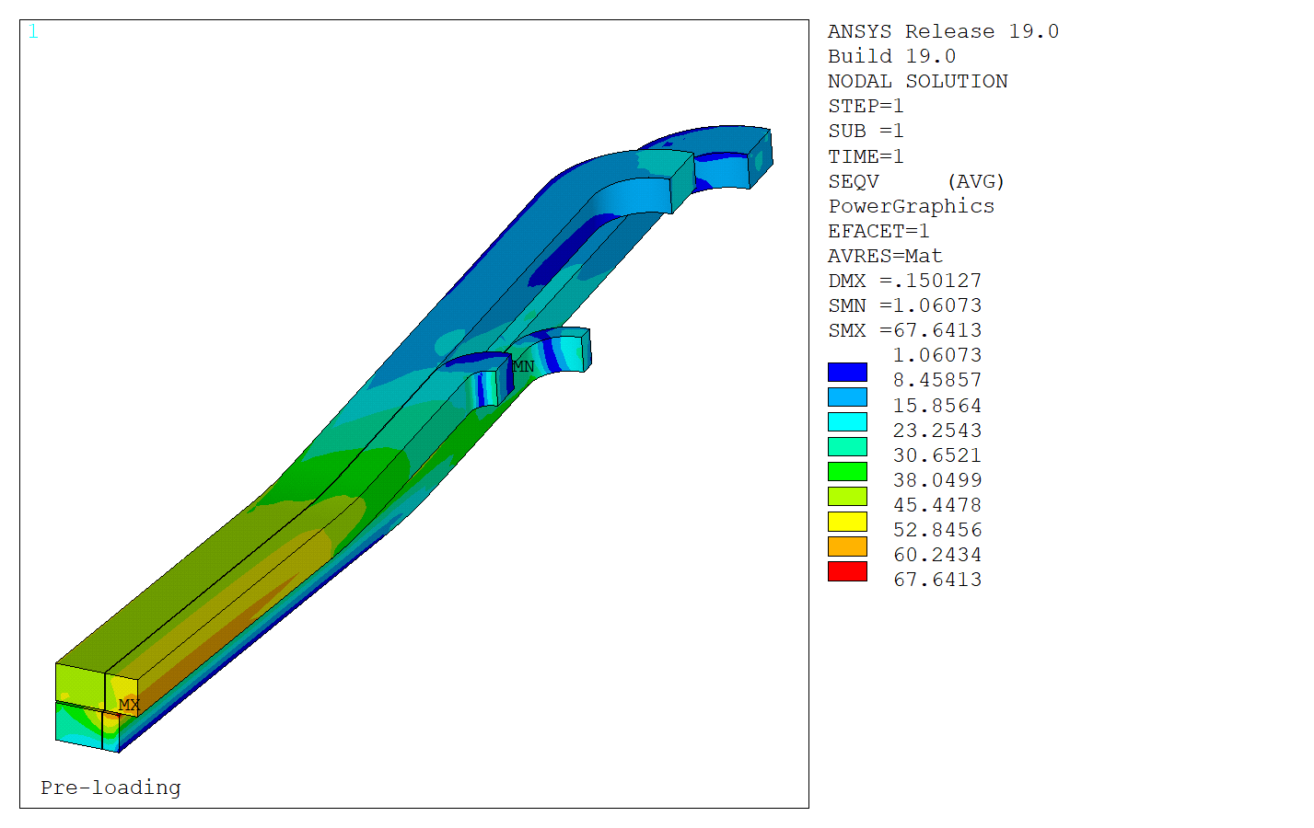
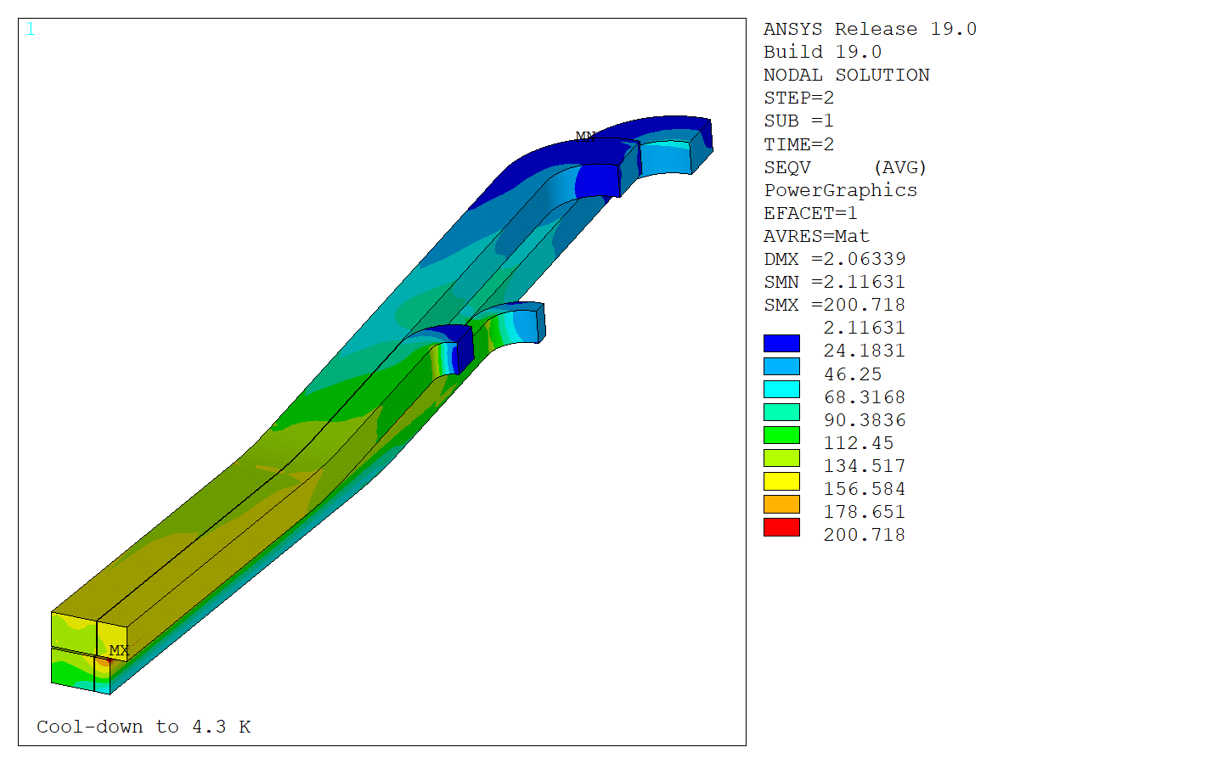
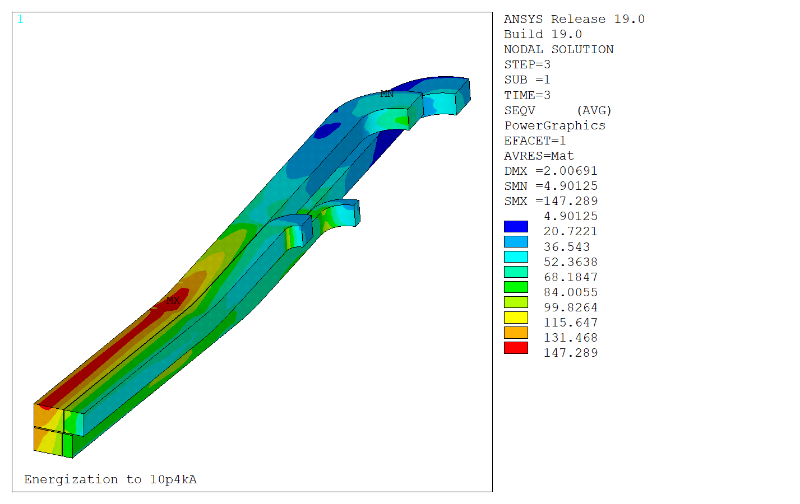
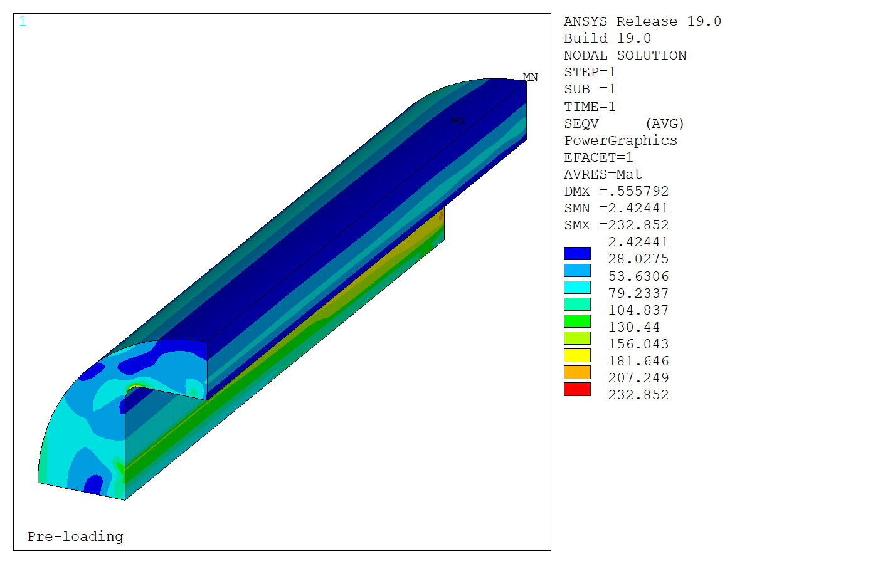
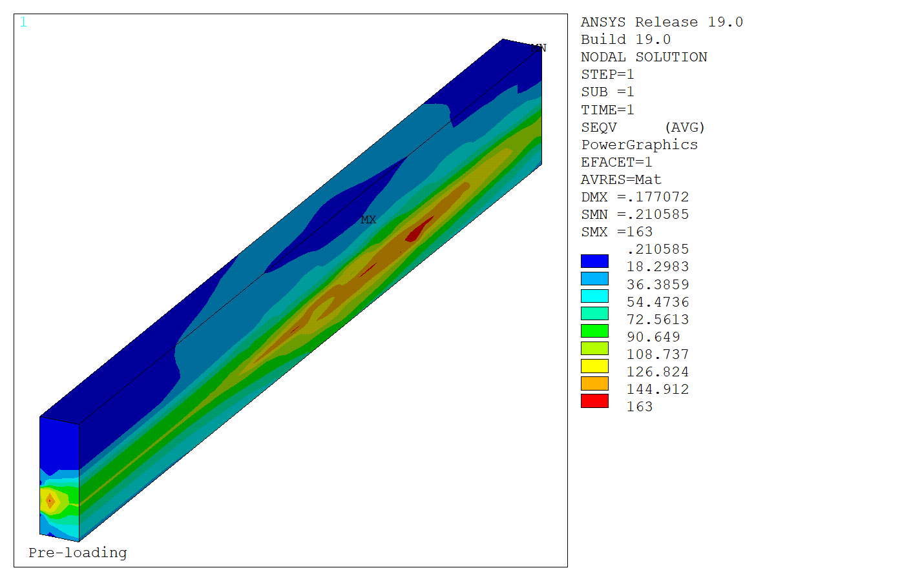
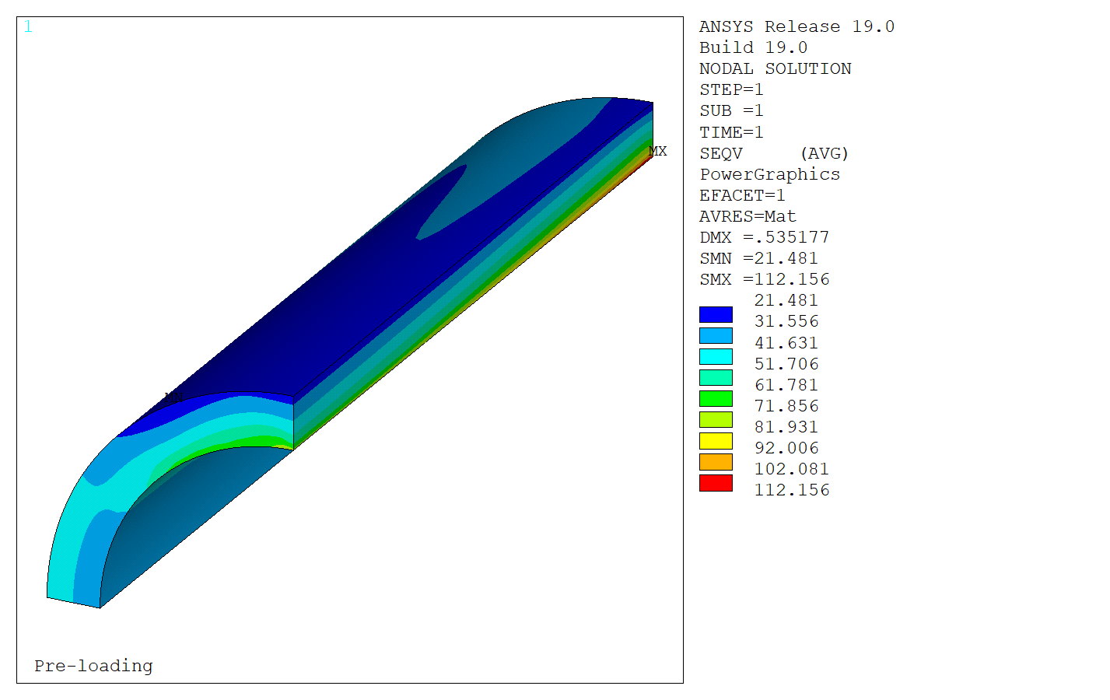
3D Mechanical Design - Ongoing
σ Von Mises
Coil
68 MPa
<150 MPa
200 MPa
~200 MPa
147 MPa
<150 MPa
233 MPa
~230 MPa
163 MPa
<200 MPa
112 MPa
<480 MPa
σ Von Mises
Yoke
X-Pad
Shell
Peak stress in coil and critical components within targets
Next step: optimize longitudinal pre-load

Slide 14
Conclusion 1/2
Goal: Demonstrate some key concepts for FCC block-coil dipoles:
    → Grading between blocks
    → Joint technology
How?
  → Relying on proven technology:
    Block-coil
    Bladders and keys structure
  Using state of the art conductors
  → Developing engineering solutions for joints
    2 proposed solutions: internal and external
    External joints selected to reduce the risks
    Room to implement internal joints
With today’s state of the art conductors:
    15.5 T achievable at 14 % margin
    ~18 T at short sample

Slide 15
Conclusion 2/2
Status:
  → Integrated magnetic and mechanical design:
    2D magnetic + 2D mechanical completed
    Protection ongoing
    3D magnetic completed, 3D mechanical ongoing
  → Engineering design:
    Conceptual design of the coil ends and structure finalized
    Technical solution validated with mock-ups
  → Challenging magnet!
Future plans: preserve complexity and mitigate risks
  1st stage: Proof-of-concept graded racetrack coils
      → Assembly and test in the F2D2 structure
  2nd stage: F2D2 graded flared-end coils
        → Assembly and test of the final F2D2 magnet

Slide 16
Backup Slides

Slide 17
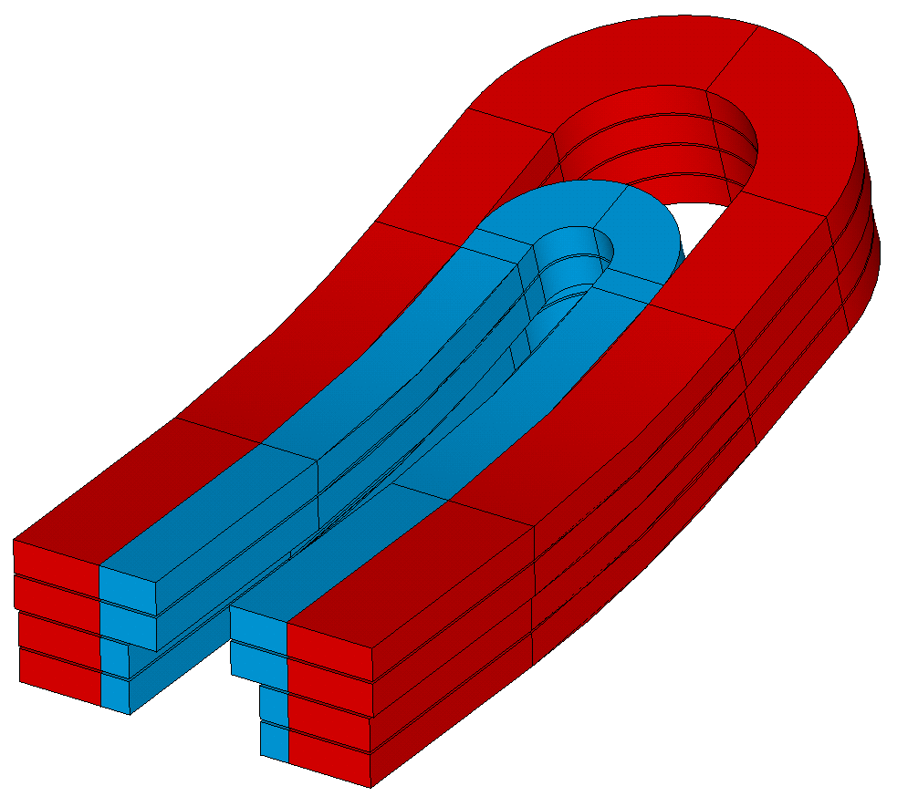
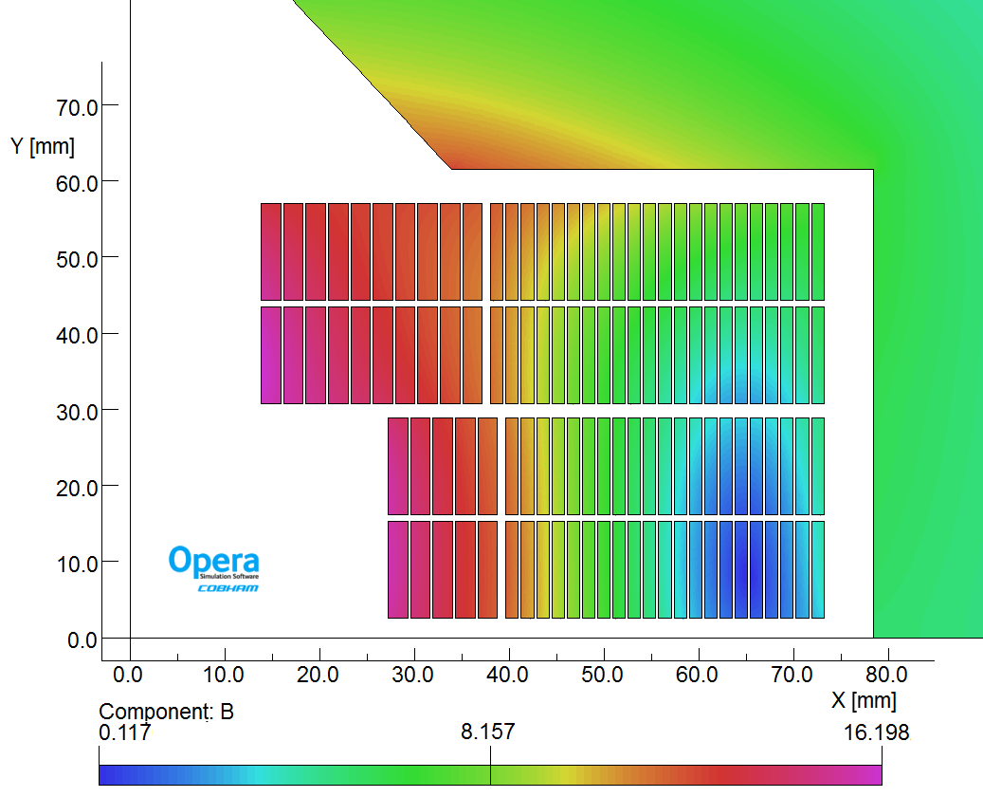


Grading concept in Block-coils
2D: “grading” needed for FCC [3]
2 cable sizes, same current
Optimizing the current density
Compact coils = less conductor
3D: need “joints” between the cable grades
Internal joints explored within EPFL-CERN Program
External joints explored at CEA
High Field “HF” blocks, low current density
Low Field “LF” blocks, high current density
LF
3D integrated design
CAD
Magnetic
Mechanical
HF

Slide 18
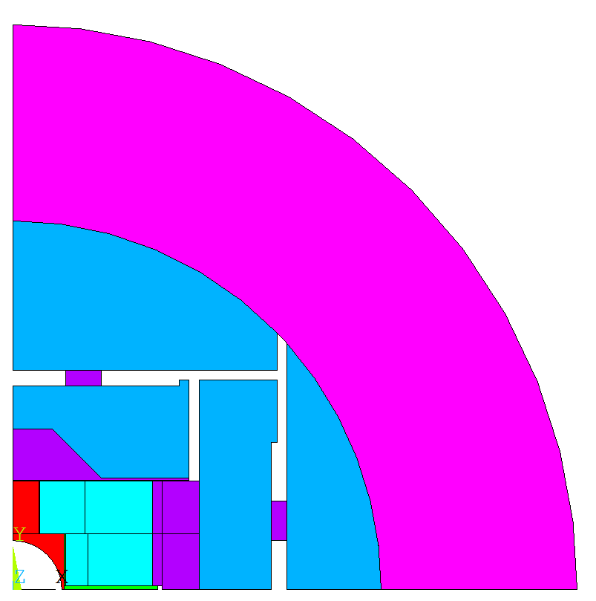
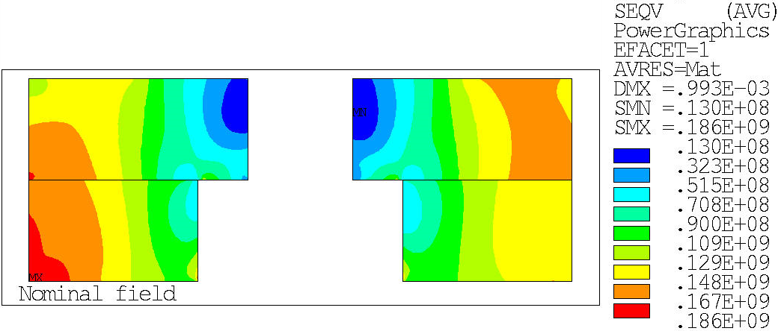
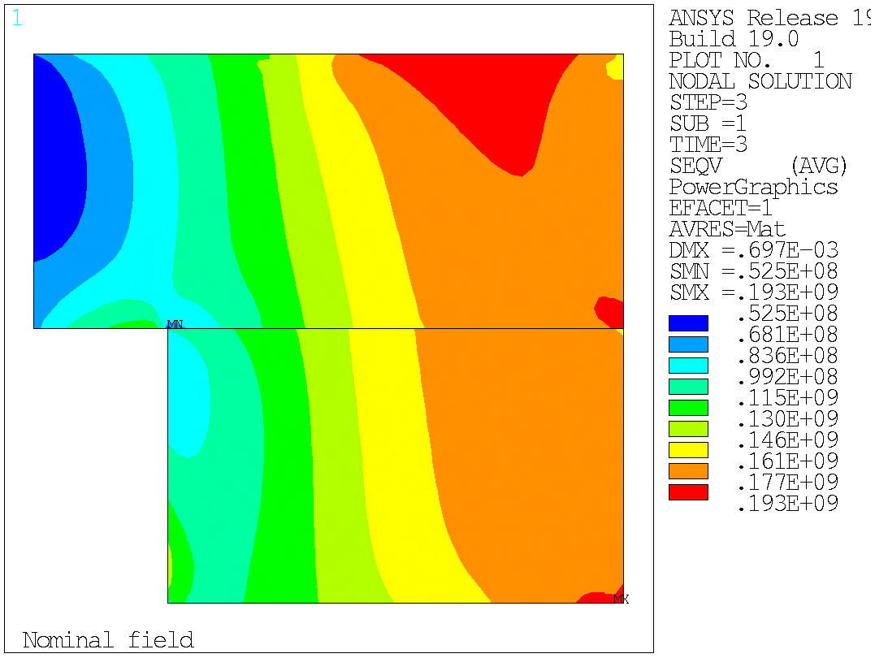
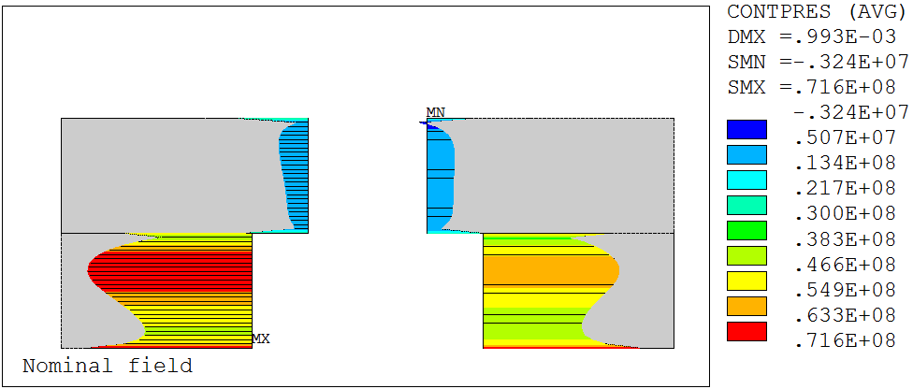
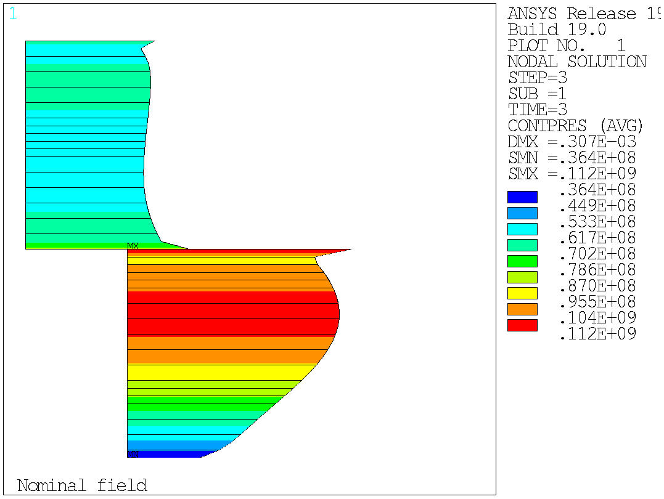
V1.1.1: from double to single aperture
ECC double aperture
Translation in a single aperture
Ø770 mm
Ø576 mm
0 mm
interbeam
97 mm
interbeam
100 mm
→ 15,8 T @ 86 %
→ 16,1 T @ 86 %
Peak stress: 186 MPa
Peak stress: 193 MPa
Min contact : -3 MPa
Min contact : 36 MPa

Slide 19
Main Design Features
Nominal Current I_{nom} | 10378 | A
Short sample current I_{ss} | 12118 | A
Bore field at I_{nom} (I_{ss}) | 15.54 (17.81 ) | T
Peak Field at I_{nom} (HF/LF) | 16.20 / 11.85 | T
Peak Field at I_{ss} (HF/LF) | 18.58 / 13.62 | T
Loadline Margin at I_{nom} (HF/LF) | 14.0 / 15.4 | %
Stored Energy I_{nom} | 1.4 | MJ/m
Rectangular Block-coils
Shell-based structure with Bladders&Keys
Conductor with present performances

Slide 20
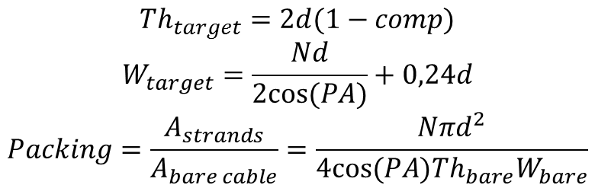
Parameter table
Parameter | Initial (Clément) V1 |  | Updated (Jerôme) |  | Proposed v4 |  | Unit
 | HF | LF | HF | LF | HF | LF
Strand diameter | 1.1 | 0.7 | 1.1 | 0.7 | 1.1 | 0.7 | mm
Number of strands | 21 | 34 | 21 | 34 | 21 | 34 | -
Unreacted width | 12.47 | 12.47 | 12.310 | 12.579 | 12.579 | 12.579 | mm
Unreacted thickness | 1.94 | 1.23 | 1.969 | 1.253 | 1.969 | 1.253 | mm
Reacted width | 12.6 | 12.6 | 12.433 | 12.705 | 12.74 | 12.74 | mm
Reacted thickness | 2.00 | 1.27 | 2.028 | 1.291 | 2.06 | 1.31 | mm
Copper/non-Copper ratio | 0.8 | 2.0 | 0.8 | 2.0 | 0.8 | 2.0 | -
Insulation thickness | 0.15 | 0.15 | 0.15 | 0.15 | 0.15 | 0.15 | mm
Bare cable compaction | 11.8 | 12.0 | 10.5 | 10.5 | 10.5 | 10.5 | %
Packing factor | 85.4 | 88.2 | 85.9 | 86.6 | 84.9 | 87.5 | %
Pitch angle | 15 | 15 | 16.5 | 16.5 | 16.5 | 16.5 | °
Transposition pitch | 93 | 93 | 83.1 | 84.9 | 84.0 | 84.0 | mm
$$Th_{target}=2d(1−comp)$$
$$W_{target}=\frac{Nd}{2cos⁡(PA)}+0,24d$$
$$Packing=\frac{A_{strands}}{A_{bare cable}}=\frac{Nπd^{2}}{4cos⁡(PA)Th_{bare}W_{bare}}$$

Slide 21
Cable Dimensions V4
Cable does not exist, baseline defined as:
  Thickness compaction after cabling: 9 to 12 % → baseline 10.5 %
  Expansion during reaction → ECC baseline: +3 % thickness / +1 % width
  Insulation → ECC baseline: 150 µm
Strategy: fixed insulated reacted cable dimensions for the CAD design
  Baseline cable with increased room for expansion
  → compensation of thicker cables
  Insulation used to compensate thinner cables
 |  | HF: 1.1mmx21 strands |  | LF: 0.7mmx34 strands
Parameter | Unit | Thick. | Width | Thick. | Width | Source
Bare Virgin | μm | 1969 | 12579 | 1253 | 12579 | Cabling formulas
Insulation thick. | μm | 150 | 150 | 150 | 150 | ECC spec
Room for expansion during reaction | % | 4.6 | 1.3 | 4.5 | 1.3 | Bare reacted/ virgin
Insulated Reacted | mm | 2.36 | 13.04 | 1.61 | 13.04 | Rounded values

Slide 22
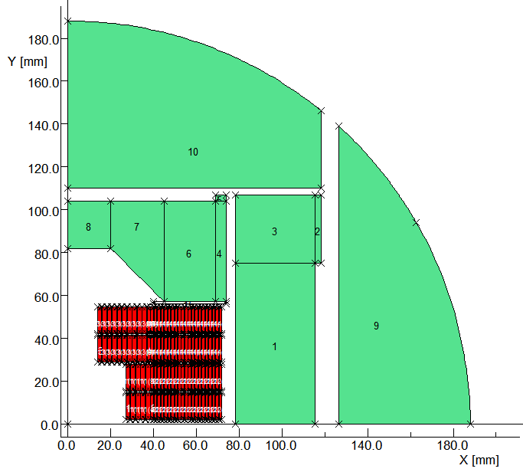
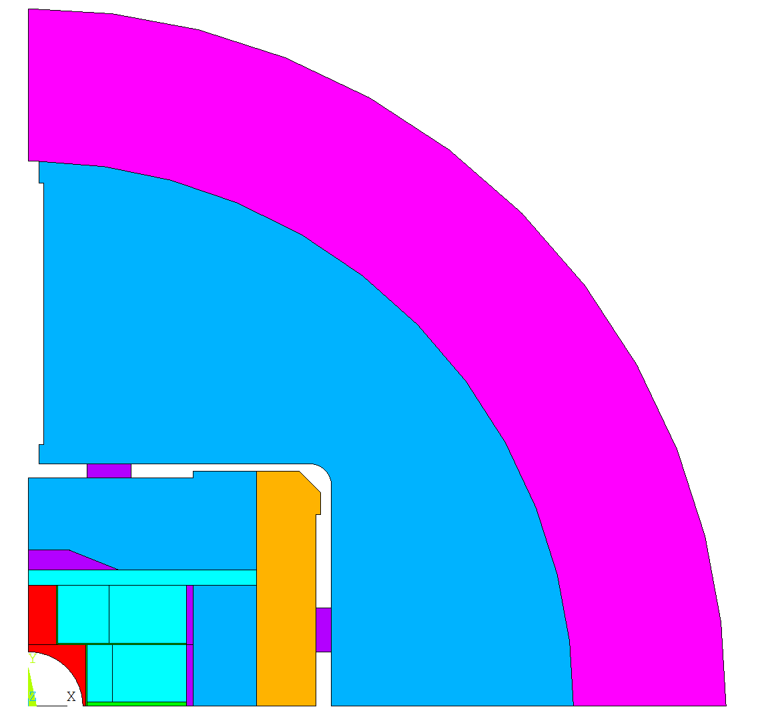

Integrated 2D Magnetic and Mechanical Optimization
V1.1.1
ECC 2017 design single aperture
V4.1.1
+ F2D2 Cable V4
V4.4.1
+ Coil position from ECC 2018
Mechanical
Magnetic
V4.4.2
Structure optimized for harmonics
Non ferromagnetic pad
Ferromagnetic filler
V4.4.n
Magnetic optimization
V4.4.3
Mechanical optimization
Geometry transfer

Slide 23

Insulated Reacted Cable for the CAD
Insulation
Bare Reacted Cable
1st margin to compensate the bare cable
Bare Virgin Cable
Uncertainty due to cabling R&D
Nominal 150 μm,
2nd possible margin
______________________
Fixed Ins. React. Th. for the CAD design
$$Ins Reacted Th=Max Bare Virg Th×\left(1+Nom Exp\right)+2×Nom Ins Th$$
$$=1.1×2×(1−9\%)×\left(1+3\%\right)+2×150=2362 μm≈2.36 mm$$
3rd margin: variable shims (insulated fiberglass)
Fixed value in the nominal drawings
Free value in the as-built drawings
POLE
SHIM
RAIL

Slide 24

Internal Vs External
 | Internal joints | External joints
Potential show-stoppers | margin at high field room for operations (placing parts, splicing) | room for support room for operations (placing parts, splicing)
Clues that it can work | Low joint resistances in FRESCA samples and for EPFL joints | Concept similar to FRESCA2 endshoes
End harmonics | Compact ends possible | Ends longer « naturally » more homogeneous
Axial loads | Behavior under Lorentz forces ? (detachment, motions…) | Impact of pre-load ? (sharp wedges, relative motion…)
Layer jumps | No LF layer jump | Need additional room for LF layer jump

Slide 25
1st Solution for F2D2: Internal Joints
Ideal solution for FCC
Concepts:
  Nb₃Sn-HF to Nb₃Sn-LF joint
  Performed in an end-spacer
Winding layout:
  HF Double-layer pancakes + layer jump
  LF single layer pancakes
LF block
HF block
Joints
Courtesy C. Lorin
Status:
  Joints under development by EPFL-SPC (See presentation “R&D on Nb₃Sn cable splices”, P. Bruzzone and Poster “Preliminary investigations of Rutherford cable splicing techniques for high field accelerator magnets”, M. Kumar)
    Several explored technical solutions
    Test on joints in Sultan
Engineering implementation in coils remains an open question
High technical risk for F2D2
High risk for the schedule

Slide 26

Alternative solution for F2D2: External Joints
Decoupling grading and joints for the demonstrator
Goal:
  Minimize risks in coil fabrication
  Each coil heat-treated and impregnated individually
  Use a known joint technique outside of the coil
CAD Geometric investigation ongoing:
  Large footprint outside of the coil
  Routing and supporting the cable
HF
blocks
LF blocks
10
22
1 coil = 1 HF double pancake
+ 1 LF double pancake
10
22
5
21
5
21
______________________
1 pole = 2 coils

Slide 27

Alternative solution for F2D2: External Joints
HF double-layer pancake with layer jump in the pole

Slide 28

Alternative solution for F2D2: External Joints
2. Routing of the HF leads in an “inter-coil wedge” → take advantage of flared ends

Slide 29

Alternative solution for F2D2: External Joints
3. LF double-layer pancake with layer jump in the end-spacer
External
joints
1 coil
4. LF leads in the end-shoe
5. Heat treatment and impregnation of the coil
6. Joints Nb3Sn-NbTi outside the coil in the inter-coil wedges

Slide 30

Alternative solution for F2D2: External Joints
7. Same concept for the other coils
1 pole

Slide 31

Alternative solution for F2D2: External Joints
8. Assembly of the coils
9. NbTi-NbTi joints to connect LF and HF leads
1 Dipole

