Slide 1


Slide 2

Energy deposition in the Betatron Cleaning Insertion of HE-LHC machine
M. Varasteh and F. Cerutti
Tracking input from BE-ABP:
M. Crouch, J. Molson, R. Bruce, A. Mereghetti
Acknowledgments: C. Bahamonde, M.I. Besana, E. Skordis, other colleagues in BMI & FLU
FUTURE CIRCULAR COLLIDER CONFERENCE 2019
Brussels, Belgium

Slide 3

Outline
Challenges for the HE-LHC collimation system
Power density on the collimators and warm magnets
Energy deposition in the cold section, IR7
Impact of the dog-leg removal
M. Varasteh

Slide 4
Parameters / challenges
 | unit | FCC-hh | HE-LHC | HL-LHC | LHC
center-of-mass energy | TeV | 100 | 27 | 14 | 14
arc dipole field | T | 16 | 16 | 8.33 | 8.33
bunch population [10¹¹] | ppb | 1 | 2.2 | 2.2 | 1.15
number of bunches |  | 10600 | 2808 | 2760 | 2808
stored beam energy | GJ | 8.4 | 1.4 | 0.7 | 0.36
total power loss for 12 min BLT | MW | 11.8 | 1.9 | 0.95 | 0.5
Main challenge is due to the restrictions caused by the geometry of the existing Tunnel
As the first stage, the same collimation design as LHC machine is used
Vertical halo scenario was studied
Considering high loss scenario of 0.2h beam life time (BLT)
M. Varasteh
FCC Conference 2019 - BRUSSELS, BELGIUM
25/06/2019
4

Slide 5
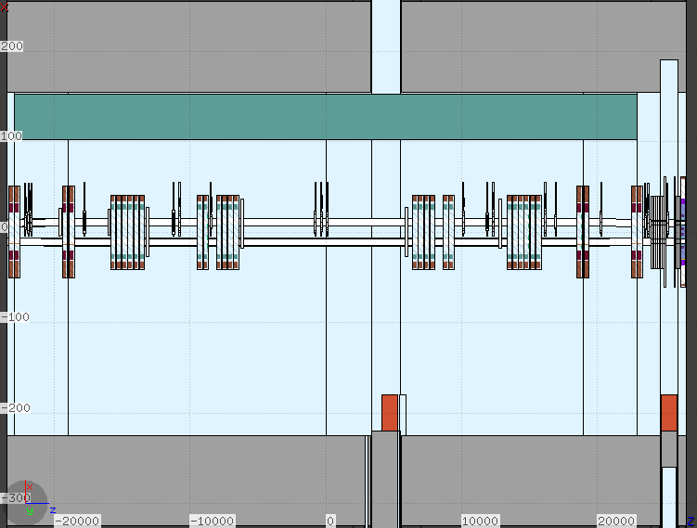
HE-LHC IR7, warm section
8 warm dipoles (MBW)
24 warm quadrupoles (MQW)
Beam-Beam separation (bbs):
  204 mm in the arc
  (194 mm for LHC)
  224 mm within the doglegs
  (same as LHC)
3 Passive absorbers (TCAP)
(1 m, 20 cm, 60 cm)
MBWs
TCPs
TCAP
TCSG
MQWs
MCBW
TCLA
MQTLs
MCBC
MQ7
 | HE-LHC | LHC | Comments
MBW | 3.4 m | 3.4 m | different return coils
MQW | 3.5 m | 3.1 m | different length
Collimators |  |  | the same
MQTLH/I | 1.3 m | 1.3 m | different bbs, beam screen, material
MCBCH/V | 0.9 m | 0.9 m | different bbs, beam screen, material
MQ7 | 3.5 m | 3.1 m | different length, material
Collimators | Length (cm) | Aperture (σ) | Material | Number
Primary | 60 | 6.7 | CFC | 3
Secondary | 100 | 9.1 | CFC | 11
Active absorbers | 100 | 11.5 | tungsten | 5
about 30 m longer w.r.t. LHC
M. Varasteh

Slide 6
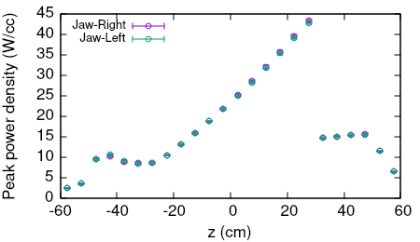
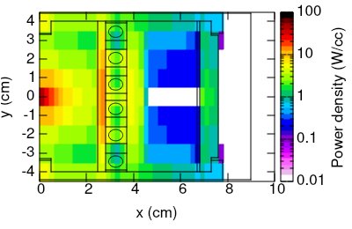
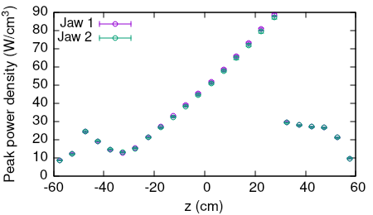
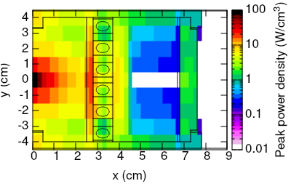
Horizontal and Skew primary collimators
Horizontal;
Skew;
Total power (kW)
Vertical | 3.7
Horizontal | 29.5
Skew | 53.1
most loaded primary collimator
x-y-z resolution: 0.2cm, 1cm, and 5cm
M. Varasteh

Slide 7
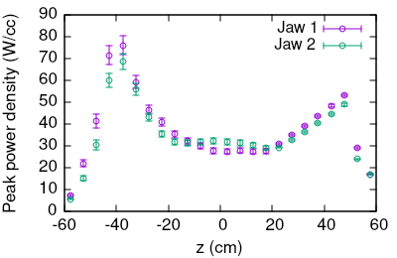
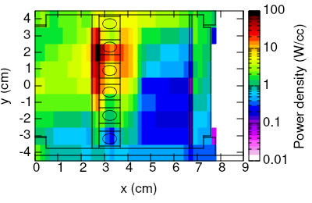
Secondary collimators
most loaded secondary collimator (1st TCSG)
Total power (kW)
Secondary Collimators
TCSG.A6L | 56.1
TCSG.B5L | 12.6
TCSG.A5L | 37.3
TCSG.D4L | 6.9
TCSG.B4L | 3.7
TCSG.A4L | 4.9
TCSG.A4R | 5.3
TCSG.B5R | 0.5
TCSG.D5R | 1.2
TCSG.E5R | 1.9
TCSG.6R | 0.2
jaw
For LHC at 6.5TeV, the max load is about 15 kW
the maximum is on the metallic support! New design with thicker jaws is mandatory…
x-y-z resolution: 0.2cm, 1cm, and 10cm
M. Varasteh

Slide 8
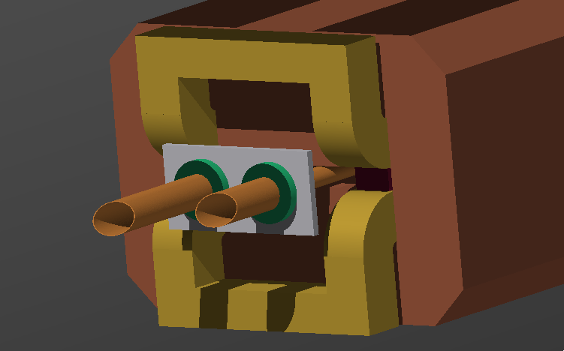
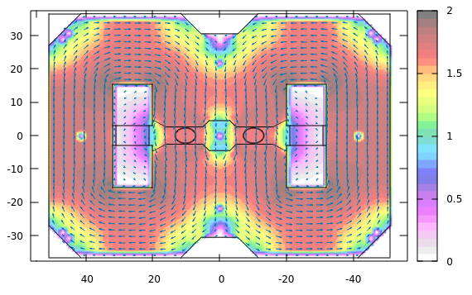
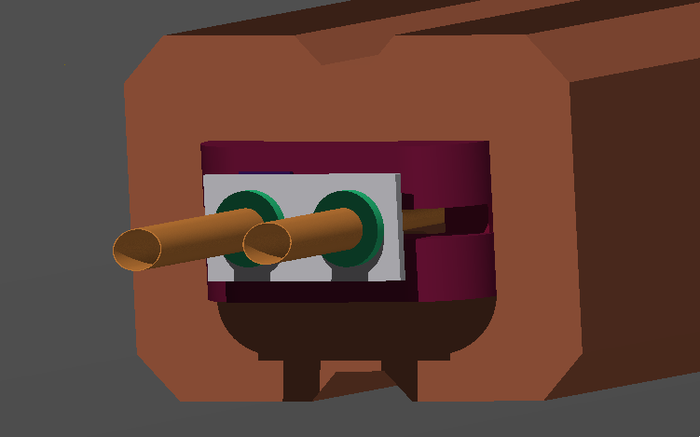
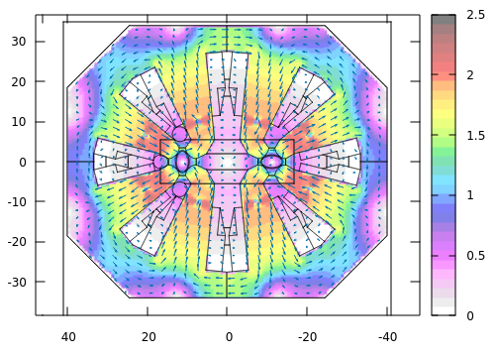
Warm dipole’s return coil (MBW)
HE-LHC
Magnetic field map in FLUKA simulation
(MBW)
Y (cm)
Magnetic field (T)
X (cm)
LHC
(MQW)
Y (cm)
Magnetic field (T)
X (cm)
M. Varasteh

Slide 9
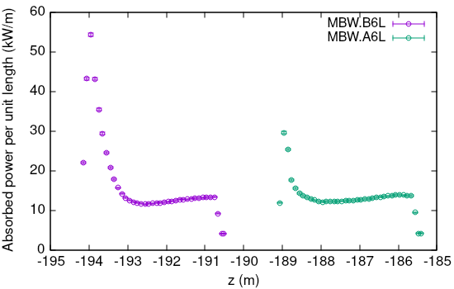
Warm dipoles
Total power (kW) over warm dipoles
MBW.B6L | 66.36
MBW.A6L | 53.57
Two MBWs downstream the TCPs take more than 99% of the total power on the warm dipoles!
at LHC the maximum is about 22 kW
Maximum power per unit length → 55 kW/m
(bulk is below 14 kW/m)
M. Varasteh

Slide 10
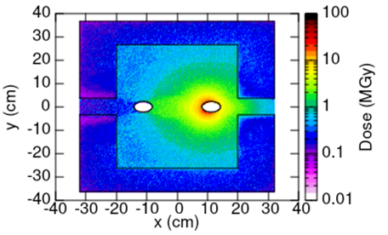
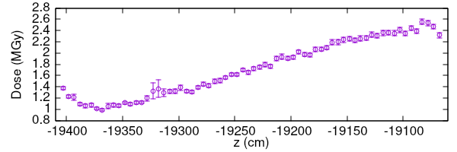
Coils in the most loaded warm dipole
MBW.B6L’s front face
moving away from the beam pipe, a factor of 10 less dose on the return coil…
Dose along the coil (per year)
In total, the coil insulator can stand about 30 MGy
**considering 1e16 proton lost per year**
0.25cm, 0.25cm, 5cm (x-y-z resolution)
M. Varasteh

Slide 11
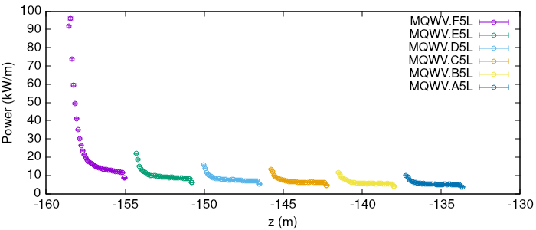
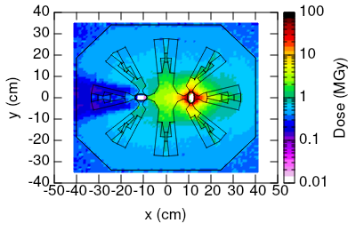
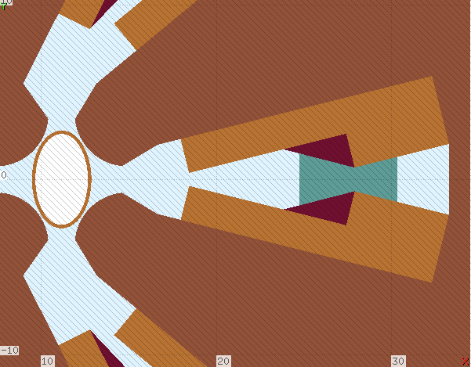
Warm quadrupoles (MQWs)
Total power (kW)
MQWVF5L | 95.1
MQWVE5L | 39.0
MQWVD5L | 31.1
MQWVC5L | 26.8
MQWVB5L | 23.5
MQWVA5L | 21.1
On the coils
≈ 4 MGy
Material dose limits is 50 MGy for the coils and 10 MGy for the spacers!
*At LHC, internal shield is used
M. Varasteh

Slide 12
Power fraction on different elements at IR7
HE-LHC @ 13.5 TeV
LHC @ 7 TeV
M. Varasteh

Slide 13
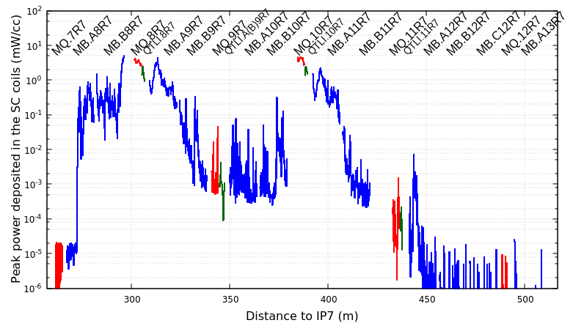
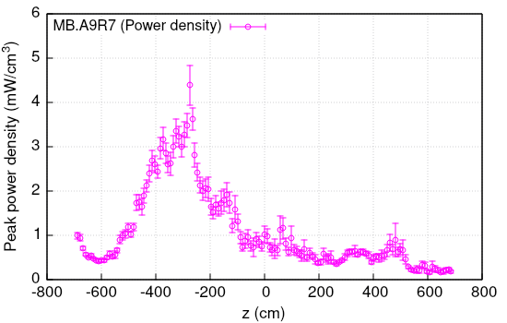
Cold section
Beam1
With two collimators (TCLDs) in the cold section, before MQ8 and MQ10, the maximum peak power density is about 5 mW/cc
r-φ-z resolution: 1.86cm, 2⁰, 10cm
(three radial bins of 1.86cm)
Values are for the 12 min BLT !
M. Varasteh

Slide 14
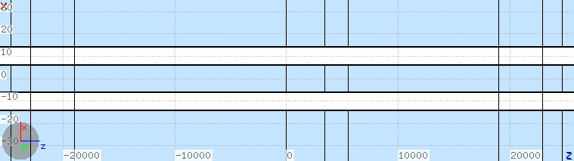
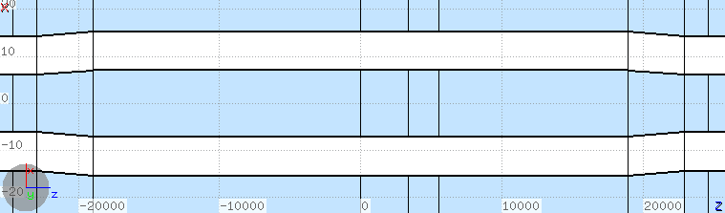
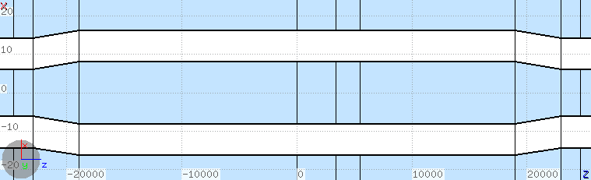
Impact of the dogleg removal - I
204mm bbs
(no dogleg) →
224mm bbs
(nominal dogleg) →
Dump plane
244mm bbs
(larger dogleg) →
M. Varasteh

Slide 15
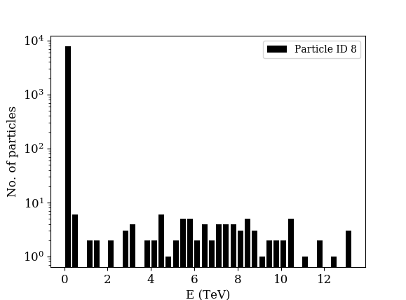
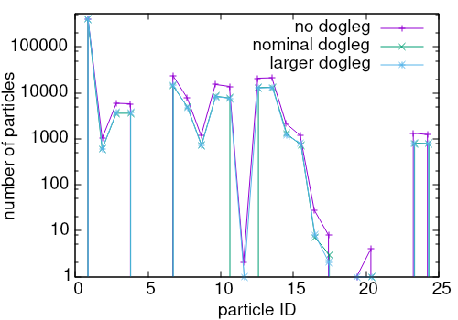
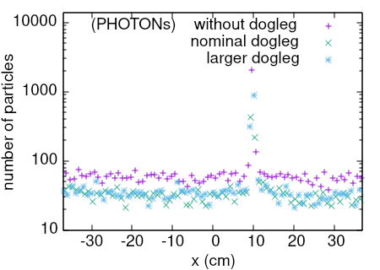
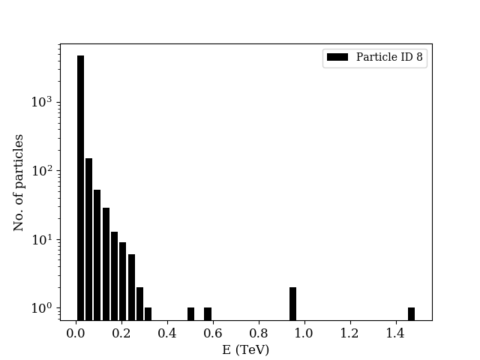
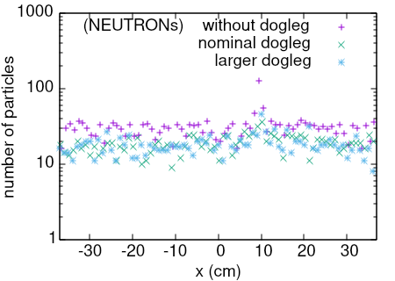
Impact of the dogleg removal - II
NEUTRONs (no dogleg)
1 Proton
7 Photon
8 Neutron
9 ANeutron
13 Pion+
14 Pion-
NEUTRONs (nominal dogleg)
M. Varasteh

Slide 16
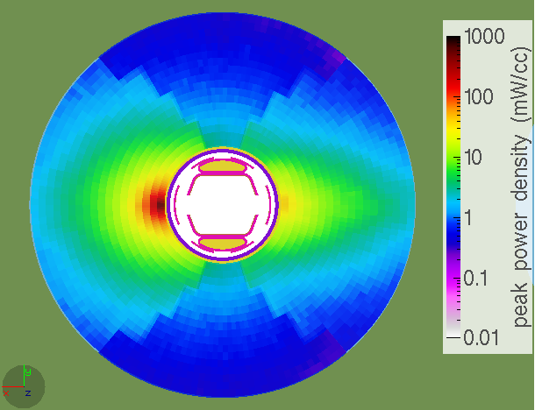
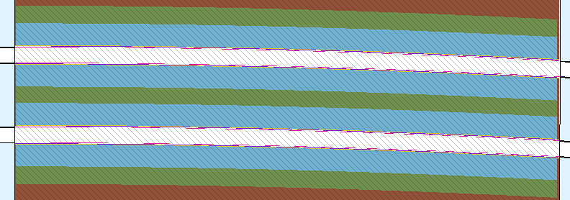
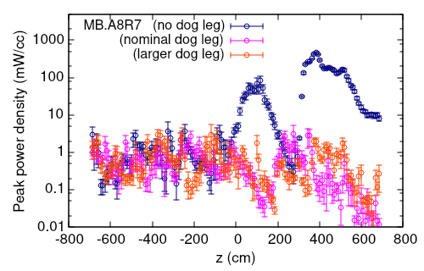
Impact of the dogleg removal - III
If no dogleg:
First cold dipole (MB.A8R7)
*
 | w/o dogleg | dogleg
PHOTON | 4E-3 | 4E-5
NEUTRON | 3E-4 | -
(per proton lost)
Total power (W)
beam separation in warm section | MQ7 | MBA8
204mm (no dogleg) | 7.1 | 419.3
224mm (nominal) | 5.9 | 12.7
244mm (larger dogleg) | 4.8 | 12.1
(r-φ-z resolution: 1.86cm, 2⁰, 10cm)
M. Varasteh

Slide 17
Messages from FLUKA simulation of HE-LHC machine
  The maximum power collected by a collimator is below 60 kW (for 0.2h BLT)
  For the first TCSG, the max power density is NOT on the Jaw! A new design would address the issue…
  Thanks to the TCLD collimators, Energy deposition in the cold section is NOT hazardous
  No apparent showstopper was seen
  Dogleg removal results in a dramatically higher impact of the neutral particles in the first cold dipole
M. Varasteh

Slide 18

Mohammad Varasteh
CERN / EN-STI-BMI
m.varasteh cern.ch

Slide 19
Backup Slides

Slide 20
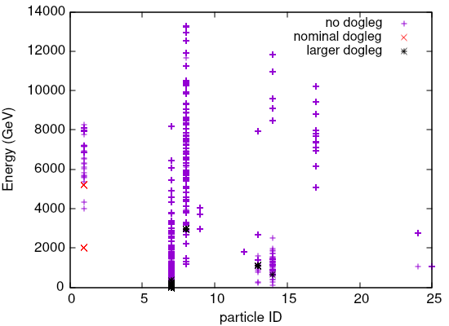
PIONs
PROTONs
PHOTONs
NEUTRONs
M. Varasteh

Slide 21
MBA8
 | w/o dogleg | dogleg
PHOTON | 48088 | 1085
NEUTRON | 3187 | -
Active absorbers | Total power (kW)
TCLA.A6R (CLAA6R1i & j) | 3.0
TCLA.B6R (CLAB6R1i & j) | 0.3
TCLA.C6R (CLAC6R1i & j) | 0.1
TCLA.D6R (CLAD6R1i & j) | 0.1
TCLA.A7R (CLAD6R1i & j) | 0.03
Passive absorbers
TCAPA.6L (CAPA6L1) | 59.8
TCAPB.6L (CAPB6L1) | 8.0
TCAPC.6L (CAPC6L1) | 150.3
ELEMENTS | HE-LHC | LHC
TCP & TCS jaws | 11.7% | 10%
MBW | 6.5% | 8.5%
MQW | 20.0% | 9.5%
TCAP | 11.8% | 13%
Beam pipe | 9.2% | 8.6%
Tunnel | 30.5% | 33.1%
Other elements | 8.6% | 9.4%
Missing energy | 2.0% | 6.5%
AIR | 0.5% | 0.5%
Cables | 1.8% | 0.9%
MAX !
In front of most exposed MQW
M. Varasteh

