Slide 1




Field Quality at injection for FCC-hh
B. Dalena
D. Boutin, A. Chance, E. Cruz, R. De Maria, S. Izsquierdo Bermudez, E. Maclean, R. Martin, A. Mereghetti, J. Molson, T. Persson, D. Schoerling, D. Schulte, R. Tomas

Slide 2
Outline
Motivation
Main Dipole Field Quality and non linear correction schemes
  Sextupole and Decapole errors
Dynamic Aperture at injection (3.3 TeV)
  With and without sextupole and decapole correction
  Laundau Octupoles
  RF acceptance
Conclusion and perspectives

Slide 3
Motivation
half arc cell
Design correction schemes for non-linear errors of main magnets of the arcs
Provide tolerances for the main high order multipoles components of magnets of the arcs
Key issues:
    Reserve space for correctors in the arc cells
    Get order of magnitude of correctors strengths to identify possible R&D needed
    Define tolerances on main fields errors
    Define tolerances on arcs magnets field quality to ensure DA > 12 σ at injection and more at collision

Slide 4
Main Dipoles Field Quality
U₈
U₁
(1)
U₂
U₇
b_{ns} systematic error component
b_{nu} uncertainty error component: 8 different sectors as in LHC
σ_{bn} random error component: different seeds for each dipole
Even normal error components change sign between inner and outer chamber*
Odd skew error components change sign between inner and outer chamber*
*NB. this is not true for the common coil design of the main dipoles…
U₃
U₆
U₅
U₄
(1) S. Fartoukh and O. Bruning LHC Project Report 501
LHC Design Report

Slide 5
Main Dipoles Field Quality tables
WP2
WP5
1st table: max systematic sextupole error can be corrected/tolerated at collision ⇒
2nd table: max value of random skew quadrupole error can be tolerate ⇒
3nd and 4th tables: limit for systematic quadrupole error ⇒
4th table: limit for systematic and random sextupole and decapole error at injection ⇒
5th table: decapole correction at injection ⇒
5 Field Quality tables
max correctors Gradients feasible with NbTi technology
new asymmetric coil design (INFN-LASA & INFN GENOVA)
new strand magnetization for persistent current effects*
*T. Spina, A. Ballarino, L. Bottura et al., "Artificial pinning in Nb₃Sn wires", IEEE Transactions on Applied Superconductivity, vol. 27, pp. 1-5, 2017

Slide 6
Sextupole corrector and tolerance
half arc cell
One corrector at each dipole powered in series for each of the arc
Max feasible gradient 3000 T/m² and 0.11 m long (NbTi technology)
Can correct systematic up to 6 (60) units of systematic b₃ at collision (injection)
Max used gradient for last table is 1205 T /m²
To reduce β-beating from feed-down, MCS relative alignment to the main dipole has to be crontrolled

Slide 7
Decapole corrector and tolerance
half arc cell
One corrector every other dipole powered in series for each of the arcs
Max feasible gradient 4.3(2.8) 10⁶ T/m⁴ and 0.066 m long, aperture 53(68) mm
Can correct a systematic component of b₅ up to 0.53 (8) units at collision (injection 3.3 TeV)
Max used gradient at injection is 2.94×10⁶ T/m⁴

Slide 8
Dynamic Aperture (DA)
defined as: initial amplitude of particle losses at 10⁵ turns
computed with SixTrack (http://sixtrack.web.cern.ch/SixTrack)
Initial conditions for long-term DA study:
60 seeds
30 particle pairs
Emit norm 2.2e-6 m.rad
E₀ = 3.3 TeV
Q’ = 2
dp/p = 0.00032
σ step = 2, σ ∈ [0-:]
5 angles ∈ [0,90º]
Fractional part of tunes:
Q_{x} = .28, Q_{y} = .31 injection
Nσ_{y}
Nσ_{x}

Slide 9
DA results at injection
Sextupole and decapole corrections required to have minimum DA above the target of 12 σ
Negligible impact of Experimental Insertion Regions (EIR) on DA
Minimum DA ~ 8.3 σ at injection energy of 1.3 TeV

Slide 10

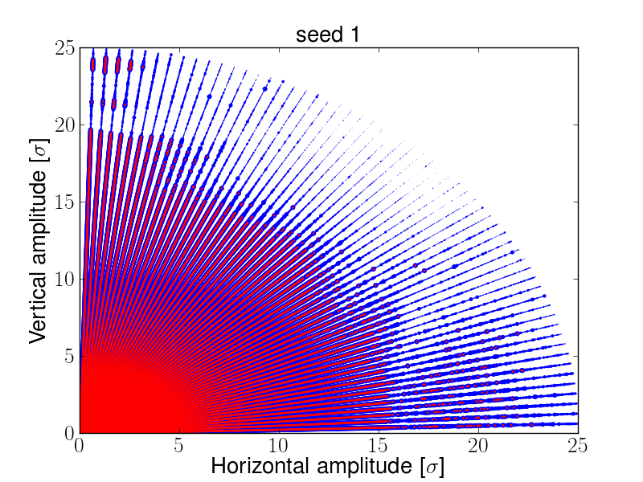
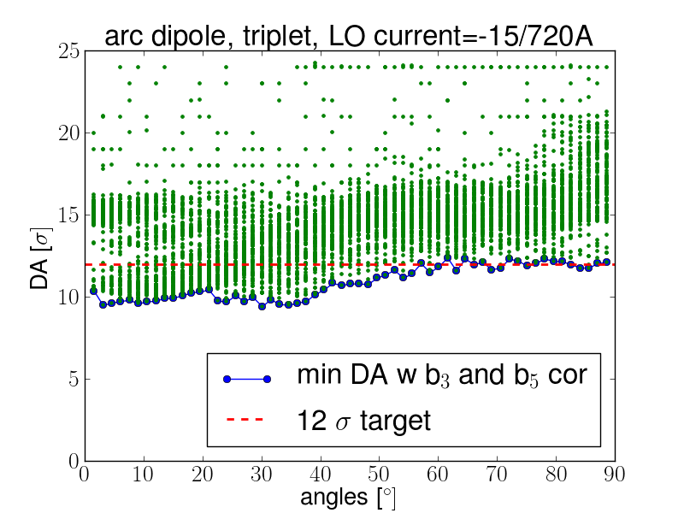
Effect of Landau Damping octupoles at injection
Minimum DA below target with LO (like for LHC)
Minimum above the collimation settings ⇒ is not considered a big issue
DA is dominated by multipoles random components with sextupole and decapole correction
DA seeds distribution is non Gaussian
all
stable

Slide 11
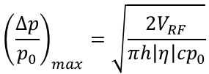
RF bucket size
 | V_{RF} [MV] | P₀ [TeV] | Δp/p max 10⁻⁴
FCC | 16 | 3.3 | 4.8
 | 32 | 50 | 1.7
LHC | 8 | 0.45 | 9.6
 | 16 | 7 | 3.4
$${\left(\frac{∆p}{p_{0}}\right)}_{max}=\sqrt{\frac{2V_{RF}}{πh\left|η\right|{cp}_{0}}}$$
A current of -15/720 A in all the Landau damping octupoles of the ring at injection
Minimum DA reduces to 9.4 σ for an initial momentum offset of the particles at 2/3 of RF bucket size
Minimum DA reduction of 2.5 σ inside the RF bucket

Slide 12
Conclusions
Main Dipole Field Quality at injection provide DA above the 12 σ target if sextupole and decapole systematic errors are corrected
LHC non-linear correction schemes and NbTi technology can be used
Landau Damping Octupoles reduced DA below the target value, but still above collimation settings
RF bucket account for ~2.5 σ reduction
Perspectives
Impact of main quadrupoles on DA
Impact of linear imperfection on DA
Working point at injection
Impact of Dynamic errors
Application of AI techniques to predict DA

Slide 13
Additional slides

Slide 14
Field Quality table

Slide 15
Field Quality table

Slide 16
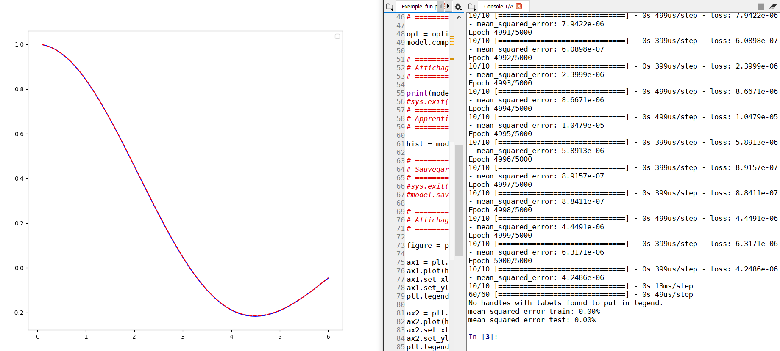
Perspectives: application of AI techniques to DA evaluation
InTheArt: discussion group about Artificial Intelligence
Using neural network to find interpolating function of DA as a function of multipole errors.
Model chaotic dynamical systems using reservoir computing methods, in order to predict long term behavior.
z
x
G. Daniel, B.D.
A. Hamid, D. Faranda, V. Gautard

Slide 17
Detuning 4th table
Detuning is larger with momentum!
Qx’’’ seems to dominate (b5 correctors required)

Slide 18


Detuning with momentum table v3
$Q_{z}^{′′}∝3βb_{4}$+…
$Q_{z}^{′′′}∝12βb_{5}$+…
Fitting with a 3rd order polynomial for seed giving minimum DA
⇒ Q’’’ is stronger than Q’’
w/o octupoles
w octupoles
With Octupoles ON Q’’ dominates and out of the RF acceptance the octupoles reduce the tune spread due to different seeds of main dipole errors

Slide 19
Detuning with momentum w and w/o b₅ (table v42)
w/o octupoles
w octupoles
With b_{5S} = 0 we have only Q’’ left and both w and w/o octupole max detuning is < 0.01 @ 3.2e⁻⁴ dp/p
⇒ Correction of b₄ from Table v42 not required

Slide 20
Tables v42 (half artificial pinning)
New asymmetric coil design (INFN-LASA & INFN GENOVA)
New strand magnetization for persistent current effects
Susana Izquierdo Bermudez, Davide Tommasini 01-10-2018
Initial amplitude of particles lost used to evaluate DA (alost2)
Energy corresponding to 2/3 of the max RF acceptance considered
Main Octupoles current of -15A @ injection (Sergey ARSENYEV communication)
 | Min DA [σ] Δp/p=0 | Min DA [σ] Δp/p=3.2e⁻⁴
arc | 16.21 | 9.4
arc+triplet | ~16.21 | ~9.4
arc+triplet+oct =-15 A | 10.55 | 6.3

Slide 21
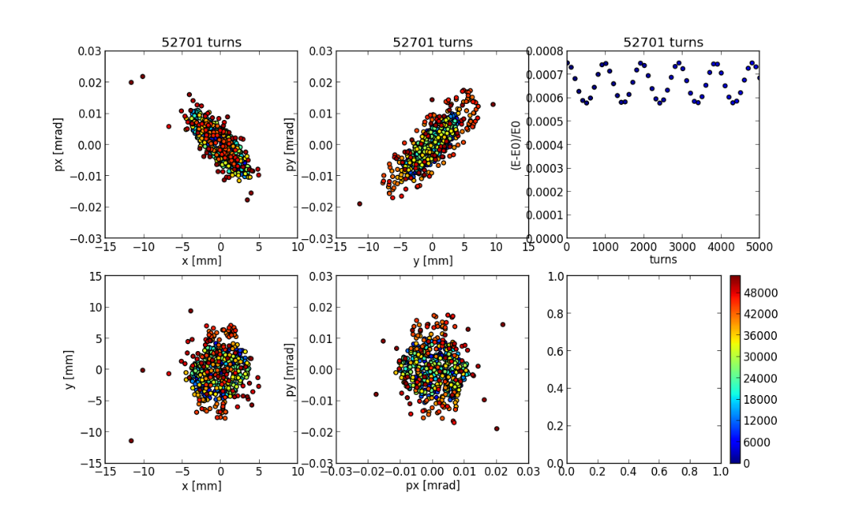
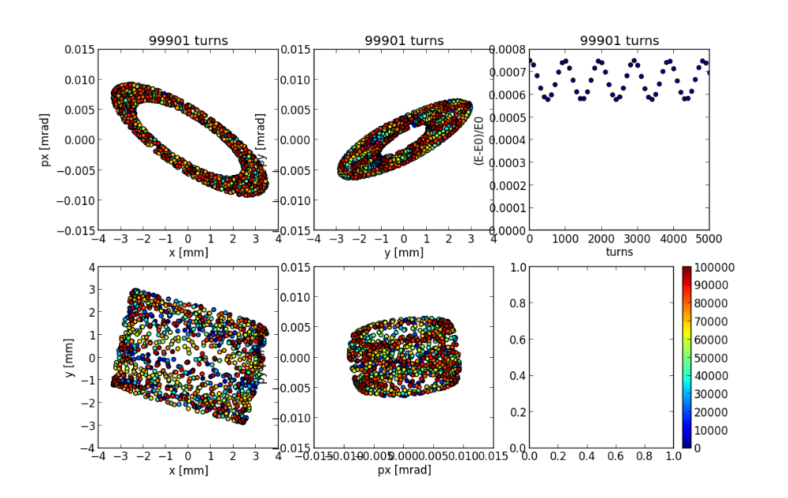
Effect of octupoles for δp/p = 7.5e⁻⁴
Arc errors only
Arc, IRs errors and octupoles I=-30 A
Lost
Stable

Slide 22
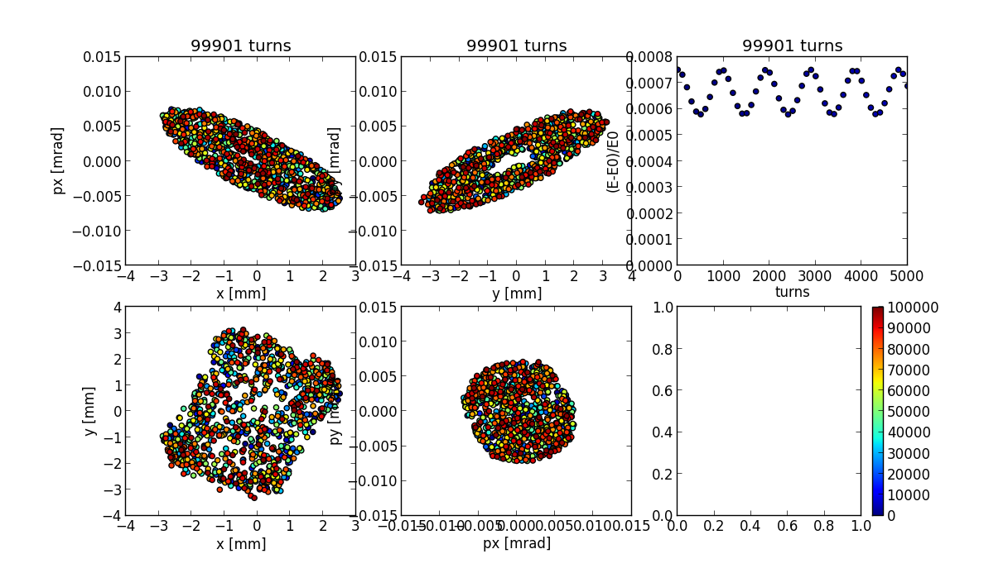
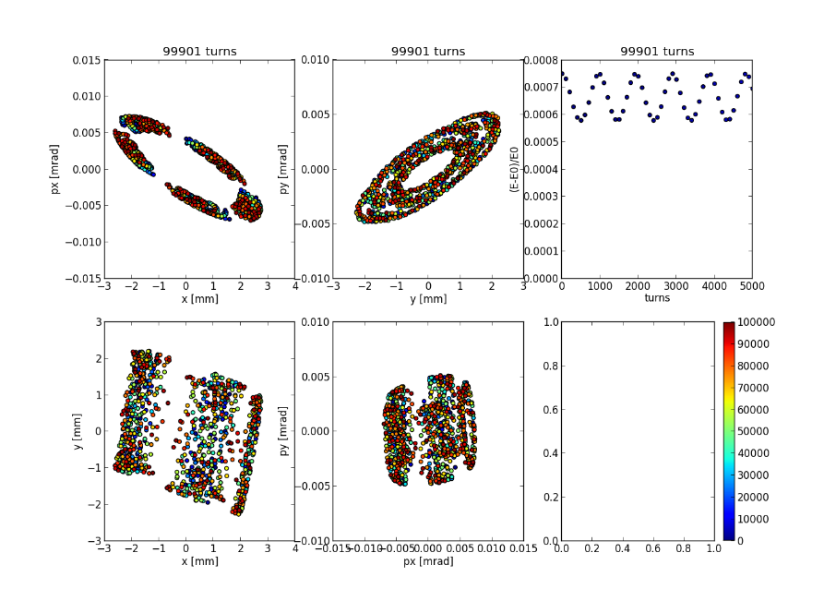
Effect of octupoles for δp/p = 7.5e-4
Arc errors only
Arc, IRs errors and ocutpoles I=-30 A

