Slide 1





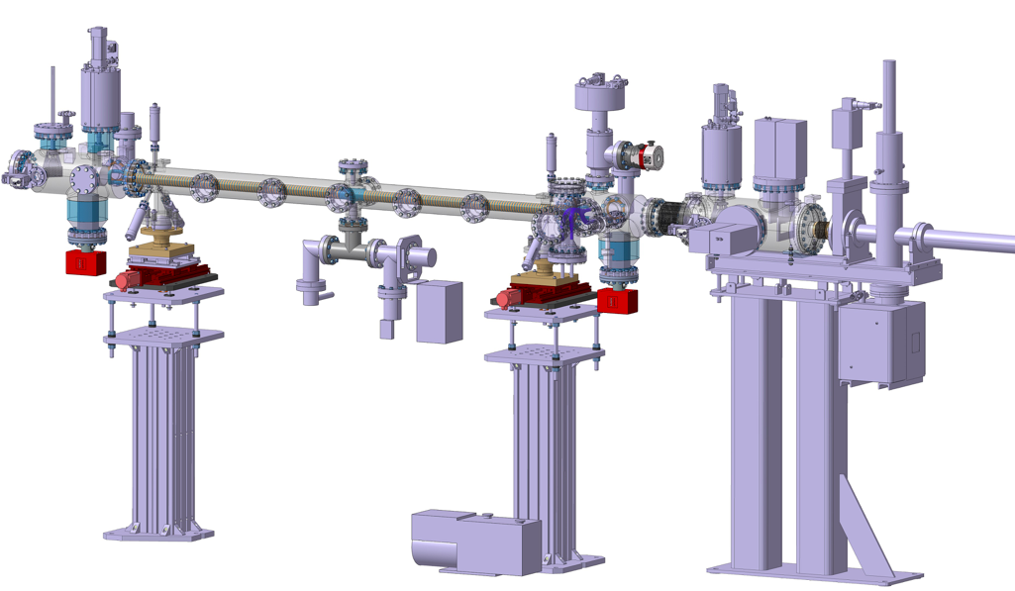
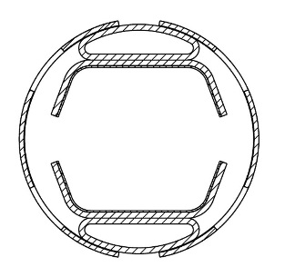


Photodesorption studies on FCC-hh Beam Screen Prototypes at KARA
L.A. Gonzalez,^{1, 2} M. Gil Costa,^{3, 2} P. Chiggiato,² V. Baglin,² C. Garion,² R.Kersevan,² S. Casalbuoni,⁴ E. Huttel,⁴ I. Bellafont^{2,5} and F. Perez⁵
1
2
3
4
5
Task4.6: Measurements on cryogenic
beam vacuum system prototype
Photodesorption studies on FCC-hh Beam Screen Prototypes at KARA
Luis Gonzalez
CERN TE-VSC
FCC Week 2019 June 26th

Slide 2
FCC-hh Beam Screen
Synchrotron radiation (SR) parameters at FCC-hh bending magnets
 | FCC-hh | LHC
Energy collision [TeV] | 100 | 14
Perimeter [km] | 100 | 28
Dipole field [T] | 16 | 8.3
Arc SR Photon Flux (E above 4 eV)* [ph/s/m] | 1.48x10¹⁷ | 4.8x10¹⁶
Arc SR Photon Flux [ph/s/m] | 1.7x10¹⁷ | 1.0x10¹⁷
SR Heat load [W/m] | 35.4 | 0.22
SR Critical Energy [eV] | 4269 | 44
FCC-hh BS has been redisigned in order to fulfill:
-Higher cooling capacity
-Higher pumping speed
also
-Due to the high SR power power deposited on it, the working temperature needs to be rised in the range 20-40K (FCC-hh arcs) vs 4-20K (LHC arcs)
 | FCC-hh | LHC
BS Working temperature[TeV] | 20-40 | 4-20
*FCC Conceptual Design Report. Volume 3: The Hadron Collider
Photodesorption studies on FCC-hh Beam Screen Prototypes at KARA
1
Luis Gonzalez
CERN TE-VSC
FCC Week 2019 June 26th

Slide 3
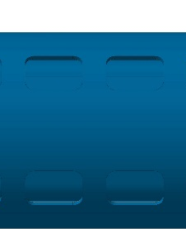
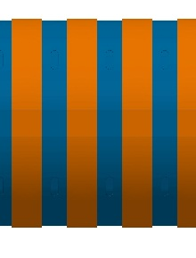
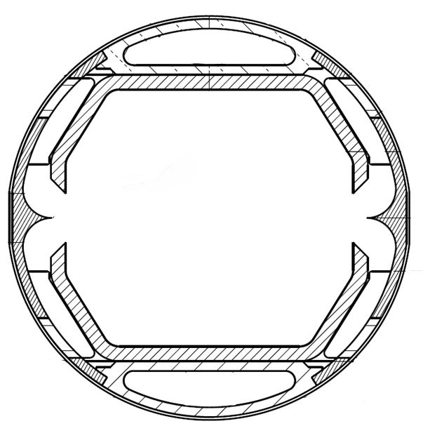
FCC-hh Beam Screen
FCC-hh Beam Screen
First Design
Baseline Design
Pumping
holes
Tip
Reflection
Pumping
holes
Sawtooth
Absorption
Coolant
Coolant
Cu
Cu
S. Steel
SR
Cu
SR
Coolant
Coolant
Side View
Front View
Side View
Front View
For full description of BS evolution and functionality please review:
Francis Perez - 24 jun. 2019 11:30
Ignasi Bellafont - 26 jun. 2019 8:30
Photodesorption studies on FCC-hh Beam Screen Prototypes at KARA
2
Luis Gonzalez
CERN TE-VSC
FCC Week 2019 June 26th

Slide 4
FCC-hh Beam Screen
Experimental Samples
First Design
Baseline Design
Pumping
holes
Tip
Reflection
Pumping
holes
Sawtooth
Absorption
Coolant
Coolant
Cu
Cu
S. Steel
SR
Cu
SR
Coolant
Coolant
Side View
Front View
Side View
Front View
2 m long FCC-hh BS prototypes have been manufactured in faithful compliance with such designs.
The samples where irradiated to validate their performance under significant levels of SR flux and power and benchmark simulations techniques.
As a first step of the experimental campaign, the experiments were performed at RT on baked samples.
Photodesorption studies on FCC-hh Beam Screen Prototypes at KARA
2
Luis Gonzalez
CERN TE-VSC
FCC Week 2019 June 26th

Slide 5
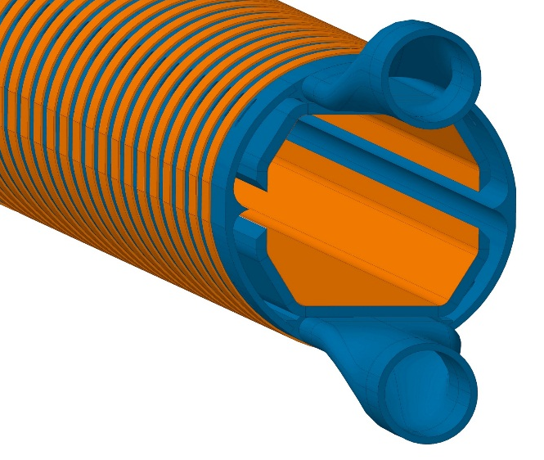
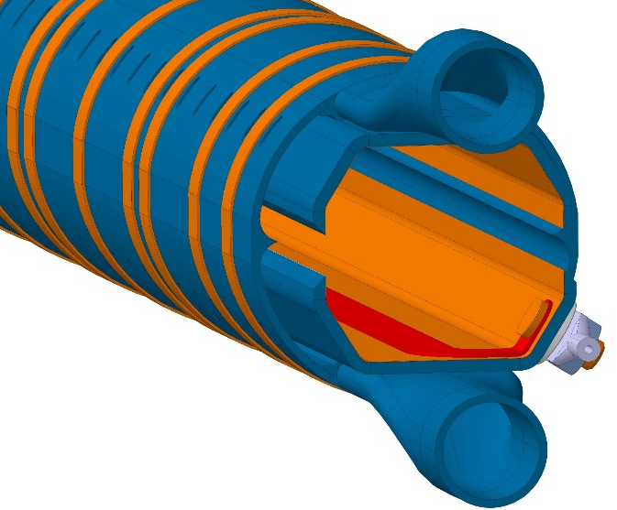
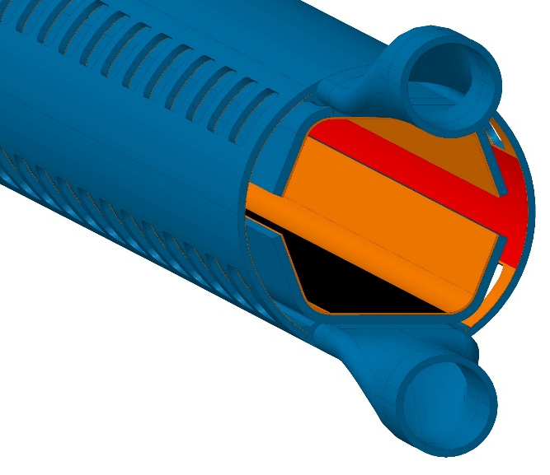
Samples: FCC-hh Beam Screen Prototypes
Experimental Samples
Prototype #1 July- Oct ‘17
Prototype #2 Jan- May ‘18
Prototype #3 June-Aug‘18
#1: Validation of temperature profile and validity of photon reflector.
#2: #1 + Cold sprayed electrode for photoelectron current measurements*. Isolation to sample performed by ceramic layer.
#3: Surface treatments as for baseline. Updated internal screen and pumping slots. Sawtooth profile substituted reflector. LASE surface at top and bottom.
*Luis Gonzalez- 10 April. 2018
Photodesorption studies on FCC-hh Beam Screen Prototypes at KARA
4
Luis Gonzalez
CERN TE-VSC
FCC Week 2019 June 26th

Slide 6
Samples: FCC-hh Beam Screen Prototypes
Experimental Samples
Prototype #1 July- Oct ‘17
Prototype #2 Jan- May ‘18
Prototype #3 June-Aug‘18
#1: Validation of temperature profile and validity of photon reflector.
#2: #1 + Cold sprayed electrode for photoelectron current measurements*. Isolation to sample performed by ceramic layer.
#3: Surface treatments as for baseline. Updated internal screen and pumping slots. Substitution Reflector for Sawtooth. LASE surface at top and bottom.
- Irradiation on Tip
- Irradiation on Tip
-Irradiation on Sawtooth
-Irradiation on LASE
*Luis Gonzalez- 10 April. 2018
Photodesorption studies on FCC-hh Beam Screen Prototypes at KARA
5
Luis Gonzalez
CERN TE-VSC
FCC Week 2019 June 26th

Slide 7
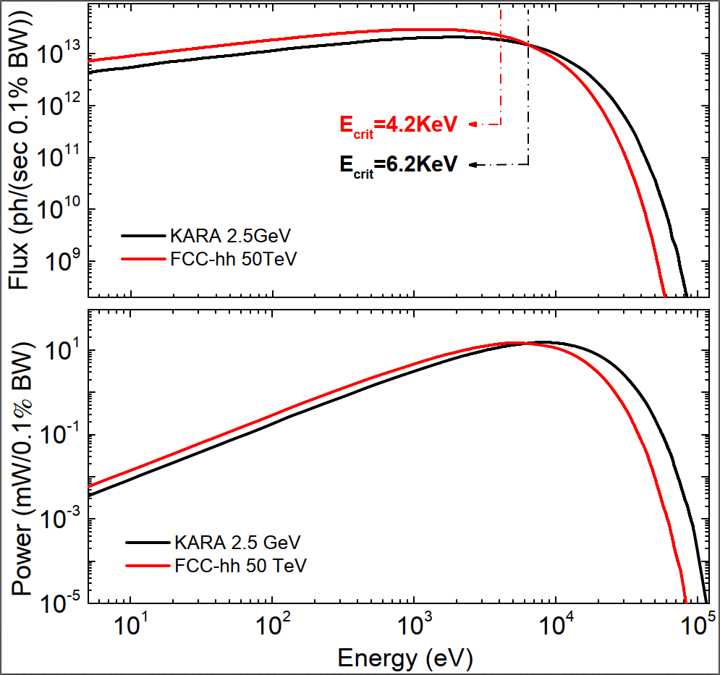
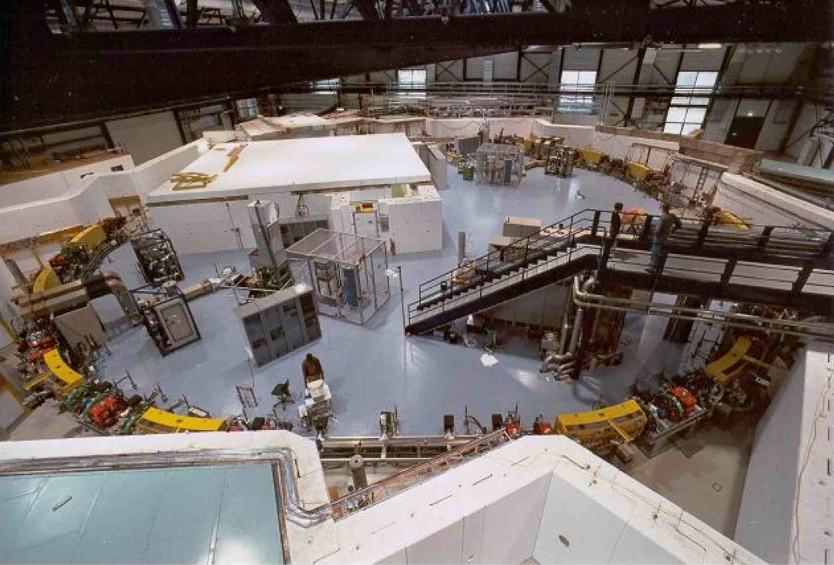
Experiment at KARA
FCC-hh Beam Screen -> Samples
KARA
(KArlsruhe Research Accelerator)
The FCC-hh’s photon spectrum and linear power are reasonambly reproduced in KARA, even at nominal beam energy
Photodesorption studies on FCC-hh Beam Screen Prototypes at KARA
6
Luis Gonzalez
CERN TE-VSC
FCC Week 2019 June 26th

Slide 8
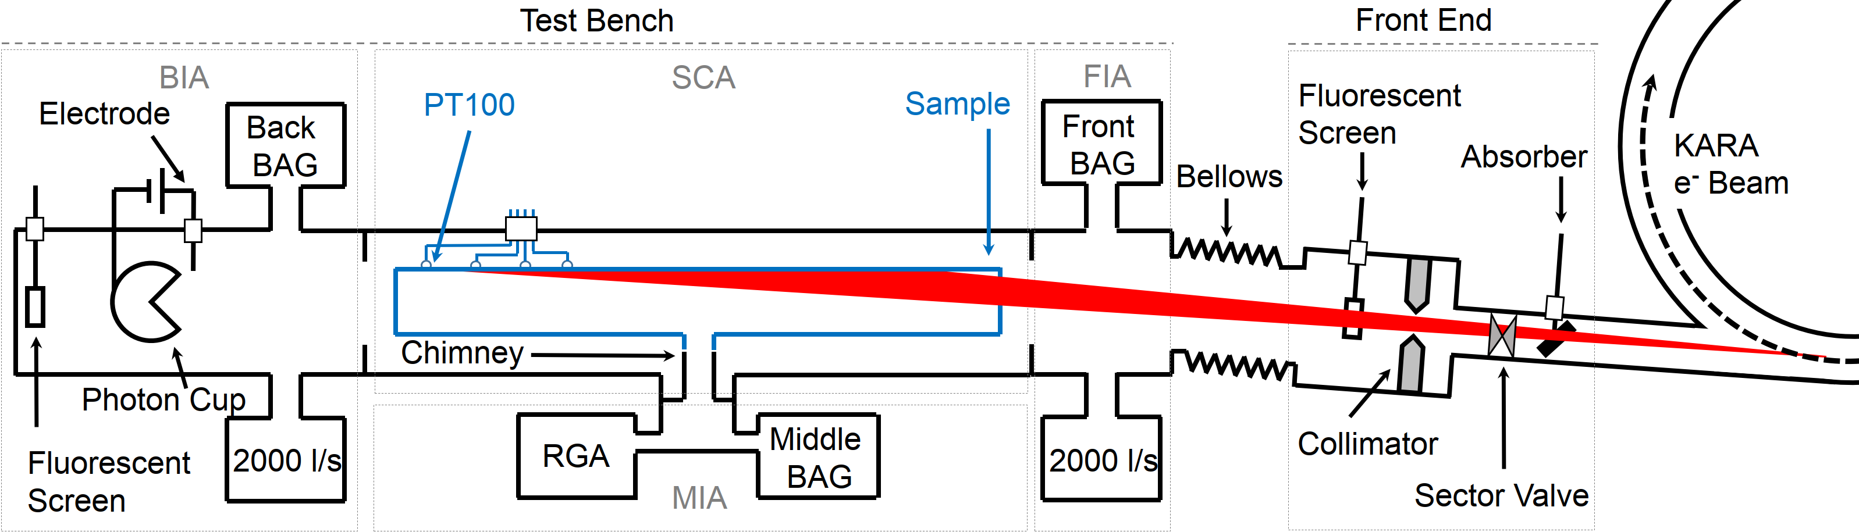
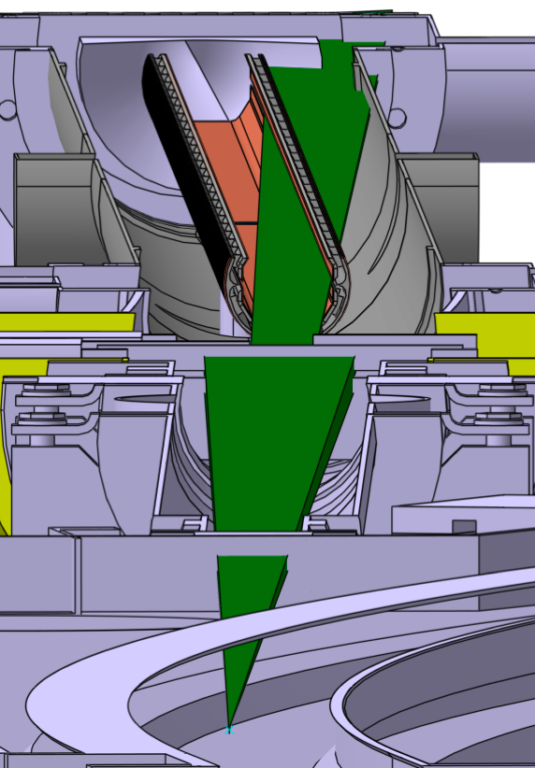
The Setup: BESTEX
Experiment at KARA-BESTEX
BESTEX (Beam Screen Testbench Experiment) is an experimental instrument designed to study SR related effects on non-leak tight samples under UHV.
The SR photon beam originated at KARA’s bending magnet is collimated so as to irradiate the samples on the selected region.
Photodesorption studies on FCC-hh Beam Screen Prototypes at KARA
7
Luis Gonzalez
CERN TE-VSC
FCC Week 2019 June 26th

Slide 9
The Setup: BESTEX
Experiment at KARA-BESTEX
After collimation :
83% of Photon Flux Cropped
69% of Photon Power Cropped
BESTEX (Beam Screen Testbench Experiment) is an experimental instrument designed to study SR related effects on non-leak tight samples under UHV
The SR photon beam originated at KARA’s bending magnet is collimated so as to irradiate the samples on the selected region.
 | KARA | FCC-hh
SR Flux | 8.7E+16ph/s | 1.7E+17 ph/s
SR Power | 32W/m | 35.4 W/m
Angle | 18mrad | <2 mrad
Ec | 6.2KeV | 4.2KeV
Photodesorption studies on FCC-hh Beam Screen Prototypes at KARA
8
Luis Gonzalez
CERN TE-VSC
FCC Week 2019 June 26th

Slide 10
The Setup: BESTEX
Experiment at KARA-BESTEX
Reflected photons
towards photon cup
Several gauges allow to obtain relevant data on PSD, reflectivity, heat loads and photoelectron generation.
A photon cup equipped with a biased electrode and placed downstream the photon direction allows to perform reflectivity studies.
Photodesorption studies on FCC-hh Beam Screen Prototypes at KARA
9
Luis Gonzalez
CERN TE-VSC
FCC Week 2019 June 26th

Slide 11
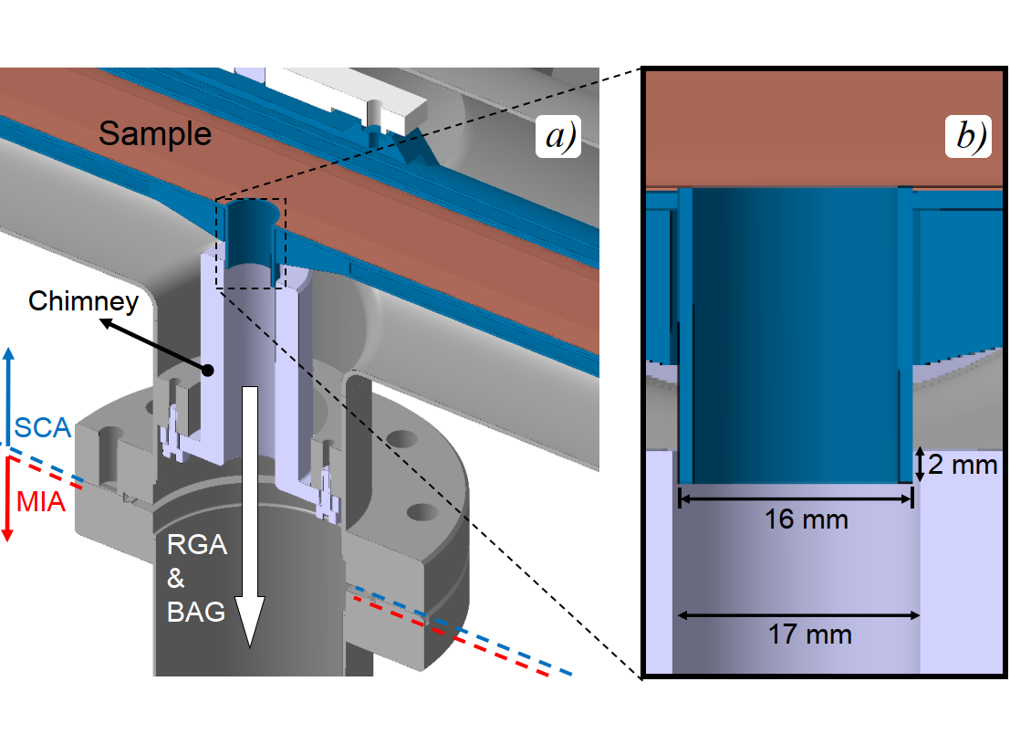
Experiment at KARA-BESTEX
The Setup: BESTEX
Several gauges allow to obtain relevant data on PSD, reflectivity, heat loads and photoelectron generation.
A photon cup equipped with a biased electrode and placed downstream the photon direction allows to perform reflectivity studies.
A chimney connection allows to explore the molecular desorption yields from the inner walls of the samples as they are irradiated (PSD studies).
Photodesorption studies on FCC-hh Beam Screen Prototypes at KARA
10
Luis Gonzalez
CERN TE-VSC
FCC Week 2019 June 26th

Slide 12
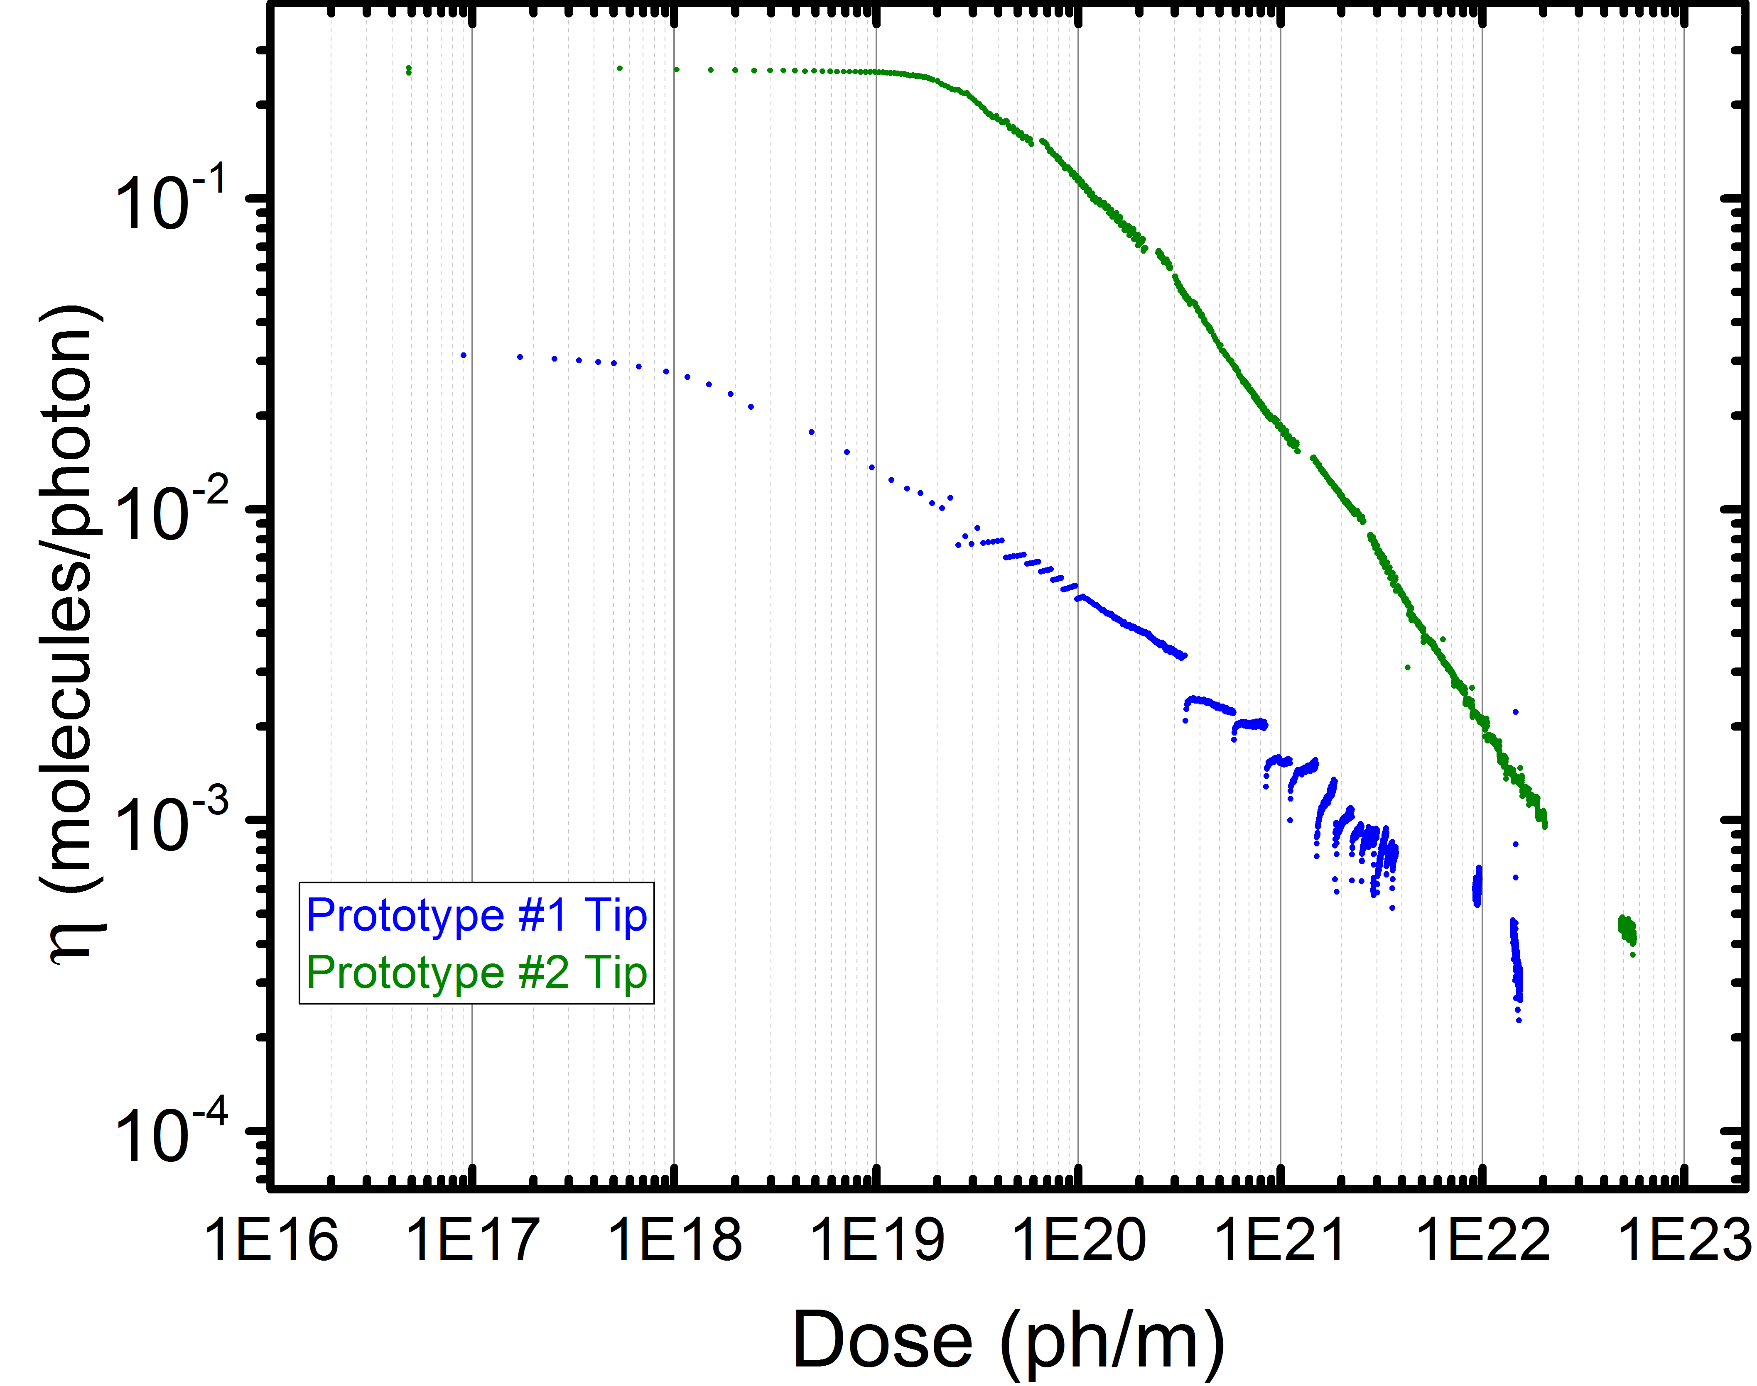
PSD Results
PSD results
-At low doses, the molecular yield of Prototype #2 is one order of magnitude higher than for Prototype #1.
-At higher doses the values for prototype #2 remain always higher than for prototype #1 (x3 at 2E22 ph/m).
-Such effect is ascribed to the high PSD yields of cold sprayed Cu and ceramics in Prototype #2.
-A large amount of photons are reflected towards the inner chamber of the BS. For prototype #2, those reflected photons play an extremely relevant role. This effect was previously foreseen by simulations.*
-The large photon reflectivity towards the inner chamber is due to
the limitations to manufacture a perfectly shrap tip.
- Large photon reflectivity enhances electron cloud developement.
  Prototype #1
  Prototype #2
  Prototype #3
*FCC Week’19. I. Bellafont et al
Photodesorption studies on FCC-hh Beam Screen Prototypes at KARA
11
Luis Gonzalez
CERN TE-VSC
FCC Week 2019 June 26th

Slide 13
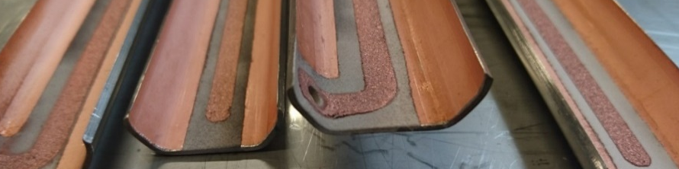
PSD Results
PSD results
-At low doses, the molecular yield of Prototype #2 is one order of magnitude higher than for Prototype #1.
-At higher doses the values for prototype #2 remain always higher than for prototype #1 (x3 at 2E22 ph/m).
-Such effect is ascribed to the high PSD yields of cold sprayed Cu and ceramics in Prototype #2.
-A large amount of photons are reflected towards the inner chamber of the BS. For prototype #2, those reflected photons play an extremely relevant role. This effect was previously foreseen by simulations.*
-The large photon reflectivity towards the inner chamber is due to
the limitations to manufacture a perfectly shrap tip.
- Large photon reflectivity enhances electron cloud developement.
  Prototype #1
  Prototype #2
  Prototype #3
*FCC Week’19. I. Bellafont et al
Photodesorption studies on FCC-hh Beam Screen Prototypes at KARA
12
Luis Gonzalez
CERN TE-VSC
FCC Week 2019 June 26th

Slide 14
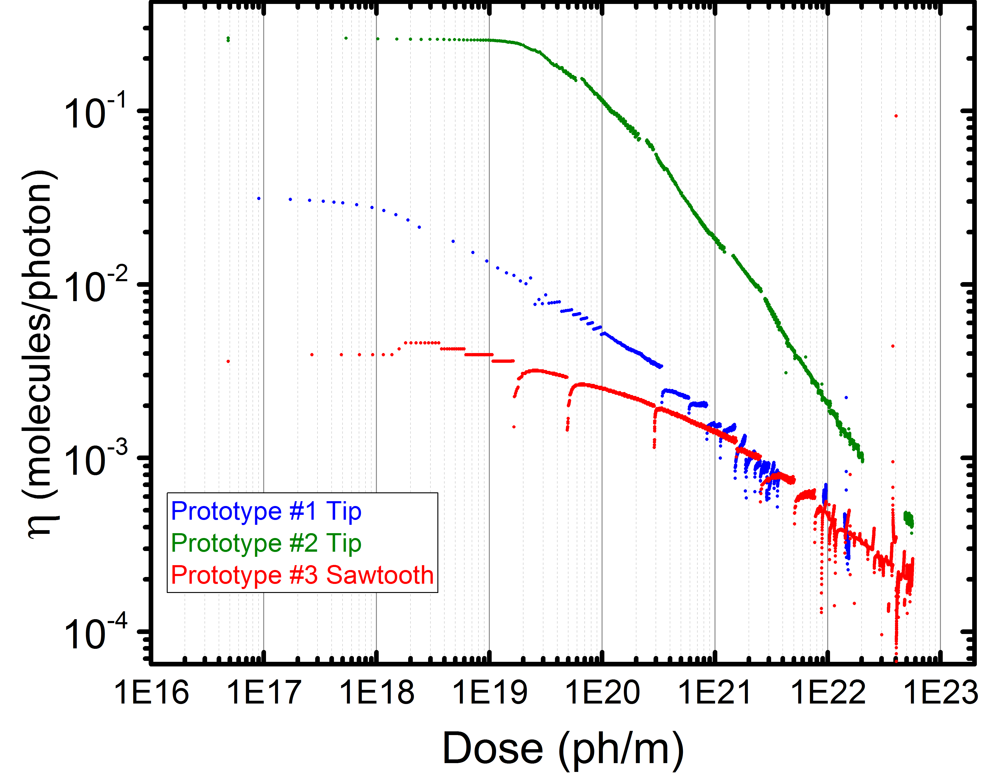
PSD Results
PSD results
-At low doses, the molecular desorption yields of Prototype #3, when irradiating the sawtooth profile, is one order of magnitude lower than for prototype #1.
-Such effect is ascribed to the high photon absorption capacity of the sawtooth profile.
-At doses higher than E20 ph/m the molecular desorption yield of prototype #1 and prototype #3 are similar.
-Such result has an important effect on the reduction of the conditioning time.
  Prototype #1
  Prototype #2
  Prototype #3
Photodesorption studies on FCC-hh Beam Screen Prototypes at KARA
13
Luis Gonzalez
CERN TE-VSC
FCC Week 2019 June 26th

Slide 15
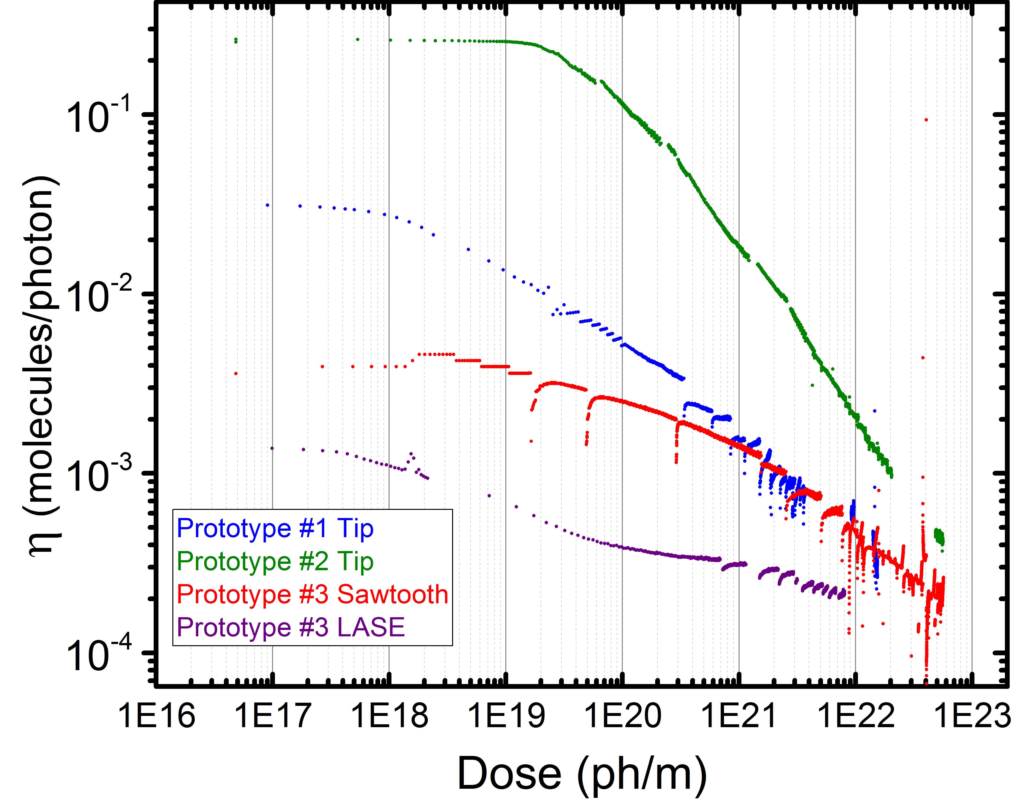
PSD Results
PSD results
-The molecular desorption yield of Prototype #3, when irradiating the LASE surface, is considerably lower than for the rest of the irradiated surfaces
-Such effect is in good agreement with the low reflectivity and low photoelectron yields associate to the very rough LASE surfaces*
- Due to the low reflectivity associated to the previously irradiated sawtooth structure, preconditioning of the LASE surface has been assumed to b negligible.
-Such assumption is confirmed by the flat part of the curve at low doses, typical of newly irradiated surfaces.
-LASE treatment provides both low PSD yields and low SEY, with respect to standard Cu surfaces
  Prototype #1
  Prototype #2
  Prototype #3
*PRST- Photo Reﬂectivity and Photoelectron Yield from Copper Technical Surfaces.
E. La Francesca et al - Submitted
Photodesorption studies on FCC-hh Beam Screen Prototypes at KARA
14
Luis Gonzalez
CERN TE-VSC
FCC Week 2019 June 26th

Slide 16
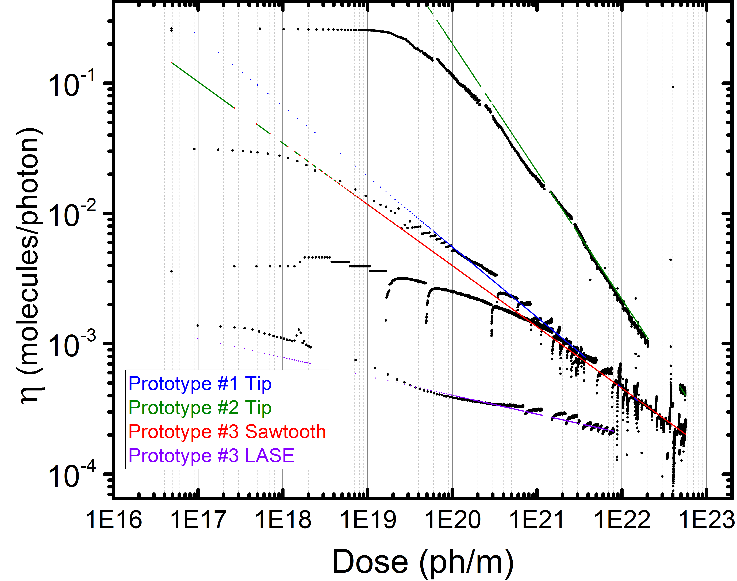





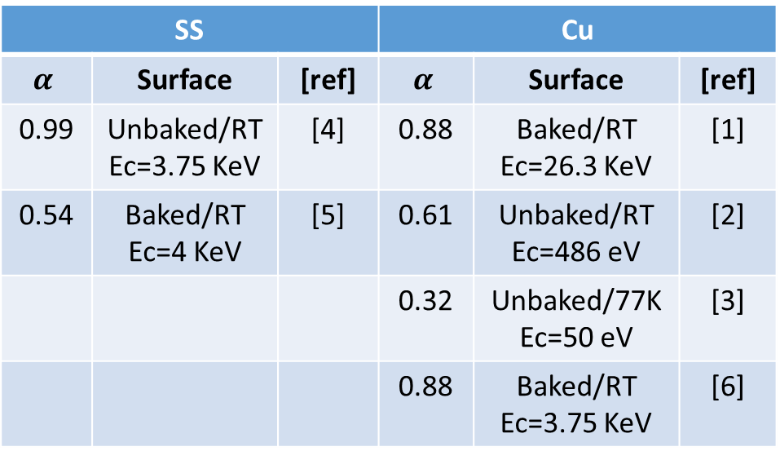
PSD Results
PSD results
$$α=0.98$$
SS |  |  | Cu
$$α$$ | Surface | [ref] | $$α$$ | Surface | [ref]
0.99 | Unbaked/RT Ec=3.75 KeV | [4] | 0.88 | Baked/RT Ec=26.3 KeV | [1]
0.54 | Baked/RT Ec=4 KeV | [5] | 0.61 | Unbaked/RT Ec=486 eV | [2]
 |  |  | 0.32 | Unbaked/77K Ec=50 eV | [3]
 |  |  | 0.88 | Baked/RT Ec=3.75 KeV | [6]
$$α=0.54$$
$α=0.4$7
$$η∝ Γ^{−α}$$
$$α=0.15$$
[1] Yusuke Suetsugu et al; Test Fabrication of a Copper Beam Duct for KEK B-Factory
[2] D. Brandt et al; CAS CERN Accelerator School
[3] R. Calder et al; Synchrotron Radiation induced gas desorption from a prototype of the
LHC beam screen prototype at cryogenic temperatures
[4] Herbeaux et al; Photon stimulated desorption of an unbaked stainless steel chamber by 3.75 KeV critical energy photons
[5] M. Ady; PhD Thesis
[6] O. Grobner et al; Gas desorption form an OFHC copper Vacuum chamber by synchrotron radiation photons
  Prototype #1
  Prototype #2
SS
Cu
  Prototype #3
Photodesorption studies on FCC-hh Beam Screen Prototypes at KARA
15
Luis Gonzalez
CERN TE-VSC
FCC Week 2019 June 26th

Slide 17

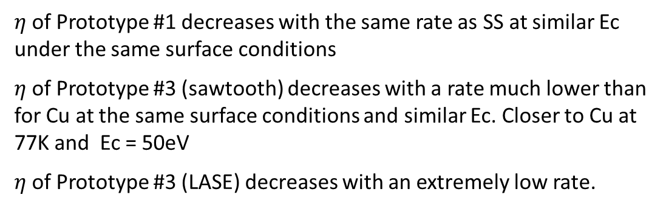
PSD Results
$$α=0.98$$
SS |  |  | Cu
$$α$$ | Surface | [ref] | $$α$$ | Surface | [ref]
0.99 | Unbaked/RT Ec=3.75 KeV | [4] | 0.88 | Baked/RT Ec=26.3 KeV | [1]
0.54 | Baked/RT Ec=4 KeV | [5] | 0.61 | Unbaked/RT Ec=486 eV | [2]
 |  |  | 0.32 | Unbaked/77K Ec=50 eV | [3]
 |  |  | 0.88 | Baked/RT Ec=3.75 KeV | [6]
$$α=0.54$$
$α=0.4$7
$$η∝ Γ^{−α}$$
$$α=0.15$$
$η$of Prototype #1 decreases with the same rate as SS at similar Ec under the same surface conditions
$η$of Prototype #3 (sawtooth) decreases with a rate much lower than for Cu at the same surface conditions and similar Ec. Closer to Cu at 77K and Ec = 50eV
$η$of Prototype #3 (LASE) decreases with an extremely low rate.
  Prototype #1
  Prototype #2
  Prototype #3
Photodesorption studies on FCC-hh Beam Screen Prototypes at KARA
16
Luis Gonzalez
CERN TE-VSC
FCC Week 2019 June 26th

Slide 18
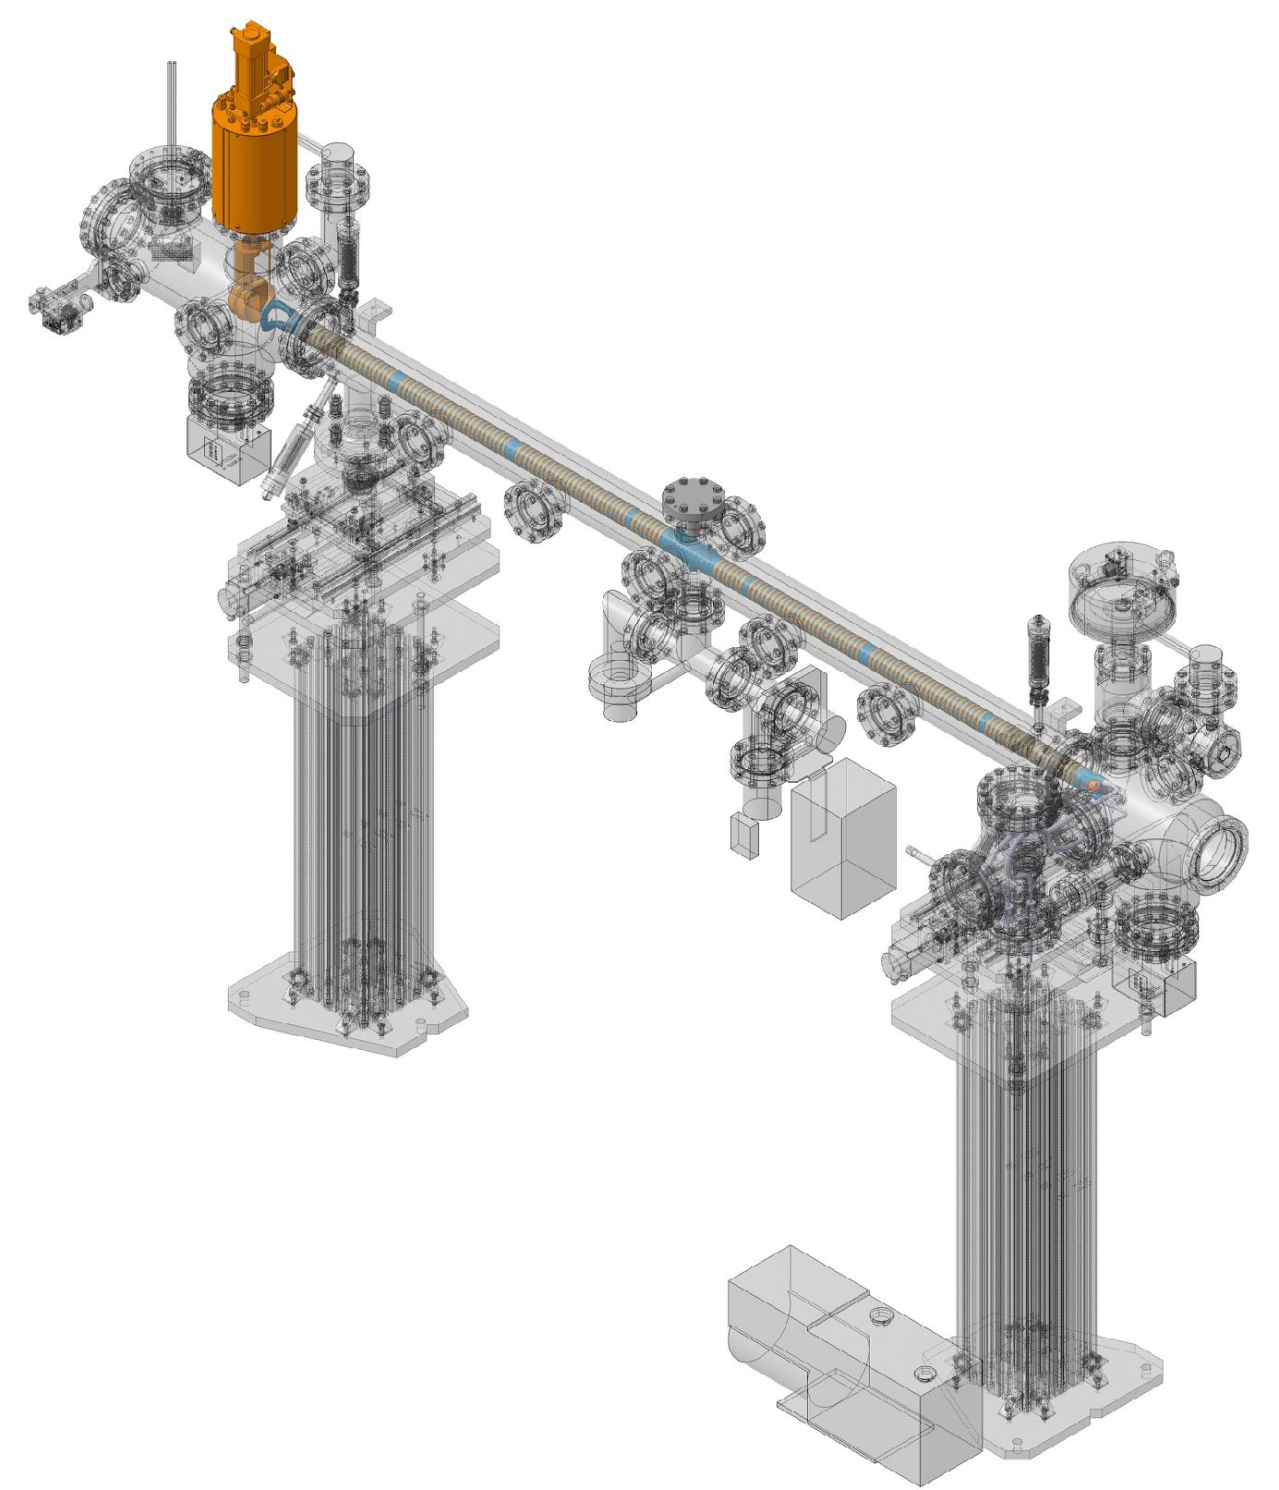
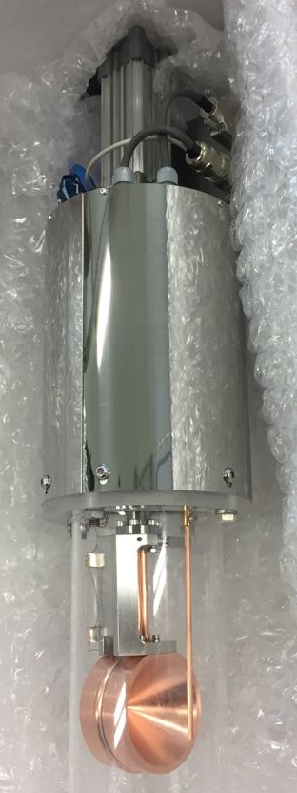
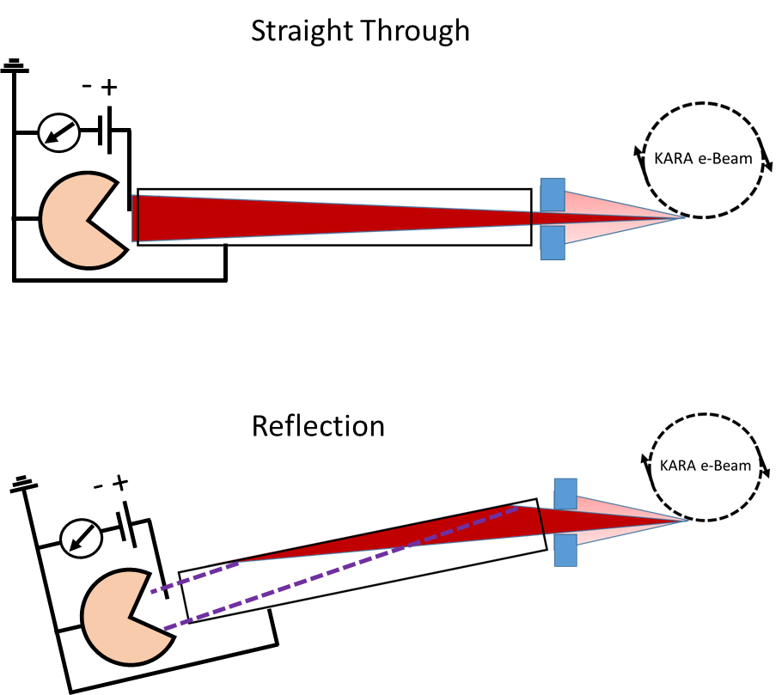

Reflectivity Results
Reflectivity Studies
Experimental Equipment
RI=$\frac{I_{Reflection}}{I_{Straight Through}}x100$
Beam
Photodesorption studies on FCC-hh Beam Screen Prototypes at KARA
17
Luis Gonzalez
CERN TE-VSC
FCC Week 2019 June 26th

Slide 19
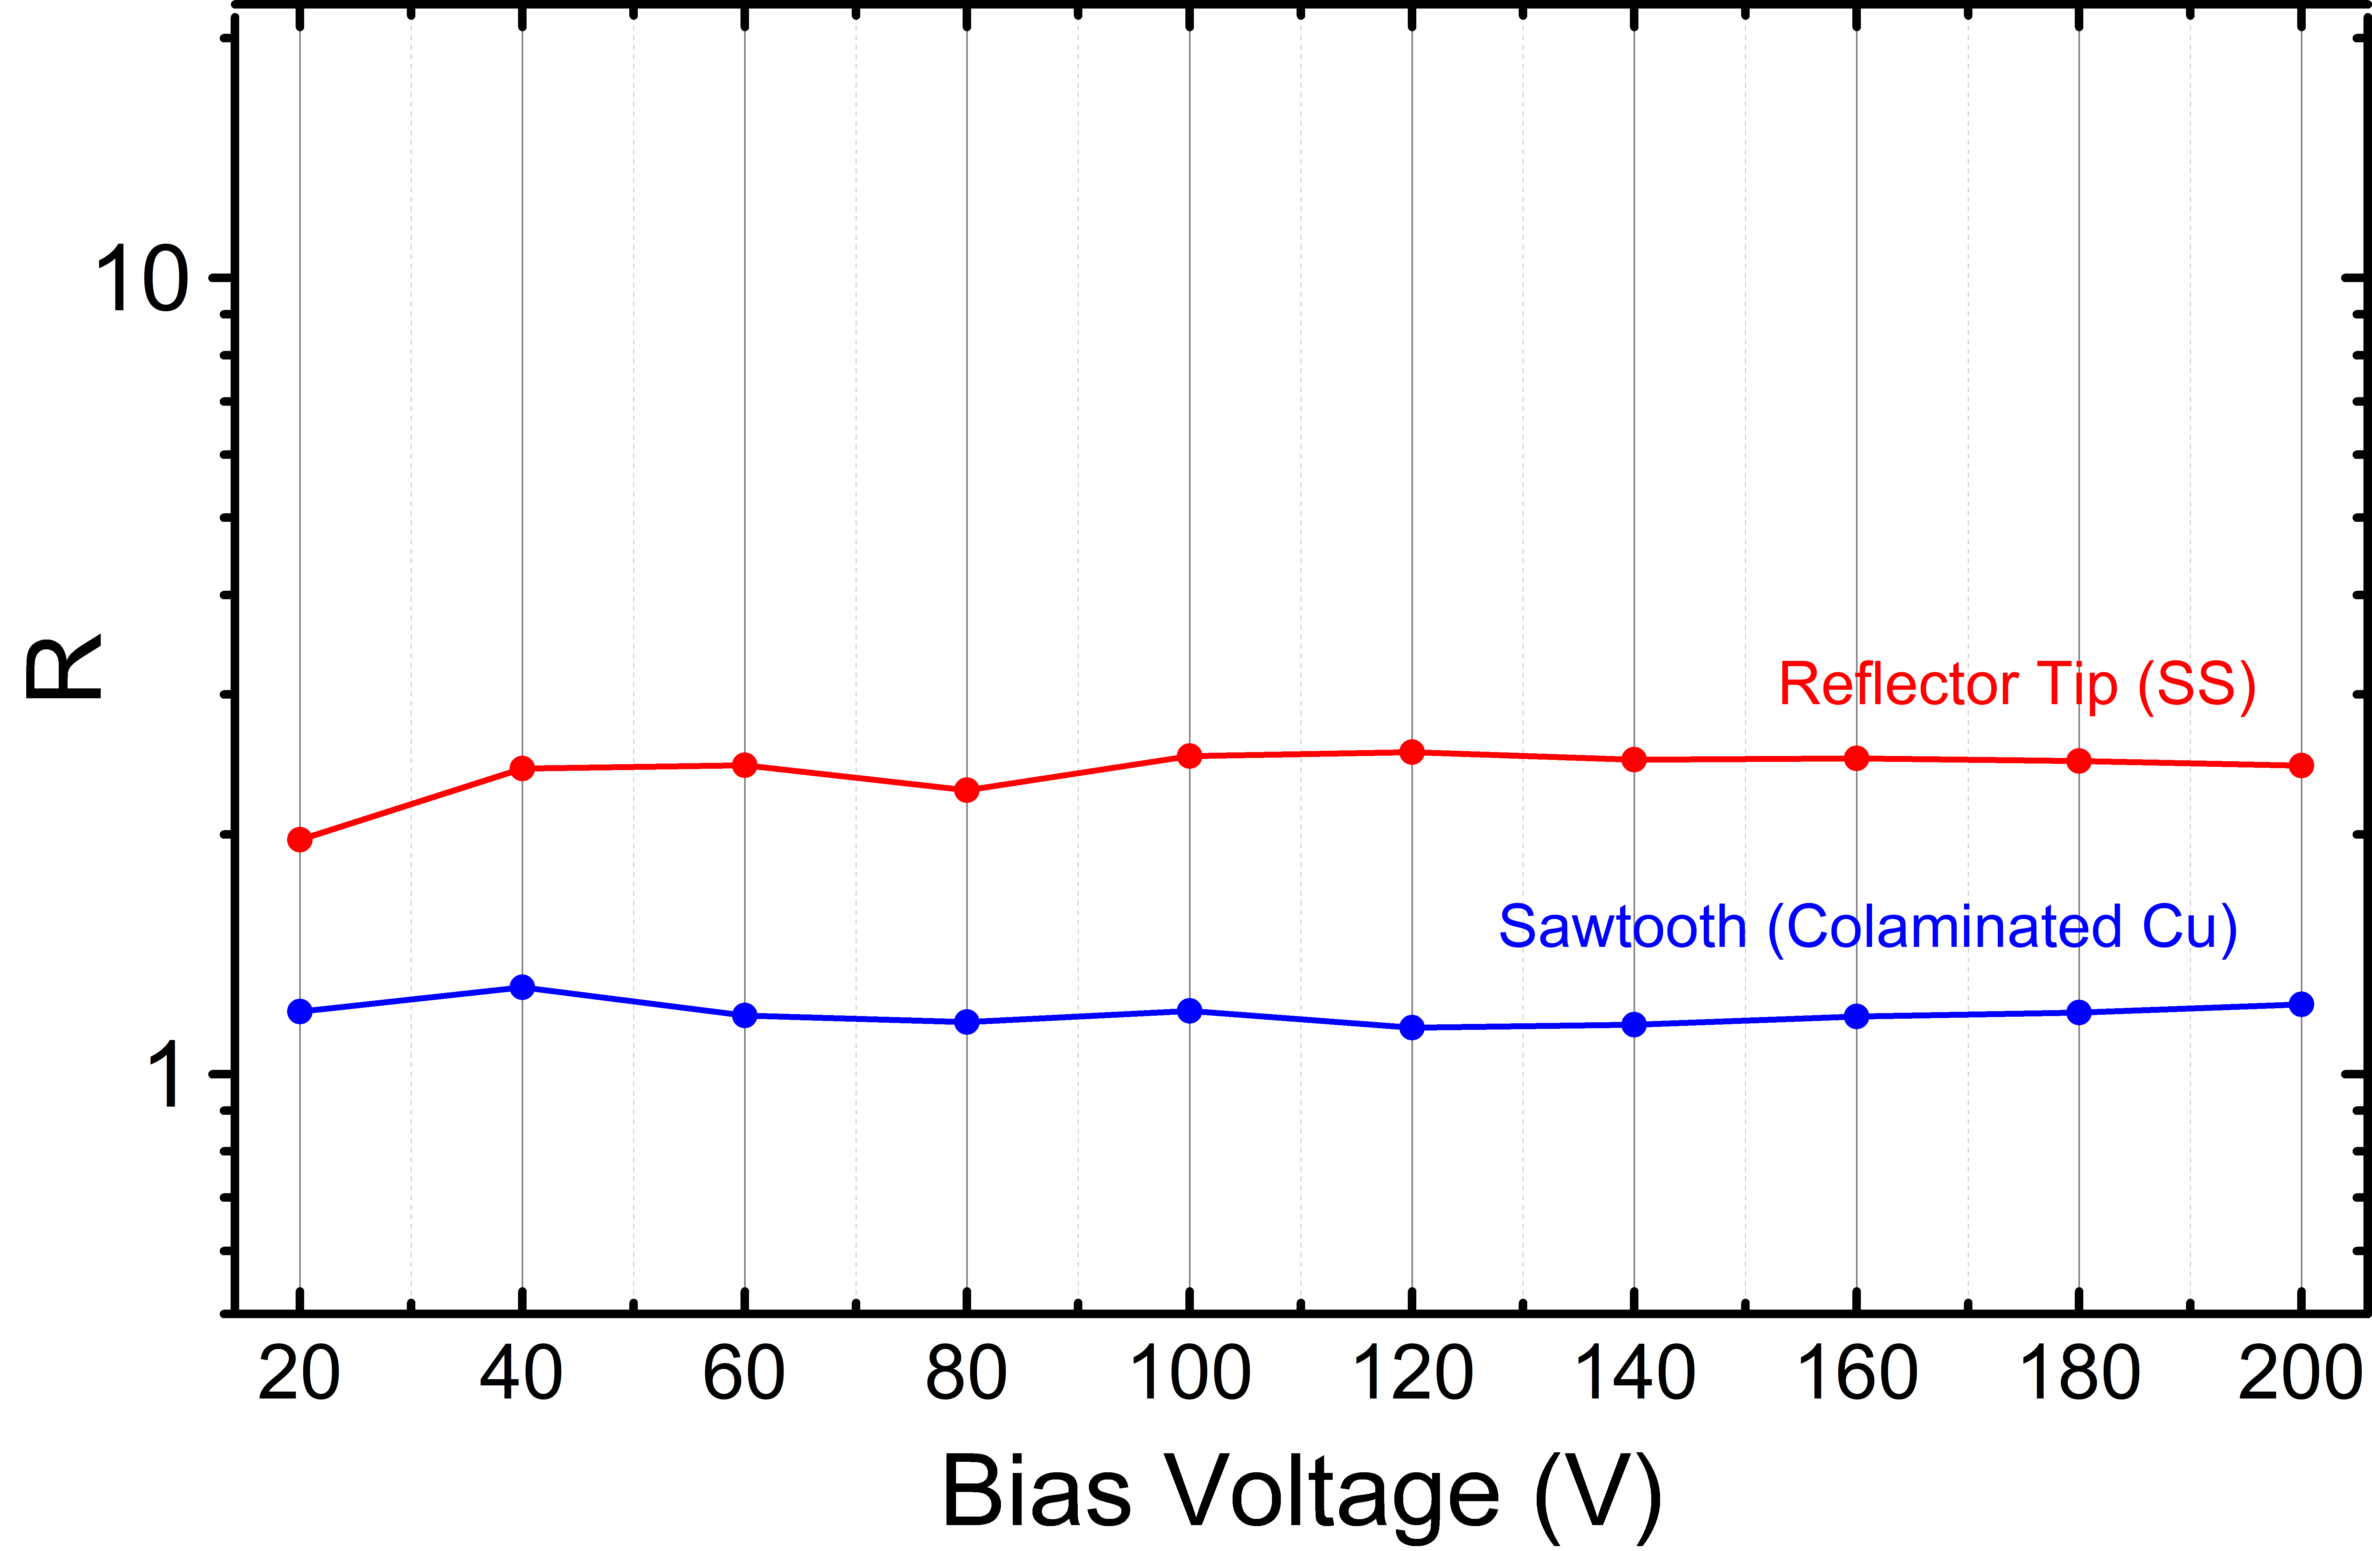

Experiment at KARA
Reflectivity Results
Reflectivity Studies
Experimental Equipment
Reflectivity Studies
Experimental Equipment
First
Prototype
Base Line
RI=$\frac{I_{Reflection}}{I_{Straight Through}}x100$
1
2
1
2
Reflectivity measurements show a reduction of photons reflected downstream the sample in good agreement
with a reduction of PSD yield due to photon absorption
Photodesorption studies on FCC-hh Beam Screen Prototypes at KARA
18
Luis Gonzalez
CERN TE-VSC
FCC Week 2019 June 26th

Slide 20
Summary and Conclusions
Molecular desorption yields have been measured for:
  Stainless steel reflector tip on prototype #1
  Stainless steel reflector tip on prototype #2
  Cu Sawtooth profile on prototype #3
  Cu LASE Surface on prototype #3
The decreasing rate of molecular desorption yield with the dose accumulated on protoype #1 is similar to that previously measured at similar Ec on leak tight vacuum chambers
Molecular yields on prototype #2 (cold sprayed electrode and ceramics). have been found to be considerably higher than for Prototype #. 1This suggests that a large amount of photons are reflected towards the inner chamber of the BS when irradiating the tip. Such experimental results are in good agreement with previous simulation results.
Sample #3 shows a satisfactory behavior under SR in terms of vacuum when irradiating the sawtooth profile and confirms the strategy of changing from reflection to absorption of photons.
Photon cup measurements showed a lower reflectivity for the sawtooth profile than for the reflector tip. Such a result is in good agreement with the reduction of the molecular desorption yield due to an increase of photon absorption by the sawtooth profile.
The molecular desorption yield of LASE, in the geometry of prototype #3, shows a drastic reduction with respect to the sawtooth profile.
Measurements on samples at LN2 temperature are to be performed in the near future.
  Prototype #1
  Prototype #2
  Prototype #3
Photodesorption studies on FCC-hh Beam Screen Prototypes at KARA
19
Luis Gonzalez
CERN TE-VSC
FCC Week 2019 June 26th

Slide 21
Thank You
Photodesorption studies on FCC-hh Beam Screen Prototypes at KARA
Luis Gonzalez
CERN TE-VSC
FCC Week 2019 June 26th

