Slide 1
Infrastructures and implementation
Volker Mertens, CERN
gratefully acknowledging the contributions of
the FCC Infrastructure and Operation WG and sub-WGs,
all FCC study teams and
the collaborating partners (list in annex)
FCC Week 2019
Brussels, 24 June 2019

Slide 2
Infrastructure and Operation topics
Geology & civil engineering
Integration
Electricity distribution
Cryogenics
Cooling & ventilation
Transport & handling
Installation
Planning & coordination
Geodesy, survey & alignment
Controls
Computing
Communications & networks
General safety
Fire safety
Access control
Radiation protection
Environmental protection
Power/energy consumption
Energy efficiency
Operation & maintenance concepts
Availability & reliability
...
Full structure in https://fcc.web.cern.ch/Documents/Organisation/WBS.pdf, hdg “3”.
Amsterdam 2018 for reference: https://indico.cern.ch/event/656491/contributions/2915646/attachments/1628719/2595760/FCC_IO_Overview_Amsterdam_VM_090418.pdf
Total of 35 slides

Slide 3
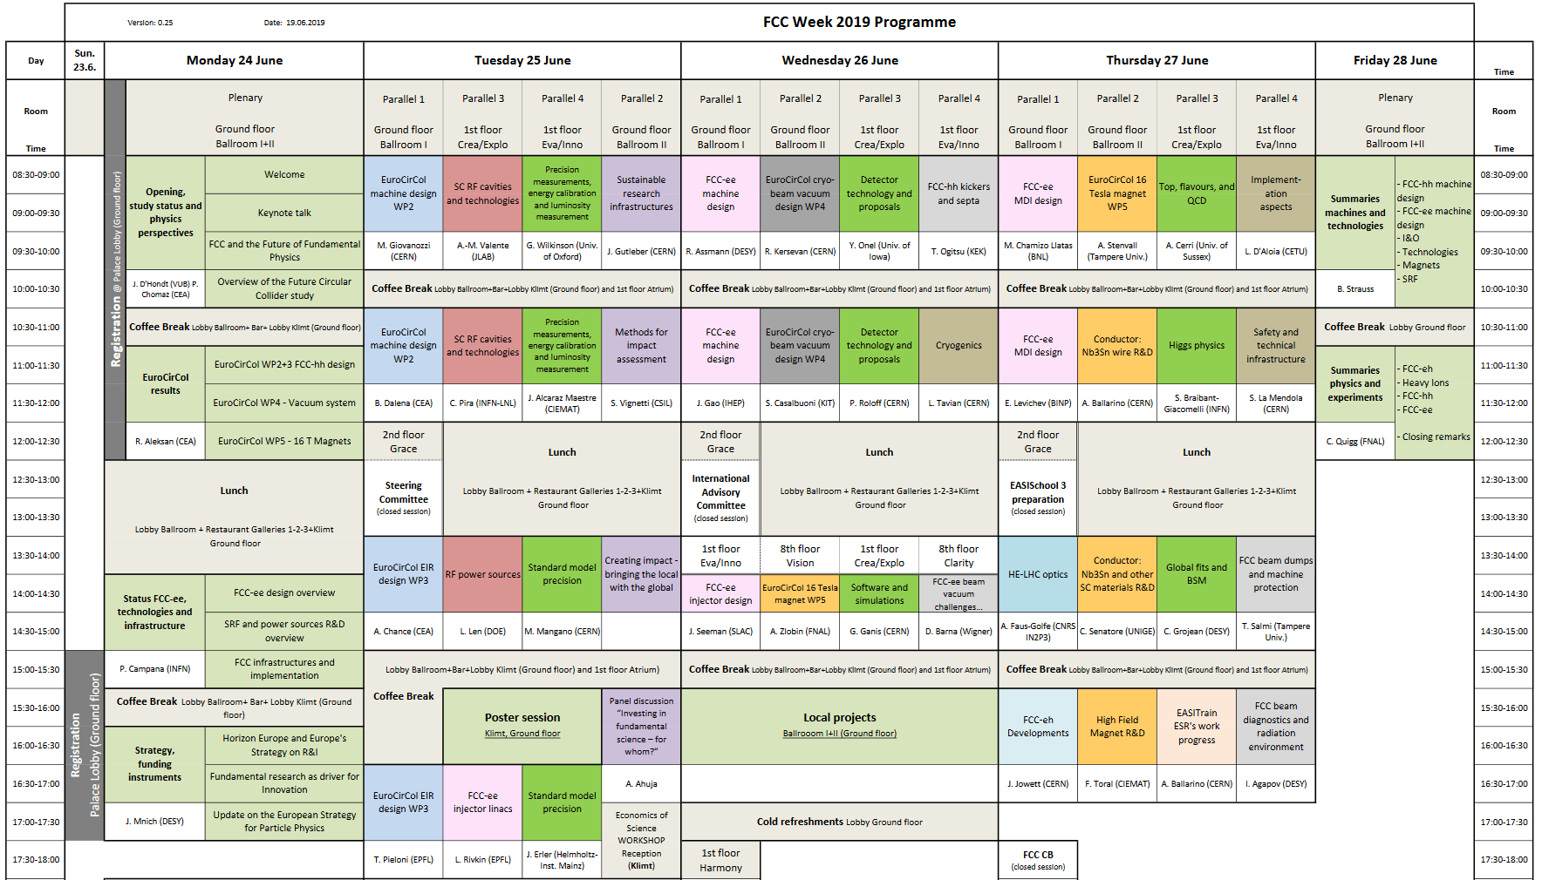
Infrastructure + implementation rel. prog.
Overview (V. Mertens, 25‘+5‘)
Wednesday-Thursday
Implementation aspects
Cryogenics
Safety
Technical infrastructure
Summary of IO related parallel sessions and posters (J. Gutleber, 15‘+5‘)

Slide 4
Oral presentations
Poster list in annex
Monday, 24.6.2019
IO overview, 25+5‘, V. Mertens
Wednesday, 26.6.2019, Cryogenics, chair: L. Tavian
Outcome of the engineering studies for the FCC-hh cryoplants, 25‘+5‘, F. Millet (CEA Grenoble)
FCC-hh inner-triplet cryogenics , 15‘+5‘, C. Kotnig
Improved concept of the Nelium Turbo-Brayton cycle for the FCC-hh beam screen cooling , 15‘+5‘,
          S. Savelyeva (TU Dresden)
Transient conjugate heat transfer numerical simulation in superfluid helium, 15‘+5‘, A. Vitrano (CEA Saclay)
Thursday, 27.6.2019, Implementation aspects, chair: L. D‘Aloia (CETU)
Activities with Host States, 20‘+5‘, J. Gutleber
FCC Host States implementation – institutional and administrative framework, 20‘+0‘, O. Martin (MAE)
Civil engineering summary – cost drivers, risk factors, schedule for preparatory phase, 15‘+5‘, A. Tudora
Excavation material use strategy, 10‘+5‘, Prof. R. Galler (U Leoben)
Analysis of excavation materials in view of re-use, 10‘+0‘, M. Haas (U Leoben)
Thursday, 27.6.2019, Safety and technical infrastructure, chair: S. La Mendola
Safety topics requiring further investigation, 17‘+5‘, T. Otto
Study of HE-LHC ventilation strategy in case of fire, 17‘+5‘, O. Rios
Update on R2E and heat load simulations, 17‘+4‘, J. Hunt
Geodetic infrastructure and alignment – planning and studies, 20‘+5‘, M. Jones
Friday, 28.6.2019
IO summary, 15+5‘, J. Gutleber
Blue info boxes → presentations

Slide 5
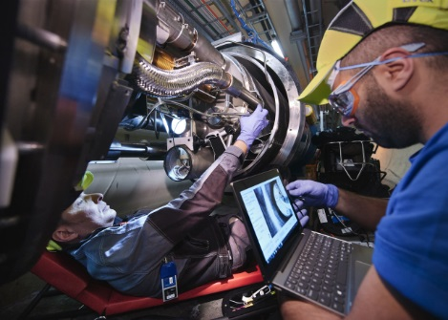
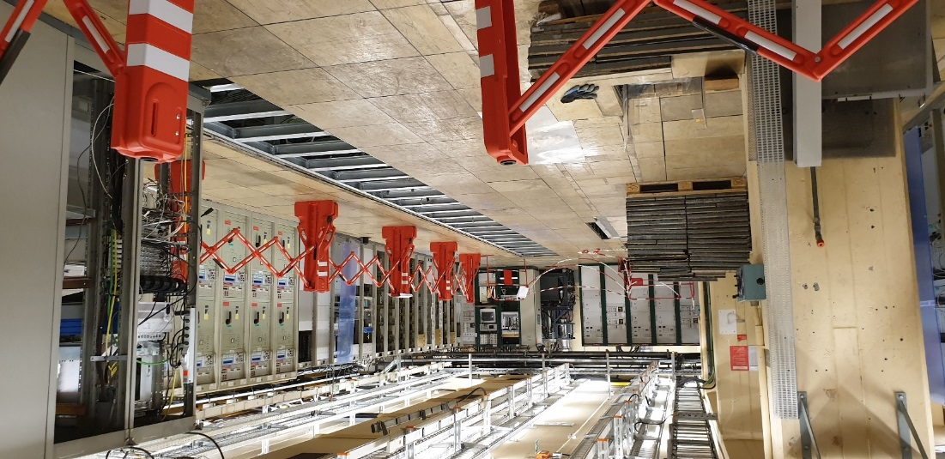
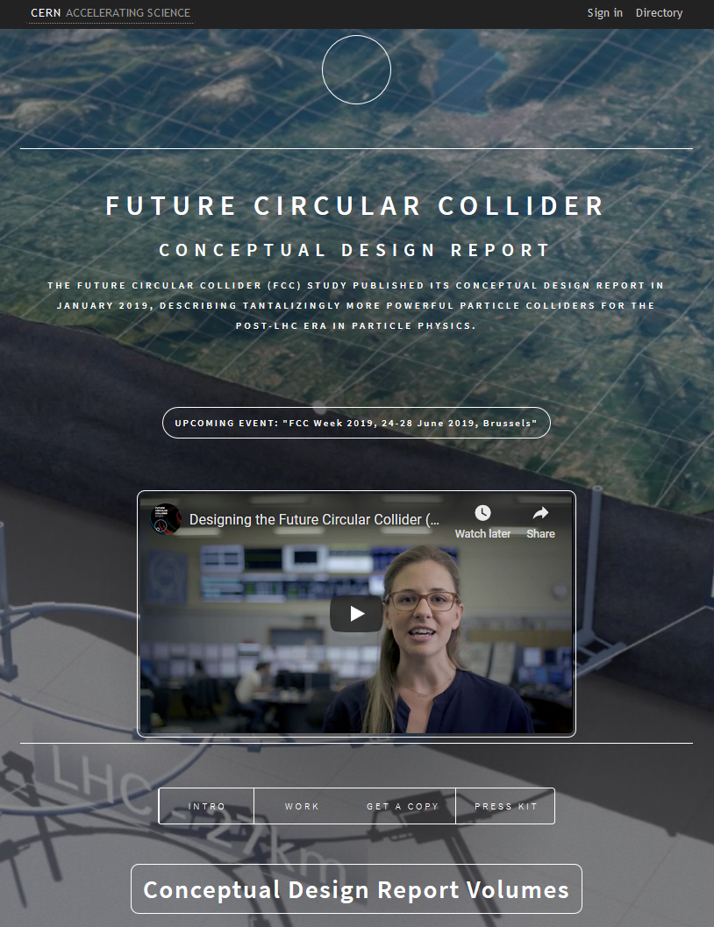
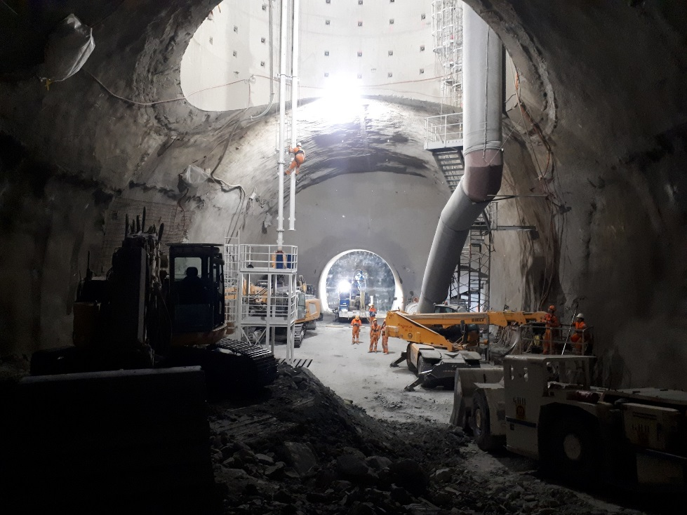

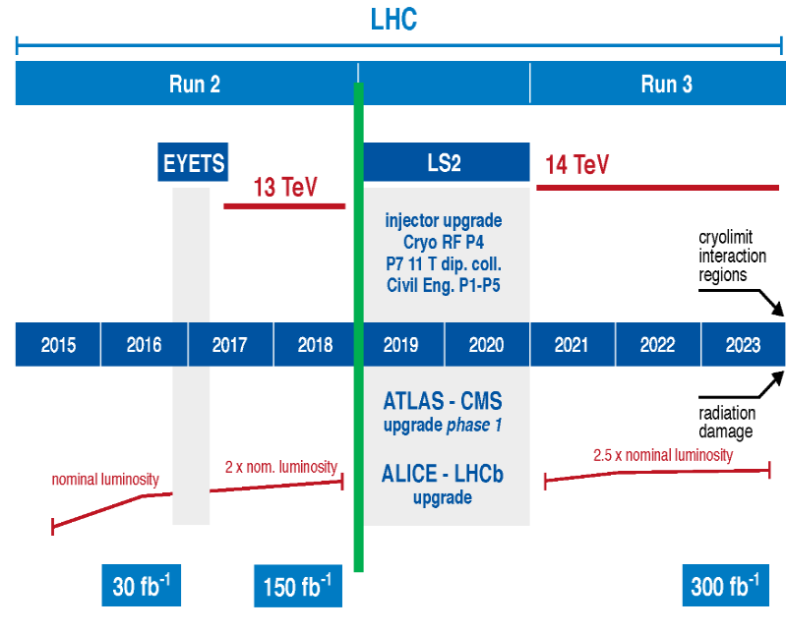
Since Amsterdam …
Long shutdown 2
LHC diode insulation
PSB power converter renovation/upgrade
IO contributed some 150 pages to the 3 CDR machine volumes, providing conceptual designs for many systems and aspects
Working on the HL-LHC project
Preparing for a smooth restart of Run 3
Pt 1 CE worksite

Slide 6



Institutional + administrative framework
Several main challenges ...
Institutional:
2 Host States, with different institutional architectures, different legislation, ...
Environmental:
Densily populated area, land scarcity, protected zones, ...
Timeframe:
Full-speed work in 2019-2025 to prepare for possible project approval
1 interlocutor: 2 interlocutors
French state Swiss Confederation
Cantonal State of Geneva
Main administrative tasks identified
(among them environmental impact study, public debate, preparation for land provision, ...)
Lots of work ahead until 2025
Keywords: trust, anticipation/cooperation,
environmental and legal exemplarity, local acceptance/communication
Thursday, 8:30: FCC Host States implementation – institutional and administrative framework (O. Martin)
O. Martin / MAE (France)

Slide 7
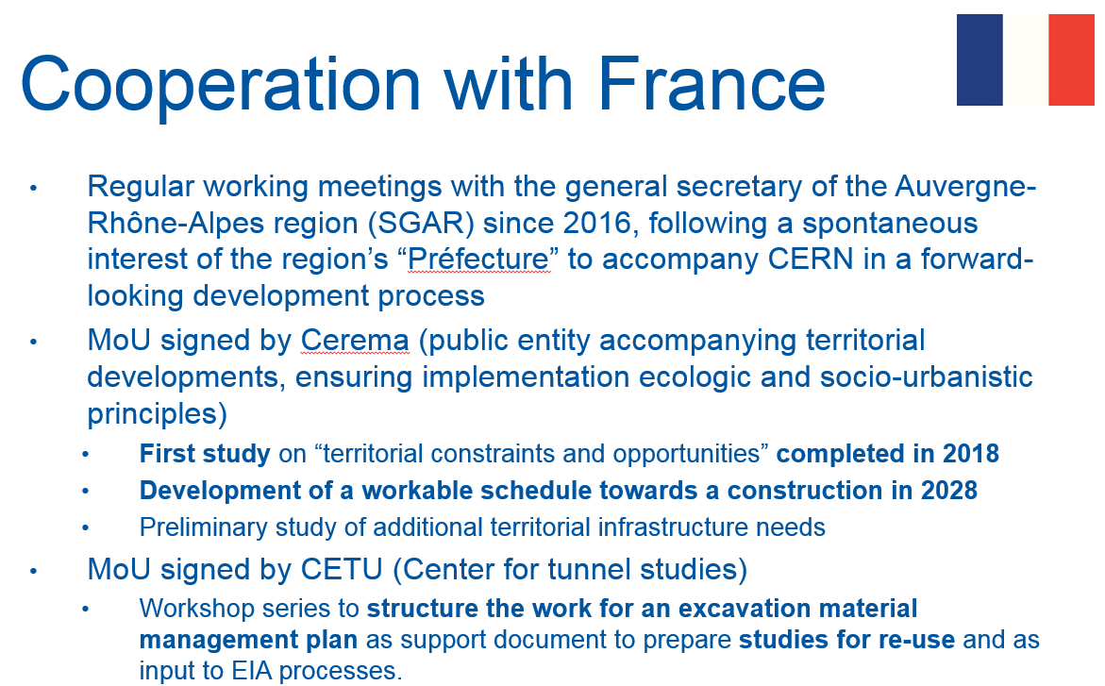
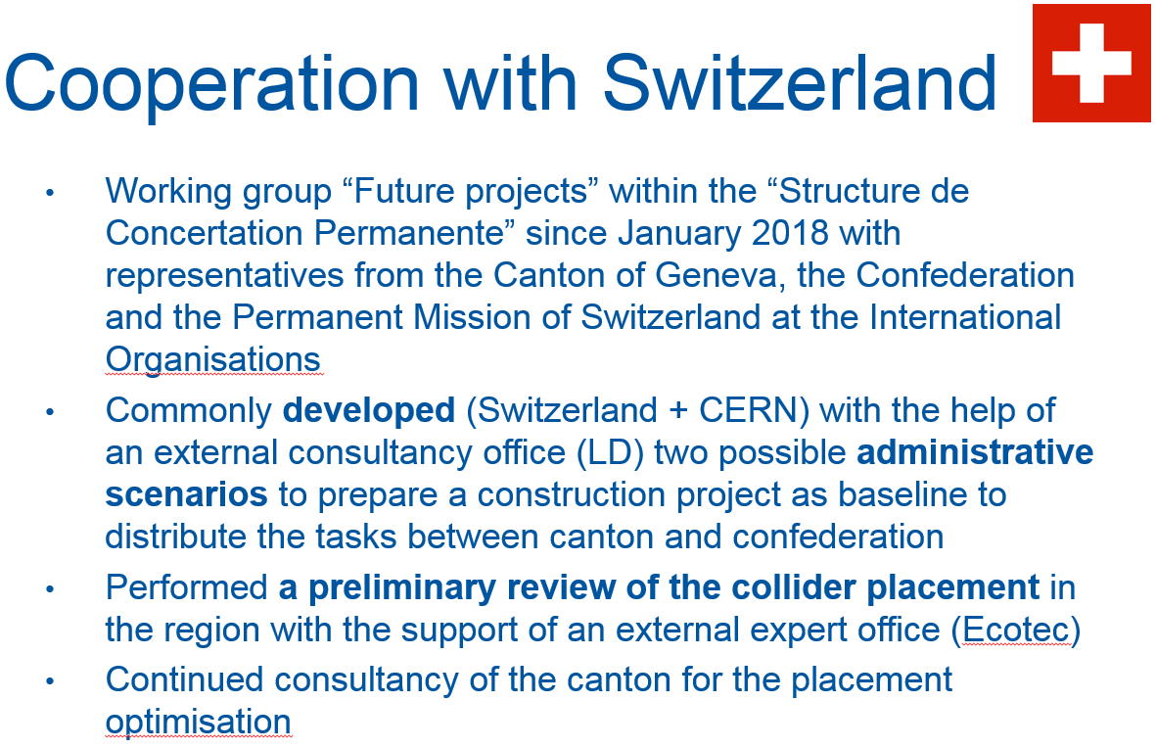
Activities with Host States
Subsidiarity Principle (valid in EU including F, as well as CH):
Social and political issues should be dealt with at the most immediate (or local) level that is consistent with their resolution.
Public projects need to ensure that all relevant stakeholders are involved
from an early concept phase.
Decisions to support a project are based on public acceptance,
significantly before the decision to construct.
Significant time needed for preparatory phase
(letting benefit the later implementation phase since decision based on broad public support).
Thursday, 8:30: Activities with Host States (J. Gutleber)
J. Gutleber / ATS-DO

Slide 8
Activities with Host States
Processes exist and have been identified,
in F and CH and for topics of transnational interest.
These need to be carried out as soon as possible
BEFORE a possible project decision with timeframe 2026.
The processes are “project scenario specific”
(i.e. concrete, not generic).
Host States are actively supporting this approach
and willing to collaborate.
All institutional and public stakeholders to be involved
as from 2020.
Timing and proper sequencing of activities is crucial
(dependencies).
The processes in the 2 Host States need to be integrated.
„Preparatory phase project“ (and team) to be set up.
Document the invariants and parts of the scenarios
which still contain some degrees of freedom (by mid-2020).
This documentation will be baseline for „political scenario validations“.
Thursday, 8:30: Activities with Host States (J. Gutleber)
J. Gutleber / ATS-DO

Slide 9
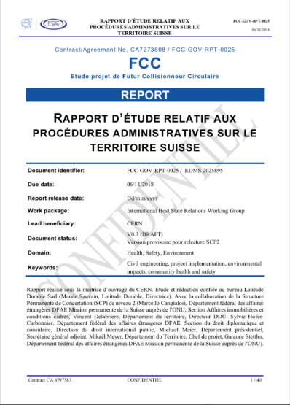

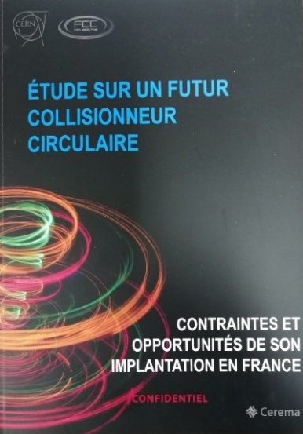
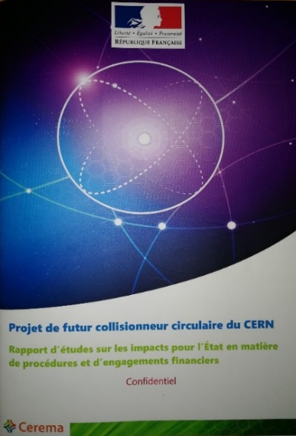
Activities with Host States
Highest priority now to optimise the FCC placement
Baseline document set
Following the commonly agreed “avoid-reduce-mitigate” approach using a documented risk management process.
Working together with public offices and companies with experience in large-scale projects in the region.
Constraint list
for each country established.
Idem opportunities listed
which need to be further
analysed (infrastructure
network, socio-economic, ...).
Données générales
Masse d’eau souterraine
Ecoulement masse d’eau
Biodiversité: inventaire
Biodiversité: protections
SRCE Rhône Alpes
Biodiversité et eau
Risques: argiles
Risques: inondations
Risques: sismique
Risques: technologiques
Densité population
Unités paysagères
Protections paysagères
Documents urbanisme
Réseau d’électrique
Réseau routier
Example (F)
Thursday, 8:30: Activities with Host States (J. Gutleber)
J. Gutleber / ATS-DO

Slide 10
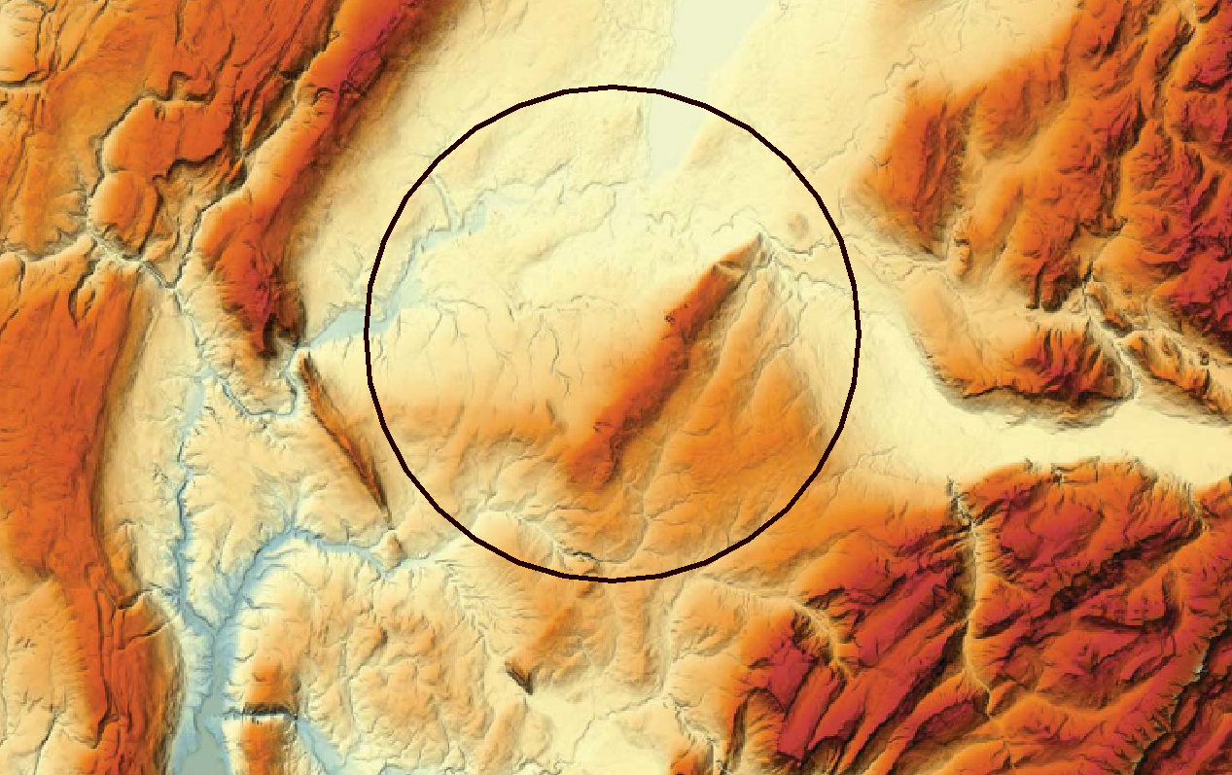

Footprint constraints and criteria
Lac Léman
300 – 372 m/mer
Urbanistic and environmental (constructed zones, zones under development, particularly protected agricultural areas, natural reserves, underground water reservoirs, ...)
Lake depth
Limestone
Plaine du genevois
350 – 550 m/mer
Vallée du Rhône
∼330 m/mer
Limestone
Mont Salève
550 - 1380
Valée de l’Arve
400 – 600 m/mer
Plateau du Mont Sion
550 – 860 m/mer
Mont Vuache
550 - 1100
Plateau des Bornes
600 – 850 m/mer
Shaft depths
Overburden
Machine design + performance (circumference, LSS lengths, short and long arc lengths, radius, symmetries, transfer line lengths and geometries, ...)
Topographical (altitude, rivers, lake)
Geological (strata, layer boundaries, fault lines)
Mandallaz
Man-made (pipelines, geothermal boreholes, ...)

Slide 11
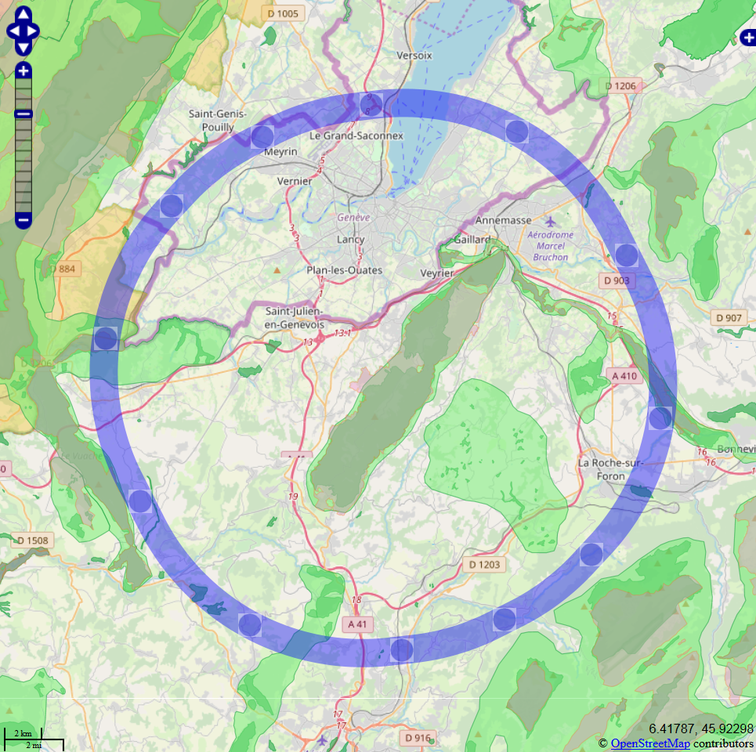
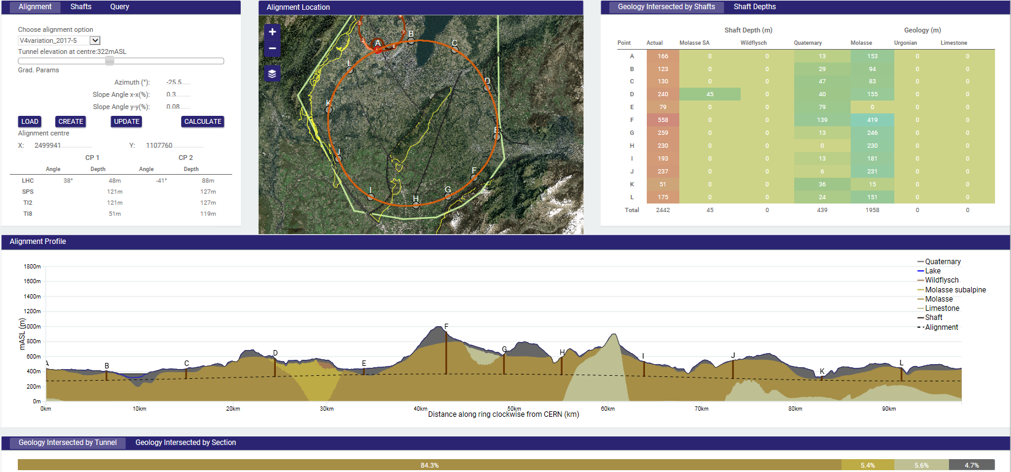
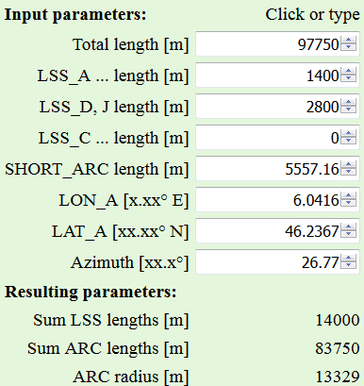
Speed-up of footprint exploration
Tunnel Optimisation Tool (TOT)
CE oriented; strong points:
3D geometry, geological layers, shaft depths, opportunities for inclined access (replacing a shaft)
but time- and manpower-intensive iterations
when wanting to test different collider shapes
(circumference, LSS/arc lengths,
other constraints like protected zones)
JavaScript front-end based on OpenStreetMap/OpenLayers
allows rapid first exploration of different access point configurations wrt to constraints from surface features and zones (in 2D).

Slide 12
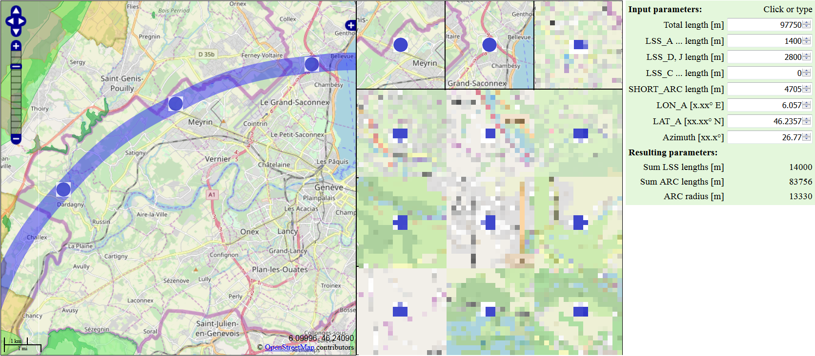
Footprint exploration
EXAMPLE
Map data: © OpenStreetMap contributors
Library/API: OpenLayers
Zones (F): Inventaire National du Patrimoine Naturel ESRI Shapefile → .KMZ format conversion: QGIS
(copyright and license)
Varying all indicated input parameters
(within „reasonable“ limits, e.g. „SHORT_ARC“ length only in multiples of FODO cells).
Once a new set of suitable surface points has been identified
→ further exploration and optimisation of CE/geological aspects with TOT
(depths, tilt, geology, overburden, ...).
Could enhance that software by 3D or even automatic optimisation wrt exclusion zones
(good comprehensive parametrisation not evident).

Slide 13
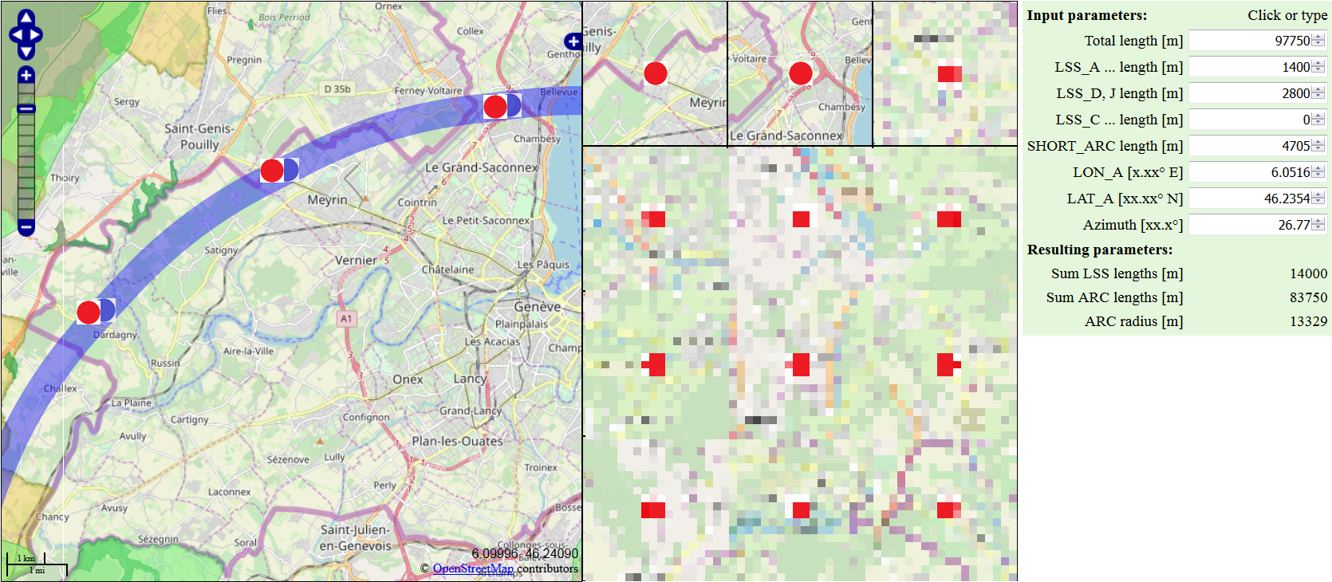
Footprint exploration
EXAMPLE
Map data: © OpenStreetMap contributors
Library/API: OpenLayers
Zones (F): Inventaire National du Patrimoine Naturel ESRI Shapefile → .KMZ format conversion: QGIS
(copyright and license)
Varying all indicated input parameters
(within „reasonable“ limits, e.g. „SHORT_ARC“ length only in multiples of FODO cells).
Once a new set of suitable surface points has been identified
→ further exploration and optimisation of CE/geological aspects with TOT
(depths, tilt, geology, overburden, ...).
Could enhance that software by 3D or even automatic optimisation wrt exclusion zones
(good comprehensive parametrisation not evident).

Slide 14
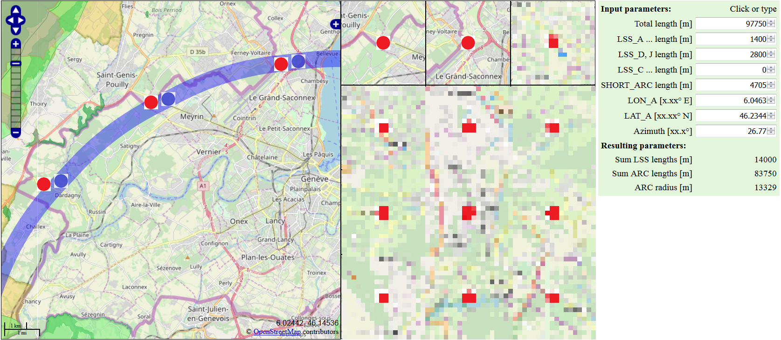
Footprint exploration
EXAMPLE
Map data: © OpenStreetMap contributors
Library/API: OpenLayers
Zones (F): Inventaire National du Patrimoine Naturel ESRI Shapefile → .KMZ format conversion: QGIS
(copyright and license)
Varying all indicated input parameters
(within „reasonable“ limits, e.g. „SHORT_ARC“ length only in multiples of FODO cells).
Once a new set of suitable surface points has been identified
→ further exploration and optimisation of CE/geological aspects with TOT
(depths, tilt, geology, overburden, ...).
Could enhance that software by 3D or even automatic optimisation wrt exclusion zones
(good comprehensive parametrisation not evident).

Slide 15
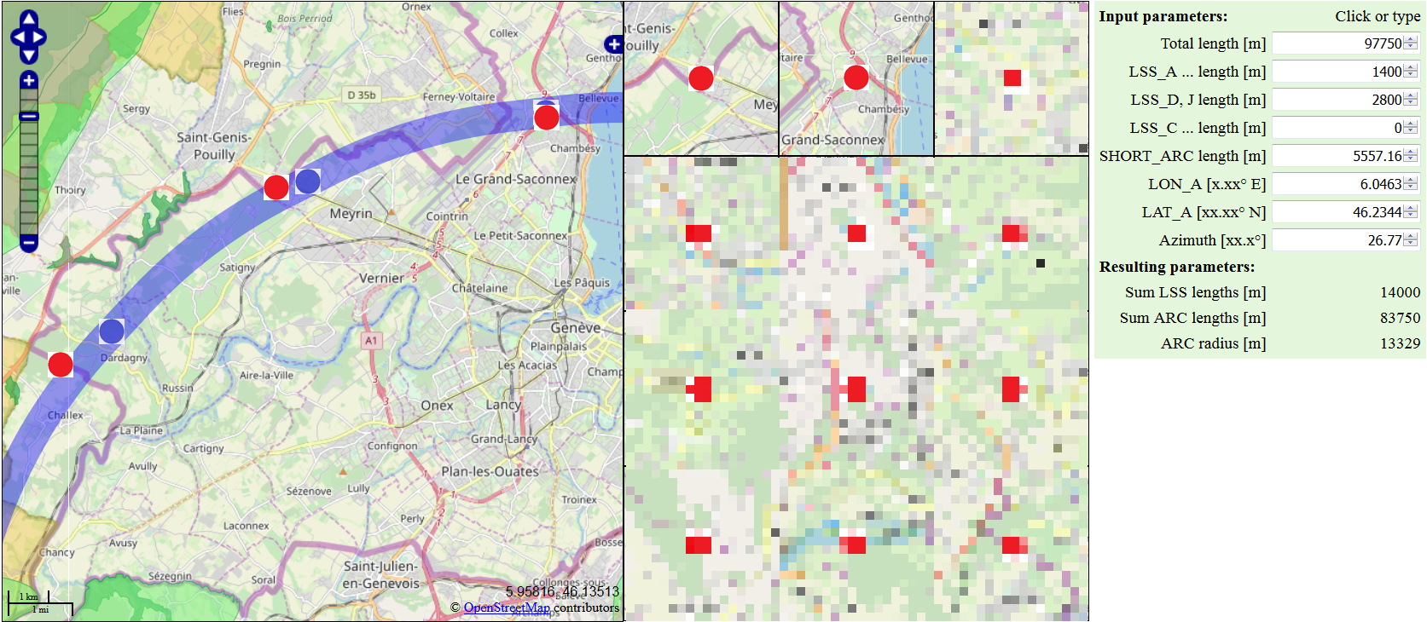
Footprint exploration
EXAMPLE
Map data: © OpenStreetMap contributors
Library/API: OpenLayers
Zones (F): Inventaire National du Patrimoine Naturel ESRI Shapefile → .KMZ format conversion: QGIS
(copyright and license)
Varying all indicated input parameters
(within „reasonable“ limits, e.g. „SHORT_ARC“ length only in multiples of FODO cells).
Once a new set of suitable surface points has been identified
→ further exploration and optimisation of CE/geological aspects with TOT
(depths, tilt, geology, overburden, ...).
Could enhance that software by 3D or even automatic optimisation wrt exclusion zones
(good comprehensive parametrisation not evident).

Slide 16
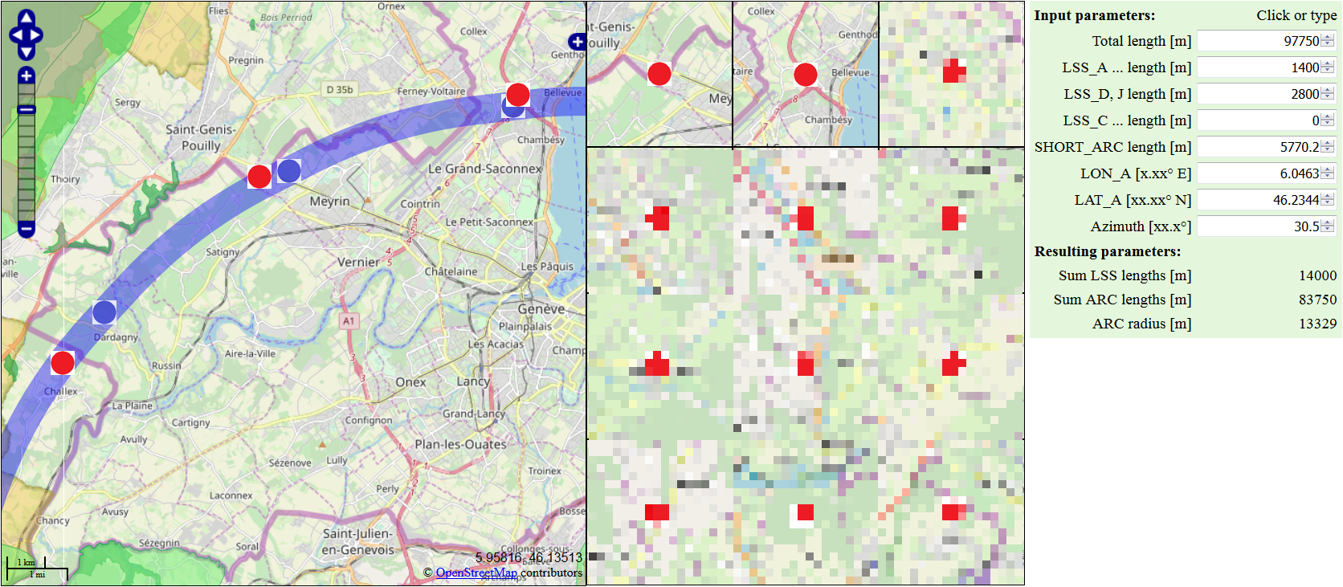
Footprint exploration
EXAMPLE
Map data: © OpenStreetMap contributors
Library/API: OpenLayers
Zones (F): Inventaire National du Patrimoine Naturel ESRI Shapefile → .KMZ format conversion: QGIS
(copyright and license)
Varying all indicated input parameters
(within „reasonable“ limits, e.g. „SHORT_ARC“ length only in multiples of FODO cells).
Once a new set of suitable surface points has been identified
→ further exploration and optimisation of CE/geological aspects with TOT
(depths, tilt, geology, overburden, ...).
Could enhance that software by 3D or even automatic optimisation wrt exclusion zones
(good comprehensive parametrisation not evident).

Slide 17
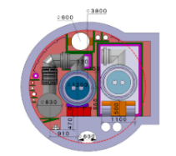



CE study progress
Cost and schedule estimate compatible with the CDR baseline for all 3 machines: FCC-hh, FCC-ee and FCC-eh
Refinement of results (fire compartments, cavern spacing)
Additional ILF studies (cash flow, spoil volume per site, HL-LHC cost comparison)
HE-LHC
Requirements gathe-red from cryogenics, electricity and HVAC, which determined the modifications needed for HE-LHC for civil engineering
Cost estimate produ-ced
Spoil Management
Study of the molasse re-use (approx. 9 Mm³ of spoil in total)
Samples tested from HL-LHC sites
Positioning
Development of common method to assess risks of surface sites, first reviews
Layout optimisation based on geology, shafts depth, construc-tion risks
Ongoing work:
Surface site investigation
Site investigation planning
Spoil management study
Transfer line design
May 2018
Aug. 2018
Sep. 2018
Dec. 2018
Jan.- June 2019
Ongoing
CDR volumes submitted to Update of
European Strategy for Particle Physics
Thursday, 8:30: Civil engineering summary – cost drivers, risk factors, schedule for preparatory phase (A. Tudora)
A. Tudora + J. Osborne / SMB-SE

Slide 18


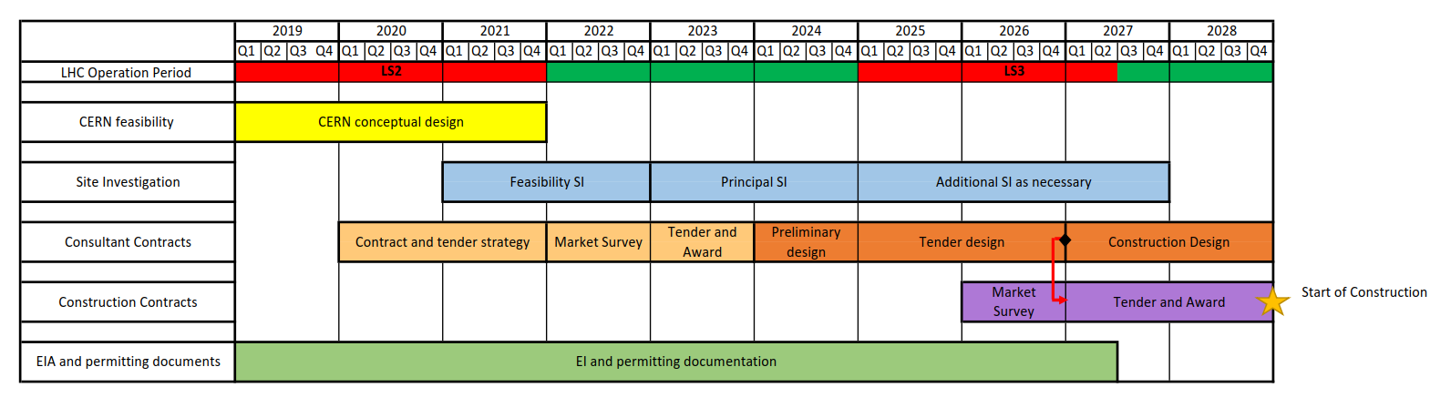
Schedule for preparatory phase
CDR
European Strategy Update 2020
Feasibility SI
(2021-2022)
Walkover survey
Geophysical investigation of all access points, Geneva Lake crossing, Rhône and Arve Valley
Principal SI (2023-2024)
Phase 1 – site investigations required for the development of preliminary design
Phase 2 – confirmation of geological profiles and engineering design parameters
Phase 3 – additional explorations needed for refined cost estimate
Types of site investigations:
Boreholes
Site testing (e.g. in-situ stress test, point load testing, SPT, CPT, permeability tests)
Rock laboratory testing (e.g. uniaxial compressive strength, petrographic studies)
Additional SI (2025-2027)
Additional data might be required after preliminary design for a more detailed geological evaluation
Thursday, 8:30: Civil engineering summary – cost drivers, risk factors, schedule for preparatory phase (A. Tudora)
A. Tudora + J. Osborne / SMB-SE

Slide 19
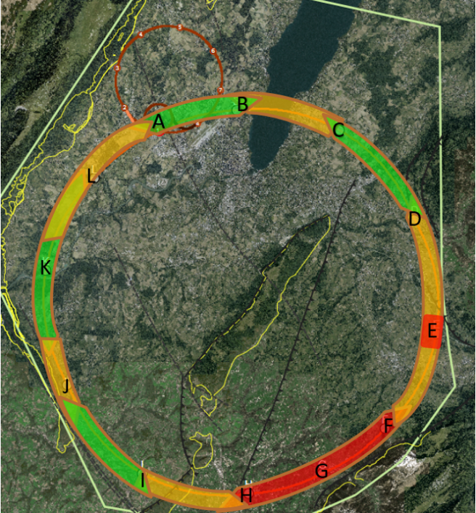
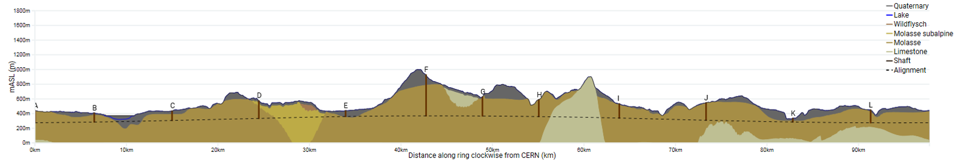
Geological uncertainty
and features of interest
Information near to CERN is strong due to previous experience on LEP/LHC.
Multiple deep boreholes in the area.
Seismic and borehole information for lake crossing from proposed road tunnel, but layered nature of lake bed leads to uncertainty.
Alignment close to limestone rockhead.
The exact location and angle of the limestone/molasse interface undefined.
Location of the interface between molasse and molasse subalpine uncertain, tunnel alignment in proximity.
Moraine/molasse interface uncertain, cavern close to interface.
Lack of deep boreholes in area.
Limestone formation known, but characteristics and locations of karsts unknown.
Lack of deep borehole in area.
Complex faulted region.
Molasse/limestone interface uncertain.
Mandallaz
Vallée de l‘Arve
Le Rhône
Lake Geneva
Shafts in shallow moraine deposits; Point of connection to LHC in deep moraines | Crossing of Lake Geneva and deep shaft in moraine | Reported faulting and interfaces between molasses types and deep shaft in moraine | Low cover to the Arve alluviums | Deepest point of the project | Possible interfaces with limestone and deep shaft in moraine | Interfaces between limestone and molasse. Possibly karst and Mandallaz fault | Interfaces between limestone and molasse. Zones of low rock head and cover with possibility of poor rock | Possible interfaces with limestone at depth and worsening ground towards K | Low cover to the Rhône alluviums | Allondon Fault and possible zones of poor rock, level of limestone
Main geological features of interest
Thursday, 8:30: Civil engineering summary – cost drivers, risk factors, schedule for preparatory phase (A. Tudora)
A. Tudora + J. Osborne / SMB-SE

Slide 20
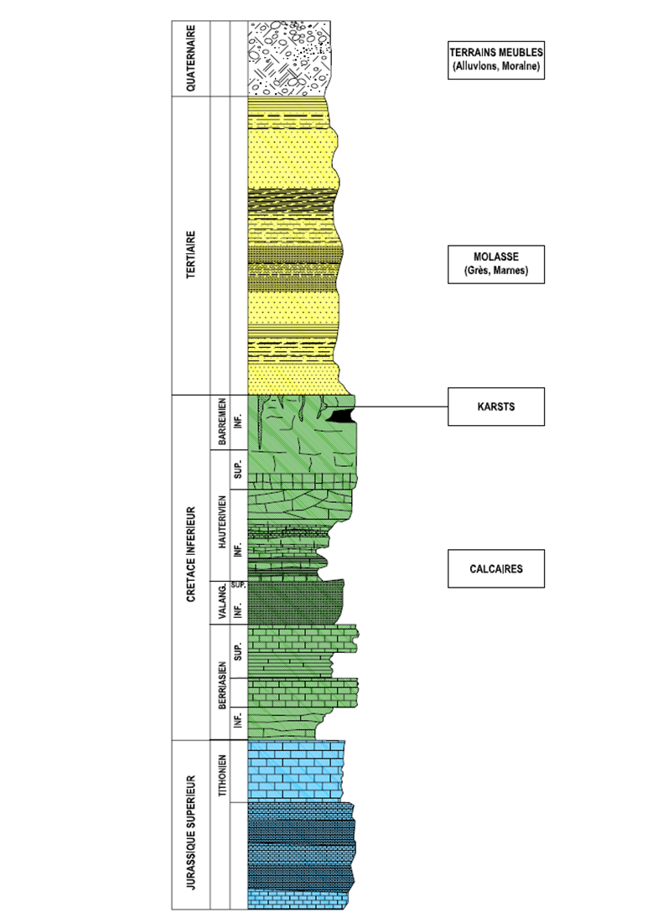
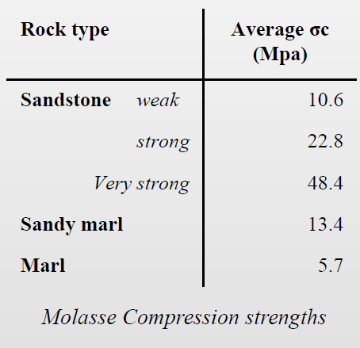
Geology in region
Moraines
  Glacial deposits comprising gravel, sands, silt and clay
  Water bearing unit
  Low strength
Molasse
  Mixture of sandstones, marls and
  formations of intermediate composition
  Considered good excavation rock
  Relatively dry and stable
  Relatively soft rock
  However, some risk involved:
  structural instability (swelling, creep, squeezing)
Limestone
  Hard rock
  Normally considered as sound tunneling rock
  In this region fractures and karsts encountered
  High inflow rates measured during LEP construction
  (600 l/sec)
  Clay-silt sediments in water filling karsts
M. Haas / Montanuniversität Leoben + SMB-SE

Slide 21

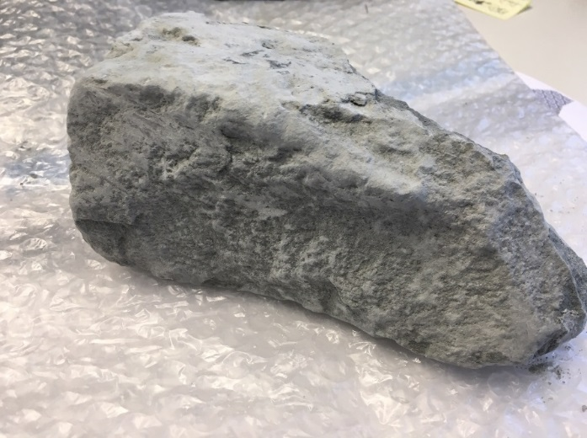
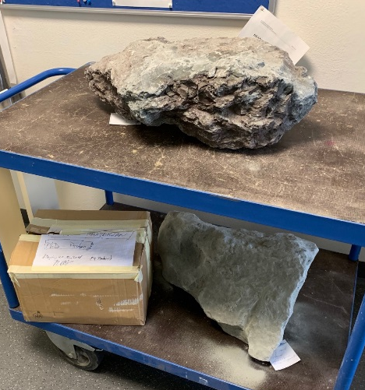
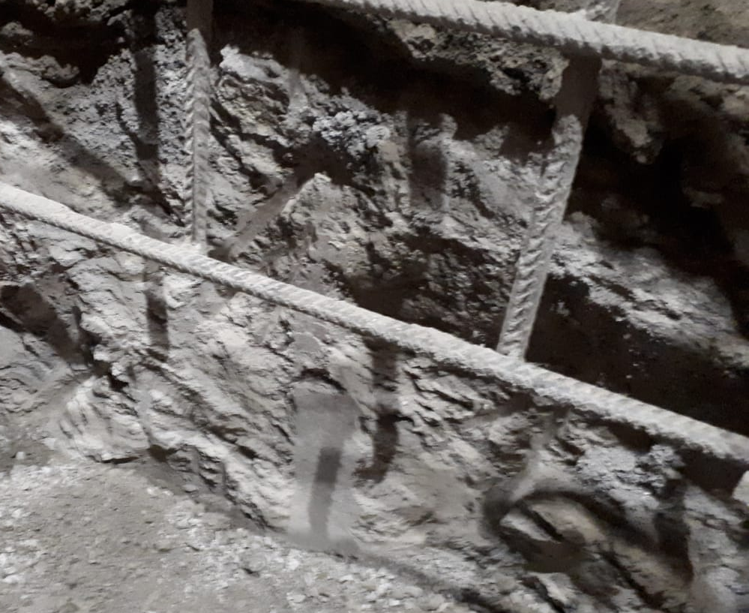
Study of molasse re-use
M. Haas / Montanuniversität Leoben + SMB-SE
Done so far
Legal and technical literature research
Derivation of legal framework (“state-of-the-art”) for the treatment and re-use of tunnel excavation material, explicitly for the FCC study
Close cooperation with GESDEC, CETU, MARTI AG, SETEC
  Received laboratory results (pollution analyses)
  Point 1 construction site, exchanging data
First samples taken at HL-LHC Point 1 and tested:
  Chemical composition
  Mineralogical composition
To come
Regular meetings with CETU & GESDEC to derive a French & Swiss guideline
Further sampling (up to 100) along FCC path to:
  Obtain new mineralogical, chemical, petrophysical & geotechnical data + combine them with existing data from previous projects (e.g. LHC, SPS, …)
  Distinguish between “red” and “grey” molasse
  Taken samples from HL-LHC Point 5
  Re-use with regard to excavation method (e.g. TBM type)
weak marl
first sample (weak marl)
support mesh
30 % of quartz content
(diamitite)
core
samples
hard porous sandstone
molasse (weak to medium marl)
Thursday, 8:30:
Excavation material use strategy (Prof. R. Galler)
Analysis of excavation materials in view of re-use (M. Haas)
GESDEC = Service de géologie, sols et déchets (Genève / CH)
CETU = Centre d’études des tunnels / F

Slide 22
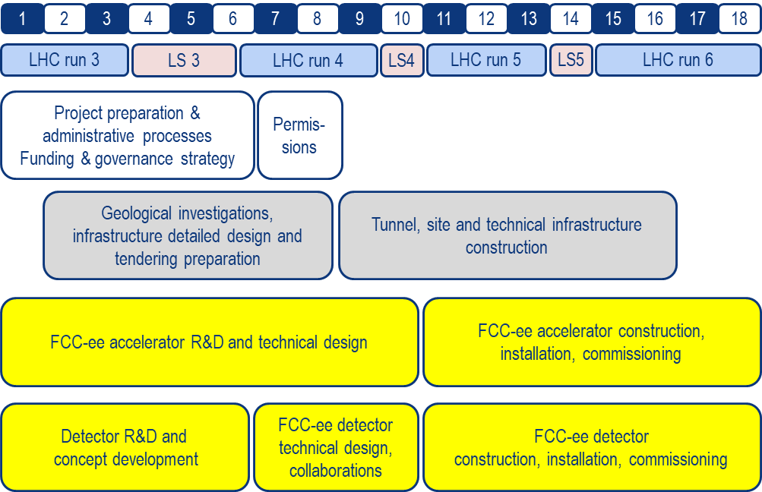

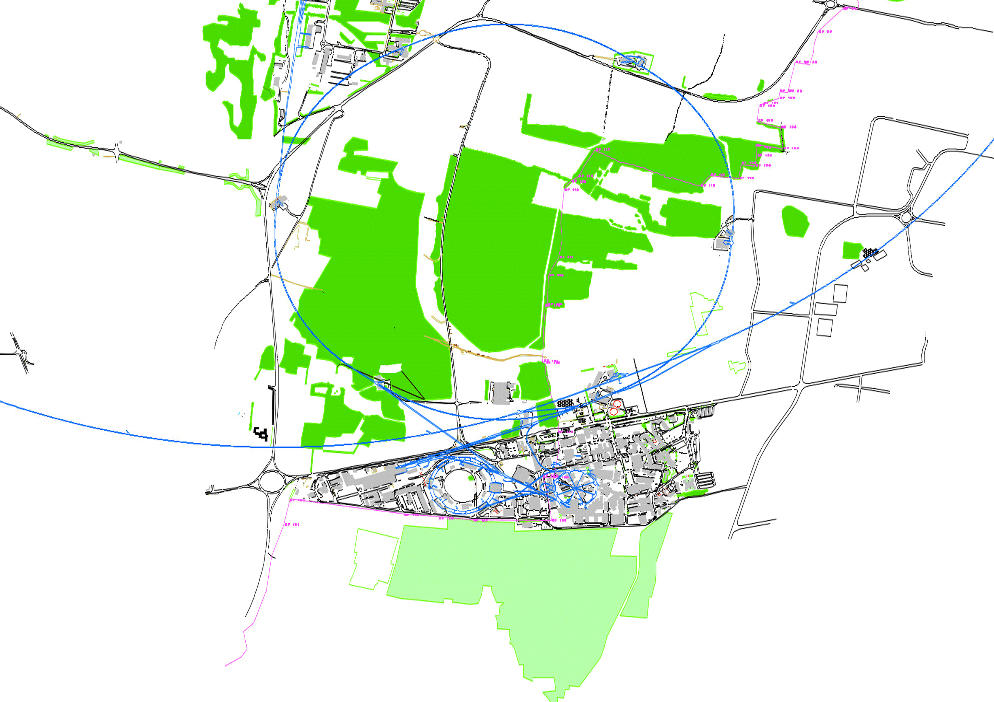
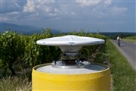
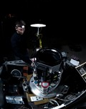
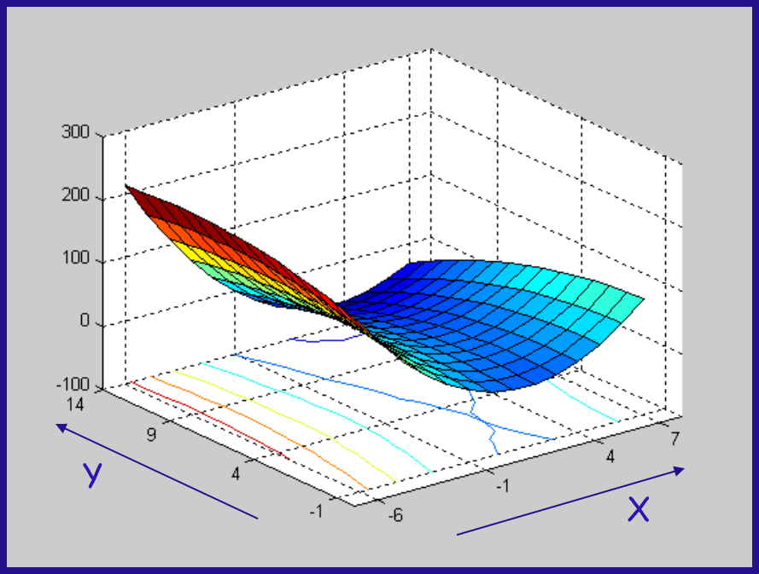
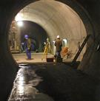
Geodesy
Reference point coordinates for CE construction
2020 +
Accelerator information required:
Theoretical design
FCC-ee integration model
Metrology & alignment precisions
To be developed:
Geodetic surface reference Network
Reference systems and transformation algorithms
Gravity field model
Geodetic transformation software
Organisational:
Planning
Resources
FCC installation start
Injector installation start
CE works start
CE construction invitation to tender start
Design Concept
Procure geodetic instruments start
Geodetic measurements start
Establish definitive reference systems end
Final update of position and orientation end
Y₃
Y₅
Y₇
Y₈
Y₈
Thursday, 10:30: Geodetic infrastructure and alignment – planning and studies (M. Jones)
M. Jones / EN-SMM

Slide 23
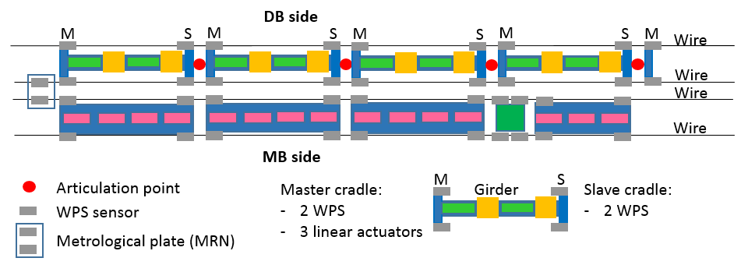
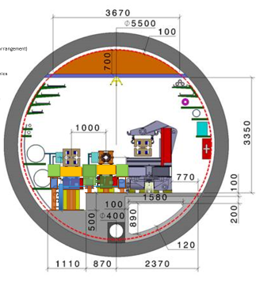
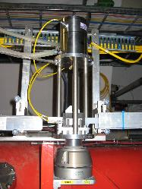

FCC-ee alignment + position monitoring
CLIC
design
Detailed integration and accessibility to be studied
Concept based on design for CLIC
Full remote position monitoring
and alignment system
Wire position sensors (WPS)
Hydrostatic levelling sensors
Motorised positioning system
Thursday, 10:30: Geodetic infrastructure and alignment – planning and studies (M. Jones)
M. Jones / EN-SMM

Slide 24
FCC-ee alignment + pos. monitoring system
Main and booster ring preparatory activities
2020 +
FCC installation start
Needs analysis
Injector installation start
Pre-prototype studies start
Prototype development and tests start
Design Concept
Pre-series upgrade and tests start
Technical design and specifications start
Market study/survey and invitation to tender start
Procurement and instrumentation control start
FCC tunnel reference Infrastructure installation start
Y₋₃
Y₋₂
Y₂
Y₆
Y₉
Y₁₁
Y_{12.5}
Y₁₄
Thursday, 10:30: Geodetic infrastructure and alignment – planning and studies (M. Jones)
M. Jones / EN-SMM

Slide 25
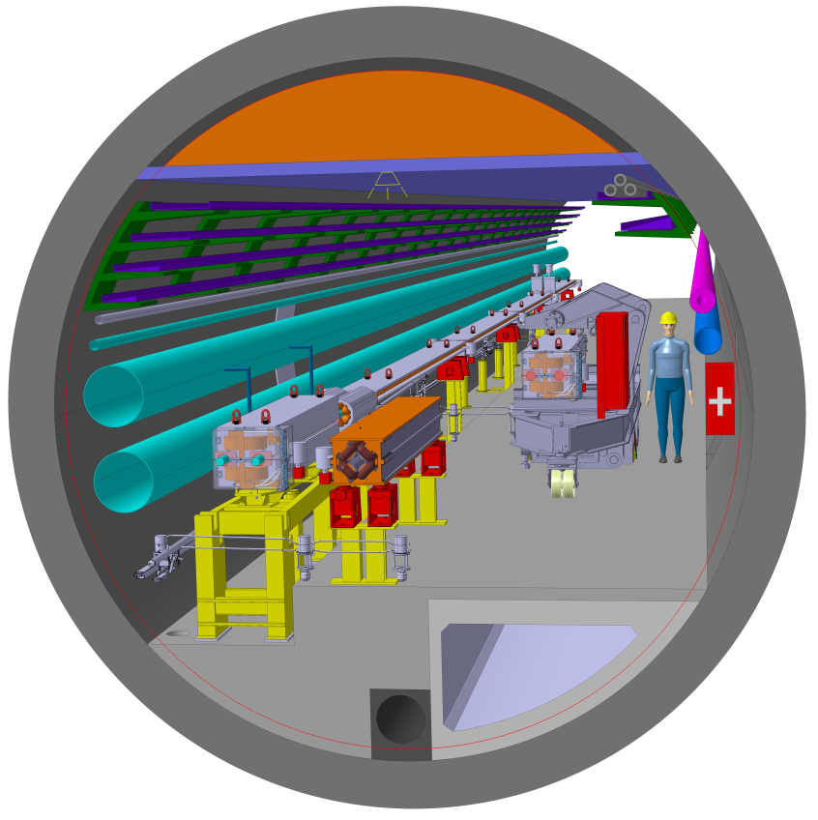
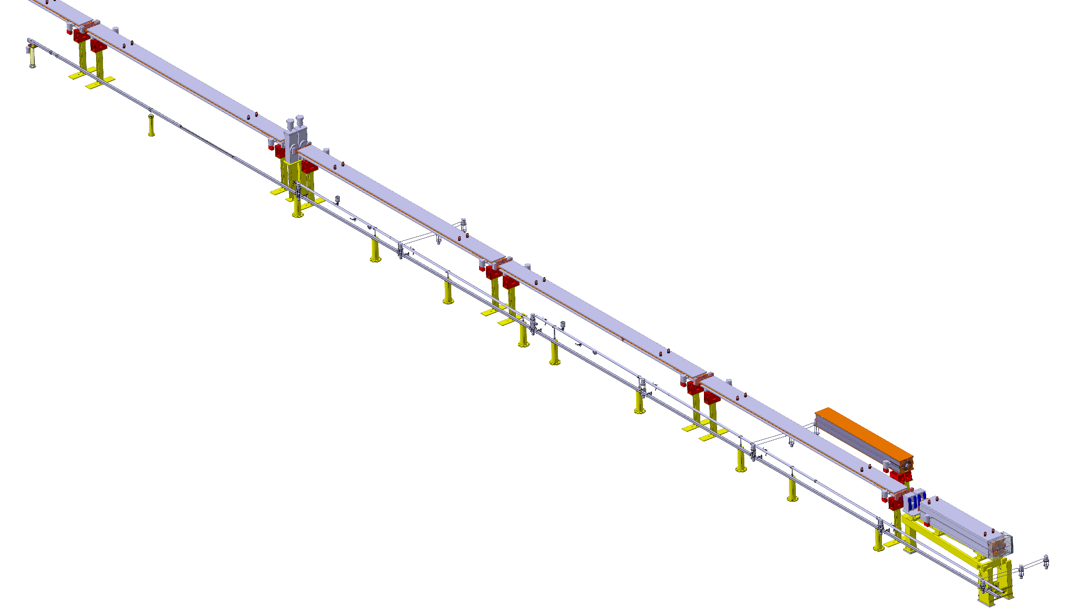

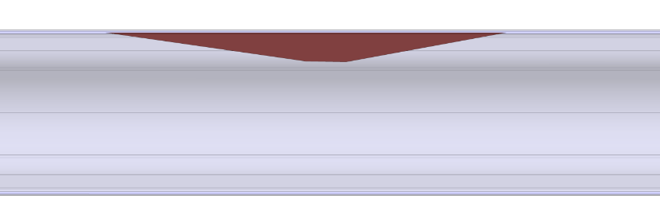
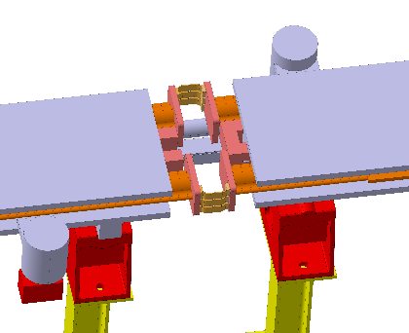
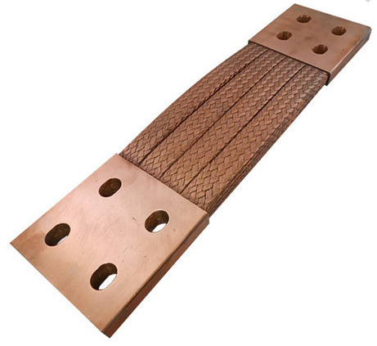
FCC-ee integration
vacuum gate valve
dipole (8 m long)
SR absorber
WPS sensors
connection through
flexible copper braids
quadrupole
HLS pipe, slope = 1.4%
corrector
girder (SSS)
F. Valchkova-Georgieva / EN-ACE

Slide 26
Cryogenics
Full session on Wednesday, 10:30
2 engineering studies of large FCC-hh cryogenic plants with industrial partners:
Completed with Linde
Close to completion with Air Liquide Advanced Technology
No showstoppers: 100 kW equivalent at 4.5 K (including 15 kW at 1.8 K)
refrigerators are feasible with additional R&D on warm and cold compressors
Cooling of high-luminosity FCC-hh inner triplet magnets:
Very large specific heat loads due to deposited secondaries:
  up to 140 W/m deposited on the magnet cold masses
  2 orders of magnitude above the heat loads of standard FCC-hh dipoles
Optimization of the cooling method:
  four bayonet heat exchangers in parallel
  split of Q1 into 3 cryo-magnets to keep the bayonet heat exchanger diameter < 100 mm
EASITrain program:
4 fellowships with following deliverables:
Architectures and models for superconducting magnet cooling (CEA)
Specification for Nelium refrigeration system (TUD)
Specification of optimised heat extraction for magnet coils (CEA)
Turbo compressor test bench operational (USTUTT)
Outcome of the engineering studies for the FCC-hh cryoplants (F. Millet)
FCC-hh inner-triplet cryogenics (C. Kotnig)
Improved concept of the Nelium Turbo-Brayton cycle for FCC-hh beam screen cooling (S. Savelyeva / TU D)
Transient conjugate heat transfer numerical simulation in superfluid helium (A. Vitrano / CEA Saclay)
L. Tavian / ATS-DO

Slide 27
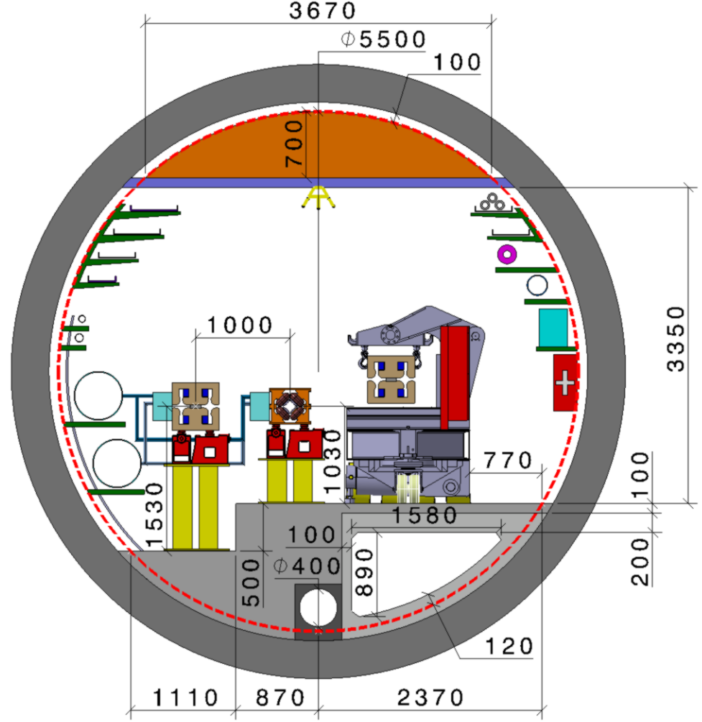
Cooling and ventilation
Integration:
Air ducts (embedded in concrete floor) to air diffusors
Fire dampers for smoke extraction system
Water sub-distribution (manifolds)
FCC-ee design:
With regard to FCC-hh equipment size → economic and integration impact
Cost model according to the installation sequence, planning and other constraints
Further RF ventilation studies
Environmental impact:
Raw water supply points and distribution depending on locally available flow rate
Similarly, reject of water into the clear water drain or in the sewage
Heat recovery possibilities at the different surface points and heat use in the local areas
Operation:
Maintenance strategy for 3 or 4 year long accelerator runs.
M. Nonis + G. Peon / EN-CV

Slide 28
Powering
Studying the optimised, high quality, powering strategy for magnets + sensitive loads; 3 topics:
Power converter design:
Main criteria: simplicity and reliability
Target is to be modular (as already successfully implemented at CERN)
Permitting energy recovery
Power quality:
Power factor = 1 required at the connection to the 400 kV electrical grid
Transient voltage dip immunity: analysis of sensitive load and the transmission grid for FCC → currently evaluating the potential of DC networks, combined with a new method for dip mitigation
Safety in underground structures:
Large scale energy storage (if required) would be at the surface
Reduction of equipment and infrastructure in the tunnel
T. Höhn / TU Graz + TE-EPC colleagues

Slide 29
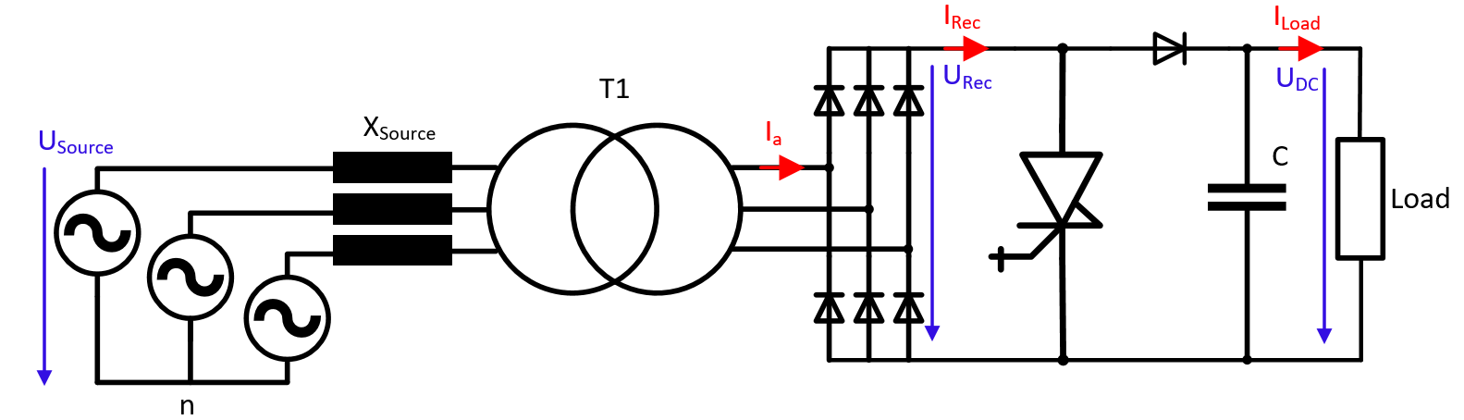
Powering
New method for transient voltage dip mitigation in medium voltage DC grids:
A boost converter topology combined with a DC grid
1-3 kV DC grid
18 or 63 kV AC
equivalent network
Advantages: cost efficiency, low losses and excellent mitigation performance
Potential applications: particle accelerators, large industrial production proc. with sensitive load
This proposal is now under evaluation, to integrate it into the EN-EL FCC baseline for power distribution and the powering strategy from TE-EPC.
Main point being analysed: is there an overall system benefit by introducing a DC grid ?
Further reading: Int‘l Conf on DC Microgrids https://power.aitech.ac.jp/ICDCM2019/
T. Höhn / TU Graz + TE-EPC colleagues

Slide 30
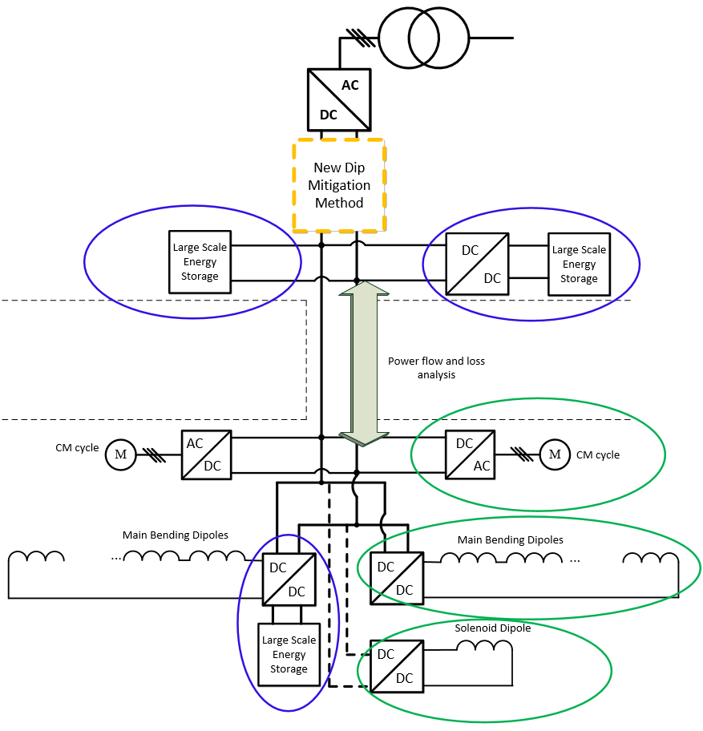
Powering
18 – 63 kV AC
powering point
of FCC
Example of a powering layout
Evaluate if there is a need for large scale energy storage, where to place it and how to connect it efficiently.
Evaluate which loads can efficiently connect to the grid.
The grid design needs to consider:
Switchgear available: established breakers and relays are preferred
Reduce conversion stages and equipment installed in the tunnel (compared to AC grid)
Energy recovery: re-use (or re-storage) of energy in the magnets
Selectivity: only the faulted load is separated from the grid, whereas other load continue operation
Scalable: to adapt easily to all FCC powering points, since the power demand between them varies considerably
T. Höhn / TU Graz + TE-EPC colleagues

Slide 31
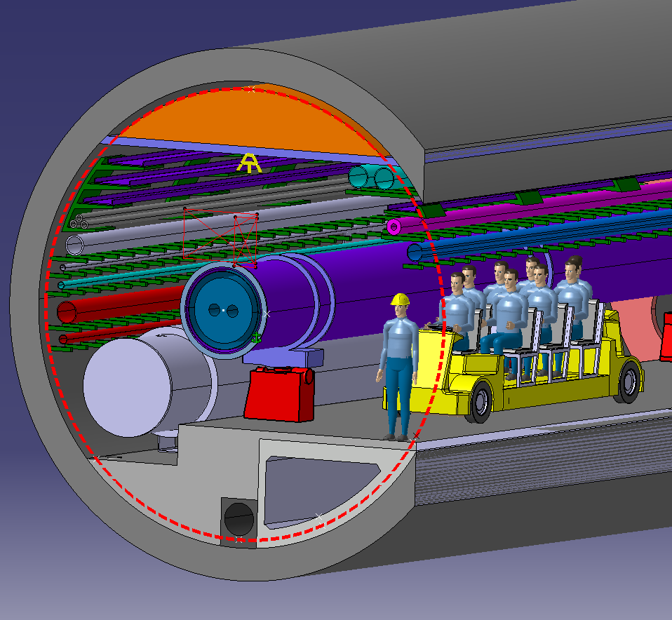
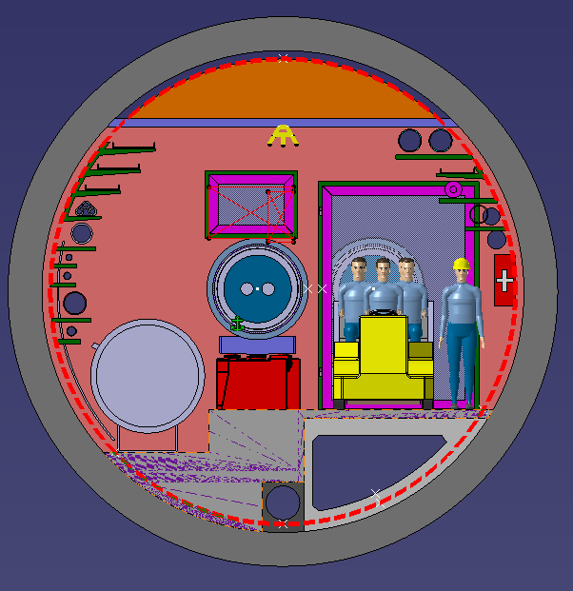
Transport
Faster system for transport of personnel (ca. 25 km/h).
I. Rühl / EN-HE

Slide 32
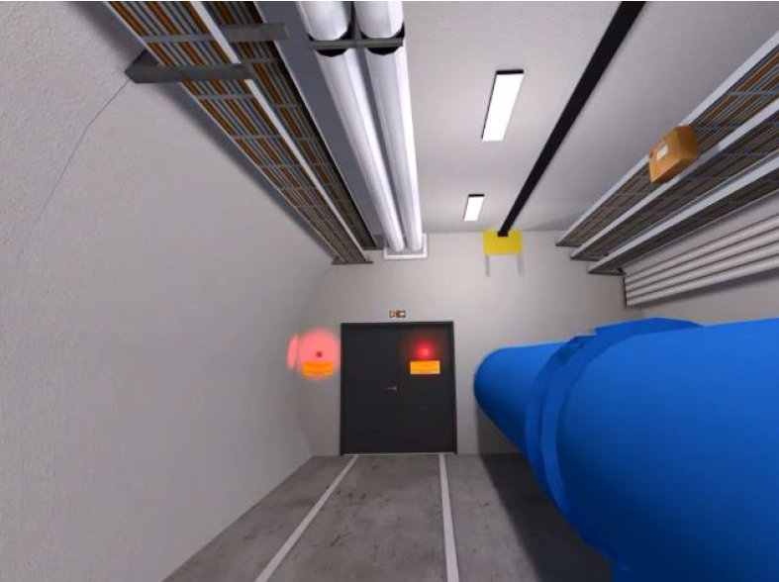
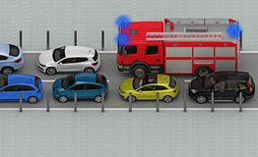
Safety
T. Otto / TE
A. Henriques, S. La Mendola,
O. Rios, M. Widorski / HSE
The CDR Safety Study (including a fire safety assessment) demonstrated that the planned facilities can meet the Life Safety Objectives
Fire safety studies for TDR phase:
Practical “details” of fire compartmentalization (installation, transport)
Organisation of Fire and Rescue Service
Thursday, 10:30: Safety topics requiring further investigation (T. Otto)
Thursday, 10:50: Study of HE-LHC ventilation strategy in case of fire (O. Rios)

Slide 33



HE-LHC ventilation in case of fire
O. Rios, S. La Mendola/ HSE
Fractional Effective Dose (FED) for toxicant assessment on victims
Fire Fighters intervention time impact on Life Safety
Amount of soot deposition to walls and devices for property impact
Thursday, 10:50: Study of HE-LHC ventilation strategy in case of fire (O. Rios)

Slide 34

Safety
T. Otto / TE, A. Henriques, S. La Mendola, O. Rios, M. Widorski / HSE
Cryogenic safety studies for TDR phase:
More accurate description of Helium releases
Interaction of cold Helium with compartment walls and smoke extraction
Thursday, 10:30: Safety topics requiring further investigation (T. Otto)

Slide 35


Safety
T. Otto / TE, A. Henriques, S. La Mendola, O. Rios, M. Widorski / HSE
Radiation protection studies for TDR phase:
Radioactivity in experiments , synchrotron radiation
Management of released air and water
Radiation monitoring programme
Thursday, 10:30: Safety topics requiring further investigation (T. Otto)

Slide 36





R2E
Beam-gas losses
Beam screen
Latest residual gas profile
Old
New
Updated beam screen design provides less shielding for coils and cold mass.
Beam screen now absorbing ~5 % of power loss density as opposed to 16 % previously.
86 % absorbed by cold mass.
Most impacted dipole receives 278 mW/m on cold mass.
Peak power density in coils: 1.64 mW/cm³
Thursday, 10:30: Update on R2E and heat load simulations (J. Hunt)
J. Hunt / EN-STI

Slide 37




R2E
R2E impact
Full 214 m arc cell (axis not to scale)
FLUKA model
Some increase in dose to electronics under beamline
Updated
Previous
J. Hunt / EN-STI

Slide 38



FCC-ee availability
Poster
Generally, e+e- colliders have a good availability track record
FCC-ee will be larger and operate with higher energy
Study^{*)} aim is to identify aspects where:
New technologies are used
System complexity scales up
Known technology is used in new environment
Model input:
Operational scenario
FCC-ee complex composition (assuming sub-availabilities)
SPS experience (also linac option)
Critical systems:
RF
Magnet supplies (power, cooling)
Electrical distribution (network perturbations)
Energy storage
Operational efficiency (filling time, rejected injections)
→ Redundancy in key systems can help.
→ Identify and document risks and solutions, focus R&D.
*) In collaboration with U Tampere + Ramentor Oy
Wednesday, 10:30: Machine availability for FCC-ee (A. Niemi)
A. Niemi / BE-OP

Slide 39
Concluding remarks
IOWG team active and motivated (despite being involved in many other activities).
CDR contributions delivered (CDR qualified as „adequate level for the current project stage”).
Work ongoing (and more planned) to consolidate, iterate on and deepen certain areas.
Currently main focus on
- optimising the footprint
- getting the preparatory phase railed up (administrative processes)
- planning for preparatory works (geodesy, CE site investigations, ...)
Much intensive work to come during the next phase.
Looking forward for news from

Slide 40
MERCI DE VOTRE ATTENTION !
DANK U WEL VOOR UW AANDACHT !
LOOKING FORWARD TO
INTERESTING PRESENTATIONS
AND STIMULATING DISCUSSIONS

Slide 41
Annex

Slide 42
Collaborations I
Cryogenics
TU Wroclaw – Design pressure impact of the FCC-hh cryogenic distribution system and superconducting magnet cryostats on the heat inleaks at different temperature levels
CEA Grenoble – New architectures and technologies for innovative helium refrigeration above 4.5 K and in superfluid helium at 1.8 K and 1.6 K including magnetic refrigeration
TU Dresden – Ne-He cycle producing large refrigeration capacity above 40 K for the cooling of the FCC beam screens, thermal shields and HTS current leads
U Stuttgart– Characterization of centrifugal compressors
Safety (fire safety engineering, FCC-FSEC)
ESS – Ignition probabilities of materials and equipment; intervention procedures for classified accelerator areas
FNAL – Tunnel fire dynamics and egress studies based on a broad range of different US underground installations
DESY – Data on tested fire detection and protection measures for particle accelerators
JRC Jülich Research Centre / University of Wuppertal –
Optimisation of Computational Fluid Dynamics tools for fire safety related calculations
Lund University – Fire and egress scenarios typical for accelerator facilities and their special geometries, including fire testing and virtual reality
MAX IV – Knowledge transfer on fire statistics for physics laboratories
…

Slide 43
Collaborations II
…
LBL – Peer review of performance based design approach
BNL – Peer review of performance based design approach
FNAL – Tunnel fire dynamics and egress studies based on a broad range of different US underground
NIST – Further development of the CFD code Fire Dynamics Simulator (FDS)
Reliability, availability
TU Tampere – RAMS design methods and tools to be applied to particle accelerators
TU Delft – RAMS modeling of LHC cryogenic system
Univ. Stuttgart – Reliability engineering training
Transport & Logistics
FIML Dortmund – Transport and logistics modeling and consulting
Plus direct or indirect support from industrial and informal support from institutional partners
(referenced in the respective presentations).

Slide 44
IO related posters
Availability:
OpenMARS modelling approach for accelerator availability studies (A. Niemi, J.-P. Penttinen / Ramentor Oy)
Cryogenics:
Cooling of the refrigerant with chilled water before the inlet of the compressor (H. Quanck / TU Dresden et al.)
Fluid mixtures properties modeling (J. Tkaczuk / CEA Grenoble)
Optimisation of a multi-stage turbocompressor architecture operating with a neon-helium gas mixture (M. P. Podeur, D. M. A. Vogt / U Stuttgart)
Test rig for the experimental evaluation of turbo-compressor impeller designs for light gases (M. P. Podeur / U Stuttgart et al.)
Field test results of self-calibrating cryogenic mass flow meter WEKASENSE (M. Okanovic / WEKA AG et al.)

