Slide 1




Collective effects in the booster synchrotron
M. Migliorati, E. Carideo, D. Quartullo, M. Zobov
Acknowledgements:
E. Belli, R. Kersevan, K. Oide, F. Zimmermann

Slide 2
Parameter list: Z-pole and booster (injection)
parameter | Z | Booster
Beam energy (GeV) | 45.6 | 20
Bunch population [10¹¹] | 1.7 | .34 (1.7/5)
Energy spread(SR/BS) [10⁻³] | 0.38/1.32 | .166
Energy loss/turn (MeV) | 36.0 | 1.33
RF frequency (MHz) | 400 | 400
RF voltage (MV) | 100 | 60
Arc optics |  | 60°ph adv | 90°ph adv
Mom compaction [10⁻⁶] | 14.8 | 14.8 | 7.27
Synchrotron tune | 0.025 | 0.030 | 0.021
Bunch length [mm](SR/BS) | 3.5/12.1 | 1.26 | 0.88

Slide 3
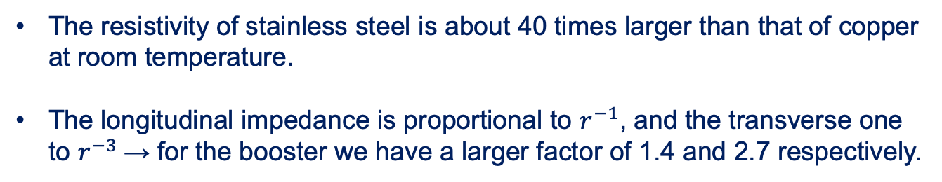
Z-pole impedance vs booster
The thresholds at Z pole without BS are 2.5x10¹¹ ppb for microwave instability and 4.2x10¹¹ ppb for TMCI, but with BS they are much higher.
The main responsible of the instabilities is the RW impedance due to a copper beam pipe of 35 mm of radius with a thin coating of NEG.
For the booster the beam pipe is 25 mm and it is made of stainless steel.
Wake potential of 3.5 mm Gaussian bunch
BPM
The resistivity of stainless steel is about 40 times larger than that of copper at room temperature.
The longitudinal impedance is proportional to $r^{−1}$, and the transverse one to $r^{−3}$→ for the booster we have a larger factor of 1.4 and 2.7 respectively.

Slide 4
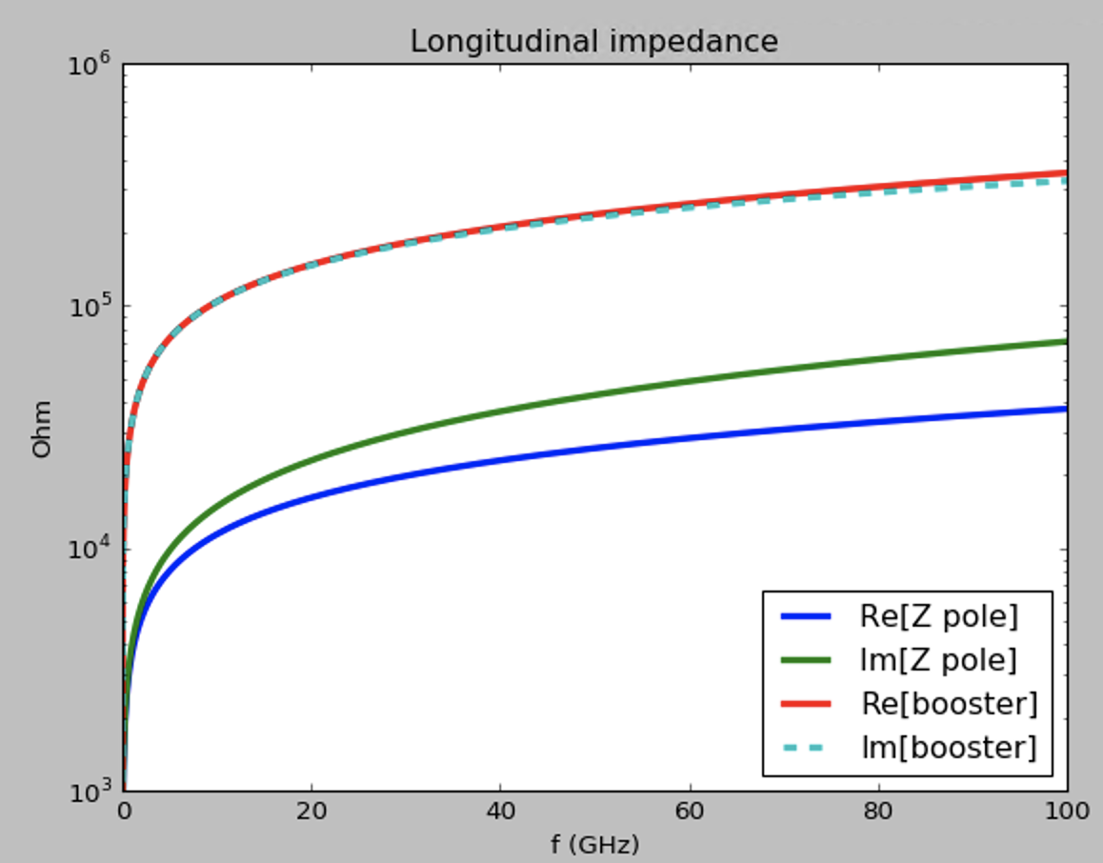
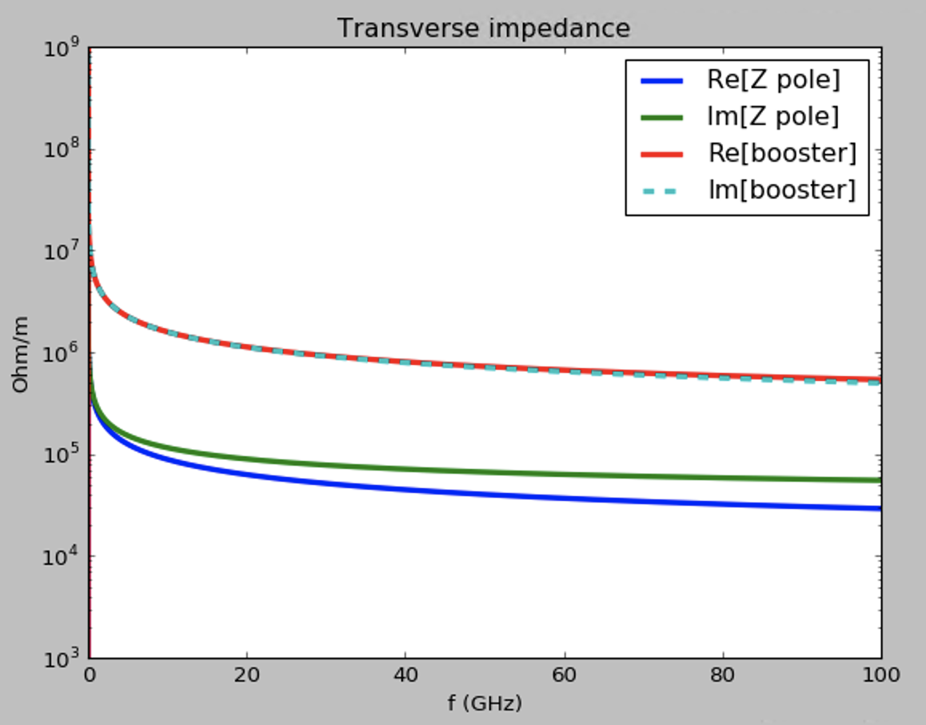
RW impedance: Z-pole vs booster
Only RW booster
~5
Only RW booster
RW + other sources
Z pole
~10
RW + other sources
Z pole

Slide 5
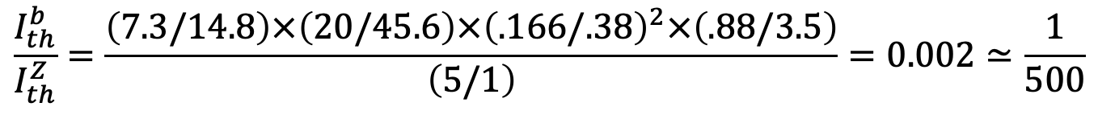
Some scaling considerations: microwave instability
∝
$$\frac{I_{th}^{b}}{I_{th}^{Z}}=\frac{\left(7.3/14.8\right)×\left(20/45.6\right)×{\left(.166/.38\right)}^{2}×\left(.88/3.5\right)}{\left(5/1\right)}=0.002≃\frac{1}{500}$$
NB1: radiation damping time is about 4.9 s compared with 0.414 s of Z pole (12 times larger)
NB2: for the 60 degrees phase advance optics (Z/W operations) the ratio is 0.006

Slide 6
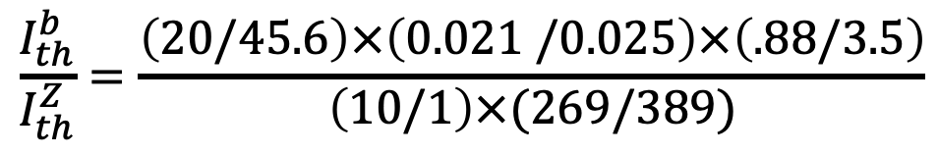

Some scaling considerations: TMCI
∝
$$\frac{I_{th}^{b}}{I_{th}^{Z}}=\frac{\left(20/45.6\right)×\left(0.021 /0.025\right)×\left(.88/3.5\right)}{\left(10/1\right)×(269/389)}$$
$$≃0.01$$
Average beta inversely propotional to machine tune

Slide 7
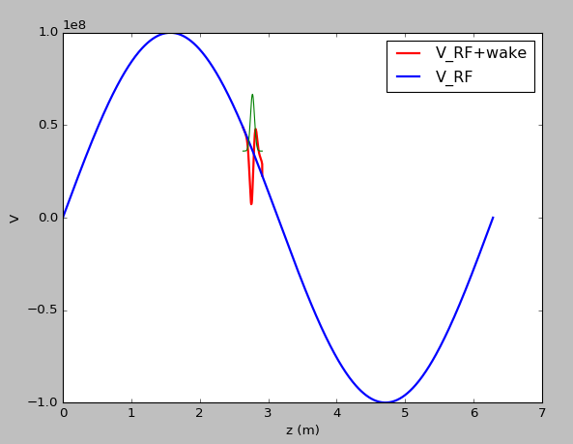
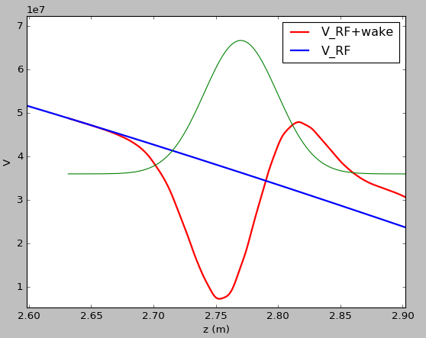

Induced voltage for Z-pole at 2.3x10¹¹ ppb
nominal bunch length: $σ_{z}=3.5$ mm

Slide 8
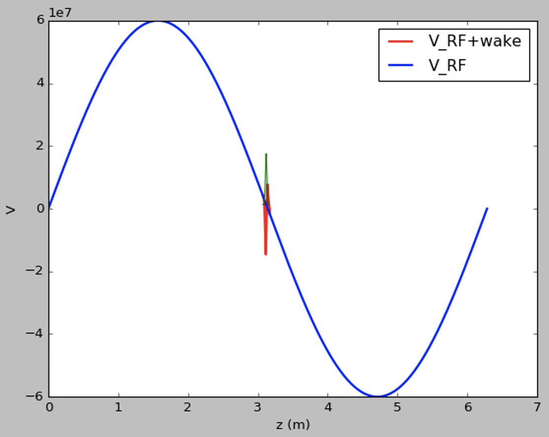
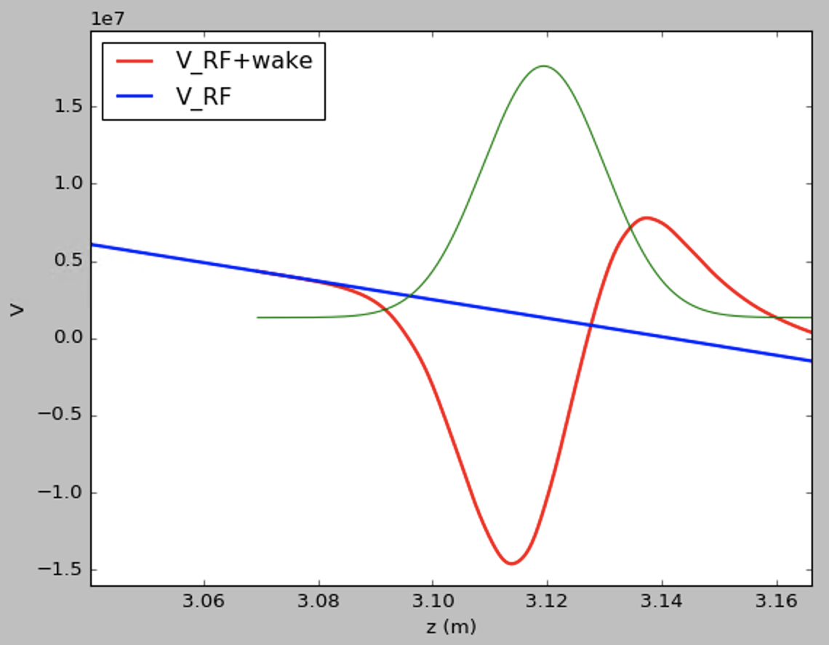
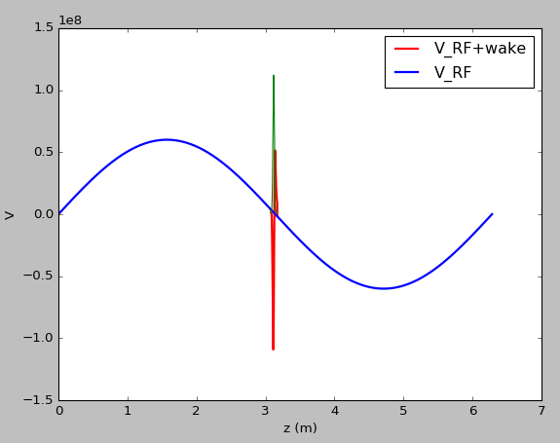
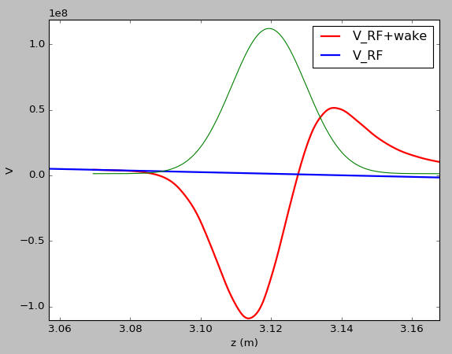
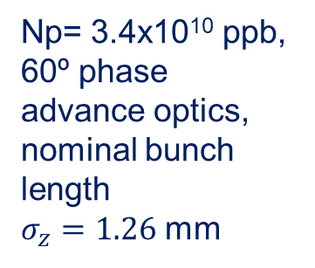
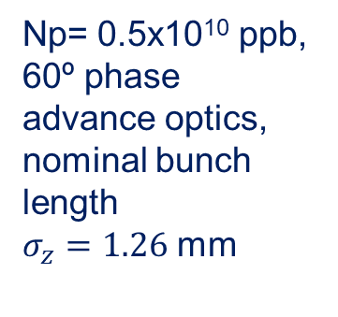
Induced voltage for booster with 60º optics
Np= 0.5x10¹⁰ ppb, 60º phase advance optics,
nominal bunch length
$σ_{z}=1.26$ mm
Np= 3.4x10¹⁰ ppb, 60º phase advance optics,
nominal bunch length
$σ_{z}=1.26$ mm

Slide 9
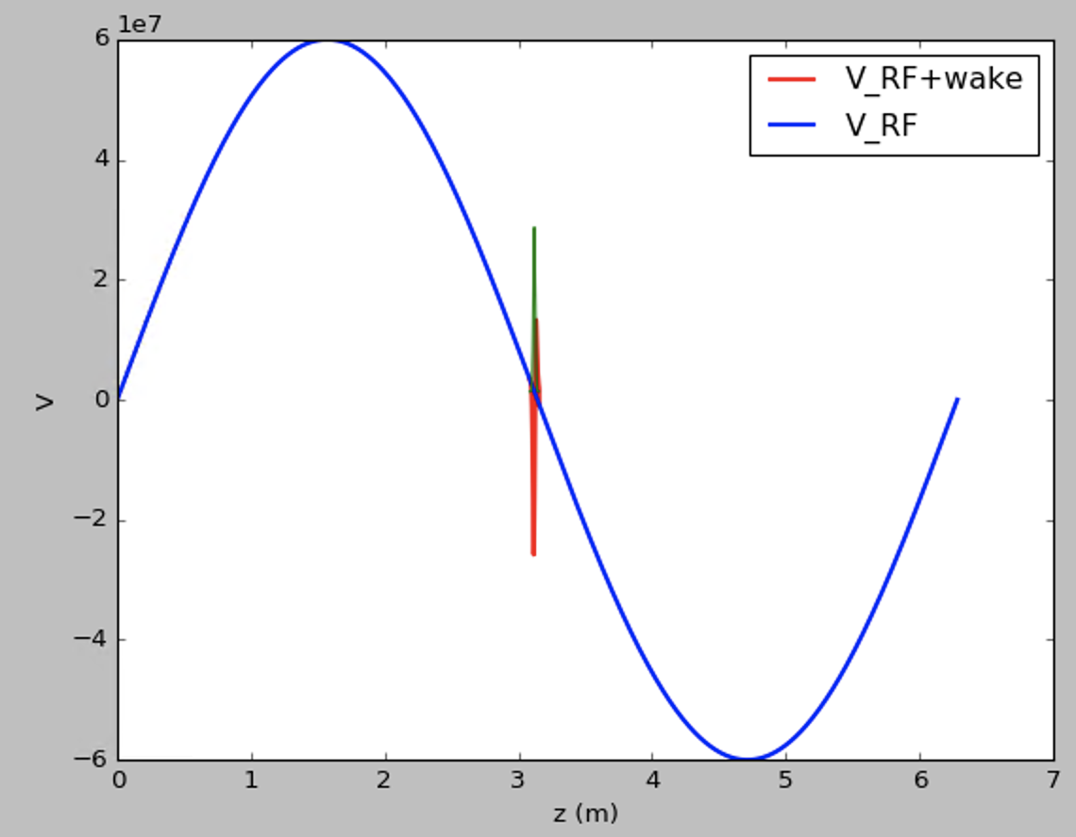
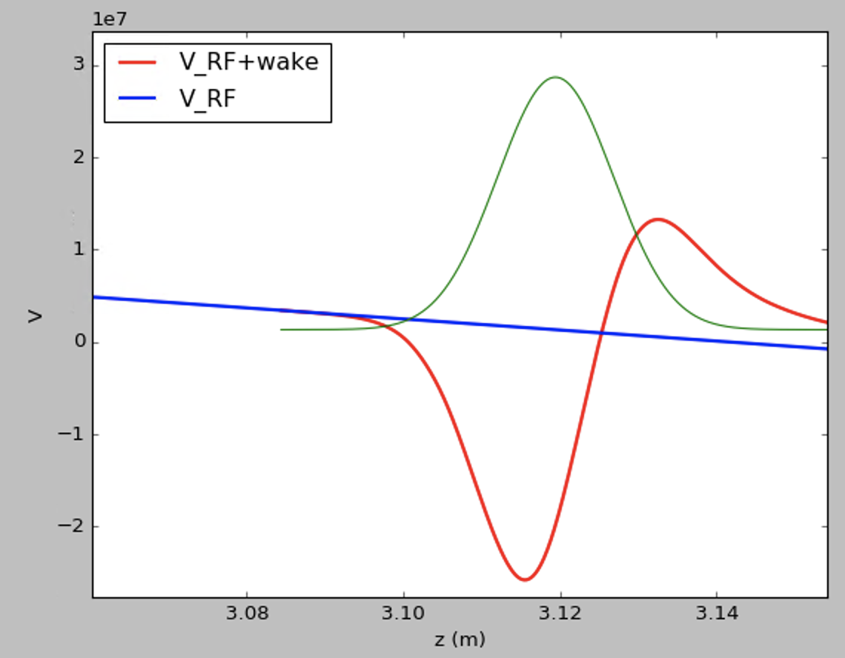
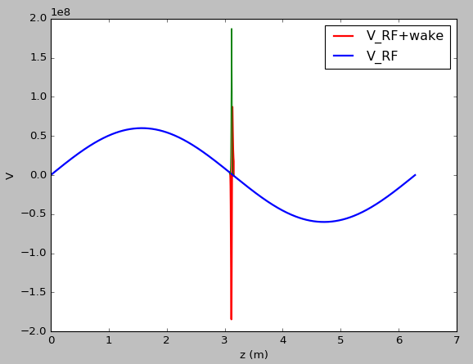
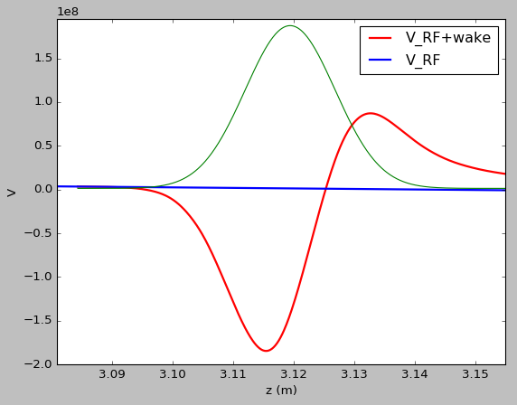
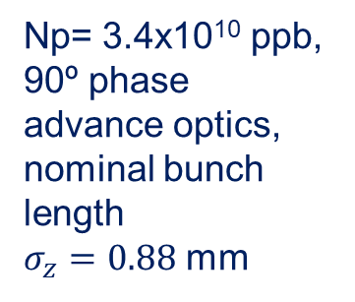
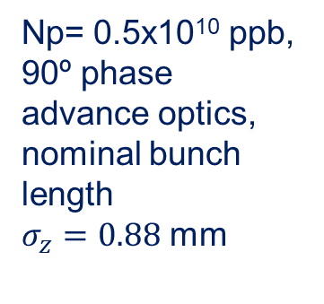
Induced voltage for booster with 90º optics
Np= 0.5x10¹⁰ ppb, 90º phase advance optics,
nominal bunch length
$σ_{z}=0.88$ mm
Np= 3.4x10¹⁰ ppb, 90º phase advance optics,
nominal bunch length
$σ_{z}=0.88$ mm

Slide 10
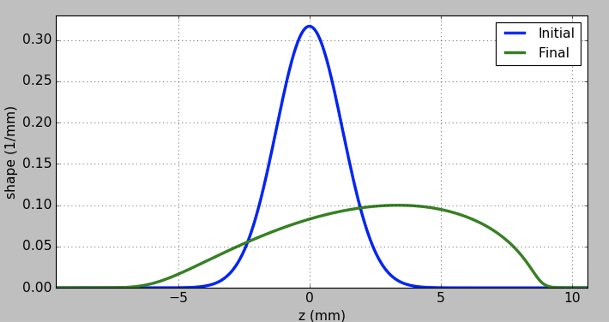


Haissinski
60°phase advance, 0.5e10 ppb
$σ_{z0}=1.26$ mm
$σ_{z}=3.4$ mm

Slide 11
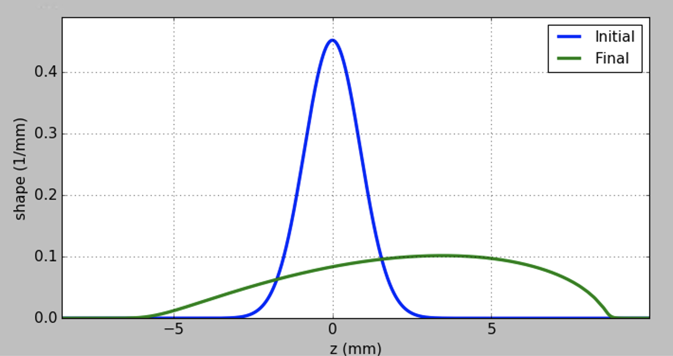


Haissinski
90°phase advance, 0.5e10 ppb
$σ_{z0}=.88$ mm
$σ_{z}=3.3$ mm

Slide 12
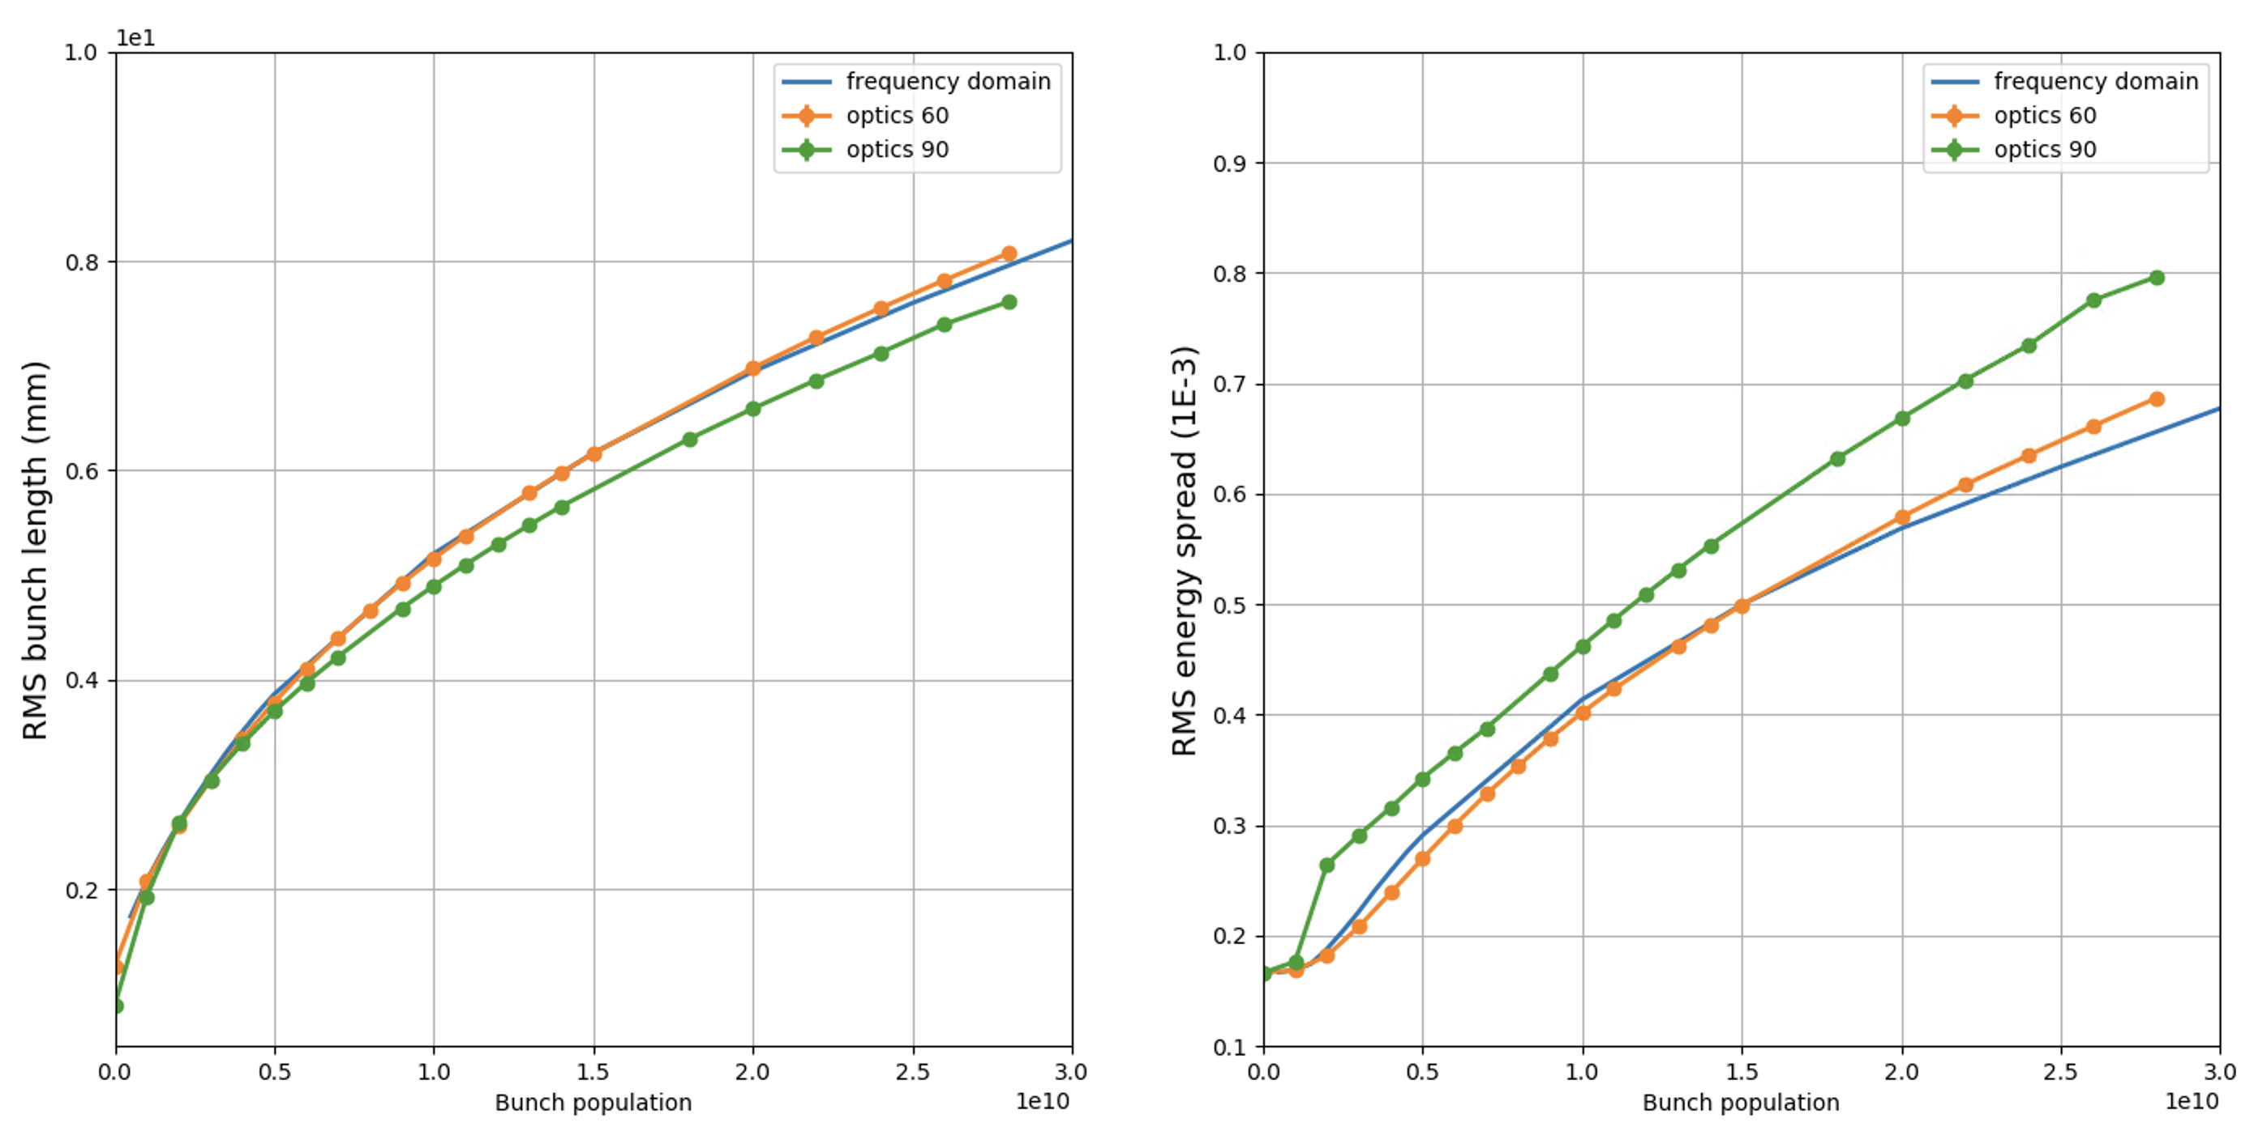
Longitudinal beam dynamics simulations
microwave instability threshold
nominal intensity
Preliminary results

Slide 13
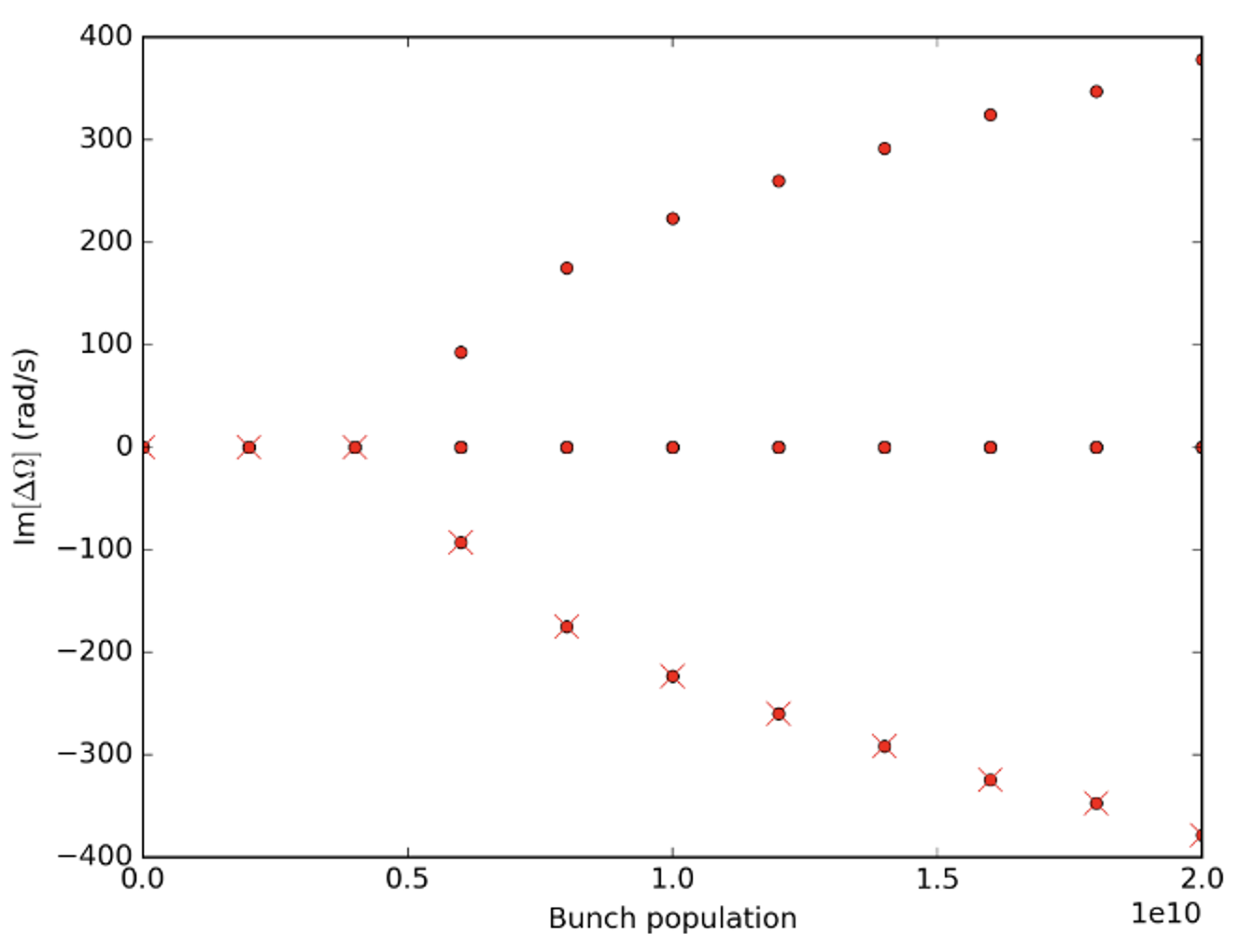
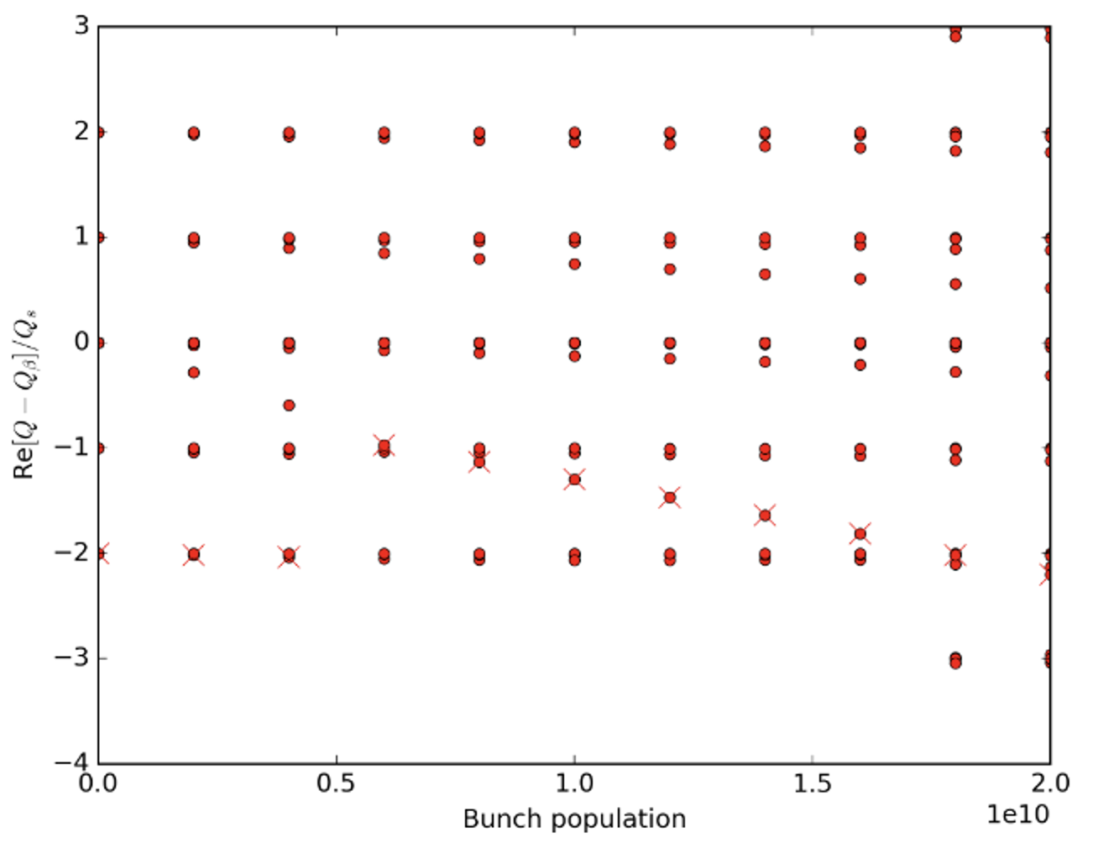
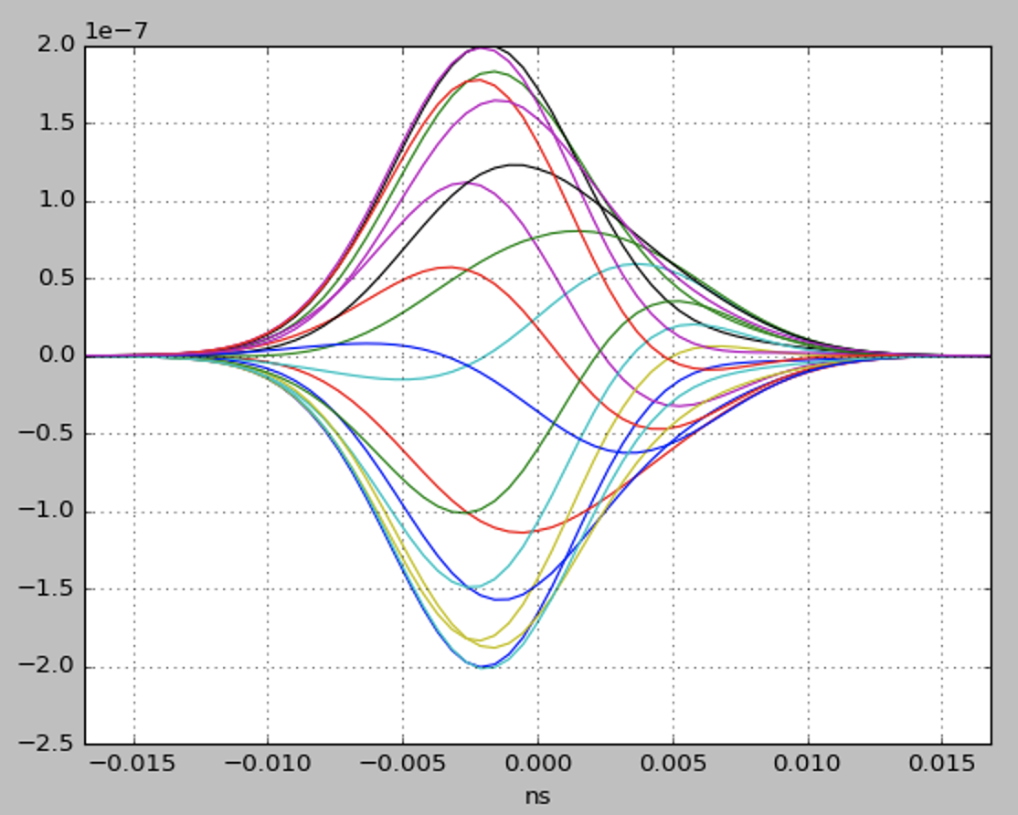
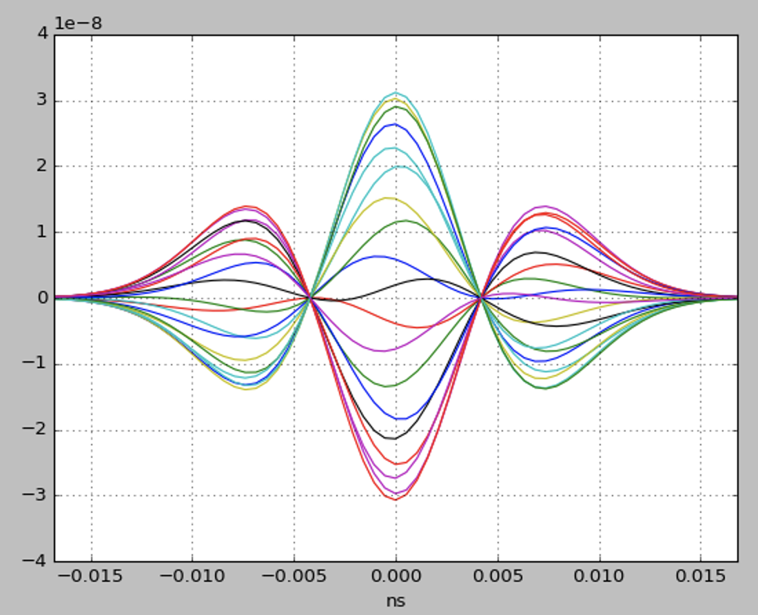
TMCI threshold
DELPHI code, optics 60°phase advance

Slide 14
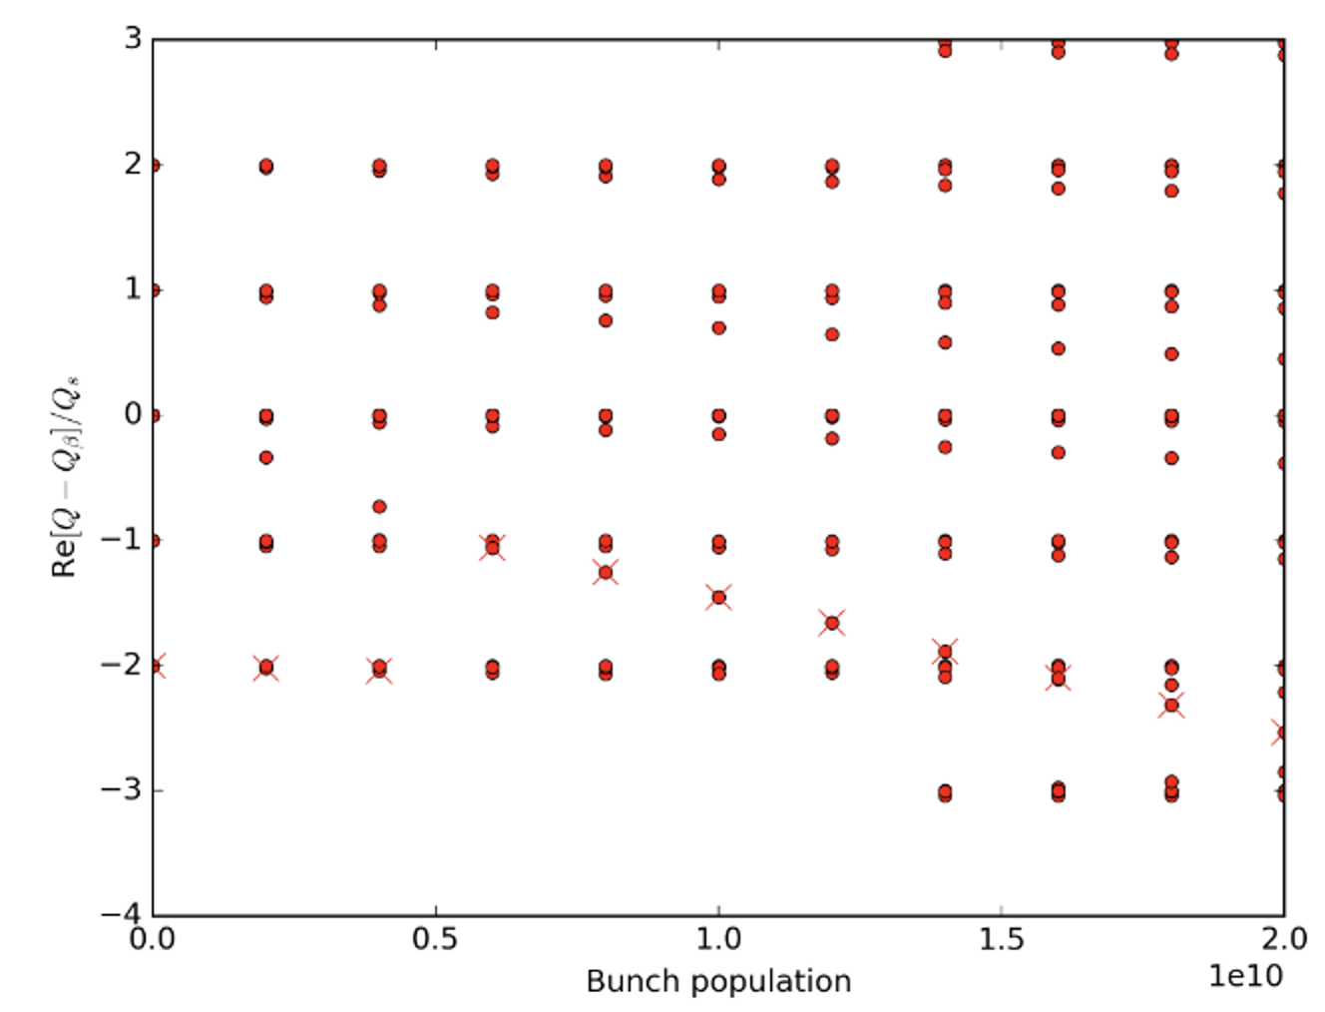
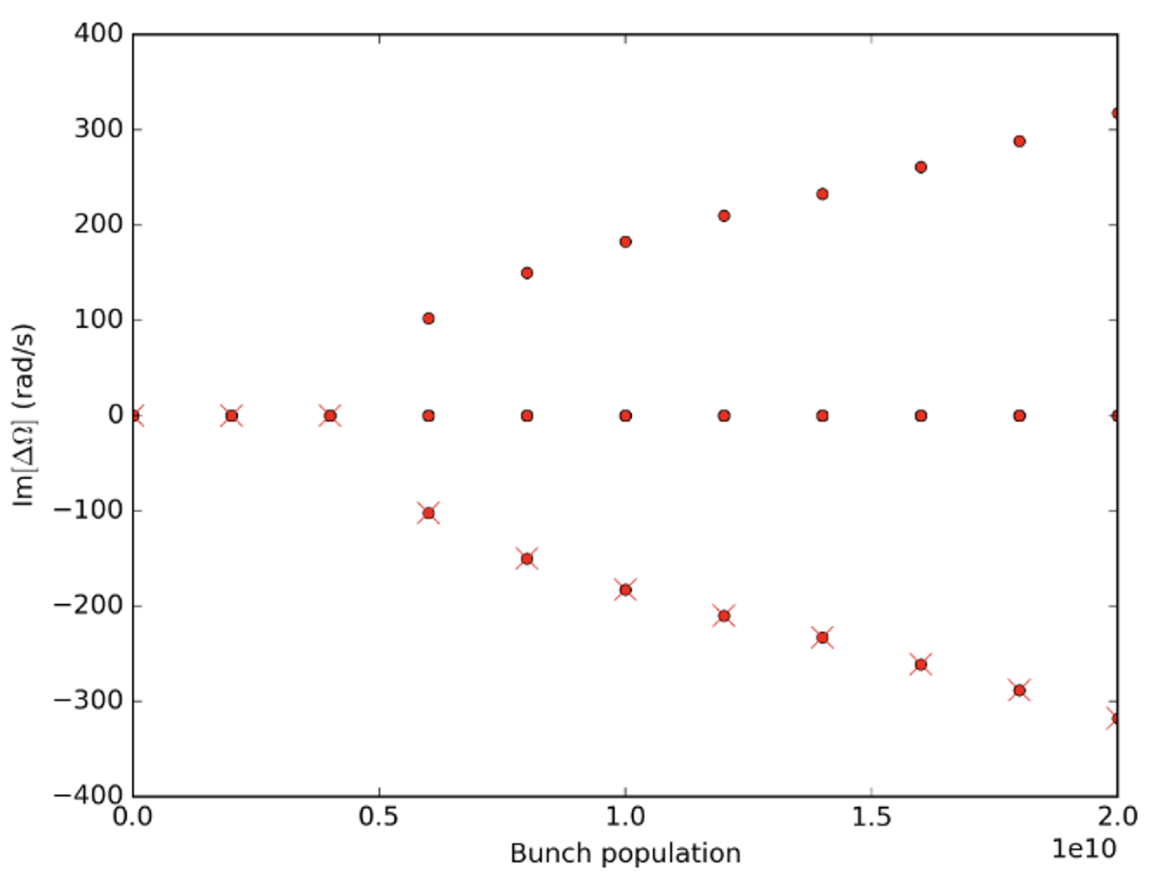
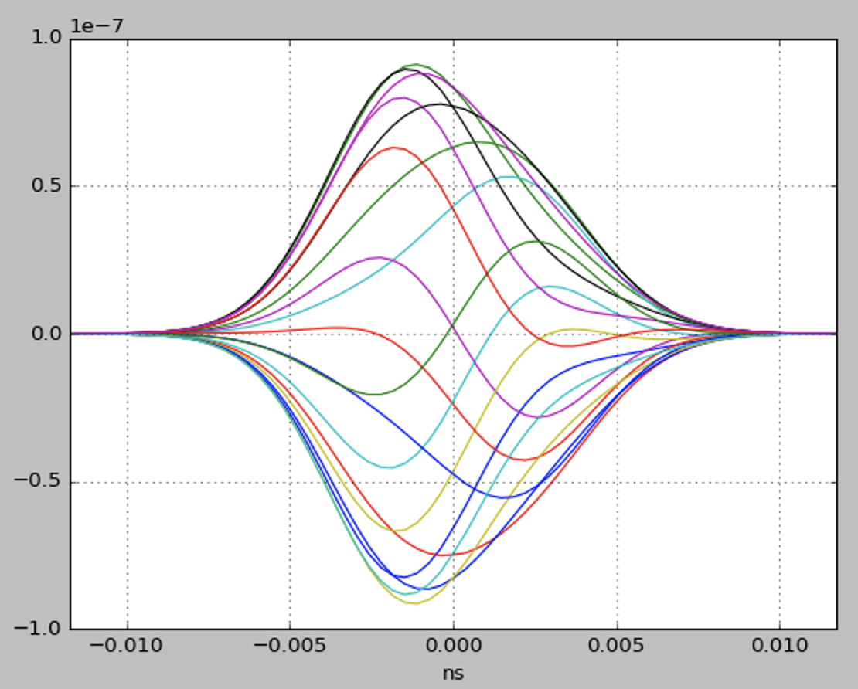
TMCI threshold
DELPHI code, optics 90°phase advance

Slide 15
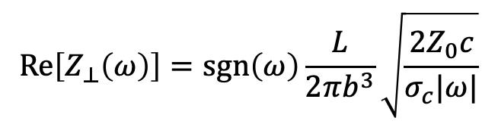


RW transverse coupled bunch instability
60º optics
Hp: azimuthal mode m=0, a Gaussian bunch, one single frequency line of coherent oscillation modes coupling the transverse RW impedance. The growth rate can be obtained with
where
$$\text{Re}\left[Z_{⊥}\left(ω\right)\right]=sgn\left(ω\right)\frac{L}{2πb^{3}}\sqrt{\frac{{2Z}_{0}c}{σ_{c}|ω|}}$$
e.g.
$$ω_{q}={−0.95ω}_{0}$$
-1
16640
16370
269.05
269.95
$$ω_{q}={−0.05ω}_{0}$$

Slide 16
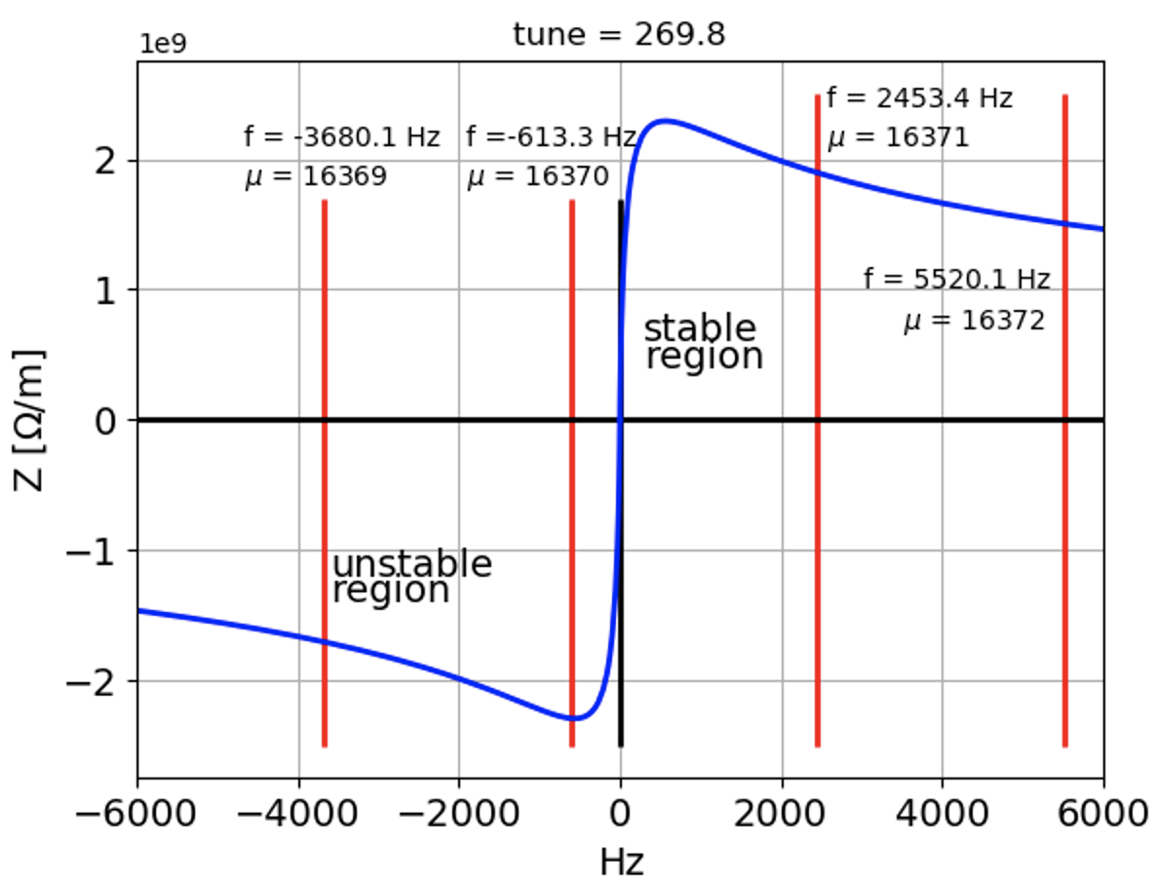
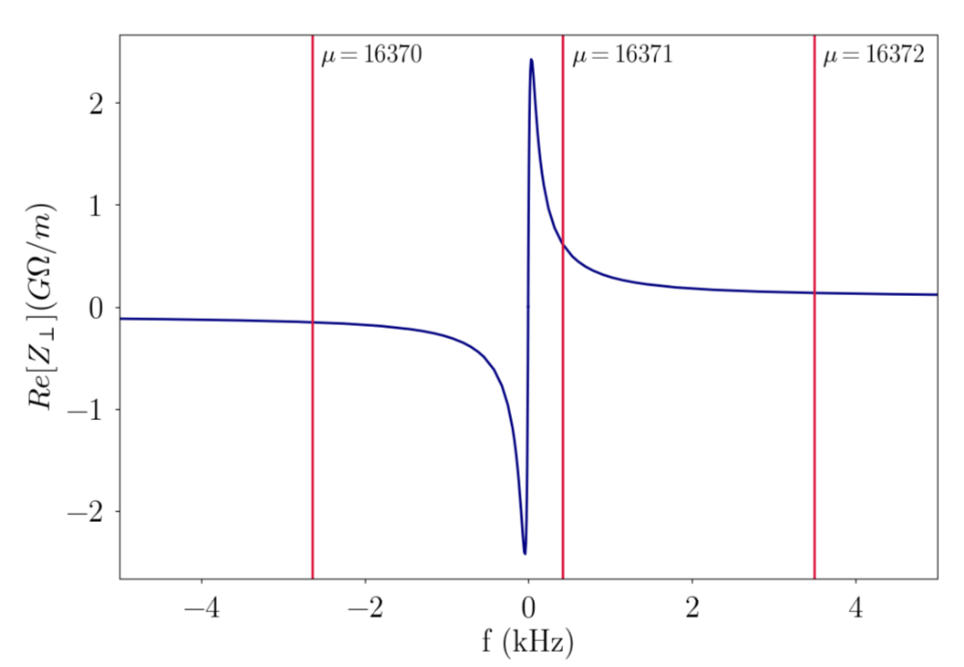
RW Transverse coupled bunch instability
60º optics
Z pole: real part of the RW impedance for a copper beam pipe of 35 mm.
Booster: real part of the RW impedance for a stainless steel beam pipe of 25 mm.
For the booster, due to the stainless steel, the peak of the impedance at low frequency is larger with respect to copper, and, differently from the Z pole, a variation of the fractional part of the tune affects only slightly the growth rate.

Slide 17
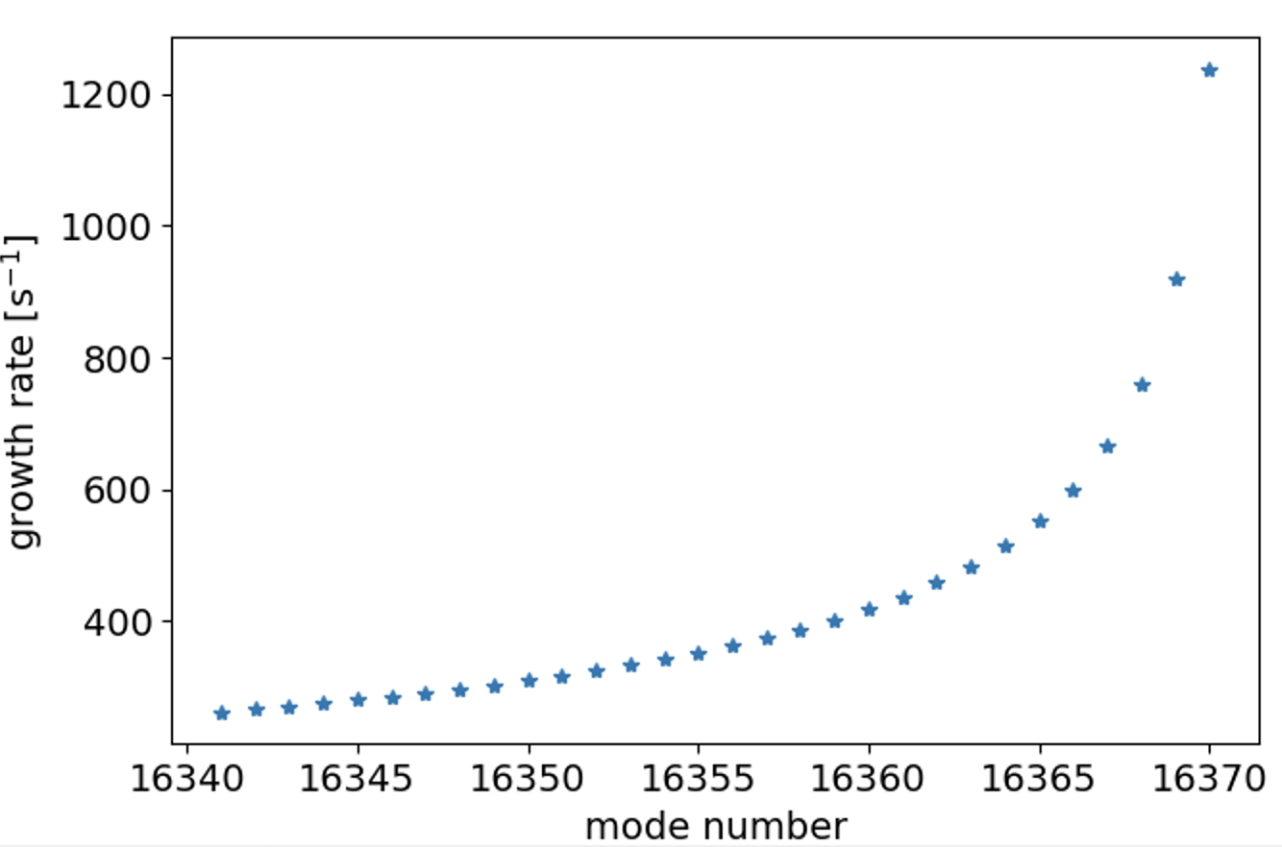
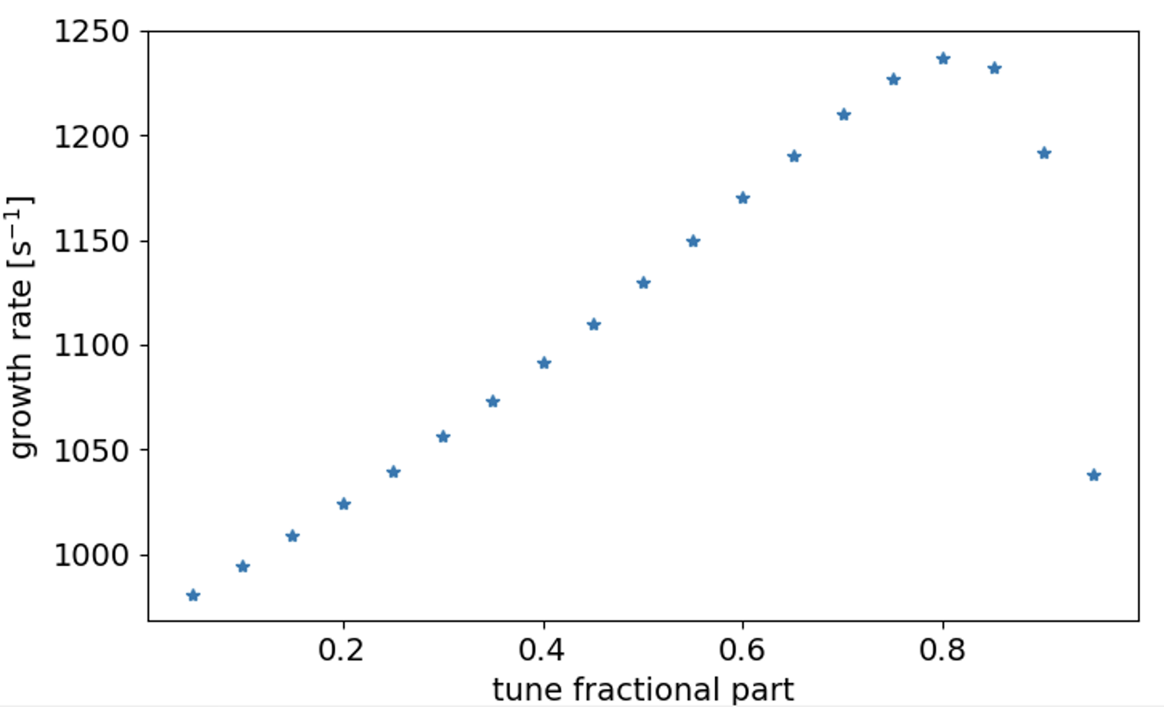
RW Transverse coupled bunch instability
60º optics
The rise time is in the order of 1 ms or a bit less, and it changes only slightly with the fractional part of the tune. This rise time corresponds to about 3 turns, a factor of ∼ 2 larger with respect to the TCBI of the collider in the Z-pole configuration.
As in the collider, new feedback schemes are required.

Slide 18
Conclusions
The RW impedance of 100 km of stainless steel with a beam pipe of 25 mm radius has a strong impact on the beam dynamics of the booster.
Thresholds of TMCI and microwave instability are lower than the nominal intensity.
Methods to mitigate the effects of the instabilities or to put the thresholds to higher values should be investigated.
Transverse coupled bunch instability due to RW is a factor of about 2 larger than in the collider.
We also need to evaluate the effect on beam dynamics of the other impedance sources.

Slide 19
Thank you very much for your attention

