Slide 1




Collective effects with ttbar configuration
M. Migliorati, E. Carideo, D. Quartullo, M. Zobov
Acknowledgements:
E. Belli, R. Calaga, I. Karpov, K. Oide, S. G. Zadeh, F. Zimmermann

Slide 2
Parameter list (from CDR)
Parameter list | Z | t
Beam energy (GeV) | 45.6 | 182.5
Beam current (mA) | 1390 | 5.4
Bunch population [10¹¹] | 1.7 | 2.3
Mom compaction [10⁻⁶] | 14.8 | 7.3
Bunch length [mm](SR/BS) | 3.5/12.1 | 2.0/2.5
Energy spread(SR/BS) [10⁻³] | 0.38/1.32 | 1.5/1.92
Synchrotron tune | 0.025 | 0.087
Bunches/beam | 16640 | 48
Energy loss/turn (GeV) | 0.036 | 9.2
Longitudinal damping time(SR/BS) [s] | 0.415 | 0.0067
RF frequency (MHz) | 400 | 400 | 800
RF voltage (GV) | 0.1 | 4 | 6.9
# cells/cavity | 1 | 4 | 5
# cavities/beam | 52 | 272 | 372

Slide 3
Z-pole microwave and TMCI instabilities
Total wake, 100 nm coating
E. Belli PhD thesis
TMCI, only RW, 100 nm coating

Slide 4
Z-pole longitudinal microwave instability
Wake potential of 3.5 mm Gaussian bunch
E. Belli PhD thesis
BPM
The thresholds at Z pole without BS are 2.5x10¹¹ ppb for microwave instability and 4.2x10¹¹ ppb for TMCI, but with BS they are much higher.
For ttbar the total impedance becomes larger due to the RF system: what are the new instability thresholds?
Moreover, the bunch length at ttbar will not be much affected by BS.

Slide 5


Some scaling considerations: microwave instability
$$\frac{17.3}{\left|Z/n\right|}$$

Slide 6
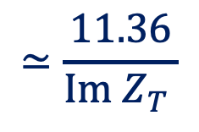
Some scaling considerations: TMCI
$$≃\frac{11.36}{Im{ Z}_{T} }$$
Average beta inversely propotional to machine tune

Slide 7
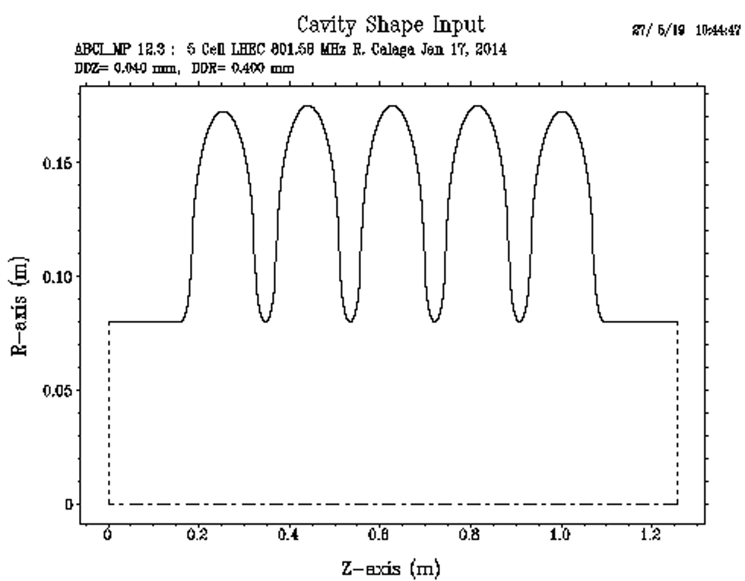
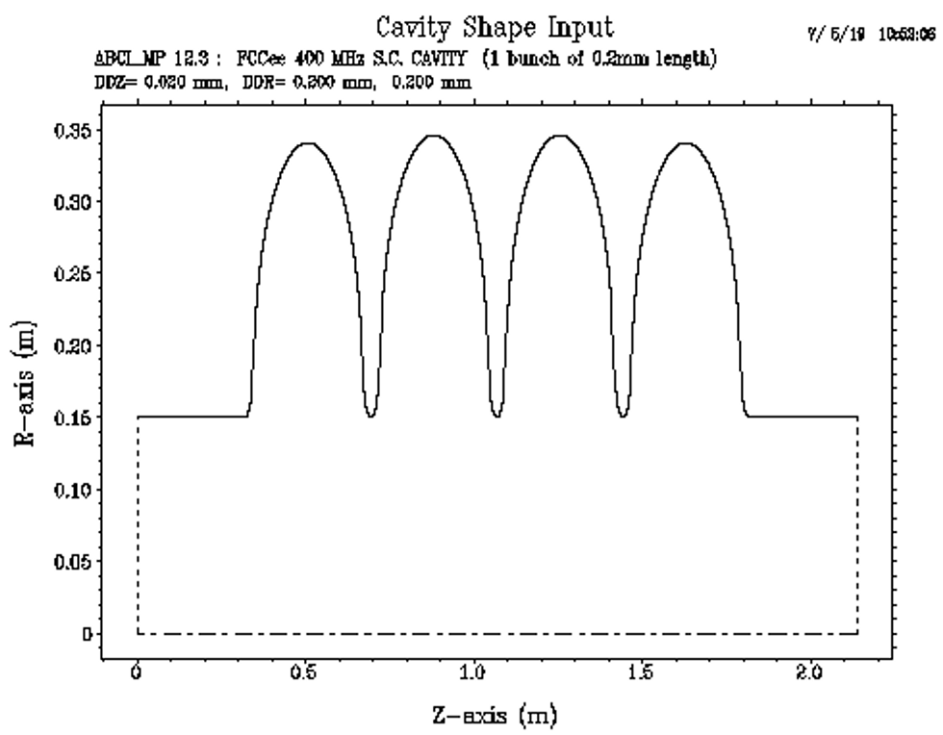
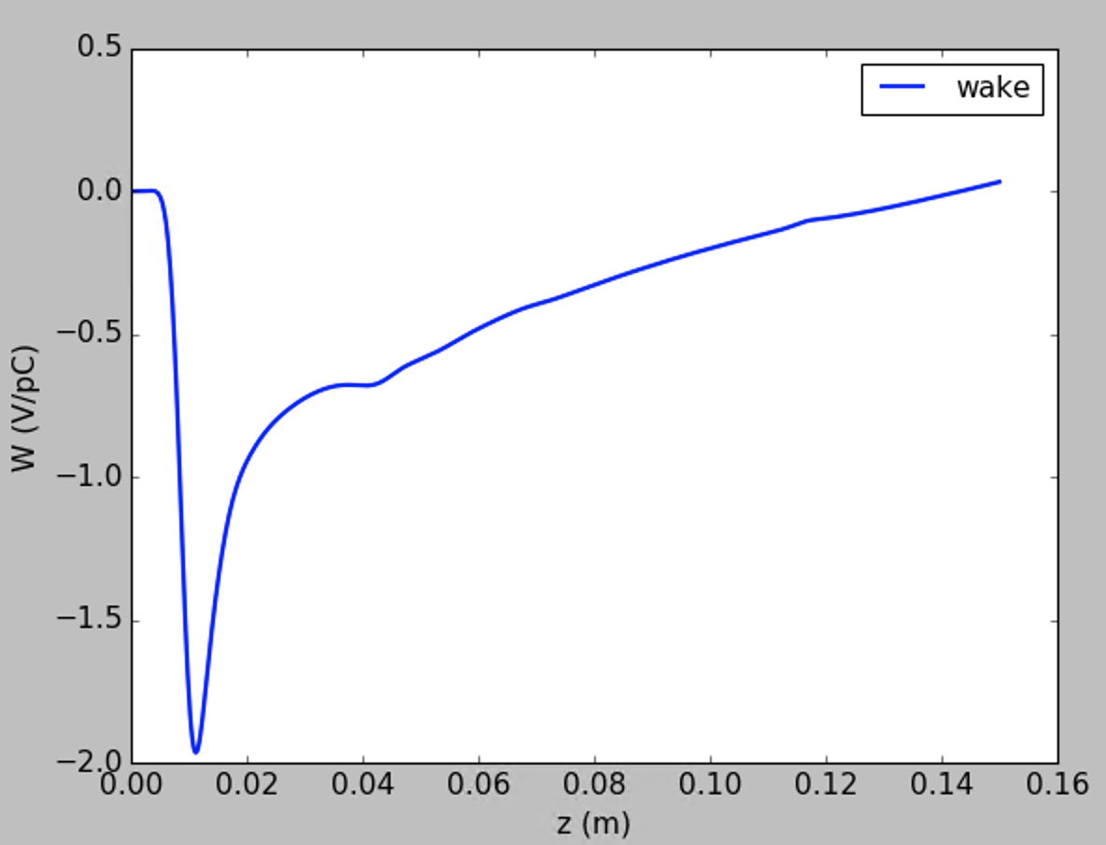
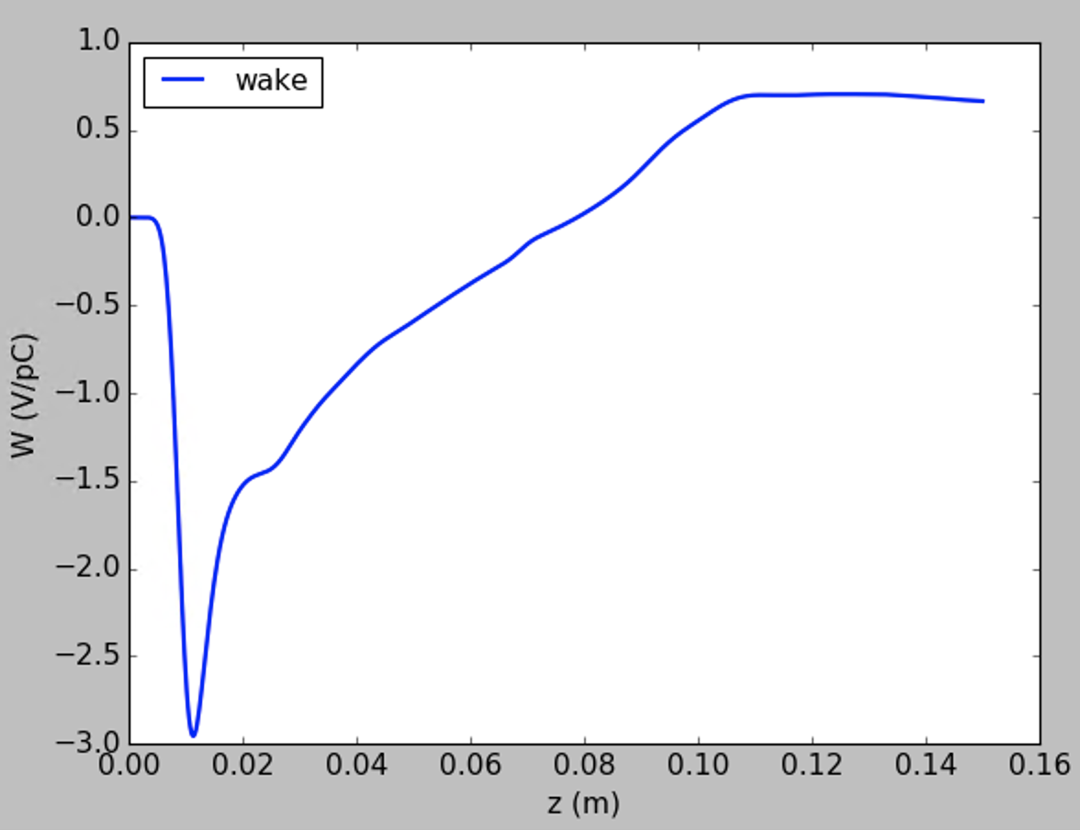
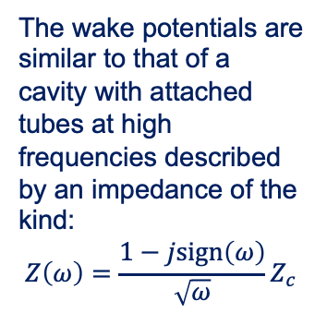
RF system for ttbar
ABCI 400 MHz system
ABCI 800 MHz system
The wake potentials are similar to that of a cavity with attached tubes at high frequencies described by an impedance of the kind:
$$Z\left(ω\right)=\frac{1−jsign\left(ω\right)}{\sqrt{ω}}Z_{c}$$
2 mm bunch length
2 mm bunch length

Slide 8
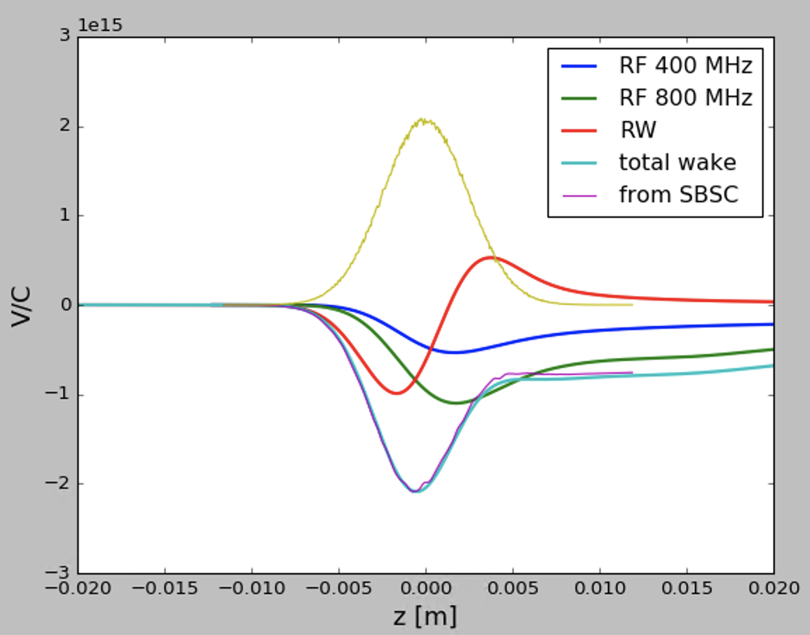
Total wake potential of 2.4 mm bunch

Slide 9
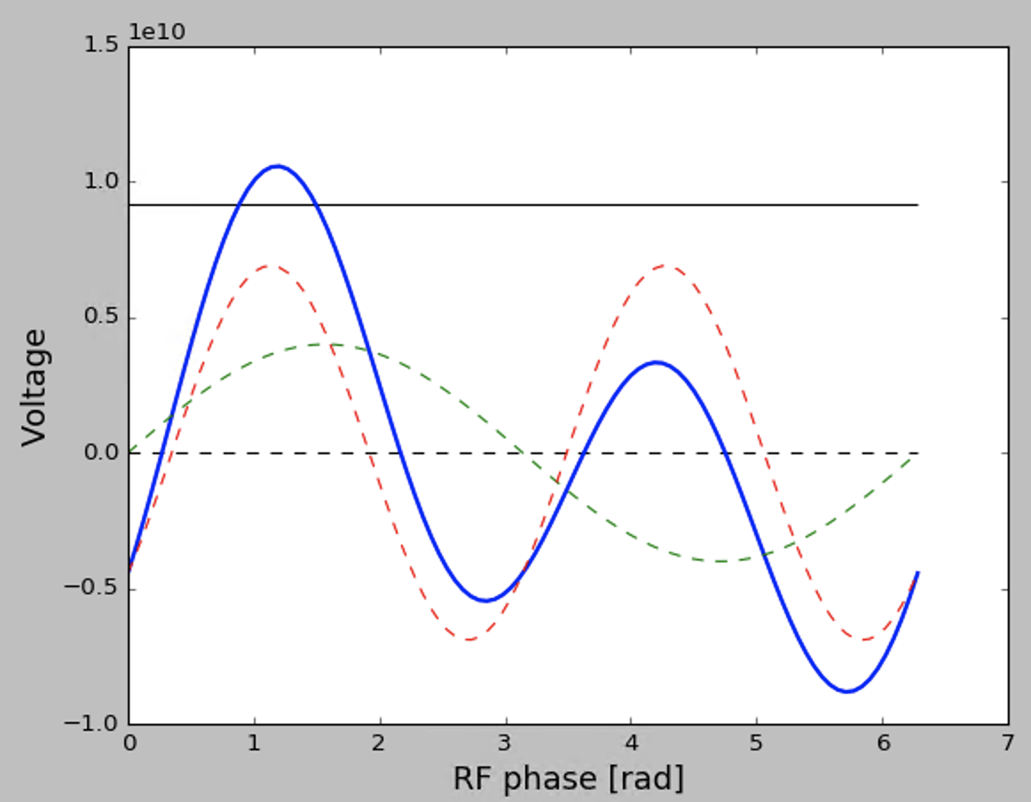

Double harmonic system and synchronous phase
$$V_{tot}=V_{1}\sin\left(h ω_{0}t\right)+V_{2}\sin\left(2hω_{0}t−φ_{off}\right)$$
$$Q_{s}=\sqrt{\frac{ehα_{c}}{2πE_{0}}\left[V_{1}\cos{φ_{s}}+2V_{2}\cos\left(2φ_{s}−φ_{off}\right)\right]}$$
$$V_{tot}\left(φ_{s}\right)=E_{loss}/e$$
$$φ_{off}≃40°$$
Synchronous phase
E loss (SR)/e
800 MHz
[V]
400 MHz

Slide 10
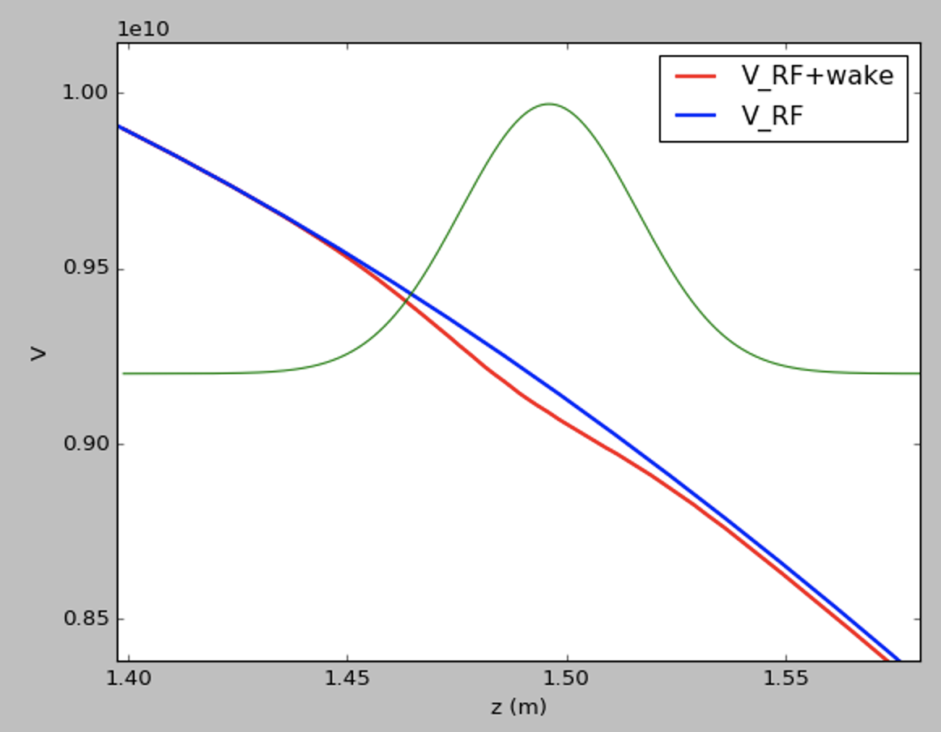
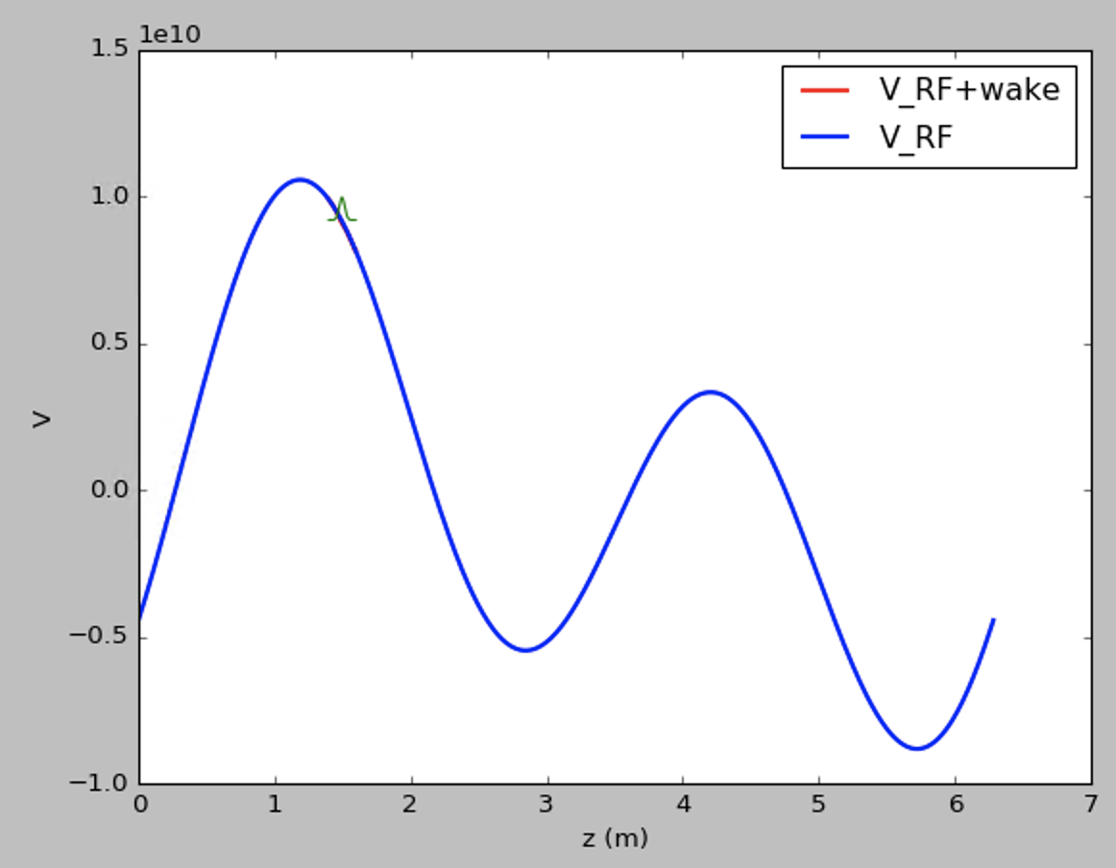
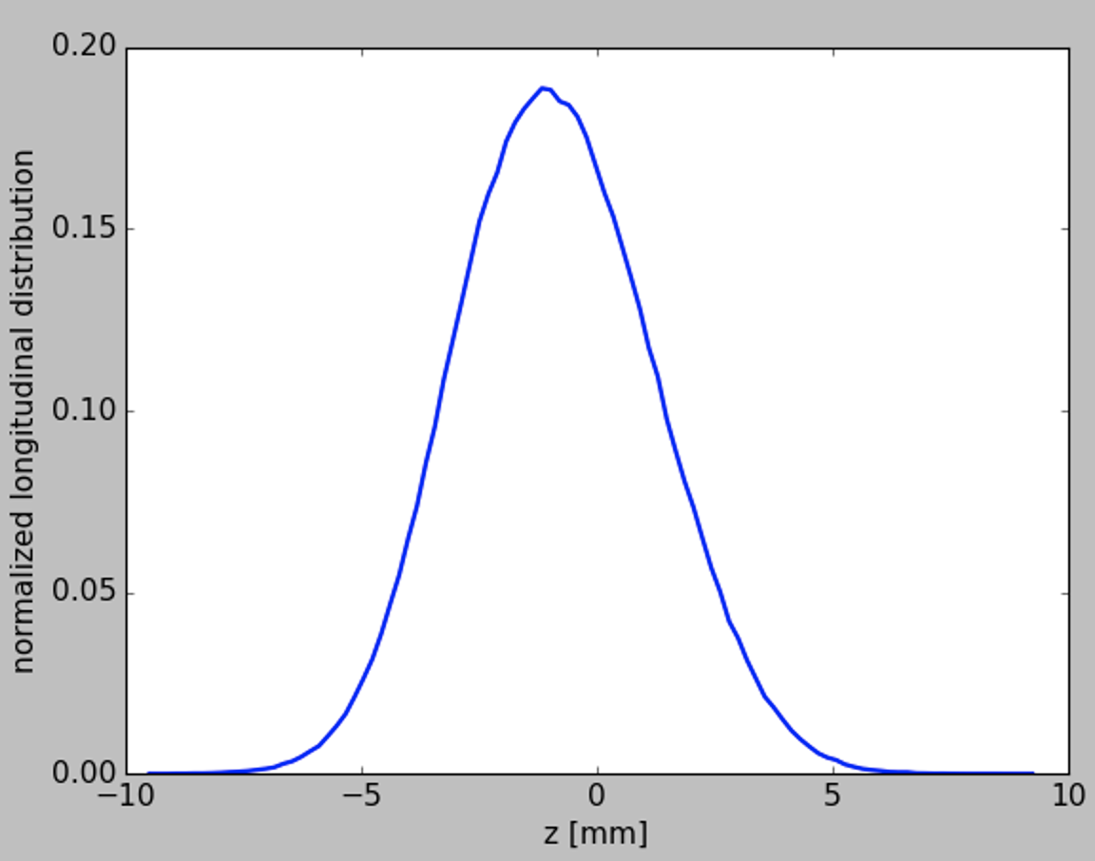
Induced voltage at ttbar for 2.3x10¹¹ ppb
There is no evident deformation from Gaussian shape, just a small displacement due to energy losses

Slide 11
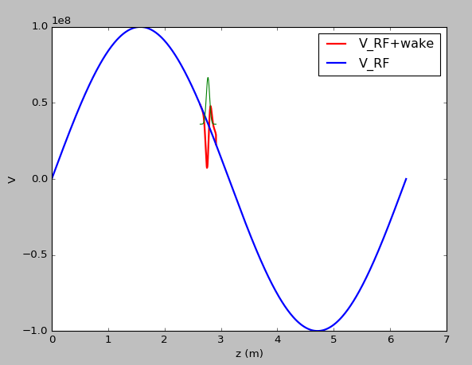
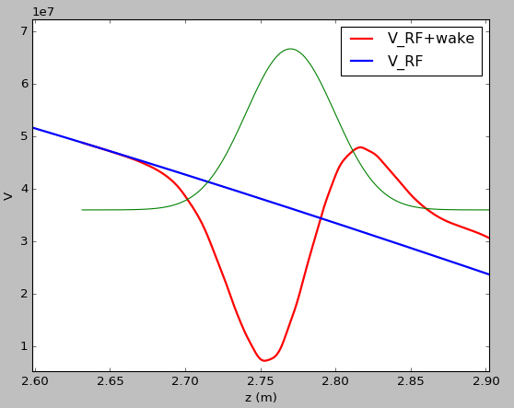
Induced voltage at Z-pole for 2.3x10¹¹ ppb

Slide 12
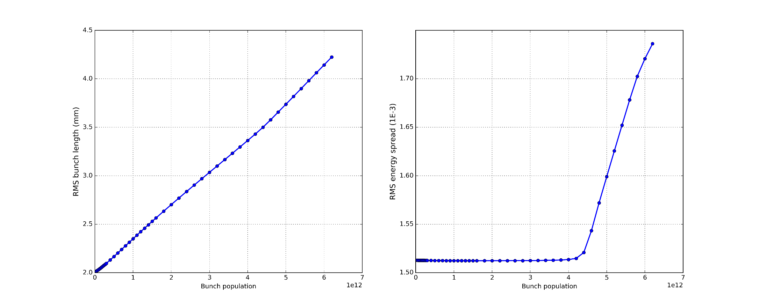
Longitudinal beam dynamics simulations at ttbar
Nominal intensity
Nominal intensity
Preliminary results

Slide 13
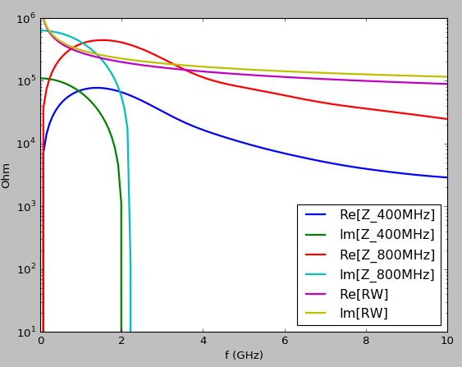
Transverse impedance

Slide 14
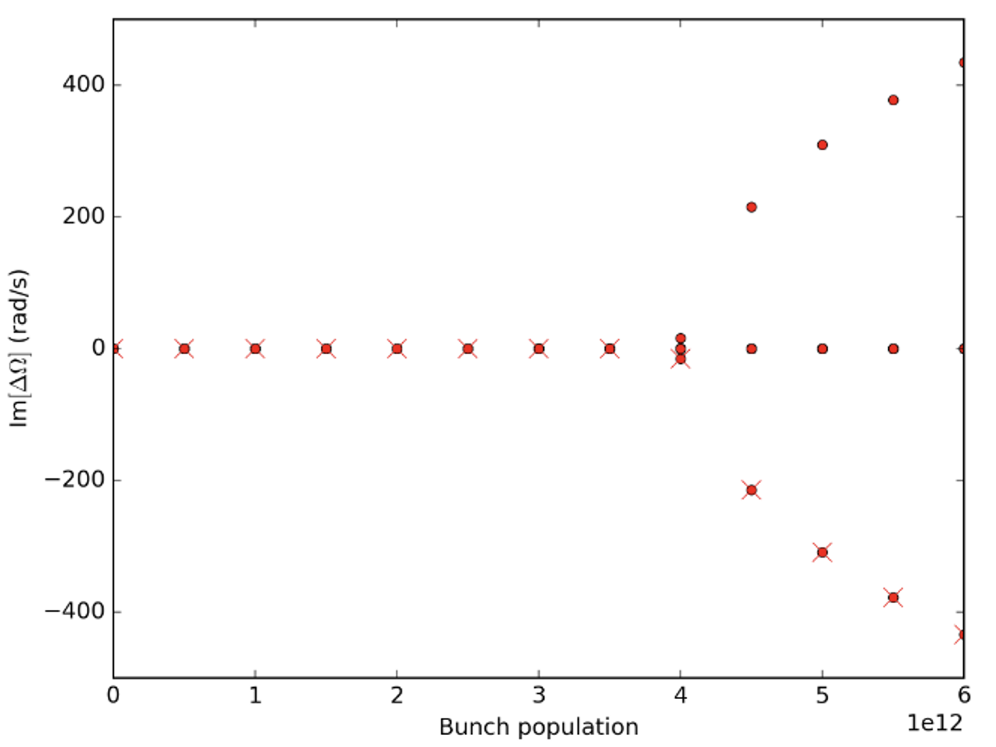
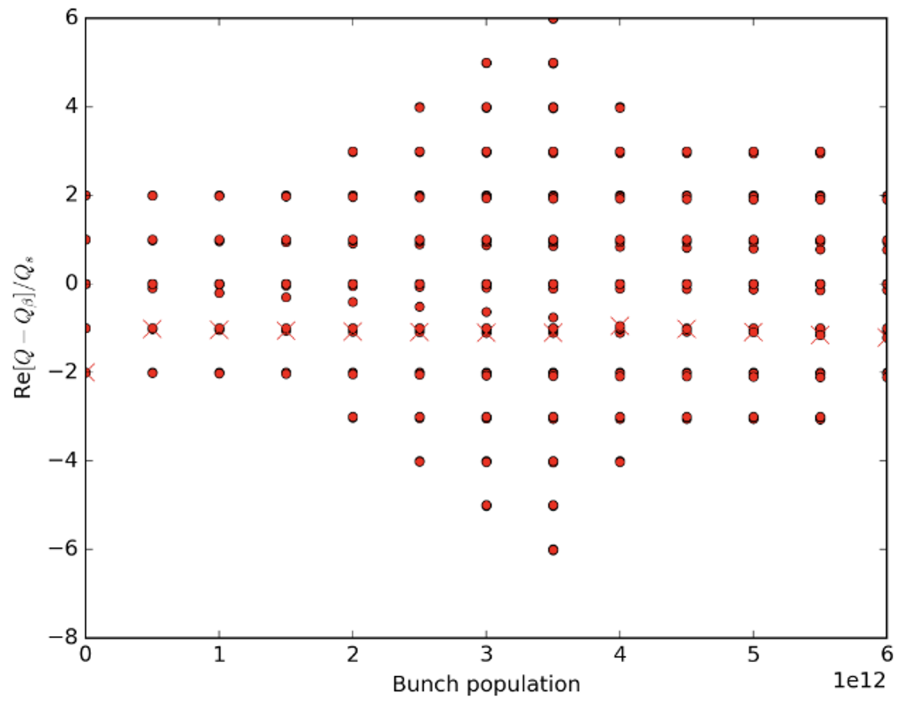
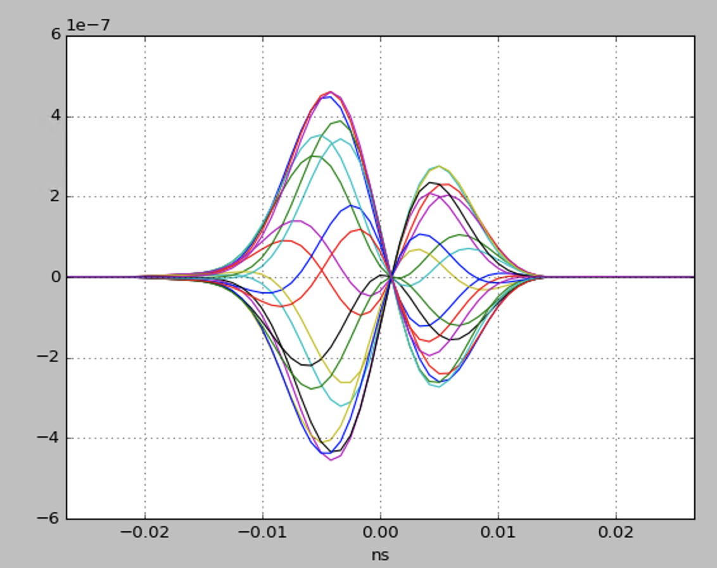
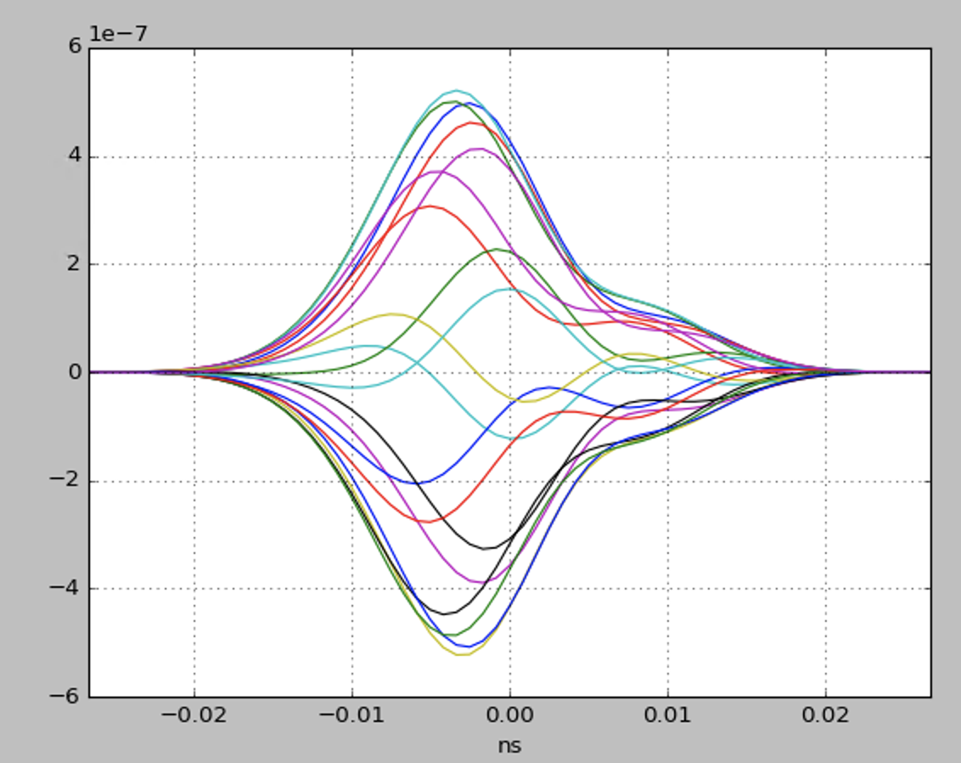
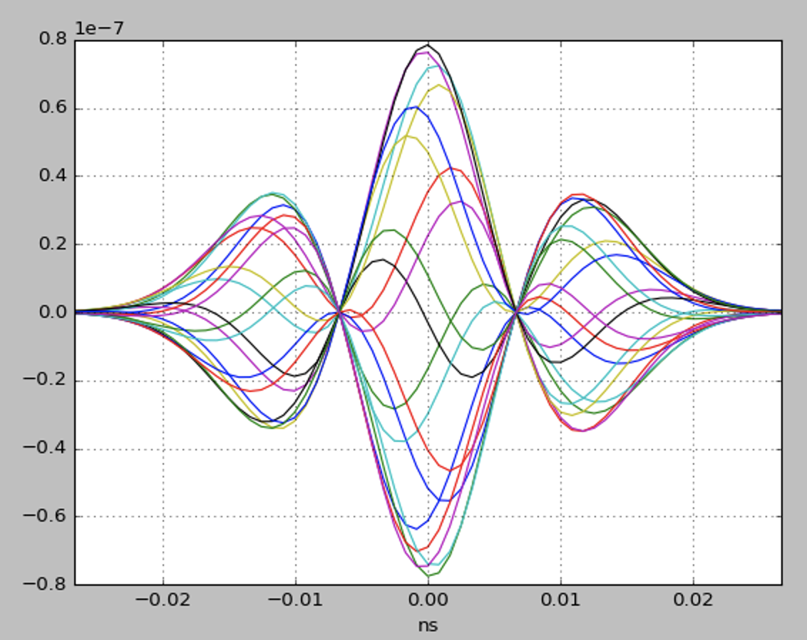
TMCI threshold
DELPHI code, only RW

Slide 15
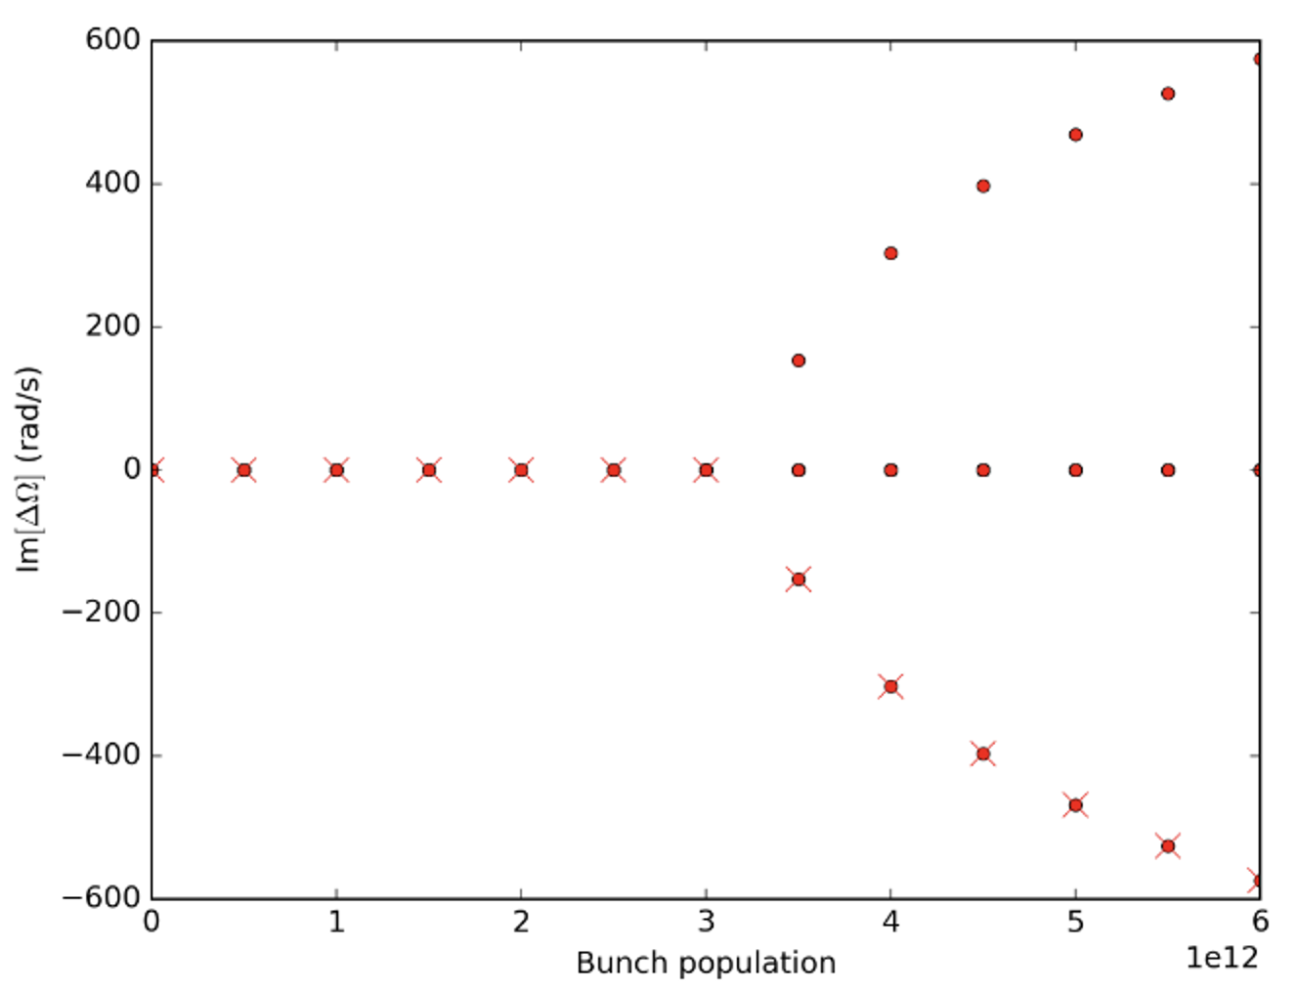
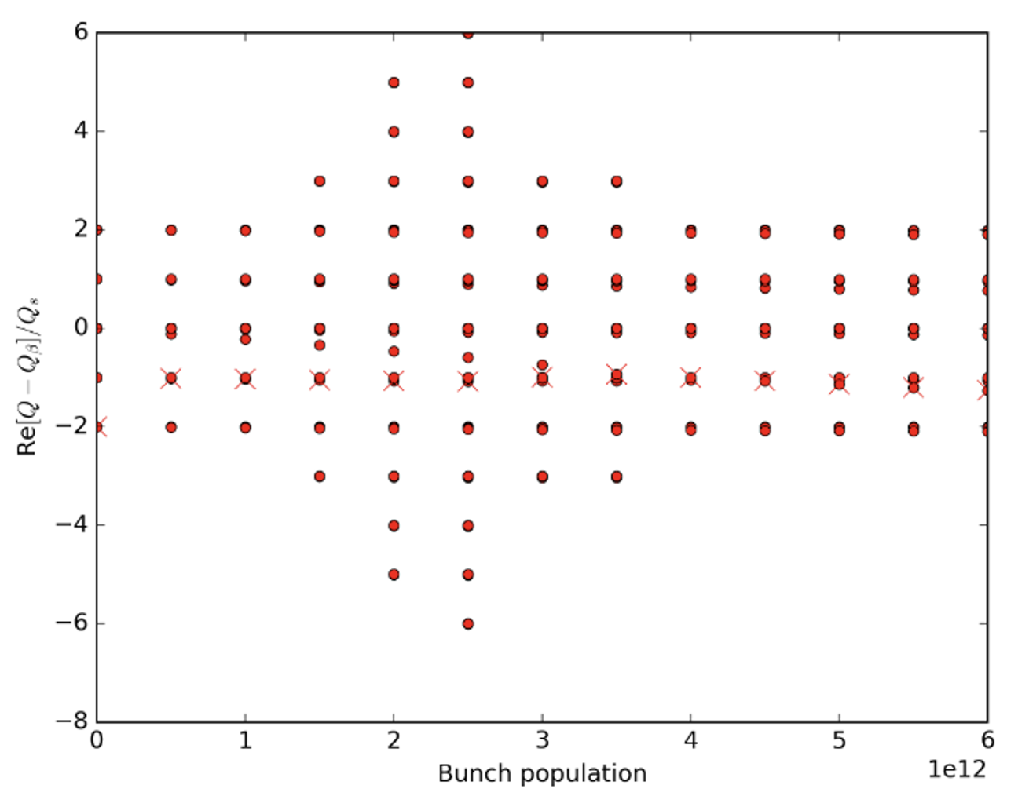
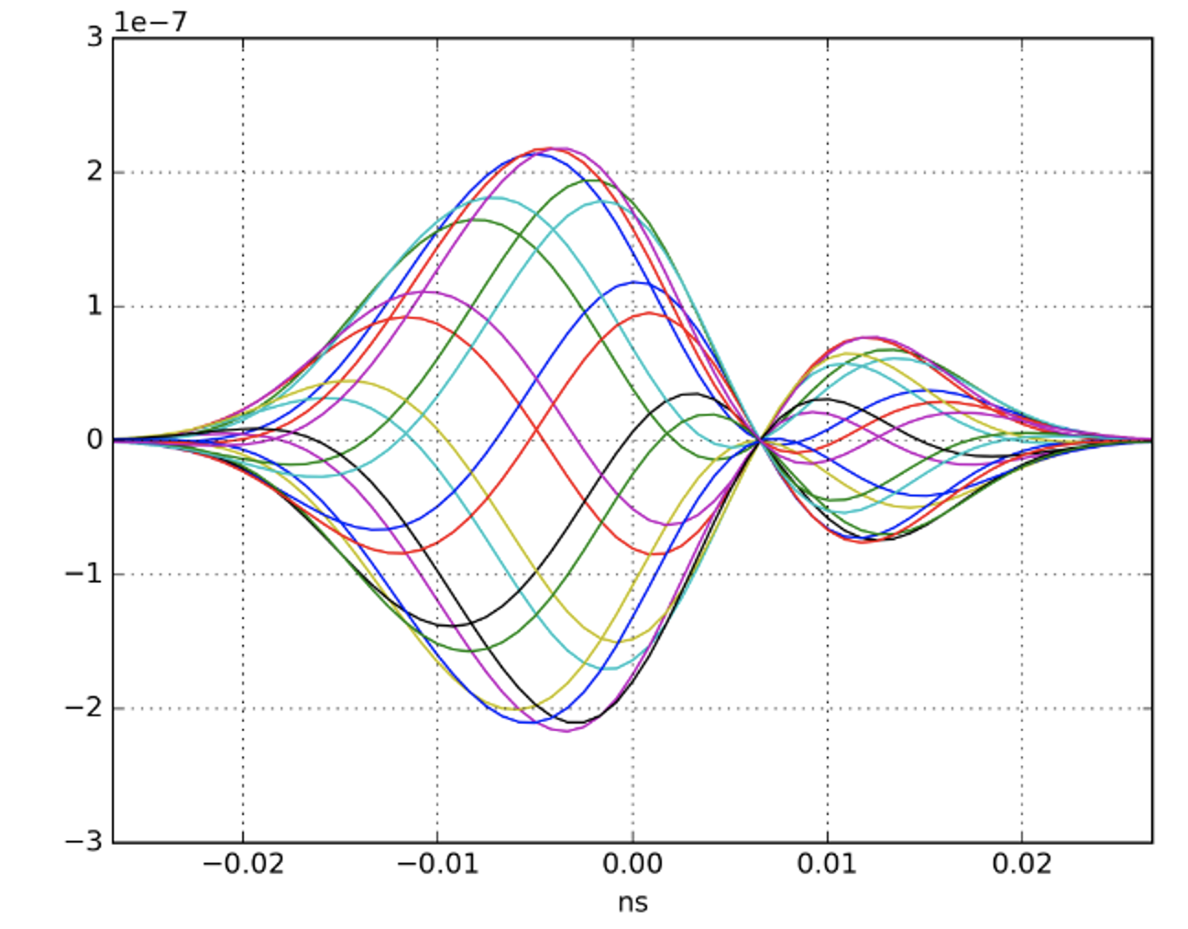
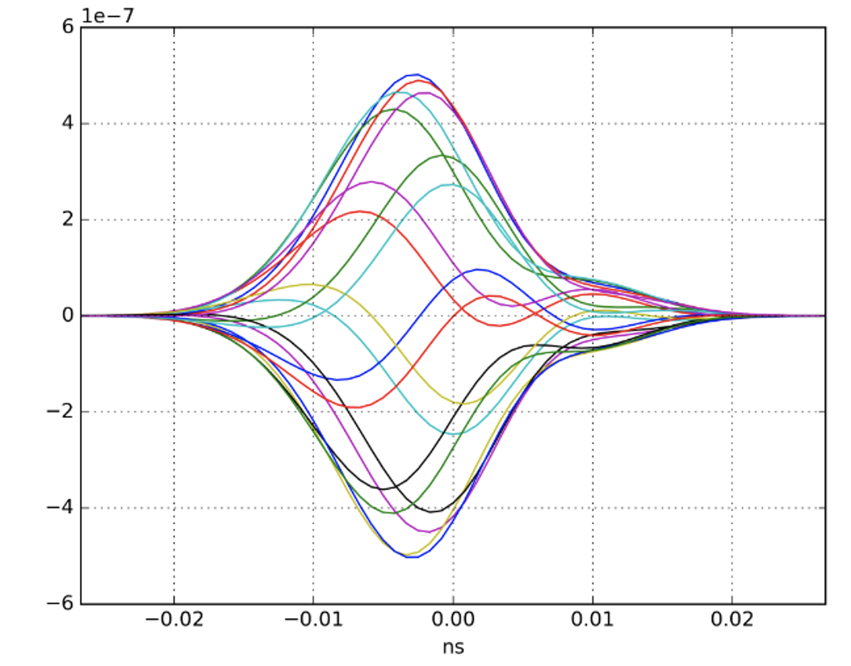
TMCI threshold
DELPHI code, RW + RF system

Slide 16
Conclusions
Despite the large number of cavities the TMCI and the microwave instability do not seem to be dangerous for the FCC-ee at the ttbar energy.
This becomes evident from:
  The intuitive picture of the RF voltage perturbation by the
  wake potential
  The scaling of Boussard criterion
  The numerical simulations
  A much stronger radiation damping

Slide 17
Thank you very much for your attention

