Slide 2


Study of HE-LHC ventilation strategy in case of fire.
CFD study of smoke and heat propagation for PBD
Oriol Rios,
Saverio La Mendola
HSE-OHS

Slide 3
Outline
Intro to PBD methodology used
FCC developed framework
Fire Safety PBD for HE-HLC
  Life Safety Objective Evaluation
  Occupants
Ventilation system design performance
Effect of compartmentalization length
Fire Fighters
Property Protection
Soot and thermal impact
  Design Optimization
  Dampers and ducts fire resistance
  External fans fire resistance
Overall conclusions
Notes:
Study of HE-LHC ventilation strategy in case of fire
The current CDR sets a ventilation strategy developed together with EN/CV. CFD simulations of the inflow and outflow requirements of such a new system are necessary to properly size it and ensure performance with all different credible and degraded scenarios (e.g. fire). Additionally, a detailed study on the mechanical smoke dampers and required fire resistance of the ducts will help on optimizing the cost/efficient solution.
Deliverable: in-depth CFD analysis of full LHC sector considering different fire scenarios and degraded modes. The simulations will also be used to establish the system requirements in terms of fire resistance.

Slide 4
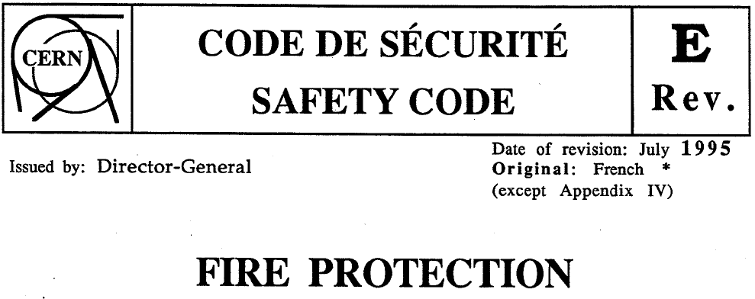
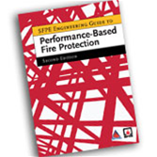
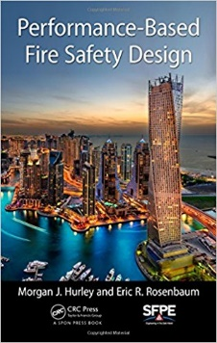
Performance-Based Design, the working solution for safety
What is safe?
Notes:
We have our own regulation. If present, it must be enforced in our site. If not regulated, we have to comply with the principles

Slide 5
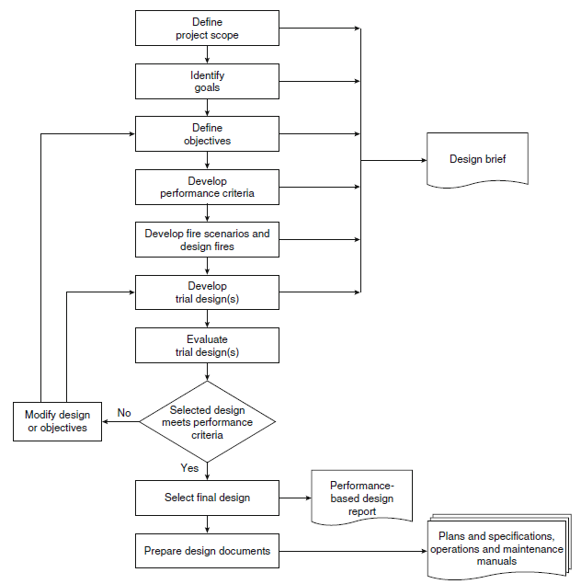
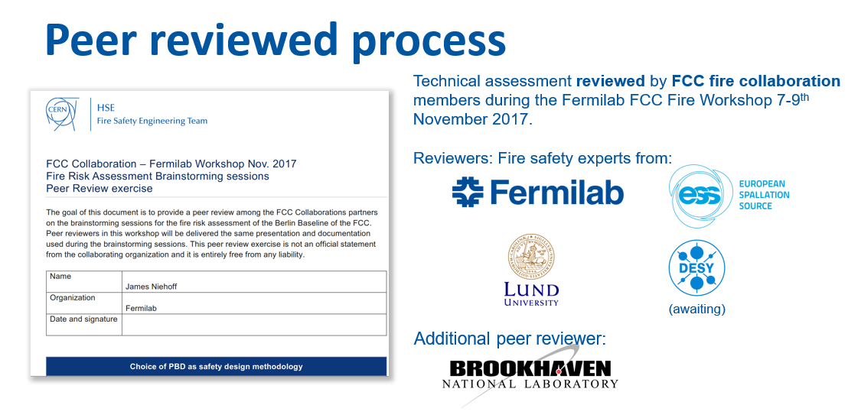
Process conducted with FCC PBD Working Group
PBD process:

Slide 6

Safety Objectives
Fire-induced radiological hazard (to environment, to evacuees or interveners) is not in this study scope. Research in progress: FIRIA project.
 | Life | Environment | Property | Continuity of operation
 | A | B | C | D
1 | Occupants shall be able to evacuate through protected areas, free from smoke/gas and other hazards at any time | Limit the release of polluting (incl. activated) agents to the environment in case of incident | The continuity of essential services and structural stability is assured in case of fire or gas release and other incidents | Limiting the downtime in case of incident
2 | Victims and other occupants, not able to self-evacuate, shall reach protected areas, and wait there to be rescued by the intervention teams | Limit the volume of polluted (incl. activated) water released to the environment in case of incidents | An incident shall not cause other potentially dangerous accidental events | -
3 | Rescue teams shall be able to intervene safely and according to current CERN SOPs | - | Limiting the property loss in case of incident | -
Source CERN EDMS 1770088v1. La Mendola (2017). Methodology proposal for performance-based safety design, La Mendola, 2017

Slide 7
Acceptance Criteria (for Life Safety Objectives)
Occupants
Occupants shall be able to evacuate through protected areas, free from smoke/gas and other hazards at any time
Victims
Victims and other occupants, not able to self-evacuate, shall reach protected areas, and wait there to be rescued by the intervention teams
Firefighters
Rescue teams shall be able to intervene safely and according to current CERN SOPs
01 Any able occupant has a reasonable opportunity of evacuating the facility without reaching any of the following criteria:
    Visibility < 10m at 1.8m high
    Fractional Effective Dose (FED) > 0.1
    T > 60°C
    Heat flux > 2.5KW/m²
References:
ISO 13571:2012. Life-threatening components of fire - Guidelines for the estimation of time to compromised tenability in fires.
Corpo Nazionale dei Vigili del Fuoco (2015). Codice di prevenzione incendi DM 3-8-2015
In a later stage, the probabilistic concept could be introduced.
(needs a call for a background study in the acceptable individual risk by the organization)
i.e.
reasonable opportunity = frequency greater than 10⁻³/year
Notes:
Fractional Effective Dose (FED) is a measure of airborne contaminants absorbed by an occupant. Hazards such as carbon monoxide and carbon dioxide are accumulated during the occupant’s movement through a burning building.
The Fractional Effective Dose index (FED), developed by Purser [46], is a commonly used measure of human incapacitation due to the combustion gases. The FED value is calculated as
FEDtot = (FEDCO + FEDCN + FEDNOx + FLDirr) × HVCO2 + FEDO2
D.A. Purser. SFPE Handbook of Fire Protection Engineering, chapter Toxicity Assessment of Com- bustion Products. National Fire Protection Association, Quincy, Massachusetts, 3rd edition, 2002.
ractional Effective Dose (FED)
The additive effects of fire gases was advanced to include con- sideration of variable exposure time. This strategy is commonly referred to as the fractional effective dose (FED) methodol- ogy.34,59,60 The FED is “the ratio of the Ct product (concentra- tion × time) for a gaseous toxicant produced in a given test to that Ct product of the toxicant that has been statistically deter- mined from independent experimental data to produce lethality in 50 percent of test animals within a specified exposure and postexposure time.”53
The additivity of FEDs has become a useful tool in com- bustion toxicology for the calculation of lethal toxic potencies from combustion product analysis data, as well as for the assess- ment of potential toxic hazards to humans.51 Mathematically, the principle is expressed as
2 FED = } }
C
i ∆t (4)
(Ct)i
Ci = Concentration of toxic component i
(Ct)i = Specific dose (concentration × time) required to produce lethality
t = Time increment (min)
When the accumulated FED = 1, it is expected that the mixture of gaseous toxicants would be lethal to 50 percent of exposed animals, that is, the LC50.

Slide 8
PBD process:
Fire Scenarios

Slide 9
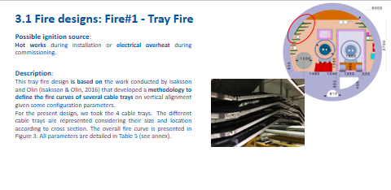
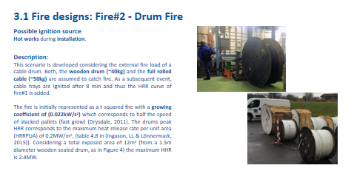
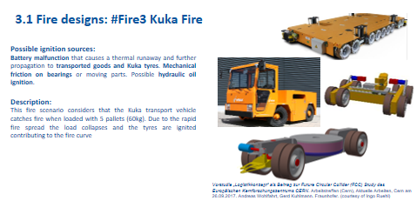
Fire Designs
Same fire scenarios as those generated for FCC tunnel assessment
DRUM
CABLE TRAY
Those 3 scenarios are considered to be more representatives ones
Only fire scenarios are considered.
Fire Scenarios resulting from explosions are not accounted for.
KUKA
Notes:
Need to better account for hazard. Gas cyliders? Hydraulics? Batteries?
Kuka scenario to be revisited with closer design onTDR!

Slide 10
Fire#1 - Tray Fire
Fire designs: Enveloping cases
Fire#2 – Drum Fire
Fire#3 - Kuka Fire
If compartmentation works, with current ventilation system HRR_{max} < 5MW (ventilation limited)
Fire#2 and Fire#3 have same growth up to 8min!
In all cases, the fire is assumed to be located at 1/3 of the length of the compartment
Notes:
Kuka fire that does not involve cables. They are not present.

Slide 11
PBD process:
Trial Design

Slide 12
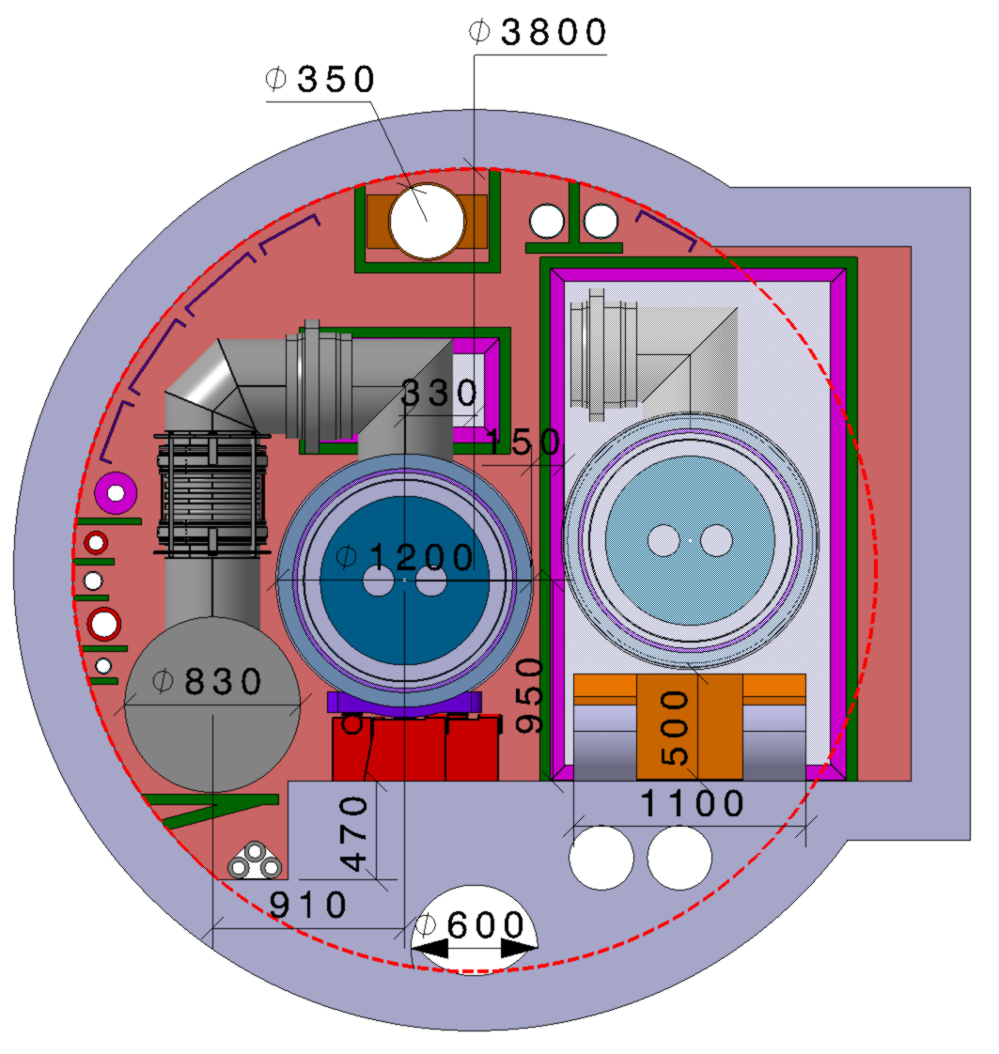
Geometry and safety measures
Baseline Safety Features
Fire compartment = 4 x cells (137m), 548m
He-Smoke extraction duct (Ø350)
Detection in compartments
Fire extinguishing pipeline on each fire door

Slide 13
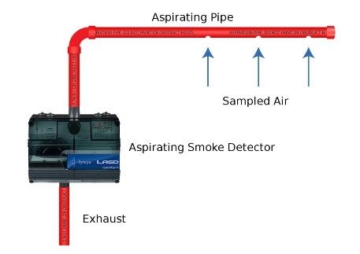
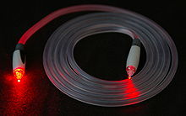
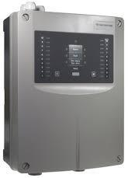
Trial design features: Detection
 | Aspiration | T Line (optical fiber) | Optical smoke detector*
Features | Resolution: 100m Max Sampling Speed: 1-1.5 m/s Analyzer must be put in the alcoves (i.e. 1.5km distance) Thus, worst case scenario (fire at 750m from alcove) the transport (i.e. sampling) time is 500s. | Resolution: order of cm Sampling speed of some seconds (for the signal processing algorithm) It detects temperature trends (more useful than absolute temperatures in terms of detection) | They are currently not radiation resistant * Resolution of 100m (4 per compartment) Instant signal communication Technology to be developed
Detection time | Central has to be shielded from radiation (installed in the tunnel) | We assume it will take up to 120s to detect a fire after de development and optimization of the detection algorithm. Hypothesis to be better studied in TDR. | 60<t<120s*
HYBRID SYSTEM?
Assumed SPEC t_{det}= 120s
*Desy (FCC Col)
Yacine Kadi EN-EA
Notes:
510s = 8.5min!
By means of air aspirating units (as present today in LHC and other CERN facilities).
*in Desy they are researching on this

Slide 14
Ventilation: Proposed Strategy
Normal Ventilation Condition
Normal Ventilation Condition
25000 m³/h
25000 m³/h
Notes:
As will be shown in a minute the Berlin Baseline ventilation didn’t meet objectives so we developed a new solution together with EN/CV

Slide 15
Ventilation: Proposed Strategy
When Fire is detected in a compartment
Normal Ventilation Condition
Small smoke exhaust: ~100 m³/h
- - - - - - - - - - - - - - - - - - - - - - - - - - -
+ + + + + + + + + + + + + + + + + + + + + + + +
+ + + + + + + + + + + + +
+ + + + + + + + + + + + +
+ + + + + + + + + + + + + + + + + + + + + + + +
25000 m³/h
25000 m³/h
3 compartment doors closes (fire compartment and neighbours)
Longitudinal ventilation blows towards the compartment
Small air extract in fire compartment (~100m3/h) (to ensure under pressure)
Overpressure created in neighbouring compartments
Safe situation for Fire Fighters intervention

Slide 16
PBD process:
Evaluate Trial Design

Slide 17
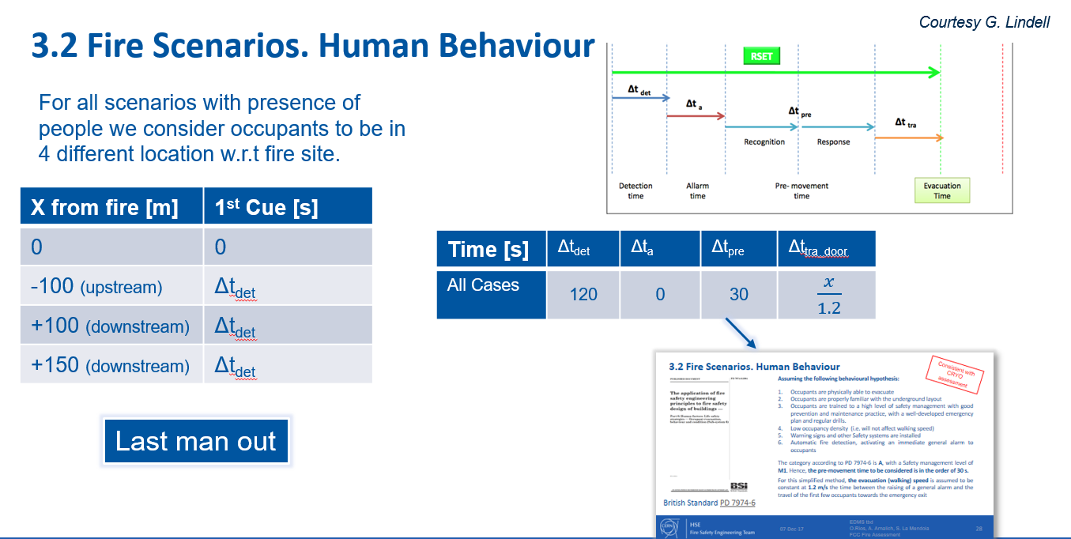
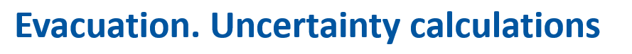
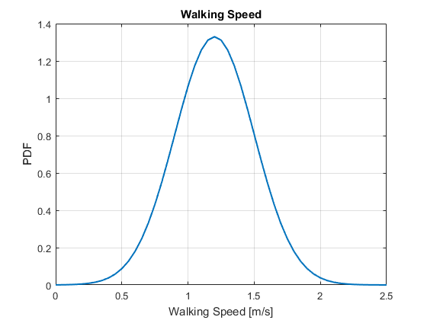
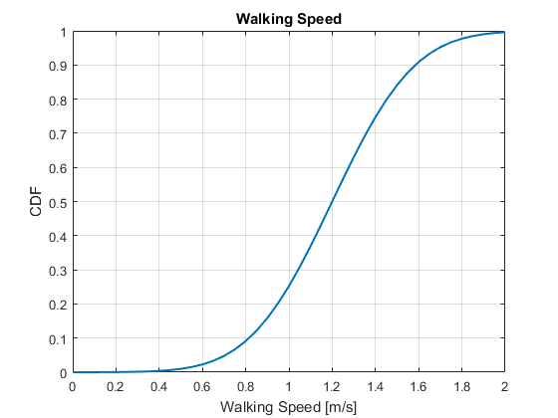
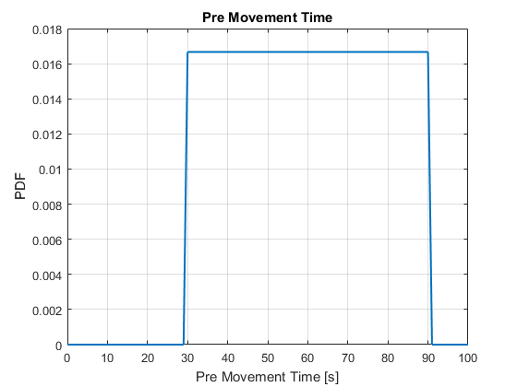
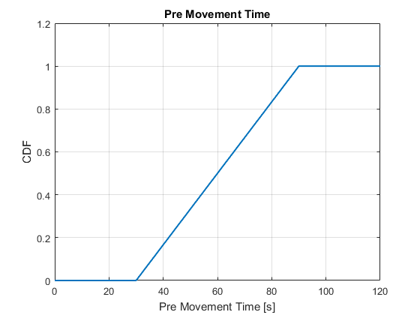
Fire scenarios and human behaviour
Walking Speed. Normal([1.2,0.3])
10th percentile = 0.8 m/s
90th percentile = 1.6 m/s
10th percentile = 36 s
90th percentile = 84 s
Pre Movement. Uniform([30,90])

Slide 18
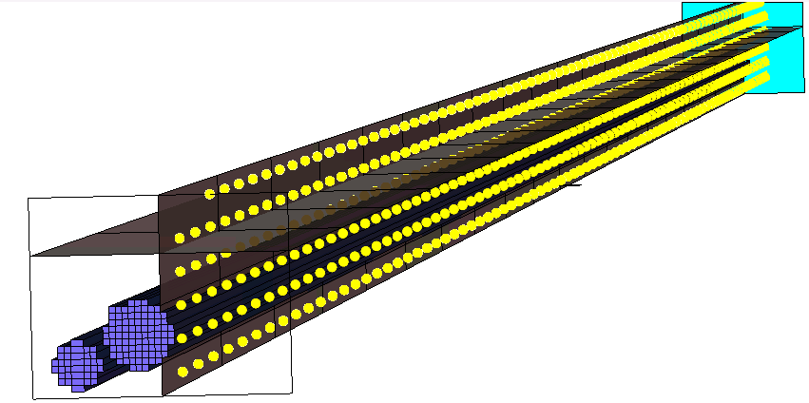
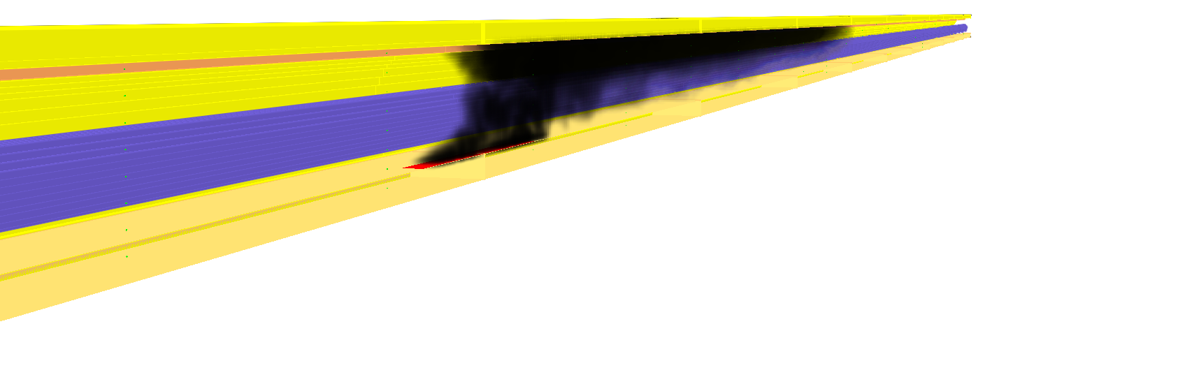
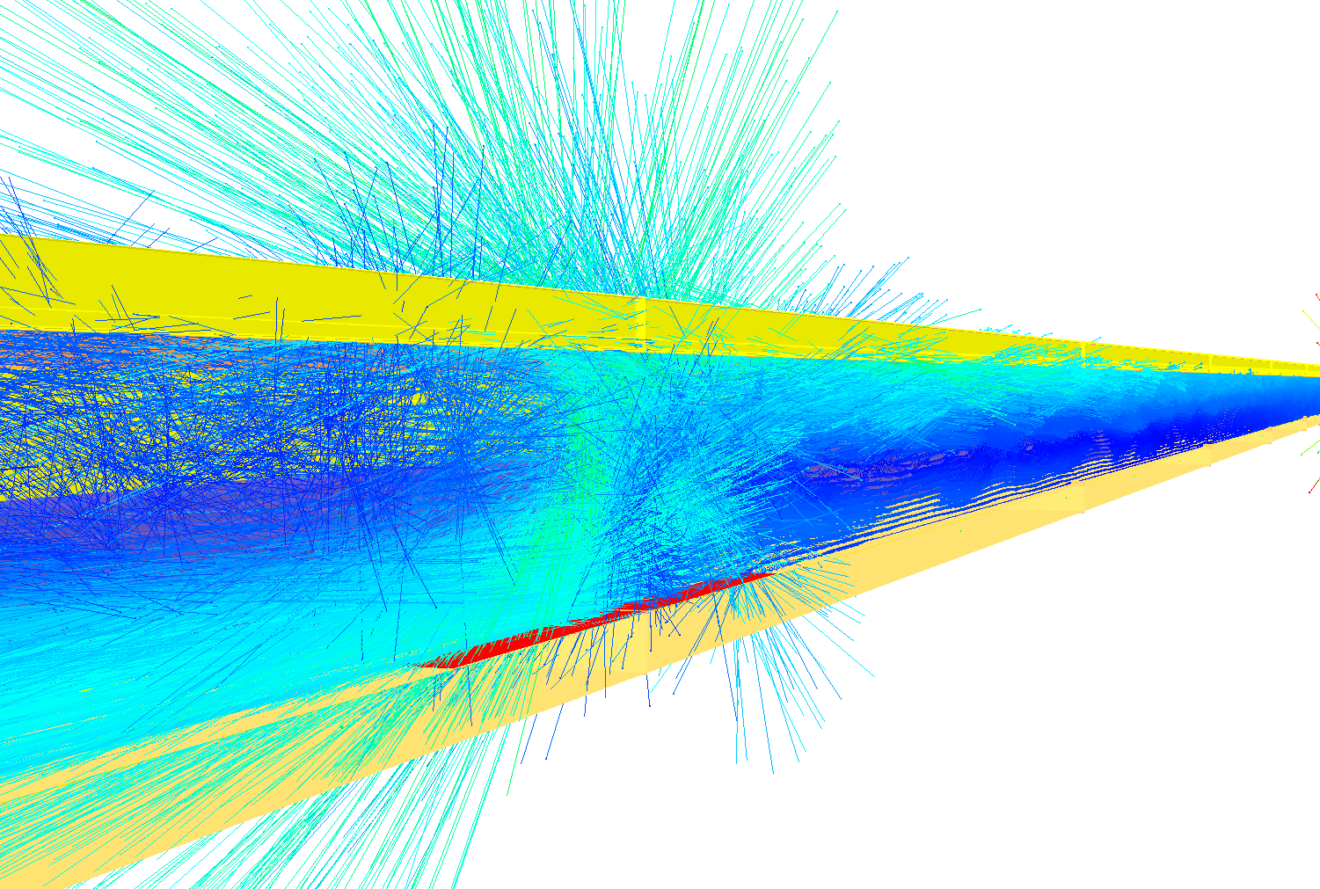
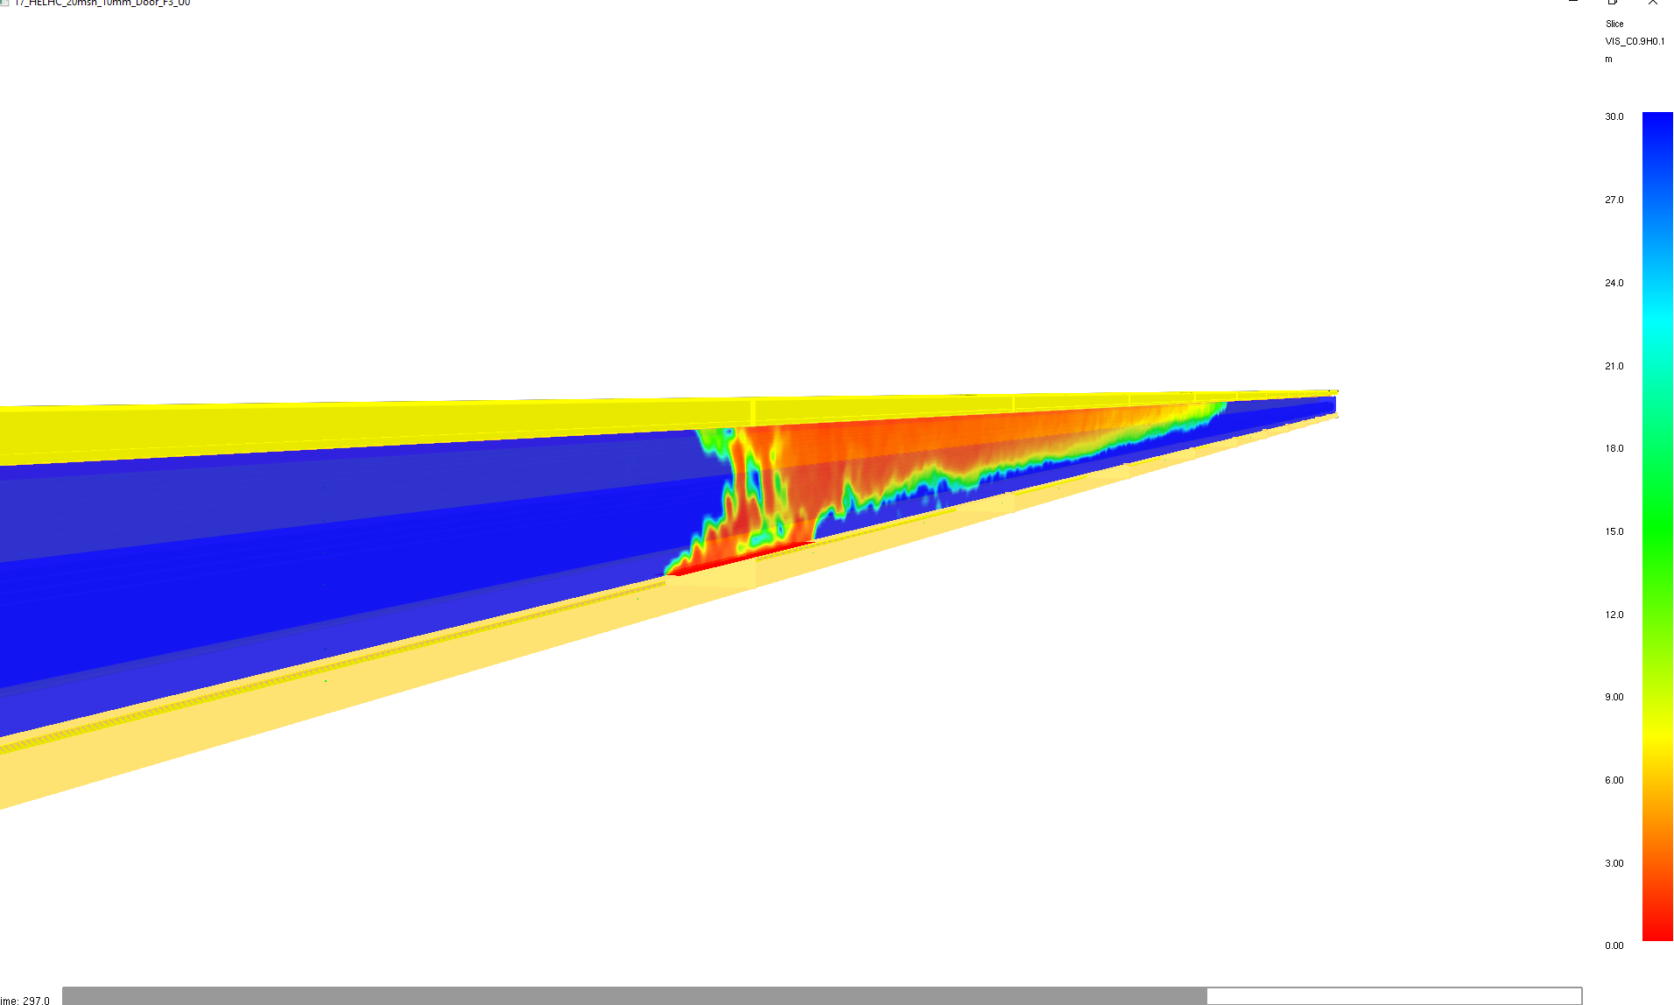
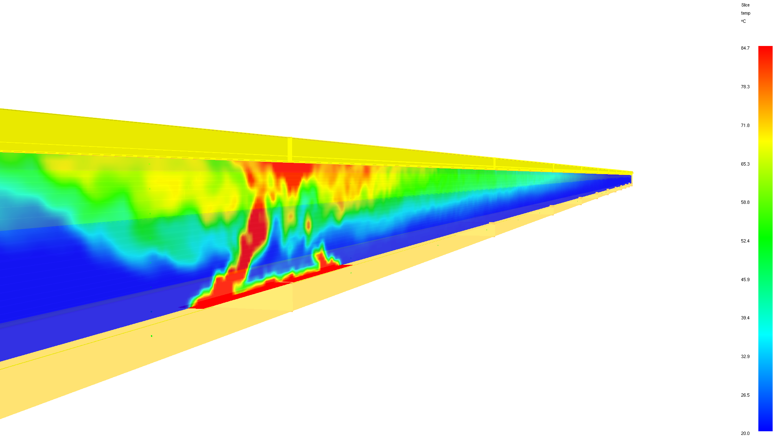
Center of the walking lane
Evaluation: CFD modelling
2m from floor
44 trees,
Δz = 0.4m
Δx = 10m
Smoke propagation
Flow fields
Smoke visibility
Temperature fields

Slide 19







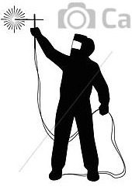
t
Start of Fire fighter intervention
t_{int}
End of evacuation
t_{ee}
Ongoing evacuation
t
Propagation driven by buoyancy
Detection, alarm on, ventilation off
v
t_{d}
Ignition
Hot works
Fire detection deactivated (IS37)
Active fire detection
v
t_{i} = 0
x

Slide 20
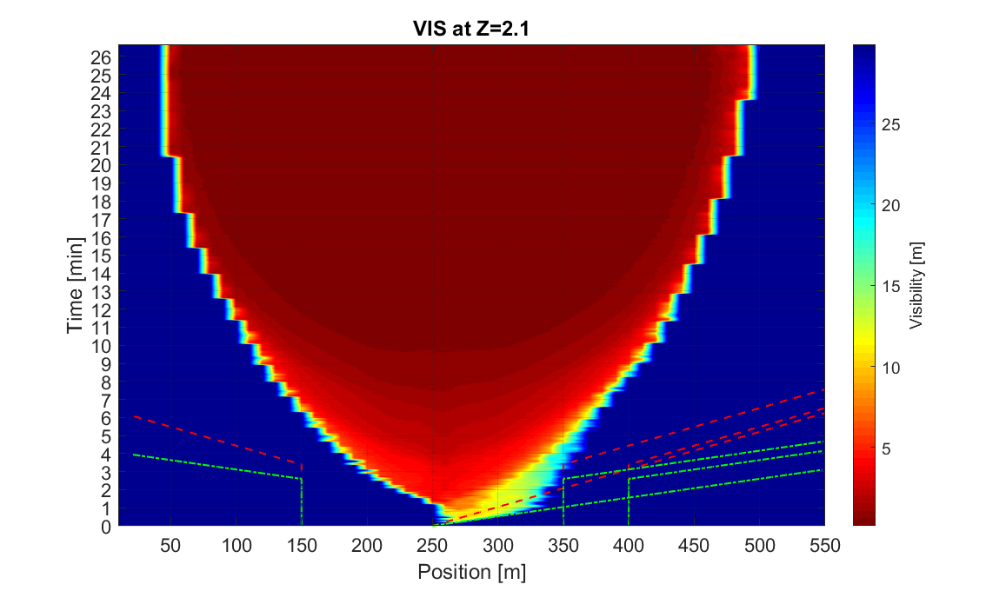
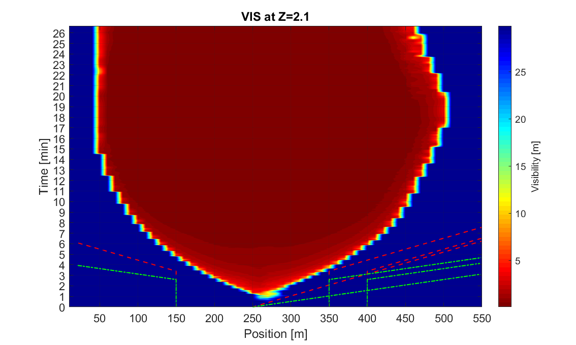
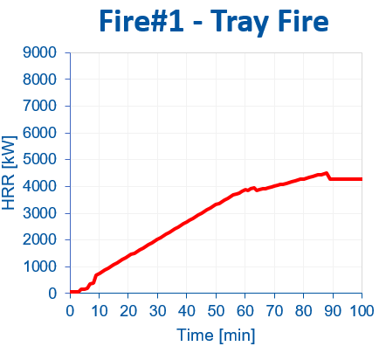
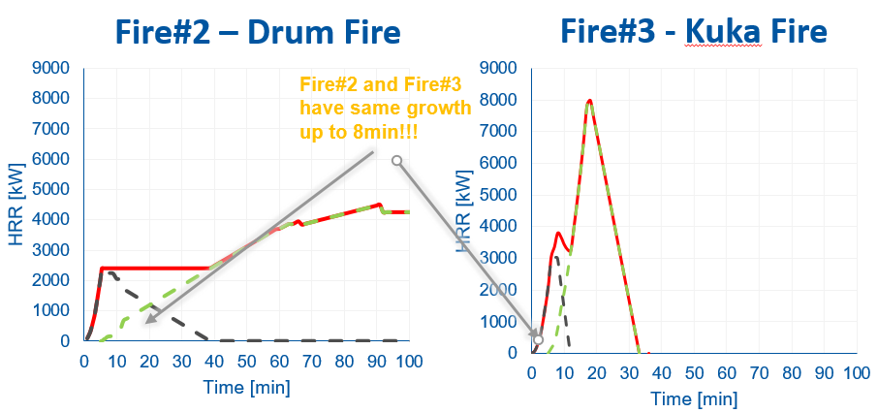
Life Safety: no smoke extraction (no inlets)
Case: Fire#1
Case: Fire#2-3

Slide 21
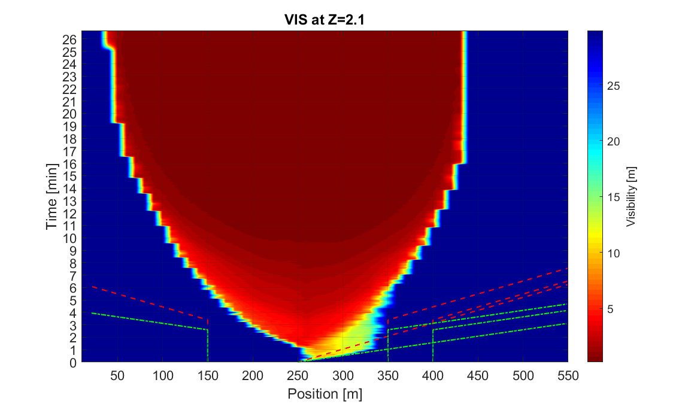
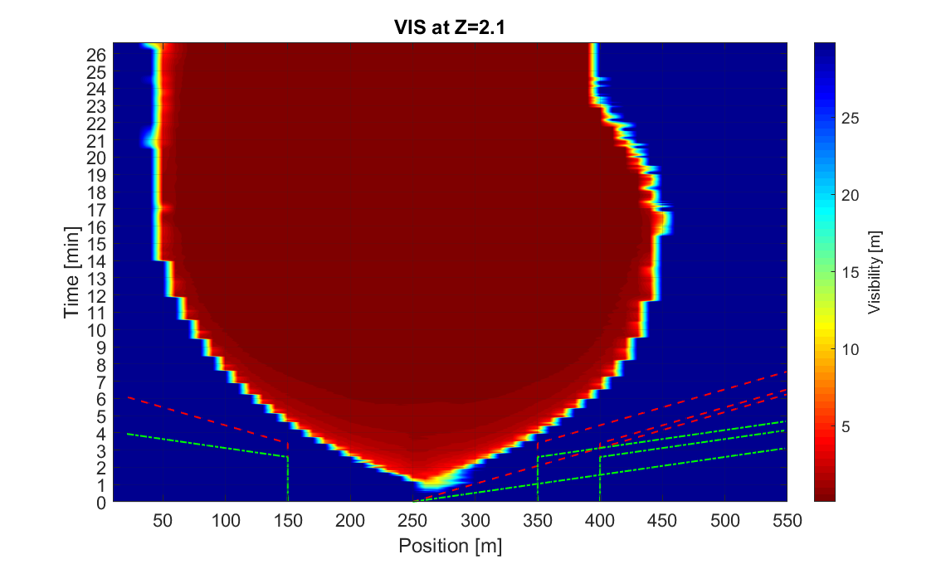
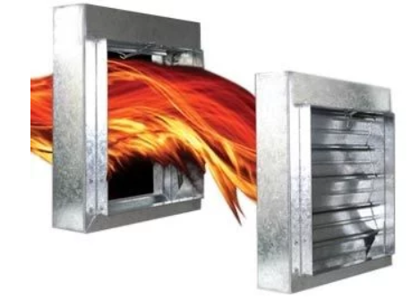

Life Safety: smoke extraction (+inlets)
Flow$≈$3000m3/h
Case: Fire#1
Case: Fire#2-3
Spurce: http://news.lifesafetyservices.com/

Slide 22
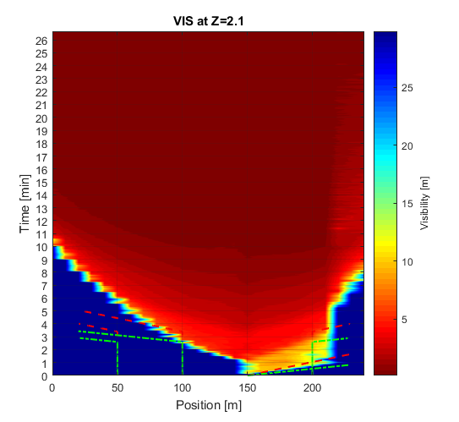
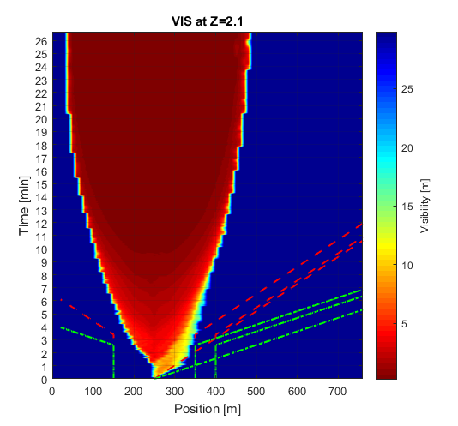
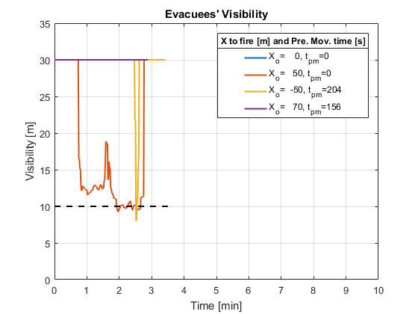
Life Safety: Compartment length (250m vs 772m)

Slide 23
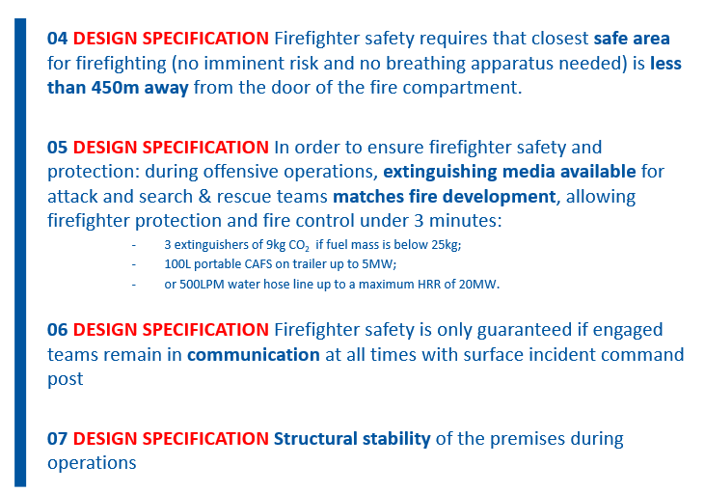
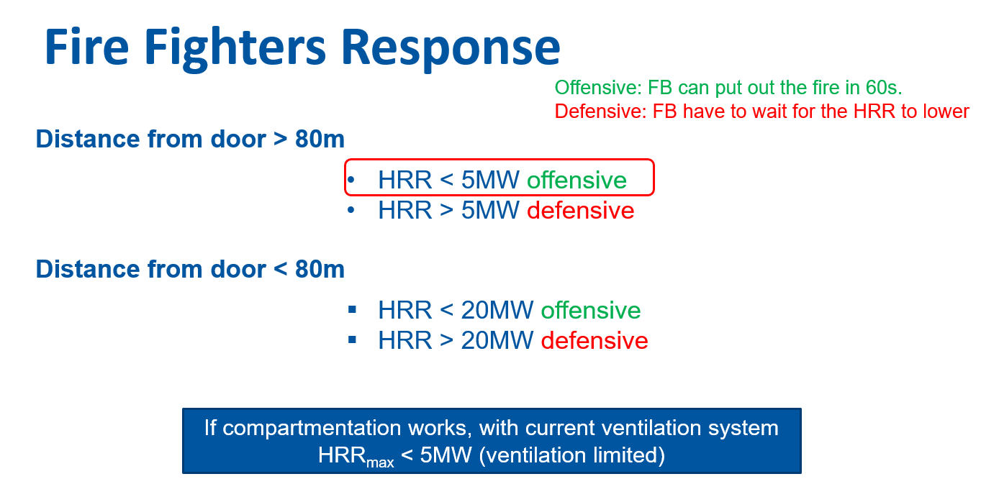
Fire Fighters Life Safety

Slide 24
Property Protection: Performance Criteria
Burnt Areas
Full replacement of equipment
Smoke damage
Cleaning operations and partial/complete replacement.
01: All material and devices that:
  -Caught fire
  -Are exposed to:
  > 20 kW/m²
  > 80ºC
02: All material and devices that:
  Undergo a deposition of soot (HCl) larger than:
    > 100 mg/m² [2] (replacement)
    > 50 mg/m² [2] (cleaning)
Notes:
XX kW/m² or 75ºC (integrated circruits max limit)
Y_{s} = 0.1 gsmoke/gfuel
C = 3 non emitting signs
3·10⁻⁴ kg/m³ produces 2g deposition in 15min in 1m2
(Giornada: this might be from HCL)
10microg/cm2
Y_HCL(PVC) >= Y_s (see ref below)
Al-Sayegh, W. A. et al. (2016) ‘PVC Cable Fire Toxicity Using the Cone Calorimeter’, Fire Science and Technology 2015, (November), pp. 175–182. doi: 10.1007/978-981-10-0376-9_17.
5microg/cm2

Slide 25
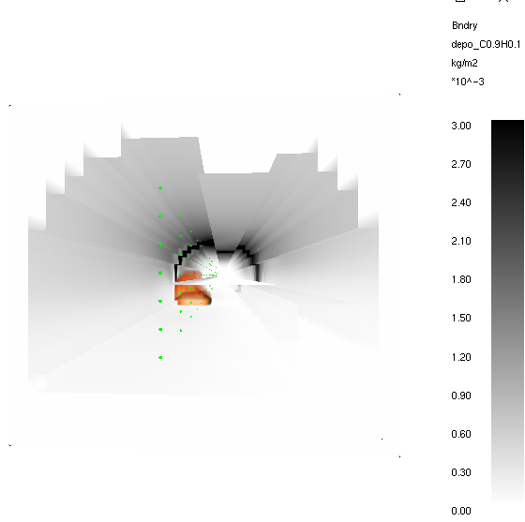
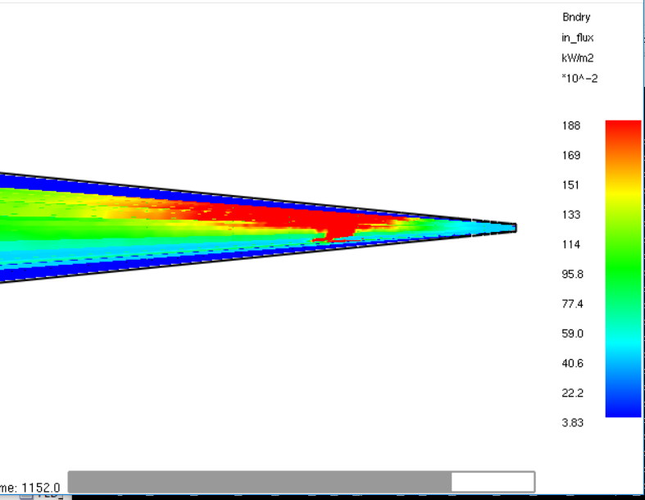
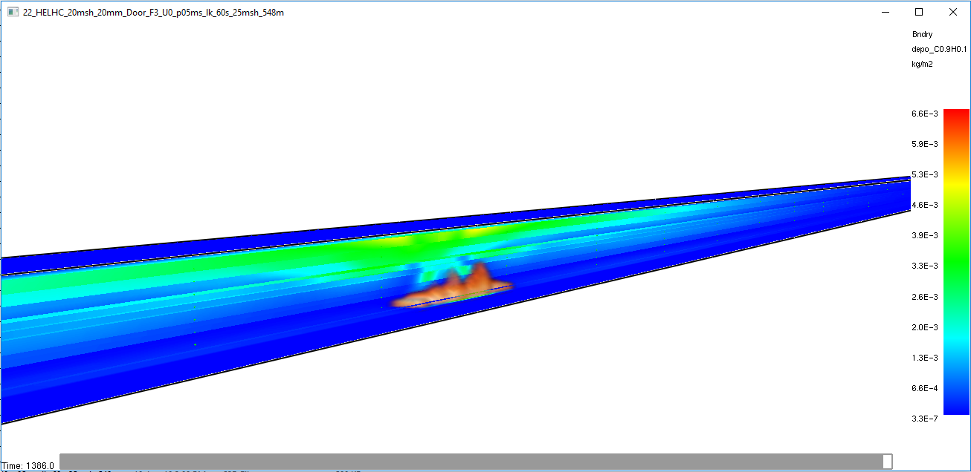
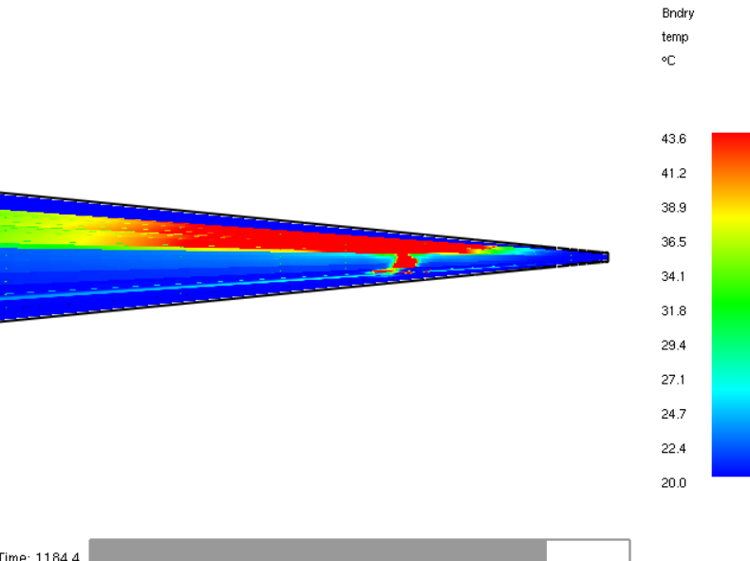
Impact to property (machine & tunnel)
Fire #1
Heat Flux
Soot Deposition
Surface Temperature

Slide 26
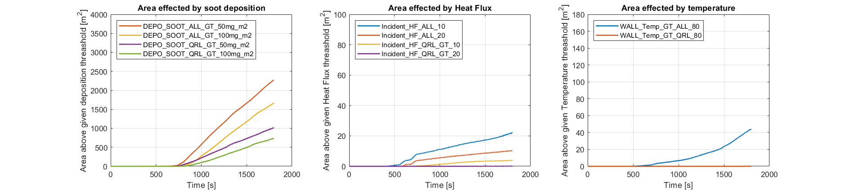
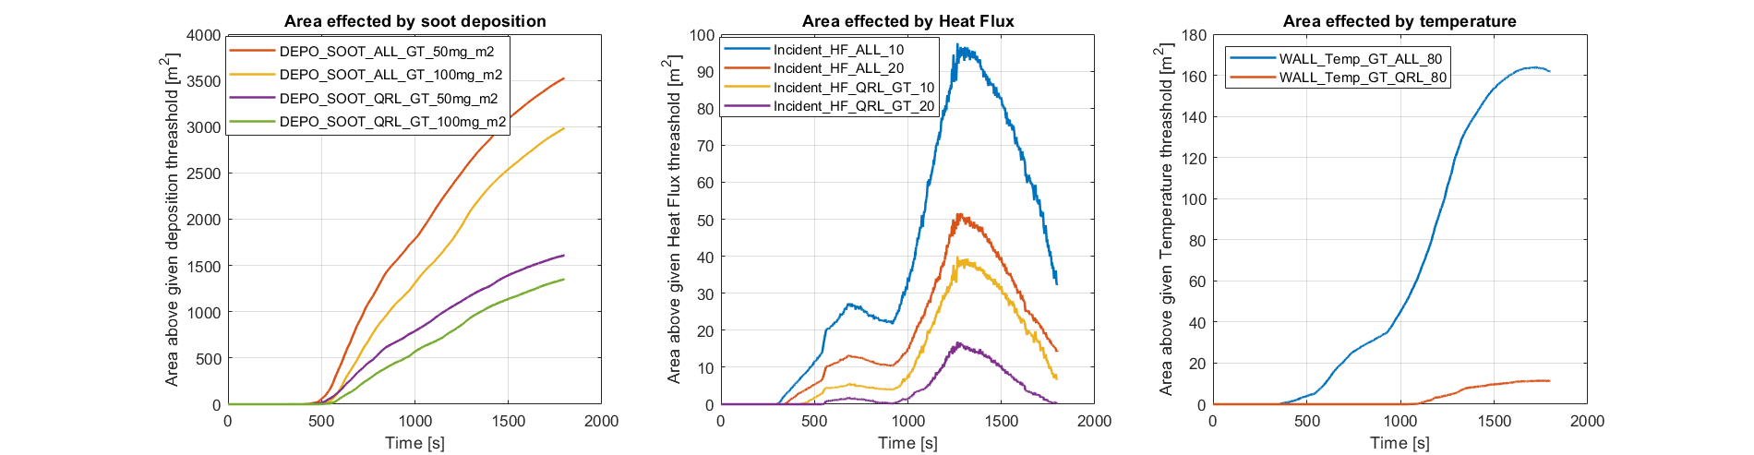
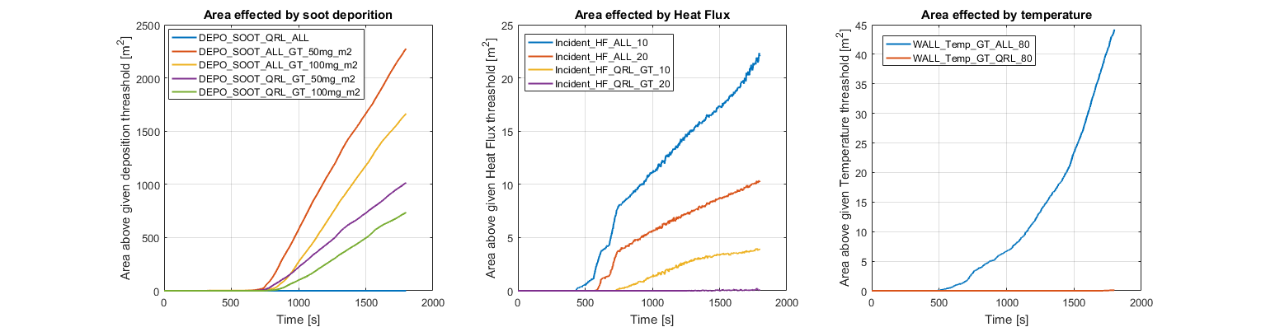
Impact to property (machine & tunnel)
3000m3/h
Fire #1
Fire #1
Fire #2(3)
Notes:
Evaluated at1800s=30min,
We can consider about 20m of linear area (so divide by 20 to estimate tunnel length affected)

Slide 27
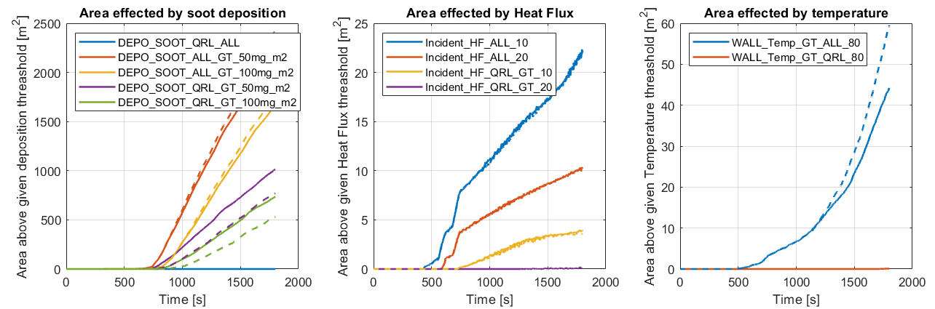
Impact to property (machine & tunnel)
Fire #1
Fire #3(2)
-- 3000 m3/h
- 100 m3/h
Fire #1
Fire #3(2)
Fire #1

Slide 28
Impact to property (machine & tunnel)
Fire #1
Fire #3(2)
Fire #1
Fire #3(2)
 | Tunnels Walls |  |  | QRL area
 | Depo >10 μg/m2 | HF>20kW/m2 | TA>80 | Depo >10 μg/m2 | HF>20kW/m2 | TA>80
Fire 1 | 1000 m² (50 m) | 16 m² | 40 m² | 700 m² | 4 m² | -
Fire 2 | 1750 m² (88 m) | 25 m² | 70 m² | 1100 m² | 25 m² | -
Fire 3 | 2000 m² (100 m) | 55 m² | 150 m² | 1500 m² | 40 m² | 11 m²
Notes:
In no ventilated case

Slide 29

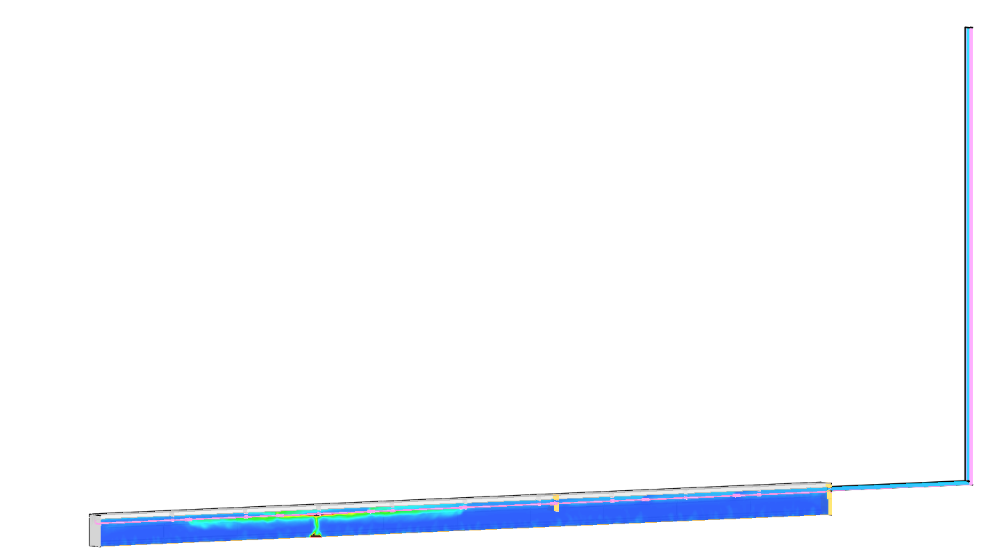
  Design Optimization
By default:
F600-2h
With the assessment:
F400-2h
Notes:
As before, two different scenarios are considered; immediate intervention of the smoke extraction system, and intervention of the smoke extraction system after 30 minutes. The first case is simulated for 30 minutes whereas the second is simulated for 1h. The value of the temperature is displayed in the figure below.

Slide 30
Conclusions
Life Safety Goal analysed for HE-LHC. Life safety goals for occupants are reached with the baseline safety measures
Two different logics in the used of the extraction system are explored. Extracting 3000m³/h reduces property damage and increases life safety margin.
Evaluation of potential impact of the fire to property quantified as affected area to be replaced and cleaned. Input data to be used in future cost-benefit analysis.
Hot smoke extraction system can be most efficiently designed and its fire resistance lowered thanks to PBD approach
Notes:
Other safety goals? Occupants safety.

Slide 31
THANK YOU

Slide 32
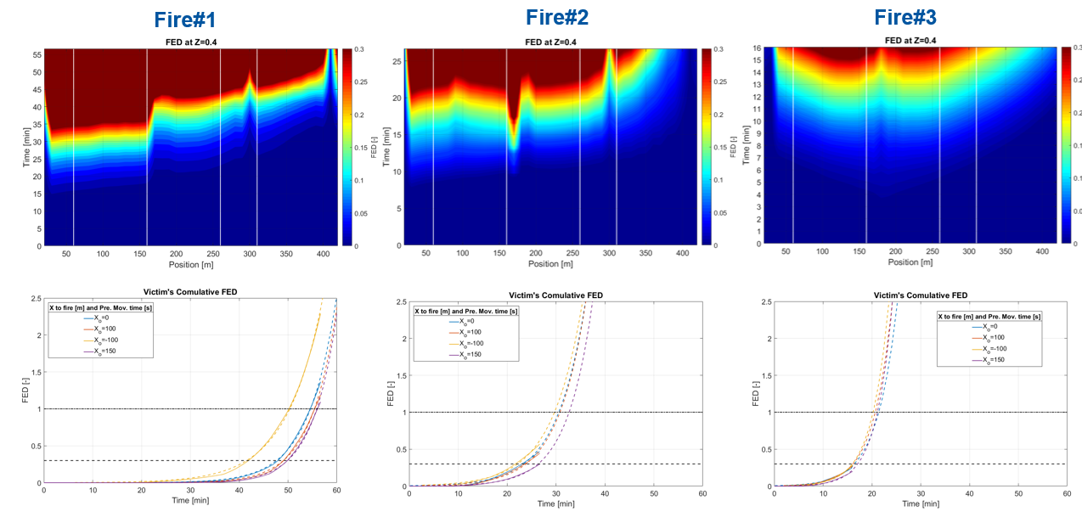
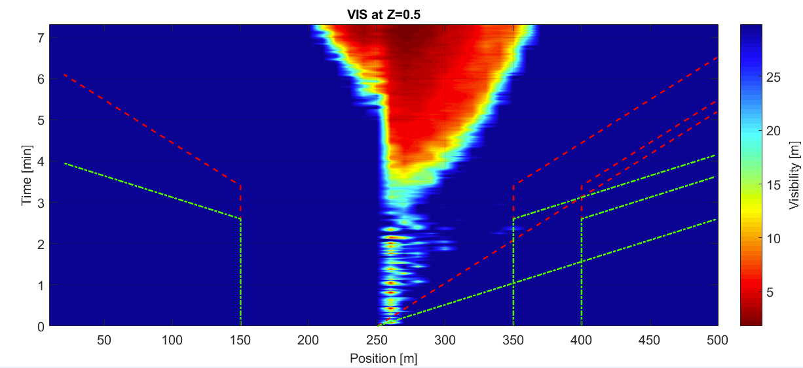
Victims assessment
FED assessment on victims
(FF intervention time)
ASET/RSET: Evacuees FED

Slide 33
Geometry and safety measures (old)
Baseline Safety Features
Fire compartment = 4 x cells, 548m
He-Smoke extraction duct (Ø350)
Detection in compartments
Fire extinguishing pipeline on each fire door

Slide 34
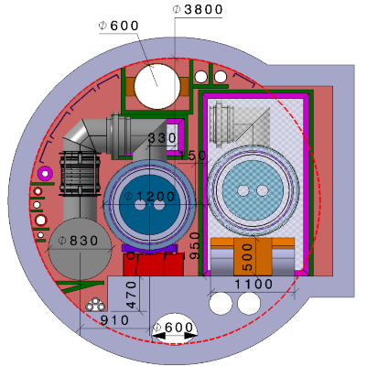
Geometry and safety measures
Baseline Safety Features
Fire compartment = 4 x cells (137m), 548m
He-Smoke extraction duct (Ø600)
Detection in compartments
Fire extinguishing pipeline on each fire door

