Slide 1
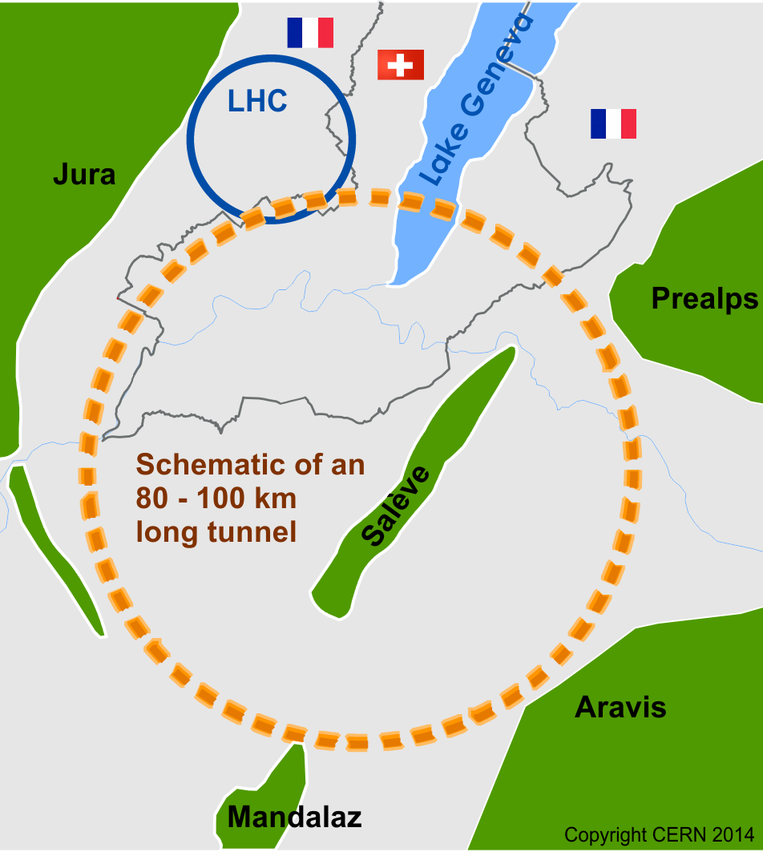
FCC Host States Implementation
Institutional and Administrative Framework
Main Challenges – Principal milestones – A first overview
27 June 2019, Brussels, FCC Week
M. Olivier MARTIN
Conseiller, Ministère de l’Europe et des Affaires étrangères République française

Slide 2

Institutional challenge
2 Host States
2 institutional architectures
2 different sets of legislations
2 different cultures and modalities for public consultation
2 distinct national sovereignties to respect + specificities of CERN as an International Organization
Transboundary project / impact on the neighbouring country
(cf. Espoo Convention on cross-border environmental impact entered into force in 1997).
Close cooperation needed between the two Host States
(cf. bilateral Treaty on CERN between the Swiss Confederation and France adopted in 1965).

Slide 3

Environmental challenge
Same precious natural environment
Land scarcity / Land acquisition complexity
Local population high level of education and standard of living /sensitivity. Dense network of locally elected officials and associations.
Anticipate possible legal actions.

Slide 4

Timeframe challenge
Earliest possible construction approval: 2026
(CERN Council’s decision following the 2026 Update of European particle physics Strategy).
Both Host States have made it very clear: important administrative processes need to be completed successfully =before 2026= if CERN wants to start the construction phase in 2027. Absolute prerequisite!
1. Host States administrations’ recommendation:
Need to work full speed in 2020-2026 on implementation aspects to be ready to start after a positive CERN’s decision in 2026.
2. Positive signal: both administrations are willing to work closely with CERN in 2020-2026 in spite of this constraint.

Slide 5

Host State FRANCE: a centralized State
Competent interlocutor for CERN = French State
Ministries (Foreign Affairs, Research - coordinated by the Prime Minister’s Office – under the leadership of the President’s Office)
State Administrations (environment, transport, housing, security and safety etc…) present on the French territory:
2020-2026: main administrative tasks identified with the French Host State – to be completed before the start of any construction phase=>
Préfecture de Région Auvergne Rhône Alpes (Lyon) – SGAR for territorial planning
Préfectures de Départements de Haute-Savoie (Annecy) et de l’Ain (Bourg en Bresse)
Sous-Préfectures d’Arrondissements (Gex / Saint Julien en Genevois – Annecy / Bonneville)

Slide 6

Carry out an Environmental impact Study (EIS) / “Etude d’impact”
2021-2024
Define a common methodology integrating both French and Swiss requirements.
EIS pre-study. Current state of the surrounding environment.
EIS study (impact on water, air, fauna, flora, excavation material etc…). Recommendations for mitigation / compensation.
To be submitted to the French “Autorité environnementale” (AE) / Préfet de region ARA.

Slide 7
Refer to the independent public body CNDP “Commission nationale du débat public”
CNDP created in 1995. Administrative independent authority since 2002. Obligatory referal for any new project > 300 million €.
File: main characteristics, socio-economic aspects, cost, environmental and territorial impacts, sites localization.
Appointment of CNDP mandated «Commissaires enquêteurs»
Public debates: preliminary public debates in 2022-2023; official CNDP led public debate in 2024
CNDP recommendations to the construction manager / alternative solutions – modifications proposals in 2025

Slide 8
Prepare for land acquisition and provision
Optimization of surface sites in coordination with French Préfecture + land freezing in 2020-2024 (“zones d’aménagement différé”).
Preparation of the “Déclaration d’utilité publique” with the French Préfecture de Région. Administrative procedure enabling the French State to expropriate surface land and underground owners on behalf of a “public interest”.
DUP contains:
File by construction manager 4) DUP decree by PM (after 2026)
Setting of a public land agency “opérateur foncier” 5) Decisions - expropriation judge
Public inquiries “Enquêtes publiques” + “Enquêtes parcellaires” (surface + underground)
+ Preparation of possible special law “Procédure unique” for adoption by the French Parliament. Would cover all aspects.

Slide 9

Host State SWITZERLAND: a federal State
For CERN: 2 sets of interlocutors / 2 intertwined legal frameworks
Swiss Federal State (Foreign Affairs Federal Department DFAE, in coordination with Research SERI) competent for federal regulation and overall policies. DFAE present in Bern and Geneva (“Mission”).
Elected Cantonal State of Geneva (Cantonal Office DT “Département du Territoire”) competent for cantonal environment and cantonal urban planning + Elected Municipalities with important legal powers.
2020-2026: main administrative tasks identified with the Swiss Confederation and Canton - to be completed before the start of any construction phase =>

Slide 10
Carry out an Environmental impact Study (EIS) / “Etude d’impact sur l’environnement”
2021-2024
Common methodology (to develop) /
Common study covering the impacted territory in Switzerland and in France.
To be submitted to the Swiss federal authorities
(“Office fédéral du développement territorial” ARE)
and Cantonal authorities
(“Direction générale de l’environnement”)

Slide 11
Prepare for land acquisition and provision
Need to reclassify the agricultural areas possibly impacted:
The agricultural areas can be turned into built-up areas only after a constraining cantonal procedure (“modification de zone” MZ) : public inquiries, approval by the municipal/cantonal executives, possibility of votes by the surrounding population (municipal/cantonal referendums).
In addition, the most fertile agricultural surface is highly protected by the Swiss federal law since 1992 (“surfaces d’assolement” SDA – federal protection with cantonal quotas).
Preparation for expropriation/compensation procedures (surface sites only).

Slide 12
Ensure a strong possible federal anchoring of the construction
Possibility to benefit from a federal “plan sectoriel” (for research infrastructures) – adoption by the Swiss federal Parliament - tool for federal planning
Option currently studied by the Swiss DFAE
Would potentially secure the procedures and ease the process.
No cantonal/municipal referendums possible on zone modifications.

Slide 13
Conclusion
Massive political / administrative work ahead with the 2 Host States – this is only the beginning!!!
Key words
Trust
Anticipation
Environmental and legal exemplarity
Local acceptance / communication

