Slide 2


Update on R2E and Heat Load Simulations
J. R. Hunt, F. Cerutti, A. Infantino:
EN/STI-BMI and the Infrastructure and Operations Working Group
FCC Week 2019
Thursday, 27th June

Slide 3
Contents
Introduction
Simulation & Updates
Power load on beam screen and magnets
Radiation levels on electronics
Conclusions

Slide 4
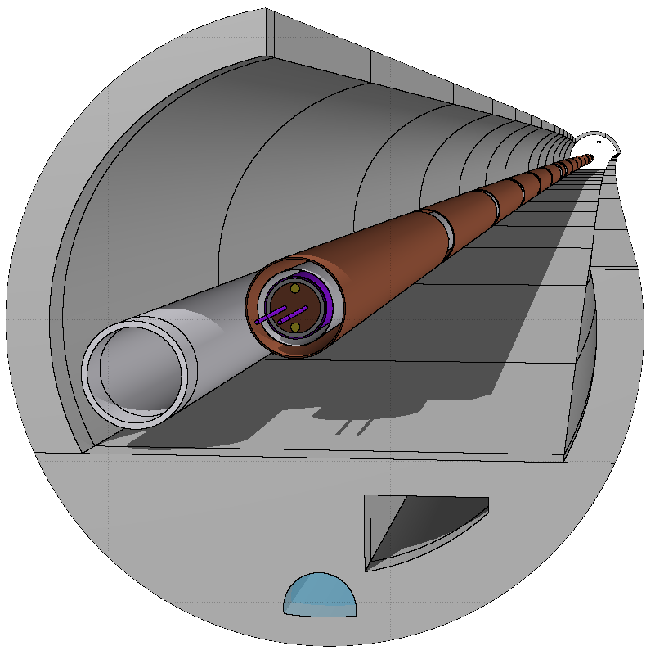

Introduction
FCC-hh arc cell beam-gas interaction
  Impact of secondary showers on magnets and electronics.
Beam lifetime, $τ$, considering losses due to nuclear scattering with residual gas:
$$τ=\frac{1}{σ_{g}cn_{g}}>100 h$$
  Where:
  $σ_{g}$nuclear scattering cross section (86.4 mb),
  $n_{g}$ molecular gas density
  -> Gives n_{g} = 1×10¹⁵ atoms/m³
Update on previous work carried out by A. Infantino
  FCC week 2017: “FLUKA Montecarlo modelling of the FCC arc cell: radiation environment and energy deposition due to beam-gas interactions”
  FCC week 2018: “Radiation environment assessment in the FCChh and FCCee machines”

Slide 5
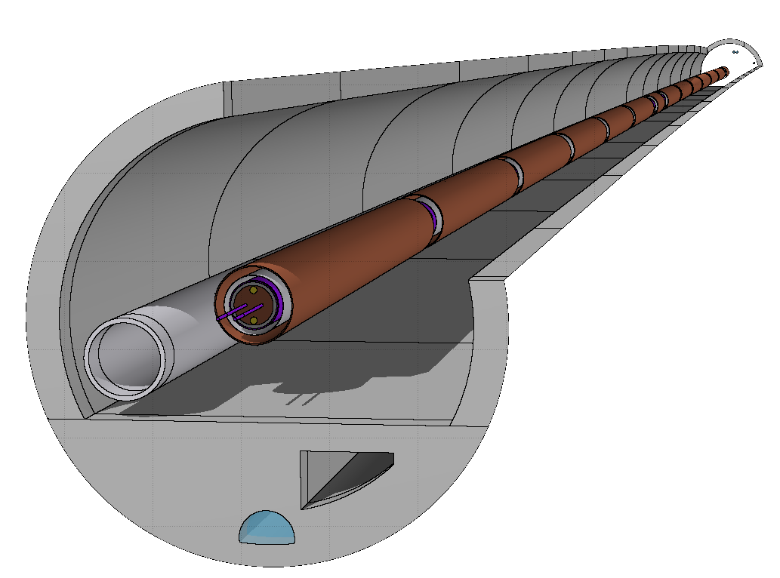
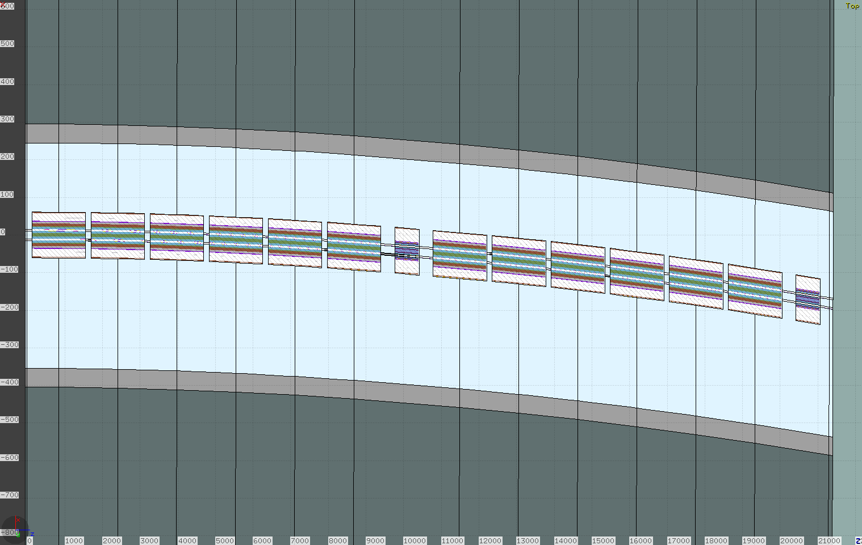
FLUKA Model
FCC-hh arc FODO cell
Lattice based on latest optics, MAD-X TWISS file (R. Martin)
214 m in length
MQ x 2
L = 6.4 m
MB x 6 x 2
L = 14.2 m
  θ = 1.3 mrad
Simulation Parameters:
  >200,000 primaries per beam
  Boundary condition
  CPU Time ~120 – 130 seconds per primary
Top View
y
MB1
MB2
MB3
MB4
MB5
MB6
z
MB7
MB8
MB9
MB10
MB11
MB12
x
x
MQ1
z
MQ1
xAxis = 0.1zAxis

Slide 6
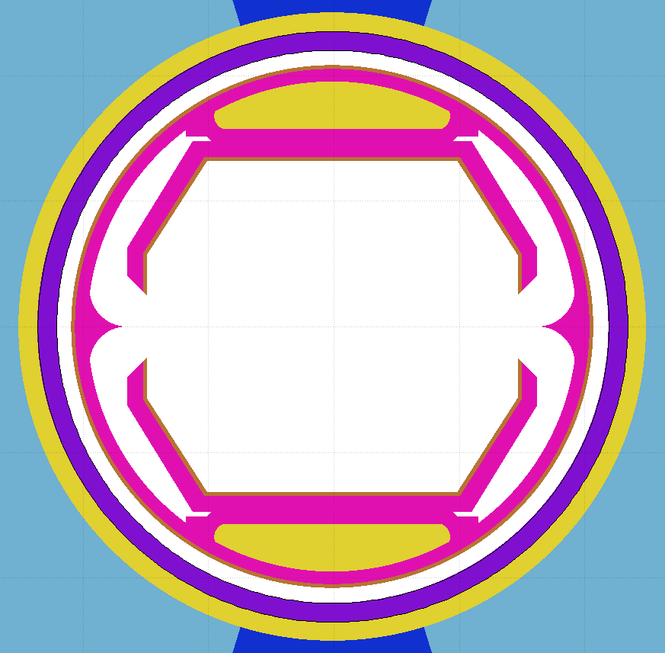
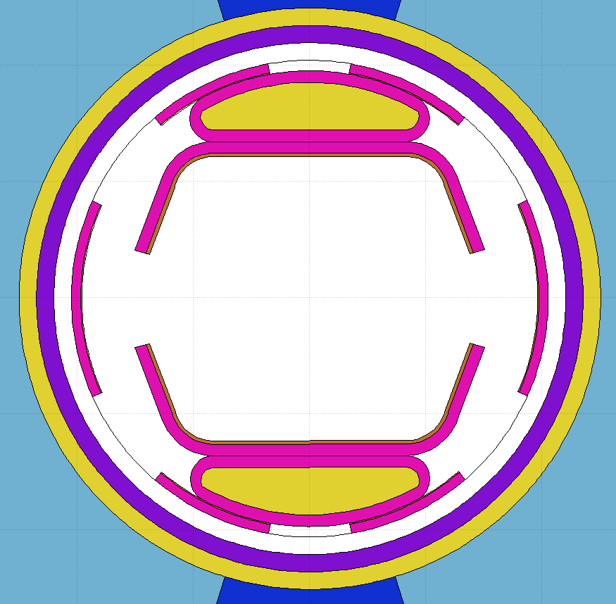
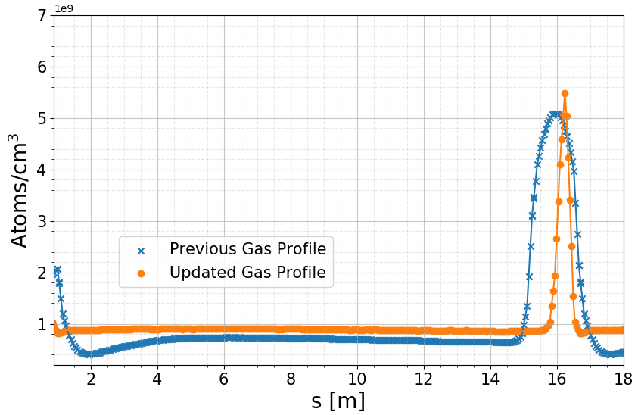
Updates
Cooling channel
Secondary chamber
Beam Screen
New scheme for dealing with synchrotron radiation effects
Better vacuum quality and lower electron cloud density
I. Bellafont:
“Study on the beam induced vacuum effects in the FCC-hh beam vacuum chamber”,
this conference, Wednesday, 8:30 am
Sawtooth surface
Primary
chamber
Perforated baffle, enlarged
(periodic)
Old
New
Dipole
Dipole
Gas Profile
Average gas density unchanged (1e9 atoms/cm³)
Shorter photon absorber (previously absorbing ~x2 more power than now which led to higher outgassing.)
Optimised interconnect region geometry, increasing the conductance of the region.
No active pumping in interconnect leads to spike in residual gas density here

Slide 7
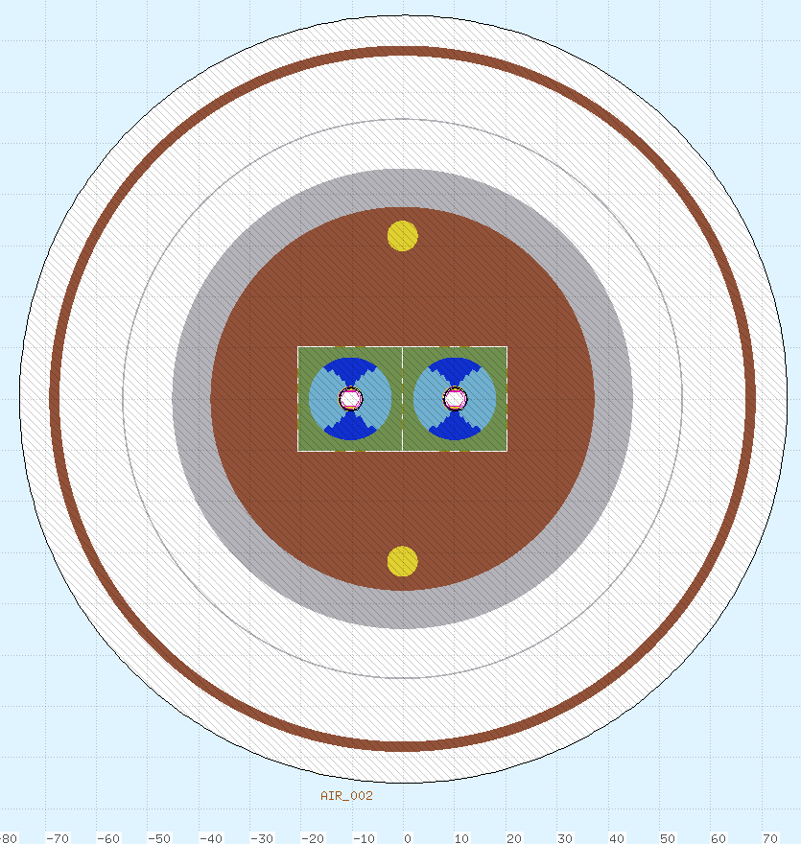
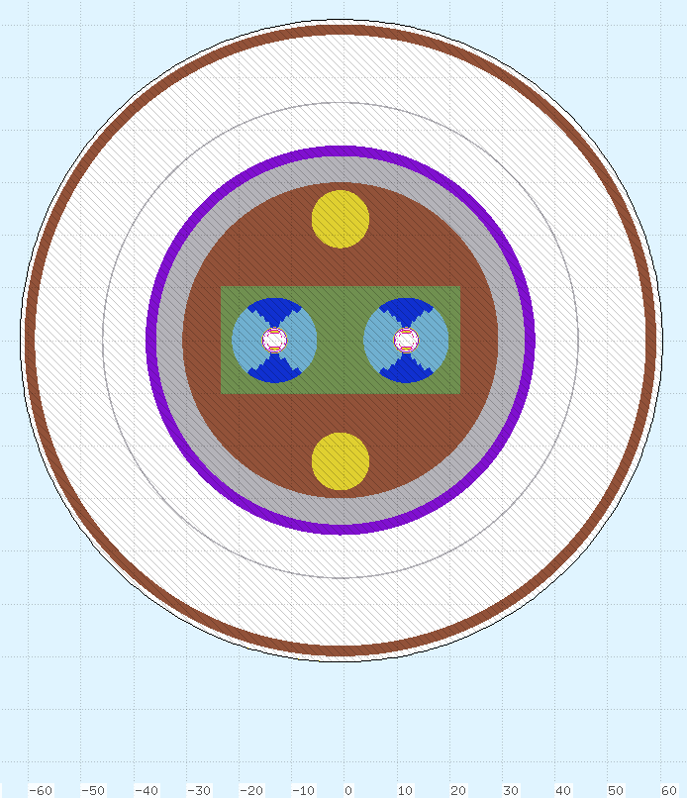
Lattice Element Updates
R_{Coil} = 8.1 cm
R_{Coil} = 8.1 cm
R_{CM} = 45 cm
R_{CM} = 37 cm
 |  | Previous Radius [cm] | Updated Radius [cm]
MB | Cold mass | 45 | 37
MQ | Cold mass | 32.37 | 24.87
MB | Coil | 8.1 | 8.1
MQ | Coil | 5.672 | 5.922
Additional increase in beam – beam separation: 20 -> 25 cm

Slide 8

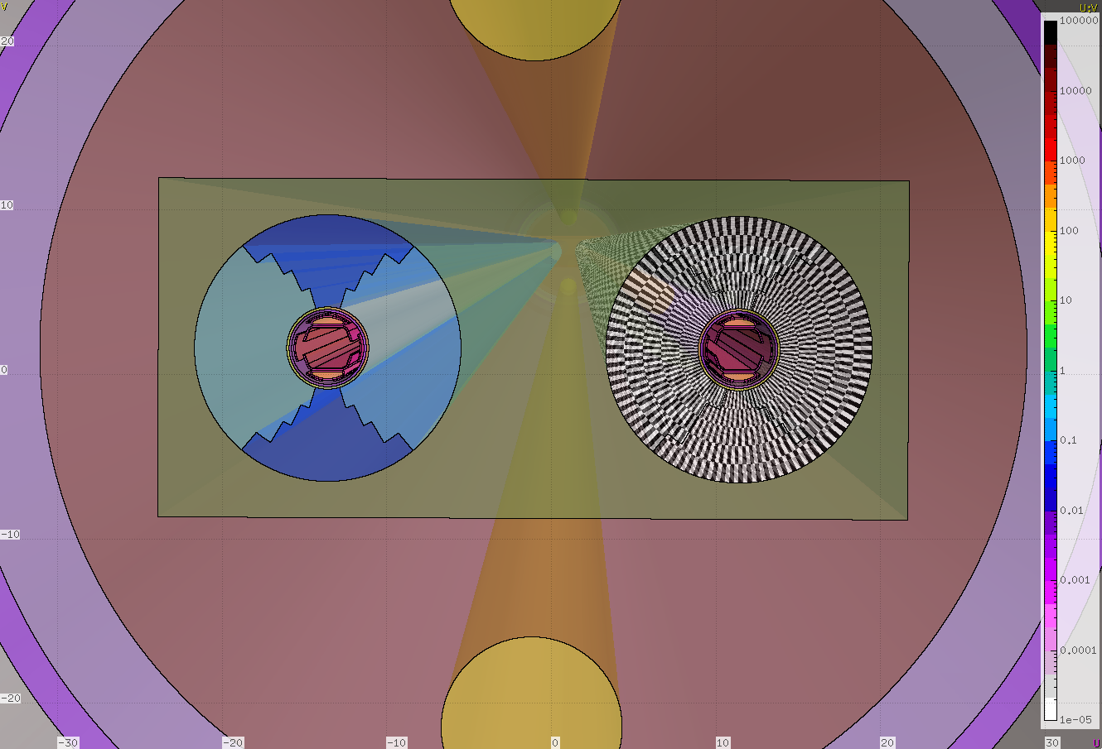
Energy Deposition on Coils
Power density: steady state losses
(as opposed to transient losses)

Slide 9
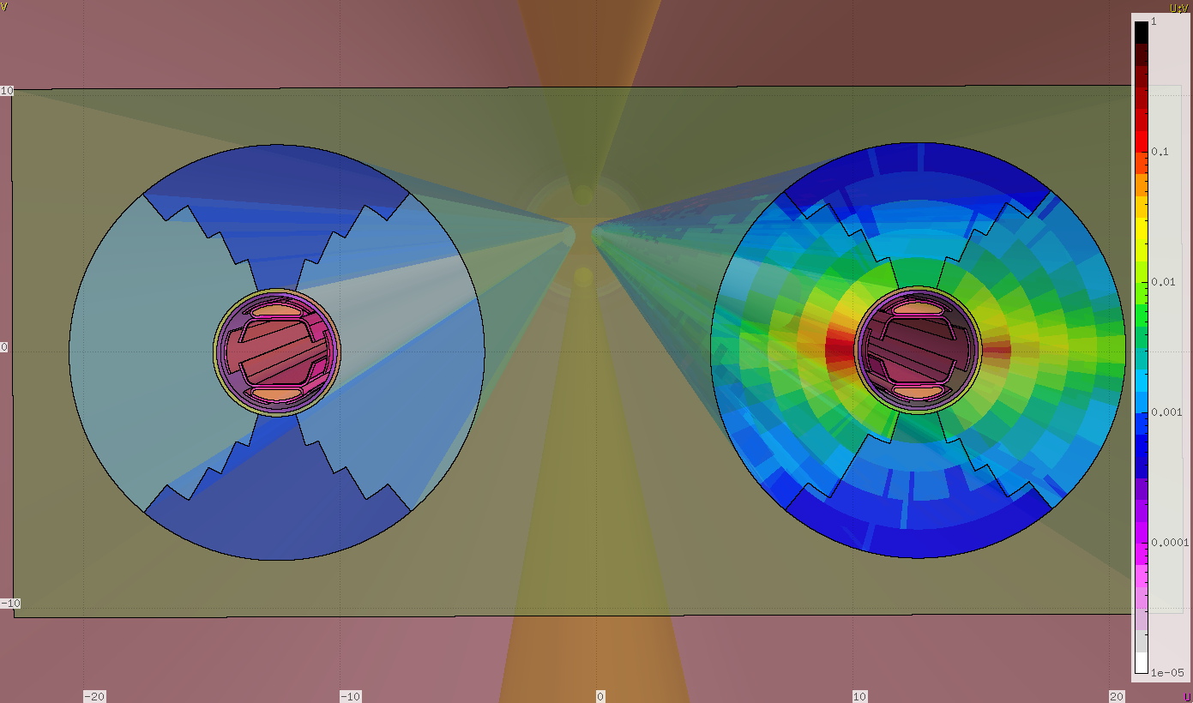
Energy Deposition on Coils
Centre of ring
Power density [mW cm⁻³]
Beam

Slide 10
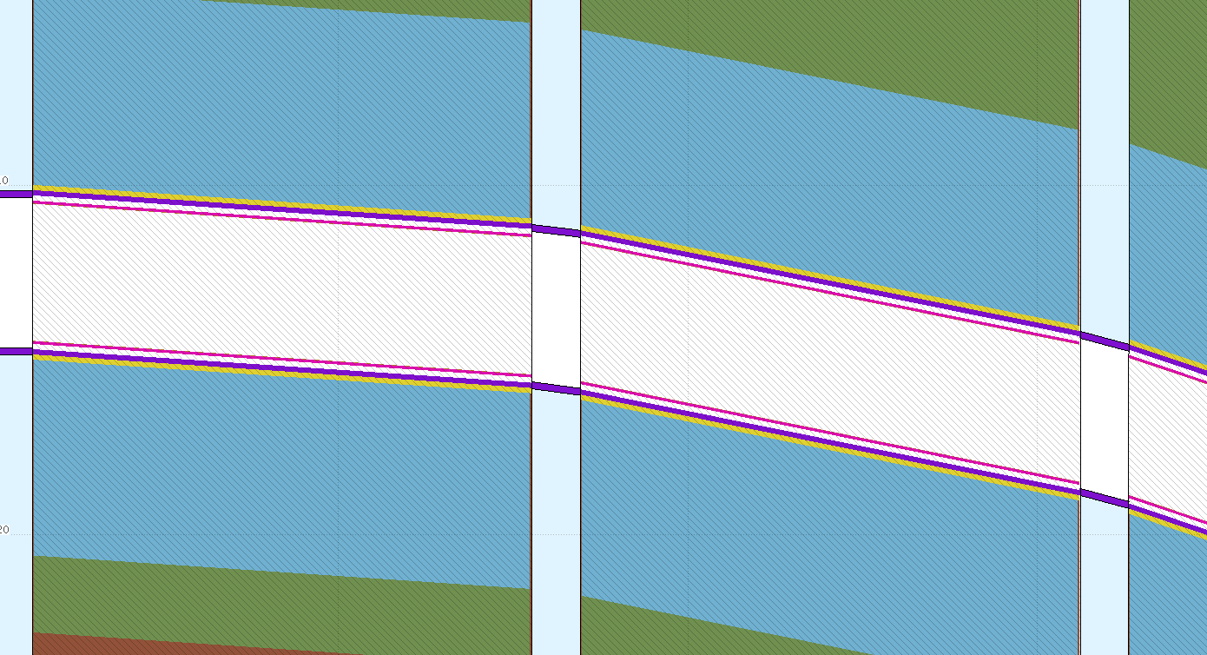
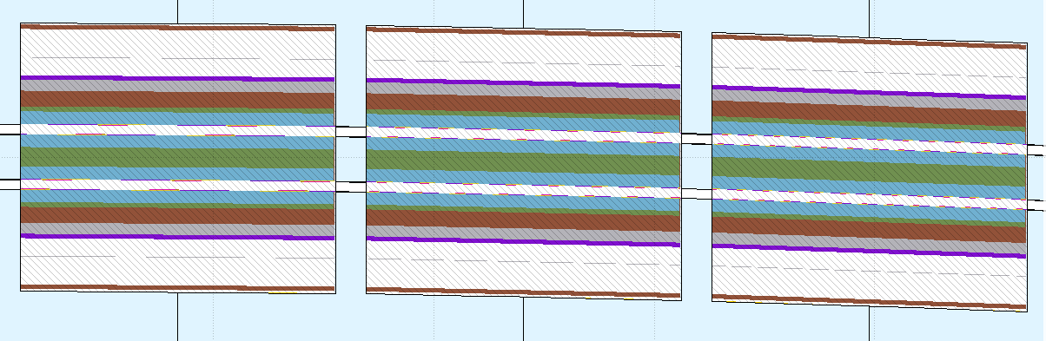
Secondary Trajectories
MB2
MB1
MB2
MB1
Top View
xAxis = 0.01*zAxis
xAxis = 0.01*zAxis
MB1
MB2
xAxis = 0.1*zAxis

Slide 11
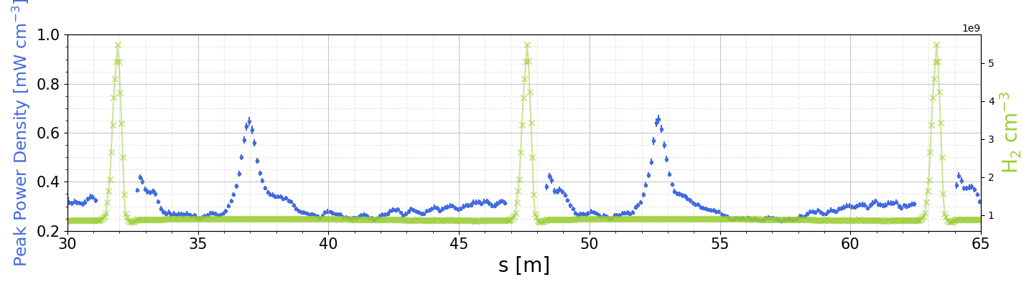
Secondary Trajectories
MB1
MB2
xAxis = 0.01*zAxis
Neutral particles

Slide 12
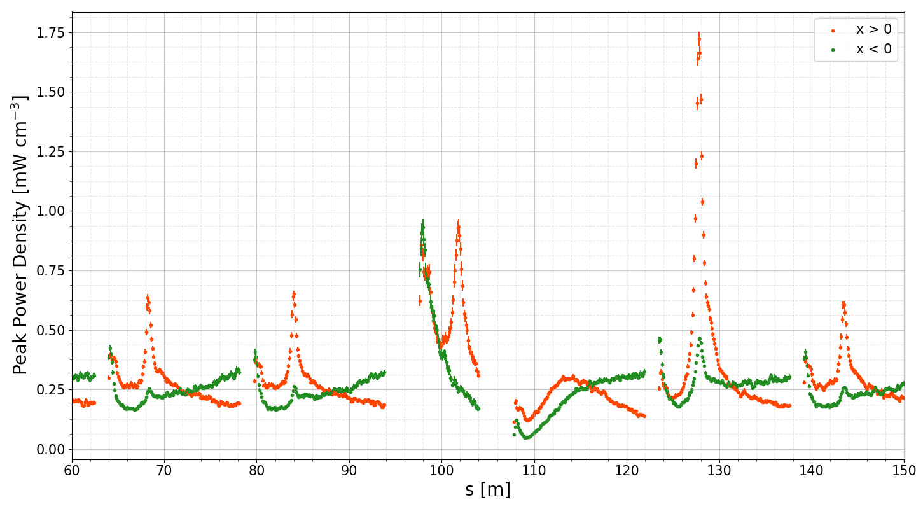
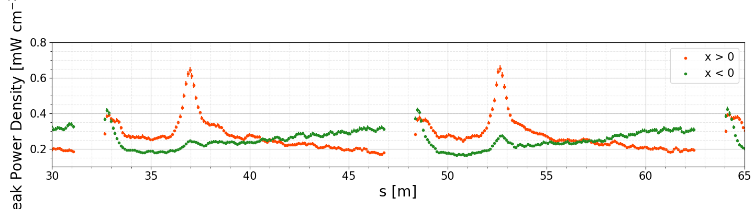
Secondary Trajectories
x
MB1
MB2
Positive x towards outside of ring
xAxis = 0.01*zAxis
Split into inner- and outer- ring scoring

Slide 13
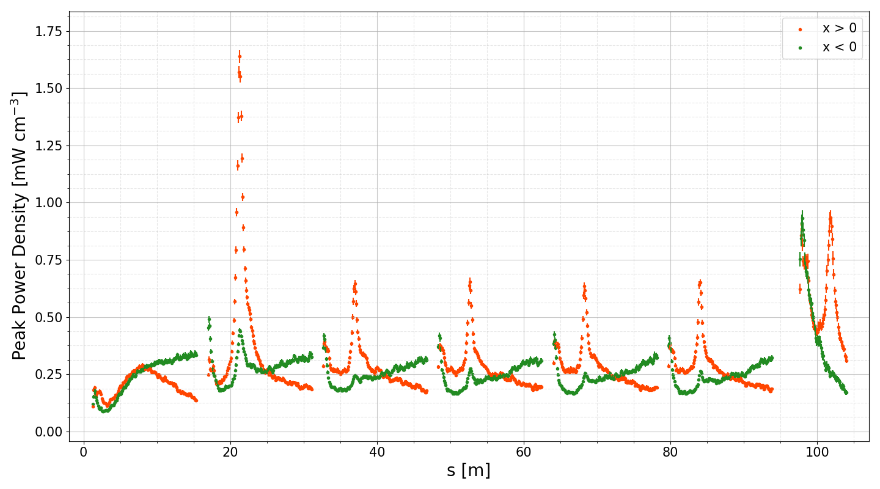
Secondary Trajectories
beam
D1
D2
D3
D4
D5
D6
Q1
Periodic lattice
Periodic lattice

Slide 14
Secondary Trajectories
beam
D5
D6
Q1
D7
D8
Periodic lattice

Slide 15
Secondary Trajectories
D6
Q1
D7
D5
D8
beam

Slide 16
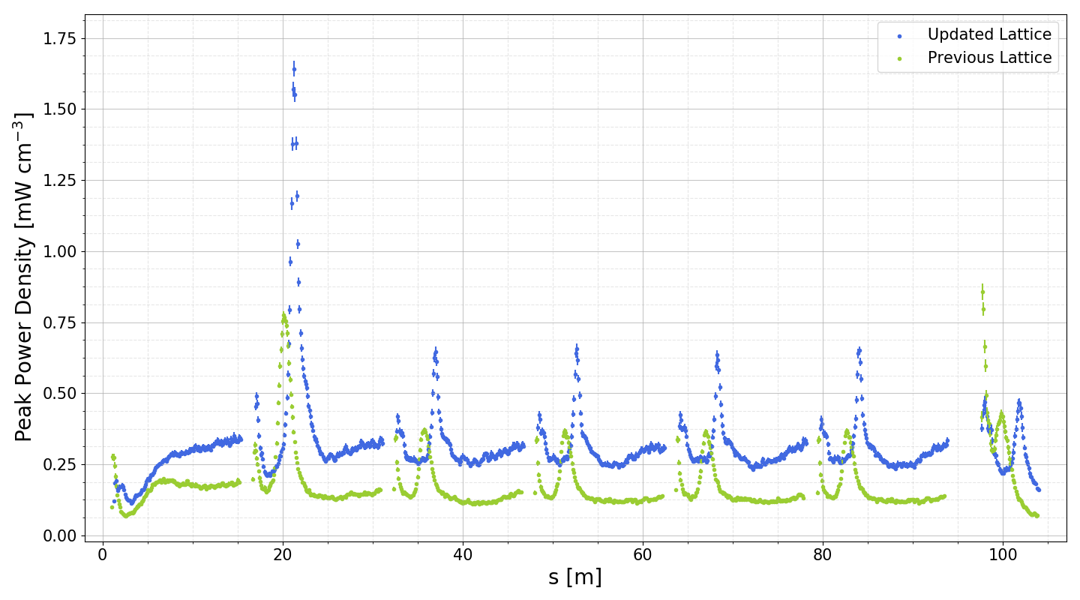
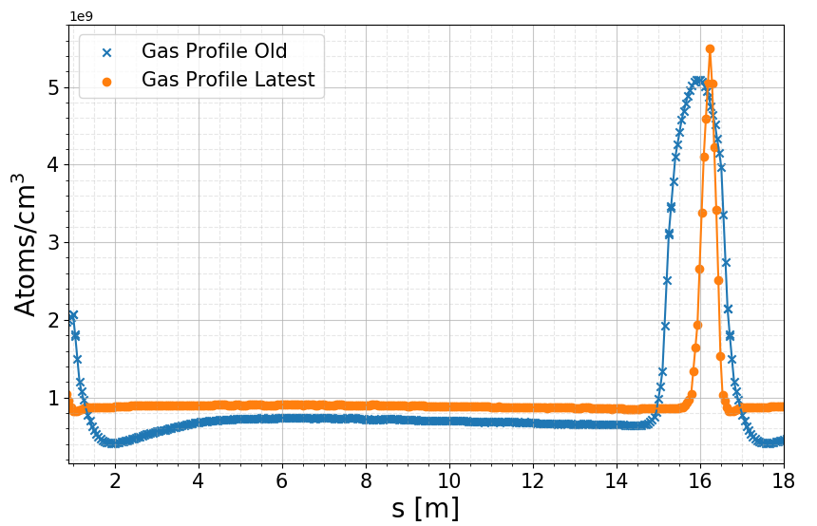


Energy deposition on coils
beam
D1
D2
D3
D4
D5
D6
Q1
Comparison with
previous study

Slide 17
Energy deposition on coils
beam
D1
D2
D3
D4
D5
D6
Q1

Slide 18
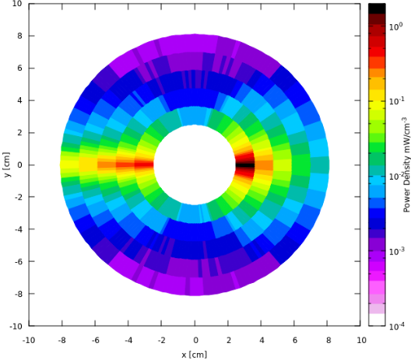
Energy deposition on coils
beam
D1
D2
D3
D4
D5
D6
Q1
Peak power density
in coils:
1.6 mW/cm³
Corresponding to a dose of:
4.1 MGy y⁻¹
Pessimistic gas density, 200x density achieved currently in LHC
Notes:
power = 1.64 # mW/cm^3
density = 7.954 #g/cm^3
densityKg = density/1000
timeScale = 1e7 # seconds
dose = power/densityKg * timeScale
print dose/1e6, "MGy y-1"

Slide 19
Power Per Element (Cold Mass)
Updated design of beam screen provides less shielding for coils and cold mass:
  Each beam screen now absorbing ~5% of power loss density as opposed to 16% previously.
  86% absorbed by cold mass, 73% previously.
Average losses along arc cell: 414 mW/m (2 beams)
Maximum heat load on most impacted dipole is 476 mW/m on cold mass (2 beams)
Two Beams Power per Element [W]
Element | Beam Screen | Cold Mass
MB1 | 0.140 | 5.52
MB2 | 0.212 | 6.51
MB3 | 0.164 | 5.84
MB4 | 0.162 | 5.87
MB5 | 0.161 | 6.76
MB6 | 0.160 | 5.67
MQ1 | 0.113 | 2.13
MB7 | 0.131 | 5.28
MB8 | 0.211 | 6.41
MB9 | 0.160 | 5.68
MB10 | 0.159 | 5.71
MB11 | 0.157 | 6.57
MB12 | 0.156 | 5.36
MQ1 | 0.121 | 2.14
Beam 1
(Current per beam: 0.5 A)
Beam 2

Slide 20
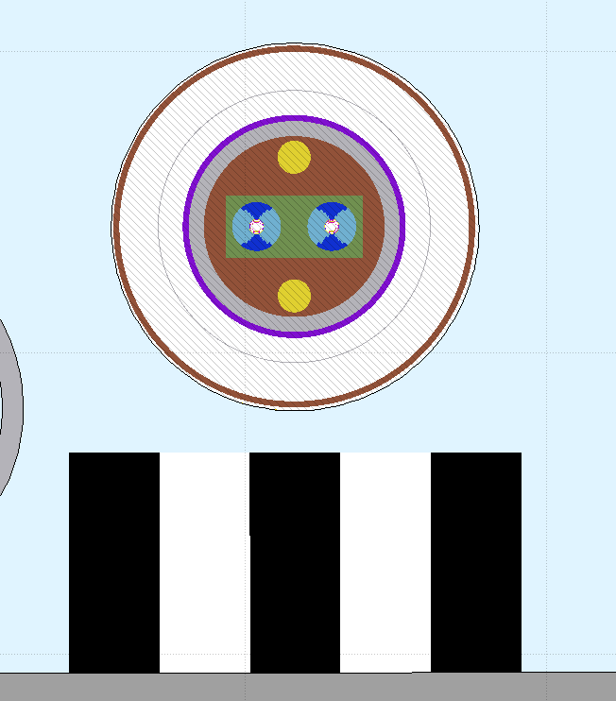
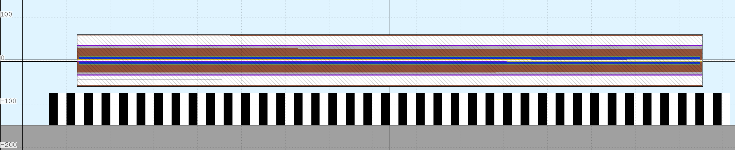
Radiation to Electronics
Scoring mesh in location of power converters/electronics
  Direct comparison with previous results
Normalised to 10⁷ s
  ~1 year beam operation
Total ionizing dose
  Cumulative effects, long-term radiation damage
High-energy hadron fluence (HEH):
  proportional to number of single event upsets (SEUs)

Slide 21

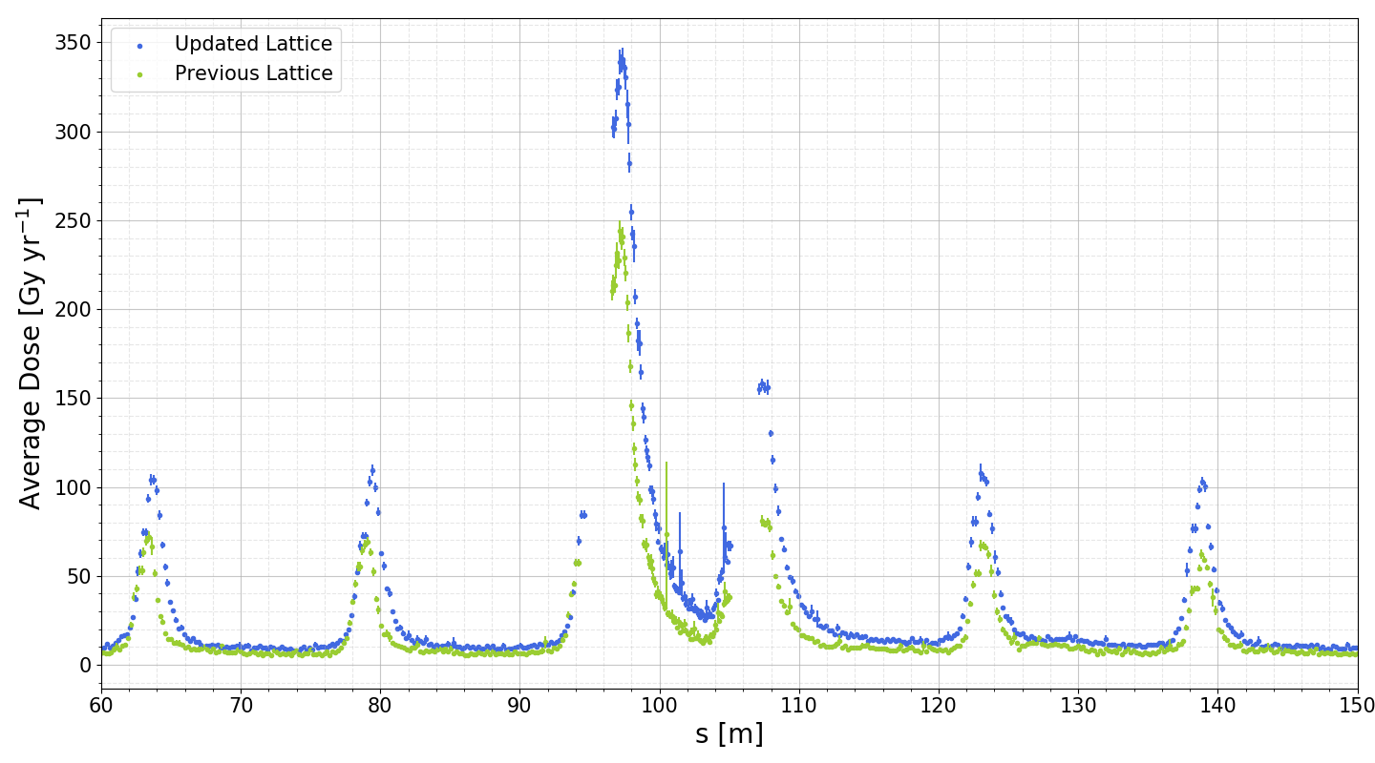
Dose on Electronics
beam
D5
D6
Q1
D7
D8
D9
Maximum:
341 Gy yr⁻¹
158 Gy yr⁻¹
Dose mostly photons & electrons, easily blocked by cold mass
Maximum:
244 Gy yr⁻¹

Slide 22
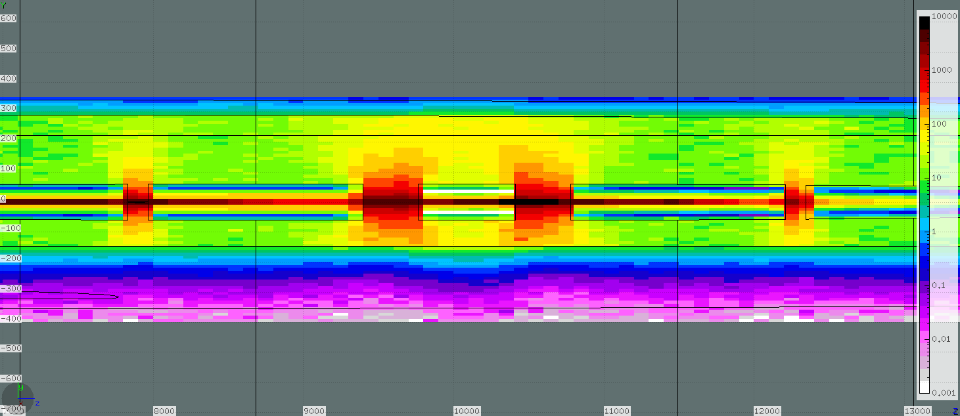
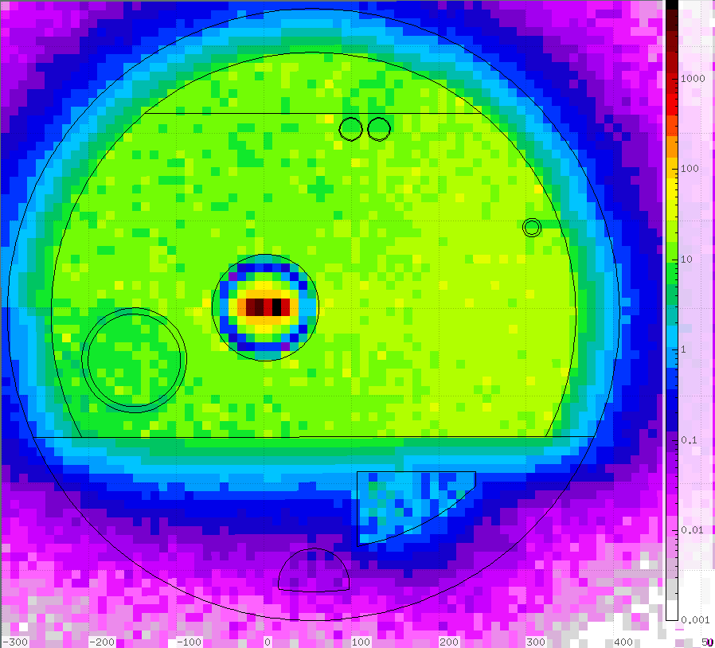
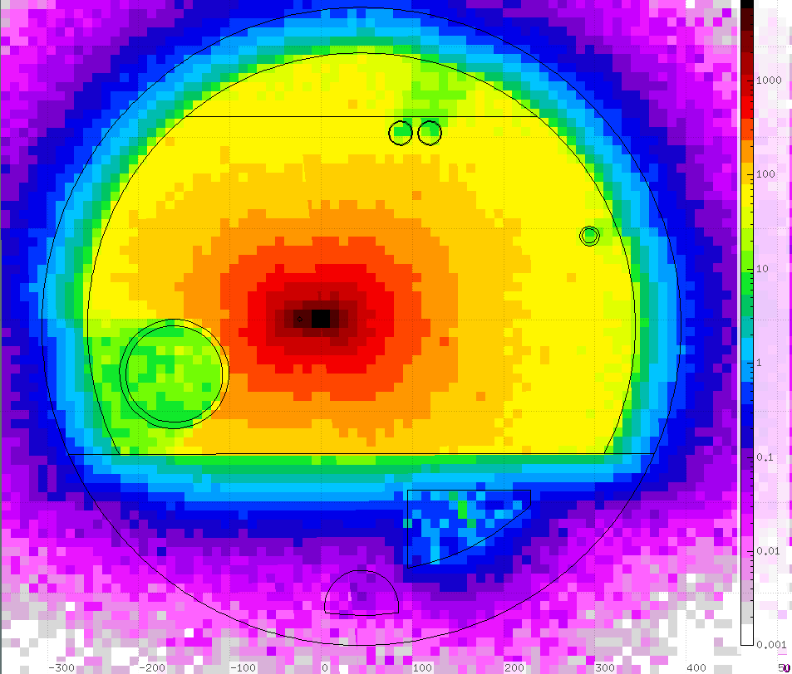
Longitudinal Plots Dose
For R2E it is important to consider 2 simultaneous beams
Beam
Beam
MB
MB
MQ
MB
MB
Average Dose [Gy y⁻¹]

Slide 23
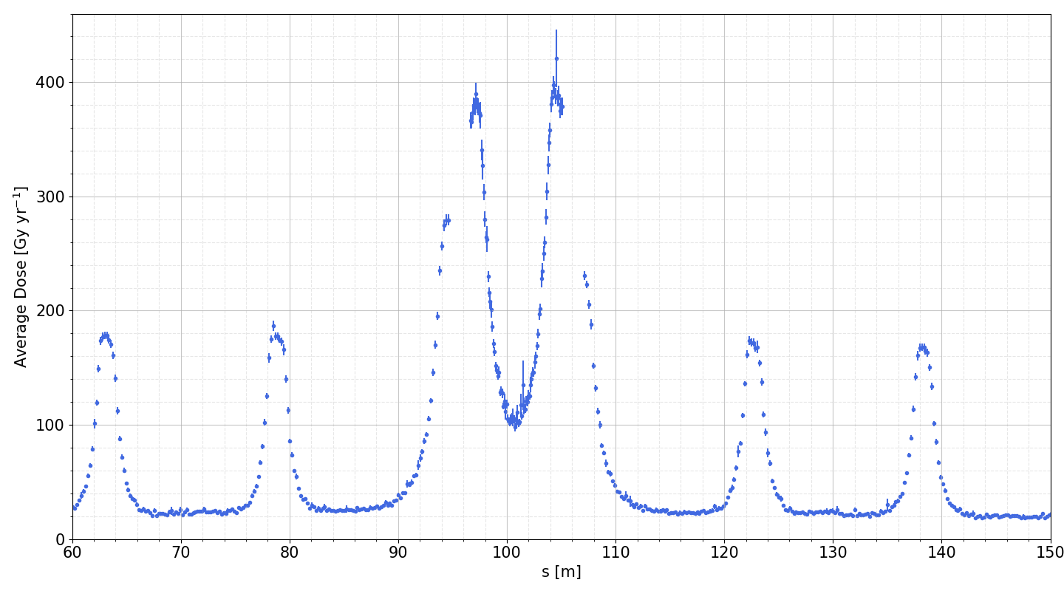
Dose on Electronics:
Combined Beams
beam
D5
D6
Q1
D7
D8
beam
Maximum:
400 Gy yr⁻¹
Based on pessimistic gas density, 200x lower density achieved currently in LHC

Slide 24
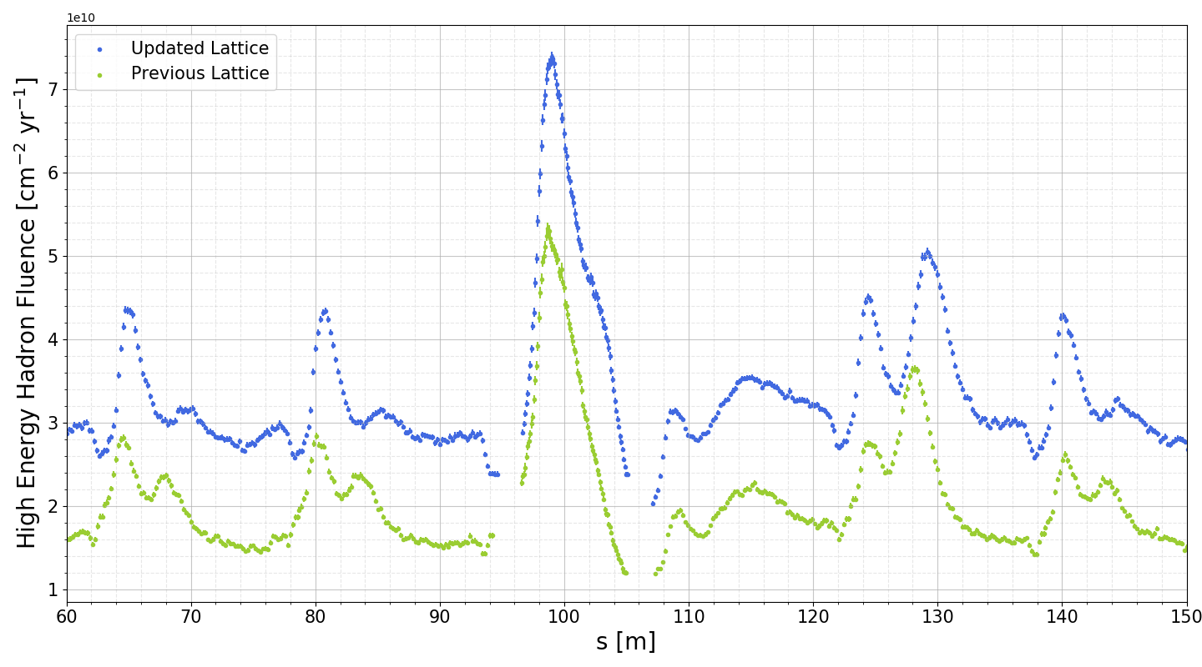
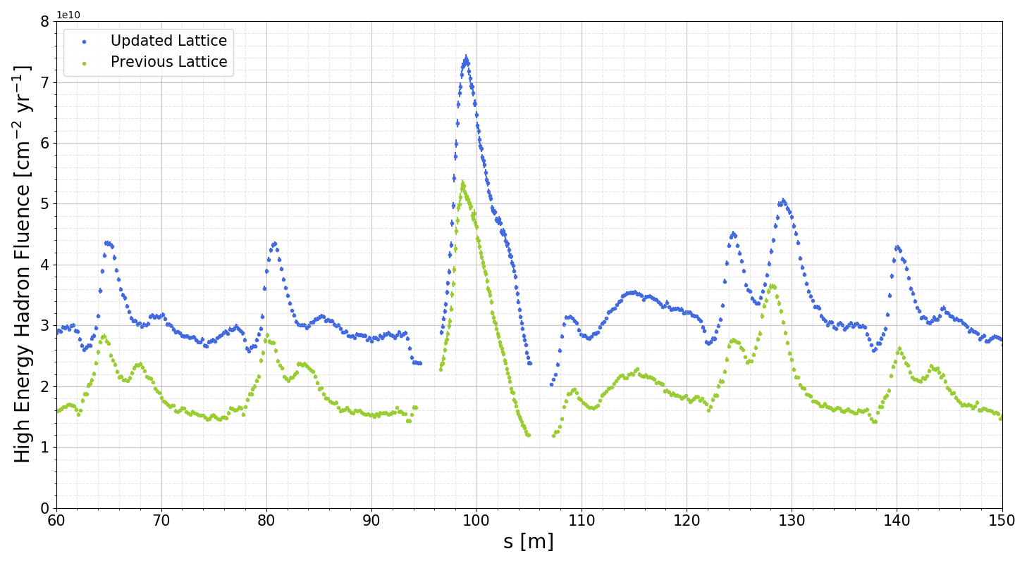
R2E impact - HEH
beam
D5
D6
Q1
D7
D8
D9
Some increase due to reduced radius of cold mass in dipoles and quadrupoles
Neutron dominated

Slide 25
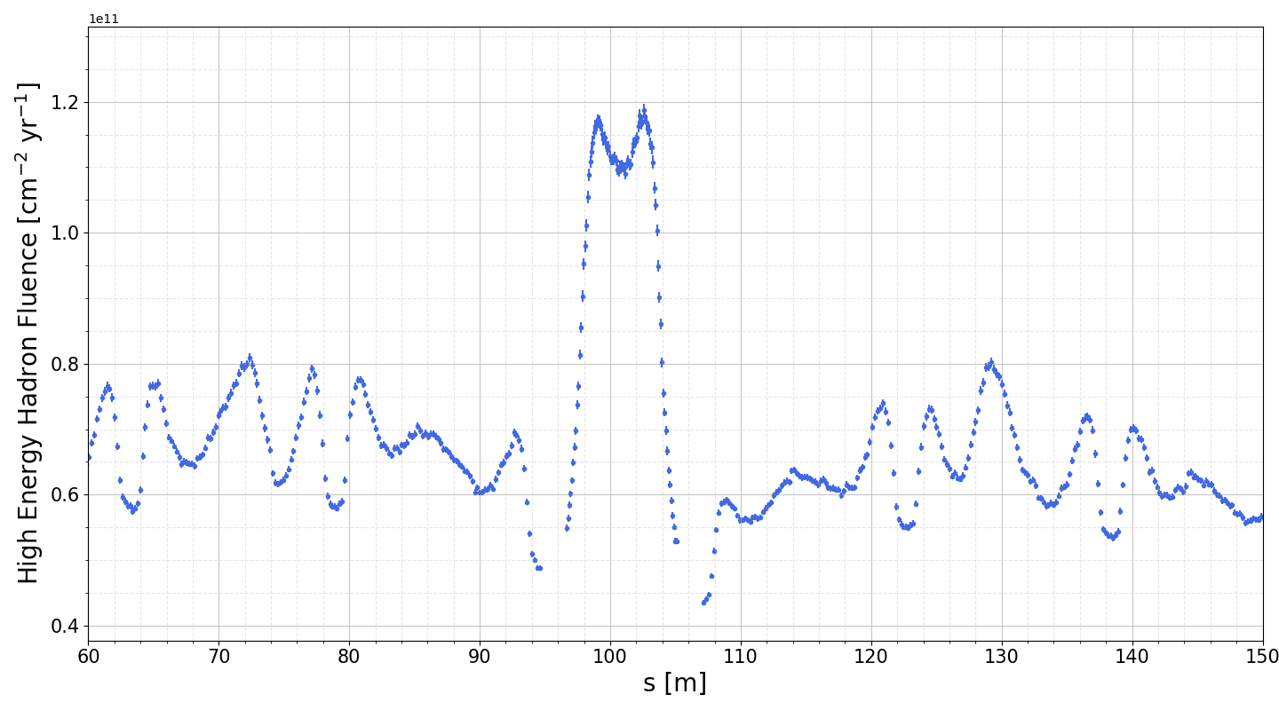
R2E impact - HEH
beam
D5
D6
Q1
D7
D8
beam
Again, based on pessimistic gas density, 200x density achieved currently in LHC

Slide 26
Summary
New beam screen design has impacted energy deposition on coils and cold mass
  Now only 5% on beam screen with 86% on cold mass
  Higher peak power density 1.6 mW/cm³ on coils
R2E outcome: an increase in radiation to electronics under beamline
  Maximum dose: 400 Gy yr⁻¹
  Maximum high energy hadron fluence: 1.2e11 cm⁻² yr⁻¹
  However, the gas density used ~200x greater than achieved currently in the LHC

Slide 27
Thanks for listening james.hunt@cern.ch
Special thanks to
I. Bellafont

