Slide 1
Alternative Optics
Leon van Riesen-Haupt, Jose Abelleira, Emilia Cruz Alaniz, Andrei Seryi

Slide 2
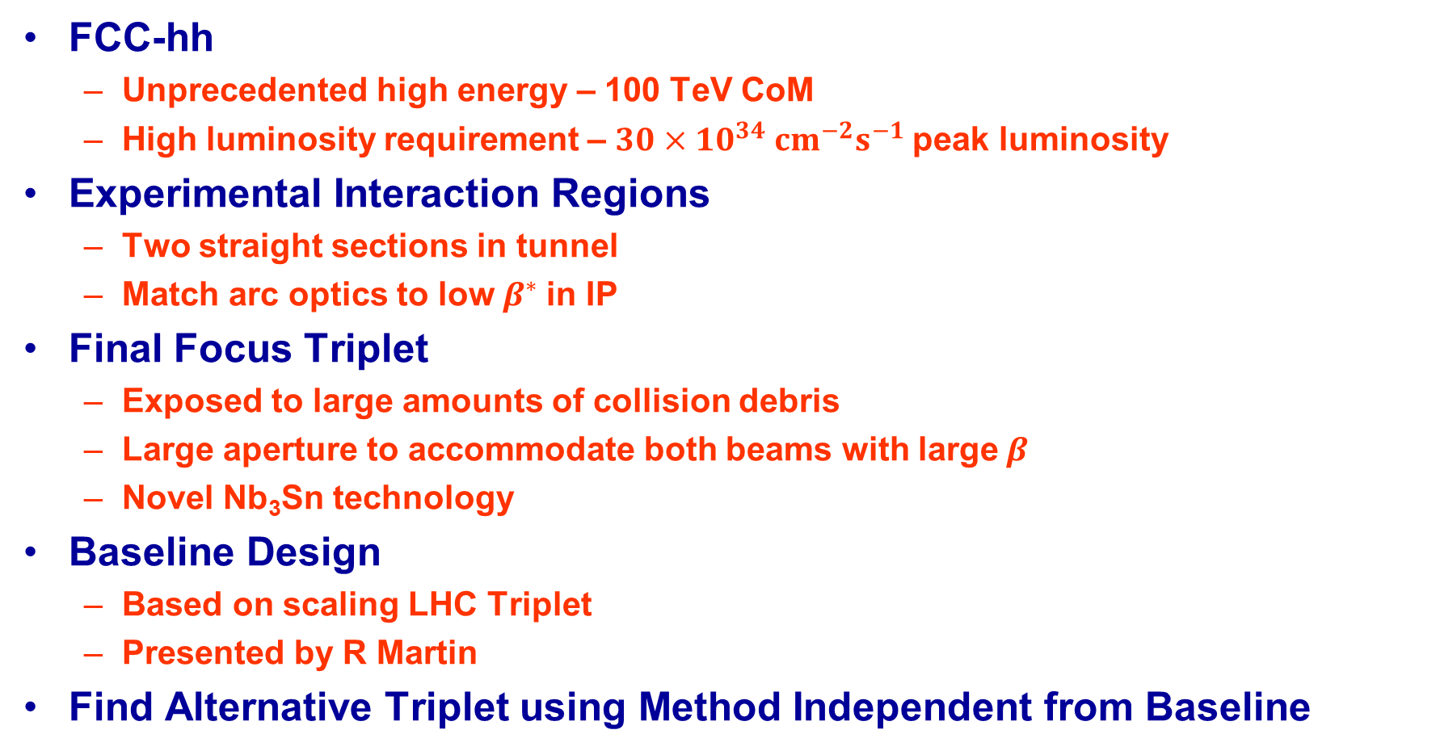
Introduction
FCC-hh
  Unprecedented high energy – 100 TeV CoM
  High luminosity requirement – $30×10^{34} cm^{−2}s^{−1}$peak luminosity
Experimental Interaction Regions
  Two straight sections in tunnel
  Match arc optics to low$β^{∗}$ in IP
Final Focus Triplet
  Exposed to large amounts of collision debris
  Large aperture to accommodate both beams with large$β$
  Novel Nb₃Sn technology
Baseline Design
  Based on scaling LHC Triplet
  Presented by R Martin
Find Alternative Triplet using Method Independent from Baseline

Slide 3
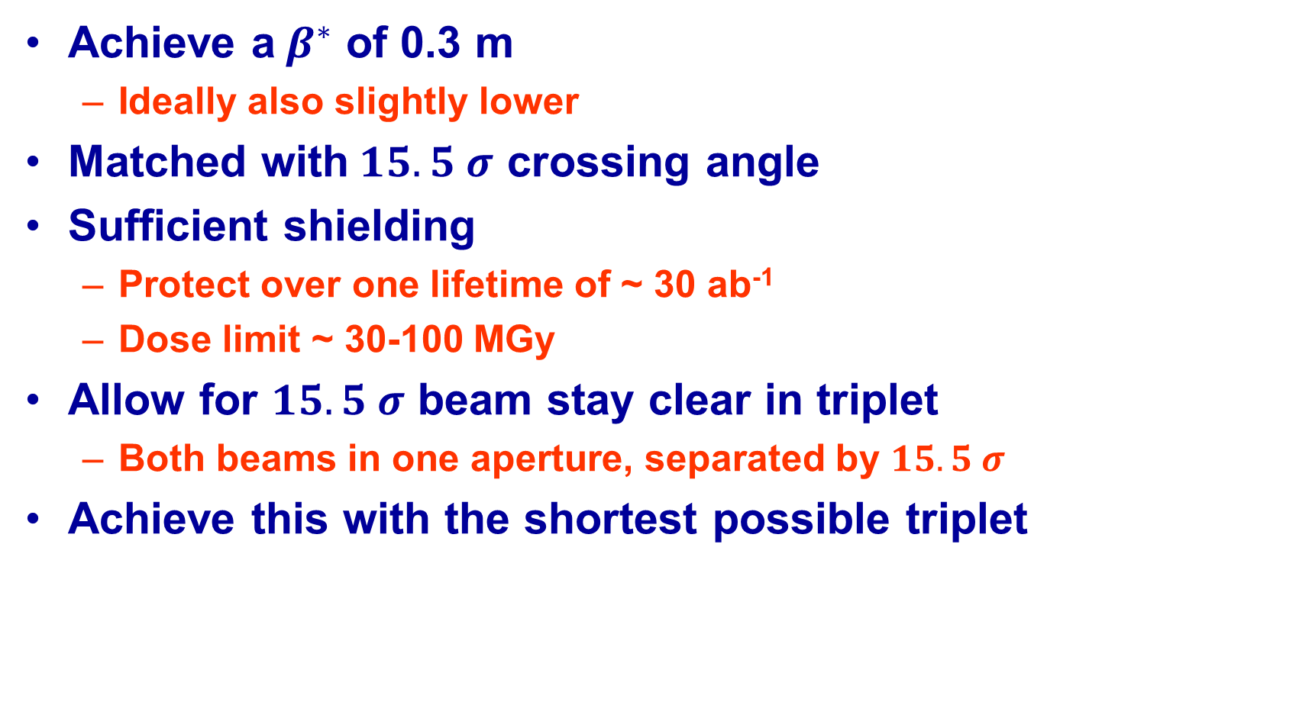
Goals
Achieve a$β^{∗}$ of 0.3 m
  Ideally also slightly lower
Matched with$15.5 σ$ crossing angle
Sufficient shielding
  Protect over one lifetime of ~ 30 ab⁻¹
  Dose limit ~ 30-100 MGy
Allow for $15.5 σ$ beam stay clear in triplet
  Both beams in one aperture, separated by $15.5 σ$
Achieve this with the shortest possible triplet

Slide 4
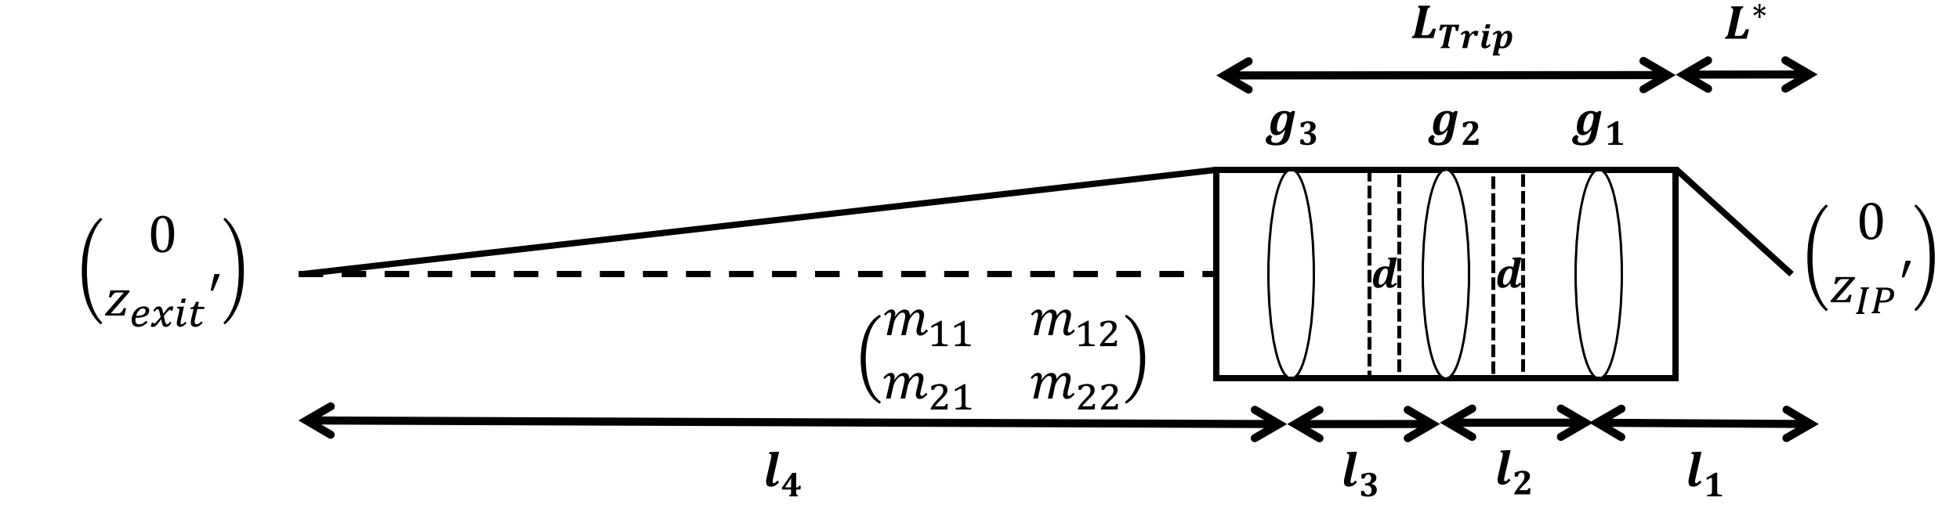
Thin Lens Approximation
Can be solved analytically
  Represent quadrupoles as thin lenses at centre
  Enforce focusing condition
Used as a first approximation
Sample large design parameter space
Initial condition for finite length matching

Slide 5
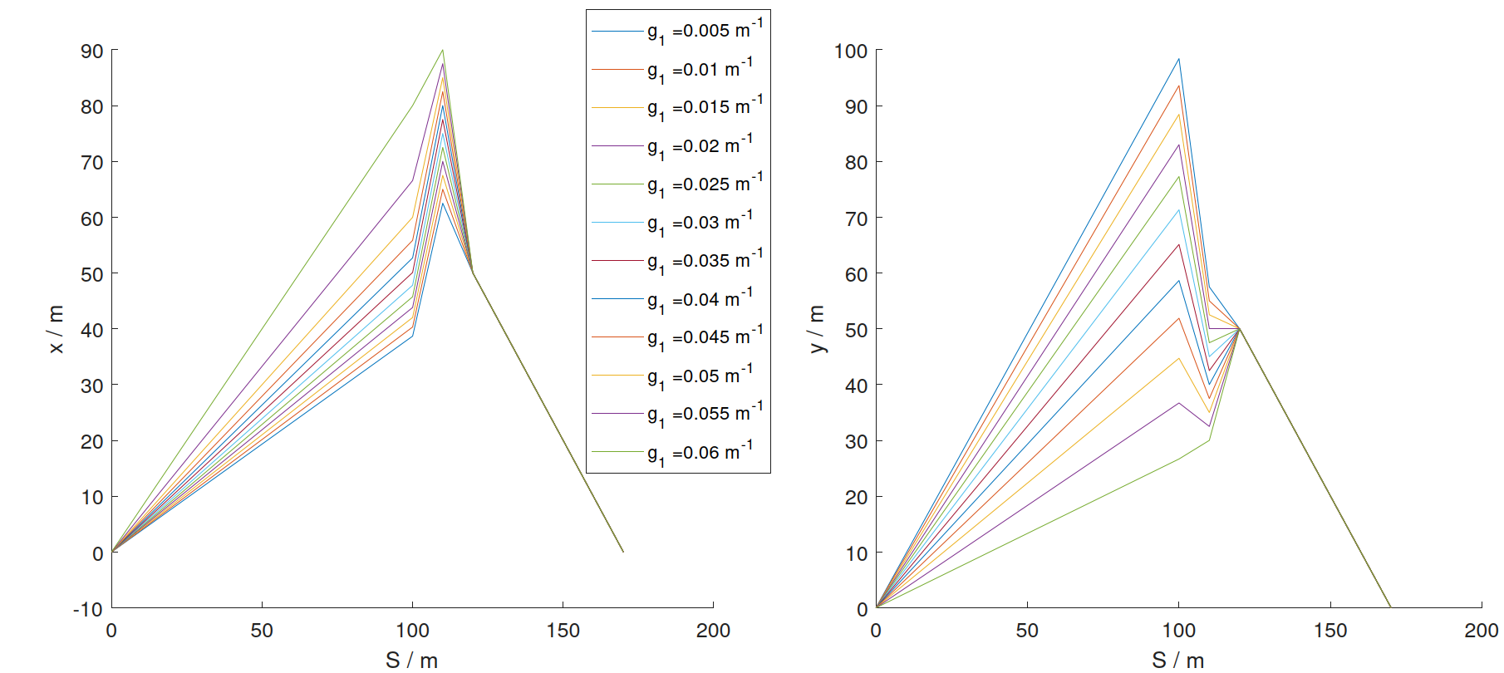
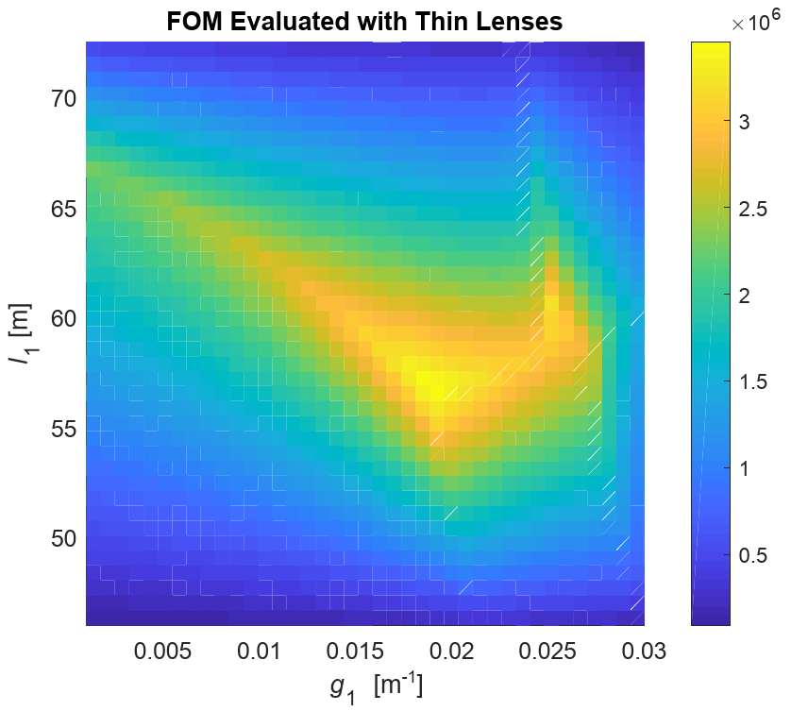
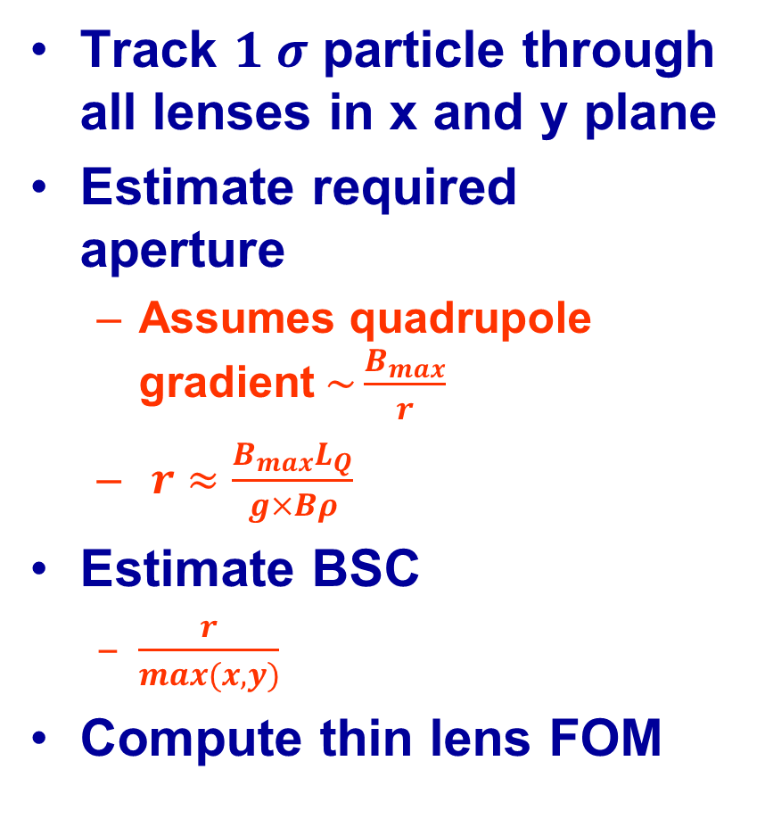
Thin Lens Figure of Merit
Track $1 σ$ particle through all lenses in x and y plane
Estimate required aperture
  Assumes quadrupole gradient$\sim \frac{B_{max}}{r}$
  $r≈\frac{B_{max}L_{Q}}{g×Bρ}$
Estimate BSC
  $\frac{r}{max(x,y)}$
Compute thin lens FOM

Slide 6
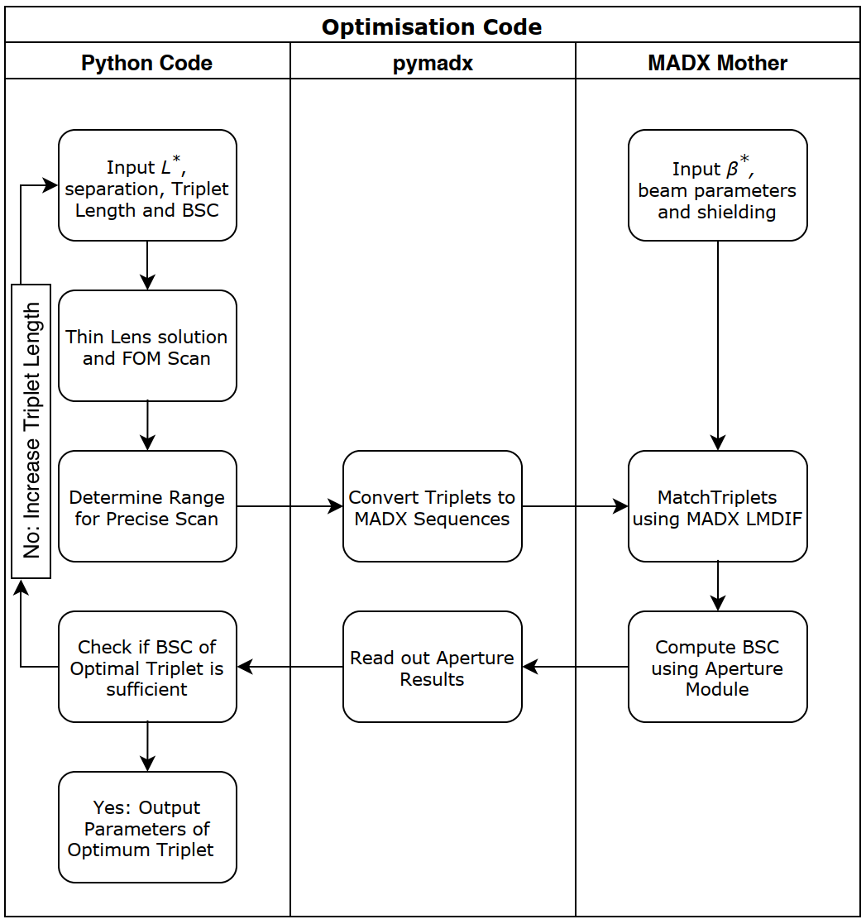
Optimisation Process

Slide 7
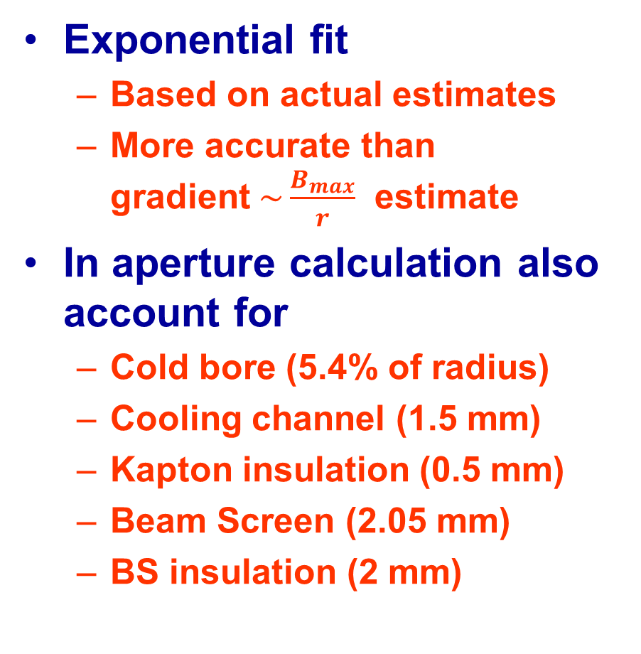
Actual Magnet Model
Exponential fit
  Based on actual estimates
  More accurate than gradient$\sim \frac{B_{max}}{r}$ estimate
In aperture calculation also account for
  Cold bore (5.4% of radius)
  Cooling channel (1.5 mm)
  Kapton insulation (0.5 mm)
  Beam Screen (2.05 mm)
  BS insulation (2 mm)

Slide 8
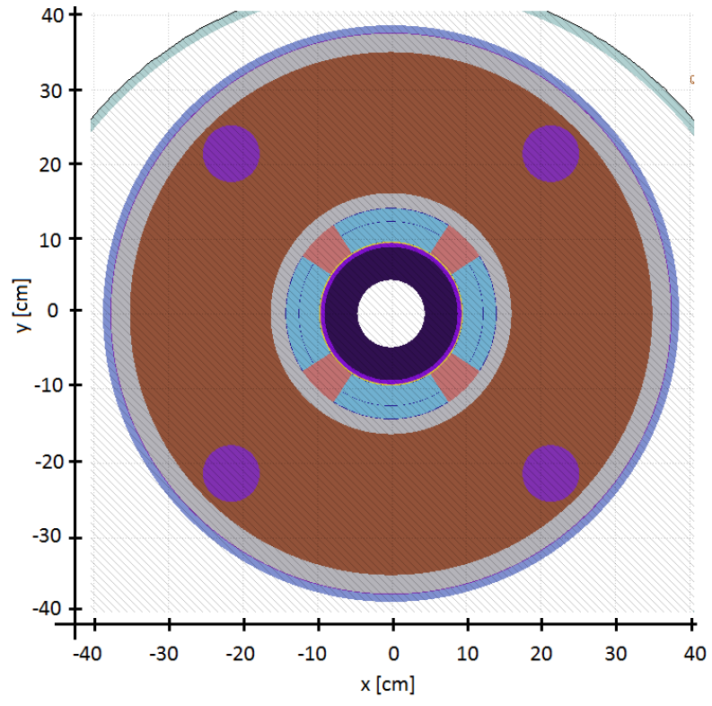
Energy Deposition Studies
Jose Abelleira (Oxford)
FLUKA model
Parameterised to be altered easily
Test final triplet designed after optics optimisation

Slide 9
Work Together
Use code to find shortest setup with good beam stay clear
Use this setup for radiation studies of triplet
Work out shielding required for this setup
Change shielding accordingly
Set required β*, L* and use initial shielding
Integrate and match into machine for further studies

Slide 10
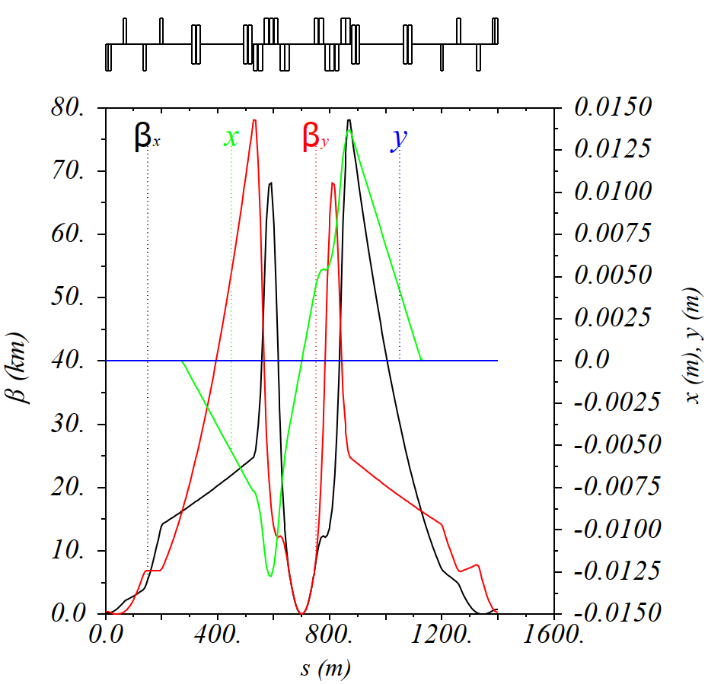
Results for 45 m L*
Parameter | Q1 | Quadrupole Q2 | Q3
Sub-magnets | 2 | 3 | 2
Sub-magnet Length (m) | 15 | 15 | 15
Coil Radius (mm) | 98.3 | 98.3 | 98.3
Gradient (Tm⁻¹) | 106 | 110 | 97
Shielding (mm) | 44.2 | 33.2 | 24.2
Triplet made of 7 identical magnets
  Uniform aperture benefits deposition
  Easier to design
  Smaller pool of backups
Shielding in magnets increases towards IP

Slide 11
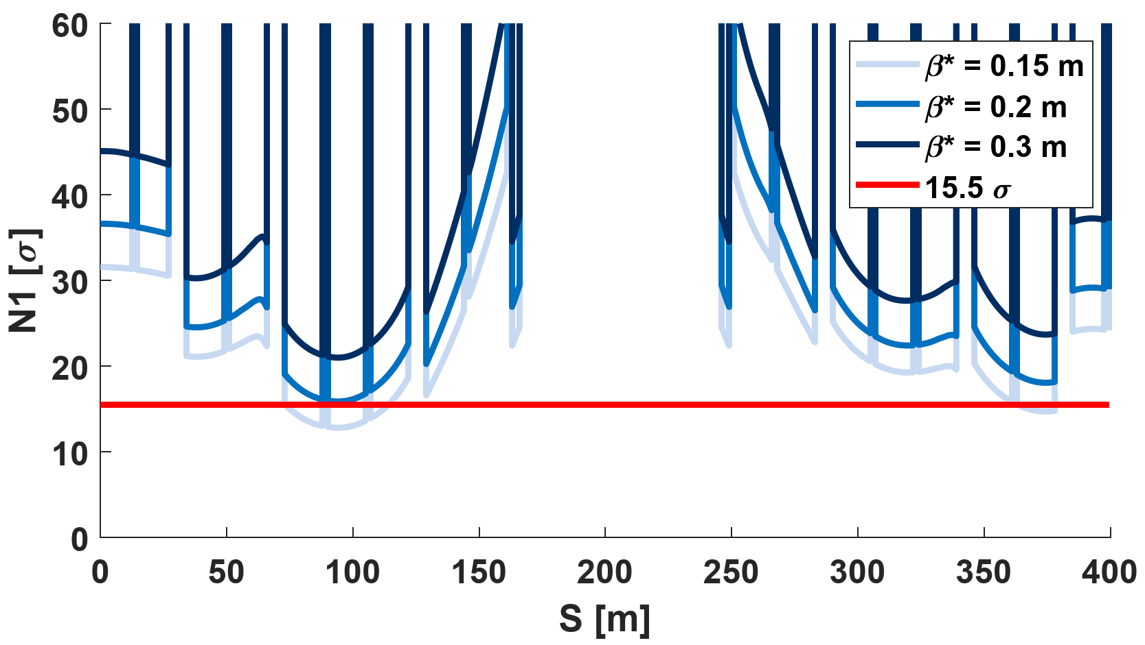
Results for 45 m L*
Parameter | Q1 | Quadrupole Q2 | Q3
Sub-magnets | 2 | 3 | 2
Sub-magnet Length (m) | 15 | 15 | 15
Coil Radius (mm) | 98.3 | 98.3 | 98.3
Gradient (Tm⁻¹) | 106 | 110 | 97
Shielding (mm) | 44.2 | 33.2 | 24.2

Slide 12
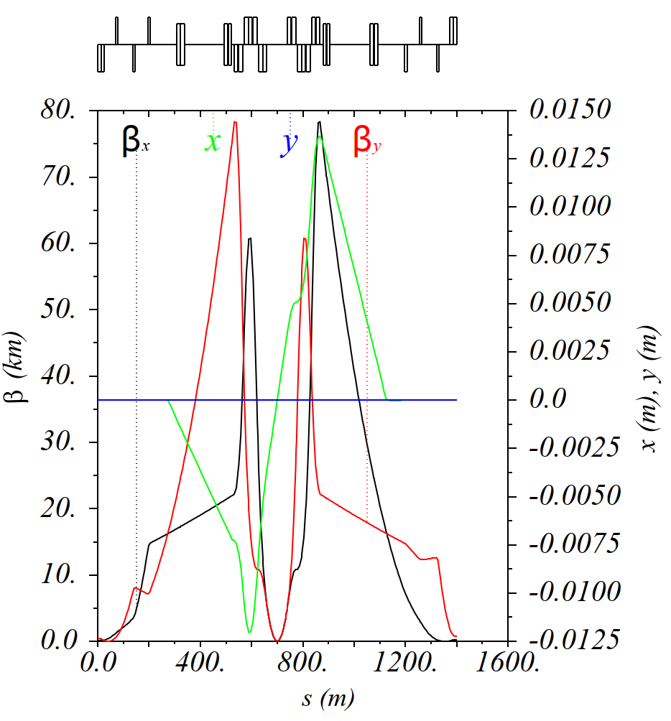
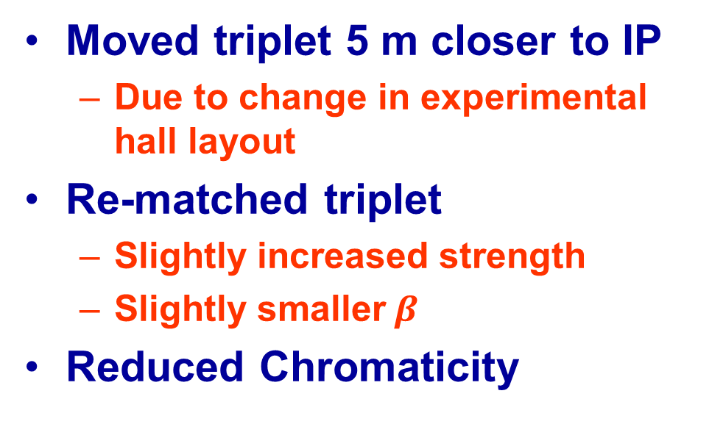
Move towards 40 m L*
Parameter | Q1 | Quadrupole Q2 | Q3
Sub-magnets | 2 | 3 | 2
Sub-magnet Length (m) | 15 | 15 | 15
Coil Radius (mm) | 96.5 | 96.5 | 96.5
Gradient (Tm⁻¹) | 106 | 112 | 99
Shielding (mm) | 44.2 | 33.2 | 24.2
Moved triplet 5 m closer to IP
  Due to change in experimental hall layout
Re-matched triplet
  Slightly increased strength
  Slightly smaller$β$
Reduced Chromaticity

Slide 13
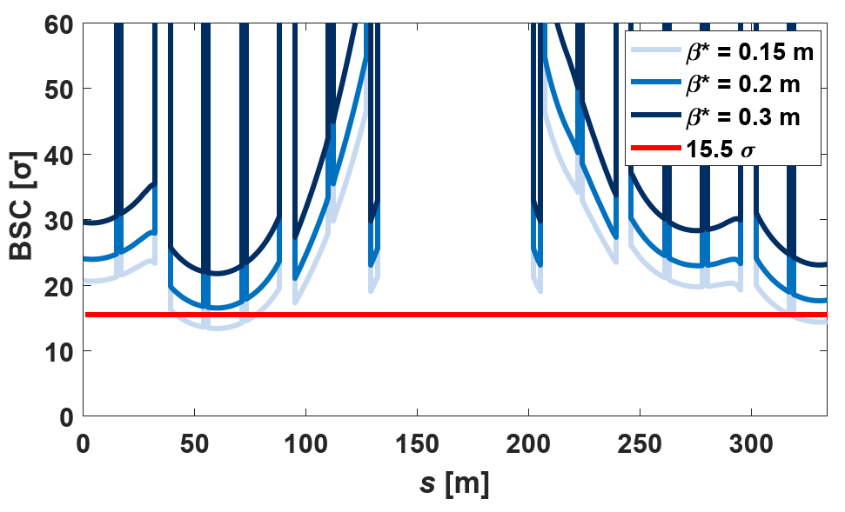
Move towards 40 m L*
Parameter | Q1 | Quadrupole Q2 | Q3
Sub-magnets | 2 | 3 | 2
Sub-magnet Length (m) | 15 | 15 | 15
Coil Radius (mm) | 96.5 | 96.5 | 96.5
Gradient (Tm⁻¹) | 106 | 112 | 99
Shielding (mm) | 44.2 | 33.2 | 24.2

Slide 14
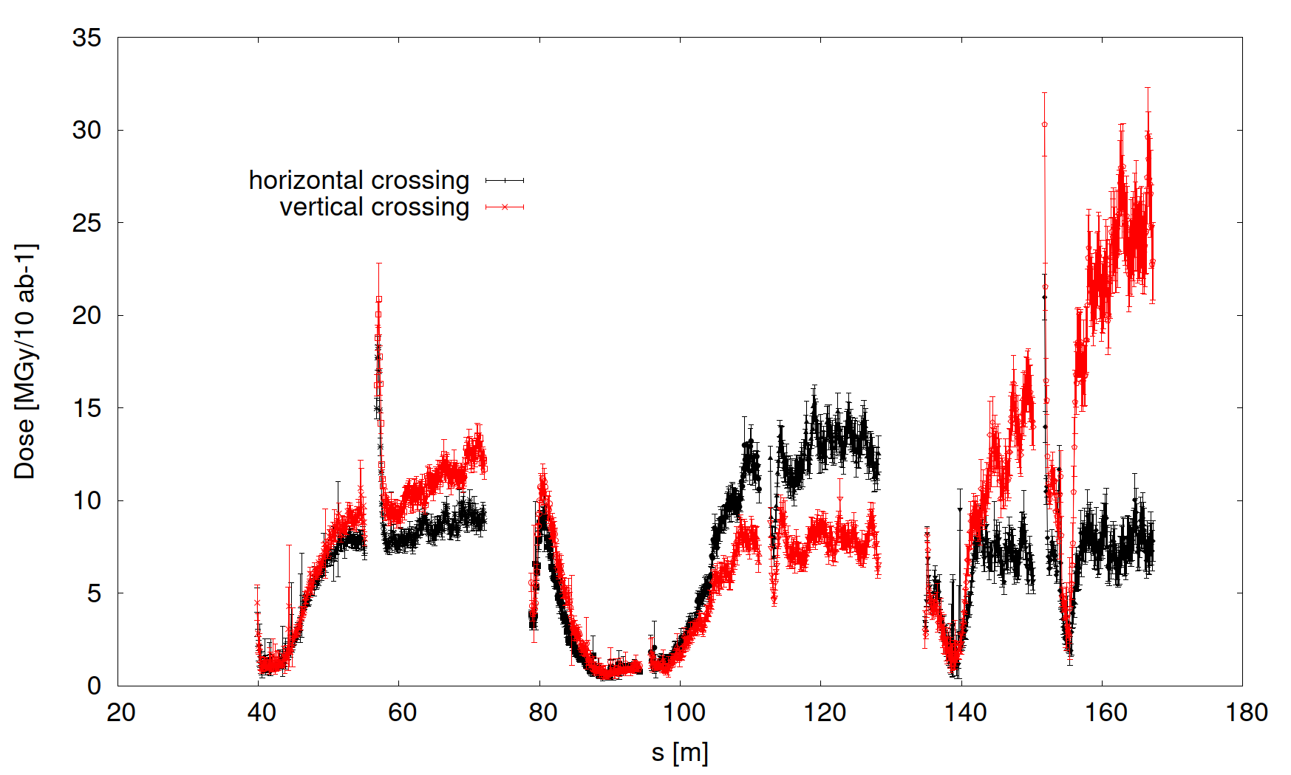
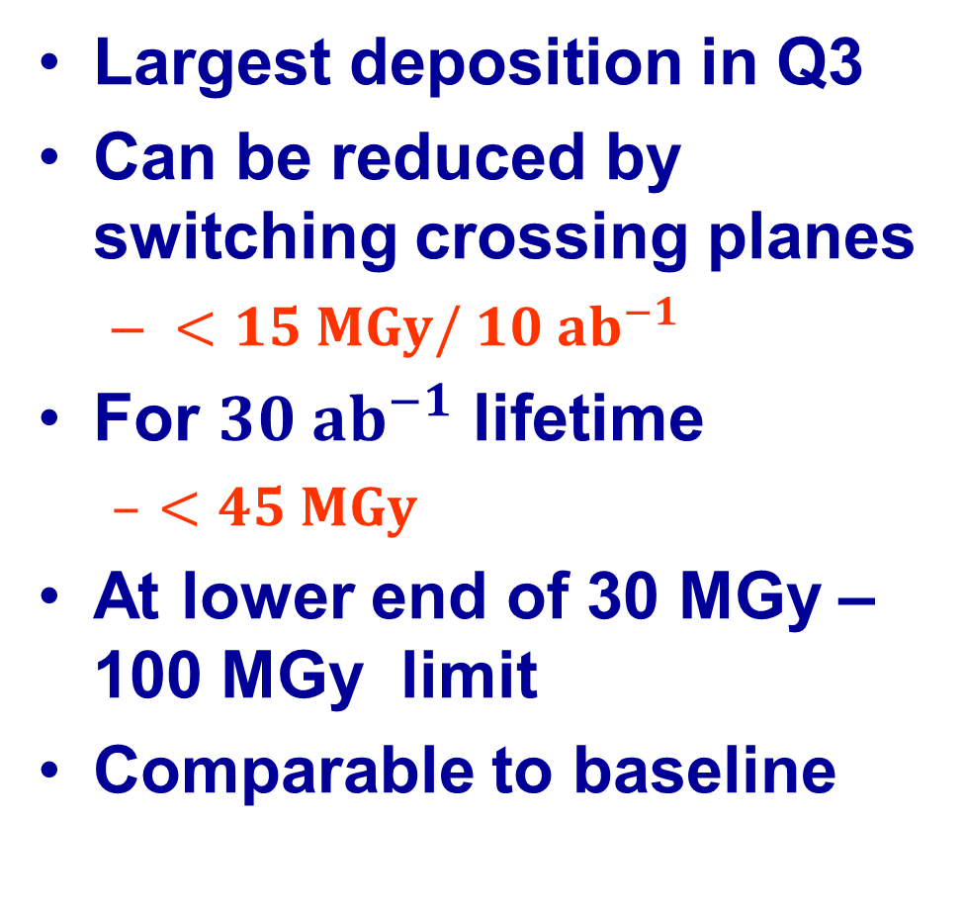
Energy Deposition
Largest deposition in Q3
Can be reduced by switching crossing planes
  $<15 MGy/ 10 ab^{−1}$
For $30 ab^{−1}$ lifetime
  $<45 MGy$
At lower end of 30 MGy – 100 MGy limit
Comparable to baseline
Jose Abelleira

Slide 15
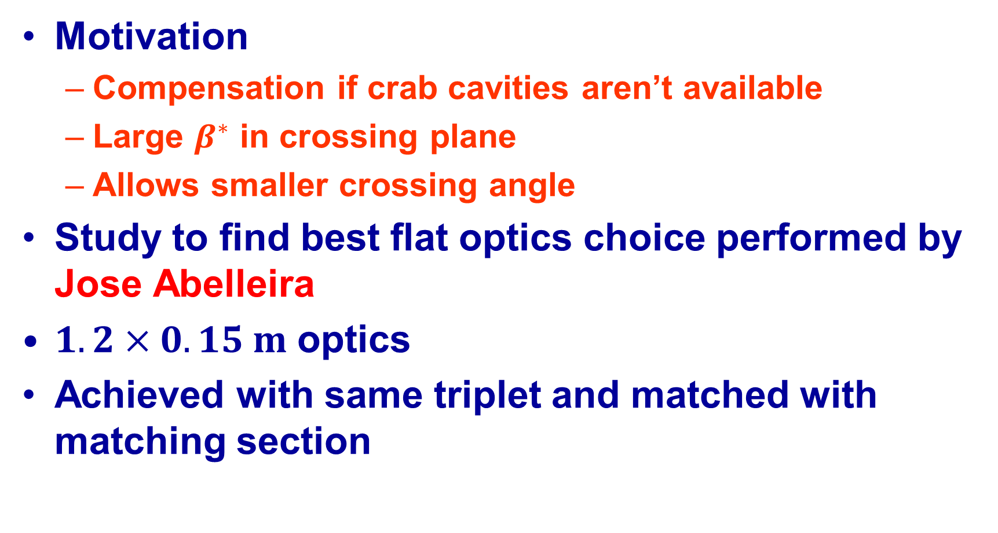
Flat Optics
Motivation
  Compensation if crab cavities aren’t available
  Large $β^{∗}$ in crossing plane
  Allows smaller crossing angle
Study to find best flat optics choice performed by Jose Abelleira
$1.2×0.15 m$ optics
Achieved with same triplet and matched with matching section

Slide 16
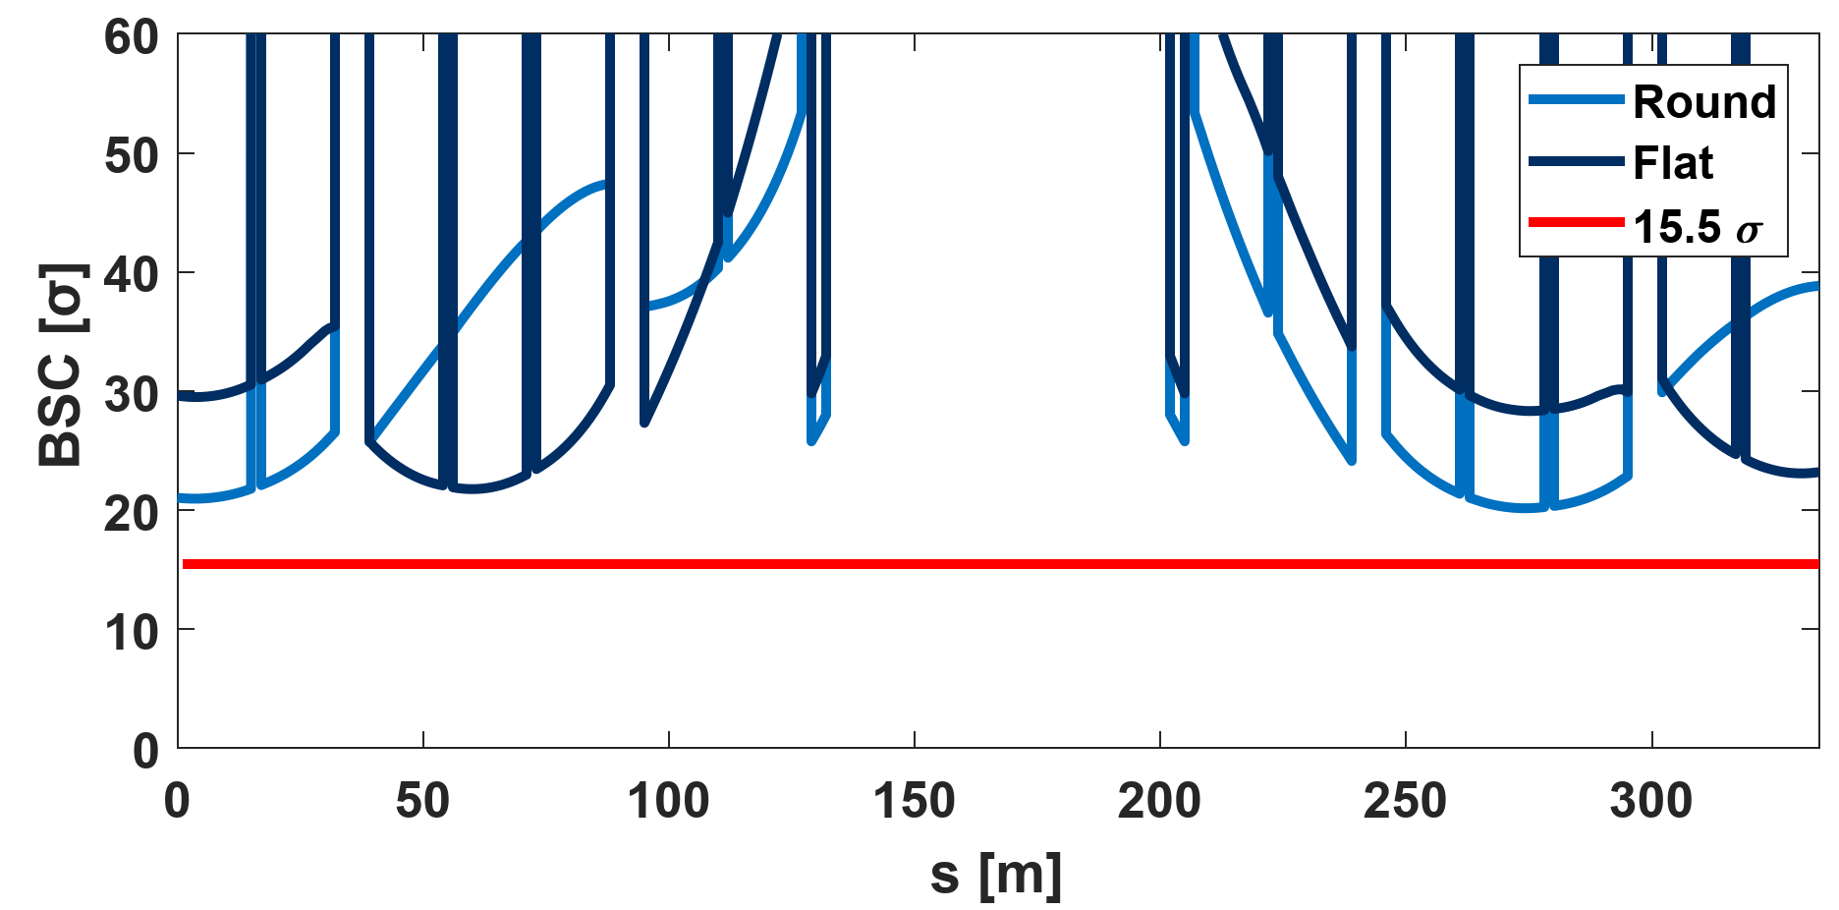
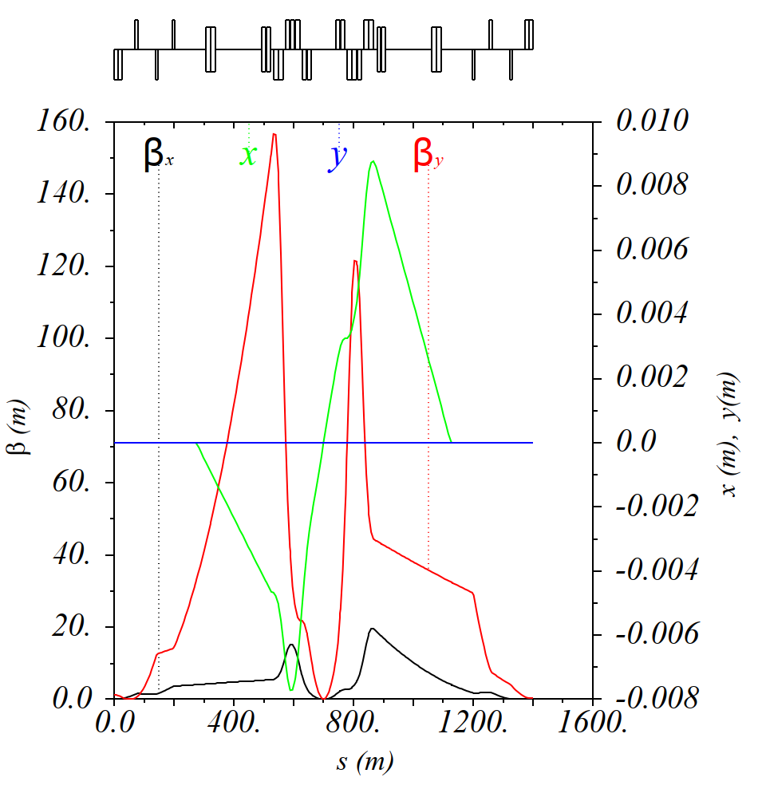
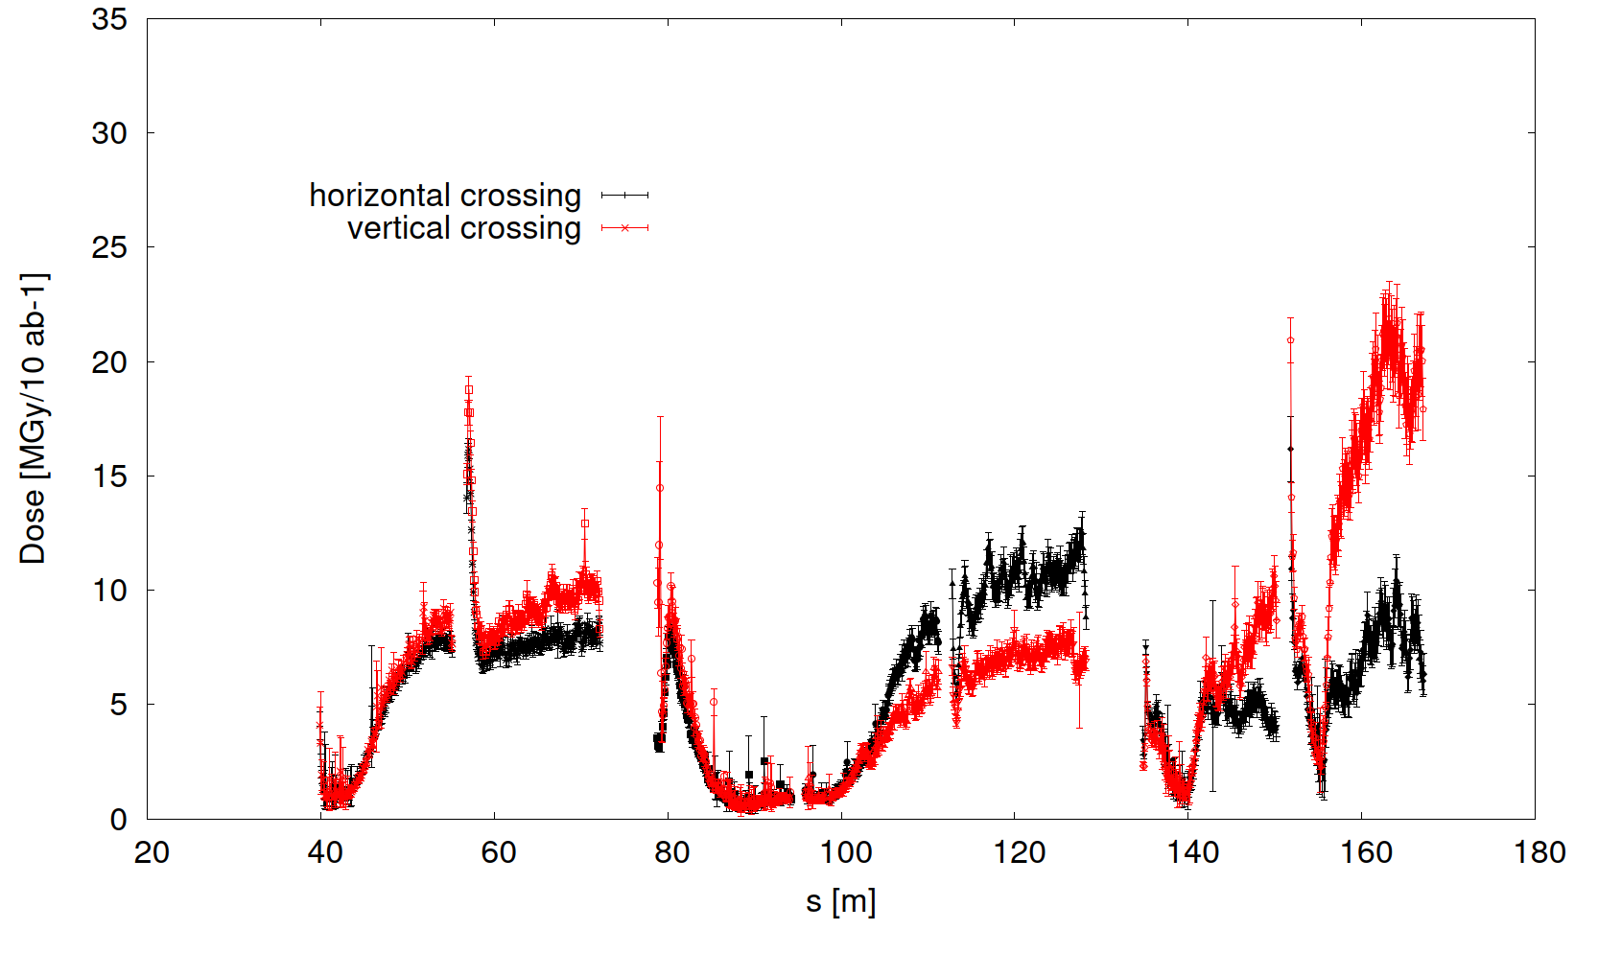
Flat Optics Results
Jose Abelleira

Slide 17
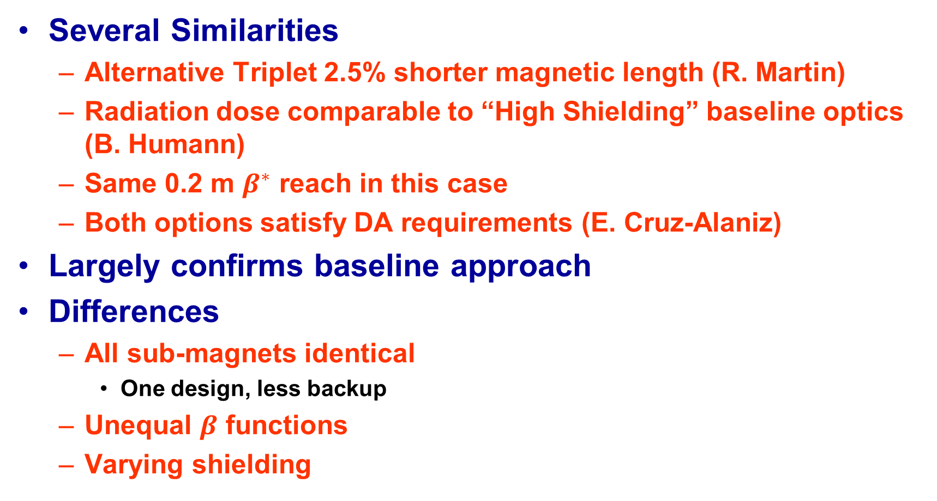
Comparison to Baseline
Several Similarities
  Alternative Triplet 2.5% shorter magnetic length (R. Martin)
  Radiation dose comparable to “High Shielding” baseline optics (B. Humann)
  Same 0.2 m $β^{∗}$ reach in this case
  Both options satisfy DA requirements (E. Cruz-Alaniz)
Largely confirms baseline approach
Differences
  All sub-magnets identical
    One design, less backup
  Unequal $β$ functions
  Varying shielding

Slide 18
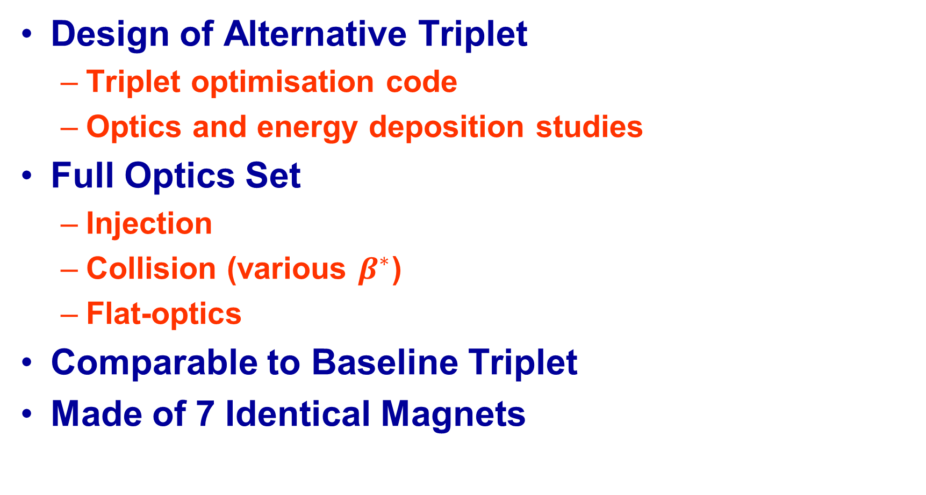
Summary
Design of Alternative Triplet
  Triplet optimisation code
  Optics and energy deposition studies
Full Optics Set
  Injection
  Collision (various $β^{∗}$)
  Flat-optics
Comparable to Baseline Triplet
Made of 7 Identical Magnets

