Slide 1




Beam-beam effects
J. Barranco, P. Goncalves, T. Pieloni, M. Schenk, C. Tambasco (EPFL)
S. Arsenyev, X. Buffat, S. V. Furuseth, N. Klinkenberg, D. Schulte (CERN)
Acknowledgements: R. Martin, M. Hofer, R. Tomas, R. Bruce, L. Rivkin, A. Seryi, B. Dalena, M. Giovannozzi, A. Mereghetti, E. Métral, O. Boine-Frankenheim, F. Zimmermann

Slide 2
Contents
FCC-hh beam-beam effects:
  Nominal crossing scheme
  Dynamic aperture studies (Round Optics)
  Low Luminosity experiments
  Beam-beam Long range global compensation and phase advance optimization
  Head-on limit studies
  Alternative solutions (flat optics)
FCC-hh two beam stability:
  Stability at the end of the betatron squeeze
  “Collide & squeeze”
  Stability during the collapse of the separation bumps
  Alternative solutions for Landau damping and compensation

Slide 3
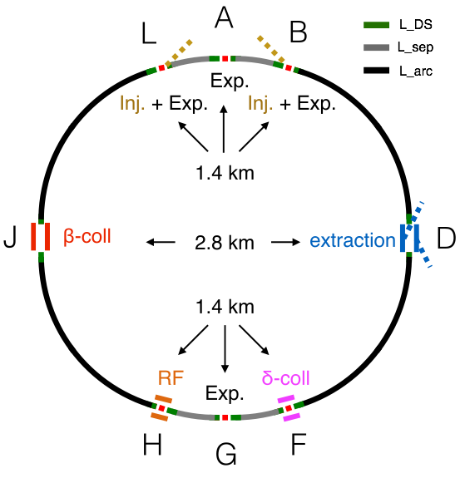

Collider Parameters
FCC CDR
Parameter | FCC-hh Baseline | FCC-hh Ultimate
Peak Luminosity [10³⁴ cm ⁻² s⁻¹] | 5.0 | < 30
Bunch distance [ns] | 25
Number of bunches | 10400
Bunch population [10¹¹ p/bunch] | 1.0
Transverse Norm. Emittance [μm] | 2.2
RMS bunch length [cm] | 8
RMS IP beam size [μm] | 6.8 | 3.5
IP beta functions [m] | 1.1 | 0.3
Maximum Total BB tune shift | 0.011 | 0.03
Full crossing angle [μrad] | 104 | 200
High luminosity experiments hosted in Interaction Point A and G → provide maximum luminosity together with good lifetimes
Low luminosity experiments hosted in Interaction Point L and B → keep beam-beam effects in the shadow of the high luminosity IPs

Slide 4
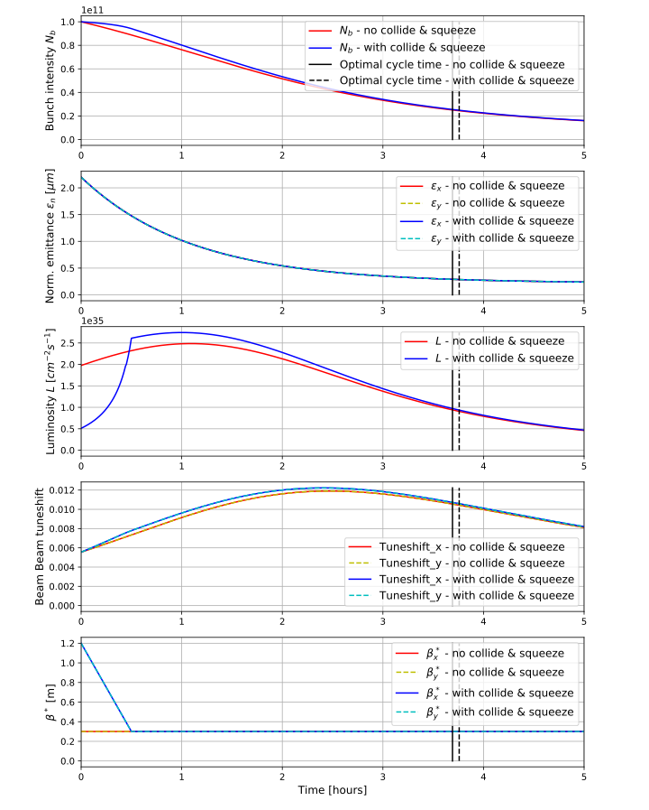
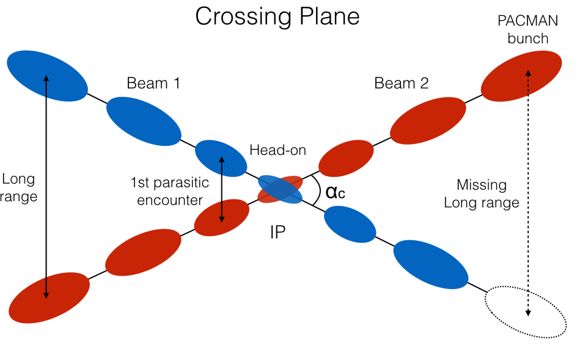
Evolution of beam parameters: beam-beam effects
An alternating (Horizontal and Vertical) crossing scheme is chosen for IPA & G in order to passively compensate for tune and chromaticity shifts for the PACMAN bunches
Due to strong radiation damping (emittance reduction) the beam-beam tune changes over the fill:
ΔQTOT = 0.011 at the beginning of the fill
ΔQTOT = 0.016 at the END of the Collide&Squeeze
ΔQTOT = 0.03 after two hours (maximum value)
    Explore limitations for the different beam-beam cases
    Propose a robust baseline and explore limits of ultimate

Slide 5
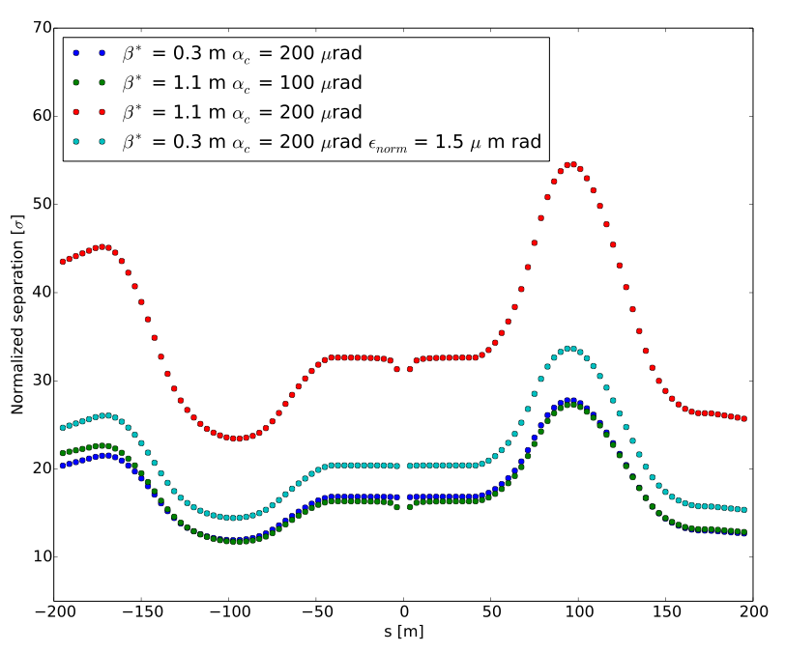
IR design : Crossing schemes and long term particle stability
See talk R. Martin
Baseline
End of Collide & squeeze
Ultimate
Baseline: LRsep = 30 σ → DA > 13 σ b*
Ultimate: LRsep = 17 σ → DA = 7.2 σ = baseline with reduced crossing angle ~ 104 μrad (green points)
End of Collide&Squeeze: LRsep = 20 σ → DA ~ 8.5 σ
Tot. crossing angle of 200 μrad
The choice of the crossing angle is based on the Dynamic Aperture studies

Slide 6
IR design : Crossing schemes and long term particle stability
Baseline
End of Collide & squeeze
Ultimate
Baseline: LRsep = 30 σ → DA > 13 σ
Ultimate: LRsep = 17 σ → DA = 7.2 σ = baseline with reduced crossing angle ~ 104 μrad (green points)
End of Collide&Squeeze: LRsep = 20 σ → DA ~ 8.5 σ
Tot. crossing angle of 200 μrad
Margins available and several crossing schemes possible (HH,VV, HV or mixed status) to “spread” energy deposited at the interaction region → ROBUST Baseline!

Slide 7
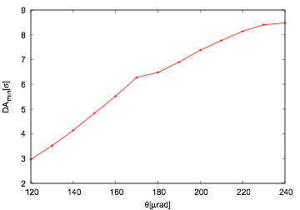
IR design : Crossing schemes and long term particle stability
H-V crossing
Nominal Bunch
Q’ = 2 units
Ultimate
Baseline
End of Collide & squeeze
Ultimate
Baseline: LRsep = 30 σ → DA > 13 σ
Ultimate: LRsep = 17 σ → DA = 7.2 σ = baseline with reduced crossing angle ~ 104 μrad (green points)
End of Collide&Squeeze: LRsep = 20 σ → DA ~ 8.5 σ
Tot. crossing angle of 200 μrad
Challenging case where limits have to be explored and understood to study the physics reach and potentials of such collider

Slide 8
IR design : Crossing schemes and long term particle stability
H-V crossing
Nominal Bunch
Ultimate
Baseline
Q’ = 20 units
End of Collide & squeeze
Ultimate
Baseline: LRsep = 30 σ → DA > 13 σ
Ultimate: LRsep = 17 σ → DA = 7.2 σ = baseline with reduced crossing angle ~ 104 μrad (green points)
End of Collide&Squeeze: LRsep = 20 σ → DA ~ 8.5 σ
Tot. crossing angle of 200 μrad
Challenging case where limits have to be explored and understood to study the physics reach and potentials of such collider

Slide 9
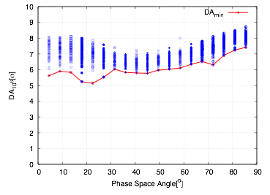

DA with multipolar errors
FCC New Lattice L* 40 m 200 μrad at IPA and IPG
LR+HO
No octupoles
  Present optics choice (IPAC2018-THPAK145) + Multipolar errors
  60 seeds simulation → 60 different machines
  Minimum of DA 5 σ reached ➞ Reduction of 2 σ w.r.t. the case without errors
  Challenging set-up that needs further studies and newer ways to look at DA because of the very large parameter space → Machine Learning project on-going to automatize the optimization of DA-lifetimes and feedback to design

Slide 10
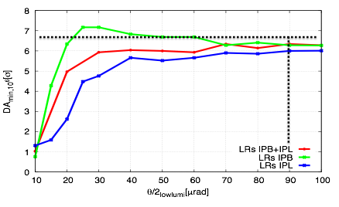
Low Luminosity experiments: IPL & IPB
See talk M. Hofer
The long-range effects of IPL and B will impact bunches differently (no passive compensation)
To have them not perturbing the high luminosity experiments should have angles (tot) > 180 μrad (3 m optics)
Head-on collisions: level by separation to avoid strong tune shifts
Long range: crossing angles larger than 180 μrad for the 3 m optics
Head-on: apply separation leveling of luminosity ➞ limit on integrated luminosity per year of run! Need to be defined together with tune optimization

Slide 11
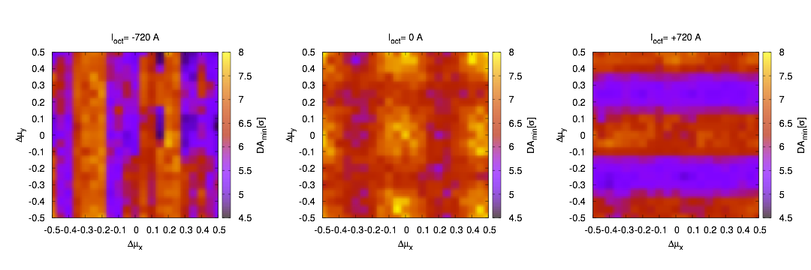
Global compensation of long range interactions
See talks A. Chance, E. Cruz
We choose to have Landau Octupoles powered such that they compensate the BB long-range effects:
provides larger stability for single beam (see beam stability studies)
allows for larger Dynamic aperture → beam lifetimes
Full integration in the lattice design (J. Shi et al., CERN-ACC-NOTE-2017-036)
Dynamic Aperture with head-on + Long range interactions
Negative (720 A)
No Octupoles
Positive (720 A)
Lattice and Beam-Beam optimized together to enhance at a design stage the natural compensation between effects and allow these flexibility.

Slide 12
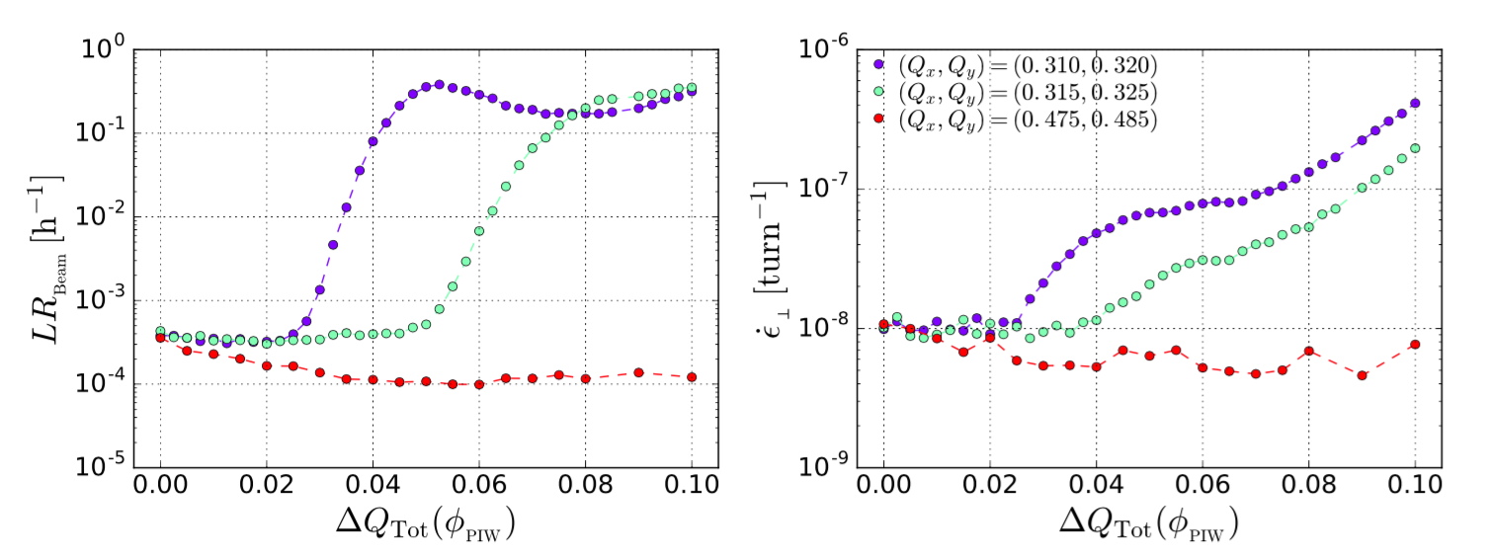
Head-on limit: losses and emittance growth
Full crab crossing
Baseline scenario (total beam-beam tune shift 0.02) shows no limitations (confirmed also by LHC measurements of lifetimes )
Ultimate (total beam-beam tune shift 0.03) is challenging ➞ optimization of the working point improves beam quality
The ultimate beam-beam tune shift of 0.03 considered for the FCC-hh baseline with crab cavities seems within reach while the limit for non-zero crossing angle is significantly smaller
    Further studies needed to explore possible limitations linked to a larger head-on beam-beam tune shift: LHC data benchmark fundamental!

Slide 13
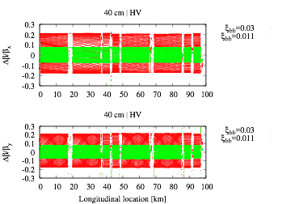
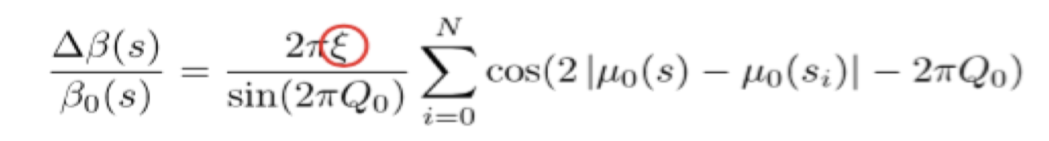
Head-on Limit: beta-beating
MAD-X (no lattice errors) L*=40 m and β*=30 cm (full crab x-ing)
The BB interaction causes non-linear amplitude detuning
For small amplitude particles (< 1 σ) the kick is linear
The change of the β-function assuming a series of small quadrupole errors is given by:
The beating is directly proportional to the BB parameter
ξbb,tot=0.011 (beg. Fill) → Δβ/β = 8 %
ξbb,tot=0.03 (max) → Δβ/β = 22 %
This optics distortion becomes another parameter on optimization (HO, octupoles)
Collimation tollerance is fixed at Δβ/β < 10 % as in the LHC

Slide 14
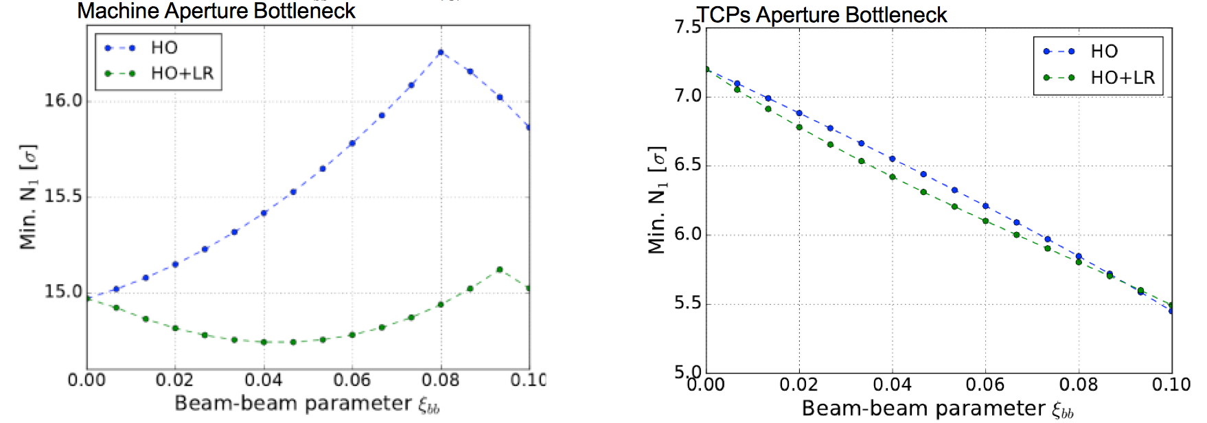
Beta-beating: impact on aperture
With Collimation team
We explored the impact on machine and collimator apertures for various ξ_{bb}. Only linear beating is considered (worst case).
Machine aperture bottleneck in separation dipole MBRD.B4RA.H1.
For HO only no aperture decrease for expected ξ_{bb} FCC range (0.01-0.03).
For HO+LRs there is a decrease of -0.25 σ for max ξ_{bb}=0.03
Collimation hierarchy is not changed
Non-gaussian beams to Luminosity impact is minimal in the range of interest ξ_{bb} FCC range (0.01-0.03).
Beg. fill
Max
Beg. fill
Max

Slide 15
Beta-beating: impact on aperture
With Collimation team
We explored the impact on machine and collimator apertures for various ξ_{bb}. Only linear beating is considered (worst case).
Machine aperture bottleneck in separation dipole MBRD.B4RA.H1.
For HO only no aperture decrease for expected ξ_{bb} FCC range (0.01-0.03).
For HO+LRs there is a decrease of -0.25 σ for max ξ_{bb}=0.03
Collimation hierarchy is not changed
Non-gaussian beams to Luminosity impact is minimal in the range of interest ξ_{bb} FCC range (0.01-0.03).
In the range of study ξ_{bb} FCC range (0.01-0.03)small impact observed → further studies needed.
Beg. fill
Max
Beg. fill
Max

Slide 16
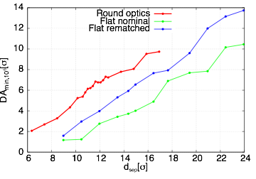
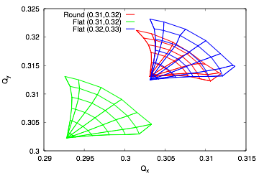
Alternative solutions: flat optics
See talk L. Van Riesen-Haupt
Flat optics is the natural back up solution in case crab cavities do not perform as expected
Beam-Beam long-range and head-on behave differently:
Due to trains and broken passive compensation tune shifts (for H-V crossing schemes)
Head-on beam-beam creates larger detuning with amplitude
Flat optics introduces some unwanted effects that have to be compensated
Study case beta ratio of 4 and H-V crossing scheme
Flat optics will need the 43 % more separation for round
Correcting for tune shift reduces the needs but still need 26% larger separation
Larger aspect ratios of betas make things worse
Need a special operation mode and further studies

Slide 17
Contents
FCC-hh beam-beam effects:
  Nominal crossing scheme
  Dynamic aperture studies (Round Optics)
  Low Luminosity experiments
  Beam-beam Long range global compensation and phase advance optimization
  Head-on limit studies
  Alternative solutions (flat optics)
FCC-hh two beam stability:
  Stability at the end of the betatron squeeze
  “Collide & squeeze”
  Stability during the collapse of the separation bumps
  Alternative solutions for Landau damping and compensation

Slide 18
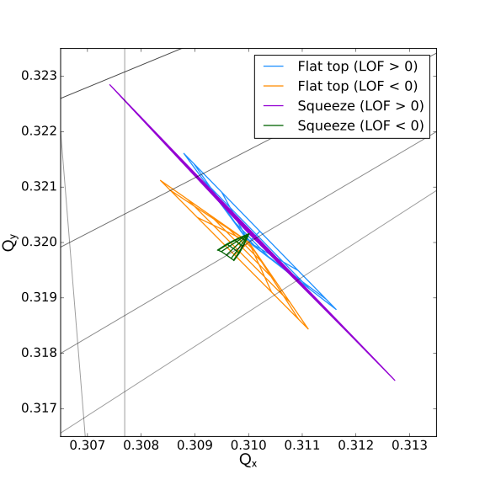
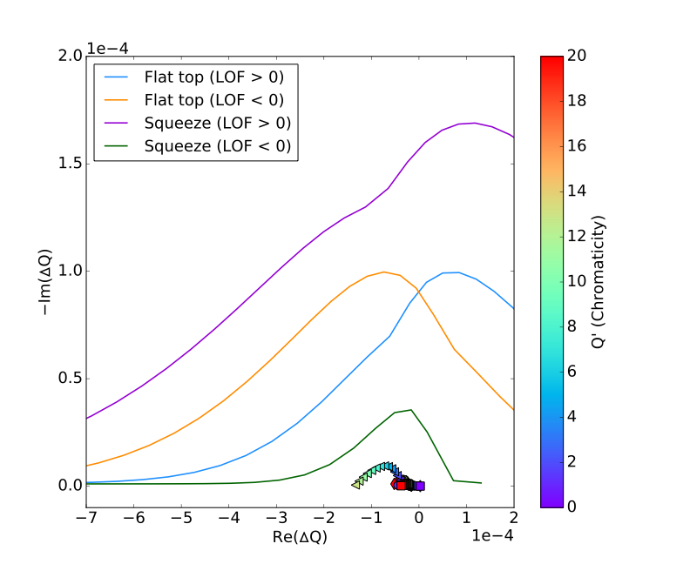
Two beam stability: fully squeezed optics
See talk of O. Boine-Frankenheim
50 TeV β*=0.30 m
Stability diagram
Maximum octupole strength
  Better dynamic aperture expected for negative oct. and optimized lattice (DA <5 σ for positive polarity to be added: multipolar errors + high chromaticity operations)
  Negative polarity provides more margins in terms of DA thanks to LR global compensation
  The stability is reduced at the end of the betatron squeeze ➔ additional margins are required: collide at larger β*

Slide 19
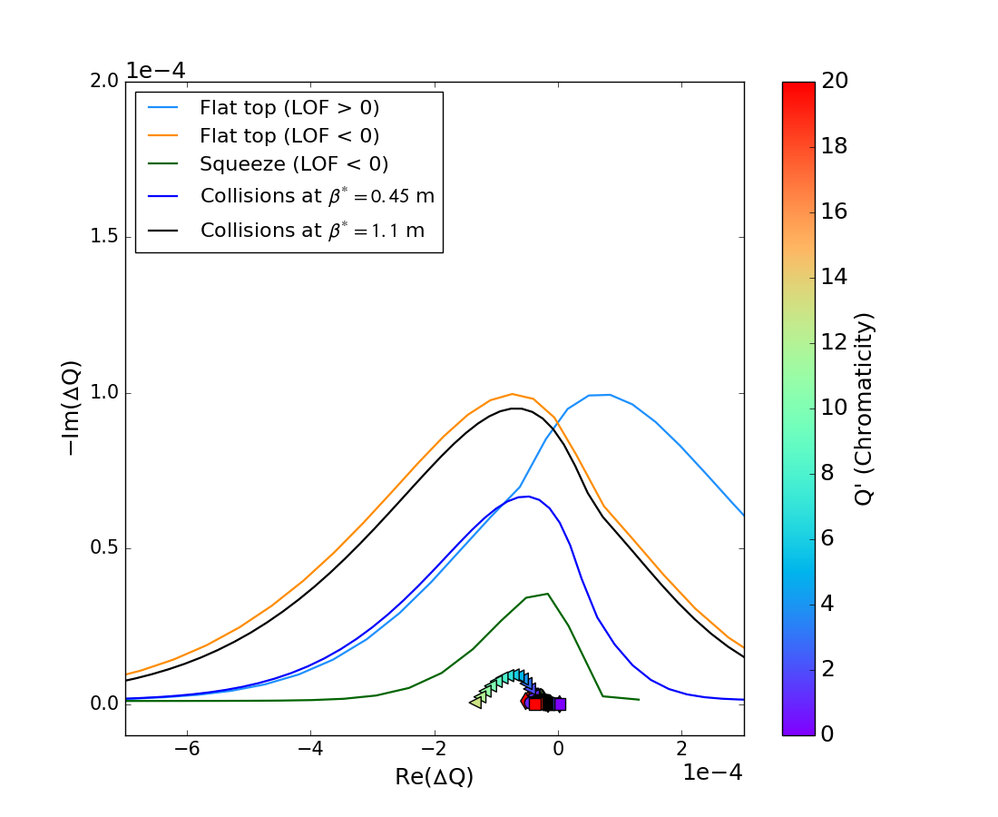
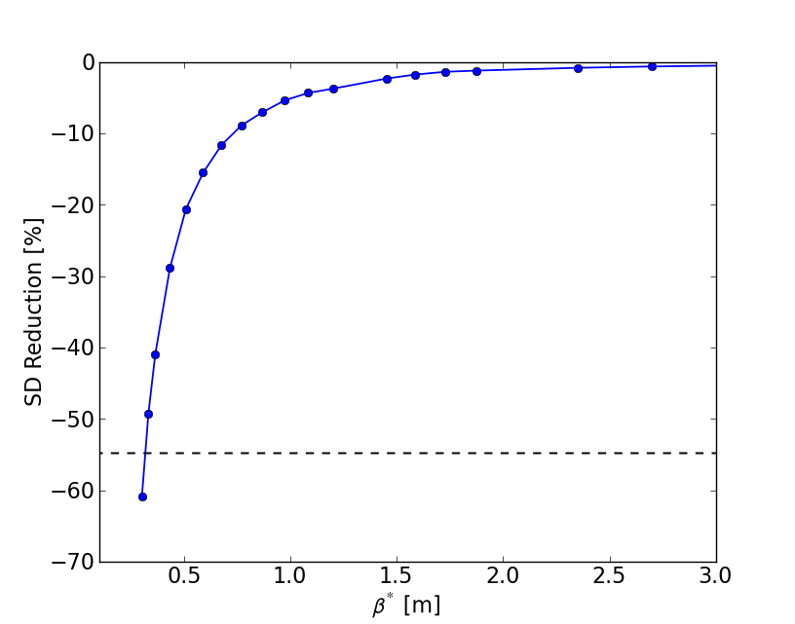
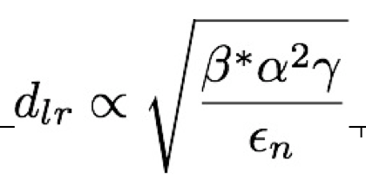
Two beam stability: Collide & Squeeze
  In order to avoid stability reduction during the squeeze, collisions at larger β* are foreseen (as for the HL-LHC)
  Beam-beam wise we cancel long-range beam-beam effects and have only head-on → go to reduced separations when beams transverse emittances have been reduced due to damping
1.1 β* collisions
Positive polarity
  Stability reduction evaluated w.r.t. the flat top SD with negative octupole polarity (relative difference of the negative real part at the half-height)
  β*= 1.1 m: reduction of stability of few percent → negligible effect

Slide 20
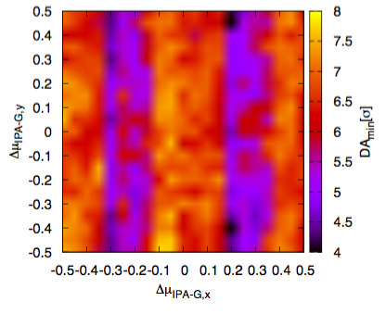
Two beam stability: fully squeezed optics
50 TeV β*=0.30 m
Beam-Beam Effects + Octupoles
Maximum octupole strength
  Better dynamic aperture expected for negative oct. and optimized lattice (DA <5 σ for positive polarity to be added: multipolar errors + high chromaticity operations)
  Negative polarity provides more margins in terms of DA thanks to Long Range global compensation→ need for a global optimization with lattice

Slide 21
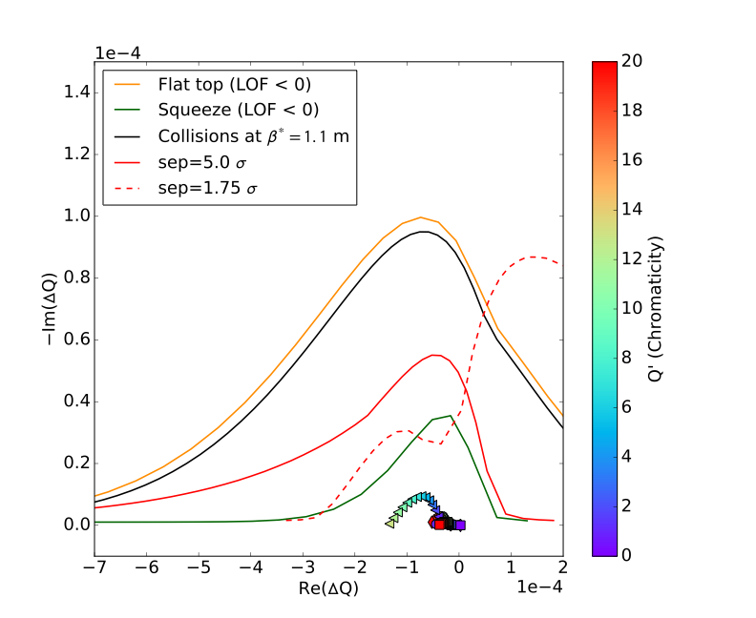
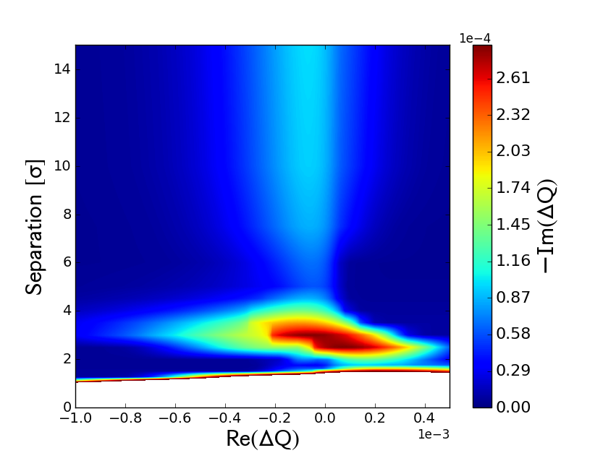
Stability during the collapse of the separation bumps
Octupoles powered with negative polarity at their maximum strength
  Collisions at β*= 1.1 m
5 σ
1.75 σ
  Maximum stability when in head-on collisions
  Two minima identified: at 5 σ and 1.75 σ separation (larger than EOS with β*= 0.30 m)
  Go faster than instability rise time < 5 s (m=-1 Q’~ 8-6 units) as done for LHC and HL-LHC

Slide 22
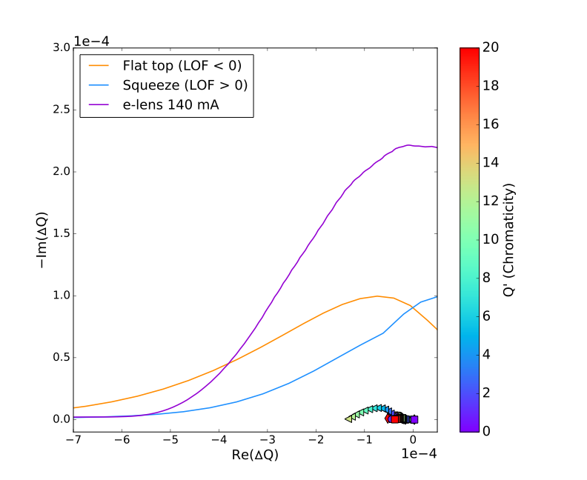
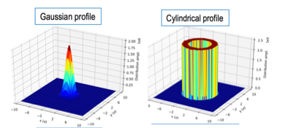
Alternatives for Landau damping: Electron Lens and RF quadrupoles
Electron lens [V. Shiltsev et al., 10.1103/PhysRevLett.119.134802]
140 mA will be sufficient to provide enough Landau damping for m=1 up tp Q’=20 units (no feedback)
400 mA are required to damp m=0 at Q’=0
→ very efficient since it acts on the core particles
Can help in compensating beam-beam head-on if needed
Collimation can also profit of studies

Slide 23
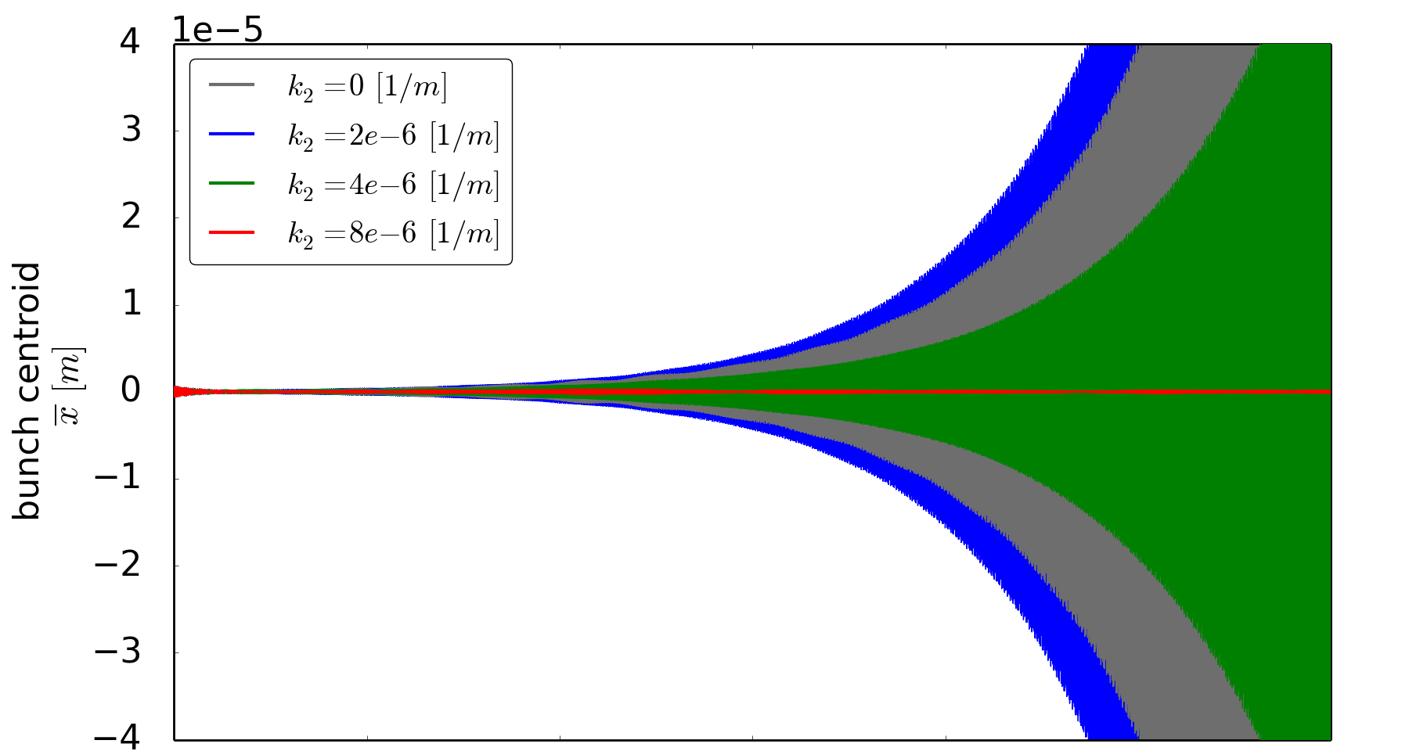
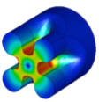
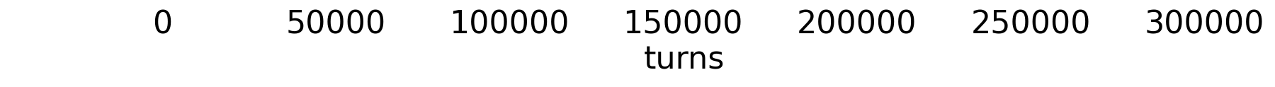
Alternatives for Landau damping: Electron Lens and RF quadrupoles
Electron lens [V. Shiltsev et al., 10.1103/PhysRevLett.119.134802]
140 mA will be sufficient to provide enough Landau damping for m=1 up tp Q’=20 units (no feedback)
400 mA are required to damp m=0 at Q’=0
→ very efficient since it acts on the core particles
Can help in compensating beam-beam head-on if needed
Collimation can also profit of studies
b⁽²⁾ = 0 Tm/m
b⁽²⁾ = 0.023 Tm/m
b⁽²⁾ = 0.047 Tm/m
b⁽²⁾ = 0.093 Tm/m
An RF quadrupole is equally able to cure the instability by introducing a large enough betatron tune spread.
RFQuad(ΔQ_{x})_{RMS} ≈ (3.5 ± 0.5)∙10⁻⁵
≈ 0.017 Q_{s}
LO(ΔQ_{x})_{RMS} ≈ (2.4 ± 0.3)∙10⁻⁵
≈ 0.012 Q_{s}
Study the impact on dynamic aperture
Extend the studies
RF quadrupole
(PyHEADTAIL)
M. Schenk, K. Li, A. Grudiev

Slide 24
Summary
A robust baseline scenario has been studied and beam-beam separation proposed based on dynamic aperture (from 30 σ to 17 σ Long Range separation for β= 1.1 - 30 cm)
Optimized optics parameters allow highest dynamic aperture together with a global compensation scheme using Landau octupoles → Scenario with negative oct. polarity included in the CDR
Head-on beam-beam limit seems far away from chosen parameters with full crab crossing (optimized working points improve beam quality)
Large beta-beating should be expected (22 %) and needs further understand of implications (collimation system, luminosity, multiple IP effects)
Alternative scenarios have been explored to allow for flexibility in the presence of other constrains
Fully squeezed optics does not allow margins at end of squeeze (limitation on the SD theory i.e. noise, diffusions mechanisms) → collisions at larger β* (1.1 m) are foreseen→ Collide and Squeeze
Alternative solutions for Landau damping: RF quads and electron lenses are explored
Continuous benchmark to LHC data is fundamental to understand predictive power of simulations

Slide 25
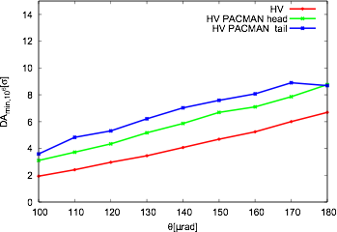
PACMAN Bunches
Dynamic Aperture for PACMAN bunches as a function of the total crossing angle in IPA&G
H-V alternating crossing scheme
DA for PACMAN bunches always above the DA for Nominal Bunches
The PACMAN effects of tune and chromaticity shifts are negligible assuming the passive compensation with alternating crossing planes in IPA and IPG

Slide 26
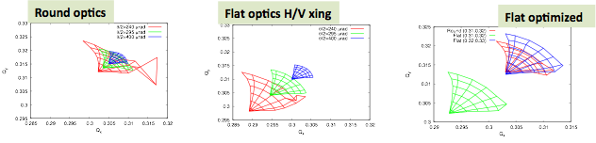
Alternative Solutions: flat optics
Flat optics is the natural back up solution in case crab cavities do not perform as expected
Flat optics introduces some unwanted effects that have to be compensated

Slide 27
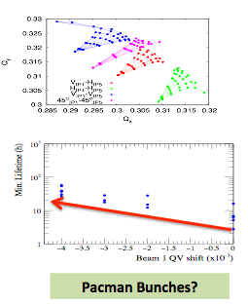
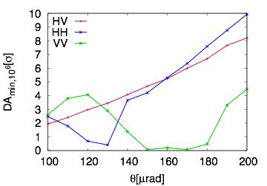
Alternative crossing schemes: H-H and V-V crossing
Alternative crossing scheme have been explored and show larger flexibility in terms of dynamic aperture with optimized tunes:
HH or VV crossing is equivalent to HV with optimization and easy for the baseline with collide and squeeze
VV not acceptable at the (0.31-0.32) working point due to strong impact of the 3rd order resonance effect ➞ mirrored tunes will solve the problem

Slide 28
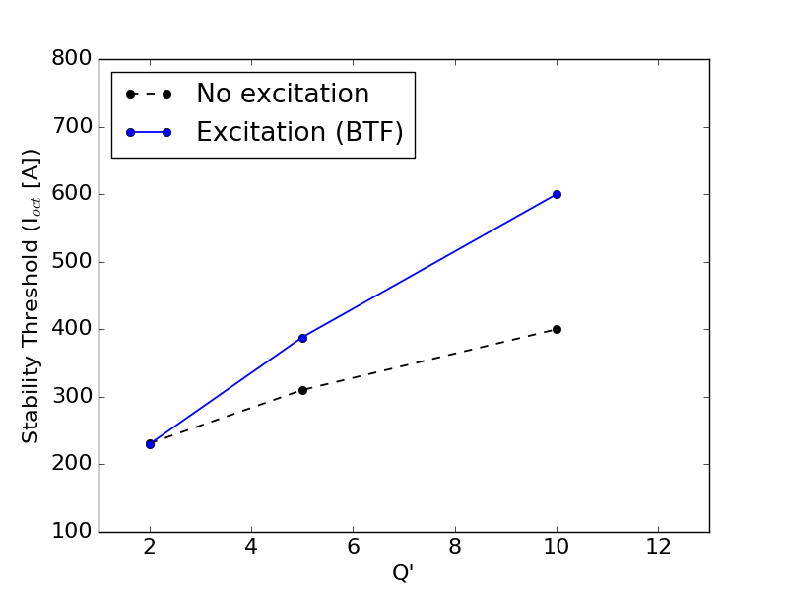
Why maximize Landau damping?
  Unwanted effects could reduce Landau damping:
  Linear coupling reduces detuning from Landau octupoles ➞ correct for it during operation
  Particle distribution deformation due to resonance excitation ➞ good Dynamic Aperture (no losses)
  Noise make the beam more sensitive to any external excitation ➞ not easy to control
BTF Exc. Amplitude = 2∙10⁻⁴ σ
For a chromaticity Q’=10 units the required increase is of ~50%
Possible mechanism to explain the observed higher octupole threshold needed during LHC operation
External sources of noise can compromise the beam stability, with latencies of several minutes as shown by recent experimental studies in the LHC by X. Buffat et al. [The impact of noise on beam stability, 8th HL-LHC collaboration meeting – CERN – 11.10.2018]
Maximize beam stability during the full operational cycle
Limitation in the strength of the FCC Landau octupoles might be a problem in the presence of noise
→ collisions at 1.1 m β* ensure stability with margins

Slide 29
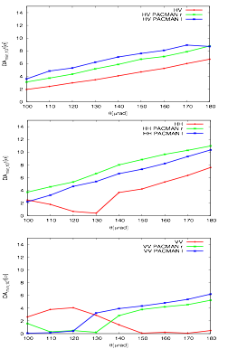
Nominal and PACMAN bunches
Nominal Bunches: bunches in the middle of a train → see all LR interactions
PACMAN bunches: located in the head or in the tails of the trains, see empty slots → see fewer long range interactions
Different beam-beam effects for the two families of bunches
Baseline no relevant PACMAN effects expected
Ultimate case differences in tune shift are expected
dynamics is driven by Nominal bunches
optimizations of working point needed also at bunch to bunch level

Slide 30
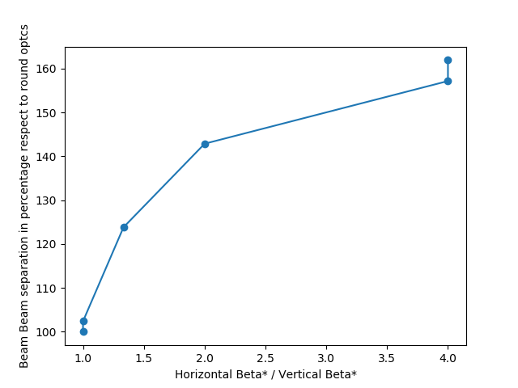
Alternative solutions: flat optics
See talk L. Van Riesen-Haupt
Flat optics is the natural back up solution in case crab cavities do not perform as expected
Beam-Beam long-range and head-on behave differently:
Due to trains and broken passive compensation tune shifts (for H-V crossing schemes)
Head-on beam-beam creates larger detuning with amplitude
Extra beam-beam separation scaling with betas ratio for optics
Study case beta ratio of 4 and H-V crossing scheme
Flat optics will need the 43 % more separation for round
Correcting for tune shift reduces the needs but still need 26% larger separation
Larger aspect ratios of betas make things worse
Need a special operation mode

