Slide 1





Overview of MDI issues toward the TDR
M. Boscolo (INFN-LNF)
Thanks to N. Bacchetta, H. Burkhardt, M. Sullivan
Future Circular Collider Conference
Brussels, 24-28 June 2019

Slide 2
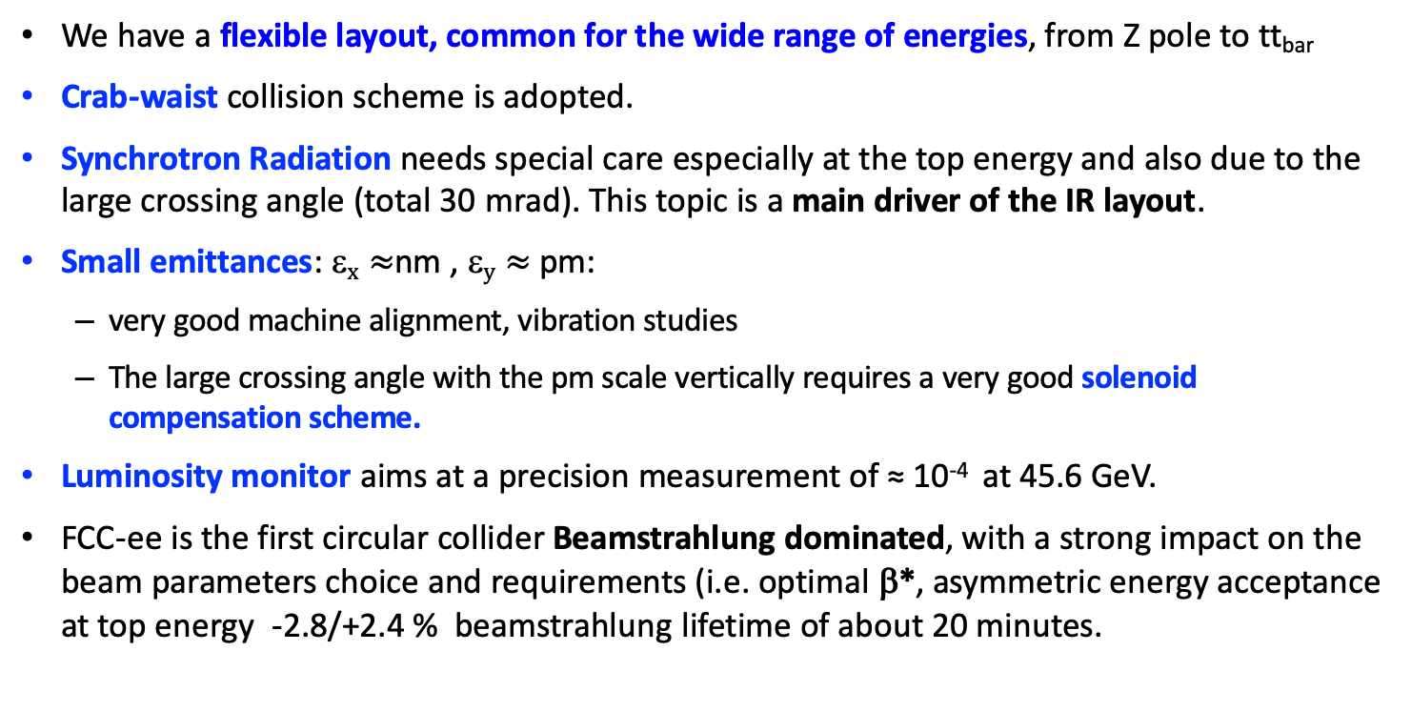
FCC-ee MDI design challenges
We have a flexible layout, common for the wide range of energies, from Z pole to tt_{bar}
Crab-waist collision scheme is adopted.
Synchrotron Radiation needs special care especially at the top energy and also due to the large crossing angle (total 30 mrad). This topic is a main driver of the IR layout.
Small emittances: ε$x≈$nm , ε$y≈$pm:
  very good machine alignment, vibration studies
  The large crossing angle with the pm scale vertically requires a very good solenoid compensation scheme.
Luminosity monitor aims at a precision measurement of ≈ 10⁻⁴ at 45.6 GeV.
FCC-ee is the first circular collider Beamstrahlung dominated, with a strong impact on the beam parameters choice and requirements (i.e. optimal β*, asymmetric energy acceptance at top energy -2.8/+2.4 % beamstrahlung lifetime of about 20 minutes.
The MDI WG has developed a layout that matches the requirements both of the machine and detector.

Slide 3
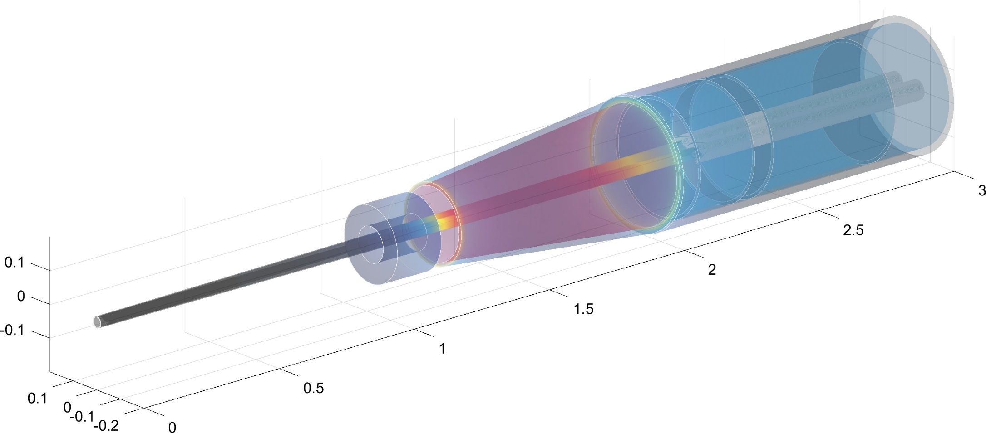
Interaction Region Layout
screening
solenoid
Compensating solenoid
QC1
2D-top view with expanded x-coordinate
100 mrad
QC1
Compensating solenoid
QC1
Lumical
IP
Be
shielding
Central detector
Lumical
L*=2.2m
HOM absorbers
L* = 2.2 m distance from IP to first quadrupole
2 T detector
Notes:
warm beam pipe, copper except for the central beam pipe, made of Be (+/- 12.5 cm , 15mm radius)

Slide 4
FCC-ee parameters
FCC-ee parameters |  | Z | W⁺W⁻ | ZH | ttbar
Beam energy | GeV | 45.6 | 80 | 120 | 175 | 182.5
Luminosity / IP | 10³⁴ cm⁻² s⁻¹ | 230 | 28 | 8.5 | 1.8 | 1.55
Beam current | mA | 1390 | 147 | 29 | 6.4 | 5.4
Bunches per beam | # | 16640 | 2000 | 328 | 59 | 48
Average bunch spacing | ns | 19.6 | 163 | 994 | 2763 | 3396
Bunch population | 10¹¹ | 1.7 | 1.5 | 1.8 | 2.2 | 2.3
Horizontal emittance ε_{x} Vertical emittance ε_{y} | nm pm | 0.27 1.0 | 0.84 1.7 | 0.63 1.3 | 1.34 2.7 | 1.46 2.9
β_{x}* / β_{y}* | m / mm | 0.15 / 0.8 | 0.2 / 1.0 | 0.3 / 1.0 | 1.0 / 1.6
beam size at IP: σ_{x}* / σ_{y}* | μm / nm | 6.4 / 28 | 13 / 41 | 13.7 / 36 | 36.7 / 66 | 38.2/68
Energy spread: SR / total (w BS) | % | 0.038 / 0.132 | 0.066 / 0.131 | 0.099 / 0.165 | 0.144 / 0.196 | 0.15 / 0.192
Bunch length: SR / total | mm | 3.5 / 12.1 | 3 / 6.0 | 3.15 / 5.3 | 2.75 / 3.82 | 1.97 / 2.54
Energy loss per turn | GeV | 0.036 | 0.34 | 1.72 | 7.8 | 9.2
RF Voltage /station | GV | 0.1 | 0.75 | 2.0 | 4/5.4 | 4/6.9
Longitudinal damping time | turns | 1273 | 236 | 70.3 | 23.1 | 20.4
Acceptance RF / energy (DA) | % | 1.9 / ±1.3 | 2.3 / ±1.3 | 2.3 / ±1.7 | 3.5/ (-2.8; +2.4) | 3.36 / (-2.8; +2.4)
Rad. Bhabha/ actual Beamstr. Lifetime | min | 68 / > 200 | 59 / >200 | 38 / 18 | 37/ 24 | 40 / 18
Beam-beam parameter ξ_{x} / ξ_{y} |  | 0.004 / 0.133 | 0.01 / 0.141 | 0.016 / 0.118 | 0.088 / 0.148 | 0.099 / 0.126
Interaction region length | mm | 0.42 | 0.85 | 0.9 | 1.8 | 1.8

Slide 5
Machine Detector Interface design
The next steps can be subdivided in the following macro-areas, all inter-connected:
Beam physics (optics, beam dynamics, collective effects)
Experimental environment & luminometer
Software
Engineering (mechanical, magnets, diagnostics, vacuum, cooling, ...)
  Input and strong collaboration from all areas of expertize are crucial to optimize the promising studies presented in the CDR and finalize them for the TDR phase.
Our goal is to have a feasible and engineered design that meets
optics, beam dynamics and high current requirements, foresees tolerable radiation and meets as well the mechanical requirements in terms of integration, stability, assembly.

Slide 6
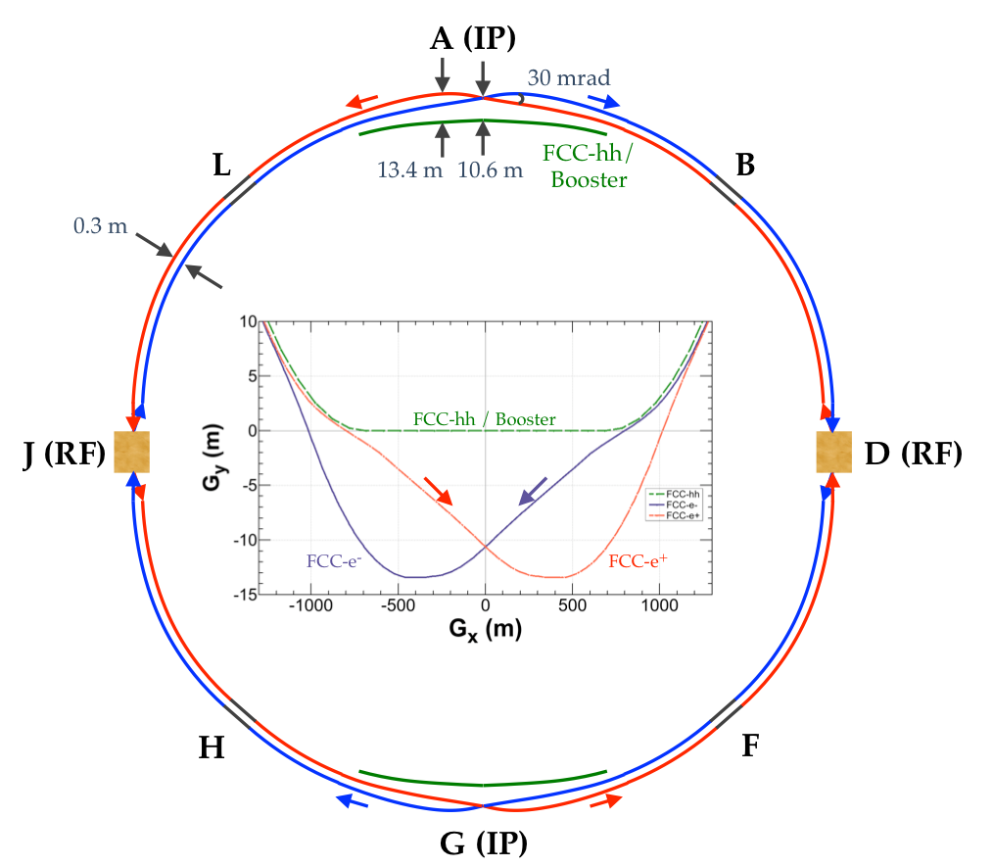
MDI & Beam physics issues
FCC-ee accelerator design is continuously
evolving and improving
Goal is to optimize the design with 4 IPs: beam-beam optimization implies an evolution of beam parameters, and MDI layout will follow the optics updates that will come also for other beam dynamics studies that may come
Beam-beam blow-up issues (D. El Khechen)
Optics variations take into account that FCC-hh footprint is not a constraint now
Optimization of beam pipe aperture, study the reduction of the central Be pipe
Synchrotron Radiation (SR) at the IR, major issue for the MDI design, well under control as reported in CDR, but work is not done, on-going study
Beam backgrounds simulations: single beam and IP processes
  Beam losses from all main processes (beam-gas, thermal photons, ...)
  Collimation system for betatron and momentum cleaning (possibly outside the MDI area, but useful to control losses in the experiments)
Heat load evaluation from RW impedance and SR at IR (strictly connected with engineering issues)
Collective effects at IR

Slide 7
Synchrotron Radiation in the IR
To fulfil the requirement that E_{critical} from dipoles is < 100 keV from ~ 500m from IP, special optics has been developed [ref. : K. Oide et al, PRAB 19, 111005 (2016)]
SR studied with SYNC_BKG, MDISim (MADX/ROOT/Geant4) and SYNRAD+
Different countermeasures undertaken to protect IR & detector
  SR mask tips in front of QC1 and QC2
  1 cm Tantalum shielding
  5 μm Gold coating in the central chamber
Countermeasures are effective:
No SR from dipoles or from quads hits directly the central beam pipe
SR impact on Vertex detector (VXD) and Tracker barrel (TB) small
mask tips prevent FF quad radiation from striking nearby beam pipe elements
  On-axis beam, non-Gaussian beam tails to 20 σ_{x} and 60σ_{y}
SR bkg comes only from the last soft bend radiation striking the mask tips

Slide 8
Synchrotron Radiation in the IR
Still a lot of work to be done:
  Refine simulations (also following the optics changes)
  More detailed studies with improvements on the simulation level:
    tracking in IR with beams tilted in solenoid
    fringe fields overlapping with quads
    X-ray reflection not yet included in Geant4 (and check for giant dipole resonance)
  Add SR collimators upstream the IR
  Neutron production from high-energy tails in FF quads: study has to continue
  Carefully evaluate the SR from final focus quadrupoles especially at the top energy: hard photons are produced, lost at ~50/60 m downstream the IP
  Primaries under control, secondary sources to be simulated more carefully
  M. Luckhof will present last results with MDISim (this session)
  M. Sullivan evaluated the impact on SR with a smaller beam pipe (this session)

Slide 9
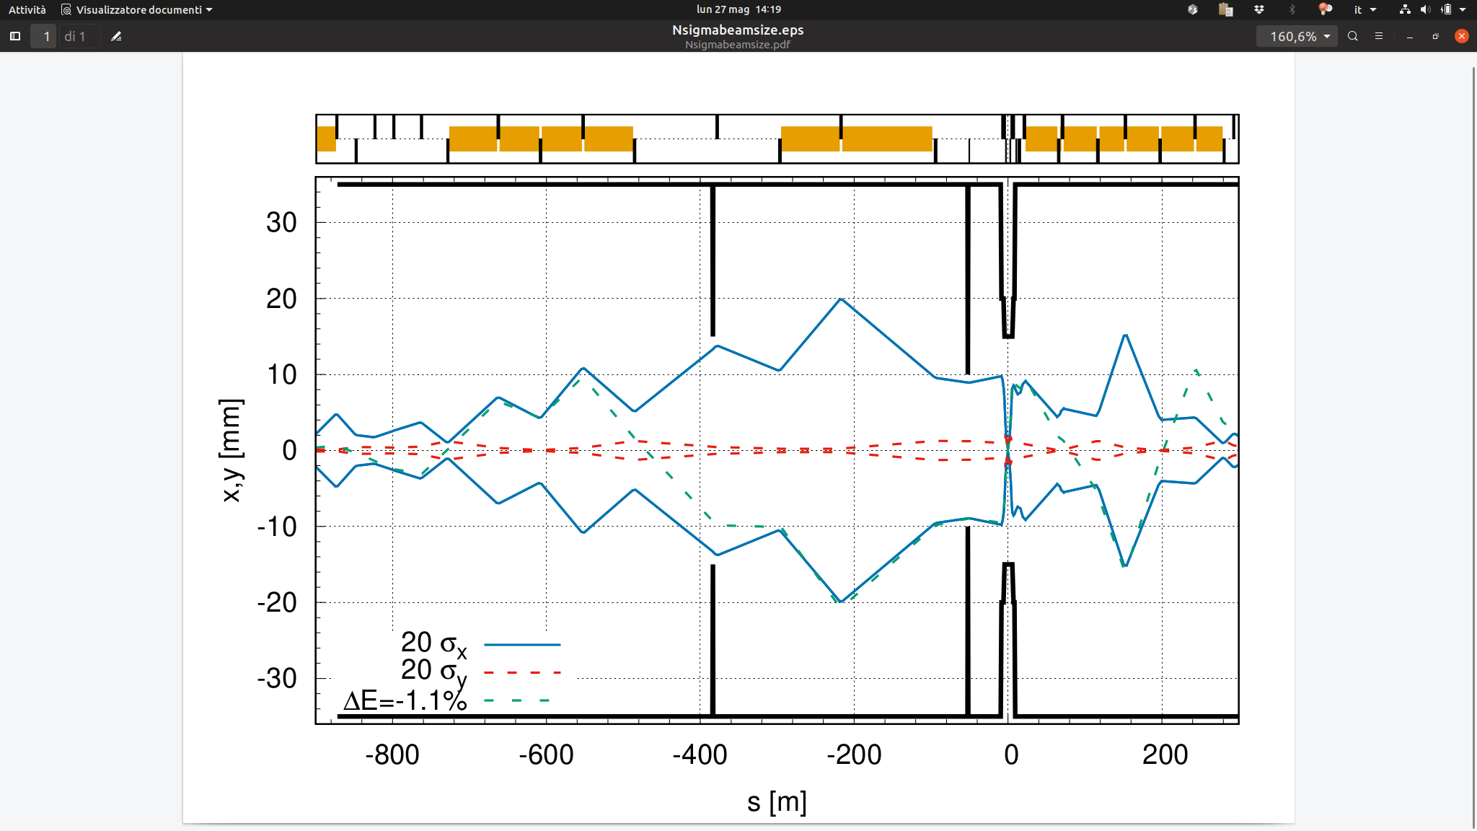
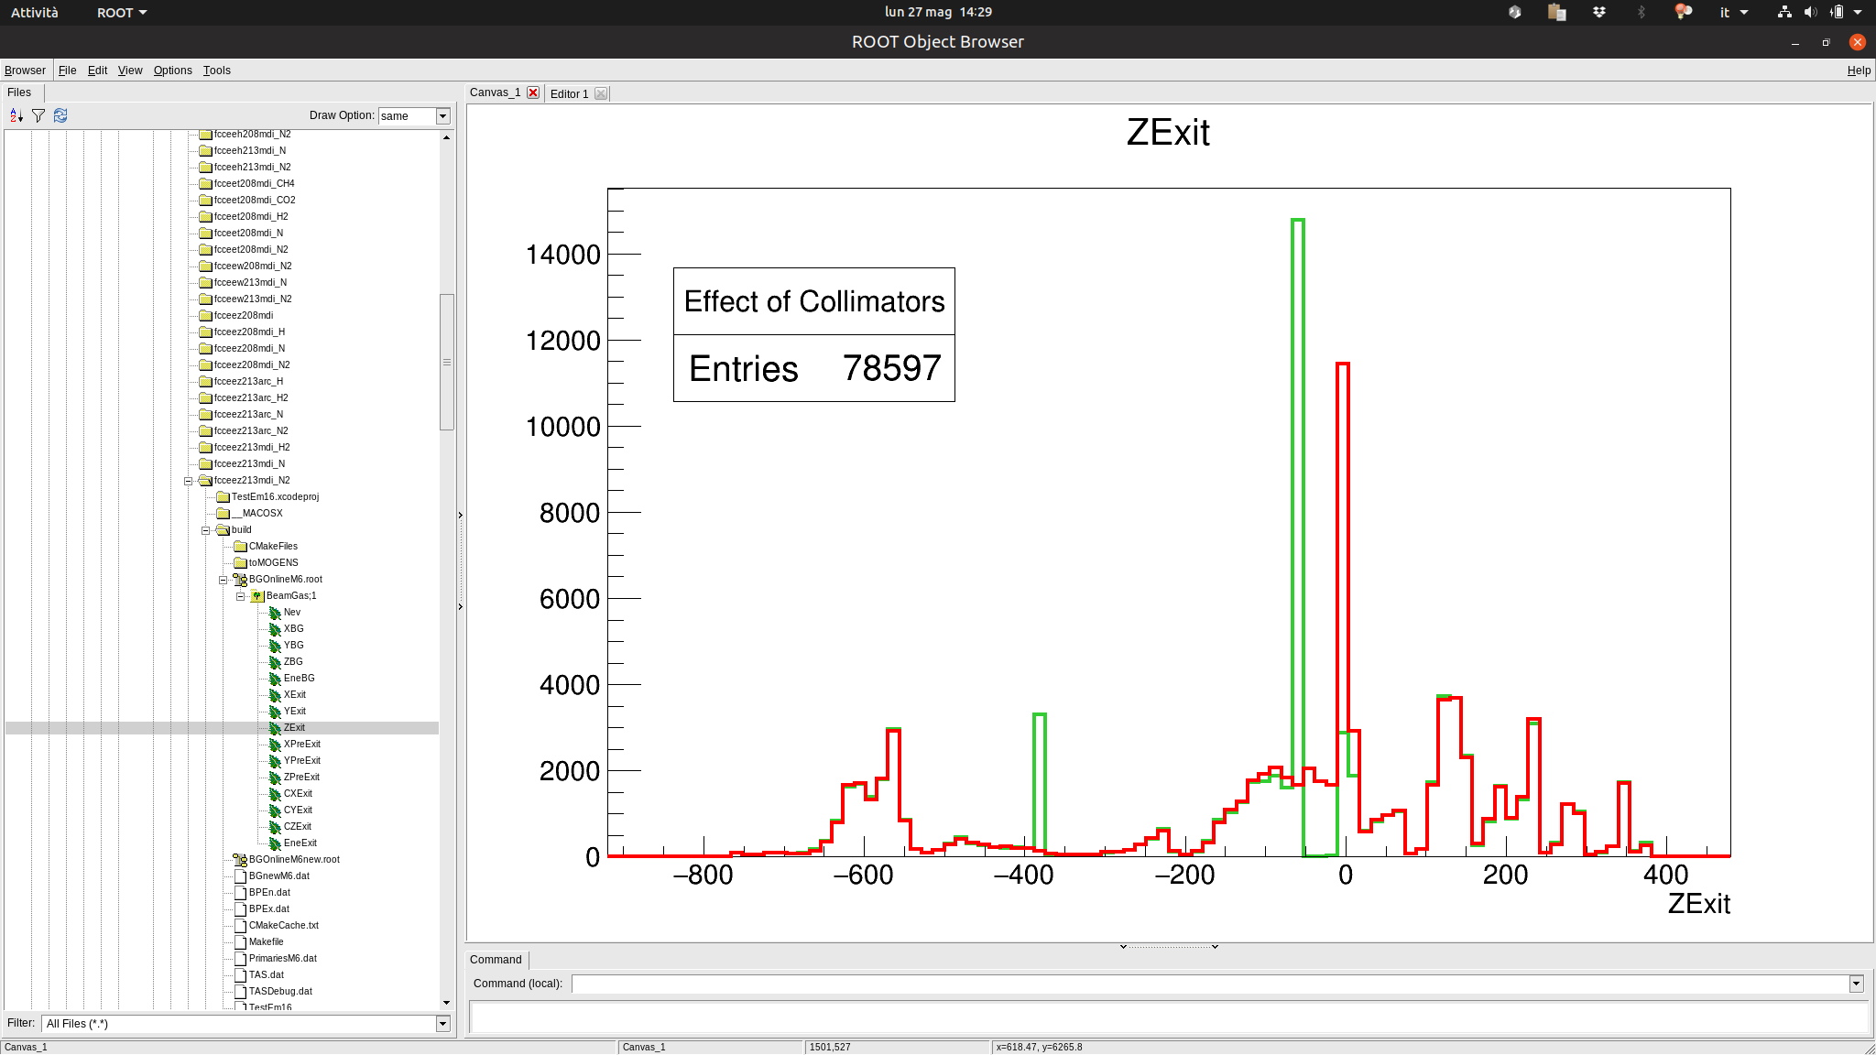
Single Beam induced backgrounds
Progress on Thermal photon scattering (talk by H. Burkhardt, this session)
aperture reduced to 10 mm (20 σ_{x})
Inelastic beam-gas simulation performed with MDISim, scattered particles tracked into the lumical, negligible background source
with collimator
Elastic beam-gas scattering just started with custom process generator & MADX-PTC (LNF)
Touschek scattering: expected not to be relevant but check of IR beam losses planned Touschek lifetime ~15/30 hrs at Z, MADX/SAD
no collimator
O. Blanco
example of
off-momentum collimators

Slide 10
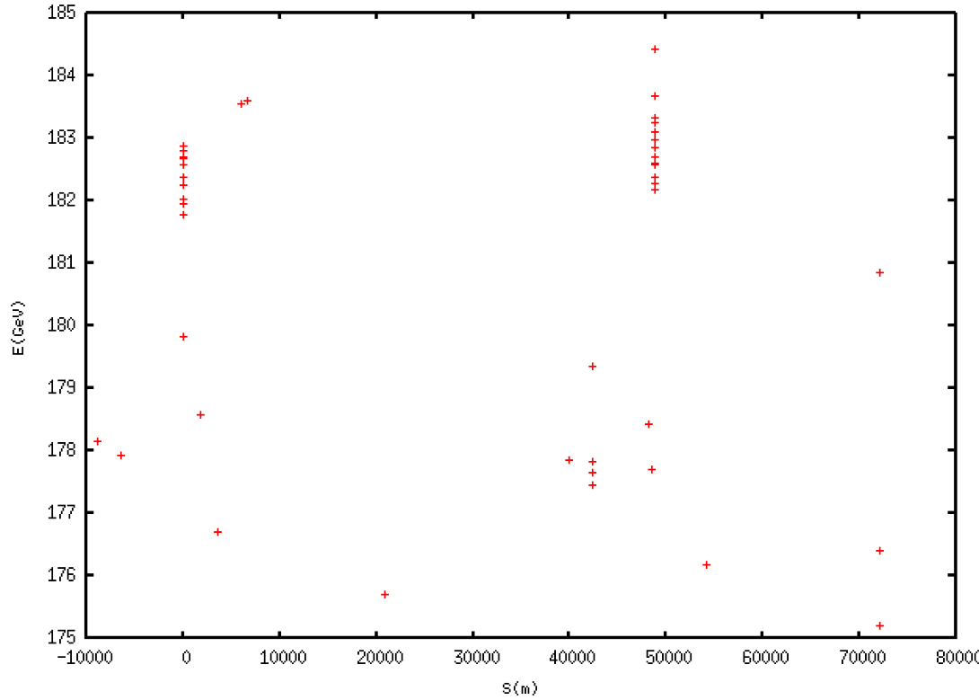
IP backgrounds: e⁺e⁻ pairs simulation with GuineaPig
Impact of backgrounds evaluated in detectors CLD & IDEA
Coherent Pairs Creation (CPC): Photon interaction with the collective field of the opposite bunch
  Negligible for FCC-ee: strongly focused on the forward direction
Incoherent Pairs Creation (IPC): real or virtual photon scattering
  Dominant effect: virtual γ scattering
IP backgrounds: γγ to hadrons
Direct production of hadrons, or indirect, where one or both photons interact hadronically
Simulation with a combination of Guinea Pig and Phythia
The effect of this background source is confirmed to be small
D.El Khechen
Beamstrahlung loss map through the ring to be continued
Radiative Bhabha loss map to be continued
Beamstrahlung photons produced at IR
IP
IP

Slide 11
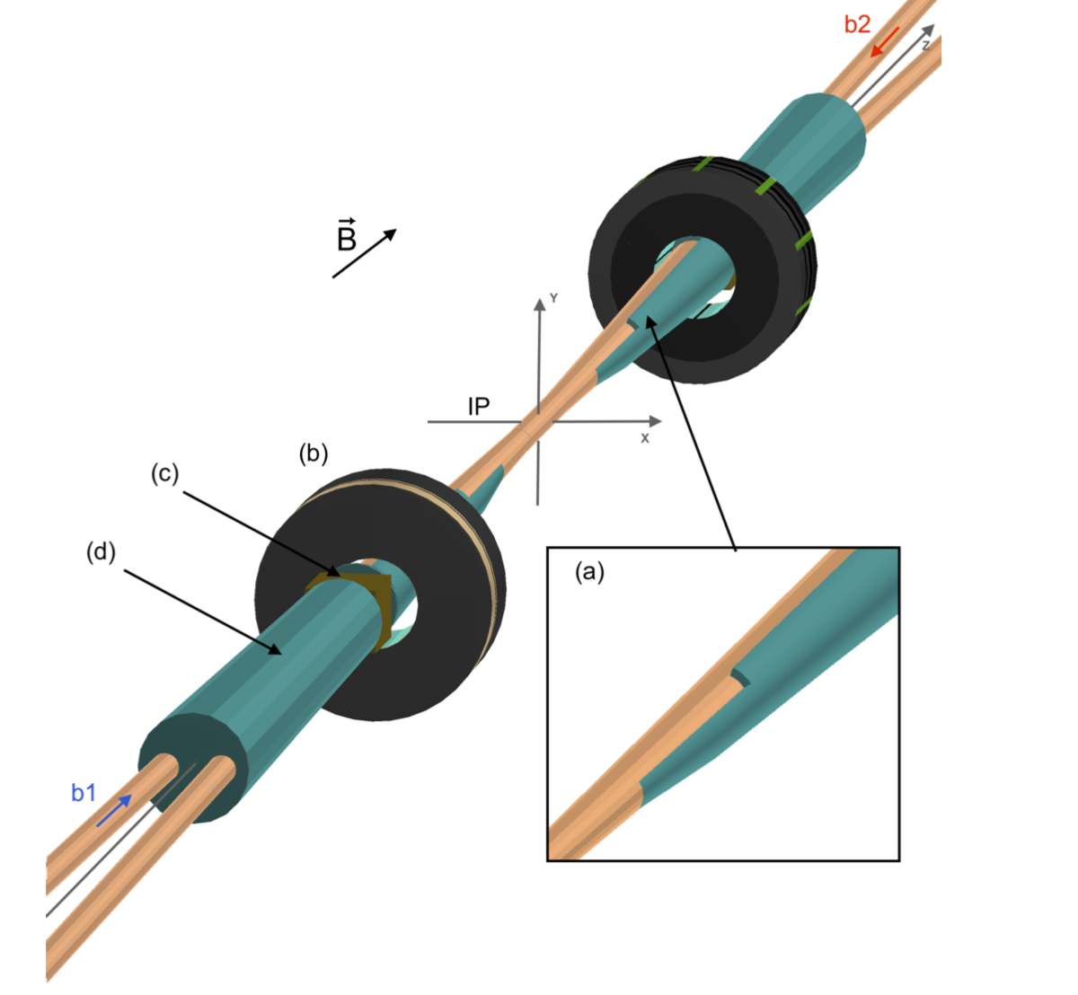
Experimental environment & luminometer
Keep refining the studies on the impact of the various backgrounds on the detector performance and impact on the luminometer, for example:
  detector performance with smaller beam pipe
  collimation system to minimize SR
  track particles in detector from all backgrounds processes
E. Leogrande, this session
Impact of beam-beam effects on luminosity measurement (E. Perez)
All of above is dynamic as the detector description becomes more refined and the engineering of the IR progresses
Geant-4 model
Software
Essential part of FCC studies is using, interfacing and further developing standard programs of general interest , in particular MAD-X, ROOT, GEANT4 (combined in MDISim) and SAD
This activity is strictly connected with the beam backgrounds simulations and with the tracking into the detector and luminometer
We need to close the loop between MDISim and the Geant4 detector model
...

Slide 12
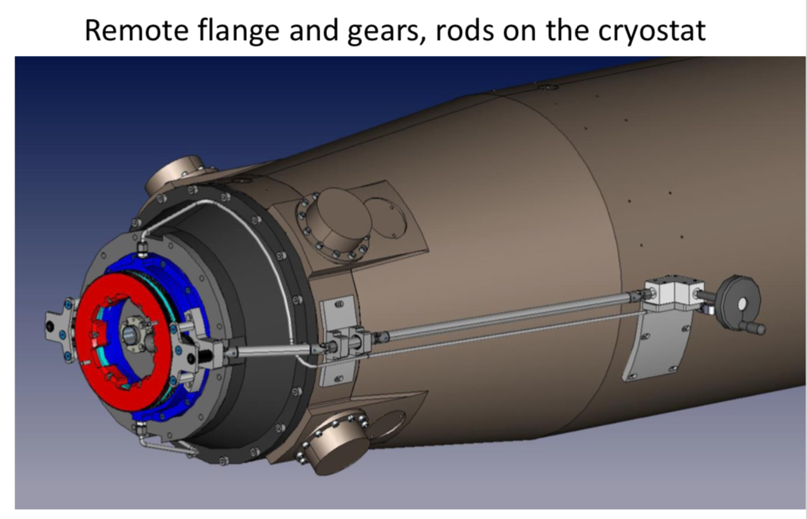
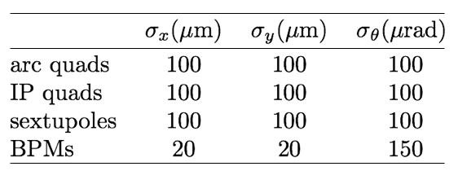
Engineering: toward the TDR
Mechanical design and integration
IR magnets: Final focus quads and anti-solenoids
Engineered design of IR components like: diagnostics (BPM), flanges, bellows to be included in the mechanical design
HOM absorbers
Beam pipe cooling system
Cryostat support and remote vacuum connection
Lumical support and alignment
Vibration control
A. Novokhatski , this session
Karsten Gadow, DESY design
alignment tolerances
Some are standard features, other require a custom study

Slide 13
Some concerns on the assembly
Remote vacuum connection
Central chamber support
Cooling pipe space for central detectors
Space for lumical, cryostat, NEG pump, HOM absorbers, shielding
Mechanical design & integration
Goal:
Try to converge on a design of the IR with sufficient details to constitute a real engineering baseline
Understand installation procedures, mechanical detector interfaces, detector and machine elements accessibility for maintenance/upgrades
Mechanical stability and position precisions of some detector elements (i.e. Lumical) is a relevant element to consider in the design
Better define the general strategy for services in and out of the detector

Slide 14
BINP group started this engineering activity -> next talk by E. Levichev
BINP is focusing on computer simulation, design and testing of several most critical components of FCC-ee IP region:
(1) The anti-solenoid with individual correctors
(2) The remotely connecting flange
(3) Multi-layers beam vacuum chamber
(4) The first FF quadrupole

Slide 15
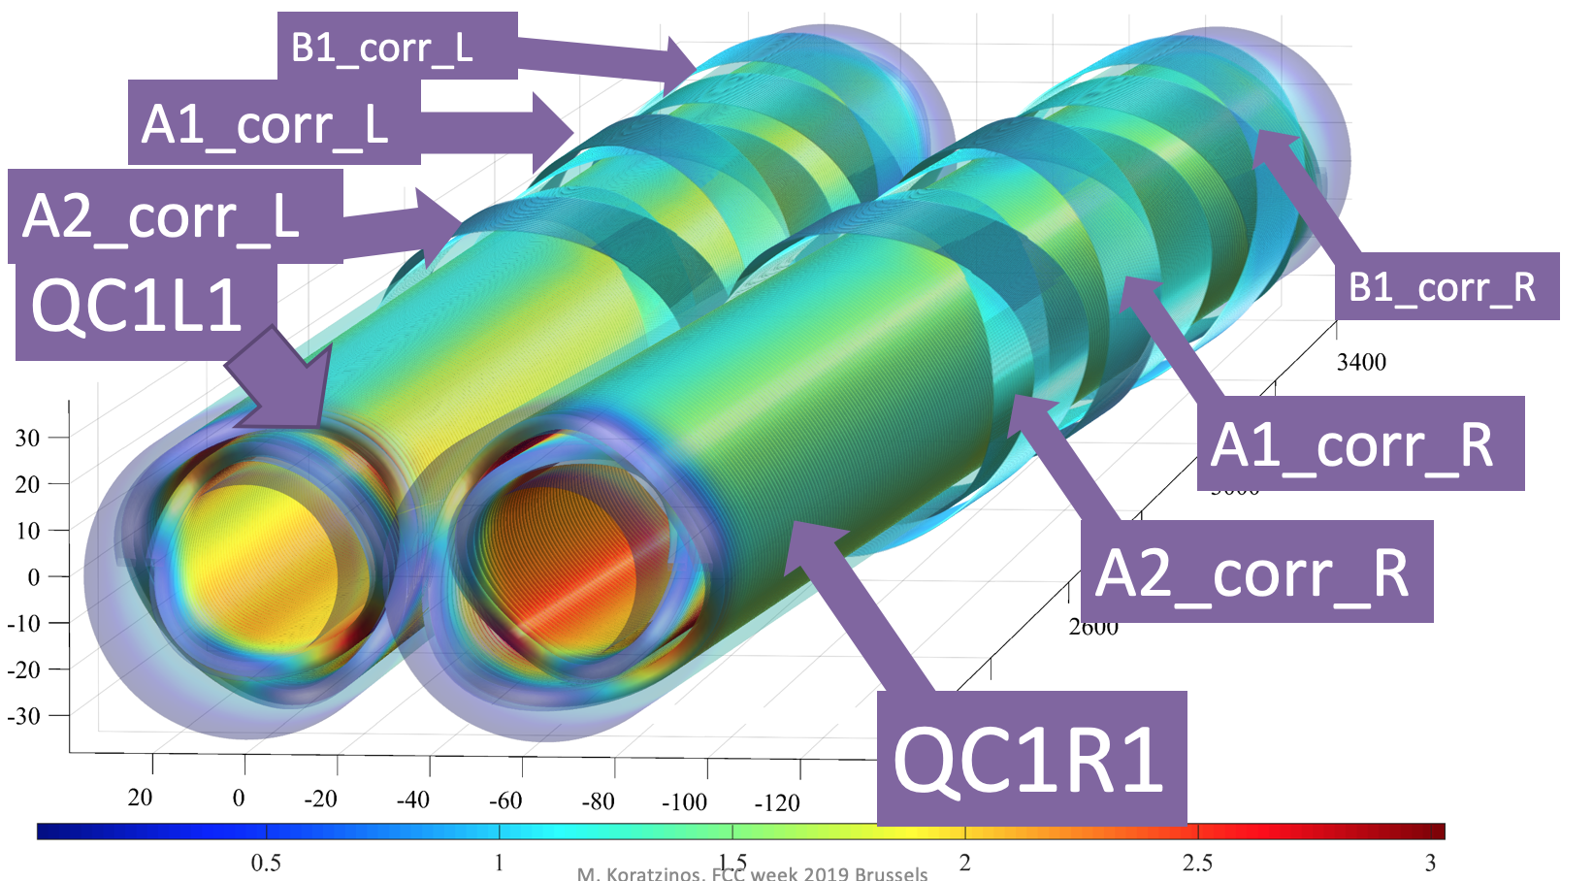
Final Focus quadrupole:
CCT project
more details by M. Koratzinos, this session
What has been achieved so far:
Conceptual design
Final magnetic design
Final mechanical design
Manufacturing
Set up of the winding table (motorized)
To be performed:
Winding of the magnet
Test at warm
Test at cold
impregnation
Test at cold of impregnated magnet
Timescales:
The timescale of the project critically depends firstly on the manufacturing of the test (rotating) probe and secondly on the availability of a small cryostat for cold testing
Winding of the magnet July 2019 – one week
Test at warm: starting when testing probe would be ready – one week
Test at cold: starting when cryostat would be ready – one week
Impregnation: one week
Test at cold of impregnated magnet: starting at next available slot of cryostat

Slide 16
MDI sessions
Overview of MDI issues toward the TDR (M. Boscolo)
Mechanical design of the interaction region (E. Levichev)
Final focus quadrupoles and solenoids (M. Koratzinos)
Beam-beam blow-up issues (D. El Khechen)
Impact of beam-beam effects on luminosity measurement (E. Perez)
Synchrotron radiation background studies (M. Luckhof)
Beam losses at IR (H. Burkhardt)
Improvement of detector performance with smaller central IP beam pipe (E. Leogrande)
HOM and heating with smaller central IP beam pipe (A. Novokhatski)
Synchrotron radiation with smaller central IP beam pipe (M. Sullivan)

Slide 17
Concluding remarks
FCC-ee MDI baseline conceptual design is solid with many details being studied as described in the CDR.
Much work has been done and continues on detailed, flexible simulation tools.
A lot of space for improvements and optimizations on the simulation level especially for beam backgrounds, SR and high current issues.
Prototype of final focus quad QC1 with CCT design in progress at CERN.
With this MDI layout we can now progress on the MDI mechanical design and integration as well as on other important engineering issues.
  Input and strong collaboration from all areas of expertize are crucial to optimize these promising studies and finalize the FCC-ee design for the next phase.

Slide 18
Thanks to all that are part of this effort on the MDI design !
N. Bacchetta, E. Belli, M. Benedikt, A. Blondel, O. Blanco, A. Bogomyagkov, H.Burkhardt, F. Collamati, M. Gil Costa, M. Dam, K. Elsener, H. Ten Kate, D. El-Khechen, A. Kolano, A. Krasnov, P. Janot, R. Kersevan, M. Koratzinos, E. Leogrande, E. Levichev, M. Lückhof, M. Migliorati, A. Novokhatski, K. Oide, E. Perez, S. Pivoravov, S. Sinyatkin, M. Sullivan, N. A. Teherani, G. Voutsinas, O. Viazlo, G. Voutsinas, J. Wenninger, F. Zimmermann

Slide 19
Some related references
CDR
MDI meetings: https://indico.cern.ch/category/5665/
1st MDI workshop http://indico.cern.ch/event/596695
2nd MDI workshop https://indico.cern.ch/event/694811
K. Oide et al, Design of beam optics for the future circular e+e- collider rings, PR-AB 19, 111005 (2016) link:
M. Boscolo, H. Burkhardt, M. Sullivan, Machine detector interface studies: Layout and synchrotron radiation estimate in the future circular collider interaction region, PR-AB 20, 011008 (2017) link
A. Novokhatski, M. Sullivan, E. Belli, M.G. Costa, R. Kersevan, Unavoidable trapped mode in the interaction region of colliding beams, PR-AB 20, 111005 (2017) link
E. Belli et al, PR-AB 21, 111002 (2018) link
H Burkhardt and M Boscolo, Tools for flexible optimisation of IR designs with application to FCC, IPAC15-TUPTY031 (2015)
M Boscolo, O R Blanco-Garcia, H Burkhardt, F Collamati, R Kersavn, M Lueckhof, Beam-gas background characterization in the FCC-ee IR, Phys.: Conf. Ser. 1067 022012 (2018) link
M Boscolo et al, Machine detector interface for the e+e- future circular collider, 62th ICFA ABDW on high luminosity circular e+e- colliders, eeFACT18, Hong Kong (2019) link

Slide 20
Back-up

Slide 21
Final Focus quadrupole SR
The energy spectrum of the SR from the final focus magnets is much higher than the spectrum from the last bend magnet
Final focus quad radiation
M. Sullivan

Slide 22
Downstream bend
Distance from IP is 29 m (38 m long)
Bend strength is 328 Gauss
  Critical energy is higher (668 keV)
  Luminosity window?
Radiation from the Final Focus magnets
  Final Focus Quad radiation is about 2 kW
  Quad radiation has high critical energies (~few MeV)
    Possible source of neutrons in the detector?
M. Sullivan

Slide 23
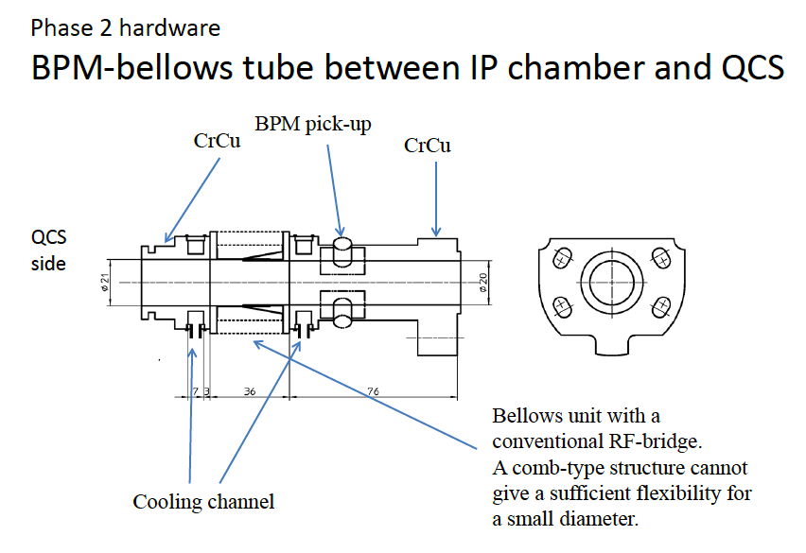
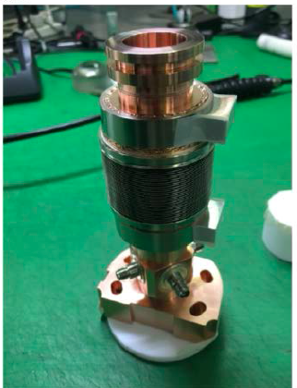
BPM
3 BPMs in the IR:
  1 before QC1
  1 between first and second section of QC1
  1 between QC1 and QC2
Special BMPs in IR needed due to space constraint: smaller than standard ones (~1 cm long instead of 4-5cm)
BPM-bellows tube
Superkekb BPMs
transversely fixed to the beam pipe, but longitudinally free to move with temperature variations

Slide 24
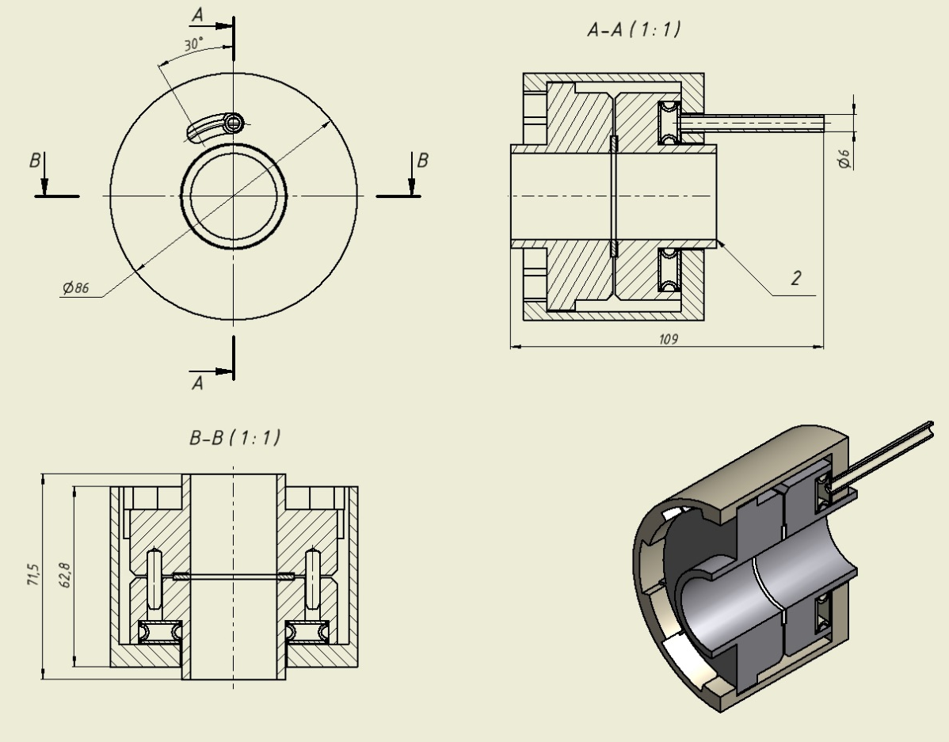
BINP
Vacuum chamber inside the cryostat
Rough estimation shows for the SCTF MDI vacuum chamber ~100 W/m thermal load due to HOMs and image currents. The task is to develop, produce and test a prototype for the multilayer vacuum chamber inside the cryostat providing tolerable heating of FF magnets.
Inner vessel 0.7 mm thick with copper coating, T=300K
0.7 mm cooling water gap against HOM & IC
Vacuum tube 0.7 mm with mirror-like coating (Cu or Au), T=300K
0.9 mm vacuum gap
Outer 1 mm vessel coated by Cu, T=4.2K
Superconducting coil on a mandrel
P=100…200 bar
Remote flange prototype

Slide 25
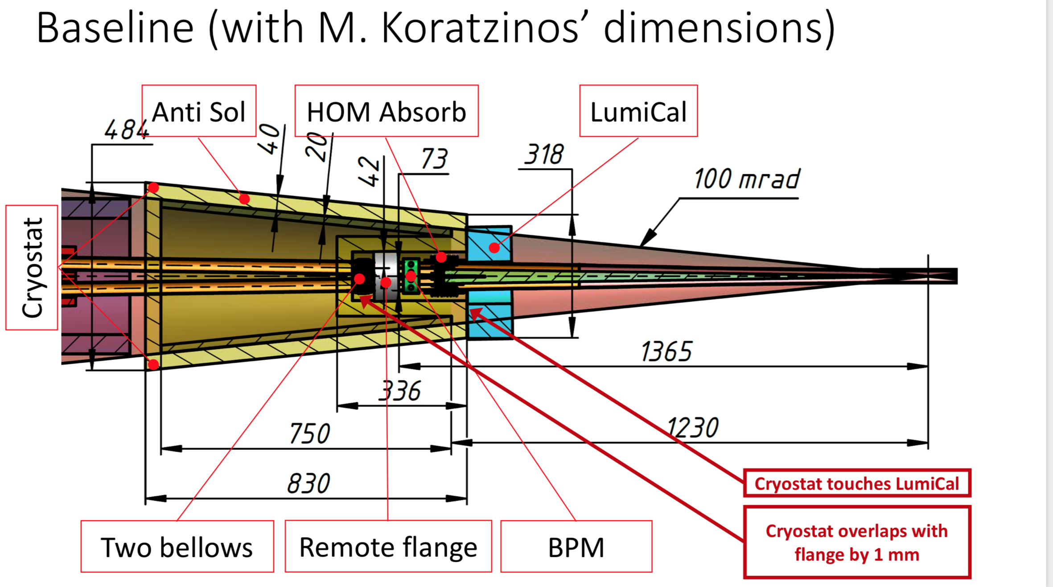

Slide 26

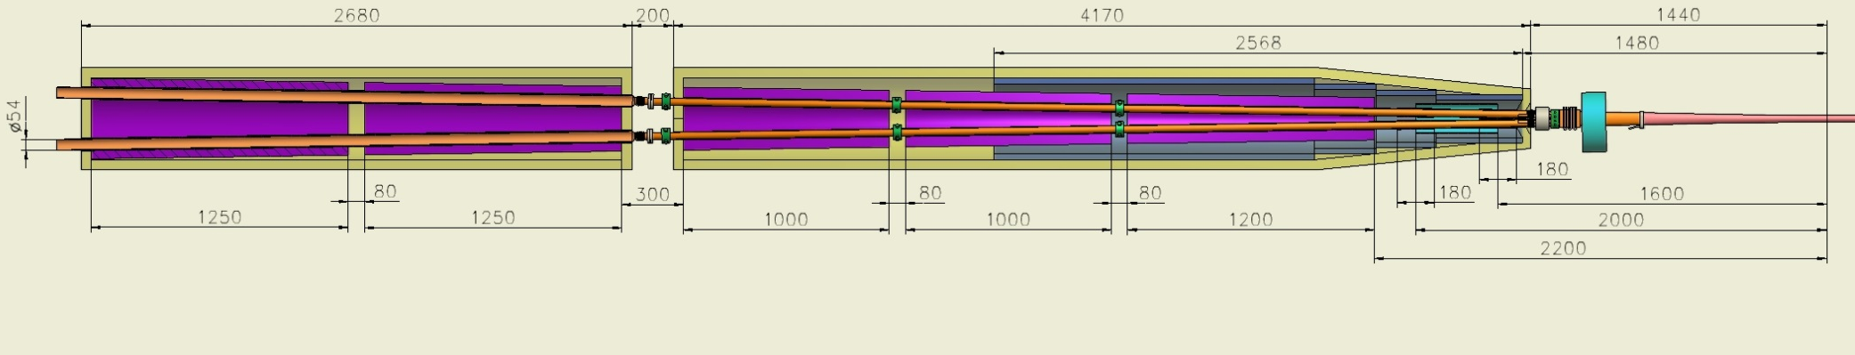
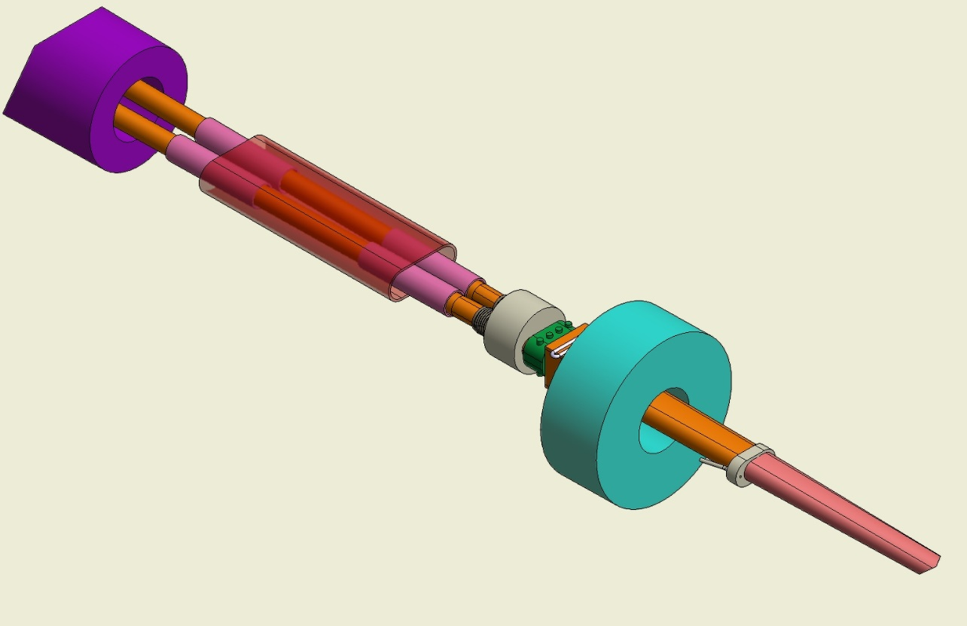
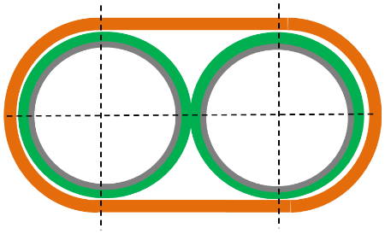
3D conceptual design Interaction Region.
BINP
QC2.2
QC2.1
QC1.3
QC1.2
QC1.1
Screening sol.
QC1.1
Cryostat “walls” thickness.
Outer SS wall 10 mm
Remote flange
10 mm vacuumn
Thermal shield 3 mm
HOM Absorber
10 mm vacuum
LumiCal
Correct. sol.(4)
Inner wall 6 mm
In total: ~40…45 mm
Anti-sol.
Cooling
Anti sol.
Two bellows
BPM
Connection Be-Cu
Compens. colls

Slide 27
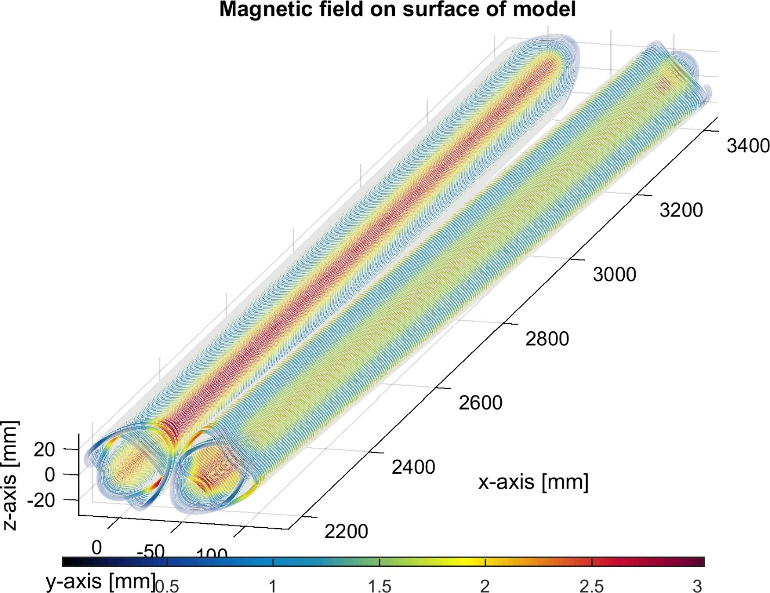
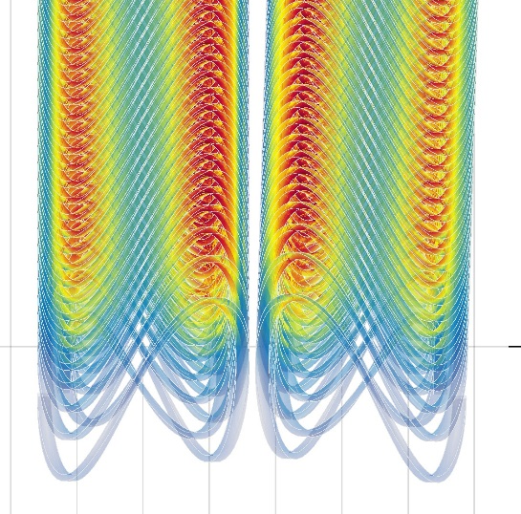
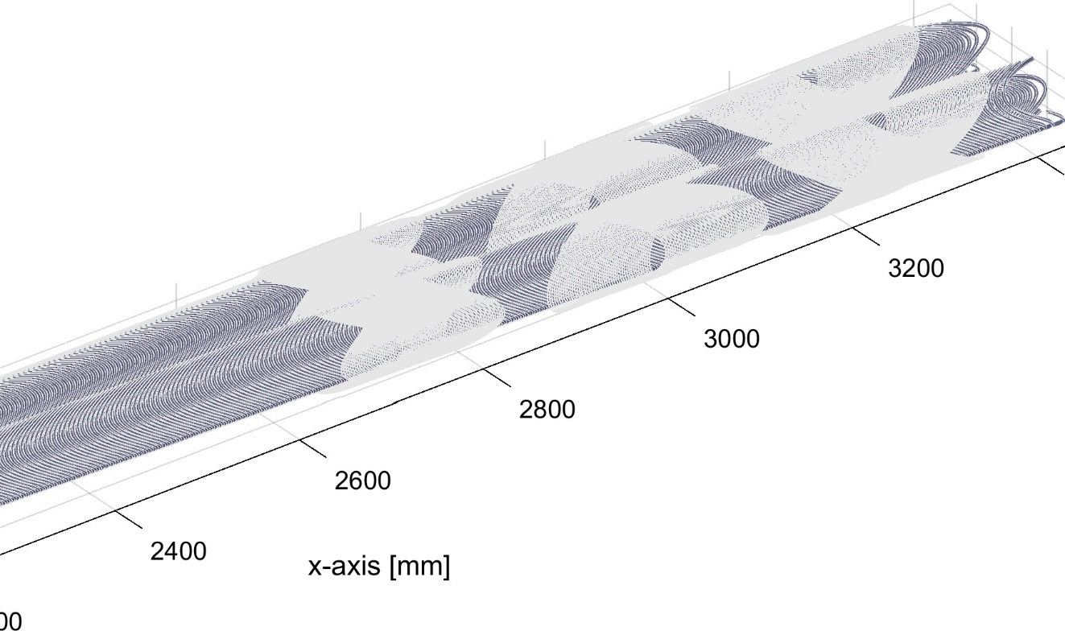
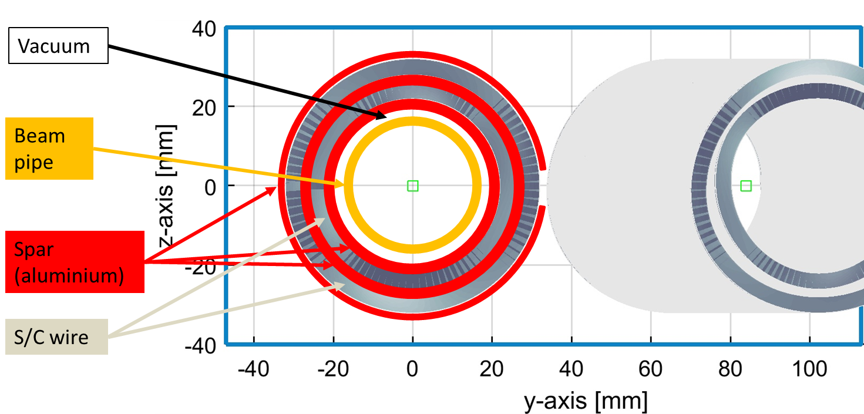
QC1 : CCT approach
M. Koratzinos
Quadrupole with embedded local edges correction and crosstalk correction
Pros:
Excellent field quality (<0.1 unit for all multipoles) at all field strengths (no saturation problems)
The design can have embedded correctors (x and y dipole correctors, skew quadrupole correctors, etc.)
Strengths up to 150T/m possible
Potentially cheaper than traditional designs
Cons:
Needs prototyping
Inner bore: 40mm (diameter)
Fits outside the warm water-cooled beam pipe of inner diameter 30mm
Distance from IP (mm)
IP
B1 corrector
A1 corrector
A2 corrector
0.5mm wire, critical current @3T is 300A, physical length ~20cm

Slide 28
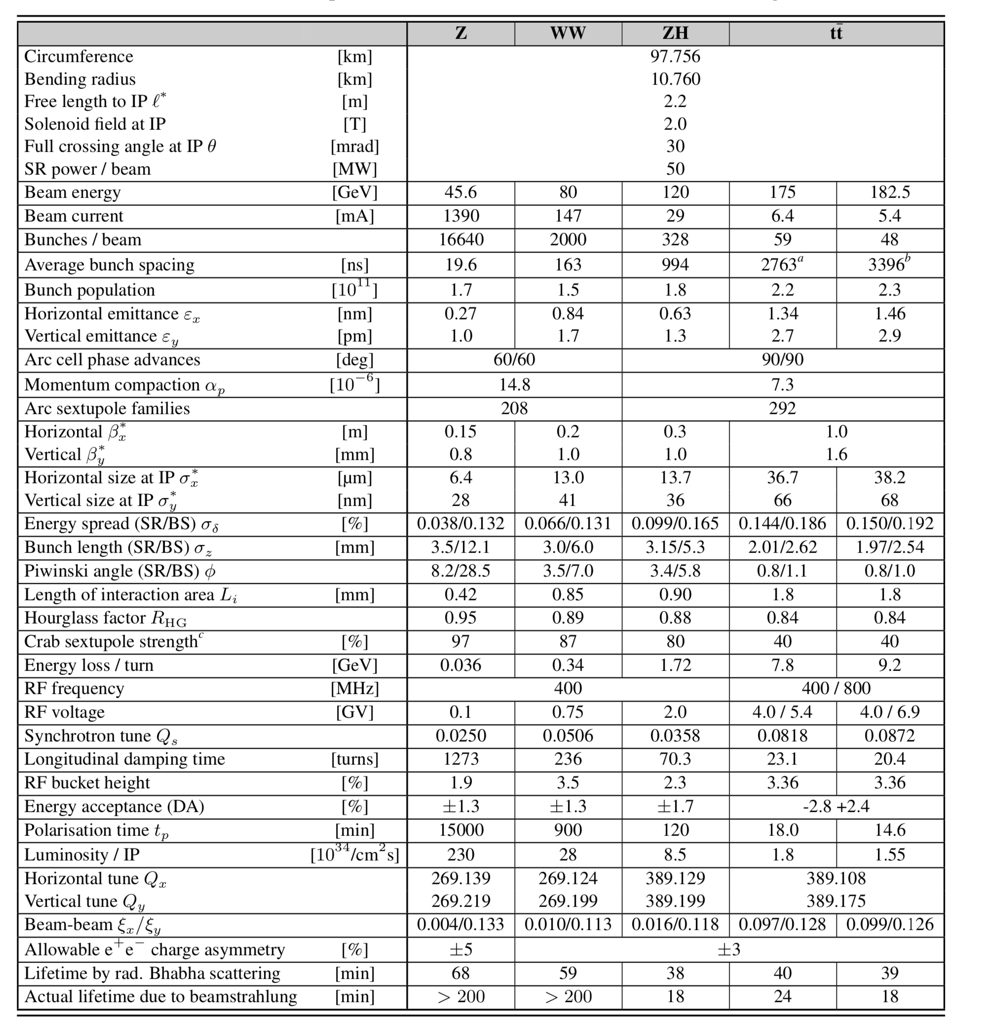
[CDR]

Slide 29
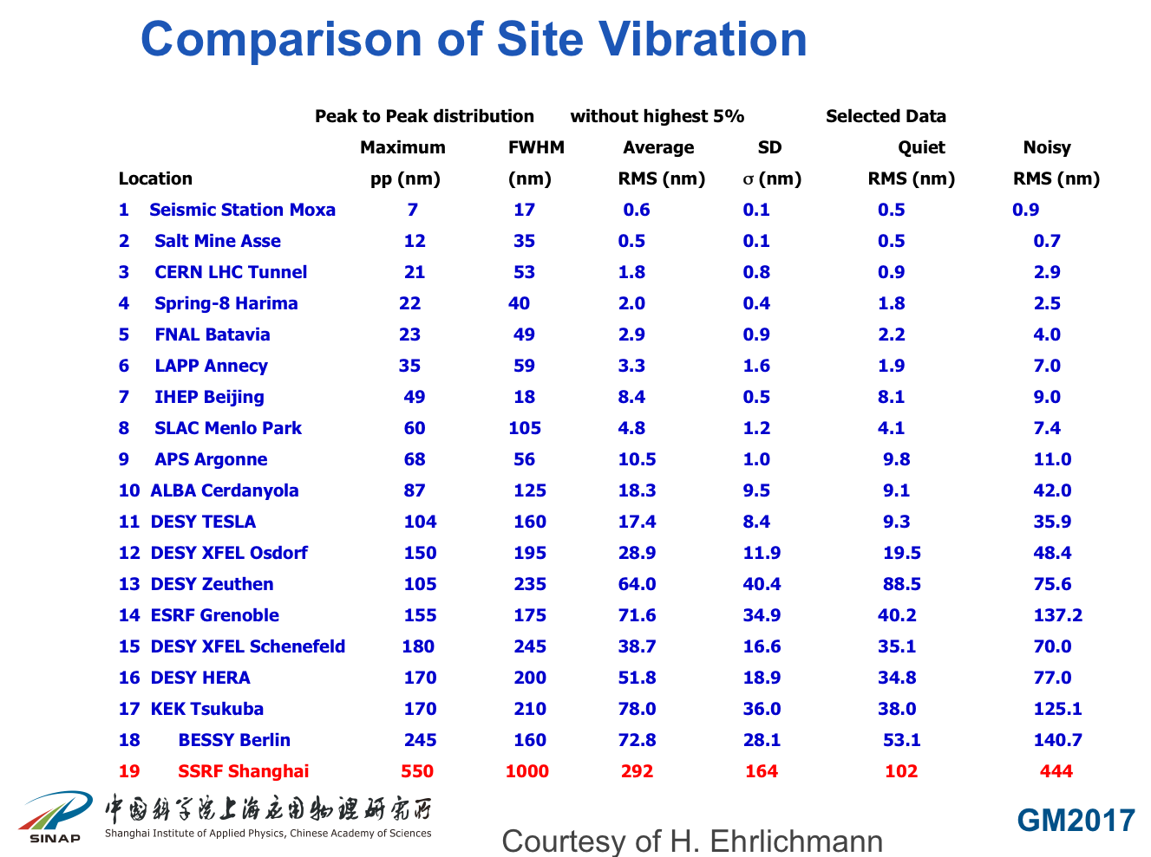
Presented by R. Deng (SINAP)@GM2017@IHEP
M. Masuzawa , “Superkekb vibration measurement and collision feedback”
2nd MDI workshop 2018

Slide 30
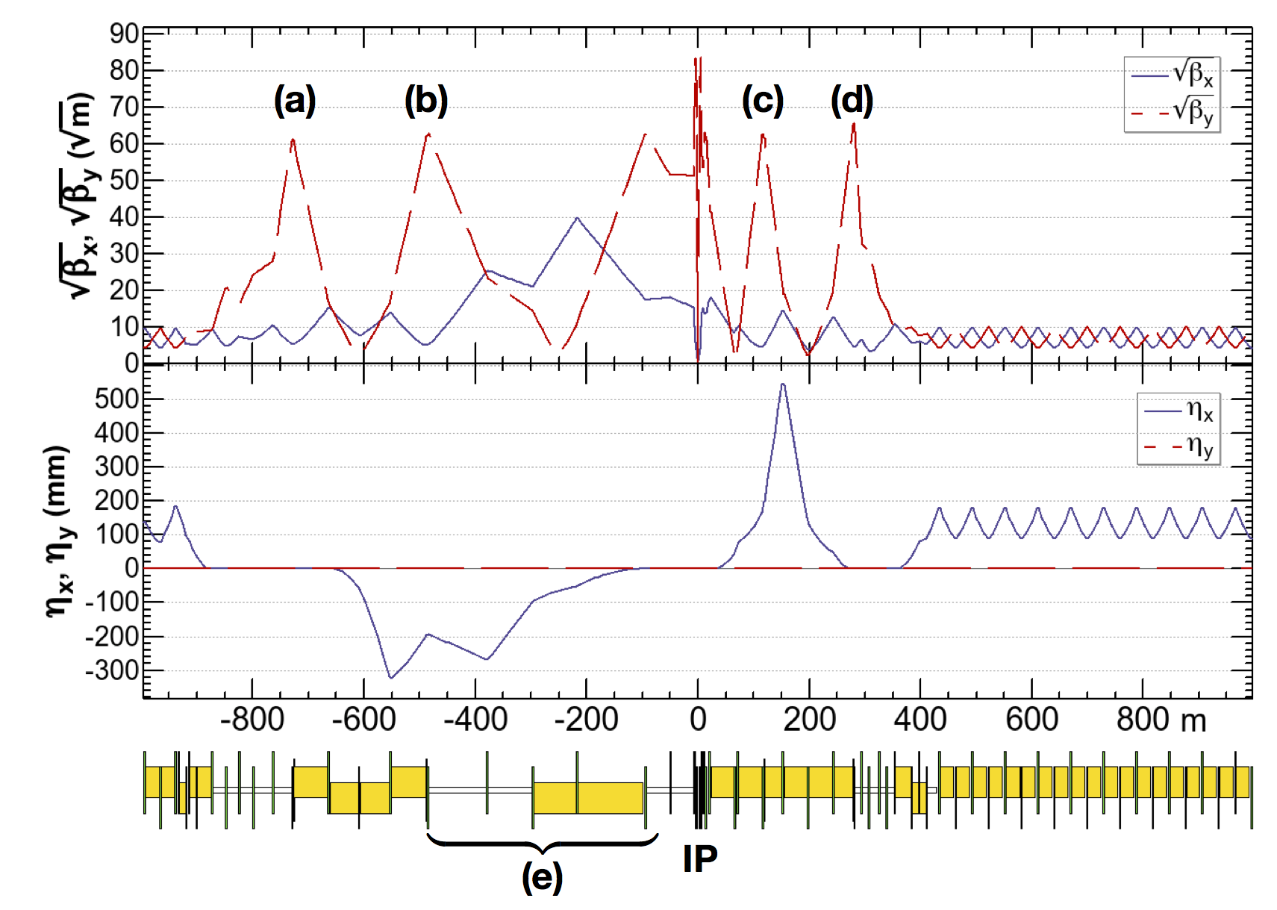
Asymmetric Interaction Region optics
Optics improvements before FCCWEEK2018
Increase of beam energy at ttbar (182.5 GeV): lattice design and parameters set optimized
Further reduction of β* at the IP at Z, W±, ZH, ttbar(β_{y})
Momentum acceptance at ttbar increased
ttbar 182.5 GeV
beam
Motivations for these changes:
  to mitigate the coherent beam-beam instability also at W±, ZH
to mitigate 3D flip-flop
K. Oide
yellow boxes:
dipole magnets
Asymmetric optics suppresses SR toward the IP, E_{critical} <100 keV from 450 m from the IP
Local chromaticity correction scheme for y-plane (a-d), incorporated with crab sextupoles (a,d), needed for energy acceptance requirement (up to 2.8%)
Notes:
There is a Local chromaticity correction scheme only in the vertical plane

Slide 31
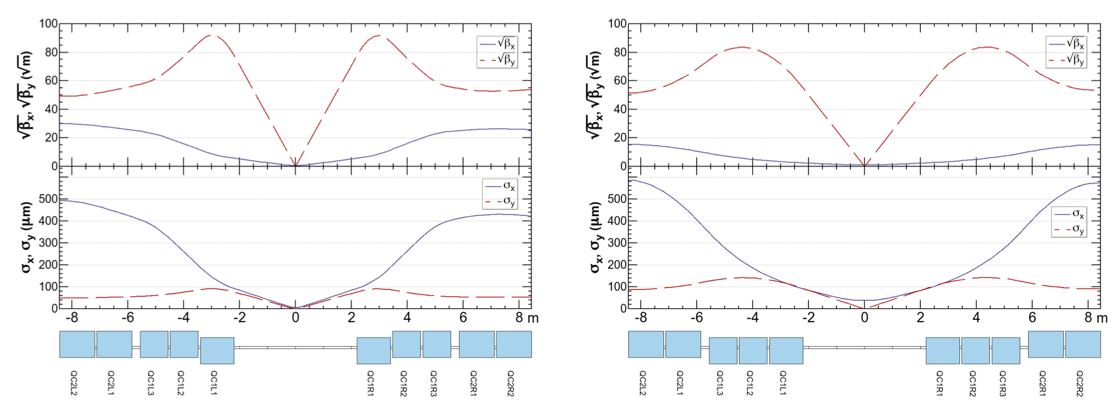
Final Focus optics
 |  | Z | W⁺W⁻ | ZH | ttbar
β_{x}* | m | 0.1 | 0.2 | 0.3 | 1.0
β_{y}* | mm | 0.8 | 1.0 | 1.0 | 1.6
Z
ttbar
QC2
QC1
QC1
QC2
QC2
QC1
Only 1st slice of QC1 is defocusing horizontally
All 3 slices of QC1 are defocusing horizontally
Flexible optics design: final focus quadrupoles are longitudinally split into three slices
  At the Z chromaticity is reduced for the smaller β*, smaller beam size
Notes:
with this triple splitting, the centre of focusing for each plane moves closer to the IP at the Z, which reduces the increment of chromaticity for the smaller beta*
Inner radius of the beam pipe is larger than 15 mm through these quadrupoles

Slide 32
Baseline for Solenoid Compensation Scheme
screening solenoid that shields the detector field inside the quads
(in the FF quad net solenoidal field=0)
compensating solenoid in front of the first quad, as close as possible, to reduce the ε_{y} blow-up (integral BL~0)
screening
solenoid
Compensating solenoid
FF quads
The discussion on the mechanical integration is actually bringing to improvements of this scheme,
due to space constraints
Lumical
100 mrad
M. Koratzinos
IP
  0.34 pm is the overall ε_{y} blow-up for 2IPs @Z
  detector solenoid dimensions 3.76m ( inner radius) (outer radius 3.818m) × 4m (half-length)
  drift chamber at z=2m with 150 mrad opening angle (IDEA design)

Slide 33
Beam induced backgrounds
Two main classes:
Synchrotron Radiation
Beam particles effects (e⁺, e⁻, e⁺e⁻)
  Beamstrahlung
    Incoherent/ Coherent e⁺e⁻ Pair Creation
    γγ to hadrons
  beam-gas elastic and inelastic
  Thermal photon Compton scattering
  Radiative Bhabha
PURPLE: collision induced backgrounds
GREEN: single beam backgrounds
Impact of backgrounds studied in detector designs CLD & IDEA

Slide 34
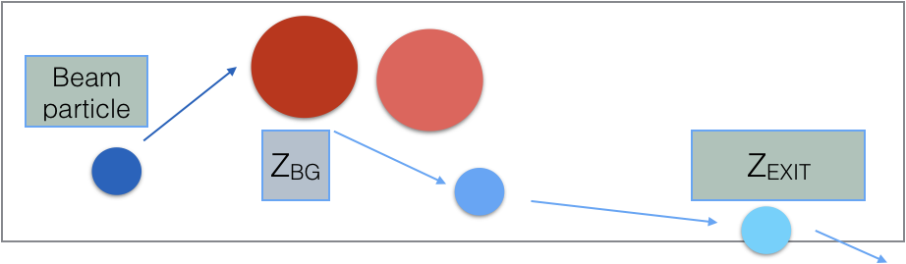
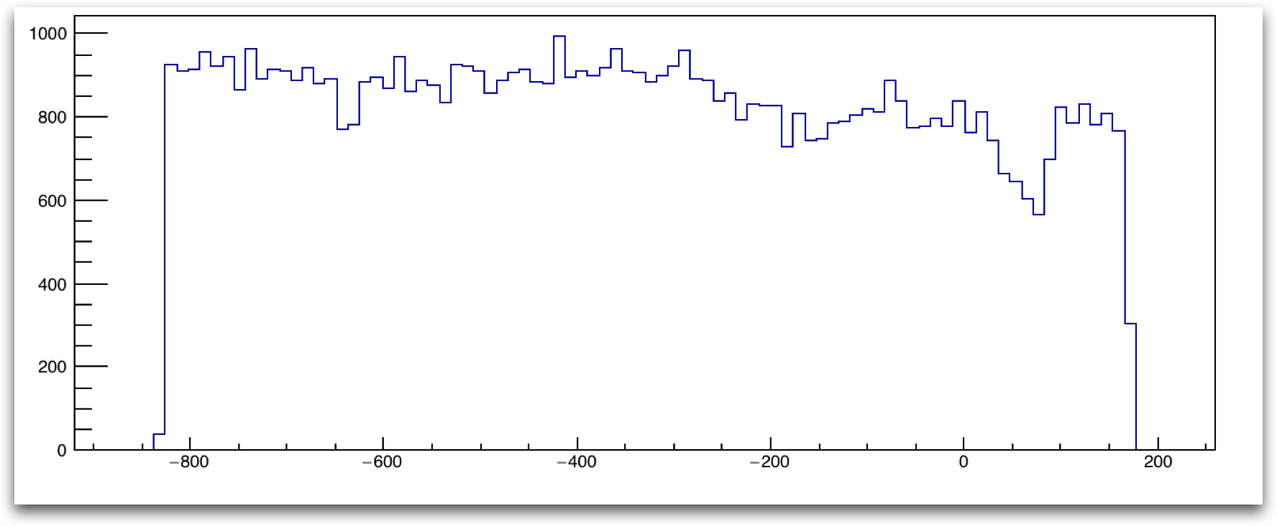
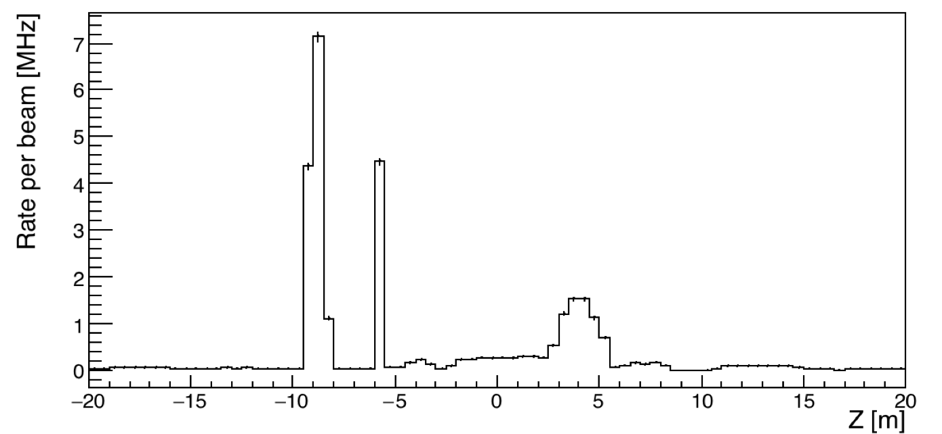
Inelastic Beam Gas scattering in the IR
more details by
F. Collamati
- MDISim was used to import in Geant4 beam pipe geometry + magnetic elements + beam characteristics
IR Loss map
Z position where a primary electron is lost after a BG interaction
Z position where the BG interaction that will lead to particle loss happened
Ready for full simulation in detector and lumical
Case | Loss Rate +/-20m from IP [MHz]
Z | 147
W | 16
H | 3
t | 0.5

