Slide 1







HE-LHC Parameter Update
Frank Zimmermann
Brussels, 25 June 2019
gratefully acknowledging input from FCC coordination group,
global design study team and all contributors
LHC
PS
HE-LHC
SPS
FCC
photo: J. Wenninger
http://cern.ch/fcc
Work supported by the European Commission under the HORIZON 2020 projects EuroCirCol, grant agreement 654305; EASITrain, grant agreement no. 764879; ARIES, grant agreement 730871; and E-JADE, contract no. 645479
photo: J. Wenninger

Slide 2











contributors
D. Amorim, S.A. Antipov, S. Arsenyev, M. Benedikt, R. Bruce, M. Crouch, S. Fartoukh, M. Giovannozzi, B. Goddard, M. Hofer, J. Keintzel, R. Kersevan, V. Mertens, J. Molson, Y. Muttoni, J. Osborne, V. Parma, V. Raginel, S. Redaelli, T. Risselada, I. Ruehl, B. Salvant, D. Schoerling, E. Shaposhnikova, L. Tavian, E. Todesco, R. Tomas, D. Tommasini, F. Valchkova-Georgieva, V. Venturi, D. Wollmann, F. Zimmermann, CERN, Geneva, Switzerland
A. Apyan, ANSL, Yerevan, Armenia
G. Guillermo, CINVESTAV Merida, Mexico
F. Burkart, DESY, Hamburg, Germany
J. Barranco, L. Mether, T. Pieloni, L. Rivkin, C. Tambasco, EPFL, Lausanne, Switzerland
J.L. Abelleira, E. Cruz-Alaniz, A. Seryi, L. van Riesen-Haupt, JAI Oxford, U.K.
A. Abramov, H. Pikhartova, JAI RHUL, Egham, U.K.
K. Ohmi, K. Oide, D. Zhou, KEK, Tsukuba, Japan
Y. Cai, Y. Nosochkov, SLAC, Stanford, U.S.A.

Slide 3
changes / updates since FCC Week 2018
more realistic turnaround time
→ larger β*, longer physics fills, lower peak luminosity
pushed parameters of Nb₃Sn cable (APCs) & modified layout of the 16 T dipole magnets → revised field errors
+ refined optics
→ updated dynamic-aperture
→ re-evaluation of injector options (scSPS)
longitudinal beam parameters
cleaning & beam-loss studies including dispersion-suppressor collimators,revised settings
updated impedance model & instability growth rates
→ J. Keintzel, L. Van Riesen-Haupt
→ M. Hofer
→ E. Shaposhnikova
→ M. Crouch, M. Varasteh, H. Pikhartova
→ D. Amorim

Slide 4


Performance Assumptions
160 days scheduled for physics per year for HL-LHC, HE-LHC, FCC-hh
Availability: (LHC 2017: 83%); HL-LHC: 80%; HE-LHC 75 %, FCC-hh: 70%
corresponding to the following fractions of “time in physics”:
HL-LHC: 54%
HE-LHC: 39%
FCC-hh phase I (initial): 49%
FCC-hh phase II (nominal): 34%

Slide 5
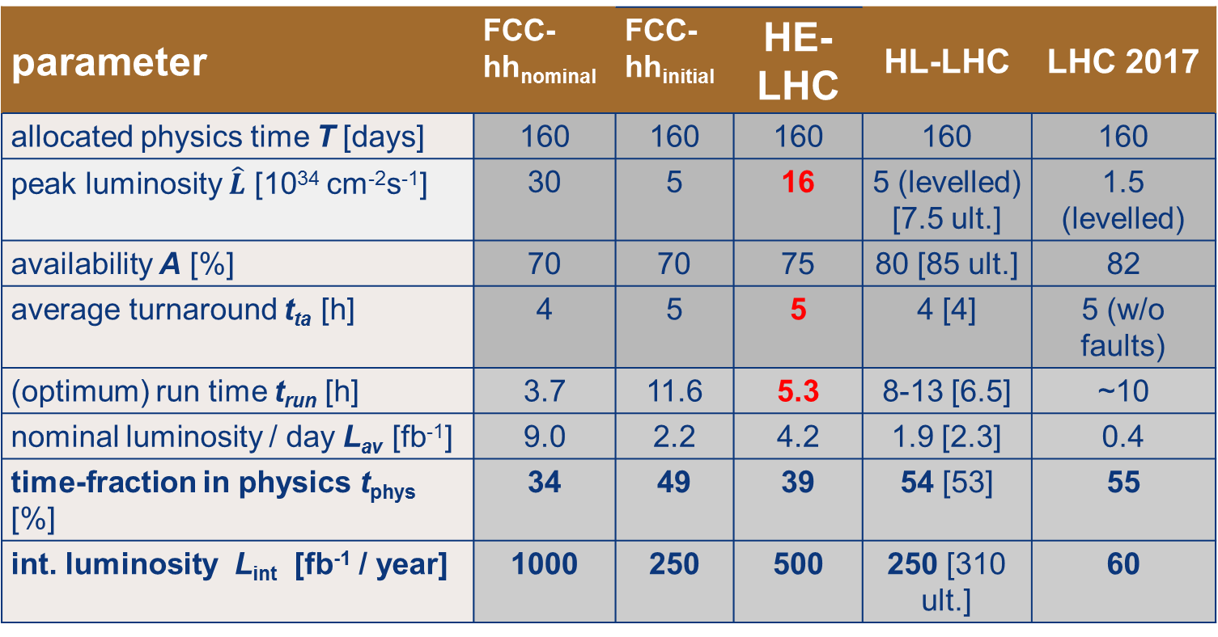


FCC-hh, HE-LHC, HL-LHC performance
parameter | FCC-hh_{nominal} | FCC-hh_{initial} | HE-LHC | HL-LHC | LHC 2017
allocated physics time T [days] | 160 | 160 | 160 | 160 | 160
peak luminosity $\hat{L}$ [10³⁴ cm⁻²s⁻¹] | 30 | 5 | 16 | 5 (levelled) [7.5 ult.] | 1.5 (levelled)
availability A [%] | 70 | 70 | 75 | 80 [85 ult.] | 82
average turnaround t_{ta} [h] | 4 | 5 | 5 | 4 [4] | 5 (w/o faults)
(optimum) run time t_{run} [h] | 3.7 | 11.6 | 5.3 | 8-13 [6.5] | ~10
nominal luminosity / day L_{av} [fb⁻¹] | 9.0 | 2.2 | 4.2 | 1.9 [2.3] | 0.4
time-fraction in physics t_{phys} [%] | 34 | 49 | 39 | 54 [53] | 55
int. luminosity L_{int} [fb⁻¹ / year] | 1000 | 250 | 500 | 250 [310 ult.] | 60
$$t_{phys}≈A\frac{t_{run}}{t_{run}{+t}_{ta}}$$
$$L_{int}≈A T L_{nominal per day}$$
all these hadron machines feature two high-luminosity experiments and up to two lower-luminosity (or special) interaction points

Slide 6
HE-LHC parameters
parameter | FCC-hh |  | HE-LHC | HL-LHC | LHC 2018
c.o.m. collision energy [TeV] | 100 |  | 27 | 14 | 13
injection beam energy [TeV] | 3.3 |  | 1.3 (0.9) | 0.45 | 0.45
dipole field [T] | 16 |  | 16 | 8.33 | 7.74
circumference [km] | 97.75 |  | 26.7 | 26.7 | 26.7
beam current [A] | 0.5 |  | 1.12 | 1.12 | 0.49
bunch intensity [10¹¹] | 1 | 1 | 2.2 | 2.2 | 1.1
bunch spacing [ns] | 25 | 25 | 25 | 25 | 25
synchr. rad. power / ring [kW] | 2400 |  | 100 | 7.3 | 2.3
SR power / length [W/m/ap.] | 28.4 |  | 4.6 | 0.33 | 0.11
long. emit. damping time [h] | 0.54 |  | 1.8 | 12.9 | 16.1
initial proton burn-off time [h] | 17 | 3.4 | 4.3 | 15 | 16
beta* [m] | 1.1 | 0.3 | 0.45 | 0.15 (min.) | 0.30 (0.25)
normalized emittance [μm] | 2.2 |  | 2.5 | 2.5 | 2.0
peak luminosity [10³⁴ cm⁻²s⁻¹] | 5 | 30 | 16 | 5 (levelling) | 2.1
int. luminosity / year [fb⁻¹] | 250 | 1000 | 500 | 250 | 63
events/bunch crossing | 170 | 1000 | 460 | 132 | 60
stored energy/beam [GJ] | 8.4 |  | 1.3 | 0.7 | 0.28

