Slide 1
Falcon Dipole
The INFN dipole model for the FCC
R. U. Valente
G. Bellomo, A. Bersani, P. Fabbricatore, S. Farinon, S. Mariotto, A. Pampaloni, M. Sorbi, M. Statera

Slide 2
Outline
Introduction
Electromagnetic design
Quench protection
Mechanical design
Conclusions

Slide 3
Introduction
Who?
  Agreement between CERN and INFN
What?
  Construction of a demonstrator/model cos-theta dipole able to reach 14 T
When?
  Next 5 years
Where?
  INFN-LASA & INFN Genova (Italy)
Why?
  Milestone technology for the FCC main dipole

Slide 4
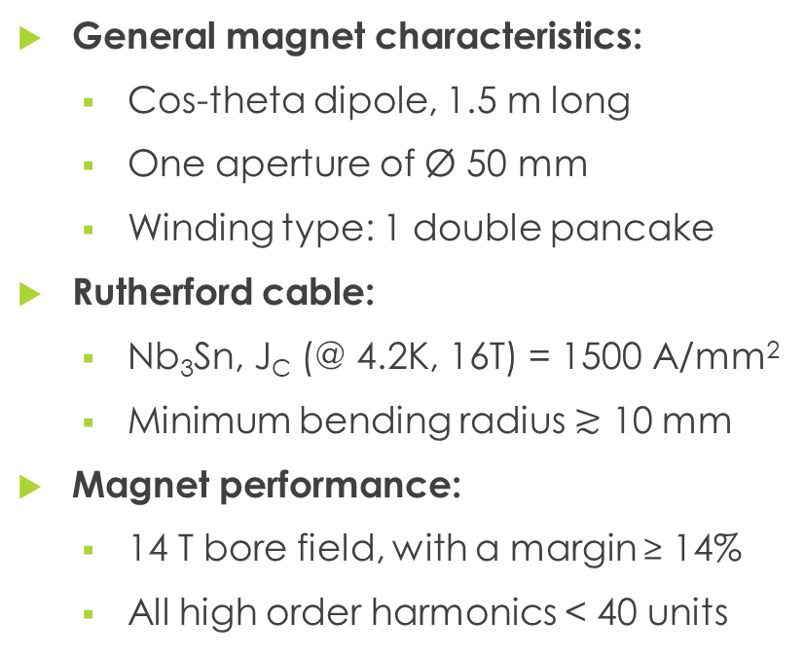
Electromagnetic design - requirements
General magnet characteristics:
  Cos-theta dipole, 1.5 m long
  One aperture of Ø 50 mm
  Winding type: 1 double pancake
Rutherford cable:
  Nb₃Sn, J_{C} (@ 4.2K, 16T) = 1500 A/mm²
  Minimum bending radius $≳$ 10 mm
Magnet performance:
  14 T bore field, with a margin ≥ 14%
  All high order harmonics < 40 units

Slide 5
Electromagnetic design - cable
Rutherford Cable Parameters
Superconducting material | Nb₃Sn
J_{c} @4.2K,16T (A/mm²) | 1500
Filament diameter (μm) | 20
Cu/non-Cu | 1
Strand number | 34 (2x17)
Strand diameter (mm) | 1.1
Height (mm) | 19.8
Inner width (mm) | 1.892
Outer width (mm) | 2.065
Keystone angle | 0.5°
Twist pitch (mm) | 100
Insulation thickness (mm) | 0.15
19.8 mm
1.892 mm
2.065 mm
34 strands
Ø 1.1 mm

Slide 6
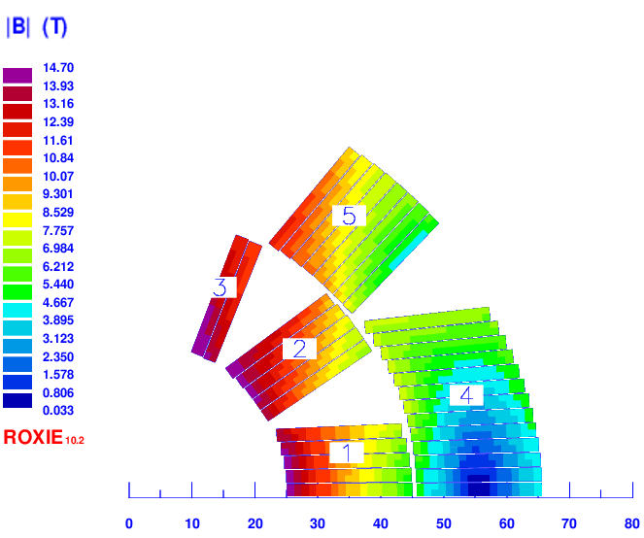
Electromagnetic design - coils
Blocks | Min. wedge thickness (mm)
1-2 | 1.08
2-3 | 1.35
4-5 | 1.77
Input Magnet Parameter
Aperture number | 1
Aperture radius (mm) | 25
Current (A) | 25000
Operation temperature (K) | 1.9
Minimum bending
radius
9.7 mm
FEM analysis results (ROXIE 10.2)
Bore field (T) | 14
Minimum margin | 14% (block 3)
J_{cu} (A/mm²) | 1547
Stored energy (MJ/m) | 0.68

Slide 7
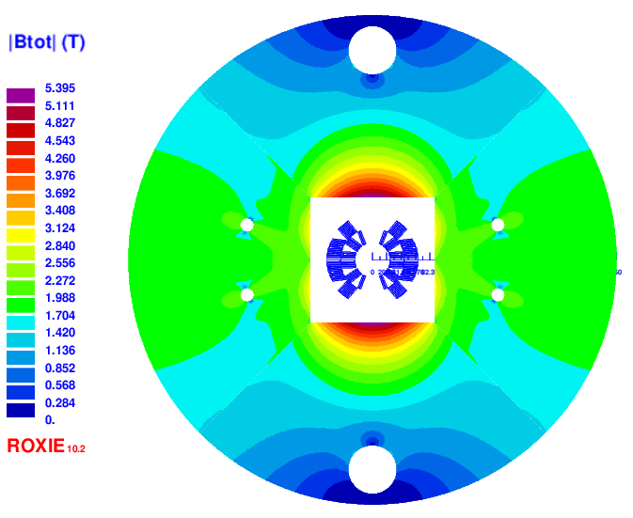
Electromagnetic design – iron yoke
Ø 70 mm
Square window (180 mm x 180 mm) is needed to use bladder & keys technology
Holes (Ø 70 mm, Ø 20 mm) for the coolant system have no effect on the field quality
180 mm
260 mm
180 mm
Ø 20 mm

Slide 8
Electromagnetic design – field quality
The field quality has been optimized keeping constructive parameters within safe limits:
Minimum wedge thickness > 1 mm
Minimum bending radius around 10 mm
Minimum steel pad thickness around 20 mm
Harmonics @ 25 kA | units
b₃ | 1.3
b₅ | -6.2
b₅ | 18
b₉ | 2
(superconductor magnetization not considered)

Slide 9
Electromagnetic design – different conductor performances
EuroCirCol target cable
(actually reached only in short units)
Conductor in procurement
(value requested in specs)
J_{C} (@ 4.2K, 16T) = 1500 A/mm²
B₀ | margin | Current (kA)
14 T | 14% | 25.0
16 T | 1.3% | 28.9
16.2 T | 0% | 29.3
J_{C} (@ 4.2K, 16T) = 1200 A/mm²
B₀ | margin | Current (kA)
13.3 T | 14% | 23.7
14 T | 9.5% | 25.0
15.4 T | 0% | 27.8
Conductor used to design Falcon Dipole short model
Conductor now available

Slide 10
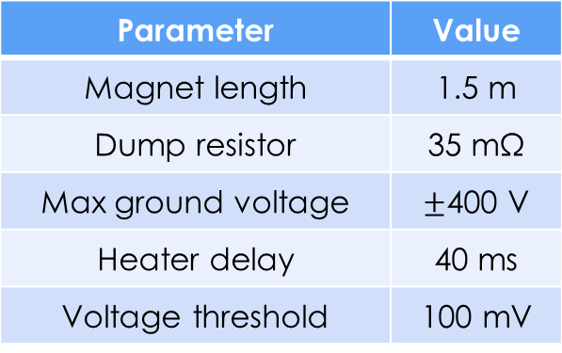
Quench analysis – short model protection
Parameter | Value
Magnet length | 1.5 m
Dump resistor | 35 mΩ
Max ground voltage | $±$400 V
Heater delay | 40 ms
Voltage threshold | 100 mV
Quench analysis performed with QLASA
Quench heaters
(outer radius only)
Hot-spot temperature
175 K
QUENCH

Slide 11
Quench analysis – long magnet protection
Parameter | Value
Magnet length | 15 m
Dump resistor | 0 mΩ
Heater delay | 40 ms
Voltage threshold | 100 mV
Quench analysis performed with QLASA
Quench heaters
Hot-spot temperature
322 K
QUENCH

Slide 12
Mechanical design – requirements
Coil in compression up to nominal field
Stress in the conductor
  Room temperature, < 150 MPa
  Cryo temperature (1.9 K), < 200 MPa
Stress on mechanical structure < yield strength (see Table below)
Material | Stress limit (MPa) |  | E (GPa) |  | ν | α (mm/m)
 | RT | 1.9 K | RT | 1.9 K |  | RT → 1.9 K
Austenitic steel (316LN) | 350 | 1050 | 193 | 210 | 0.28 | 2.8
Al7075 | 480 | 690 | 70 | 79 | 0.3 | 4.2
Coil Radial dir. Azimuthal dir. | 150 | 200 | 30 25 | 33 27.5 | 0.3 | 3.1 3.4
Ferromagnetic iron | 230 | 720 | 213 | 224 | 0.28 | 2.0
Ti6Al4V | 800 | 1650 | 115 | 126 | 0.3 | 1.7

Slide 13
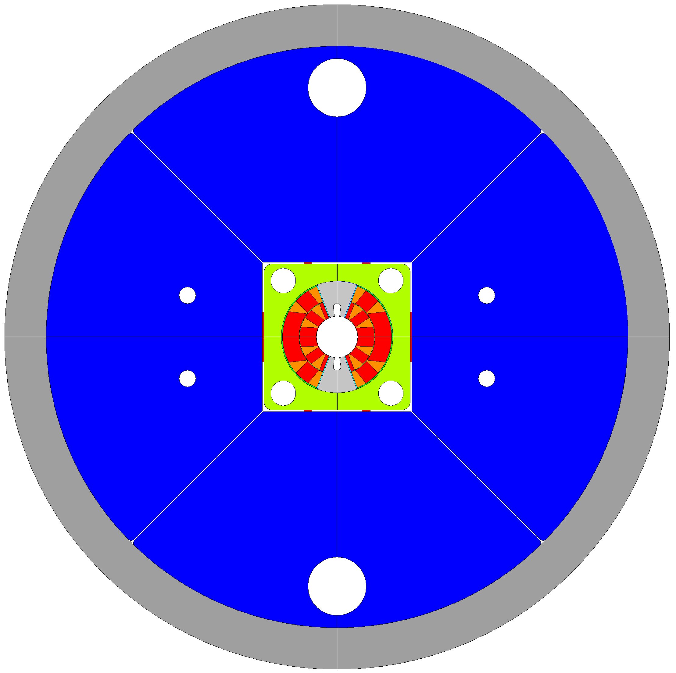
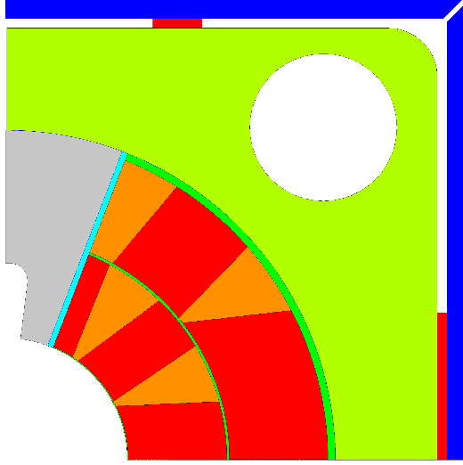
Mechanical design - ANSYS model
Cold mass: Ø 800 mm
Steel pads: 180 mm x 180 mm
AL alloy shell (50 mm thick)
Iron yoke (Ø 700 mm)
Horizontal key (interference: 0.1 mm)
Stainless steel pad
Titanium pole
Ø 20 mm
Copper wedge
Ø 70 mm
Conductor
Vertical key (interference)

Slide 14
Mechanical design - ANSYS model
Simulation steps
Assembly → keys insertion
Cool down → thermal contractions
Energization → Lorentz forces in the conductor element
Load cases | Bore field | Margin | Required vertical key interference
Nominal field | 14 T | 14% | 0.5 mm
Cable in procurement short sample | 15.5 T | 0% | 0.6 mm
EuroCirCol cable short sample | 16 T | 0% | 0.7 mm

Slide 15
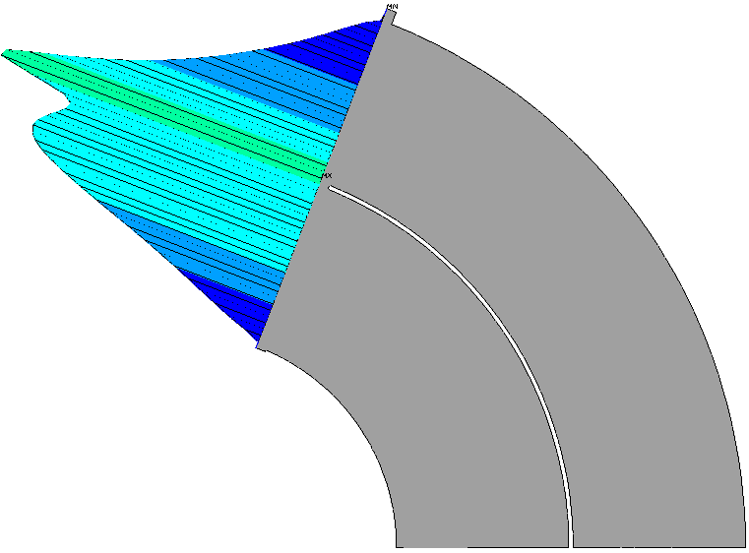
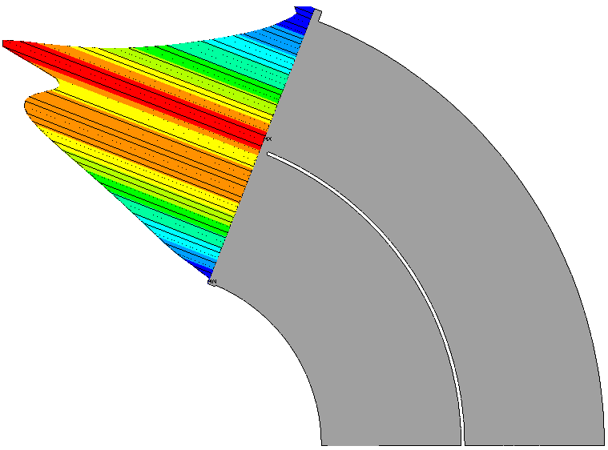
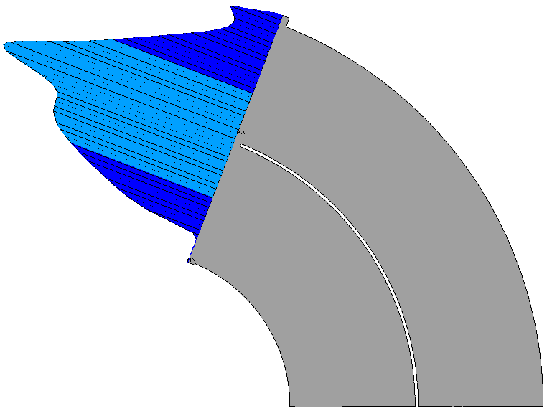
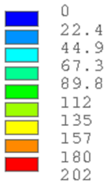
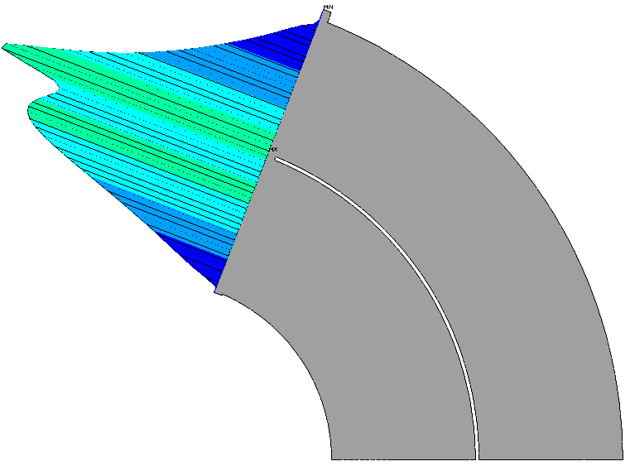
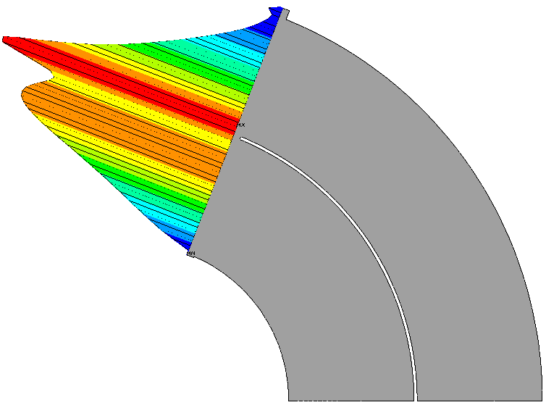
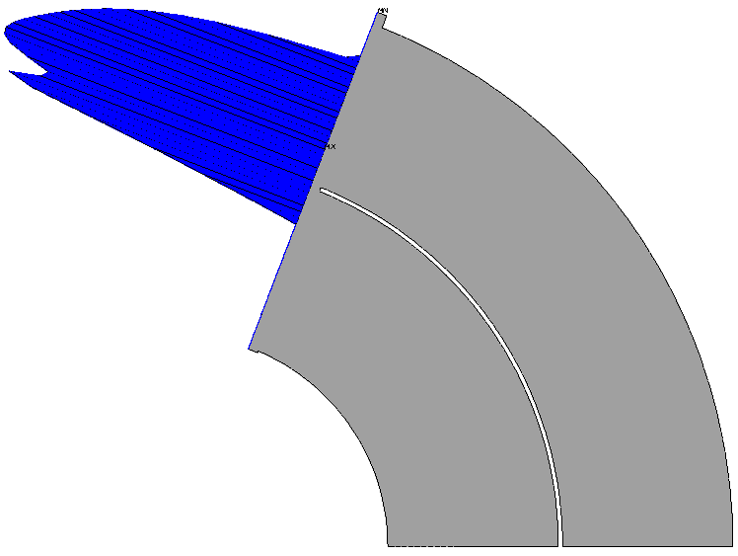
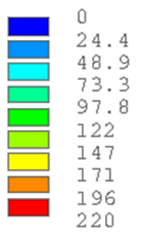
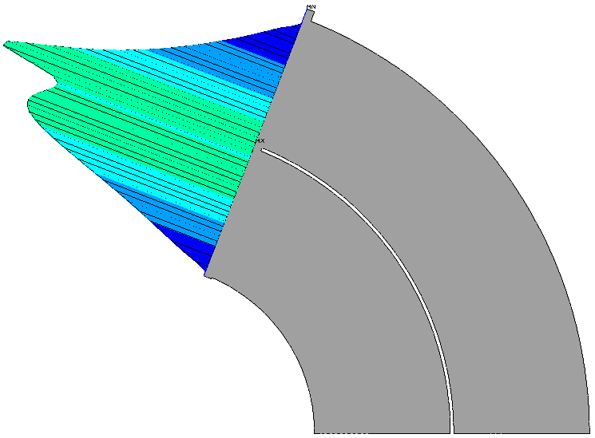
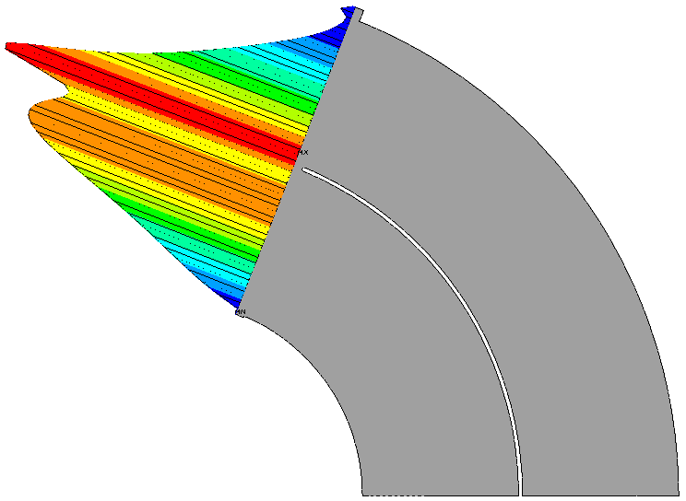
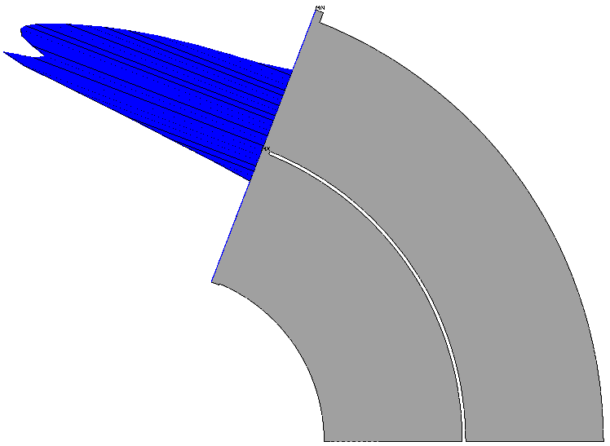
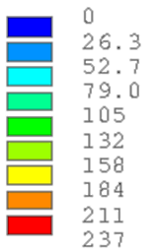
Mechanical design – contact pressure
ASSEMBLY
COOL DOWN
ENERGIZATION
Contact pressure [MPa]
14 T
Key interference 0.5 mm
Gap (where contact pressure = 0 MPa) < 3.2 μm
Contact pressure [MPa]
15.5 T
Key interference 0.6 mm
Gap (where contact pressure = 0 MPa) < 11.3 μm
Contact pressure [MPa]
16 T
Key interference 0.7 mm
Gap (where contact pressure = 0 MPa) < 10.6 μm

Slide 16
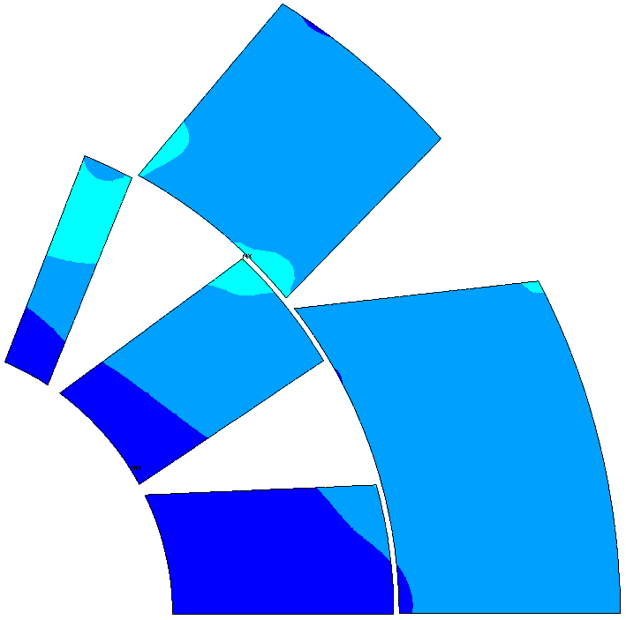
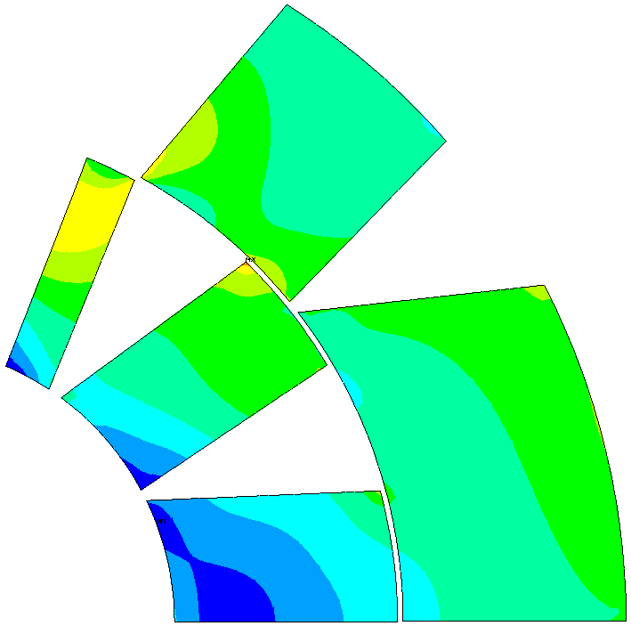
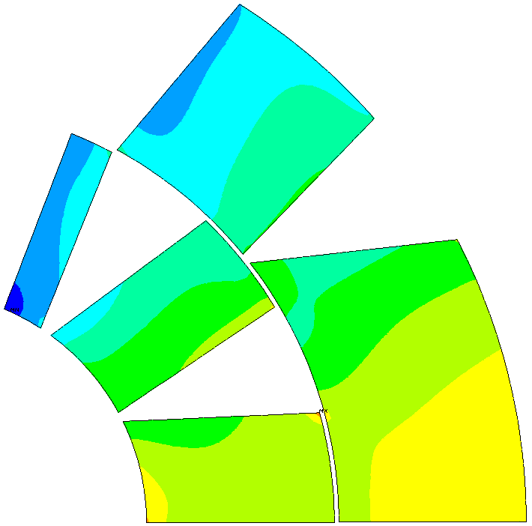
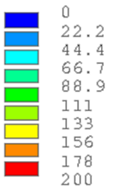
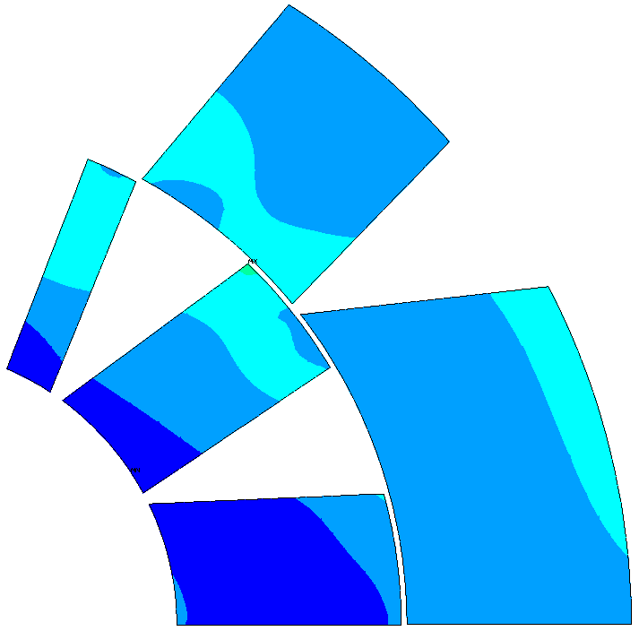
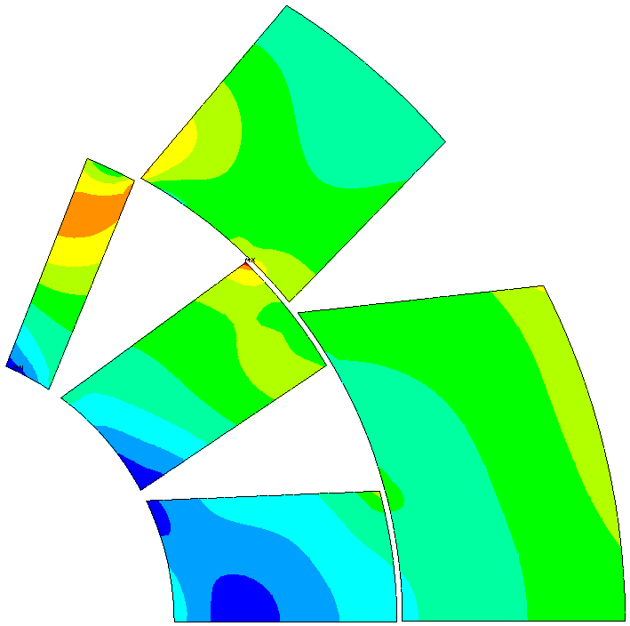
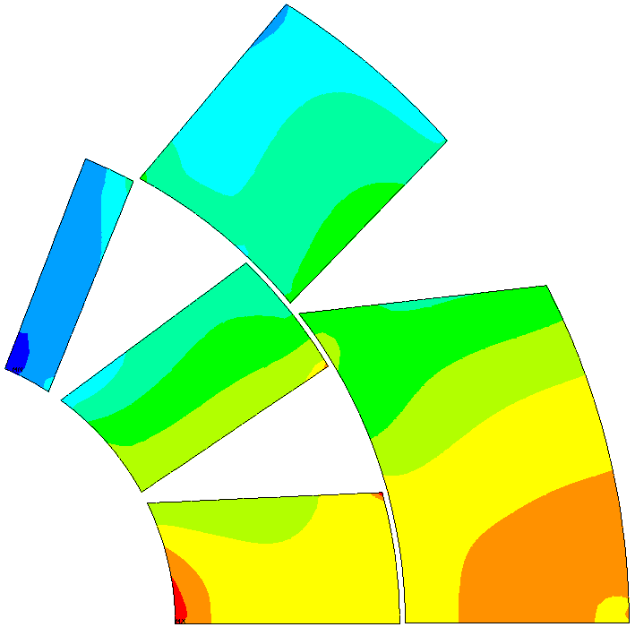
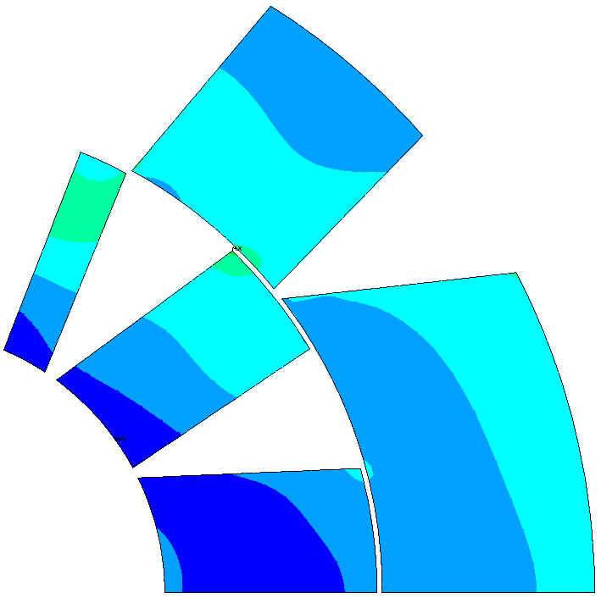
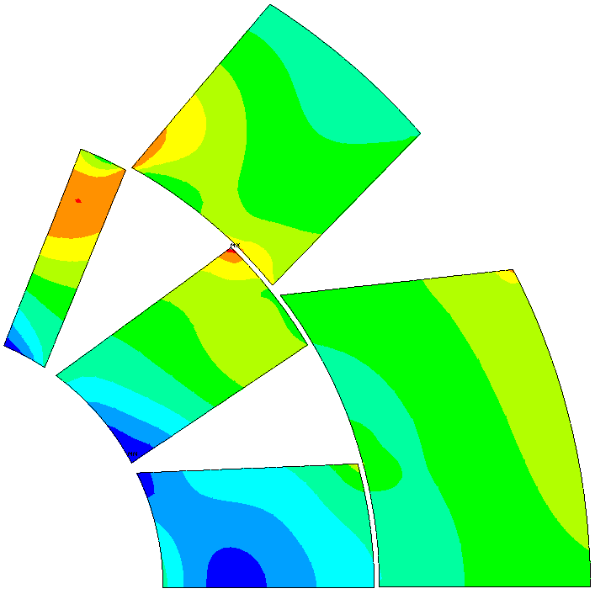
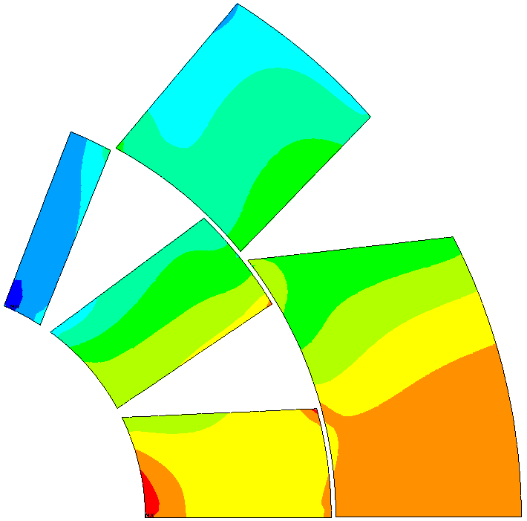
Mechanical design –
Von Mises stress in conductors
ASSEMBLY
COOL DOWN
ENERGIZATION
VM stress [MPa]
14 T
Key interference 0.5 mm
σ_{VM,max} = 72.4 MPa
σ_{VM,max} = 172 MPa
σ_{VM,max} = 177 MPa
VM stress [MPa]
15.5 T
Key interference 0.6 mm
σ_{VM,max} = 86 MPa
σ_{VM,max} = 192 MPa
σ_{VM,max} = 201 MPa
VM stress [MPa]
16 T
Key interference 0.7 mm
σ_{VM,max} = 99.5 MPa
σ_{VM,max} = 210 MPa
σ_{VM,max} = 209 MPa

Slide 17
Conclusions
We designed a model dipole for FCC (named Falcon Dipole) with the goal of making the winding and assembly procedure as feasible as possible.
The results of our analysis satisfy the requirements:
The magnet is able to reach 14 T in the bore within the margin of 14%, using the conductor with EuroCirCol specs
In principle the same target of 14 T may be reached using the specs of the conductor under procurement, but with a reduced margin of 9.5%
All the stress in the magnet are always below the limits, in particular in the coil the maximum stress is 177 MPa at energization
Notice that:
A bore field of 16 T theoretically may be reached with the current at the ‘short sample limit’ (EuroCirCol target cable)

Slide 18
Thank you
for
your attention

Slide 19
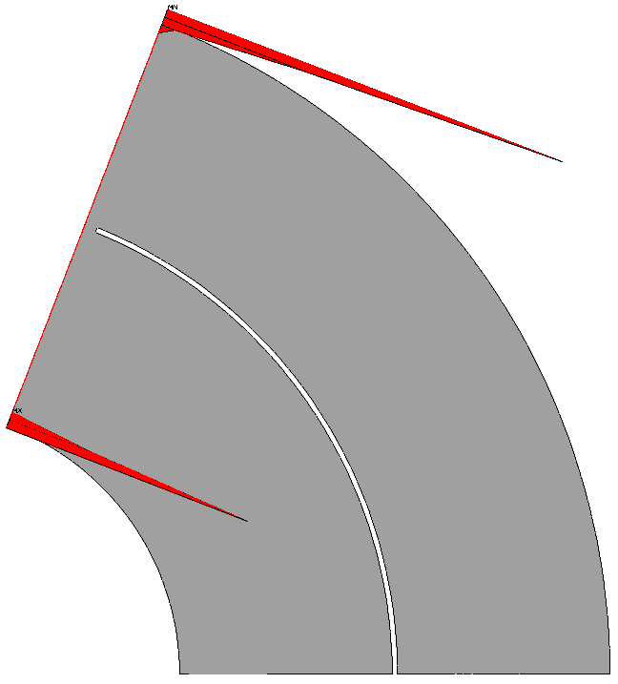
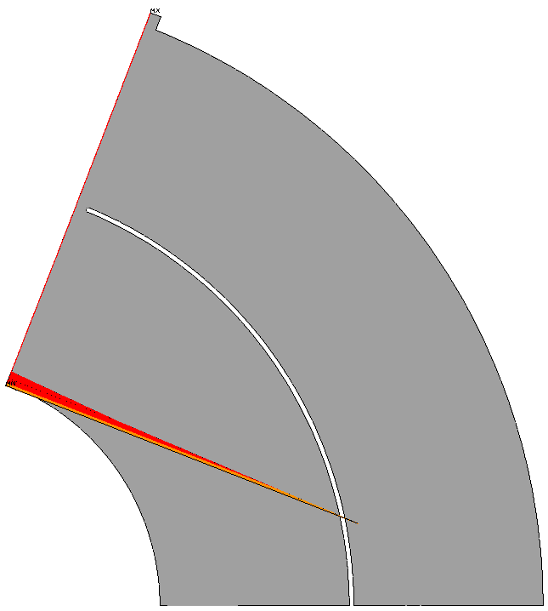
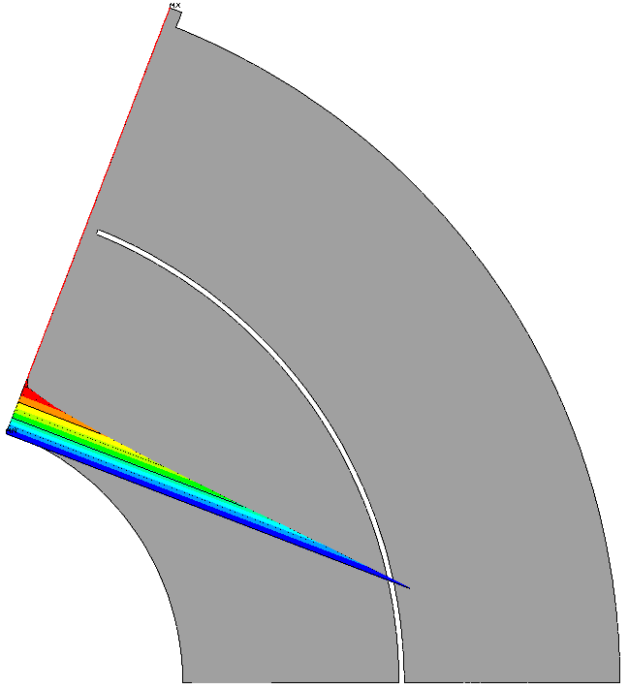
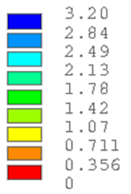
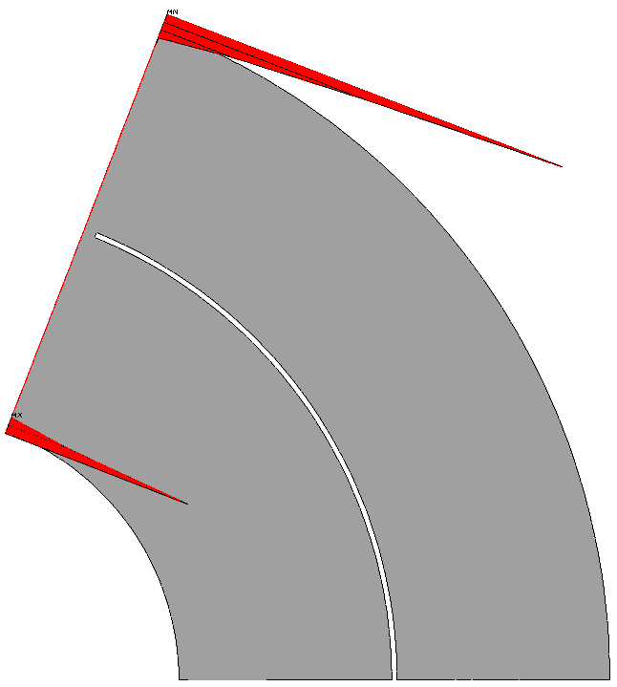
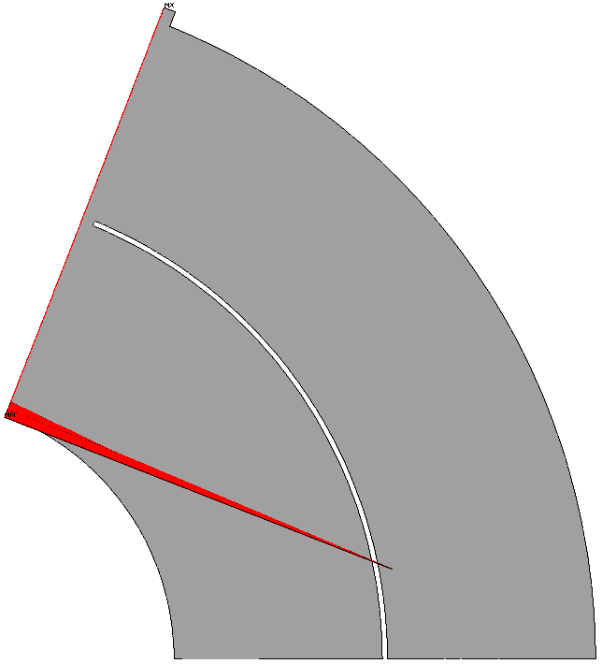
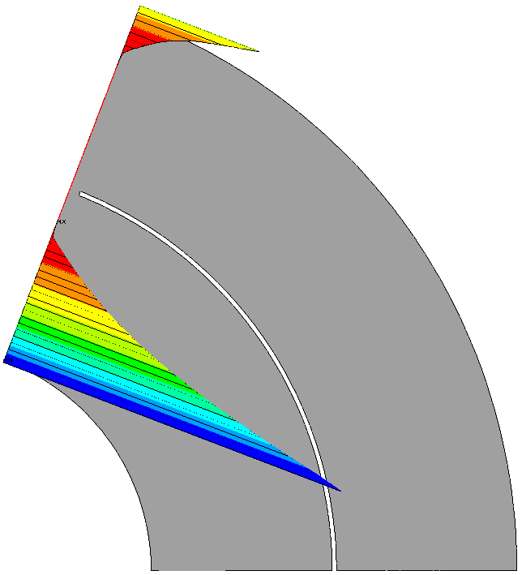
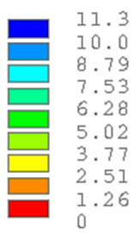
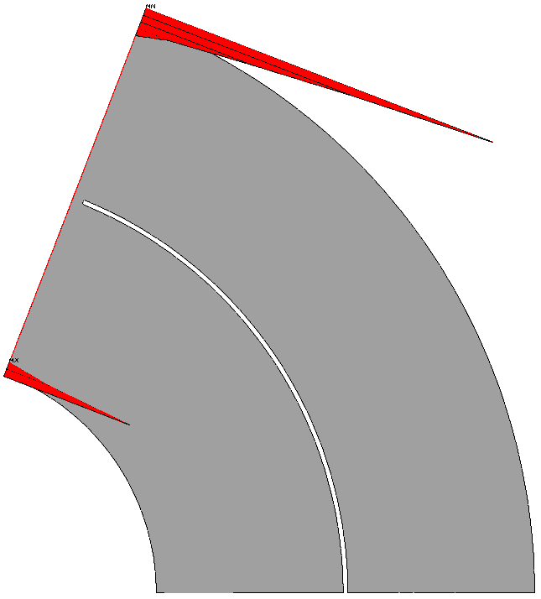
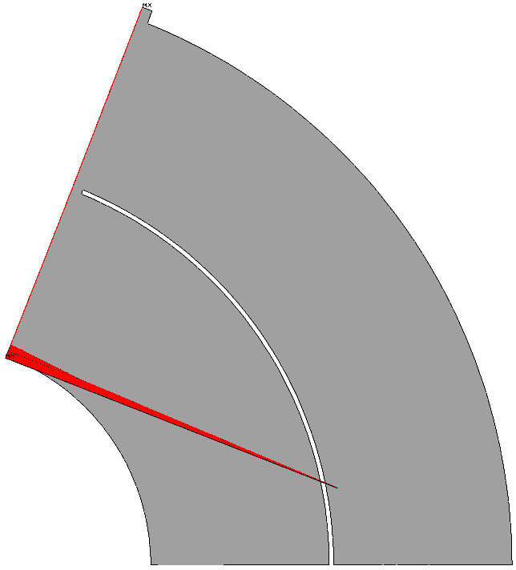
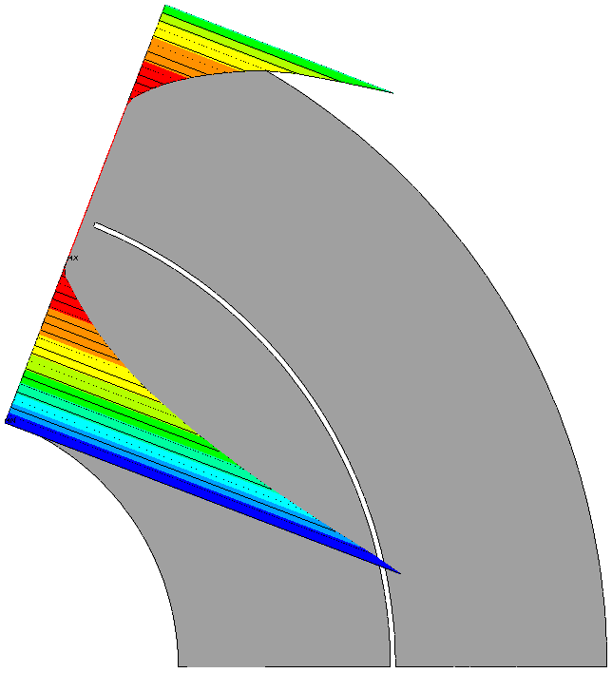
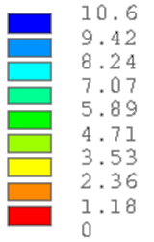
Mechanical analysis – gap at pole
ASSEMBLY
COOL DOWN
ENERGIZATION
Gap [μm]
14 T
interference 0.5 mm
Gap [μm]
15.5 T
interference 0.6 mm
Gap [μm]
16 T
interference 0.7 mm

