Slide 1
FCC-ee Beam Dump System Concept and Technological Challenges
A. Apyan¹, W. Bartmann², B. Goddard², A. Lechner², S. Ogur², K. Oide³, F. Zimmermann²
ANSL, Yerevan, Armenia
CERN, Geneva, Switzerland
KEK, Tsukuba, Japan

Slide 2
Different options
CDR option: Using FCC-hh tunnel with dilution
External dump in short alcove without dilution
Internal dump with dilution

Slide 3
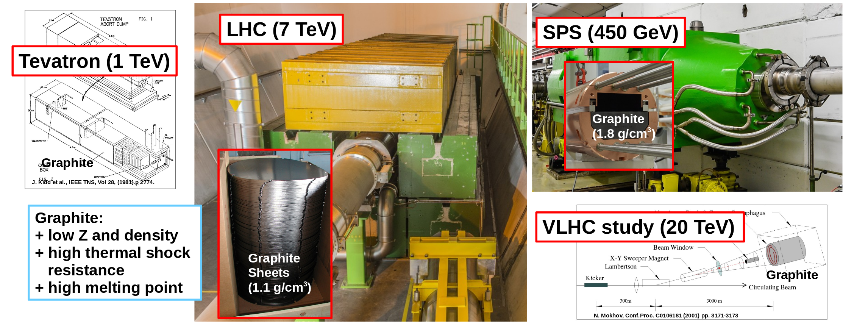
Dump material
Graphite is the material of choice for many particle dumps because of its excellent material properties
For CDR option of beam dump a density of 1.7 g/cm³ was used
For the alternative FCC-ee studies, we assume a low density Graphite grade (1 g/cm³) similar to the one already used in the LHC dump

Slide 4
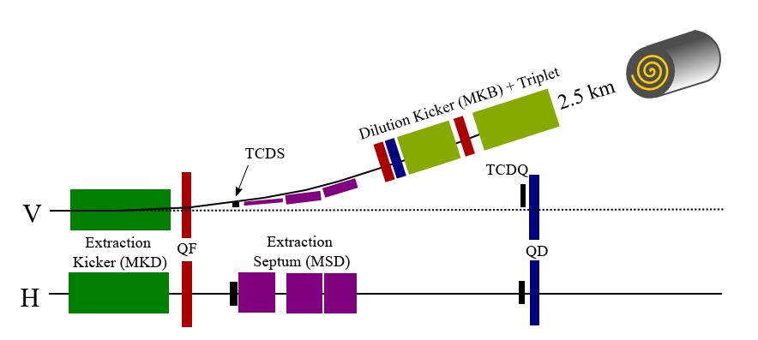
Present Baseline
Use of FCC-hh tunnel
  Assuming the 2.5 km dump tunnel for FCC-hh is built
  Design existing with HW parameters for kickers (extraction and dilution), septa and dump block
  Very similar to FCC-hh dump system – apart from dump line focussing not needed here
The system of extraction kickers and a septum deflects the beam by 12 mrad.
The beam is spread over the front surface of the dump in a spiral pattern by means of horizontal and vertical dilution kicker magnets.

Slide 5
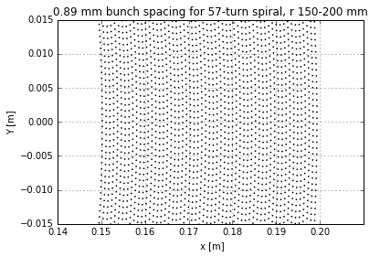
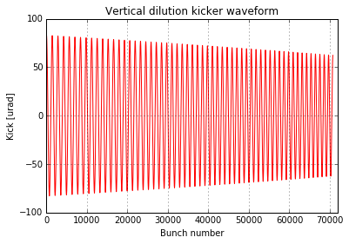
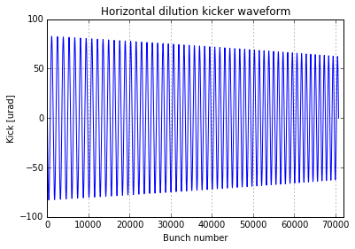
Dilution system and sweep on dump
Archimedean spiral with equal spacing between turns
Fixed outer sweep radius as 200 mm
Bunch spacing depends on inner radius
Maximum kicker frequency 200 kHz
57 turns optimum – 0.89 mm spacing
The pattern are constructed such that the temperature in the dump remains acceptable (below 2000 ºC).

Slide 6
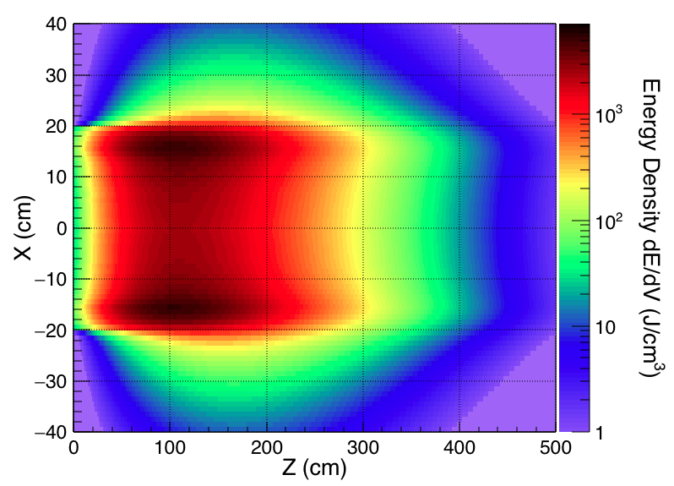
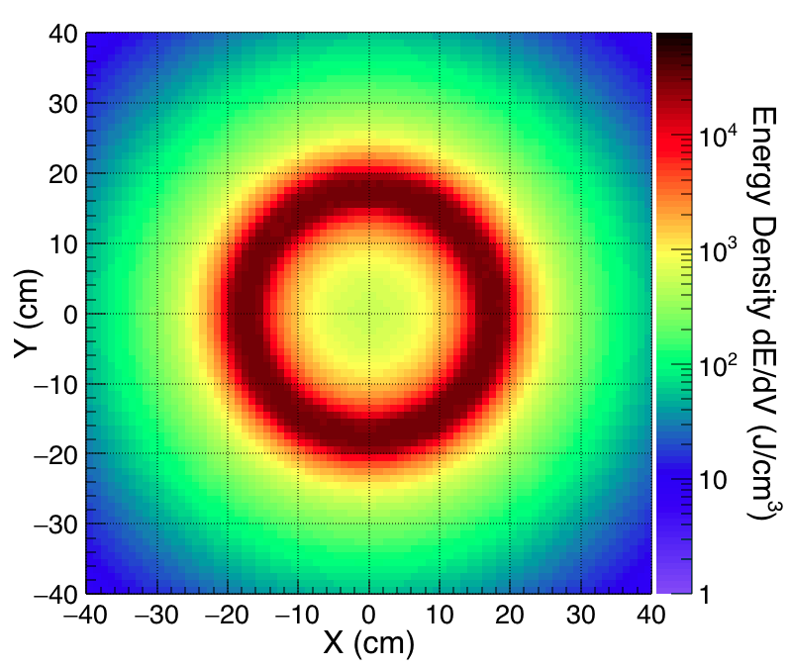
Deposited energy density in Graphite
Number of turns in spiral is 57, distance between the center of bunches is 890 μm.
The energy density deposited in the graphite beam dump in the vertical-longitudinal (x-z) plane.
The energy density deposited on the graphite beam dump in the transverse (x-y) plane.

Slide 7
FCC-hh tunnel option - features
2.5 km tunnel branching of in extended straight section PD - not compatible with RF
Septum strength defined by hadron cryostats → factor 4 larger deflection angles than needed for extracting from ee machine
Original dilution pattern leads to ~500 deg on dump; up to 2000 deg still acceptable for damage limits → could reduce tunnel length, dilution kicker strength or frequency
Most ‘capable’ option in case beam parameters change for the worse

Slide 8
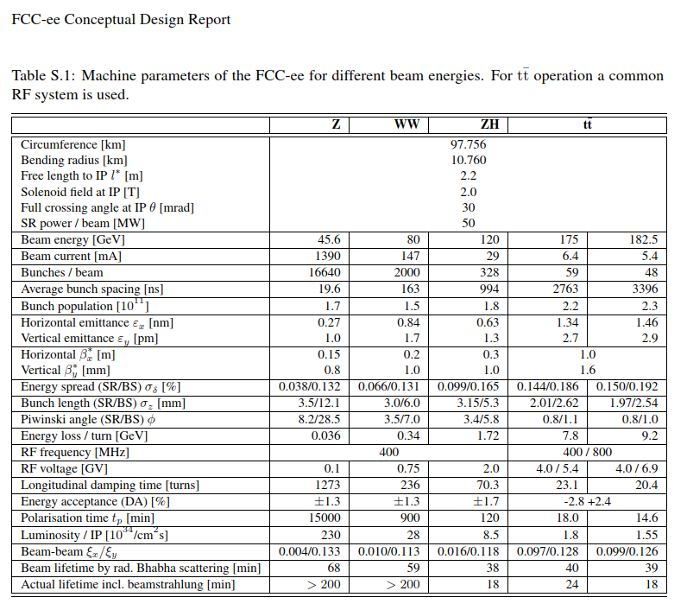
Beam parameters relevant for dump system
Z, WW operation most critical for beam power on absorbers
  In case of dilution this drives the dump pattern and dilution kicker frequency
tt operation with highest energy drives kicker/septum/diluter strength
  Here we would not even need dilution on the dump
Envisage system optimisation
  Dilution: allow for reduced beam pattern for tt operation where energy is highest but beam power lowest
  Extraction through coil window
  …

Slide 9
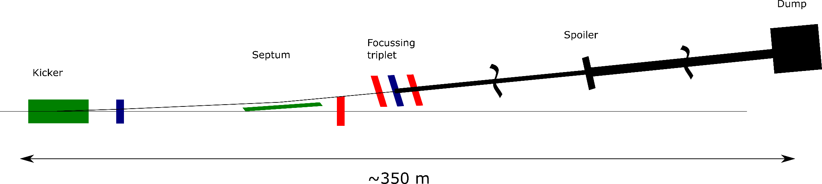
External dump without dilution
Extract beam – blow up with focussing structure and possibly spoilers in dump line – place dump in an alcove at the end of the LSS
No active dilution system required → robust wrt machine protection
Location of the dump system
  Suggest placing kicker/septum 350 m upstream the end of the LSS and place dump in an alcove (short tunnel/cavern of 10-20 m length) where the arc tunnel is bending away
  Alternatively can extract anywhere in the LSS and place the dump in middle of straight – RP, integration, etc to be checked

Slide 10
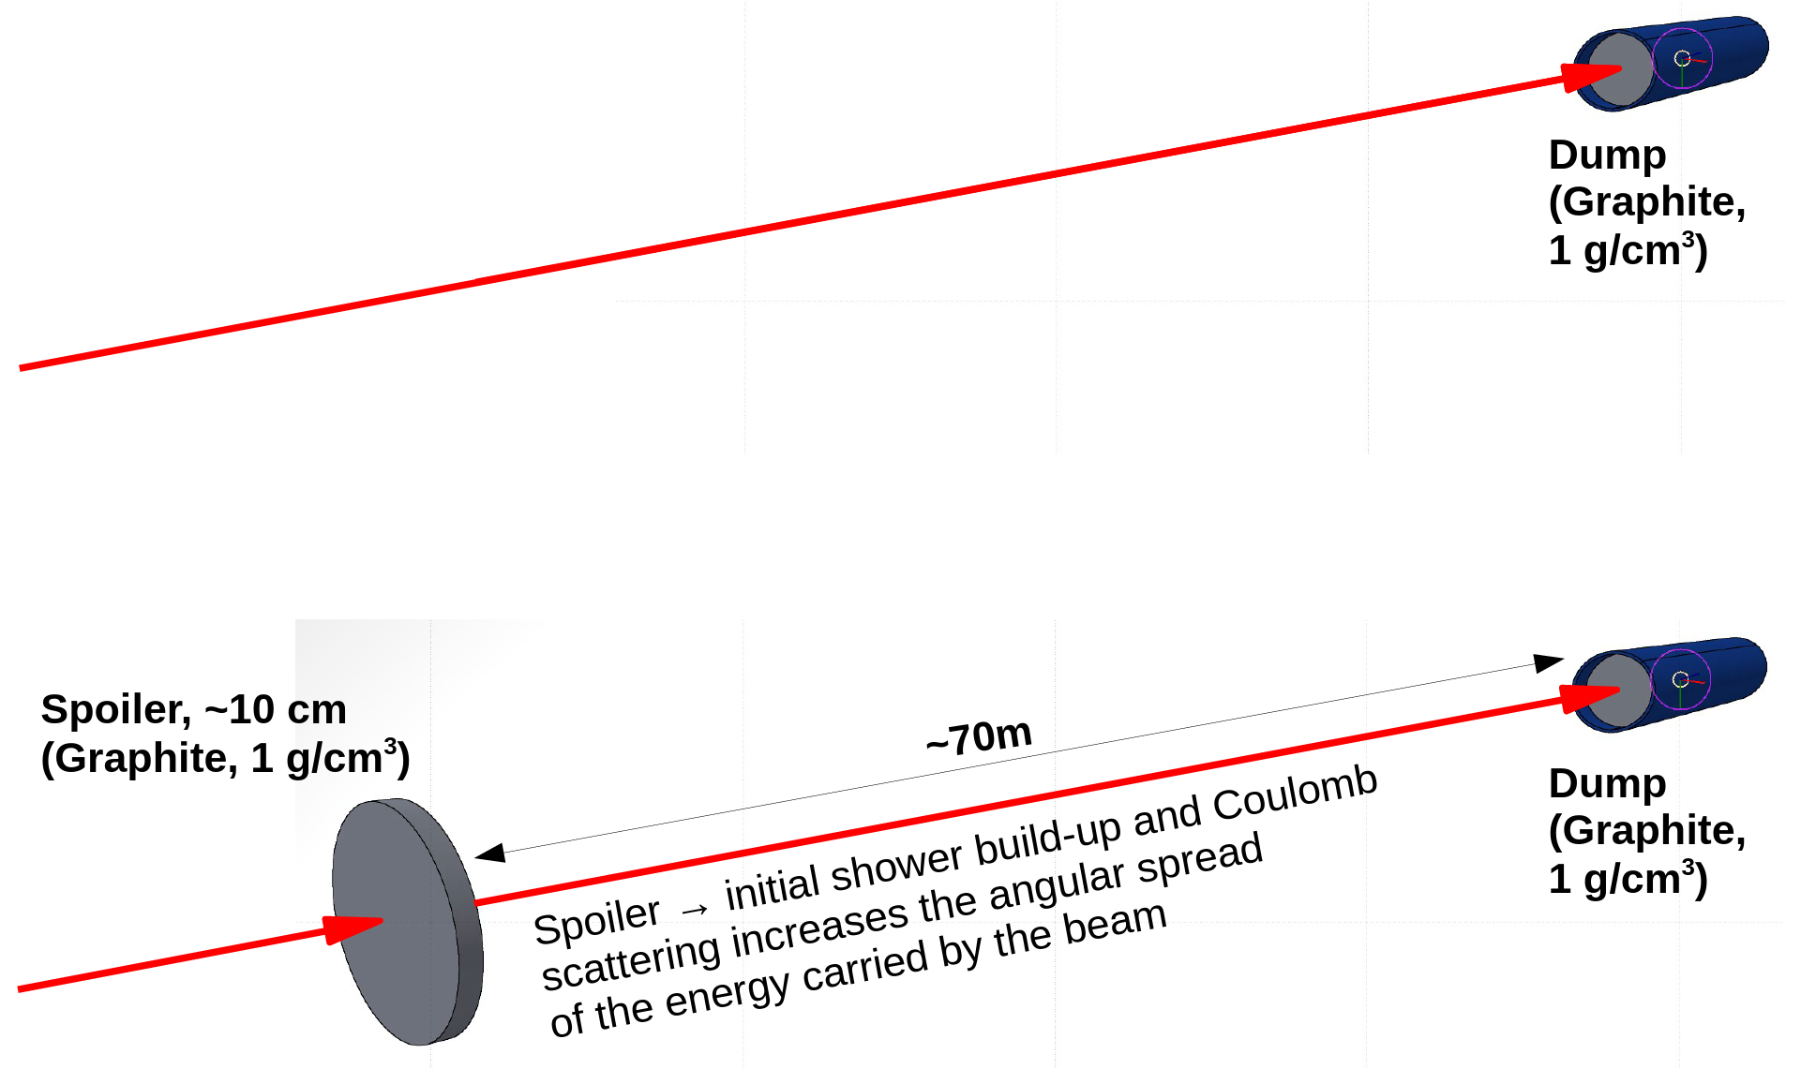
External dump
Option 1: blow up transverse beam size such
that the dump can sustain the impact of the
full beam on a single spot
Use triplet to blow up betas in dump line
If spoiler is deployed the full extraction system (kicker to dump) takes 350 m
  Spoiler must not be too thick (say < X₀/4) and transverse spot size needs to be large enough such temperatures remain acceptable
  Need 400 km betas at spoiler
  70 m distance between spoiler and dump
Without spoiler the system requires 700 m
  Need 5000 km betas at dump
Option 2: in addition to option 1, use a spoiler upstream
of the dump which enhances the transverse distribution
and hence reduces length of dump line

Slide 11
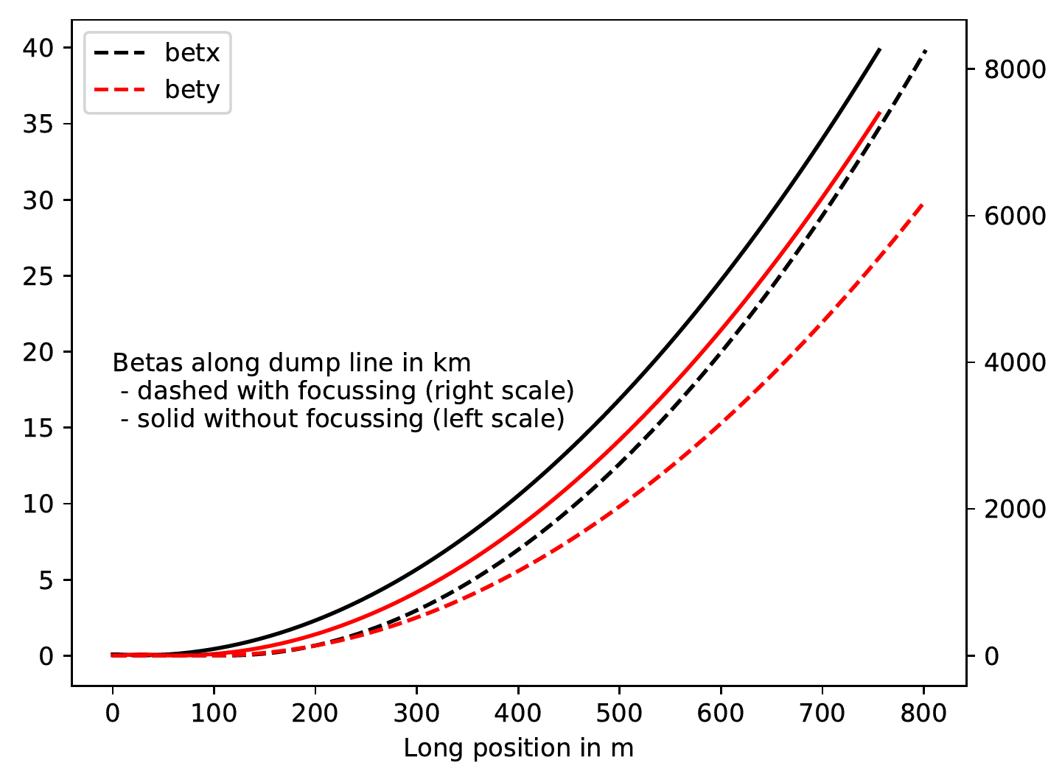
External dump
With spoiler:
Without spoiler:
Spoiler at 270 m
(β=400 km)
Dump at 340 m
(β=800 km)
Dump at 700 m
(β=5000 km)

Slide 12
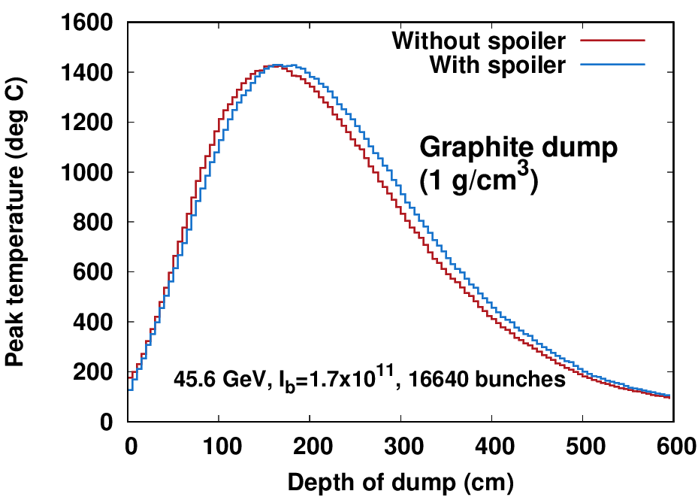
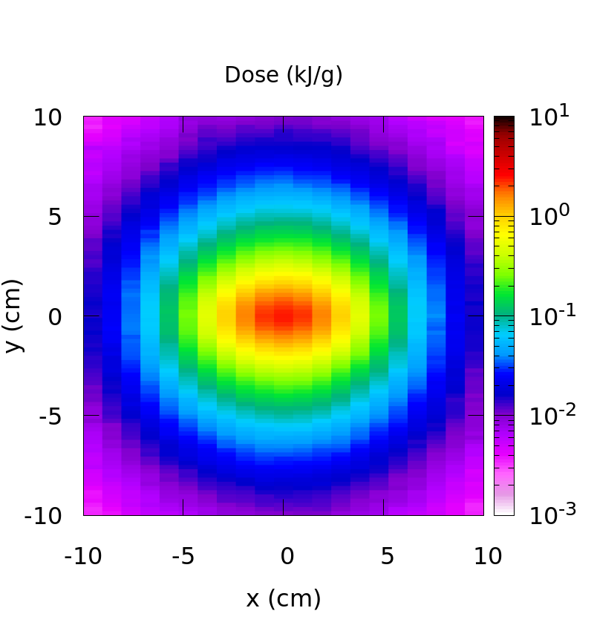
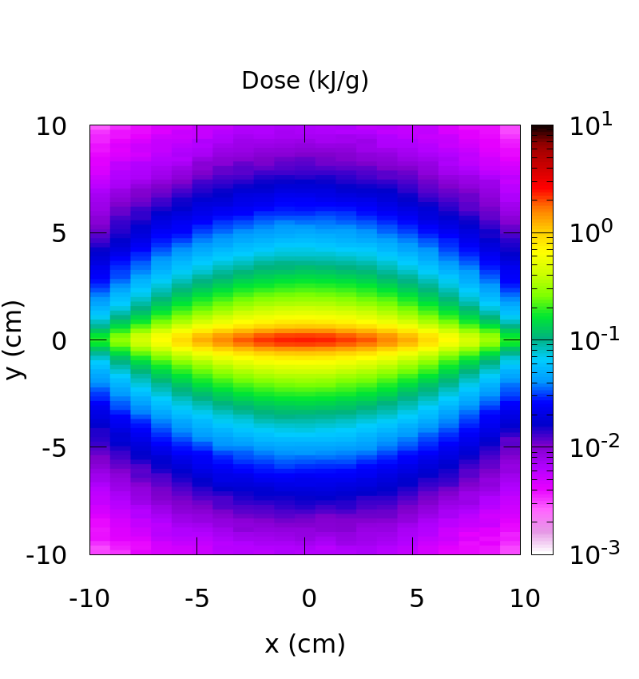
External dump
Transverse dose map at a depth of 170 cm)
With spoiler:
Without spoiler:
The two options are equivalent in terms of peak temperature inside the dump

Slide 13
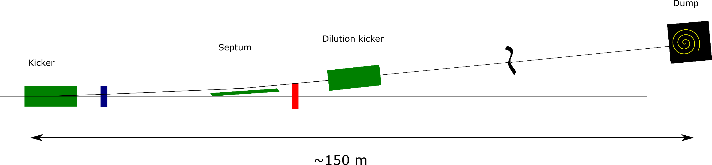
Internal dump
Deflect/dilute like for the SPS dump system
  Extraction/dilution system combined or separated
  Betas at dump > 1 km for suggested dilution pattern → 150 – 180 m system length
Active dilution system
RP considerations to define needs of shielding/alcove
  Into alcove where the tunnel starts bending away or along the LSS
150-180 m

Slide 14
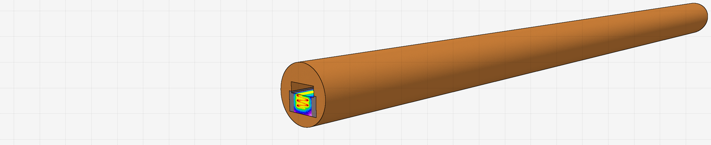
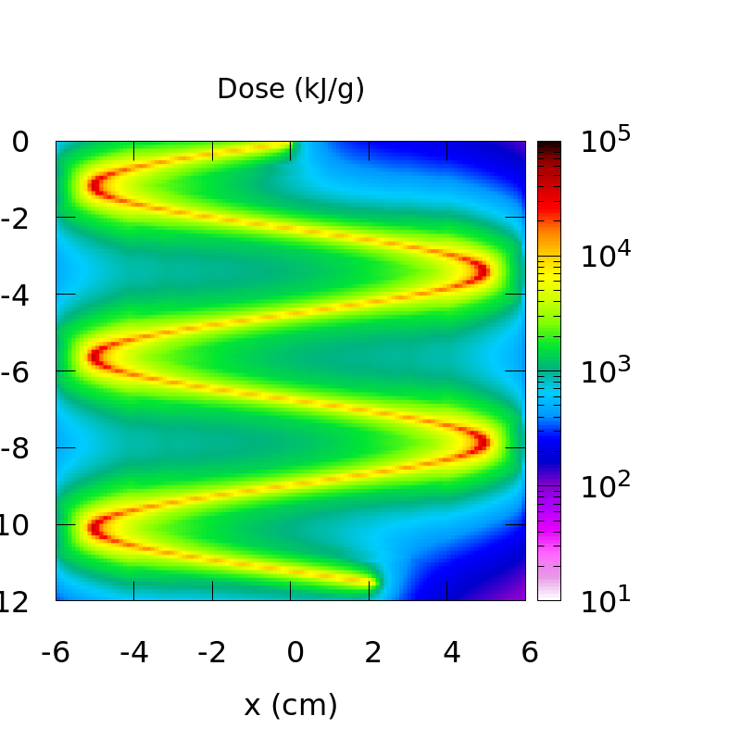
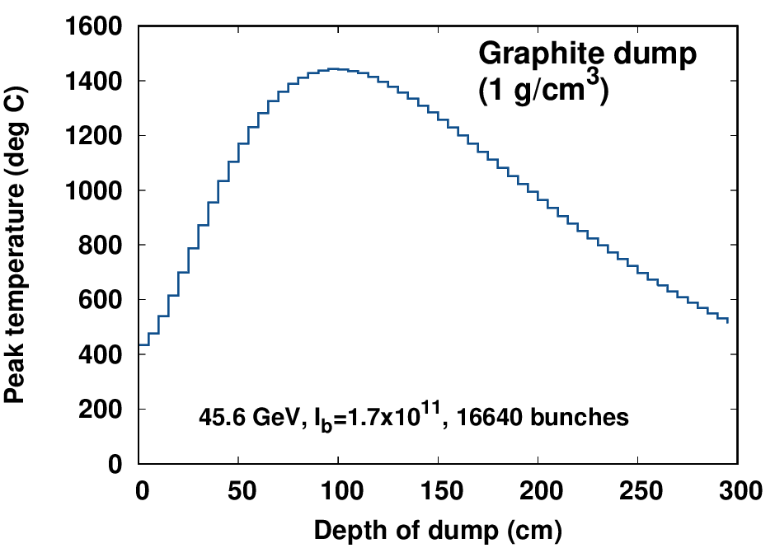
Internal beam dump (with dilution system)
Total length: ~6-7 m
circulating beam
Absorber: Graphite, 1 g/cm³
dumped beam
Assumed dilution pattern:
Vertical speed v= 350 m/sec on dump surface → 1 mrad, 3 us rise time
Horizontal dilution= 8 kHz, amplitude = 5 cm, 0.5 mrad
→ reasonable kicker parameters
About 1500 deg C at return points

Slide 15
Layout for both alternatives to CDR
150 m
350 m
700 m
Internal with dilution
External with spoiler
External without spoiler
1100 m
700 m
0 m
150 m
350 m
700 m
For the shortest system – internal dump with active dilution – and minimum needed extraction angles → beam separation of 0.5 m at the end of the straight, directly on the beam line
  A good km of free space between extraction systems for other systems
With alcove of several 10 m where arc starts get reasonable distance for shielding
Both internal options are modular, ie can also be placed at any other location in the straight
  Then RP integration, etc needs to be checked carefully

Slide 16
Conclusion
Two alternatives to CDR beam dump option suggested
CDR option is very capable and heavy in terms of HW and tunnel length
Alternatives with greatly reduced HW needs for kickers/septum and it does not need a tunnel
System without active dilution possible → robust for machine protection
System with active dilution of ~180 m length → leaves ~1 km of LSS free for other systems. But operational experience from the internal dump at the SPS shows, that an internal dump on the beam line is not the preferred solution (engineering-wise it is much more challenging and a less robust solution).
To be studied: protection devices, failure scenarios, full optimisation of all options (CDR dump pattern to reduce, extr/dilution kickers combined, spoilers, civil engineering, integration, RP …..…)

