Slide 1



Status of FCC-hh main magnet circuit layout, powering and protection
Arjan Verweij, CERN-TE-MPE
with input from: B. Auchmann, L. Bortot, M. Maciejewski, M. Prioli, T. Salmi, R. Schmidt, A. Siemko
The European Circular Energy-Frontier Collider Study (EuroCirCol) project has received funding from the European Union's Horizon 2020 research and innovation programme under grant No 654305. The information herein only reflects the views of its authors and the European Commission is not responsible for any use that may be made of the information.
Arjan Verweij, CERN-TE-MPE, FCC Week 2019

Slide 2
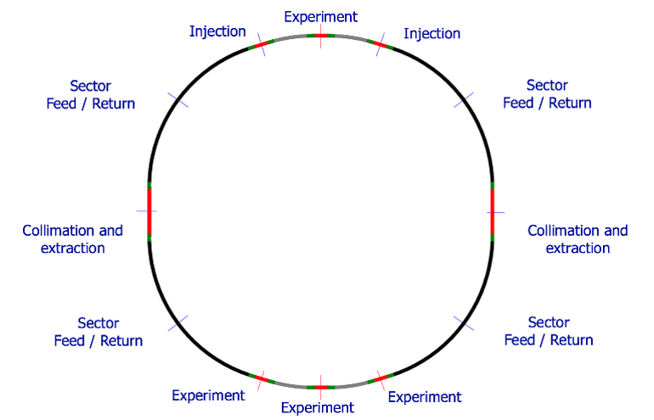
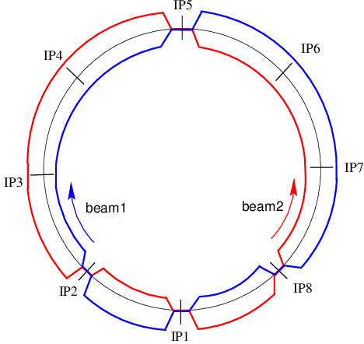
Intro
 | LHC | FCC
Number of arcs | 8 | 8
Length arc | 3 km | 8 km
Number of dipoles per arc | 154 | 438
Nominal current of the dipoles | 11.9 kA | 10-18 kA
Stored energy per arc | 1.1 GJ | 16-20 GJ
Number of mini-arcs | - | 4
Length mini-arc | - | 3.2 km
Number of dipoles per mini-arc | - | 180
Stored energy per mini-arc | - | 7-8 GJ
Total stored energy in the dipoles | 8.8 GJ | 108-176 GJ
Dipole locations
8 km Arc
3.2 km Mini-arc
FCC
LHC
Arjan Verweij, CERN-TE-MPE, FCC Week 2019

Slide 3
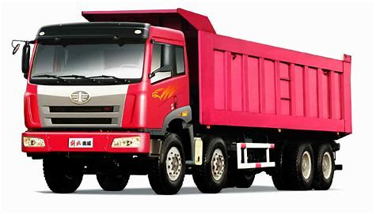

Equivalent of 140 GJ
15’000 trucks of 20 ton at 110 km/hr
35 ton of TNT
Arjan Verweij, CERN-TE-MPE, FCC Week 2019

Slide 4
Magnet protection
The individual magnet protection has been presented by Tiina Salmi (THU 8h50).
For EuroCirCol we consider a maximum voltage to ground of an individually quenched magnet equal to U_{Q,max}=1.2 kV.
Four different FCC magnet designs (Cosθ, block, common coil, CCT) are considered, varying significantly in terms of inductance and current.
 | Cosθ | Block | Common Coil | CCT
L [H] | 0.591 | 0.745 | 0.339 | 0.284
I [A] | 11390 | 10100 | 16100 | 18000
E [MJ] | 38 | 38 | 44 | 46
PS: small deviations are possible compared to the latest designs
Arjan Verweij, CERN-TE-MPE, FCC Week 2019

Slide 5
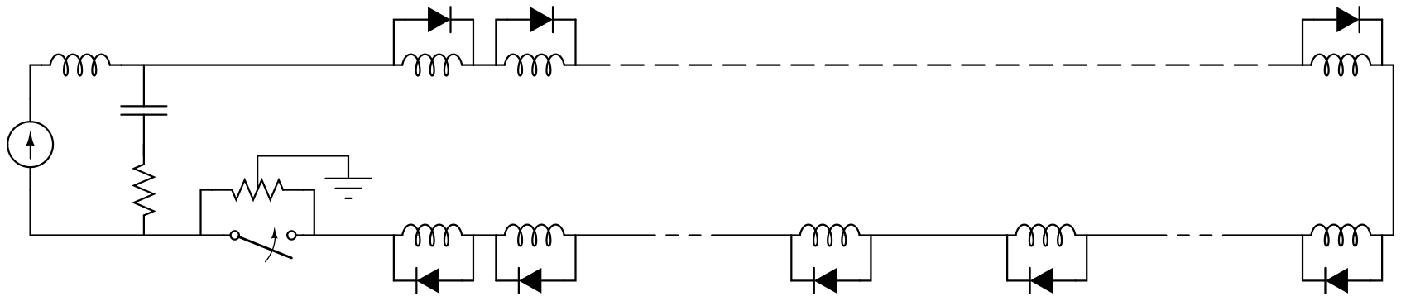
Circuit protection
For the FCC we consider LHC-type of powering and protection:
series connection of magnets to limit the number of power converters and current leads;
cold bypass diodes, to protect a quenching magnet;
warm Energy Extraction (EE) systems to protect the circuit, including bypass diodes, busbar and current leads. LHC uses a passive R_{EE} (⇒ exp. decay τ_{decay}=L_{circ}/R_{EE}). For FCC we consider an active R_{EE}(I) (⇒ lin. decay t_{decay}=L_{circ}/R_{EE,0}) to reduce the MIIts for the same maximum circuit voltage.
grounding of the circuit in the centre of one of the EE resistances.
L_{circ}=N_{mag}L_{mag}
R_{EE}
L_{mag}
Arjan Verweij, CERN-TE-MPE, FCC Week 2019

Slide 6
Circuit design targets
Minimize the peak voltage to ground during a Fast Power Abort
Minimize the discharge time during a Fast Power Abort
Minimize the number of magnets in series in a circuit
Minimize the complexity of the circuits
Minimize the thermal heat inleak
Minimize the required peak voltage and power of the power converters
Minimize the number of spurious triggers of the quench detection system (QDS)
Some of these targets are contradictory and a good balance has to be found.
Arjan Verweij, CERN-TE-MPE, FCC Week 2019

Slide 7
Voltage Withstand Level (VWL)
Minimizing the VWL level has a positive impact on the insulation and testing of the magnets, and also on all the auxiliary equipment (voltage taps, other sensors, quench detection electronics)
VWL=f*(U_{Q,max}+U_{circ,max}) with: f: safety factor
U_{Q,max}: max. magnet quench voltage
U_{circ,max}: max. circuit voltage after a FPA
U_{circ,max}=I_{max}*R_{EE,0}/2 with: R_{EE,0}: initial resistance of one EE system
In EuroCirCol we consider VWL=3 kV, f=1.2, U_{Q,max}=1.2 kV and U_{circ,max}=1.3 kV not taking into account failure scenario’s.
Note: various plausible failure scenario’s can add a significant voltage, for example a short-to-ground in the circuit, resulting in blowing up of the grounding fuse.
Arjan Verweij, CERN-TE-MPE, FCC Week 2019

Slide 8
Circuit decay time (t_{decay})
Minimizing t_{decay} (after a Fast Power Abort or magnet quench) reduces:
dissipated energy in the SC busbars and current leads ⇒ reduces the required cross-section,
dissipated energy in the diode heat sinks of a quenched magnet ⇒ reduces the required volume of the heat sink,
probability of quench propagation to neighbouring magnets ⇒ less frequent thermal stress in the magnets; faster cryogenic recovery; smaller probability of failures.
t_{dec}=L_{circ}/(N_{EE}*R_{EE,0}) with: N_{EE}: the number of EE systems in the circuit
For the LHC: τ_{decay}=100 s, copper cross-section busbar = 270 mm², heat sinks of about 30 kg per diode. At nominal current, a quench propagates to typically 5 adjacent magnets.
For the FCC we target t_{decay}=120 s.
Arjan Verweij, CERN-TE-MPE, FCC Week 2019

Slide 9
Nr of magnets in a circuit
A small number of magnets in a circuit:
Reduces the stored energy in the circuit and hence the damage potential in case of accidents;
Reduces the ramp voltage for given ramp rate;
Reduces the duration of a training campaign. Imagine a circuit of 438 magnets, each needing 1 training quench with a cryogenic recovery time of 12 hours. Such a campaign would take more than 7 months!
Increases the number of power converters and current leads.
Arjan Verweij, CERN-TE-MPE, FCC Week 2019

Slide 10
Circuit topology
Reducing the VWL (⇒ reducing R_{EE}) and reducing as well t_{decay} (⇒ increasing N_{EE}R_{EE}) can be met by two circuit topologies:
Increase the number of EE systems per circuit (uniformly distributed along the circuit) in order to have an acceptable decay time.
Subdivide each circuit in N sub-circuits, each with one EE system, located close to the power converter.
Also taking into account the advantages of having less magnets per circuit (smaller damage potential, smaller ramp voltage of the converter, shorter training campaign) makes option 2 the preferred topology.
Arjan Verweij, CERN-TE-MPE, FCC Week 2019

Slide 11
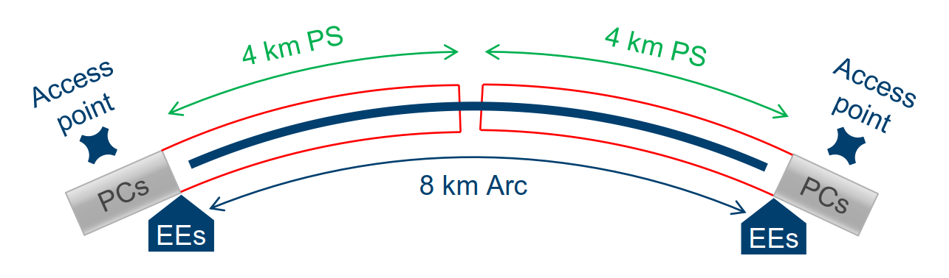
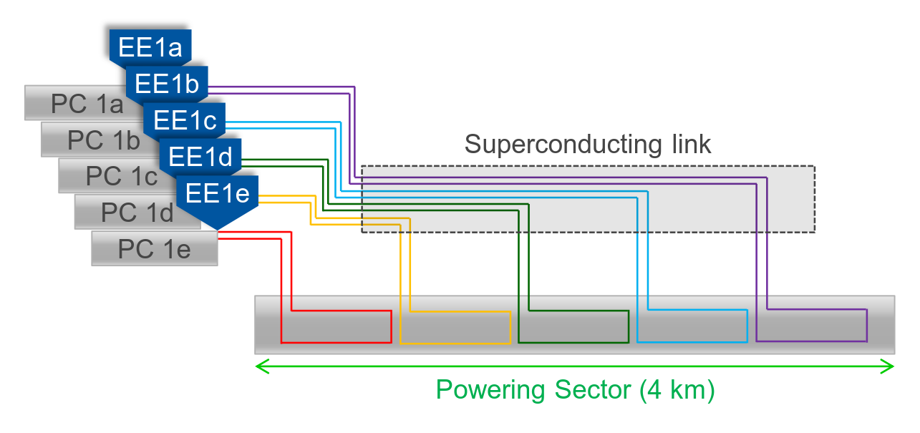
Circuit topology
Power converters (PC) and energy extraction (EE) systems close to access points
  Space optimization and easier maintenance
Power each 8 km long Arc from two sides, obtaining powering sectors (PS) of 4 km
Power each 3.2 km long Mini-arc from one side, so PS_{mini}=3.2 km
Subdivide PS in N circuits (16N circuits in total)
Subdivide PS_{mini} in N_{mini} circuits (4N_{mini} circuits in total)
Equip each circuit with one PC and one EE system
Power the circuits through superconducting links
Example for N=5
Arjan Verweij, CERN-TE-MPE, FCC Week 2019

Slide 12
Circuit topology
Setting t_{decay}=120 s, and requiring U_{circ,max}<1300 V, gives:
 |  | Cosθ | Block | Common Coil | CCT
 | L [H] | 0.591 | 0.745 | 0.339 | 0.284
 | I [A] | 11390 | 10100 | 16100 | 18000
 | E [MJ] | 38 | 38 | 44 | 46
Arc | Nr of circuits N | 5 | 6 | 4 | 4
 | U_{circ,max} [V] | 1230 | 1140 | 1250 | 1170
Mini-arc | Nr of circuits N_{mini} | 4 | 5 | 4 | 3
 | U_{circ,max} [V] | 1260 | 1130 | 1020 | 1280
Total | Total nr of circuits | 96 | 116 | 80 | 76
Arjan Verweij, CERN-TE-MPE, FCC Week 2019

Slide 13
Circuit topology
Setting t_{ramp}=1200 V, constant ramp rate, gives:
 |  | Cosθ | Block | Common Coil | CCT
 | L [H] | 0.591 | 0.745 | 0.339 | 0.284
 | I [A] | 11390 | 10100 | 16100 | 18000
 | E [MJ] | 38 | 38 | 44 | 46
 | U_{M,ramp} [s] | 5.6 | 6.3 | 4.5 | 4.3
Arc | Nr of circuits N | 5 | 6 | 4 | 4
 | U_{Circ,ramp} [V] | 246 | 229 | 249 | 233
 | Max P_{PC} [MW] | 2.8 | 2.3 | 4.0 | 4.2
Mini-arc | Nr of circuits N_{mini} | 4 | 5 | 4 | 3
 | U_{ramp} [V] | 252 | 226 | 205 | 256
 | Max P_{PC} [MW] | 2.9 | 2.3 | 3.3 | 4.6
Arjan Verweij, CERN-TE-MPE, FCC Week 2019

Slide 14
Distribution of peak power
t_{ramp}=1200 s
 | Cosθ | Block | Common Coil | CCT
[MW] | 25.5 | 25.3 | 29.1 | 30.6
[MW] | 28.0 | 27.7 | 32.1 | 33.6
Values do not take into account losses and inefficiency
Arjan Verweij, CERN-TE-MPE, FCC Week 2019

Slide 15
Peak power
Peak powers can be reduced significantly using an adaptive ramp rate, requiring however a higher voltage (to keep t_{ramp} constant).
Arjan Verweij, CERN-TE-MPE, FCC Week 2019

Slide 16



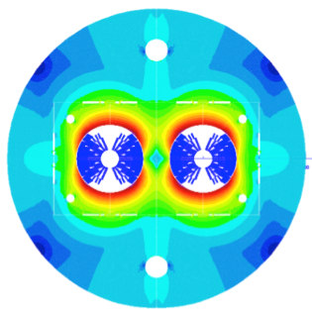
Response of the QDS if a neighbouring magnet quenches
Simulations performed using the framework
L_{filt}
M₁
M₂
CLIQ
QDS
M₂₂
C_{filt}
PC
R_{EE}
R_{filt}
M₄₄
M₄₃
M_{n+1}
M_{n}
M₂₃
Actions if a magnet quenches:
the power converter is switched off,
the magnet is protected using CLIQ (or quench heaters),
the EE is switched in.
These actions cause voltage waves in the circuit, which could trip the QDS.
Quenching magnet:
CLIQ simulation
Neighbouring magnet:
Simulation of voltage response
Arjan Verweij, CERN-TE-MPE, FCC Week 2019

Slide 17
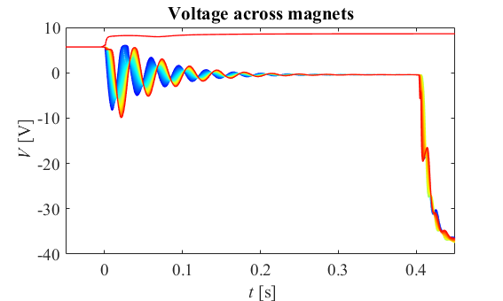
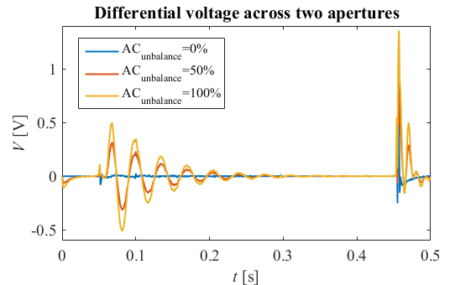
Response of the QDS if a neighbouring magnet quenches
PC off
CLIQ fired
EE activated
Differential voltages increase for larger ‘AC imbalance’ between the 2 apertures,
→ assure that the voltage transient remains below the QD threshold, by:
      Circuit optimization (adding components to reduce the voltage waves)
      QDS optimization (adding filters, subdividing voltages)
      Conductor development (homogeneous AC behaviour)
Arjan Verweij, CERN-TE-MPE, FCC Week 2019

Slide 18
Conclusion
The main dipoles of the FCC-hh have to be powered in about 80-120 circuits, each with one power converter and one active EE system.
The converters and EE systems will be located in the access points, hence an additional cryogenic distribution line, in parallel to the dipole cryostats, is needed to house the SC busbars that feed the current to all the circuits.
The ramp time, max circuit voltage, max power from the grid, busbar dimensions, diode characteristics, etcetera depend on the magnet current and inductance. However, all these parameters can be kept within the allowed limits by tuning the number of circuits. The first focus should be on defining the most reliable/feasible/cost-efficient magnet design. Circuit topology and protection will follow/adapt, ultimately with an additional cost (being much less than the magnet cost).
All other type of circuits can be powered & protected in a similar way as done in the LHC.
Arjan Verweij, CERN-TE-MPE, FCC Week 2019

Slide 19
Further study & Optimization
Protection: several mitigation measures have to be studied to:
  minimize spurious triggering of the QDS,
  reduce probability and consequences of failures ⇒ redundancy,
  increase reliability & optimize availability.
Optimization of the ramp time, taking into account:
  maximum ramp voltage and power ⇒ converter specifications / cost,
  maximum voltage per magnet ⇒ number of diodes,
  optics requirements.
Reduction of the quench propagation along the chain of magnets, e.g. by means of:
  quench stoppers in the busbars,
  reduced helium heat flow between magnets.
Optimization of the Cryogenic Distribution Line.
Arjan Verweij, CERN-TE-MPE, FCC Week 2019

