Slide 1


Status of
radiation environment assessment in the FCC-hh and FCC-ee machines
Francesco Cerutti on behalf of the EN-STI-BMI FLUKA team
and Ruben Garcia Alia, Salvatore Danzeca, Federico Faccio, Federico Ravotti
for the Radiation Hardness Assurance task
FCC week 2019, Brussels
June 27th

Slide 2
OUTLINE
Simulation tools
Radiation level calculations:
FCC-hh arc
FCC-hh EIR (detector and machine)
FCC-hh betatron cleaning insertion
FCC-ee arc
HE-LHC betatron cleaning insertion
FCC-hh extraction region
HE-LHC arc
HE-LHC EIR
RHA work
refreshed (J. Hunt talk, Thu morning 11.14 AM)
available (A. Infantino talk, FCC week 2018)
to be updated
to be calculated
to be modelled

Slide 3

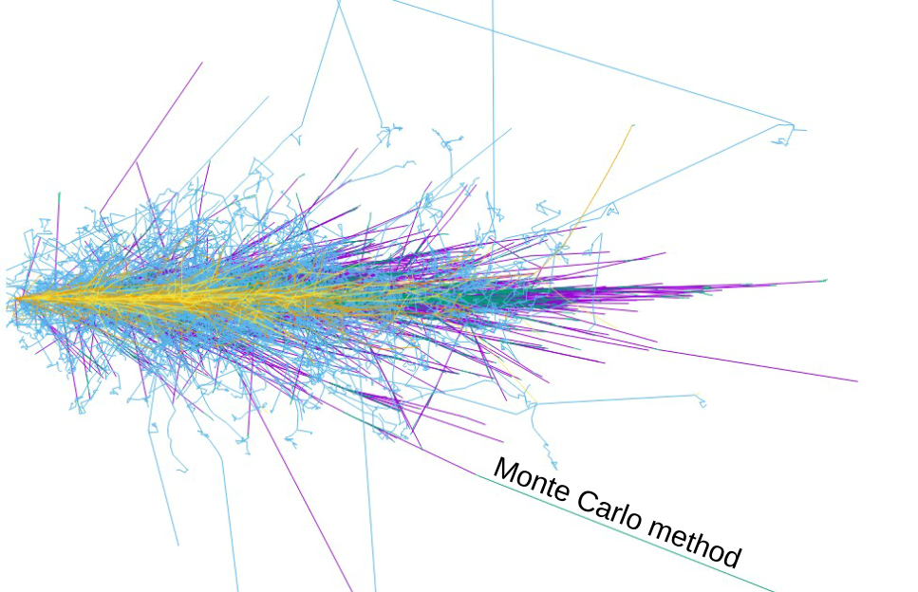

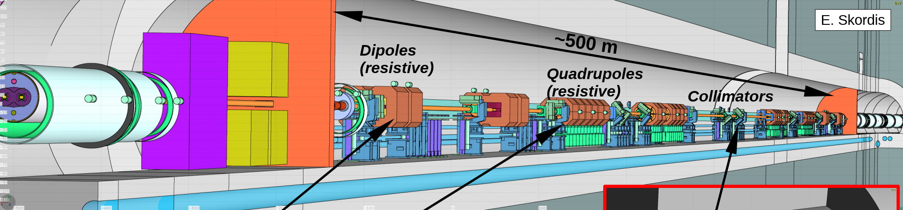
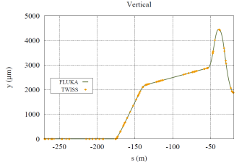
MONTE CARLO SIMULATION
OF BEAM-MACHINE INTERACTION
hadron-nucleus
reaction
validation up to LHC Center-of-Mass energy
(of the DPMJET event generator)
need for continuous development and benchmarking
(model transition from 7 TeV to 50 TeV LAB energy)
magnetic field tracking
ionization
particle decay
multiple scattering
low energy neutron
transport
electromagnetic shower
Line Builder
[A. Mereghetti et al., IPAC2012, WEPPD071, 2687]
Beam orbit

Slide 4
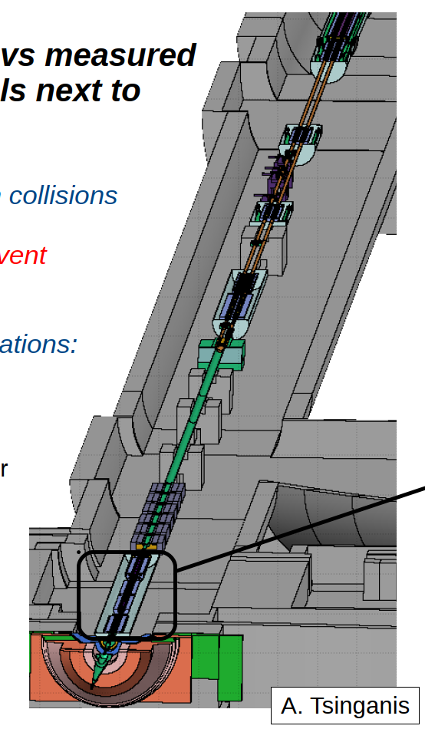
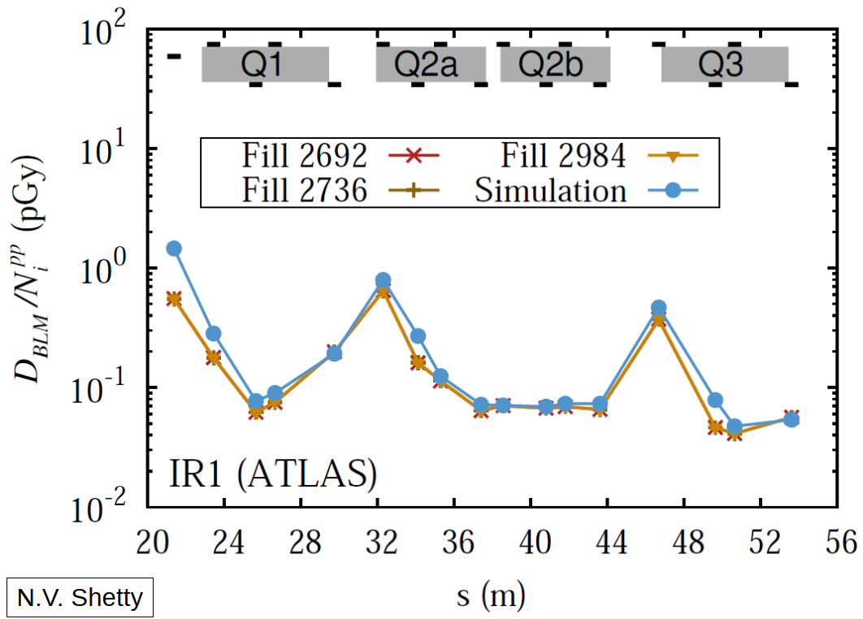
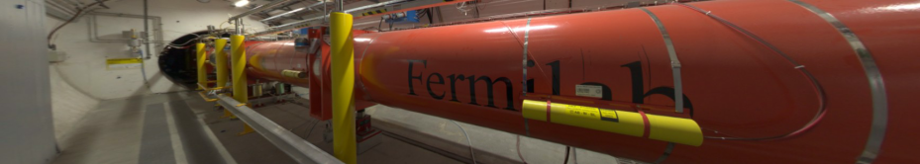
SIMULATION RELIABILITY
6.5 TeV beams
4 TeV beams

Slide 5
RADIATION SOURCES
beam intercepting devices (targets, collimators, dumps, stoppers, stripping foils, … )
  regular
  accidental: smearing failures, injection mis-steering, asynchronous beam dump, top-off
diffused losses
  synchrotron radiation, beam-gas interaction, gas bremsstrahlung
debris from regular collisions at the interaction points
unexpected obstacles (UFO, ULO, … )
loss quantification and distribution
gas density profile
luminosity scaling

Slide 6
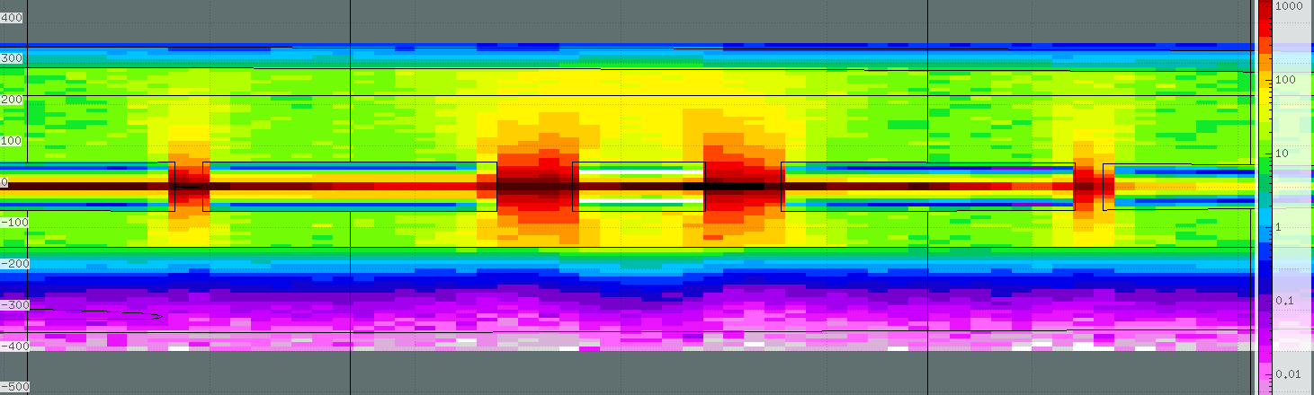
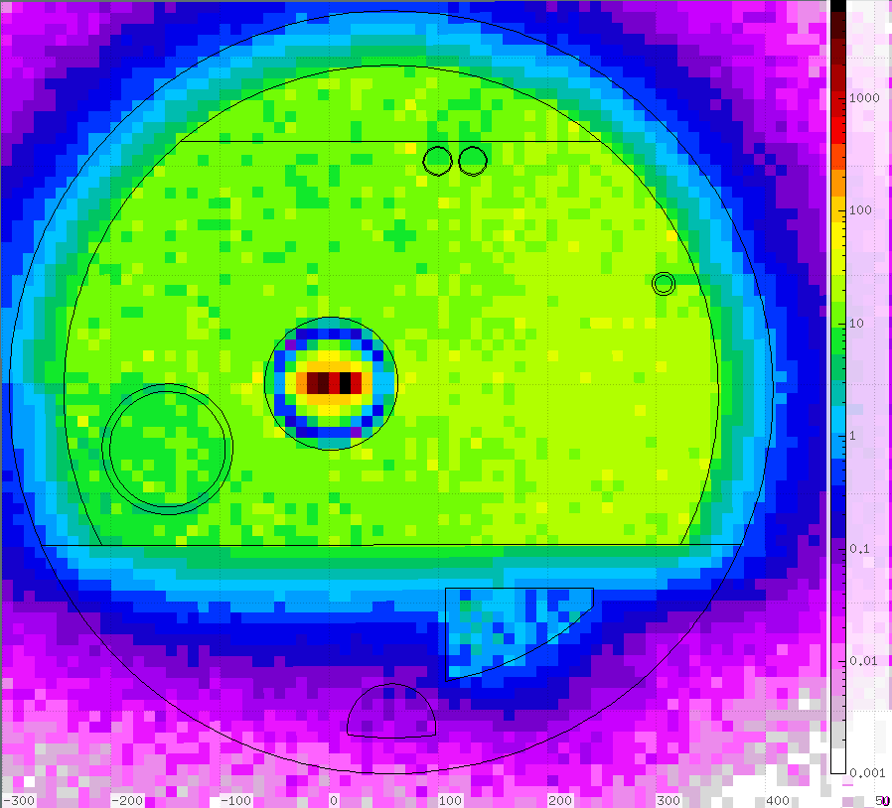
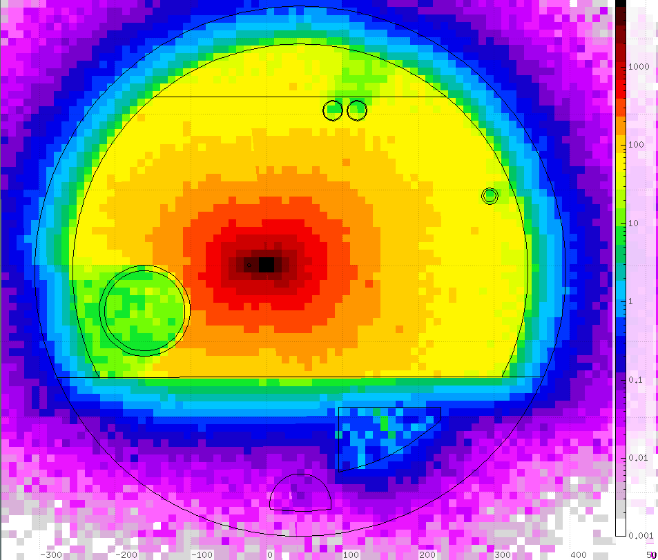
FCC-hh ARC [I]
J. Hunt
beam-gas interaction
annual (10⁷ s) dose [Gy/ y] for 10¹⁵ H₂ m⁻³
both beams
MB
MB
MQ
MB
MB

Slide 7
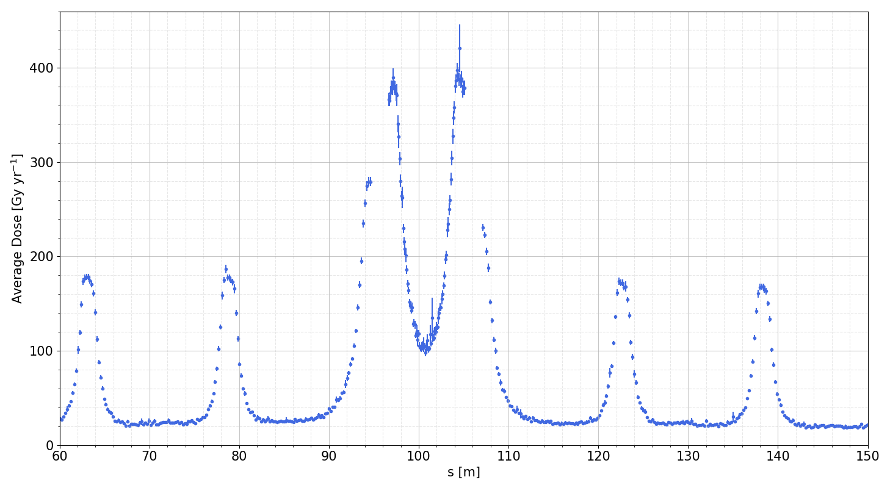
FCC-hh ARC [II]
J. Hunt
beam
D5
D6
Q1
D7
D8
beam
400 Gy/y for 10¹⁵ H₂ m⁻³
i.e. 2 Gy/y with the LHC vacuum quality (200 times better than the design value)
20 Gy/y for 10¹⁵ H₂ m⁻³
i.e. 100 mGy/y for 5 10¹² H₂ m⁻³ (LHC)

Slide 8
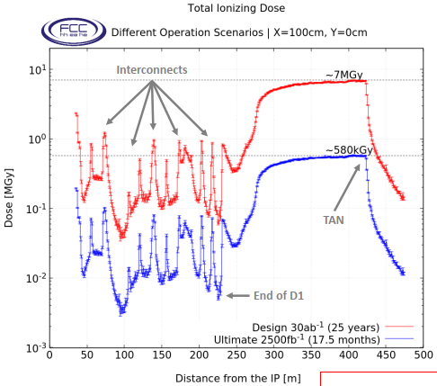
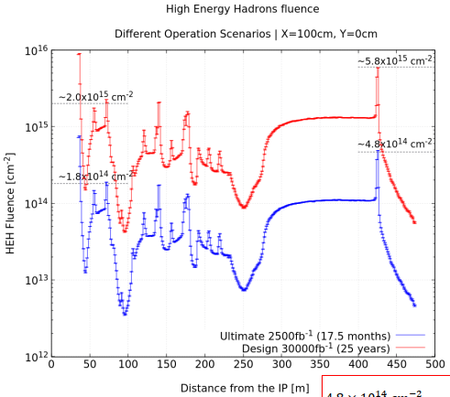
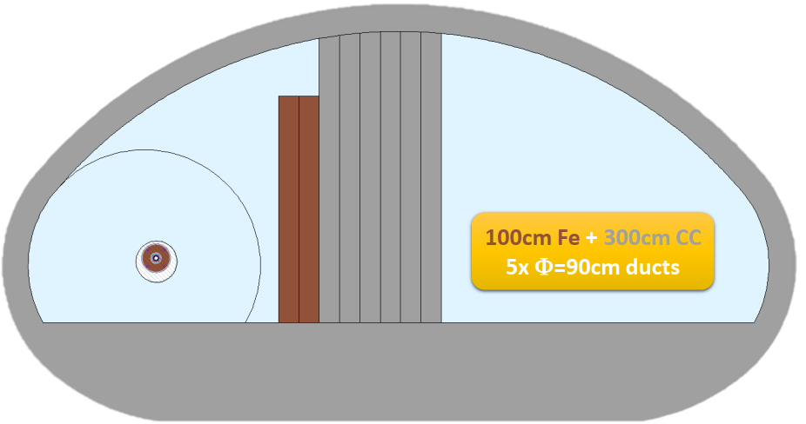
FCC-hh EIR
A. Infantino
collision debris
10⁸ – 10⁹ HEH cm⁻² per 2.5 ab⁻¹
as the annual (250 fb⁻¹) level in the HL-LHC UJ

Slide 9
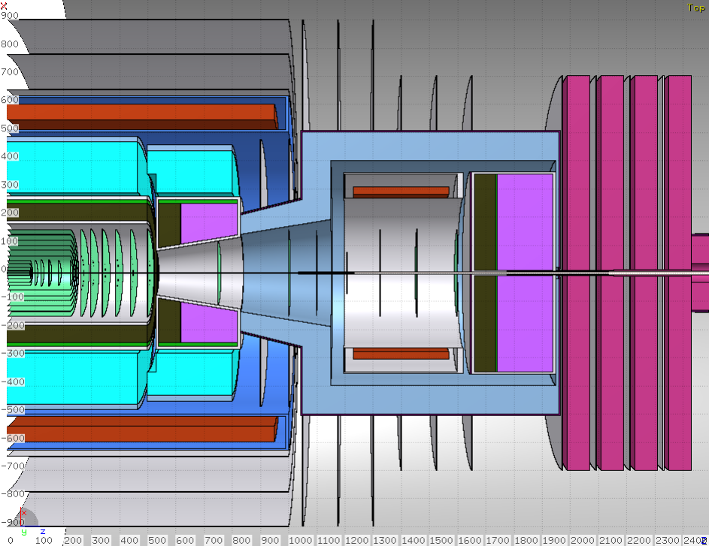
FCC-hh DETECTOR [I]
M.I. Besana

Slide 10
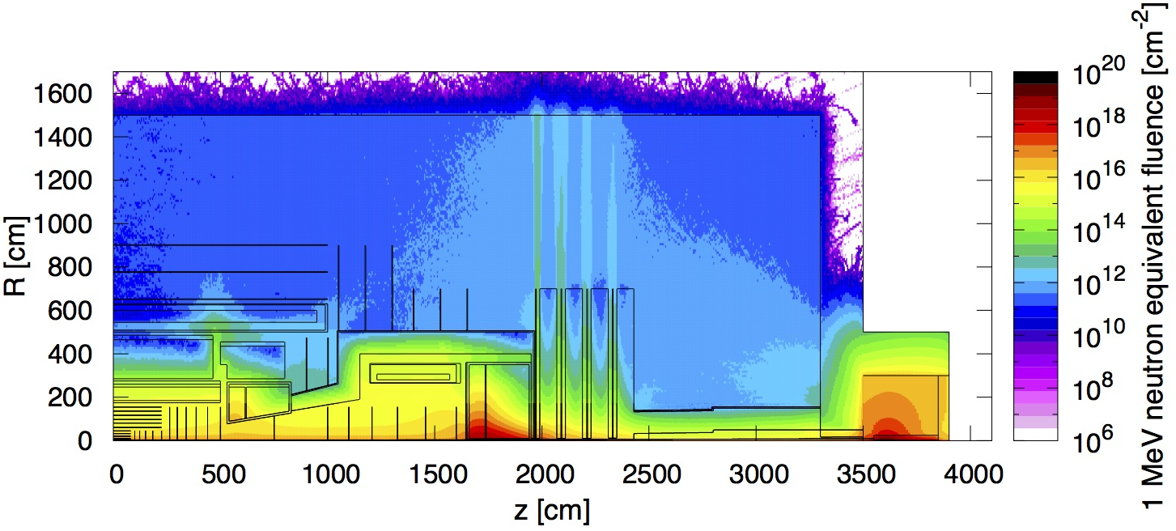
FCC-hh DETECTOR [II]
M.I. Besana
collision debris
after 30 ab⁻¹
Barrel calorimeter:
EM-calo: 4 10¹⁵ cm⁻²
HAD-calo: 4 10¹⁴ cm⁻²
Forward calorimeters:
  maximum at ~5 10¹⁸ cm⁻² for both the EM and the HAD-calo
  10¹⁶ cm⁻² at R=2 m
End-cap calorimeter:
  EM-calo: 2.5 10¹⁶ cm⁻²
  HAD-calo: 1.5 10¹⁶ cm⁻²
End-cap calorimeter:
EM-calo: 2.5 10¹⁶ cm
HAD-calo:: 1.5 10¹⁶ cm
Muon chambers:
  barrel: 10¹² cm⁻²
  end-cap: 10¹³ cm⁻²
  forward: up to 10¹⁷ cm⁻², 10¹⁵ at R=2 m
Central tracker:
first IB layer (2.5 cm ): ~6 10¹⁷ cm⁻²
external part: ~5 10¹⁵ cm⁻²
Calorimeter gap: from 10¹⁶ cm⁻² to 10¹⁴ cm⁻²

Slide 11
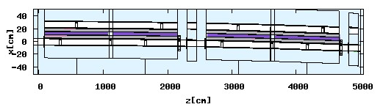
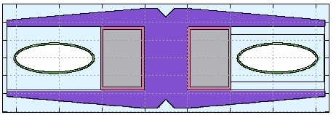
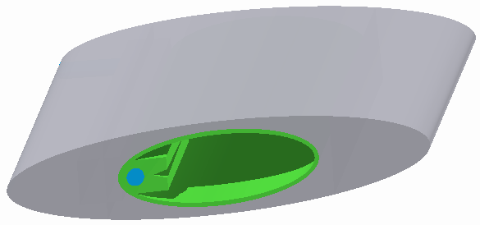
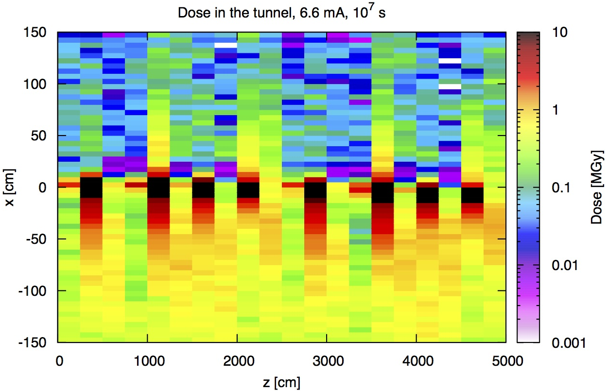
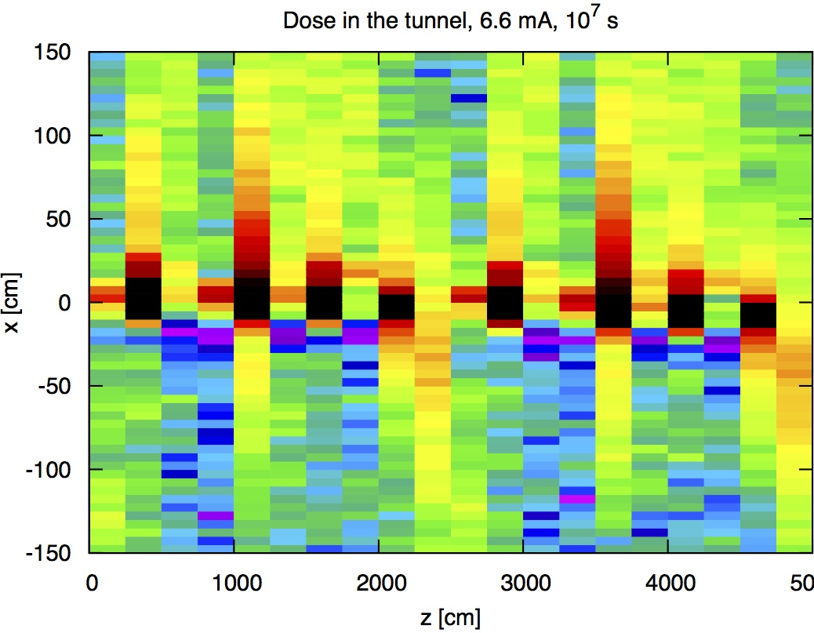
FCC-ee ARC
M.I. Besana (2016)
synchrotron radiation from 175 GeV electrons
internal beam
external beam
top view
- 5 cm < y < 5 cm
> 100 kGy/y, 10¹² 1 MeV n eq cm⁻²/y, 10⁷ HEH cm⁻²/y
m

Slide 12
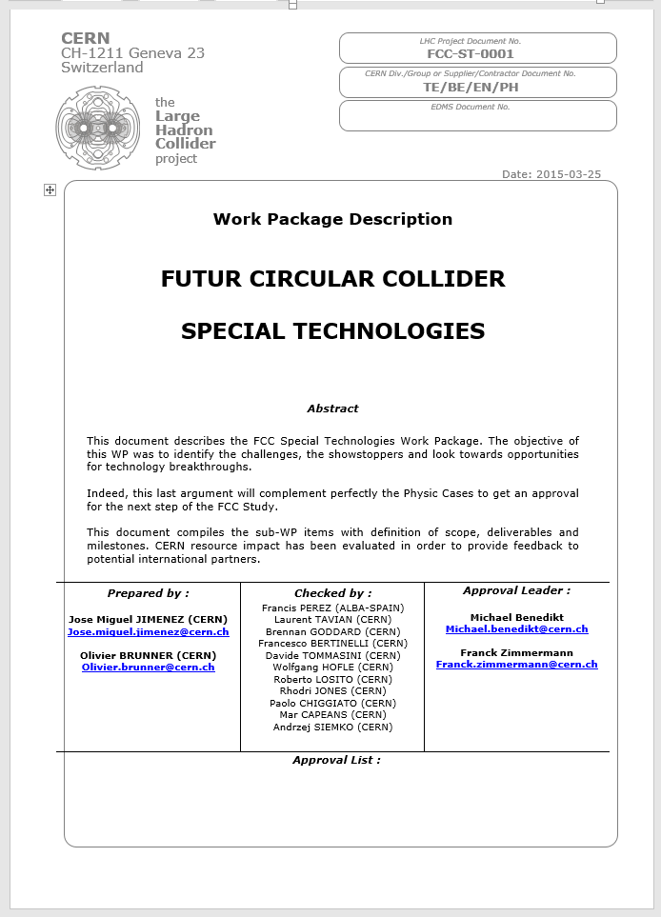
ST WP: RADIATION HARDNESS ASSURANCE
OF ELECTRONICS TASK
The unprecedented radiation field expected questions the possibility to reliability operate FCC and its experiments. An exploratory study on this crucial issue has been carried out, within the RHA task, on the following themes:
  development of Rad-hard electronics
    study of radiation tolerance of new CMOS technologies for the design of Application-Specific Integrated Circuits (ASICs)
  qualification of Rad-tol components
    no resources allocated
  needs for adequate irradiation facilities
    identification and investigation of limitations for CERN facilities
  development of suitable radiation monitoring systems (for the components qualification and FCC operation)
    focus on ultra-high level dosimetry
FCC Week 2018:
https://indico.cern.ch/event/656491/sessions/263078/#20180412

Slide 13
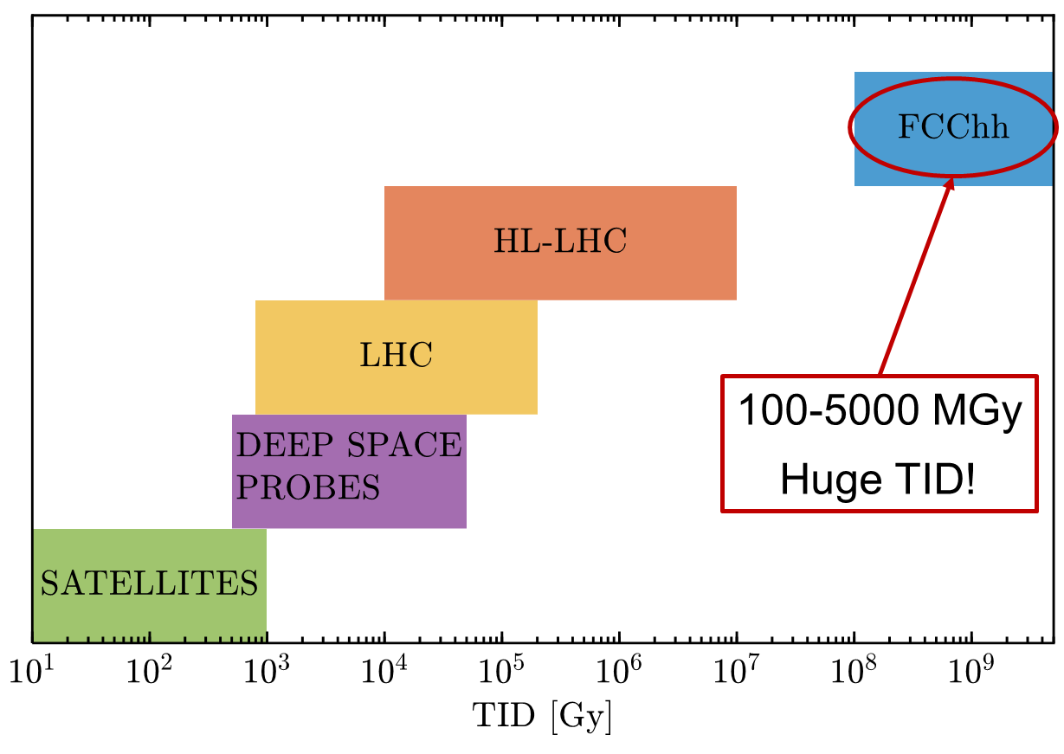
DEVELOPMENT OF RADIATION HARD ELECTRONICS
Application-Specific Integrated Circuits (ASICs) are designed in CMOS technologies and are composed almost exclusively by nMOS and pMOS transistors. Therefore, the measurement of the radiation response of the transistors in different CMOS technologies is representative of the achievable level of radiation tolerance for the ASICs.
We have studied the radiation tolerance of transistors in the CMOS technology nodes from 130nm to 28nm (only TID).
Best performer:
28nm CMOS
It appears that the 28nm technology node has better radiation tolerance, suggesting that appropriately designed ASICs could survive radiation levels approaching 1Grad. However, this radiation level is well below those expected in some locations at the LHC-hh experiments.
Figure-of-Merit:
% decrease of max current in nMOS and pMOS transistors of minimum size
1Grad
(=10 MGy)
F. Faccio, G. Borghello PhD (CERN-EP)
Increasing TID levels

Slide 14
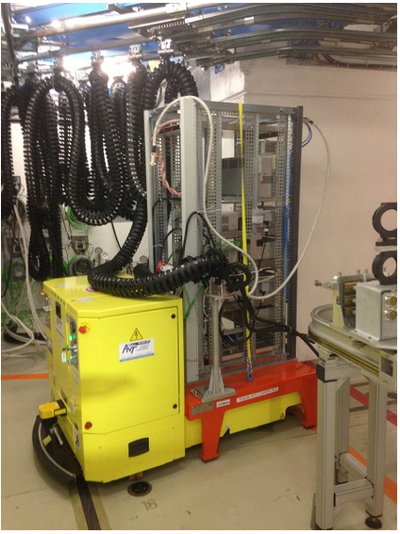
RAD-TOL DESIGN AND QUALIFICATION FOR FCC
Present landscape for accelerator qualification of COTS-based systems:
  Critical electronic components are tested at device level, however final validation for reliable operation in representative radiation field is performed at system level (i.e. at the dedicated CHARM facility)
  Approach already at the limit of requirements for distributed HL-LHC systems (e.g. power converters)
Evaluation and roadmap for FCC:
  Higher radiation levels, larger amount and complexity of systems, tighter reliability/availability requirements
  System design/architecture considerations:
      Importance of common building blocks, centralized versus embedded approach, degraded mode operation, failure self-diagnose, on-line hot-swap, remote handling capability, etc.
  Need of progressing in design, qualification and facility requirements and guidelines for FCC
  Importance of international collaboration with space and ground-level (e.g. server farms, automotive) applications
~1m
Maximum system size allowed at CHARM facility
R. Garcia Alia, S. Danzeca (CERN-EN)

Slide 15
LIMITATIONS OF CURRENT CERN IRRADIATION FACILITIES
Main shortcomings identified in current CERN infrastructure of irradiation facilities
Name | Main Purpose | Issues w.r.t. FCC-driven targets (10 years operation) | Possible solution
IRRAD | Study of IEL and NIEL effects on performance of detectors, calorimeters and FE electronics for HEP experiments. | low particle flux. | Increase flux to reach target fluence faster.
CHARM | Test of COTS electronics in a LHC-like environment for SEE evaluation such as failure cross sections and system sensitivity to radiation. | not enough space. | Larger irradiation bunker to test more racks in parallel.
GIF⁺⁺ | Evaluation of detection performance and aging of muon chamber detectors in ionizing dose environment. | both limited space and low dose-rate. | Larger irradiation bunker to test bigger equipment + stronger gamma source.
CC60 | Validation and test of electronic components and systems to ionizing radiation. | both limited space and low dose-rate. | Stronger source.
VESPER | Characterizing electronic components to SEE, TID and DD, for the operation in a Jovian space-environment. | facility not equipped for wafer level testing, and small irradiation table. | Upgrade of testing infrastructure.
X-ray generators | Characterizing electronic components (COTS, ASIC) to TID. | Insufficient dose-rate. | Unknown.
Database of irradiation facilities (EU-funded AIDA-2020 project) to boost international collaboration for FCC radiation testing. http://cern.ch/irradiation-facilities

Slide 16
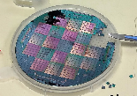
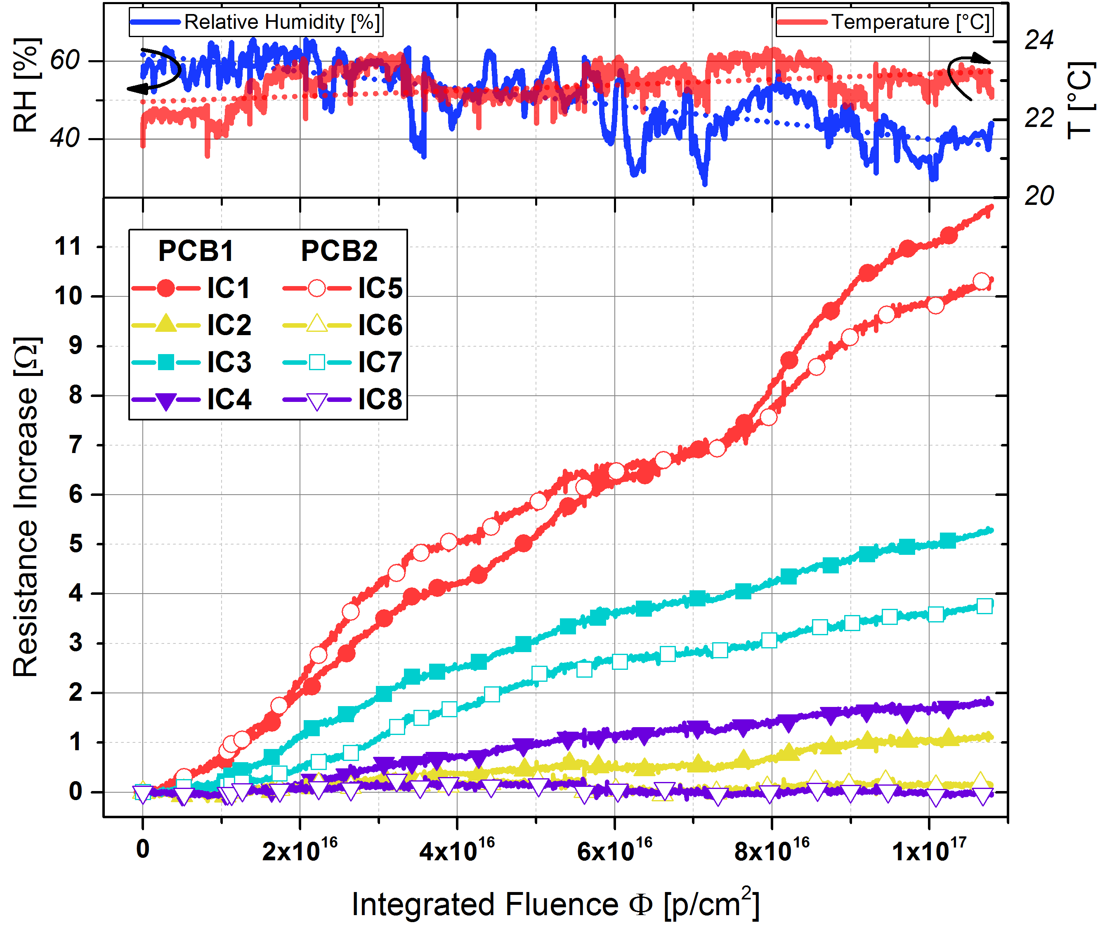

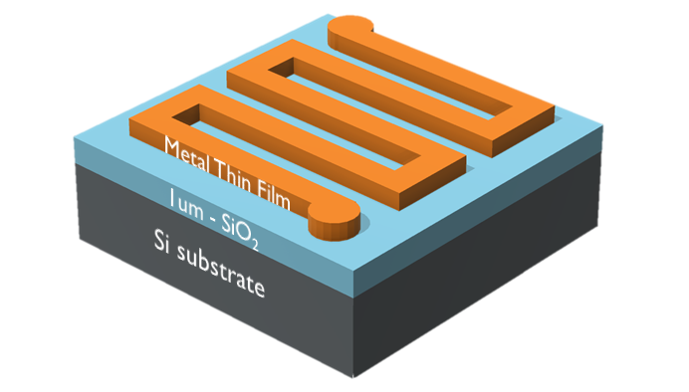

ULTRA HIGH RADIATION DOSIMETRY
R&D on a new dosimetry technology based on nm-thick Copper thin films.
Variation of electrical resistivity due to Radiation Enhanced Oxidation of copper exposed to radiation, tested up to 5x10¹⁷ p/cm².
Technology to further develop, potentially suitable to build a FCC radiation monitor.
Design and Fabrication
Irradiation and Measurement
[1] IEEE Trans. Nuc. Sci. 10.1109/TNS.2018.2797540
[2] RAD Journal, 10.21175/RadJ.2018.03.029
[3] AIP Advances, under review Radiation enhanced oxidation of proton-irradiated copper thin-ﬁlms
Resistance increase during proton irradiation
3 x 3 mm²
Radiation Dependent Resistor
F. Ravotti, G. Gorine PhD (CERN-EP)

Slide 17
STATUS OF RHA TASK RESOURCES IN ST WP
Task Leader: Rubén García Alía (EN/STI)
Deputy Task Leader: Federico Ravotti (EP/DT)
Activities (including FCC-funded PhDs and fellowships):
  Radiation environment simulation (Francesco Cerutti, EN/STI):
      fellowship of Angelo Infantino finished in Jan 2019; fellowship of James Hunt (partially FCC funded) started in Mar 2019
  Deep sub-micron CMOS tech. evaluation (Federico Faccio, Giulio Borghello, EP/ESE):
    PhD of Giulio Borghello finished in 2019. No further FCC resources allocated
  Common building-block technologies development and qualification (Salvatore Danzeca, EN/SMM):
    synergies with R2E and RADSAGA activities but no dedicated FCC resources allocated so far
  Test facilities and radiation monitoring (Federico Ravotti, EP/DT):
    PhD of Georgi Gorine finished in 2019. No further FCC resources allocated

Slide 18
PROSPECTS
refocus the calculation effort according to refreshed priorities
reprofile the RHA task activities on the basis of available resources

