Slide 1

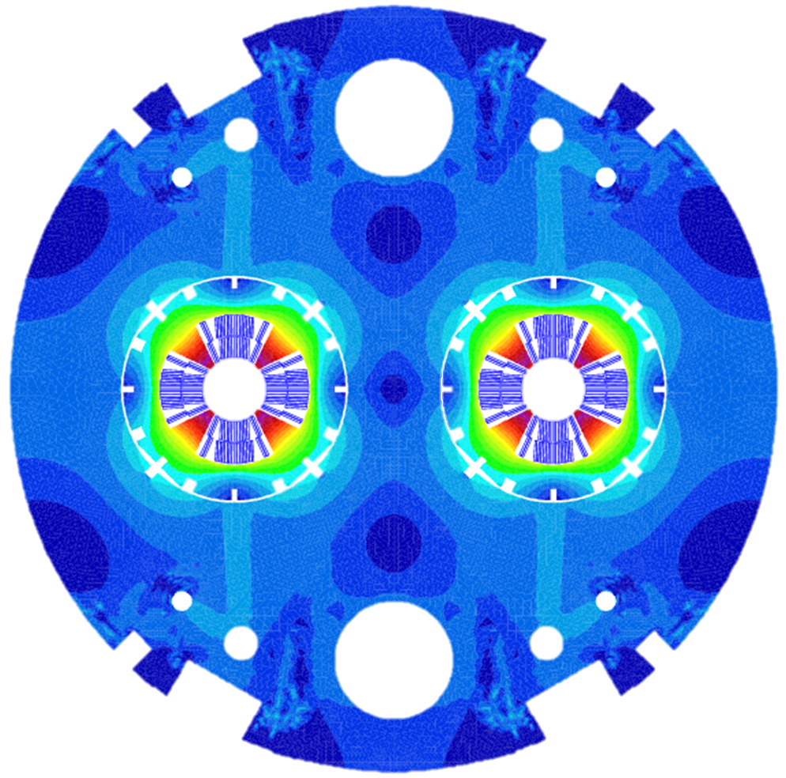


FCC Main Quad
Clément GENOT, Clément LORIN, Gilles MINIER, Tiina SALMI, Davide TOMMASINI
Inputs from: D. Schoerling, E. Rochepault, H. Felice, I. Pong, J. Fleiter, M. Segreti, M. Prioli
27 june 2019

Slide 2
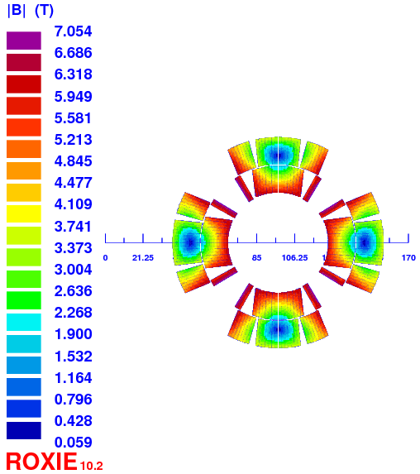
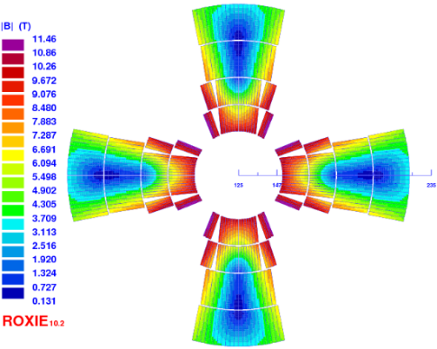
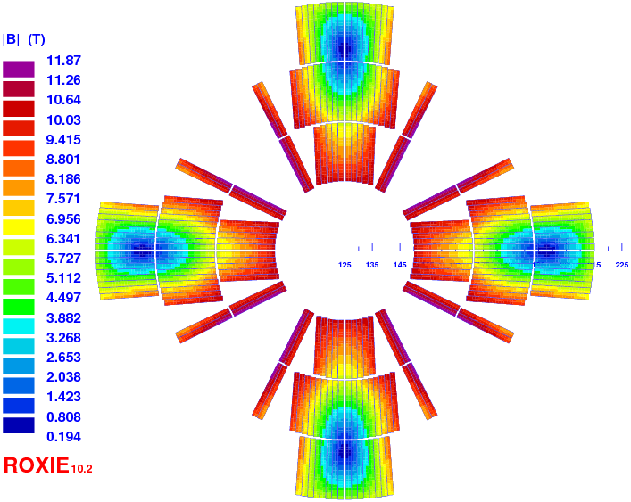
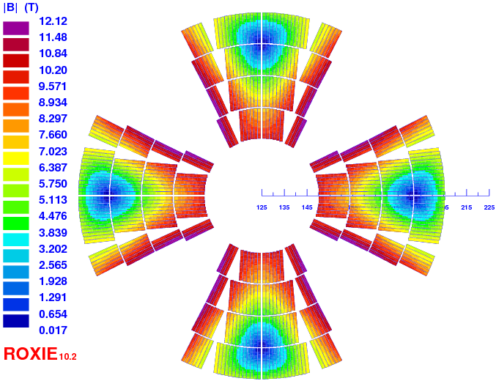
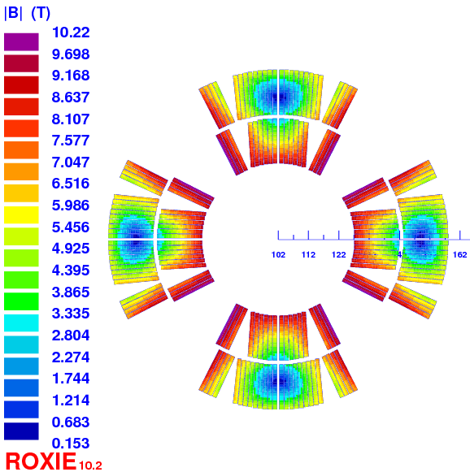
“History”
LHC
MQ: 223 T/m x 3.2 m
2 layers design (Nb-Ti)
1st FCC week
Baseline: 450 T/m × 6.0 m
4 layers graded design (2×Nb₃Sn + 2×Nb-Ti) 407 T/m with 20% LL margin, no protection check
2nd FCC week
Baseline: 420 T/m × 6.5 m
3 layers design (3×Nb₃Sn) 413 T/m with 20% LL margin [E. Todesco], 40 ms protection delay
3rd FCC week
Baseline: 381.2 T/m × 6.0 m
4 layers design (4 × Nb₃Sn) 400 T/m with 14% LL margin, 40 ms protection delay
4th FCC week
Baseline: 360 T/m x 7.2 m
2 layers design (2×Nb₃Sn) 353 T/m with 20% LL margin, 30 ms protection delay

Slide 3
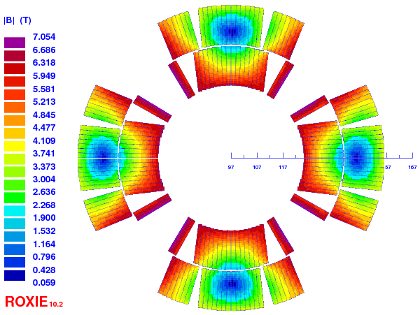
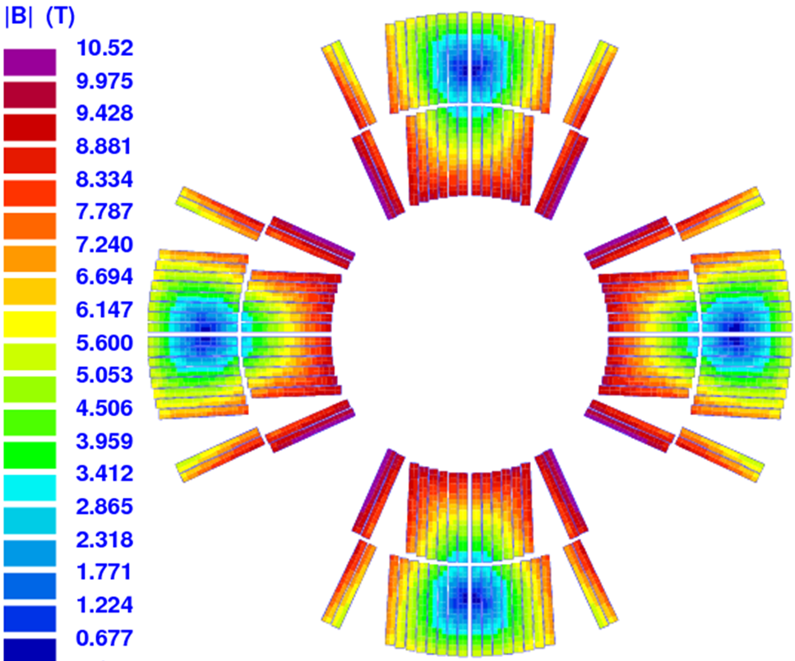
Last FCC-hh MQ version
Magnet parameter | Units | LHC MQ | FCC-hh MQ
Gradient | T/m | 223 | 367.4
Nominal current | A | 11870 | 22500
Peak field | T | 7.0 | 10.52
Peak field / (Radius x Gradient) | - | 1.12 | 1.15
Loadline margin | % | 20.0 | 20.0
Temp magin | K | 2.0 | 4.6
Inductance (2 ap.) | mH | 11 | 14.4
Stored energy (2 ap.) | kJ | 800 | 3670
Azimuthal force (per ½ coil) (1st + 2nd layers) | MN | 2.6 | 12.3
Radial force (per ½ coil) | MN | 0.9 | 5.5
Fx (per ½ coil) | MN | 1.5 | 7.8
Fy (per ½ coil) | MN | 2.4 | 11.4
Midplane shim | µm | 137 | 330
Hotspot (total delay) | K | - | 350 (30 ms)
Nb of turns per layer | - | 10 + 14 = 24 | 8 + 10 = 18
Total weight of conductor | tonnes | - | 272
Magnetic length | m | 3.15 | 7.06
56 mm
50 mm
LHC MQ
FCC-hh MQ

Slide 4
Harmonics contents 2D analysis
Current ramp-up after preparation cycle from injection (3.3 TeV/beam) to nominal (50 TeV/beam)
Filament diameter:
55 µm (RRP QXF state of the art*)
20 µm (FCC target**)
I = 1485 A; G = 24 T/m
I = 22500 A; G = 367 T/m
*QXF cable is made with a strand of 0.85 mm in diameter, too - Simon Hopkins et al., The FCC conductor development programme, 4th FCC week, Amsterdam 9th-13th April 2018
**Ballarino A., Bottura L., Targets for R&D on Nb3Sn conductor for High Energy Physics, IEEE TAS, 6000906, (2015)

Slide 5
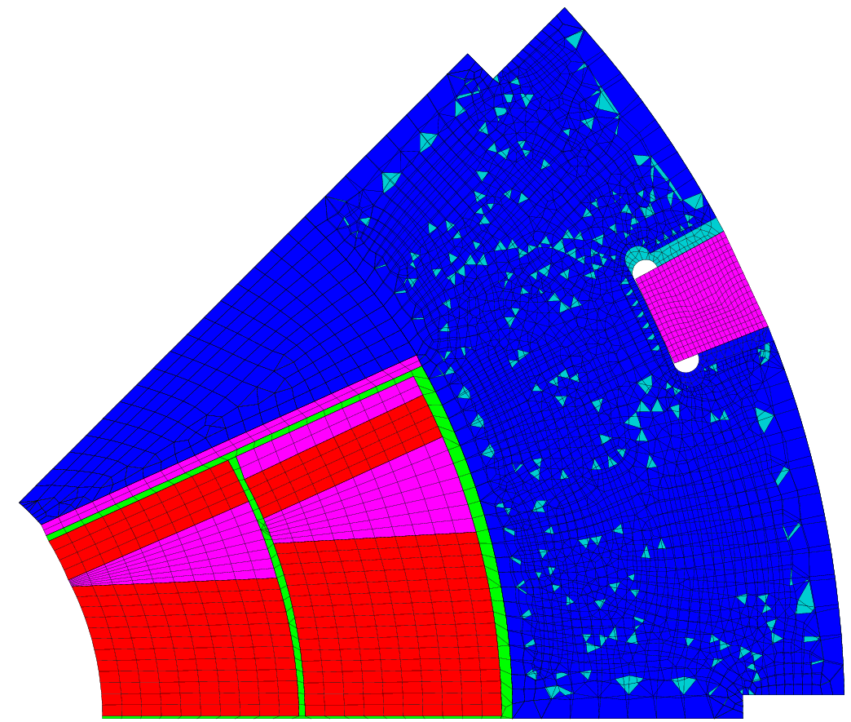
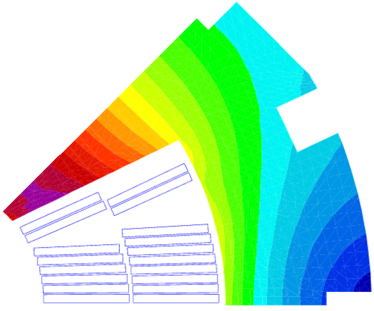
Mechanical model
Double pancake glued (dark area)
Sliding contact elsewhere (without separation)
Mechanical properties:
Material | E [GPA] / 293 K | E [GPA] / 4.2 K | Pr | (L4.3K – L293K)/L293K
Nb₃Sn | 30 | 33 | 0.3 | 3.4e-3*
Epoxy | 5 | 8 | 0.34 | 6.0e-3
13RM19 (steel) | 200** | 210* | 0.28* | 2.7e-3**
DISCUP (copper) | 96*** | 96 | 0.3 | 3.3e-3
*Tommasini D. et al. https://indico.cern.ch/event/556692/contributions/2591664/ 3rd FCC week Berlin, 2017 + EuroCirCol meeting
**Lanza C., Perini D., Characteristics of the austenitic steels used in the LHC main dipoles, MT17, 24-28 September 2001, Geneva
***Scheuerlein et al, Mechanical properties of the HL-LHC 11 T Nb3Sn magnet constituent materials, IEEE TAS, 4003007, (2017)

Slide 6
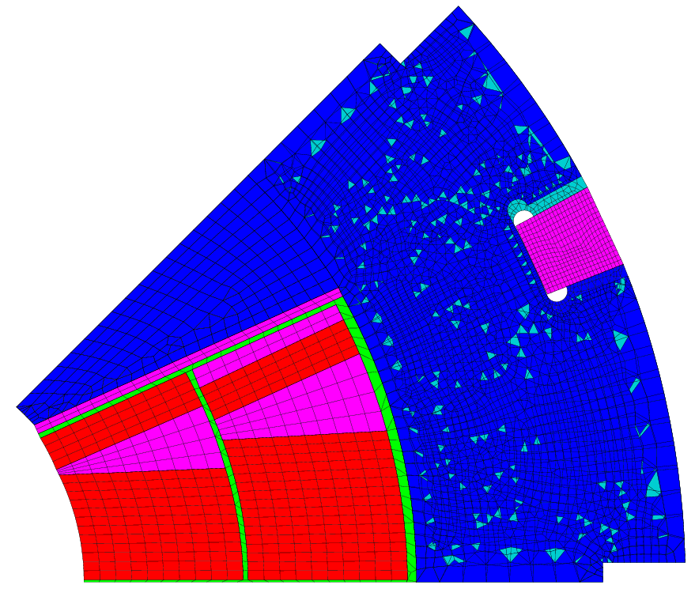
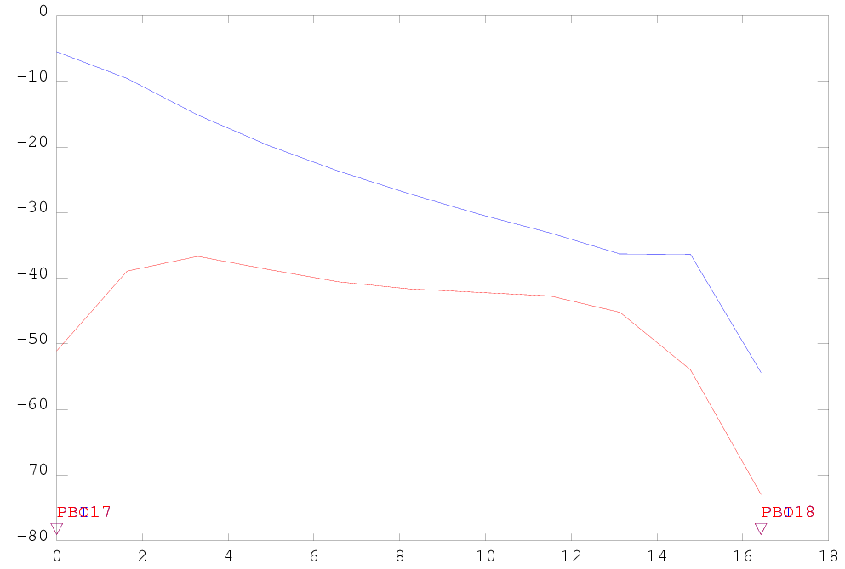
Peak stress in the coil
Goal:
good coil-pole contact at nominal (< -5 MPa)
[MPa]
inner layer
outer layer
Azimuthal stress in the Nb₃Sn blocks of the coil
Insulated cable width
[mm]
Collaring | Collaring - 10% creep* | Cold | Powering
peak / average | peak / average | peak / average | peak / average
-101.5 / -85.5 | -91.4 / -76.9 | -88.5 / -73.2 | -111.1 / -69.7
The pole could be even more loaded
*Felix Wolf : “Strong creep behavior starting at 125 MPa” in Effect of transverse stress applied during reaction heat treatment on the stiffness of Nb3Sn Rutherford cable stacks, https://indico.cern.ch/event/743626/contributions/3154023

Slide 7
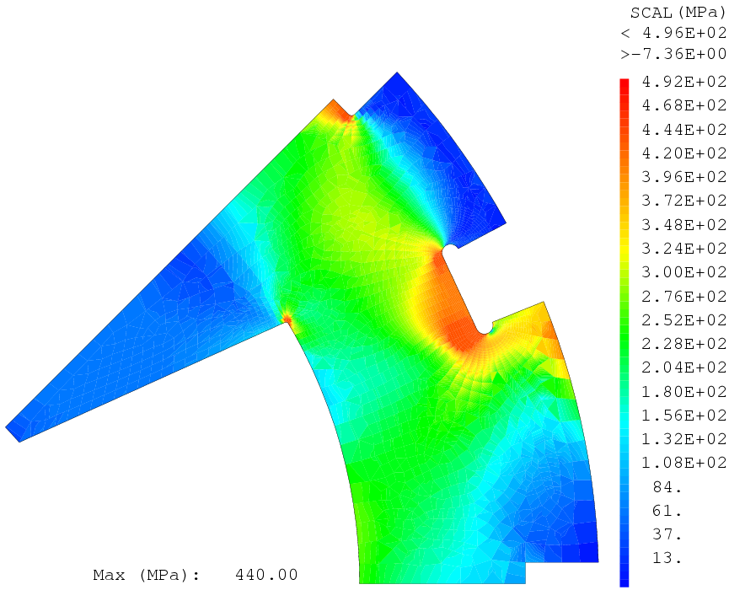
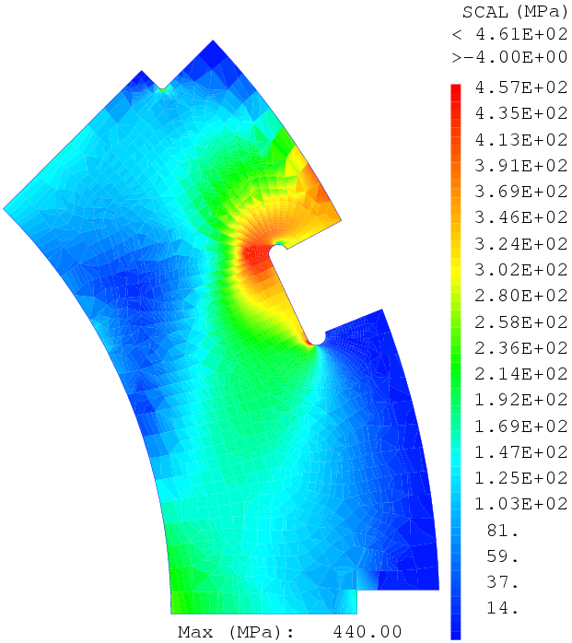
Elasto-plastic model for collar
Stress
conservative
440 MPa
200 GPa
Strain
Collar steel: 13RM19 (LHC quad steel)
Yield strength of the collars σ_{0.2} = 440 MPa*
Azimuthal stress in the Nb₃Sn blocks of the coil
Collaring Elasto Plastic model
peak / average
-111.6 / -86.5
Collaring Elastic model
peak / average
-101.5 / -85.5
*Lanza C., Perini D., Characteristics of the austenitic steels used in the LHC main dipoles, MT17, 24-28 September 2001, Geneva
**Bertinelli F., et al., Production of austenitic steel for the LHC superconducting dipole magnets, IEEE TAS, vol 16, no 2, (2006)
(for information YUS130 S for LHC dipoles**)

Slide 8
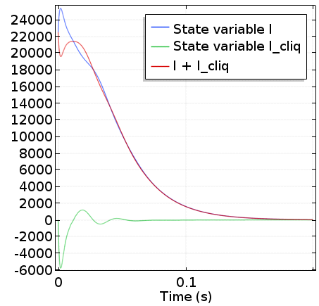
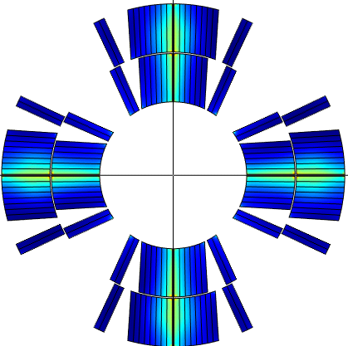

CLIQ Protection
[T. Salmi, M. Prioli, E. Ravaioli]
I
I_{CLIQ}
I + I_{CLIQ}
Energy deposition after 10 ms [mJ/cm³]
600
P2
P1
500
400
I
P1
P2
P4
P3
300
Current [A]
I
200
CLIQ
P3
P4
100
Quantities | Values | Unit
Capacitance CLIQ unit | 50 | mF
Voltage CLIQ unit | 500 | V
Detect. + val. + trig. times | 10+10+1 | ms
Hotspot temp. 100% I_{nom} | 300 | K
Hotspot temp. 105% I_{nom} (< 350 K) | 325 | K
Voltage to ground (<1.2 kV) | 250 | V

Slide 9
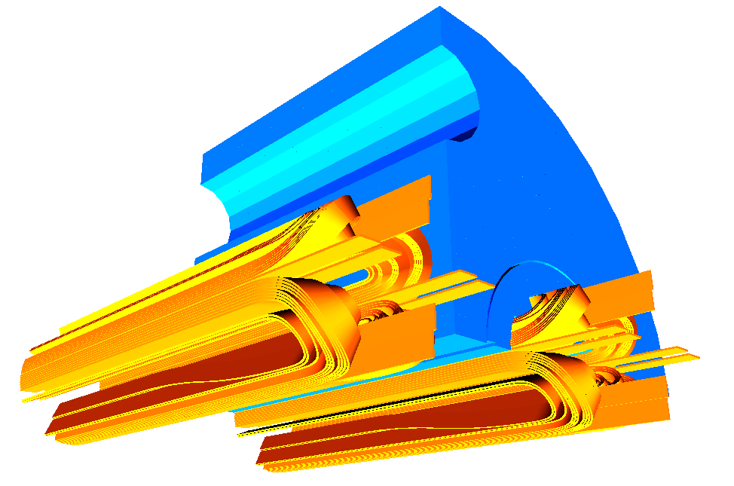
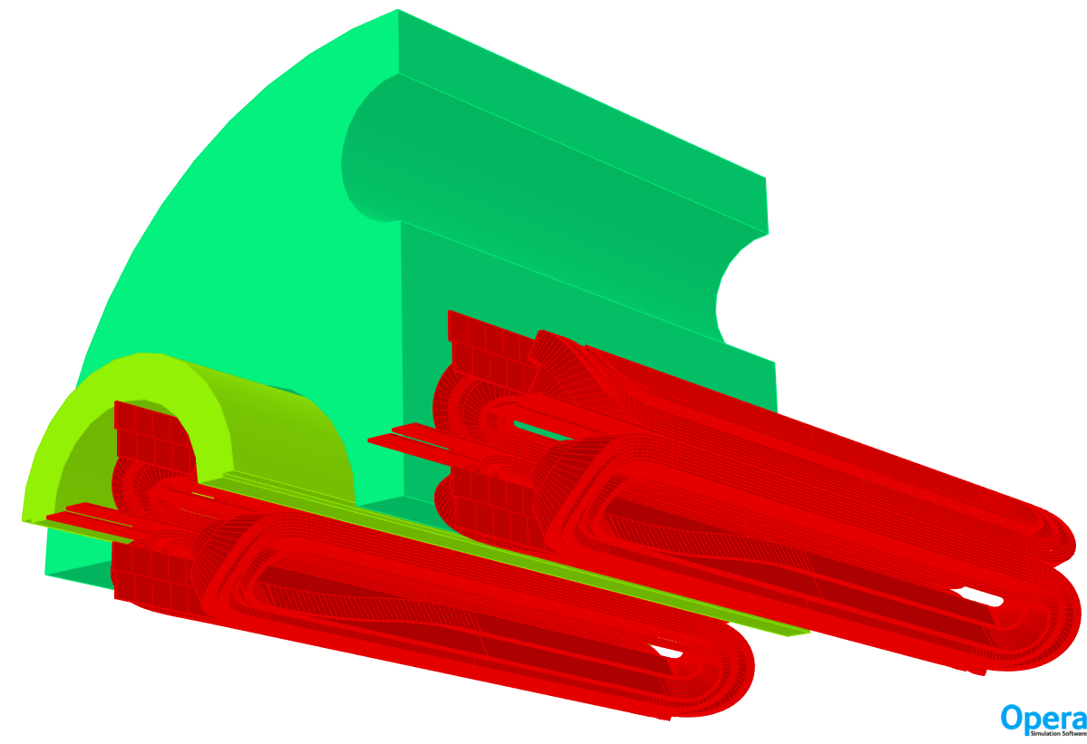
3D emag analysis – OPERA/ROXIE
Coil end design via ROXIE
  Cable windability
  Harmonic optimization
Geometry ROXIE -> OPERA
  End collar via OPERA
  Peak field calculation (ongoing investigation)
Lead extra length = 5 cm
ROXIE

Slide 10
3D emag analysis – OPERA/ROXIE
Return end
Layer jump
Lead end

Slide 11
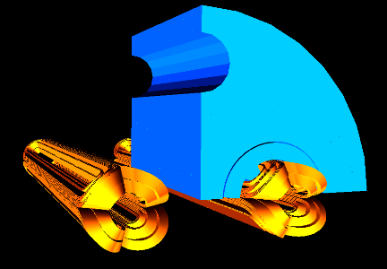
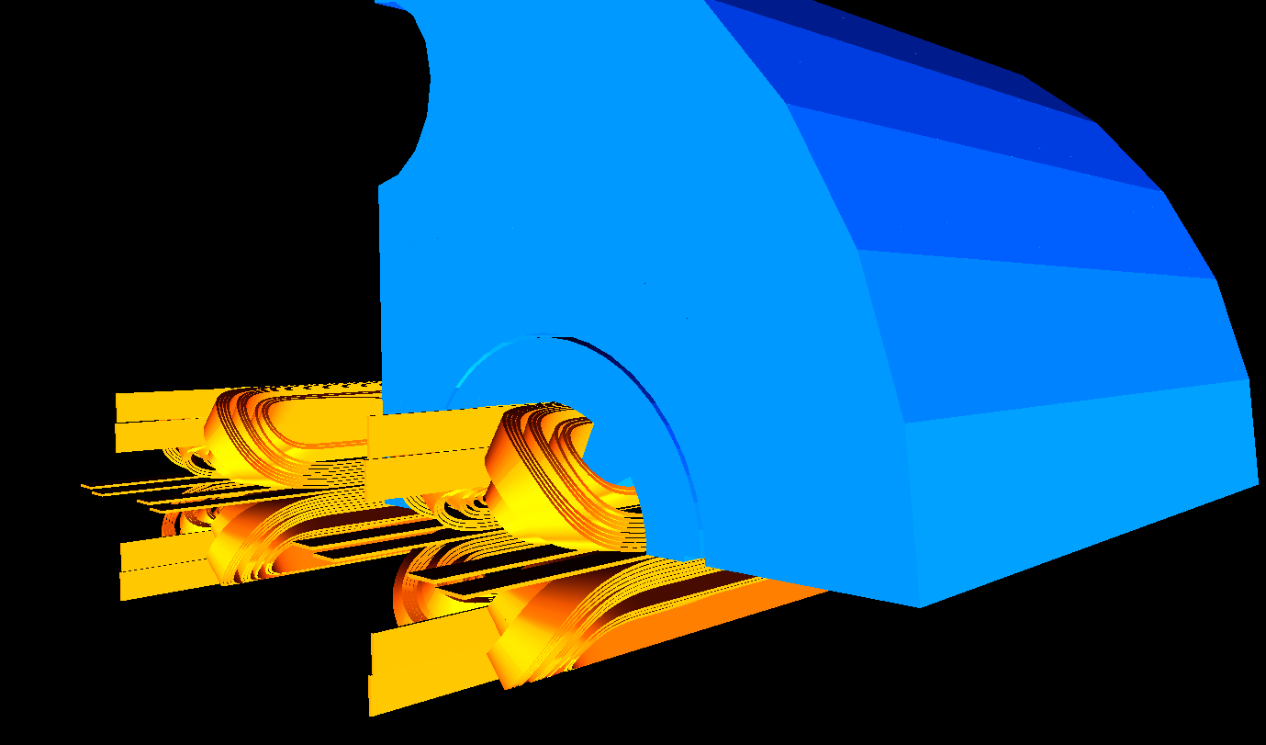







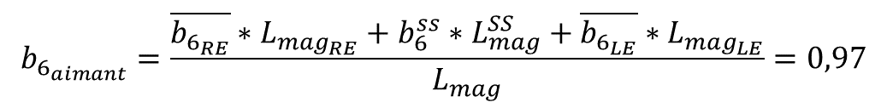



3D integrated harmonics (L_{mag} = 7,06 m)
Return end
Straight section
Lead end
$$L_{mag_{RE}}=77,42 mm$$
$$L_{mag}^{SS}=6700 mm$$
$$L_{mag_{LE}}=282,64 mm$$
$$\overline{b_{6_{RE}}}=−2,14$$
$$b_{6}^{ss}=0,14$$
$$\overline{b_{6_{LE}}}=21,37$$
$$\overline{b_{{10}_{RE}}}=−0,76$$
$$b_{10}^{ss}=−0,68$$
$$\overline{b_{{10}_{LE}}}=−2,83$$
//
$$b_{6_{aimant}}=\frac{\overline{b_{6_{RE}}}∗L_{mag_{RE}}+b_{6}^{ss}∗L_{mag}^{SS}+\overline{b_{6_{LE}}}∗L_{mag_{LE}}}{L_{mag}}=0,97$$
$$b_{{10}_{aimant}}=−0,77$$

Slide 12
Cable windability
Nb₃Sn cable less compact than Nb-Ti: stability ↘
Nb₃Sn interstrand resistance less control (steel core): stability ↘
Machine | LHC (Nb-Ti) | FCC-hh (Nb₃Sn)
Aperture (mm) | 56 | 50
Strand size (mm) | 0.825 | 0.85
Cu/non-Cu | 1.95 | 1.65
Number of strand (-) | 36 | 35
Bare cable width (mm) | 15.1 | 15.956
Mid-thickness (mm) | 1.48 | 1.493
Keystone (°) | 0.9 | 0.4
Inuslation (µm) | 130 | 150

Slide 13
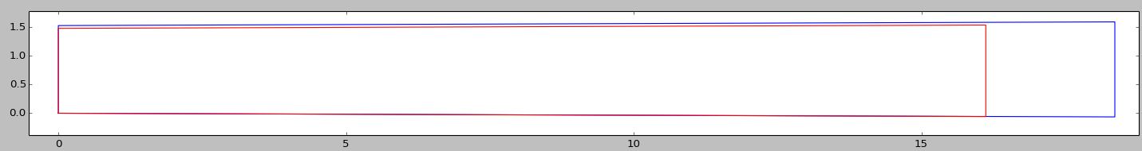
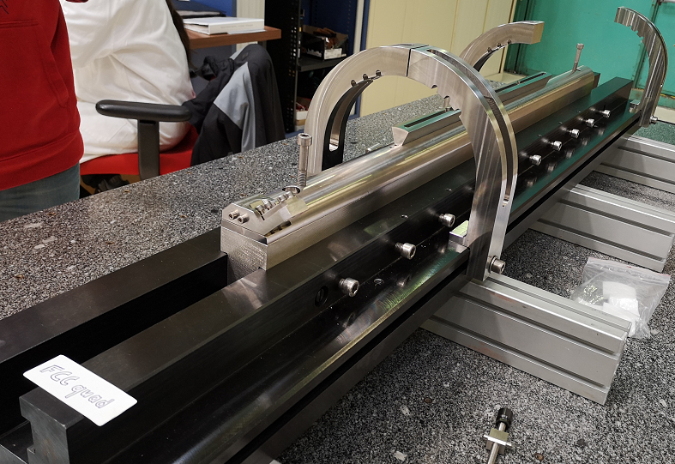
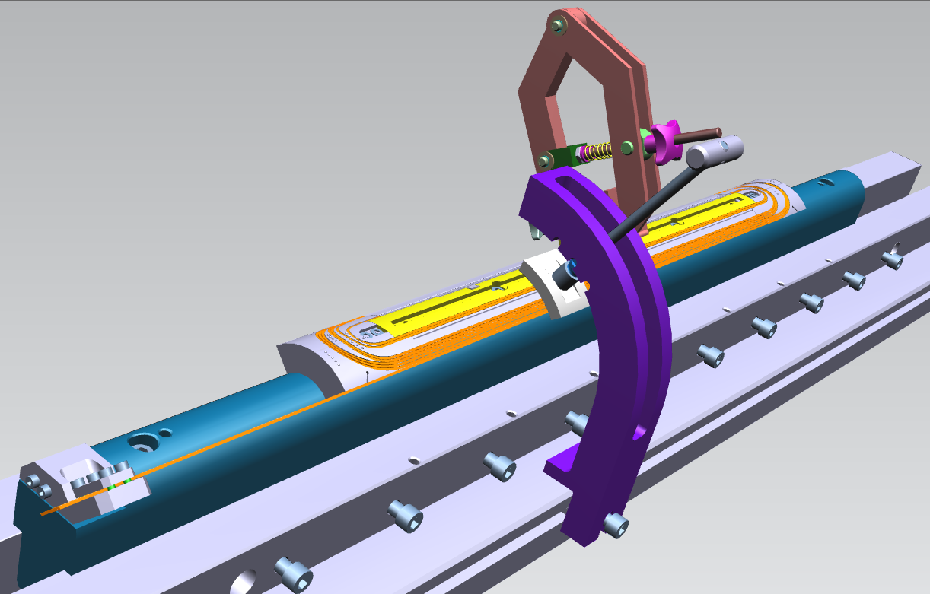
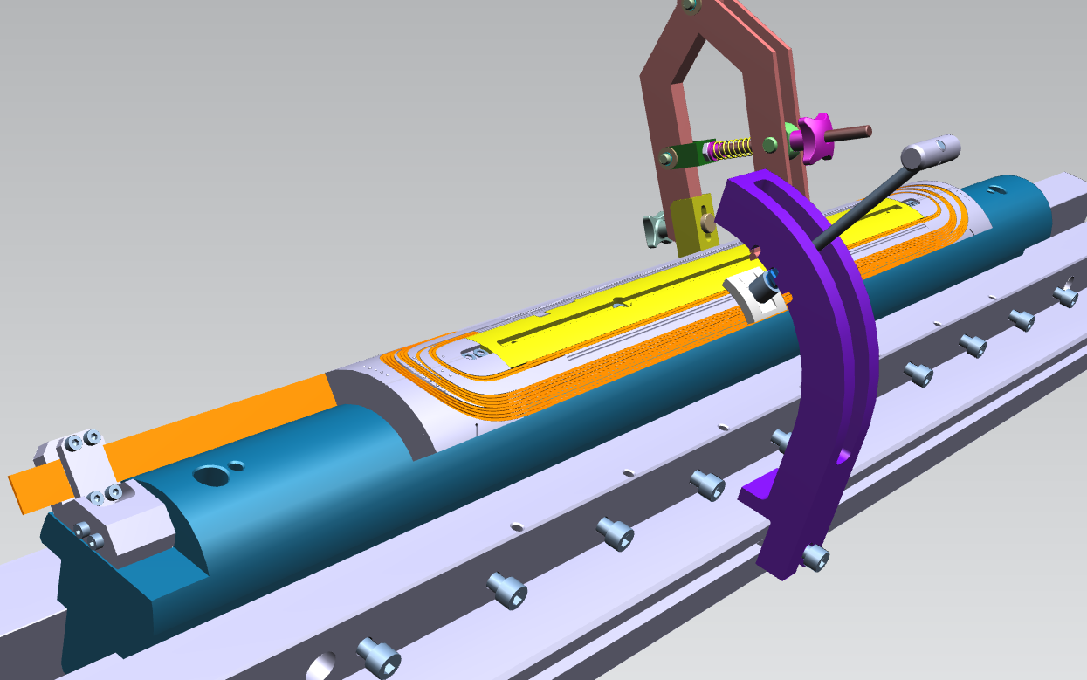
Windings trials
Closest cable geometry available is MQXF one: 40 strands instead of 35
  Δthickness = 50 µm
[mm]
~2 mm
[mm]
Inner layer CAD with MQXF cable
Outer layer CAD with MQXF cable

Slide 14
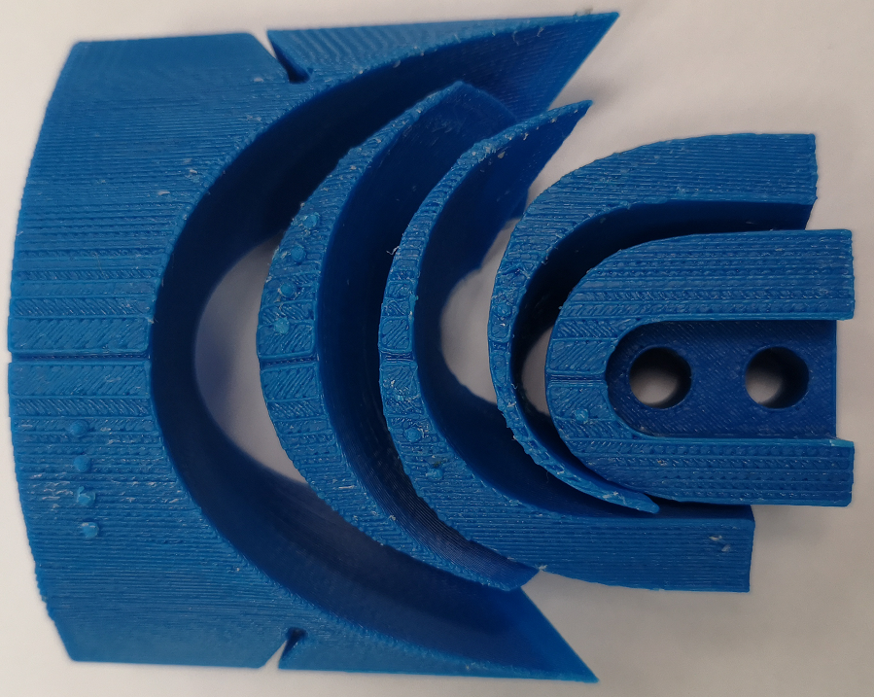
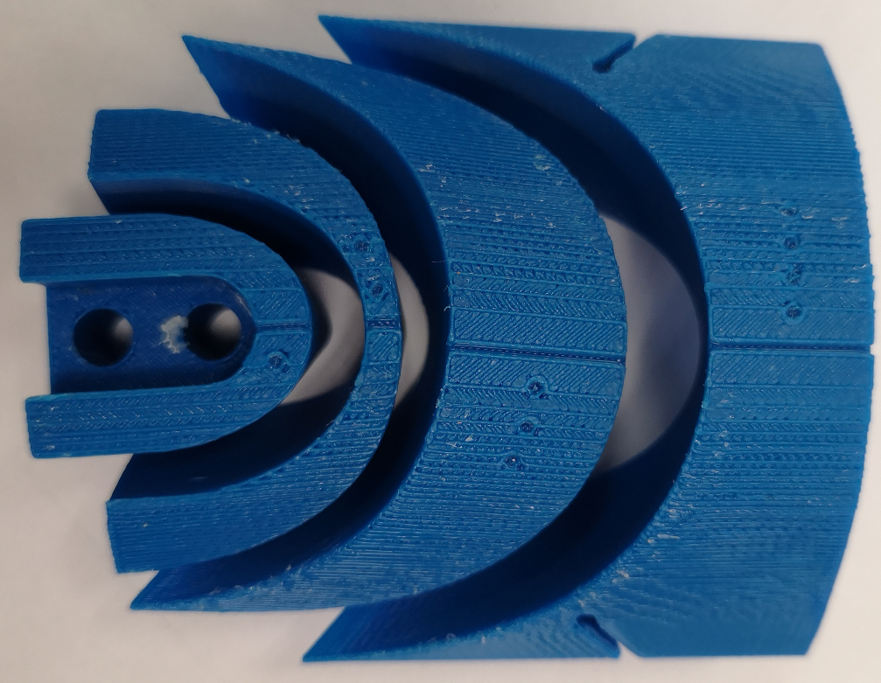
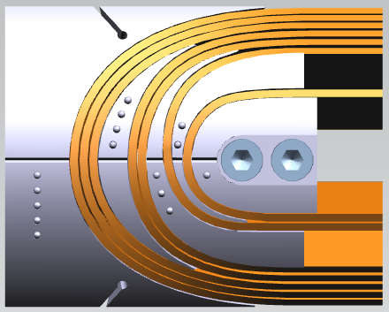
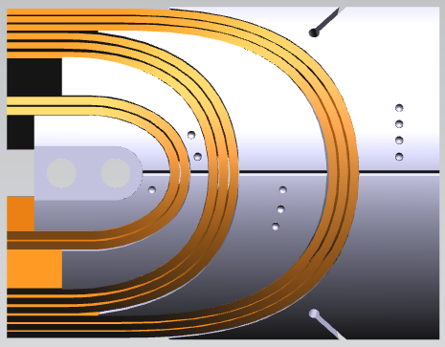
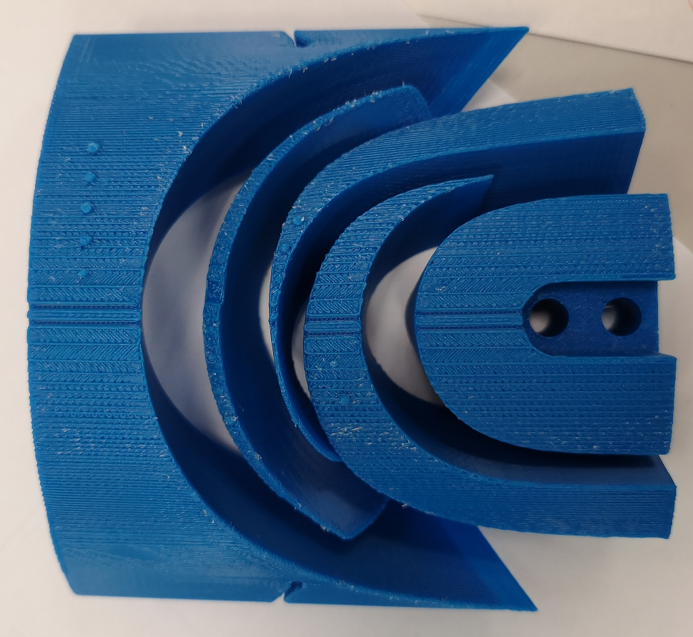
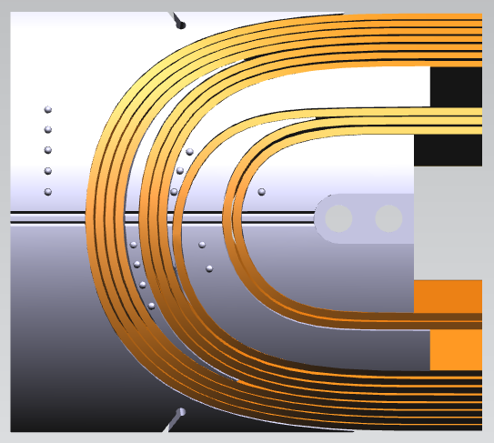
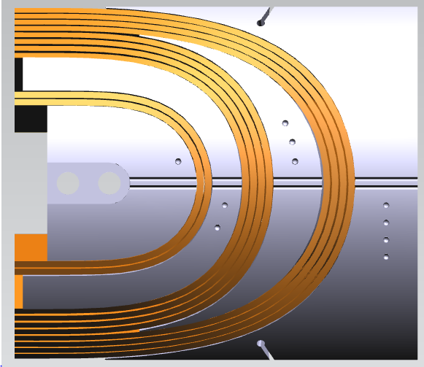
Inner layer
FCC quad end spacers extruded to the MQXF cable width
LE
RE
Some of the spacers 3D printed
Fused Deposition Modelling
Tolerance~ 0.2 mm
ABSpluS-P430
LE
RE
Outer layer

Slide 15

Conclusion
Several designs investigated over the past 5 years
Gradient in the 360 T/m range looks feasible
Mechanic : < 150 MPa
Protection : < 350 K
NEVERTHELESS, to me:
  very challenging in terms of windability of two layers magnet to reach 360 T/m
    0.85 mm x 35 strands (or 0.7 mm x 43 strands) -> too unstable?
    Validation on going with winding trials
    -> Back-up plan : to go back to 4 layer designs to reach 360 T/m

Slide 16
EXTRA SLIDES

Slide 17
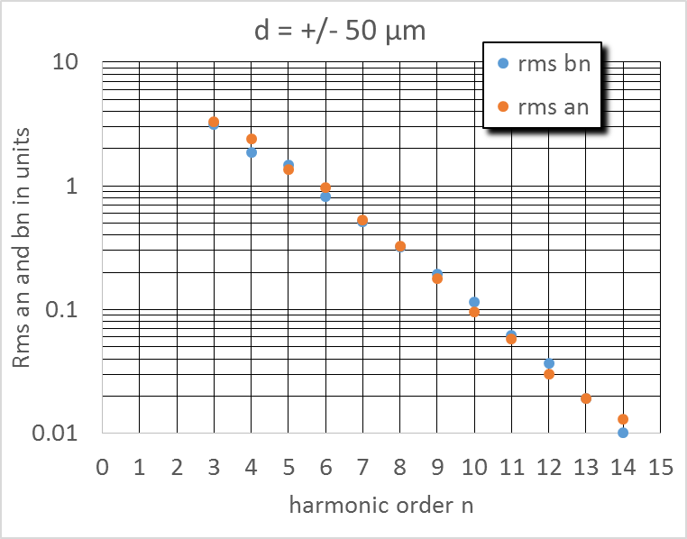
Cable position versus harmonic content
Random positioning
Random harmonics:
σ_{n}(d) = dαβ^{n} in units
d = 50 or 100 in µm
β = 0.58
α = 0.4
(for allowed harmonics α = 0.8, Ezio/Susana’s comment, nevertheless no statistics reported on quadrupole, only for dipoles)

Slide 18
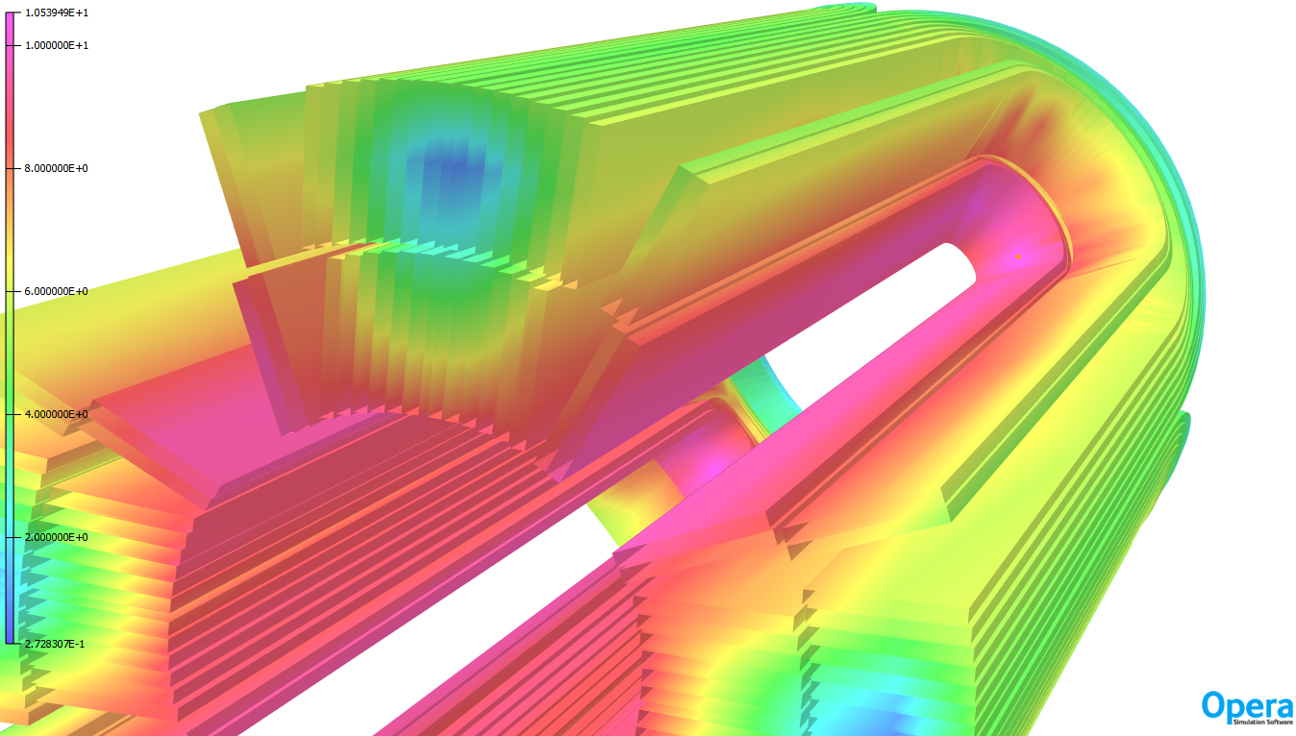
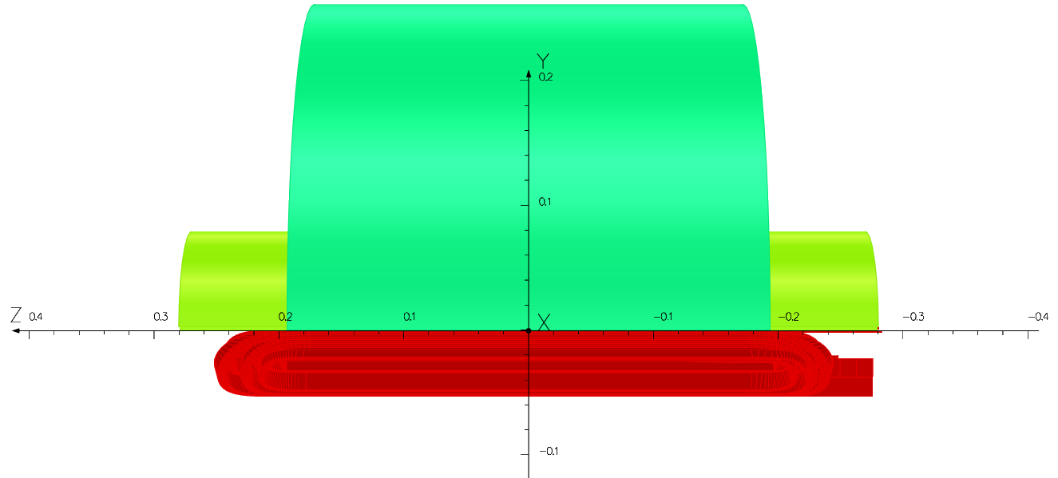





OPERA (no iron) : $B_{p_{head}}=10,29 T$
OPERA (no iron) : $B_{p_{SS}}=9,91 T$
B_{peak} | 10,54 | T
L_{straight section} | 180 | mm
L_{iron} | 392 | mm
L_{coil} | 539 | mm
L_{mag} | 484 | mm
L_{coil end RE} | 27,5 | mm
L_{coil end RE} | 269,5 | mm
OPERA (with iron) : $B_{p_{head}}=10,54 T$
OPERA (with iron) : $B_{p_{SS}}=10,04 T$
L_{iron}
+0.3 T in the RE head
~17% margin
367 T/m -> 360 T/m -> +19% margin
300 K@ Inom -> 350 K
Could recover the margin
L_{coil end RE}
L_{mag}
L_{coil end LE}
L_{coil}
Actually, Bp_{head} could be reduced by 0.3 T by inserting a spacer between the first two turns of the inner layer / return side. Under investigation.

Slide 19
MQXF vs FCC MQ cables
Cable Parameter | Units | MQXF | FCC quad (v12)
Strand diameter | mm | 0.85 | 0.85
Cu/NonCu | - | 1.2 ± 0.1 | 1.65
Nb of strands | - | 40 | 35
Cable bare width (before/after HT) | mm | 18.15/18.363 | 15.956/16.120
Cable bare mid-thick.(before/after HT) | mm | 1.525/1.594 | 1.493/1.538*
Cable bare thinness (before/after HT) | mm | 1.462/1.530 | 1.438/1.481* (15.4%)
Cable bare thickness (before/after HT) | mm | 1.588/1.658 | 1.549/1.596* (8.9%)
Cable width expansion | % | 1.2 | 1.0**
Cable thickness expansion | % | 4.5 | 3.0**
Keystone | ° | 0.40 | 0.40
Transposition pitch length | mm | 109 | 96
Insulation thickness per side (5 MPa) | µm | 145 ± 5 | 150

Slide 20
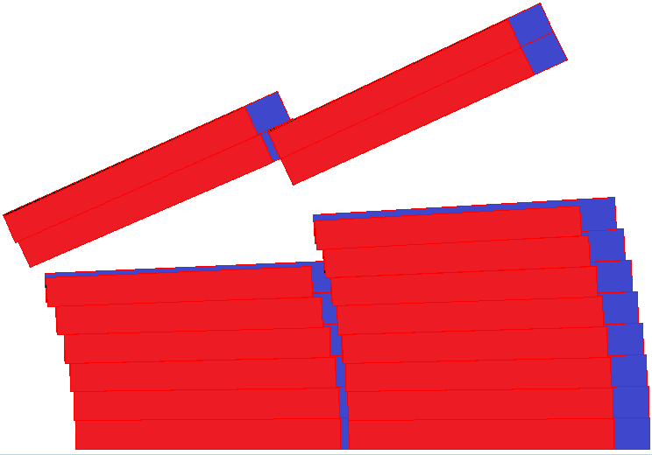
Winding trials:
Reconcile FCC quad geom. and QXF cable
  Red reacted FCC cable (0.4°)
  Blue reacted MQXF cable (0.4°)
  -> Δthickness = 50 µm
  Same insulation: 150 µm/side
  Inner radius: 25.00 mm
  Outer radius: 41.92 mm
  2 mandrels (no layer jump)
  FCC quad 2D optimization:
    Central post -> extrapolated to MQXF cable width
    Copper wedges -> extrapolated to MQXF cable width
  FCC quad 3D optimization:
    End spacers ->extrapolated to MQXF cable width
  MQXF cable
    Bearing in mind that the components are based on the reacted cable -> bare cable 70 µm thinner
[mm]
[mm]
25.00 mm
41.92 mm

Slide 21
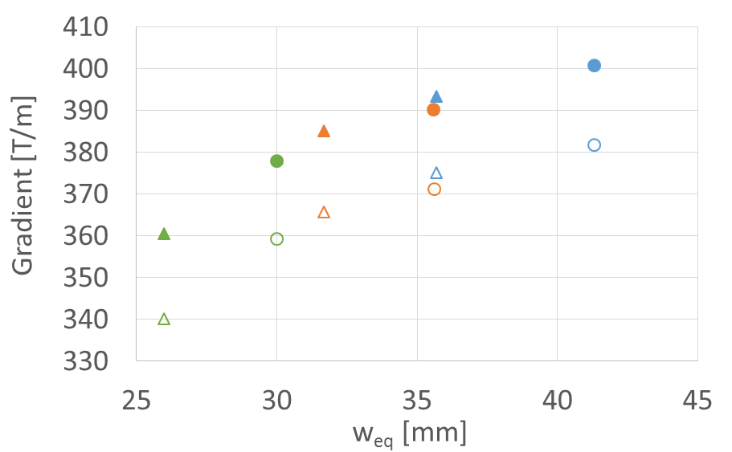
2D exploration of the parameter space
Strand diameter: 0.7 mm or 0.9 mm
Nb of strands: 40-51-60
Protection delay: 30 ms or 40 ms
Protection: 40 to 30 ms (Hotspot = 350 K)
  + 20 T/m on the gradient (~5%)
2 layers efficiency:
  Lower than ~51 strands
Worry about windability (50 mm aperture)
  Windability test with MBH 11 T cable or MQXF cable would be welcome
~MQXF
MBH
11 T
Design selected for this study:
Most simple design in-line with the optics baseline of 360 T/m
60 strands
0.7 mm
30 ms
51 strands
0.9 mm
40 ms
40 strands

Slide 22
Layer jump impact on b6
calcul b6 le long de l'aimant :
R [mm]= | b6= | L_saut
300 | 0,75 | 141
400 | 0,84 | 163
500 | 0,92 | 183
575 | 0,97 | 196

Slide 23

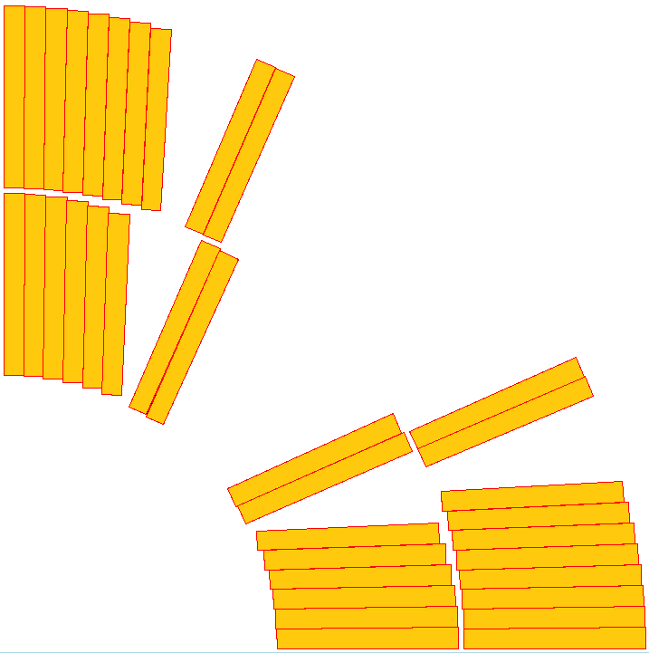
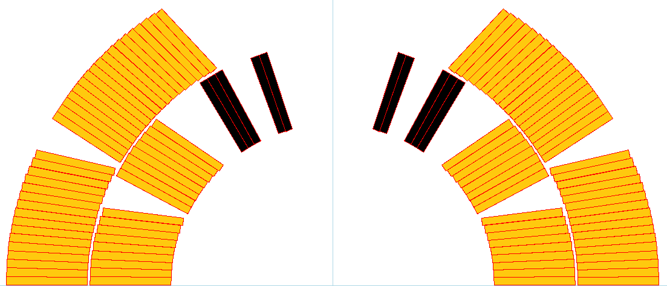
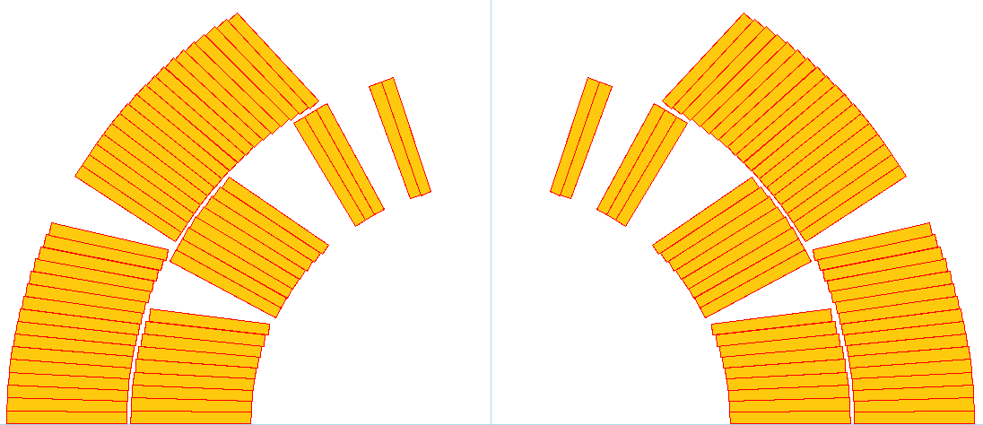
11 T HL-LHC coil versus FCC quad coil
FCC quad: Rmin ≈ 4.0 mm
11T MBH: Rmin ≈ 7.5 mm
Magnet summary 1st FCC week (2015) by E. Todesco

Slide 24
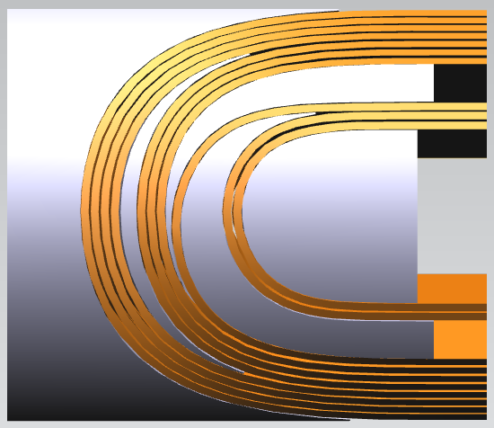
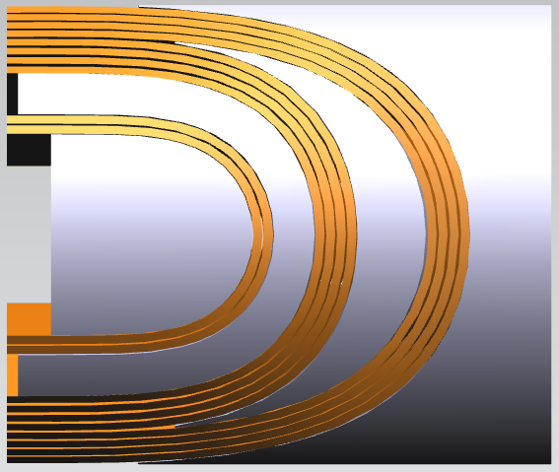
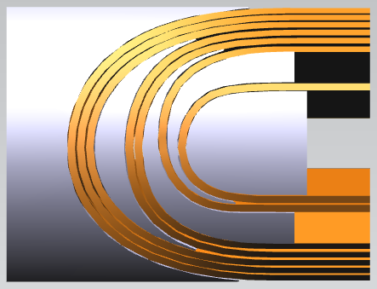
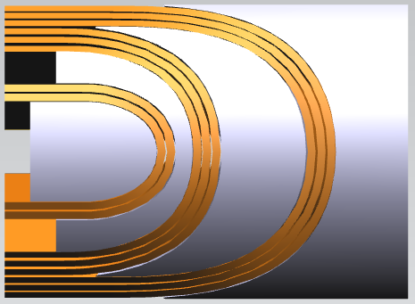
FCC quad end spacers with FCC quad cable
« Top » view
From outside

Slide 25
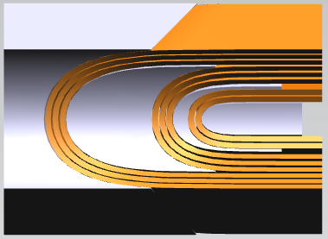
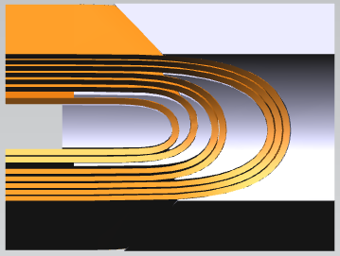
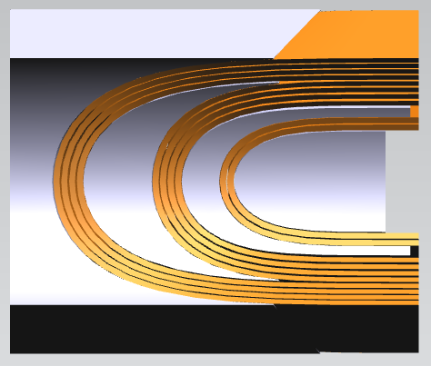
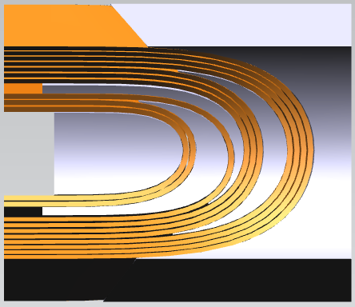
« Bottom » view
From the aperture

Slide 26
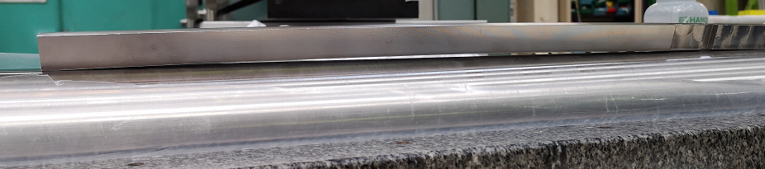
Some out-of-tolerance tooling
2 central posts and all angular wedges sent back to the manufacturer

