Slide 1











FCC
WEEK
2019
BRUSSELS, BELGIUM
24 – 28 June 2019
Crowne Plaza Brussels
Le Palace
-talk
REBa₂Cu₃O₇ coated conductors as a beam screen coating:
Linking surface resistance to microstructure
A.Romanov¹, J. Gutierrez¹ , P.Krkotic², J. O’Callaghan³, F. Perez², M. Pont², X. Granados¹ , S. Calatroni⁴, M. Taborelli⁴ and T. Puig¹
1 Institut de Ciència de Materials de Barcelona, CSIC, Bellaterra (Spain)
2 ALBA Synchrotron Light source, Cerdanyola del Vallés (Spain)
3 Universitat Politècnica de Catalunya, Barcelona (Spain)
4 CERN - The European Organization for Nuclear Research, Geneva (Switzerland)

Slide 2
Outline
REBCO CCs for beam screen coating
Linking CC´s surface resistance to microstructure
Evaluation of secondary electron yield

Slide 3




Motivation: REBCO CCs for beam screen coating
Synchrotron radiation in FCC much higher:
$$P_{beam}^{LHC}\sim 0.2 W/m$$
Limit the cryogenic load to 100 MW
$$ΔT_{FCC}=40−60K$$
$$P_{beam}^{FCC}\sim 35.4 W/m$$
Cryogenic load
Impacts $T_{FCC}$
100MW
Cu may not provide low enough surface impedance at 40-60K
Superconductors belong to only material class where $R_{s}^{SC}<R_{s}^{Cu}$

Slide 4






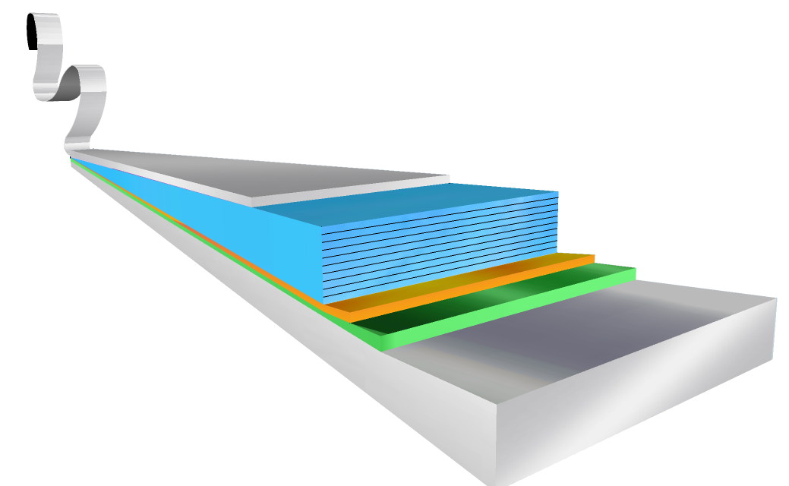


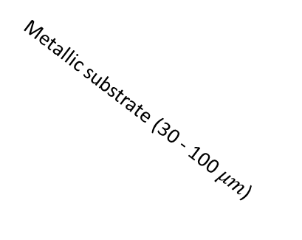



Motivation: REBCO CCs for beam screen coating
Superconductive at FCC conditions:
$$T_{c}≈93K$$
$$B_{c2}\left(50K\right)≈80T$$
$$I_{c}\left(50K,16T\right)>25A$$
REBCO coated conductors are layered structures consisting of:
Multifunctional oxides
  HTS REBa₂Cu₃O_{7-x}
  Buffers that allow epitaxial growth
Flexible, metallic substrate
Commercially available in km length ($≈$5000 km/a).
Participating manufacturers in FCC study
Protective layer (Ag+Cu)
High customization through microstructure tailoring :
REBCO (1 – 3$μm$)
Buffers (0.2 – 1 $μm$)
Rare earth | Intrinsic PC | Artificial PC
Y | Grain boundaries | BaZrO₃
Gd | Secondary phases | BaHaO₃
Eu | Stacking faults | …
Dy | Point defects
… | …
Metallic substrate (30 - 100 $μm$)

Slide 5
Outline
REBCO CCs for beam screen coating
Linking CC´s surface resistance to microstructure
Evaluation of secondary electron yield

Slide 6
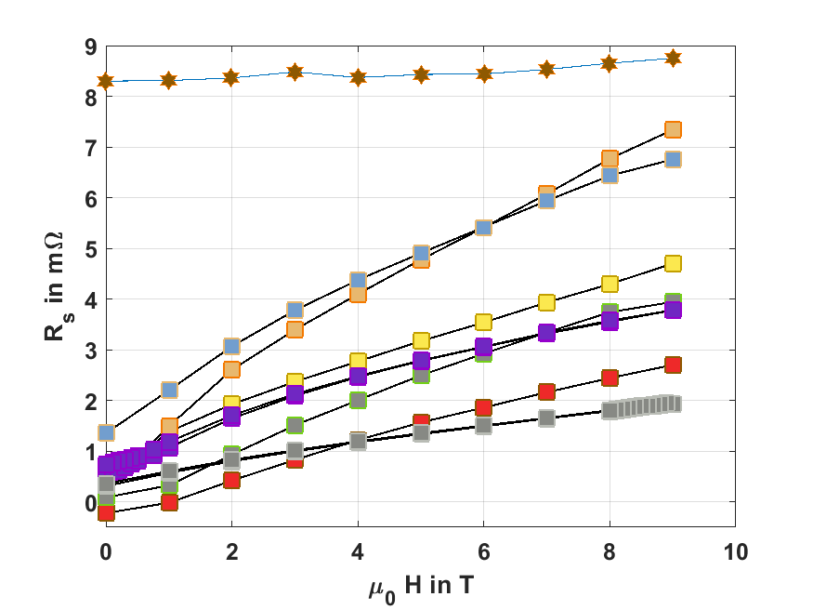
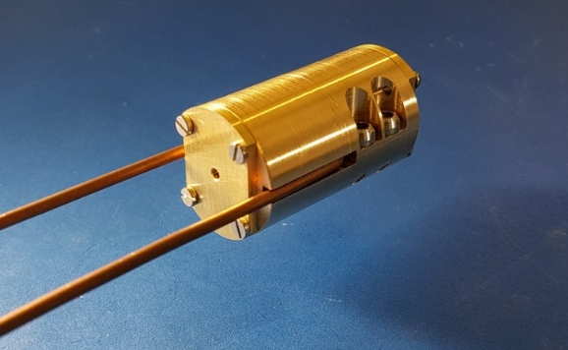

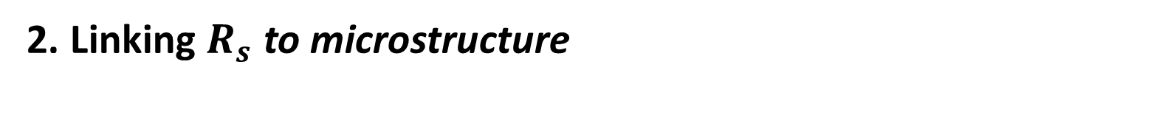

2. Linking $R_{s}$ to microstructure
$$T=50K, ν≈8GHz$$
FCC Cu (300$μm$ on st.st.)
SuNAM
SuperOx
Bruker
Fujikura
Within the consortium, ALBA and UPC developed 8 GHz cavity dielectric resonator
compatible with 25mm bore 9 T magnet at ICMAB
SuperPower
Theva
Fujikura NP
T. Puig et al. (SUST accepted)
State of the art REBCO CCs outperform Cu at 50K, 8 GHz and up to 9T

Slide 7
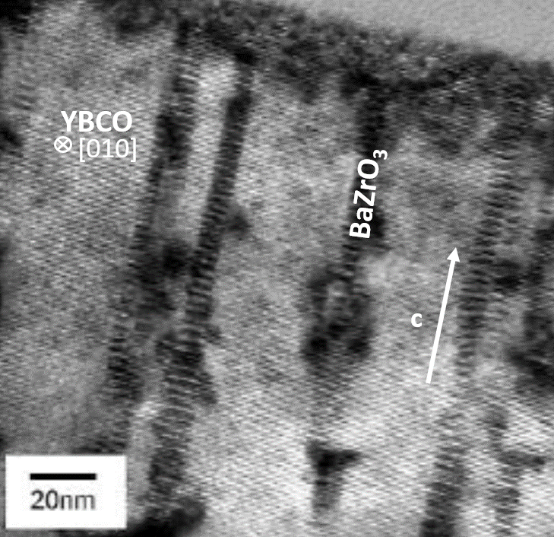
2. Linking $R_{s}$ to microstructure
$$T=50K, ν≈8GHz$$
Microstructure of YBCO with BZO nanorods
FCC Cu (300$μm$ on st.st.)
REBCO pristine region
REBCO nano engineered region
S. Kang, Science 311 (2006)
T. Puig et al. (SUST accepted)
State of the art REBCO CCs outperform Cu at 50K, 8 GHz and up to 9T
R_{S} is microstructure dependent

Slide 8





2. Linking $R_{s}$ to microstructure
Classical rigid-fluxon model
S. Calatroni and R. Vaglio, IEEE Transactions on Applied Superconductivity 27, 2017
Flux tube lattice
Assumptions:
Fluxon shape cannot be deformed
Rigid flux tube lattice
$$d$$
$$\vec{B}$$
Equation of motion for fluxons:
$$m\ddot{x}+η \dot{x}+kx=J_{rf}Φ_{0}$$
Surface resistance:
$${\vec{J}}_{rf}$$
$$R_{fl}(T,H,ν)=R_{n}\sqrt{\sqrt{a^{2}(J_{c},ρ,B_{c2})+b^{2}(J_{c},ρ,B_{c2})}−b(J_{c},ρ,B_{c2})}$$
Depinning frequency:
$$ν_{0}=ρ_{n}\frac{J_{c}}{B_{c2}}\sqrt{\frac{H}{φ_{0}}}$$

Slide 9
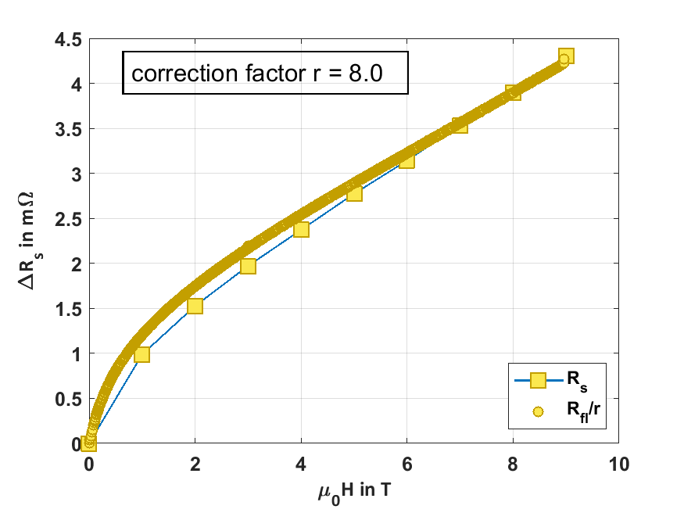


2. Linking $R_{s}$ to microstructure
$$T=50K,ν≈8GHz$$
Overestimation of $R_{s}$ with rigid-fluxon model:
$$R_{fl}(T,H,ν)=R_{n}\sqrt{\sqrt{a^{2}(J_{c},ρ,B_{c2})+b^{2}(J_{c},ρ,B_{c2})}−b(J_{c},ρ,B_{c2})}$$
Calculated from transport values
Introducion of correction factor $r$:
$$R_{fl}(T,H,ν)/r$$
Measured with resonator

Slide 10
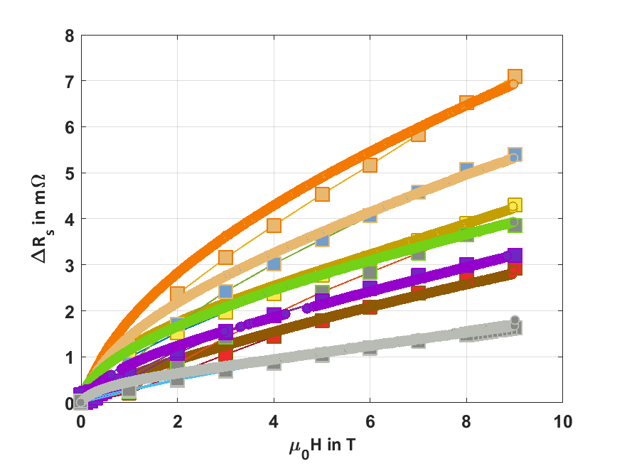








2. Linking $R_{s}$ to microstructure
Correction factor $r$ depends on the microstructure of CC
$$T=50K, ν≈8GHz$$
$$r_{SuNAM}=5.4$$
$$r_{SuperOx}=7.7$$
$$r_{Bruker}=8$$
$$r_{Theva}=24$$
$$r_{Fujikura}=10$$
$$r_{SuperPower}=11.5$$
$$r_{Fujikura NP}=30$$

Slide 11
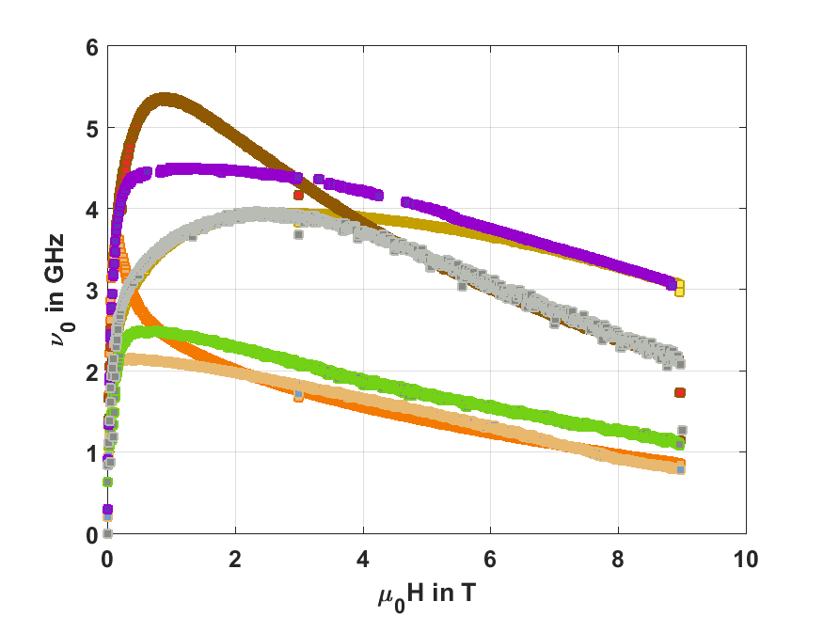
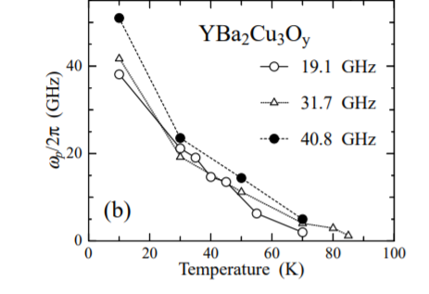


2. Linking $R_{s}$ to microstructure
Tsuchiya, Yoshishige, et al. "Electronic state of vortices in YBa2CuO7-x investigated by complex surface impedance measurements." Physical Review B 63.18 (2001): 184517.
$$ν_{0}=ρ_{n}\frac{J_{c}}{B_{c2}}\sqrt{\frac{H}{φ_{0}}}$$
$$T=50K$$
Underestimation of $ν_{0}$ compared to literature $ν_{0}^{lit}\left(50K\right)≥15GHz.$

Slide 12
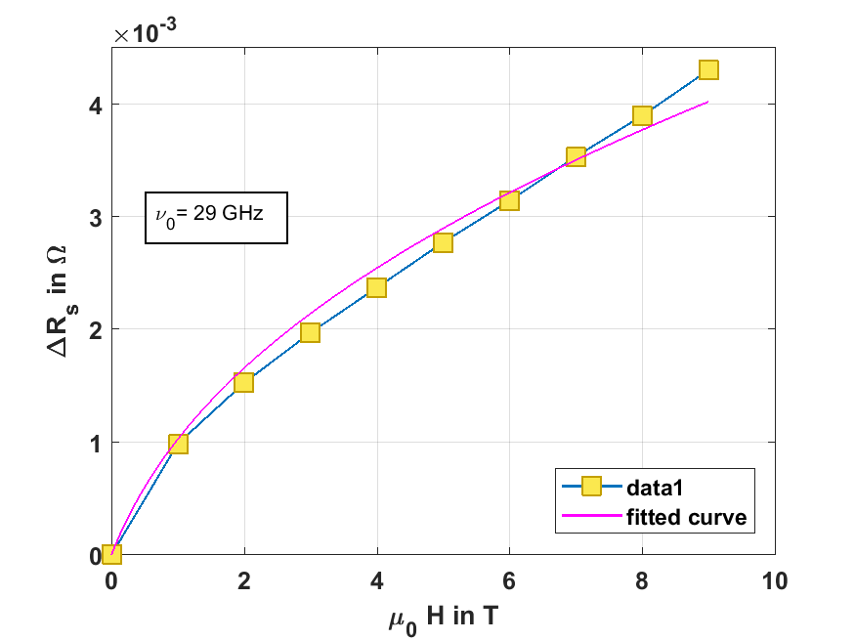



2. Linking $R_{s}$ to microstructure
$$T=50K, ν≈8GHz$$
Ignore the depinning frequency derived from rigid-fluxon model:
$$ν_{0}=ρ_{n}\frac{J_{c}}{B_{c2}}\sqrt{\frac{H}{φ_{0}}}$$
→Use $ν_{0}$ as fitting parameter.
Fitted value $ν_{0}≈29 GHz:$
No correction factor needed
Matches better with literature

Slide 13
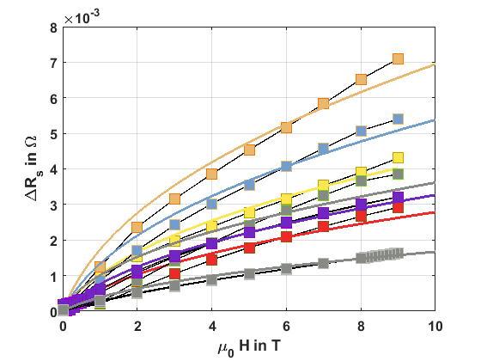

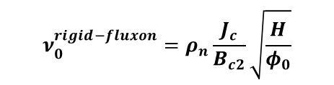
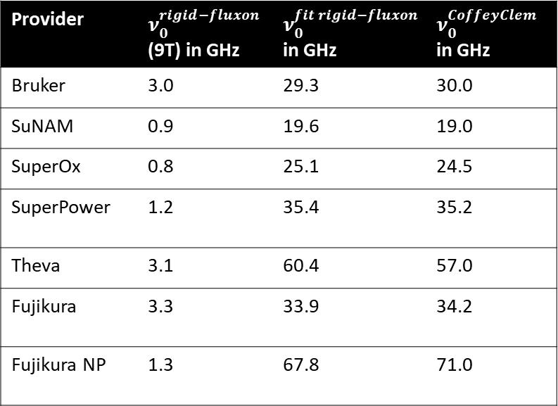
2. Linking $R_{s}$ to microstructure
$$T=50K, ν≈8GHz$$
Provider | $ν_{0}^{rigid−fluxon}$(9T) in GHz | $ν_{0}^{fit rigid−fluxon}$in GHz | $ν_{0}^{CoffeyClem}$ in GHz
Bruker | 3.0 | 29.3 | 30.0
SuNAM | 0.9 | 19.6 | 19.0
SuperOx | 0.8 | 25.1 | 24.5
SuperPower | 1.2 | 35.4 | 35.2
Theva | 3.1 | 60.4 | 57.0
Fujikura | 3.3 | 33.9 | 34.2
Fujikura NP | 1.3 | 67.8 | 71.0
$$ν_{0}^{rigid−fluxon}=ρ_{n}\frac{J_{c}}{B_{c2}}\sqrt{\frac{H}{φ_{0}}}$$
identified as weakness of model→ Gives potential to adjust model.

Slide 14
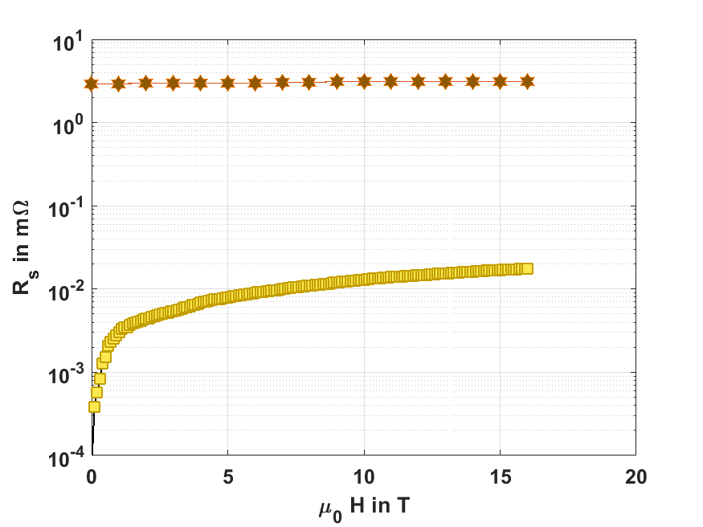


2. Linking $R_{s}$ to microstructure
Extrapolation of $R_{s}$ using rigid-fluxon model with${ ν}_{0}^{fit rigid−fluxon}$ to 1GHz and 16T:
$$T=50K, ν=1 GHz$$
FCC Cu (300$μm$ on st.st.)
x175
Predicted by rigid-fluxon model: Out performance of Cu by HTS CC at FCC conditions even more pronounced!

Slide 15
Outline
REBCO CCs for beam screen coating
Linking CC´s surface resistance to microstructure
Evaluation of secondary electron yield

Slide 16
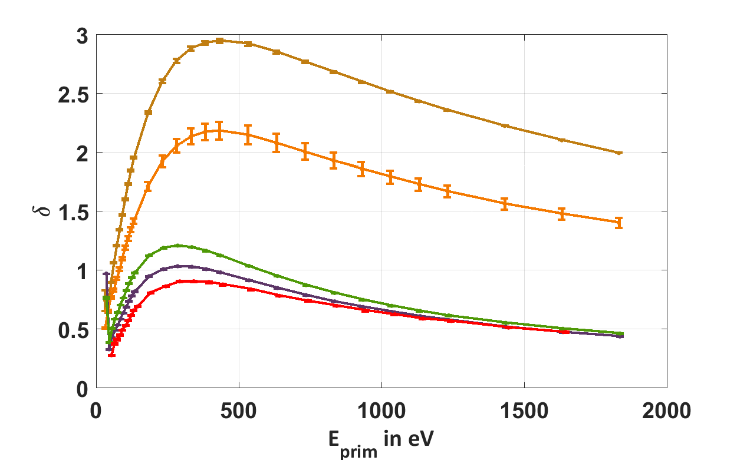

3. Beam instability: Secondary electron yield
SuperPower
In untreated form not suitable for use in particle accelerators
Conditioning treatment not sufficient
Roughness of a-C decreases SEY under desired limit
Ti as adhesion and protection layer
untreated
3.8e-3 C/mm²
$$δ_{lim}$$
100 nm Ti + 50 nm a-C
150 nm Ti + 100 nm a-C
50 nm a-C
Thin layers of a-C and Ti decrease the SEY below threshold value 1.3.

Slide 17
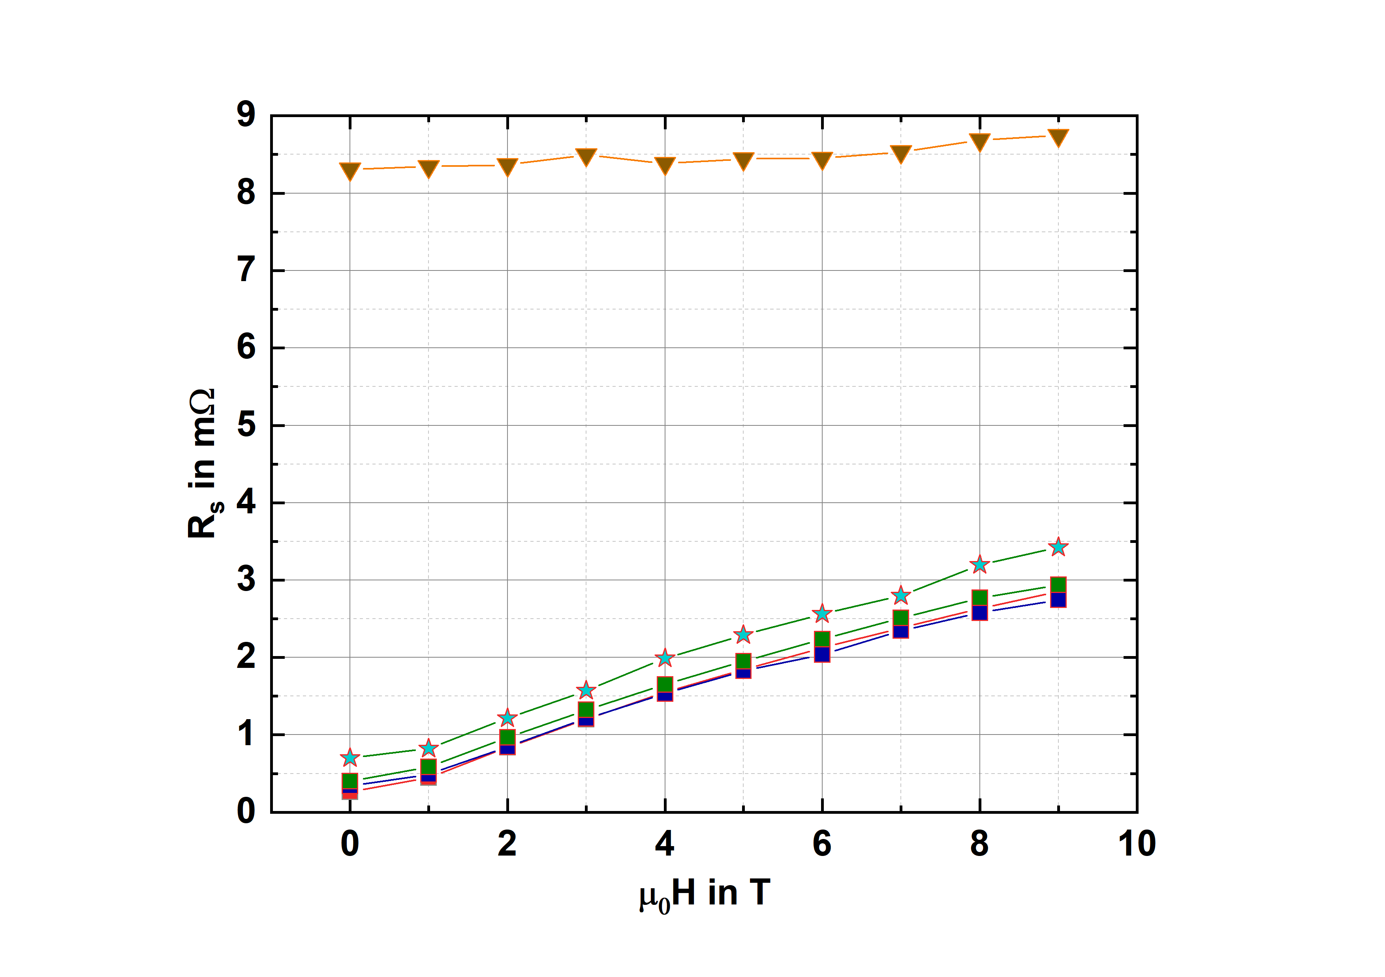

3. Beam instability: Secondary electron yield
SuperPower
$R_{sf}$ vs. $H$ @ 50K
FCC Cu
100 nm Ti + 50 nm a-C
150 nm Ti + 100 nm a-C
50 nm a-C
Uncoated
Increase of $R_{s}$ for 150 nm Ti + 100 nm a-C not detrimental.

Slide 18
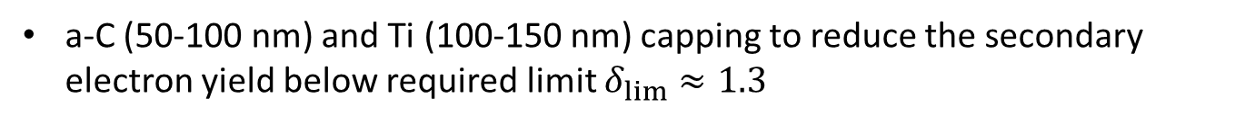
Conclusions
State of the art REBCO CCs outperform Cu at 50K, 8 GHz and up to 9T
Extraction of $ν_{0}$ as for all CCs by means of ridig-fluxon model
Extrapolation of surface resistance to FCC conditions 1 GHz, 16 T, 50K → outperformance of Cu by CCs by two order of magnitude expected at FCC conditions
a-C (50-100 nm) and Ti (100-150 nm) capping to reduce the secondary electron yield below required limit $δ_{lim}≈1.3⁡$
Increase in $R_{s}$ due to capping is not significant at 50K, 8GHz, up to 9T

Slide 19





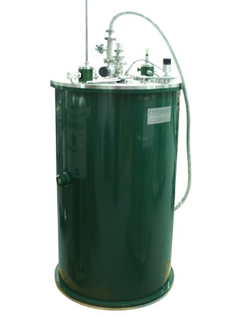
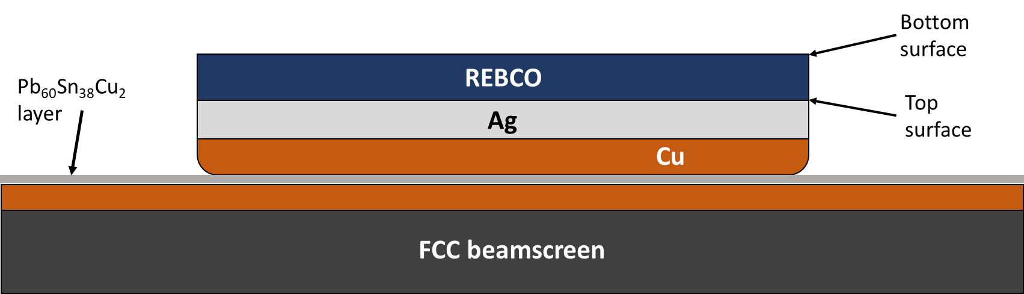
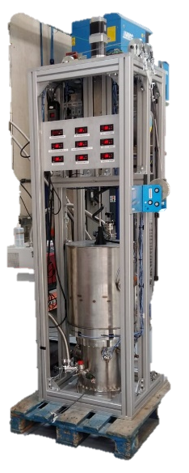
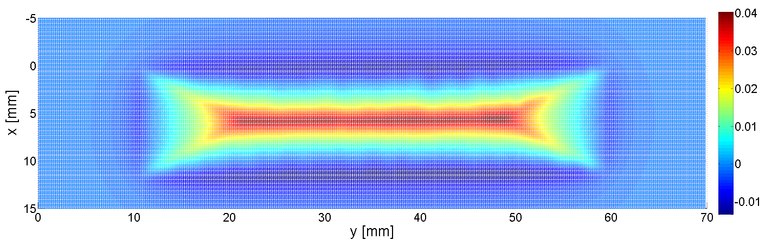
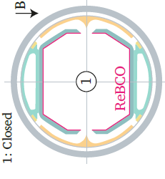
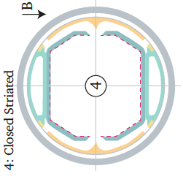



Outlook: REBa₂Cu₃O₇ coated conductors for beam screen coating
1. Characterization of CCs up to 16T:
3. Welding solutions of aC/REBCO/Steel stacks
Poster 448. Coating the FCC-hh beam screen chamber with REBa2Cu3O7-x coated conductors at FCC week 2019
Cylindrical dielectric resonator $ν≈8 GHz$
Resonator configuration with $ν≈1GHz$ (currently in development at UPC/ALBA)
Soldering of REBCO CCs to st. st. with delamination of superconducting layer possible in large scales
Delaminated bottom layer shows no degradation in $R_{s}$ performance
Compatible with
Surface impedance $Z_{s}$ measurable at FCC conditions.
$ν=1 GHz, 8GHz$
Wide Temp. range
Up to 16 T
Superconducting perfomance of delaminated layers still to be investigated
New cryostat with 16 T SC magnet to be installed in Q1 2020 at ICMAB.
→ Understanding the influence of magnetic field on vortex dynamics up to 16T.
2. Evaluation of persistent currents
4. Mechanical tests of aC/REBCO/Steel stacks
Hall mapping measurement of CC done at ICMAB
Analyzing persistent currents will define the required aspect ratio of Cu and REBCO CC in beam screen
Experimental system to assess 2D /3D stress maps based in optical image correlation with in situ monitoring the I_{c} has been finished and will be taken into operation in Q3/Q4 2019
Full evaluation of stresses accociated to new welding solution targeted
Construction of proof-of-concept device based on generated knowledge

Slide 20
Acknowledgement
The authors acknowledge the support and samples provided by Bruker, Fujikura, Sunam, SuperOx, SuperPower and Theva. Authors acknowledge CERN funding FCC-GOV-CC0073/1724666/KE3359, MAT2014-51778-C2 COACHSUPENERGY, 2017-SGR 1519 from Generalitat de Catalunya and COST Action NANOCOHYBRI (CA16218). ICMAB authors acknowledge the Center of Excellence award Severo Ochoa SEV2015-0496 and its Future Interdisciplinary Projects action.
This project has received funding from the European Union’s Horizon 2020 research and innovation programme under the Marie Skłodowska-Curie grant agreement No 754397”.
Financial support from the Spanish Ministry of Science, Innovation
and Universities, through the “Severo Ochoa” Programme for Centres
of Excellence in R&D (SEV-2015-0496)

Slide 21
Thank you for your attention!

