Slide 1
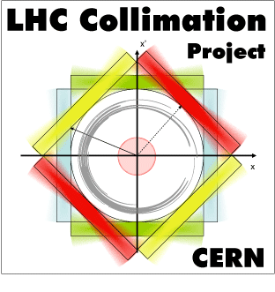


Status of FCC-hh
collimation studies
R. Bruce
On behalf of many colleagues…
Notes:
1
1

Slide 2
Collaboration
Talk based on material from many colleagues
Author list for collimation chapter in long CDR:
  CERN BE/ABP: S. Arsenyev, R. Bruce, M. Fiascaris, A. Krainer, A. Langner, R. Martin, A. Mereghetti, D. Mirarchi, J. Molson, S. Redaelli, D. Schulte
  CERN EN/STI: M.I. Besana, F. Cerutti, S. Gilardoni, A. Lechner, E. Skordis, M. Varasteh
  CERN EN/MME: A. Bertarelli, F. Carra, G. Gobbi, M. Pasquali
  CERN TE/ABT: W. Bartmann, E. Renner
  RHUL: A. Abramov, L. Nevay
  LAL/IN2P3: A. Faus-Golfe, J.L. Perrot
  CEA: B. Dalena, A. Chance
  LAPP/IN2P3: M. Serluca, G. Lamanna
  FNAL: Y. Alexahin, E. Gianfelice-Wendt, N. Mokhov, I. Tropin
  NIU: A. Narayanan, M.J. Syphers

Slide 3
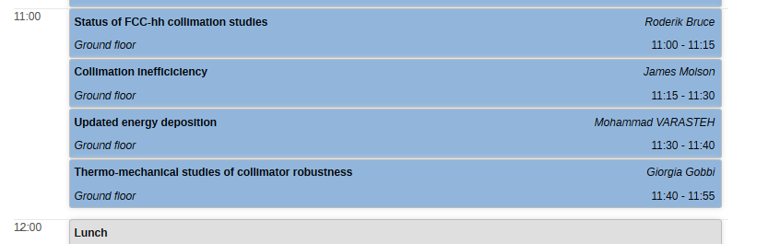

Further talks on collimation
FCC-hh proton collimation in this session
FCC-hh ion collimation this afternoon
HE-LHC collimation on Thursday afternoon

Slide 4
Why do we need collimation?
Roles of collimation system: clean unavoidable regular losses, passive machine protection, optimize background and radiation dose
  At the same time, keep the impedance within limits
Main design loss scenarios
  Unavoidable off-momentum losses of unbunched beam at start of ramp:
  1% loss over 10 s
  Extraction and injection kicker pre-fire, other possible failures
  Betatron cleaning 0.2 h beam lifetime during 10 s or “steady-state” 1 h beam lifetime
    0.2 h lifetime and 8.3 GJ stored energy => 11.6 MW beam loss power

Slide 5

How much is 8.3 GJ?
8.3 GJ = kinetic energy of an empty Airbus A380 cruising at 880 km/h

Slide 6
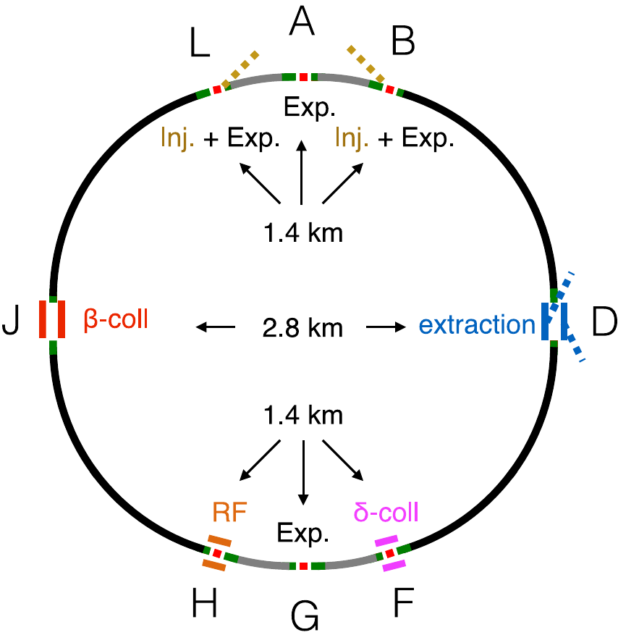
FCC collimation insertions
The FCC-hh collimation system is a scaled up version of the HL-LHC/LHC system (NIM, A 894 (2018) 96-106)
  Betatron collimation in IPJ
  Momentum collimation in IPF

Slide 7
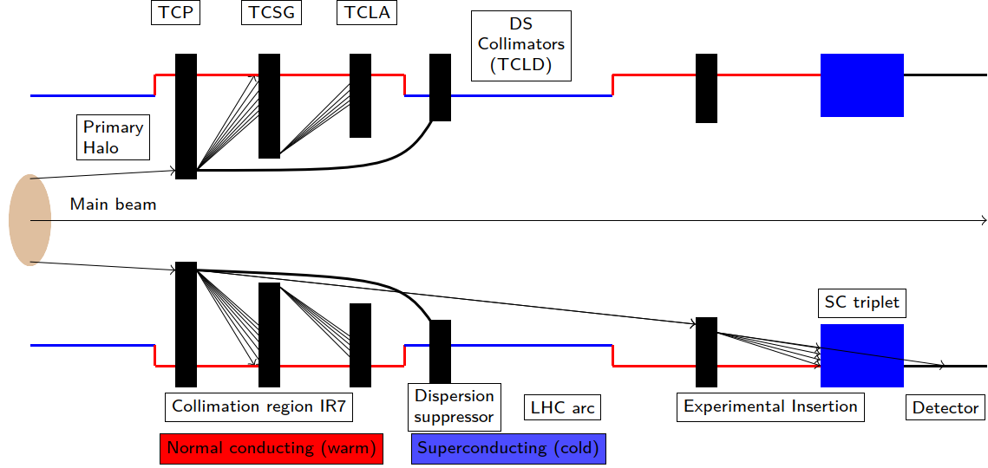
Collimation hierarchy
Multi-stage system to intercept and absorb the losses
Dispersion suppressor collimators to intercept off-energy particles

Slide 8
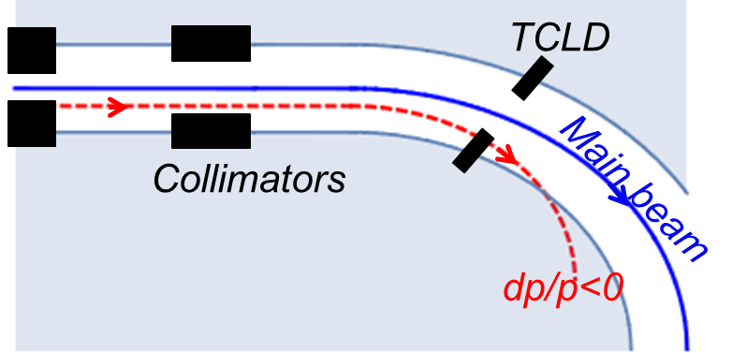
Dispersion suppressor collimators
Dispersion suppressor collimators (TCLD) intercept off-energy particles
  scattered out of primary (mainly) in collimation insertion
  created in collisions at IPs
  LHC installation of TCLDs on each side of IR2 and IR7 planned for LS2 (for HL-LHC)

Slide 9
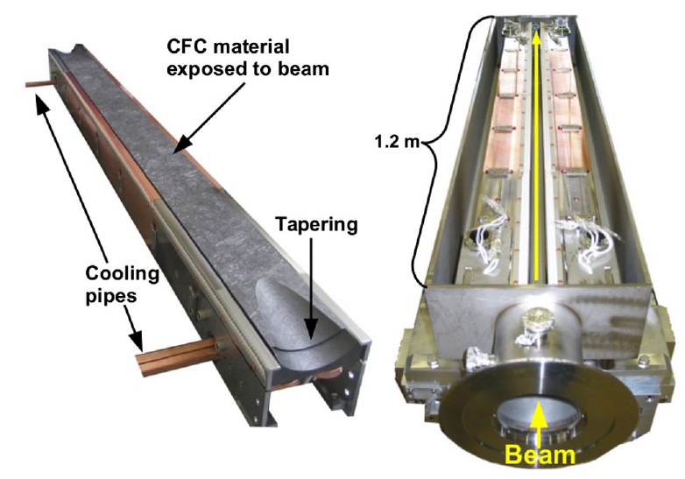
FCC-hh collimators
Assuming HL-LHC type collimators
  Two movable jaws per collimator
Some modifications
  Shortened primaries
  Thicker jaws of primary and some secondary

Slide 10
News since last year
Studies and optimization of system performance with new lattice (v 10)
Optics optimizations (A. Chance, J. Molson)
  New optics in momentum cleaning insertion for significantly improved momentum cut and off-momentum cleaning performance
  Removed dispersion peaks around the ring that caused local losses
Added new collimators at critical locations (J. Molson)
  More dispersion suppressor collimators (TCLDs) and active absorbers (TCLAs)
Extended studies of energy deposition , quench limits and collimator robustness (see talks M. Varasteh, G. Gobbi)
Studied Pb ion collimation in detail (see talk A. Abramov)
Revised collimator materials to stay within impedance budget

Slide 11
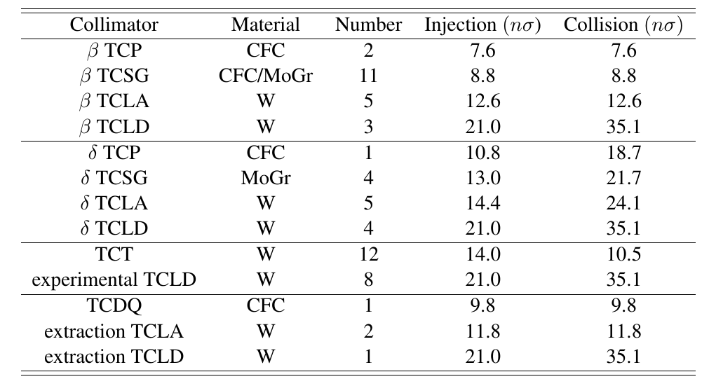
Present baseline collimation system
Most loaded collimators (primaries and first secondary) in CFC (carbon-fibre composite) for robustness, other secondaries in molybdenum-graphite with Mo coating for better impedance (taking over the HL-LHC design)
primary
secondary
Betatron
cleaning
absorber
dispersion suppressor
primary
Momentum
cleaning
secondary
absorber
dispersion suppressor
tertiary
Experiments
dispersion suppressor
dump protection (ABT)
Extraction
absorber
dispersion suppressor
Still to be added in lattice: active physics debris absorbers
For 2.2 µm emittance

Slide 12
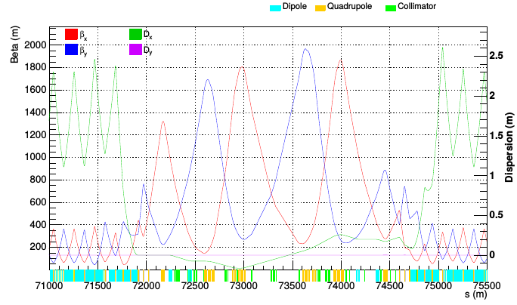
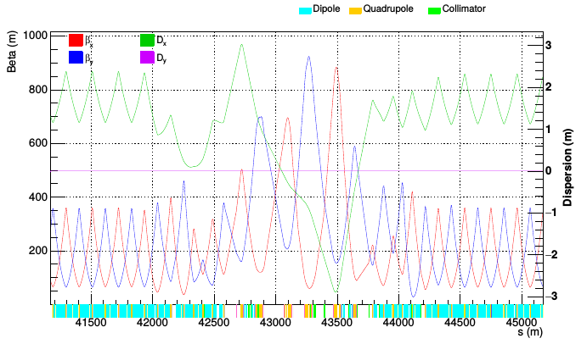
Optics of collimation insertions
Starting point: Scaled β-functions and insertion length by factor 5 from the LHC
News since last FCC week: Increased dispersion in IRF, added TLCDs
IRJ (Betatron cleaning)
IRF (Momentum cleaning)

Slide 13
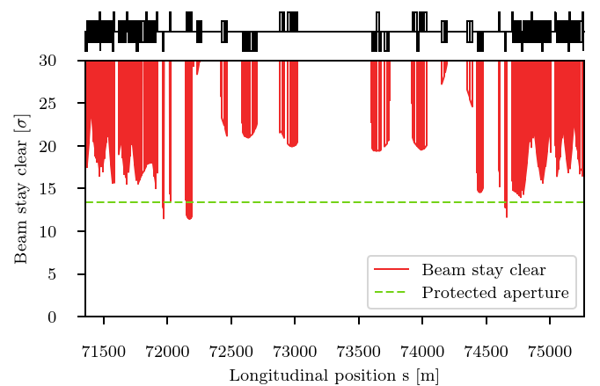
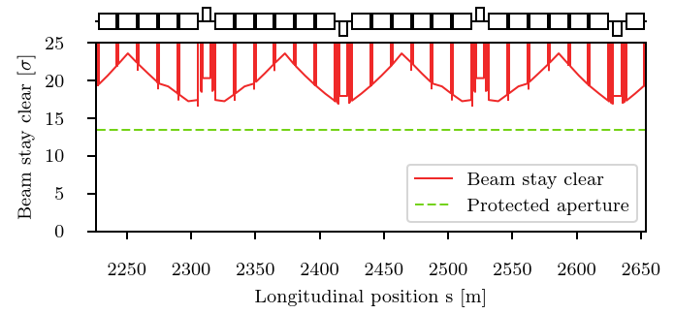
Geometric aperture
At injection, larger quench margin than at 50 TeV, but geometrical aperture more critical due to larger emittance
  Using 13.4 sigma criterion for allowed aperture scaled from HL-LHC, vast majority of ring elements are within spec
  Very few (< 10) outliers : dispersion suppressors, a couple of quadrupoles β-collimation
  Good hope for solution: switch of magnet type and minor design changes from LHC elements
  Still some work to do, in particular on refining aperture tolerances and calculation models
Arc
IRJ DS
R. Martin et al.

Slide 14
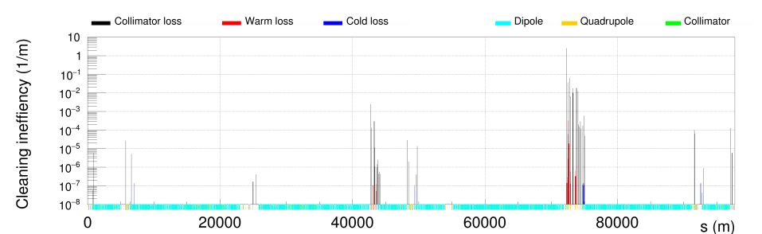
Status of betatron cleaning studies
Betatron cleaning has been the priority so far. Most critical case for quenches: top energy (50 TeV)
After some iterations, cleaning inefficiency in the new lattice is OK (see talk J. Molson)
  Protection of cold magnets around the ring for design losses (talk M. Varasteh)
3-step simulation with tracking, energy deposition and thermo-mechanical studies
Significant power loads on collimators is challenging for the collimator robustness (talk G. Gobbi)
  No serious showstopper found, but a few issues that require further iteration
quench limit

Slide 15
Status of other studies
Momentum cleaning
  With new lattice, momentum cleaning is within specification for losses at the start of the ramp
  Still to check: Quantify tolerable ramp rate at the start
Extraction failure
  With new extraction design from CERN/ABT team, extraction kickers segmented (150 modules)
  With present lattice and optics, up to three kickers could pre-fire before collimators are damaged
    Relies on a “good” phase advance between kickers and primary collimator
More details: talk J. Molson

Slide 16
Conclusions (1)
The collimation system, as described in the CDR, protects the machine aperture very well and survives without damage to active absorbers in spite of 11.6 MW loss power
  Most challenging part: the collimators and warm section must sustain very high power loads during betatron losses at 50 TeV
A few points require further iteration
  Outgassing from collimators due to high temperatures
  Power loads on warm magnets passive absorbers – study local shielding
  Material of cooling pipes – risk of damage

Slide 17
Conclusions (2)
Possible topics for future studies
  Placement of skew primary
  Crystal collimation
  Active halo control (hollow electron lens?)
  Novel collimator materials
  New improved system design, possibly shorter, not starting from the LHC

