Slide 1



The drivers of innovative collaborations and the role of public policies
FCC Week 2019 – Economics of Science
Tuesday, 25 June 2019, Brussels, BE
Riccardo Crescenzi
London School of Economics

Slide 2
This talk
Regional Innovation and R&D Investments
The missing link: collaboration
Public investments in innovation: can they foster collaboration?
Some reflections

Slide 3
Regional Innovation and R&D Investment

Slide 4
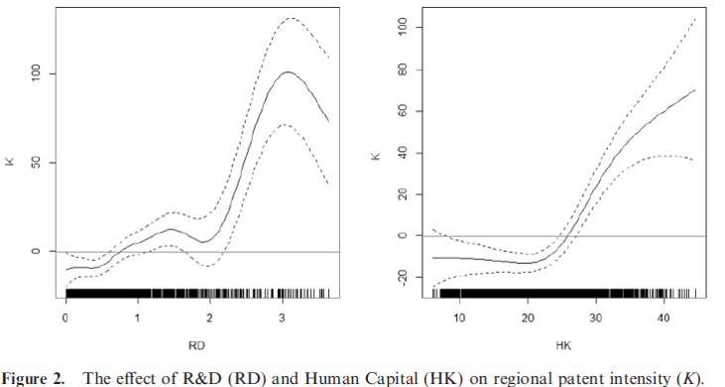
How Regional Innovation works (1)
Source: Charlot, Crescenzi and Musolesi, JEG, 2016

Slide 5
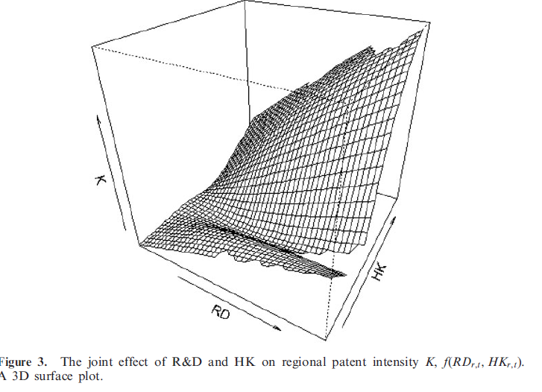
How Regional Innovation works (2)
Source: Charlot, Crescenzi and Musolesi, JEG, 2016

Slide 6
The missing link: Collaboration

Slide 7
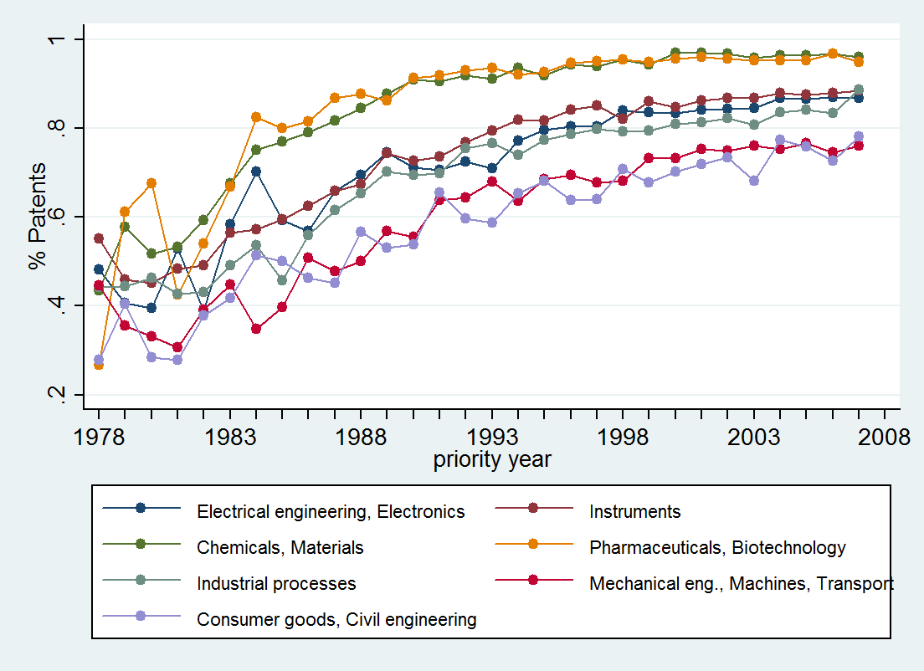
…Innovation is increasingly collaborative
Co-invented patents by technology field, 1978-2007.
Source: Crescenzi et al. 2013

Slide 8
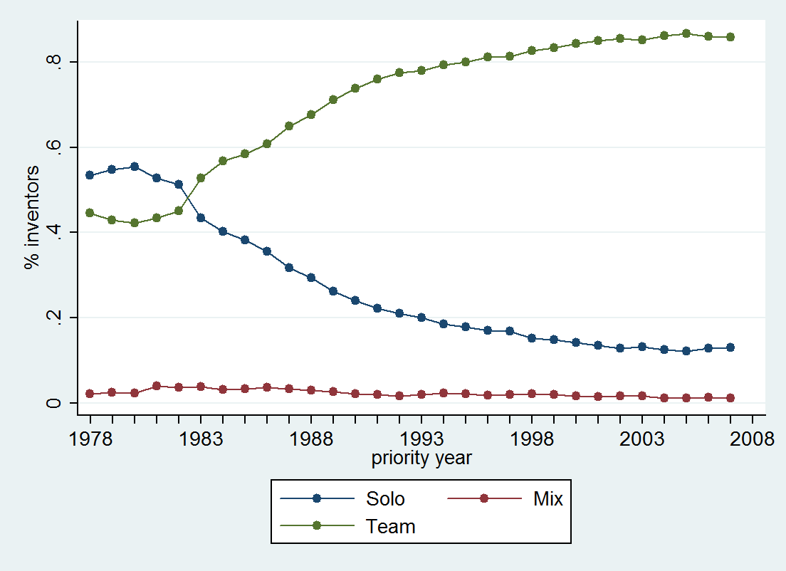
… and team-work is the norm for inventors
Source: Crescenzi et al. 2013

Slide 9

Questions (1)
Do we need geographical proximity
for innovative collaborations to happen?

Slide 10
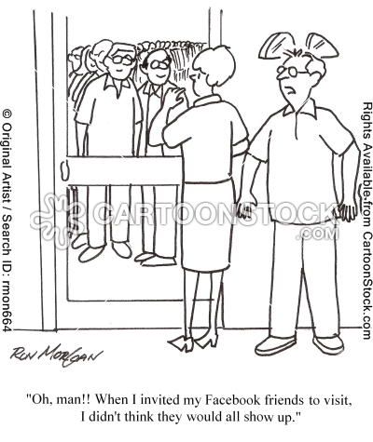
Questions (2)
What forms of proximity influence the incidence of collaborative knowledge creation?

Slide 11
Does innovation need geographical proximity? (1)
In order to answer these questions Crescenzi, Nathan and Rodriguez-Pose 2016 analysed patents microdata from the PATSTAT database, running from 1978-2010, comprising 116,351 patents with at least one UK-resident inventor.
We look at how physical, organisational, institutional, cognitive, social, and ethnic proximities between inventors shape their collaboration decisions.
We explore the net effects of all these ‘proximities’ on the choice of collaborator and on the underlying decision to collaborate.
11

Slide 12
Does innovation need geographical proximity? (2)
Research highlights
  Physical proximity has become more important over time but it is mediated by organisational and cultural/ethnic closeness;
  For multiple inventors (highly innovative individuals) geographic proximity is much less important than organisational and social factors;
In a follow-up paper Crescenzi, Filippetti and Iammarino (2014) look at the role of geographical and institutional proximity in shaping University-Industry collaborations:
  Quality of university (academic stars) crucially important
12

Slide 13
Public investments in innovation: can they foster collaboration?

Slide 14
Innovation Policies to leverage collaborations (1)
Crescenzi, De Blasio & Giua (2018) evaluate the impact of a scheme (Collaborative Industrial Research - CIR) supporting innovative activities of firms located in less developed regions in Italy (1 billion euros)
Co-financed by the EU Cohesion Policy in 2007-2013 it anticipates some key features of Smart Specialisation Strategy Programmes
Makes it possible to draw insights on :
  What features of Innovation Programmes (such as S-3 in the European Union) work best?
  What is the impact and 'value added' when innovation programmes that try and leverage links with public research centres?

Slide 15
Innovation Policies to leverage collaborations (2)
Unique collection of detailed programme-level and firm-level data
Information on applicants, selection scores and beneficiaries with actual payments and firm characteristics and performance (5 different datasets)
RDD approach using the evaluation score of the applications as the forcing variable (some projects are eligible but not funded due to limited resources)
Focus on project-level heterogeneity

Slide 16
The CIR Programme in a nutshell
Beneficiaries: firms, universities, research centres.
Promotes partnerships among firms, and collaboration with Universities and Public Research Centres
Concentration of support in specific pre-selected sectors
The territorial coverage: ‘Mezzogiorno’ Regions

Slide 17
CIR’s features for empirical assessment
Each project submitted to CIR is assigned a score by an independent evaluation committee appointed for this purpose
Only projects with scores higher than a certain value (>= 96) have been declared eligible for CIR incentives
HOWEVER Only projects with scores higher than 104.4 have been IN FACT funded due to budget availability
Therefore we have a number of projects in principle eligible for funding but NOT funded due to available resources and their absorption by higher ranked project

Slide 18
Research questions on CIR impacts
What is the impact of CIR on the economic performance of the beneficiary firms?
How does the impact of CIR depend on specific aspects of the program?
  Does the impact of CIR incentives change if the beneficiary project/firm:
      collaborates with public research centres?
      collaborates with other partners?
      targets specific - innovative - activities?
      operates in low tech industrial sectors?
      has a consolidated innovative capacity?
      is a multinational?

Slide 19
Heterogeneous Impact (H-ATE ) Results
 |  | Investments | Value Added | Employment
Z1: Public research (presence of a University in the project partnership) | Treatment*Z1 | -1.1480 (0.8926) | 0.4142 (0.7503) | 1.0767* (0.4205)
Z2: Collaboration (project partnership involving large number of firms) | Treatment*Z2 | -0.5514 (0.5438) | -1.9874*** (0.5263) | -1.9942*** (0.4992)
Z3: Advanced Activities (activity of the project classified as advanced) | Treatment*Z3 | -0.4083 (0.4439) | -0.2672 (0.4907) | -1.4622* (0.5910)
Z4: Low tech (firms operating in low tech sectors) | Treatment*Z4 | 1.2951** (0.4333) | 0.1203 (0.4162) | 1.3514** (0.4749)
Z5: Patenting (firms with a high capacity of patenting) | Treatment*Z5 | -0.1697*** (0.0477) | 0.2223*** (0.0596) | 0.1248 (0.0876)
Z6: Internationalisation (multinational corporations) | Treatment*Z6 | -0.7148 (0.6535) | -0.9529* (0.3698) | -1.7699* (0.7928)
Source: Crescenzi, De Blasio & Giua (2018)

Slide 20
Heterogeneous impacts (what works?)
Z1- Collaboration with public research centres or Universities does not increase impact
Z2 - Large partnerships have a negative impact value added and employment
Z3 - Most innovative activities (e.g. ICT or Health and bio-technologies) do not show any additional benefits vs. more 'traditional' activities (e.g. Agro-industrial system, Cultural heritage).
Z4 - Firms operating in low tech economic sectors benefit the most
Z5 - Firms with more consolidated innovative capabilities reduce investments (crowding-out) and focus on value added
Z6 - No benefit for large internationalized firms

Slide 21
Conclusions
The generation of local impacts from public investments in research remains a challenge for current and future regional innovation policies
Large research infrastructure are difficult to embed in regional innovation eco-systems and local strategies
Even targeted incentives for collaborative activities might not reach the intended targets
Overall this is a complex challenge for regional innovation strategies:
  The development of ‘ new proximities’ can be facilitated and supported
  Dedicated processes are needed to identify areas with the highest potential for collaboration.
More research is needed on tools that work in practice.

Slide 22
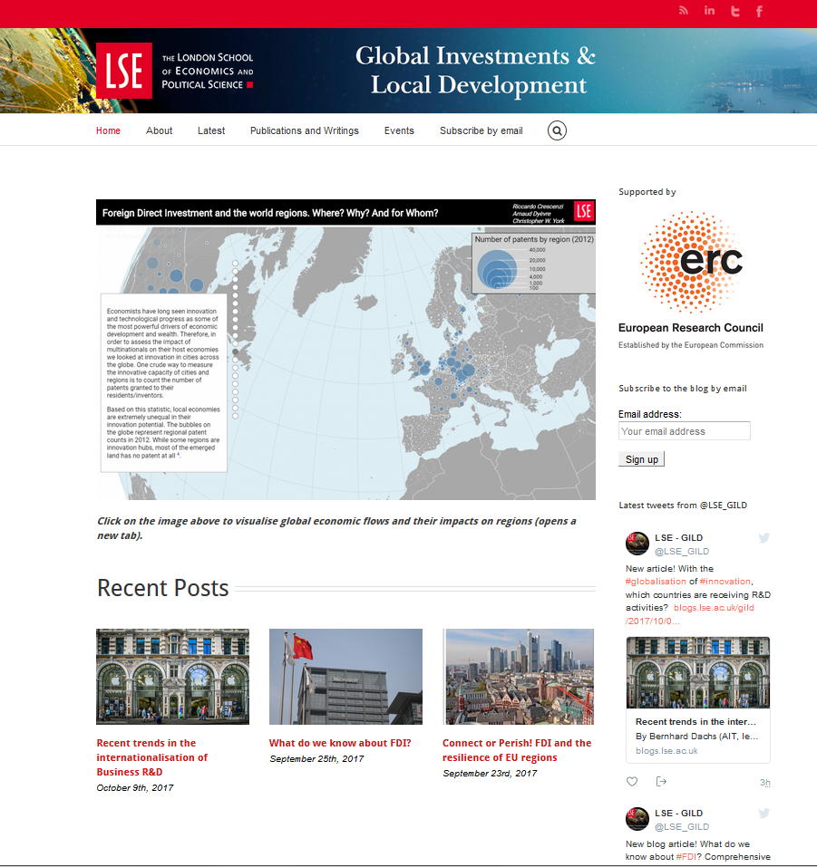
http://blogs.lse.ac.uk/gild/

Slide 23
Key References
Crescenzi R., Nathan M., Rodríguez-Pose A. "Do Inventors Talk to Strangers? On Proximity and Collaborative Knowledge Creation", Research Policy, 45 (1), 177-194, 2016, doi: 10.1016/j.respol.2015.07.003
Crescenzi R., Filippetti A., Iammarino S., "Academic Inventors: Collaboration and Proximity with Industry", Journal of Technology Transfer, 2017,
Crescenzi R., De Blasio G. and Giua M. “Cohesion Policy Incentives for Collaborative Industrial Research. The Evaluation of a Smart Specialisation Forerunner Programme” LSE SERC/CEP (Centre for Economic Performance) Urban and Spatial Programme Discussion Paper No' SERCDP0231, 02-2018
→ Read VoxEU Column: https://voxeu.org/article/smart-specialisation-strategies-italy-s-mezzogiorno

