Slide 1
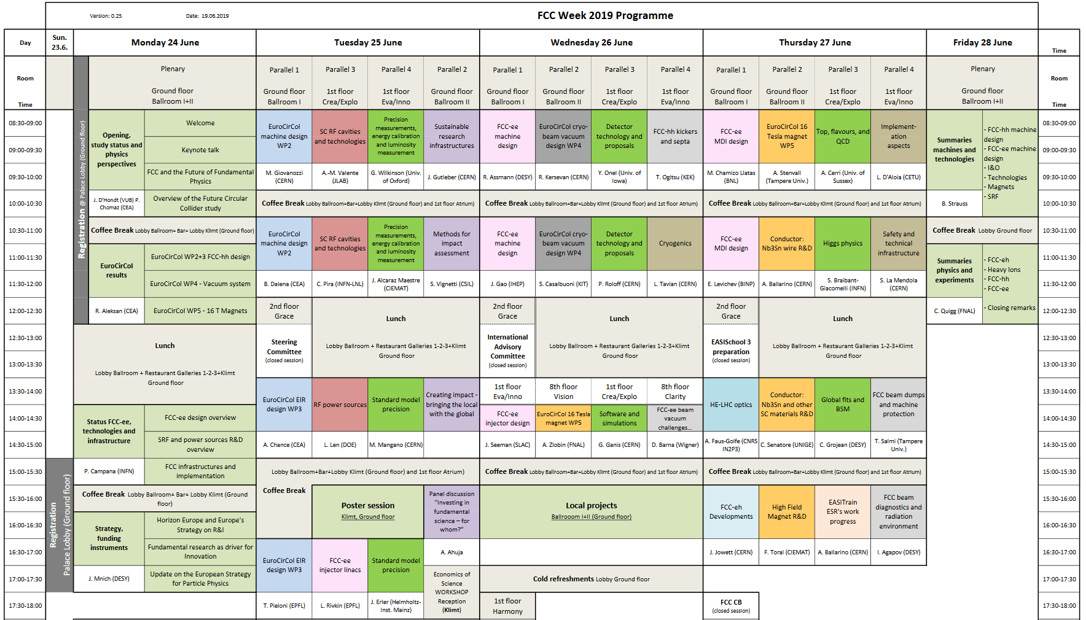
Infrastructures and Operation Summary
Overview
Wednesday-Thursday
Implementation aspects
Cryogenics
Safety
Technical infrastructure
Johannes Gutleber
Accelerator and Technology Sector Directorate Office, CERN, Switzerland June 25, 2019
Summary

Slide 2
Cryogenics

Slide 3


Industry studies for FCC-hh Cryoplants
Process cycle options
He-Ne-mix compressors
Helium
compressors
Helium
compressors
Nitrogen compressors
Helium
compressors
Ground level
Ground level
T6
HX1
HX1
T6
T6
HX1
Ground level
T5
T5
CC5
T5
HX2
CC5
HX2
CC5
HX2
HX4
HX3
T3
T4
HX4
HX3
T3
T4
HX4
HX3
T3
T4
HX5
shaft
HX5
shaft
HX5
shaft
Evaluation of three precooling options down to 40K
Estimation of performances and pre-design of components
HX6
T2
HX6
T2
HX6
T2
HX7
HX7
HX7
CC4
T1
CC4
T1
CC4
T1
CC3
HX8
CC3
HX8
CC3
HX8
CC2
CC2
CC2
CC1
HX9
CC1
HX9
CC1
HX9
cavern
cavern
cavern
tunnel
tunnel
tunnel
Qcl
40 to 290K
Qcl
40 to 290K
Qcl
40 to 290K
Qbs+Qts 40 to 60K
Qcm 1.9K
Qbs+Qts 40 to 60K
Qcm 1.9K
Qbs+Qts 40 to 60K
Qcm 1.9K
Concept A – Ne/He precooling
FCC-hh CDR proposal
Concept B – Pure Helium
LHC-like option
Concept C – LN2 precooling
ITER-like option
F. Millet (CEA)

Slide 4
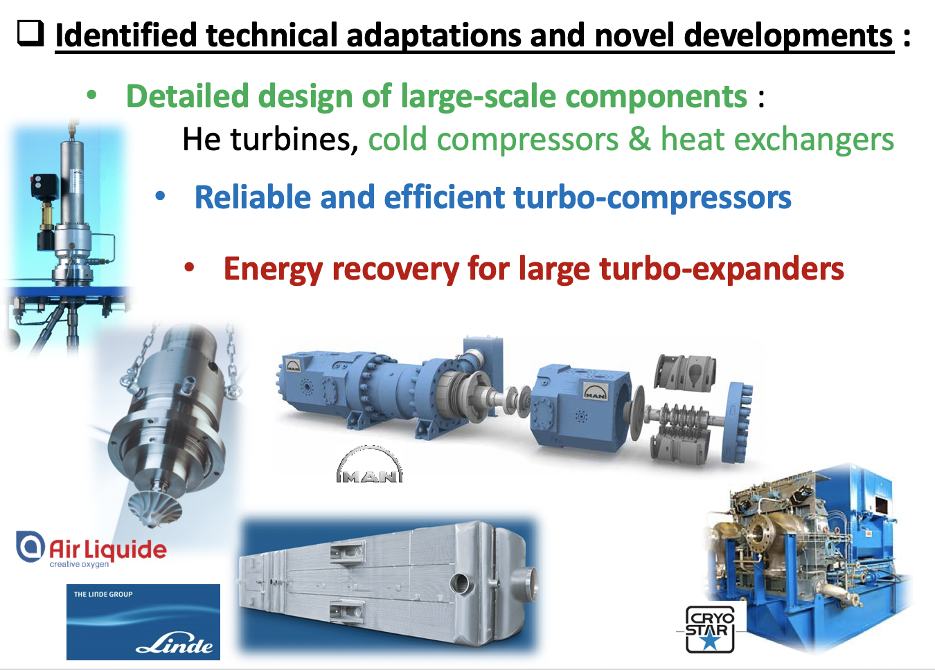
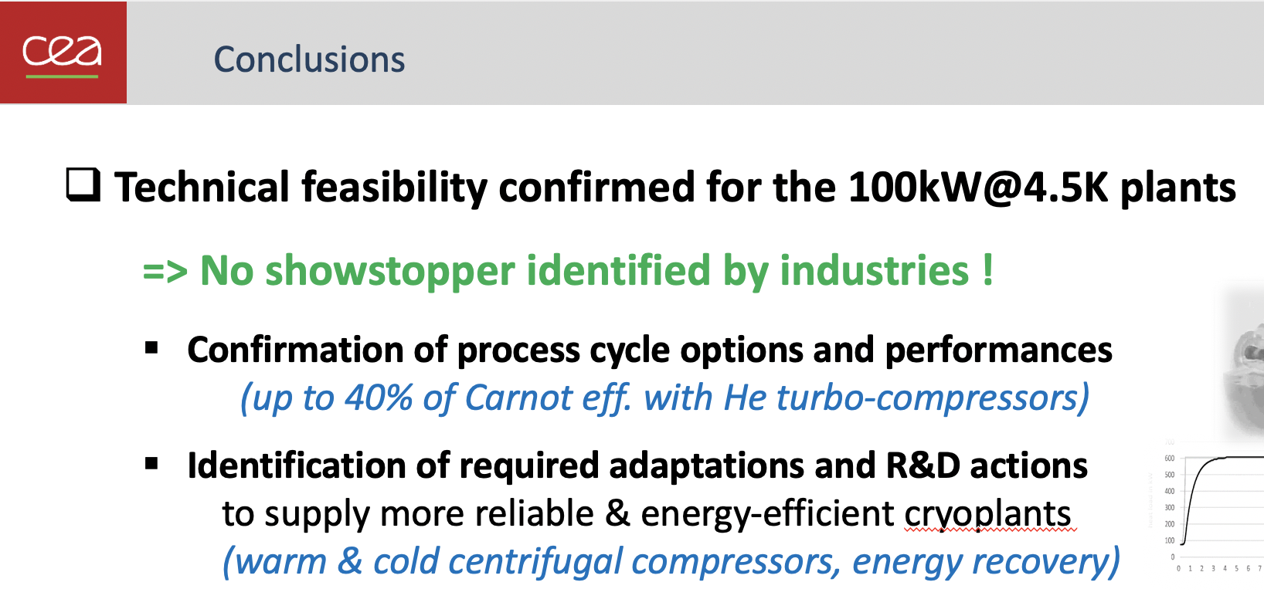
Conclusions
F. Millet (CEA)
Notes:
conclusions of the Linde and Air Liquide studies are :
- no showstopper identified by industries for the 100kW @ 4.5K plants
- more energy-efficient cryoplants feasible with additional R&D actions on large-scale rotating machines (warm and cold compressors, energy recovery)

Slide 5
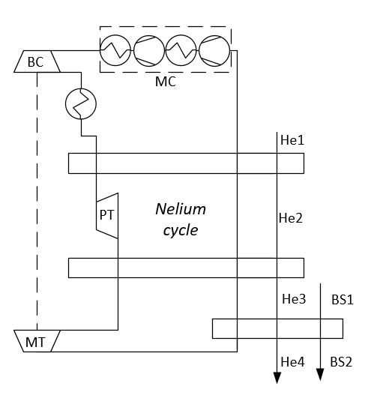
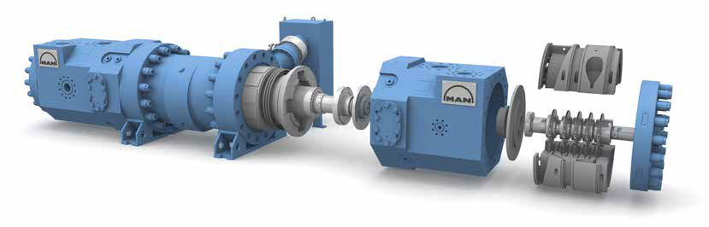
Nelium Turbo-Brayton cycle improvement
Problem statement:
Nelium mixture composition improvement is limited with centrifugal compressor design.
1-tandem machine is available for 40 vol. % of helium.
Baseline cycle
Image courtesy: MAN Diesel and Turbo
S. Savelyeva (TUDresden)

Slide 6
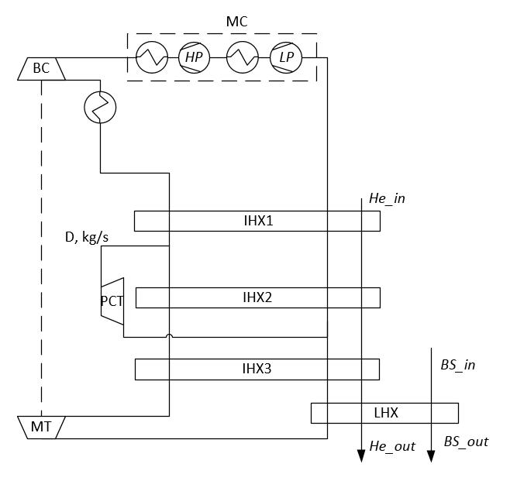
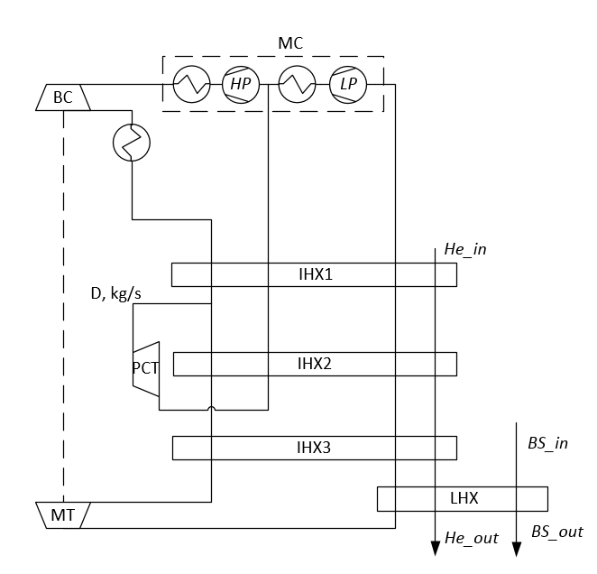
Nelium Turbo-Brayton cycle improvement
Cycle A (baseline)
Cycle B
Cycle C
New cycles baseline was offered to improve the system components design
Helium content can be increased up to 60 vol. % He to reduce heat exchangers sizes
or
- Remove 1 compressor impeller → +4..5 % to the total compressor efficiency ηs↑
✓ 2 inner heat exchangers | ✓ reduced pressure ratio | ✓ reduced pressure ratio
 | ✓ easier pressure control | ✓ higher volumetric flow to the second compressor casing
 |  | ✓ reduced pressure ratio of pre-cooling turbine compared to cycle B
✗ higher pressure ratio | ✗ additional heat exchanger | ✗ additional heat exchanger
 | ✗ high speed of the pre-cooling turbine (high pressure ratio)
Main future target: adjust the Turbo-Brayton cycle design to help the industrial turbo-compressor design
Improved baseline
S. Savelyeva (TUDresden)

Slide 7
FCC Inner Triplets Cooling – Heat Source
Cryogenics’ task is to extract heat load generated by collision debris in the IP
Collision debris
High and strongly varying specific heat loads call for large cryogenics installations or very short cooled units
C. Kotnig (CERN)

Slide 8
FCC Inner Triplets Cooling – Cooling Schemes
Two cooling concepts based on superfluid helium technology were investigated
Two-Phase Flow Cooling
Both systems could fulfil the cooling task with the available space in the cold mass for the current Inner Triplet design
Small increases of magnetic lengths (e.g. for optical reasons) are within the margins and favors the application of the two-phase cooling concept
Less space +
more flexible for different lengths
Pure Conduction Cooling
Better suited for short magnets
C. Kotnig (CERN)

Slide 9
Development of a heat transfer model compared to experimental data.
Steady state model looks OK
Transient under development
A. Vitrano (CEA)
Johannes Gutleber
Accelerator and Technology Sector Directorate Office, CERN, Switzerland June 25, 2019

Slide 10
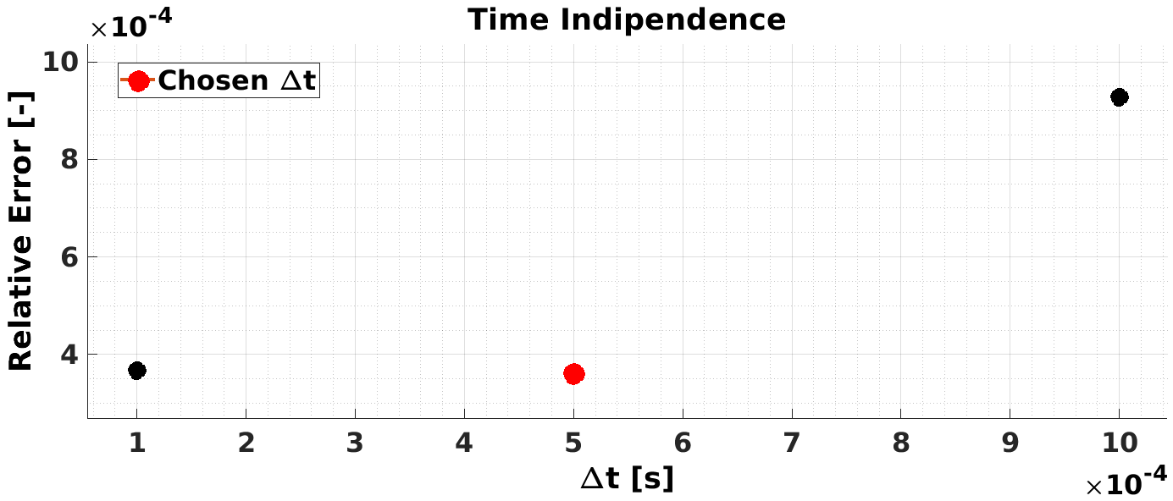
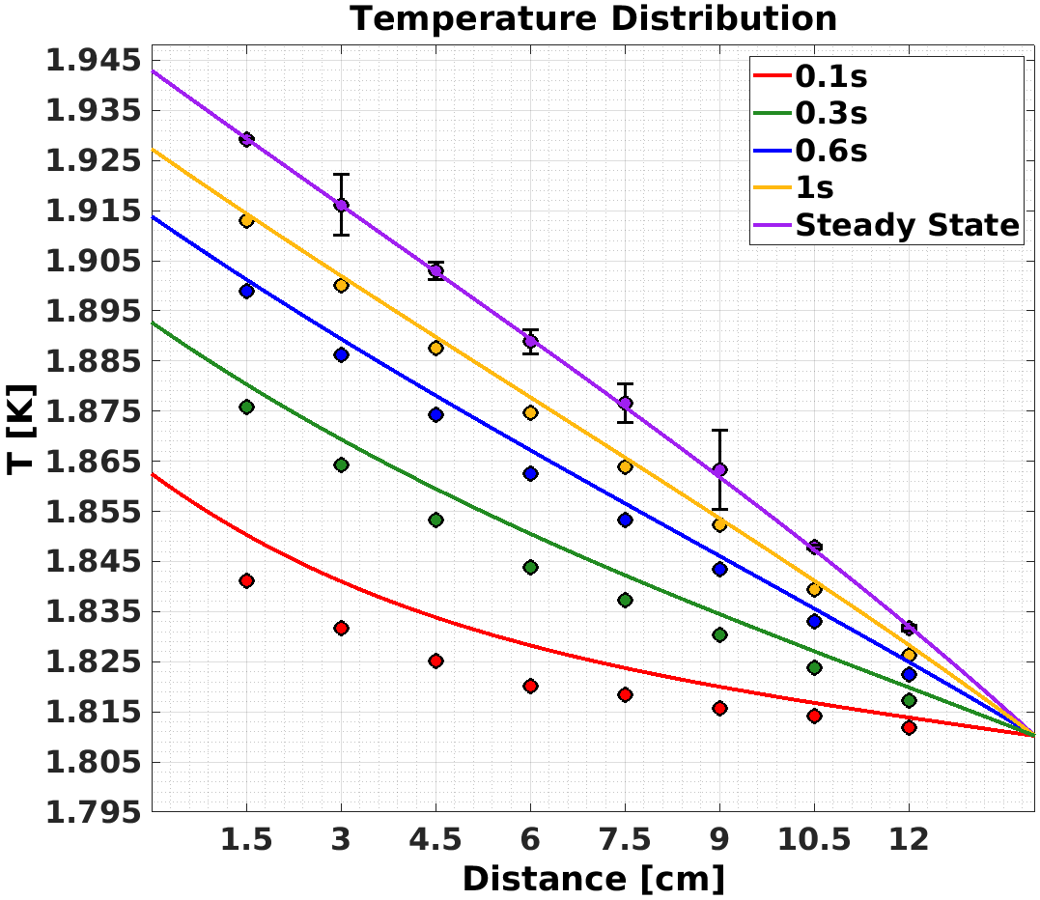
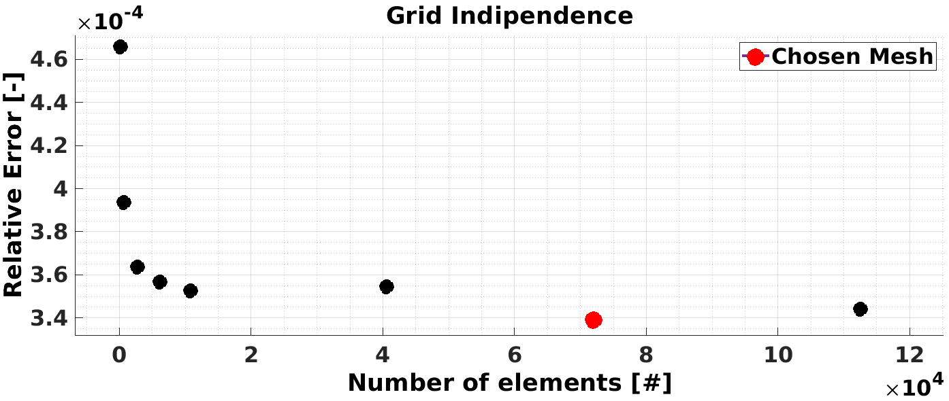
He II Model Validation
Research question
Experime-ntal setup
Numerical model
Ongoing work
Heat Flux ≈ 22 [kW/m²]
T_{bath} = 1.8102 [K]
Also a simplified model looks promising in terms of qualitatively forecasting the heat transfer behavior. Work ongoing to validate and consolidate the model.
A. Vitrano (CEA)

Slide 11
Technical Infrastructures and Safety

Slide 12


Scope of the CDR Safety Study
Identification of hazards, based on project breakdown structure, and “Standard Best Practice” to cope with them.
Three safety domains require special treatment:
  Fire in underground facilities
  Cryogenics in underground facilities
  Radiation Protection
Safety performance based study for Fire and Cryogenics
Standard prescriptive measures for Radiation Protection
Future Circular Collider Study
FCC Week 2019
Thomas Otto
T. Otto (CERN)

Slide 13
Safety Studies Proposed
The CDR Safety Study demonstrated that planned facilities can meet the Life Safety Objectives
Additional studies are necessary for a TDR:
  Fire Safety:
    Implementation of fire compartmentalisation
    Impact of fire scenarios on property and environment (slightly radioactive particles)
  Cryogenic Safety
    More accurate description of Helium releases
    Interaction of cold gas with smoke extraction, pressure on compartment walls
Future Circular Collider Study
FCC Week 2019
Thomas Otto
T. Otto (CERN)
18

Slide 14
Safety Studies Proposed
Additional studies are necessary for a TDR:
  Radiation protection
    Radioactivity in experiments and beam loss points
    Management of effluents (air and water)
    Radiation monitoring programme
Precise study programme will be determined once CERN’s strategy is defined
  Specific topics in e⁺/e⁻ collider
Future Circular Collider Study
FCC Week 2019
Thomas Otto
T. Otto (CERN)
19

Slide 15
FCC-hh PBD for fire safety applied to HE-LHC for validating ventilation concept
O. Rios, S. La Mendola (CERN)

Slide 16
Conclusions
Life safety goals for occupants are reached with the baseline safety measures
Two different concepts (with and without compartments) explored.
Hot smoke extraction system can be most efficiently designed and its fire resistance lowered thanks to PBD approach.
O. Rios, S. La Mendola (CERN)
Notes:
Other safety goals? Occupants safety.

Slide 17

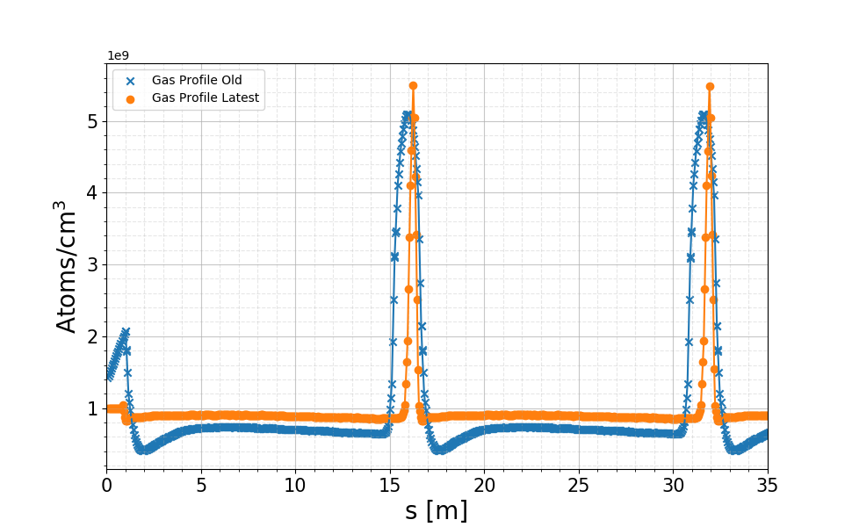
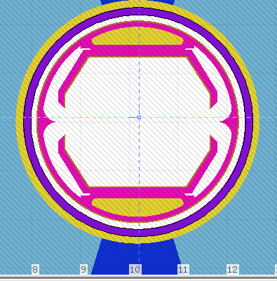
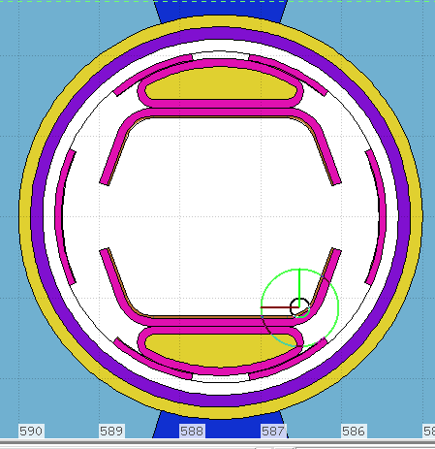
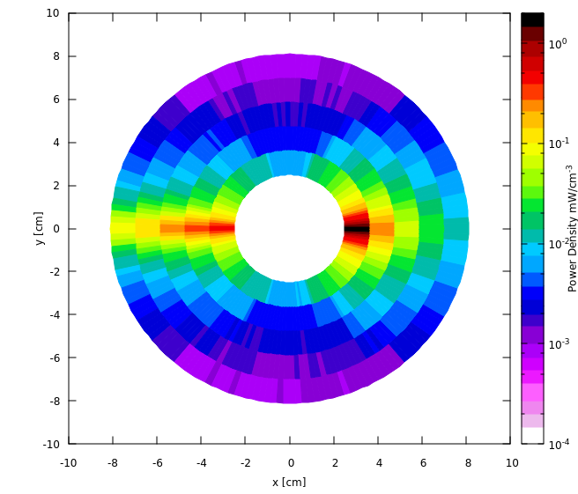
R2E
Beam-gas losses
Beam screen
Latest residual gas profile
Old
New
Updated beam screen design provides less shielding for coils and cold mass.
Beam screen now absorbing ~5 % of power loss density as opposed to 16 % previously.
86 % absorbed by cold mass.
Most impacted dipole receives 278 mW/m on cold mass.
Peak power density in coils: 1.64 mW/cm³
Assumes 10¹⁵ particles/m³ as pessimistic assumption as in LHC. Finally was 200 times less.
J. Hunt / EN-STI

Slide 18
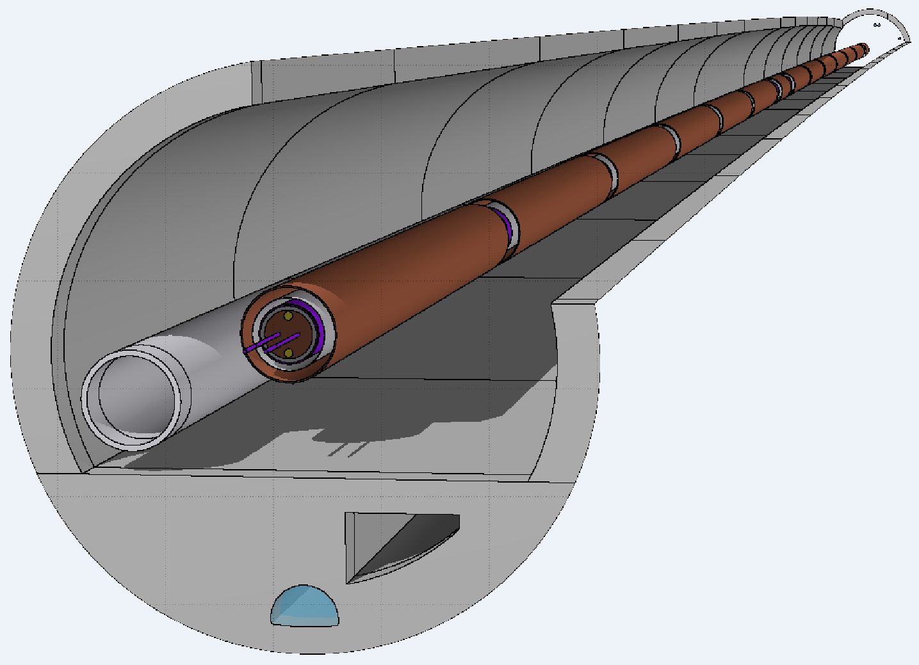
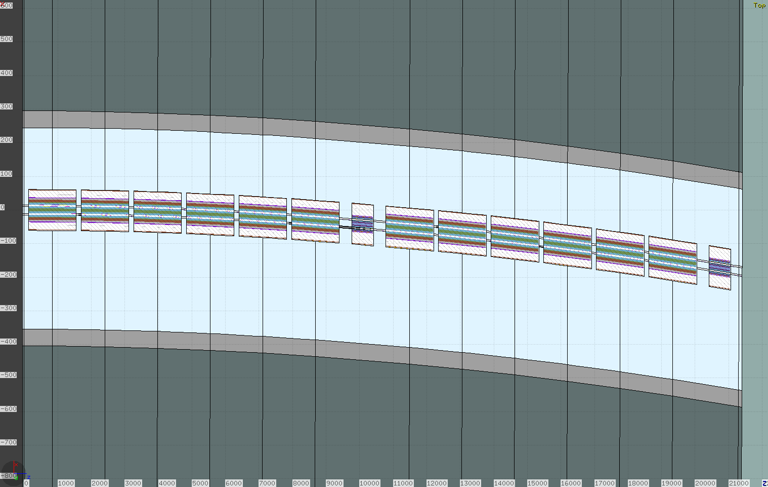
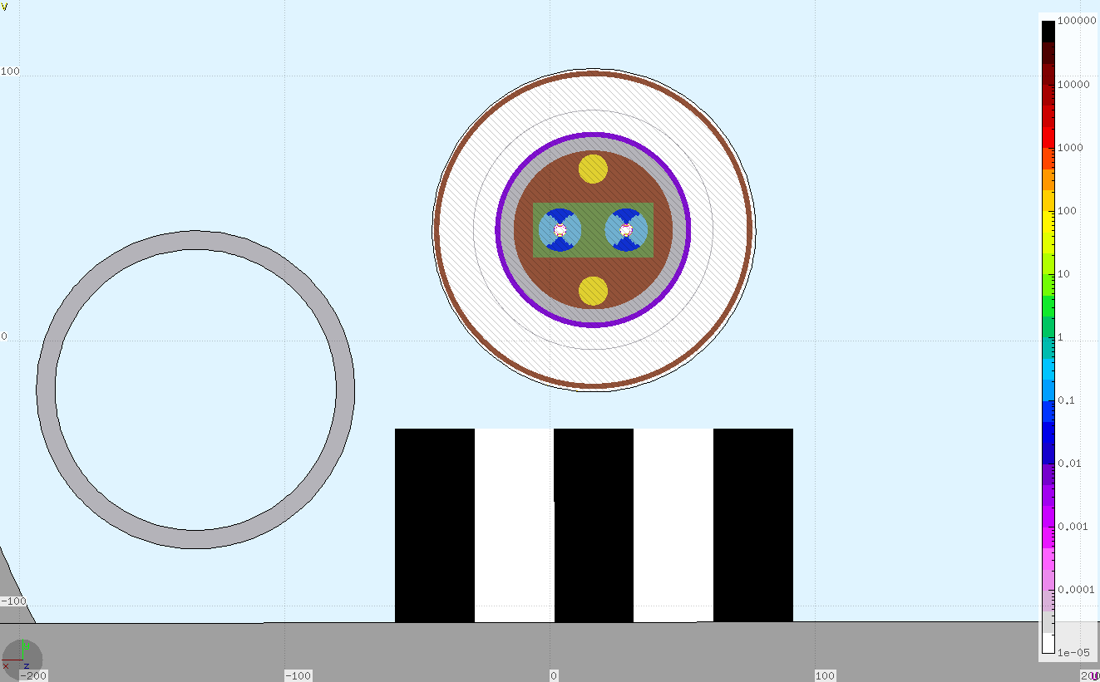
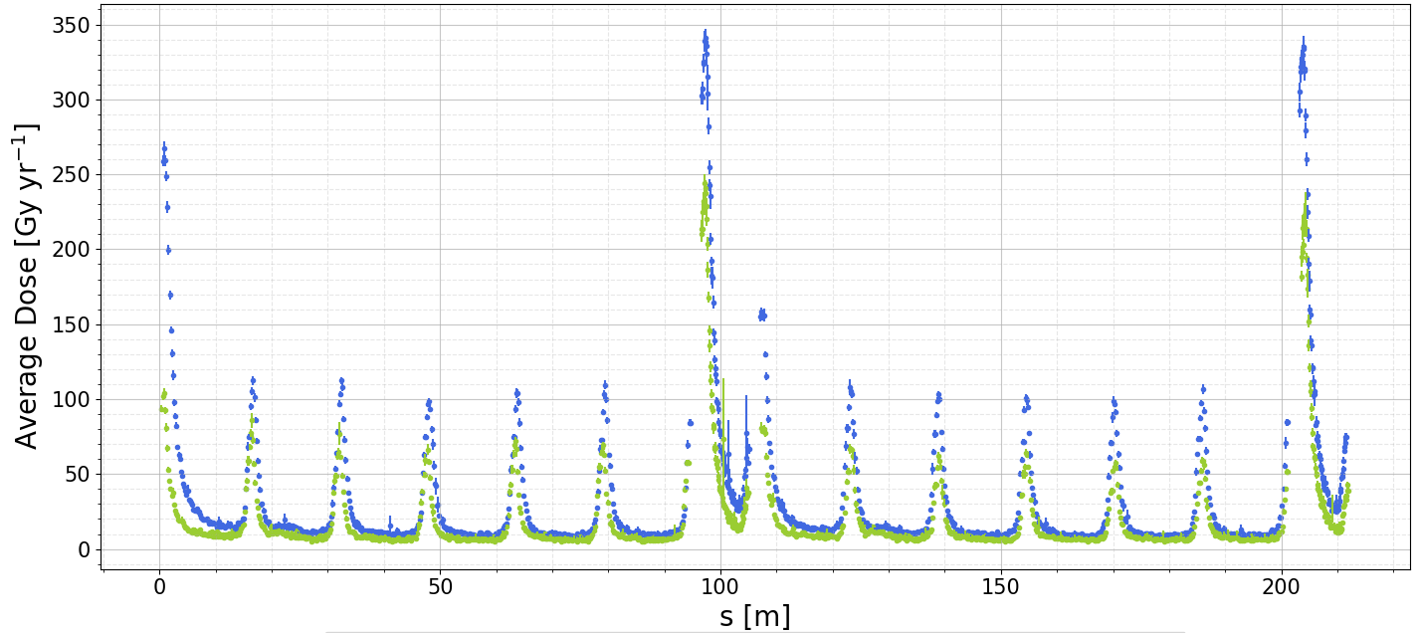
R2E Impact
Full 214 m arc cell (axis not to scale)
FLUKA model
Some increase in dose to electronics under beamline
Updated
Previous
J. Hunt / EN-STI

Slide 19
Civil Engineering

Slide 20
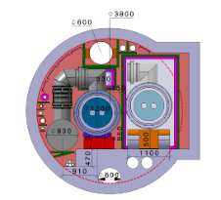

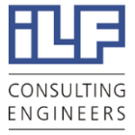

CE study progress
Cost and schedule estimate compatible with the CDR baseline for all 3 machines: FCC-hh, FCC-ee and FCC-eh
Refinement of results (fire compartments, caverns spacing)
Additional ILF studies (cash flow, spoil volume per site, HL-LHC cost comparison)
HE-LHC
Requirements gathered from cryogenics, electrics and HVAC, which determined the modifications needed for HE-LHC for civil engineering
Cost estimate produced
Spoil Management
Study of the molasses re-use (approx. 9 million cubic meters of spoil)
Samples tested from HL-LHC sites
Optimisation of tunnel alignment
Tunnel layout optimisation based on geology, shafts depth, construction risks and surface sites
Potential surface areas identified following first review with host states
Ongoing work:
Surface site investigation
Site investigation planning
Spoil management study
Transfer line design
May 2018
Aug. 2018
Sep. 2018
Dec. 2018
Jan.- June 2019
Ongoing
CDR volumes submitted to European Strategy update for Particle Physics
Future Circular Collider Study
FCC Week 2019, Brussels
Alexandra Tudora
A. Tudora, J. Osborne (CERN)

Slide 21

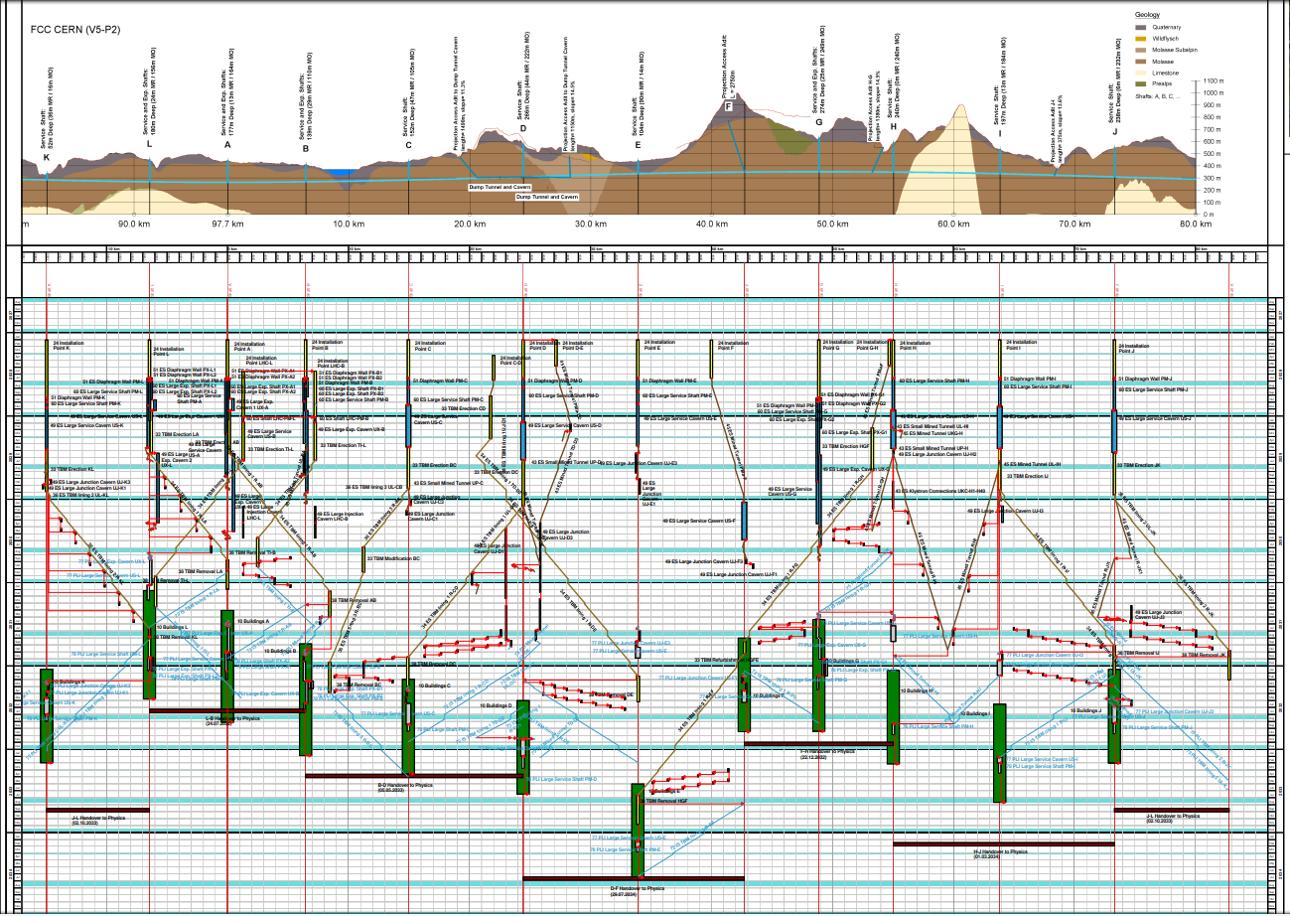
Construction Schedule
Sector L-A-B : 4.5 years
Sector D-E-F : 6.5 years
Future Circular Collider Study
FCC Week 2019, Brussels
Alexandra Tudora
A. Tudora, J. Osborne (CERN)

Slide 22
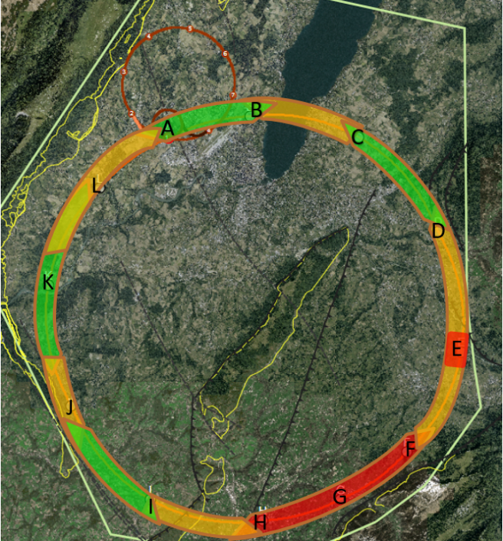
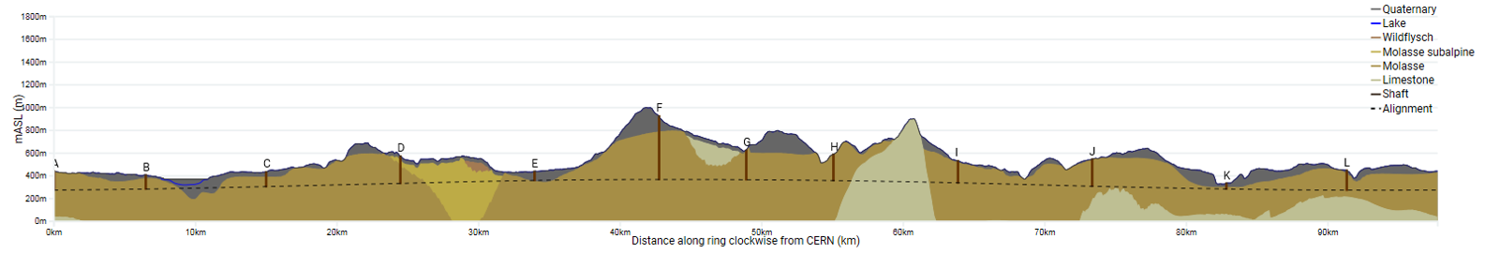
Geological uncertainty
Information near to CERN is strong due to previous experience on LEP/LHC.
Multiple deep boreholes in the area.
Location of the interface between molasse and molasse subalpine not certain, tunnel alignment in proximity.
Seismic and borehole information for lake crossing from proposed road tunnel, but layered nature of lake bed leads to uncertainty.
Alignment close to limestone rockhead.
The exact location and angle of the limestone/molasse interface undefined.
Moraine/molasse interface not certain, cavern close to interface.
Lack of deep boreholes in area.
Limestone formation known, but characteristics and locations of karsts unknown.
No deep borehole information available in the area.
Complex faulted region.
Molasse/limestone interface uncertain.
Vallée de l‘Arve
Mandallaz
Lake Geneva
Le Rhône
Future Circular Collider Study
FCC Week 2019, Brussels
Alexandra Tudora
A. Tudora, J. Osborne (CERN)

Slide 23


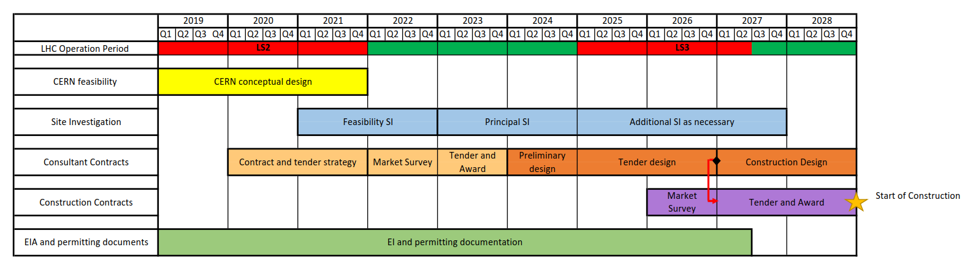
Schedule for preparatory phase
CDR
European Strategy Update 2020
Feasibility SI
(2021-2022)
Walkover survey
Geophysical investigation of all access points, Geneva Lake crossing, Rhône and Arve Valley
Principal SI (2023-2024)
Phase 1 – site investigations required for the development of preliminary design
Phase 2 – confirmation of geological profiles and engineering design parameters
Phase 3 – additional explorations needed for refined cost estimate
Types of site investigations:
Boreholes
Site testing (e.g. in-situ stress test, point load testing, SPT, CPT, permeability tests)
Rock laboratory testing (e.g. uniaxial compressive strength, petrographic studies)
Additional SI (2025-2027)
Additional data might be required after preliminary design for a more detailed geological evaluation
A. Tudora + J. Osborne / SMB-SE

Slide 24
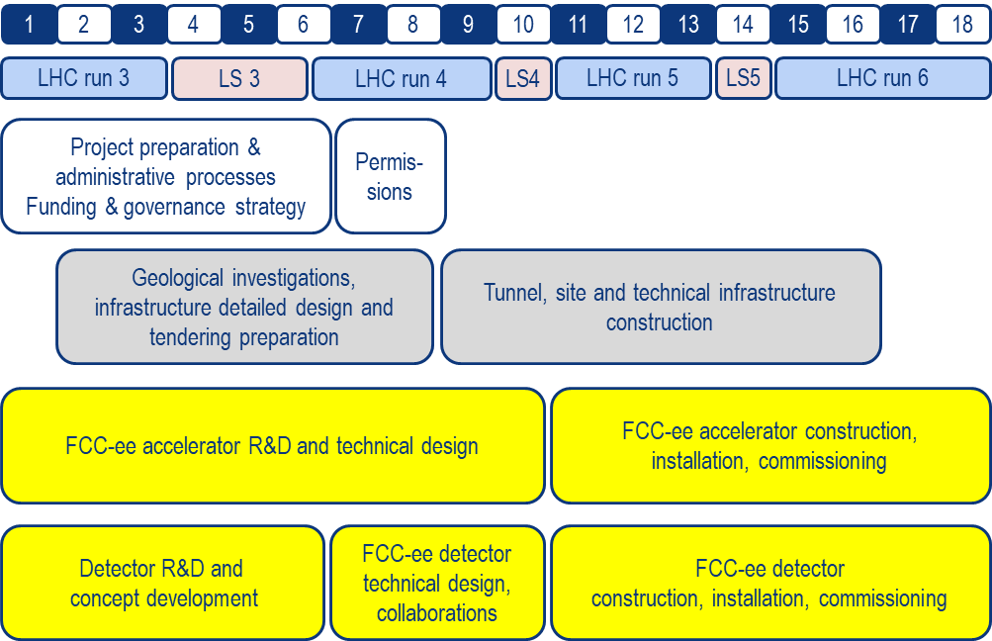

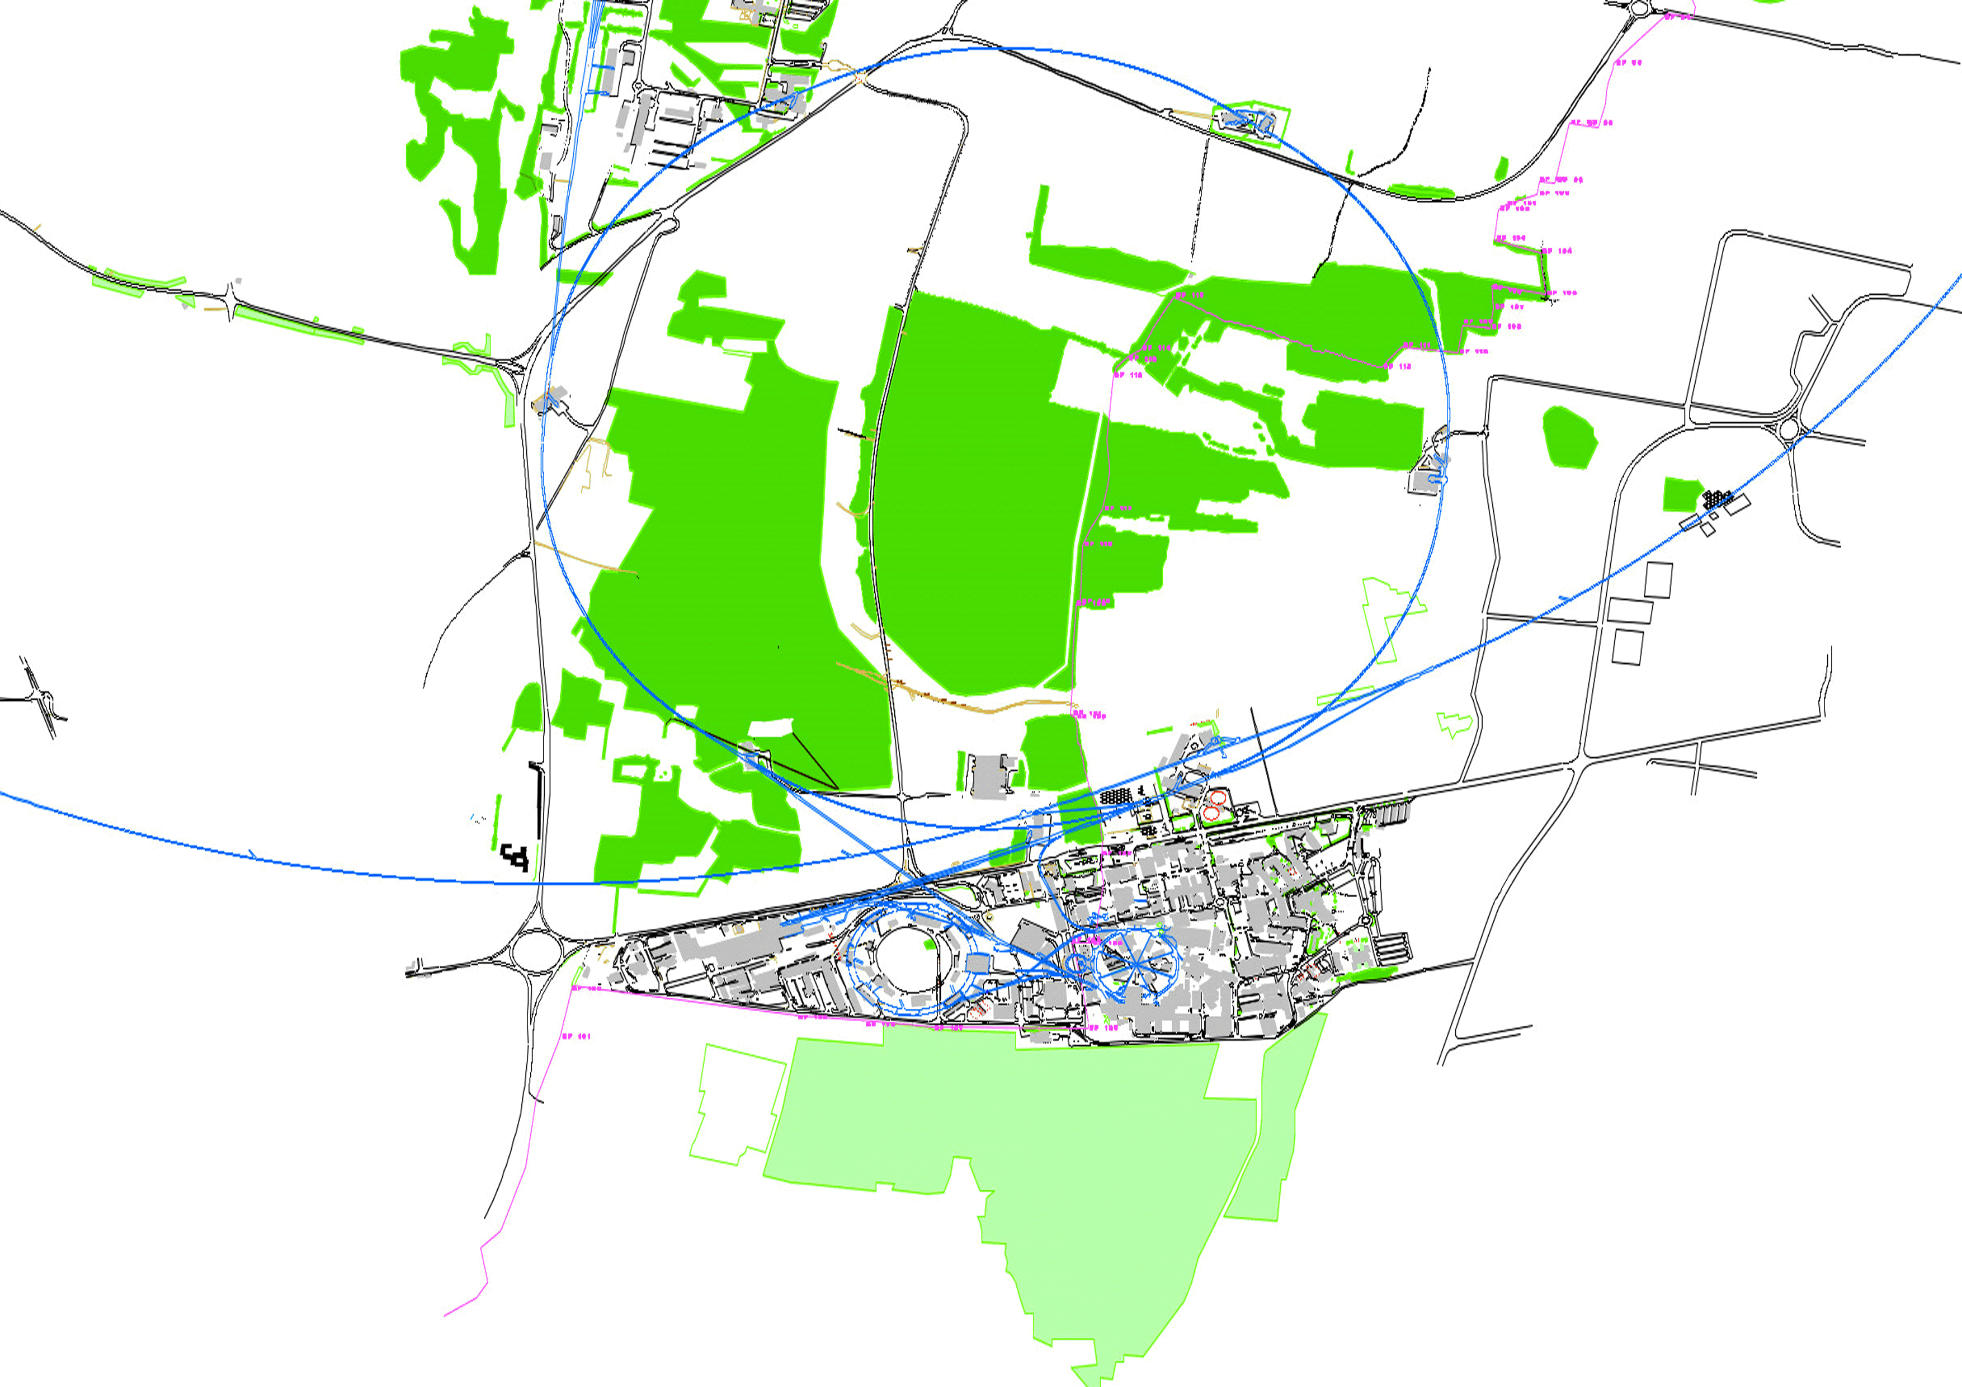
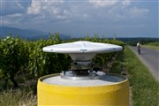
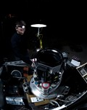
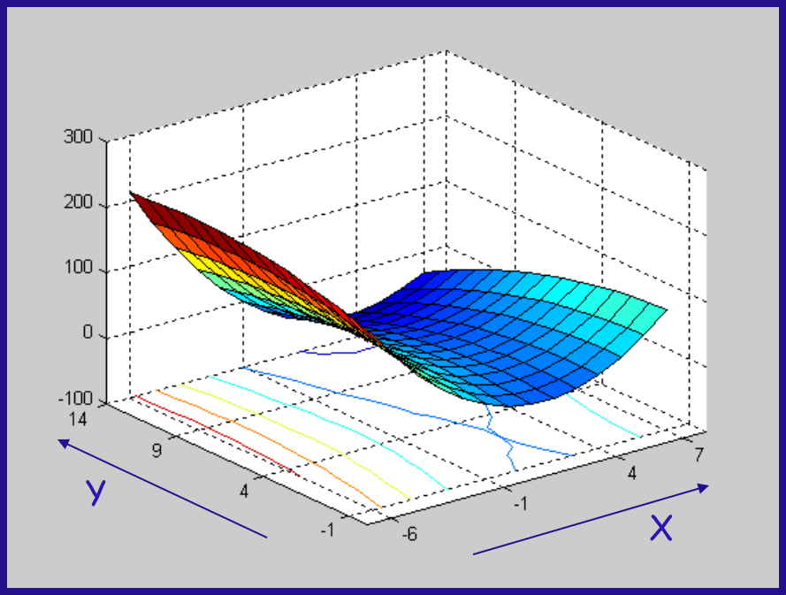
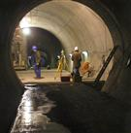
Geodesy
Reference point coordinates for CE construction
2020 +
Accelerator information required:
Theoretical design
FCC-ee integration model
Metrology & alignment precisions
To be developed:
Geodetic surface reference Network
Reference systems and transformation algorithms
Gravity field model
Geodetic transformation software
Organisational:
Planning
Resources
FCC installation start
Injector installation start
CE works start
CE construction invitation to tender start
Design Concept
Procure geodetic instruments start
Geodetic measurements start
Establish definitive reference systems end
Final update of position and orientation end
Y₃
Y₅
Y₇
Y₈
Y₈
M. Jones (CERN)

Slide 25
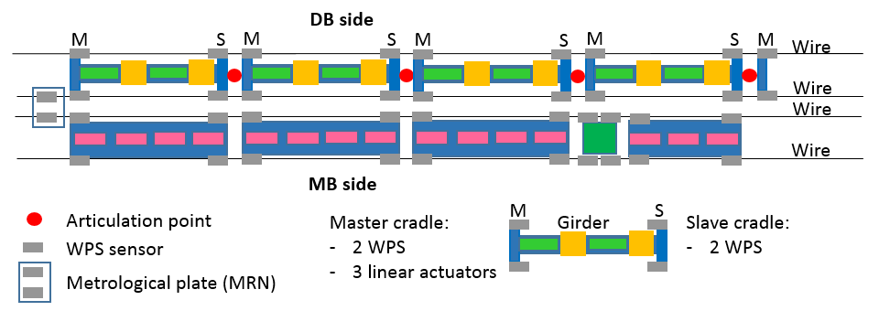
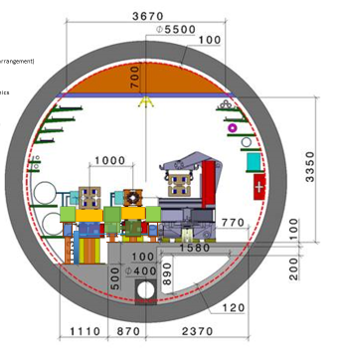
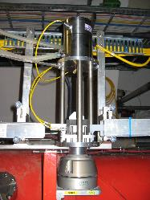

FCC-ee alignment + position monitoring
CLIC
design
Detailed integration and accessibility to be studied
Concept based on design for CLIC
Full remote position monitoring
and alignment system
Wire position sensors (WPS)
Hydrostatic levelling sensors
Motorised positioning system
M. Jones (CERN)

Slide 26
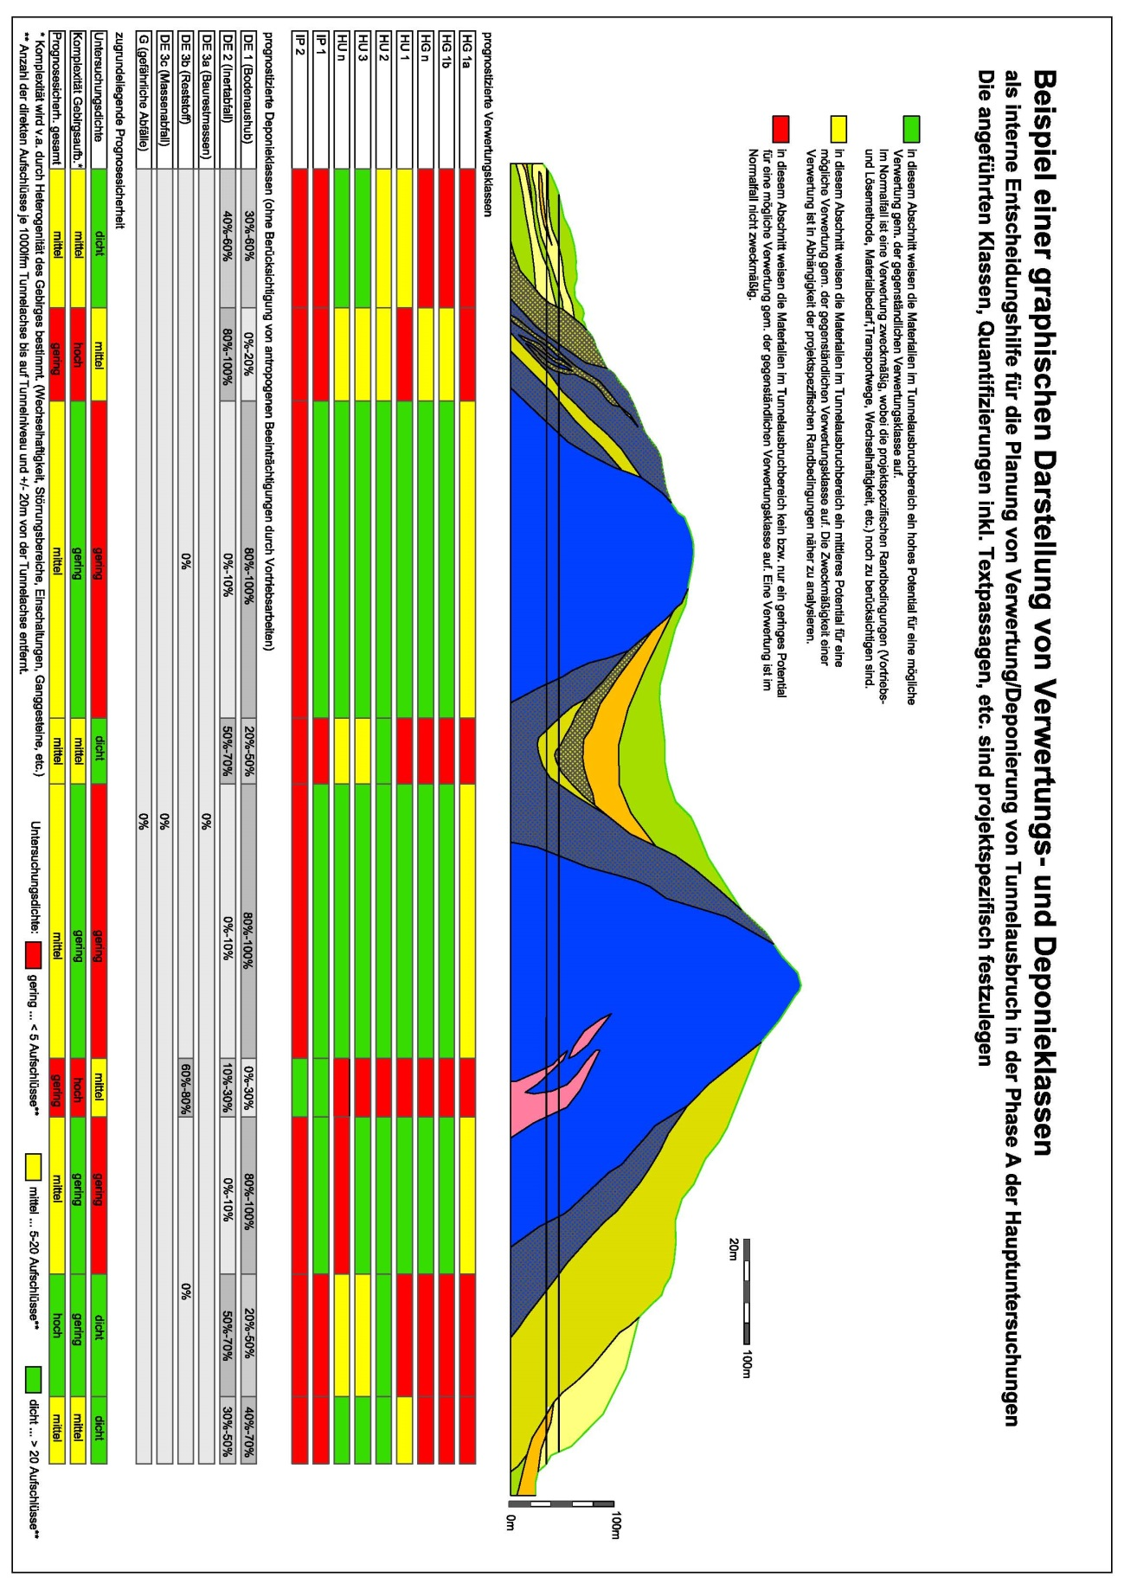
Excavation Materials Management
Classes of possible reuse versus landfill classes
including the probability of the prognoses in an early stage design
Concept from Brenner Base Tunnel

Slide 27
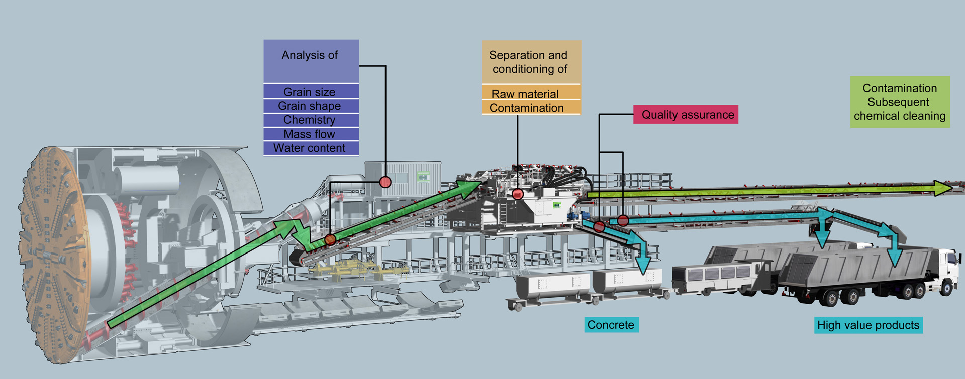
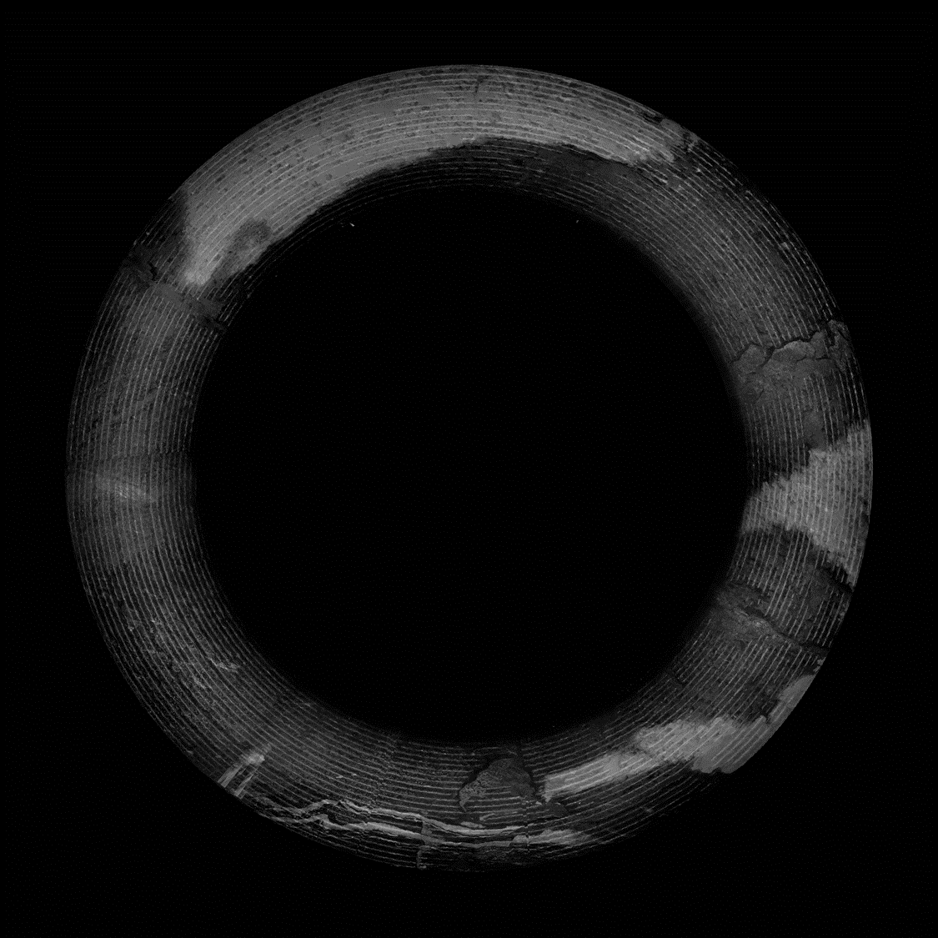
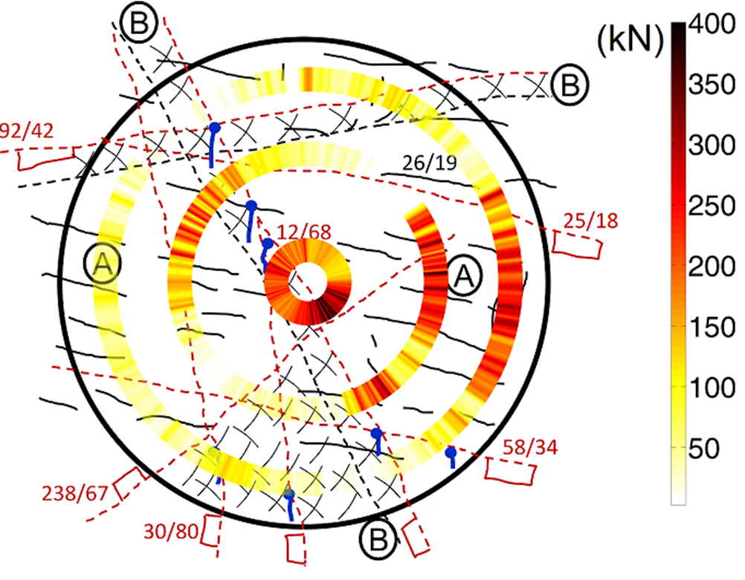
… to be able to react during construction
the concept
[Dragon 2015]

Slide 30
Host State Activities

Slide 31
Host State Activities
Accompanying of the study by SGAR (F), Etat et Canton de Genève (CH), DFAE (CH) and «mission permanente de la Suisse auprès des organisations int. à Genève»
Optimisation of the scenario in the region across France and Switzerland
Identification of activities to be carried out by project owner, by host states and by external contractors.
Develop administrative process schedule toward construction
Estimate impacts on the host states concerning administrative processes & financial engagements
Identification of needs for additional territorial developments for the project
Ensure participation of the population in the pre-construction phase
Ensure communication with all notified bodies and official study offices are implemented
Ensure compatibility of the infrastructure during all lifecycle phases with socio-urbanistic and environmental requirements.
Participation in the socio-economic impact studies
FCC
Identify development potentials and develop plans to generate socio-economic impacts.

Slide 32
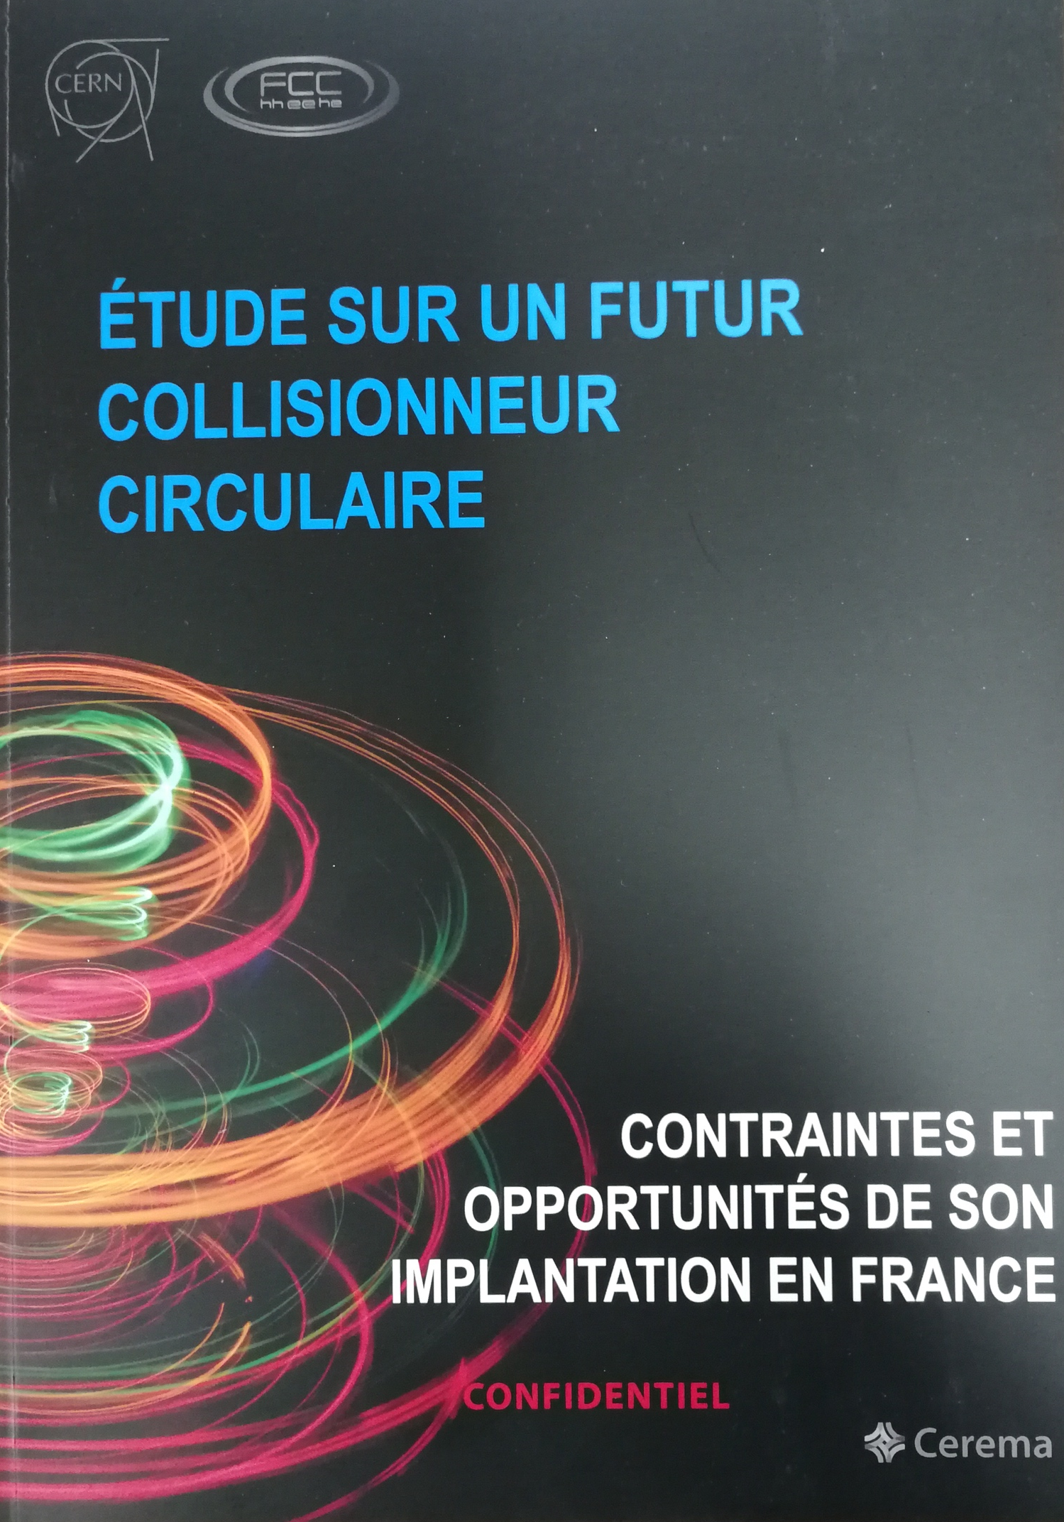
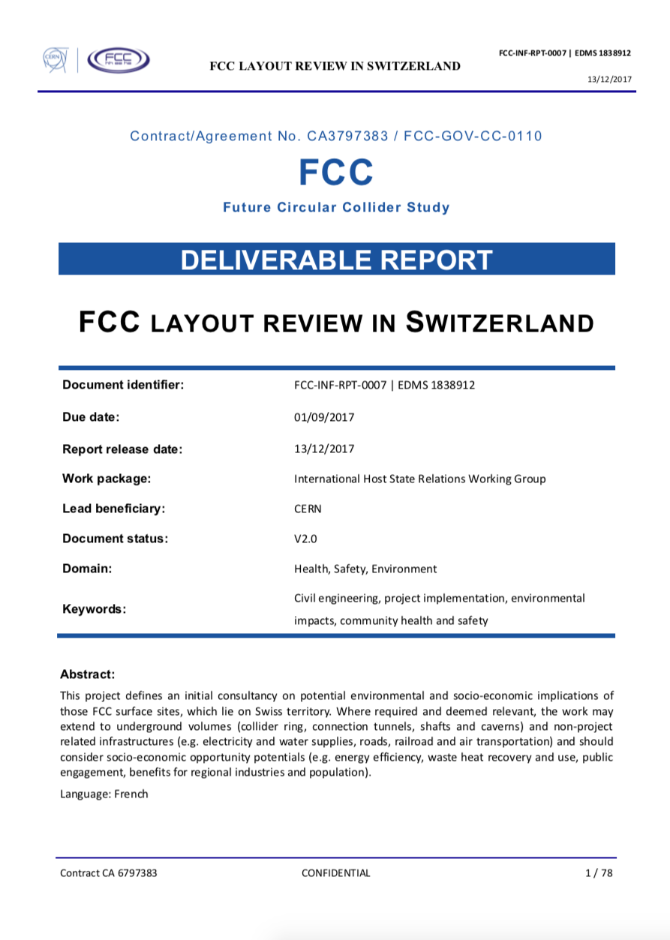
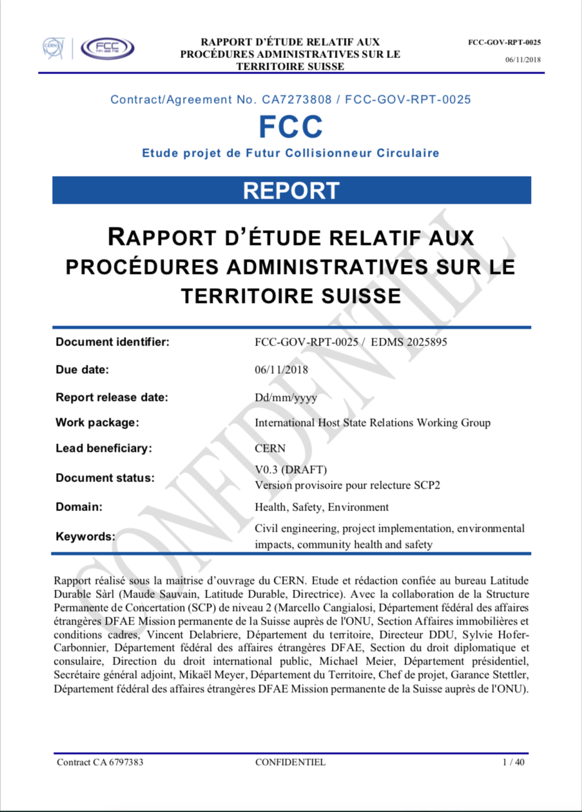
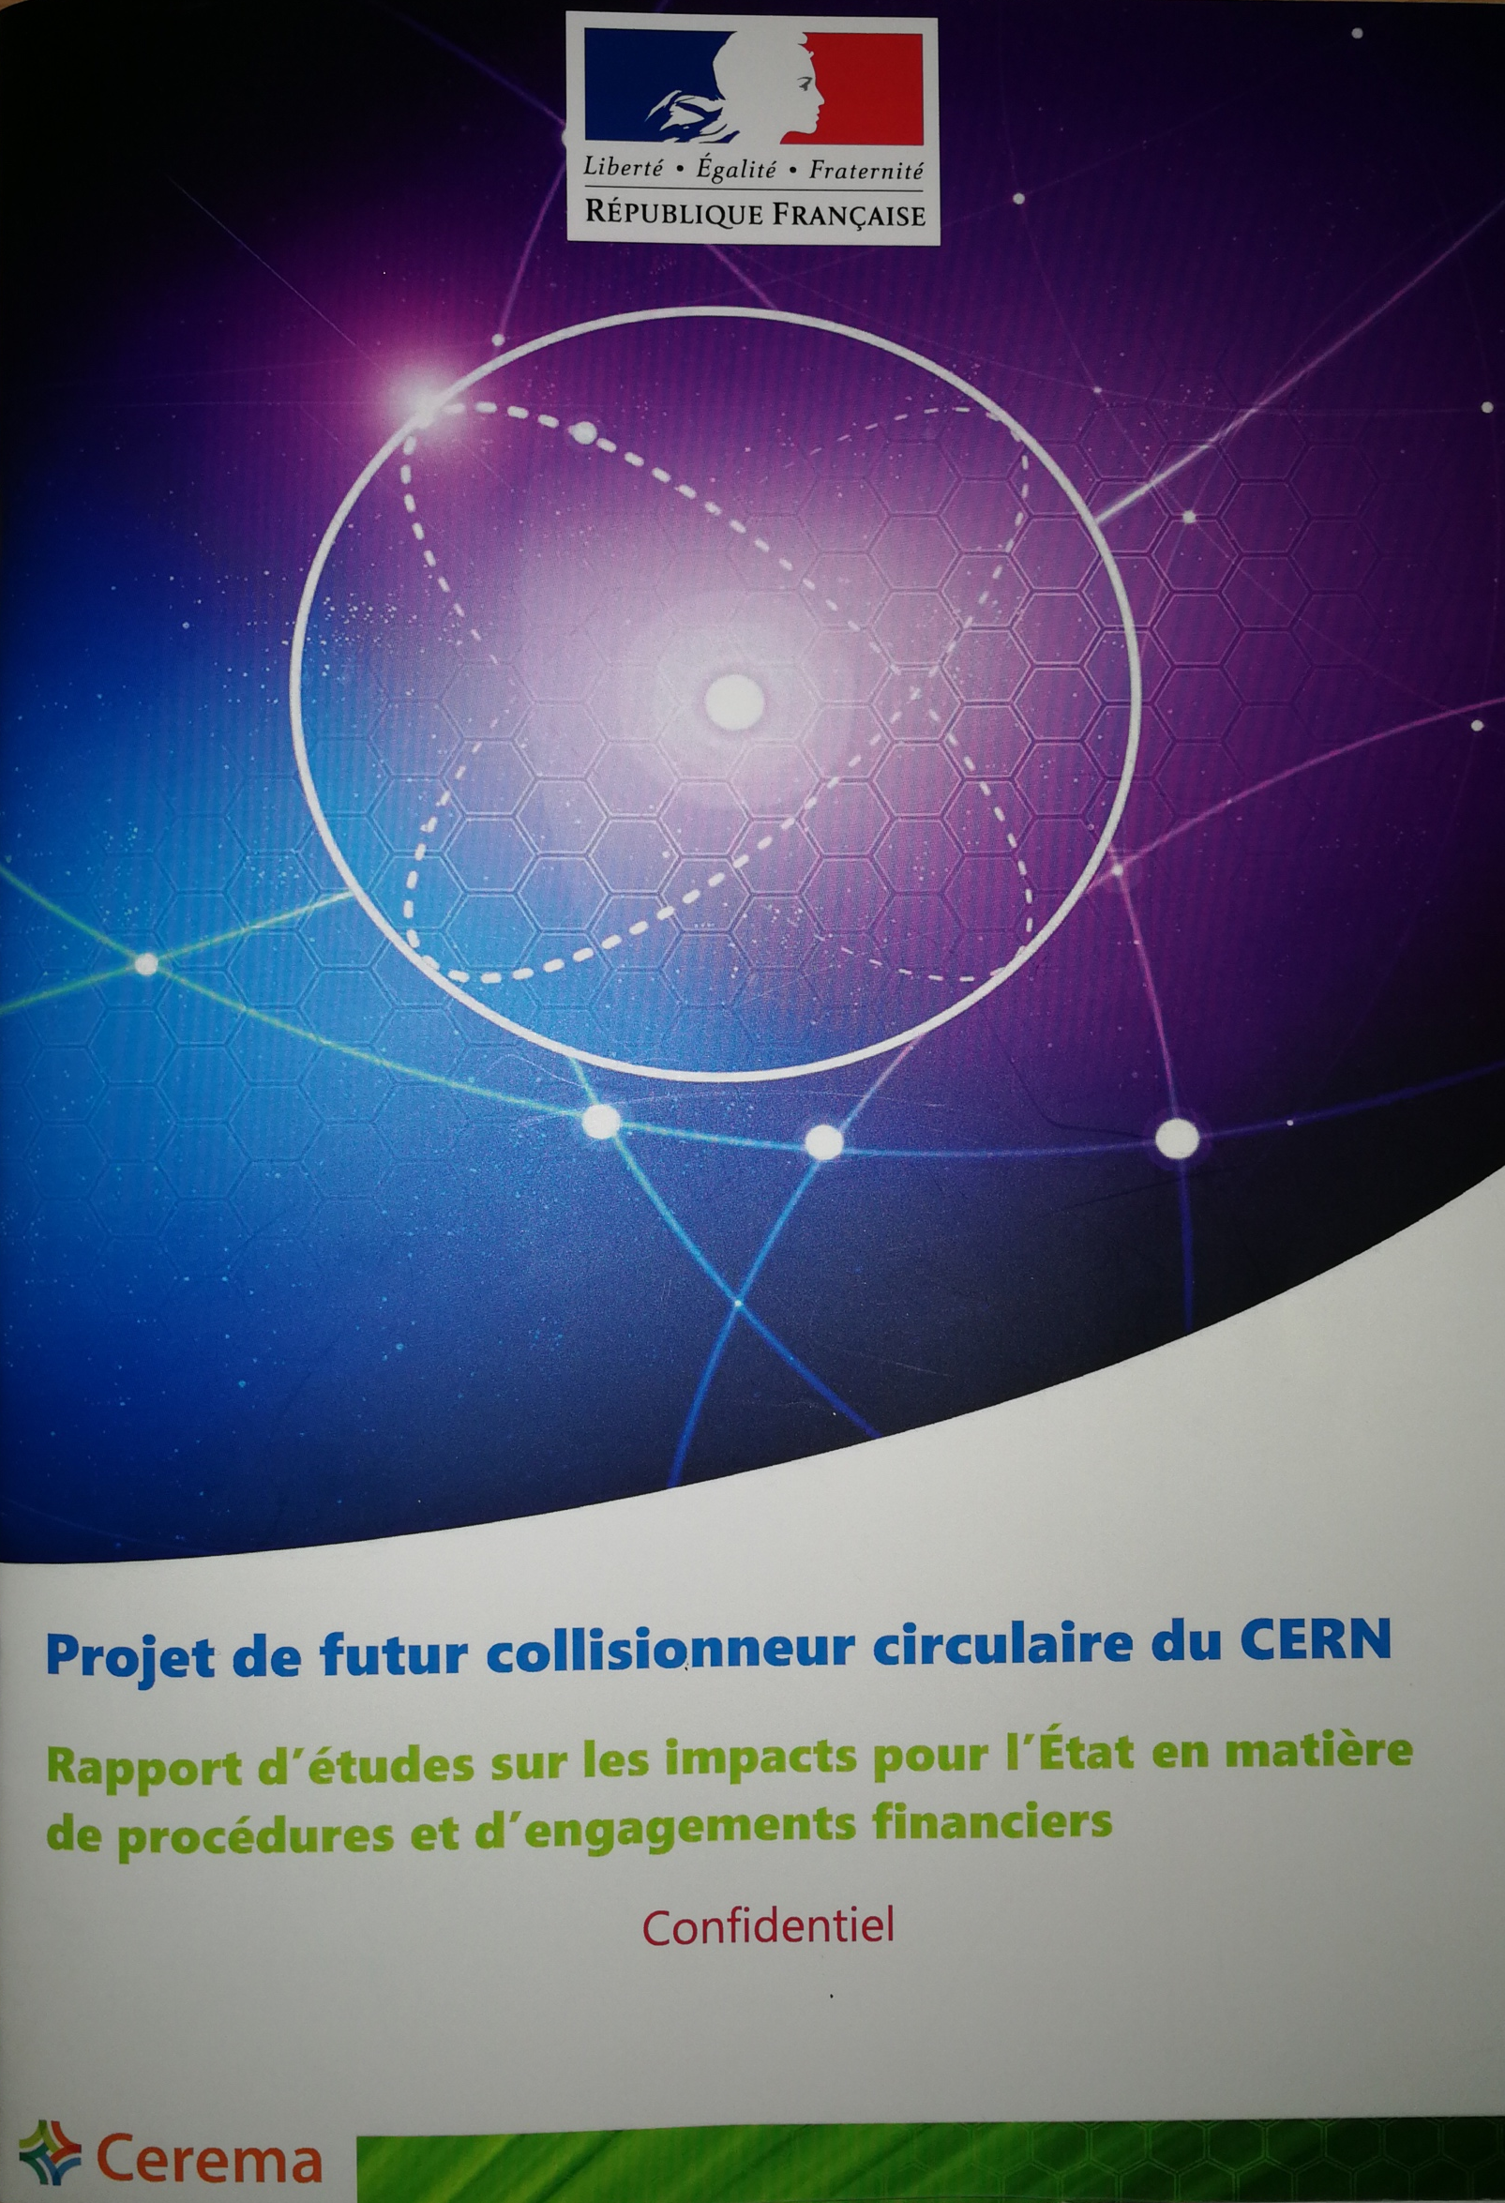
Baseline Document Set

Slide 33
Schedule
Challenging to be ready for construction by 2028,
but still feasible
Determining factors are sequential dependencies
  Identifying and documenting a suitable placement with host state notified bodies, which still has room for adjustment during participative processes (2 yrs)
  Governmental scenario validation and débat public in France (~ 5 years)
  Zone re-classification and acquisition process in Switzerland (6 – 10 years depending on cantonal or federal sector plan procedure, foresee need to adjust plan due to oppositions)
  Débat public with preparatory phase in France (4 years) + formal processes following (enquête, DUP ca. 1.5 years)
  Provisioning of land plots to CERN in both countries (treaty)

Slide 34
Take Home Messages
Processes need to be carried out and have to be successfully completed in both Host States, before a decision to construct can be taken.
Processes are “scenario specific”. Cannot be carried out in generic ways.
Stakeholders of both Host States actively support the processes.
Preparatory phase design project needed to carry out activities in time.
Processes take time (~ 8 years) and require the involvement of institutional and public stakeholders from 2020 onwards.
Highest priority is now to optimize the collider placement, to document the invariants and the remaining degrees of freedom to adapt. This documentation is the baseline for ”political scenario validations” in both Host States, serving officials to develop their schedules towards a construction decision by 2026.

Slide 35
O. Martin (MAE)

Slide 36
Conclusion
Massive political / administrative work ahead with the 2 Host States – this is only the beginning!!!
Key words
Trust
Anticipation
Environmental and legal exemplarity
Local acceptance / communication

