Slide 1
Development of Nb₃Sn in Japan
T. Ogitsu, T. Nakamoto, M. Sugano, K. Suzuki; KEK,
S. Awaji; Tohoku Univ., H. Oguro; Tokai Univ.,
A. Ballarino, S. Hopkins; CERN,
D. Larbalestier; NHMFL
S. Kawashima, T. Kawarada, Y. Murakami, K. Saito; Kobe Steel and JASTEC
D. Asami, H. Ii, H. Sakamoto, T. Kato; Furukawa Electric

Slide 2
R&D Plan
CERN, KEK and Tohoku & Tokai university have jointly launched a R&D program
The scope of the program is to develop, produce in representative lengths and characterize Nb₃Sn wire with enhanced characteristics.
The final goal is to achieve in representative unit lengths of material the development targets defined, on the basis of magnets performance, for the FCC Nb₃Sn conductor: 1500A/mm² @ 16T
Contract with 2 Japanese companies: Task 3; 4 R&D contracts each
  JASTEC/Kobelco: Distributed Tin (DT) Method
  Furukawa Electric: Nb Tube Method
4 Years Plan
Task1
Review past technologies and select.
First review meeting in Feb. 2016
Task2
Design wire layout and composition
Procure material (possible trial billets)
Task4
Select candidate
Produce 5km wire
Heat treatment study
Task5
Production of 20km wire
with unit length > 100m
Task3
Production of R&D billets
L>3km * N>3

Slide 3


Development of DT Nb₃Sn wire
for FCC in KSL/JASTEC
Notes:
Future

Slide 4
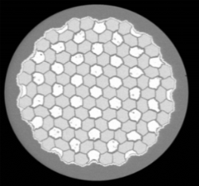
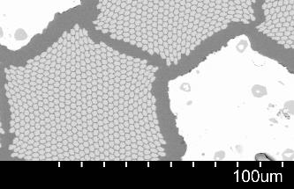

Key factors for higher J_{C} Nb₃Sn
Confidential
KSL/JASTEC are developing the DT wire for FCC.
Cross-section of DT wire (before Heat treatment)
Sn
Nb
• Multi Nb module (pure Nb)
• Mono Sn module (Sn-Ti alloy)
• Nb common barrier
• Stabilized Cu outside barrier
Sn
Nb
For higher Jc…
Improvement of Sn diffusion ： Reduction of Sn diffusion distance
(2) Increase of Nb volume fraction： Reduction of useless volume
(3) Ternary additive elements ： Amount and method
(4) Optimization of heat treatment ：Stoichiometry, Refinement

Slide 5
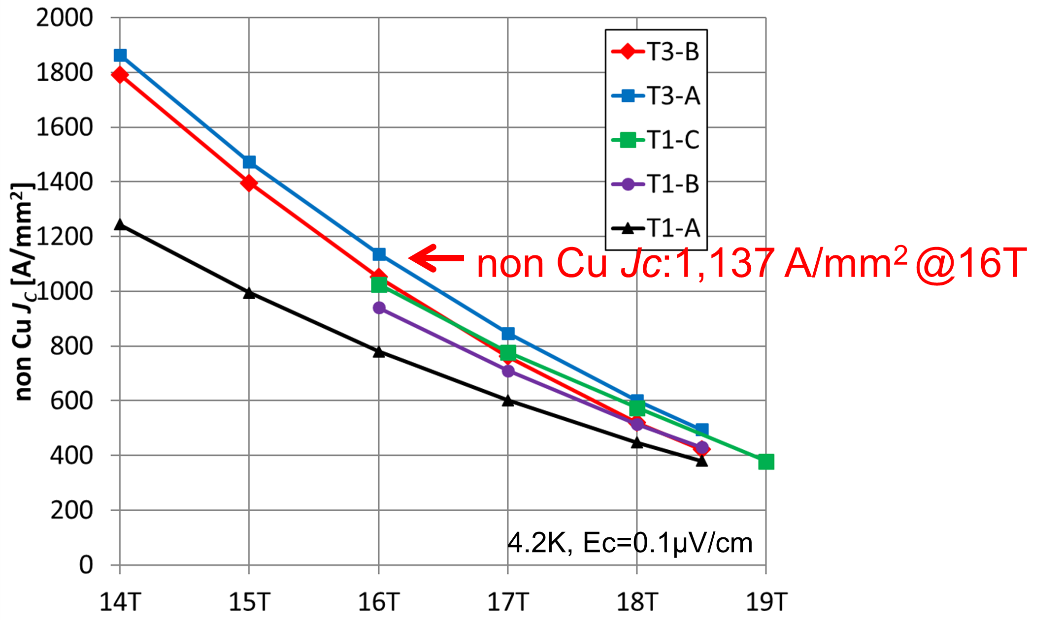
Non Cu J_{C} v.s. B
 | T1-A | T1-B | T1-C | T3-A | T3-B
Wire diameter (mm) | 0.80 | 0.74 | 0.64 | 0.80 | 0.80
Sn diffusion distance (µm) | 60 | 58 | 48 | 32 | 32
Ti ratio (wt%) | 0.55 | 0.55 | 0.55 | 0.48 | 0.35
non Cu J_{C} ( A/mm² )@16T | 800 | 930 | 1025 | 1137 | 1032
Non Cu Jc of 1,100 A/mm² at 16 T, 4.2 K has been achieved
by improving Sn diffusion and optimizing Ti content.

Slide 6
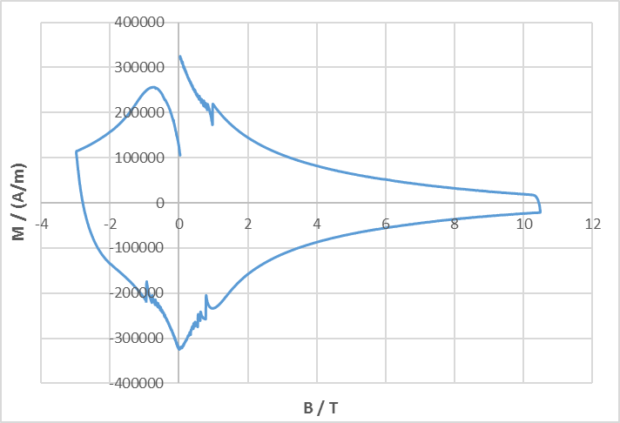
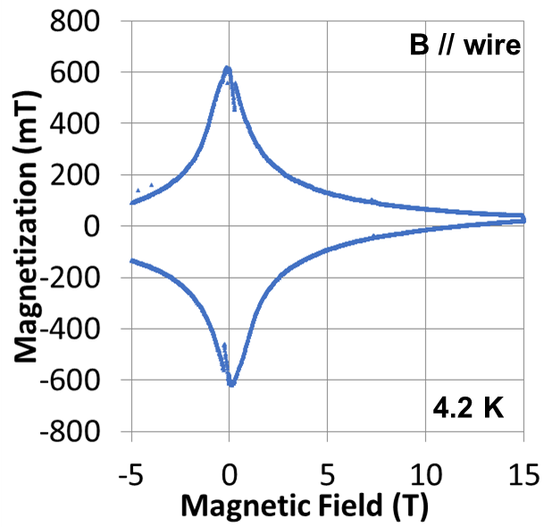
Magnetization characteristics
・For high Jc wire (T3-A,B), KSL/JASTEC evaluated magnetization characteristics and changes of Jc and RRR after rolling.
・The magnetization were measured at 4.2 K at CERN and Tohoku University, separately.
【Magnetizations of T3-A 】
@ CERN
@ Tohoku Uni.
【Calculated d_{eff} 】
at Tohoku University.
Sample name | T3-A | T3-B
d_{eff} by CERN (µm) | 54.5 | 55.0
d_{eff} by Tohoku Uni. (µm) | 35.1 | 30.6
※Nominal Nb module dia.: 32µm
・ There is no large flux jump.
・ The calculated d_{eff} (effective filament diameter) were 30 to 60 μm, which was for one or two modules. It is possible to achieve a value close to the current target ( ≤ 60 μm).

Slide 7
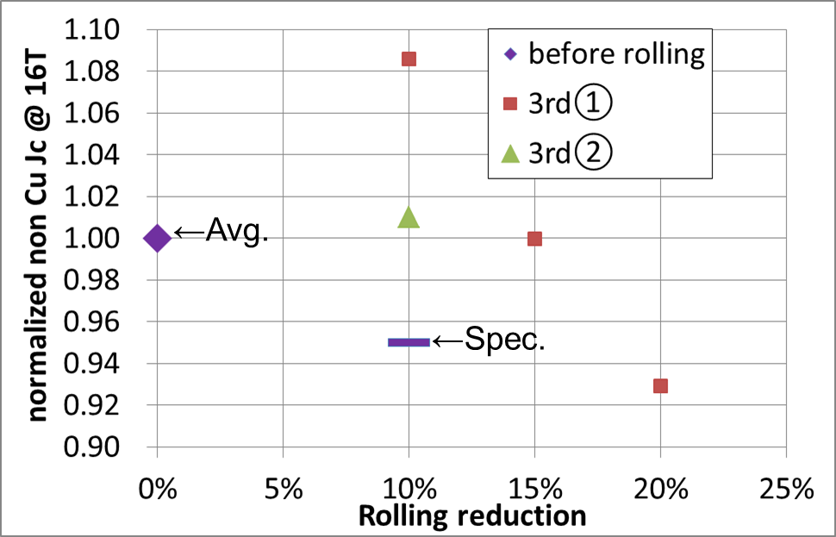
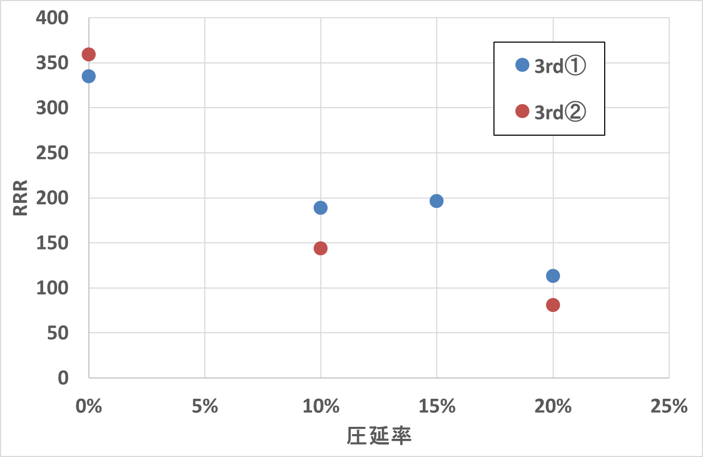
Rolling test (J_{C}, RRR)
Required specifications for FCC wire (16 T dipole mag.)
After 10 % rolling : 1) I_{C} (J_{C}) > 95 % for round wires, and 2) RRR > 100.
【 Normalized non Cu Jc 】
【RRR】
T3-A
T3-A
T3-B
T3-B
←Spec.
Rolling reduction
・Both J_{C} and RRR after rolling meet the specifications.
・From the SEM images of cross section, at any rolling reduction level, the deformation of Nb/Sn modules were only partial.
Also at 10% reduction, there was no Nb barrier break.

Slide 8
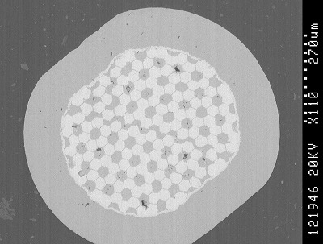
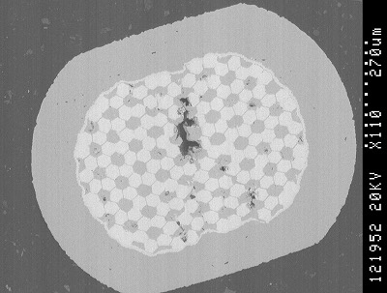
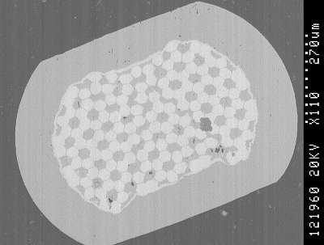
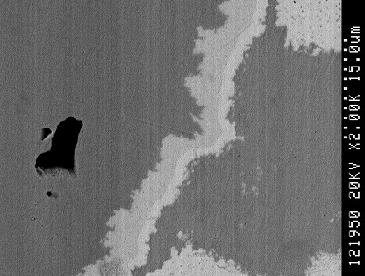
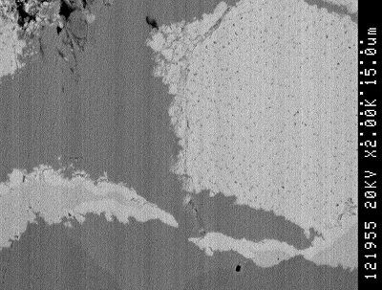
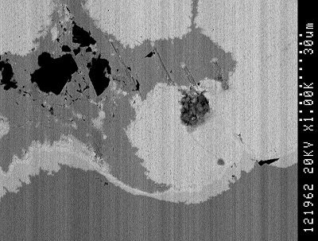
Cross section of T3-A after rolling (after heat treatment)
10％ (0.72mmt) | 15％ (0.68mmt) | 20％ (0.64mmt)
 | －
・At any rolling reduction, the deformation of the Nb / Sn modules were only partial.
・At 15 and 20% of rolling reduction, there were Nb barrier breaks,
but at 10% reduction, there was no Nb barrier break.

Slide 9
Current Results and Next steps
KSL/JASTEC have achieved non Cu Jc @16T 1,100 A/mm²,
by improving Sn diffusion and optimize Ti content.
These wires also showed reasonable results in d_{eff} and rolling test.
We will investigate the followings to overcome the provisional
Jc target of 1,200A/mm²:
Increase of Nb area ratio
Control of ternary additive element
Further refinement of Nb₃Sn grain by controlling
heat-treatment condition
(4) Artificial Pinning Center (APC)

Slide 10
Materials for the FCC Week 2019

Slide 11
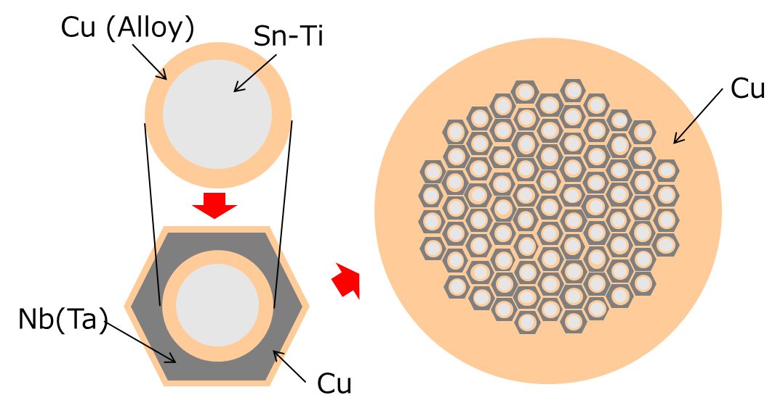
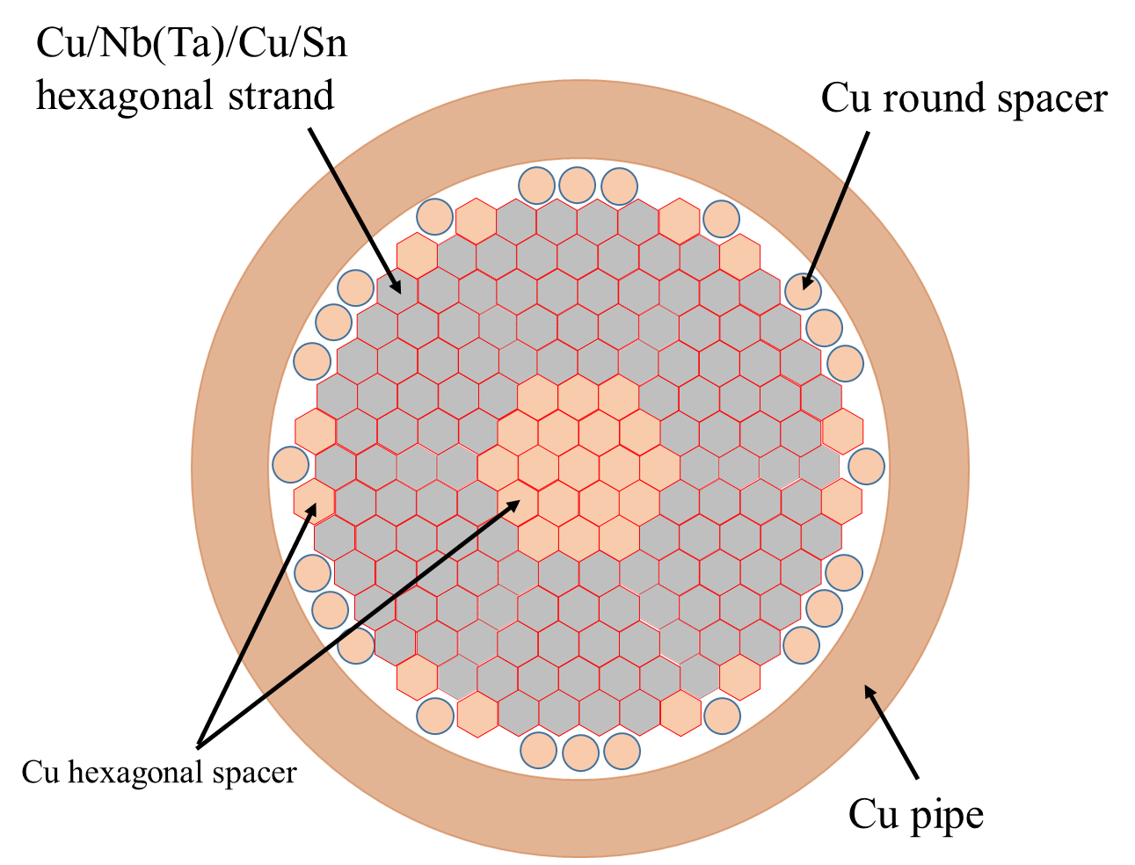
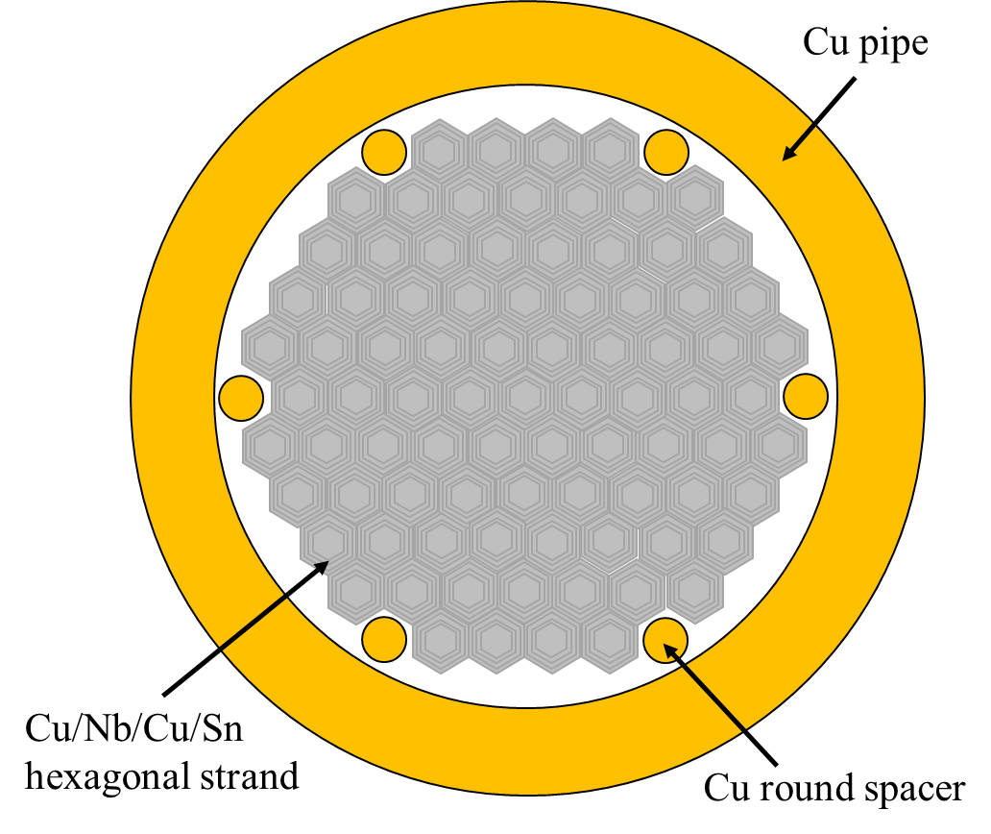
Wire Design of Nb tube type Nb₃Sn wire
Items | Wire A | Wire B | Wire C | Wire D
No. of Filament | 85 | 132
Filament Material | Nb |  |  | Nb-7.5wt%Ta
Nb/Sn ratio | ~2.1 |  | ~3.3
Filament Dia. (at φ0.83) | 64 mm | 45 mm
Cu/non-Cu ratio | ~1 | ~1.6
Nb pretreatment(℃) | 1,150 |  | 850
Wire A
Wire B~D

Slide 12
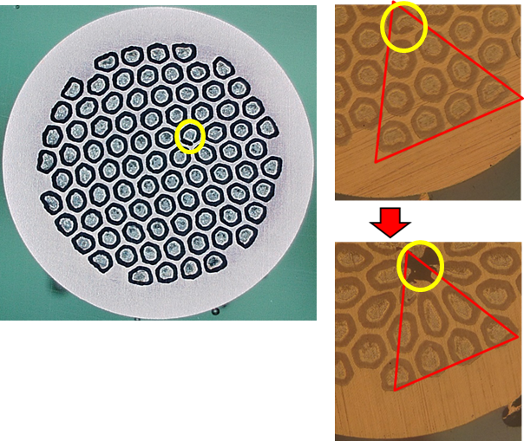
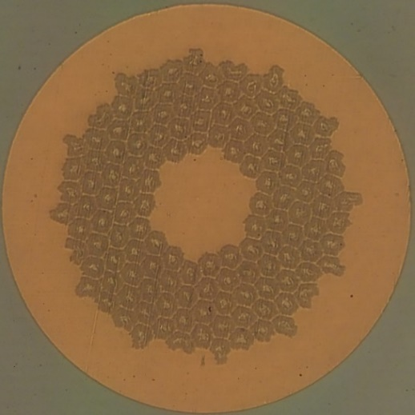
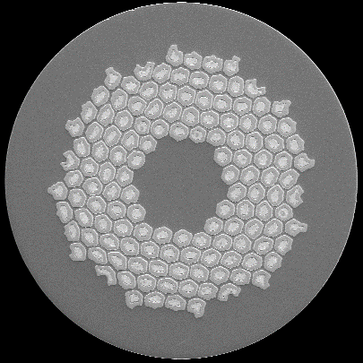
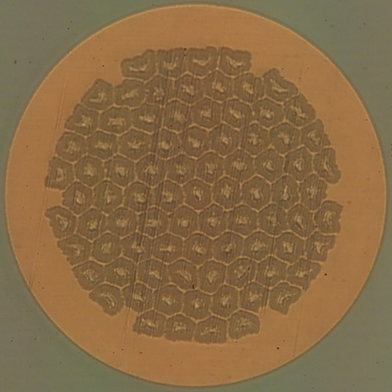
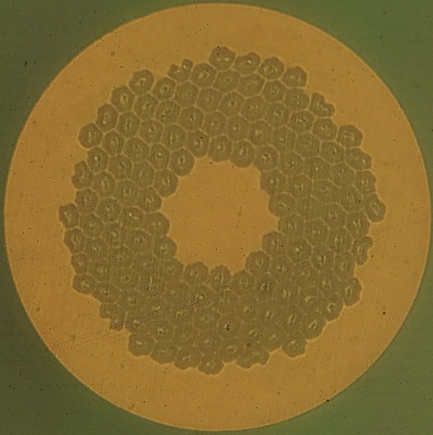
Drastic improvement of wire workability
Wire A , φ4.8 mm
Wire B , φ0.83 mm
Wire C , φ0.83 mm
Improvement
of production
process
✓Some improvements were conducted for
wire workability.
・material pretreatment
・Cleaning method of strands
・drawing parameter
✓Wire drawing is succeeded to φ0.83 mm.
✓The filament diameter is reduced to 45 μm.
Wire A , φ0.83 mm
Wire D , φ0.83 mm

Slide 13
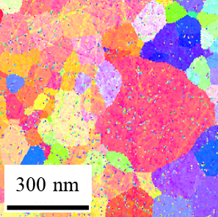
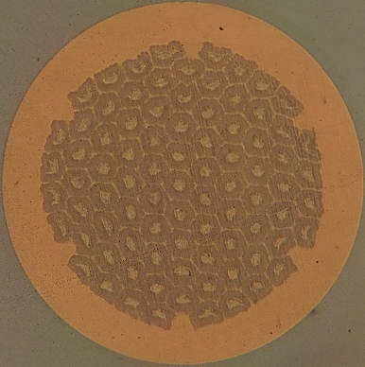
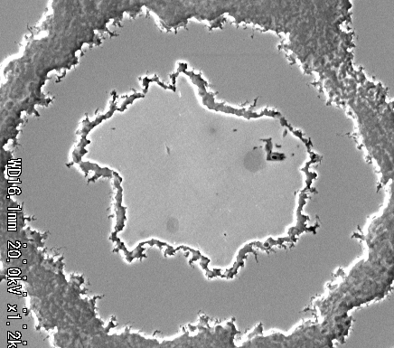
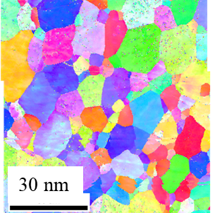
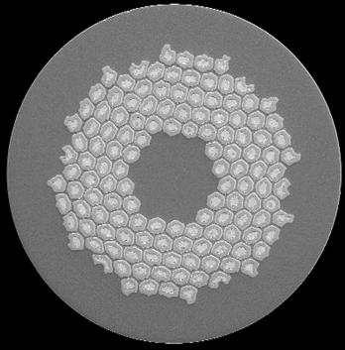
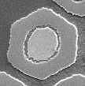
Improvement of filament shape
Wire | Nb tube grain (before drawing) | Filament shape (Cross section)
A
C
✓Nb tube grain size greatly affects filament shape.
✓Filament shape is improved by optimization of Nb tube pretreatment.

Slide 14
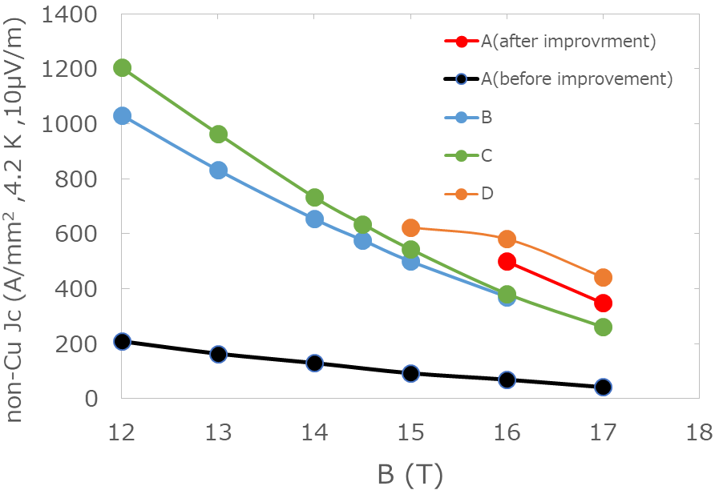
Non-Cu Jc
Wire | A | B | C | D
No. of Filament | 85 | 132
Filament Material | Nb |  |  | Nb-7.5wt%Ta
Nb/Sn ratio | ~2.1 |  | ~3.3
Filament Dia. (at φ0.83) | 64 mm | 45 mm
Cu/non-Cu ratio | ~1 | ~1.6
Nb pretreatment(℃) | 1,150 |  | 850
✓Non-Cu Jc of 580 A/mm² @16 T was obtained in Wire D.
✓Some improvements have been conducted for higher non-Cu Jc.
・Optimization of heat-treatment condition
・Nb/Sn ratio in filaments
・Grain size reduction of Nb₃Sn (including APC technique)

Slide 15
Summary
✓Nb₃Sn wire with 85 or 132 Nb-tube filaments was tried.
✓Multiple wire was drawn to 0.83 mm by improvements for wire workability.
✓Nb pre-treatment optimization give a good influence on the
filament shape.
✓Non-Cu Jc of 580 A/mm² @16 T was obtained in Wire D.

Slide 16
Summary
Task 3 almost completed
Review
  May 17-24: D. Larbalestier, S. Hopkins, T. Ogitsu
  Visit JASTEC, Furukawa, and Tohoku Univ.
  Review R&D plan and discuss new plan
The R&D work so far
  8 R&D contracts: DT reach 1100 A/mm², Nb Tube workability improved
Propose to modify Task 4 and Task 5
  Task 4: R&D contracts 4 more each for JASTEC and Furukawa
    With advanced technologies to aim for 1500 A/mm²
  Task 5: Produce 5 km x 2 with best conductors
Task1
Review past technologies and select.
First review meeting in Feb. 2016
Task2
Design wire layout and composition
Procure material (possible trial billets)
Task 4
Production of R&D billets with Advanced Technologies
1 ~ 5kg * N=8
Task 5
Select candidate
Produce 2*5km wire
Heat treatment study
Task3
Production of R&D billets
1 ~ 5kg * N=8

