Slide 1
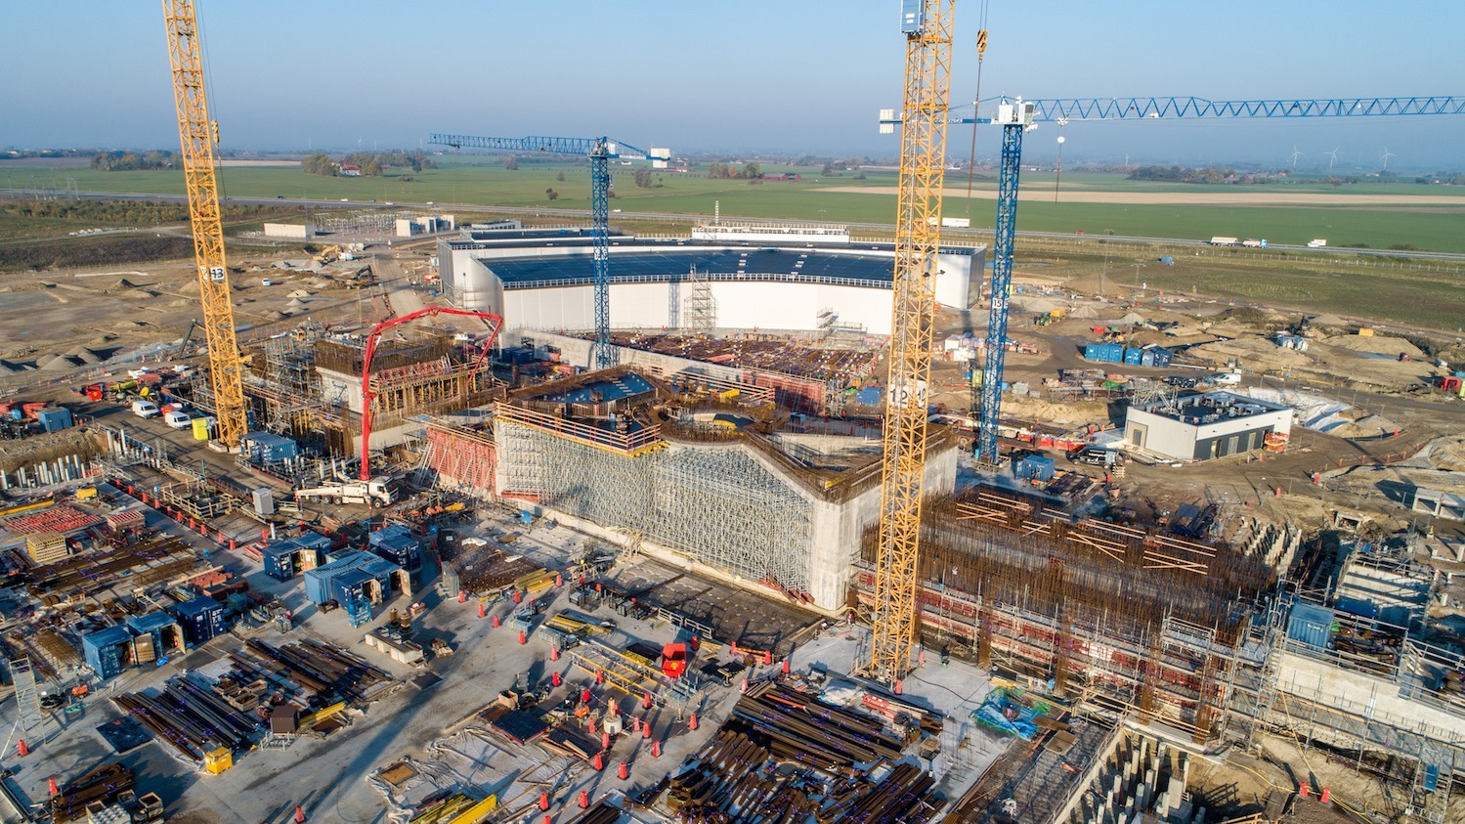

  The European Spallation Source:
  Designing a Sustainable RI for Europe
  John Womersley, Director General
  Workshop on ‘The Economics of Science’, Brussels, June 2019

Slide 2
Key challenges in building sustainable support for any science megaproject
✅ Science case
✅ Technical R&D, cost estimates understood
✅ Project management plan
✅ Credible funding and governance plan
✅ Stakeholder engagement
✅ Compelling investment case

Slide 3
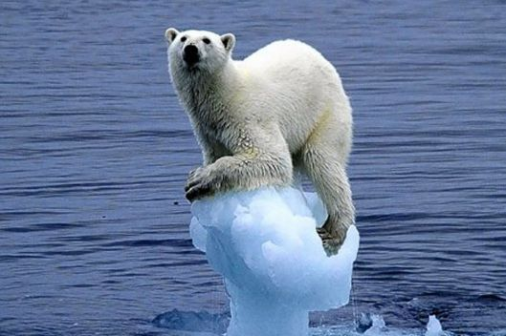
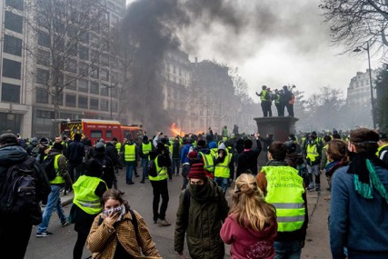
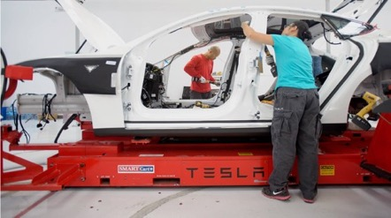
The investment case in a nutshell
Scientific and technological innovation is essential
global challenges of energy, climate, environment, healthcare
economic and societal challenges of stalled productivity and long term wage stagnation

Slide 4




Materials and molecules
Where are the atoms and what do they do?
New materials, new drugs, new processes,
new energy technologies

Slide 5
Our vision is to build and operate the world’s most powerful neutron source, enabling scientific breakthroughs in research related to materials, energy, health and the environment, and addressing some of the most important societal challenges of our time.
Reactor sources
Accelerator-driven sources
ESS
Effective thermal neutron flux 10¹⁵ n/cm²-s
J-PARC
NIST
ILL
LANSCE
ISIS
FRM-II
SNS
CSNS
Year

Slide 6













1843 M€ construction cost 2013 prices
5 MW world’s most powerful particle accelerator
2MW at start of operation
15 experimental stations
20 ⨉ more sensitive on average than today’s best
at 2MW
800 experiments per year
2023 first science for users
13 member nations in the ESS ERIC

Slide 7
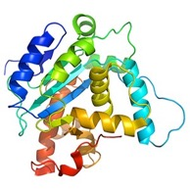
How a spallation neutron source works
instrument
neutrons
moderator
sample
proton accelerator
target
“spallation” is the process that releases neutrons from the target nuclei

Slide 8
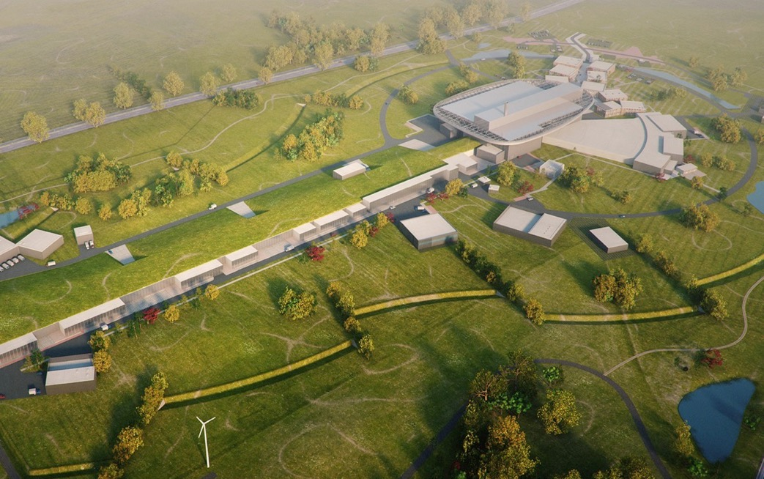
Neutron Production Target
Experiments
Superconducting Proton Accelerator

Slide 9
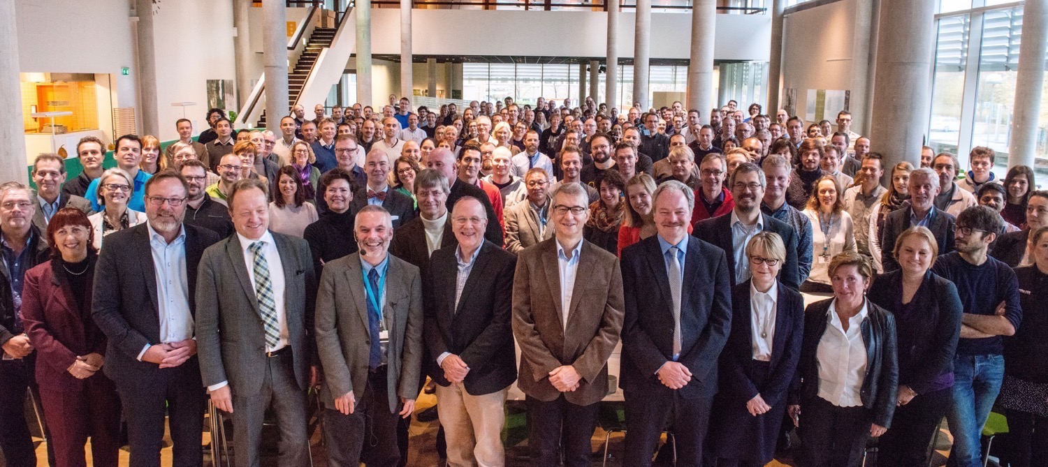


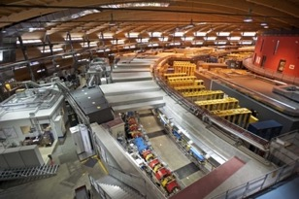
Organisation and People
499
Employees
54
Nationalities
~ 100
Collaborating Institutions
Notes:
Updated September 2017

Slide 10
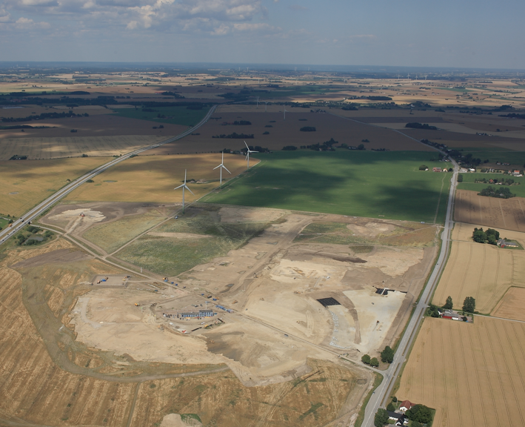
September 2014

Slide 11
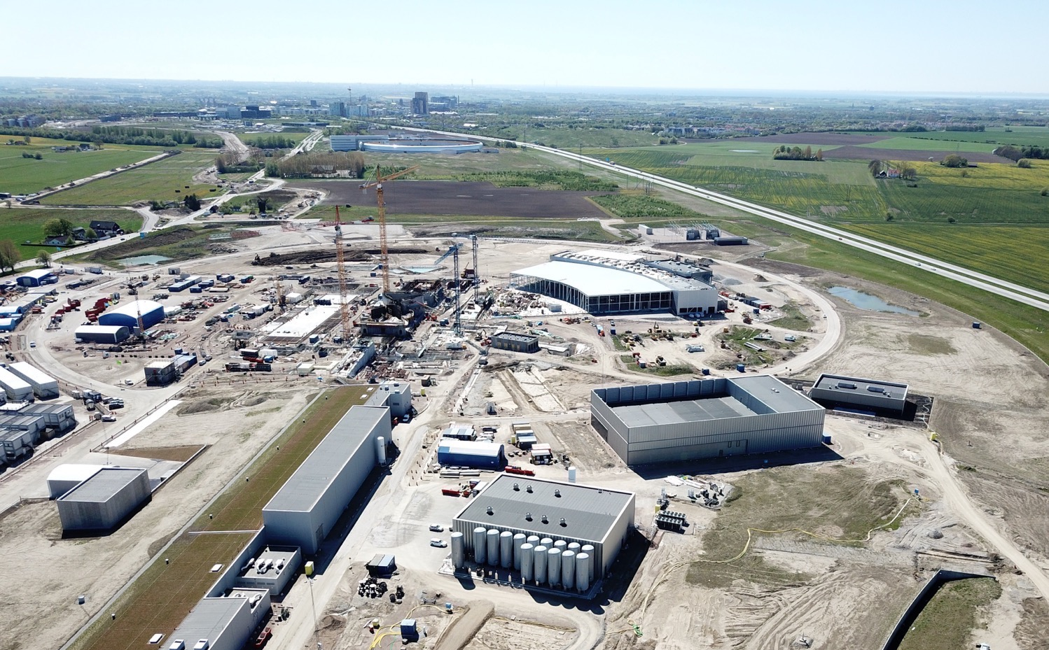

Slide 12
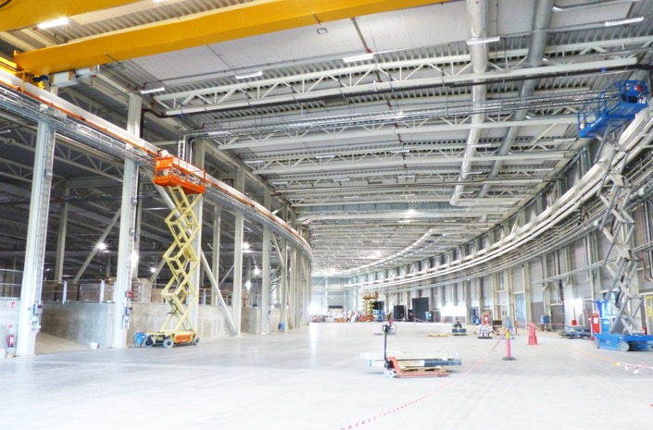
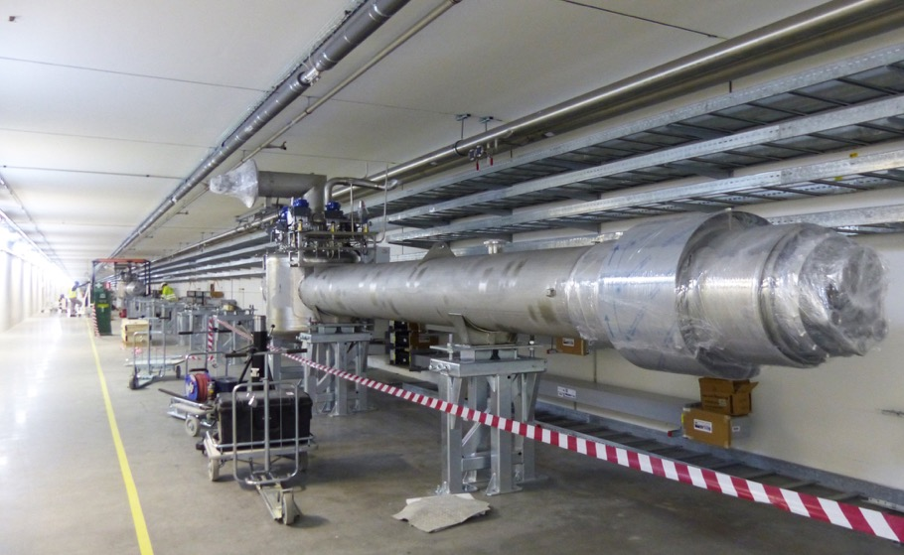
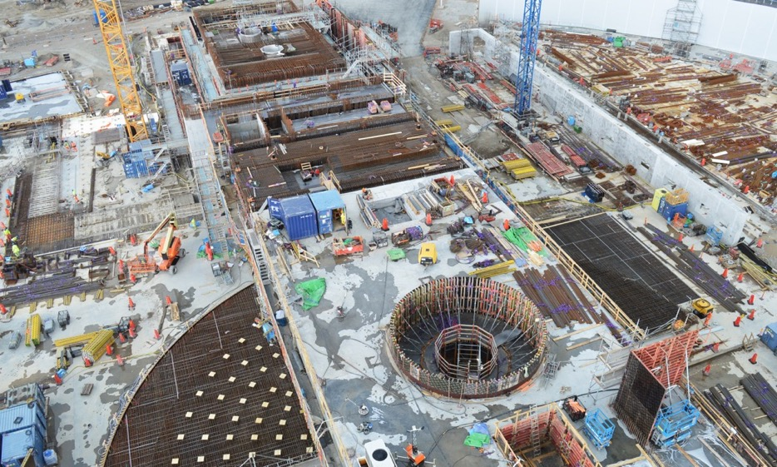
ESS is 58 % complete
Peak of construction activity
Accelerator commissioning started
Instrument hall E01 handover summer 2019

Slide 13











Financing and Governance
The European Spallation Source ERIC established in 2015
Host Countries Sweden and Denmark
Construction 47.5% Cash Investment ~ 97%
Operations 15%
Non Host Member Countries
Construction 52.5% In-kind ~ 70%
Operations 85%
13 European Member Countries

Slide 14
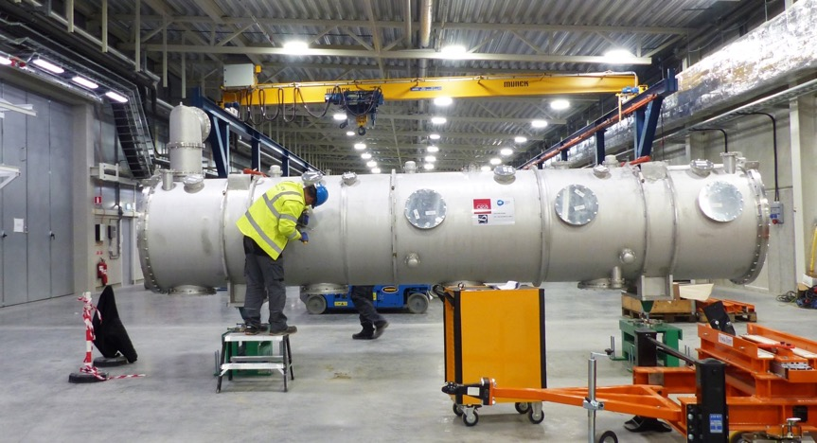
In-kind contributions
Significant technical workpackages
procured or constructed in partner
countries rather than centrally
  partner holds and manages the risk
A project management challenge… but a political necessity
  Helps avoid situation where the host region benefits greatly and
  the others just pay cash
  ESS – 70% for non-hosts, 35% overall, just about manageable
  ITER – 90% in kind, close to unmanageable

Slide 15
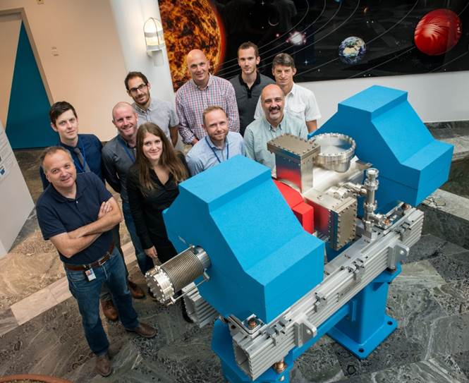
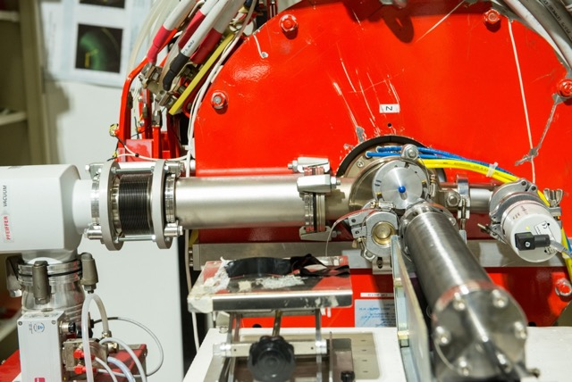
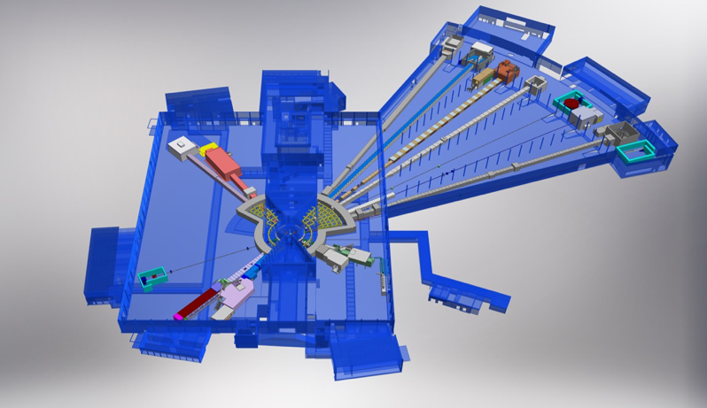
ESS In-kind Partners
Aarhus University
Atomki - Institute for Nuclear Research
Bergen University
CEA Saclay, Paris
Centre for Energy Research, Budapest
Centre for Nuclear Research, Poland, (NCBJ)
CNR, Rome
CNRS Orsay, Paris
Cockcroft Institute, Daresbury
Elettra – Sincrotrone Trieste
ESS Bilbao
Forschungszentrum Jülich
Helmholtz-Zentrum Geesthacht
Huddersfield University
IFJ PAN, Krakow
INFN, Catania
INFN, Legnaro
INFN, Milan
Institute for Energy
Research (IFE)
ISIS - Rutherford-Appleton Laboratory, Oxford
Laboratoire Léon Brilouin (LLB)
Lund University
Nuclear Physics Institute of the ASCR
Oslo University
Paul Scherrer Institute (PSI)
Polish Electronic Group (PEG)
Roskilde University
Tallinn Technical University
Technical University of Denmark (DTU)
Technical University Munich (TUM)
Science and Technology Facilities Council
University of Copenhagen (KU)
University of Tartu
Uppsala University
Wigner Research Centre for Physics
Wroclaw University of Technology
Warsaw University of Technology
Zurich University of Applied Sciences (ZHAW)

Slide 16
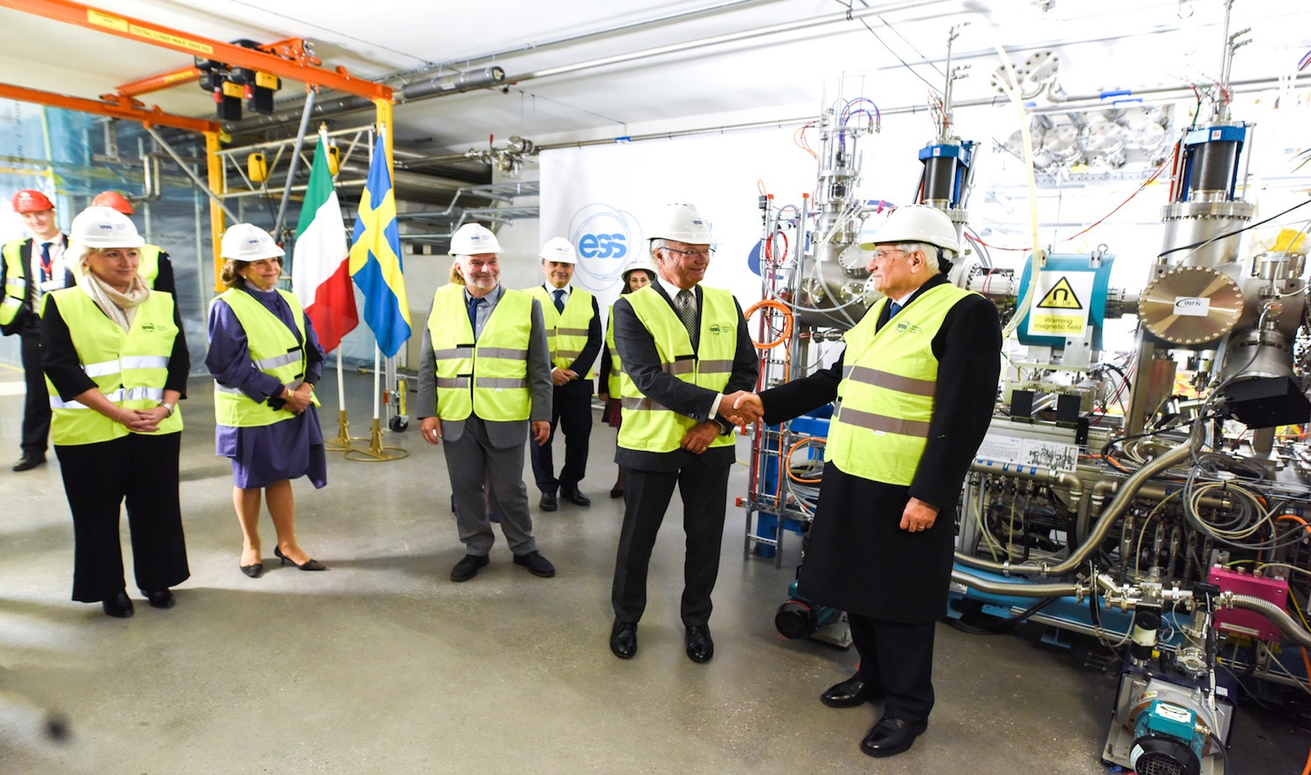
Ion source & LEBT installation
Ion Source inauguration

Slide 17
Project management
Follow best practice
Based on US DOE Office of Project Management
energy.gov/projectmanagement/project-management
Resource Loaded schedule
Sufficient contingency
Change control process
…

Slide 18
Project planning strategy
NSS (Instrument Program)
EOC
Building
occupancy
In-kind deliveries
Science
Beam Comm.
First instruments
We are focused on delivering first science at ESS, initially with three instruments operational, as close as possible to our original goal in 2023
Critical Path
CF + Target + NSS (Bunker+TBL) + ICS
BOT
Target Building
In-kind deliveries
Accelerator + ICS
RBOT
BOD – Beam on Dump
RBOT – Ready for Beam On Target
BOT – Beam On Target
SOUP – Start Of User Program
EOC – End of Construction
TBL – Test Beam Line
In-kind deliveries
BOD

Slide 19
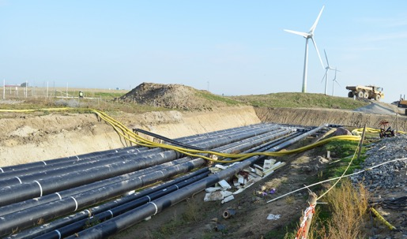
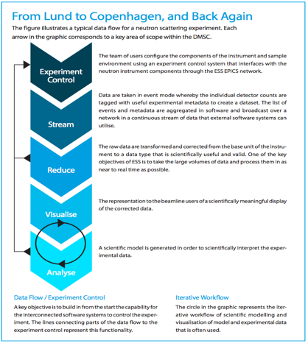
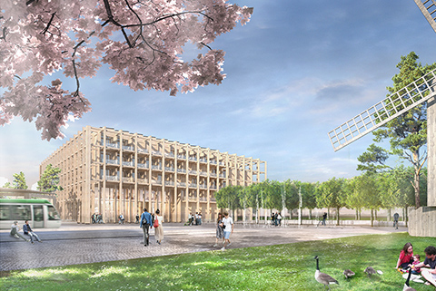
Meets modern environmental expectations
  Green construction site
  Purchase all electrical power from renewable sources
  Waste heat recovery into Lund district heating system
Support for full computing, software and analysis chain
  Open data model, EOSC-compliant
Development of science and innovation campus between ESS and MAX IV light source

Slide 20
✅ Science case
✅ Technical R&D, cost estimates understood
✅ Project management plan
✅ Credible funding and governance plan
✅ Stakeholder engagement
✅ Compelling investment case
A few closing observations:

Slide 21
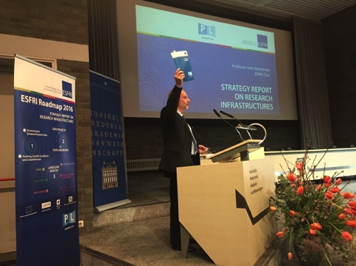
Why do big projects fail to get started?
In 2016 The European Strategy Forum for Research Infrastructures reviewed implementation progress of the projects on its roadmap
Found inadequate stakeholder engagement and lack of a credible funding plan to be the biggest barriers
  much more so than any weakness of the science case

Slide 22
Stakeholders include
The General Public
Media, opinion formers
Students
Educators
(STEM skills pipeline)
University bosses
Other science areas
Members of Parliament
Science Ministers
Finance Ministers
Opposition political parties
Local and regional politicians
Civil Servants
Economists
× 13 partner countries, each with their own science strengths, industrial profile, media and decision making culture

Slide 23
Normative values
shift in emphasis since
the end of the Cold War
Market values
Cultural value
Prosperity
Science for peace
Jobs
Education
Public outreach
Innovation
Openness
International
Collaboration
Startup companies
Democracy
Grand challenges
Science drives economic growth
Makes the country worth defending
Scientists are much happier over here…
… but this is where investment decisions are now made

Slide 24
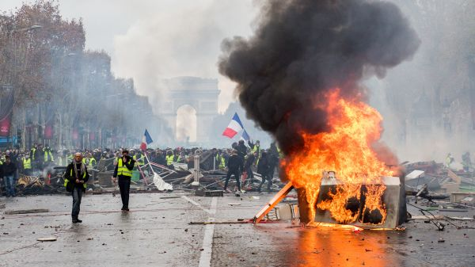
A parting challenge
The biggest economic challenges of our time
Globalisation
Together with automation and
new technologies
Leading to fewer good jobs
Leading to low growth, stagnant wages
No one really has the answer
… but general consensus that scientific innovation and STEM skills are key
  at least economies and people that have these skills will be better positioned
So what is our project going to do to help?

Slide 25
Thank you!
@johnwomersley @essneutron europeanspallationsource.se

