Slide 1





EASISchool 3 and related events Fall2020 in Genoa
Physics Dept
Genoa University
Emilio Bellingeri
CNR-SPIN

Slide 2
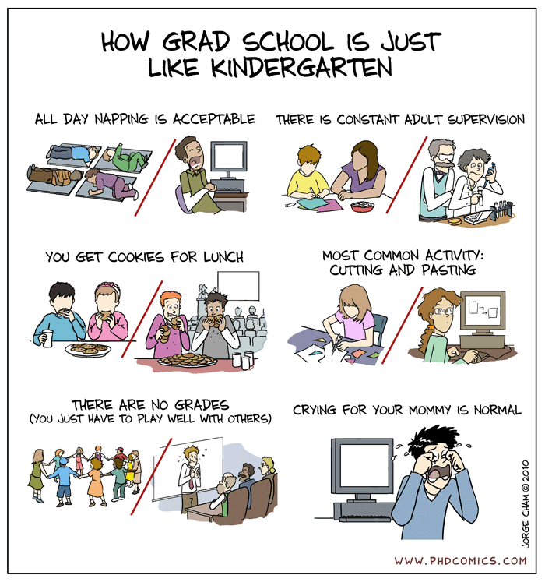
EASISchool 3
ESRs have to learn

Slide 3
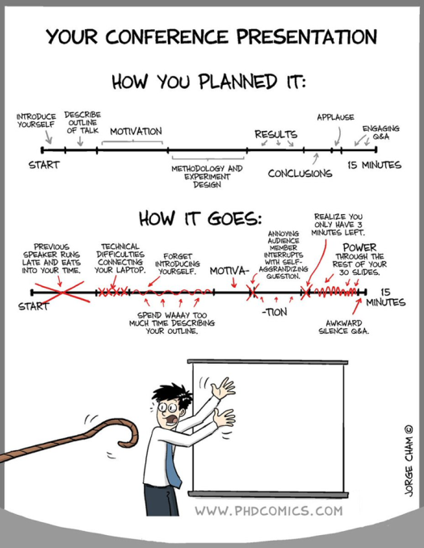
EASIWorkshop
ESRs have to learn
HOW to present

Slide 4
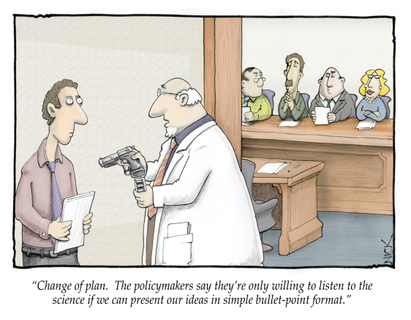
Science Communication
ESRs have to learn
HOW to disseminate

Slide 5
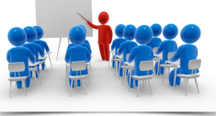
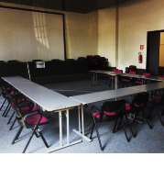
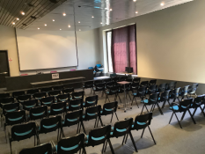
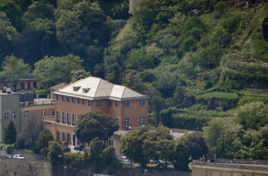
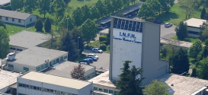
EASISchool 3
The 3rd and last EASISchool is foreseen in Genoa in Fall 2020 and will cover two weeks.
It will be focused on many applicative superconductivity and cryogenic issues not yet encountered in the two previous edition.
In detail it will be focused on:
RF superconductivity and accelerating cavities
Superconducting magnets design modelling and realization
Superconducting devices (Squid, Qbit,…), sensing and quantum computation
Are forseen visit at:
Industries operating in superconductivity field in Liguria,
Legnaro INFN lab (RF cavities lectures)
Cadarache ITER construction site (??)
Venue: CNR Spin Genova Campi (GE) Sala Azzurra/Sala Rosa
LAB INFN Legnaro (PD)
Data: 28/9/2020-9/10/2020 ??

Slide 6
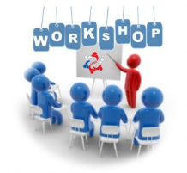

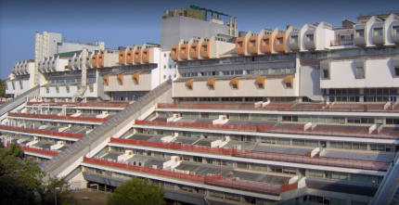
EASIWorkshop
for young researcher
In conjunction with the school we propose that the
ESRs organize a young researchers workshop on
Applied Superconductivity
Cryogenics
Reserved to young researcher (participant less than 30 years old)
In collaboration with the Physics PhD school (Superconductivity curricula)
Venue DIFI-Department of Physics Genoa University
Date 9/10/2020 ?

Slide 7

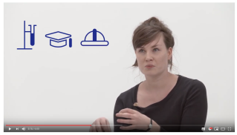

Science Communication
With the training purpose of preparing young researchers also in scientific dissemination (an increasingly important requirement !!), it is proposed that (with the collaboration of Terra Mater Factual Studios?):
each ESR will make a short video (FAMELab or TEDx style) in which illustrates the objectives and results of its research to a non-specialist public.
These 15 videos, eventually dubbed in Italian, can then be shown in a continuous loop on a large screen in a special room inside the superconductivity exhibition presented a few days later at the “Festival della Scienza”

Slide 8
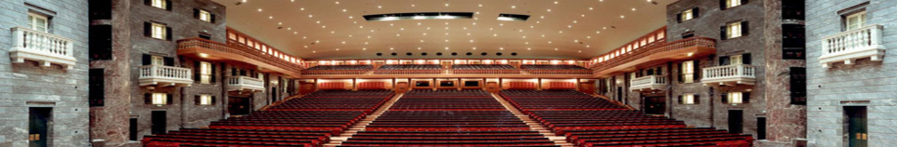
Public Event:
"Genoa for superconductivity, superconductivity for us"
We proposes a divulgative public event, open to the city, on superconductivity thematic
We imagine a debate involving skilled science communicators (Paco Lanciano?) presenting some demos (magnetic levitation, null resistivity ...), followed by discussion of technical experts in the field.
In order to make more attractive by the general audience the debates will be interspersed with live music with screen shots of science fiction movie soundtrack with Supercondudtivity (Avatar, See No Evil, Hear No Evil, Hunt for Red October, Back to the Future II, Strange Day).
Possible outline and ideas for guests:
Moderator: well-known character in journalism or the entertainment world
Introduction to the phenomenon with demos (levitation, live etc. with on-screen playback) and a brief history of applications. Promoter: Paco Lanciano?
The great magnets (CERN, ITER, ...:) Guests: Lucio Rossi, MirKo Pojer Fabiola Gianotti ?
Magnets for NMR and MRI and Adrotherapy. Guests: ...
Sensors (SQUID), Superconducting Electronics and Quantum Computation, Magnetoencephalography Guests: Gianluca Romani?
Orchestra: Filarmonica Sestrese

Slide 9
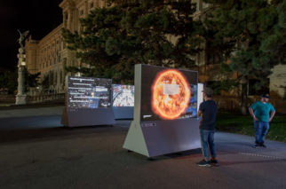
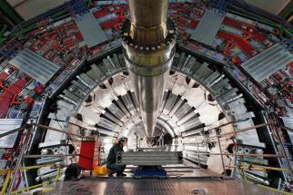
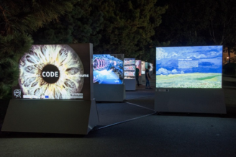
Travelling Exhibition: "The code of the universe"
What the Universe is made of ? What is the nature of the physical laws that make life possible ? Why is there something rather than nothing? These are some of the long-standing questions that drive our endless quest to learn. Human curiosity, creativity and collaboration are the three keys to crack the CODE of the UNIVERSE.
The exhibition, consist of 20 weather proof, electrically powered outdoor light installations (1’500 kg each, storm and vandalism proof). Each one is 2 meters wide, 1 meters deep and 2 meters high. They can be placed in free configurations (linear, rectangular, circular) as long as it is possible to interconnect the elements with 2 to 5 meters of standard 220 V/AC cables.

Slide 10

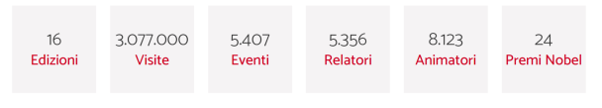
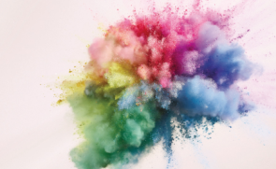
The Genoa Science Festival is...
A fixed point of reference for science dissemination
A great opportunity to meet for researchers, science enthusiasts, schools and families
One of the major international scientific events.
An event for everybody
Meetings, workshops, shows and conferences to tell science in a new, engaging way, crossing over traditional subject boundaries.
11 days during which the classical barriers between mathematic, natural and human science fall down to take an intedisciplinary approach, explore and investigate science with no limits.
A new paradigm
Every year the Genoa Science Festival takes inspiration from the latest and most burning issues of the day, offering a multifaceted scientific debates, absolute previews, shows and exhibitions crossing over and exploring the connections between Art & Science, paying special attention to the latest research findings, as well as to what’s new in emerging countries.
A global event
Intimately tied to the city of Genoa and to the region of Liguria, the Science Festival also features a high international level. Panel discussions and face-to-face meetings with Italian and foreign top experts make every year a unique event fully dedicated to science, establishing longlasting partnerships and networking with prominent personalities and institutions from all over the world.

Slide 11
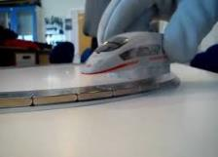
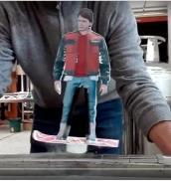
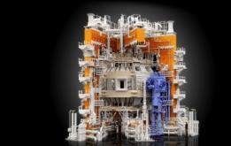
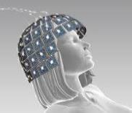
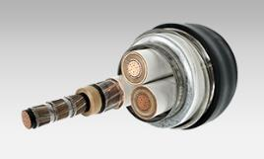

CNR exhibition at FdS 2020
CNR SPIN will realize a scientific exhibition based on interactive experiments
IDEAS:
Interactive
  Zero resistance measurements-persistent current
  Magnetic levitation
  MagLev Train model
  Superconducting Bicycle
  Flying weel (Geneva University ?)
  Magnetic resonance medical imaging (Paramed?)
Statics
  Large Magnet models (ASG, ENEA?)
  Cable Pieces (ASG?, ENEA?)
  LHC Magnet models (CERN exhibition object)
  SQUID magnetoencephalography (Uni Chieti)
    Show of EASITrain
    «Science Communication» videos

Slide 12
Summary
EASISchool 3
EASIWorkshop
Science Communication
Public Event:
"Genoa for superconductivity, superconductivity for us"
Travelling Exhibition:
"The code of the universe"
CNR exhibition
at Festival della Scienza 2020

Slide 13




Summary (and funding)
EASISchool 3
EASIWorkshop
Science Communication
Public Event:
"Genoa for superconductivity, superconductivity for us"
Travelling Exhibition:
"The code of the universe"
CNR exhibition
at Festival della Scienza 2020

Slide 14
Summary (and funding)
EASISchool 3
EASIWorkshop
Science Communication
Public Event:
"Genoa for superconductivity, superconductivity for us"
Travelling Exhibition:
"The code of the universe"
CNR exhibition
at Festival della Scienza 2020

Slide 15

Summary (and funding)
EASISchool 3
EASIWorkshop
Science Communication
Public Event:
"Genoa for superconductivity, superconductivity for us"
Travelling Exhibition:
"The code of the universe"
CNR exhibition
at Festival della Scienza 2020

Slide 16




Summary (and funding)
EASISchool 3
EASIWorkshop
Science Communication
Public Event:
"Genoa for superconductivity, superconductivity for us"
Travelling Exhibition:
"The code of the universe"
CNR exhibition
at Festival della Scienza 2020

Slide 17


Summary (and funding)
EASISchool 3
EASIWorkshop
Science Communication
Public Event:
"Genoa for superconductivity, superconductivity for us"
Travelling Exhibition:
"The code of the universe"
CNR exhibition
at Festival della Scienza 2020

Slide 18




Summary (and funding)
EASISchool 3
EASIWorkshop
Science Communication
Public Event:
"Genoa for superconductivity, superconductivity for us"
Travelling Exhibition:
"The code of the universe"
CNR exhibition
at Festival della Scienza 2020

Slide 19

Thank You !

