Slide 2
Portable configurator for network switches
Project 5 - Julius Hussl & Can Hopp
Supervisor: Tommaso Colombo

Slide 3
Table of contents
description of the project/aim
work steps
draft designs
end results
materials

Slide 4
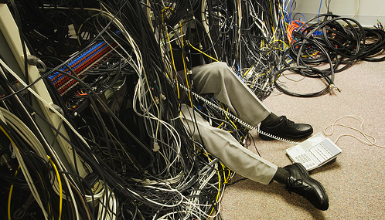
Status Quo
technicians: they have to work in an unpleasant environment
  they‘d like to do their work in their offices

Slide 5
Goal
design and assembly of a portable configurator for network switches
initial configuration needs a serial connections
  common standard: RS-232
WIFI: usually available in CERN data centers
  build a “WIFI to RS-232 gateway“

Slide 6
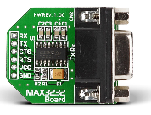
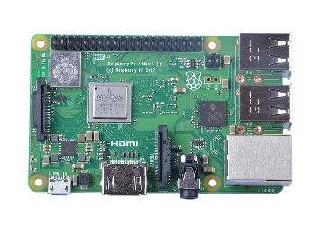
Concept A
WIFI-chip
GPIO-pins
RS-232 connector
various cables
processor
power cable
ethernet port

Slide 7
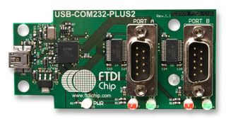

Concept B
WIFI-chip
USB to micro USB cable
Micro USB port
USB ports
processor
ethernet port
RS-232 connectors

Slide 8
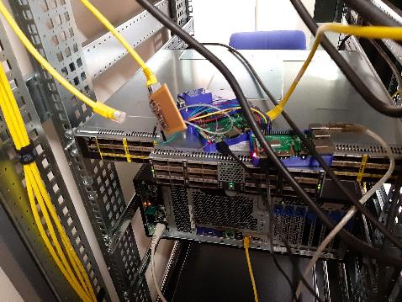
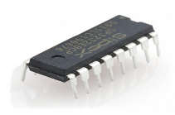
Concept C (Protoptype)
compact version with 4 ports
    Raspberry Pi 4
    MAX3232 chip
    RJ45 connector
    PCB design

Slide 9
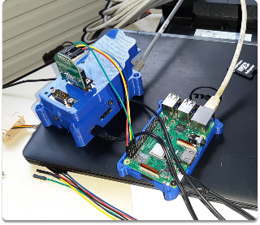
Work Steps (1)
assessment of available material
ordering needed components
software configuration
tests
designing and printing the case
assembly of various components
(design and assembly of a new prototype)

Slide 10
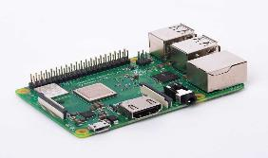
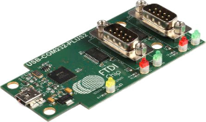
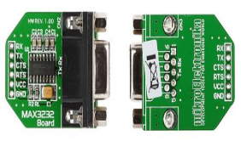
Materials (1)
Raspberry Pi 3 B+
USB-COM232-Plus2
MIKROE-602
https://www.raspberrypi.org/products/raspberry-pi-3-model-b-plus/
https://uk.rs-online.com/web/p/products/6877749/
https://uk.rs-online.com/web/p/products/8829060/

Slide 11
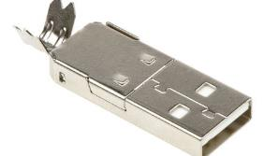
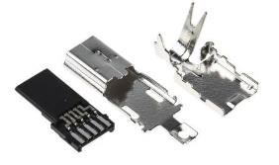
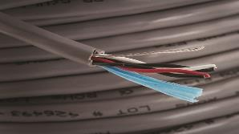
Materials (2)
A-USBPA-N
UX40A-MB-5P
5472C SL005
https://uk.rs-online.com/web/p/products/6742268/
https://uk.rs-online.com/web/p/products/7644578/
https://uk.rs-online.com/web/p/products/1118950/

Slide 12
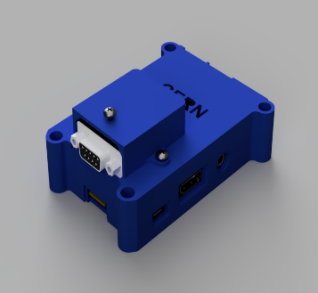
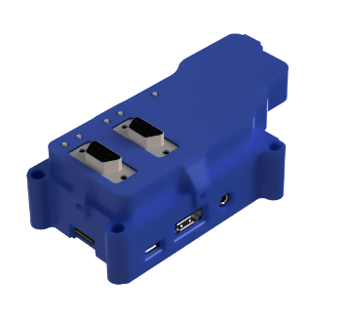
Draft Design

Slide 13
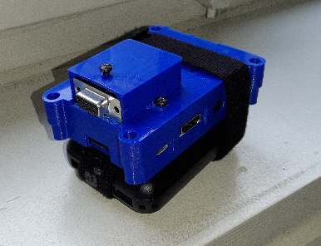
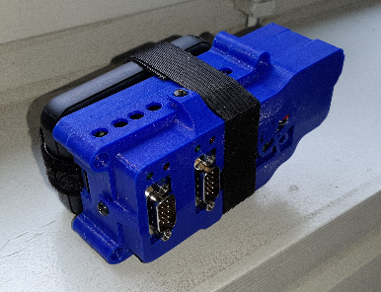
End result

Slide 14
Are there any questions?

