Slide 1
muon detector
Building a Multi-gap resistive plate chamber (MRPC)

Slide 2
The eee project
“Extreme Energy Events”
Collaboration of Italian schools and universities
60 telescopes in total
Cosmic rays hit particles in the atmosphere
Pions are created and decay into muons and muon anti neutrinos
Detection of muons

Slide 3
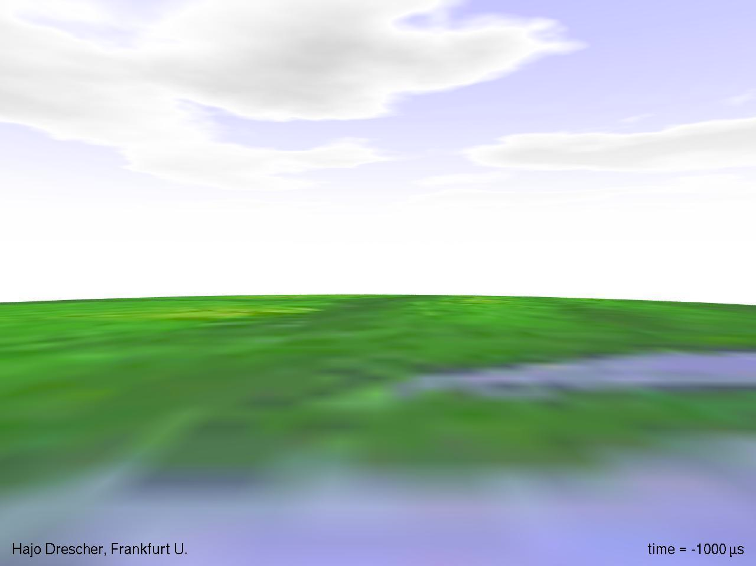

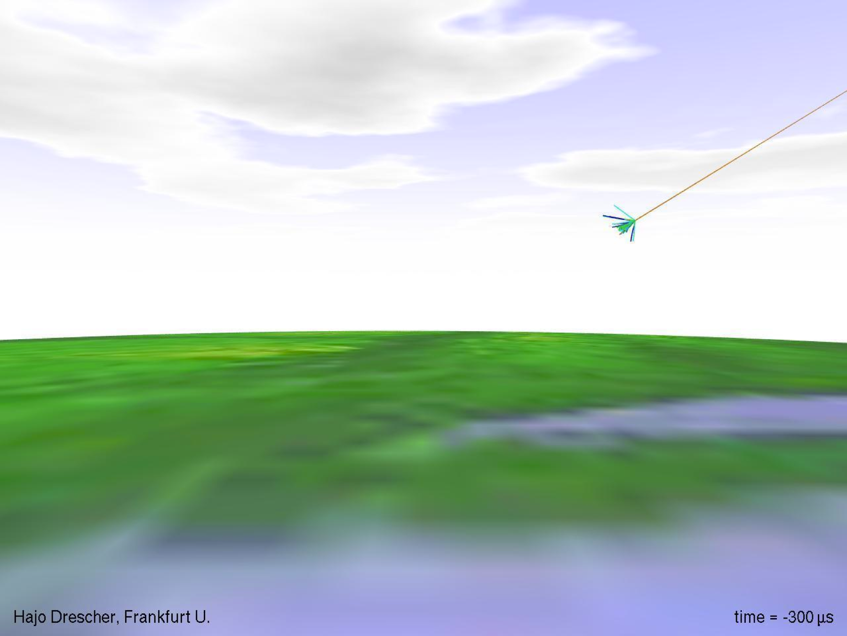
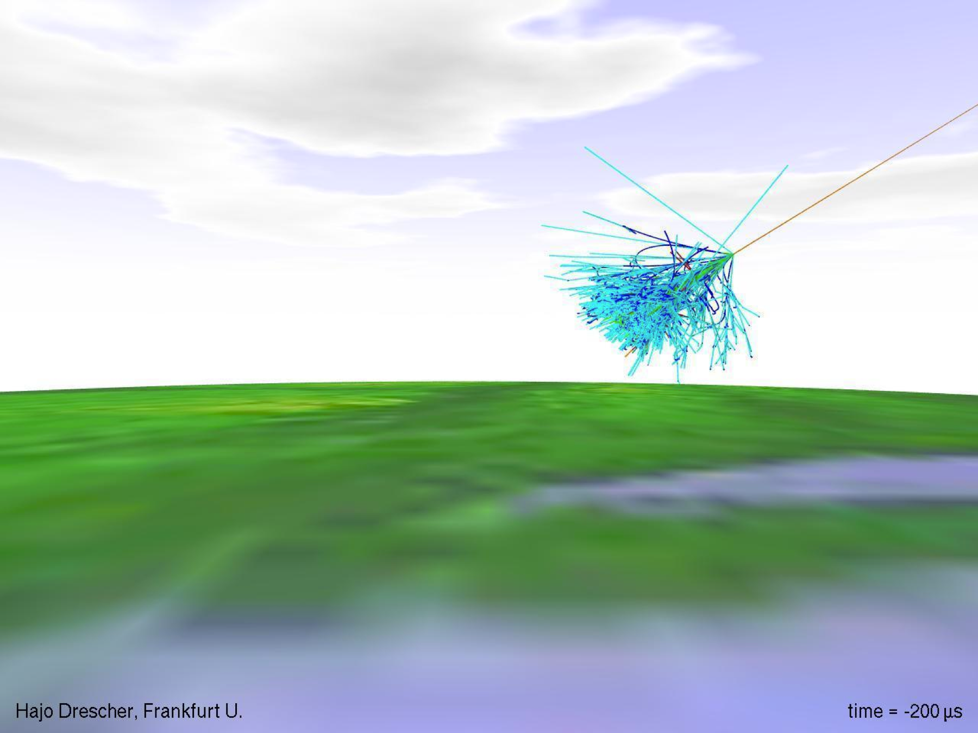
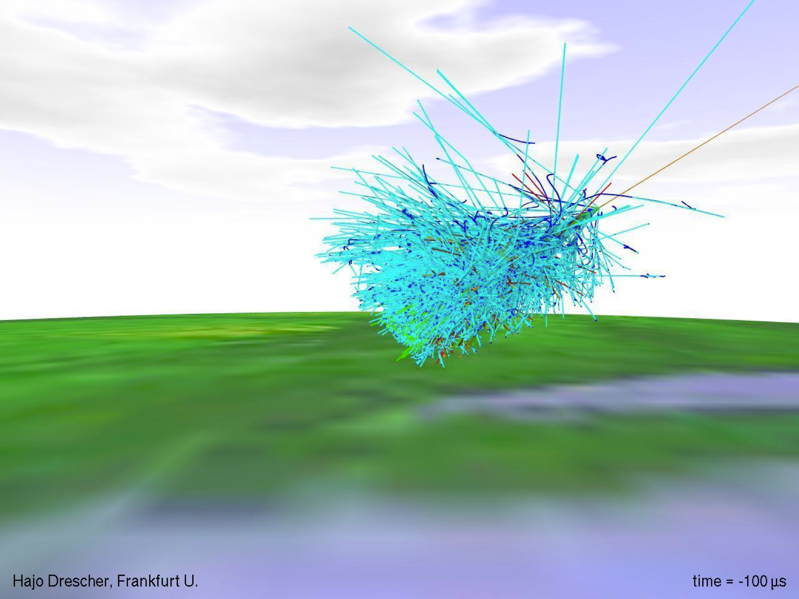
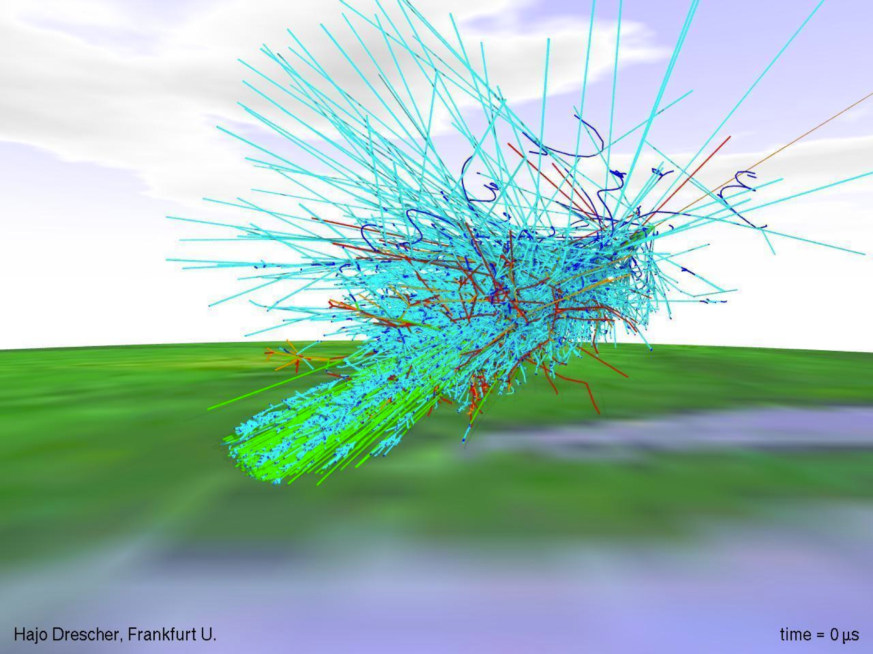
INTRODUCCIÓN
¿¿??

Slide 4
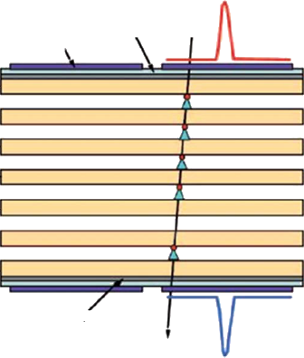
Working principle of a MrPC
High voltage cathode
Insulator
Pick up electrode
Glass plates
Pick up electrode
High voltage anode

Slide 5
Physical construction

Slide 6
TDC

Slide 7
Construction process

Slide 8
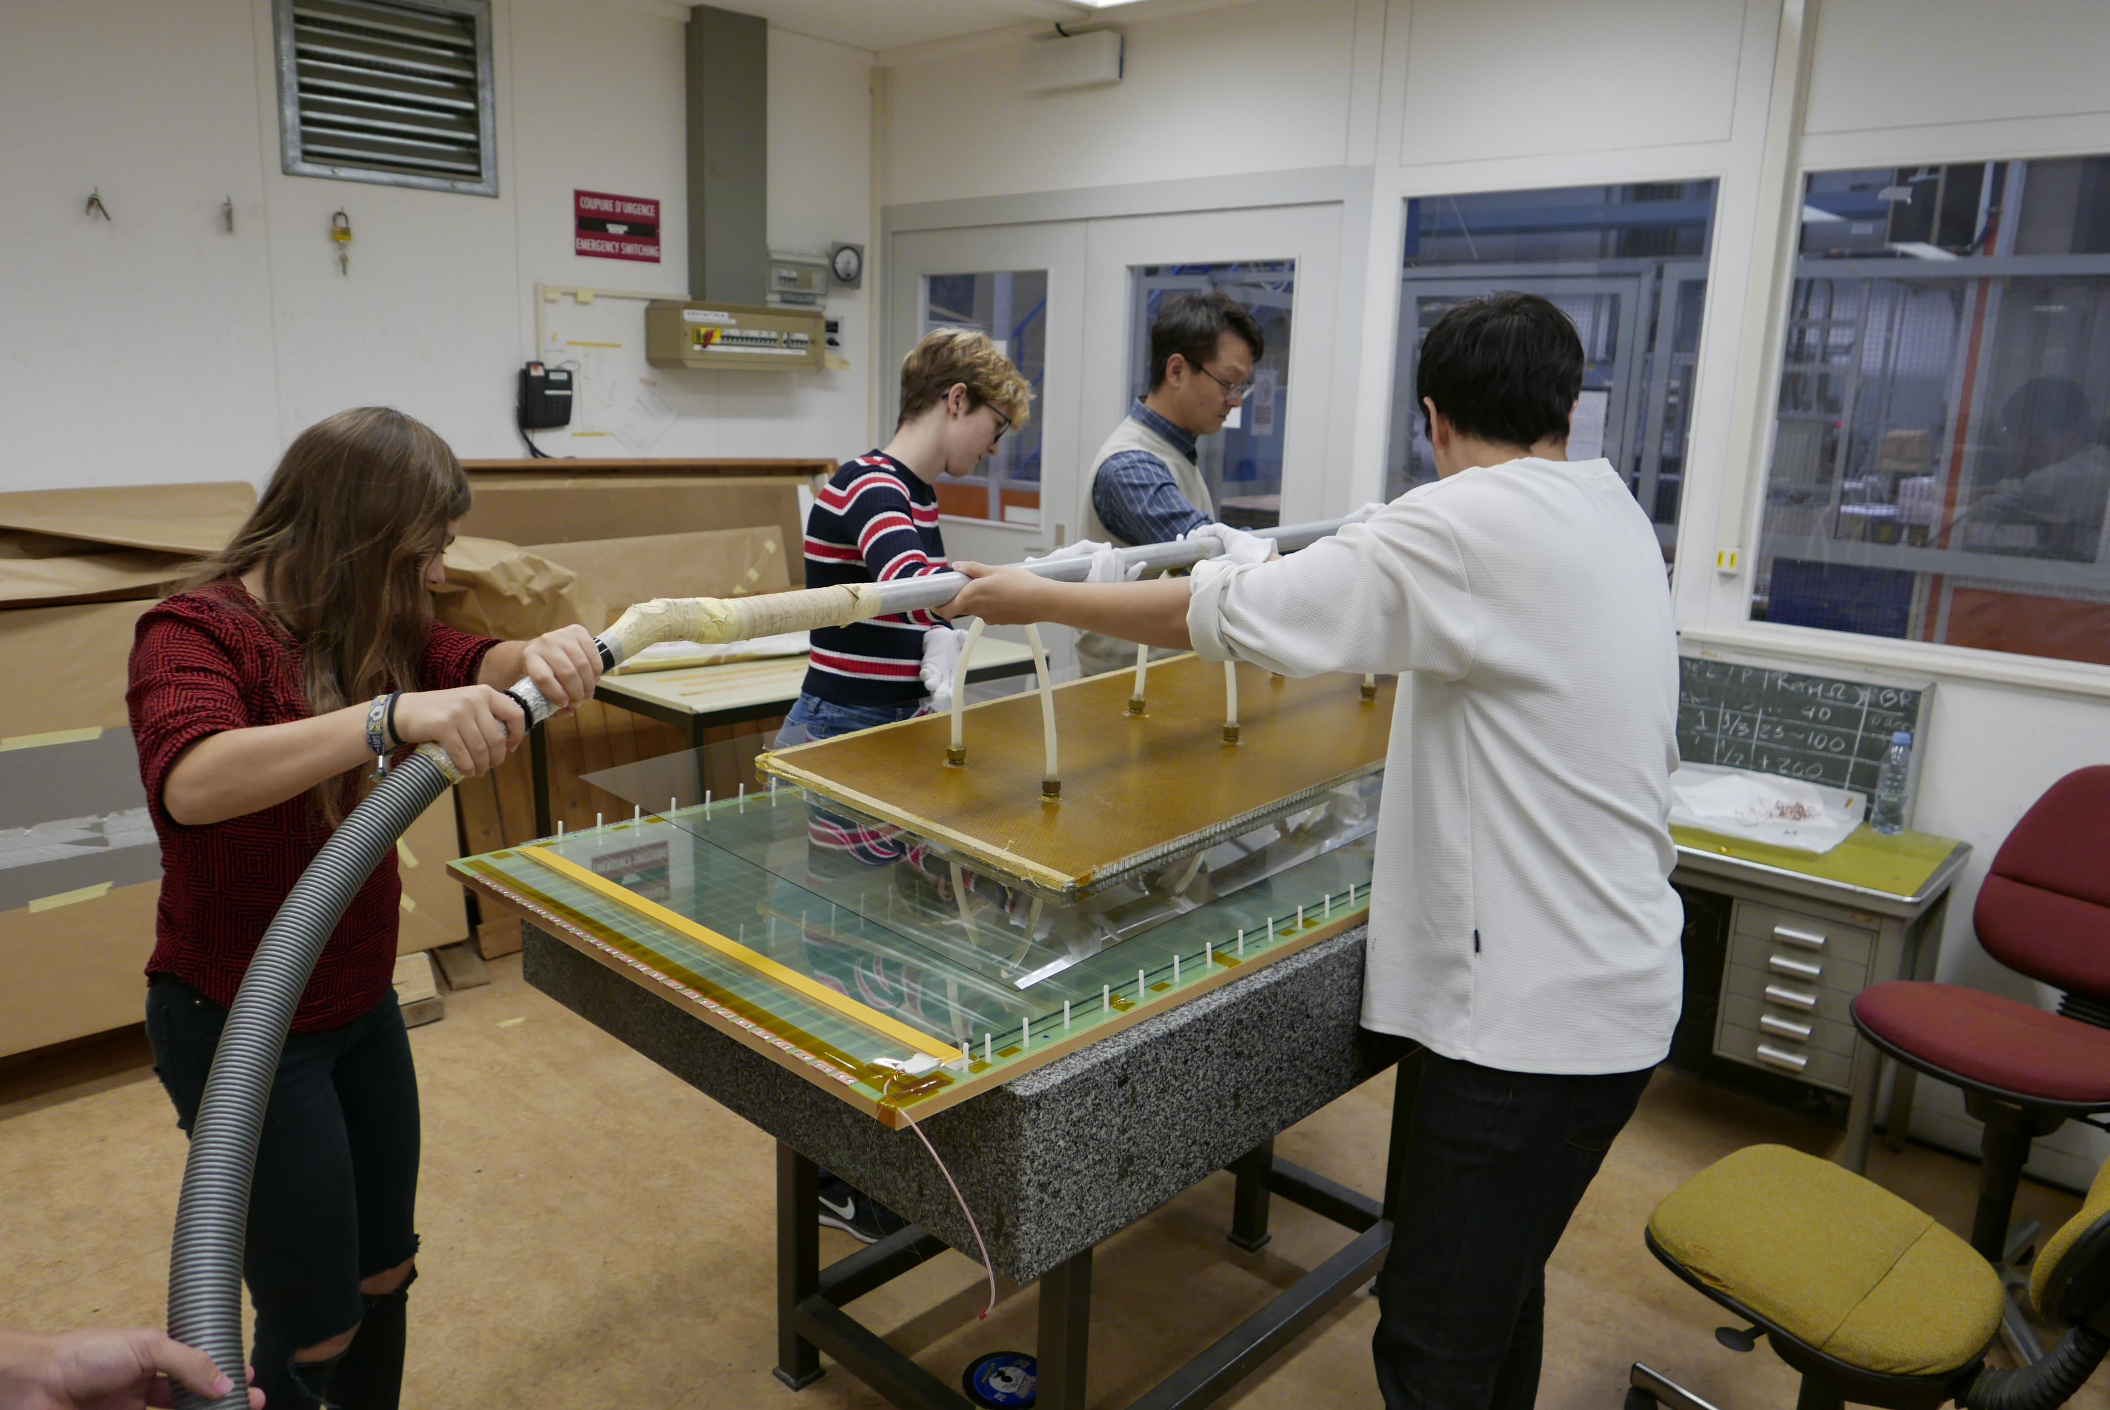

Slide 9
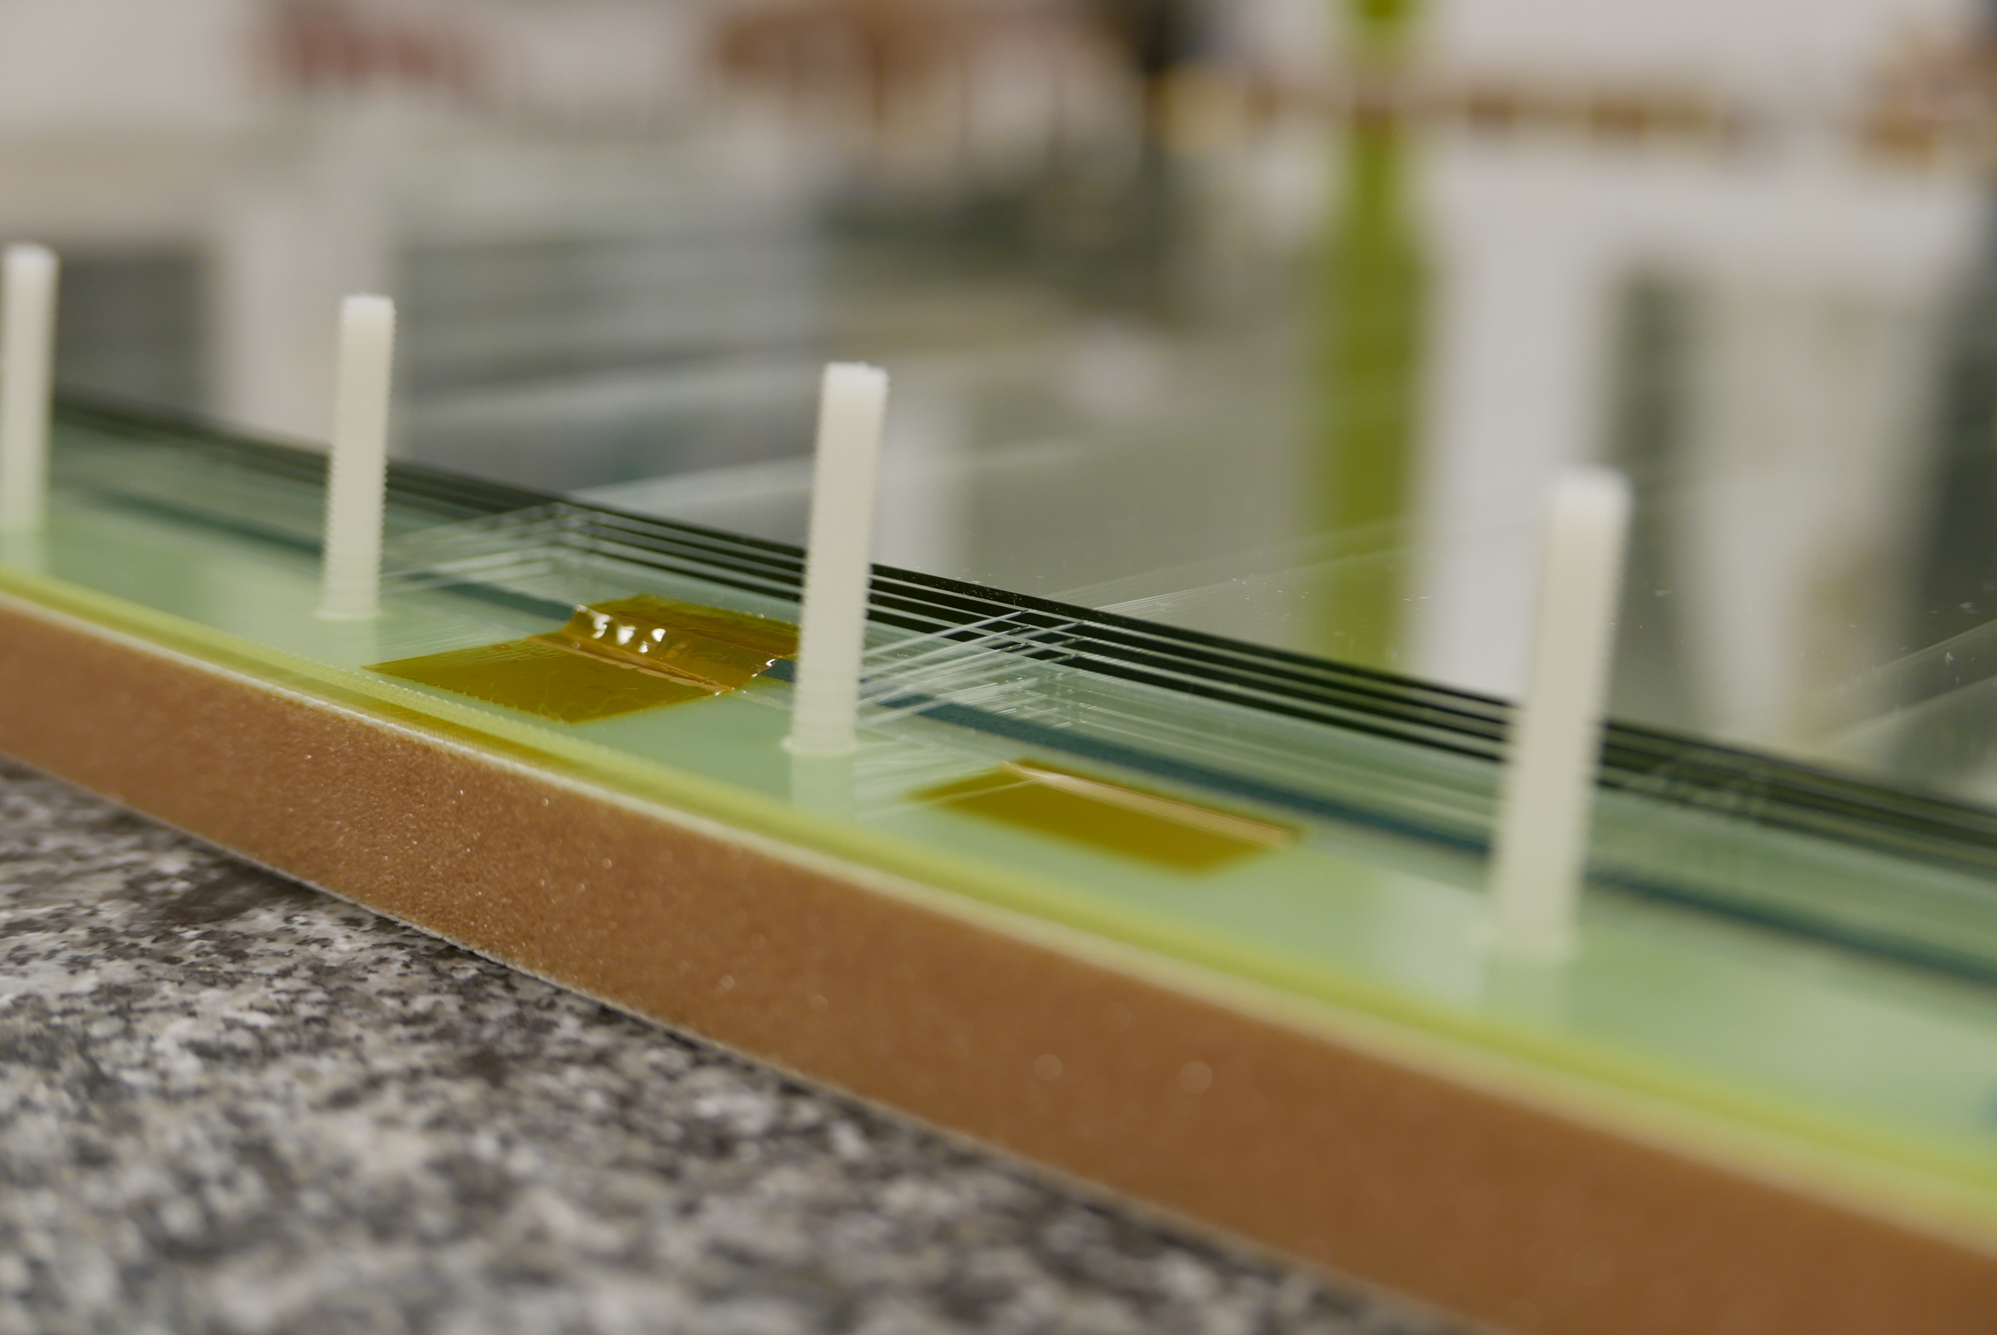

Slide 10
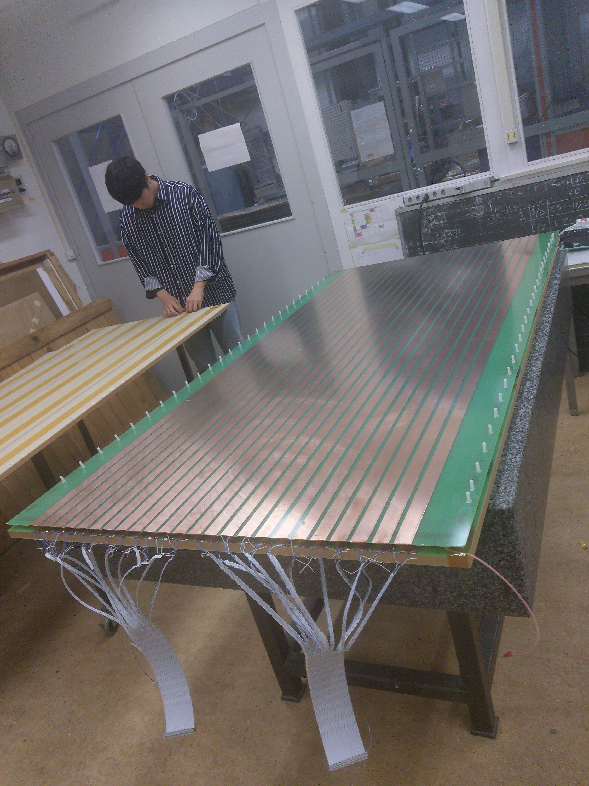

Slide 11
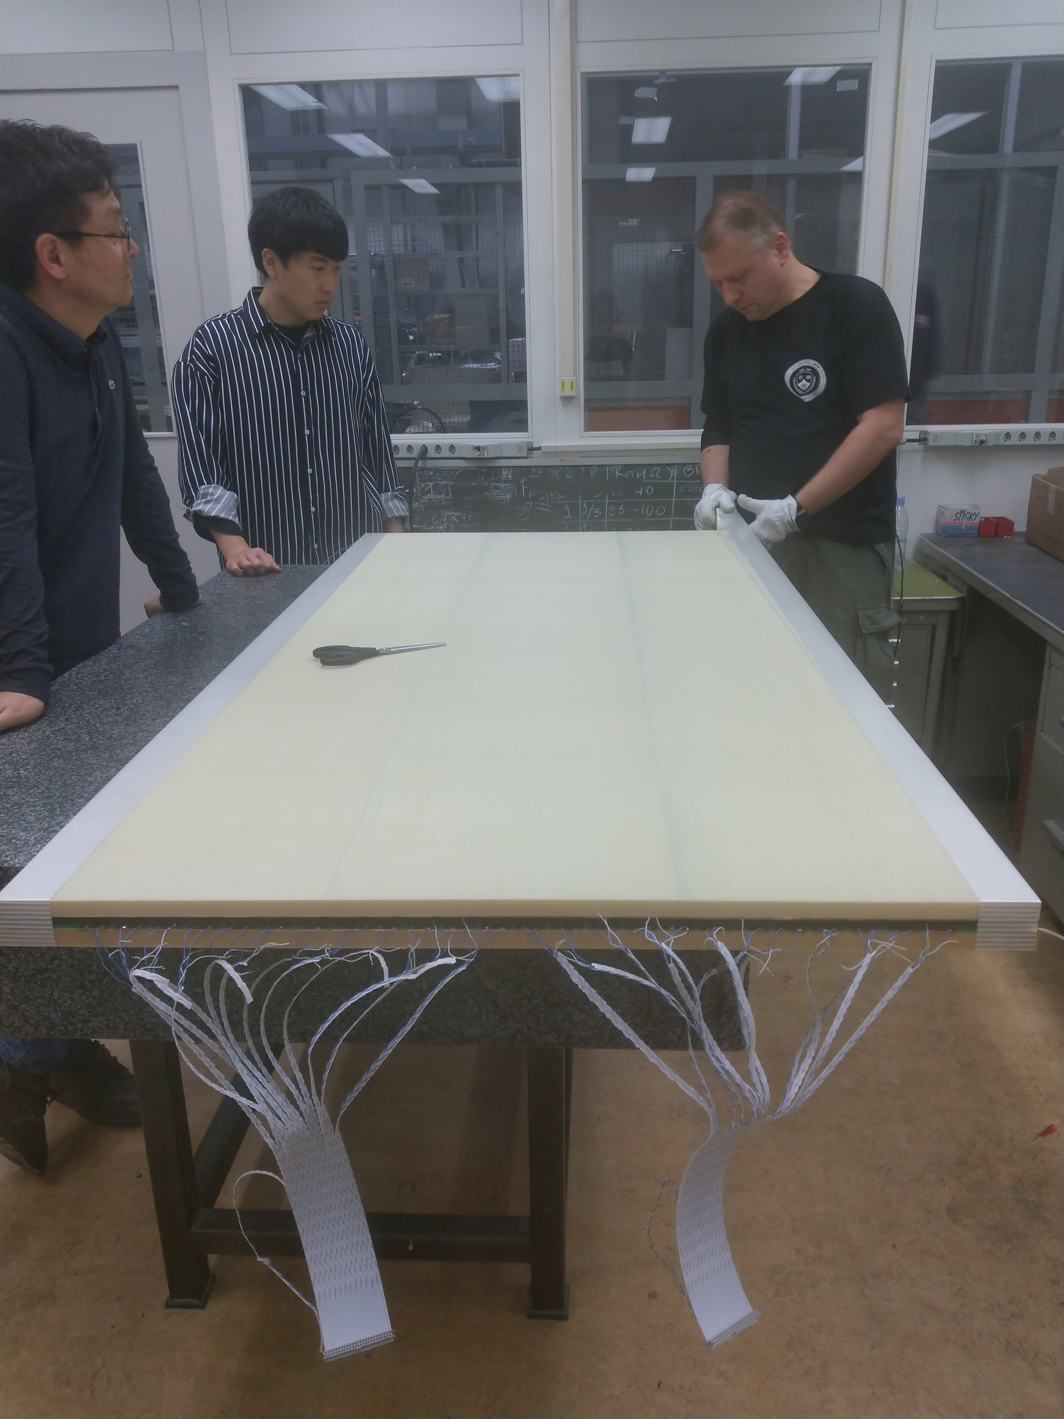

Slide 12
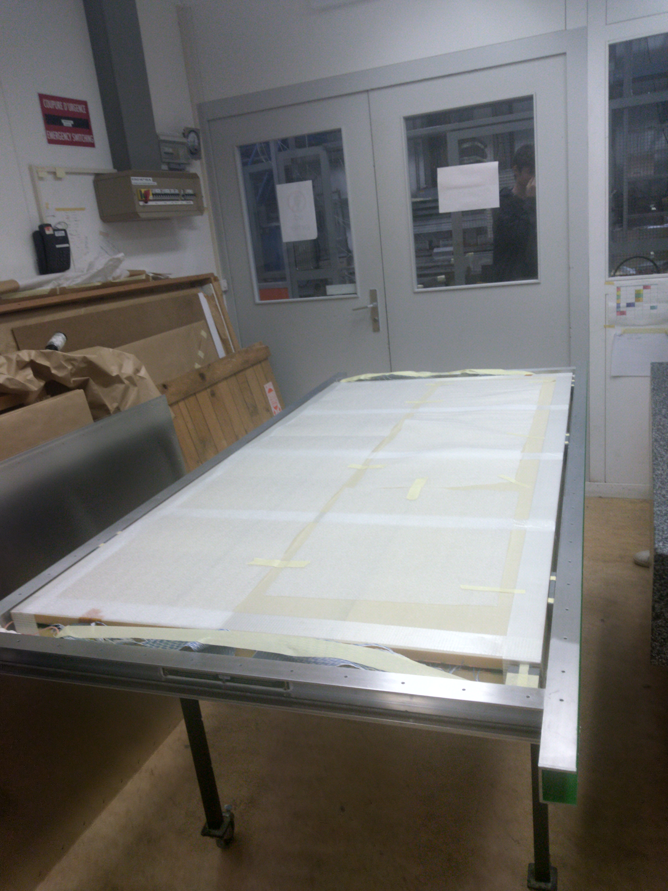

Slide 13
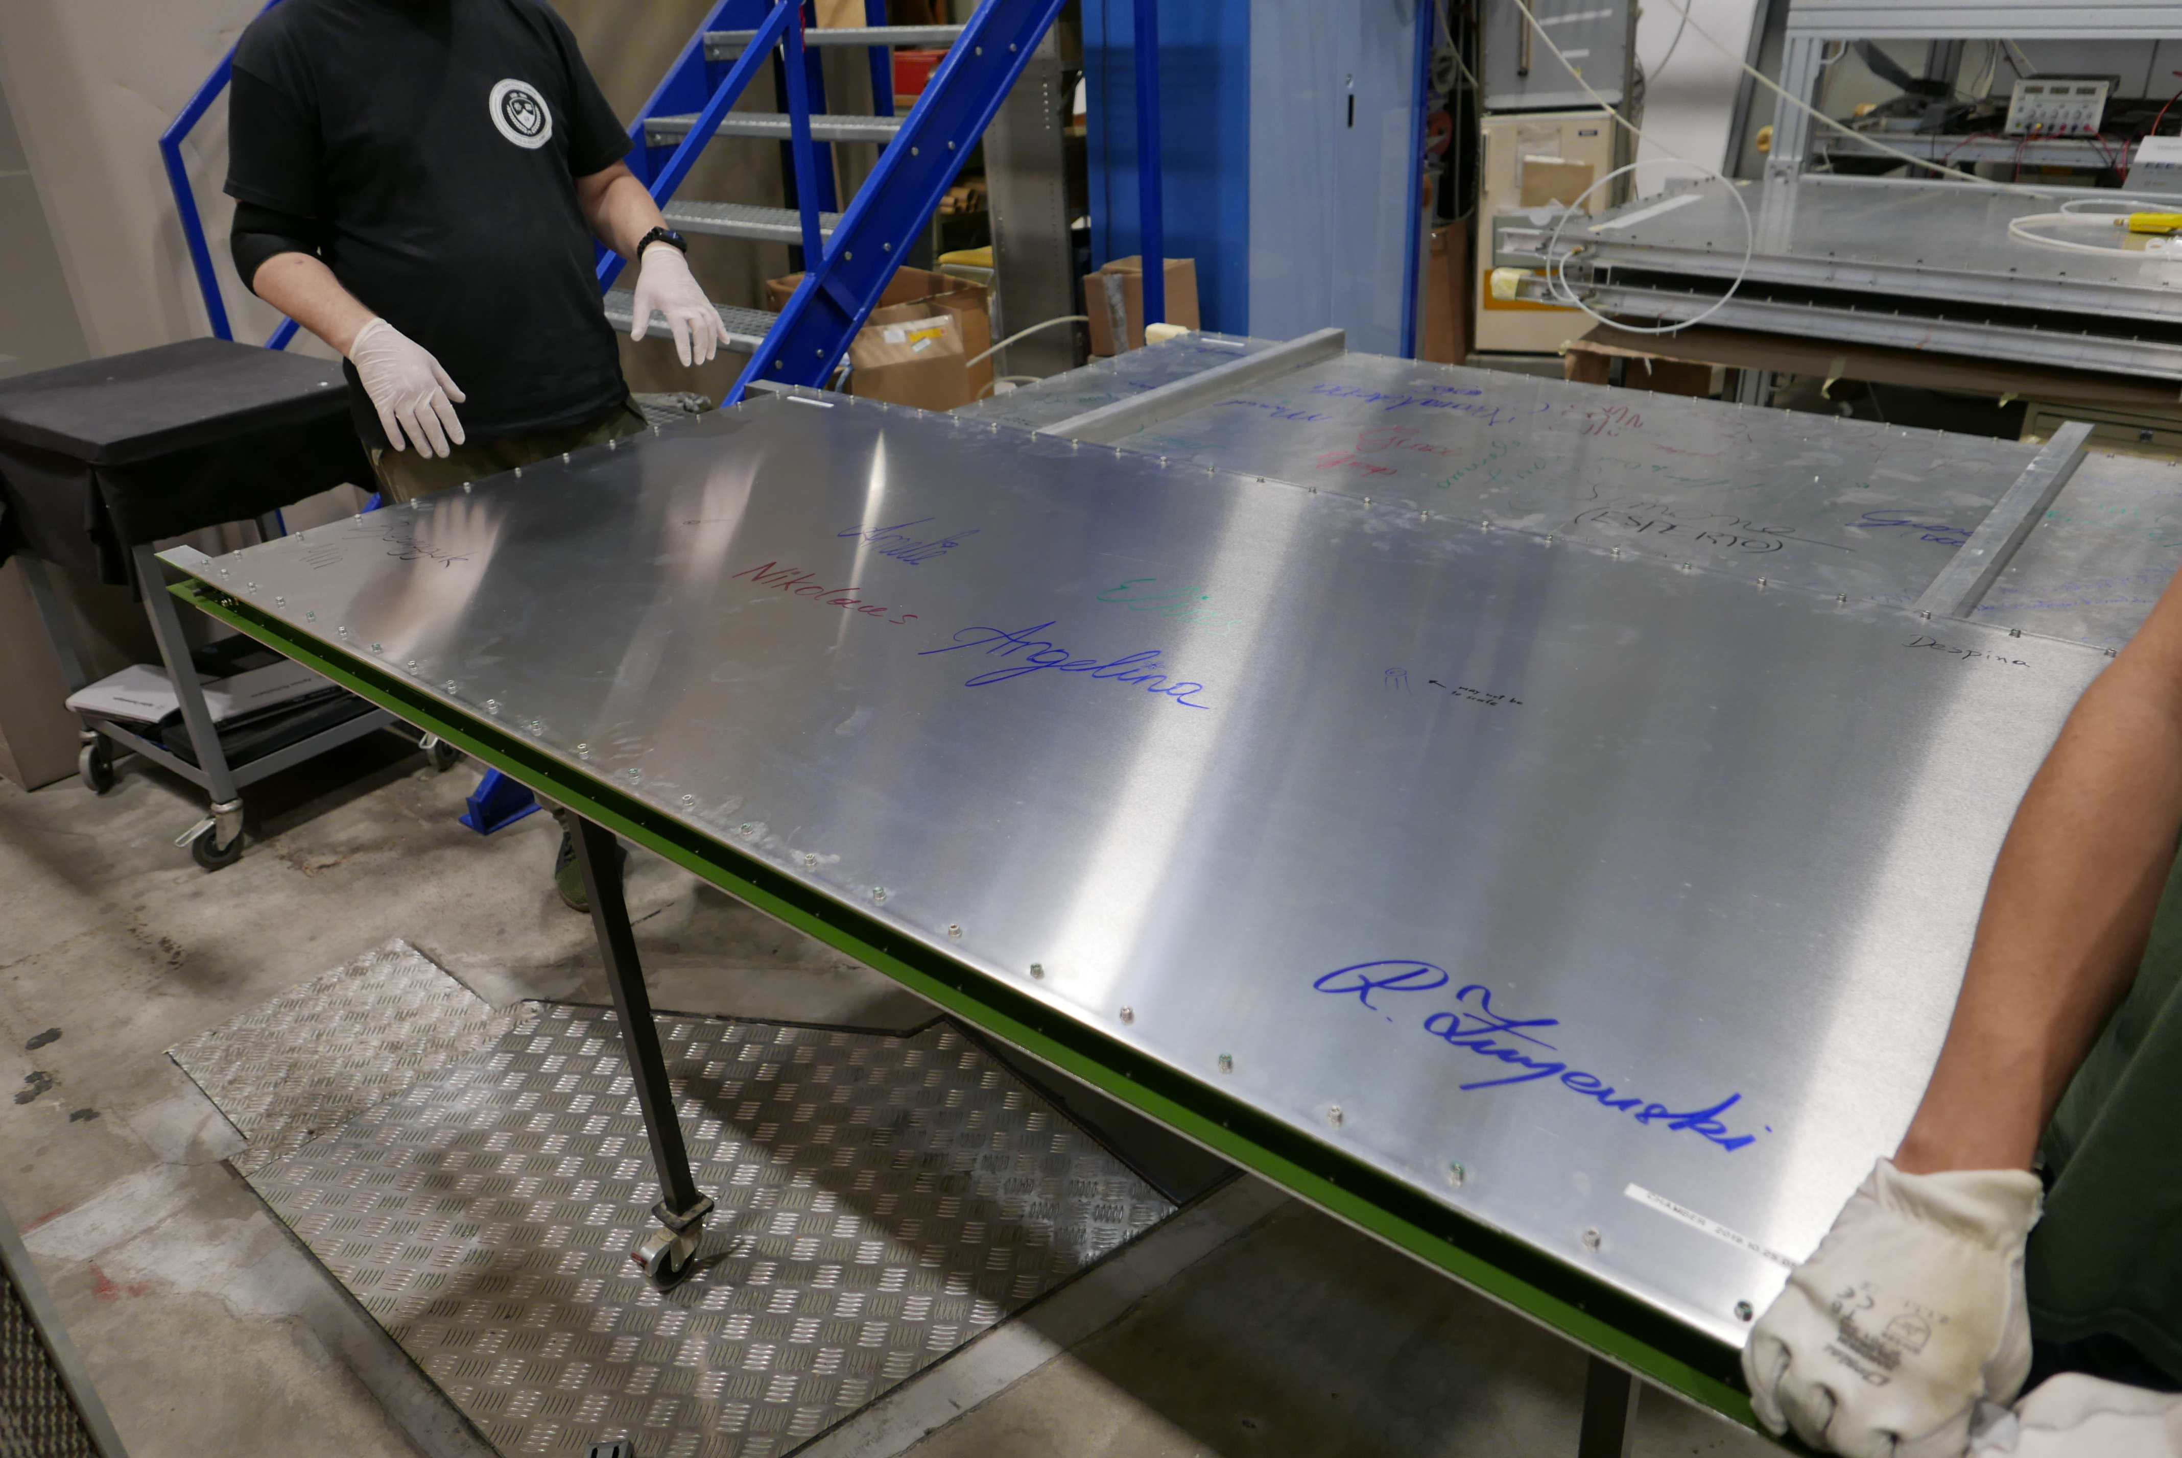

Slide 14
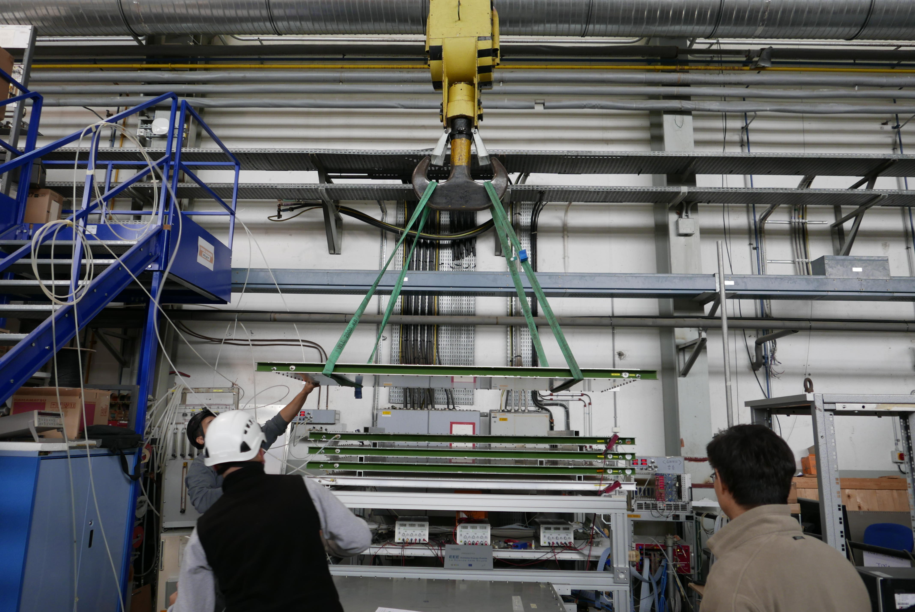

Slide 15
Telescope

Slide 16
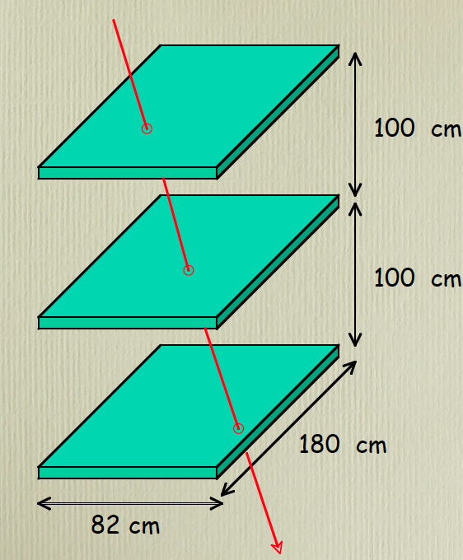
Muon Telescope and Trigger mechanism
One trigger per chamber
One coincident trigger for all 3 chambers
Coincident events trigger data acquisition
(TDC)

Slide 17
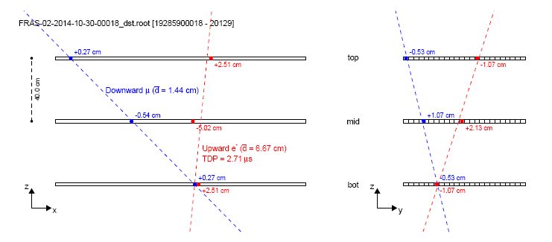
Upward going events

Slide 18
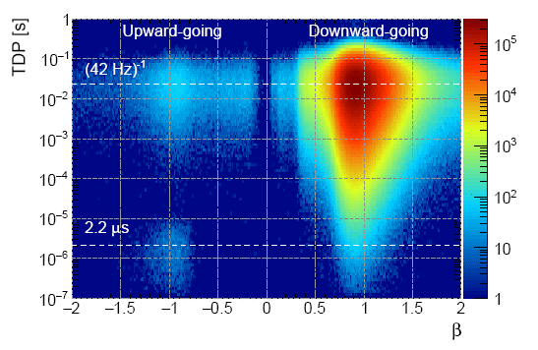

Slide 19
Evaluating efficiency

Slide 20
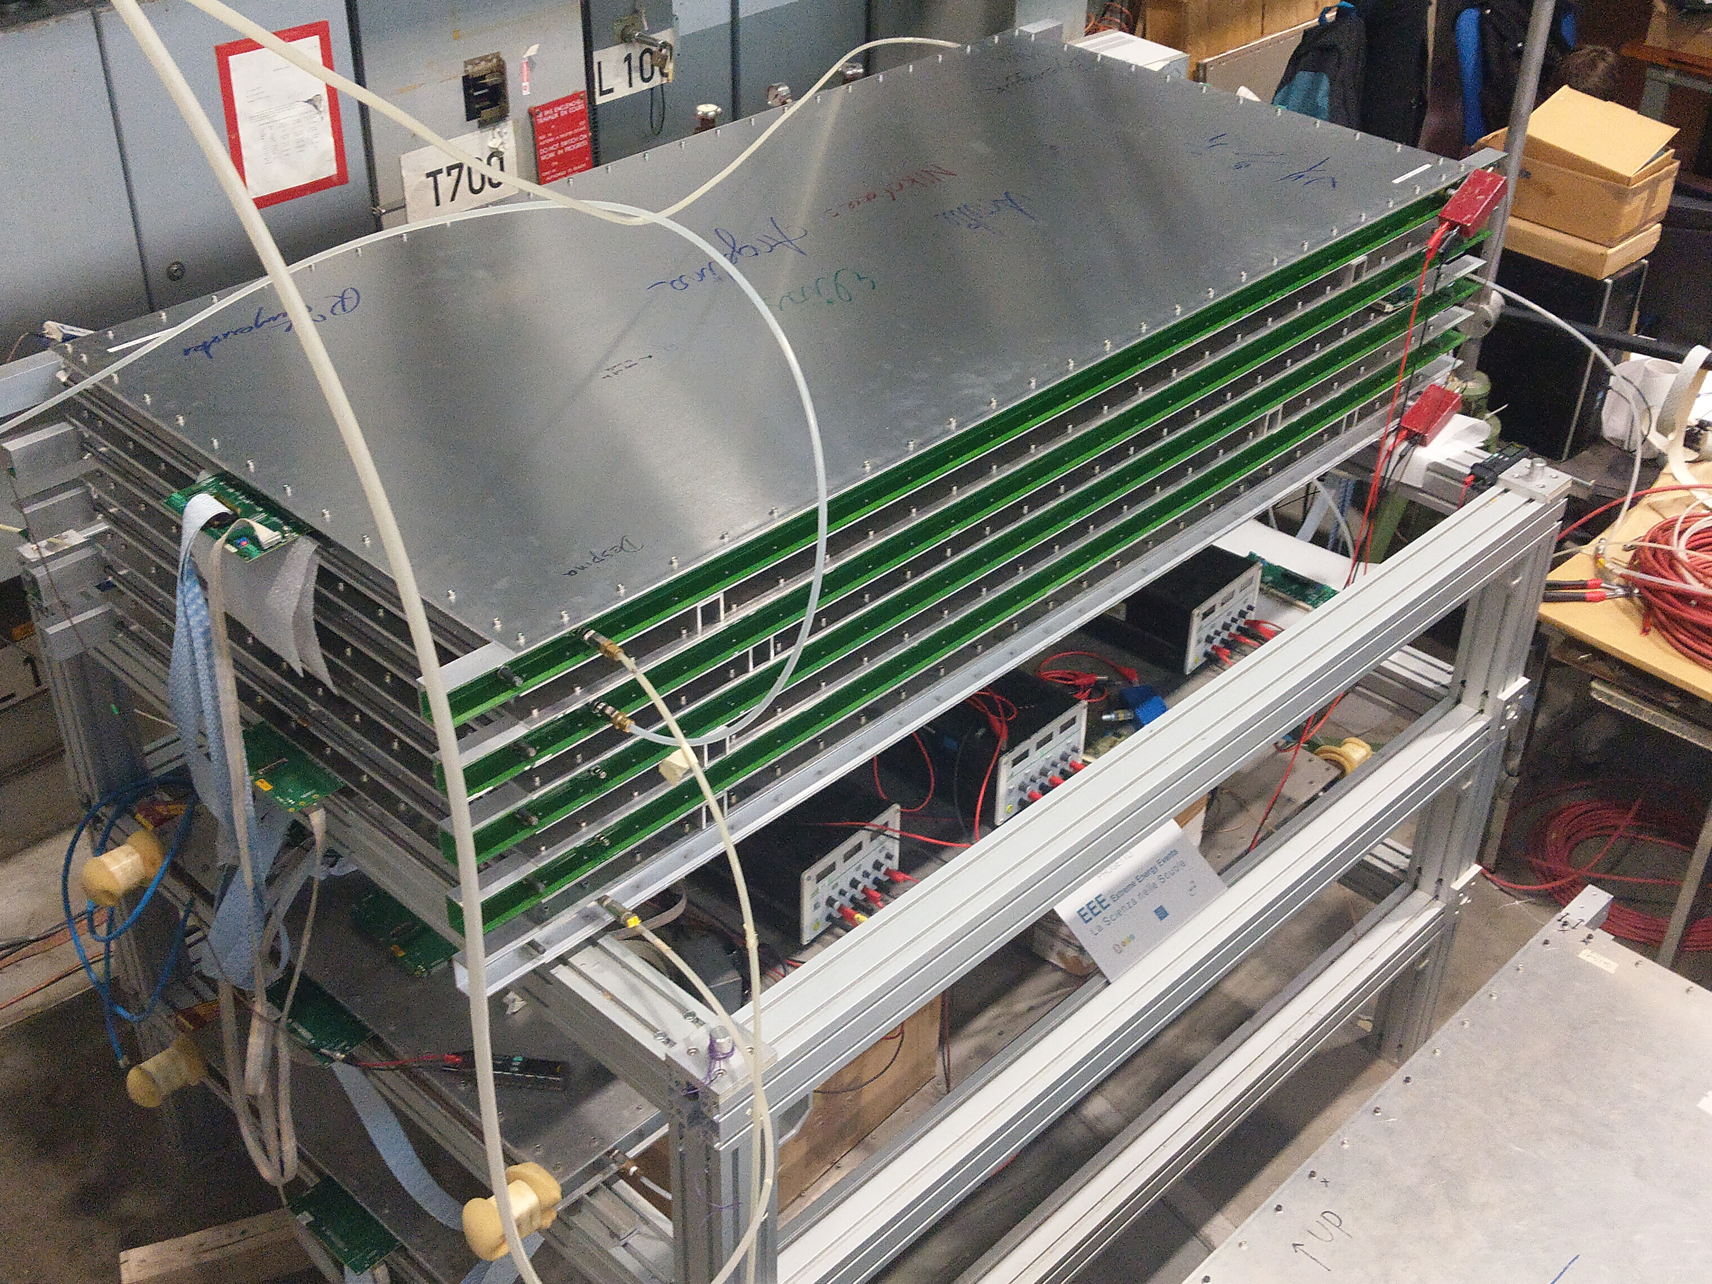

Slide 21
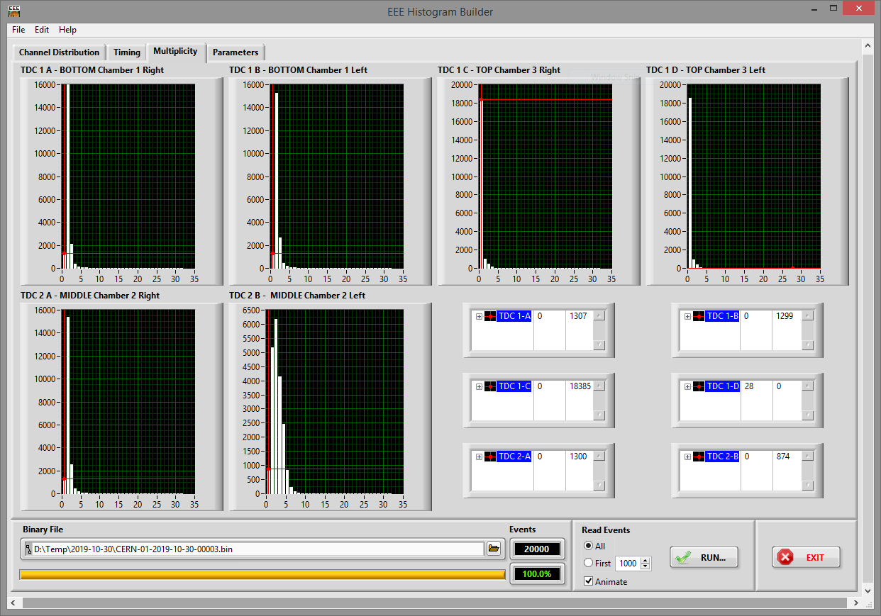



Calculating the efficiency:
Missed hits: 18 385
GPS caused mishits: 1 307
Total registered hits: 20 000
$$18 385−1 307=17 078$$
$$\frac{\text{17 }078}{20 000}=0,8539=85,39\%$$
≈85% seems good
$$1−0.85≈15\% efficiency$$
15% efficiency ?!? Holy sh*t what happened there?

Slide 22
speed x1200

Slide 23
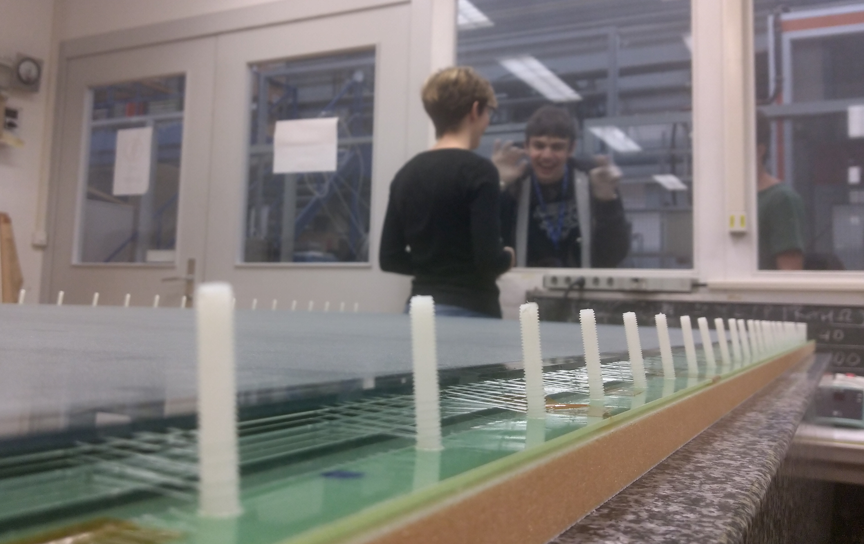
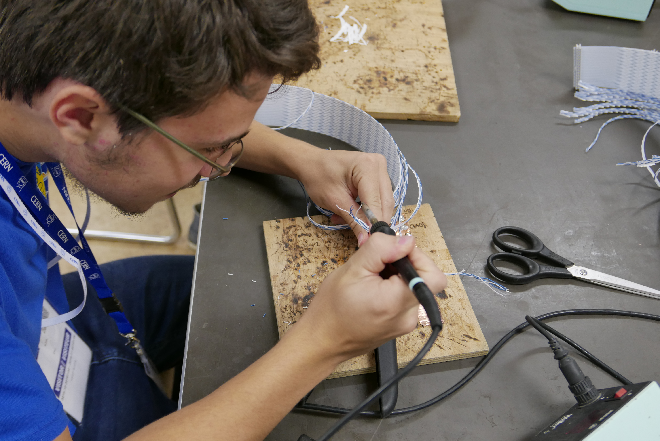
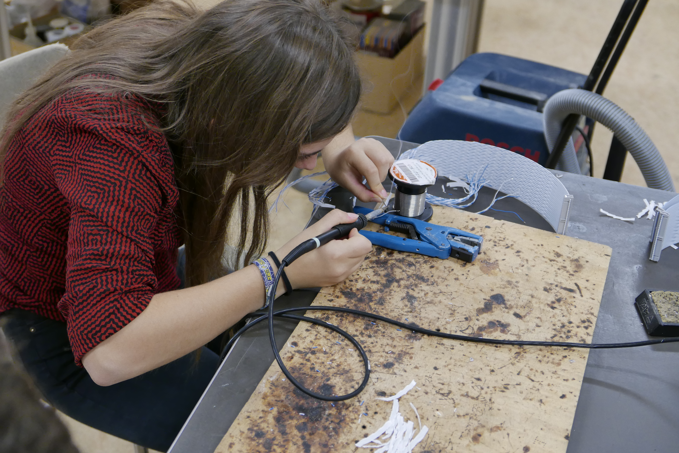
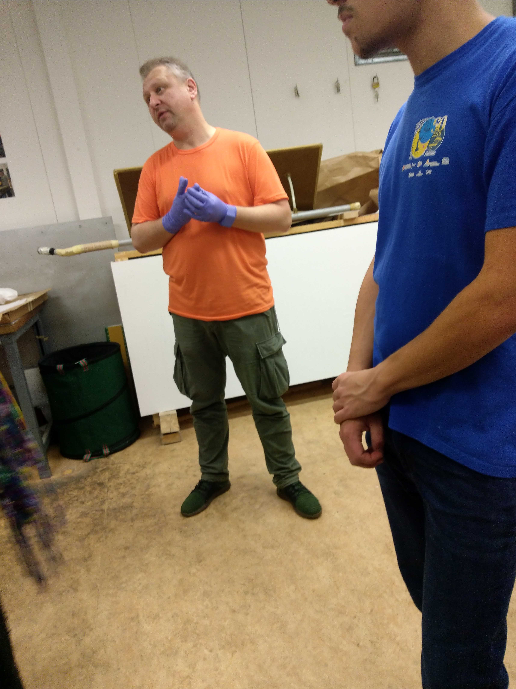
Any
questions?

