Slide 1
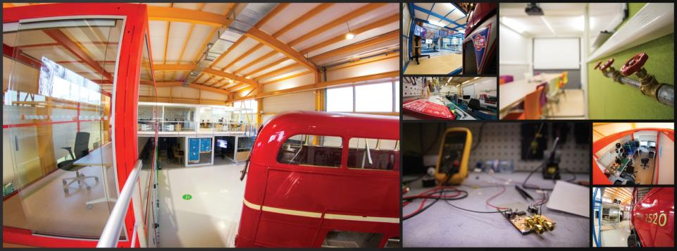
CERN Ideasquare
Markus Nordberg
Head of Resources Development
Development and Innovation (IPT-DI)
Serendipity, June 28-29, 2018

Slide 2
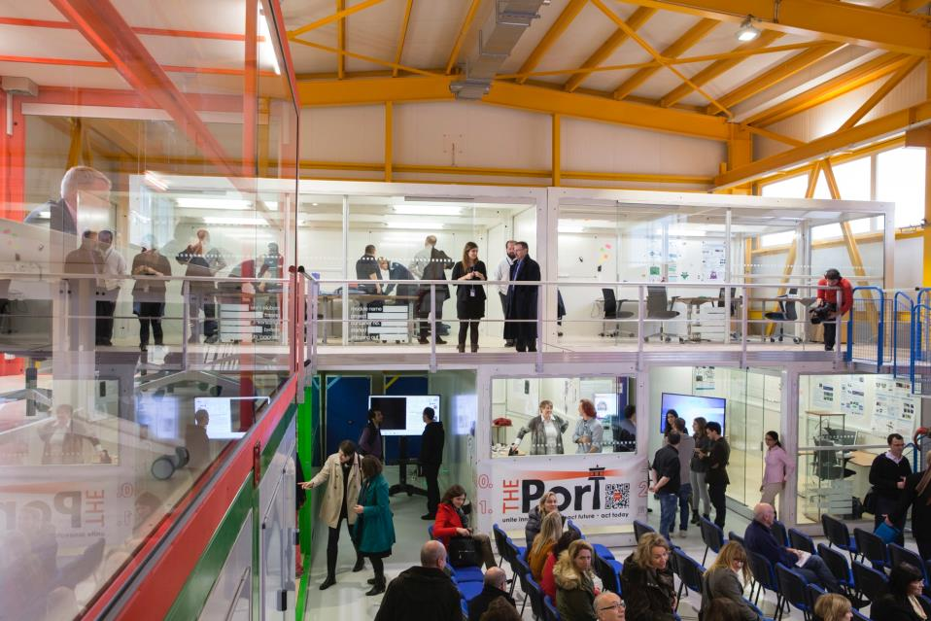
IDEASQUARE IN BRIEF
“Ideasquare is an Experiment that brings together researchers, engineers, industrial partners and cross-disciplinary student teams to work together on detector upgrade R&D technologies. The dual purpose is to co-develop new technologies for research purposes and create a fruitful environment for socially and globally relevant new product ideas and innovation.”

Slide 3
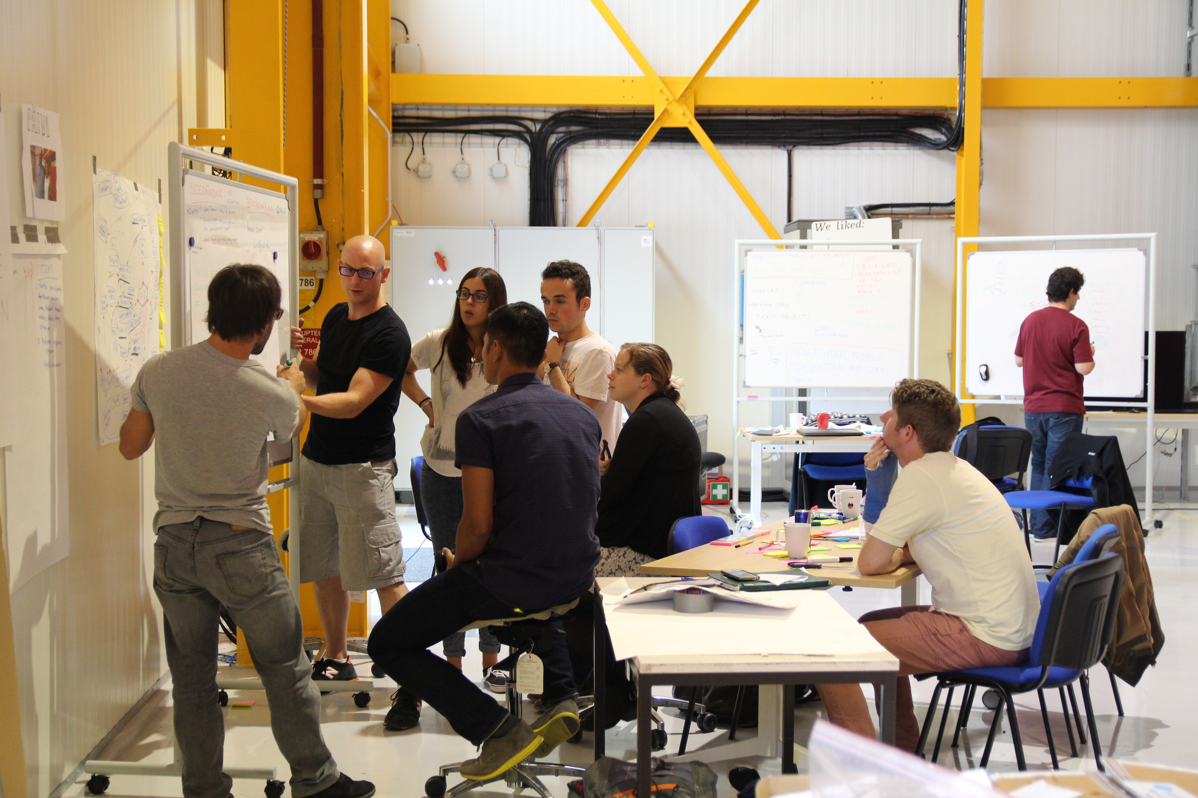

IDEASQUARE IS
Project with a dedicated building, hosting:
  Detector upgrade R&D projects
  Innovation events, workshops, hackathons
  Multidisciplinary master level student programs
...to prototype, test and iterate new forms of collaboration and co-creation in the areas or Research, Education and Technology - RET
Research
Education
Technology

Slide 4

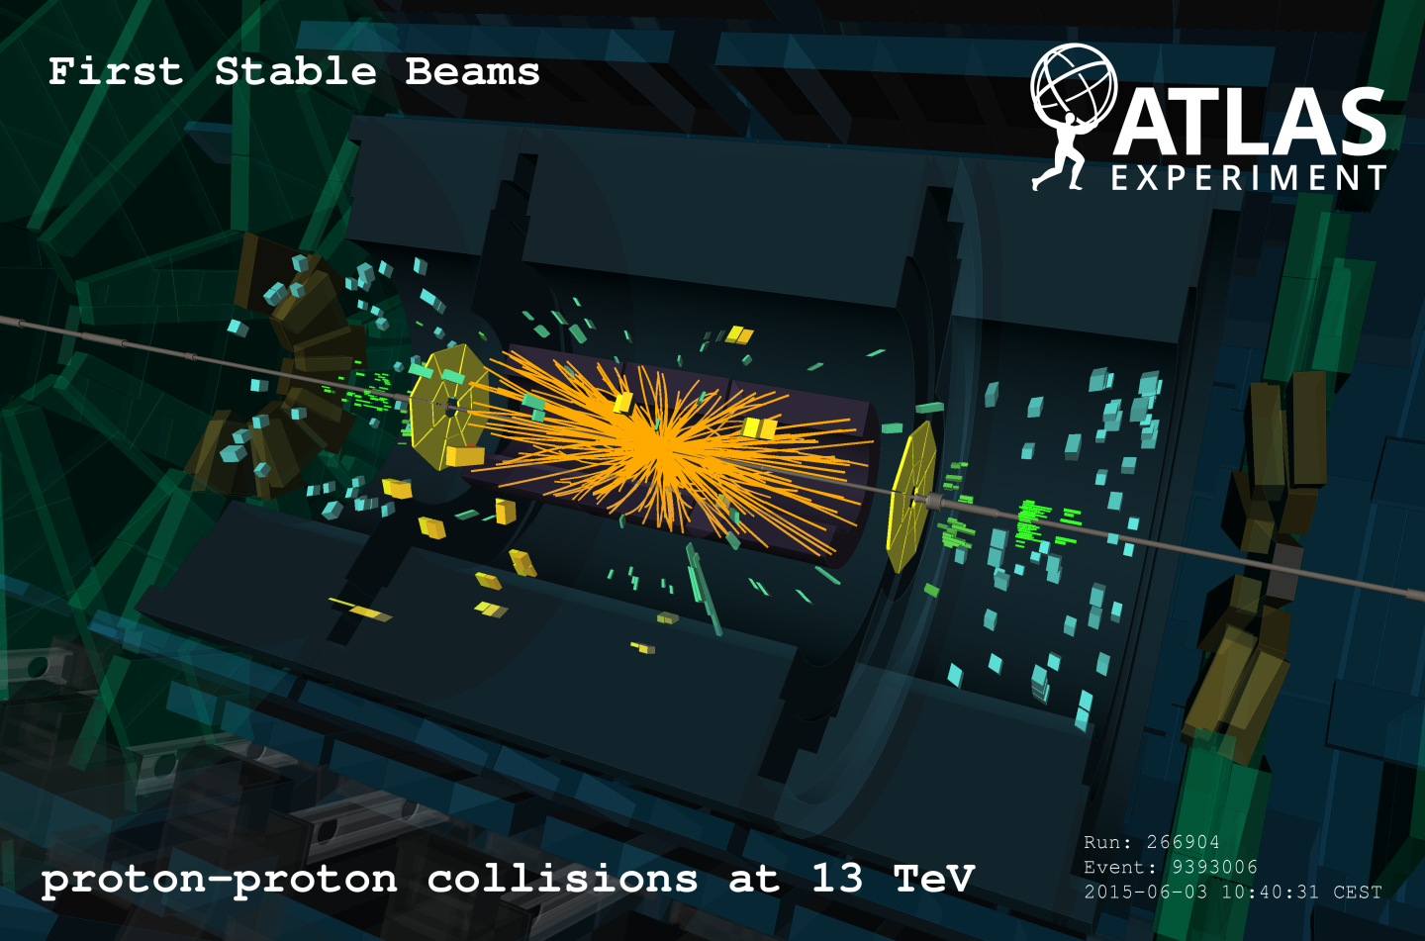


WHAT IS THE MOST INTERESTING LINK FOR NEW INNOVATION?
Detector R&D
Projects
Defined/closed
Technology
MSc-Level Student Programs, Hacks etc.
Initially undefined/open
Product
Process
Focus

Slide 5
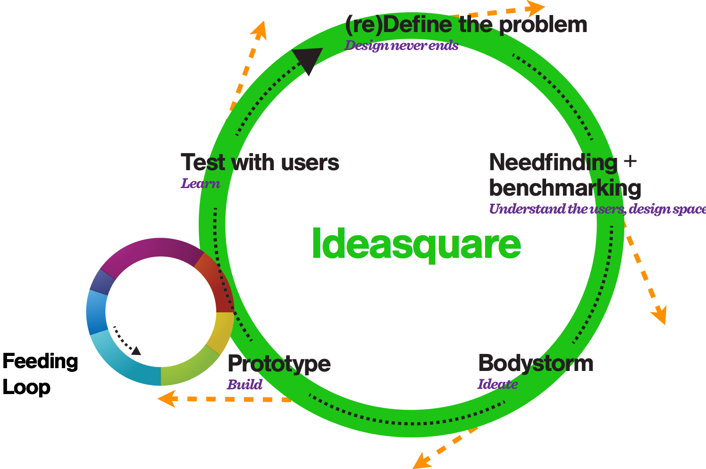
IDEASQUARE
The Large Human Collider

Slide 6
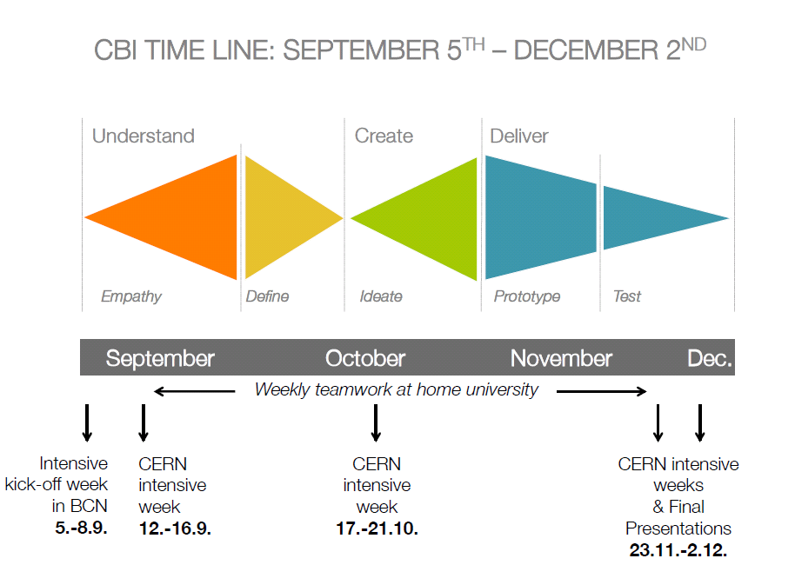
TYPICAL STRUCTURE OF MSC-LEVEL STUDENT PROGRAM AT IDEASQUARE (CBI)
Design Thinking
http://www.cbi-course.com/

Slide 7
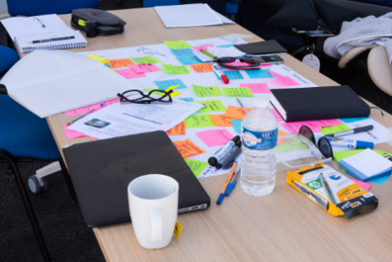
EXAMPLES OF STUDENT PROJECTS

Slide 8

PREVENTING HIP INJURY FROM INVOLUNTARY FALL
http://2014.cbi-course.com/

Slide 9
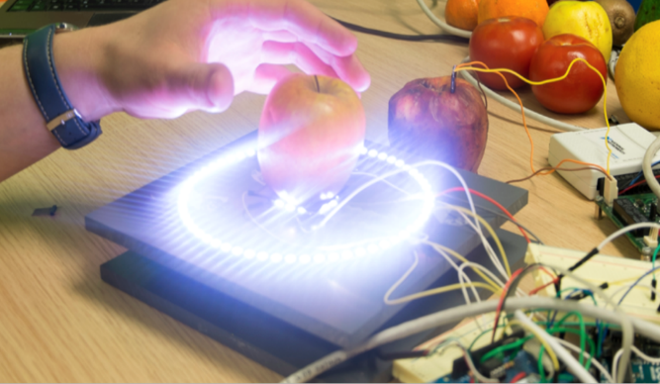
YOUR FRIDGE SENDING A MESSAGE WHEN FOOD IS RIPE TO EAT FOR YOU
http://2014.cbi-course.com/

Slide 10
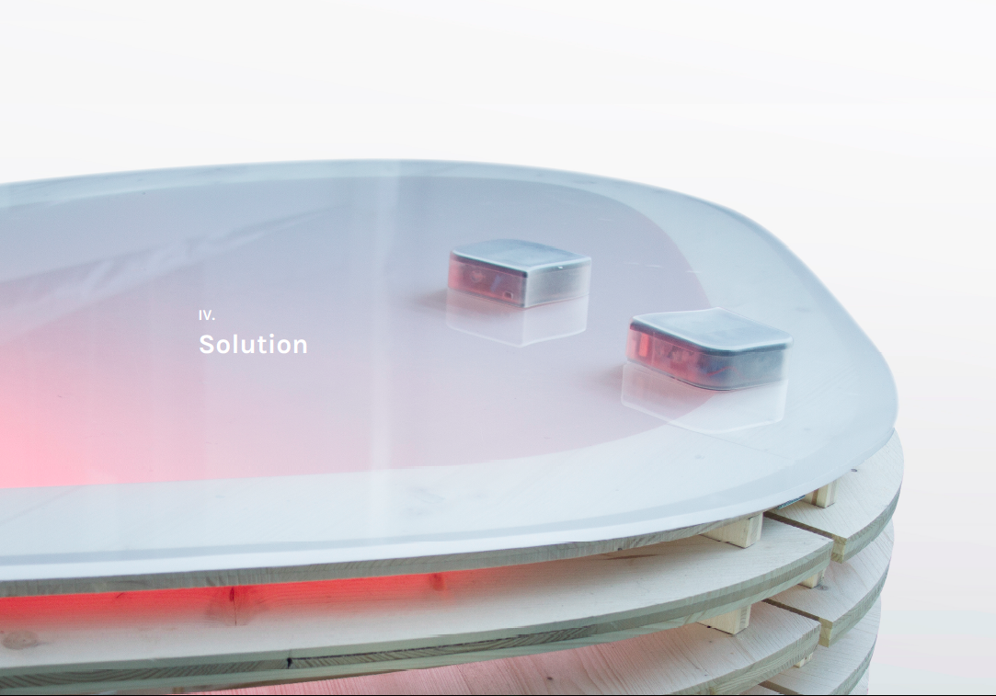
HELPING YOUNG AUTISTIC CHILDREN TO COMMUNICATE
https://www.youtube.com/watch?v=w5S8vSHH_XA
Notes:
Another example is Team Edumind – combining inspiration from a research project on augmented reality for maintenance workers with a societal challenge on helping autistic kids to communicate better with their surroundings

Slide 11
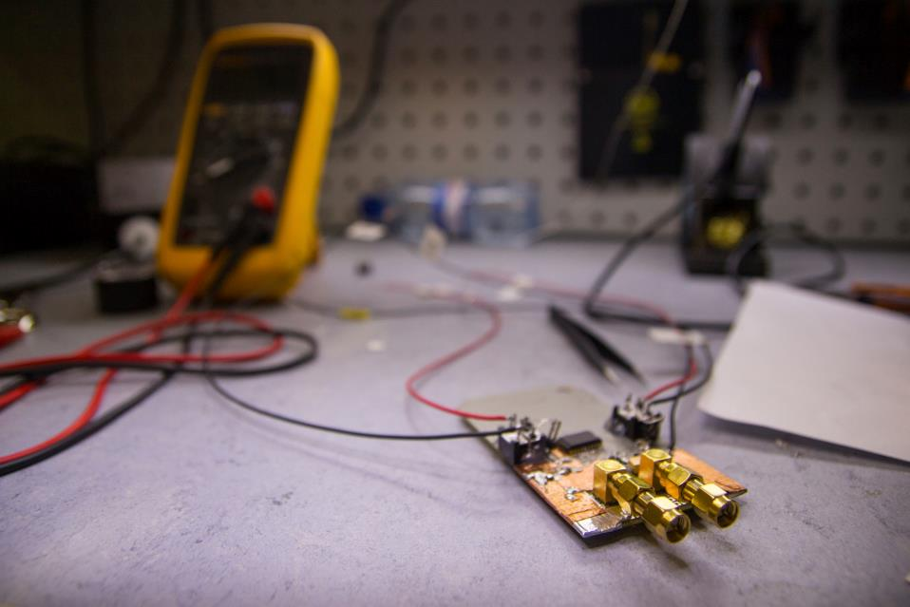
IDEASQUARE OUTPUT
Education of future scientists and innovators
Creating talent for both basic research and entrepreneurship (iterative prototyping, new business concepts)
Sharing of ideas, spaces and resources improved in and between versatile development projects in a high-tech environment
Societal value from basic research
Shared experimental data on innovation processes (CIJ)
Demonstrator for ATTRACT (www.attract-eu.org) to create local entrepreneurial ecosystems using centers like CERN as engines of innovation

Slide 12

SOCIO-ECONOMIC RESEARCH ON EXPERIMENTAL INNOVATION
IdeaSquare Journal of Experimental Innovation
Online, cited (Reuters) open access journal
Targeted for research on experimental innovation processes and methodologies, (to be) tested or used at IdeaSquare
Short, peer-reviewed articles to communicate key results
Annual workshops to work further on published articles for special issues in well-established journals
First issue in Autumn, 2016
Editor-in-chief: Prof. Saku Makinen (TTY)
Senior Editors: Prof. Julian Birkinshaw (LBS), Roberto Verganti (Milan)
http://cij-ei.web.cern.ch/cij-ei/

Slide 13
HOW TO GET INVOLVED WITH IDEASQUARE?
Through physics experiments at CERN doing detector R&D that have some connection with society (e.g. non-physics student initiatives)
  e.g. ATTRACT
Proposing and participating in initiatives to bring together engineering, business management and design students (and their professors) who ask IdeaSquare to host them (e.g. CBI)
Participating in new events and initiatives (e.g. hackathons, see Port)
Doing research (e.g. PhD) together with us about innovation processes (CJI)
www.cern.ch/ideasquare

Slide 14


Questions? Comments?
Contact information:
Email
Skype
Let’s have a cup of coffee and make it happen!

