Slide 1
Consortium organization
Amalia Ballarino, Johannes Gutleber
CERN
10 December 2018

Slide 2
Project Office at CERN
Amalia Ballarino (TE/MSC, PI, head of CERN’s superconductivity R&D programme)
Michael Benedikt (ATS/DO, Head of the Future Circular Collider study)
Panagiotis Charitos (ATS/DO, communication officer, scientific information manager)
Cecile Granier (HR, MSCA office)
Johannes Gutleber (ATS/DO, head of project office)
Julie Hadre (ATS/DO, project officer of H2020 projects and FCC study)
Coralie Hunsicker (ATS/DO, project officer EASITrain)

Slide 3
BENEFICIARIES
  Bruker HTS GmbH (Germany)
  CEA - *IRFU *INAC/SBT (France)
  CERN (International Organisation)
  CNR – SPIN (Italy)
  ASG / COLUMBUS SUPERCONDUCTORS SRL (Italy)
  HZB (Germany)
  I-CUBE RESEARCH (France)
  INFN LNF (Italy)
  Technical University Dresden (Germany)
  Technical University Wien (Austria)
  University Siegen (Germany)
  University Stuttgart (Germany)
  University of Business and Economy Wien (Austria)

Slide 4
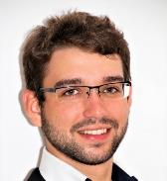
BRUKER HTS GmbH
  Non-academic
  Produces Nuclear Magnetic Resonance (NMR) spectroscopy devices based on superconducting high field magnets
  Superconducting wires for applications
  ESR 2
    Johannes Gnilsen
    Supervised by Alexander Usoskin
    Hanau, Germany

Slide 5
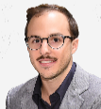
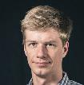
CEA - *IRFU *INAC/SBT- COMMISSARIAT A L’ENERGIE ATOMIQUE ET AUX ENERGIES ALTERNATIVES
  Academic
  CEA-DRF develops solutions for cryogenics and superconducting magnets in its INAC (Institute for NAnosciences and Cryogenics) and IRFU (Institute of Research into the Fundamental laws of the Universe) institutes
  CEA has develops technologies along the entire value chain of superconducting magnets including the cooling infrastructures
  ESR 3
    Andrea Vitrano
    Supervised by Bertrand Baudouy
    Grenoble, France
  ESR 4
    Jakub Tkaczuk
    Supervised by François Millet
    Grenoble, France

Slide 6
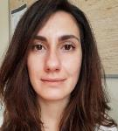
CERN - EUROPEAN ORGANIZATION FOR NUCLEAR RESEARCH
  International Organisation (project coordinator)
  provides a unique range of particle accelerator facilities that enable research at the forefront of human knowledge.
  Covers the entire value chain of all superconducting and cryogenic technologies
  Interface thin film/substrate at cryogenic temperatures
  ESR 1
    Dorothea Fonnesu
    Supervised by Torsten Köttig
    Switzerland/France

Slide 7
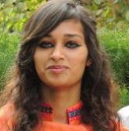
CNR SPIN - CONSIGLIO NAZIONALE DELLE RICERCHE
  Academic
  Its mission is the study of superconductors and other innovative materials for electronic devices and for energy applications
  Thallium thin films and MgB₂ wires
  ESR 6
    Aisha Saba
    Supervised by Emilio Bellingeri
    Genoa, Italy

Slide 8

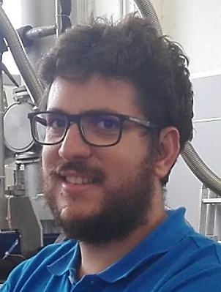
ASG (formerly Columbus Superconductors SRL)
  Non-academic
  The company focuses on the R&D and application development of superconducting wires and magnets, based on MgB₂ technology
  Improvement of wire production process
  ESR 7
    Mattia Donato
    Supervised by Matteo Tropeano
    Genoa, Italy

Slide 9
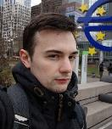
HZB - HELMHOLTZ-ZENTRUM BERLIN FÜR MATERIALIEN UND ENERGIE GMBH
  Academic
  The institute studies the structure and dynamics of materials and investigates solar cell technology. Several large scale facilities are available, including a 10 MW nuclear research reactor at the Lise Meitner campus in Wannsee and the third-generation BESSY synchrotron in Adlershof.
  Superconducting thin film production and characterization.
  ESR 8
    Dmitry Tikhonov
    Supervised by Oliver Kugeler
    Berlin, Germany

Slide 10
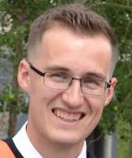
I-CUBE RESEARCH
  Non Academic
  I-Cube is a company providing R&D services for advanced metal processing solutions using pulsed power that are produced and marketed by sister company BMax. Major application domains are automotive, aeronautics and packaging industries
  Electro hydraulic forming for metals
  ESR 9
    Jean-François Croteau
    Supervised by Elisa Cantergiani
    Toulouse, France

Slide 11

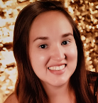
INFN LNF- ISTITUTO NAZIONALE DI FISICA NUCLEARE
  Academic
  Istituto Nazionale di Fisica Nucleare (INFN) is the major Italian research organization dedicated to the study of the fundamental constituents of matter, conducting theoretical and experimental research in the fields of sub-nuclear nuclear and astroparticle physics.
  Superconducting thin film coating
  ESR 10
    Vanessa Garcia Diaz
    Supervised by Cristian Pira
    Legnaro, Italy

Slide 12
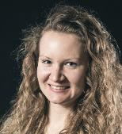
TUD - TECHNISCHE UNIVERSITÄT DRESDEN
  Academic
  TU Dresden is a multi-discipline university, also offering humanities and social sciences as well as medicine. TUD is the key developer of a novel refrigeration concept based on neon-helium light gas mixture (Nelium)
  Nelium refrigeration cycle and test stand
  ESR 11
    Sofiya Savelyeva
    Supervised by Christoph Haberstroh
    Dresden, Germany

Slide 13
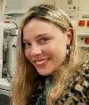
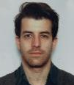
TUW - TECHNISCHE UNIVERSITÄT WIEN
  Academic
  TU Wien is the largest technology-oriented university in Austria. The Institute of Atomic and Subatomic physics (ATI) specializes in teaching and research on atomic, nuclear, neutron, solid state and low temperature physics as well as radiation effects, nuclear chemistry and quantum optics. It operates a research reactor. The USTEM institute carries out advanced material microstructure analysis .
  Superconducting wire and thin film characterisation and microstructure analysis of all superconducting materials in view of identifying the performance limitations and proposing potential break-through approaches to improve the performance.
  ESR 12
    Alice Moros
    Supervised by Johannes Bernardi
  ESR13
    Mattia Ortino
    Supervised by Michael Eisterer

Slide 14
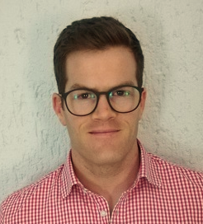
USIEGEN – UNIVERSITÄT SIEGEN
  Academic
  The university consists of four faculties, which run a broad spectrum of degree programs. The university institute on surface technology under Prof. Xin Jiang is internationally considered a technology leader.
  Radiofrequency properties of superconducting thin films
  ESR 14
    Stewart Leith
    Supervised by Michael Vogel
    Siegen, Germany

Slide 15

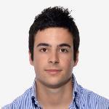
USTUTT - UNIVERSITÄT STUTTGART
  Academic
  It is one of the top nine leading technical universities in Germany (TU9) with highly ranked programs in civil, mechanical, industrial and electrical engineering. The university has a history in co-developing Nelium refrigeration together with TU Dresden.
  Turbo compressor development for light gases
  ESR 15
    Maxime Podeur
    Supervised by Damian Vogt
    Stuttgart, Germany

Slide 16
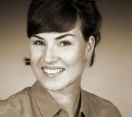
WUW - WIRTSCHAFTSUNIVERSITÄT WIEN
  Academic
  It is a world-leading institution with respect to research in the field of open and user innovation management. The institute participating in the project has pioneered the “Technology Competency Leveraging” method.
  Assessing technologies along all R&D value chains with respect to identifying credible market opportunities.
  ESR 5
    Linn Kretzschmar
    Supervised by Peter Keinz
    Vienna, Austria

Slide 17
PARTNER ORGANISATIONS
  Air Liquide
  ASG Superconductors
  Babcock Noell GmbH/Bilfinger SE
  CemeCon
  MAN Diesel & Turbo
  Terra Mater Productions GmbH / Terra Mater Factual Studios
  Criotec Impianti
  IEEE CSC
  Reseach Instruments
  SigmaPhi
  Università degli Studi di Genova
  Université de Genève
NOTE: In addition to this formal list of project partners, there are numerous additional organizations participating in the research, since this project is part of a world-wide R&D project that is coordinated by CERN. It federates today more than 130 institutions and 25 companies.

Slide 18
  Non-academic
  Sassenage, France
  Air Liquide S.A. is a French multinational company which supplies industrial gases and services to various industries including medical, chemical and electronic manufacturers.
  It has a long standing business relation with CERN in the world’s largest cryogenic installation.

Slide 19
ASG superconductors
  Non-academic
  Genova, Italy
  ASG is a world leader in superconducting magnetic systems design, construction and testing for high energy physics and thermonuclear fusion applications and through its subsidiaries Paramed and Columbus Superconductors in the field of biomedical applications (diagnosis and therapy) and the energy sector (SMES, FCL, wind turbines and energy transport).
  Columbus merged recently with ASG

Slide 20
Babcock Noell GmbH / Bilfinger SE
  Non-academic
  Mannheim, Germany
  The Würzburg based Babcock Noell GmbH is a company of the Bilfinger SE. Operating worldwide in the product areas of nuclear service, nuclear technology, magnet technology and environment technology, BNG delivers experience into practice with great success.

Slide 21
CemeCon
  Non-academic
  Würselen, Germany
  CemeCon is the world's largest coating centre for cutting tools and the market leader in the area of CVD diamond coatings.

Slide 22
MAN Diesel & Turbo
  Non-academic
  Zürich, Switzerland
  MAN is a manufacturer of large scale turbomachinery under the holding of MAN Diesel & Turbo SE. The product range covers conventional axial and centrifugal compressors, Isotherm compressors with integrated re-cooling, the magnetically-levitated MOPICO® and HOFIM™ compressors as well as the TURBAIR® vacuum blowers.

Slide 23

Terra Mater Productions GmbH/ Terra Mater Factual Studios
  Non-academic
  Wien, Austria
  The company is a subsidiary company of Red Bull and specialises in factual production and distribution for cinema, TV and multimedia platforms.
  A one day media training took place at TMFS premises during in September 2018.

Slide 24
Criotec Impianti
  Non-academic
  Chivasso, Italy
  The specific skills in the cryogenic and vacuum sector of the founder and his team of technicians are immediately recognized and appreciated by the market. Within a few years, Criotec is committed to acquiring important customers among large gas-producing companies. In 1996, Criotec faced Europe by demonstrating technological excellence in cryogenic systems. It begins to arouse the interest of the Institutes and Research Centers.

Slide 25
IEEE CSC
  Non-academic
  United States and worldwide
  The IEEE was formed in 1963 from the amalgamation of the American Institute of Electrical Engineers and the Institute of Radio Engineers. Today, it is the world's largest association of technical professionals with more than 400,000 members in chapters around the world.
  Its objectives are the educational and technical advancement of electrical and electronic engineering, telecommunications, computer engineering and allied disciplines. Inside the IEEE the technical Council on superconductivity (CSC) promotes programs and activities that cover the science and technology of superconductors and their applications.

Slide 26
Research Instruments Ltd.
  Non-academic
  Bergisch Gladbach, Germany
  Research Instruments is an excellent example of how fundamental physics research effectively leads to the creation of industrial products and services. The internationally renowned industrial manufacturer of niobium and copper-based accelerating structures has produced systems for large-scale projects such as the European XFEL and now offers turn-key particle sources, electron and ion linear accelerators for a variety of industrial and medical areas. RI is a majority owned subsidiary of Bruker Energy & Supercon Technologies Inc., a subsidiary of Bruker Corporation and was established in 2009. RI is a medium sized company with management holding a significant equity stake of the company and staffed with a highly motivated team.

Slide 27
SigmaPhi
  Non-academic
  Vannes, France
  SigmaPhi Magnets is a company founded in 1981, specialized in the design and building of magnetic systems for particle accelerators, it has built up considerable expertise in the design and production of normal and superconducting magnets for research, industry and healthcare. Among its clients are leading physics research facilities and hadron accelerator cancer treatment facilities.

Slide 28
Università degli Studi di Genova
  Non-academic
  Genova, Italy
  The University of Genoa is a teaching and research institution, founded in 1933, operating according to the principles of the Constitution of the Italian Republic and of Magna Charta subscribed by European Universities in 1988. UGENOA has a synergic collaboration with the “Italian Institute of Technology”, promoting excellence in research in Italy by attracting the brightest researchers in a variety of scientific disciplines.

Slide 29

Université de Genève
  Academic
  Geneva, Switzerland
  The university holds and actively pursues teaching, research, and community service as its primary objectives.
  The group of applied superconductivity focuses on the development of both low- and high-Tc superconductors for applications in various fields, from the high field magnets for NMR/MRI systems and particle accelerators to the emerging applications in the electric power infrastructure.

