Slide 1

Mid-Term Review
10 December 2018, Brussels
Mattia, DONATO
ESR7, WP3
donato.mattia@as-g.it

Slide 2
ESR7, WP3 - Background
Background:
  2006 – 2010: Bachelor in Physics (Laurea Triennale) at University of Genova (Italy)
  2010 – 2013: Master in Physics (Laurea Magistrale) at University of Genova (Italy)
    10 months: ERASMUS Student Mobility for Study at Uppsala University (Sweden)
    8 months: ERASMUS Student Mobility for Placement at Applied Nuclear Division of Department of Physics and Astronomy - Uppsala University (Sweden) – Master Thesis
  19.08.2013 – 18.08.2017: European XFEL GmbH (Detector Group), Hamburg as Doctoral Candidate
  Enrolled at University of Hamburg
  11.12.2018 (Tomorrow afternoon 2pm in Hamburg): Oral Doctoral Defence - “Commissioning and Characterization of the first DSSC Ladder X-ray Camera Prototype for the European XFEL”
    PhD University: Universität Hamburg
    PhD Supervisor: prof. Erika Garutti

Slide 3



ESR7, WP3 - Background
Contract start date: 1st June 2018
EASITrain Supervisor(s): Dr. Matteo Tropeano
Company: Columbus Superconductors SRL
(Small enterprise, about 25 employee)
The 1st November 2018 the three companies merged into ASG Superconductors SpA
(Industry, about 150 employee)

Slide 4
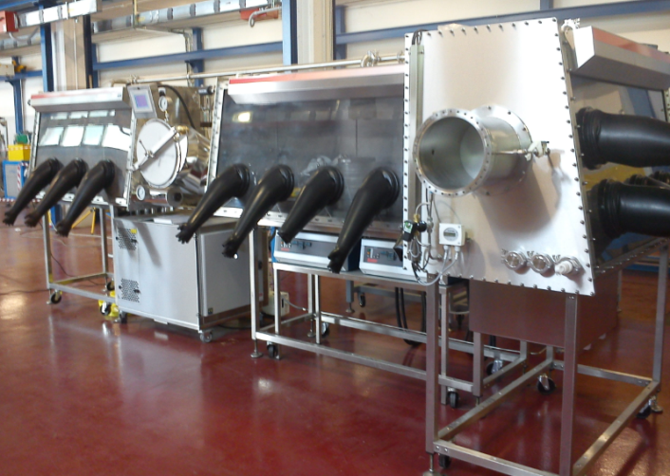
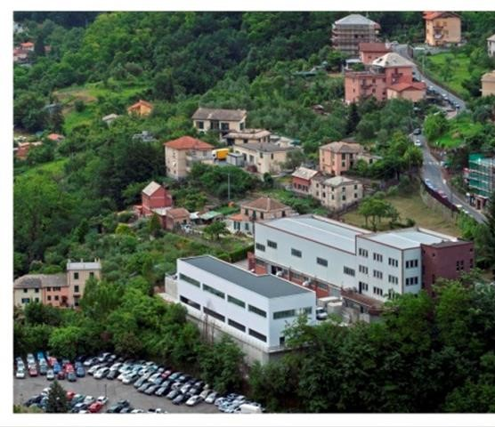
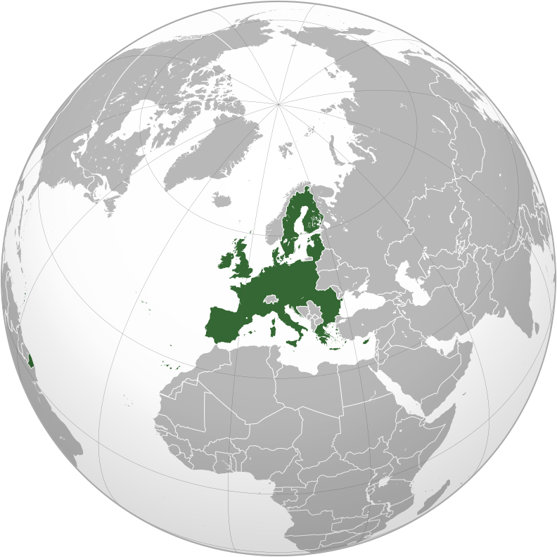
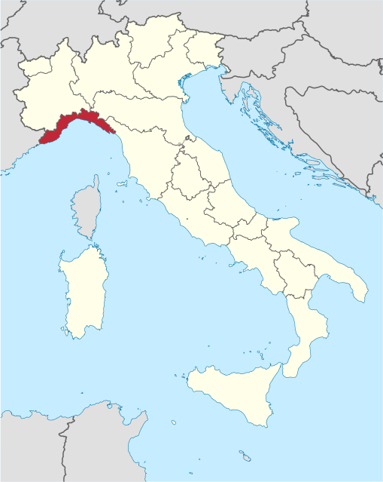
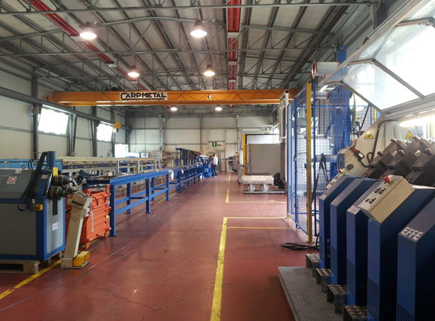
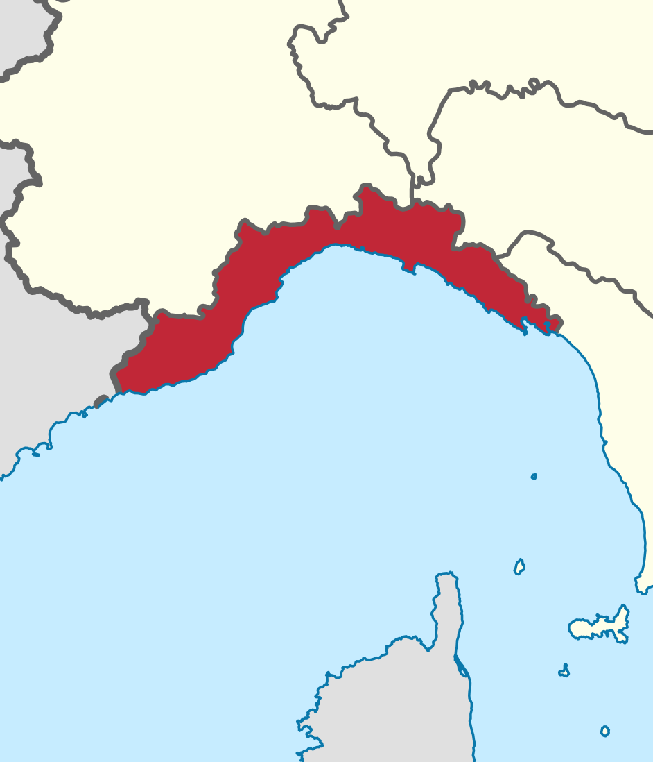
Columbus Superconductors
The actual plant is fully operational for
MgB₂ wire production
MgB₂ chemical synthesis
Wire unit length today up to 2- 4 Km in a single-piece length
ASG Columbus MgB2 Unit
LIGURIA
GENOVA
LA SPEZIA
ITALY
SAN DESIDERIO, GENOVA

Slide 5



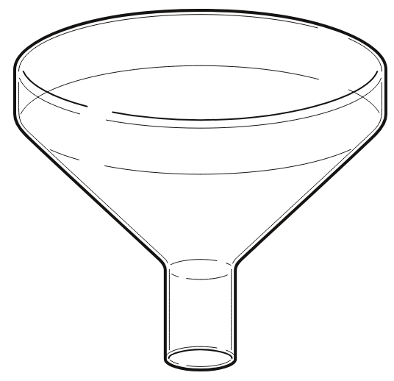
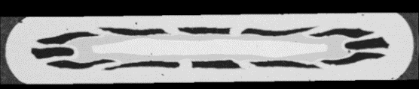
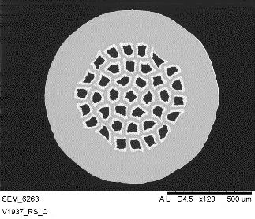
Production
I phase
II phase
III phase
Rolling
+
B
Mg
Single-core
800 - 900 °C
300 – 500 °C
MgB₂
~ 100 m
Final Thermal Treatment
(Sintering)
MgB₂
Multi-core assembling
Sheath
Thermal Treatment
(Mechanical feature)
Quality Assurance
s
Critical Current
Measurement
Multi-core Drawing
Current
Cryogenic
Temperature
Assembled wire
Residual-resistance ratio
SC Wire
~ 1 meter
~ 2-4 km
Magnetic Field
Spool
Sample
billet

Slide 6
Role in the Project & Objectives
Main Objective: Development of MgB2 wire for high-field magnet application.
MgB₂ tape 3.6mm x 0.6mm
MgB₂ round wire diameter 1mm
WP3 (Manufacturing workpackage),
The goal is oriented to the optimization of the superconductors production processes.
Develop and define procedures to control and improve the manufacturing process of MgB2 wires, in particular of the wires suitable for use in high field magnets.
Improve the critical current testing capabilities of the production plant improving cooling efficiency and introducing automatic measurements.
Enhance automatization and control of the manufacturing process parameter
CERN
TUW
I-CUBE
BRUKER
CNR
HZB
COLUMBUS
USIEGEN
INFN
WP3

Slide 7
Research, Methodology, Results
& Next Steps
TUW, both ATI and USTEM, are key collaboration partner
  1. TUW (ATI), Vienna:
    Evaluation of superconducting properties of MgB2
    wires to understand mechanism and enhance in-field performance
  2. TUW (USTEM), Vienna:
  Microscopy on MgB2 powder and wire for characterization and
    study of the impact of the wire design and the production process on its performance
  Planned secondments:
    TUW, ATI 04.03.2019 – 17.03.2019
    TUW, USTEM 14.10.2019 – 27.10.2019:
MgB₂ tape 3.6mm x 0.6mm
MgB₂ round wire diameter 1mm

Slide 8
Research, Methodology, Results
& Next Steps
Activities and training topics: | 1 – 6 | 6 – 12 | 12 – 18 | 18 – 24 | 24 – 30 | 30 – 36
Superconductivity and application (introduction)
Materials characterization (powder, X-ray diffraction, XRF, Granulometry, Micro-Hardness, Stress-strain)
Critical Current tests – Cryogen coolant free (Cryogenics system, principle of measurement techniques, LabView ACQ system, improvement test, post-processsing data analysis)
Manufacturing process – phase I (introduction to PIT technique and related critical issues)
Critical Current tests – Liq. Helium (defining the technical specification of a new test facility; commissioning and test)
Manufacturing process – phase II (Relationship between PIT aspect and Jc enhancement; process control; wires parameters control; automatization; in-line quality assurance)
EASI Schools
Secondments at TUW ATI and TUW USTEM
Project Management
1st June 2018

Slide 9
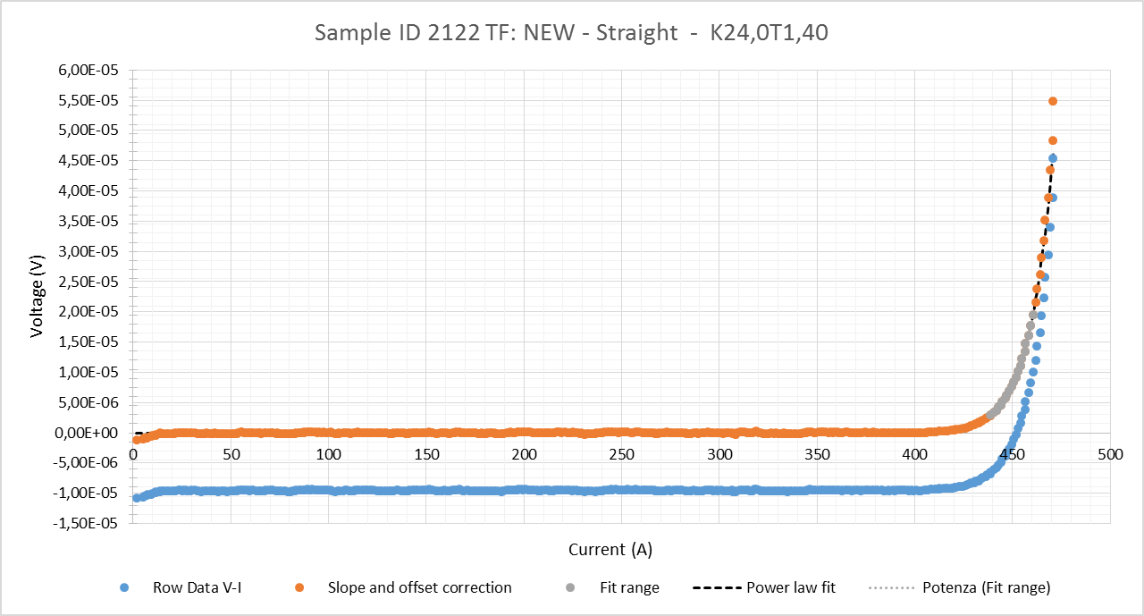
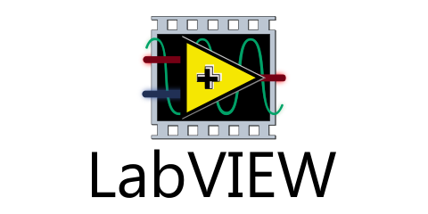
Research, Methodology, Results
& Next Steps
Critical Current Test Facility:
  Improvements Control Software
    Introducing facility diagnostic measurments
    (current leads, voltage meas)
  Improvements Data Analysis Scripts/Macros
Up to 1000A
Current
Generator
Current
Nano-Voltmeter
Cryogenic
Temperature
Temperature
Control (PID)
Magnetic Probe
SC Wire
Facility Diagnostic
Magnetic Field

Slide 10
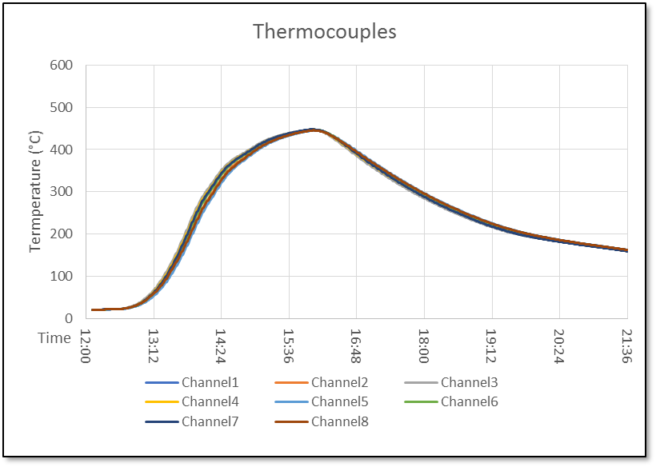


Research, Methodology, Results
& Next Steps
Control of process:
  Heat Treatments, Temperature Real-time Monitoring
Picotech TC08
Raspberry PI
●A ●4 ●3
●8 ●5 ●2
●7 ●6 ●1
SPOOL

Slide 11
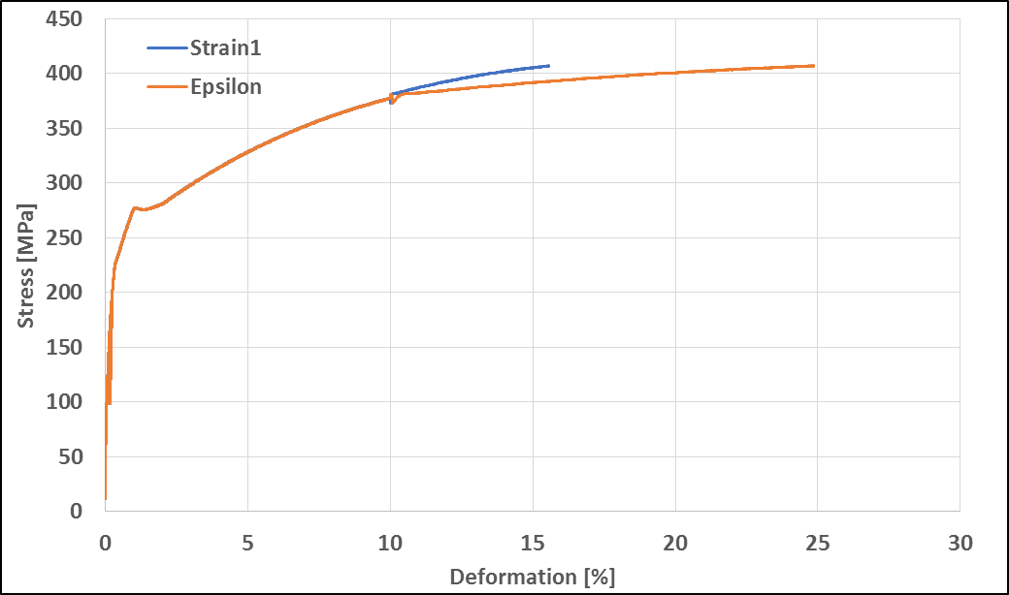
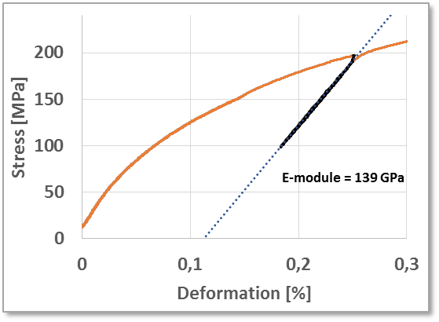
Research, Methodology, Results
& Next Steps
Tensile testing machine
Force
EXTENSOMETER
PC
DAQ

Slide 12
Training, Conferences
& Workshops
Attended EASITrain events:
  EASISCHOOL 1 Vienna 2018 :
    EASITRAIN/ESAS SUMMER SCHOOL on Applied Superconductivity (2 ECTS)
    EASITRAIN Training Course on Project Management (2 ECTS)
    Terra Mater EASITRAIN Media Training
Training
  Safety Training: general risks and specific high risks (16h)
  Privacy and Security Awareness
  Tensile testing machine Training
Conferences & Workshops
  For the first year the participation to conferences or workshop is not expected.
  Planned conference:
    EUCAS 2019 and ICEC-ICMC International Cryogenics Engineering Conference)

Slide 13
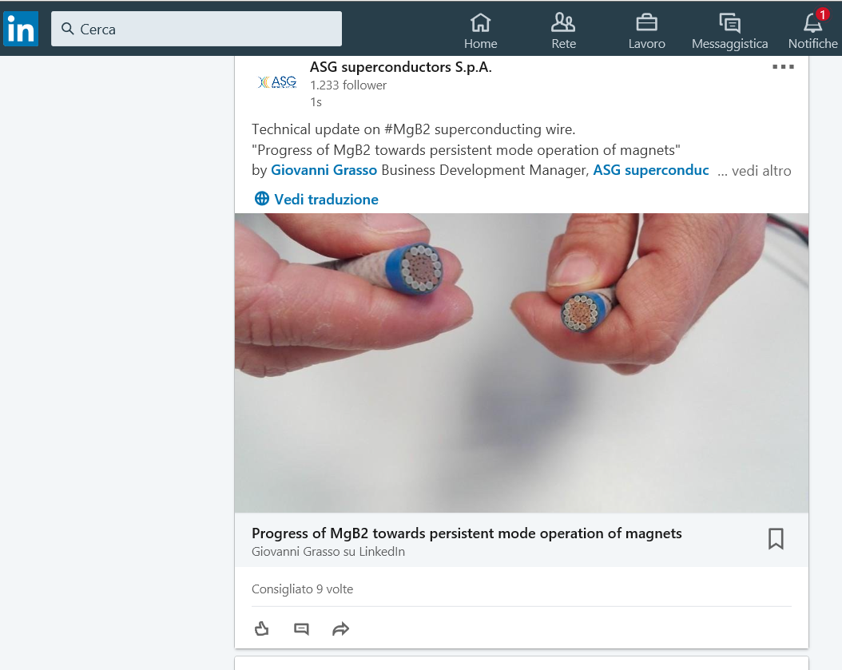

Outreach, Dissemination
& Networking
Outreach activities
  The work in EASITrain will be described through the ASG Superconductors official page on several social media
  Every year in Genova there is Festival of Science, an event which involves whole town and scholar,
  students and adults come to visit the scientific expositions, the lectures or public debate.
  I would like to organize one event or stand.
Dissemination activities
  For the next year the participation to the EUCAS 2019 is planned
Networking activities:
  EASISchool week
  Seminar “Thermomagnetic Mechanism for Self-Cooling Cables” meeting scientists and visiting to CNR-SPIN laboratory 20.11.2018
  Meetings with providers of cryogenic systems and electronic equipments for building new test facility

Slide 14
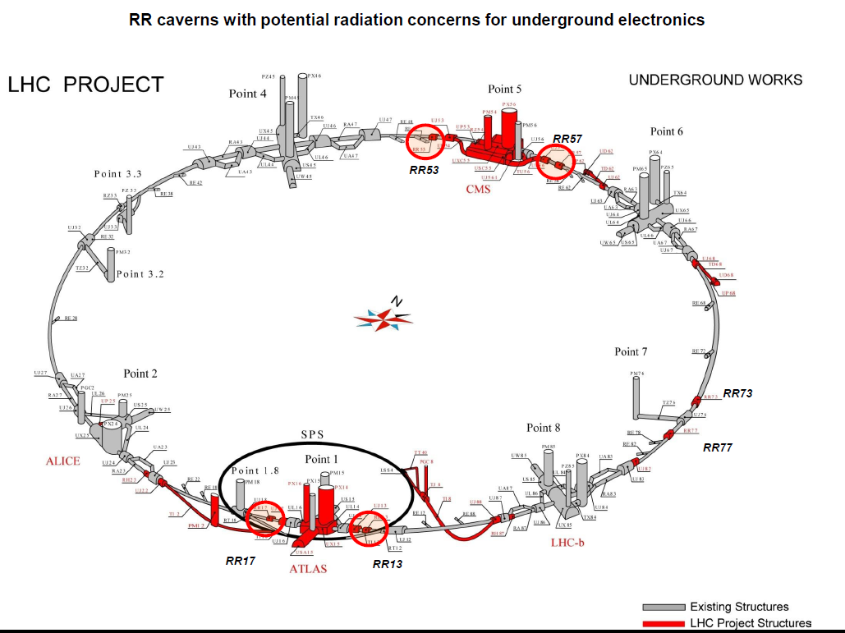
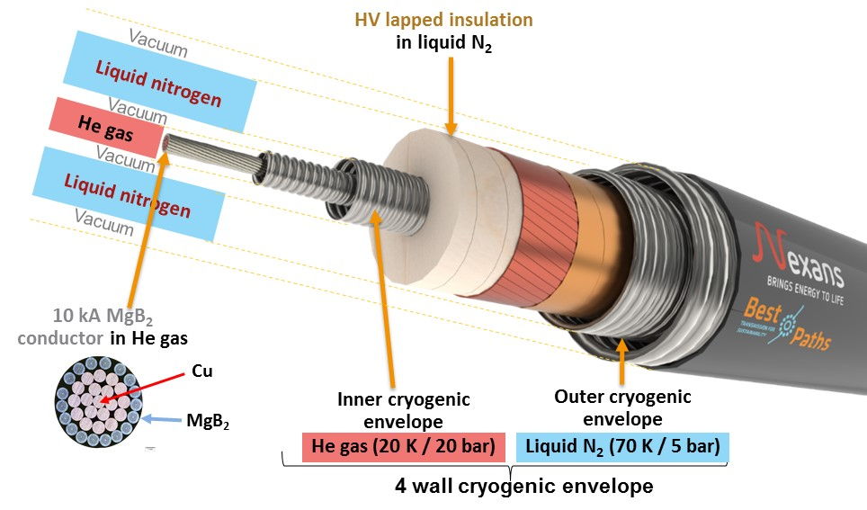
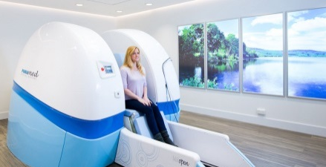
Impact
The improvement of MgB2 superconducting wire performance and quality will extend the market possibilities
The core business of the MgB2 wire is now related to cable for electricity transport (superconducting link project at CERN-HVDC line)
and for low field MRI magnet (Paramed MRI magnets).
Wires with improved characteristic will extend the market to medium-high field MRI and to magnets for scientific experiment (FCC).
This is really a big opportunity for me, it’s giving me the possibility to:
Work in high-technology field industry
Have a training and learning
Local and International networking
Open new possibilities for future employement (companies or reasearch institutes)

Slide 15
Thank you for your attention!

