Slide 1
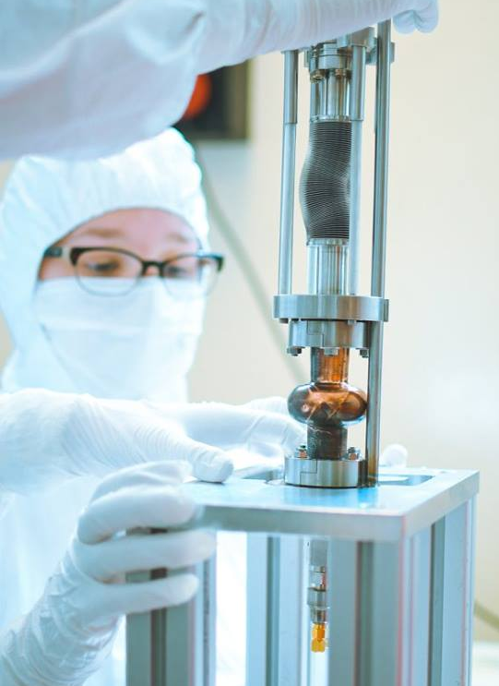

Mid-Term Review
10 December 2018, Brussels
Advanced surface coating techniques for superconducting radiofrequency cavities
Vanessa Andreina, GARCIA DIAZ
ESR 10, WP 3 (Manufacturing)
1

Slide 2

ESR 10, WP 3 - Background
Background: Master in Physics, Caracas-Venezuela. Master in surface treatments for industrial applications, Padova-Italy
Host Institution: INFN – LNL
Contract start date : 01/02/2018
Supervisor: Dr. Cristian Pira
PhD University: Ferrara University
Planned secondments:
  1. I-Cube, Electro-hydro forming technique for seamless cavities, early 2019 for 2 weeks.
  2. CERN, RF characterization, end of 2019 for 2 weeks.
  3. RI, Coated cavities production and efficiency, early 2020 for 2 weeks.
2

Slide 3
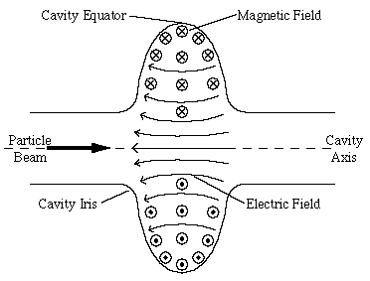
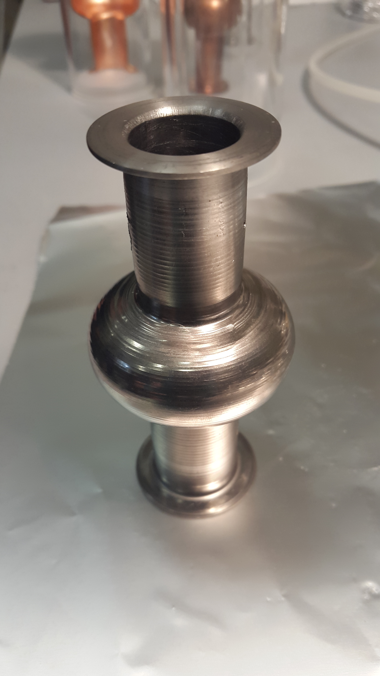
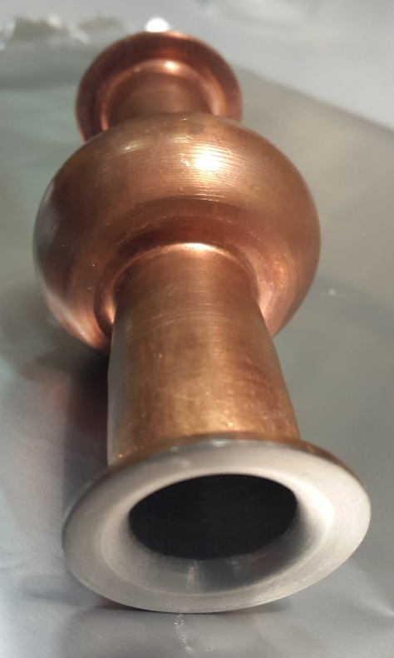
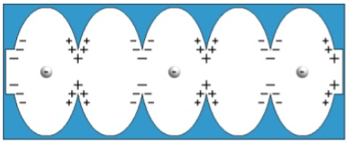
Research, Methodology, Results
& Next Steps
Superconducting Radio Frequency Cavities
Nb bulk 6 GHz Cavity
Nb/Cu 6 GHz Cavity

Slide 4
Research, Methodology, Results
& Next Steps
Cavity Fabrication
Collaboration with I-Cube (ESR-09)
Mechanical Finishing
Improve spinning process
Insert 6 GHz tumbling
Chemical Polishing
PVD process
Study effects of different sputtering parameters
Insert Active magnetic shielding
RF Characterization
Collaboration with CERN (ESR-01) and HZB (ESR-08)

Slide 5
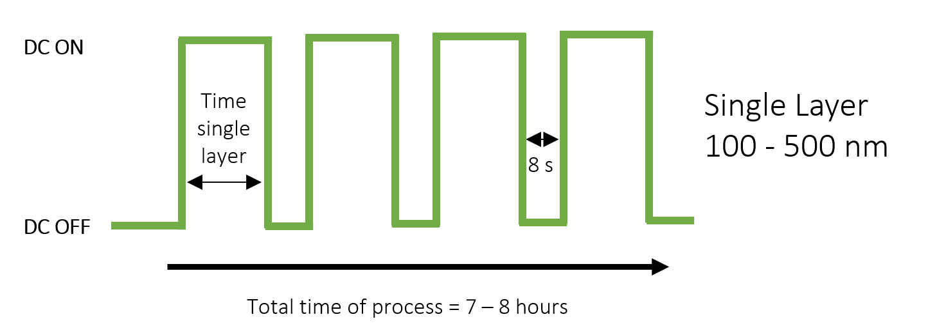
Research, Methodology, Results
& Next Steps
In order to overcome the Q slope on the Nb/Cu cavities, in this research is used a thick film approach in a multilayer deposition mode
Multilayer
Niobium
Niobium
Copper
Total Thickness (on the cell) = 70 µm
4

Slide 6
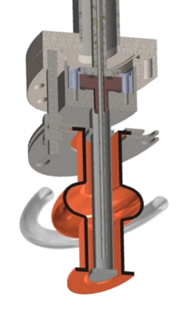
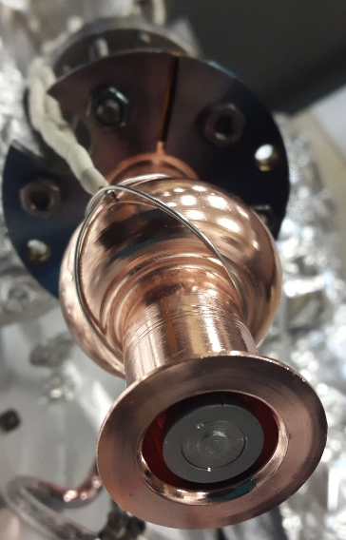
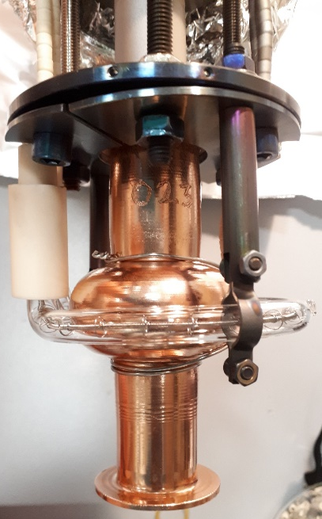
Research, Methodology, Results
& Next Steps
Thermocouple
IR Lamp
Cavity
Target
4

Slide 7
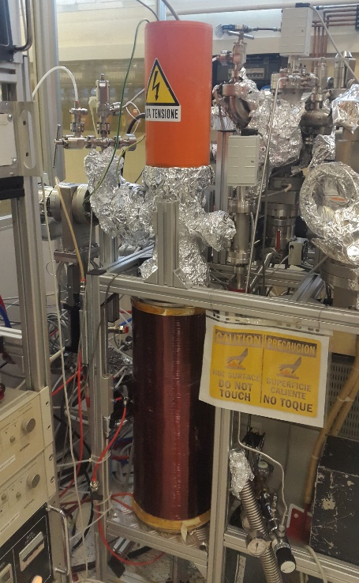
Research, Methodology, Results
& Next Steps
Deposition parameters and system
Baking = 600°C for 48 hours
Temperature = 550 °C
Base pressure < 2 x 10⁻⁹ mbar
Magnetic Field = 830 Gauss
Current = 1 A
6GHz Nb/Cu Cavity

Slide 8
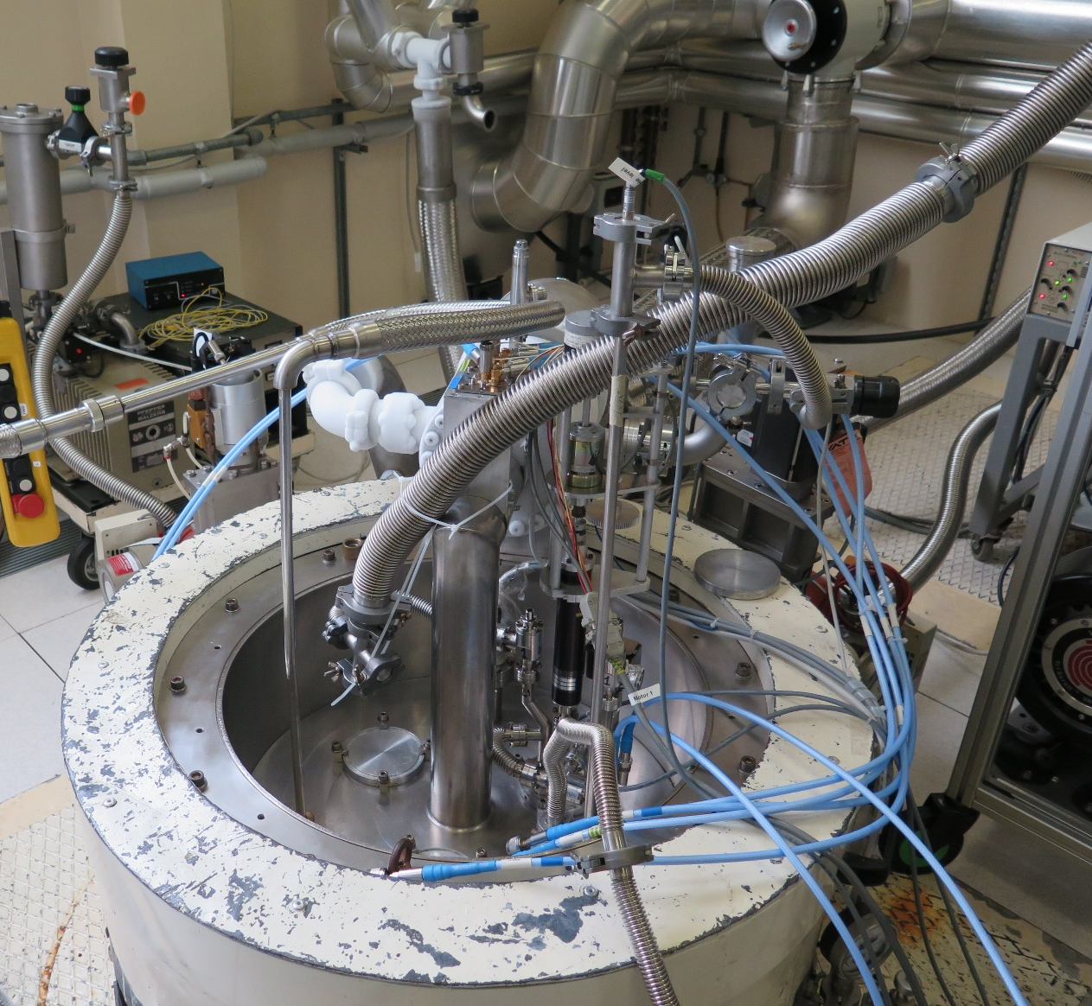
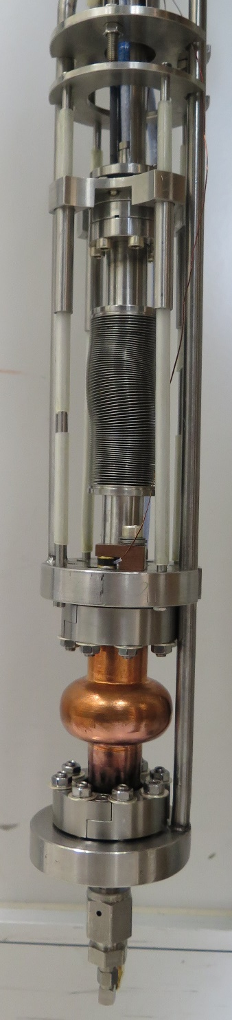
Research, Methodology, Results
& Next Steps
RF characterization
At 4,2K and 1,8K
5

Slide 9
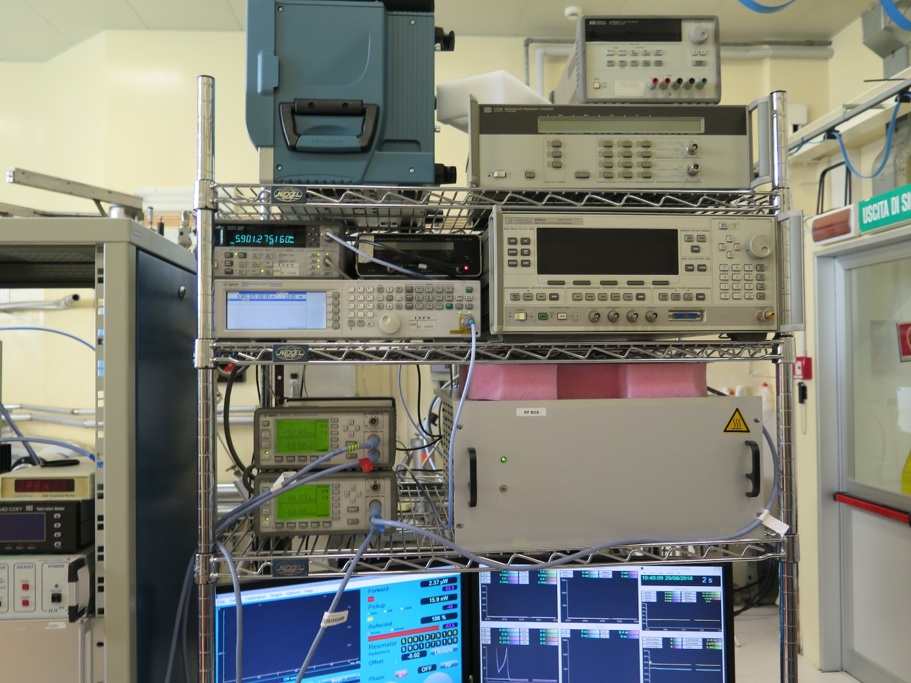
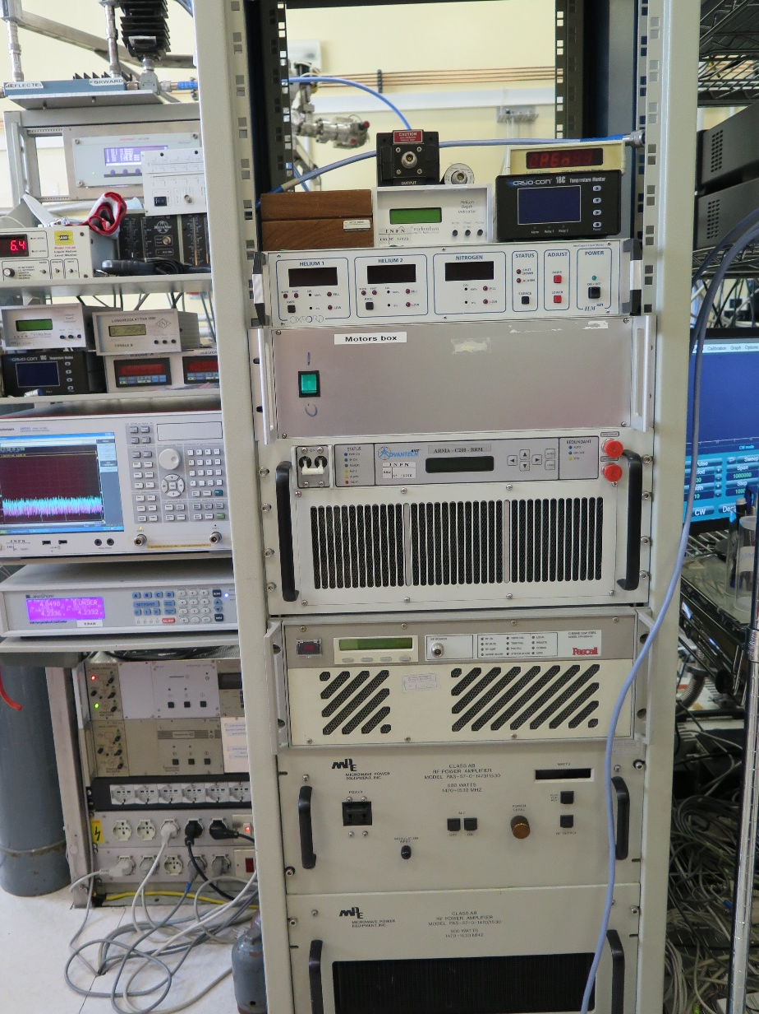
Research, Methodology, Results
& Next Steps
RF characterization
At 4,2K and 1,8K
5

Slide 10
Research, Methodology, Results
& Next Steps
6GHz
5

Slide 11

Research, Methodology, Results
& Next Steps
4,2K
5

Slide 12
Research, Methodology, Results
& Next Steps
1,8K
5

Slide 13
Research, Methodology, Results
& Next Steps
1,8K
Higher Q₀ for 500nm thickness single layer Cav 21
5

Slide 14
Research, Methodology, Results
& Next Steps
1,8K
Higher E_{acc} for 400nm thickness single layer Cav 18

Slide 15
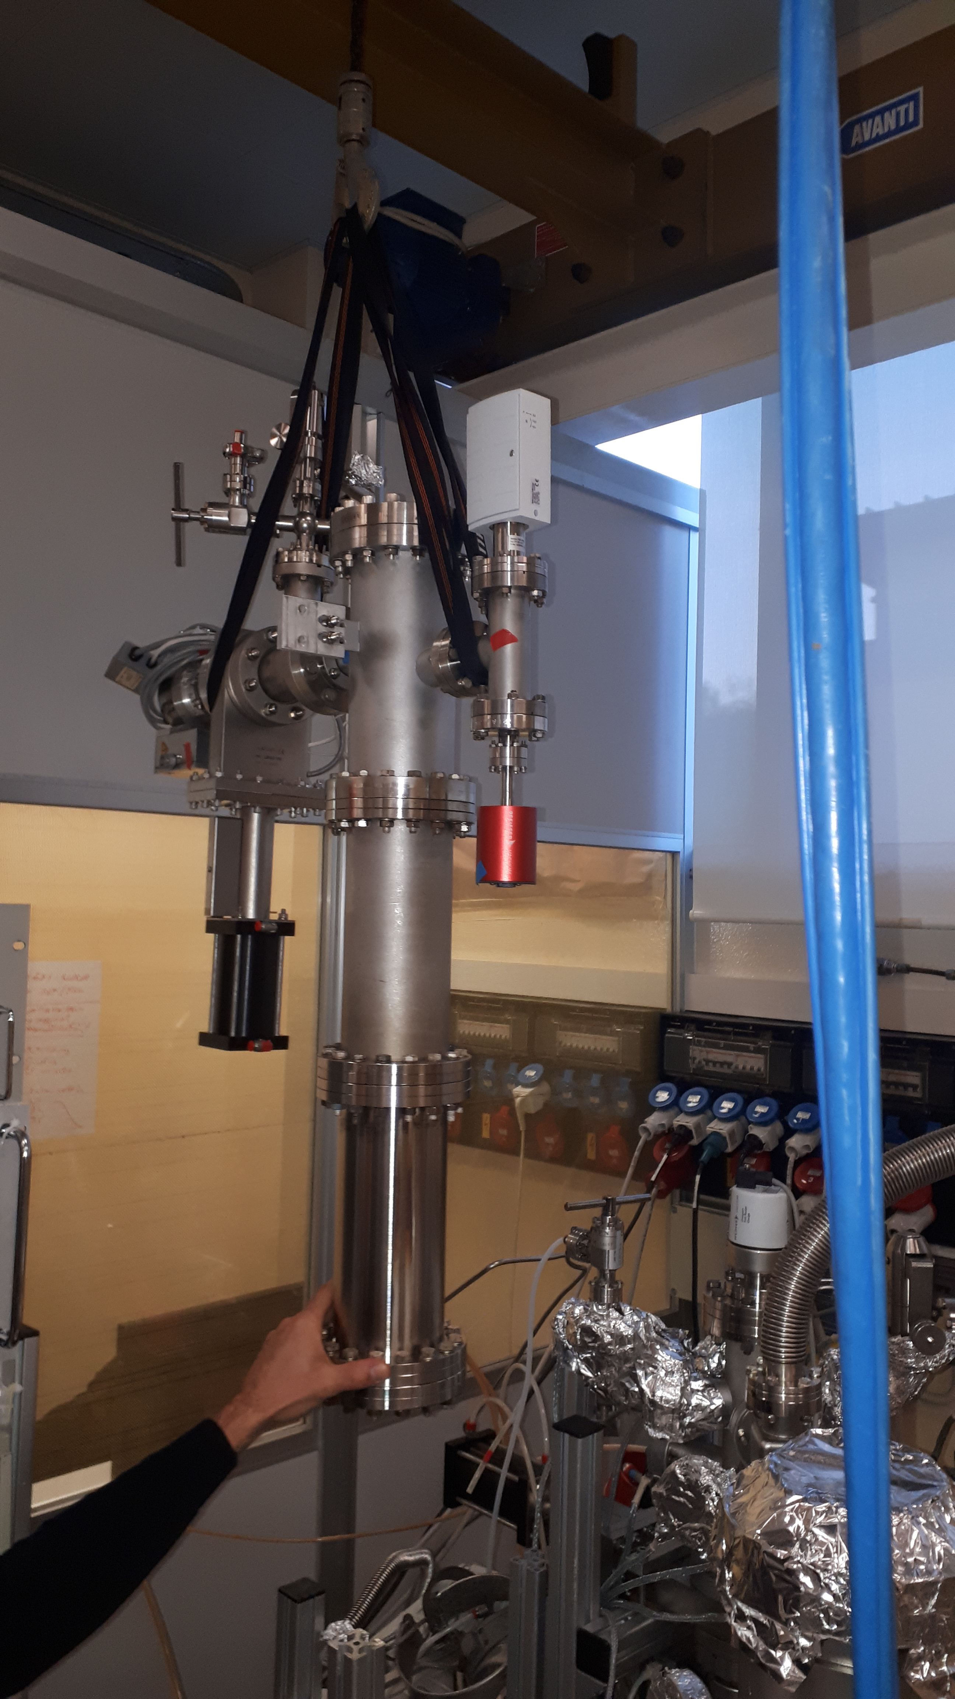
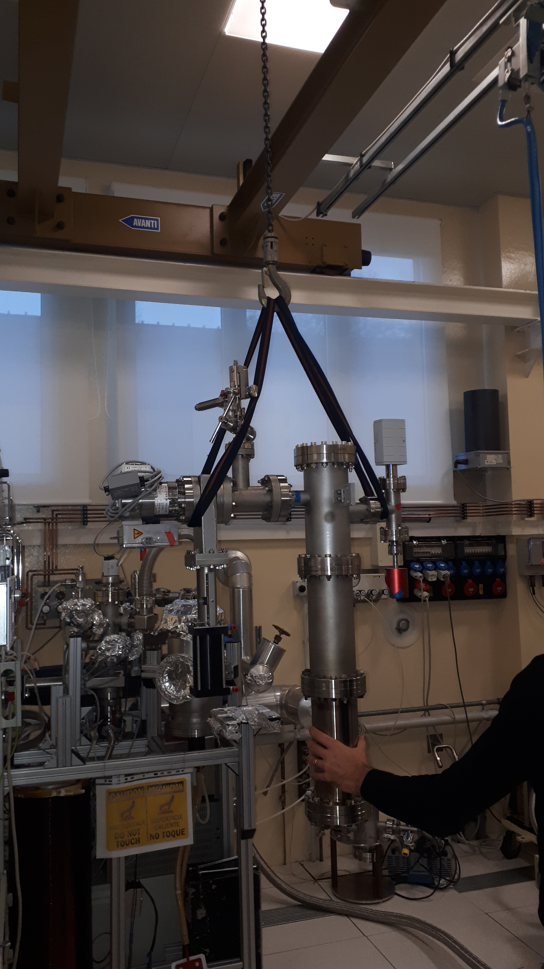
Research, Methodology, Results
& Next Steps
Vacuum chamber
Refurbishing of deposition system
Vacuum chamber

Slide 16
Research, Methodology, Results
& Next Steps
Vibro-tumbling and active shielding techniques are being studied and will be installed as a part of our protocol
6

Slide 17
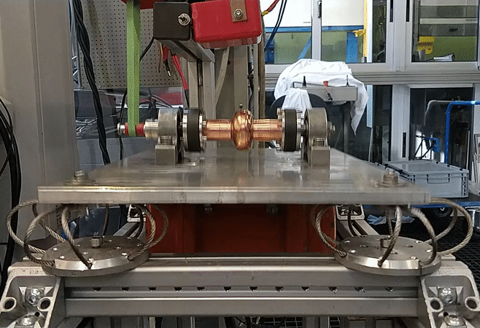
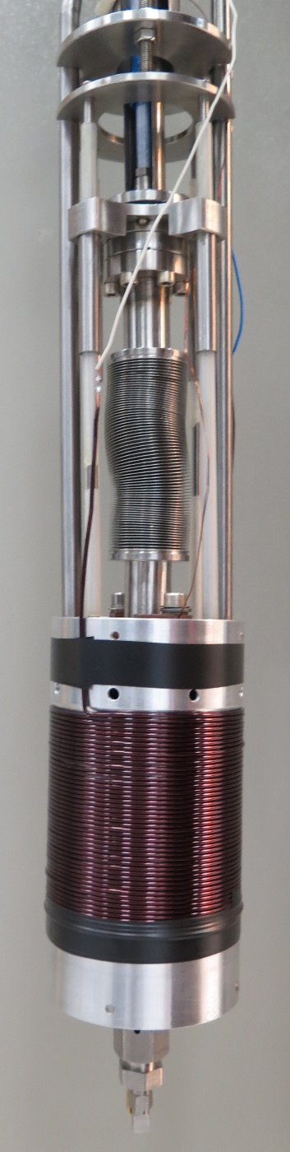
Research, Methodology, Results
& Next Steps
Active magnetic shielding
Rotation
Vibro-tumbling
Vibration
Reproducibility issue
Understand trapped magnetic flux
6

Slide 18
Research, Methodology, Results
& Next Steps
Vibro-tumbling and active shielding techniques are being studied and will be installed as a part of our protocol
Deposition of different thickness in multilayer mode and N – doping
Implementation of post sputtering treatments such as baking before RF characterization
6

Slide 19
Training, conferences and Workshops
Tesla meeting (Milano, February)
FCC week (Amsterdam, April)
EASITrain Lectures Spring (CERN, March)
EASISchool (Wien, September)
8th International Workshop on Thin Films and new ideas for pushing the limits of RF superconductivity (Legnaro, October). Member of the organizing committee.
TTC/ARIES topical workshop on flux trapping and magnetic shielding (CERN, November)
Safety courses. English and Italian Course

Slide 20
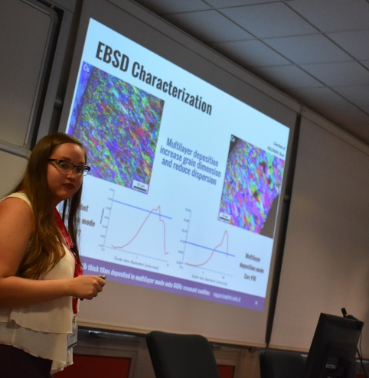
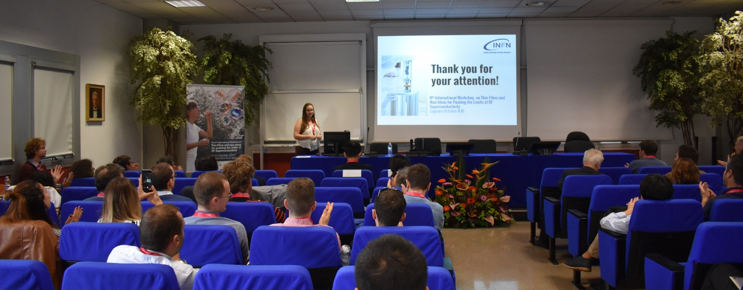
Outreach, Dissemination
& Networking
Presentation in conferences:
  FCC week
  8th International Workshop on Thin Films and new ideas for pushing the limits of RF Superconductivity
6

Slide 21
Outreach, Dissemination
& Networking
Presentation in conferences:
  FCC week
  8th International Workshop on Thin Films and new ideas for pushing the limits of RF Superconductivity
Dissemination to high school students as part of their stages at LNL-INFN
Guidance to cryogenic laboratory during Thin Film Workshop at LNL-INFN
6

Slide 22
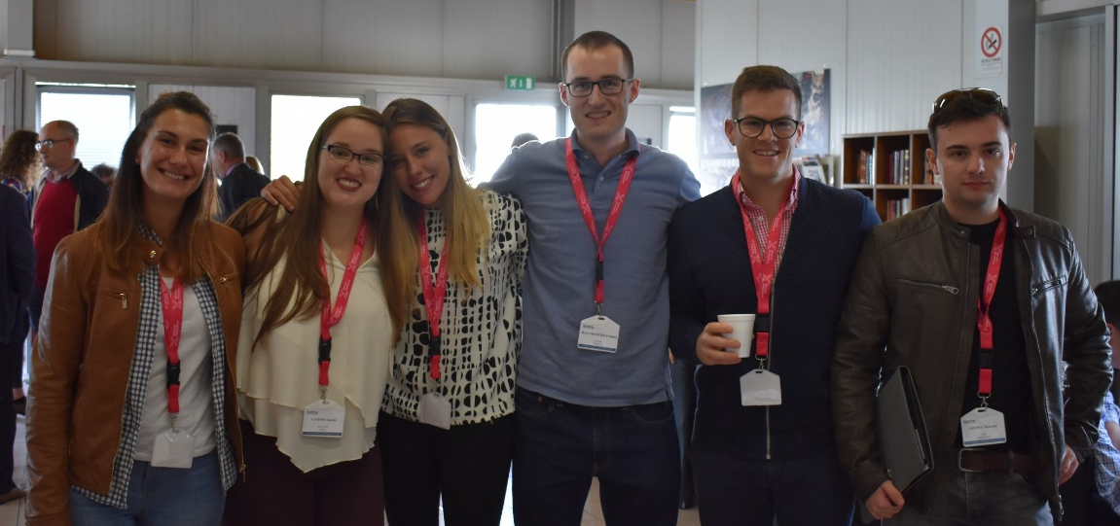
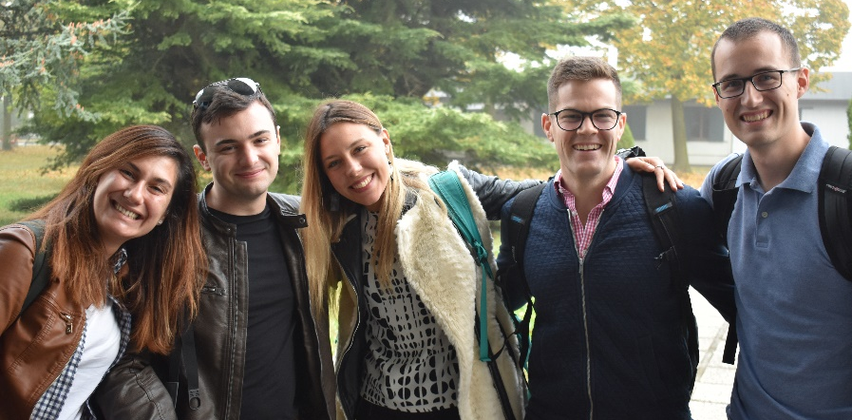
Outreach, Dissemination
& Networking
Presentation in conferences:
  FCC week
  8th International Workshop on Thin Films and new ideas for pushing the limits of RF Superconductivity
Dissemination to high school students as part as their stages at LNL-INFN
Guidance to cryogenic laboratory during Thin Film Workshop at LNL-INFN
Guidance to ESR 01, 08, 09, 14 in the Material Science and Technologies for Nuclear Physics Service at LNL-INFN.
ESR01
ESR09
ESR08
ESR12
ESR14
ESR01
ESR10
ESR12
ESR09
ESR14
ESR08
6

Slide 23
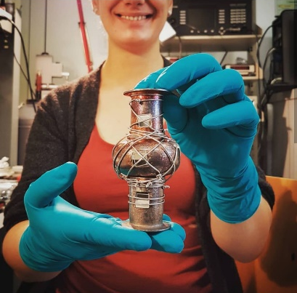
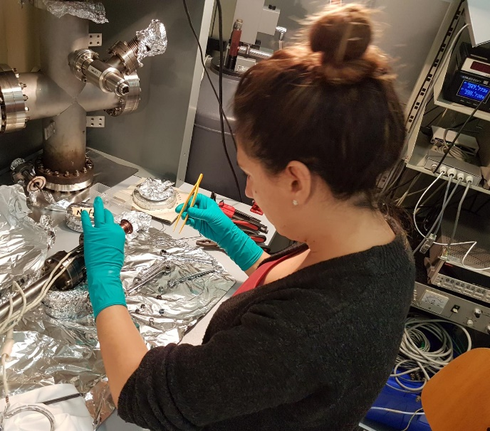
Outreach, Dissemination
& Networking
Presentation in conferences:
  FCC week
  8th International Workshop on Thin Films and new ideas for pushing the limits of RF Superconductivity
Dissemination to high school students as part as their stages at LNL-INFN
Guidance to cryogenic laboratory during Thin Film Workshop at LNL-INFN
Guidance to ESR 01, 08, 09, 14 in the Material Science and Technologies for Nuclear Physics Service at LNL-INFN.
Guidance during ESR01 secondment at LNL-INFN
ESR 01
Dorothea Fonnesu
6

Slide 24
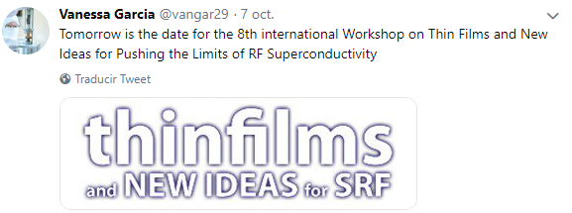
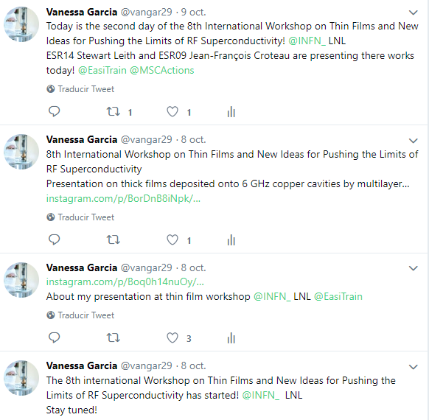
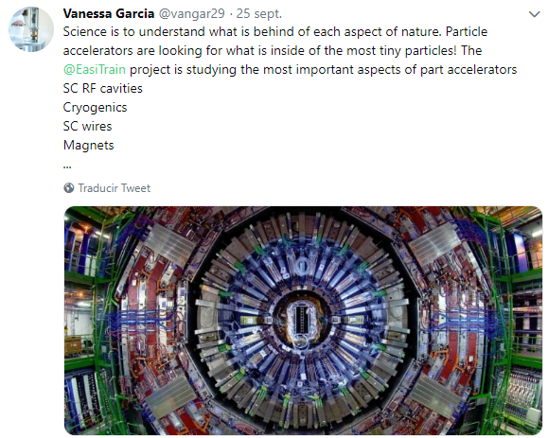
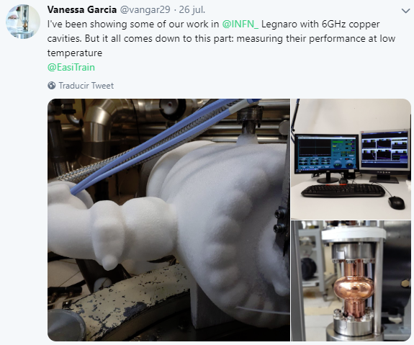
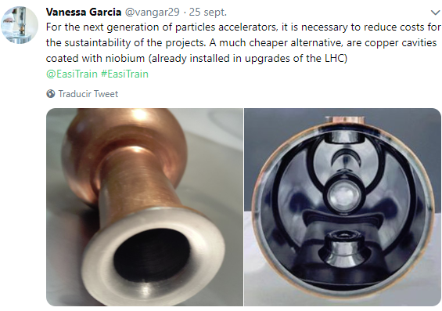
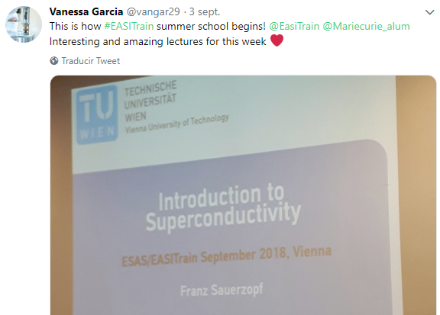
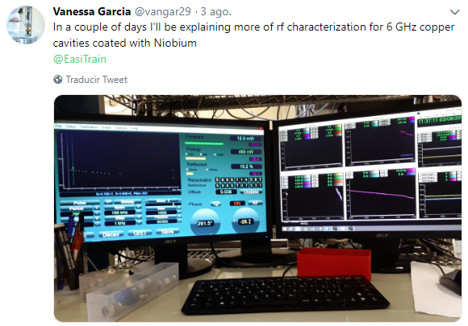
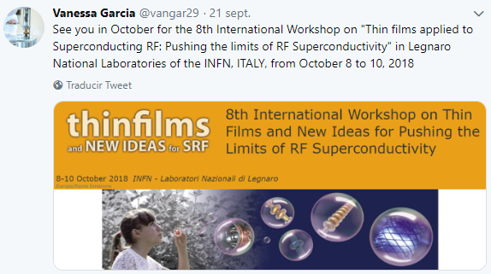
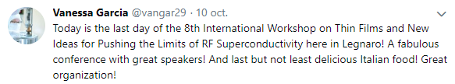
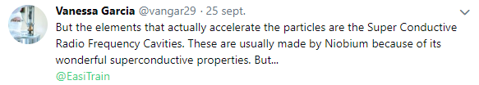
Outreach, Dissemination
& Networking
Constant dissemination in social media: Twitter
6

Slide 25
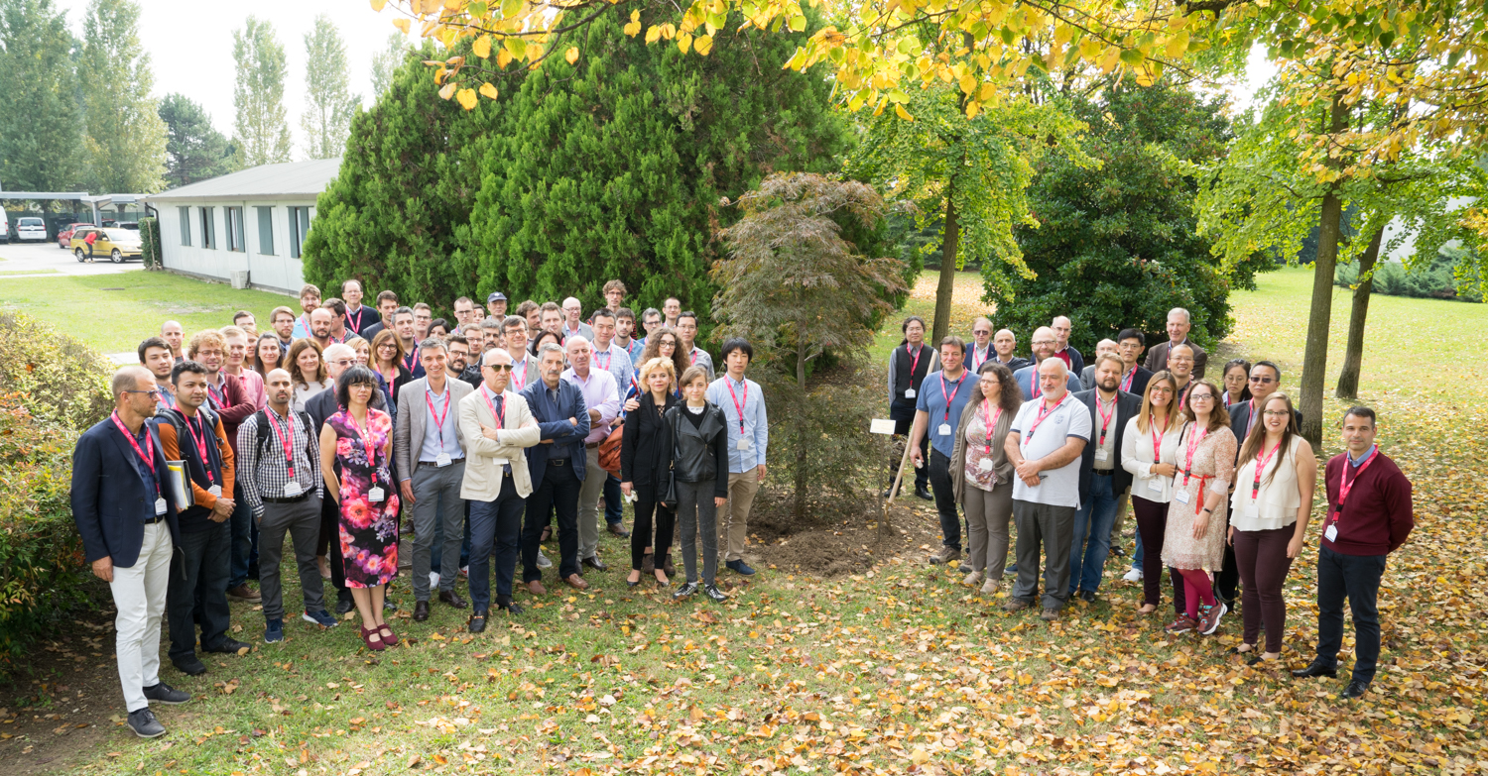
Outreach, Dissemination
& Networking
Constant networking due to constant collaborations between lab and industry or others research groups.
Wide networking during workshops and conferences.
8th International Workshop on Thin Films and new ideas for pushing the limits of RF Superconductivity
6

Slide 26
Impact
Medical physics
Cancer treatments and imaging
Industrial applications
Change mechanical properties of materials
Research
Fundamental physics research
Material identification
Non destructives methods
7

Slide 27
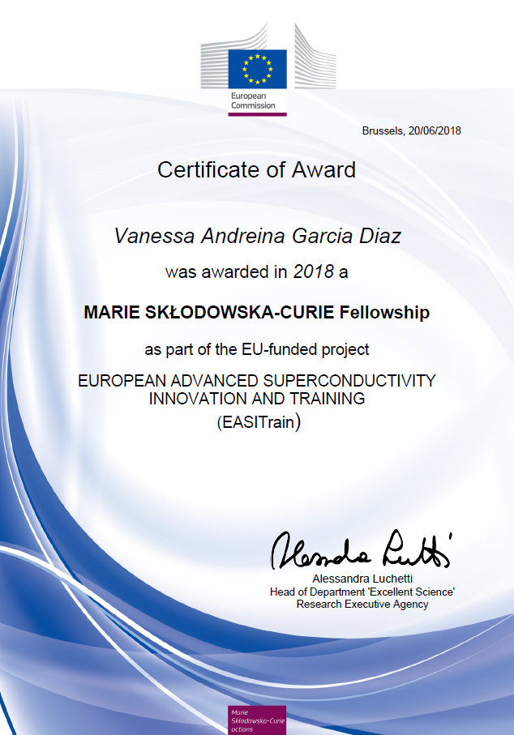
Impact
Learned:
How to push myself out of the comfort zone
Different languages
How to work in a international and collaborative environment
Different cultures
Give presentations
… and still learning
Being where I want to be in the scientific field
Traveling and getting to know a lot of people
7

Slide 28
Conclusions
The project at INFN-LNL has started successfully.
The PhD has started at Ferrara University.
The project has been an opportunity to be part of a scientific community.
Conferences and workshop are fundamental for the networking.
Dissemination is a fundamental part of being a scientist.
Being a Marie Curie Fellow in EASITrain has been an
incredible experience!

Slide 29
Thank you!

