Slide 1


Mid-Term Review
10th of December 2018, Brussels
Sofiya Savelyeva
ESR11, WP4
Institution: Technical University of Dresden
Supervisor: Prof. Dr. Christoph Haberstroh

Slide 2

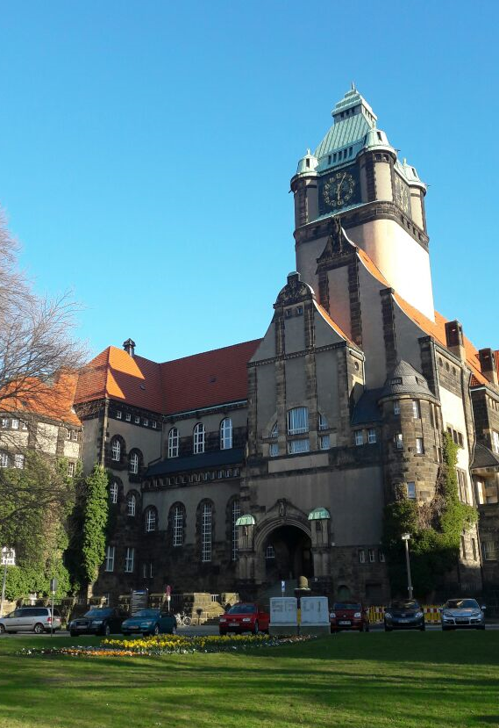

Background & Recruitment
Home country: Russia
Field: Cryogenics
Education: Bauman Moscow State Technical University
Work experience: Engineer in the cryogenic laboratory of Bauman University, 2014-2017
Hosting country: Germany
Host institute/PhD University: Technische Universität Dresden
EASITrain Supervisor/PhD Supervisor: Prof. Dr. Christoph Haberstroh
Contract start - end date: 01.02.2018 – 31.01.2021
Current employment period: 10 months
EASITrain Project title: “Development and efficiency assessment of a Nelium refrigeration cycle”
Georg-Schumann-Bau
of the TU Dresden

Slide 3
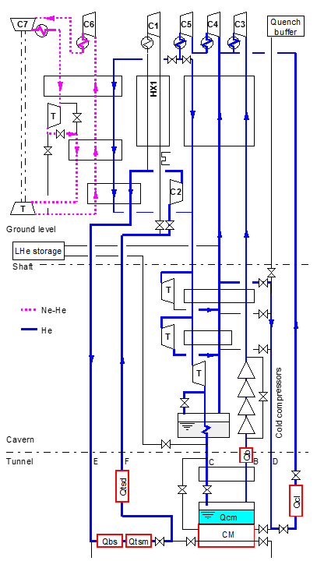
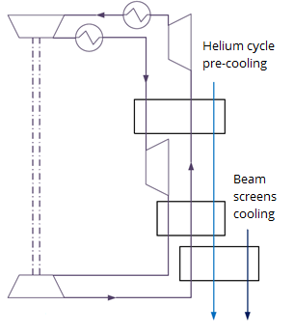
Project subject
Subject: Nelium (neon-helium) Turbo-Brayton cycle
Application: part of the FCC cryogenic system (the beam screens and thermal shield cooling and Helium cycle pre-cooling)
Reasons for research:
unconventionally high cooling capacity required at 40 K temperature level: 680 kW
development of new promising cryogenic technology: more efficient than the conventional helium cycle thanks to turbo-compressors application (10 % higher Carnot efficiency)
industrial application: superconducting cables cooling (40-77 K)
Nelium cycle
FCC-hh cryogenic layout
(L. Tavian, S. Klöppel)

Slide 4




Project Objectives
Improving the cooling system for beam screens, thermal shields and the Helium cycle pre-cooling, using Nelium Turbo-Brayton cycle – in cooperation with CEA (ESR 4), CERN
Industrial applications of cryogenic mixture cycles below 80 K – in cooperation with Linde AG (München), Linde Kryotechnik (Pfungen) – secondment in 2019
Development of turbo-compressors for the light gases – in cooperation with University of Stuttgart (ESR 15)

Slide 5
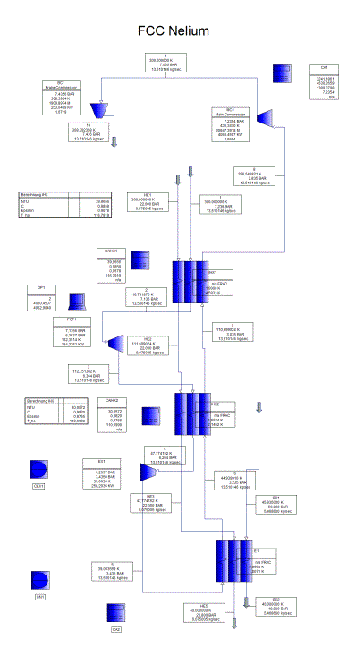
Current status - Research
Work performed:
Review of literature and previously done work
Cycle simulation in PRO II
Neon market analysis and fluid composition improvement
Neon production process study – possible alternative mixture composition found
Neon-helium mixture composition influence on the cycle parameters and components (in progress)
Screenshot of the cycle simulation in PRO II

Slide 6
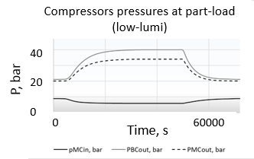
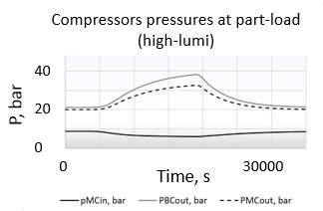
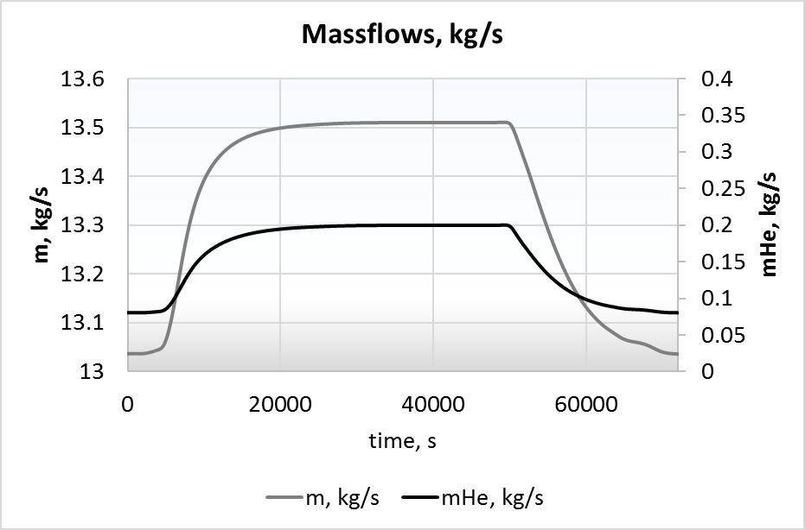
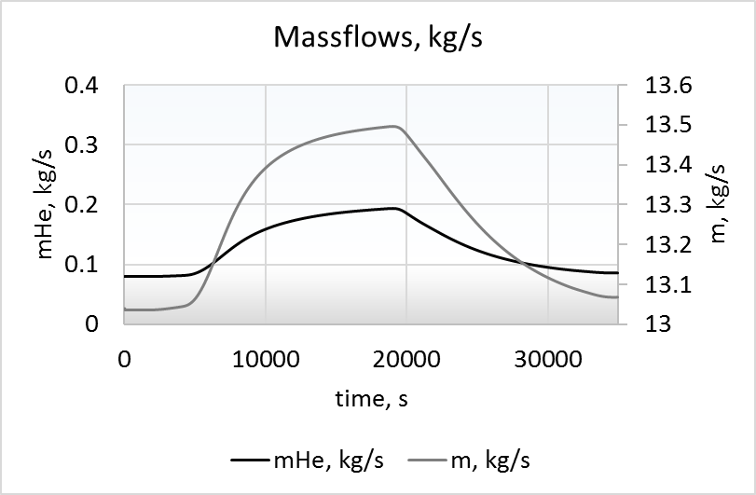
Current status - Research
Part-load operation model – for updated mixture composition and Helium cycle precooling
Compressor model
Cycle model in PRO II
Cycle parameters for
components design
Time, s
– P mc in, – Pbc out, -- Pmc out
– P mc in, – Pbc out, -- Pmc out
Inputs for ESR 15
(compressor design)

Slide 7
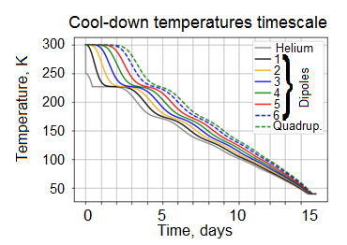
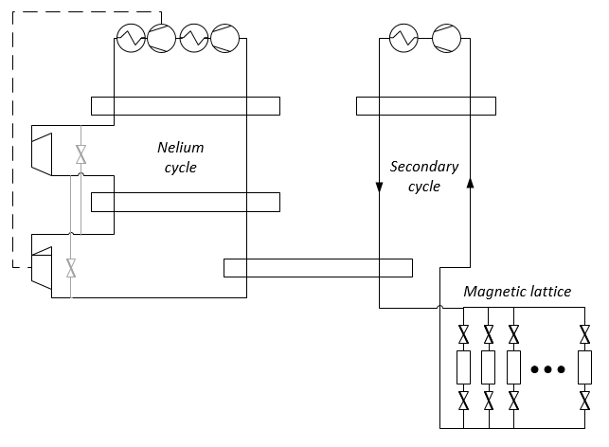
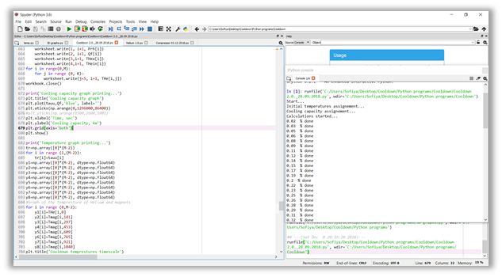
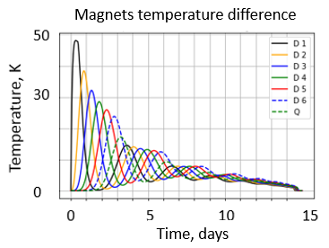
Current status - Research
Simulation results
Cool-down operation model in Python – for magnets and secondary cycle (for the Nelium cycle – in progress)
Cool-down operation flow diagram
Programming in Python

Slide 8
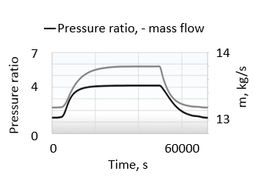
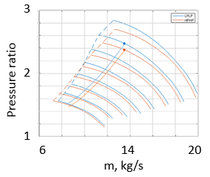
Current status - Cooperation
Main compressor pressure ratio and massflow (low-lumi)
Main compressor operation map
University of Stuttgart (ESR 15)
preparation for the compressor test rig setup
and common experiment from March 2019
inputs for the main compressor design
email correspondence; Skype meetings
Linde AG, Munich/Linde Kryotechnik, Pfungen
industrial conventional and turbo Brayton cycles comparison;
neon production process study – common paper is planned for Cryogenics 2019 conference;
regular internal Skype meetings (once per month)
secondment
LP
HP
Inputs
M. Podeur (ESR 15)
Industrial conventional and Turbo-Brayton cycles compared
Unit name | LIPA I | Mayekawa | NeoKelvin |  | Air Liquide
Cooling power | 4 kW | 5 kW | 2 kW | 10 kW | 7-150 kW
Fluid | He | Ne | Ne | Ne | Ne
Power consumptions | 41 kW | 52 kW | 55 kW | 170 kW | 85-1200 kW

Slide 9
Next steps
Further cycle design and operational modes improvements
Hardware specification
Industrial approach – cycle scaling for different mixtures and temperatures below 80 K – secondment at Linde Kryotechnik in 2019
Study of turbo-compressor performance in cryogenic cycles with the light gases:
common work on the test rig (~15 kW) with ESR 15 at the University of Stuttgart from March 2019 (sensors installation, getting system running, data analysis)
implementation of the turbo-compressor model to cycle calculations
repeated stays at USTUTT

Slide 10
Training, Conferences
& Workshops
Trainings:
Conferences/Workshops:
EASITrain lectures spring 2018 | CERN, Geneva |  | 03.03.-23.03.2018
Workshops on superconducting cables, magnet testing, treatment surface chemistry, cryogenics, manufacturing, project management
EASIschool 2018 | Vienna |  | 03.09.-14.09.2018
Course on applied superconductivity, project management course, media training, innovation management
LabView course |  | TU Dresden | 16.04.-18.04.2018
German, upper-intermediate |  | TUDIAS, Dresden | 04.04.-25.07.2018
German, pre-advanced |  | Goethe Institute, Dresden | 18.09.-30.11.2018
FCC Week 2018 | Amsterdam | 09.04.-13.04.2018
PhD Seminar | Bad Schandau | 21.10.-23.10.2018
DKV Conference | Aachen | 21.11.-23.11.2018

Slide 11
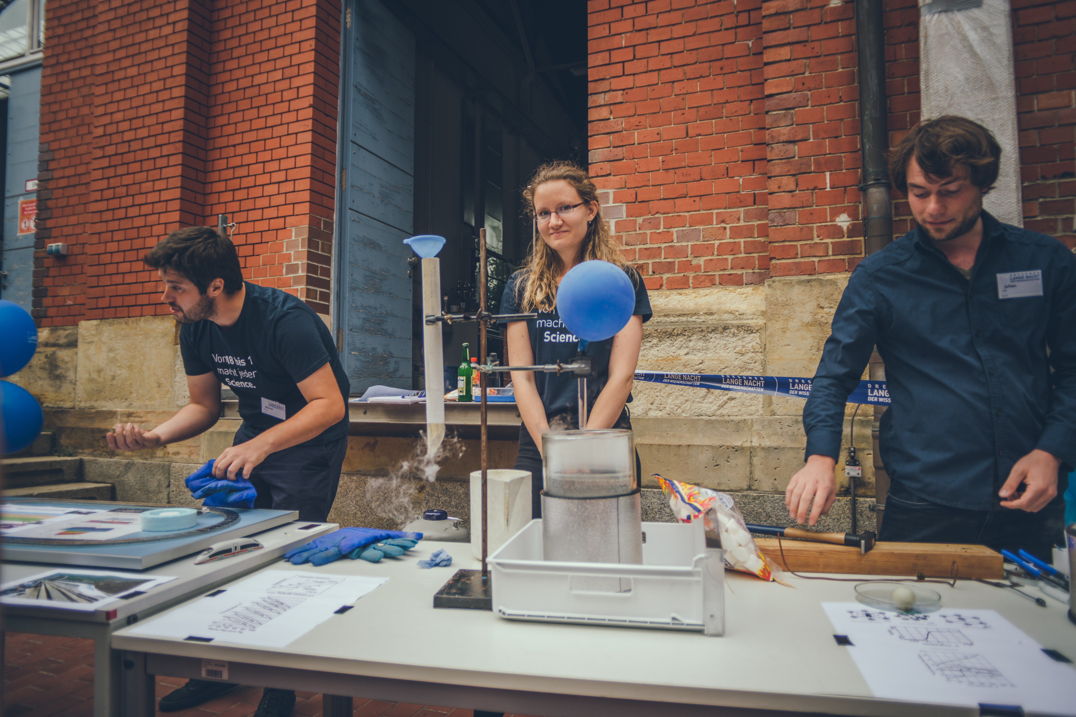
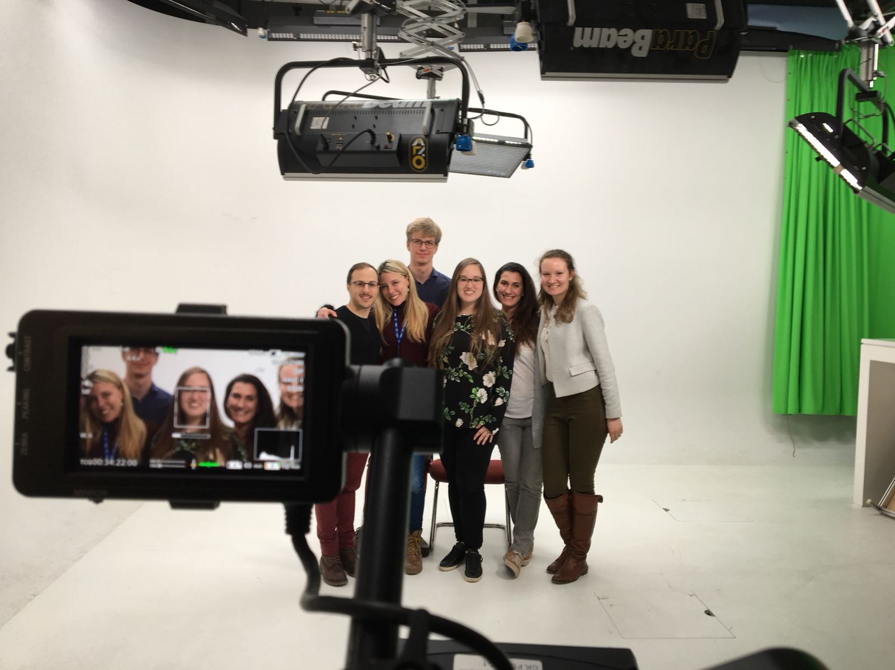
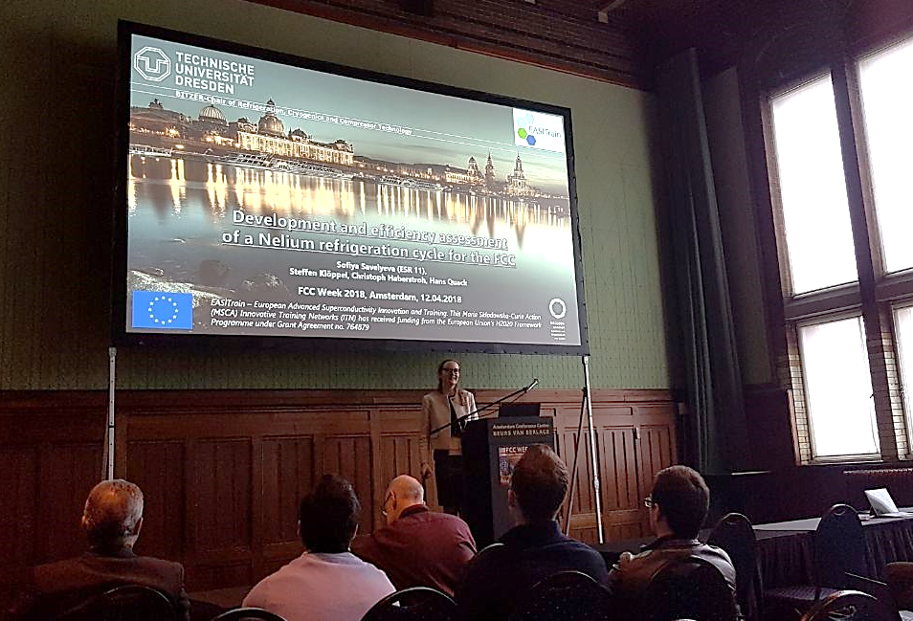
Outreach, Dissemination
& Networking
Lond Night
of Science
Outreach activities
  Video Interview, CERN, March 2018
  International Refrigeration and Compressor Course,
  TU Dresden, 21.05. - 25.05.2018
  Long Night of Science, TU Dresden, 14.06.2018
Presentations:
  FCC Week 2018, Amsterdam, 12.04.2018
  PhD seminar, TU Dresden, 21.10.-23.10.2018
Networking activities
  FCC meetings, meetings with companies, conferences, EASITrain meetings incl. social events
  Project cooperation with other ESRs and industry
CERN Video
Interview
FCC Week 2018

Slide 12
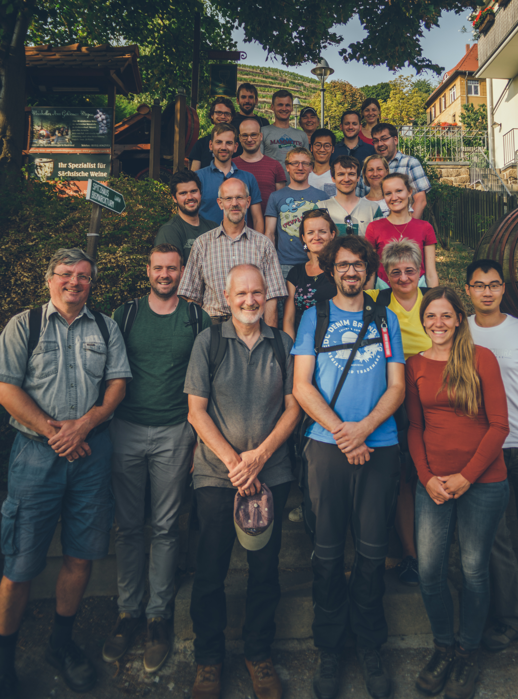
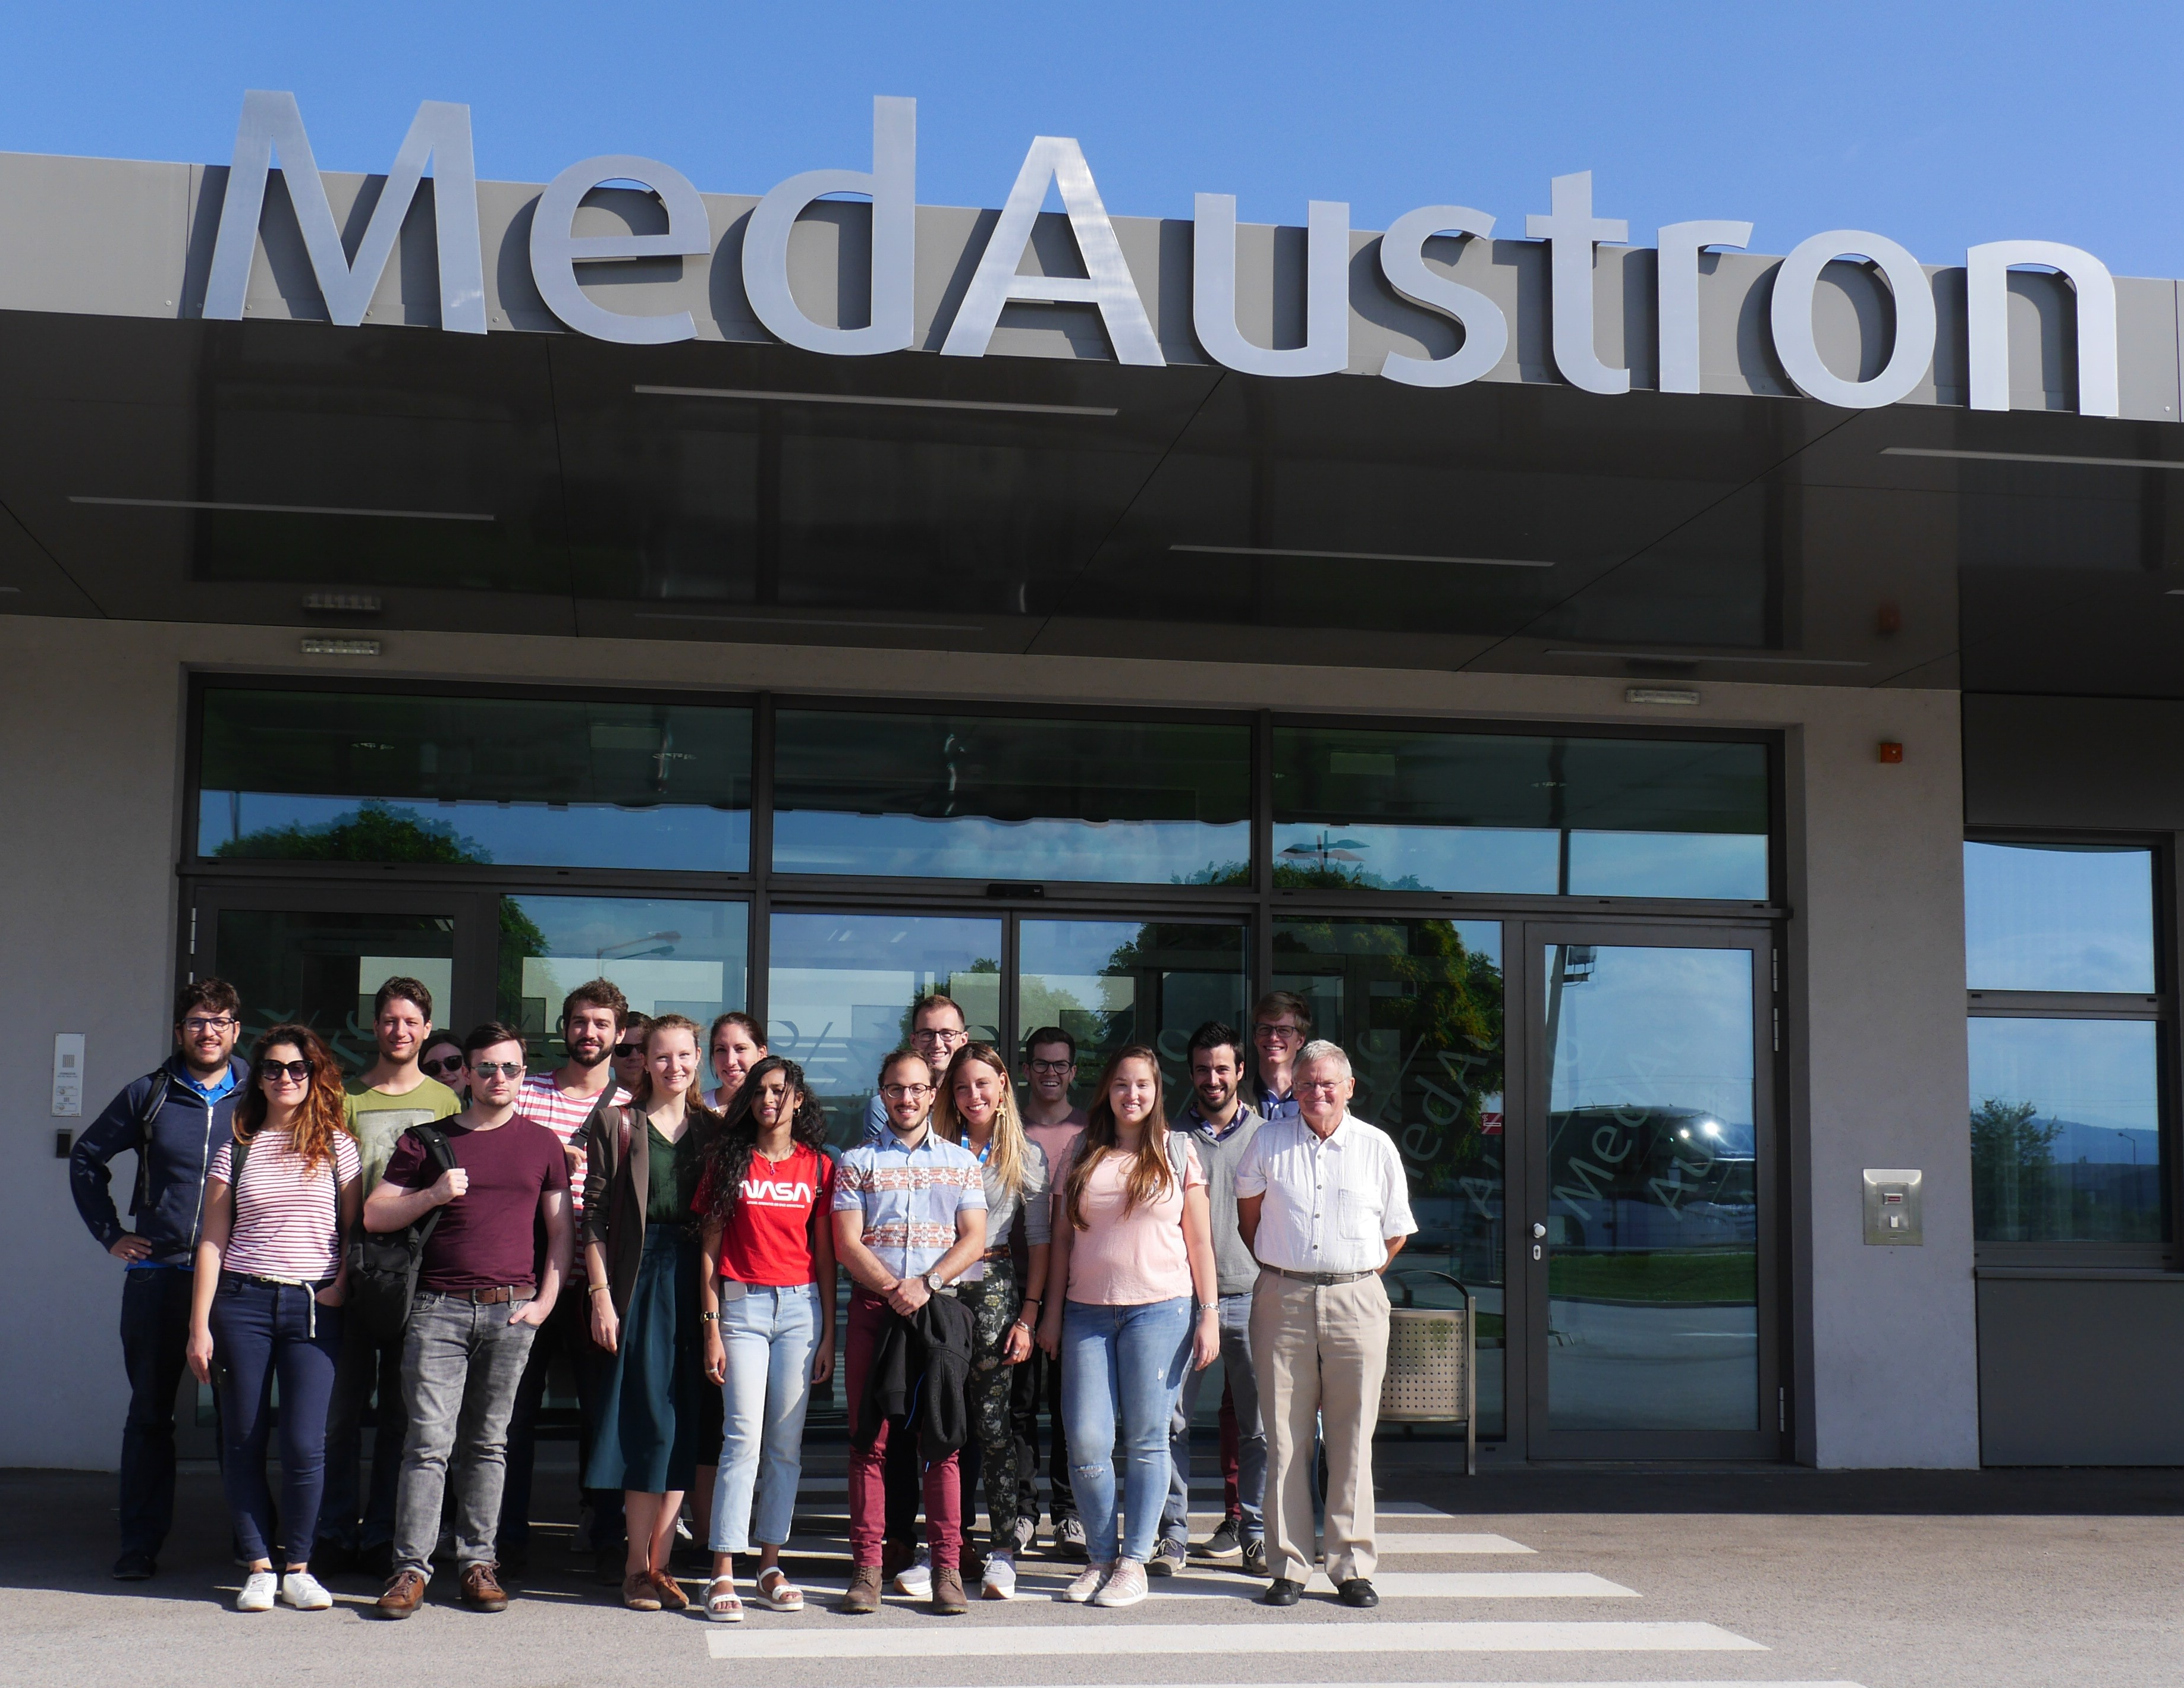
Impact
Personal impact of MSCA fellowship :
Open the border to the research society of Europe
PhD project in cooperation with research institution + industry
Technical/non-technical trainings
Mobility (secondments, schools, scientific events attendance)
Access to facilities closed for public
TUD
team
Scientific Network
Multicultural environment
Future career plans:
Research & Development in industry
or
Academic career
EASITrain
team

Slide 13

Thank you for your attention!
Sofiya, Savelyeva
ESR11, WP4
Mid-Term Review
10th of December 2018, Brussels

