Slide 1



Mid-Term Review
10 December 2018, Brussels
Mattia, ORTINO
ESR13, WP2
ESR13, WP2

Slide 2


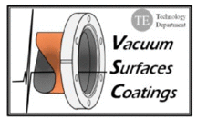

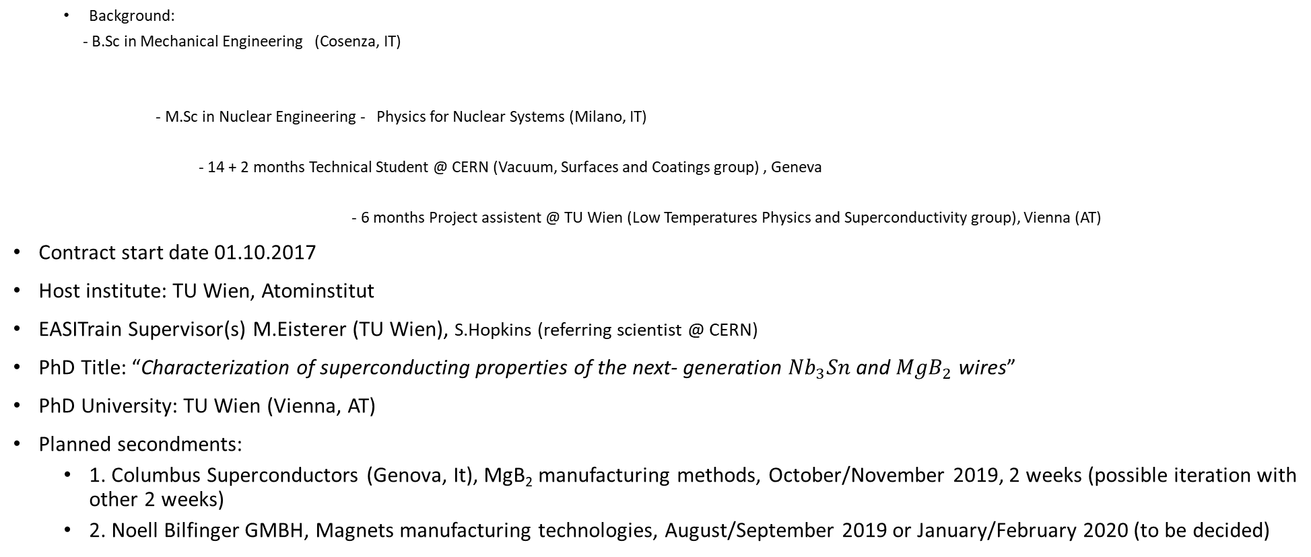
ESR13, WP2 - Background
2010
  Background:
  - B.Sc in Mechanical Engineering (Cosenza, IT)
  - M.Sc in Nuclear Engineering - Physics for Nuclear Systems (Milano, IT)
  - 14 + 2 months Technical Student @ CERN (Vacuum, Surfaces and Coatings group) , Geneva
  - 6 months Project assistent @ TU Wien (Low Temperatures Physics and Superconductivity group), Vienna (AT)
Contract start date 01.10.2017
Host institute: TU Wien, Atominstitut
EASITrain Supervisor(s) M.Eisterer (TU Wien), S.Hopkins (referring scientist @ CERN)
PhD Title: “Characterization of superconducting properties of the next- generation ${Nb}_{3}Sn$ and ${MgB}_{2}$ wires”
PhD University: TU Wien (Vienna, AT)
Planned secondments:
  1. Columbus Superconductors (Genova, It), MgB₂ manufacturing methods, October/November 2019, 2 weeks (possible iteration with other 2 weeks)
  2. Noell Bilfinger GMBH, Magnets manufacturing technologies, August/September 2019 or January/February 2020 (to be decided)
2017
ESR13, WP2
1

Slide 3
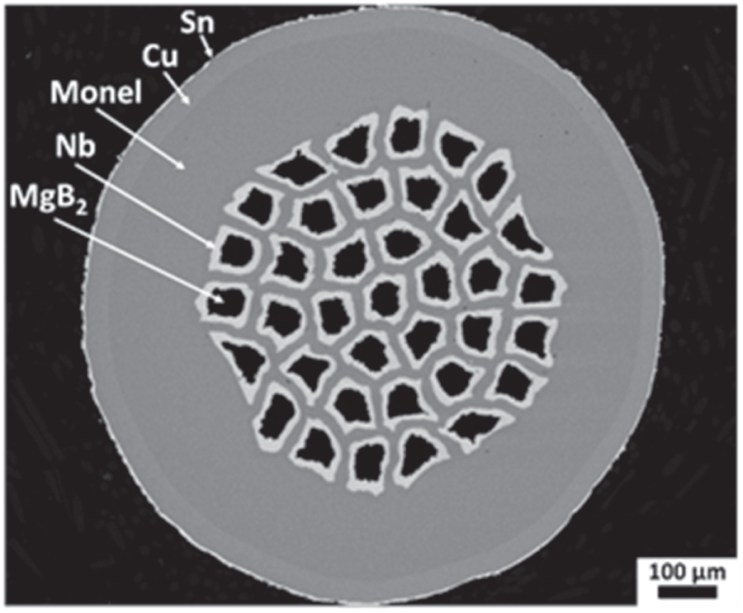
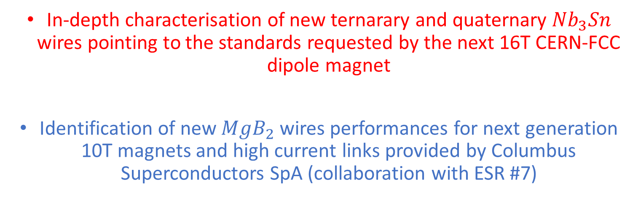
Role in the Project
& Objectives
The ESR13 receives the superconducting samples manufactured by the companies inside the network (or inside the FCC-collaboration), with the aim of characterizing and understanding how to improve their performances
In-depth characterisation of new ternarary and quaternary ${Nb}_{3}Sn$ wires pointing to the standards requested by the next 16T CERN-FCC dipole magnet
Identification of new ${MgB}_{2}$ wires performances for next generation 10T magnets and high current links provided by Columbus Superconductors SpA (collaboration with ESR #7)
ESR13, WP2
2

Slide 4

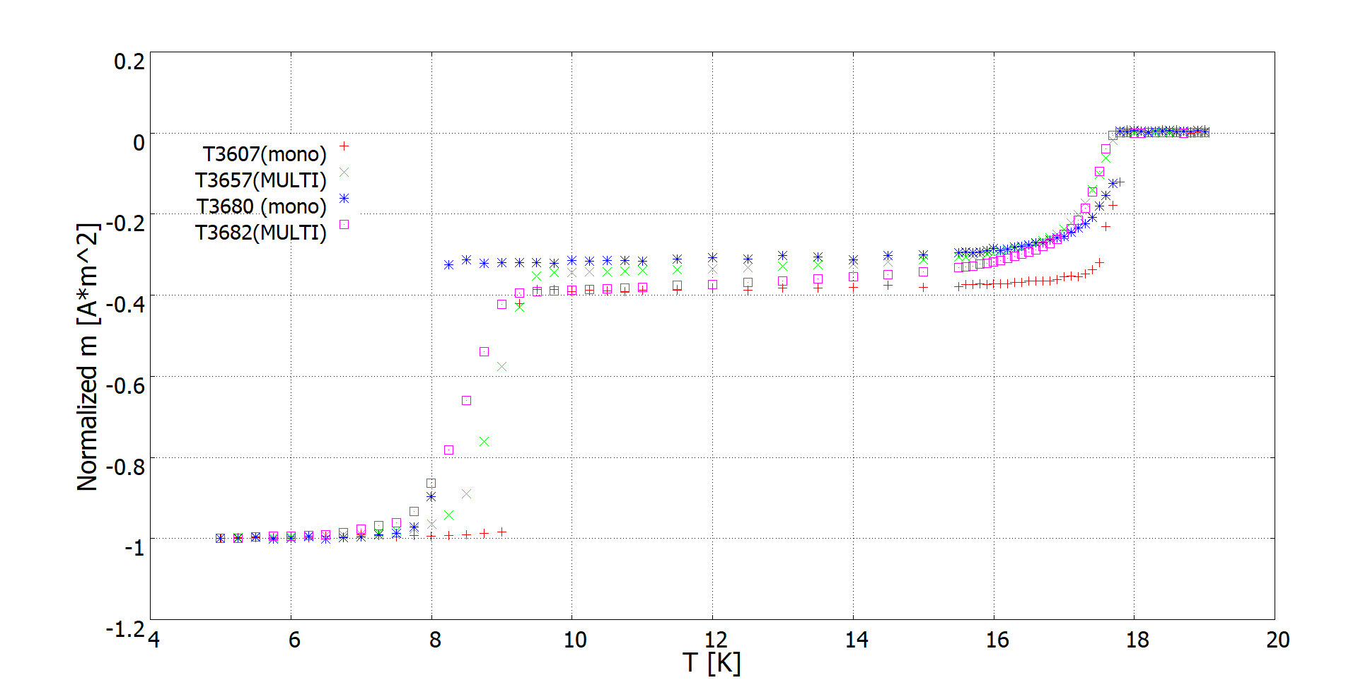
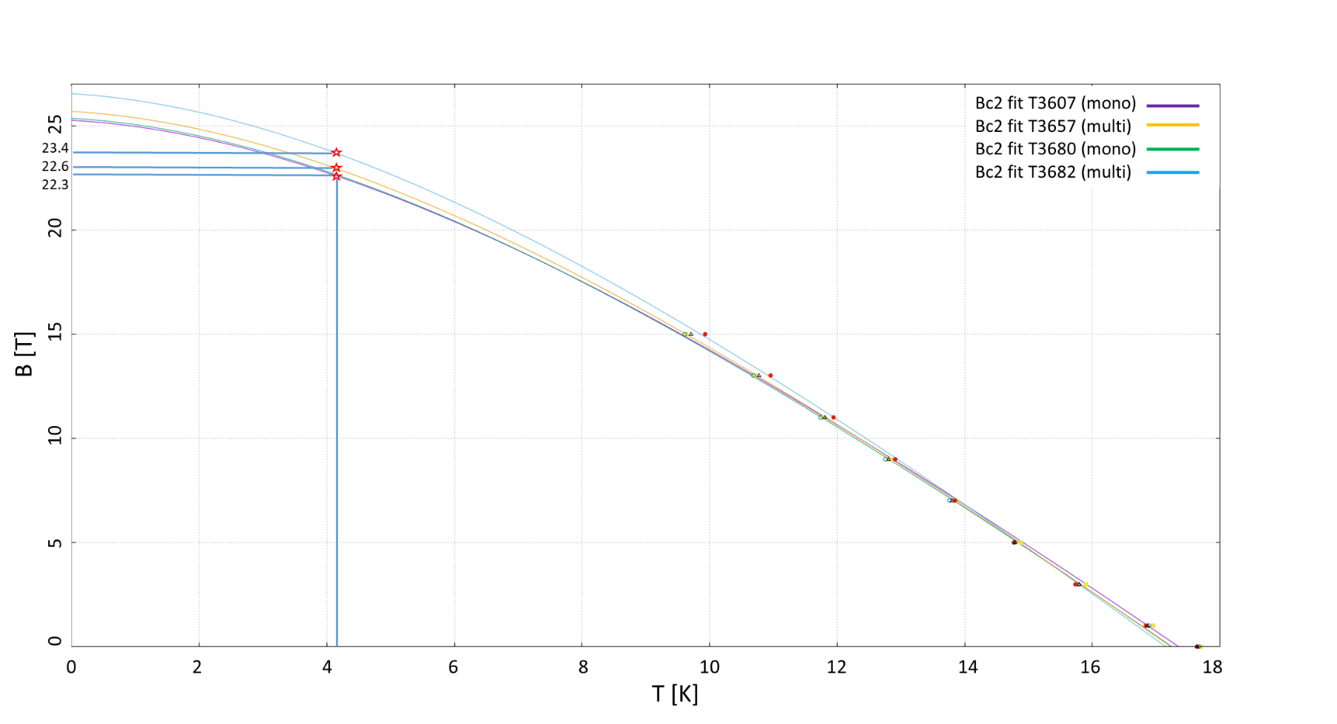
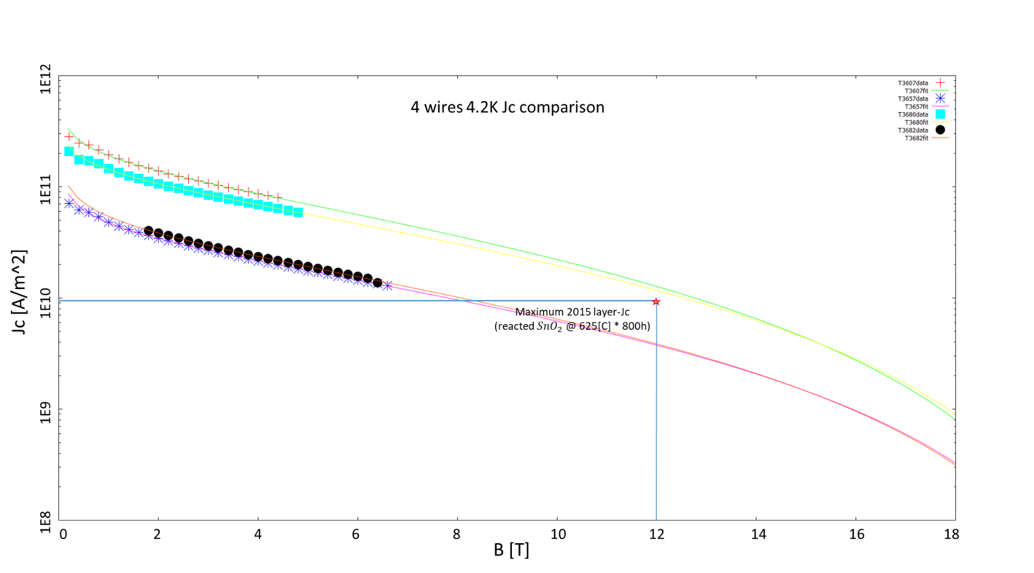
Research, Methodology, Results
& Next Steps
Nb₃Sn
1. Four Ternary (with artificial pinning centers) Tube-Type (TT) wires from have been analyzed trying to correlate the superconducting and microstructural features
1.b AC-susceptibility measurements
1.a Resistive measurements (Tc and Bc2 via standard 4 points technique)
1.c Magnetization measurements
ESR13, WP2
3

Slide 5

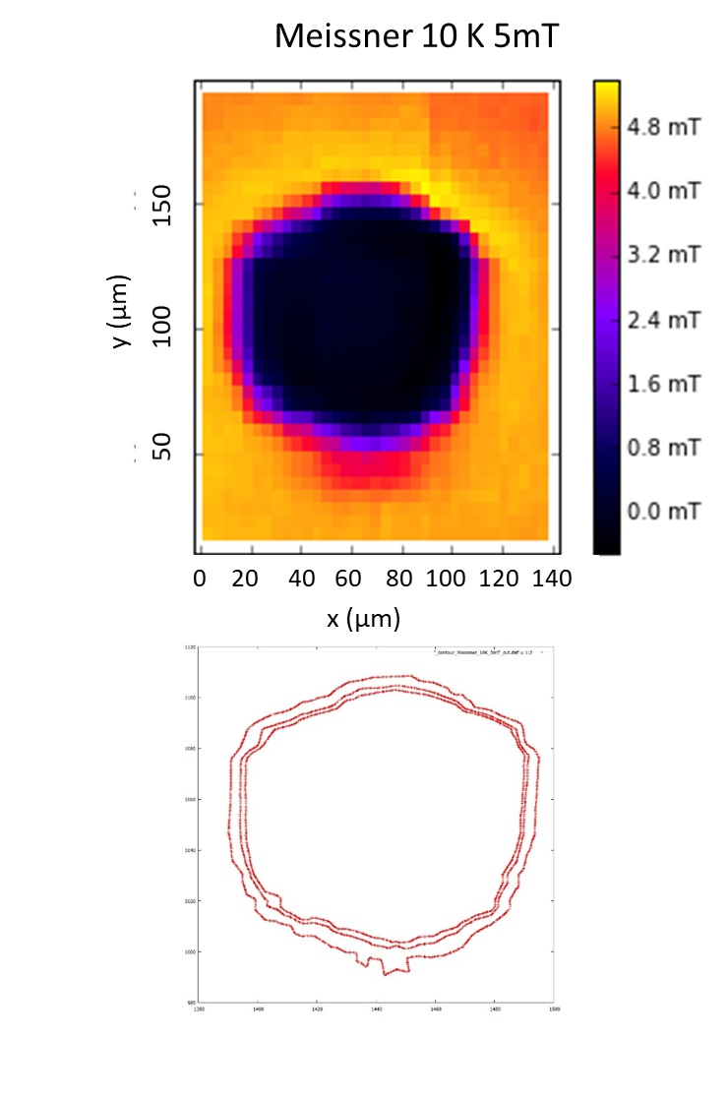
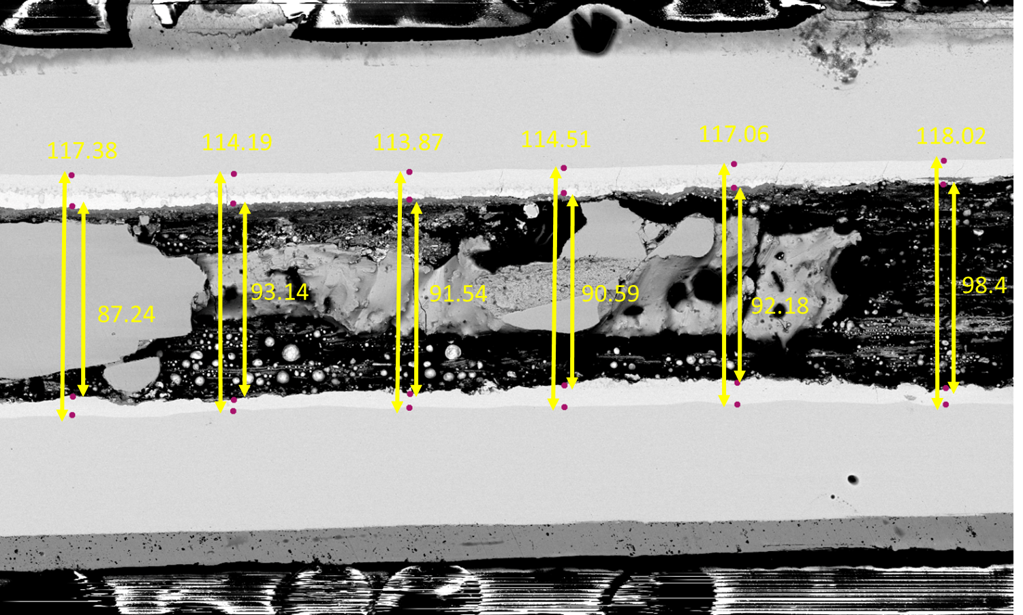
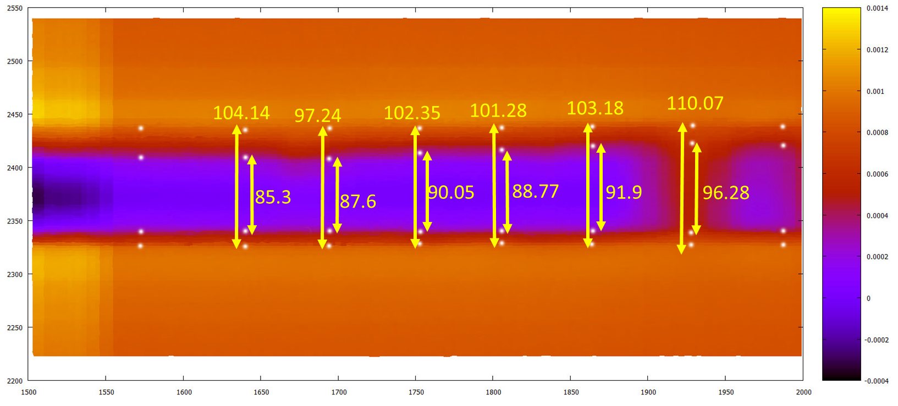
Research, Methodology, Results
& Next Steps
Nb₃Sn
1.d Scanning Hall Probe Microscopy (SHPM) + SEM/TEM comparison
Next steps
New wires coming: ternary and quaternary samples with the aim of a further non-Cu J_{c} improvement and a higher Bc₂;
Potential irradiation campaign to be performed on the old and the new wires, assessing the additional artificial pinning effects;
Further SHPM investigations (currents evaluation via Biot-Savart inversion) and comparison between the two generations of wires
ESR13, WP2
4

Slide 6
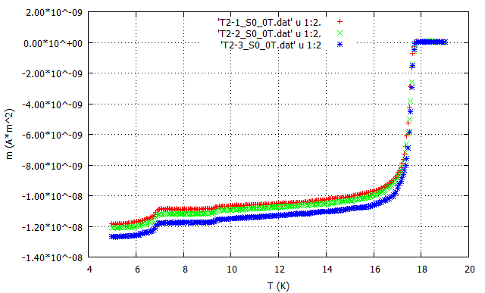
Research, Methodology, Results
& Next Steps
Nb₃Sn
2. 8 Internal-Tin (IT) wires from have been recently received and partially analyzed
Analysis of the A-15 phase inhomogenities via AC susceptibility ongoing;
SHPM measurements to be provided (coupled with SEM by ESR12) ;
ESR13, WP2
5

Slide 7

Research, Methodology, Results
& Next Steps
MgB₂
5 wires with different additives from have been analyzed: resistive measurements
Zero-resistivity field B_{ρ=0}
Transport current Jc
Schematic drawing of the 17T cryostat @ Atominstitut.
1: sample space
2: heater
3: superconducting magnet
4: needle valve
5: helium bath
6: sample
ESR13, WP2
6

Slide 8
Training, Conferences
& Workshops
Training
  B1.2 German course (language training, Deutschinstitut Wien, 03.01.18-28-02-18.)
  B2.1 German course (language training, Deutschinstitut Wien, 01.11.18-21-12-18.)
Conferences
  FCC Week (conference, Amsterdam, 9-13/4/2018)
Attended EASITRain events
  CERN Spring Lectures, CERN (Geneva, CH), 05-23.03.2018
  Summer School (Vienna, AT), 03-14.09.18
ESR13, WP2
7

Slide 9
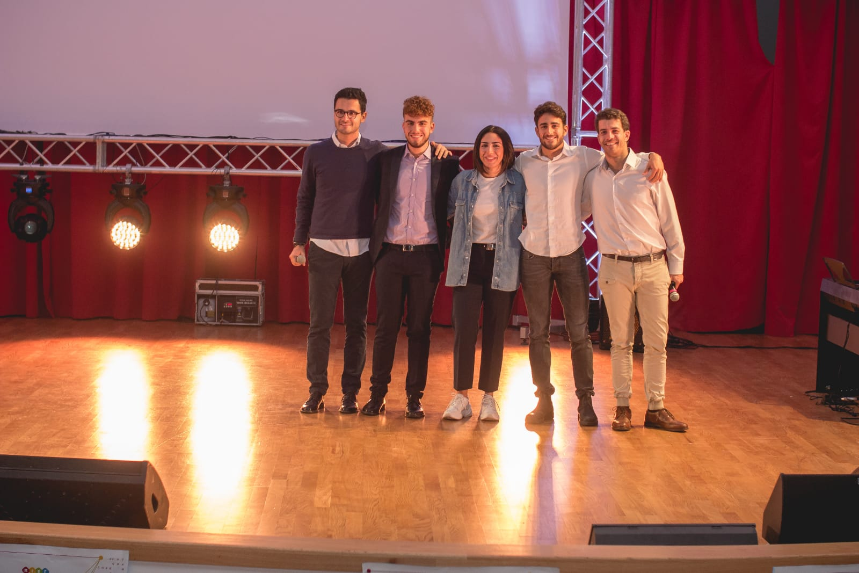
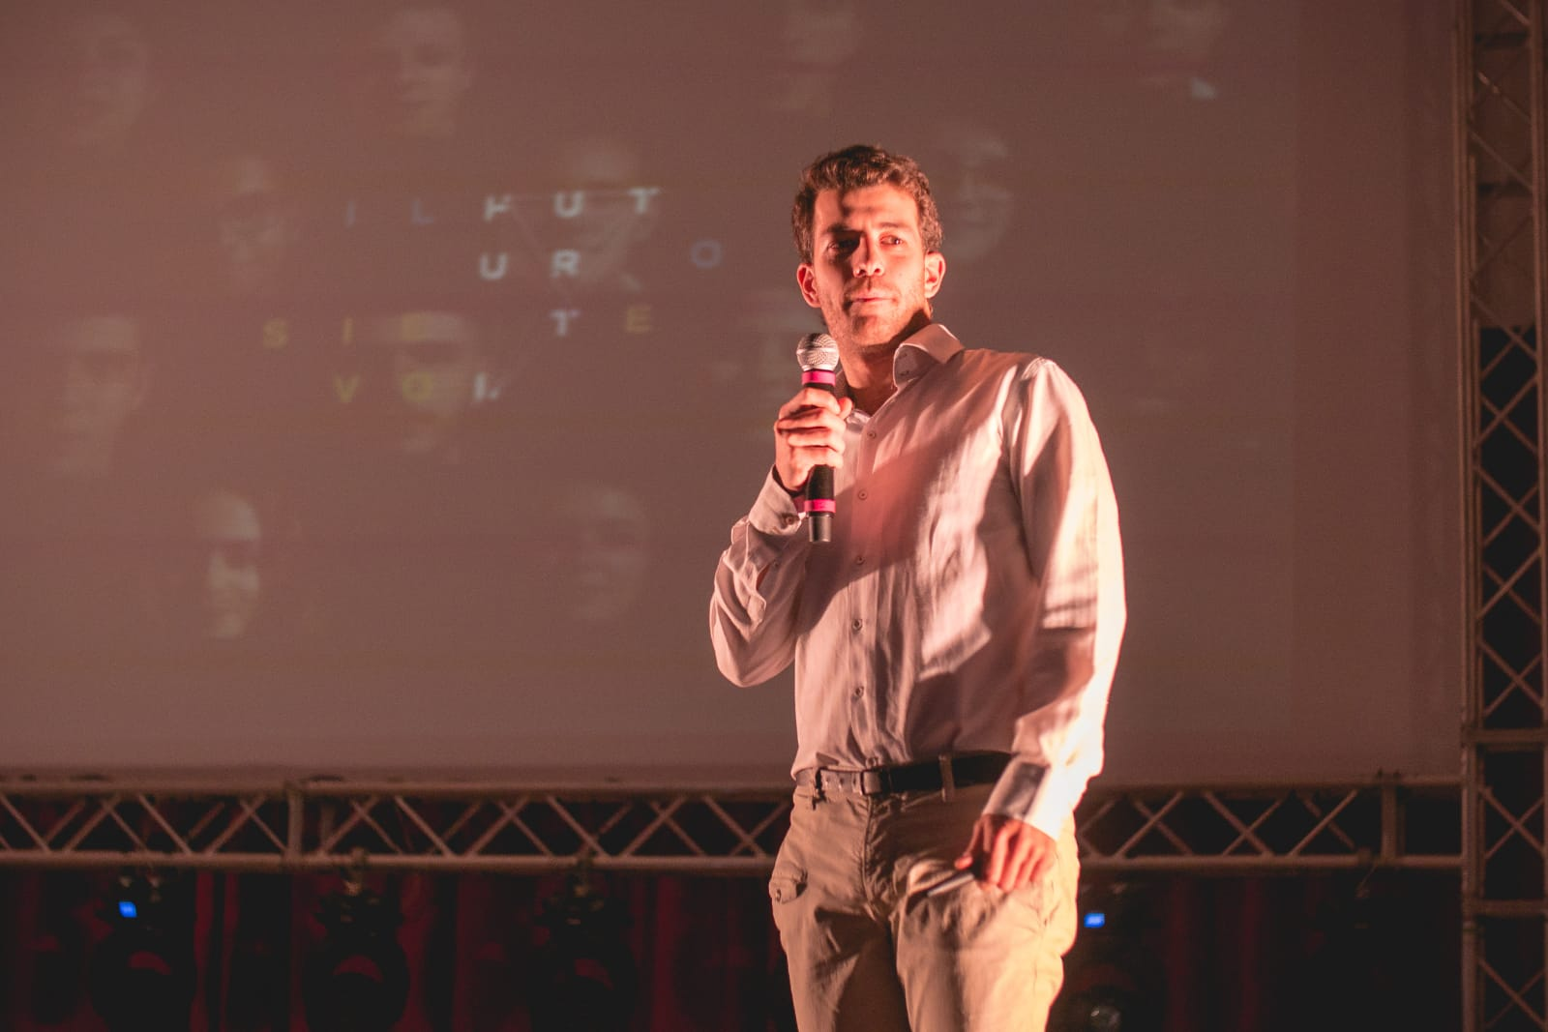
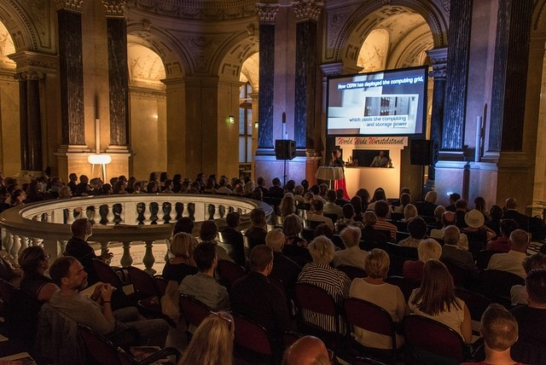
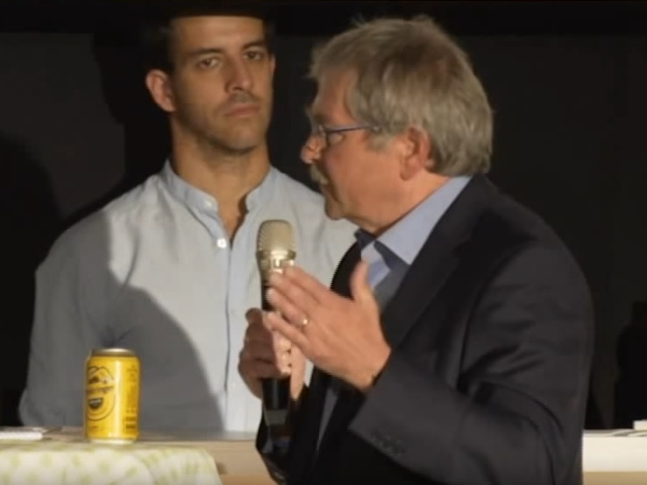
Outreach, Dissemination
& Networking
Outreach activities
  Attending with lecture to “ FUTURA COSENZA- Magna Grecia 4.0” (17-18.10.18, Cosenza, IT)
  An event organized for the high-school students in the ESR home town (Cosenza, IT), where the ESR meets young pupils presenting his experience as a viable early stage scientific career path.
  Participation to the event: “Forschung! Was geht mich das an?“ in Vienna, AT (08.09.18, Vienna, AT).
  The ESR toke part to an event with Austrian scientists, politicians and the 1987 Nobel Price Mr.Bednorz organized in the Naturhistorisches Museum.
ESR13, WP2
8

Slide 10
Outreach, Dissemination
& Networking
Dissemination activities
  FCC-Week 2018 presentation: outline of the work to be done by the ESR within his project
  ASC 2018 co-authorship on MgB2 paper (under review)
Networking activities
  Inspiring discussions with the 1987 Nobel Laureate Mr.Bednorz through the ESAS Vienna Summer School (Vienna, AT)
  Collaboration with other PhD Students from CERN (CH) and UNIGE (IT) on a project related to possible lunar transport systems using superconductors ( abstract for paper under further development). The project follows the work done at the Superconductivity Hackathon (Geneva (CH), 09.2017)
  Networking possibilities with international field experts via EASITrain-organized activities
  Started collaboration as a contributor on https://magazine.impactscool.com/en/
ESR13, WP2
8

Slide 11
Impact
The ESR13 work foreseen a long-term social-relevant impact. Pushing forwards the limits of Low Temperature Superconductors (LTS) has nowadays possible relevant weight in specific niche markets (NMR/MRI, energy storage systems, high energy physics).
MSC fellowship individual impact:
  Experience: new nation, new language, new customs. Being moreover in a capital (Vienna) helps finding the ESR path into that culture via different possibilities.
  Understanding the differences, PROs and CONTROs of both academia and industry;
  Less time for pure scientific production than a «standard» PhD path but wider range of learning opportunities
  Responsibility
ESR13, WP2
9

Slide 12
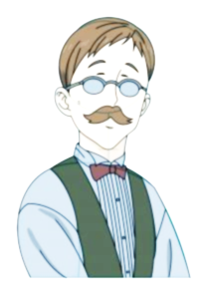
Thanks for your attention!
ESR13, WP2
9

