Slide 1


Mid-Term Review
10 December 2018, Brussels
Stewart, LEITH
ESR14, WP3
ESR14, WP3
1

Slide 2

ESR14, WP3 - Background
Background: Bachelor and Masters in Mechanical Engineering
  Intern – IAEA (Vienna, Austria), 11/2014-04/2015
  Project Engineer – MHPSA (Johannesburg, South Africa), 05/2015-01/2018
Contract start date: 01/02/2018
Host institute: University of Siegen
EASITrain Supervisor(s): Dr Michael Vogel
PhD Title: Production of superconducting thin films for large scale particle accelerators
PhD University: University of Siegen
Planned secondments:
  CemeCon AG (Germany), 02.2019, +-2 weeks, in-depth PVD coating training, including use of CemeCon CC800 coating machine
  CERN (Switzerland), +- 1 month, (Mid-2019) PVD coating of cavities. Full life cycle of samples from surface preparation to deposition
ESR14, WP3
2

Slide 3
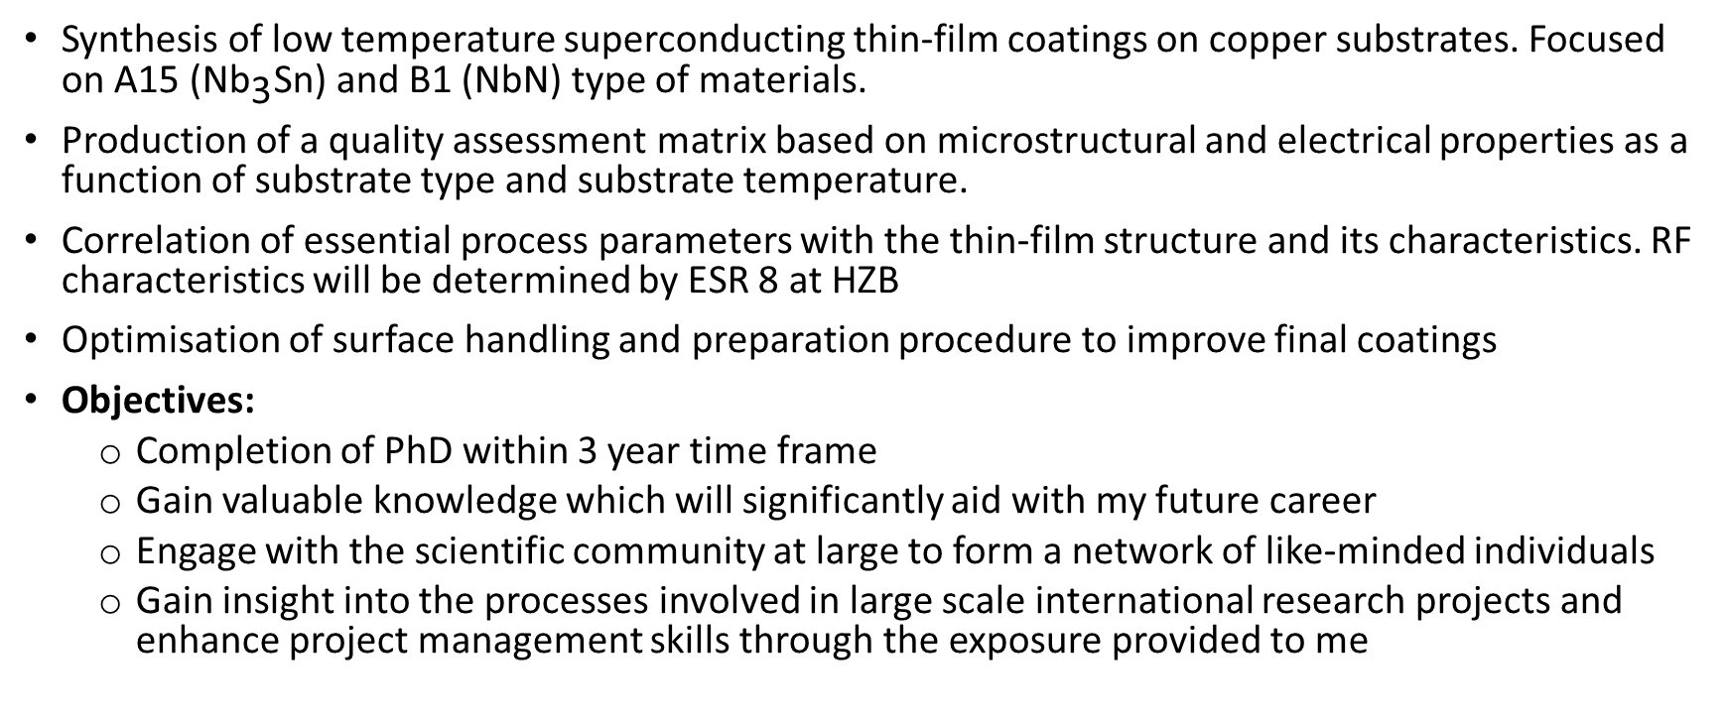
Role in the Project
& Objectives
Synthesis of low temperature superconducting thin-film coatings on copper substrates. Focused on A15 ($\text{N}{\text{b}}_{\text{3}}\text{Sn}$) and B1 (NbN) type of materials.
Production of a quality assessment matrix based on microstructural and electrical properties as a function of substrate type and substrate temperature.
Correlation of essential process parameters with the thin-film structure and its characteristics. RF characteristics will be determined by ESR 8 at HZB
Optimisation of surface handling and preparation procedure to improve final coatings
Objectives:
  Completion of PhD within 3 year time frame
  Gain valuable knowledge which will significantly aid with my future career
  Engage with the scientific community at large to form a network of like-minded individuals
  Gain insight into the processes involved in large scale international research projects and enhance project management skills through the exposure provided to me
ESR14, WP3
3

Slide 4
Research, Methodology, Results
& Next Steps
Methodology
  Complete coatings of different materials with various deposition parameters in a statistical fashion to determine their effects and any interdependencies
  Complete full characterisation studies to understand the outcomes of changes in parameters and optimise the process accordingly
  Results
  Initial results of Nb and NbN on copper provided a good understanding of the process and how to continue with future tests
  Initial results of chemical polishing and electropolishing have proved insightful.
  Next Steps
  Begin next step in niobium nitride deposition (new deposition technique) and enhance knowledge in material characterisation
  Further testing and optimisation of the surface handling and preparation process
ESR14, WP3
4

Slide 5
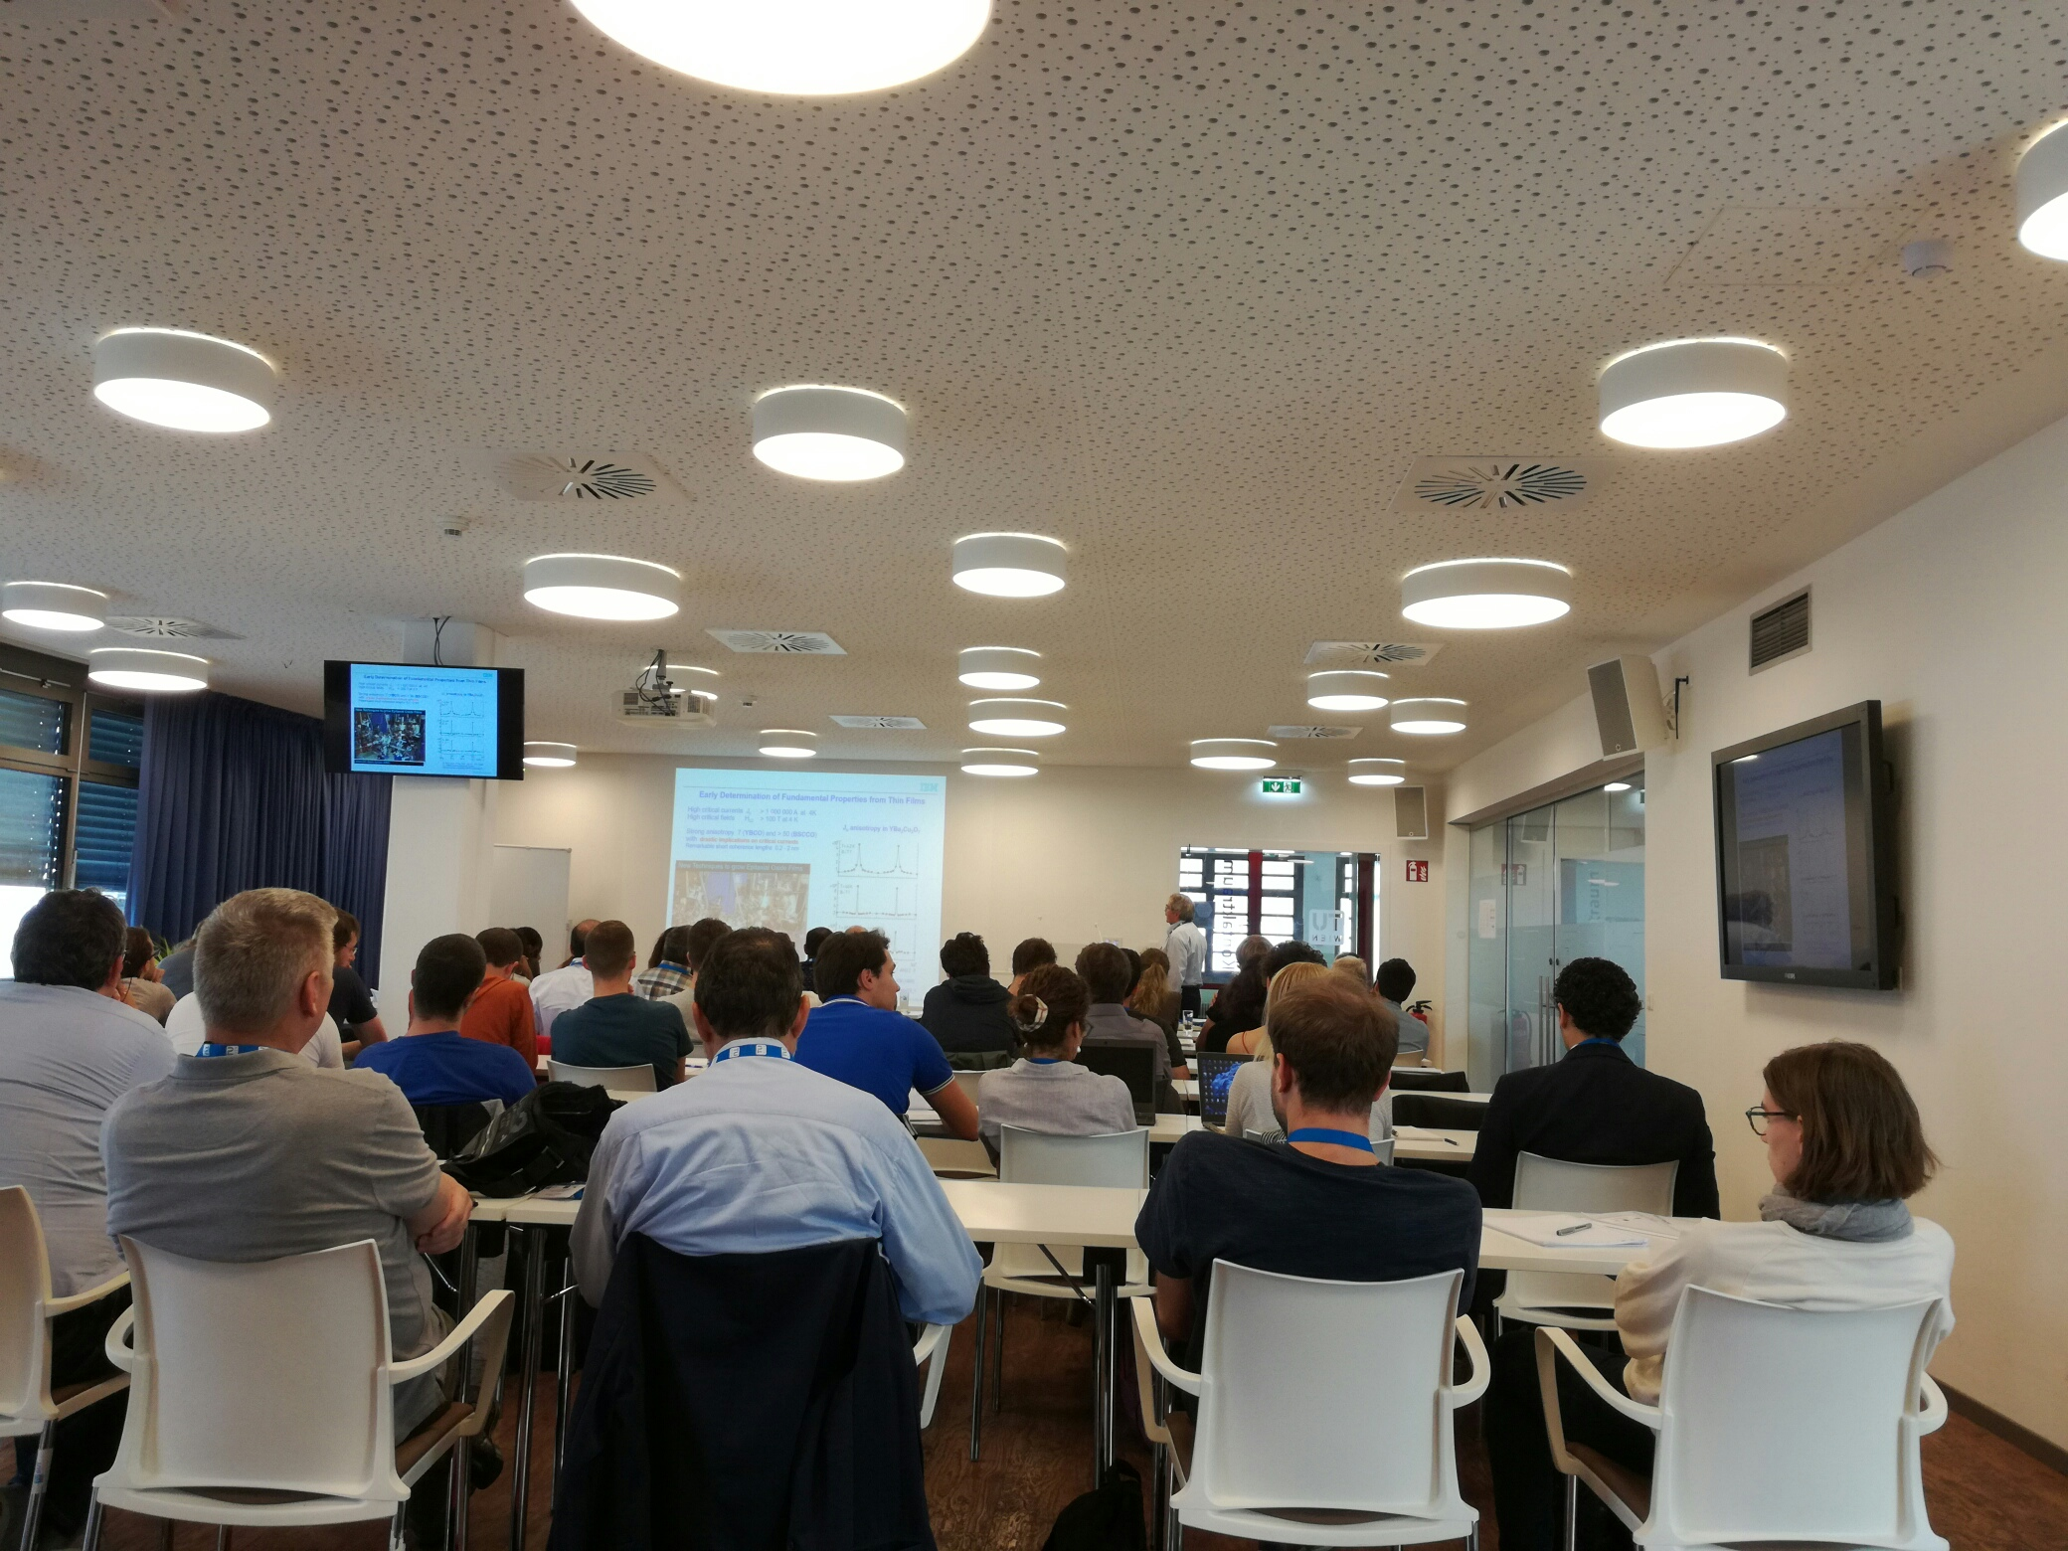
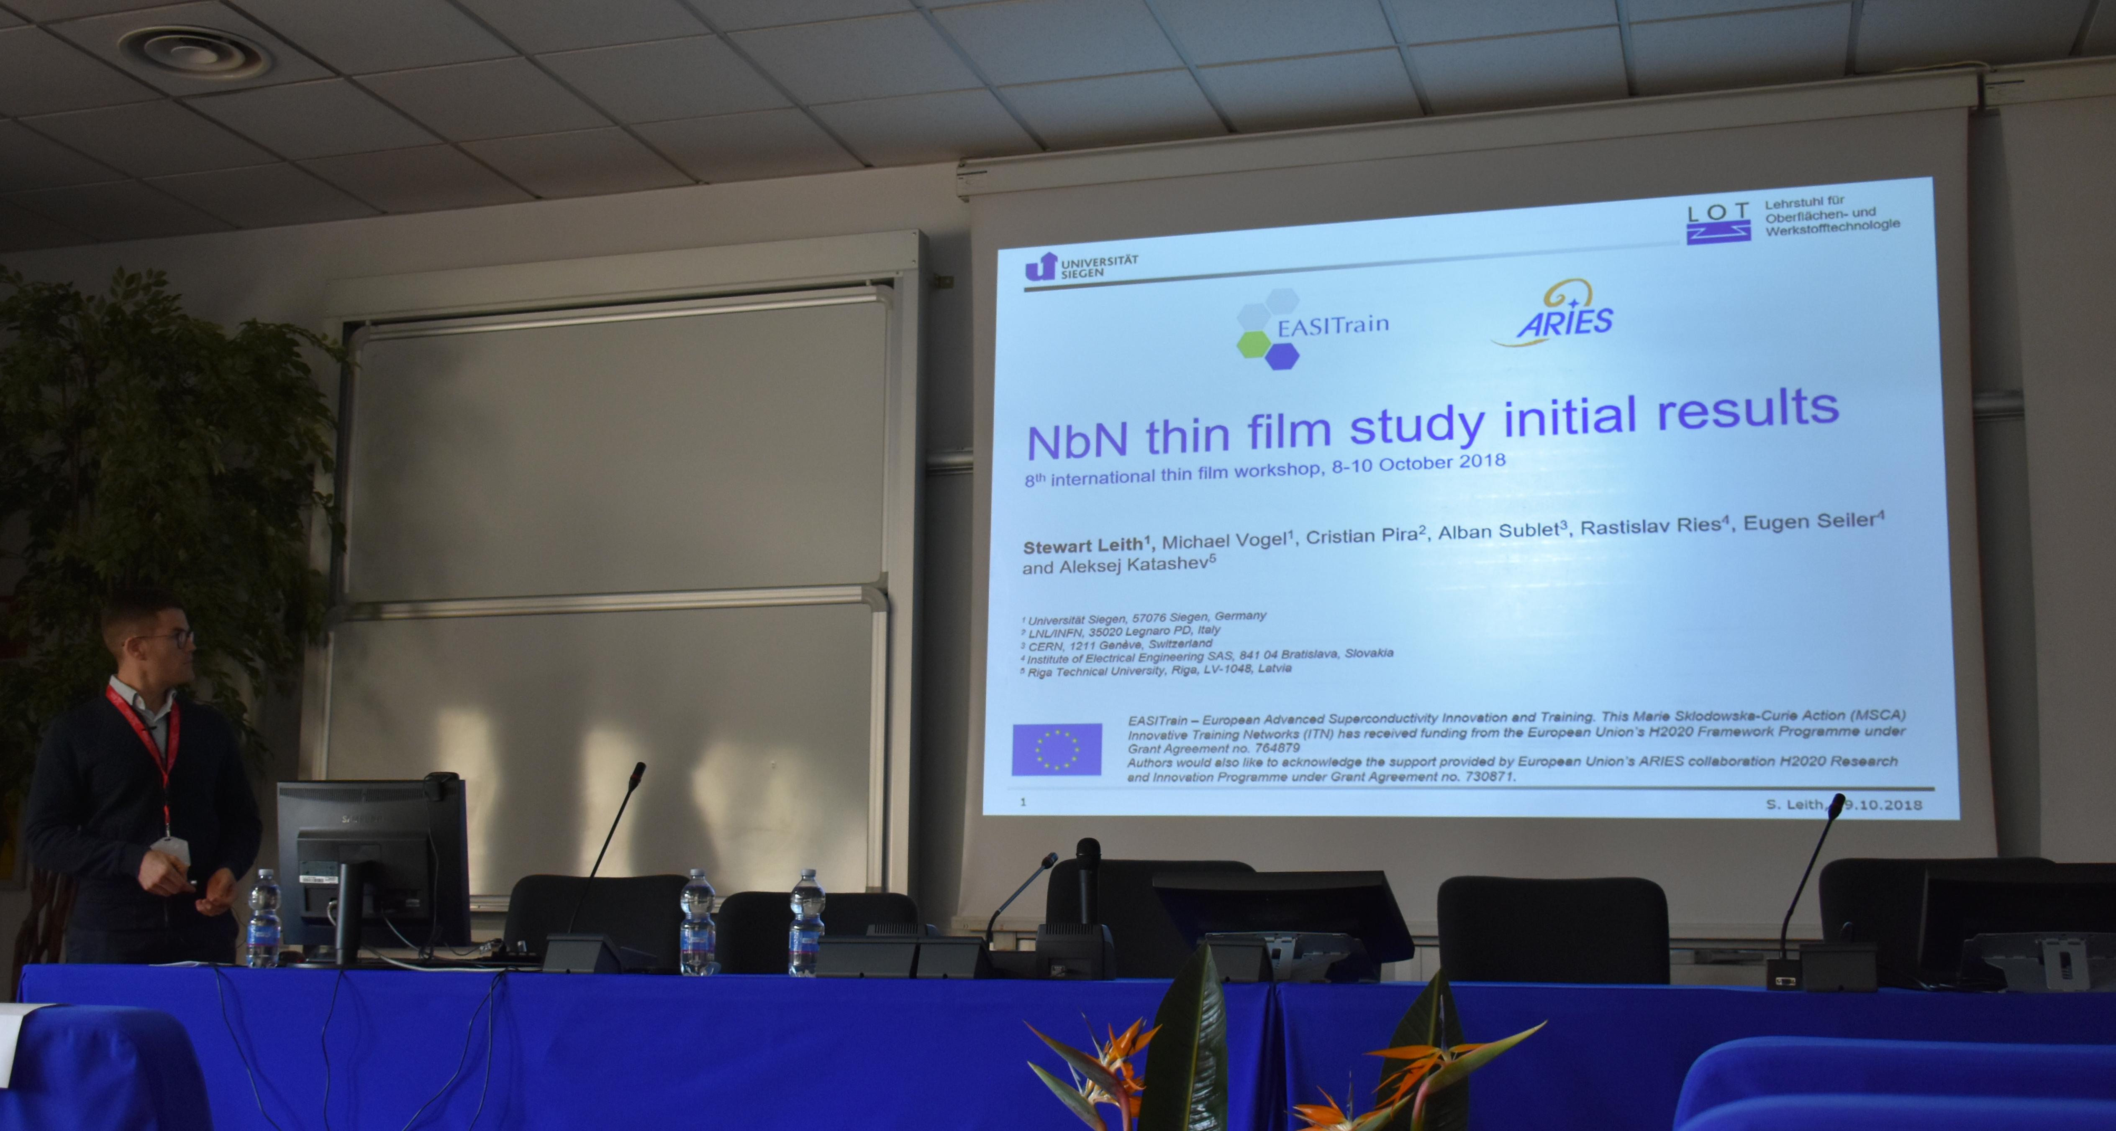
Training, Conferences
& Workshops
Training
  CERN EASITrain Kickoff Training, Geneva (Switzerland), 03/2018
  Media training at Terra Mater (during EASISchool 1), Vienna (Austria), 09/2018
  EASISchool 1, Vienna (Austria), 09/2018
  “General Accelerator Physics” Lectures, Siegen (Germany), Summer semester 2018.
  German language course A1.2 completed (A2.1 Started), Siegen (Germany)
Conferences
  FCC Week 2018, Amsterdam (Netherlands), 04/2018
  8th International Workshop on Thin Films, Legnaro (Italy), 10/2018
Attended EASITRain events
  CERN EASITrain Kickoff Training, Geneva (Switzerland), 03/2018
  FCC Week 2018, Amsterdam (Netherlands), 04/2018
  EASISchool 1, Vienna (Austria), 09/2018
ESR14, WP3
5

Slide 6
Outreach, Dissemination
& Networking
Outreach activities
  Planning to complete EASITrain story
  Looking to join in scientific discussion with non-scientific communities
Dissemination activities
  Presentation: FCC Week 2018
  Presentation: 8th International Workshop on Thin Films 2018
Networking activities
  The Kickoff at CERN provided the opportunity to meet the group involved with thin film deposition and SRF as a whole. A great opportunity to gain knowledge
  FCC week permitted interaction with researchers in the particle accelerator community from around the world. Great feeling of pushing boundaries with scientific progress
  Thin film workshop to present my initial results and receive feedback from experts on any problems being experienced
ESR14, WP3
6

Slide 7
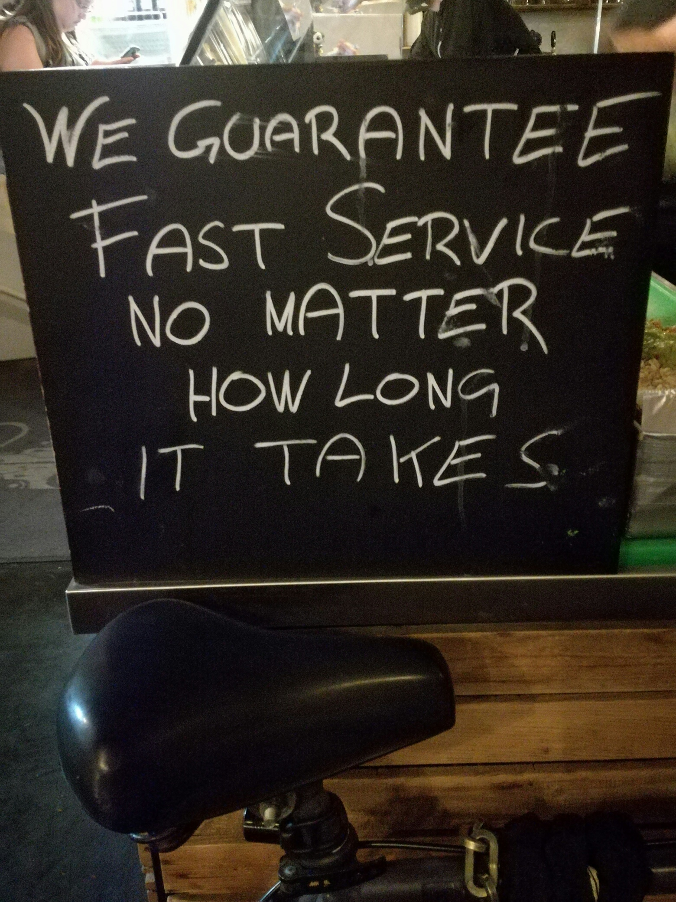
Impact
Increased knowledge regarding the performance of alternative materials to niobium. This will provide possibilities for increased performance and cheaper operation of accelerators around the world.
Alternative materials could provide cross-sectoral applications, expecially in the electronics area
Impact of being part of an MSC fellowship:
  A chance to experience cutting edge science and to gain valuable insight into how to complete scientific studies professionally
  Meeting like-minded young scientists who are all pushing each other to produce the best research possible. A great way to push your career forwards
  The opportunity to attend different schools and conferences around the world, thereby growing my professional network and helping my future career
  Amazing opportunity to experience a different culture, thereby expanding my horizons, and also to travel throughout Europe
ESR14, WP3
7

Slide 8
Conclusion
Very informative and successful start to the project. The base learning phase is now over and more specific knowledge acquirement is underway
Progress remains on track with a lot of good results already achieved. A clear plan for the future is in place as well.
Minimal risks foreseen at present and deliverable deadlines are not in jeopardy
PhD completion within three years remains on track.
Supervision at University of Siegen has been great so far. The ESR is well integrated into the group already and busy learning German.
ESR14, WP3
8

Slide 9
Ngiyabonga!
Questions?
ESR14, WP3
8

