Slide 1
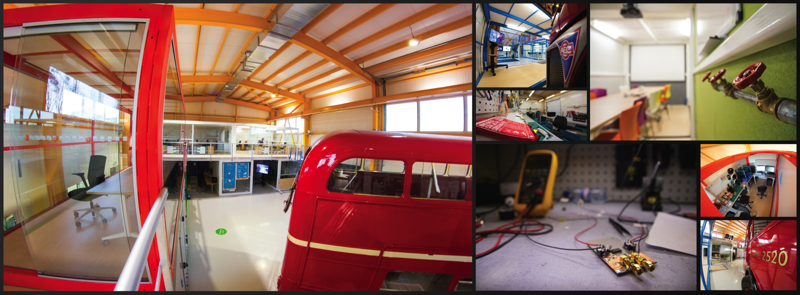
CERN Ideasquare
Harri Toivonen
CERN, July 31st , 2018
INTRODUCTION

Slide 2
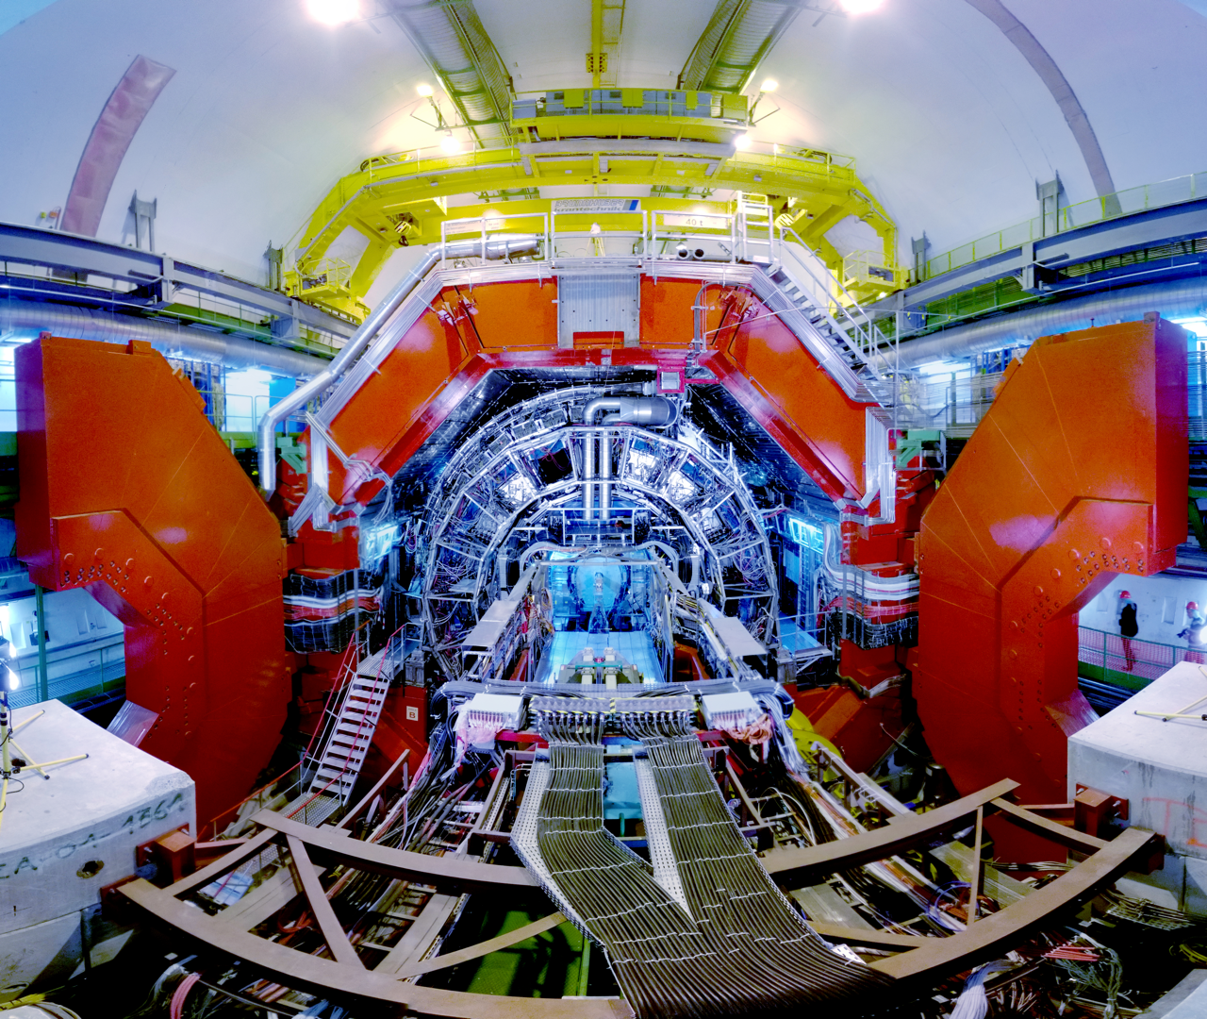
EUROPEAN RESEARCH INFRASTRUCTURE CHALLENGES
The ERI´s, CERN included, deal with engineering and innovation challenges stemming from scientific progress
Accumulated knowledge, capabilities and infrastructure aligned to drive advanced scientific field forward -> societal value and benefits are challenging to measure as the time from discovery to application is long
How might we accelerate societal value creation (new technology, products, services, jobs, startups, etc) from basic research?

Slide 3
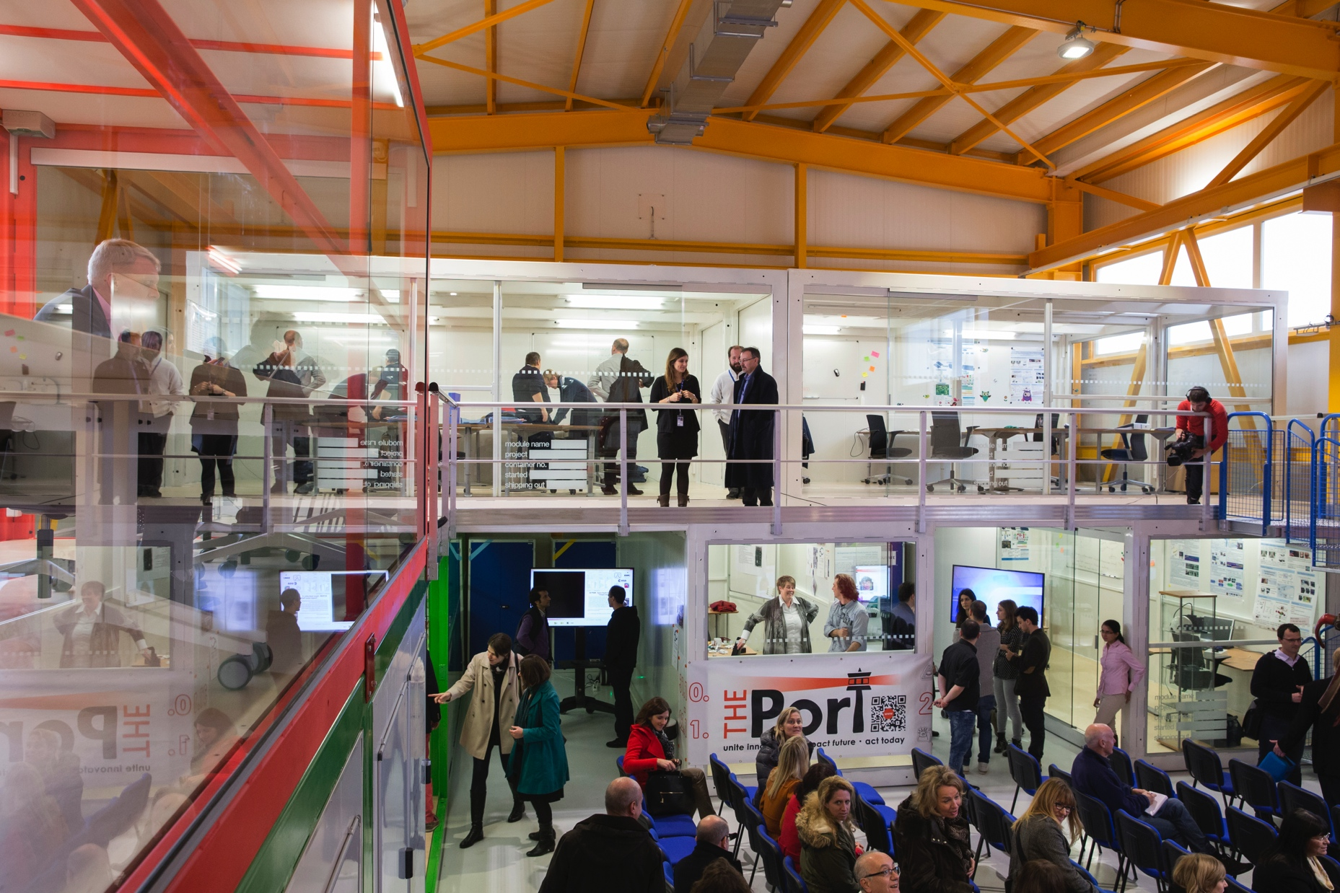
IDEASQUARE IN BRIEF
“Ideasquare is a pilot project that brings together physicists, engineers, industrial partners, early-stage researchers and cross-disciplinary teams of students to work together on detector upgrade R&D technologies. The purpose is to co-develop new technologies for research purposes, and at the same time, create a fruitful environment for socially and globally relevant new product ideas and innovation.”

Slide 4
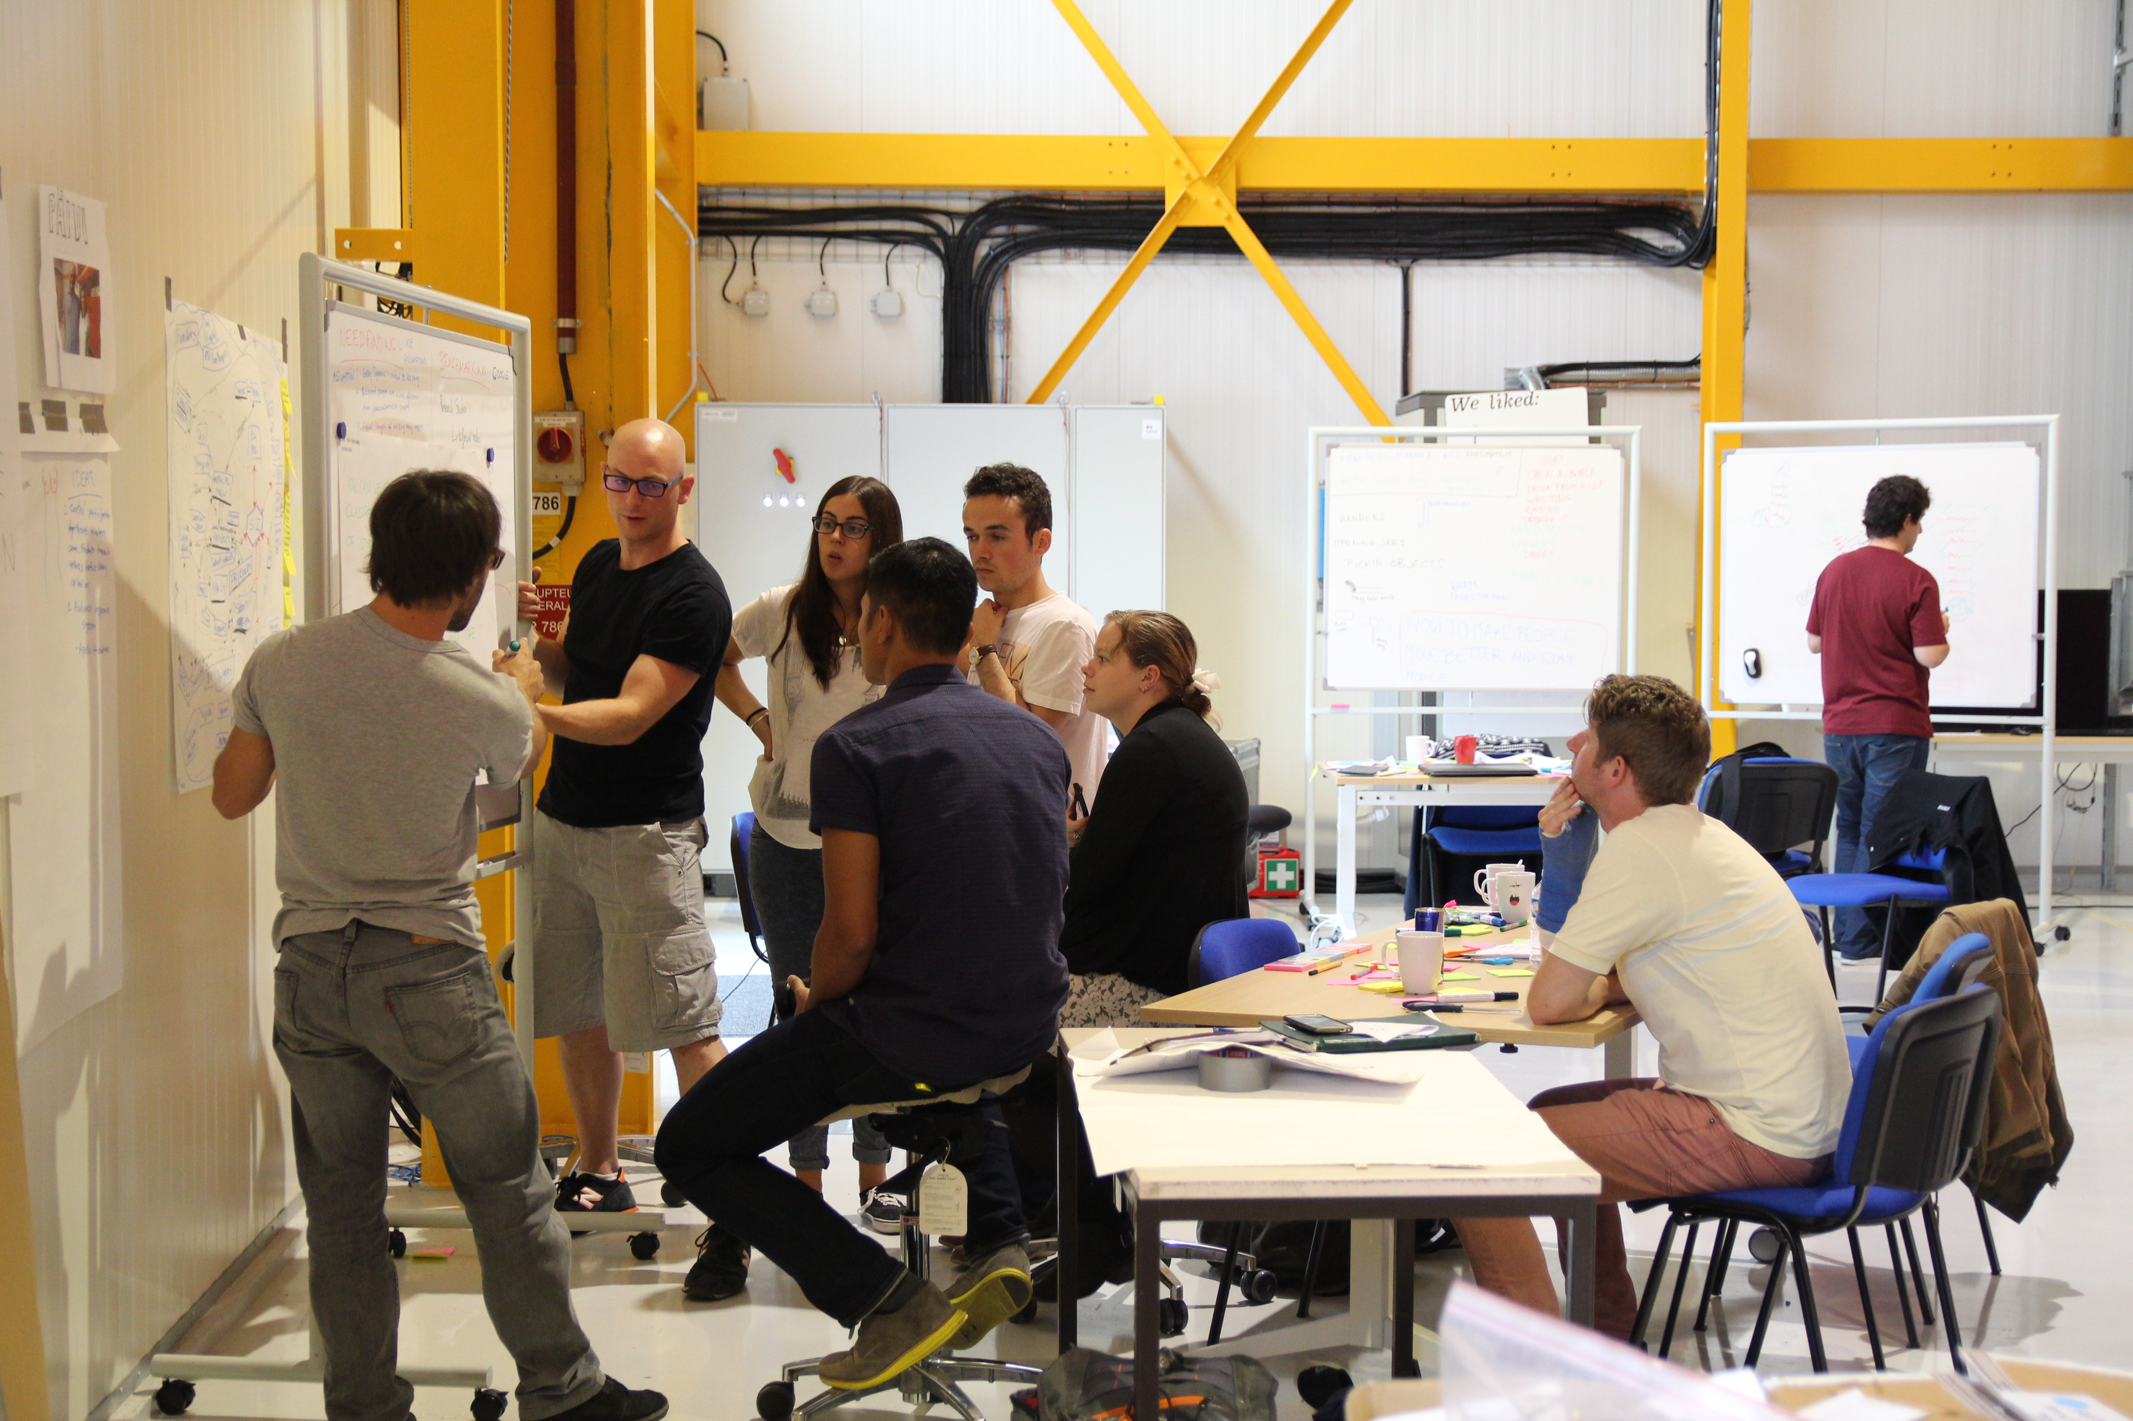

IDEASQUARE IS
Project with a dedicated building, hosting:
  EU-funded detector upgrade R&D projects
  Multidisciplinary master level student programs
  Innovation events, workshops, hackathons
...to prototype, test and iterate new forms of collaboration and co-creation in the areas or Research, Education and Technology - RET
Research
Education
Technology

Slide 5
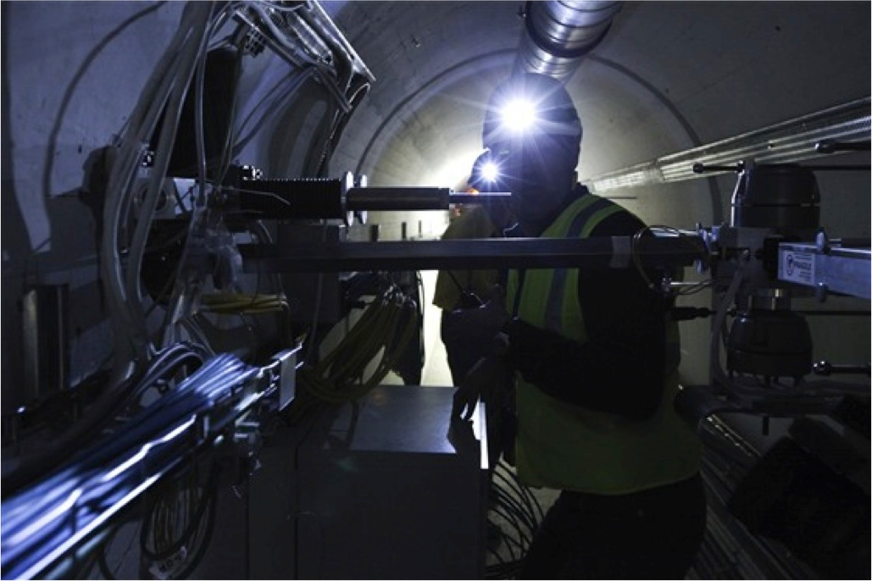

EXAMPLE: EU-FUNDED DETECTOR UPGRADE R&D PROJECT
EDUSAFE is a 4-year Marie Curie ITN project
Training for 10 Early Stage and 2 Experienced Researchers
Focuses on research into the use of Virtual Reality (VR) and Augmented Reality (AR) during planned and emergency maintenance in extreme environments
The result will be an integrated wearable VR/AR system (+control system) which can be implemented and tested as a prototype, using LHC at CERN as a test and demonstration platform

Slide 6
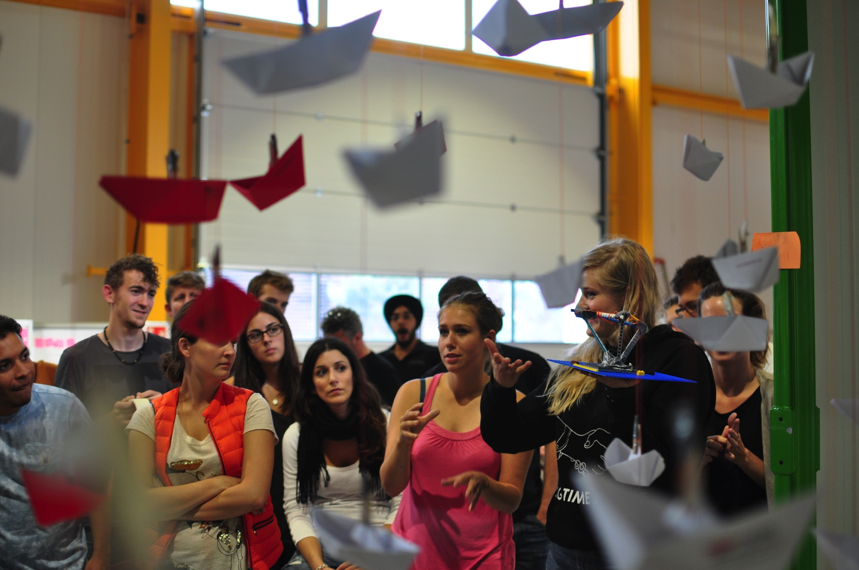

EXAMPLE: MASTER-LEVEL STUDENT COURSE
Challenge Based Innovation (CBI) is 4-6 month MSc-level specialization course for product and service development, run by participating universities from (currently) 8 countries around the world
Three pilot runs completed, 12 proof-of-concept prototypes produced
In the course, multidisciplinary student teams learn how to apply Design Thinking – process (PBL) for new product/service development; CERN researchers act as technological coaches in the process
“Work extremely hard, learn and have fun!”
“Fail fast and often to succeed sooner”

Slide 7

EXAMPLE: STUDENT PROJECT PROTOTYPE

Slide 8
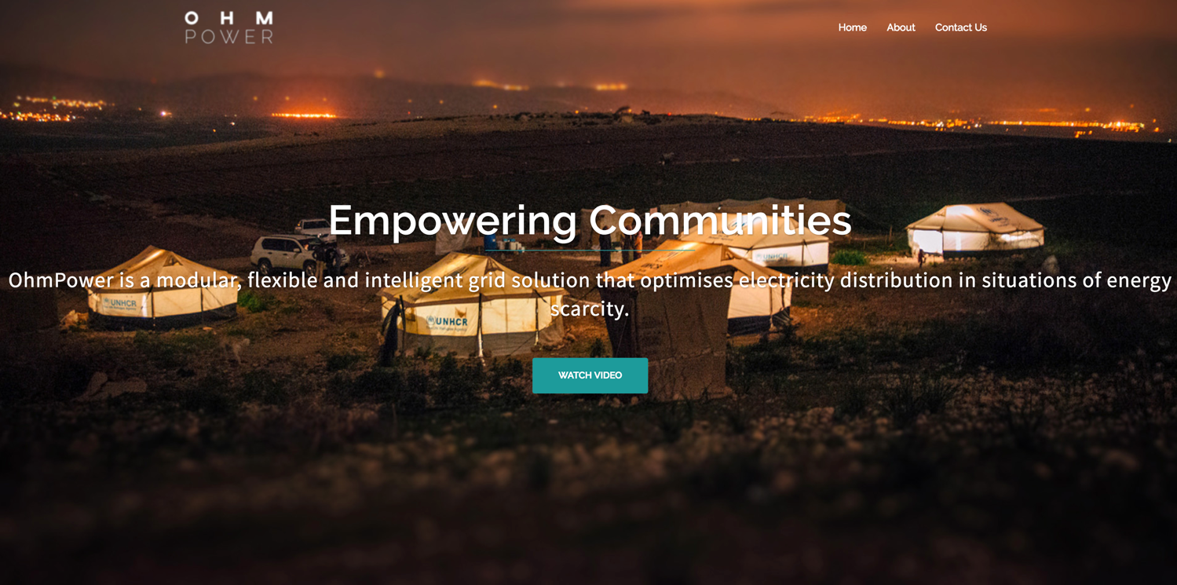
EXAMPLE: OhmPower
www.ohmpower.org

Slide 9
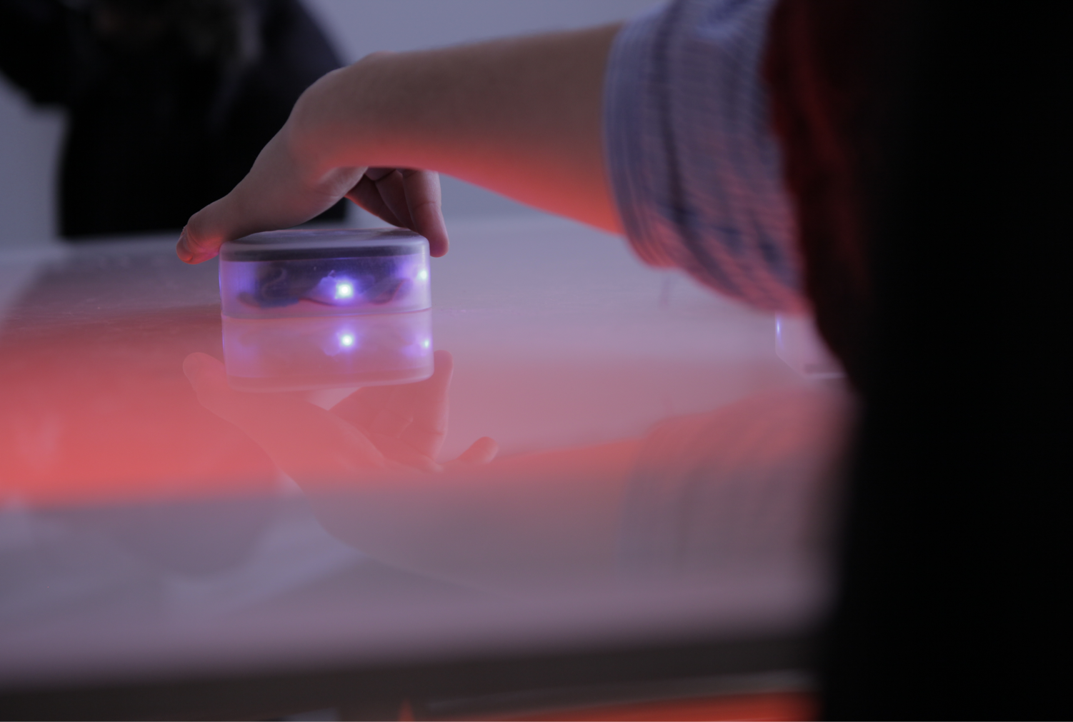
EXAMPLE: EduMind
https://www.youtube.com/watch?v=w5S8vSHH_XA

Slide 10
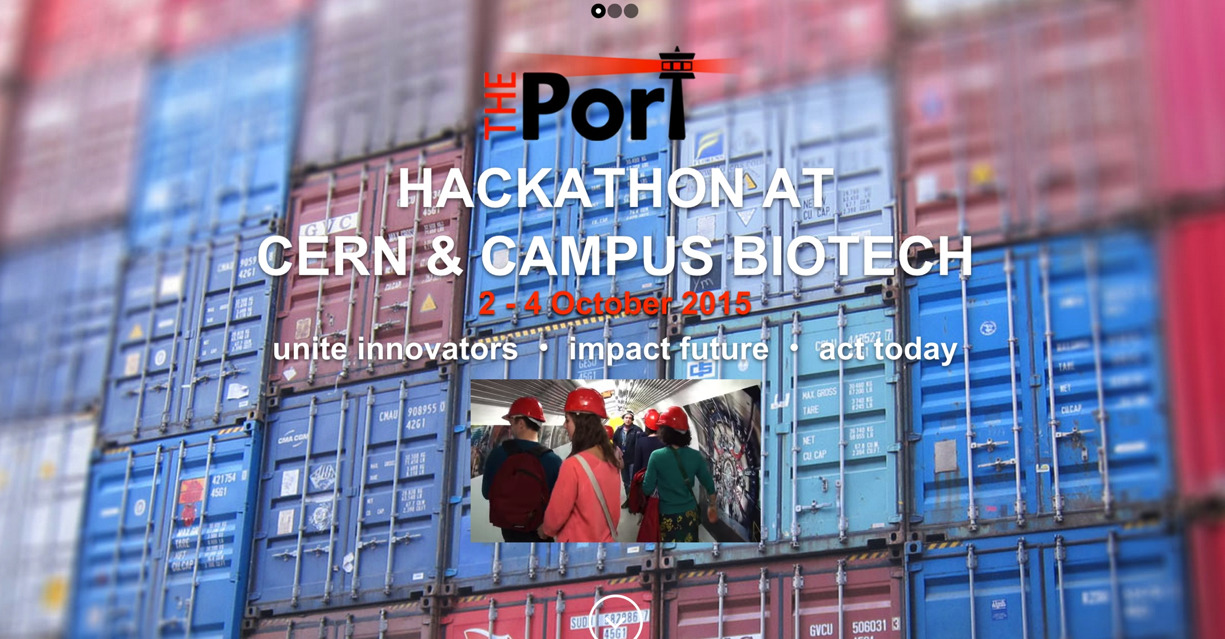

EXAMPLE: HACKATHON
Organised by THE Port Association, hosted by CERN Ideasquare and with partners from other non-governmental organisations, a three-day problem solving workshop hackathon with the theme “Science for Humanitarian Purposes”
Example prototypes produced included: open-source cosmic ray detector, an assistive electronics suit to help mine detection dogs, an inflatable fridge for vaccines, a terrain-mapping tool for refugee camps, etc.

Slide 11
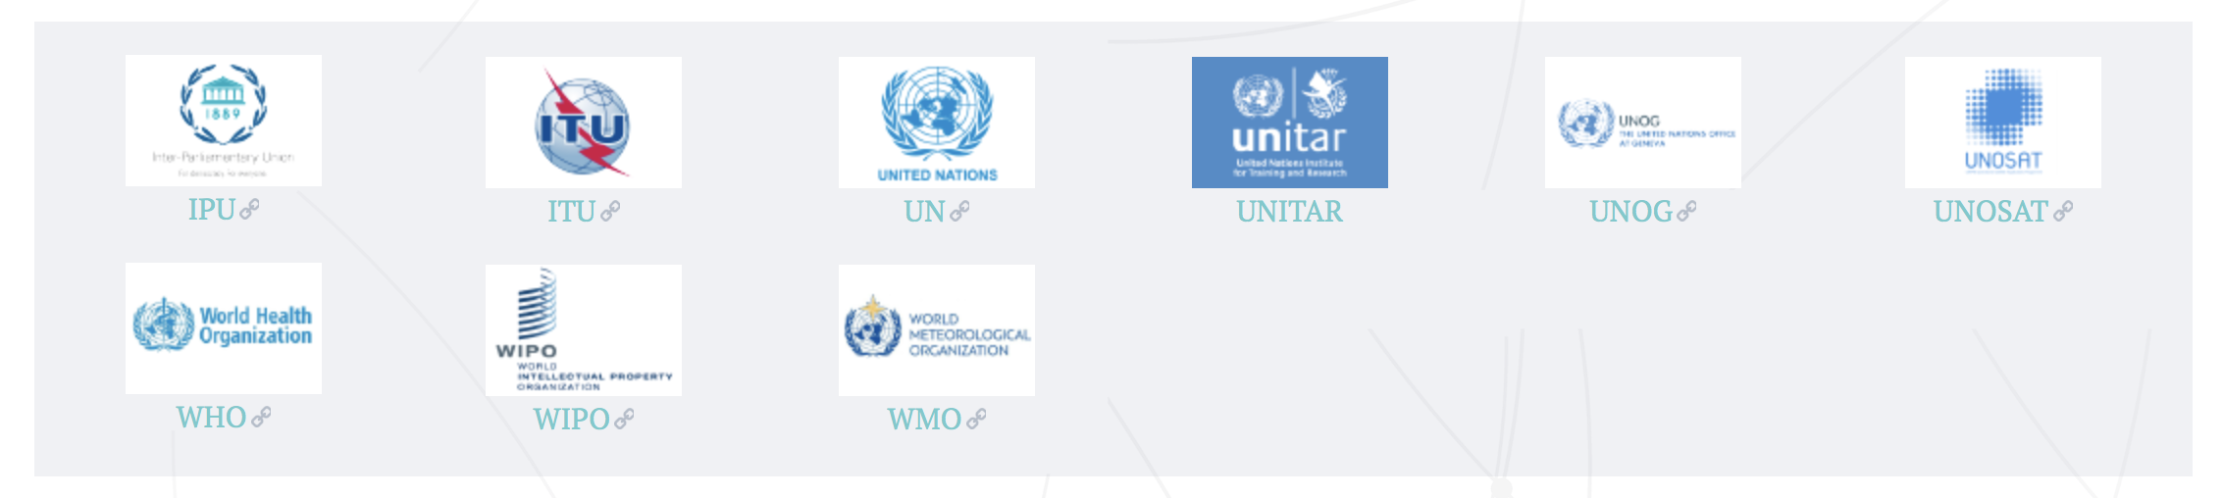
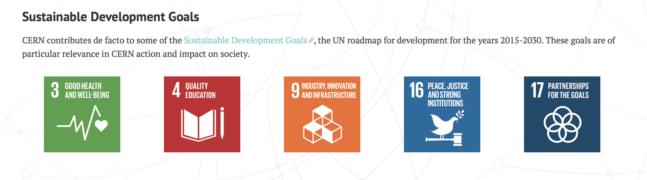
CERN connections to UN & Sustainable Development Goals

Slide 12
HOW DO THESE PROJECTS DIFFER?
Detector R&D
Projects
Hi
Time period (physically) at IdeaSquare
(3-5 year marathon)
Short duration
innovation events
“Hacks”
MSc-Level Student Programs
Lo
(1-5 days sprint)
(6 month run)
Lo
Hi
Level of complexity/required integration

Slide 13
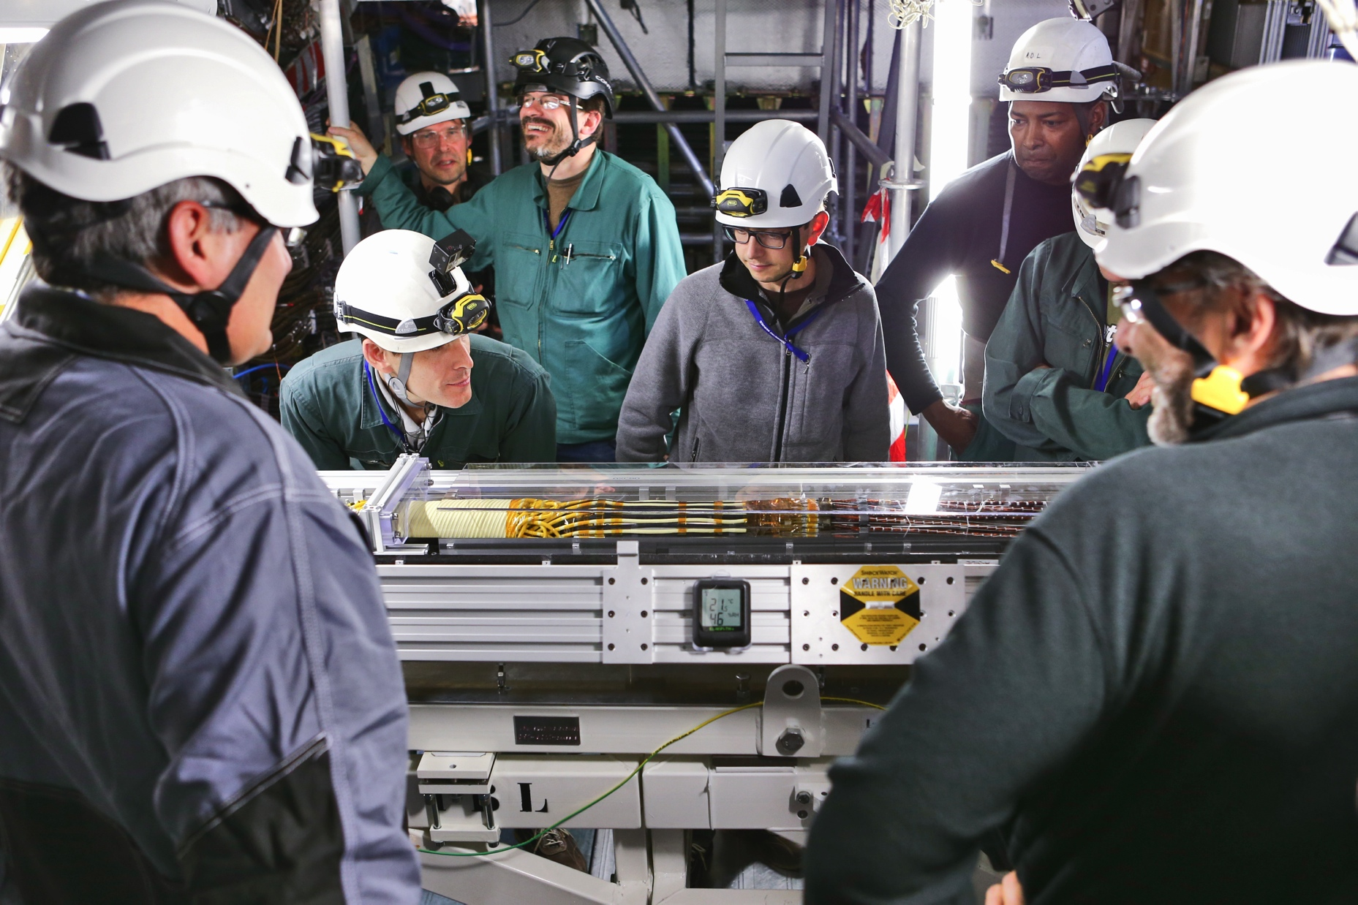
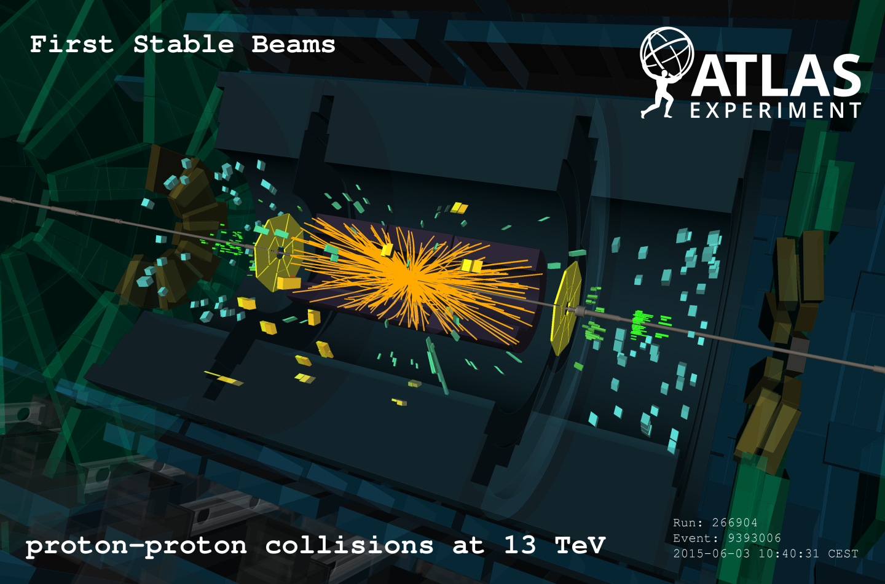
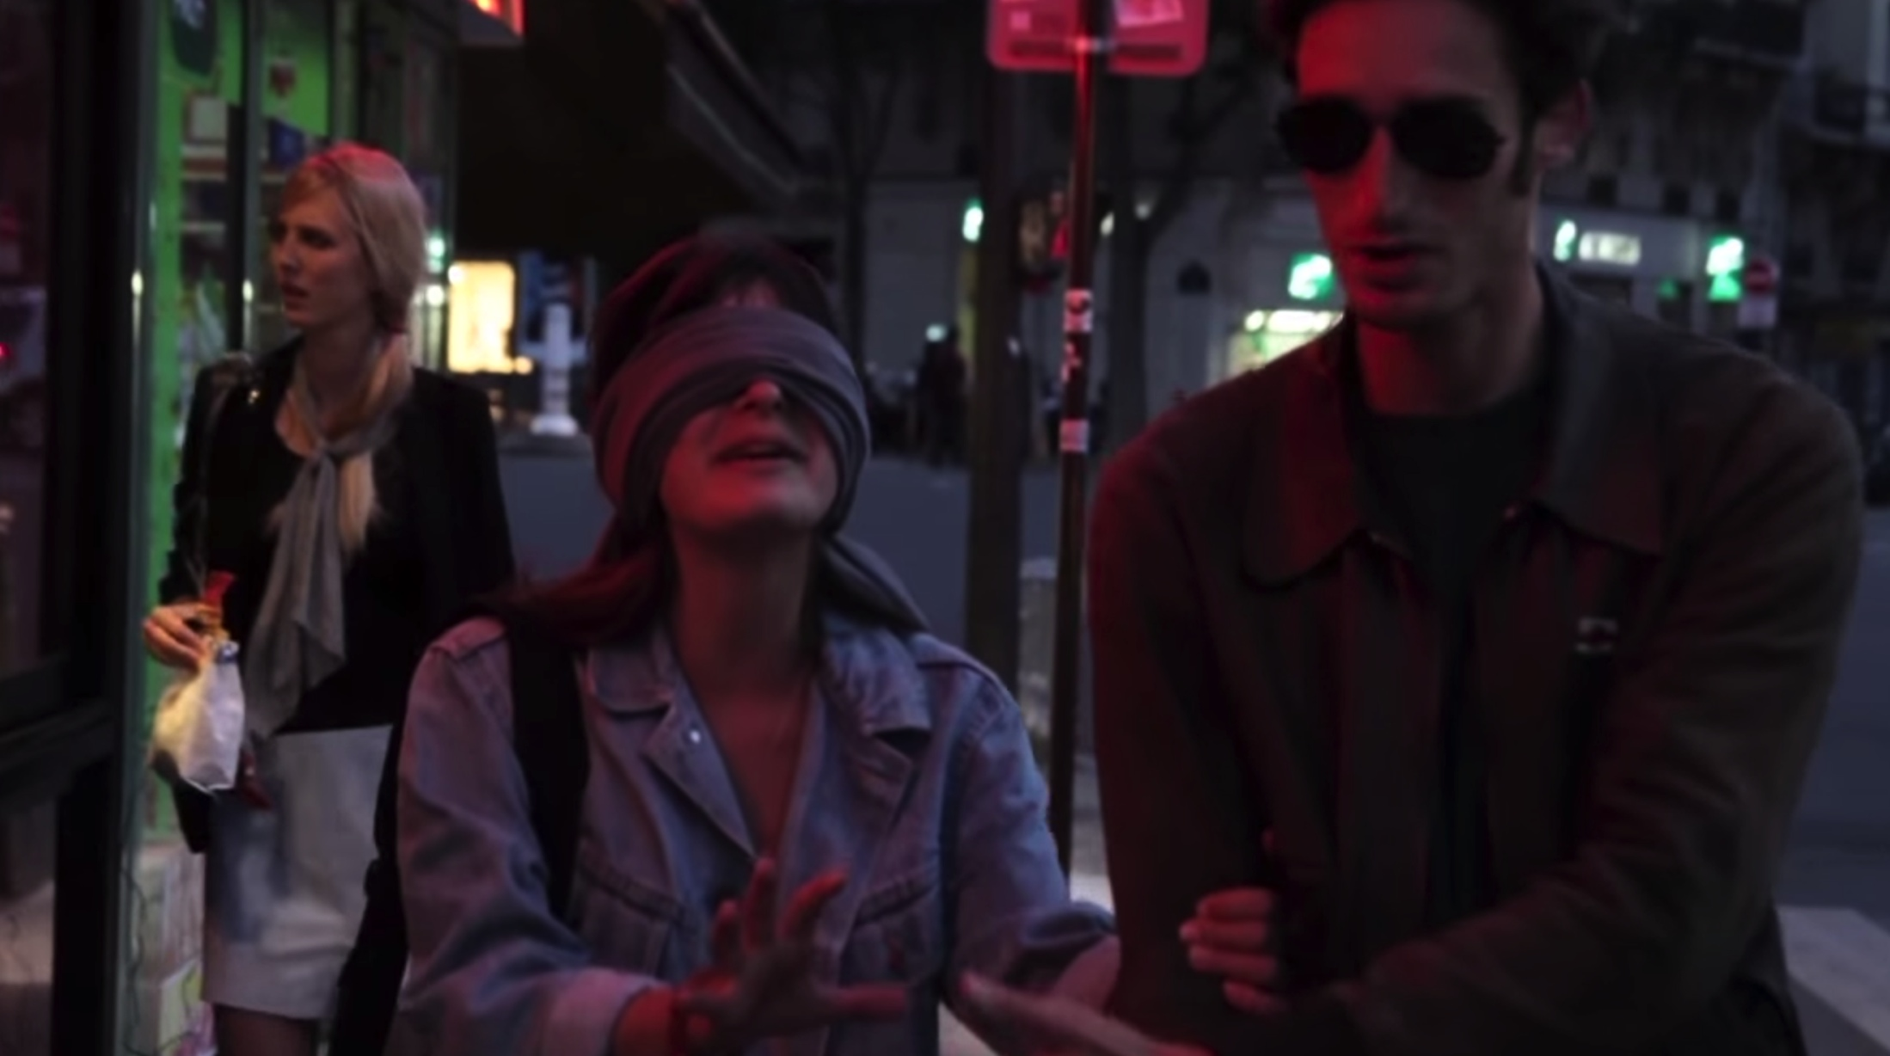
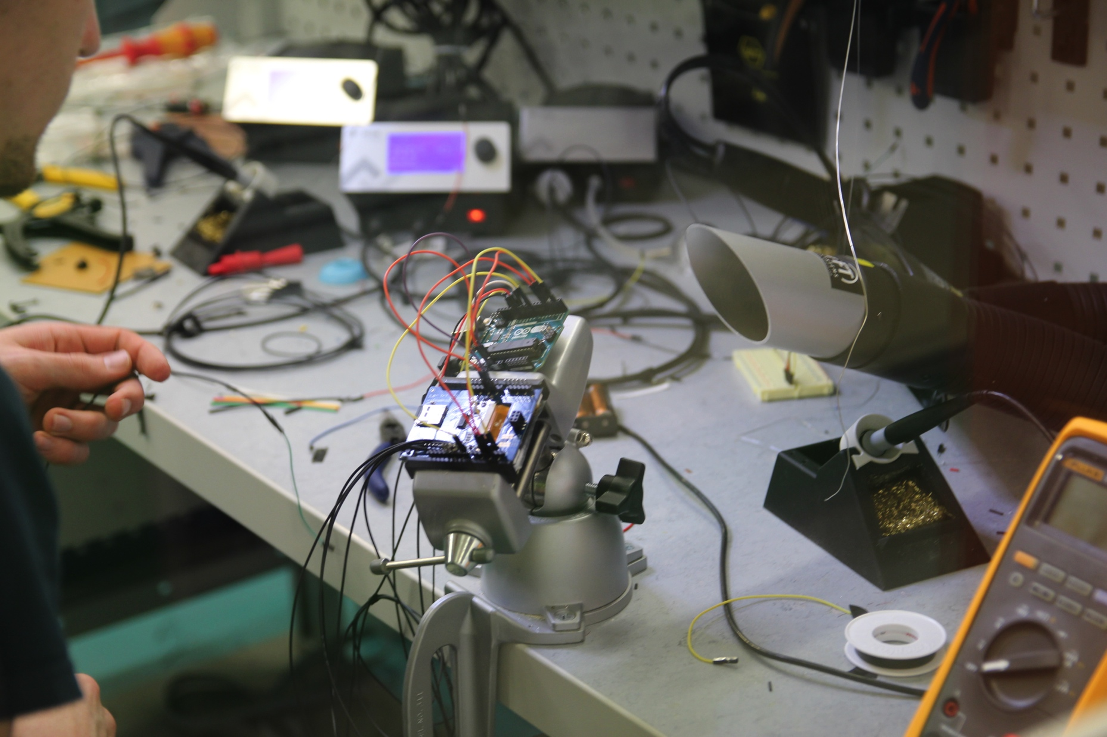
WHAT IS THE MOST INTERESTING LINK FOR NEW INNOVATION?
Detector R&D
Projects
Defined/closed
Technology
MSc-Level Student Programs
Initially undefined/open
Product
Process
Focus

Slide 14
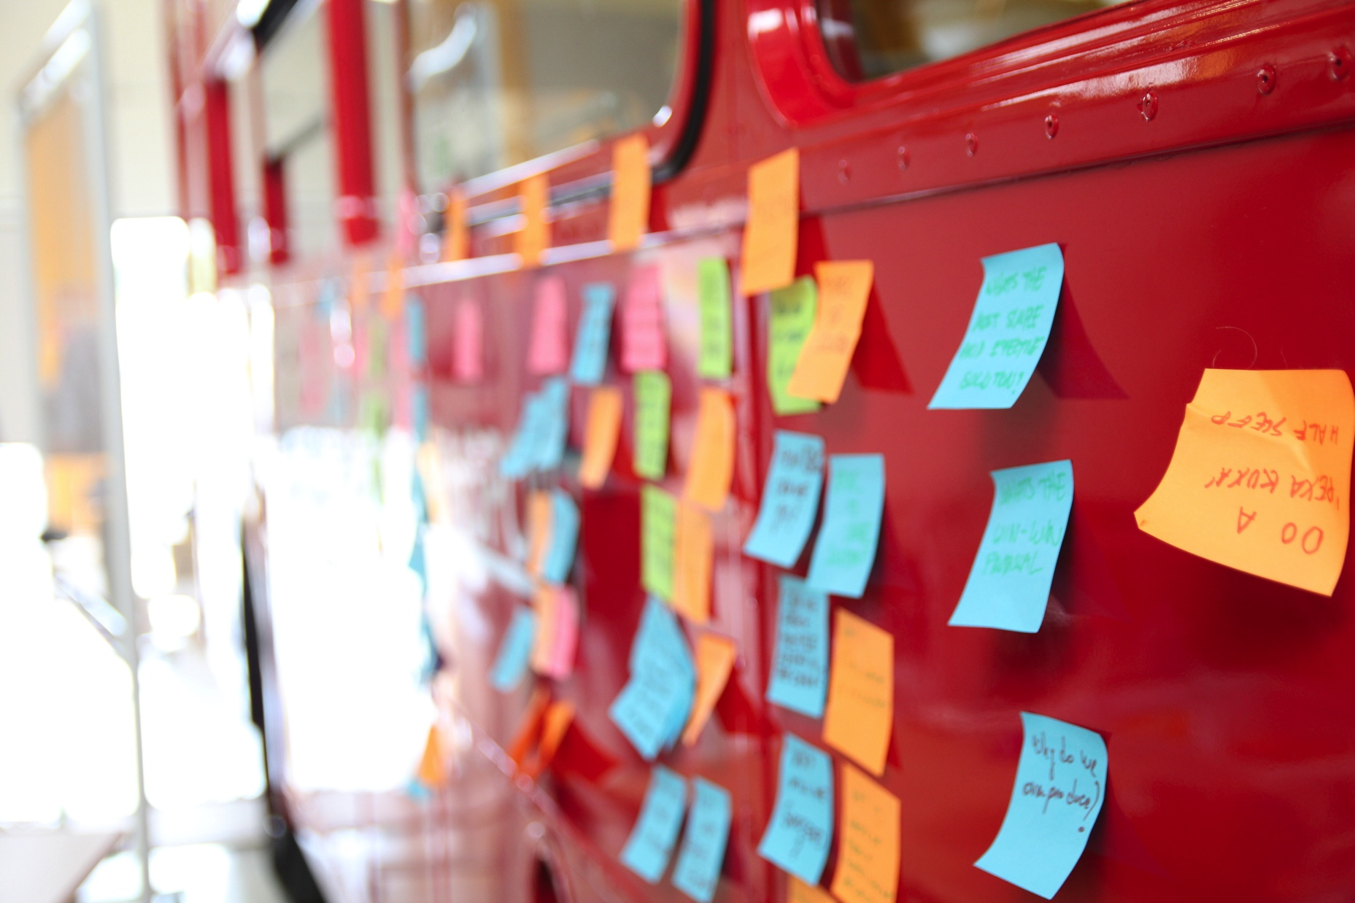
HOW DOES IDEASQUARE WORK?
Where is the magic? Bringing different people together. Empowering them. Putting people first.
  Information doesn’t radiate (communication deprived at 4m distance, goes to nearly zero at 20m) (TJ Allen, 1976)
  Single disciplinary teams do not radiate (single mindset leads thus far, but not beyond the rainbow)
People from different backgrounds are amazed by each others skills... but only when they see them! Diversity is key factor!
Innovation is 1% about ideas, 99% execution & iteration: finding ways in which people can collaborate and co-create efficiently

Slide 15
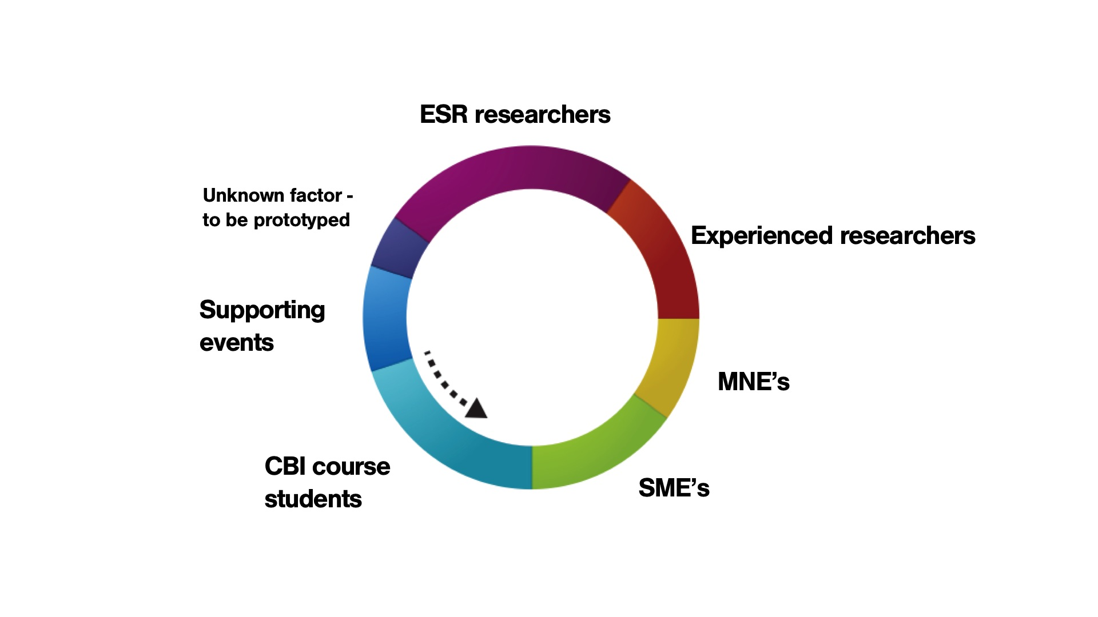
FEEDING LOOP
Ingredients for Creative Collaboration

Slide 16
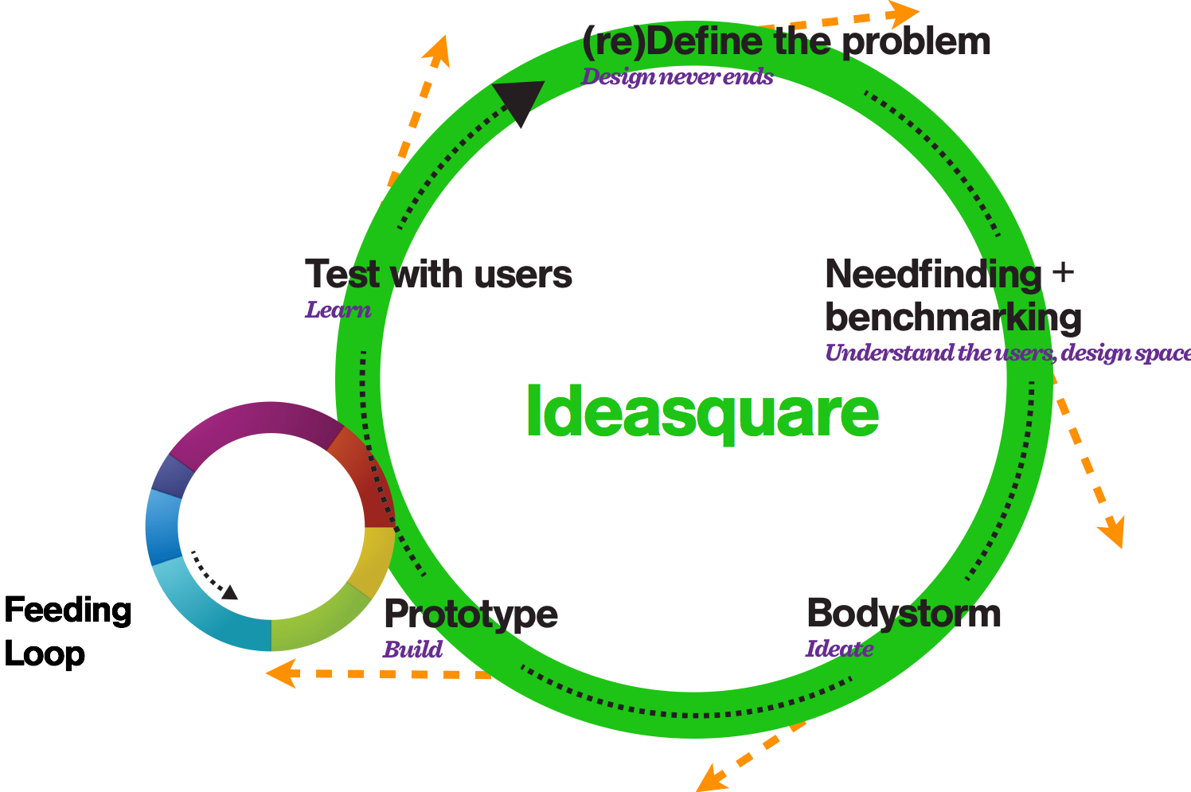
IDEASQUARE
The Small Human Collider

Slide 17
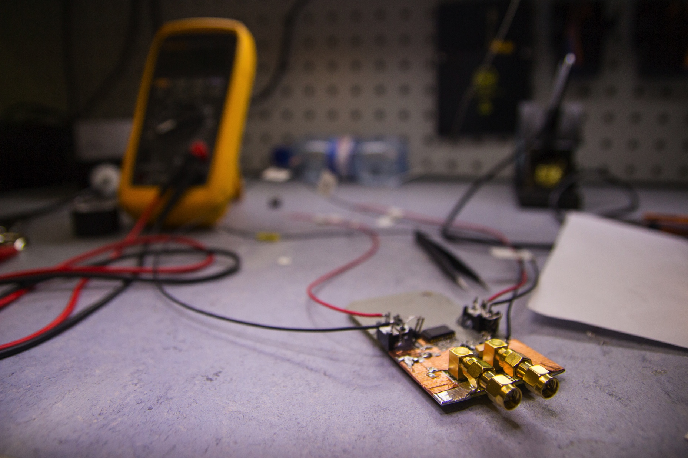
IDEASQUARE (EXPECTED) OUTPUT
Pilot project = outcomes and measures for them are in development with in-situ research
Communication, sharing ideas, spaces and resources improved in and between advanced technology development projects
The counter-intuitive, controlled addition of variation, diversity, connections, ideas that are realised as prototypes to accelerate technology development
Time span from discovery to application compacted
Societal value of basic research more visible and tangible
Education of future talent capable of working in basic research, commercial product & service development, or both
Demonstrator for ATTRACT

Slide 18
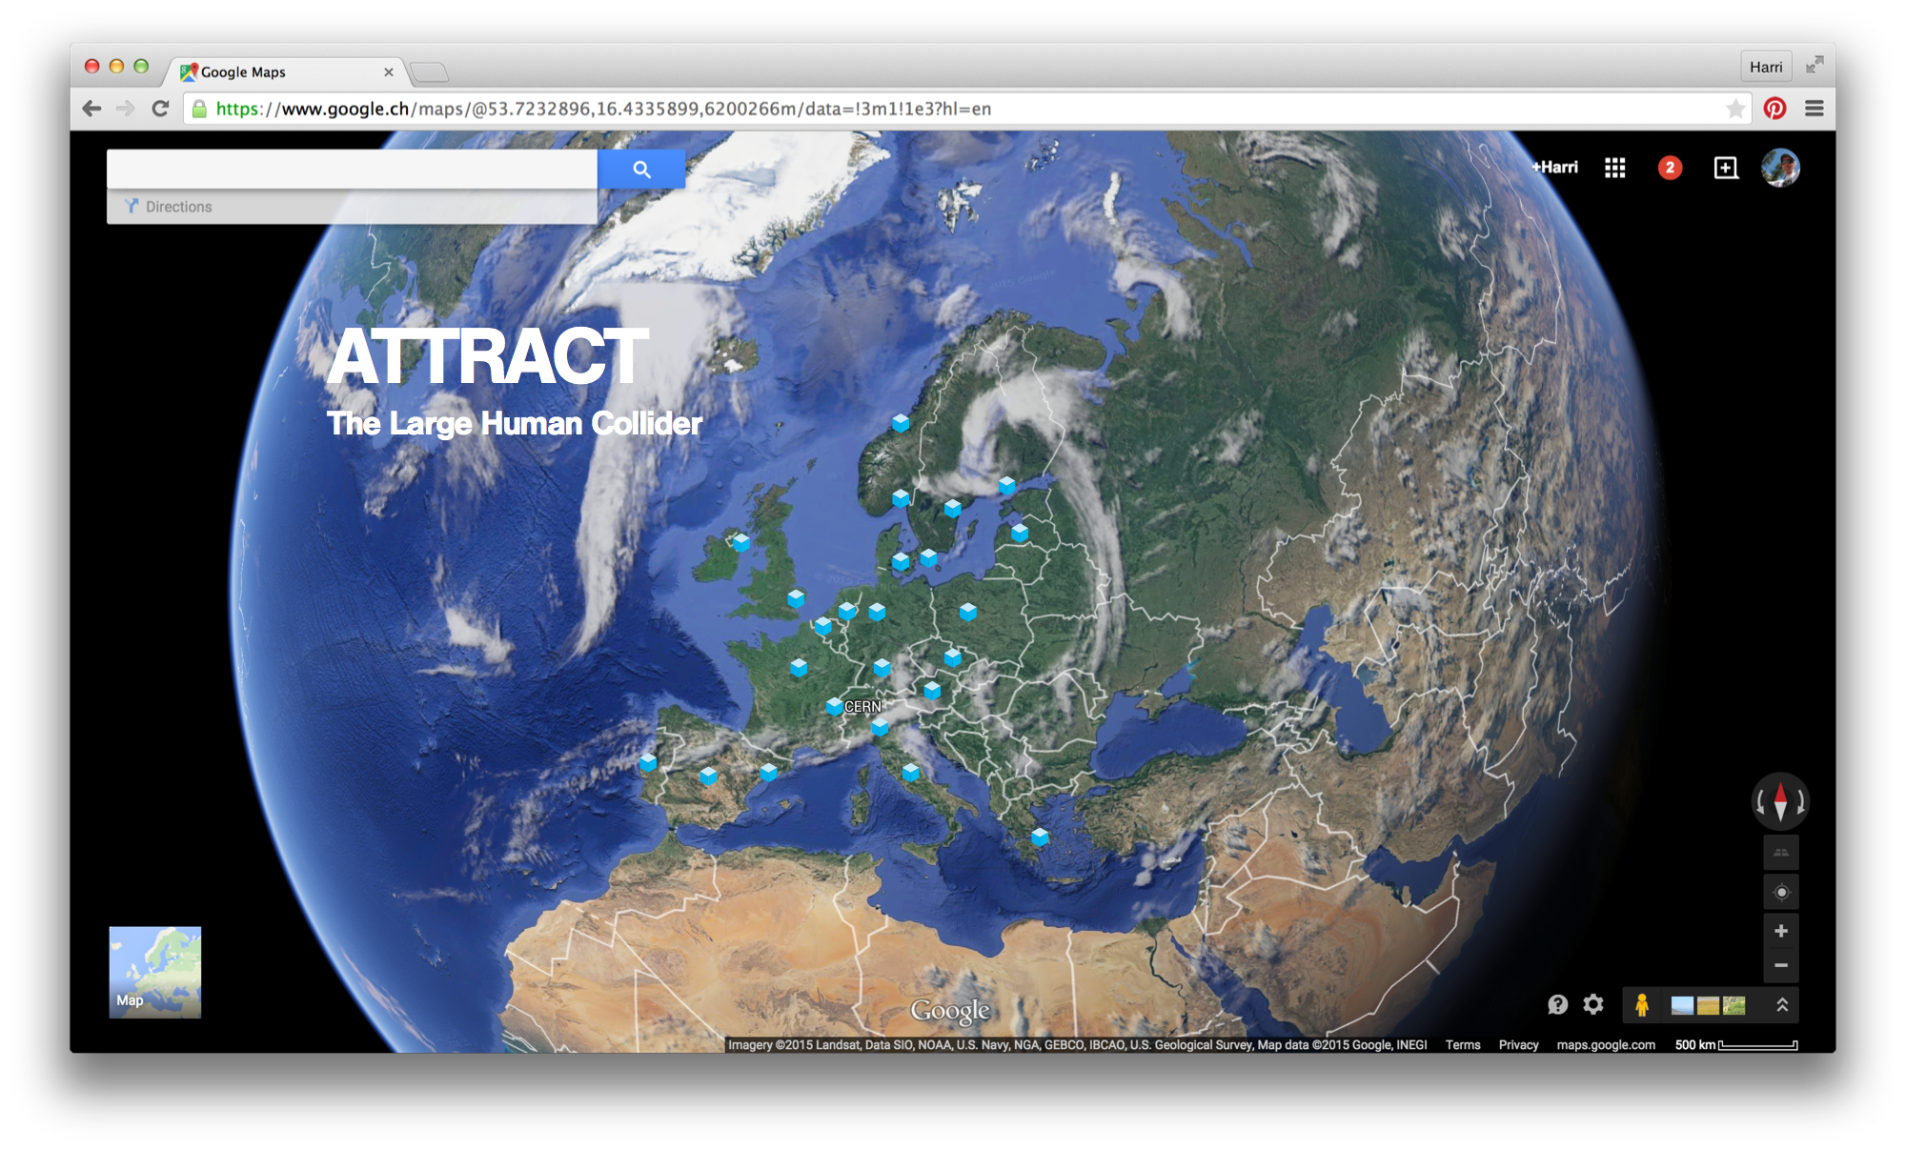

Slide 19


Questions? Comments?
Contact information:
Email: harri.toivonen@cern.ch
Skype: olavi-dude
Let’s have a cup of coffee and make interesting projects happen!

