Slide 2
Service Management
not only for IT anymore
Olaf van der Vossen
Service Manager
CERN
13/06/2018

Slide 3
ITSM
X
Notes:
This is the key message: everyone talks about ITSM; service-now is an ITSM platform; but it can be a SM platform….because ITSM is not limited to IT and is completely relevant and applicable outside IT with little effort. It will easy the lives of all users/customers to be confronted with one behavior, one system and one place to go for any problem if it’s IT or non IT (say HR, infrastructure, finance, whatever). We have no proven it can be done over the last 2 years with success using service-now.

Slide 4

BUT let’s start with
CERN
What is it ?

Slide 5
CERN
Who?
Notes:
Who is behind CERN?

Slide 6
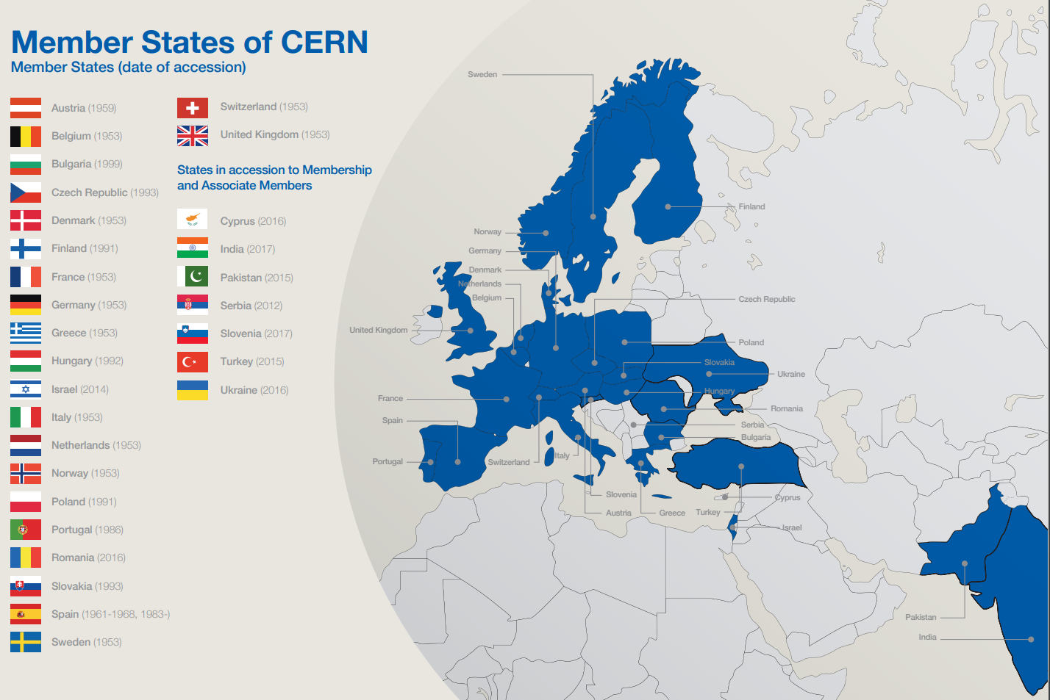
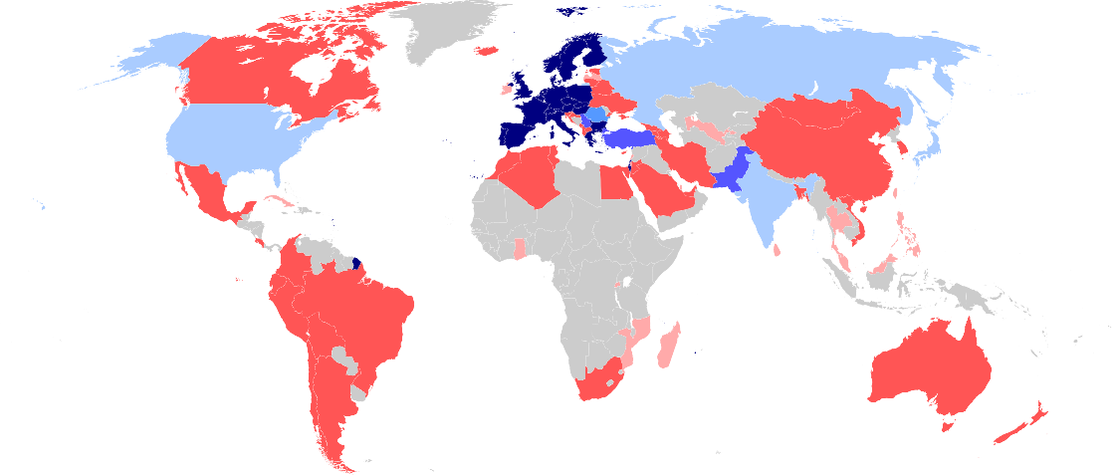
22 member states
Global collaboration
Associates
Observers
Cooperation agreements
Scientific contacts
Notes:
First, CERN is funded by 21 Members States.
Mostly European ones. But since 2008 any country in the world can apply for membership, either full or associate.
Israel is the last country which has joined CERN as full Member in 2014.
These countries give ca 1 Bn CHF (this is the budget of a mid-sized University) per year.

Slide 7








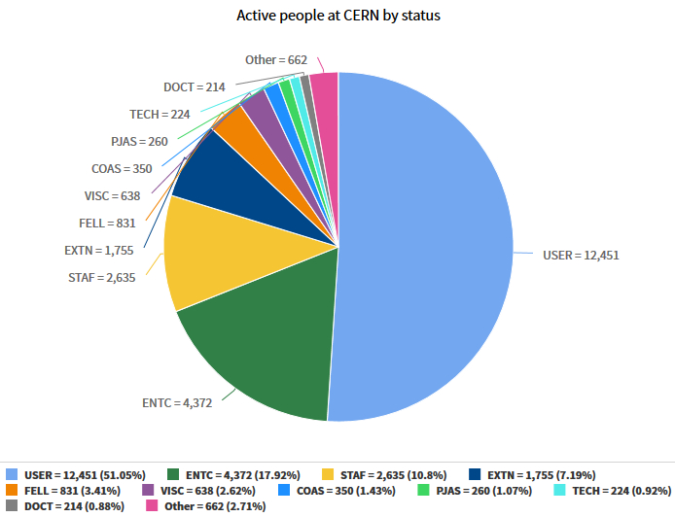


How many people?
+15’000!
2’500 staff
650 fellows & apprentices
500 students
12 000 users
4’000 contractor employees
Notes:
CERN employs «only» 2500 persons.
As Fellows and Apprentices are here for a first employement experiences.
The number of students can vary from 300 to 600 depending of the time of the year. It’s mostly university students.
The core population of CERN is made of about 11’000 «users», called like that because they are here to «use» CERN’s facilities.
They are NOT employed by CERN and come in the frame of the collaborations.
They are not all the time at CERN. Some spend 5% of their time at CERN (a few days a year), some spend 100% of their time.
It really depends on their function in the collaboration, on the need for them to be on site, or, on the other hand, the possibility for them to work remotely.
Given the size for CERN’s population, many services are externalized (mail, transport, restaurants, etc) to firms.

Slide 8
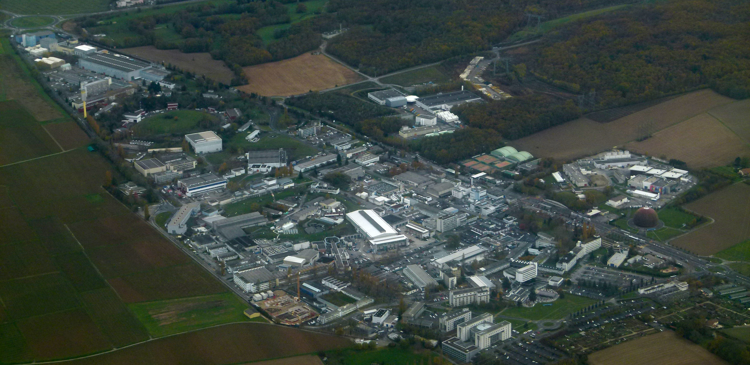

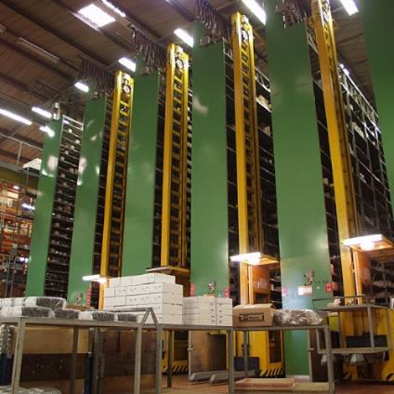
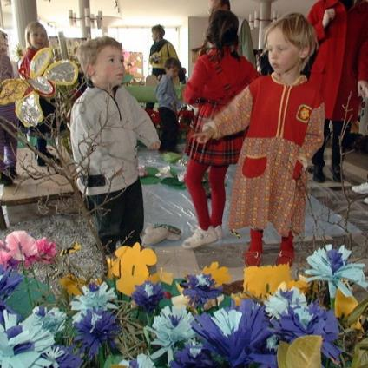
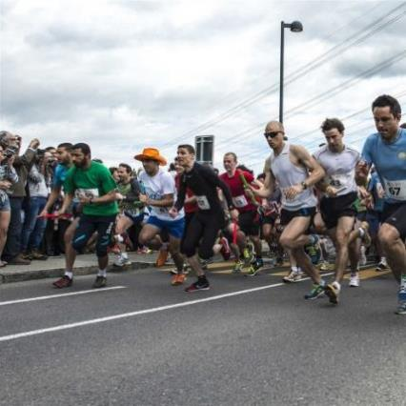
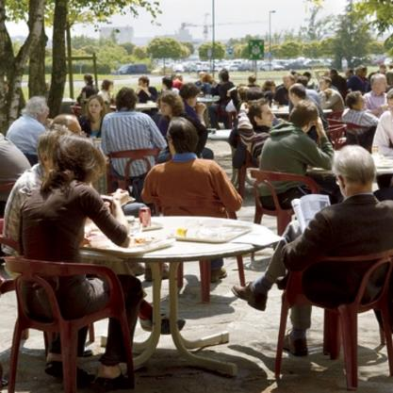
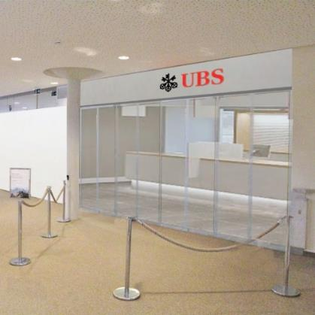
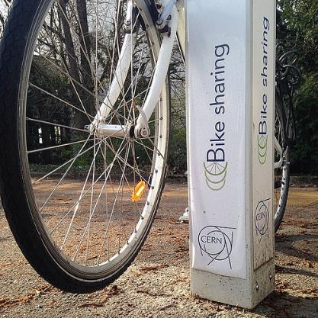
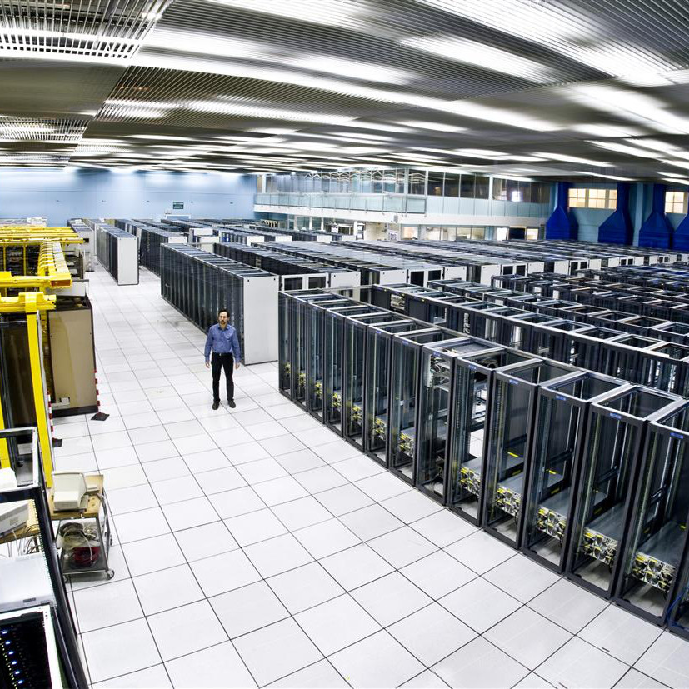
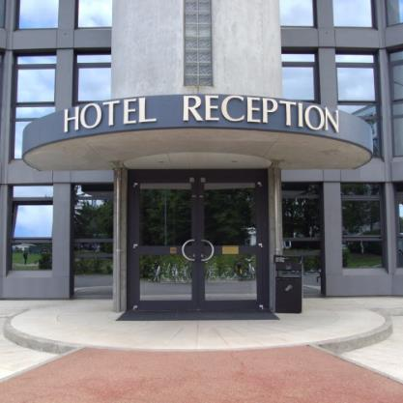
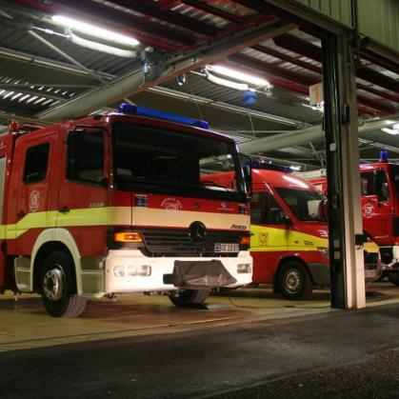
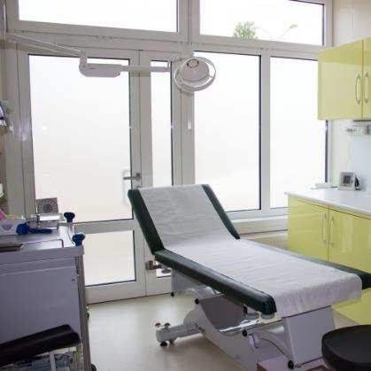
Like a town
Bank, Post Office,
Travel Agent
3 Hotels
Clubs, Associations
Tramway, bus, bikes
Data Centre
Medical Service
Mail, Stores…
Library
Restaurants
Kindergarten
Fire Brigade

Slide 9
CERN
What for ?
Guided tours at Lunch & 17:00

Slide 10
WHY Service Management @ CERN
Do more with less
Resources under scrutiny → Demonstrate optimization of efficiency and effectiveness
Shift from project (build LHC) to operate (run LHC) → Customer/User Service Orientation
(Culture Change)

Slide 11



CERN Service Management System Vision
Simplify life for users and supporters in the CERN town
ONE point of contact
ONE behaviour
ONE tool
ONE definition
I am cold… the Heating doesn’t work..
I need help about car sharing
I can not access the wifi network
How can I access LXPLUS?
I need a key for my new office !
When does the shuttle to the airport leave
Notes:
Service management at CERN aims to simplify users and supporters life by providing
An
- Unique point of contact for different services
- same behaviour and process to contact all services
- One tool to facility the work between services
And finally ONE business service catalog for all those services

Slide 12

Service Management System Expected Outcomes
For users simplify life by providing a single point of contact for all services.
For supporters ease work using a single collaborative highly automated tool.
For management improve monitoring and control (Dashboards!).
For governance committees demonstrably improve efficiency and effectiveness.
  Alignment with good practice (ITILv3 and ISO20k)
  Framework for continuous improvement
  AND DO THIS FOR ALL SERVICES (NOT ONLY IT)

Slide 13
Service management – What we think it IS ?
Established industry best practice, used with success by thousands of organisations worldwide
(“de facto” standard)
A strategic framework, covering all services (not only IT)
Business/customer/user focussed (primary focus on WHAT not HOW)
A set of management processes covering the complete service lifecycle
An approach to ‘adopt and adapt’ to ensure service solutions provide the best possible fit to the specific requirements of the organization
Service management – What we think it IS NOT !
A tool (like ServiceNow)
A service desk
A conspiracy to monitor people
A website ☺

Slide 14
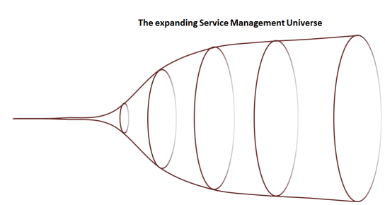
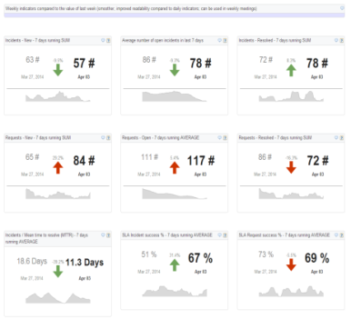
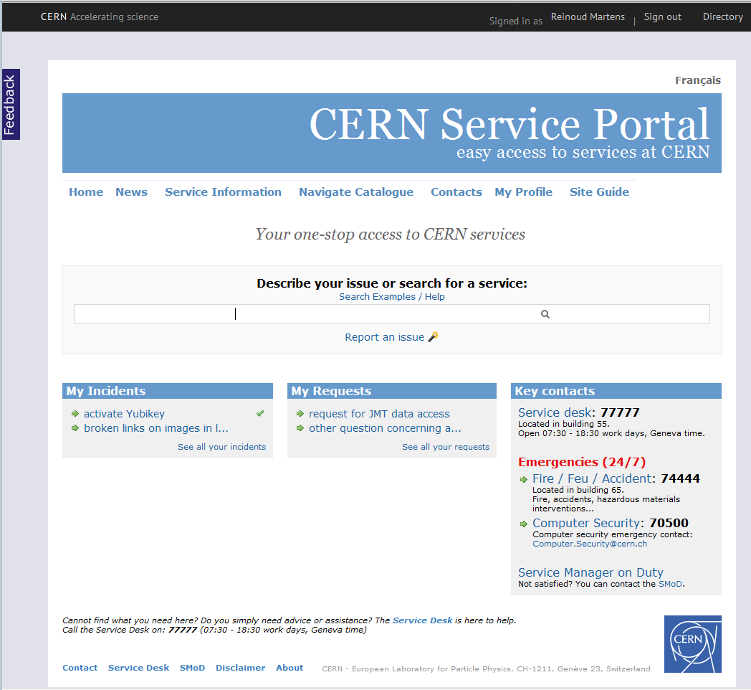
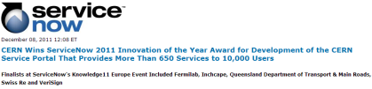
A long story
KPI’s & DASHBOARDS !
> Services
Catalog and Processes and Portal in ServiceNow
> Maturity (Coaching)
Convince Peers & Management
Tool Selection
> Processes
Eureka !
IT joins;
Project Starts
Tool Bought
Go Live
KPI Dashboards
CERN structure change
No impact
2009
2011
2012
2013
2014
2015
2016
2010
Train 400 Supporters
1000 Supporters
1300 Supporters
Mobile applications
MANAGEMENT REQUESTS
KPI DASHBOARD
Extend Catalog and Processes to IT
Recruit and train Service Desk
>350000 End User Inc/Req Resolved
Work Orchestration
>250000 tickets / year
Define user Facing Processes for Non IT
(Request and Incident)
Define Business Service Catalog for Non IT

Slide 15
How we did it

Slide 16
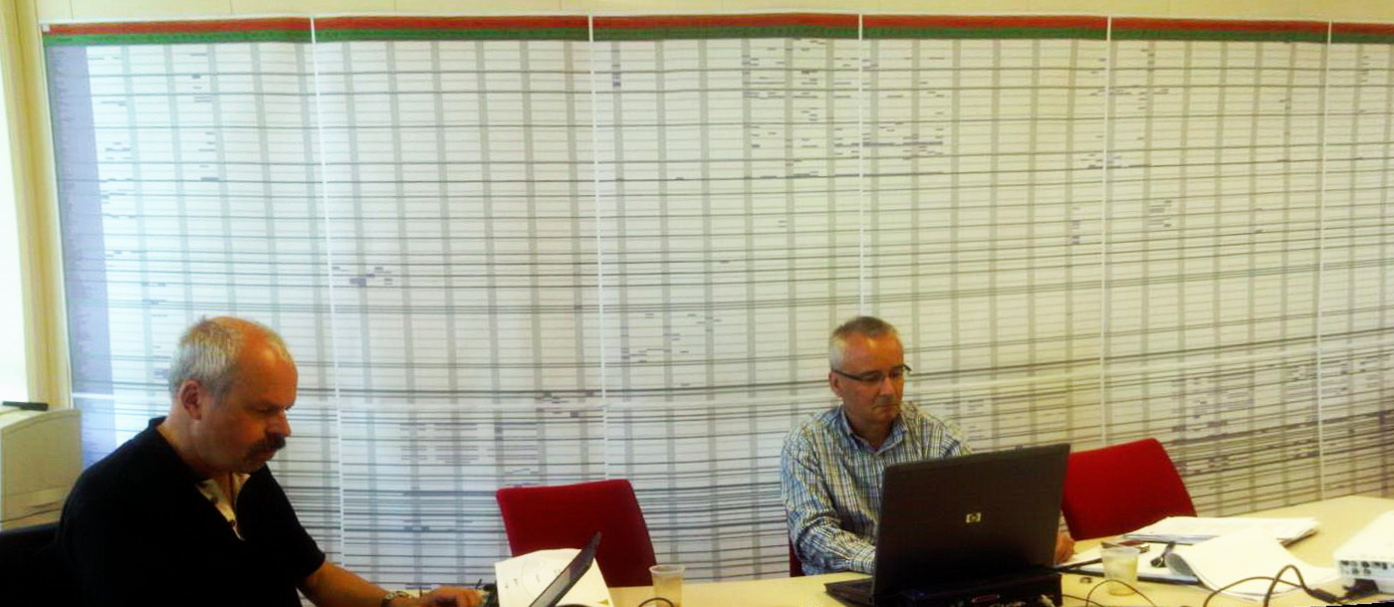
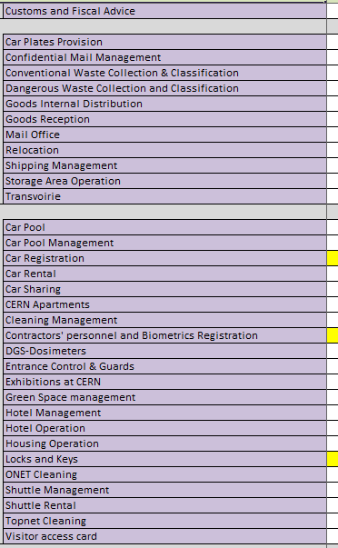
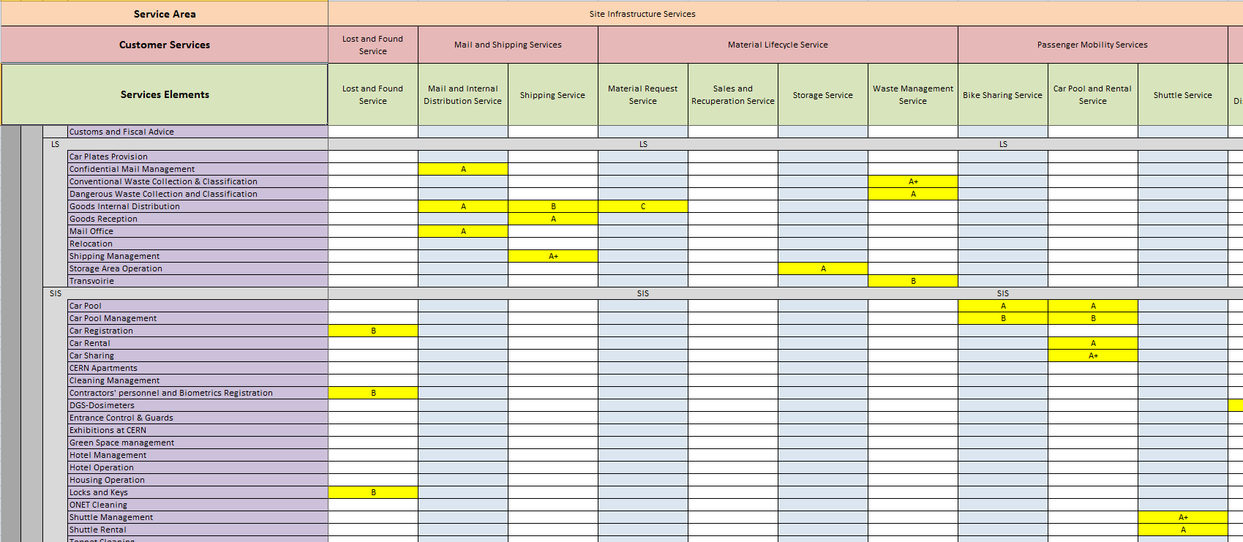
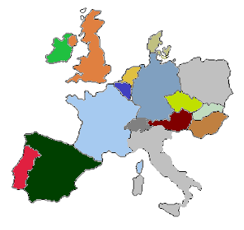
Business Service Catalogue
Matrix structure with 2 dimensions:
  Columns: Services (What, User View) (today ~300 operational)
  Rows: Functions (How, Supporters View) (today ~600 active)
What
How

Slide 17

Service Portal (hide complexity)
Easy access to all services
Search function
Browse the catalogue
Report issues
Follow-up issues
Access knowledge base
Access to service status info

Slide 18
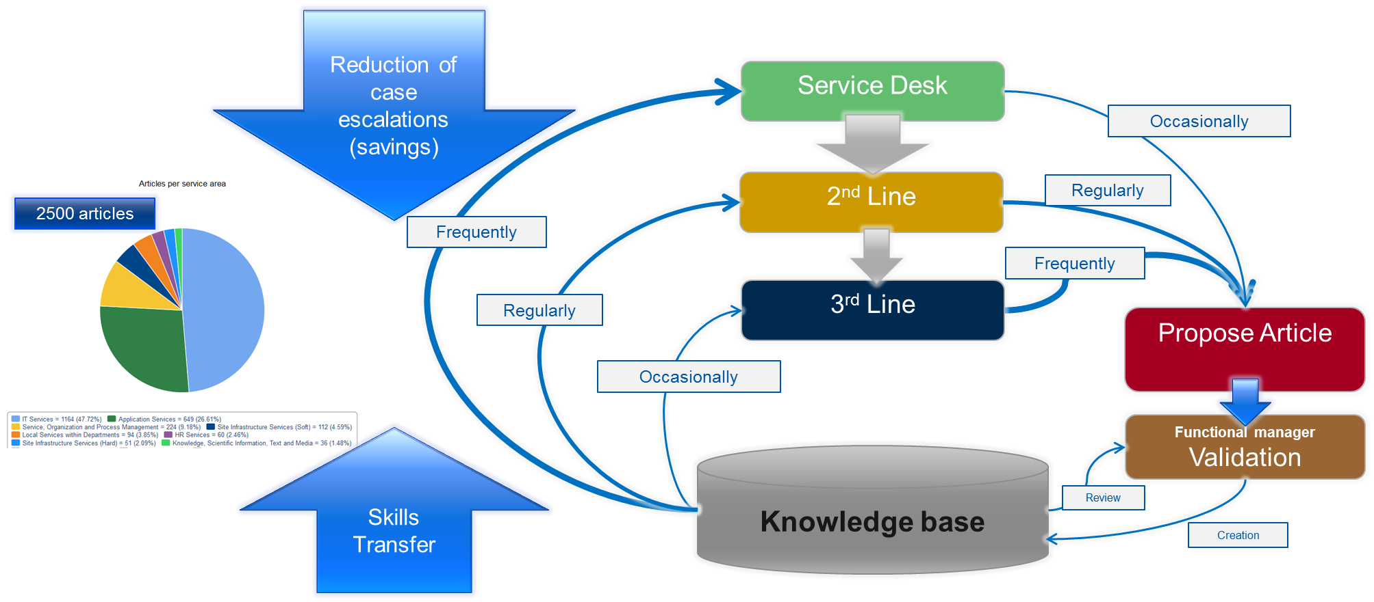
Knowledge (for Self Help and Business Continuity)

Slide 19
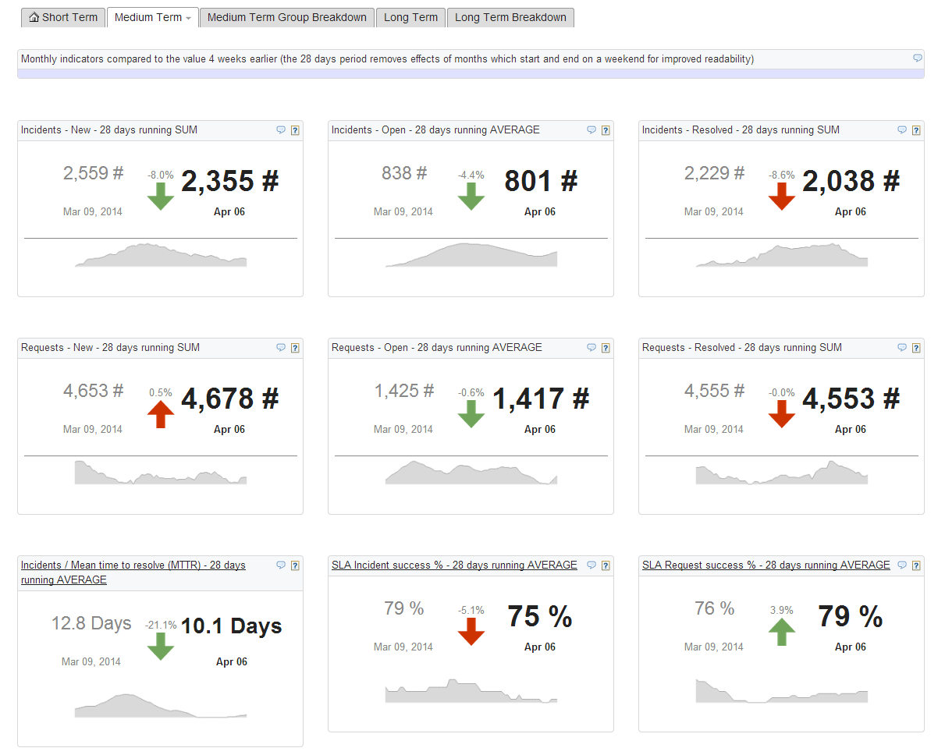
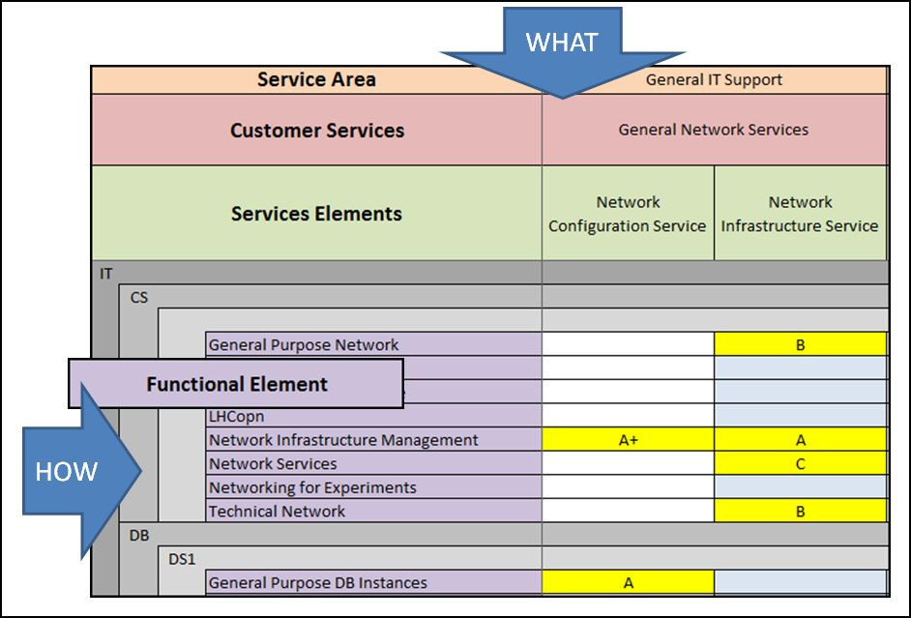
Dashboards create awareness
Dashboards by
  Service Area, Customer Service and Service Element (What)
  By Department, Group and Function (How)
Finally we can improve ☺

Slide 20
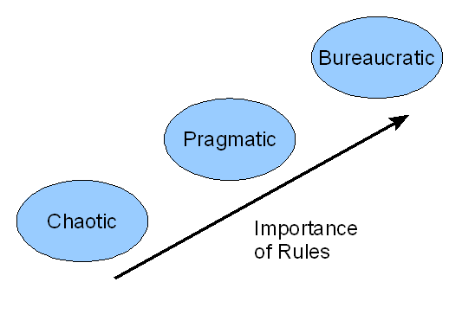
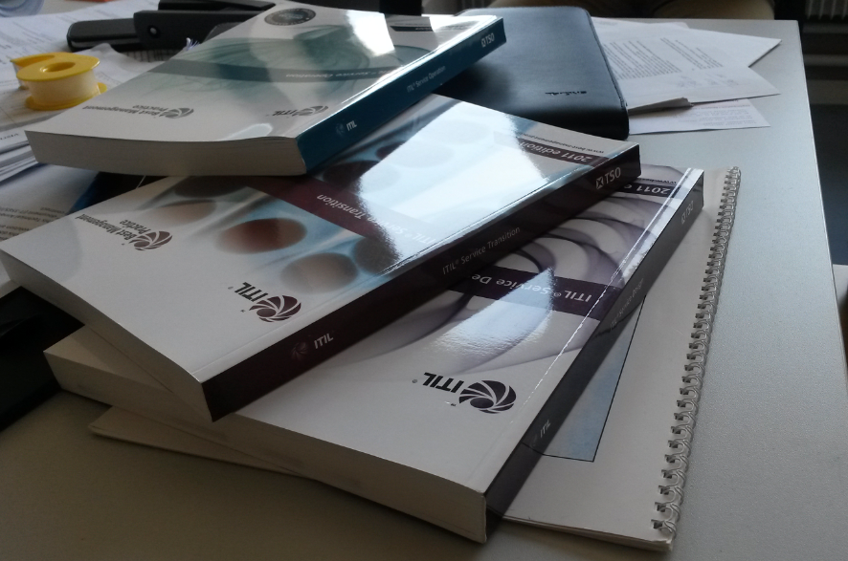
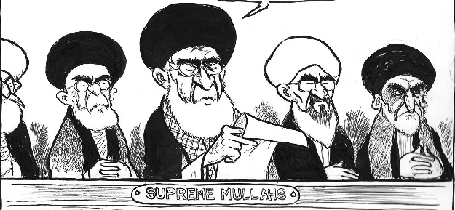
ITIL V3 framework for non IT, but
Remove all references to IT
(a ‘reinterpretation’ keeping the spirit, generalizing beyond IT)
Stay PRAGMATIC
(only take what is useful; leave the rest for ‘later’ ☺)
No over-engineering
KISS (Keep It Simple Stupid)
ITIL
Service Management team

Slide 21
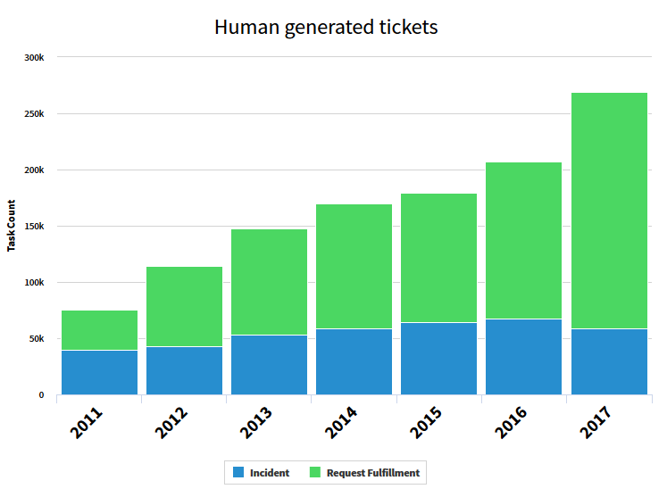
7 Years of Enterprise service management
Annual growth # cases ~ 20%
Focus in last years shifted from
  end user experience
  To
  process support / work orchestration
We improved
  efficiency (users and supporters)
  control (transparency through metrics for our managers)
We enabled the continuous improvement process
We facilitated collaboration and knowledge sharing
We think we help CERN to become more efficient and effective..

Slide 22





Conclusion
  Yesterday’s CERN
  Future CERN
  Goals (What)
Simplicity
Efficiency
Facility
Services
HR
Services
Shuttle Service
Training Service
Accountability
S e r v i c e I n t e g r a t i o n
Application
Services
Other
Services
Cleaning Service
Electricity Service
Transparency

User

User
Effectiveness
End-2-End Responsibility
Technical
Infrastructure
Services
Hotel Service
Alignment (good practice)
Mobility
Services
Payroll Service
IT
Services
Finance
Services
Guards Service
ANY SERVICE
  Goals (How)
ONE point of contact
ONE process
ONE tool

Slide 23
Top Takeaways
1
ITSM is RELEVANT beyond IT and it WORKS
X
2
Invest in a comprehensive
Business Service Catalog & Service Portal
3
ESM can generate significant (unplanned) savings
4
No “rocket science”, this will work for you too

Slide 24

Thank You
Olaf van der Vossen
CERN

