Slide 1

Evolution of Hadoop and Spark service at CERN
Zbigniew Baranowski
CERN IT-DB Hadoop and Spark Service, Streaming Service
May 17th, 2018

Slide 2


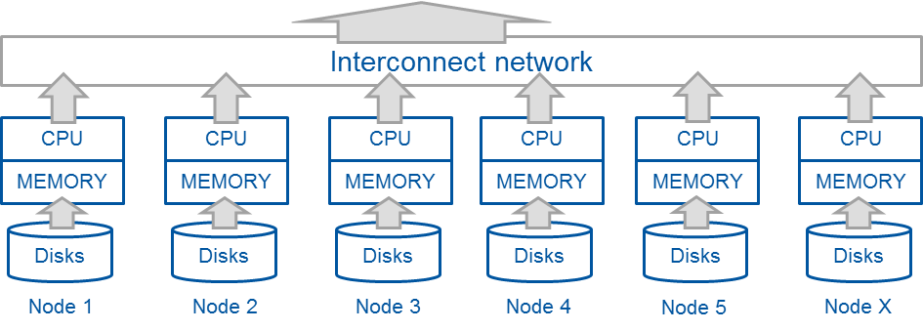
Hadoop and Spark for big data analytics
  Distributed systems for data processing
    Storage and multiple data processing interfaces
    Can operate at scale by design (shared nothing)
    Typically on clusters of commodity-type servers/cloud
    Many solutions target data analytics and data warehousing
    Can do much more: stream processing, machine learning
Already well established in the industry and open source
Scale-out data processing

Slide 3
CERN Hadoop Service - Timeline
2013
2014
2015
2016
2017
2018
Start of Hadoop pilot service
Adoption of Hadoop 2 (YARN) and Apache Spark
Adoption of SQL-based solutions (Hive, Impala)
Starting Kafka pilot
Rolling out HDFS backups
XRD connector and monitoring
Production ready
High availability, Custom CERN distribution
Adoption of Jupyter Notebooks (SWAN)
LHC critical projects commits to use the service
First secured
cluster
deployed
Central IT Monitoring project moves to Hadoop
Started R&D with other RDBMS-based projects
Start of CMS Big Data project
Fourth cluster installed
(for LHC mission critical systems)
Spark cluster on Kubernetes
First projects by ATLAS and CASTOR
Second cluster installed
IT Security project moves to Hadoop
Start of series of introduction training
Third cluster installed

Slide 4
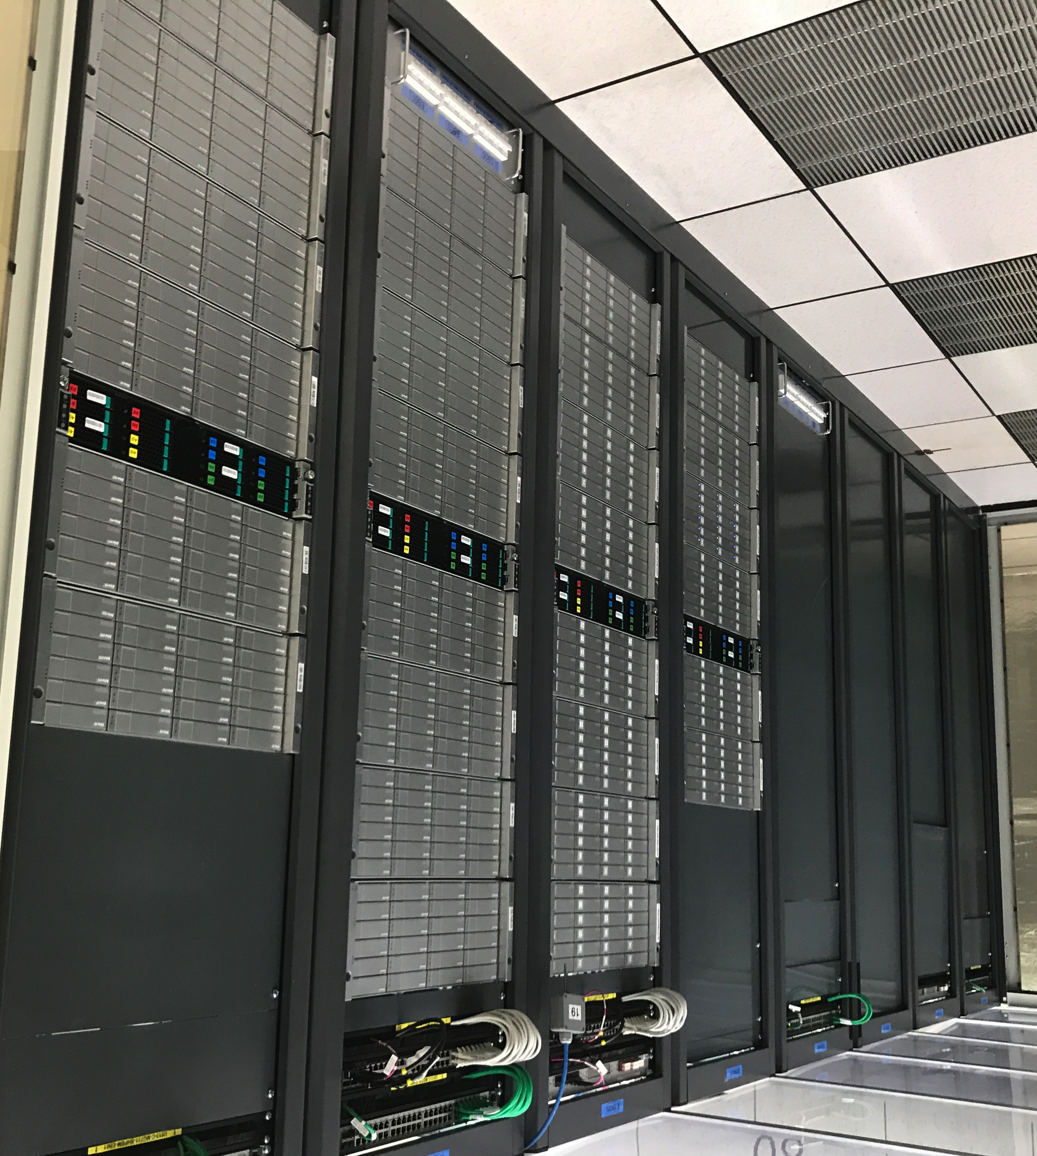
Hadoop Service at CERN IT
Setup and run the infrastructure
Support user community
  Provide consultancy
  Ensure knowledge sharing
  Train on the technologies

Slide 5



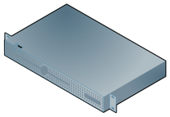




Hadoop service in numbers
6 clusters
  4 production (bare-metal)
  2 QA clusters (VMs)
110+ physical servers
40+ virtual machines
14+ PBs of Storage
20+ TB of Memory
1500+ physical cores
HDDs and SDDs
Data growth: 4 TB per day
CPU

Slide 6
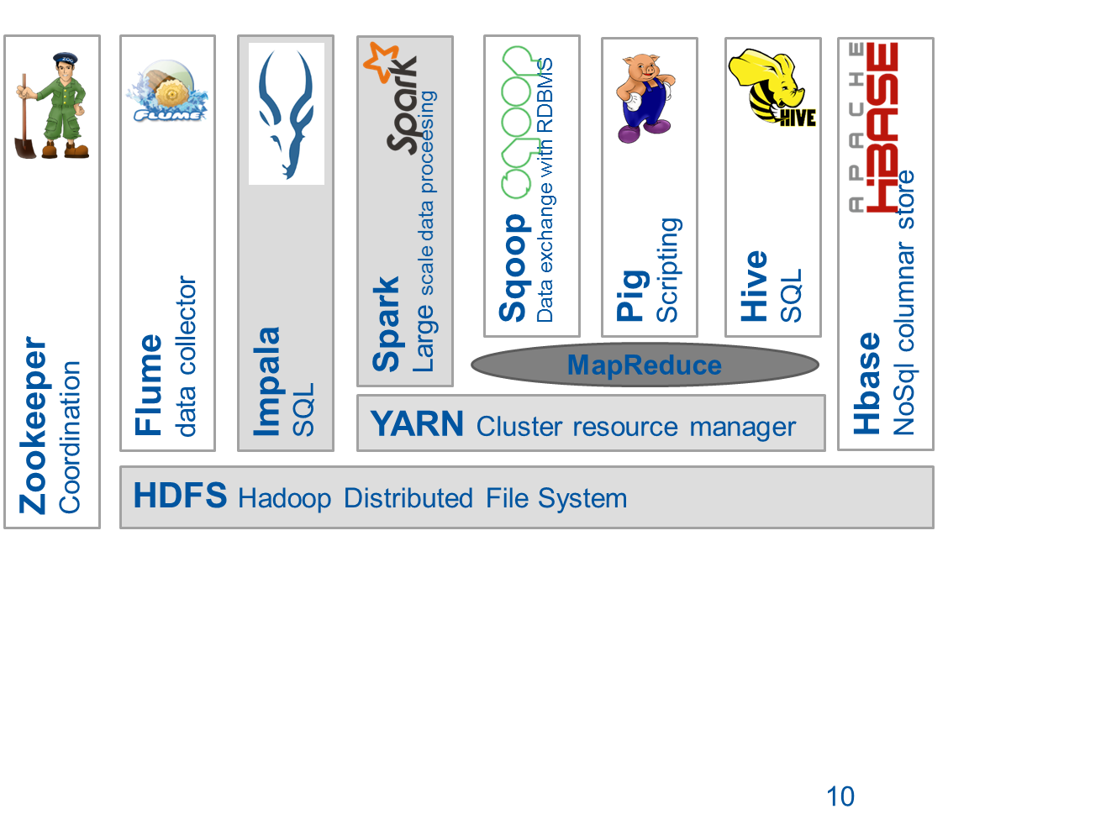

Overview of available components in 2018
Kafka:
streaming and ingestion
6

Slide 7



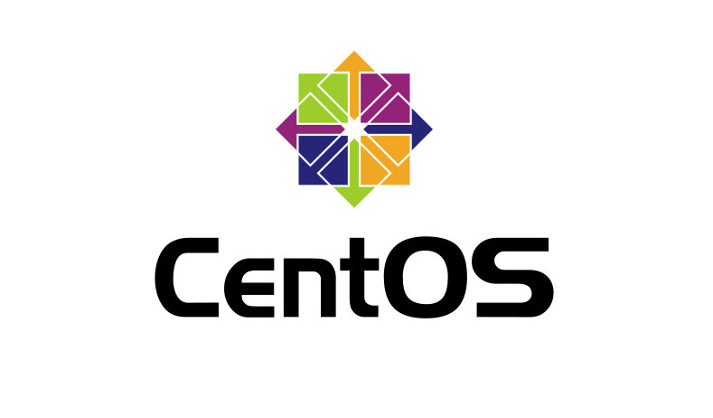





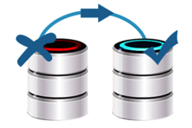

Hadoop and Spark production deployment
Software distribution
  Cloudera (since 2013)
  Vanilla Apache (since 2017)
Installation and configuration
  CentOS 7.4
  custom Puppet module
Security
  authentication Kerberos
  fine-grained authorization integrated with e-groups (since 2018)
High availability (since 2017)
  automatic master failover
  for HDFS, YARN and HBASE
Rolling change deployment
  no service downtime
  transparent in most of the cases
Host monitoring and alerting
  via CERN IT Monitoring infrastructure
Service level monitoring (since 2017)
  metrics integrated with: Elastic + Grafana
  custom scripts for availability and alerting
HDFS backups (since 2016)
  Daily incremental snapshots
  Sent to tapes (CASTOR)

Slide 8


XRootD connector for Hadoop and Spark
A library that binds Hadoop-based file system API with XRootD native client
  Developed by CERN IT
Allows most of components from Hadoop stack (Spark, MapReduce, Hive etc) to read from/write to EOS and CASTOR directly
  Works with Grid certificates and Kerberos for authentication
  Used for: HDFS backups, performing analytics on data stored on EOS (CERNBox)
C++
Java
Hadoop
HDFS
Spark
(analytix)
EOS
Storage
System
EOS
Storage
System
XrootD
Client
Hadoop-XrootD
Connector
Xrootd
Client
JNI
JNI

Slide 9

Moving to Apache Hadoop distribution (since 2017)
Better control of the core software stack
  Independent from a vendor/distributor
  In-house compilation
  Enabling non-default features (compression algorithms, R for Spark)
  Adding critical patches (that are not ported in upstream)
We do rpm packaging for core components
  HDFS and YARN, Spark, HBase
Streamlined development
  Available on Maven Central Repository

Slide 10
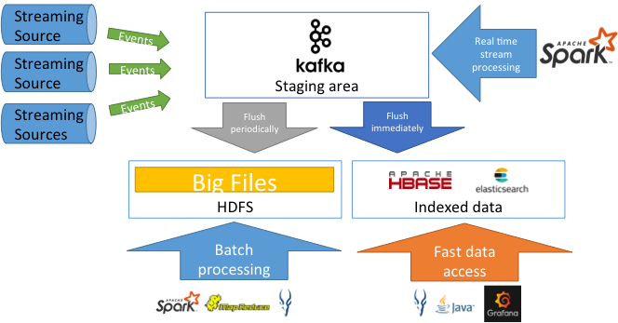
Apache Kafka - data streaming at scale
Apache Kafka streaming platform becomes a standard component for modern scalable architectures
Started providing Kafka as a pilot service in 2017

Slide 11



SWAN – Jupyter Notebooks On Demand
Service for web based analysis (SWAN)
  Developed at CERN, initially for physics analysis by EP-SFT and IT-ST
An interactive platform that combines code, equations, text and visualizations
  Ideal for exploration, reproducibility, collaboration
Fully integrated with Spark and Hadoop at CERN (2018)
  Python on Spark (PySpark) at scale
  Modern, powerful and scalable platform for data analysis
  Web-based: no need to install any software

Slide 12
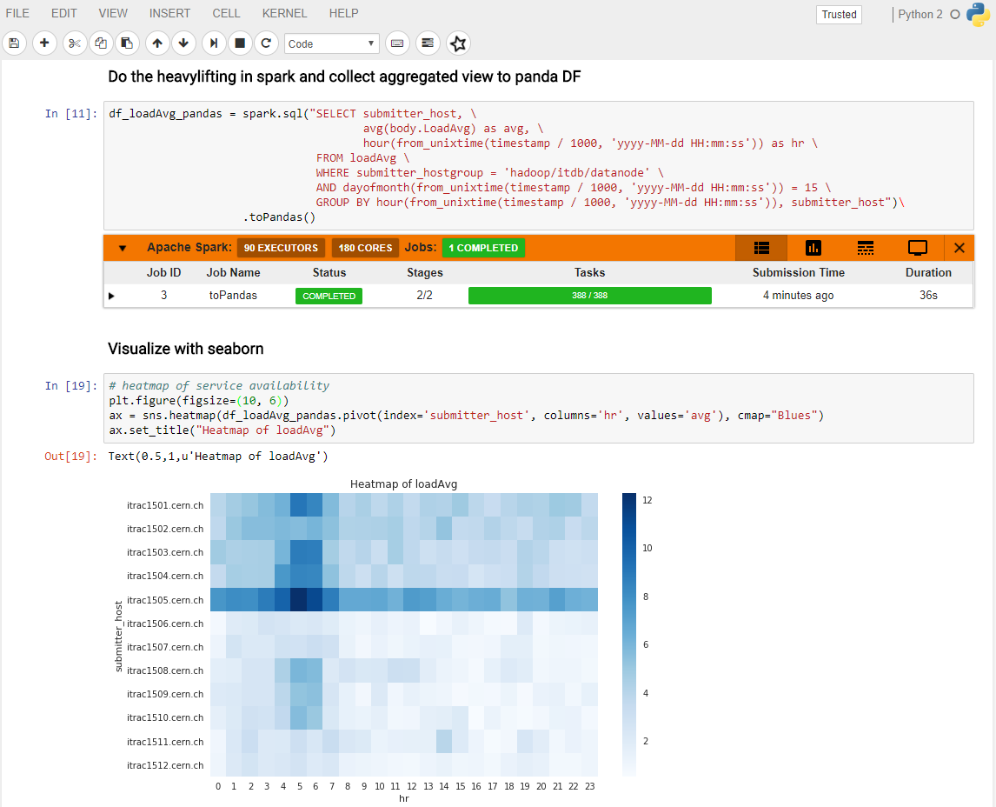
Text
Code
Monitoring
Visualizations

Slide 13




SWAN_Spark – Architecture
SSO
Web portal
IT Hadoop and Spark clusters
Spark Worker
Python task
Container Scheduler
Python task
User 1
User 2
User n
Spark Driver
AppMaster
CERN Resources
EOS
(Data)
CVMFS
(Software)
CERNBox
(User Files)

Slide 14



Spark as a service on a private cloud
Under R&D since 2018
Appears to be a good solution when data locality is not needed
  CPU and memory intensive rather than IO intensive workloads
  Reading from external storages (AFS, EOS, foreign HDFS)
  Compute resources can be flexibly scale out
Spark clusters - on containers
  Kubernetes over Openstack
  Leveraging the Kubernetes support in Spark 2.3
Use cases
  Ad-hoc users with high demand computing resource demanding workloads
  Streaming jobs (e.g. accessing Apache Kafka)

Slide 15
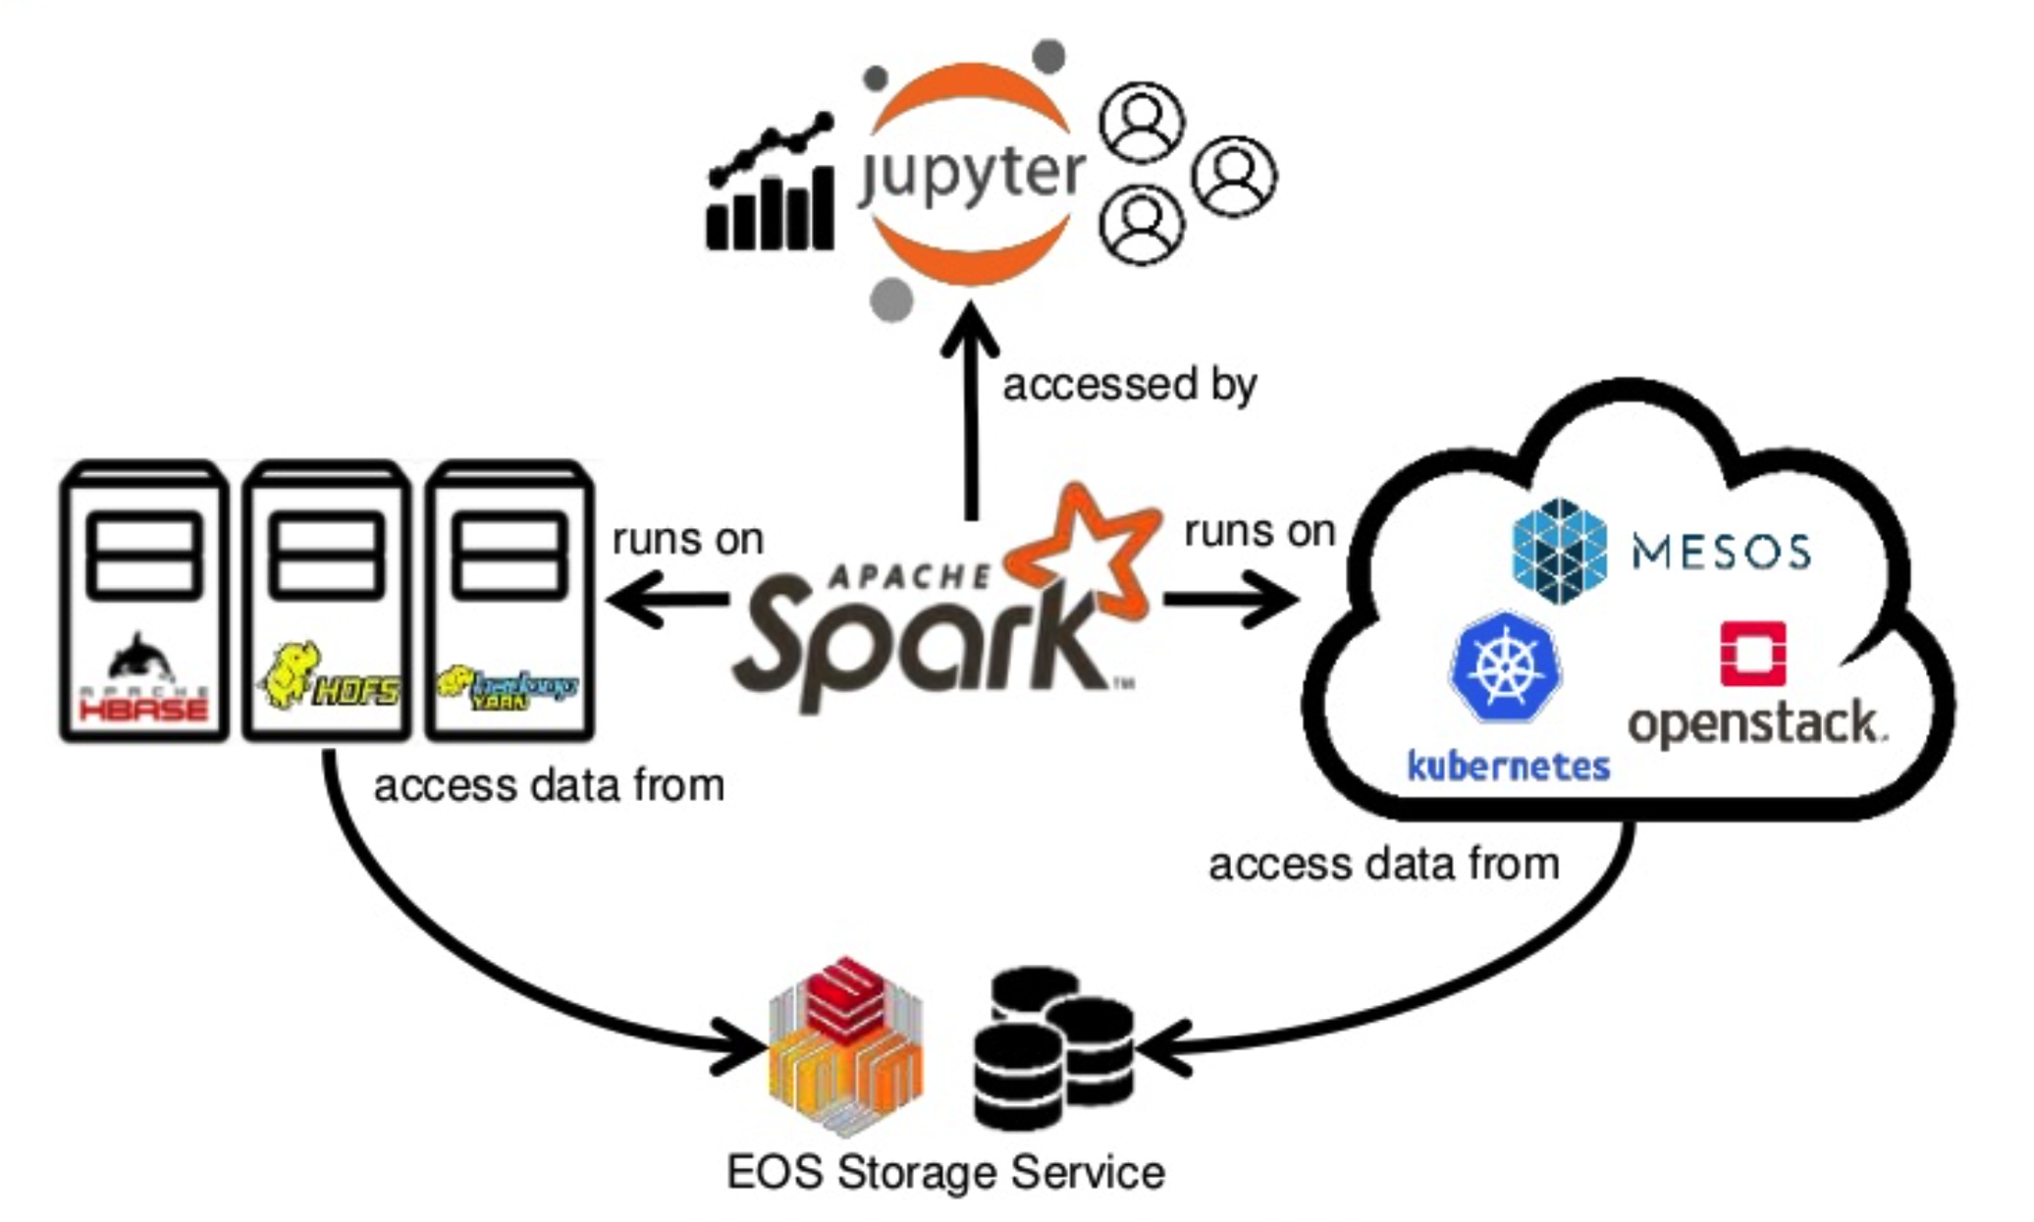
Analytics platform outlook
High throughput IO and compute workloads
Established systems
Flexible scalability for compute intensive workloads
Ad-hoc users

Slide 16
Selected “Big Data” Projects at CERN

Slide 17
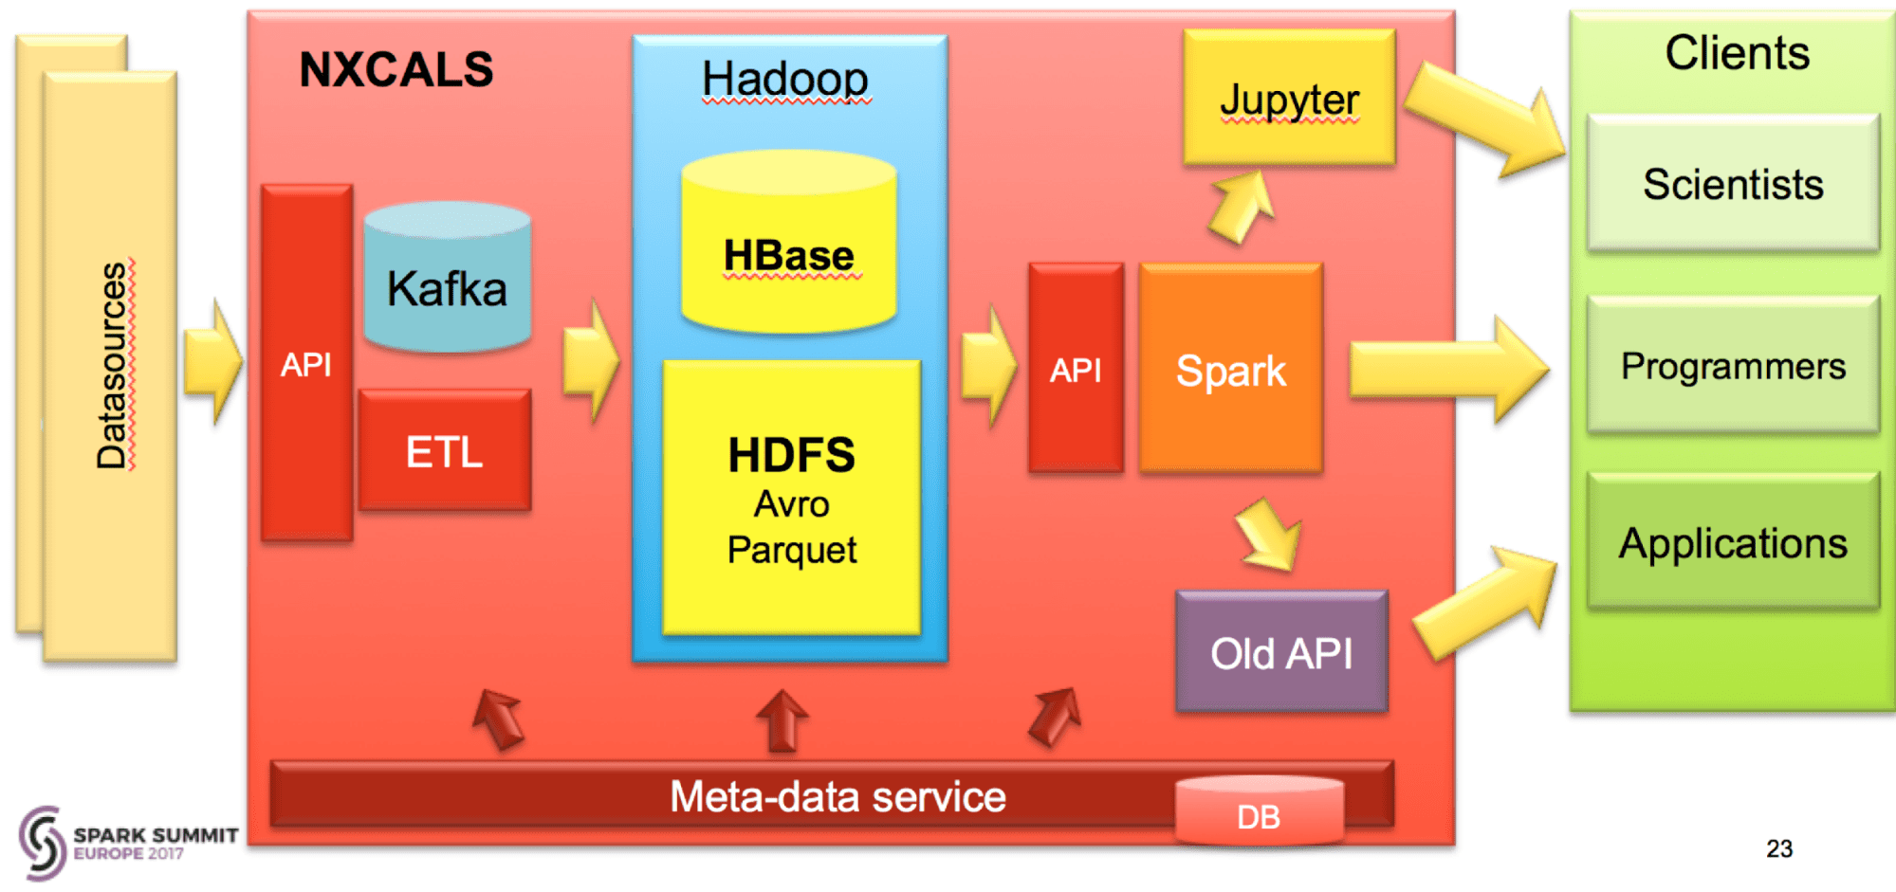
Next Gen. CERN Accelerator Logging
A control system with: Streaming, Online System, API for Data Extraction
Critical system for running LHC - 700 TB today, growing 200 TB/year
Challenge: service level for critical production
Credit: Jakub Wozniak, BE-CO-DS

Slide 18








New CERN IT Monitoring infrastructure
Critical for CC operations and WLCG
Data
Sources
Storage &
Search
Data
Access
Transport
AMQ
Flume
AMQ
Flume
Kafka
sink
Flume
sinks
Kafka cluster
(buffering) *
HDFS
FTS
DB
Flume
DB
Rucio
XRootD
HTTP feed
Flume
HTTP
ElasticSearch
Processing
Data enrichment
Data aggregation
Batch Processing
Jobs
…
Logs
Flume
Log GW
Lemon
syslog
…
Lemon metrics
Flume
Metric GW
CLI, API
app log
Others (influxdb)
Data now 200 GB/day, 200M events/day
At scale 500 GB/day
Proved to be effective in several occasions
Credits: Alberto Aimar, IT-CM-MM

Slide 19
The ATLAS EventIndex
Catalogue of all collisions in the ATLAS detector
  Over 120 billion of records, 150TB of data
  Current ingestion rates 5kHz, 60TB/year
WLCG
CERN
Events metadata extraction
Data enrichment
Analytics Web UI
Event extraction Web UI
Grid job
Object Store
Hadoop
RDBMS
Data file
MetaFile
Mapfiles + HBase
Table

Slide 20
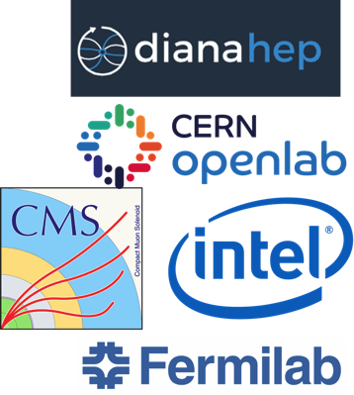
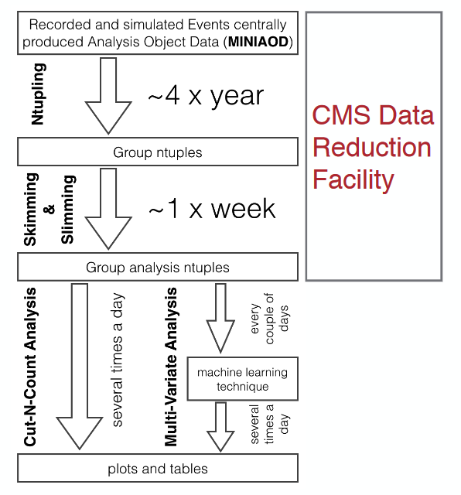
CMS Data Reduction Facility
R&D, CMS Bigdata project, CERN openlab, Intel:
  Reduce time to physics for PB-sized datasets
  Exploring a possible new way to do HEP analysis Improve computing resource utilization
  Enable physicists to use tools and methods from “Big Data” and open source communities
CMS Data Reduction Facility:
  Goal: produce reduced data n-tuples for analysis in a more agile way than current methods
  Currently testing: scale up with larger data sets, first prototype successful but only used 1TB

Slide 21








R&D: Data Analysis with PySpark for HEP
EOS Storage Service
Data access – XRootD
Reading root files – spark-root
User interface - SWAN

Slide 22
Data Ingestion: spark-root
0.1.16 available on Maven Central!
Scala
// inject the Dataset[Row]
import org.dianahep.sparkroot.experimental._
val df = spark.read.option(“tree”, <treeName>).root(“<path/to/file>”)
// pretty print of the schema
df.printSchema
|-- Particle: array (nullable = true)
| |-- element: struct (containsNull = true)
| | |-- fUniqueID: integer (nullable = true)
| | |-- fBits: integer (nullable = true)
| | |-- PID: integer (nullable = true)
| | |-- Status: integer (nullable = true)
| | |-- IsPU: integer (nullable = true)
| | |-- M1: integer (nullable = true)
| | |-- M2: integer (nullable = true)
| | |-- D1: integer (nullable = true)
| | |-- D2: integer (nullable = true)
| | |-- Charge: integer (nullable = true)
| | |-- Mass: float (nullable = true)
| | |-- E: float (nullable = true)
| | |-- Px: float (nullable = true)
| | |-- Py: float (nullable = true)
| | |-- Pz: float (nullable = true)
| | |-- PT: float (nullable = true)
| | |-- Eta: float (nullable = true)
| | |-- Phi: float (nullable = true)
| | |-- Rapidity: float (nullable = true)
| | |-- T: float (nullable = true)
| | |-- X: float (nullable = true)
| | |-- Y: float (nullable = true)
| | |-- Z: float (nullable = true)
|-- Particle_size: integer (nullable = true)
spark-root - ROOT I/O for JVM
Extends Apache Spark’s Data Source API
Maps each ROOT TTree to Dataset[Row]
Parallelization = # ROOT files.
Credits: V. Khristenko, J. Pivarski, diana-hep and CMS Big Data project
22

Slide 23
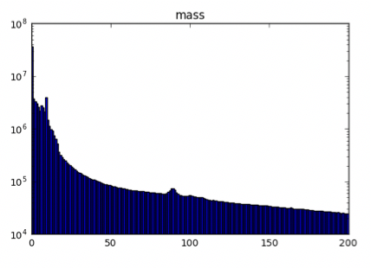
Data Processing: CMS Open Data Example
Let’s calculate the invariant mass of a di-muon system?!
# read in the data
df = sqlContext.read\
  .format(“org.dianahep.sparkroot.experimental”)\
  .load(“hdfs:/path/to/files/*.root”)
# count the number of rows:
df.count()
# select only muons
muons = df.select(“patMuons_slimmedMuons__RECO_.patMuons_slimmedMuons__RECO_obj.m_state”).toDF(“muons”)
# map each event to an invariant mass
inv_masses = muons.rdd.map(toInvMass)
# Use histogrammar to perform aggregations
empty = histogrammar.Bin(200, 0, 200, lambda row: row.mass)
h_inv_masses = inv_masses.aggregate(empty,
  histogrammar.increment,
  histogrammar.combine)
Transform a collection of muons to an invariant mass for each Row (Event).
Aggregate (histogram) over the entire dataset.
Credits: V. Khristenko, J. Pivarski, diana-hep and CMS Big Data project

Slide 24
Conclusions
Demand of “Big Data” platforms and tools is growing at CERN
  Many projects started and running
  Projects around Monitoring, Security, Accelerators logging/controls, physics data, streaming…
Hadoop, Spark, Kafka services at CERN IT
  Service is evolving: High availability, security, backups, external data sources, notebooks, cloud…
Experience and community
  Technologies evolve rapidly and knowledge sharing very important
  We are happy to share/exchange our experience, tools, software with others
  HEP sites welcome to join discussions at Hadoop User Forum: https://indico.cern.ch/category/5894/
  Interest of HEP sites in collaborating with CERN on some projects?

Slide 25
Future work
Spark on Kubernetes (continuation)
Rolling out Kafka service in full production state
Improve monitoring of individual users in Hadoop
Service web portal for users
  Integrate multiple components of the service
  Single place for monitoring and requesting the service resources
    HDFS quota, CPUs, memory, Kafka topics etc
Explore further the big data technology landscape
  Presto, Apache Kudu, Apache Beam etc.

Slide 26
Acknowledgements
Colleagues in the Hadoop, Spark and Streaming Service at CERN
Users of the service, including IT Monitoring, IT Security, ATLAS DDM and EventIndex, CMSSpark project, Accelerator logging and controls
CMS Big Data project, with Intel and openlab
Collaboration on SWAN with CERN colleagues in EP-SFT, IT-ST

