Slide 1
Intro to “Big Data” and Analytics Services
Luca Canali, CERN Hadoop, Spark and Streaming service
Meeting with ESAC-ASDC
May 22nd, 2018

Slide 2
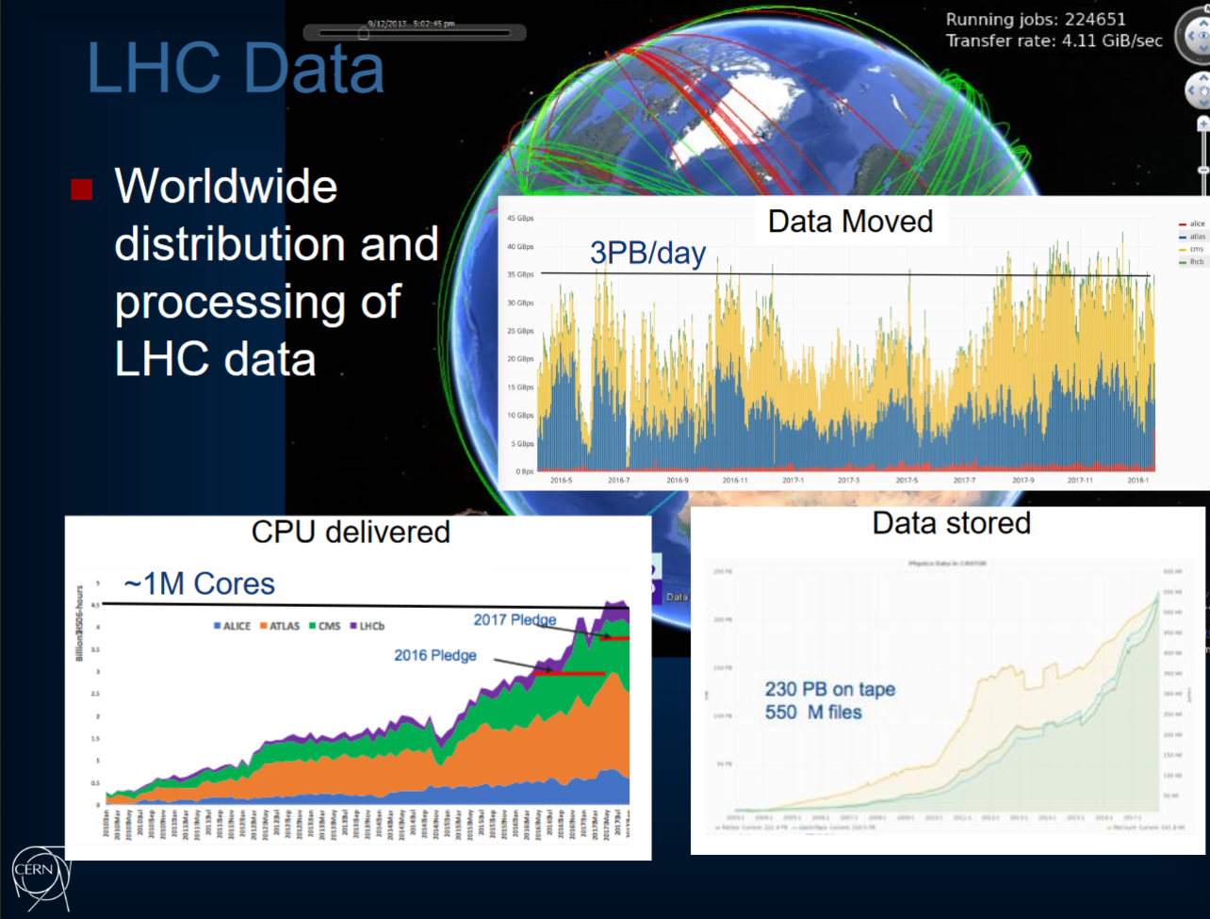
LHC data processing has custom built solutions and very large scale
2

Slide 3
Hadoop Clusters at CERN IT
Several orders of magnitude below LHC data processing systems
3 current production Hadoop clusters
  + environments for NXCALS DEV and HadoopQA
  Just commissioned a new system for BE NXCALs (accelerator logging) platform
Numbers relate to the size of the infrastructure (updated Q2 2018):
  14 PB Storage, 110 nodes, 3100 logical cores, 20 TB memory

Slide 4
Analytics Pipelines – Use Cases
Many use cases at CERN for analytics
  Data analysis, dashboards, plots, joining and aggregating multiple data, libraries for specialized processing, machine learning, …
Communities
  Physics:
    Analysis on computing metadata (e.g. studies of popularity, grid jobs, etc) (CMS, ATLAS)
    Development of new ways to process ROOT data, e.g.: data reduction and analysis with Spark-ROOT by CMS Bigdata project, also TOTEM working on this
  IT:
    Analytics on IT monitoring data
    Computer security
  BE:
    NX CALS – next generation accelerator logging platform
    BE controls data and analytics
  More:
    Many tools provided in our platforms are popular and readily available, likely to attract new projects, notably the analytics platform with hosted notebooks SWAN_Spark
    E.g. Starting investigations on data pipelines for IoT (Internet of Things)
2

Slide 5
“Big Data”: Not Only Analytics
Data analytics is a key use case for the platforms
Scalable workloads and parallel computing
  Example work on data reduction (CMS Big Data project) and parallel processing of ROOT data (EP-SFT)
Database-type workload also important
  Use Big Data tools instead of RDBMS
  Examples: NXCALS, ATLAS EventIndex, explorations on WINCC/PVSS next generation
Data pipelines and streaming
  See example of monitoring and Computer security (Kafka development with help of CM)
  Also current investigations on IoT (project with CS)

Slide 6




Highlights of “Big Data” Components
Apache Hadoop clusters with YARN and HDFS
  Also HBase, Impala, Hive,…
Apache Spark for analytics
  Apache Kafka for streaming
Data: Parquet, JSON, ROOT
UI: Notebooks/ SWAN

Slide 7
Challenges and Activities
Platforms
  Provide evolution for HW (Hadoop platform) and SW (distribute and update software and configuration)
Service
  Support production services (IT monitoring, Security, ATLAS EventIndex)
    Build robust service for critical platform (NXCALS and more) using custom-integrated open source software solutions in constant evolution
  Evolve service configuration and procedures to fulfil users needs
  Further grow value for community and projects
    SWAN and general efforts to build and grow a data analysis platform
Knowledge, experience, community
  Technology keeps evolving, need to learn and adapt quickly to change

