Slide 1
Hadoop and Spark User Forum
Emil Kleszcz, Zbigniew Baranowski
IT-DB-SAS

Slide 2

Interacting with Hadoop clusters
What is needed to use the Hadoop and Spark clusters?
  config files, binaries
  e-group-based ACL granted, valid Kerberos ticket
Supported ways of accessing the service (today)
  1) Ssh to a cluster machine (will be removed as of the end of August)
  2) Puppet client module
  3) Sourcing environments from CVMFS
    LXPLUS or any machine with CVMFS (see KB0004426)
  4) Using SWAN for interactive analysis (PYSPARK)

Slide 3

Limitations of the current setup
Two configuration workflows to maintain
  Puppet
  CVMFS
Automatically updated configuration possible only with puppet
  There are communities that do not use puppet
Puppet module is suboptimal
  Single module for server and client
  Executes all the server logic on a client machine
  Takes time to execute
  Configuration files contain to much information
Extraction of service configuration for CVMFS is complex
  Virtual machine per cluster to fetch and update new configuration

Slide 4
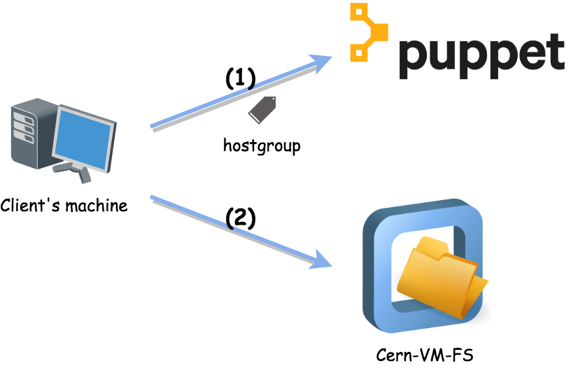
Current ways for config extraction

Slide 5
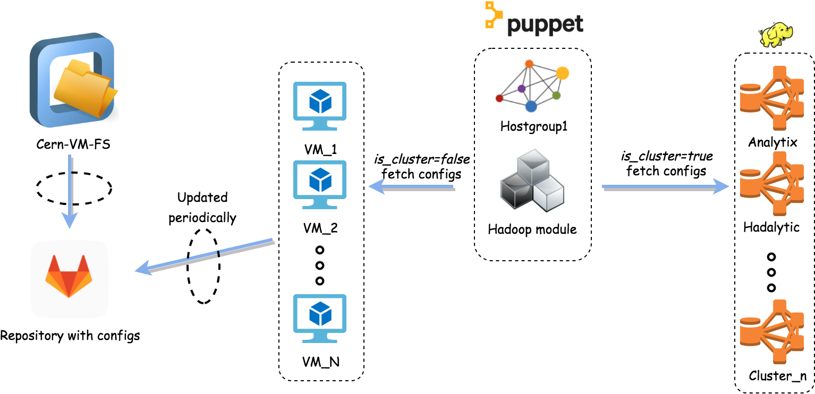
Current config extraction

Slide 6
New Hadoop Client
Simplicity – clean set of required config files, unify the configuration workflow for all client use cases
Performance – simple puppet module separated from the server module
Automation – automatic updates (cron job), no VM per cluster needed
Accessibility – various ways to configure, depending on needs
Flexibility – one can easily connect to another cluster, without major reconfiguration

Slide 7




New Hadoop configuration - client
Config files accessible via:
  Web server (https://hadoop-config.web.cern.ch/files/hadoop/)
  RPMs
  Puppet module (https://gitlab.cern.ch/ai/it-puppet-module-hadoop/tree/new_client)
  CVMFS
Separated from server components
Clean structure of files and scripts

Slide 8
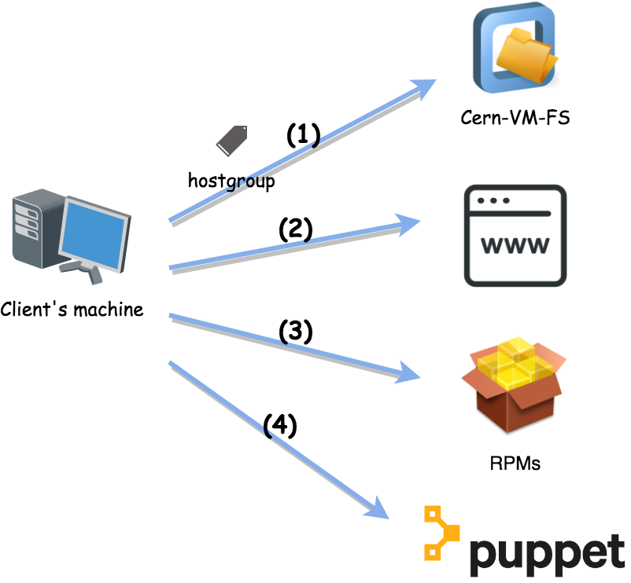
New ways for config extraction

Slide 9
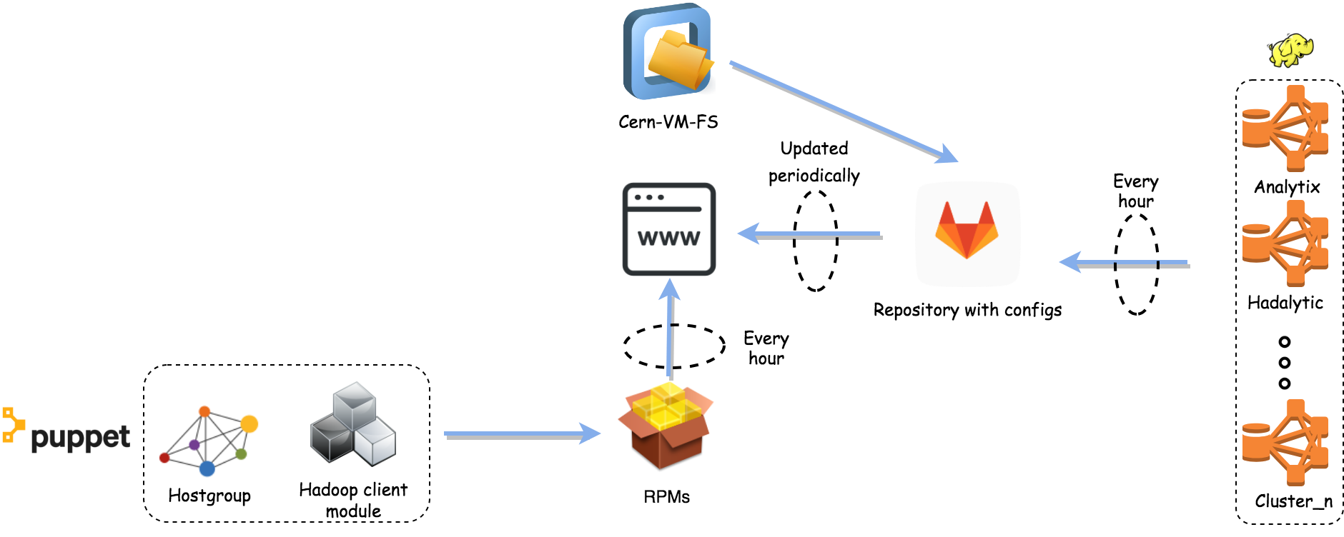
New config extraction

Slide 10
Files structure on www
clusters.txt <- list of available clusters
conf/ <- configuration for each component
(incl. Hadoop, HBase, Hive, and Spark)
hadoop-configs.tar.gz <- all scripts and conf.

Slide 11
Setting up target cluster for client
Configuration per cluster & per Hadoop component
Script for default configuration – run once
configuration per shell session
hadoop-default-set-conf.sh cluster_name
source hadoop-setconf.sh cluster_name

Slide 12






RPM packages
cern-hadoop-client
  cern-hadoop-config
  spark-bin-2.3.0
  hadoop-bin-2.7.5
  hbase-bin-1.2.6
  java-1.8.0-openjdk
cern-hadoop-xrootd-connector
  For EOS and Root files use case
Available in QA repository (hdp7-qa)
  http://linuxsoft.cern.ch/internal/repos/hdp7-qa/x86_64/os/Packages/

Slide 13
Other dependencies
Deployed
  Java Development Kit (JAVA_HOME) – installed automatically with the RPMs
Required
  Kerberos valid ticket (kinit)
  For Spark – enabled ports for incoming traffic on a block manager and a driver
  Sufficient permissions for scripts execution
  Yellowdog Updater, Modified (YUM)

Slide 14
Installation with Puppet
Include new Hadoop module in your hostgroup manifest (new_client branch)
For accessing different cluster than analytix parameterize the module with a cluster name via Hiera parameter
Supporting backward compatibility for current way of including the module –> no need to change manifests
include ::hadoop
# In data/hostgroup/<hostgroup_name>/<class_name>.yaml
hadoop::cluster_name: hadalytic

Slide 15
More information in the User guide
Client configuration step-by-step
Troubleshooting
User guide:
  https://hadoop-user-guide.web.cern.ch/hadoop-user-guide
  KB0005494

Slide 16

Future work and ideas
Docker images integrated into GitLab
  With Docker Container Registry
  Support for other OSs
Available at the beginning of July

Slide 17
Timeline
Available for testing since 1st of June
  module: hadoop , branch: new_client
11th of June available on QA branch
28th of June on master branch
2nd of July - Docker images
28th of August full transition to the new Hadoop module (no backward compatibility support)
28th of August access via ssh revoked

Slide 18
Thank you for your attention

