Slide 2
Longitudinal MD studies in 2018
LIU-PS Beam Dynamics Working Group
17 May 2018
H. Damerau, A. Lasheen

Slide 3
Introduction
Address major performance limitations for LHC-type beams in PS
  Coupled-bunch instabilities
  Uncontrolled longitudinal emittance blow-up
  Losses at PS-SPS transfer
Main MD study objectives for 2018
  Intensity reach with LHC-type beams
  Reference measurements for comparison of before/after LS2
  Optimization of PS-SPS transfer
  Beam-based cavity impedance measurements (and reductions)
  Technical studies in view of beam control upgrade
Try to map study subjects to available MD weeks
  Assuming ‘ideal days'
  2 subjects per week and additional preparation

Slide 4
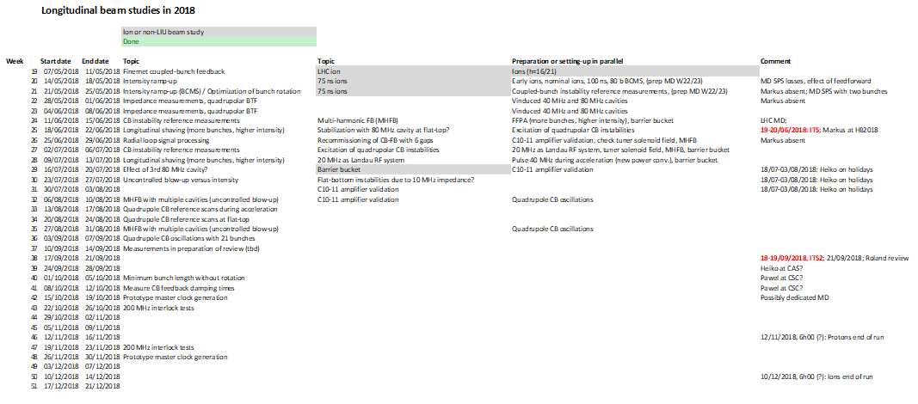
Draft MD planning
Draft MD list, subject to updates according to progress: link
Already well packed until August

Slide 5
Intensity reach
Finemet coupled-bunch feedback (~1.5 days, April/May, June)
  All signal processing channels working with 4/6 cavity gaps
  Repair of gaps/recommissioning during/after June technical stop
Intensity ramp-up (~2-3 days, May)
  Provide at least 2 ∙ 10¹¹ ppb for SPS MDs
    Tested up to PS extraction with standard triple-splitting beam
    High-intensity BCMS variant available from PSB

Slide 6
Intensity reach – cavity impedances
Measurements with upgraded 10 MHz amplifier prototype (~4 days, July)
  Validate final prototype
  Check correspondence between beam-based and electrical transfer function measurement of cavities
  Revive old TOF beam with lower dB/dt during 2018
Beam induced voltages in 40 MHz and 80 MHz RF systems (2 days, June)
  Beam-based check of feedback gain with different anode power supply configurations
  Benefit of new amplifier installed in the fast feedback loop of C80-88
Multi-harmonic feedback 40 MHz and 80 MHz (MHFB, ~4 days, August)
  Uncontrolled emittance growth reduction and stability improvement with MHFB
  Studies with MHFB on multiple cavities simultaneously
  Preparation and studies with single system during May-July

Slide 7
Studies in preparation of Landau cavity
Landau cavity measurements with existing 40 MHz cavities (~1 day, July)
  Consolidate beam measurements with new anode power converters
  Re-check possibility to operate cavities before arrival at flat-top
20 MHz RF cavity as higher-harmonic system (~1 day, July)
  Potentially validate scaling of beam stability with synchrotron frequency spread
  Relevant for choice of harmonic for Landau RF system
Effect of RF voltage at 80 MHz on beam stability (~1 day, June/July)
  Complete studies with higher-harmonic cavity, but little beneficial effect expected
Excitation of quadrupolar coupled-bunch instabilities (~1 day, July)
  Measure ‘excitation sensitivity’ for quadrupolar instabilities at flat-top
    Try to excite instability with 2f_{s}-sideband at ~10 MHz, 20 MHz, 40 MHz or 80 MHz
    In view of feedback as alternative to Landau RF system

Slide 8
Reference measurements
Broadband impedance (~4-5 days, May/June)
  Bunch distance measurements to determine synchronous phase shift
  Quadrupolar beam transfer function (longitudinal)
Dipolar coupled-bunch instabilities (~2-3 days, June/July)
  Evolution of instability, in particular at flat-top
Quadrupolar coupled-bunch instabilities (~3-4 days, July/August)
  Evolution of instability (during acceleration and) at flat-top
  Mode spectra with 21 bunches in h = 21

Slide 9
PS – SPS transfer optimization
Optimization of bunch rotation (~2 days, May)
  Check settings timing and phase settings for bunch rotation of LHC-type beams
Longitudinal shaving (~2-3 days, June/July)
  Fixed-frequency post acceleration with new anode power supplier of 40 MHz systems
  Expect to post-accelerate 72 bunches with high intensity
  Measurements in collaboration with SPS
Minimum bunch length without bunch rotation (~1-2 days, October)
  Re-measure with new anode power supplies of high-frequency cavities
Effect of 3rd 80 MHz cavity on bunch rotation (~2 days, July)
  Re-check the interest of three 80 MHz cavities for bunch compression

Slide 10
Intensity reach – further studies
Uncontrolled blow-up versus intensity (~2-3 days, July)
  Intensity scans with different configurations of high-frequency cavities
Damping time with coupled-bunch feedback (~3-4 days, October)
  Excite well-defined oscillation and observe damping
Flat-bottom instabilities due to 10 MHz cavities (~2 days, October)
  Excellent study case with known source of impedance
  No issue up to LIU intensities thanks to de-tuning of unused cavities

Slide 11
Beam control upgrade – technical studies
Radial loop signal processing (~1-2 days, June)
  Test digital detection of radial position
Prototype master clock (~1-2 days, October/November)
  Integrated 256 f_{rev} (other 2^{n} f_{rev} multiples) replacing existing NIM hardware
  May requires couple of hours dedicated
200 MHz interlock tests (~4 days, October/November)
  Measurements with and without proton beam

Slide 12
Ion or non-LIU studies
Lead ions with 75 ns (~3 days, May)
  Studies advances to conclude on 75 ns bunch spacing well ahead of ion physics in LHC
Barrier-buckets using existing Finemet cavity (~4 days, July)
  Inject or de-bunch beam into barrier bucket
  Study longitudinal beam behavior with moving barriers

Slide 13
THANK YOU FOR YOUR ATTENTION!

