Slide 1






Planning of MD studies for transverse impedance measurements
M. Migliorati, N. Biancacci, E. Koukovini-Platia
LIU - LHC Injectors Upgrade Project

Slide 2
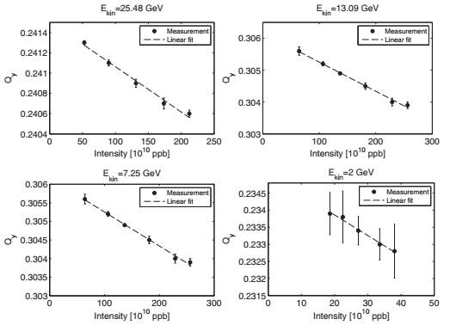
Previous transverse impedance measurements
Tune shift with intensity at different energies
TOF-type beam
TOF-type beam
TOF-type beam
LHCINDIV beam

Slide 3
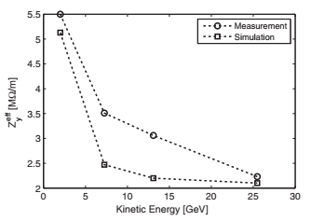
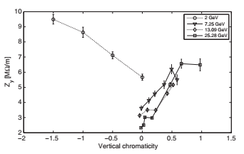
Previous transverse impedance measurements
Tune shift with intensity at different energies
Tune shift with intensity at different chromaticities

Slide 4
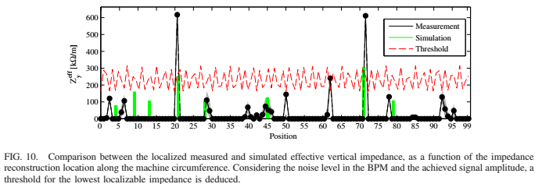
Plan for 2018
TOF-type beams - reference measurements:
  tune shift with intensity at different energies and chromaticities (imaginary part of transverse impedance)
  instability growth rate vs chromaticity (real part of transverse impedance)
  impedance localisation at top energy

